Slide 1
Lessons Learned On the Second Entry in a Cariboo Mule Deer Winter Range
Alex Fraser Research Forest
Ken Day, Manager
SISCO Winter Workshop, February 10, 2015 | Kamloops, BC

Slide 2

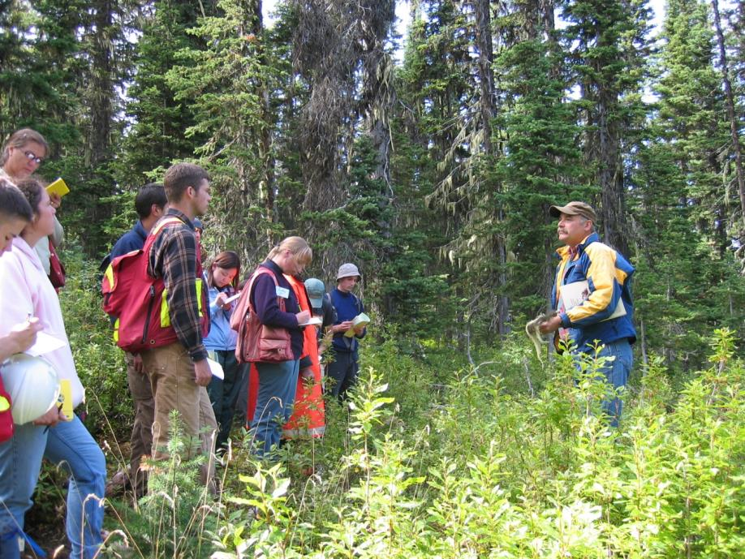
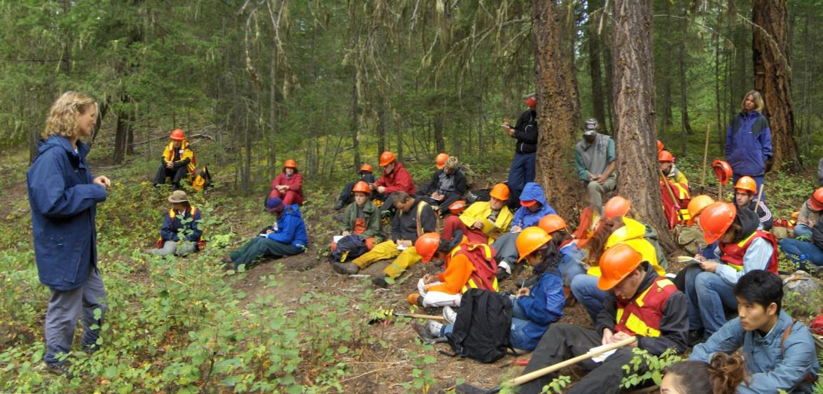
EP903 – Coordination of Timber and Mule Deer Management
Acknowledgements

Slide 3
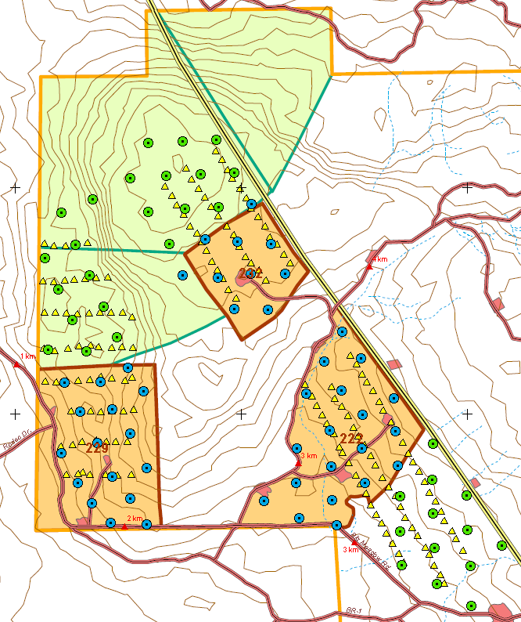
Three Cutblocks
As established 1984
  Paired blocks with controls
  Remeasured cruise plots harvest and control
  Re-established track transects and re-measured pre-harvest
17.9 ha
IDFdk3
38.4 ha
IDFxm
38.2 ha
IDFxm

Slide 4
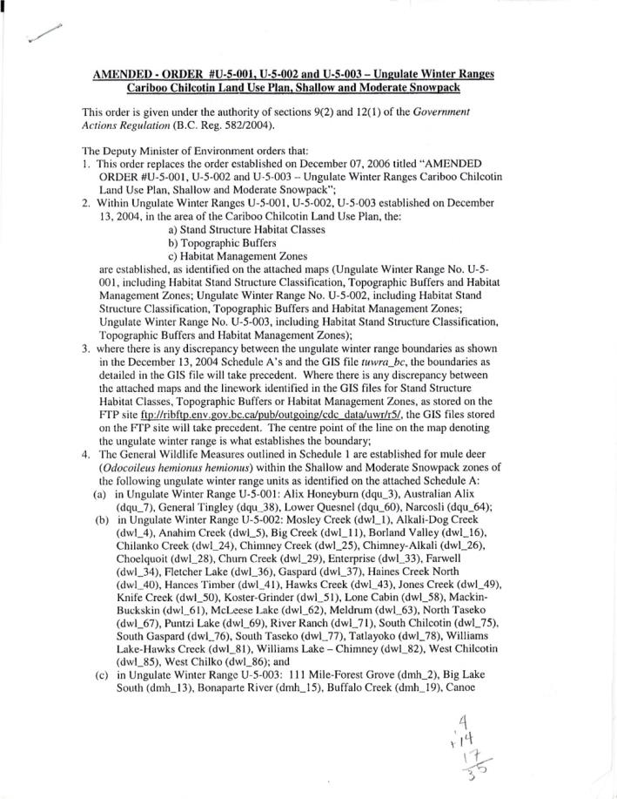
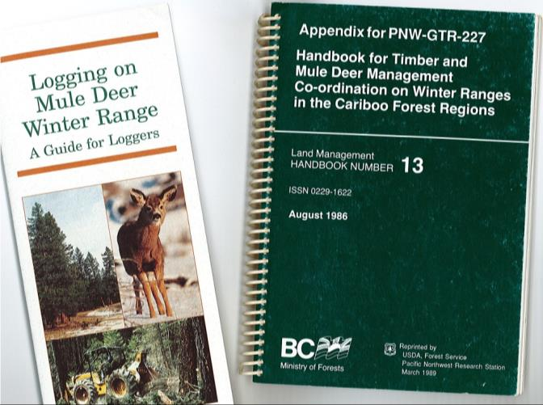
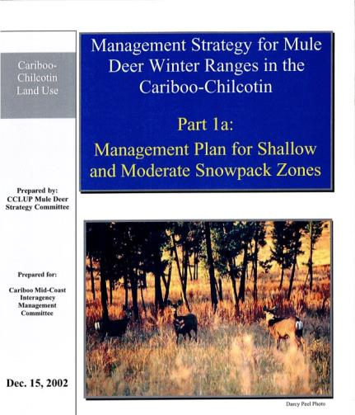
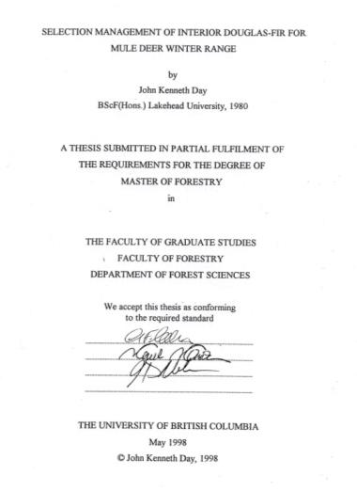
Mule Deer Winter Range Cariboo Style
History
Guidance
GAR Order

Slide 5
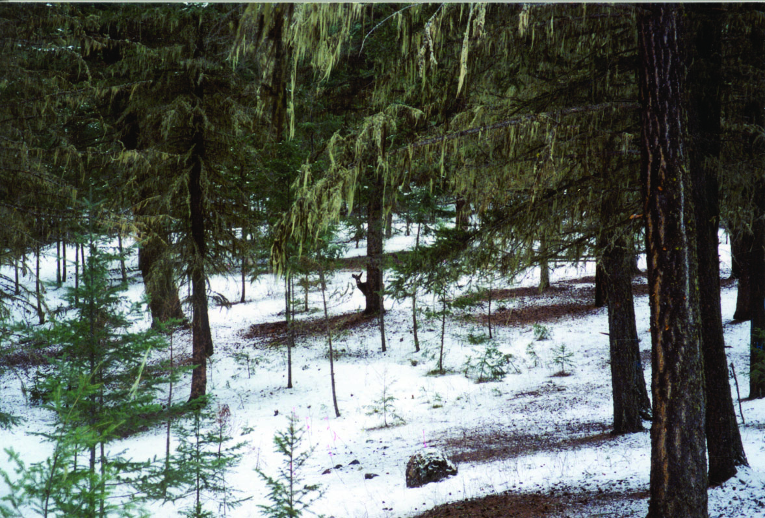
Basic Tenets
Snow Interception
Food
Security and thermal cover
High, Medium and Low Habitat
Continuous supply of Douglas-fir
Proximity to spring range
Slope, aspect, topography

Slide 6
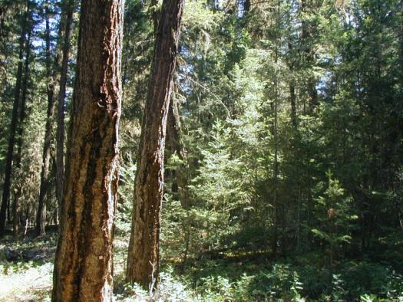
Silvicultural Approach
Management Objective:
  Continuous supply of large, wide crowned Douglas-fir
Strategy
  Clumpy Single Tree Selection
  BDq regulation
  Regeneration gaps up to 1 tree length in diameter
  Retain clumpy structure

Slide 7
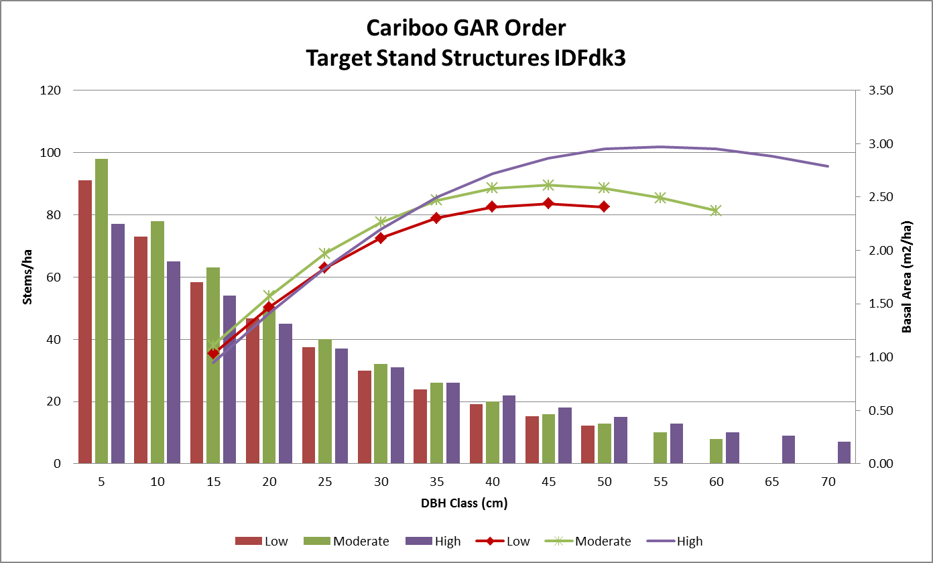
Target and Prescribed Stand Structure

Slide 8
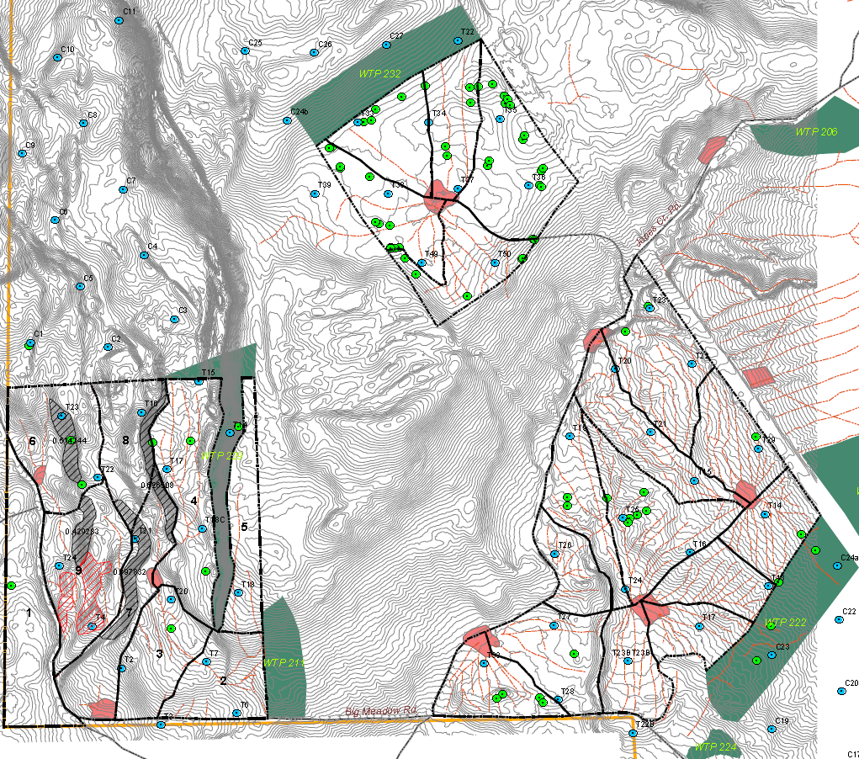
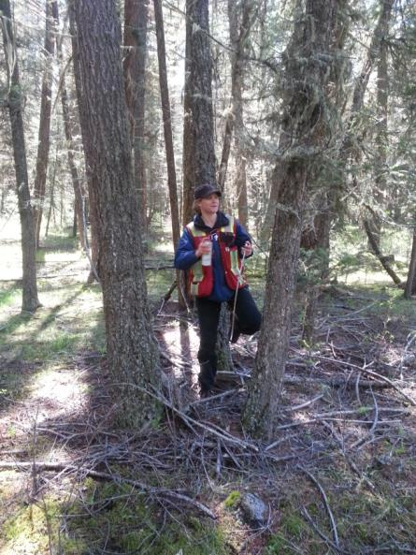
Mark to Cut

Slide 9
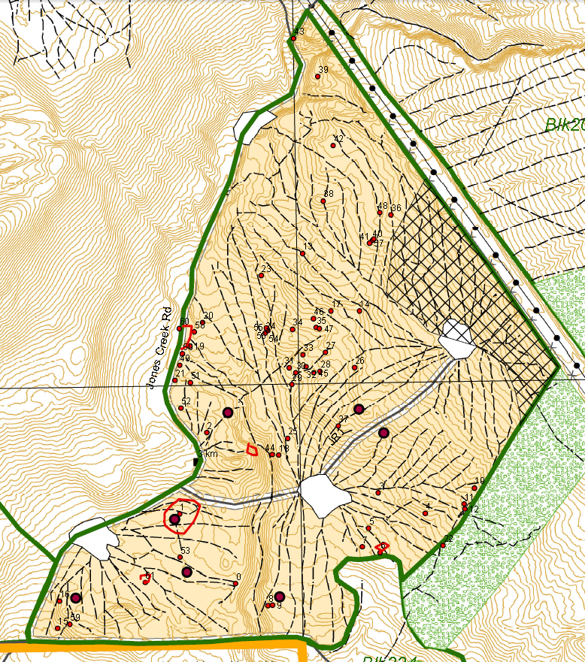
Map Existing and Planned Skid Trails
Area of trails is
limited in GAR Order
Also map
  Wildlife and Danger Trees,
  No-work zones,
  Non-merch areas
Digital map to logger

Slide 10
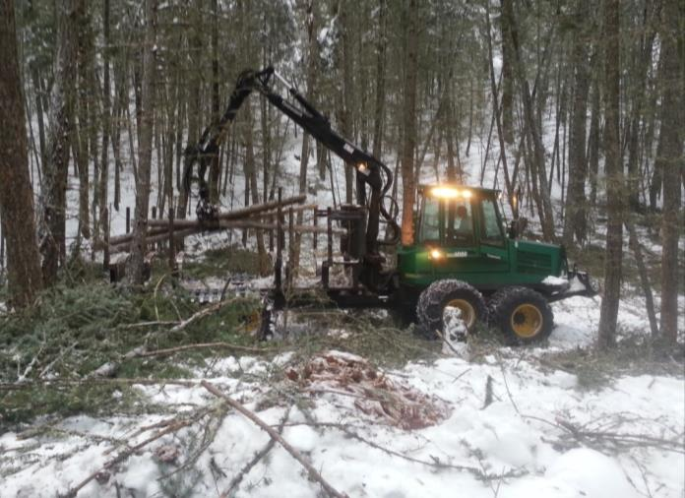
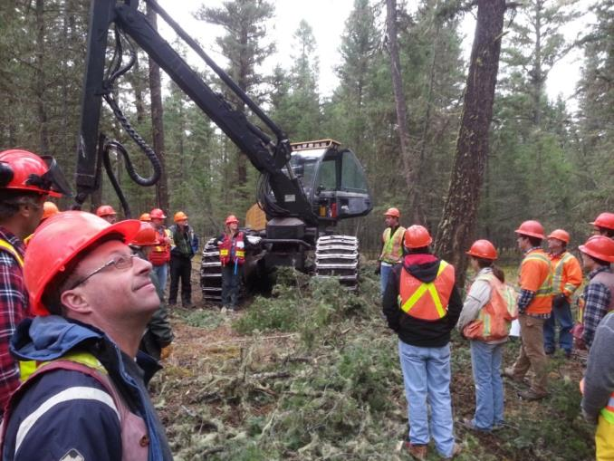
Logging Contractor
Nilsson Select Contracting Williams Lake
Harvester and Forwarder
  Cut to length at the stump
  Marking was critical to making his time efficient

Slide 11
End Result Compared to Plan

Slide 12
End Result Compared to Plan

Slide 13
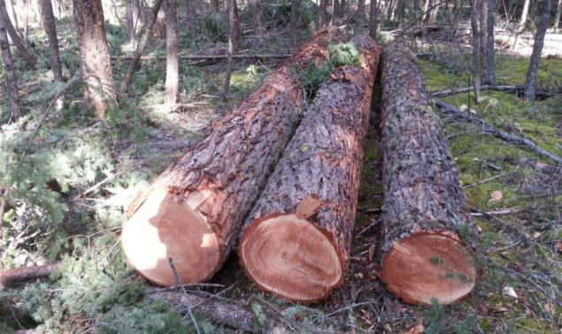
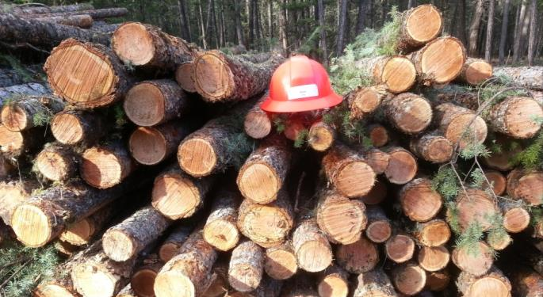
Value and Costs

Slide 14
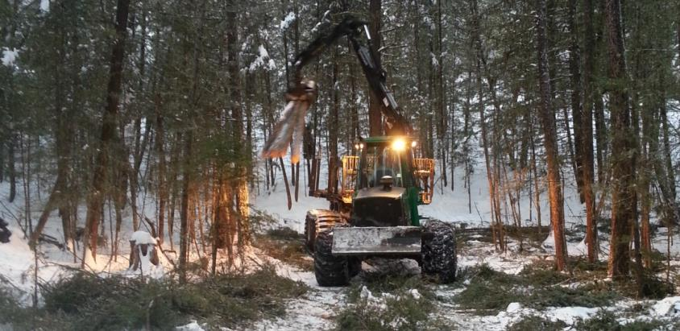
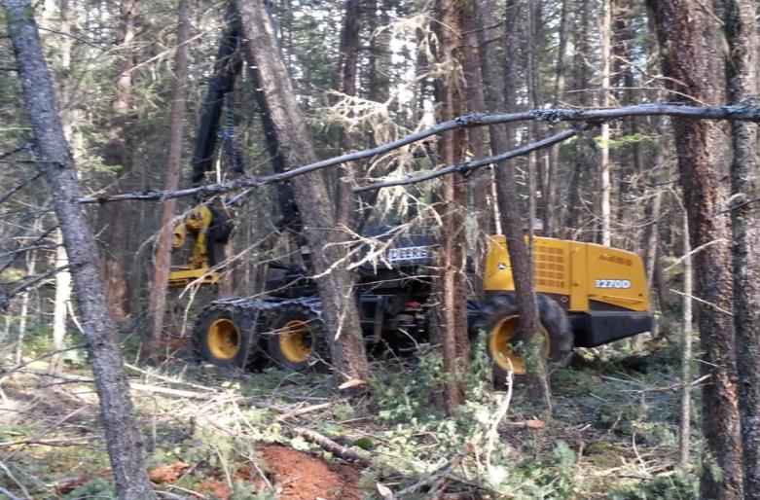
Costs and Productivity

Slide 15
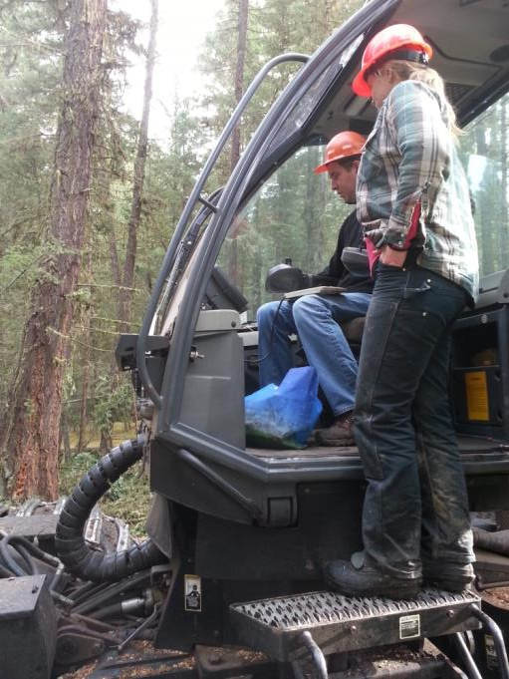
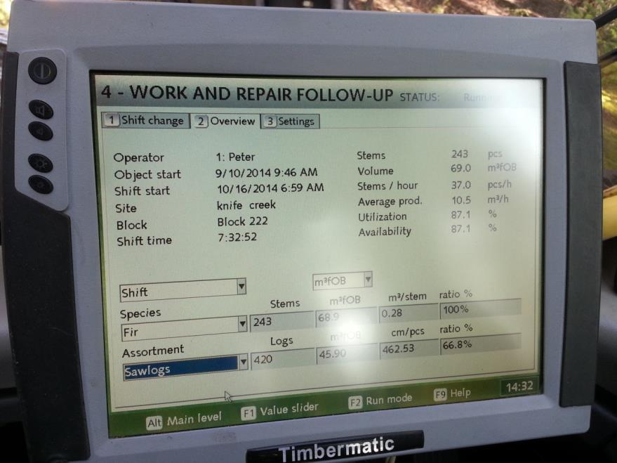
Managing Costs and Productivity

Slide 16
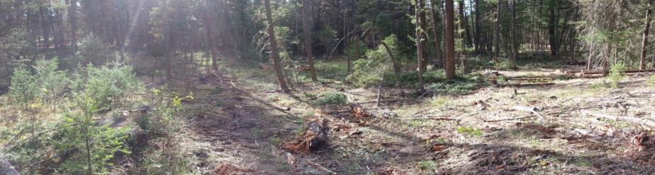
Summary
High Habitat MDWR
  By regulation the harvest opportunity is limited
  Much of the growing stock is poorer than sawlog
  High accounts for 1/3 of the MDWR in the Cariboo IDF
On this trial we broke even
  $0.25/m³ stumpage
Presented costs do not include
  cruising, layout, planning & supervision
Harvester/Forwarder is the right method
Though marking is expensive, it needs to be done
  Less expensive to make decisions in your boots, than in the cab of a machine
Pulpwood market
  Every pulp log we made cost us money
  But those trees need to be cut to release the growing space
These treatments will improve G&Y and contribute to long term habitat objectives

Slide 17
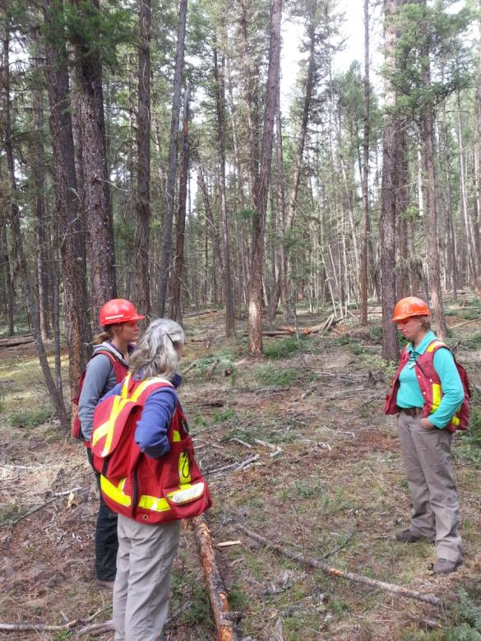
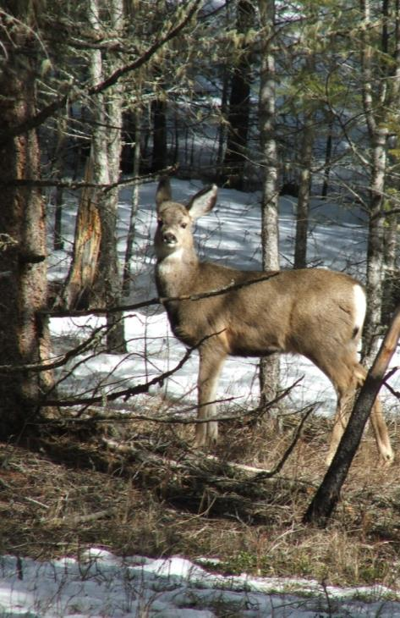
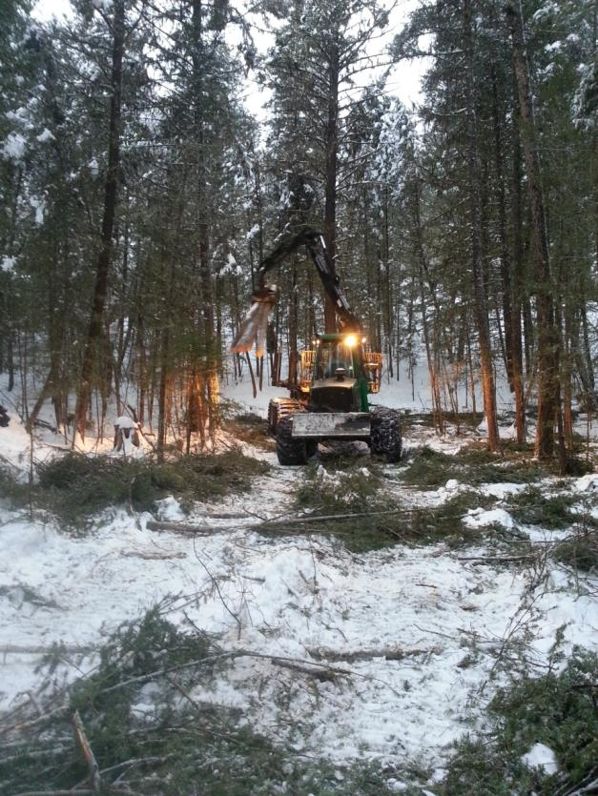
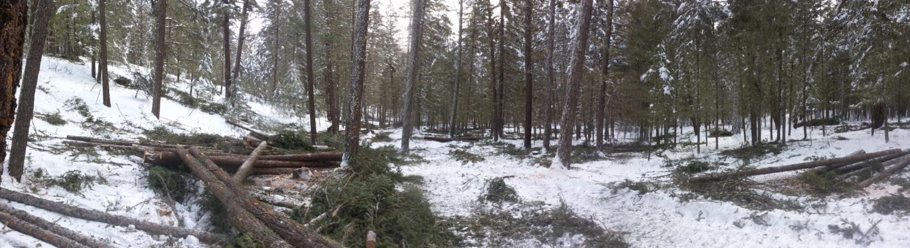
Questions?

Slide 18
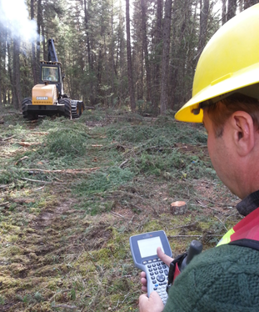
Costs and Productivity
Ken Byrne, Preliminary Results FPInnovations 2014
Time and motion study for one shift
Elements will be applied to shift-level data and actual production at the block level

