Slide 1

KEY LEGISLATION DEALING WITH SITE AND TRAIL CONSTRUCTION MAINTENANCE AND MANAGEMENT
Updated June 16. 2011

Slide 2
Key Sections
Section 57 FRPA
Section 56 FRPA
Section 118 FRPA
Section 20 of the Forest Recreation Regulation

Slide 3
Key Facts
Provincial Recreation Sites and Trails are in the WORKING FOREST
They are not PARKS
They are not PROTECTED
There are often other stakeholder who have TENURED RIGHTS on the site or trail.
There are no or very negligible reductions made to licence's annual allowable cuts for Provincial Recreation Sites and Trails.
A Recreation Site and Trails status signals INTEGRATED Resource Management that requires people to work together to achieve their goals.

Slide 4
Section 57 FRPA
Provides authority to construct, rehabilitate or maintain a trail or facility on crown land.
It does NOT
  Provide for any formal tenure or recognized use or rights. Holders of a section 57 are not formal stake holders.
  It does not provide for any protection.
  It does not give a land manager any authority under FRPA to establish rules.
Prior to giving approval under Section 57 the application must be referred to other stake holders and their concerns must be addressed or mitigated.
Once one is given authority under Section 57 there is no legal requirement for a stake holder to make referrals to the Section 57 holder when exercising their tenured rights.
Or in other words there is no formal referral provided to someone who has been given a Section 57 authority by a stakeholder exercising his/her tenured rights.
One hopes that referrals would take place on a volunteer bases and the Stakeholder and Section 57 holder work together to address each others concerns.

Slide 5
Section 56 FRPA
Provide authority to establish a interpretive forest site, recreation trail or a recreation trail as a Provincial site or trail.
Once established objectives can be set for the site or trail. –these objectives must be consistent with other government objectives that pertain to the area.

Slide 6
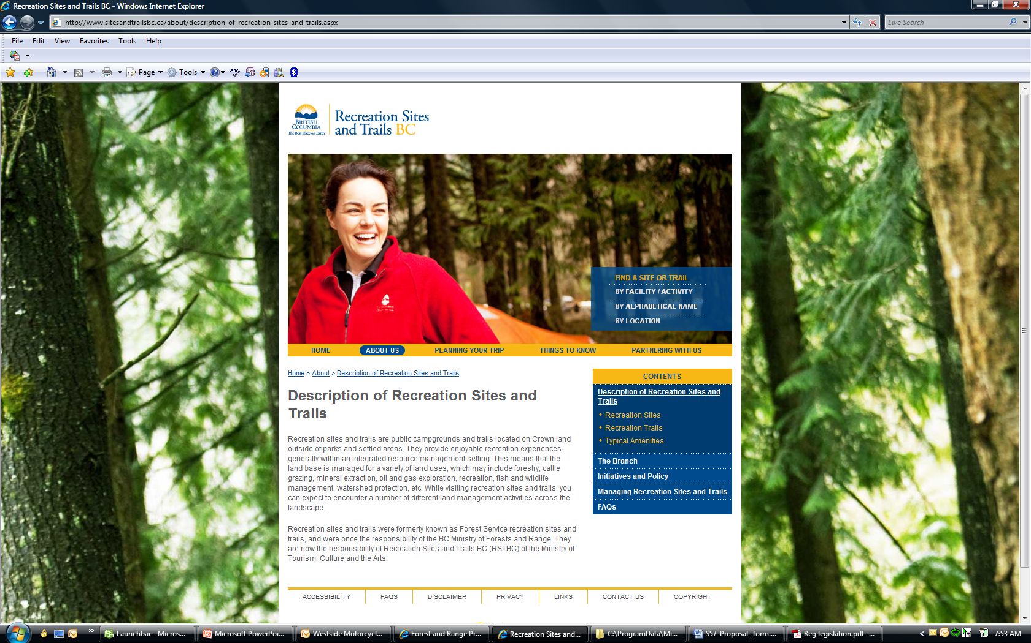
What does establishment mean under Section 56?

Slide 7
Section 56
It is a requirement that stakeholders work together and practice INTEGRATED resource management.
There is a more formal referral process
It implies a higher level of protection or NEGOTIATED USE
It provides the land manager the authority to enter into agreements under section 118 of FRPA.
It provides the land manager the authority to make and post rules for RECREATION USE of the area.
It makes the land manger more responsible for the safety of the Recreating public.

Slide 8
Integrated use
Section 57 process allows stakeholders to make their concerns know and opens up the channels for communication
Stake holder land manager and applicant look for mitigative solutions.
Solutions are reflected in approval letter.
Exceptions
Tenure holders with mining rights can be more difficult to deal with–they are outside of the Forest and Range Practices Act (FRPA)
Forest Licensees who have built the roads that being used as trails have precedence. (Ex Logging roads in the summer / snowmobile trails in the winter)

Slide 9
NEGOTIATED USE
Applicant and stake holder and land manager can enter into a memo of understanding to indicate how they will address each other concerns / expectation (Ex between a Forest Licence holder and Section 57 holder or holder of a partnership agreement under section 118)
This is signed off and becomes a condition of the approval letter.
Such a memo may address:
  A requirement to meet annually and discuss plans
  Identify areas where harvesting is likely / unlikely
  Identify trails that may be harvested and address efforts costs to re-establish by all parties.
  Identify high use trails that a buffer is recommended on
  Identify when and how trails will be closed for harvesting
  Wildlife fire protection concerns
Conditions of the MOU may be able to be reflected in the legal Objectives of the Site (These are what licensees reflect in their Forest Stewardship Plans)
PROTECTED TRAILS = FEWER TRAILS

Slide 10
Forest Recreation Regulation –Section 20
Under section 20 of the Forest Recreation Regulation, the land manager can post rules at a recreation site or trail
There are fines for breaking these rules.

Slide 11
Forest Recreation Regulation –Section 20
A land manager or C&E officer for contravention of the act or regulation can order an individual to vacate a site or trail for a specified period of time.

Slide 12
Section 118 Agreement
Provides authority for a land manger to enter into an agreement to develop, expand, maintain, repair or close an recreation site or trail.
Referred to as a partnership agreement (2 types)
  With fees- for providing a service ex grooming fees for Nordic or Snowmobile Clubs –Fees for camping at an enhance site (cleaned and maintained on a regular basis)
  Without fees-usually a volunteer group providing a community service.
Under agreements
  Agreement holders will maintain and develop the site for PUBLIC use
  Agreement holders are required to submit a annual report and operating plan
  Recreation Sites and Trails BC (RSTBC) provides 2,000,000 liability insurance, and if possible signage and building materials and supplies like toilet paper
  RSTBC will look after big ticket items (Pumping of Outhouses repair of roads and bridges)
By entering into a agreement makes the agreement holder formally recognized as a stake holder.

Slide 13
Section 57 Process
The Section 57 approval process is slow and labours
Sites and trails BC assigns a Rec number, and puts the line work in our system and builds the required Front Counter BC Maps- We only have one person in the province that does this work.
Maps for Front counter BC
  Overview map at 1:50,000 to 1:250,000
  General location map 1:20,000 to 1:30,000
  Specific location map 1:2,000 to 1:10,000
Other information required by our GIS technician:
  A summary of the trail length and/or polygon area
  1,250,000 map sheet number
  A UTM point for the center of the applicaton
  A KML file
  Shape files –(there are more and more requests for shape files so they can be over laid on such things as traditional use maps etc

Slide 14
Section 57 Process
Often applications have to be re-worked by land manager so they can move them forward more efficiently
Referrals are sent out by Front Counter
  to stake holders, agencies and local government (30 day to respond)
  to First Nations groups (60 days to respond)
Front counters BC resources are limited
The recent staff reductions, reorganization and budget reductions have reduced the collective ability to act promptly on these applications. It takes time to get the applications in the system.

Slide 15
First Nations Referrals
First Nations groups who have interests in the area are asked to comment on the application . (Often several groups)
There concerns are generally associated with impacts on traditional use.
They may require an archaeological review-this should be rationalized.

Slide 16
First Nations Referrals
Often referrals are left to a First Nations Relations Officer. They handle the First Nations Referrals and advise a course of action.
They also check:
  Do a Preliminary Archaeological Site Assessment (i.e. check RAAD maps
  Archaeology Overview Assessment (AOA)
  Archaeology Impact Assessment (AIA) Report
  Traditional Use/Cultural Heritage Resources Information
If a trail or site falls within a high or medium archaeological polygon from an overview assessment an archaeologist will have to review before any approvals can be made in that polygon. The applicant may have to look after organizing and paying for this work.

Slide 17
Polygon Approach
Traditionally we give section 57 approval for trail corridors. This works good for a trails going to and from a destination of a one trail loop
It is not appropriate for intensive trail systems where trail construction and improvement is ongoing

Slide 18
Polygon Approach
Suitable for intensive trail networks.
Handled much like a Forest Stewardship plan –People who are asked to provide referral information over the total polygon or advise where trails may not appropriate.
Applicant will be required to addressed these concerns when designing, building and laying out these trails.
It is expected that the applicant will establish a relationship with stakeholders and communicate new plans and get the support of these plans.
Section 57 applications will still be required to sent and approved by the land manager.
The land manger will approve if he /she feels the referral concerns have been adequately addressed.
Land manager still may send out referrals.
Intent is to reduce the number or referrals and involvement of Front Counter BC
Memos of understanding are more important when using this approach

Slide 19
Section 56
Polygons vs Trails
Because of the large nature of polygons suitable for trails there may be resistance to establish them under section 56.
In such cases once trails are built to standard they can be established under Section 56

Slide 20
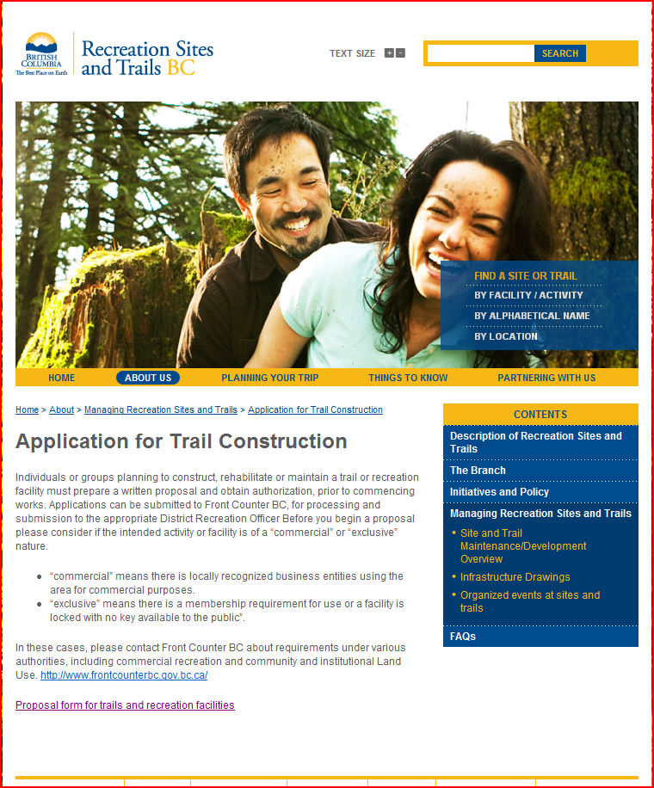
Submitting a Section 57 Application
An application can be downloaded from our website at:
  http://www.sitesandtrailsbc.ca/about/application-for-trail-construction.aspx
The application must be submitted digitally.
  Type out the word document and go over it with the land manager-likely he can suggest wording that will make the application stronger. If the application is a word document you can do it on the spot. It is also much more professional looking when sent out for referral.

Slide 21
Submitting a Section 57 Application
The application must be submitted digitally.
  Type out the word document and go over it with the land manager-likely he can suggest wording that will make the application stronger. If the application is a word document you make revisions on the spot.
  Submit either a GPX track file from a GPS unit or if you can accurately show the trail location in Google Earth submit a Kml or Kmz file.
Often Recreation Officers have a loaner GPS unit that can be used.
(Note we do not have the capacity to process a non digital map location)

Slide 22
Using Google Earth
The following links will provide instructions
  Creating a New Placement
  http://earth.google.com/support/bin/static.py?page=guide.cs&guide=22364&topic=22367&answer=148142
  Drawing Paths and Polygons
  http://earth.google.com/support/bin/static.py?page=guide.cs&guide=22365&topic=23729
  Sending and Saving the file
  Just pick the file from the left hand window then right click on it and use the email or save as function

Slide 23
Demonstrated Will and Resources
In order for applications to proceed the land manager must be satisfied that our standards will be met and the applicant has demonstrated that they have the resources and will to carry through on the application.

Slide 24
Prior to Submission
The applicant should share their plan with major stake holders and get buy in prior to submission.
This may be a good time to enter into a letter of understanding
The less work that a land manager has to do to mitigate concerns identified the quicker the approval process.
Personal contact is allot better than getting a referral in the mail.

Slide 25
More Information
One can get more information from the Recreation and Trail BC Website at:
  http://www.sitesandtrailsbc.ca/about/application-for-trail-construction.aspx
Find below an embedded Section 57 application with background information
To get information on the Forest Recreation Regulation go to:
  http://www.bclaws.ca/EPLibraries/bclaws_new/document/ID/freeside/14_16_2004

Slide 26
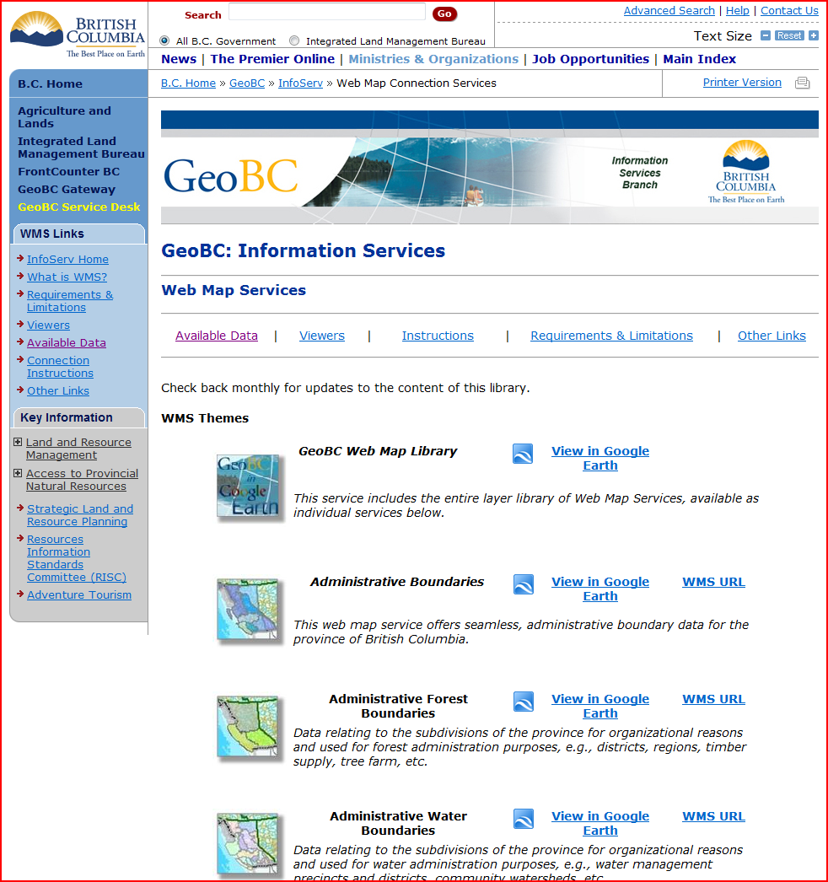
GOOGLE EARTH –GEO BC RESOURCES
You now can go to the GeoBC website and down load a Google Earth layers that show such things as:
  Recreation sites and trails
  Forest roads
  Woodlot licenses
  Private land
Go to: http://archive.ilmb.gov.bc.ca/dm/wms/index.html
This information will help determine other interests

Slide 27
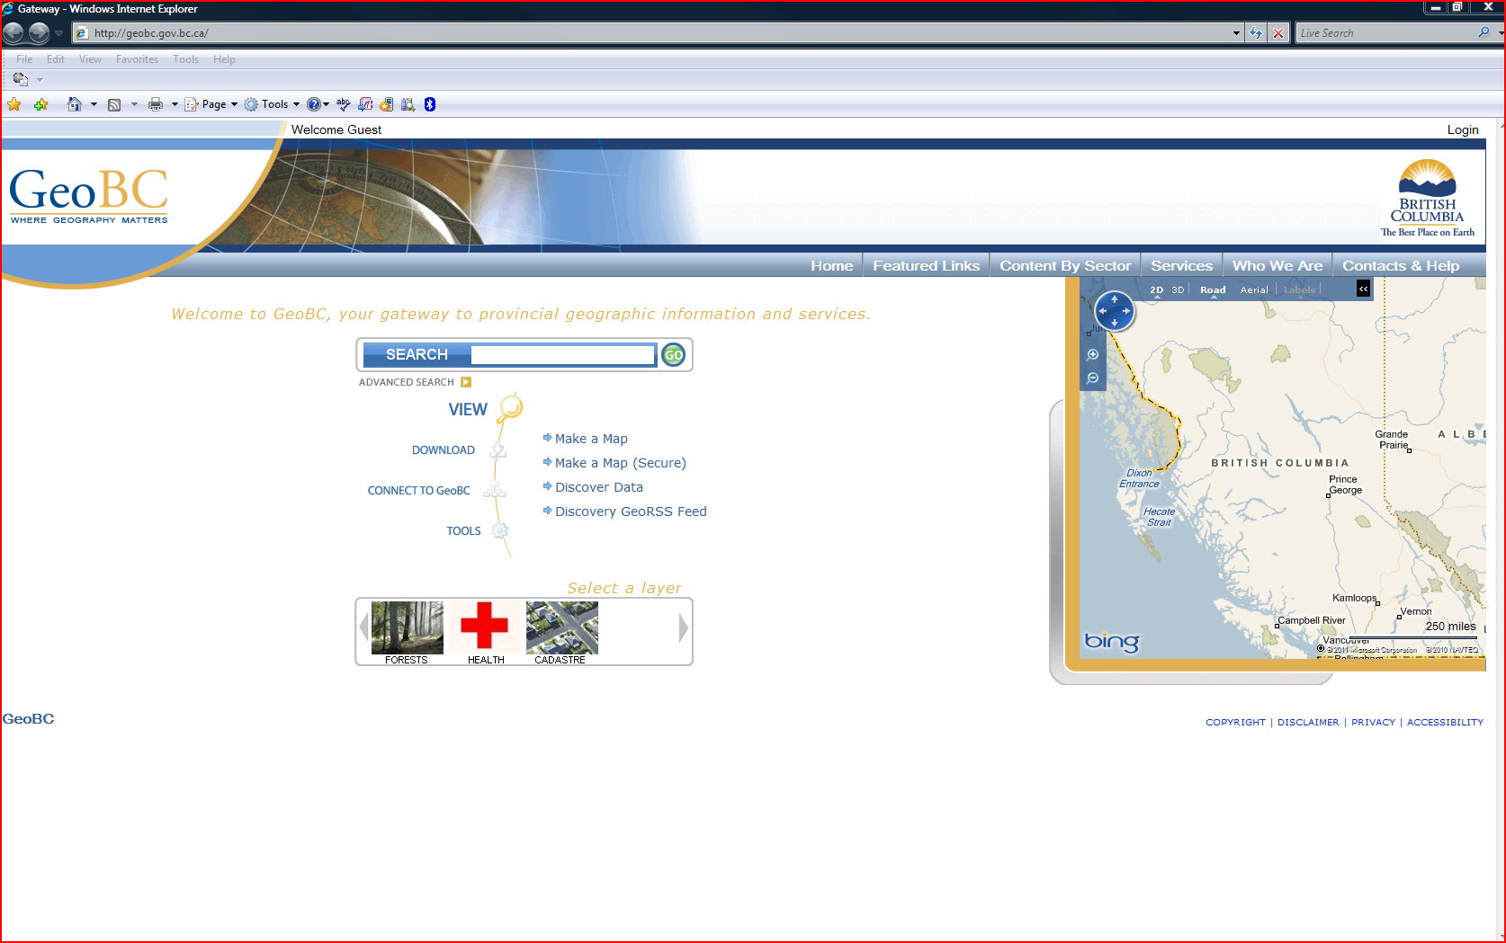
Making a Map-GeoBC
Go to: http://geobc.gov.bc.ca/

Slide 28
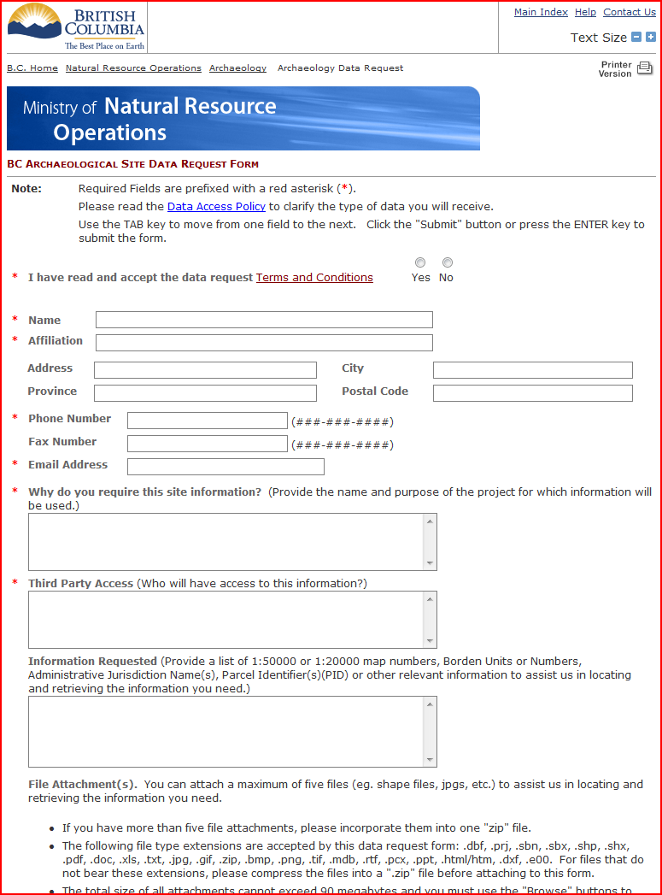
Getting Archaeological Data
To make a request for Archaeological data go to:
http://www.archdatarequest.tca.gov.bc.ca/

