Slide 1
SNOWMOBILE CLUB
BROUCHURE MEETING
JUNE 22, 2011

Slide 2
MEETING OBJECTIVES
To introduce key players
To discuss the initial vision of he brochure
To come up with a common name for the brochure.
To review and comment on the CAC’s mock up.
To determine what the club’s needs are
To discuss provincial template for club needs vs blank page
To discuss what each group will provide
To discuss timelines

Slide 3
MEETING NOTES OR MINUTES
Notes and comments from the meeting will be in green

Slide 4
PEOPLE ATTENDING
Ken RSTBC
Nicola The Drawing Board Arts and Design Studio
John CAC
Brent CAC
Angie Snowmobile Revelstoke Society
Greg Revelstoke Snowmobile Club
Gord Eagle Valley Snowmobile Club
Aaron Golden Snowmobile Club

Slide 5
RECREATION SITES AND TRAILS BC
Part of the Ministry of Forests Lands and Natural Resource Operations
Referred to as Recreations Sites and Trails Branch
RSTBC=Recreation Sites and Trails BC
Marketing logo is Recreation Sites and Trails BC

Slide 6
KEY PLAYERS
Golden club / society
Revelstoke club / society
Eagle valley club society
CAC staff
RSTBC
Design and layout artist
CAC Snowmobile committee
BCSF
ABC
Do the work
Given tight time lines likely that these groups will only look at final product and provide input for future products
Review and provide comment

Slide 7
THE BROUCHURE
(Initial Vision)
Basically has 2 sides
  CAC Avalanche Safety Side
  Club needs side
  Also RSTBC branding
Goal is to try to standardize (with flexibility)so that a template can be used by most clubs in Province

Slide 8
WHAT DO WE CALL IT?
Intent is to develop thru out the province so it should probably be given a name
Terrain Riding Guide?
Riding Guide
Snowmobile Trail Guide
SNOWMOBILE TERRAIN GUIDE

Slide 9
CAC SIDE
  Contains all the terrain maps for a club’s riding area under agreement.
  Maps try to focus on riding areas not access to them
  Contains the Avalanche Danger Rating Card
  Contains the Avaluator-Trip Planner Card
  Contains some slope evaluation information
  Contains some basic safety messaging
  Contains a disclaimer

Slide 10
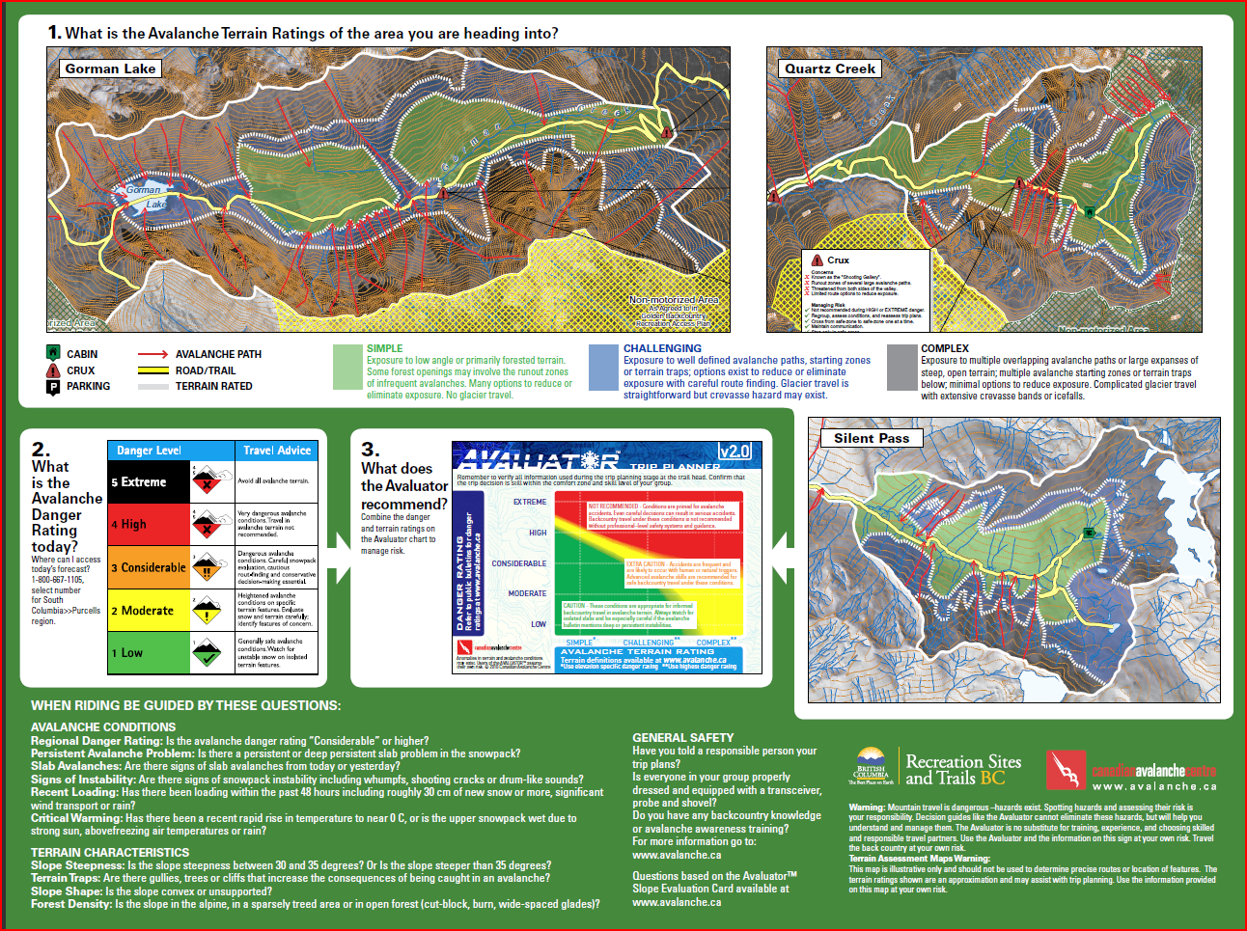

Slide 11
INITIAL FEED BACK
From CAC Snowmobile committee
MAP - Use hill shade( shows some contour shades)
Conforms to other map/brochures
Take Crux text boxes out

Slide 12
CLUB INITIAL FEED BACK
Greg felt that more information could be added to the Revelstoke map. (Point was made that the review of maps was an iterative process and they would get better over time.) Maps were printed for Greg to review with his group. Revisions could be made for the brochure map.
Golden and Eagle Valley maps were first generation and they should be reviewed for addition of local names
Aaron felt contours could be better for the orthos. (Hill shade was ok)
Ken and John to discuss with GeoBC
  All new maps just use hill shade
  Geo BC not required to put in text boxes –(layout and design person will do)
  Some additions for location of play areas etc may be coming

Slide 13
CLUB NEEDS?
Club acknowledgment –Work with RSTBC and CAC to make riding safer
Website address
Club logo
Advertizing
  (Please support our Corporate Sponsors as they support Snowmobiling)
Fee Information
Community Information
Overview map
Other riding areas (Traditional and non controrvertional)
GPS locations
Trail Safety?
Riding etiquette ?
Emergency Information
Regulatory Information
Key messages-These Trails are in the Working Forest

Slide 14
Provincial Recreation Sites and Trails are in the working forest
Given that an important mandate of RSTBC is integrated resource management we need a simple message on our brochures or kiosks like:
THESE TRAILS ARE IN THE WORKING FOREST (with possible a picture of a logging truck)
OR
WE WORK WITH OUR STAKEHOLDERS

Slide 15
CLUB NEEDS-LOTS OF DISCUSSION
Basically there is a large diversity of clubs that have different needs.
Some questioned dealing with etiquette, safety and community info.
Some felt given RSTBC’s help the need for advertising did not seem to be as great.
Some felt the need to address sled skiing
Some see the map as important thing to carry when sledding ex it would contain emergency contacts, key GPS coordinates, overview maps etc

Slide 16
OTHER RIDING AREAS
The RSTBC logo will be on this brochure so contravertional riding areas cannot be put on this brochure. (RSTBC cannot be seen as promoting contravertional areas)
If there are contravertional areas just put a statement on the brochure: “A complete list of our riding areas can be found at http://www. _______

Slide 17
TYPE OF BROCHURE
Shelf
Pocket
Other

Slide 18
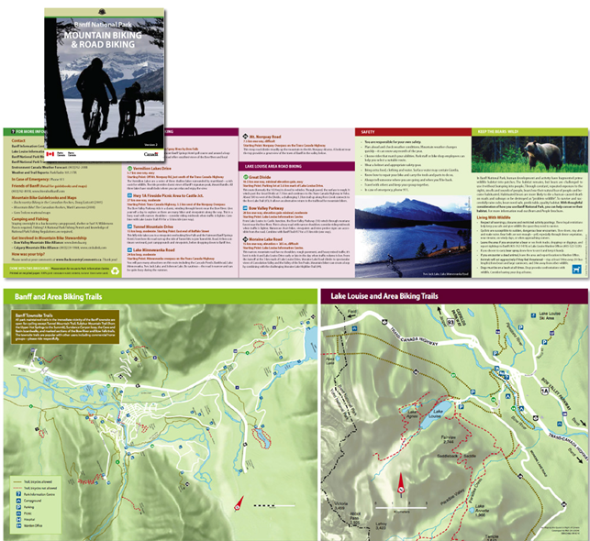
Pocket Brochure-Ruled out
General feeling was that a lot of the brochures get put in racks which are not suitable for the pocket brochures –they drop down and get lost.
-Would sledders have it in there pocket and be more inclined to use it?
-Can just fold shelf brochure in half

Slide 19
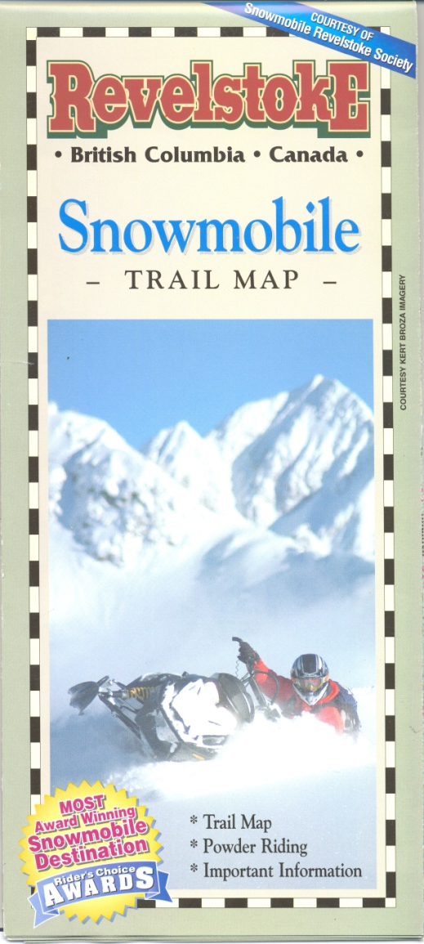
SIZE AND TYPE OF BROUCHURE
Brochure will be 24 inches wide and 18 inches high when unfolded
Each pane or folded size will be 4 inches Wide by 9 inches high.
When folded it will have 12 panes on one side.
(Based on existing Revelstoke Brochure)
-Given the fact that the local clubs have several riding areas the 24 x18 inch brochure should work- Smaller clubs with 1 riding area can go to a smaller brochure

Slide 20

RSTBC BRANDING
(Cover)
All brochures would start out with SNWOMOBILE followed by community name ex “SNOWMOBILE GOLDEN”
Agreed call the brochure “SNOWMOBILE TERRAIN GUIDE”
Your Picture-(RSTBC will not pay)
Add Club logo
CAC Logo

Slide 21

Another Example
  In co-operation with club
Club and CAC logs

Slide 22


RSTBC BRANDING
(Bottom of last Page)
-JK commented that the back side of the brochure is prime real-estate for adds. Maybe a few adds can be placed here for big dollars.
-Ken is not too concerned if the RSTBC came off the back as long as it is on the front. (RSTBC website should be listed someware)

Slide 23
CLUB SIDE / SPACE ALLOTMENT

Slide 24
SPACE ASSIGNMENTS
Space by pane could be allotted to the various club needs.
In a logical or agreed to order?
Objective is to come up with a template

Slide 25
AN EXAMPLE FOR DISCUSSION
Emergency Info
Club / Community Information
Trail Etiquette
Advertising
Prime real-estate for adds
Overview map
Other Riding Areas
Advertising

Slide 26

CAN WE ALLOT SPACE WITH NEED
Pane # | Items to be addressed
1 | Backside /Prime-real-estate for add / RSTBC logo
2
3
4
5
6
7 | Cover Picture / RSTBC Branding
8
9
10
11
12

Slide 27
DISCUSSION
Given diversities it will be difficult to come up with a template that will work for everyone.
Ken will provide 16 hours of Nicola’s time to each club to input and address their needs into a brochure. If club over exceed 16 hours Nicola invoices club.
When building club brochures she will then see if some common themes materialize that can help develop a template.

Slide 28
1
2
3
4
5
6
7
8
9
10
11
12

Slide 29
KEY MILSTONES
Milestone | Date
Initial Meeting | June 22
Heads up to GeoBC | June 23
Revised available info to GeoBC | July 6
Revised Caribou mapping to Angie | July 6
Club information to Nicola | July 15 (The sooner the better –Nicola will work on first come basis)
Revised Terrain map info (Place names) to JK | Aug 1 (Would be nice by July 4 to Ken)
Mock up for each club | Aug 15
Final Brochure for each club | Sept 1
Printing of Brochures | Sept 10
Delivery of Brochures | Sept 15
Snow Shows | October 15,2011

Slide 30
Information to Nicola
Club logos
Other riding area maps
Overview maps
Pictures
GPS information
Key messages / information as to your needs. (This should be well though out with the words as to how you would like to see them in the Brochure –Nicola should not have to do any word smiting or editing)
Advertisements

Slide 31
HIGH RESOLUTION FILES
Logs, maps, pictures, adds etc need to be high resolution.
Such files maybe too large for email –Brent will send out a note to provide a means of sending large files

Slide 32
NICOLA’S CONTACT INFORMATION
the DRAWING BOARD
art & design Studio
Box 2797 . Revelstoke BC . V0E 2S0
250 837 5070
nicolamcgarry.com
Email: nicola_mcgarry@yahoo.com

Slide 33
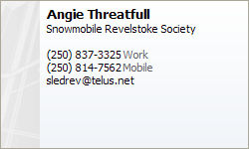
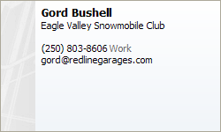

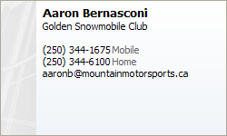
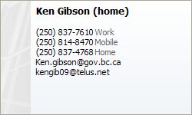
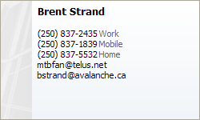
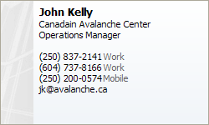
Key Contacts

Slide 34
WORK FOR KEN
Make Nicola’s contract
Determine the color coding for our key colors like Green and get to Brant and Nicola
Figure out printing logistics / costing
Bring GeoBC in the picture
  Get them revised caribou mapping
  Find agreed to closure terminology for Silent pass and send out revised map for club / stakholder review

Slide 35
SUMMER HOLIDAYS
Ken gone July 6 to Aug 19
CAC office closed for July
GeoBC more available for work in the summer vs the fall

Slide 36
OUTSTANDING MAPPING ISSUES
Eagle Valley maps are ready to go (Check for addition of play area names)
Revelstoke –need get Caribou mapping on Frisby map and futher review to add names for play area etc
Golden need to review terrain classification for Silent pass (done) and also check closure terminology. Also add names for play areas (missed for earlier maps)

Slide 37
OFFERINGS
GEOBC / RSTBC to supply terrain maps
CAC to build CAC side of brochure
Clubs to provide input / design ideas and local data / advertizing artwork etc.
RSTBC to provide up to16 hours of design work to each club for building of their brochure (48 hours total)
RSTBC to provide 16 hours towards template(s) construction
RSTBC to provide 5000 brochures to each club

