Slide 1
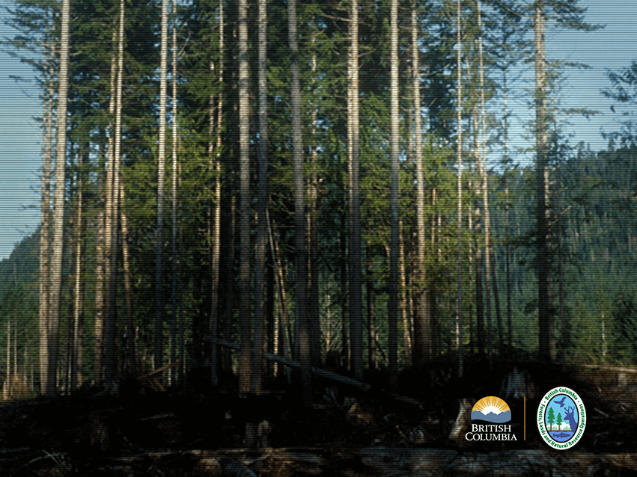
Forest Stewardship Plans
2016 Workshops
review refresh replace
Notes:
Lead: Patrick
FIRST NATIONS TERRITORY Recognition

Slide 2
Welcome!
Introductions
  Your facilitation team
  Participants
House rules and safety
Breaks
Sign-in sheet
Course length (1.5 days)
Notes:
Lead: Patrick

Slide 3
Outline of discussions
DAY 1 – Issues and expectations
Context for change Role of the professional Minister / Chief Forester guidance Obtaining an approved FSP
DAY 2 – Practical applications
Stocking standards Results, strategies and measures Forest development units Review and comment
Notes:
Lead: Patrick

Slide 4
Why are we here?
FLNRO Executive Perspective
Notes:
Lead: FLNRO Executive Representative

Slide 5
A Reminder…
You’re the experts
  Few corporate experts remain
  Under FRPA, it’s the perspective of the practitioners that counts
We’re not here to teach you
  You already know the law, there is plenty of existing reference / interpretive material
You’re going to leave here without all the answers
  No clear answers / interpreting is your job
Notes:
Lead: Patrick

Slide 6
Objective
To discuss the following:
What are the ministry’s expectations for change?
What does the Chief Forester’s guidance mean?
What improvements to my FSP are realistic?
What are others doing to address pressures?
Notes:
Lead: Patrick

Slide 7
Meeting your needs
Use the Post-It notes at your table to:
Write an expectation you have for this workshop
Ask a question you would like addressed
Stick your Post-Its to the wall when you’re done.
Notes:
Lead: Patrick

Slide 8
Professional Reliance:
A Word from the ABCFP
Mike Larock, RPF
Director of Professional Practice and Forest Stewardship
Notes:
Lead: Mike Larock or other?
A presentation on professional reliance and the role of professionals in preparing and adjudicating the plan.
Role of the coordinating professional in overseeing the preparation of the plan.
Role of subject matter expert contributing content to the plan.
Role of professional peer review of subject matter within the plan.
Role of professionals in reviewing the plan.

Slide 9
ABCFP – Professional reliance
  Professional Service
  Role of Forest Professional
  Professional Reliance
Notes:
Lead: Mike Larock or other?

Slide 10
ABCFP – Professional reliance
The Public Trust
Exclusive Practice
Self-Regulation
Competent Practice
Public Interest
Notes:
Lead: Mike Larock or other?

Slide 11
ABCFP – Professional reliance
“The crisis of confidence in the professions, and perhaps also the decline in professional self-image, seems to be rooted in a growing skepticism about professional effectiveness” (Schon, 1983)
Is this a problem for us?
Notes:
Lead: Mike Larock or other?

Slide 12
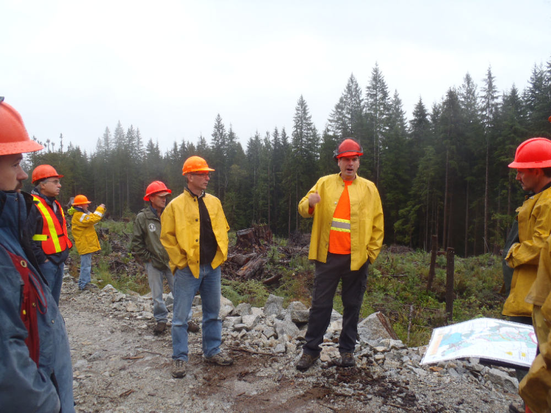
Role of the Forest Professional
Big picture understanding of complex issues and environments (social, economic, ecological)
Application of science into FSP content
Specific task
  Incorporate
  Assess
  Review
  Implement
Notes:
Lead: Mike Larock or other?
Turn presentation over to the facilitator.

Slide 13
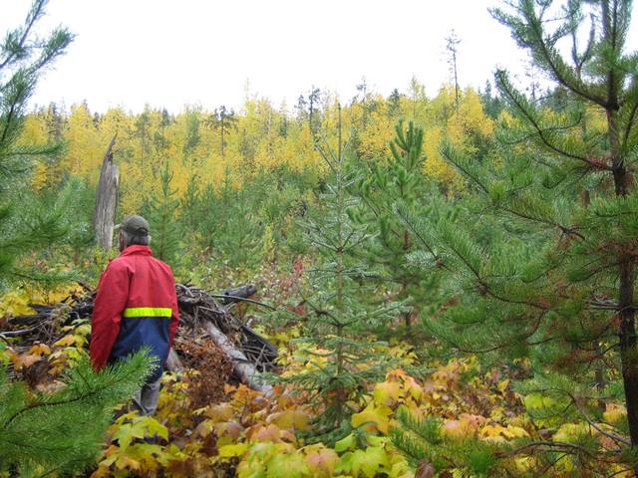
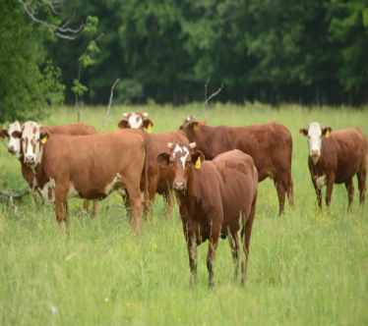
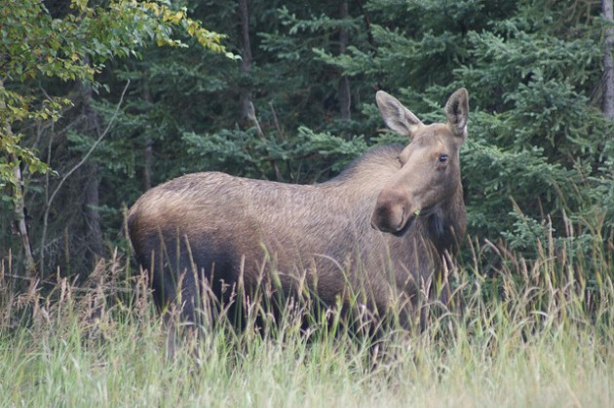
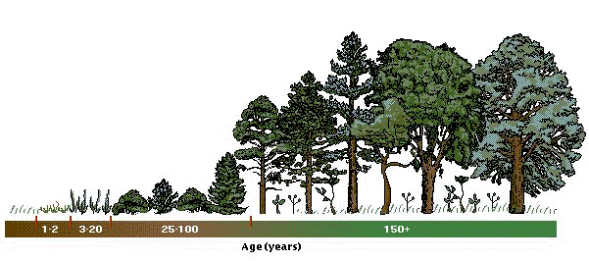
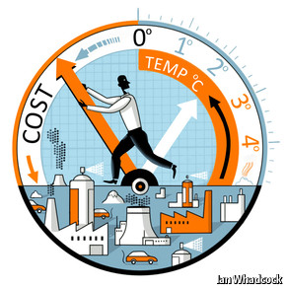




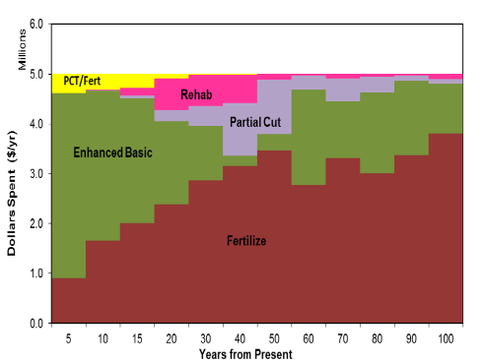
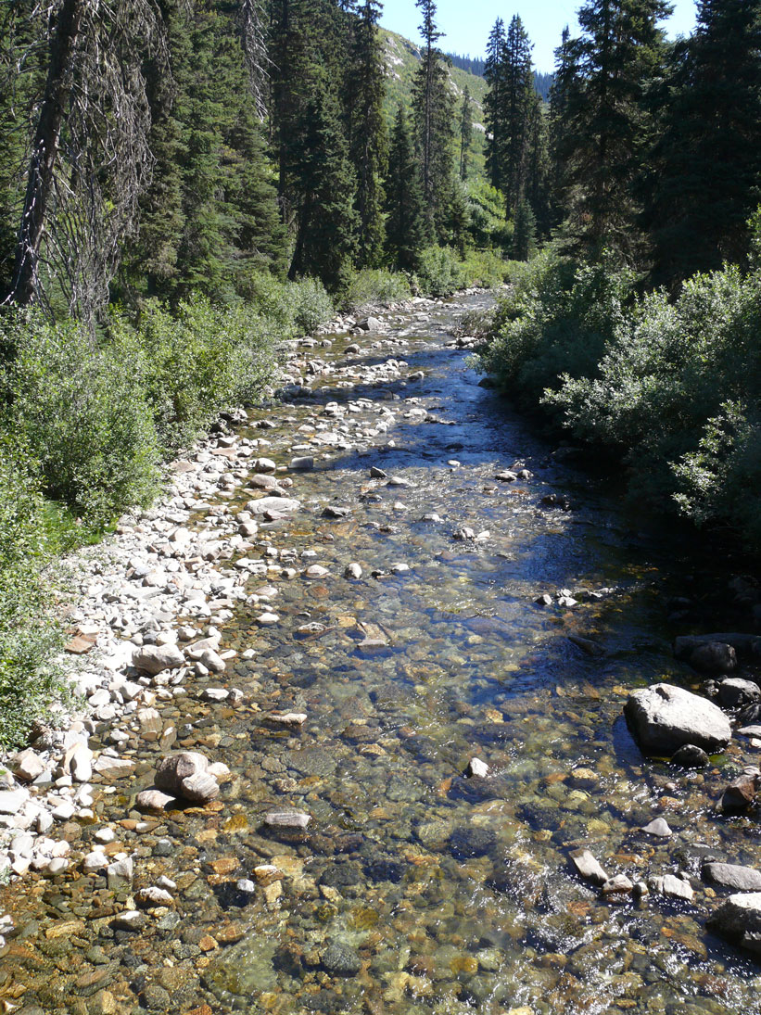

???
Notes:
Lead: Mike Larock or other?

Slide 14
A Growing List of Expectations
Both ends of the gap that I am expected to bridge are changing rapidly: the body of knowledge that I must use, and the expectations of the society that I must serve. (Schon, 1983)
The forest professional does not decide the forest land use
The forest professional does affect the outcomes
Notes:
Lead: Mike Larock or other?

Slide 15
Professional Reliance
PR = Rely on judgement x Accountable
Judgement = direction, advice, decisions
(knowledge, training, experience)
Accountable = answerable beyond employment
(member of regulated profession)
Notes:
Lead: Mike Larock or other?

Slide 16
Professional Reliance
PR = Rely on judgement x Accountable
Professional Reliance affected by:
Professionals are not assigned to the task
Judgement is constrained in the options
Social decisions and choices are already made
Professionals lack knowledge and understanding
Professionals do not act in the public interest
Notes:
Lead: Mike Larock or other?

Slide 17
Professional Reliance
Foresters Act
Bylaws - professional practice determined by members
- 11 Code of Ethics
- 12 Professional Practice Standards
Guidelines – resolutions by ABCFP council
(competence, independence, integrity, due diligence, stewardship and safety)
http://abcfp.ca/regulating_the_profession/documents/guideline_standards_professional_practice_2010.pdf
Notes:
Lead: Mike Larock or other?

Slide 18
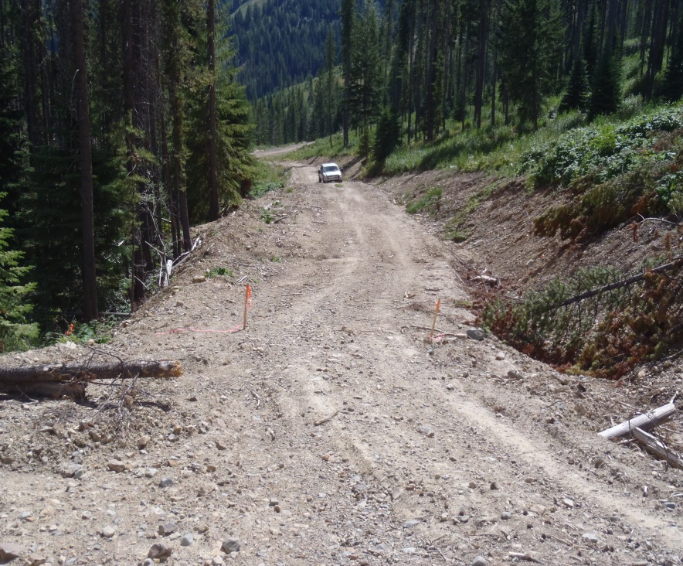
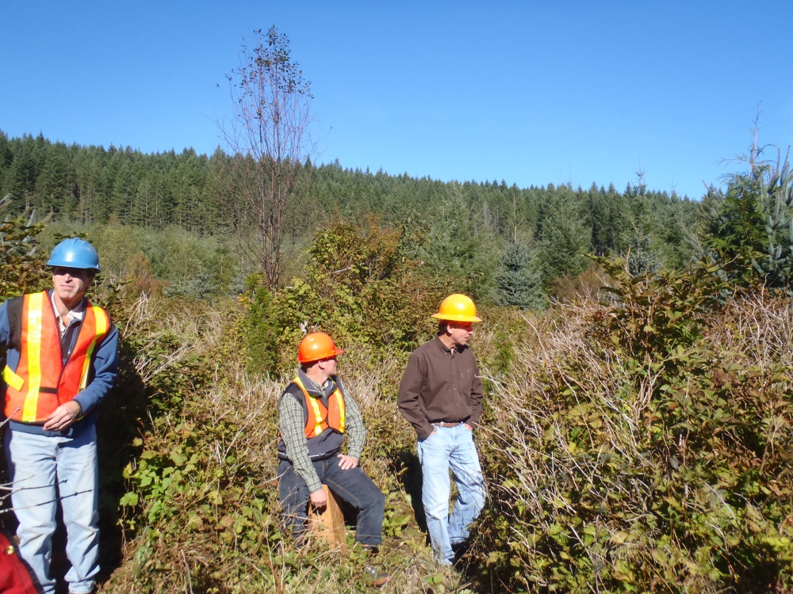
Professional Reliance
Bylaw 12.2.1
Competent members maintain sufficient knowledge in their field(s) of practice.

Slide 19
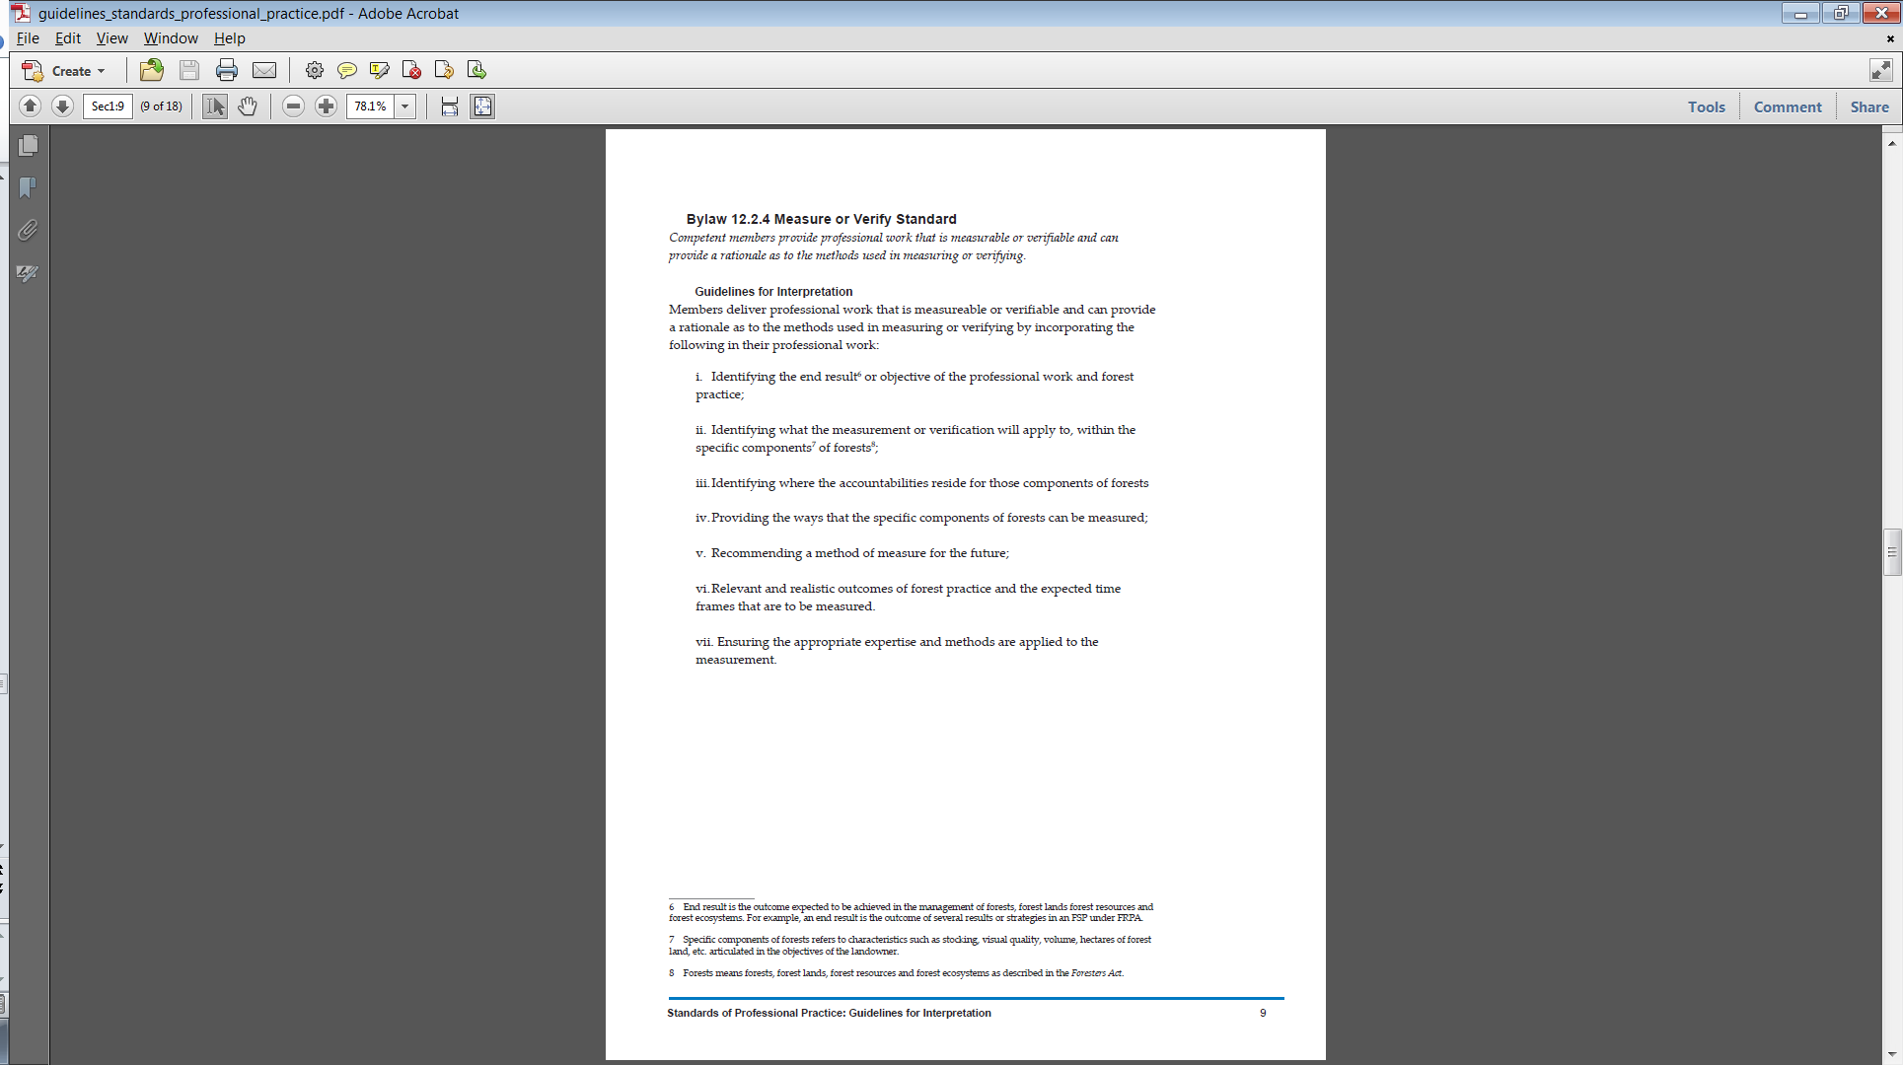
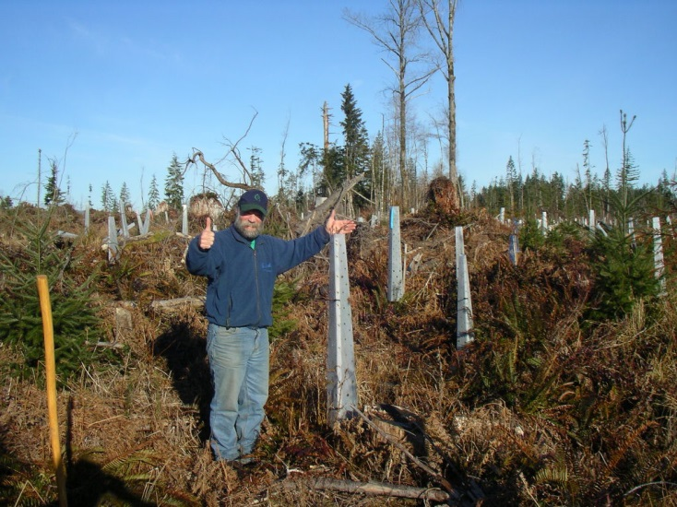
ABCFP – Professional reliance
12.2.4:
Competent members provide professional work that is measurable or verifiable and can provide a rationale as to the methods used in measuring or verifying.
ABCFP Standards of Professional Practice: Guidelines for Interpretation, June 2014

Slide 20
ABCFP Professional Practice Guidelines in Forest Operations
  Forest Roads
  Crossings
  Supervision
  Professional Rationales
  Field Work
  Interpreting Public Interest
  Professional Independence
  Terrain Stability
Notes:
Lead: Mike Larock or other?

Slide 21
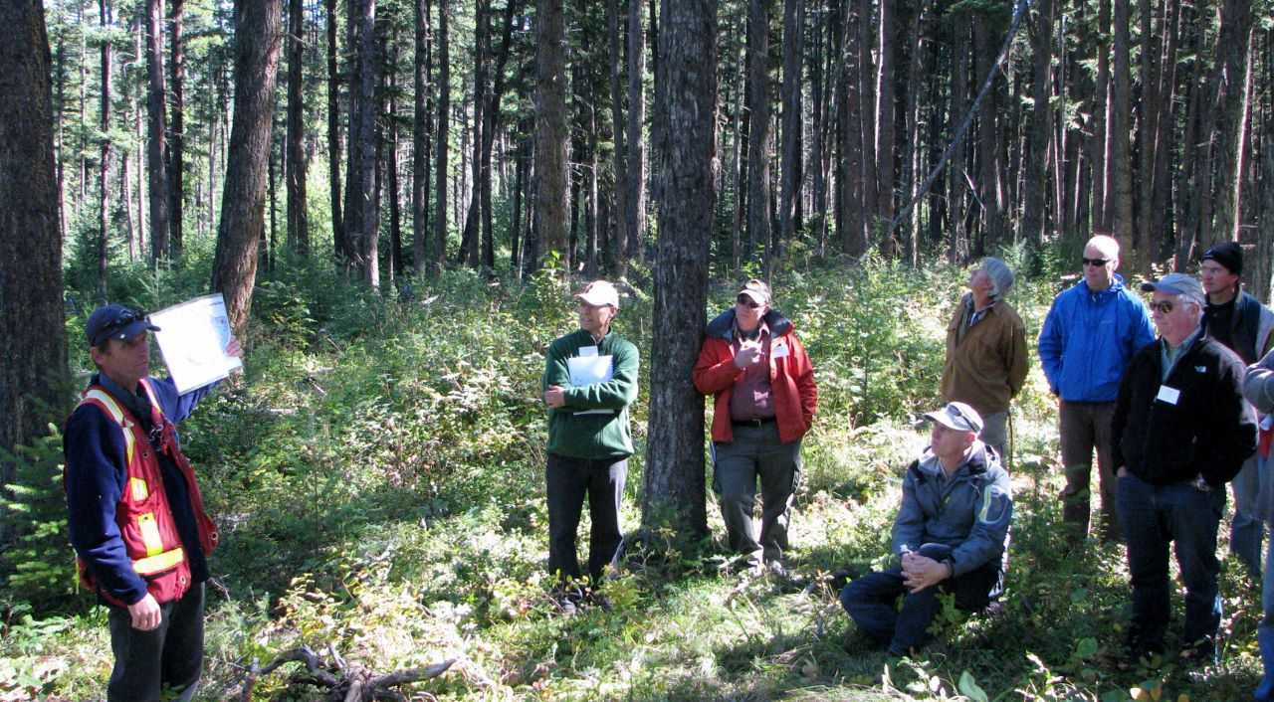
Time to Reflect
Notes:
Lead: Mike Larock or other?

Slide 22
Opportunities
Establish strong professional relationships
Improve the workability of the FSP
Demonstrate the value of professional service
Commit to regular improvements to our professional practice.
Notes:
Lead: Mike Larock or other?

Slide 23
ABCFP – Professional reliance
Thank-you
Questions or Conversation?
Contact Mike Larock RPF
604-331-2324
mlarock@abcfp.ca
or
Check us out
www.abcfp.ca
Notes:
Lead: Mike Larock or other?

Slide 24
Overview of the FRPA Model
Notes:
Lead: District Manager or industry rep

Slide 25
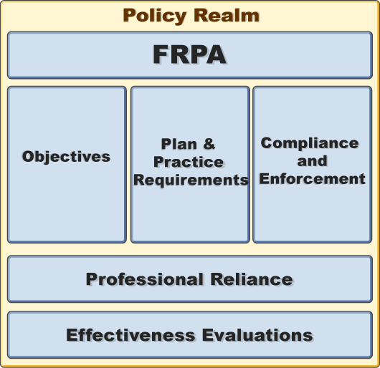
The elements of FRPA
Notes:
Lead: District Manager or industry rep

Slide 26
BC’s forest policy framework
Resource statutes e.g. FRPA
Professional statutes
Legal Realm
Common law: civil liability
Common law: professional negligence
Non-legal Realm
Societal expectations
Scientific / technical knowledge
(Underpins societal expectations, and some aspects of the legal realm)
Notes:
Lead: District Manager or industry rep
The Act itself is only part of the framework – the “tip of the iceberg” – there are many factors that influence the implementation of policy and law. As government, we must be alive to them all.

Slide 27
So, what is an FSP?
Notes:
Lead: Patrick

Slide 28
The FSP is…
Sole plan requiring government approval under FRPA
Operational commitments to meet government objectives
Subject to public review/comment
Provides guidance to site plans
What else?
Notes:
Lead: Patrick

Slide 29
Lunch Break

Slide 30
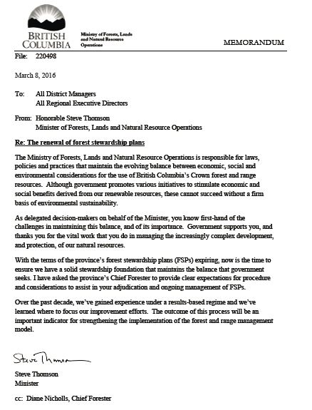
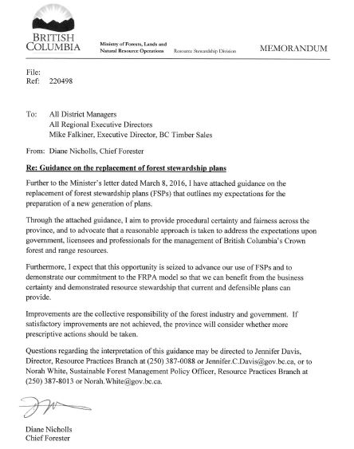
Minister and Chief Forester guidance
Notes:
Lead: Norah or proxy

Slide 31
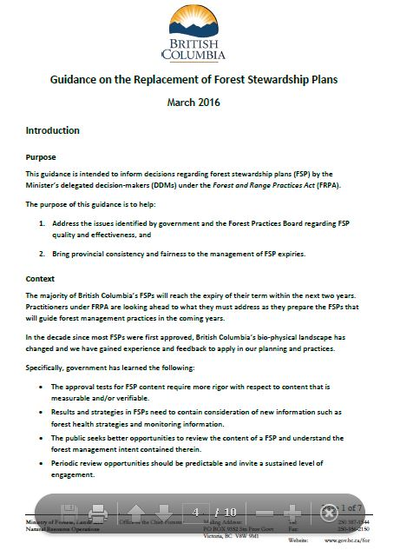
Minister and Chief Forester guidance
Imminent expiries
Opportunities for improvement
Many changes – land base, operators, knowledge
Stakeholder interest increasing
Notes:
Lead: Norah or proxy

Slide 32
Minister and Chief Forester guidance
Replace FSPs
Conditional, temporary extensions
Engage affected parties and First Nations
Simplify FDUs
Document the process: DDM expectations, approval rationales
Notes:
Lead: Norah or proxy

Slide 33
Minister and Chief Forester guidance
New information
More rights holders overlap land base
No unjustified financial or operational hardship on licensees or districts
Notes:
Lead: Norah or proxy

Slide 34
Key Points from the Chief Forester
More rigour with regard to content that is measurable / verifiable
Results, strategies and measures consider new information
Improved public understanding of FSPs
Review should be predictable and invite ongoing engagement
Improved planning and site-level information sharing with affected parties
No unjustifiable hardship, financial or operational
Notes:
Lead: Patrick

Slide 35
Exercise
In your tables, discuss the Chief Forester guidance and identify the parts that relate to your operating areas / operations.
Record and share your tables views.
Notes:
Lead: Patrick

Slide 36
Afternoon Break

Slide 37
Exercise
In your tables, discuss the Chief Forester guidance and what you would expect to see in district expectations?
Record, and share your table’s views.
Notes:
Lead: Patrick

Slide 38
Alternate table discussion / activity
How does this change your planning for your expiring FSP?
What’s feasible / not feasible?
what more can be done to share information at the site level?
How can we make forestry planning better?

Slide 39
Summary of today:
What was most important to you?
What question do you still have?
What expectations have been met / not met?
Notes:
Lead: Patrick
A few thoughts for summary:
We’re facing pressure to do more
Chief Forester’s guidance provides focus for our efforts
The FSP is a broad authorization and set of standards
Specific expectations for change are created through a joint process
You had ideas for your own processes

Slide 40
Adjourn Day 1

Slide 41
Day 2 Roadmap
Practical applications for:
Stocking Standards
Results, strategies and measures
  Measurable / verifiable
  Reasonable & appropriate
  Consistent with objectives
FDUs
Review and comment
Notes:
Lead: Patrick

Slide 42
Focusing In: Stocking Standards
Notes:
Lead: FLNRO technical rep
The preparation of proposed stocking standards for your plan
Review regulatory context of stocking standards in the FSP
Discuss situations and circumstances as to where and when unique stocking standards will be applied
Role of the factors in proposing stocking standards.
Government expectations for acceptable proposed stocking standards.
Resources to support the development of stocking standards

Slide 43
An alternative standard
Innovation & flexibility for operations – why propose a different standard?
  Forest health
  Species migration
  Wildlife habitat
  Wildfire
  Etc.?
Notes:
Lead: FLNRO technical rep

Slide 44
A few considerations
Are there restrictions or specific applications for some species?
Are there local forest health risk/hazards that need to be considered?
Are there risks associated with the species mix and prescribed densities with regard to future volumes and/or values?
Define the situation / circumstance
Notes:
Lead: FLNRO technical rep

Slide 45
A few more considerations
New information such as:
    Effectiveness evaluations
    Monitoring information (yours, FLNRO’s)
    Desired future products
    Forest health strategies
    Silviculture strategies
Notes:
Lead: FLNRO technical rep

Slide 46
Exercise
Work in groups to discuss a scenario from your Participant Manual.
Record the important points from your discussion and share your conclusions.
Notes:
Lead: Patrick

Slide 47
Results, Strategies and Measures
Notes:
Lead: Patrick

Slide 48
Results, Strategies & Measures
What have we learned?
Notes:
Lead: Patrick

Slide 49
Results, Strategies & Measures
What We’ve Learned :
Avoid imprecise phrases and words
  “will consider”, “may”, “if necessary”, “reasonable effort”
Define important terms
  “triggers” for action
Avoid broad or vague exceptions - use those provided in the FPPR
Default practices cannot be modified in an FSP
Notes:
Lead: Patrick

Slide 50
Results, Strategies & Measures
What We’ve Learned :
Measures are subject to the approval tests of enforceable, reasonable and appropriate
Invasive plants
  should reduce the likelihood of introduction and spread of invasive plants including risk assessment, detection, treatment, and reporting
Natural range barriers
    consult with range tenure holders
    clearly identify who is responsible for carrying out the measure
Notes:
Lead: Patrick (or FLNRO rep?)

Slide 51
Results, Strategies & Measures
Tips:
Focus on what you will do, not what you won’t
Use the essential elements: who, when, what, where
From: FRPA Bulletin # 12 , #25
Notes:
Lead: Patrick (or FLNRO rep?)

Slide 52
Results, Strategies & Measures
A. Essential elements of ‘measurable or verifiable’
  Who is doing it
  What is being done
  Where will it occur
  When will it occur
  B. Consistent with objectives
  From: FRPA Bulletin 12
Notes:
Results and strategies must be measureable or verifiable as stated in the legislation.
To draft a result or strategy that it is measurable or verifiable, you should address the following essential elements with data or information that can be used to determine if the outcome has been achieved (e.g., may involve quantifiable attributes that can be reported, or clearly defined conditions that can be examined or demonstrated to exist)
The essential elements are:
Who is doing it
What is being done
Where will it occur
When will it occur
CF: “Default practices should not be modified or they are no longer defaults. Default practices listed in the Forest Planning and Practices Regulation must be either followed as-written, or alternate results and/or strategies that better meet local conditions should be proposed.”
CF: “Where a result or strategy is proposed in an FSP, the plan should clearly indicate which option (result or strategy) has been selected and how it will be measured or verified. Adhering to the guidance set out in C&E Bulletin 12 will improve the measurability of results and the verifiability of strategies in FSPs.”
C&E Program Staff Bulletin # 12 available on the FRPA Bulletin website – Can be found by Googling

Slide 53
Innovation
Alternatives to default practices
Characteristics:
  Significantly different than default
  Based on research or sound professional opinion
  Will ease implementation
  Will improve results / outcomes
Notes:
In the context of FRPA implementation, the term ‘innovation’ generally applies to ‘alternative’ results and strategies that significantly differ from default practices. These are the key characteristics of innovation.
Innovation also applies to other operational commitments in FSPs, such as stocking standards that deviate from the Chief Forester’s Reference Guide or district policies (stocking standard defaults). Under a changing climate, alternative stocking standards will be proposed more often to address maladaptation, drought, fire resiliency, and emerging forest health issues.

Slide 54
Example: Inconsistent w/Objective
…the FSP holder will design its cutblocks and roads…so that, when assessed from significant public viewpoints relevant to the scenic area, the altered forest landscape is consistent with the established VQOs.
(should say)…harvest cutblocks and build roads…

Slide 55
Example: Not Measurable or Verifiable
“At the end of the term of this FSP, the young forest patch size categories found in TFL 99 will trend towards or fall within the desired target ranges shown in the following table…”

Slide 56
Example: Not Measurable or Verifiable
“If necessary, alter planned development in order to conserve, or if necessary protect….”

Slide 57
Example: Not Measurable or Verifiable
“On an annual basis, the area of known sites of invasive plants, and sites considered as high and extremely high risk to invasive plant establishment through forest practices will be identified.”

Slide 58
Forest Development Units
Notes:
Lead: Patrick

Slide 59
Chief Forester Guidance on FSPs
  “… the overlap of forest development units should be minimized and/or a
  single multi-signatory FSP
  should be proposed...”
Notes:
Lead: Patrick

Slide 60
A few facts on FDUs
More than one-third of FSPs are multi-signatory
Parts of the province have up to 5 overlapping FDUs
FDUs can be millions of hectares
Notes:
Lead: Patrick

Slide 61
Review and Comment
Notes:
Lead: Patrick

Slide 62
Chief Forester Guidance on FSPs
    “The public seeks better opportunities to review the content of a FSP and understand the forest management intent contained therein.”
    “Periodic review opportunities should be predictable and invite a sustained level of engagement.”
Notes:
Lead: Patrick

Slide 63
Chief Forester Guidance on FSPs
    “Improvements in planning and site-level information-sharing are needed with all interested and affected parties, including reaching a common understanding of how the FSP can/cannot support these improvements.”
Notes:
Lead: Patrick

Slide 64
Workshop Wrap-up
Notes:
Lead: Patrick

Slide 65
Discussion Highlights
  Government challenge to practitioners for (re)commitment to FRPA
  Key points of the Chief Forester guidance
  Addressing issues in the ‘non-legal’ realm
  A joint process in getting a new generation of replacement FSPs
  Practical application of ‘measurable/verifiable’ and ‘consistent with objectives’
Notes:
Lead: Patrick

Slide 66
Available guidance
The basics:
  Administrative Guide for FSPs (AGFSP) –Volumes 1 and 2
  FRPA Bulletins (roughly, 40)
  Ask Districts or Industry Association for government publications and joint industry-government guidance.
  … Just Google It!
Notes:
Lead: Patrick

Slide 67
Things to remember
What will learning, realization or insight will you take away from this workshop?
Notes:
Lead: Patrick
Some of the major lessons learned over the past 10 years:
Invest in a quality plan – a well written plan is easy to understand by your internal staff (implementation) as well as reviewers (Public, First nations, other stakeholders) and adjudicator (DDM).
Ensure results, strategies, measures meet definition
Results and strategies must be measureable and verifiable. Clearly identify when you plan to use “defaults” and when you are proposing alternatives
Measures must be reasonable, appropriate and enforceable.
Avoid self-exemptions.
Utilize review and comment activity to communicate and solicit feedback – assisting the Public, First Nations and other stakeholders to understand the plan will enhance the quality of the feedback and set expectations for operational activities down the road.
Consider innovation and flexibility to adapt to changing conditions and for operational benefits – look for innovative approaches and solutions to benefits in operations (e.g., reduced costs, increased flexibility, quicker free growing stands).

Slide 68
Please take 2-5 minutes to complete an evaluation.
Notes:
Lead: Patrick

Slide 69
Thank You!
Notes:
Lead: Patrick

