Slide 1

Stand Development Monitoring
FREP
Timber Production Protocol
SDM

Slide 2
The goal of SDM is to monitor shifts in stand attributes from the baseline data set from FG surveys. This will allow us to make inferences about our Stocking Standard and FG Policy as well as Forest Health Issues
SDM data can be valuable for many other uses:
Monitoring the impacts of forest management decisions such as site prep, planting density, spacing and fertilization
Feedback to Standards Contained in Operational Contracts ie Spacing, Planting contracts
Calibrating our stand level models
Comparing our stands to TIPSY to supply input to TSR for Managed Stand Analysis Units

Slide 3
Average Age of stands at Breast Height
Average of all blocks = 20
Notes:
This is the average age at dbh from the GI trees – one per plot. For Pli a breast height age of 20 equates to a total age of around 26.
Would like to “throw out” SDM#5 as it is really not old enough for a true reflective post free growing analysis. Would be a good one to redo in five years as it had a high amount of rust.

Slide 4
Years from Disturbance and Planting
Notes:
This is interesting – Unit #5 had the same disturbance year as 15 A and 15B – but because it was left for natural – the stand age is 4 – 6 years younger. Unit 5 and 15A and 15B were our only appraisal blocks.

Slide 5
Total Trees & Total Conifers per Hectare
Average of TC = 3241
Notes:
Only had one block where the deciduous was really still an issue. Mostly decid was scattered enough to provide some diversity without alot of competition. Would like to track the decid competition somehow. Could show it on the cards by calling it FG on the left side of the card, but not on the right where we are supposed to track FG how it was done at the time of the previous survey.

Slide 6
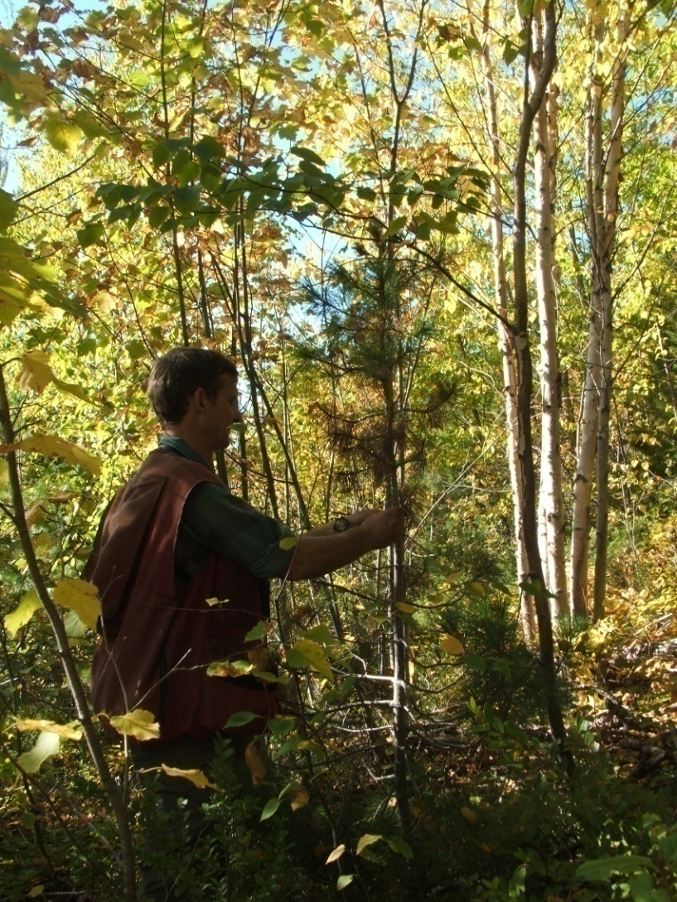
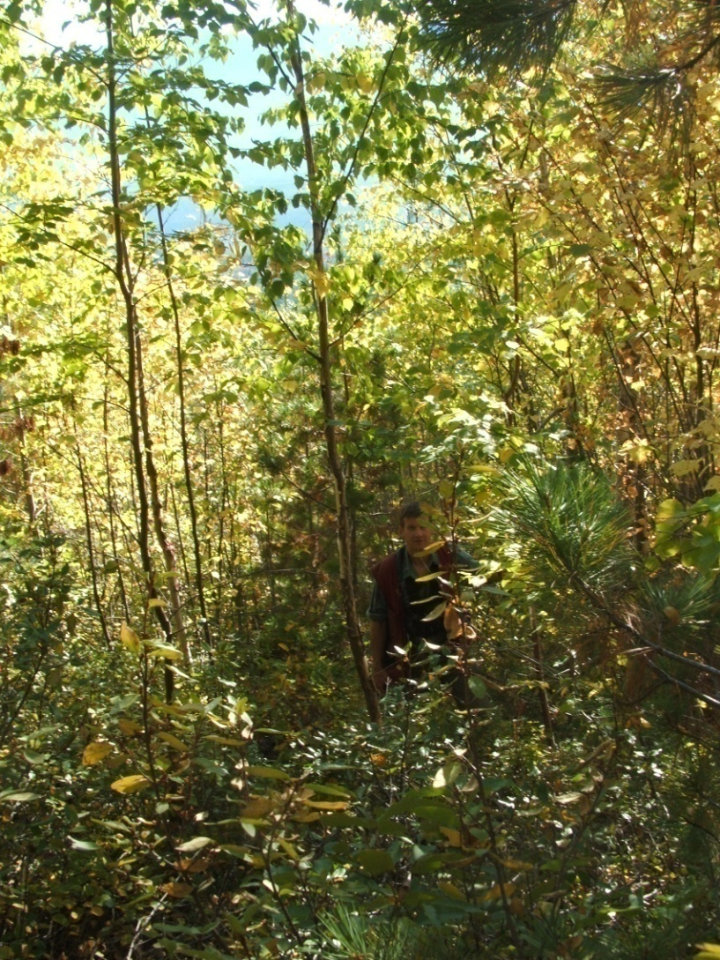
There is no assessment of the Free Growing status of the WS trees
Notes:
As per previous slide notes – would like to track whether a tree meets our FG definition. Easy to do on the left and right side of the card.

Slide 7
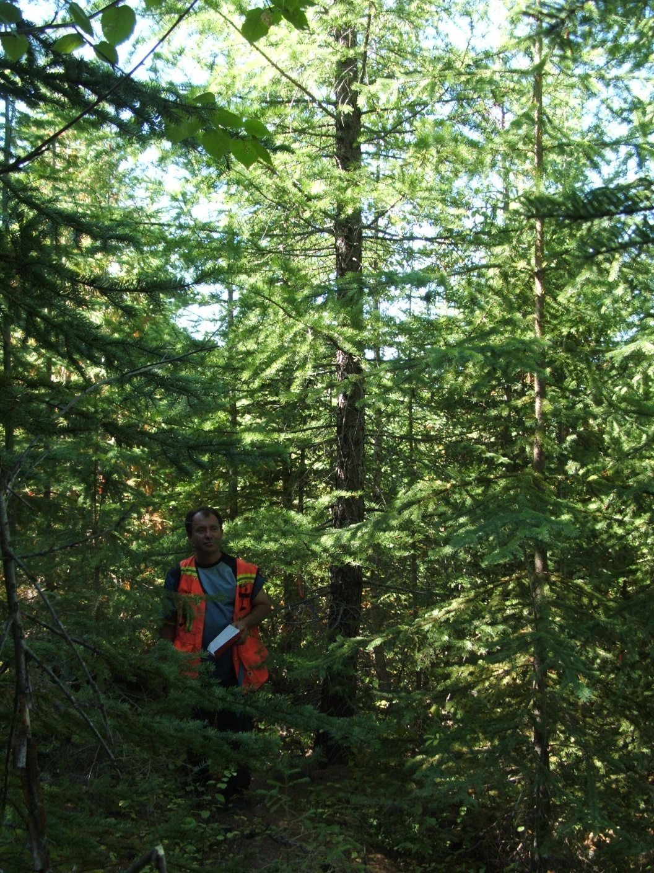
Another dense 28 year old stand - ICH Donald Hill
SDM Unit #21
4860 total stems/ha
Planted Pli, Lw and Sx
Planted Lw is just to the right of Jason
Smaller trees are L3 naturals – Sx, Fdi, Bl, Cw
Notes:
Great example of how there is a mix of large planted trees and thrifty naturals. About 1500 stems/ha of deciduous – but scattered in the stand. A really diverse stand with some ht and diam variation. But not really what we are modelling in the Golden TSA. Unfortunately the bears loved the big Lw and Pli!

Slide 8
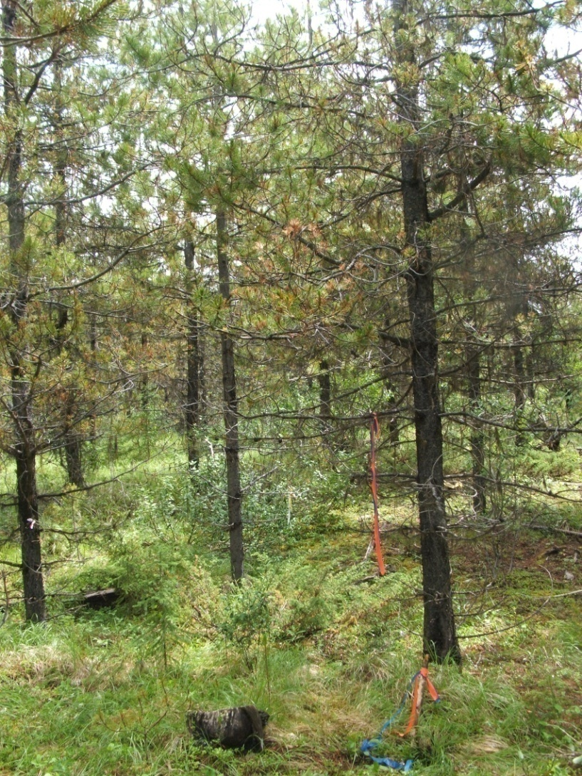
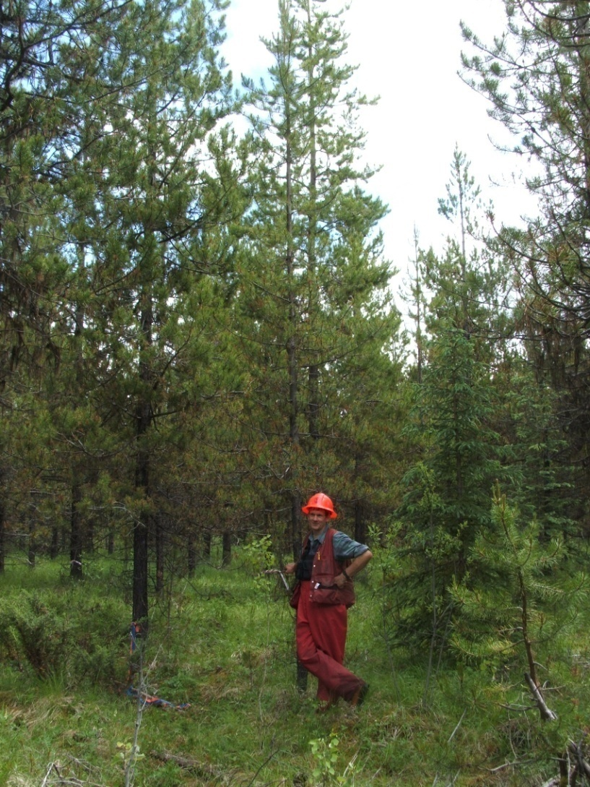
Least Dense Stand Sampled
MS - Beaverfoot - SDM Unit #27
1360 Total Conifers – Spaced at 10 years of age
Notes:
Only 740 WS trees. This Pli spacing looks awful and is almost NSR. Would definitely not space Pli down to this low density. Think we may have underestimated the Pli rust in this block. Not too much L4 understory. We tracked L4 in the comments – just a number tally. Would recommend an understory retention clause in a Pli spacing contract. Not a resilient stand.

Slide 9
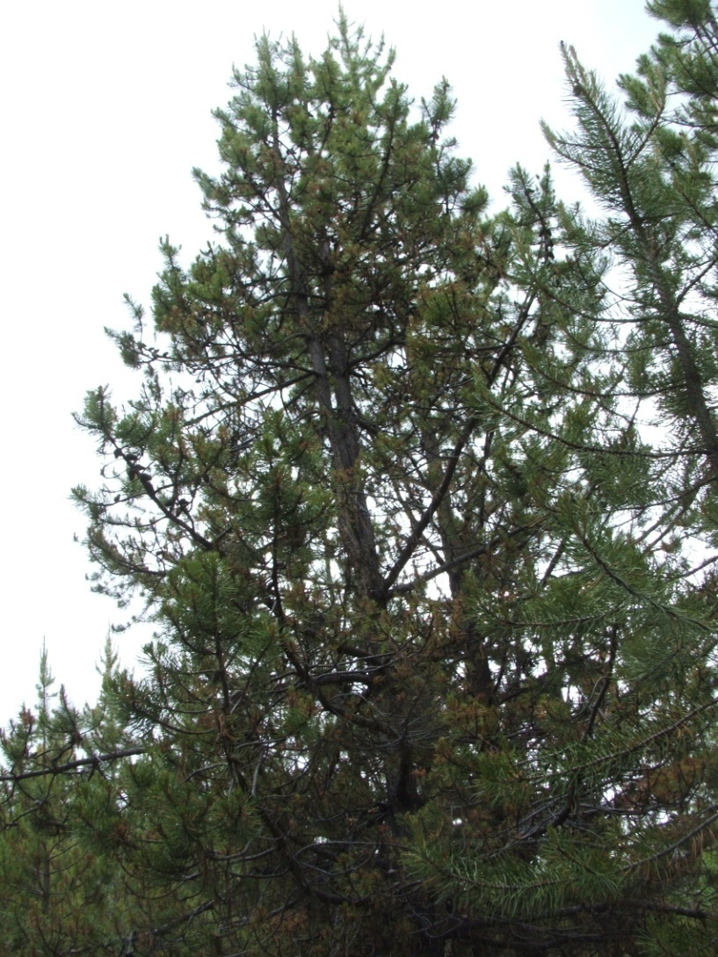
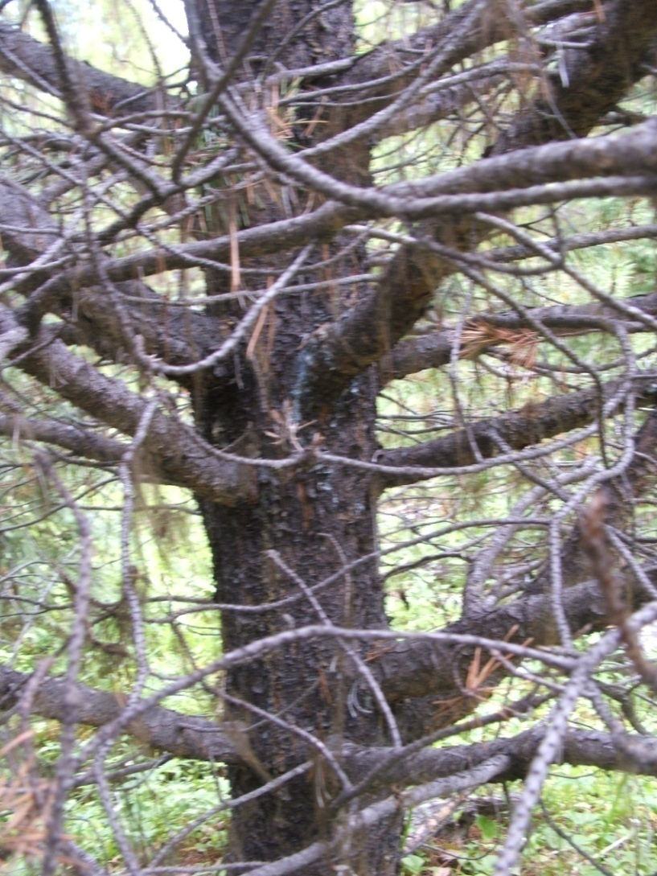
This spaced stand also had the poorest formed (ugly) trees
Notes:
Consequences of early spacing to a low density – the quality in this block was terrible. Would not totally rule out Pli spacing as a treatment as we have walked some really nice spaced Pli in other areas.

Slide 10
Well Spaced Conifers per Hectare
Average = 1054
Dark Green with Glow – block had JS treatment
Notes:
This is obviously an “uncapped” WS number – but would not change the results of the lower stocking as there were no plots over M. Have not calculated blocks that use the mean as stocked with the LCL below minimum.

Slide 11
The importance of SDM data to Managed Stand Yield Predictions
We should be able to use SDM data to calibrate TIPSY or change our assumptions on how these stands are developing
For example:
With the exception of SDM # 5 these stands are all old enough that a Layer 3 tree is either ingress or a planted tree that ran into trouble.
Counting a Layer 3 tree as a Well Spaced Crop tree has implications to genetic gain, regen delay, and our assumption that our stands all have a “planted” distribution

Slide 12
Percentage of Total Conifers that are L3
Average = 58% of TC are L3 trees
Notes:
Block 24A is interesting as it had one of the lowest total densities and well spaced number. The numbers show that 51% of total conifers are L3 but that drops down to 15% of the WS. In unit 25 the L3s’ drop from 45% of TC to 4% of WS. SDM block 5 is the youngest/smallest trees and pushes the average up. The difference between 15A and 15B is really interesting because they are different strata of the same block.

Slide 13
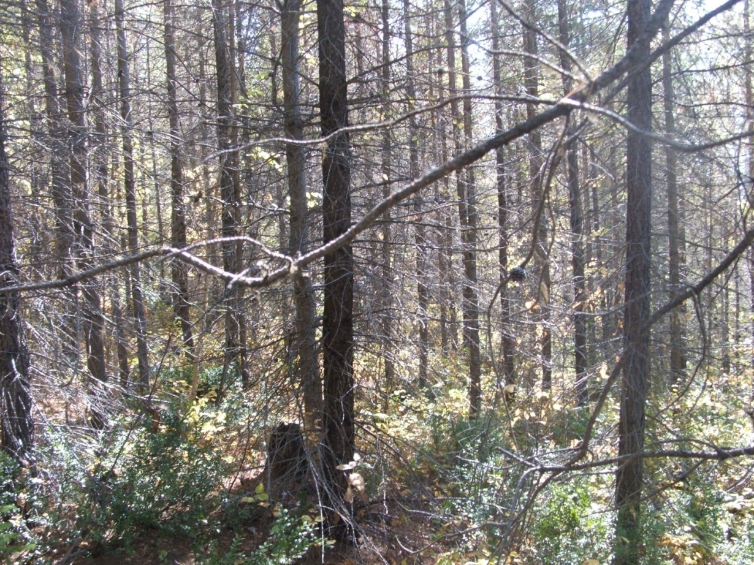
SDM 12 had the lowest number of L3 trees
This block had very regular spacing: 1620 Total conifers & 1140 WS
It was planted to Pli and Lw in 1987
This block was planted at a density of 2500 stems/ha
Notes:
Have not done a match with TIPSY yet – but I think this stand will match really well. Have no idea why they planted the stand this dense in 1987. The minutes from our Provincial Silv Call circulated a Sustainable Forest Management plan from Sweden. In the plan then they recommend planting 2500/ha for SI 24-28. This site had a SI of 26. Looks like it works.

Slide 14
% of Well Spaced that are L3
Average = 34%
Notes:
Have not crunched any numbers and there are not enough samples for a true statistical analysis – but there looks like a significant difference between the blocks that have a “glow” highlight and the others. The previous picture was of Unit 12. Unit 25 was right across the road and also planted to 2500 stems/ha

Slide 15
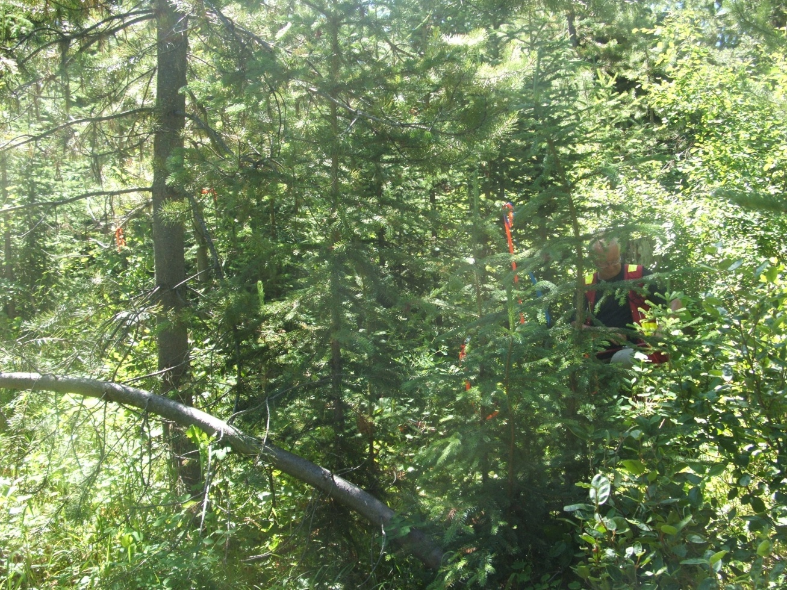
Highest % of WS L3 trees
The youngest Pli stand and the ESSF stand had the highest % of Well Spaced trees that were L3
The picture shows an example of a stand planted to Pli where natural Sx has come in under the planted trees
Initial Planting density was 1236 stems/ha
SDM #20
Notes:
The two blocks with the highest number of L3 trees are obvious. The youngest Pli one and the ESSF block. Next to them this block SDM #20 had the highest % of L3 trees as a % of WS. The bears took out quite a number of large Pli.

Slide 16
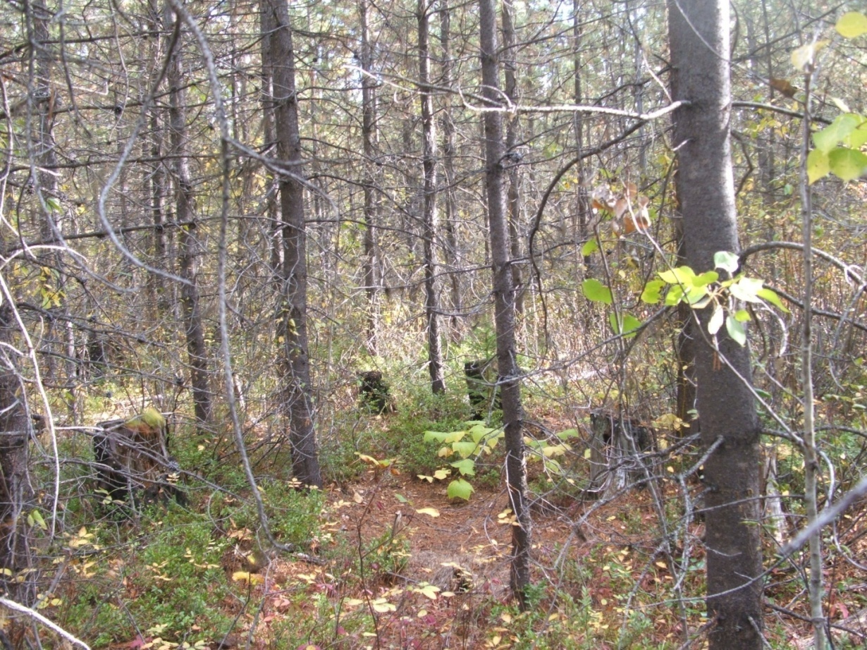
The least % of WS that are L3 was in SDM #25
This block had very regular spacing - 2180 total conifer 1060 WS
This block was planted to Pli and Lw in 1987
Initial planting density was 2500 stems/ha
Notes:
This block will probably have a really good match with the TIPSY planted distribution. Lots of trees very regularly spaced. There were a couple of other blocks planted to this density that I would like to target as SDM samples after we have completed our 30 random samples.

Slide 17
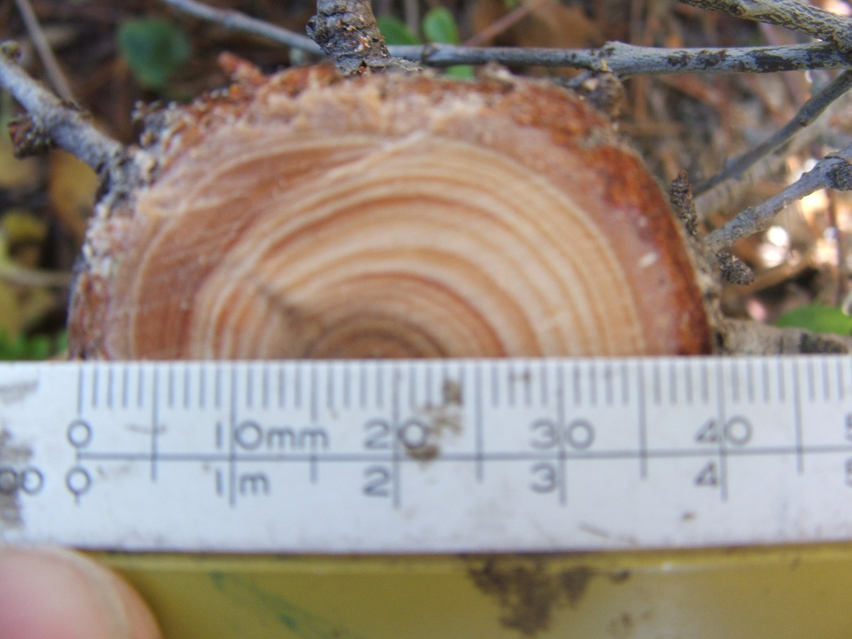
What are the consequences of having L3 trees in the WS count?
In the Golden TSR all the managed stands are assumed to be planted
At the age of the stands in the SDM sample - L3 trees are naturals or ‘loser’ planted trees
TIPSY assumes there are planted trees at a very regular spacing (like picture in previous slide)
Genetic Gain is applied to all the crop trees
Regen Delay is assumed to be 2yrs
The L3 trees have a much longer regen delay and have no genetic gain
This is a L3 planted Lw Most of the Lw are L1
Example SI tree 16.7 dbh and 15.3 M ht
Notes:
This planted Lw was part of the stand from the previous slide picture. Most of the planted Lw were really big – L1 trees. For whatever reason this guy did not make it and is suppressed. If you are working in a TSA that has assumed planted distribution in TIPSY then I consider every L3 tree counted to be a “hit” to volume and to the timing and genetic gain.

Slide 18
Do we have as many large trees as TIPSY assumes?
Looking at the distribution of large diameter stems in the stands is very interesting
Analyzing the number of large trees present in the stands should also help to calibrate TIPSY

Slide 19
Number of L1 Well Spaced Trees
Notes:
Kind of just the reverse of the L3 graphs but illuminating none the less. Again looks like a significant difference with the “glow” blocks. SDM #3 is the oldest block and had a weird site prep treatment that resulted in a ”spaced” distribution of the crop trees. The site prep rows are still really obvious on the ortho after 35 years. I would have thought that the stands planted to greater than 2200 would be taller, but maybe not consistently larger. However this shows that the densely planted trees that closed crown and grew up without any ingress are just as big or bigger than the blocks that had a JS treatment.

Slide 20
Percentage of WS trees that are L1

Slide 21
Average Dbh of the L1 trees in each unit. Not a huge range – but the spaced fertilized stand has the largest Dbh
Blue glow is planted to >2200
Green glow is spaced
Yellow glow is spaced and fertilized
Notes:
Should use a smaller scale to highlight differences as they are more significant than they look. The graph came out the way it did because SDM #5 has no L1 stems. As the previous two graphs showed it is the number of big trees that the treatments really highlight.

Slide 22
How do we achieve an even distribution of large diameter trees?
These preliminary results show that spacing or planting to a high density achieved the distribution of large trees that TIPSY assumes is present in planted stands
Looking at the L3 data in combination with the L1 suggests that perhaps planting to less than 2000 stems/ha results in a stand that has a more “natural” distribution for TIPSY than planted

Slide 23
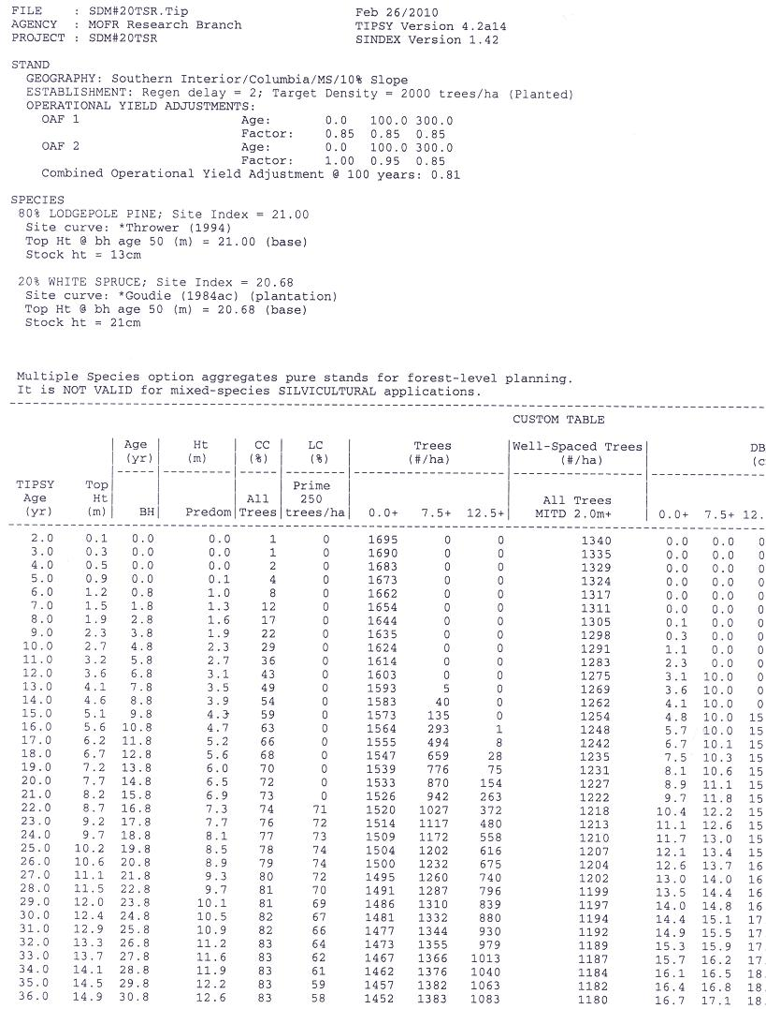
Custom TIPSY Table
With the SDM data collected you can match the BGC Zone, Site Index , Leading Species, and with Breast Height Age – match an exact line in the TIPSY table.
Then direct comparisons can be made to determine if our stands “look like” the TIPSY model we have chosen for TSR.
SDM #20 – BGC Zone - MS
From Inventory Label – Pli80 Sx20
SI from GI = 21
Average age at Breast Ht = 20
TIPSY table for DCO TSR Managed Stand Analysis Units

Slide 24
Comparison of 5 TIPSY runs to SDM block #20
The left column is how this stand was modelled in TSR
Notes:
The left bar is how we model our stands in TSR – Planted Distribution, Initial Density 2000 and 2 year regen delay. Because we had so many stems in our SDM block I tried a Planted Distribution with 4444 (the max TIPSY will allow for planting) and 2 year regen delay – 2nd bar. The third bar shows Natural distribution using 2000 initial density and 7 year regen delay. 4th bar shows Natural Distribution with 4444 stems and 7 year regen delay. The 5th bar is working backwards from my SDM data – it said to start with 6132 stems and I used a 10 regen delay to try to simulate the ingress. The last bar is our actual SDM stand. We had 340 L1 stems, and TIPSY assumed almost twice that many in the first bar – which is how we model the stand. The natural distribution with a 7 year regen delay came closest to modelling what our large trees were. Nothing came close to showing the number of ingress trees.

Slide 25
Layer 1 and 2 of TIPSY Runs

Slide 26
Stand Distribution Impacts
Deciding if the stand distribution is more like a planted distribution or a natural distribution has a direct impact on volume calculations.
The next slide from Alex and Wendy shows the relative difference of the distributions on volume

Slide 27
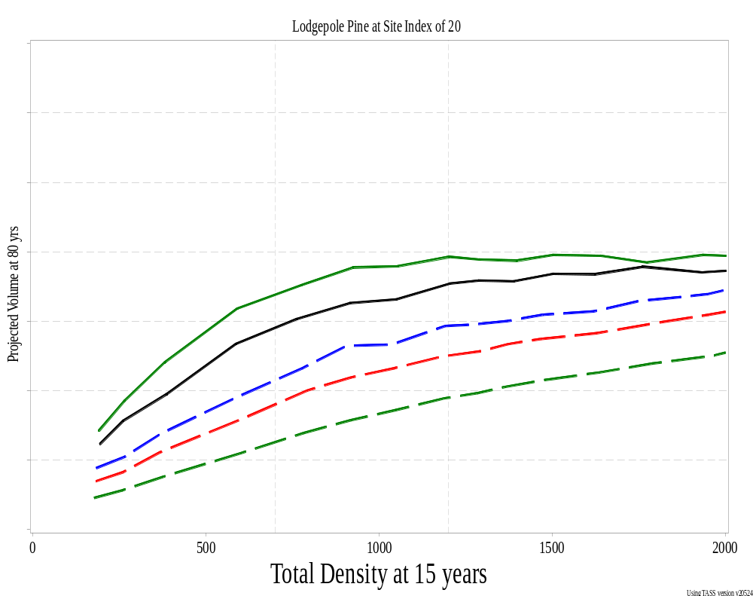
W. Bergerud
Spatial distribution affects projected volume

Slide 28
TIPSY OAF’s
SDM data should help us to refine Operational Adjustment Factors - especially OAF 2
TIPSY provides a cumulative OAF impact for each age in the table – but will take some thinking to figure out if any comparisons can be drawn to the SDM data

Slide 29
% of Live TC with Damage
Average = 14%

Slide 30
Unit 15B ICH
 | L1 | L2 | L3
AB | 220 | 120 | 0
DSC | 20 | 80 | 0
ISQ | 20 | 0 | 0
NY | 0 | 0 | 60
Healthy | 80 | 600 | 920
 | 340 | 800 | 980 | 2120
 | %
L1 | 76
L2 | 25
L3 | 6
Stand | 24

Slide 31
Unit 15 ICH

Slide 32
Unit 15 B Dead Trees

