Slide 1

Update on
Management Plans for Protected Areas
(Central Coast and Bella Coola Mgmt Units)
Volker Michelfelder
Planning Section Head

Slide 2
Outline
Geographical Area
What are management plans for protected area?
Framework for management plans
Planning Process
First Nation Commitments
Potential Marine Foreshore Additions
Planning Status

Slide 3
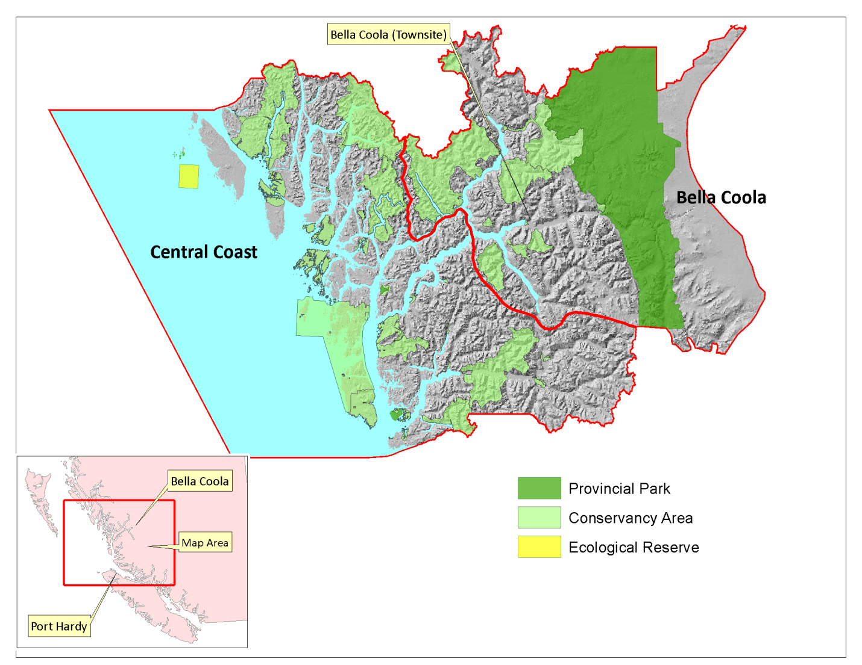

Slide 4
Protected Areas
(Bella Coola, Central Coast)
52 Protected Areas (43 conservancies)
Protect significant natural and cultural features:
e.g., endangered ecosystems and regionally and nationally important wildlife (e.g. Spirit Bear)
Key (commercial) recreational opportunities (e.g., bear viewing)

Slide 5
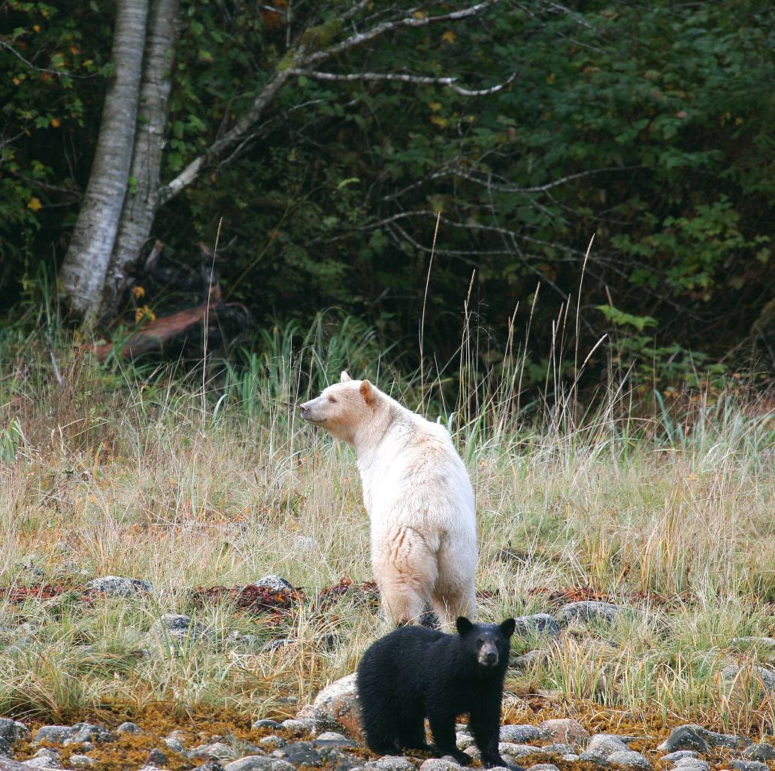

Slide 6
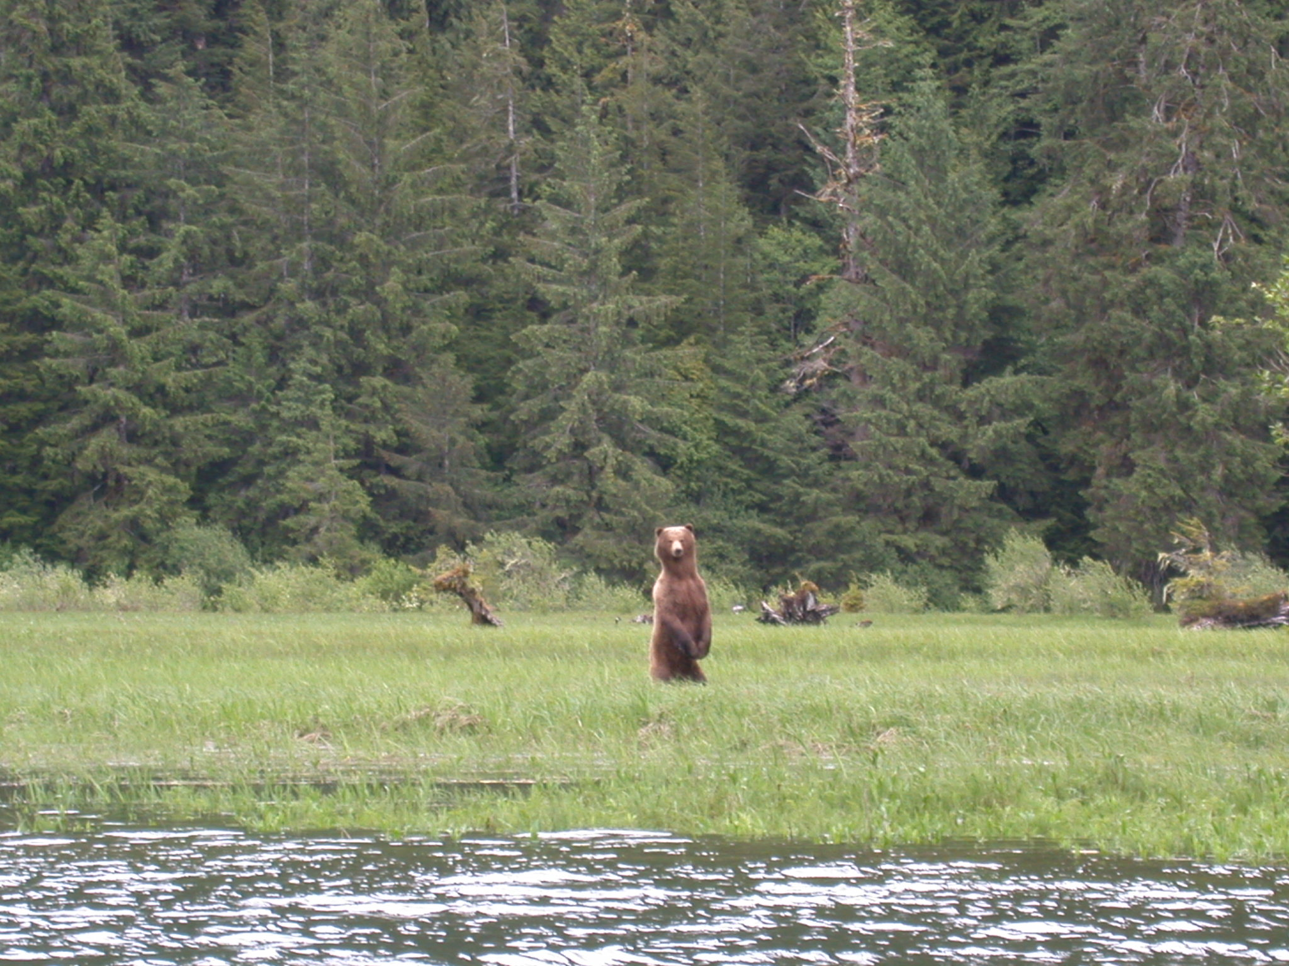

Slide 7
What are management plans for protected areas?
Guidance Documents
  Need plans to maintain features and values that make protected areas special.
  Plans articulate:
    Key features and values of protected area.
    Long-term vision and management objectives.
    Appropriate levels of use and development.
    Management strategies to address threats and opportunities.

Slide 8
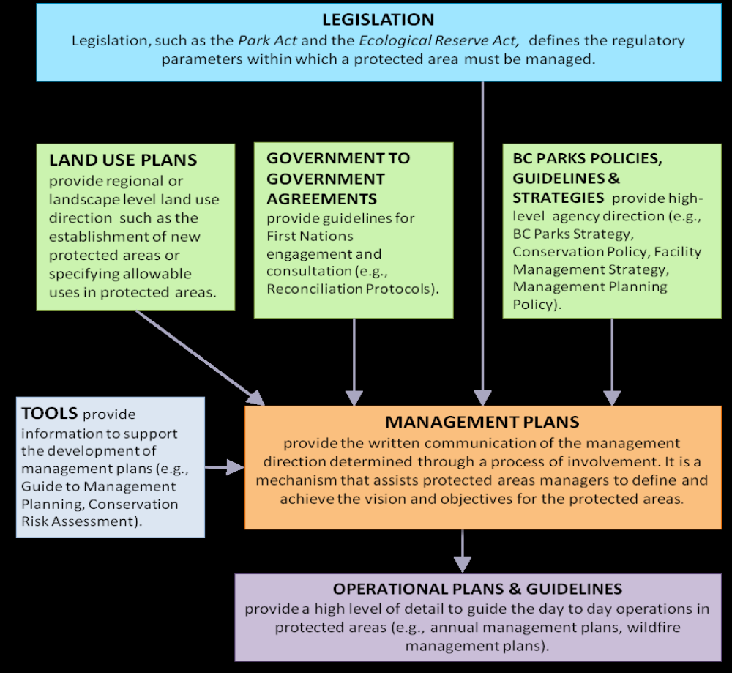
Framework for Management Plans

Slide 9
Management Planning:
A Transparent Process...

Slide 10
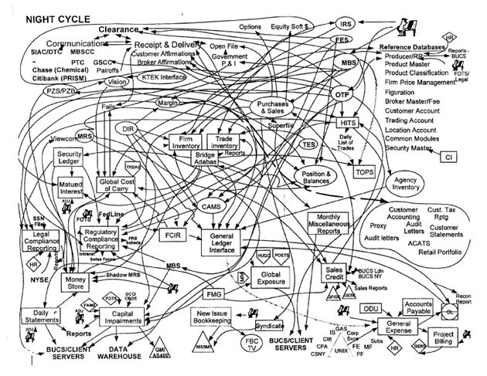

Slide 11
BC PARKS MANAGEMENT PLANNING PROCESS
Pre-Planning
Monitoring &
Evaluation
Initial Planning
Implementation
Draft
Management
Plan
Final
Management
Plan
Conduct Internal Plan
Assessment
Complete Risk Assessments
Select Priority Projects
Prepare the Project Plan
Review and Approve the Project Plan
Notify the Public
Distribute the Plan Internally and Externally
Transfer the Project to Operations Staff
Finalise the Management Plan
Complete Final Reviews and Approvals of the Management Plan
Prepare the Draft Management Plan
(may include public involvement)
Review and Approve the Draft Management Plan
Release Draft Management Plan for Public Review

Slide 12
First Nation Commitments
Reconciliation protocol with CFN.
Collaborative Management Agreements with Heiltsuk, Wuikinuxv, Kitasoo, and Nuxalk.
Bottom line:
commitment to develop and implement management plans collaboratively with FN.

Slide 13
Marine Foreshore Additions
Mgmt plans may include recommendations for marine additions.
As per Minsters’ Decision Note (2007).
Notification of interest for marine additions after consultation process (2009-2011) .
Additional imminent consultation process including agencies and stakeholders.

Slide 14
Planning Status
Priority Plans initiated:
Kitasoo Spirit Bear (KSB) Conservancy (Public review imminent).
Proposed marine addition for KSB plan (consultation imminent)
Dean River and Dean River Corridor Conservancies.
Wuikinuxv conservancies (Sheemahant, Machmell, Owikeno).
Kilbella Estuary Conservancy (Public Review Completed).
Atnarko Corridor Bear Viewing plan (Stakeholder review completed).
Burnt Bridge Creek Conservancy (project plan initiated).
Potential additional priorities for 2014:
Dean, Ellerslie/Roscoe, Fiordland, Burnt Bridge Creek, Thorsen Creek, and conservancies with minimal FN territory overlap issues.

Slide 15
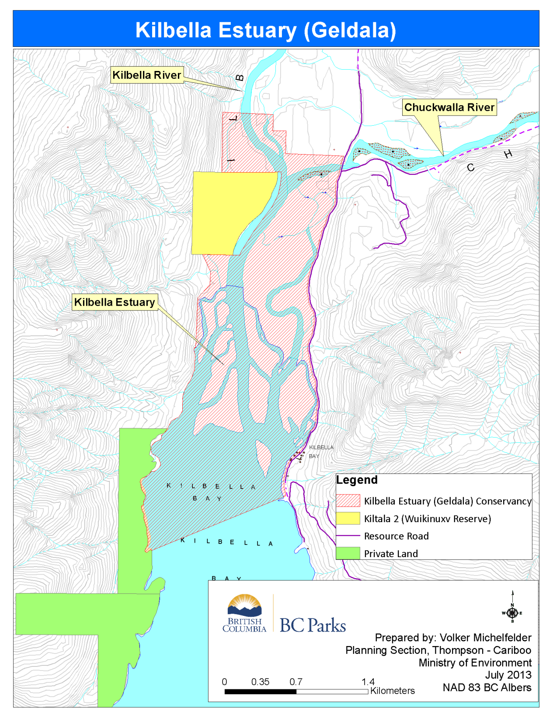

Slide 16
