Slide 1

Assessing the shelf life of spruce beetle-killed wood
OMINECA SPRUCE BEETLE AND SHELF LIFE UPDATE
Sorin Pasca, Director Applied Research and Innovation - CNC
Jeanne Robert, Regional Entomologist - FLNRORD
June 18, 2020

Slide 2
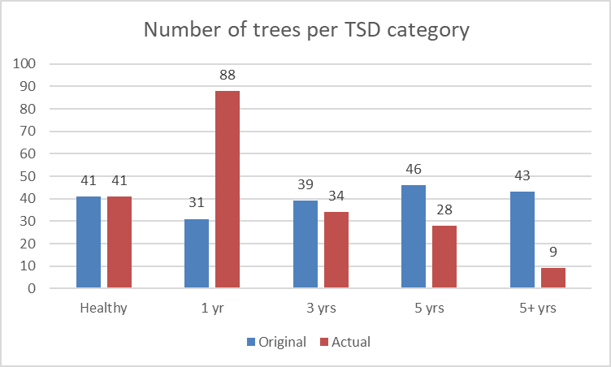
Trees distribution with time since death

Slide 3
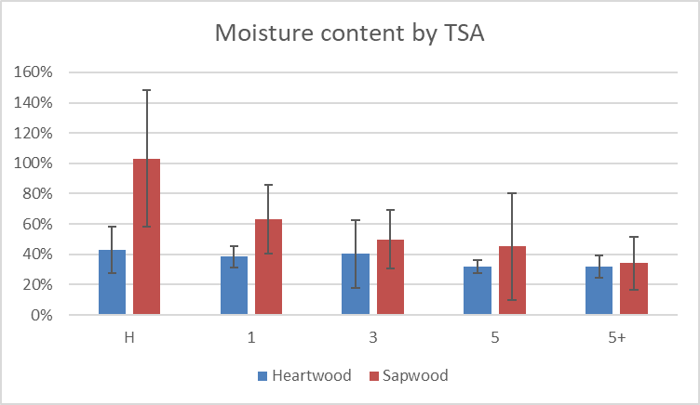
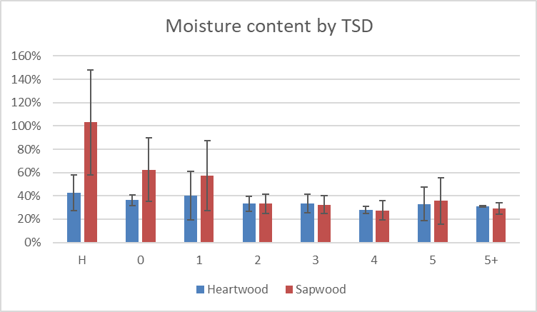
Moisture content

Slide 4
Presence of Checking
Proportion of sample inventory with checking and cracking, across estimated TSD categories.

Slide 5
Severity of Checking
Checking length (depth) in samples, across estimated TSD categories. Lengths of checks and cracks were summed, doubled to account for the complete disc, and expressed as a proportion of sample disc diameter.

Slide 6
Presence of Decay
Proportion of sample inventory with observable decay across estimated TSD categories.

Slide 7
Severity of Decay
Percentage sample area having decay and degradation, across estimated TSD categories.

Slide 8
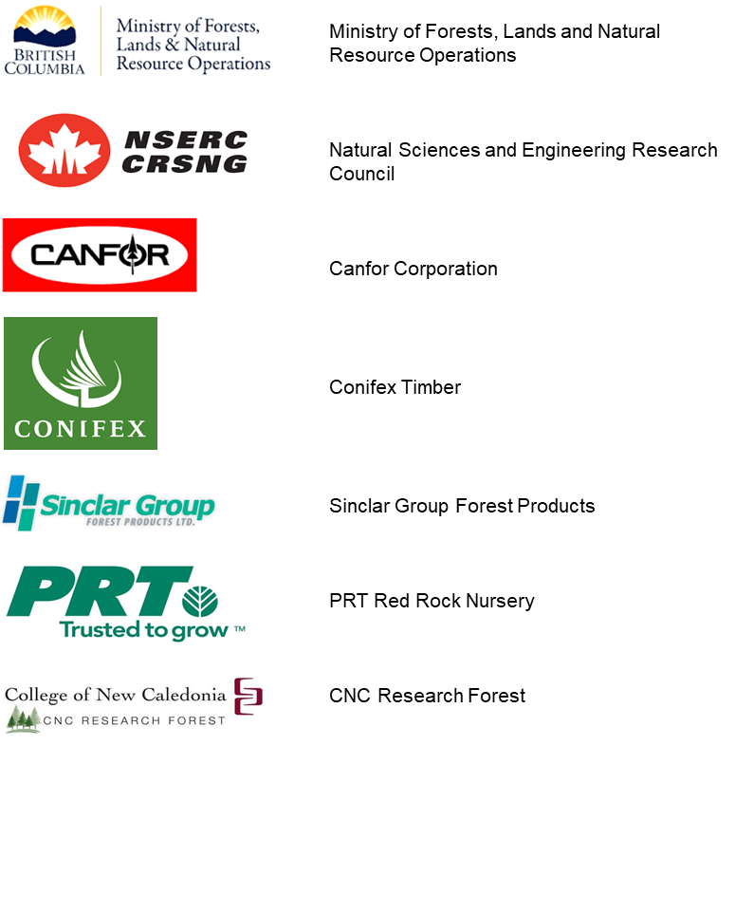
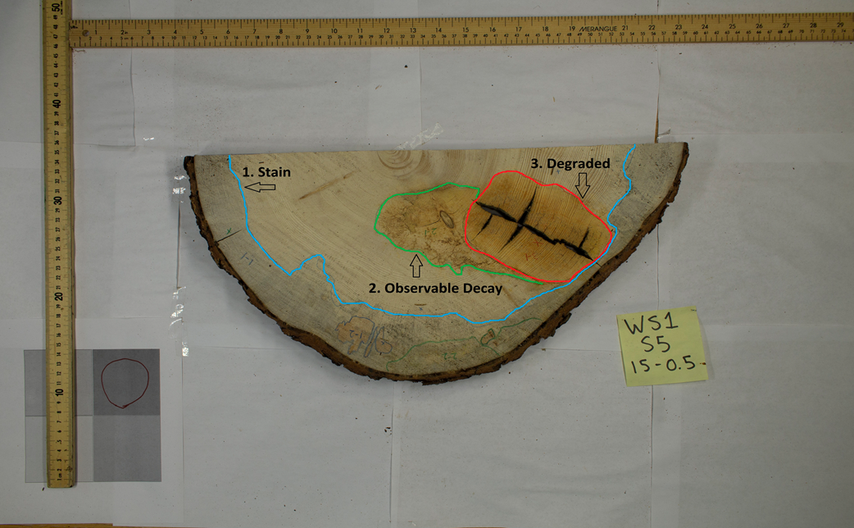
Many thanks to our sponsors and partners

