Slide 1
Land Based Investment
Strategy and Opportunities
John McClarnon & Al Powelson

Slide 2

2003 - Initial Signal - Cabinet Committee interest in financially appropriate reforestation issues, created incentive to develop ROI process
2005, February - Government Request for TB Submission:
  Long term, large scale reforestation program
  At the program’s inception, the estimates of FFT eligible areas provided to the Ministry of Forests and Range Executive (i.e., ~8% of the land base, or 300,000–1,000,000 ha) reflected the state of land base knowledge in 2004
  Judicious application of silviculture treatments to reforest “destroyed” areas quickly & efficiently where economically viable
  Drivers: NSR ratio, long term timber supply, stewardship response to 2003 wildfires & MPB impacts, jobs, restoration

Slide 3
2005 Presentation to Executive
  Mitigate long-term timber supply & biodiversity impacts (including funding to MoE)
  Initial focus –areas affected by recent wild fires and the MPB epidemic
  FRPA s108
  Protect existing & new investments (include impeded)
  Update inventory information for complete and accurate timber supply planning & forecast (included inventory)
  Scope out silviculture opportunities to mitigate mid term timber supply (including planning spacing & fertilization treatments)
  Ensure lessons learned from AG Audit of FRBC are fully considered in program design

Slide 4
Auditor General – FRBC Audit (2000)– Key Findings
Enhanced forestry and backlog silviculture carried out in the absence of an overall provincial strategy
Objectives for its silviculture programs are not clear
Extensive information is available about the potential benefits of enhanced forestry activities, but there is continuing debate about how effective some of the activities are
Spending targets for silviculture programs were generally met, but without specific objectives it is not clear whether the right level and mix of activities have been funded
Job creation targets are limited to the short-term
Contract administration is generally adequate, except that the contracts do not define quality expectations

Slide 5
2006 Mountain Pine Beetle Action Plan
  Objective 6 – restore the forest resources in areas affected by the epidemic
    Restore forest ecosystem productivity
    Restore productivity of areas not reforested as part of normal harvesting activities on a priority basis which may include important areas for protection of water or wildlife
    Reforest on priority basis to return best sites to timber productivity quickly
    Reforestation will consider methods to prevent future widespread epidemics

Slide 6
Program Management Plan – 1 (2006) and 2 (2007)
    Clarify strategic context
      Set out program goals, objectives, guiding principles and priorities
      Priorities for eligible work
        Aggressively reforest recent wildfire affected areas
        Enhance long term timber supply of areas impacted by MPB
        Enhance long term timber supply of other areas
        Eligible management units: 13TSA’s, 8 TFL’s
      Identify key affiliated programs (First Nations & MFR MPB commitments , MPB Action Plan, Forest Worker Safety)
    Outline program planning, evaluation and reporting processes
    Ensure appropriate return on investment
    Scope expanded to include fertilization

Slide 7
Business Case – 2008
  Provided rationale for ongoing investment and end state
  Expanded eligible units to the 22 units most impacted by MPB
  Provided new analysis of potentially treatable area
  Set out 4 investment options -- $53M to $60M / year , 13 to 24 year term, total investment of $1 to $1.3 B

Slide 8
Non Recoverable Losses
Mature > 70% Pli = 3.2 M ha
Estimate 10% treatable = 300,000 ha
Young Pli at Risk
Total Area = 800,000 ha
Estimate 10% treatable = 80,000 ha
Fires
2003 fires – 200,000 ha, 40,000 ha FFT eligible , 10,000 ha identified for reforestation
Based on 5 year average fire activity and net down estimate 1000 ha/ year of FFT fire related reforestation * 20 years = 20,000ha

Slide 9
LBIS 10/11
LBIS 11/12
Tight time frame
DM direction
Dropped investment categories
Workshops
Broader based input
Beginning of more local input

Slide 10
Investment Category | Sub Category | 2011/12 ($ M)
Forest For Tomorrow | Current reforestation | 34.515
 | Timber Supply Mitigation | 11.85
 | Forest health | 7.16
 | Invasive plants | 0.60
Tree Improvement |  | 3.5
Inventory | Site Prod., VRI | 5.45
 | EBM | 0.50
 | Visual | 0.15
Fire management |  | 0.085
Fish Passage |  | 1.5
Ecosystem Restoration |  | 0.75
Range |  | 0.50
Recreation |  | 0.75
LBI Plan |  | 0.69
Total |  | 68.0
LBIS Budget for 2011/12

Slide 11
FFT
Vision (draft)
The impacts of catastrophic disturbances and constrained timber supplies are, effectively and efficiently, mitigated by stand tending and reforestation while supporting forest resilience.
Mission (draft)
Reforest and manage productive forest land and environmentally sensitive areas.
http://lbis.forestpracticesbranch.com/LBIS/node/9

Slide 12
Timber supply mitigation
Fertilization, spacing, and backlog brushing in the central Interior will focus on mitigating the reduction in the mid-term timber supply by targeting these activities within the “economic fibre-baskets” associated with the following areas:
  Priority 1: Lakes, Quesnel, Prince George, Williams Lake
  Priority 2: 100 Mile House, Merritt, Morice, Okanagan
  Priority 3: Cranbrook, Kamloops, Invermere, Arrow
Fertilization and stand tending (juvenile spacing) on coastal, southeast, and northwest forest management units with constrained timber supply and where highest return-on-investment will be achieved to improve timber availability and value.
Spacing treatments should be focused on managing density of repressed, or potentially repressed, stands with low forest health risks.
  Stands and spacing densities should be targeted for future fertilization treatments and value improvement..

Slide 13
Current reforestation
Maintain adequate growth rates on existing government-funded land based investments through vegetation management.
Annual reforestation level of13 million seedlings (at least) with a variety of species, on areas where the mid- and long-term timber supply has been impacted by catastrophic disturbance.
Eliminate the provincial backlog (pre-1987) Not Satisfactorily Restocked (NSR) by 2015.
Meet government obligations under Forest and Range Practices Act section 108

Slide 14
Current Status LBIS 12/13 (How we currently decide on weigh things)
Logic for current process:
  Analysis of latest data from FAIB
  MPB/wildfire impacts – distribution and severity
  Community dependencies
  Filter 1: Provincial level determination of silvicultural response
    Determination of silvicultural response to provincial level timber supply issues will be based upon the ability to mitigate impacts on timber supply caused by catastrophic disturbance or constrained timber.
      Constrained timber = Public policy decisions that reduce harvest levels (e.g Government Action Regulations)
    LINK TO TSM ranking table
    LINK TO CURRENT REFORESTATION ranking table

Slide 15
Filter 2: Provincial level determination of Regional/District Investment level
Determination of level of investment in each management unit or combinations of management units will be based upon the level of need and opportunity for mitigation of impacts on timber supply caused by catastrophic disturbance or constrained timber relative to the contribution of the region or combination of regions to the provincial revenue from timber.
Information for consideration:
Contribution of current harvest levels to salvaging and reforesting areas impacted by catastrophic disturbance.
Type 2 silviculture strategies
Timber supply review background information
Silviculture opportunities map
Amount of volume projected to be impacted by Mountain Pine Beetle in the future
Ability to naturally regenerate with appropriate commercially valuable species and abundance of secondary stand structure – incorporate research findings by subzone (Coates etc) to help prioritize
Product value (current, historic, and future)
Capacity to implement
Reliability/security of intended investment benefits (e.g. potential park, protected area, urban, or recreational development

Slide 16
Questions to be asked under Filter 2:
Will investment in the management unit result in a significant impact on mitigating the timber supply issue being addressed?
Will investment on the specific areas to be treated return a substantial return on investment?
Will investment in the management unit provide significant employment benefits on a local, regional, or provincial basis?

Slide 17
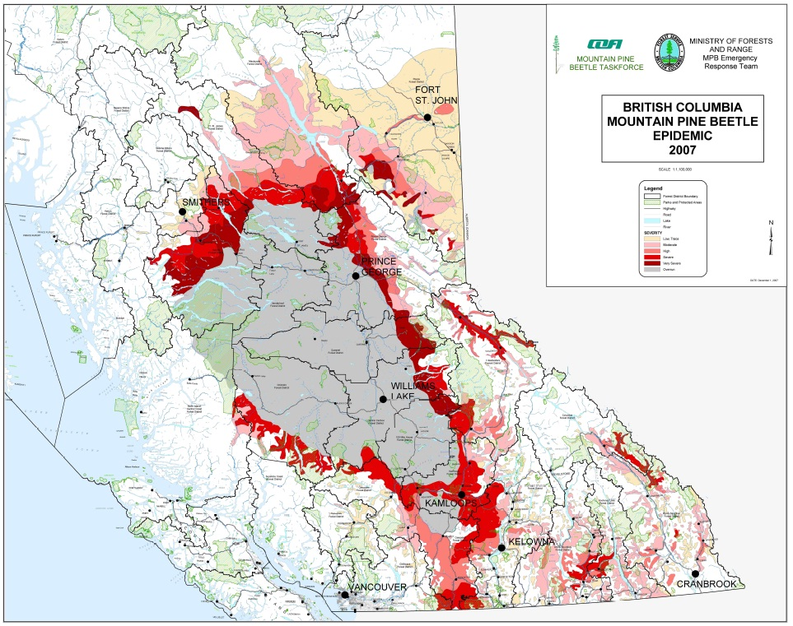
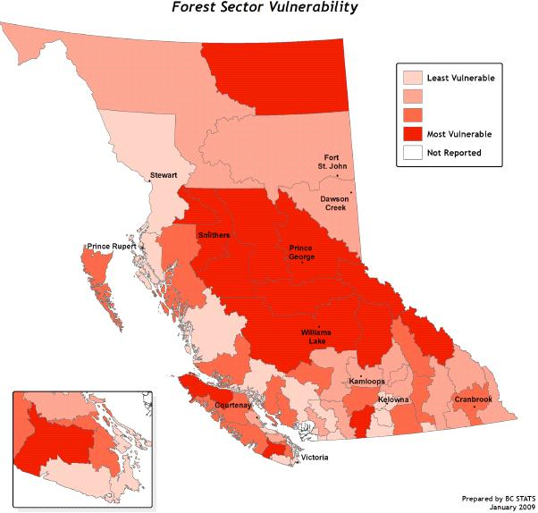
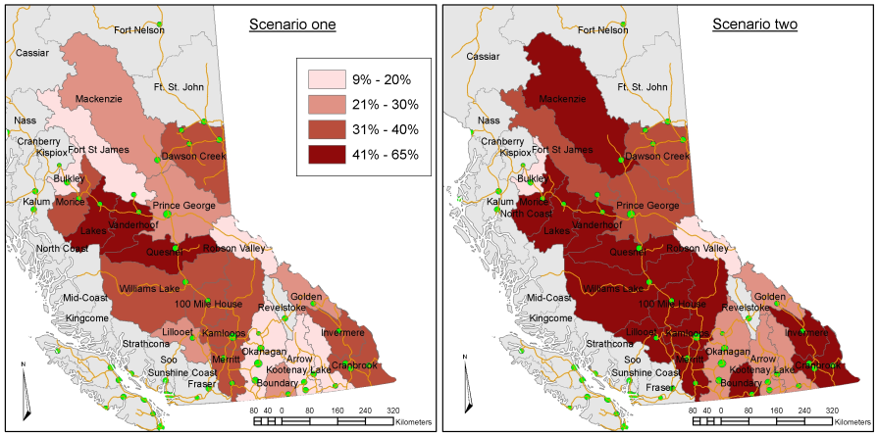

Slide 18
Context of Investments
estimated standing tree value of the estate is $1/4 trillion
It generates up to $16-19 billion/year in exports
It generates up to $1.6-1.9 billion/year in stumpage, rents and fees
Industry and BCTS spend ~ $200 million/yr in basic maintenance (silv)
Throne speech commitment to plant 60 M seedling between 2008/09 and 2011/12)
NSR status provincially
  Throne speech commitment to eliminate backlog NSR by 2015

Slide 19
Changes in Not Satisfactorily Restocked (NSR) Crown Land (2001-2011)

Slide 20
Investment Category | Sub-Category | 2011/12 ($M) | Output | Target
Forests For Tomorrow | Current Reforestation | 34.515 | 40,000 ha NSR reduction, 14 M seedlings planted | 2.6 M tonnes CO₂, 2.7 M m³ timber, $303 M GDP
 | Timber Supply Mitigation | 11.85 | 24,000 ha fertilization, 1,200 ha spaced | 0.5 M tonnes CO₂, 0.5 M m³ timber, $56 M GDP
Tree Improvement |  | 3.5 | 108,000 ha reforested with select seed | 3.7 M tonnes CO₂, 3.65 M m³ timber, $435 M GDP

Slide 21
What are we getting from what we are investing:
  Performance Measures = Silviculture Activities will produce (in 65 years):
    ~ 7.6 M m³ of wood
    ~ 7.6 M Tonnes of CO₂
    ~ $877 M GDP
    674 short term FTEs and
    direct long-term employment of 19,000.

Slide 22
New Directions: Deputy Minister direction, CIO role
In 2011, following the creation of MFLNRO, the LBIS was evaluated to consider:
  How the strategy’s scope and suite of activities for 2012/13 and beyond could reflect government’s priorities for the broader natural resource sector; and,
  How it could contribute to the achievement of the ministry’s vision of “environmental sustainability and economic prosperity ”.

Slide 23
Purpose of the program
Impacted Areas:
  Timber Supply (long term)
  Midterm mitigation
  Social benefit impacts where it makes technical sense

Slide 24
Annual Process/Timelines
Continual process of planning and evaluation
Targeting Nov 1 beginning of budget period
Winter months (Jan to march) finalize upcoming field season operational plan
Spring – summer planning for following year – collect information
Early fall (sept) produce draft annual and revised 5-year plan
http://lbis.forestpracticesbranch.com/LBIS/node/246

Slide 25
Invitation for input

Slide 26


