Slide 1
Backlog NSR Project Review and RESULTS Issues
Land Based Investment Strategy (LBIS):
Current Reforestation and Timber Supply Mitigation Meeting
September 28, 2011
Richmond, BC
Matt LeRoy
Dave Weaver
Paul Rehsler
Resource Practices Branch

Slide 2
Backlog Management Policy
"backlog area" means an area a) from which the timber was harvested, damaged, or destroyed before October 1, 1987; and, b) that in the District Manager's opinion, is insufficiently stocked with healthy, well-spaced trees of a commercially acceptable species
Not satisfactorily restocked (NSR)" means productive forest land that has been denuded and has not been regenerated to the desired stocking standards for the opening

Slide 3
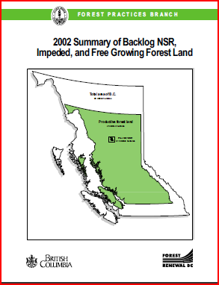
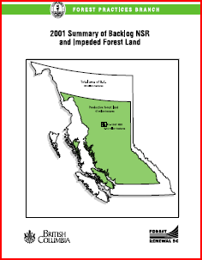
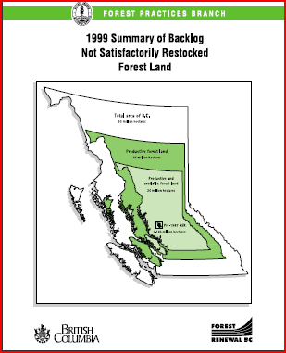
Previous NSR Reports

Slide 4
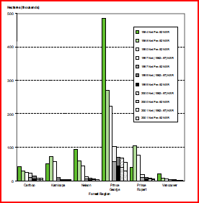
By Region, backlog NSR would be eliminated by:
2007 in PR, PR
2005/06 in Car, Kam, Nel
2003/04 in Van

Slide 5
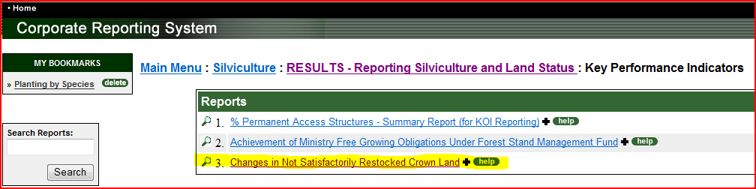
Where do these backlog NSR numbers come from?
  RESULTS via the Corporate Reporting System

Slide 6


Slide 10
Known Challenges:
  Not just an opening file exercise
  Getting down to the most challenging openings
    Anticipating year over year increasingly challenging openings
  Resourcing
  Do folks know about their options with survey standards?

Slide 11
Where does Forsite fit in?
  Forsite is our provincial contractor, initially handling category 1, and 6 backlog NSR openings
NSR Project Categories
Declared with NO FC Update
Opening FG with NSR with No Planned Treatments
Survey with no FC update
Survey with FC update no spatial
NSR with no SU’s
NSR Increased No Planning

Slide 12
  Quick Wins
  -There are a number of openings in the backlog NSR listing that are in excess of 1,000 hectares
  -Where no RAH’s in place let’s make use of Forsite’s horsepower to clean up these openings

Slide 13
Survey standard talk with Dave Weaver

Slide 14
