Slide 1


FFT Fall Meeting
How do we improve delivery
September 28-29
2011

Slide 2
Objectives
Overview of key issues with regard to delivery
Current capabilities
Key assumptions about staffing moving forward
Key roles and responsibilities for district and region
Key directions on moving forward
How to improve delivery with BCTS, recipient holders and industry

Slide 3


Slide 4
2.0 Key Issues that need to be addressed
Need for strategic focus and addressing priority issues that can be mitigated through a silvicultural response
Need to ensure the scale and tactical location of treatments undertaken within the identified priority units have a meaningful positive timber supply affect .
Need to have district oversight to ensure local contribution to provincial strategic objectives, as well as, to ensure treatment cost control and efficiency.
Ensuring continuity and consistency of treatments that the desire objectives are achieved over time (e.g. rehab and reforestation of MPB areas)
Ensure that activities are coordinated with overall unit strategy to avoid resource conflicts.

Slide 5
Current Capabilities
In 2011 about 90% of the Tree improvement, Inventory, Fire Management, ecosystem restoration, Range, and Recreation components are coordinated and managed by existing ministry staff.
About 91% of the Forest health activities are being delivered through existing district and regional staff.

Slide 6
Current Capabilities
In 2011 about the current reforestation and midterm mitigation activities are being delivered in the following manner:
  12% of the FFT program will be delivered by BCTS,
  59% is delivered by Industry and by Recipient agreements that are administered by regional ministry staff
  26% is managed internally by Districts.

Slide 7
Current Capabilities
Throughout BC, the BCTS program has varying levels of staff to deliver key goals and objectives.
  In the south area about 22% of the program is delivered by BCTS
  In the northern area about 2% of the program is delivered by BCTS
  On the coast area about 19% of the program is delivered by BCTS

Slide 8
Current Capabilities
Throughout BC, the ministry has varying levels of staff to deliver key goals and objectives.
  In the south about 42% of the program is directly lead by the districts
  In the north about 17% of the program is directly lead by the districts
  On the coast about 8% of the program is directly lead by districts

Slide 9
Licensees have varying interests and abilities to deliver current reforestation, forest health and timber supply mitigation activities. While about 80% of the fertilizer program is delivered by licensees, in many areas, due to staffing reductions, industry is unable to be involved in the FFT programs that require extensive long term planning and work at this time.

Slide 10
Key assumptions
Dont expect major increase in total ministry staff
Like original FFT program either use existing allocated FFT staff or utilize additional existing staff or
  Use BCTS
  Use recipients
  Licensees
  Implementation contractors

Slide 11
Key objectives for the new delivery model moving forward
Create organizational capacity and clarity of direction
Create transparency and understanding of strategic priorities, plans and budgeting
Create continuity of programs and direction in order to warrant district involvement
Improve communication between district and regional and HQ staff.
Provide clarity on who prime local regional and district contacts and dedicated champions are for the LBIS program
Ensure continuity of projects over time to follow through on key existing and previous investments
Ministry to act as the steward on behalf of the public to ensure provincial priorities are addressed and to ensure public funding is cost efficiently applied in the right investments.
Efficient, cost-effective, and timely delivery of projects

Slide 12
Key roles and responsibilities
Planning (model described in appendix 1)
Delivery
Reporting and monitoring

Slide 13
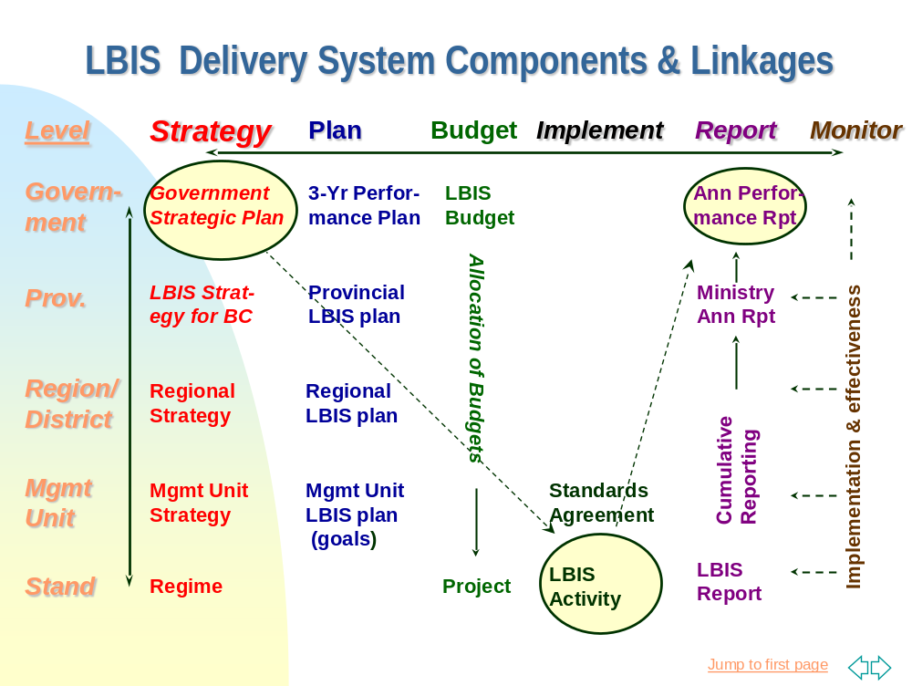

Slide 14
Key directions going forward
7.1 District
One person formally assigned responsibility in their EPDP to be the key district contact for the LBIS program.
Recommend that a minimum 0.5 FTE be assigned to support the role of
  Coordinating and developing plans (August-October)
  Coordinating delivery agents and ensuring goals are assigned to appropriate delivery agents (March-April)
  Reporting and monitoring (August-Oct, March)
  Continual improvement and adjustment (January-March)

Slide 15
The district contact would represent the District Manager on all key meetings for LBIS
The district contact would be responsible for organizing annual local LBIS planning sessions each fall
The district contact would also be responsible for organizing annual local LBIS implementation meetings each spring, to debrief what went well, what needs to be adjusted in the upcoming field season. The district contact would also be responsible for identifying and coordinating who the key delivery agents would be in the upcoming field season.

Slide 16
The ministry will have a varied delivery model for LBIS activities. Depending on regional and district priorities, the ministry may use:
  Internal staff
  BCTS staff
  Licensees
  Recipient agreement holders to deliver on behalf of the district
The district contact will be responsible for determining with the District Manager the best mix of delivery that will meet government goals and objectives, given funding constraints and available staffing.

Slide 17
Region
One person formally assigned responsibility in their Employee Performance and Development Plan (EPDP) to be the key regional contact for the LBIS regional program.
Recommend that a minimum 0.5 FTE be assigned to support the role of
  Coordinating and developing plans (August-October)
  Coordinating delivery agents and ensuring goals are assigned to appropriate delivery agents (March-April)
  Reporting and monitoring (August-Oct, March)
  Continual improvement and adjustment (January-March)
The regional contact would represent the Regional Manager on all key meetings for LBIS
The Regional contact would be responsible for organizing annual regional LBIS planning sessions each fall

Slide 18
The regional contact would also be responsible for organizing annual regional LBIS implementation meetings each spring, to debrief what went well, what needs to be adjusted in the upcoming field season. Where the regional office, holds recipient agreements, the regional contact would also be responsible for identifying and coordinating who the key delivery agents would be in the upcoming field season and communicating with annual plans with the District Manager.

Slide 19
How to improve delivery with
BCTS
Recipient holders
Industry
District

