Slide 1
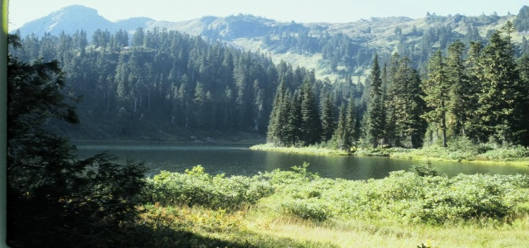
Managing Tree Species Diversity for Forest Resilience and Adaptability
Andy MacKinnon - Research Ecologist -Coast Area
Provincial Ecologists
Nanaimo BC
June 14, 2011

Slide 2
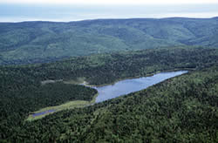
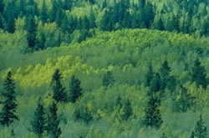
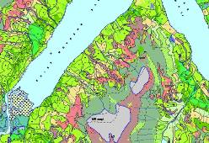
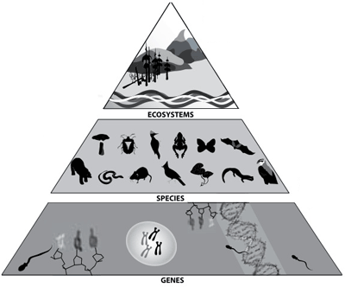
What IS diversity?
Variety in structure, composition and function across levels of ecological organization
  genes (different seed sources)
  species (Fd, Cw, Hw, Ba,...)
  ecosystems (mature and seral)
  stand structure
variety at any one of these levels across scales of space and time
  stand (within-stand)
  landscape (among stands)
Landscapes!
Notes:
The red highlights indicate our area of focus for this workshop

Slide 3
Species diversity is one aspect of
Ecosystem Resilience
“the capacity of ecosystems to absorb disturbance without collapsing into a qualitatively different state that is controlled by a different set of ecological] processes.”
Interplay processes between species and with environment
Adaptive cycles
Processes working at different time/space scales
Diversity
Biological legacy and “memory”
Connectivity

Slide 4
Species diversity is more than just number of species
Balance of species (evenness)
Diversity of species traits (r, K)
“natural” species composition
“Key” species
Notes:
Even-ness want more evenness in general
Shannon Diversity index = # of species and evenness
Want a mix of fast growing pioneer species and slower mature forest species
Emphasis on species normally dominant in the landscape (and native to the BGC) i.e less Pl in a non-Pl landscape
Key species like redcedar have high values (timber, ecological, habitat, first nations)

Slide 5
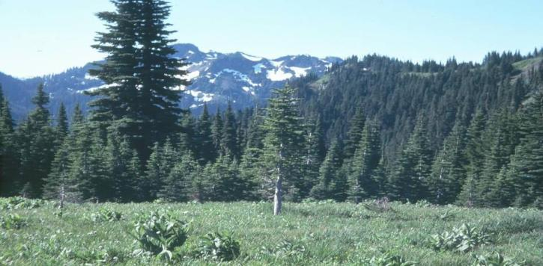
Diversity Is Insurance Against Uncertainty
Maintains ecosystem response diversity to environmental change (including climate change)
Reduces ecosystem vulnerability to any single future disturbance event
Improves the potential for ecosystem reorganization following disturbance
“... complexity at a hierarchy of scales is a highly desirable attribute to maintain the capacity of ecosystems to gradually change in response to changing environmental conditions and provide benefits to future generations.”
E.A. Campbell et al. (2009)
Notes:
This provides general concepts regarding importance of diversity

Slide 6
Objective
We want our managed stands to adapt or self-organize after unexpected disturbances or changes and to continue to provide desired goods and services. (D. Coates NSC presentation 2011)
We want our forest landscapes to have sufficient diversity to limit the impacts of a single species-specific disturbances and improve adaptability to a changing environment

Slide 7
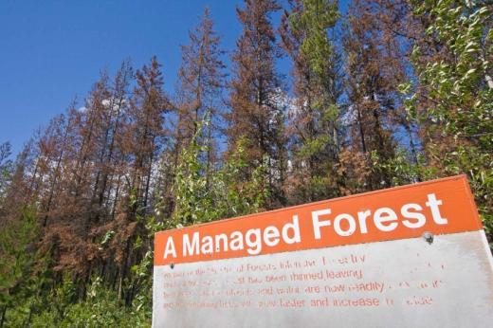
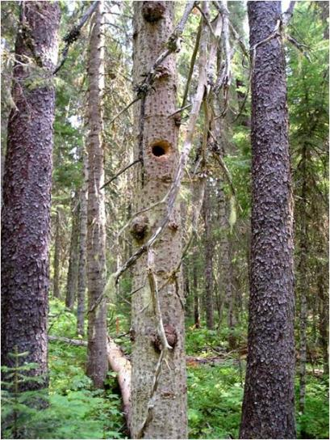
Stand Scale
Tree species diversity
Focus on the success of a single stand
Reduces:
  risk of complete stand failure
  pest outbreak severity
Enhances:
  stand yield in a changing environment
  structural attributes of habitat diversity
  range of forest products
Notes:
The red highlights indicate our area of focus for this workshop
Relationships to soil nutrient condition, primary productivity
Structural attributes and legacies often species-specific
ecosystem functionMaintains or enhances

Slide 8
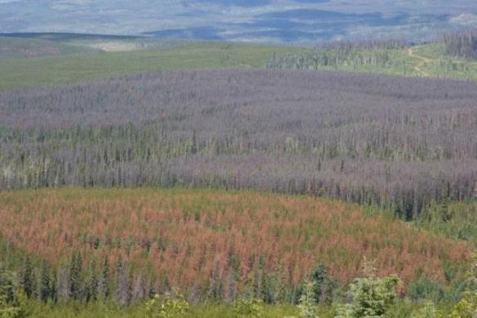
Landscape Scale
Tree species diversity
Focus on the overall success of the forest landscape (forest adaptability)
Cumulative effects of individual stand-level decisions
    Risk of widespread losses from species-specific pests
Regional population of species for adaptability to future climatic conditions
Variation in stand management while meeting broader targets
Notes:
Protect Resources and Values – diverse biological legacies and climate refugia to reduce risk of loss due to climate mediated mortality;
stand level: diversity of species in wildlife trees and tree patches
Landscape level: diversity in ecological representation (reserves) at landscape scales

Slide 9
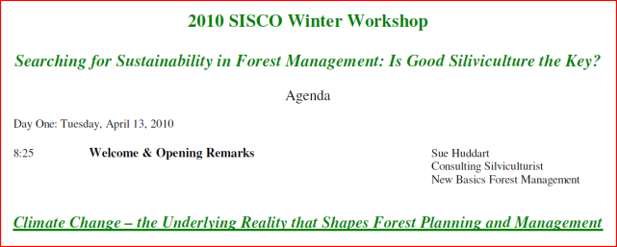
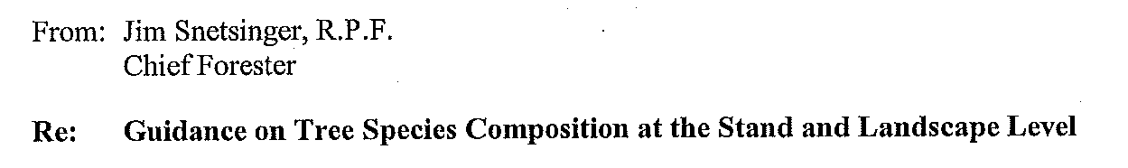
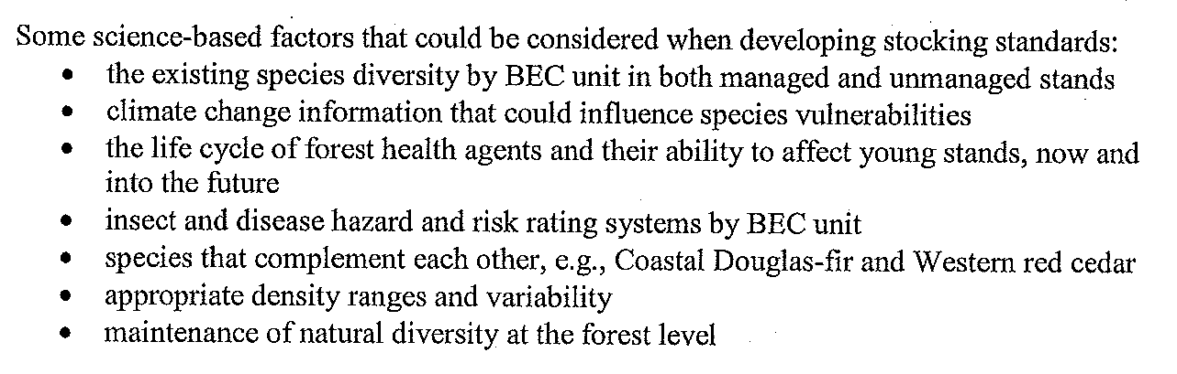
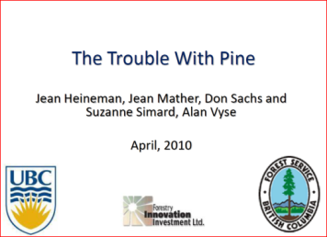
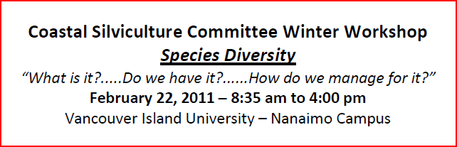
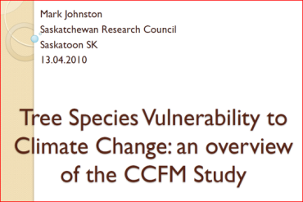
This is not new news...
We Know
Tree species diversity is important
Climate change introduces greater uncertainty
Notes:
We know that
Tree species diversity is important
Climate change is a source of uncertainty
Lots of good and important scientists and policy makers have discussed this before today...e.g., Chief Forester’s guidance (2009) on tree species composition at stand and landscape scale, e.g., SISCO climate change workshop 2010; e.g., Coast SCO species diversity workshop 2011

Slide 10

Coastal Silviculture Committee summer workshop 2010
June 22nd & 23rd 2011
Whistler. BC
Species Diversity and Climate Change

Slide 11
Notes:
4-9 Natural 1-6 Harvested
Ba 10% 5%
Cw 32% 19%
Dr 2% 14%
Fd 4% 6%
Hw 39% 56%
Ss 3% 1%
Yc 9% 0.4%

Slide 12
Landscape level species composition in ICHmc2 stands (<60yrs)
Notes:
Landscape level - stand conversion
Stand conversion may increase risk (there may be a reason why a species is not widespread in a BGC) (note Dothostroma).
Only 22% of landscape is converted so future management can still have a big impact on future landscape
Long-term impacts of decisions will become more pronounced
Note that Pl might already be falling out from beetle and Doth.
Conclusion
With the current managed second growth in the ICHmc2 occupying only about 22% of the forested landscape, there is still significant opportunity to alter management intent into the future. Past management activities have over-emphasised only one or two species and while our desire is not necessarily to mimic natural old-growth forest composition, a managed landscape that includes a more balanced distribution of all native ICHmc2 tree species would be an ecologically appropriate target to manage toward. These managed stands would include an intended or planned wider diversity of commercial and non-commercial tree species which will in turn increase overall forest productivity and resiliency to deal with the anticipated changes in climate and forest health impacts. To further increase forest resilience and to buffer the impacts of climate change, it may be also reasonable to begin the introduction of off-site tree species such as western larch (Larix laricina) and interior Douglas-fir (Pseudotsuga menziesii) in some parts of the ICHmc2 (planned assisted migration).
This pilot study has demonstrated that the existing VRI and RESULTS provincial datasets can be used to assess the current status of managed and natural species composition/diversity at the landscape level, and that the efficacy of this assessment has been corroborated by regionally specific and relevant datasets. A potential tool has been proposed to use this and additional information to develop, and monitor performance of landscape species composition /stocking targets throughout the province. Use of this new approach should not require significant changes to the current reforestation regulations.

Slide 13
What ecology tools are available
BEC
  Landscape level ecological unit (subzone/variant)
  Ecologically suitable species (by site and BGC)
  Climate change projections of BEC
Tree Species Selection Tool
Landscape level assessment methodology pilot

Slide 14
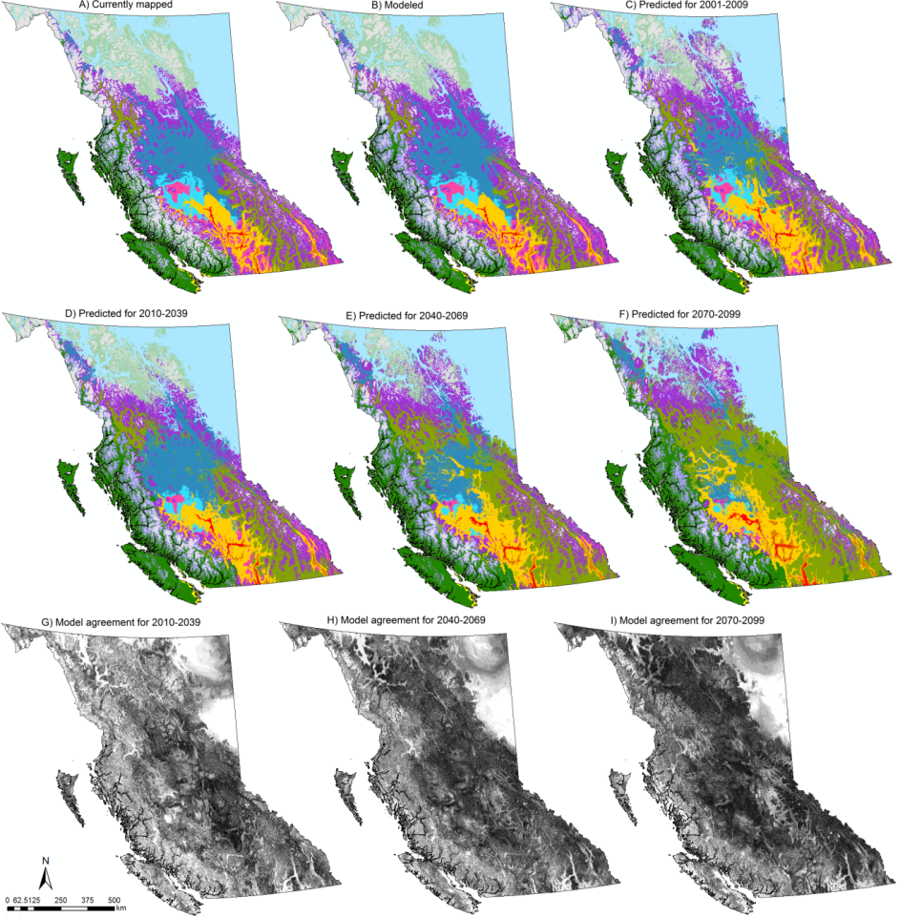
Modelling Future BECs
Wang et al. 2011 in prep.
Notes:
Latest BEC projections.
Lower graphic indicates degree of model agreement between many runs where white is high agreement and black is 20% agreement
uncertainty, uncertainty, uncertainty

Slide 15
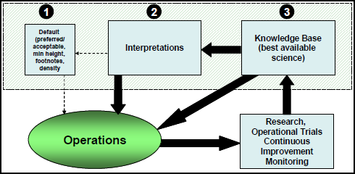
Tree Species Selection Tool
  Compiled species information presented in the BEC framework for ecologically-suitable species and the ecological factors (environmental and forest health) limiting their performance.
  Goal : To provide easy access to current scientific information needed to support decision-making for
      Stand and landscape levels
      Short and long term objectives
  Expected release – 2011 for the Northern
  Interior BEC subzone/variants
  http://www.for.gov.bc.ca/hfp/silviculture/TSS.htm
Notes:
Ecologically Suitable Species – Tree Species Selection Project definition:
“Coniferous or deciduous tree species that are adapted to a site’s environmental conditions, including the variability in these conditions that may occur over time.”

Slide 16
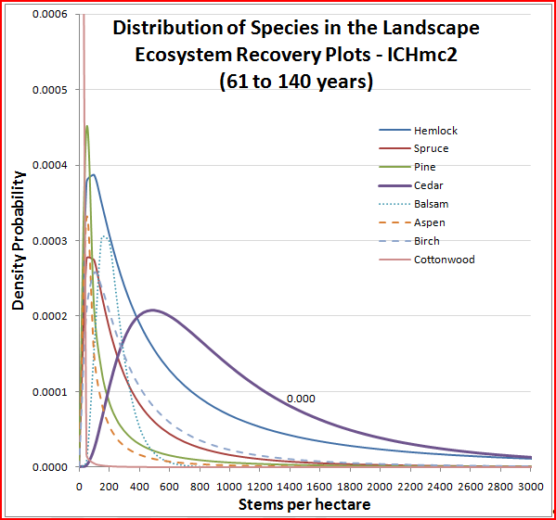
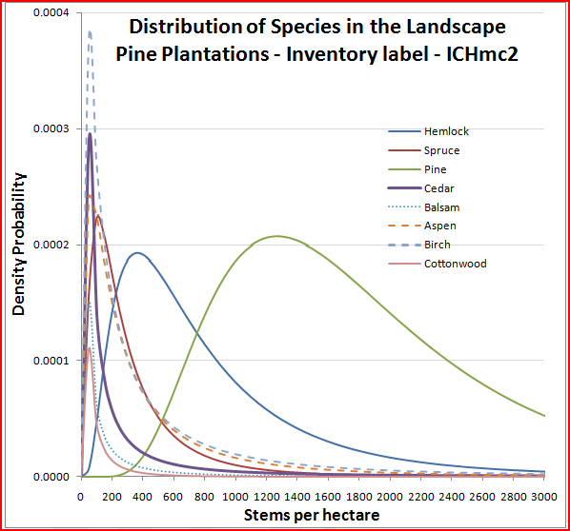
ICHmc2 Landscape-level Pilot Approach
  Part of Species Selection Tool
  Database tool to compile and analyze available data
  Diversity analysis comparing natural vs managed stands
  Determining range of stand variation at the landscape scale (beyond averages)
  Evaluate flexible management options at the stand scale (to meet objectives at the landscape scale)
Banner et al. (2010)
Notes:
Data sources = RESULTS, VRIMS, BEC plots and classification, Ecosystem Recovery Research
Status is “research pilot” framework
first 3 points were done and the pieces to build a formal tool are there.
4th point was not tackled in draft report

Slide 17
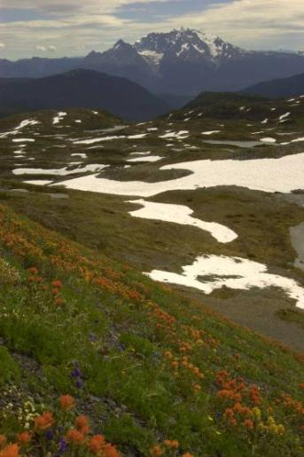
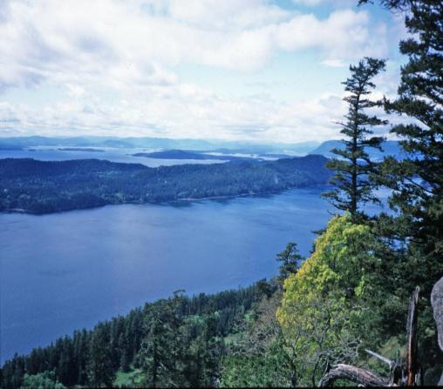
Climate Change =
Increased Variability and Uncertainty
If diversity improves adaptability to change, then diversity management is becoming more important
Build Adaptive Capacity
Target higher levels of diversity than natural
Encourage experimentation
and adaptive management
Evaluate success over longer
time scales
Notes:
options exist for experimental plantings, and for adaptive management and monitoring at different scales. How can we capitalize on these?
options exist for collaborative research trials/operations to evaluate some of these potential new species mixes

Slide 18
A Diversity/Adaptability Approach Would...
Promote and accept a wider range of management intents
Encourage species mixes
Reduce levels of species conversion in landscape
Consider uncertainty and climate change in species selection
Reduce efforts to bring all stands to a uniform standard
Evaluate success at a landscape scale to allow variable management at the stand level

Slide 19
Decisions
Which scale is appropriate for diversity management?
What is the geographical unit we should evaluate diversity in?
What is the tree spp. diversity baseline?
What is our diversity objective?
Notes:
Underlined = the Ecology “answer”
Stand or Landscape?
Stand = Opening by opening. Landscape = BGC unit by landscape management unit
Ecologically suitable tree species by BGC, VRIM by BGC. Evenness
Meet or exceed species diversity. Maintain evenness. Emphasis “naturalness”. Add climate change species to exceed normal diversity.

