Slide 1

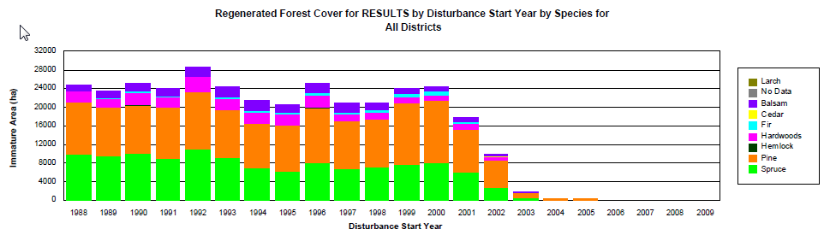
Live Meeting
RESULTS - Reports
Species Monitoring

Slide 2
RESULTS – Species Monitoring
Requirement
Concerns regarding reforested species not consistent with pre-harvest profile
Emerging requirement to closely monitor to:
  Ensure achievement of young stands as per stocking standards; are we meeting only minimums versus preferred species?
  Sufficient species diversity to deal with future climate change and future market conditions

Slide 3
RESULTS – Species Monitoring
Requirement
Species concerns identified through various reports:
  Forest Practice Board Reports
    High Retention Harvesting and Timber Sustainability on the British Columbia Coast (2008)
    Tree Species Harvested in Areas Affected by Mountain Pine Beetles (2007)
    Species Composition and Regeneration in Cutblocks in Mountain Pine Beetle Areas (2006)
  State of Forest Report (2006)
    Are Species before and after harvest similar?

Slide 4
RESULTS – Species Monitoring Challenges
Information to address monitor species reside in multiple corporate system’s “silos”
Information not easily accessible without undue effort, skills, cost and time to obtain.
Information not presented in an easily to interpret manner (trending) to assist decision-making.
Ministry lacks real time information to change actual practices

Slide 5
RESULTS – Species Monitoring
Interim Solution
Build key Species Monitoring Reports that spans across Ministry’s “silos”
Establish the key species information in common format and location.
Provide graphical formats that enables easier interpretation.
Provide real time information to influence actual practices.
Encourage collaboration and coordination of data.

Slide 6
RESULTS – Species Monitoring
Data for Species Monitoring Reporting
Key questions are:
  What is the current timber profile?
    Inventory Vegetation – Pending work to be completed
  What is being extracted?
    Volume Billed – Harvest Billing System
    Previous Stand Label - RESULTS
  What species are being planted
    Planted Species – RESULTS
  What is the reforested stand species composition?
    Forest Cover - RESULTS

Slide 7
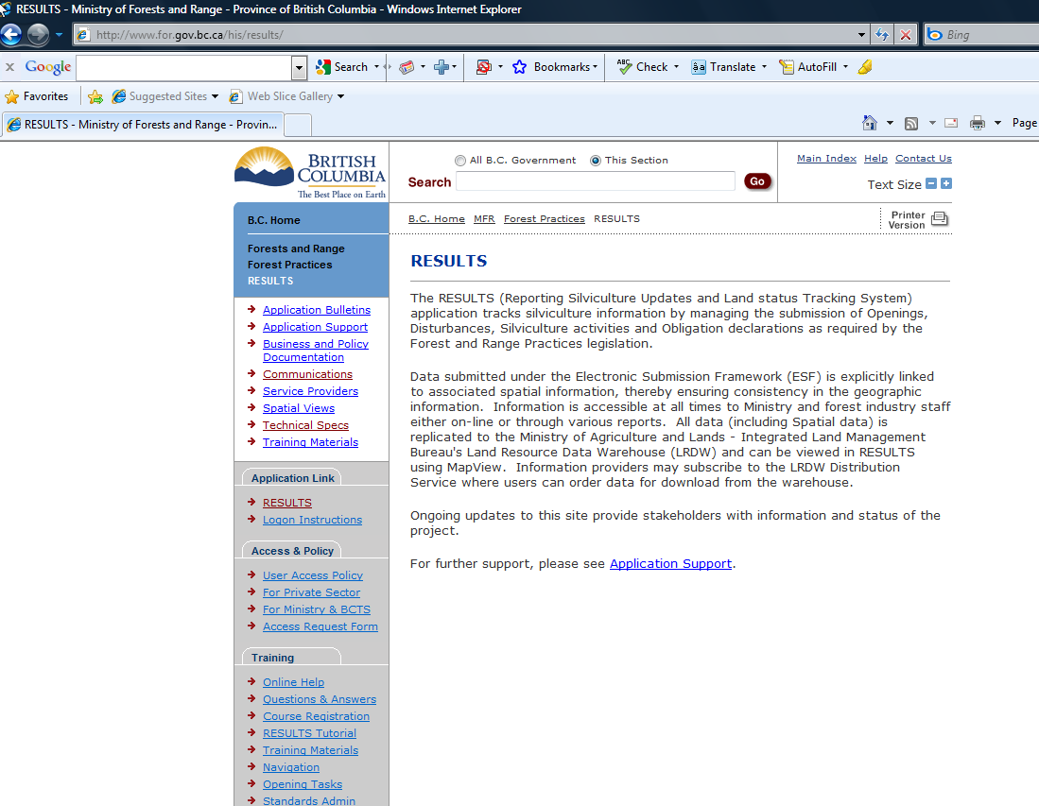
RESULTS – Species Monitoring
Current Tool – RESULTS Corporate Reporting System (CRS)
Access CRS via RESULTS
Complete Access Request form for access

Slide 8
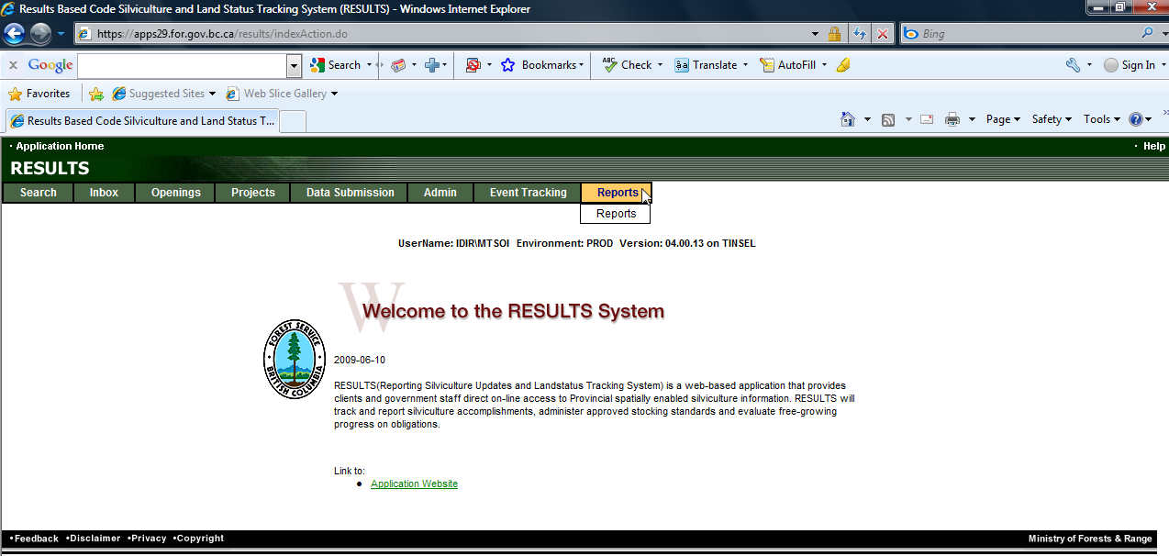
RESULTS – Species Monitoring
Current Tool – RESULTS Corporate Reporting System (CRS)

Slide 9
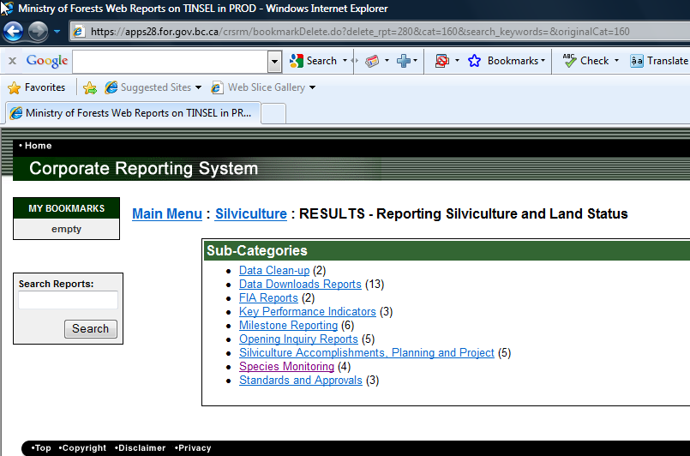
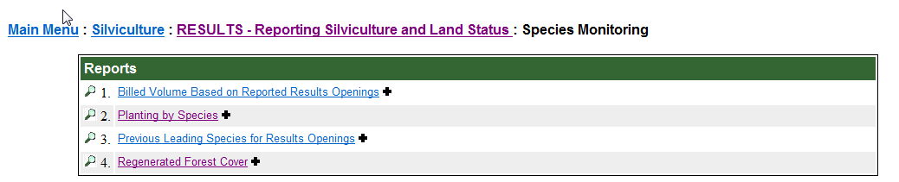
RESULTS – Species Monitoring
Current Tool – RESULTS Corporate Reporting System (CRS)

Slide 10
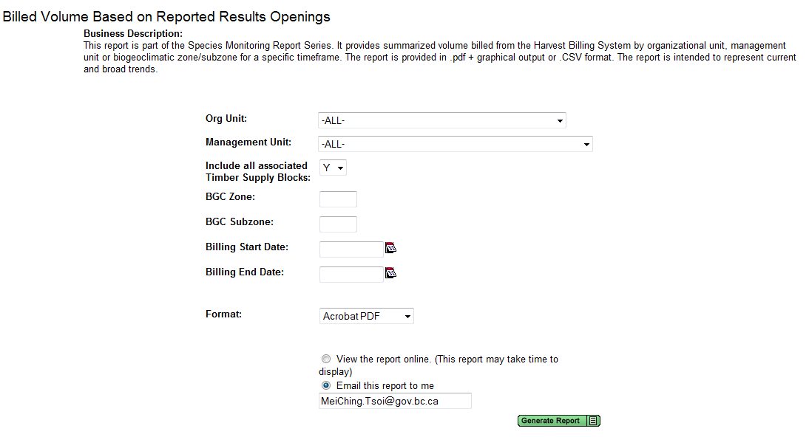
RESULTS – Species Monitoring
Current Tool – RESULTS Corporate Reporting System (CRS)
All Reports have similar report filters
All Reports provide .pdf & CSV (comma separated values to display and summarize different than default option); ignore other o
Mandatory filter requirement – date range
Enter any combination
Set to “Y”
if require entire Management Unit
Must provide
Date range
Only 2 formats are available:
Acrobat PDF or CSV

Slide 11
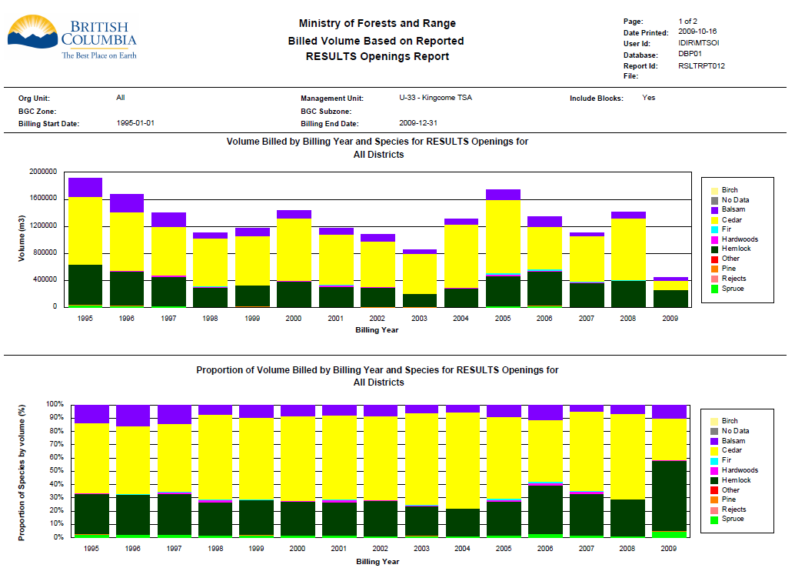
RESULTS – Species Monitoring
Report Format - pdf
Report filters

Slide 12
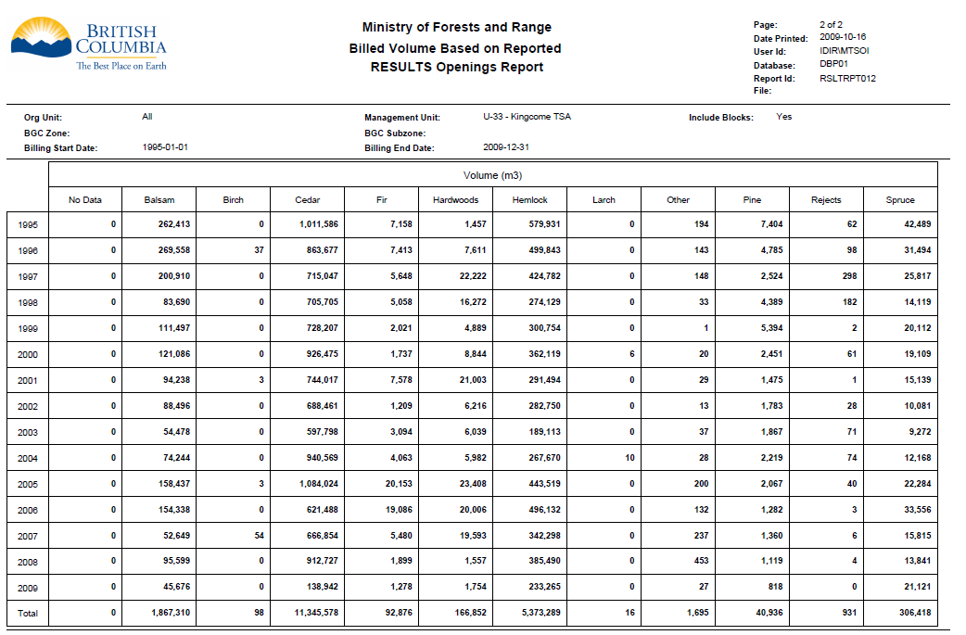
RESULTS – Species Monitoring
Report format - pdf
Report filters

Slide 13
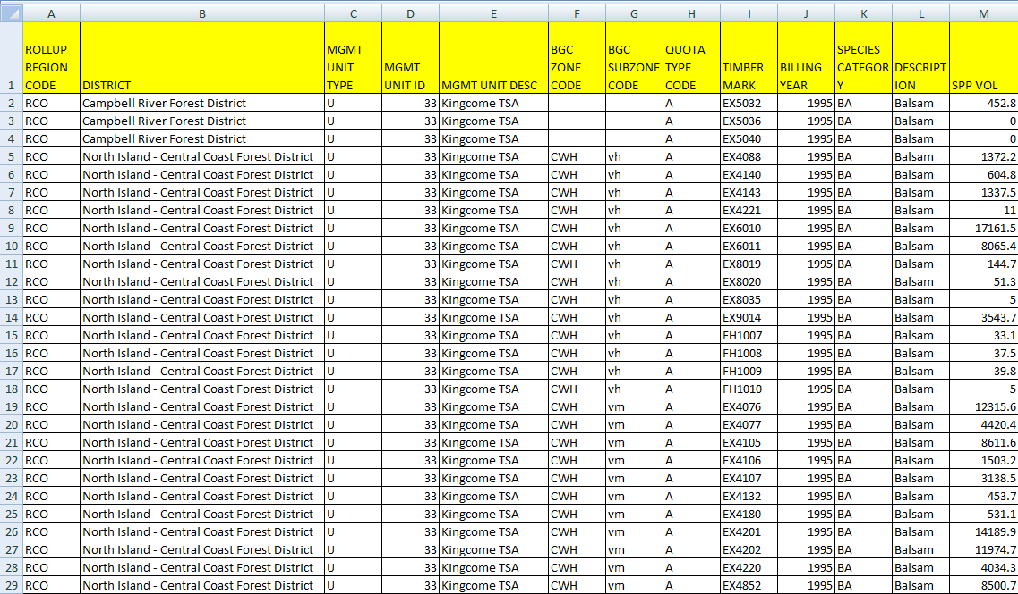
RESULTS – Species Monitoring
Report format – CSV (comma separated value)
CSV importable into MSAccess, MSExcel, other tools for analysis or representation due to fixed format of CRS .pdf presentation
Contains additional information that may be useful but not shown in graphs

Slide 14
RESULTS – Species Monitoring
Report format – CSV – offers flexibility
 |  | Reports
CSV Fields | Volume | Previous | Planting | Regen
ROLLUP REGION CODE | X | X | X | X
ORG UNIT CODE |  | X | X | X
MGMT UNIT TYPE | X | X | X | X
MGMT UNIT ID | X | X | X | X
MGMT UNIT DESC | X | X | X | X
BGC ZONE CODE | X | X | X | X
BGC SUBZONE CODE | X | X | X | X
QUOTA TYPE CODE | X
BILLING YEAR | X
DISTURBANCE START YEAR |  | X | X | X
SEED SOURCE |  |  | X
GENETIC WORTH CODE |  |  | X
GENETIC WORTH RTNG |  |  | X
SPECIES DESCRIPTION (Generalization) | X | X | X | X
STAND TYPE (Even vs Uneven-aged) |  |  |  | X
SPP VOL (Volume) | X
SUM SPP NAR (Net Area) |  | X
SUM Of PRORATE AREA (Planted & Regenerated Area) |  |  | X | X
Some data is not available as filter option but is available in the CSV dataset.
Data is based on theme of report.

Slide 15
RESULTS – Species Monitoring
Report format – CSV – offers flexibility
Example of focus 0n specific BEC Zone
Planting csv extract for planting contains subzone, genetic class, genetic worth

Slide 16
RESULTS – Species Monitoring
Report format – CSV – offers flexibility
Example of focus 0n Cedar & Genetic Class

Slide 17
RESULTS – Species Monitoring
Usage of Reports – Strategic Focus
Monitoring of harvesting of species over time through identifying shifts in the proportion of species
Monitoring the shift of species planted over time – are we over-deploying certain species over certain zone, subzone and/or management unit.
Monitoring the species makeup on established stands that are 7 years or older – identifying are we shifting species over time
Good for broad trending, to assist in overview and monitoring… then if area of concern, then required to refer to the source data for more detailed analysis.

Slide 18
RESULTS – Species Monitoring
Data Limitations
Billing Report
Billing data – only available by Timbermark (not cutblock/opening specific); therefore took the largest BEC represented by the Timbermark to enable attribution for Zone/subzone.
Data range available starting as of 1995-01-01 to current data
Previous Stand Report
BEC Zone & subzone for RESULTS opening based the largest Standards Unit.
Previous Stand report is only based on the leading species, where provided.
There are historical records with missing previous stand label, “no species” is indicated.
Data range available starting as of 1988-01-01 to current data

Slide 19
RESULTS – Species Monitoring
Data Limitations
Planting Report
BEC zone & subzone for RESULTS opening based on the largest Standards Unit.
Planted trees by species reported by number of trees planted, not by area. Planted species by area pro-rated based on trees applied to the total planted area.
Recent disturbance years may have low numbers due to lag between harvest completion and reporting of planting activities.
Data range available starting as of 1988-01-01 to current data

Slide 20
RESULTS – Species Monitoring
Data Limitations
Regenerated Forest Cover Report
BEC Zone & subzone for RESULTS opening based the largest Standards Unit.
Only inventory label where stocking status is immature and current age >= 7 years is considered.
Even-aged & uneven-aged polygons are used, but they can be filtered in the CSV by the Stand Type field.
Species distribution is based on applying the percent species reported against the silviculture polygon area.
Recent disturbance year will have fewer records as it has not met threshold 7 year minimum.
Data range available starting as of 1988-01-01 to current data

Slide 21
RESULTS – Species Monitoring
Advantages
Based on current data collected (reflects all data submitted into HBS & RESULTS) - not static onetime reports.
Flexible for historical review BUT can also run for current practices to see current forestry practices/ behaviour (e.g. can run for what is being done for more recent months for HBS).
Advantage – you can quickly review and monitor – CSV allows easy downloading of information into Excel to enable easy graphical displays using pivot charts.
Fixed Disturbance Start Date as benchmark for comparison for RESULTS dataset. But HBS uses Billing Year as close comparison.

Slide 22
RESULTS – Species Monitoring
Sample Reports
Sample reports for full timeframe of data available for:
    Bulkley TSA
    Prince George TSA
    Quesnel TSA

Slide 23
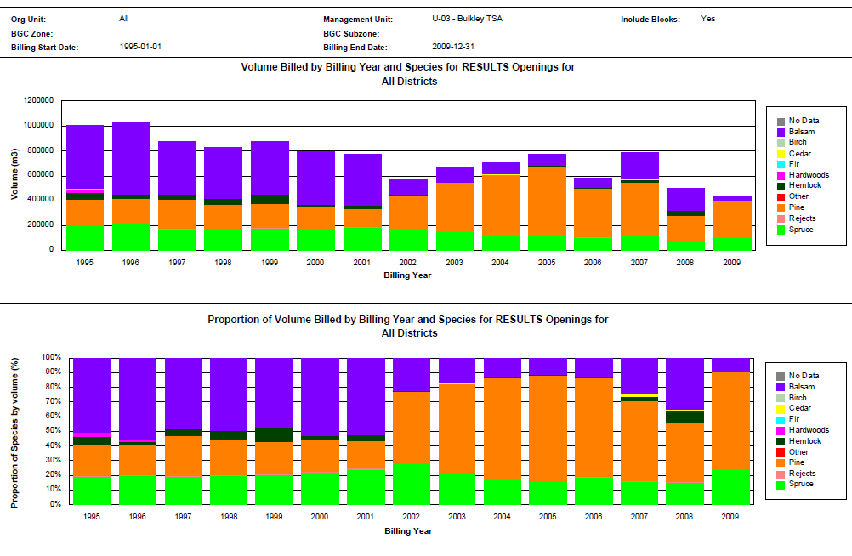
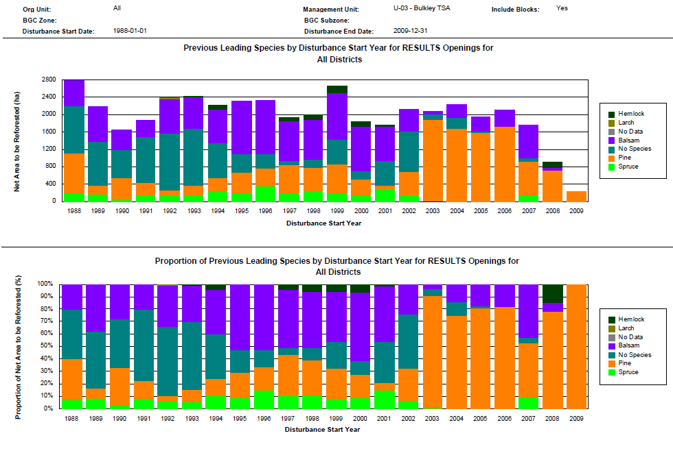
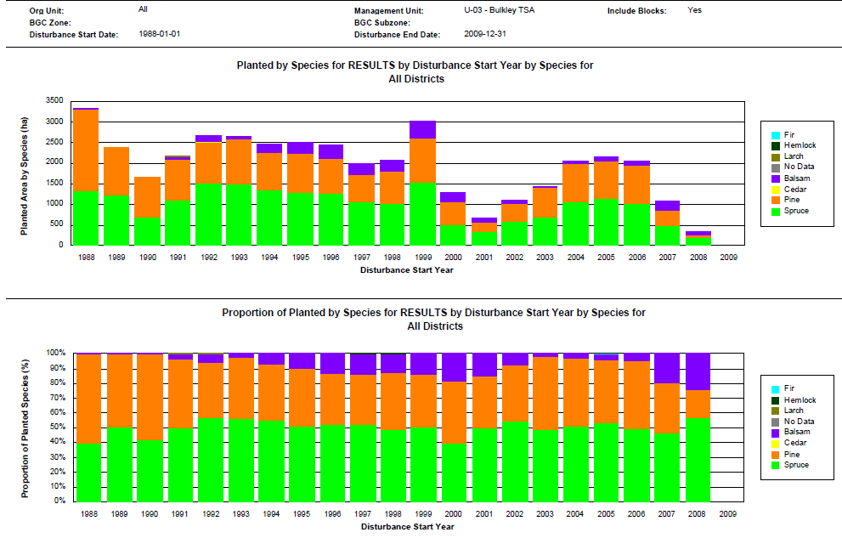
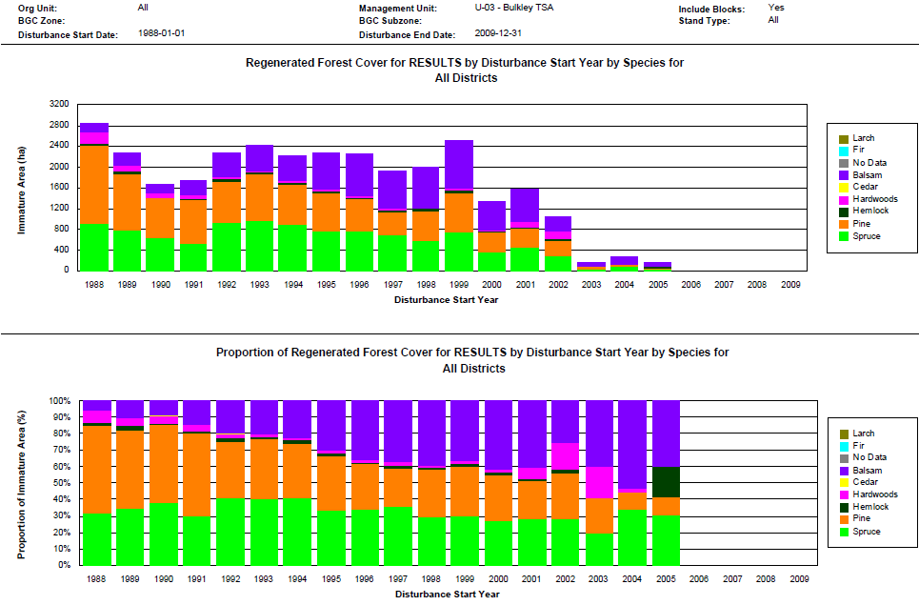
RESULTS – Species Monitoring - Bulkley TSA
Notes:
High level of pine planted, but recent issues with Dothstroma on young pine stands, there is shift in behavior in planted species.
Regen shows gradually increasing amounts of balsam. Can use reports to monitor species deployment based on emerging concerns.

Slide 24
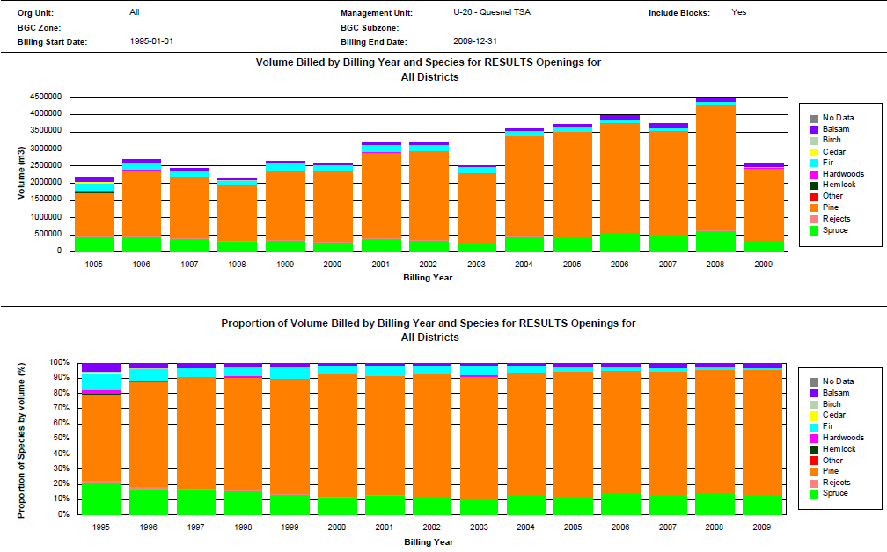
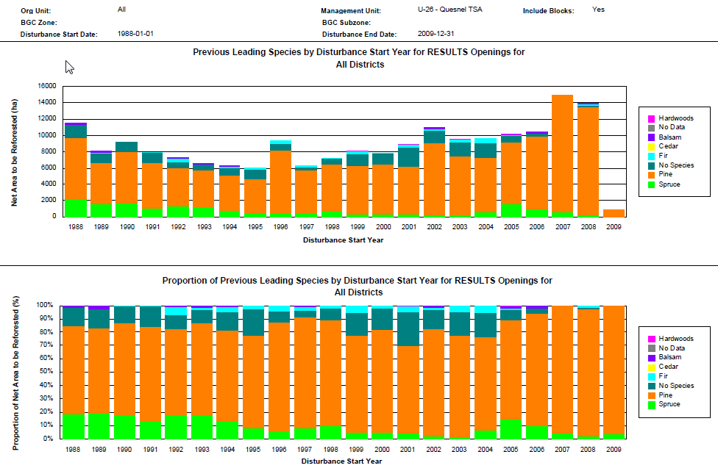
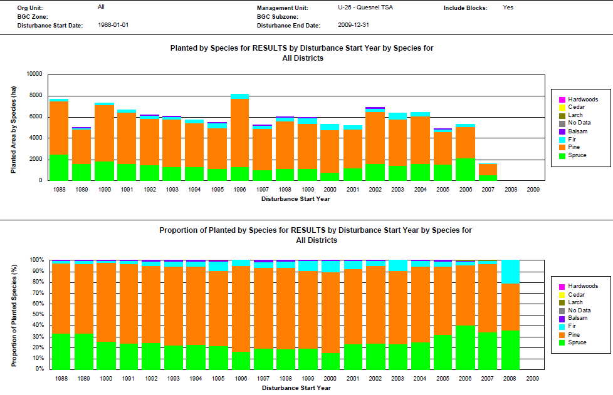
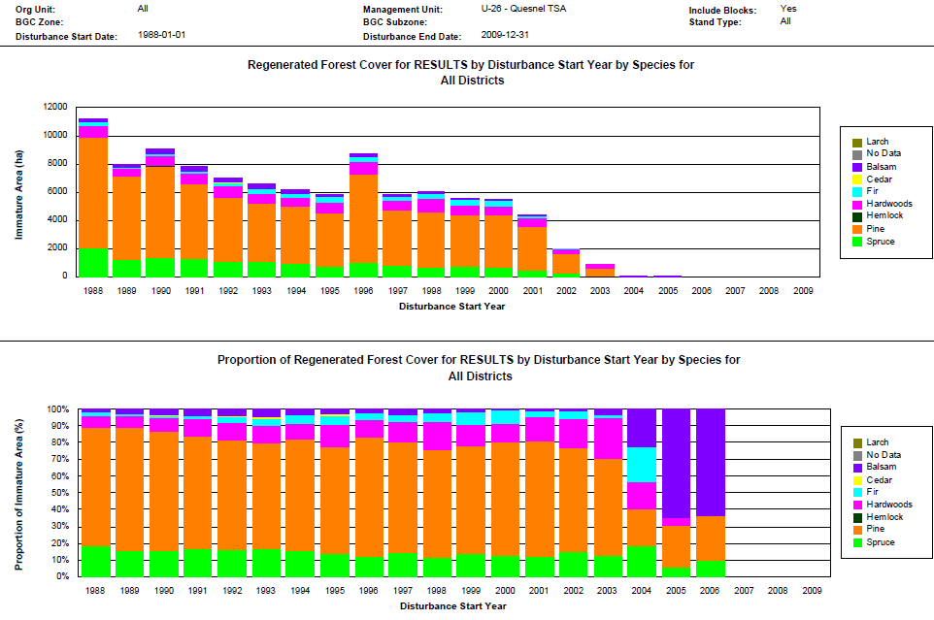
RESULTS – Species Monitoring – Quesnel TSA

Slide 25
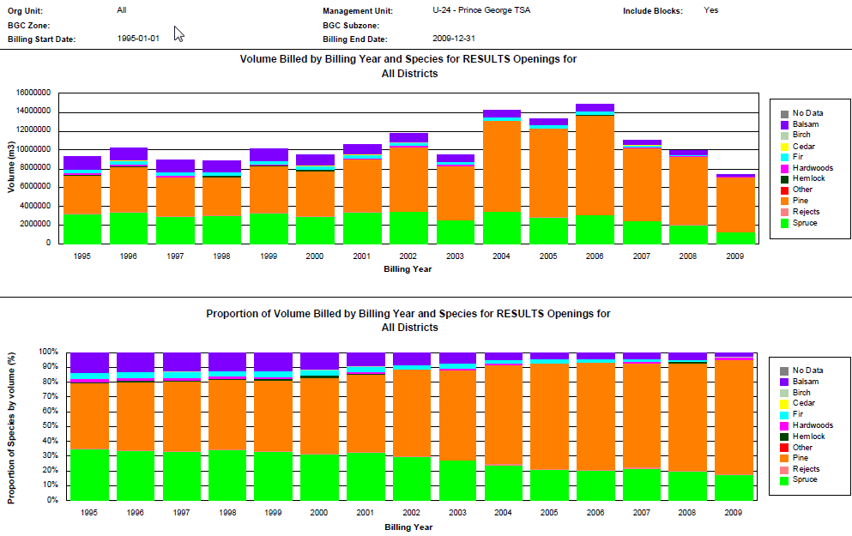
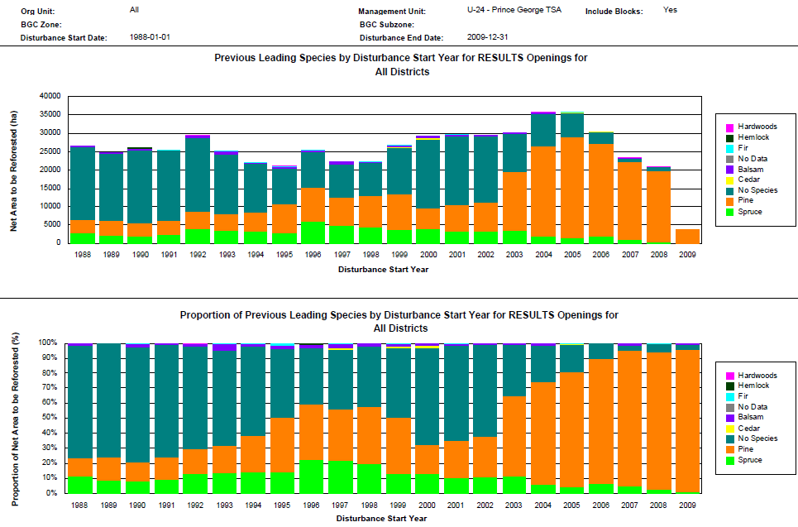
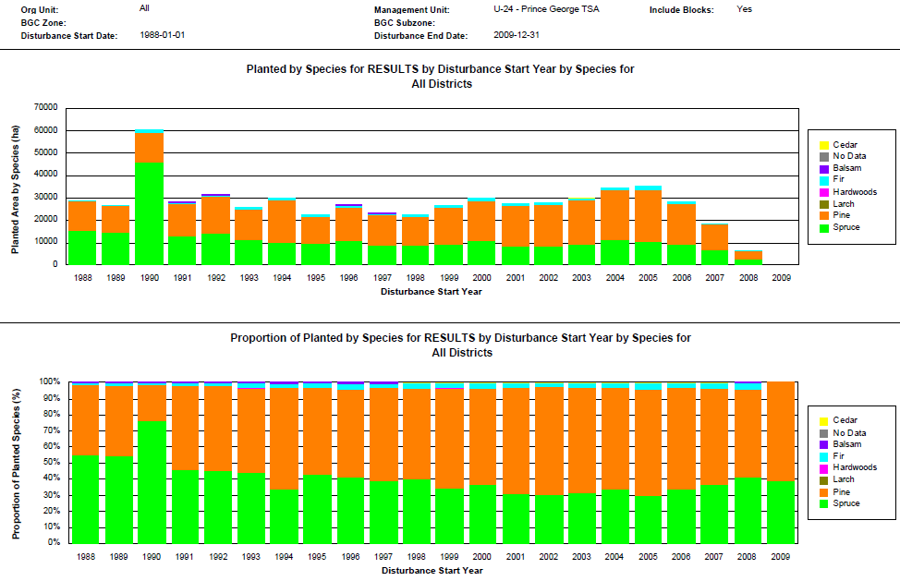
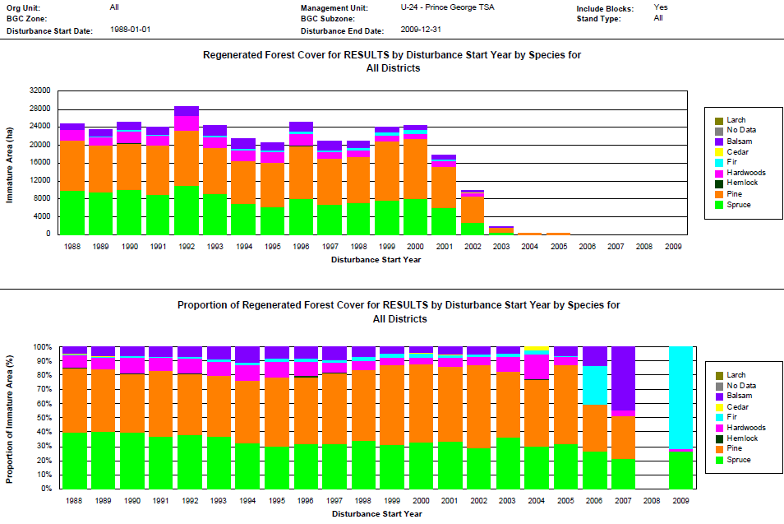
RESULTS – Species Monitoring – Prince George TSA

Slide 26
RESULTS – Species Monitoring
Usage of Reports
Reports are strategic to show general trends.
Can always focus on finer detail.
Points to key questions in species management:
Are we are aware of the species shifts?
Do we have the right balance of species mix (before vs. after)?
Do we have the right stocking standards that assist in controlling species at landscape level?
What can we do to prevent with some of the profile shifts?

Slide 27
RESULTS – Species Monitoring
Moving into the Future
These prototype reports to look at “mining” corporate data to deal with complex yet important strategic questions.
First step is to understand what are the key strategic questions we have and whether we have the right information to report out to answer those questions.
These 4 species monitoring report are 1st attempt to mine and summarize large volumes of data.
We are learning & assessing:
  how difficult is it to build these?
  what are the steps and whether there are critical steps involved?
  determine if these sorts of reports are useful, the right format?

Slide 28
RESULTS – Species Monitoring
Moving into the Future
We learn to cooperate , collaborate and find synergies by leveraging corporate data.
We need to define what are the big questions? These reports are one example of different themes. This is start of thinking what are the types of strategic reports we need.
Our experience with these reports will help us when better tools are available – Business Intelligence Tool that will ultimately have better functionality, flexiblity, automation, etc.
But before embarking on the right technology, we have understand what are the business questions that are the most important….
Any operational feedback on these reports & future ideas is appreciated.

Slide 29
RESULTS – Species Monitoring
Contact information:
RESULTS Lead:
Caroline MacLeod, Caroline.MacLeod@gov.bc.ca
RESULTS Business Support:
Mei-Ching Tsoi, mtsoi@shaw.ca
RESULTS main website: http://www.for.gov.bc.ca/his/results/
Species Monitoring documentation: http://www.for.gov.bc.ca/his/results/RESULTS_Species_Monitoring_Report_Feb2009_v2.pdf

