Slide 1
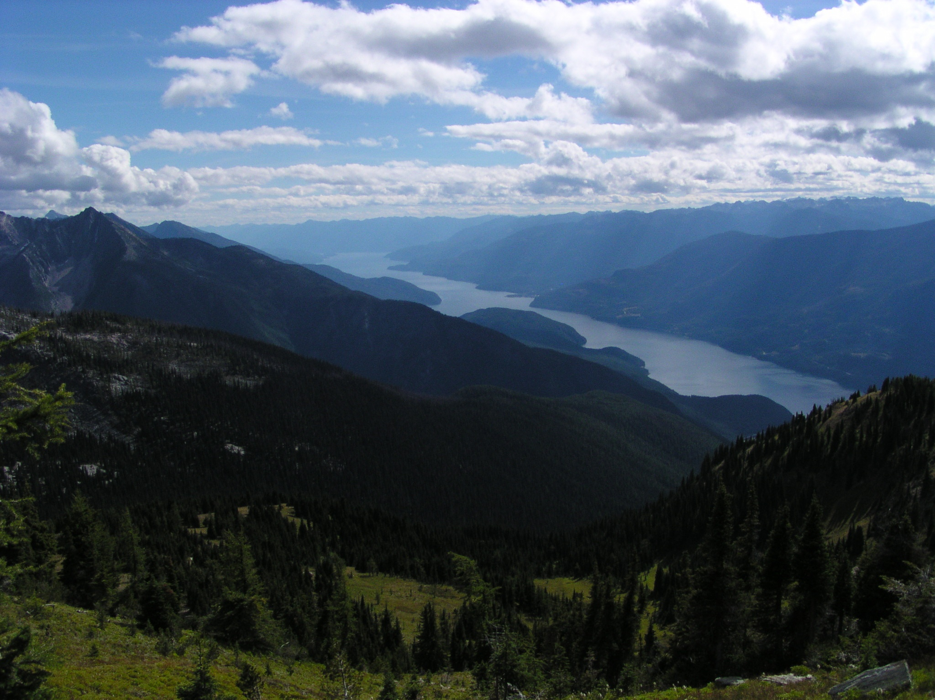
Climate Vulnerability and Resilience
Adaptation potential for ecosystems and management in the W. Kootenays
A Brief Project Overview
www.kootenayresilience.org
Rachel Holt and Greg Utzig
Veridian Ecological Consulting Kutenai Nature Investigations
Nelson, BC CANADA

Slide 2
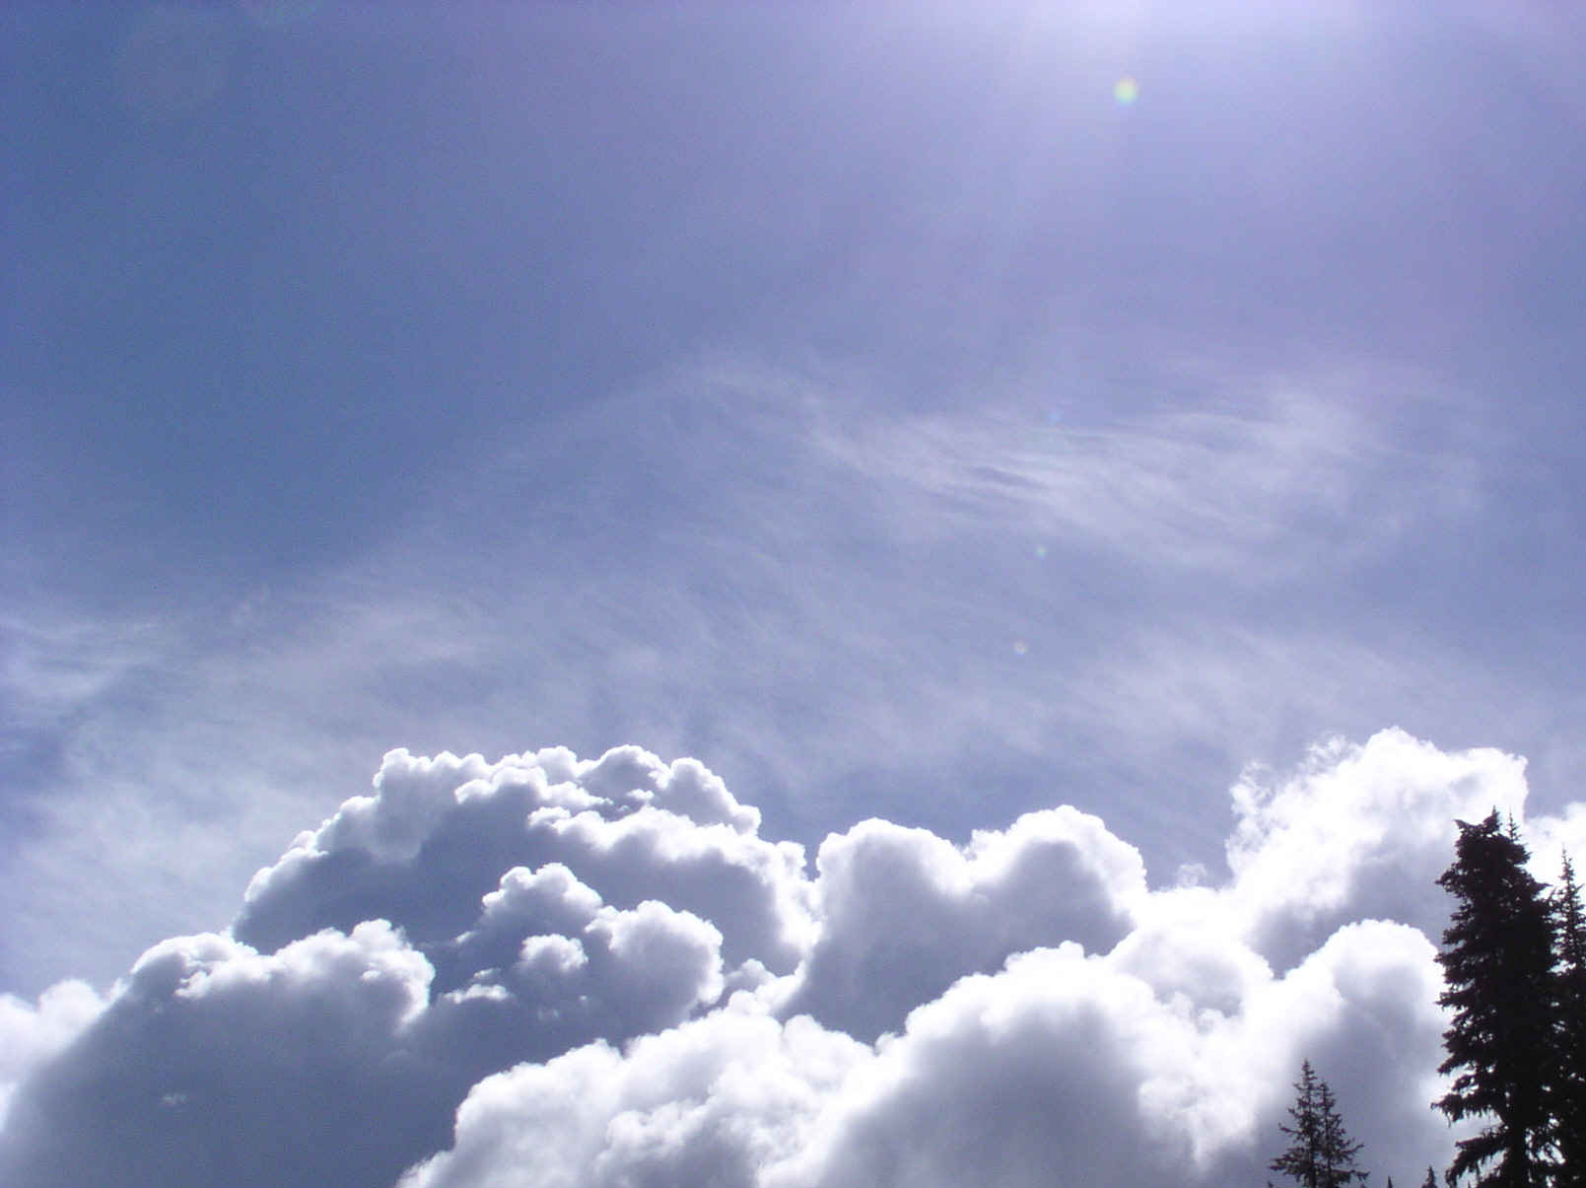
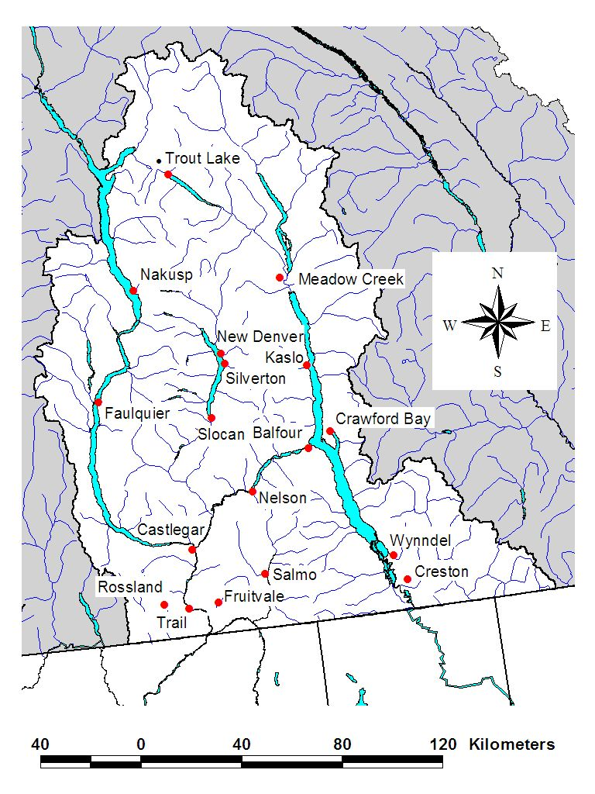
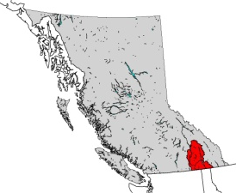
West Kootenay Climate Change Vulnerability and Resilience Project
Project Participants
  Core Team
    Greg Utzig
    Rachel Holt
    Heather Pinnell
    Cindy Pearce
  Science Advisors
  Local Forest Managers/ Stakeholders
Funding
  British Columbia Ministry
  of Forests – Future Forest
  Ecosystem Scientific Council
Data
  Pacific Climate Impacts Consortium (PCIC)
  University of Alberta – Andreas Hamann’s group
ID
MT
WA

Slide 3
Main Objectives
  To explore the potential implications of climate change for West Kootenay ecosystems with local forest managers and scientists
  To undertake an ecological vulnerability assessment for the West Kootenays, using a range of climate change scenarios
Main Project Components
  Collating local climate change information
  Summarizing potential impacts
  Series of workshops with local forest managers and scientists
  Ecological vulnerability assessment incorporating resilience
  Identification of adaptation options and barriers
  Reporting

Slide 4
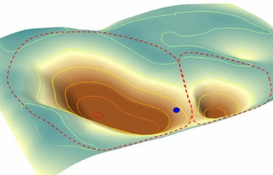
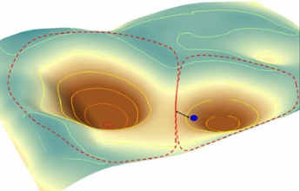
Resilience and vulnerability
  Somewhat interchangeable
  Strict versus loose definitions
Vulnerability – exposure x sensitivity x adaptive capacity
Resilience
  rebounding’ from disturbance
  to avoid changing regime; To re-organize and continue after changing regime
  Characterized by thresholds and non-linear responses

Slide 5
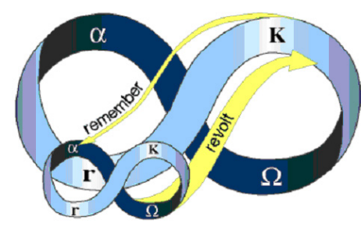
Interpreting significance of projected future bioclimates -
No Regime Shift
Non-Catastrophic regime shift
  Different natural disturbance regime
  Different tree species
  Similar pathway
Catastrophic regime shift
  Different natural disturbance regime
  Different species
  Stalled pathway / invasive species, brush .. Very slow or difficult to manage out of.

Slide 6
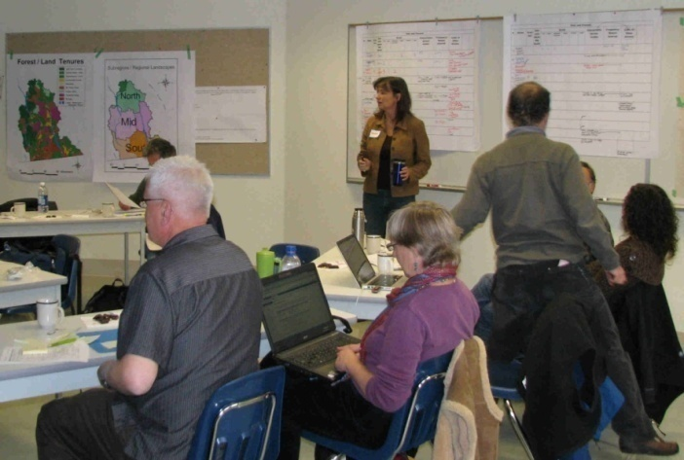
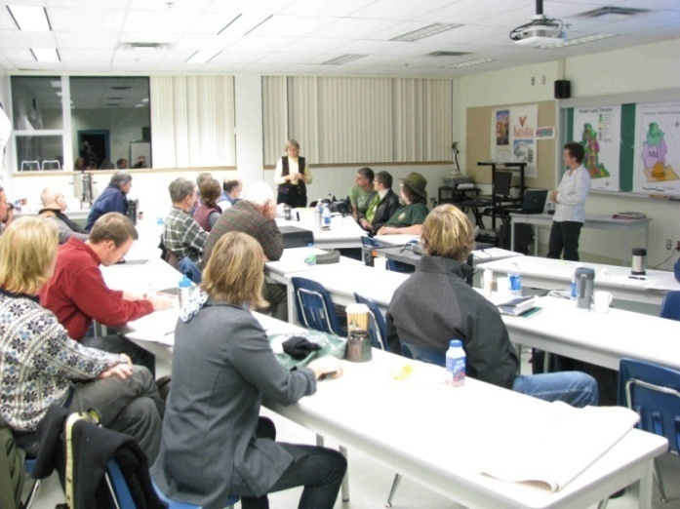
Technical Workshops (2)
Attendance: 6-12 technical experts
in ecology, fire, forest health,
geomorphology, silviculture, forest policy
Managers Workshops (3)
Attendance: 20-30 “forest managers” and
“forest practitioners in silviculture, terrestrial
and aquatic biology, forest health, field
planning, geoscience, hydrology and forest policy
From government, industry, woodlots, community
forests, consulting companies and Regional District planners
Notes:
Technical workshop held in early November – generally enthusiastic interest

Slide 7
West Kootenay Forest Managers Climate Change Impacts – South Sub-Region
SUMMER (June – Aug.)
CLIMATE
CHANGES
2050s
FOREST
MANAGEMENT
IMPACTS
ECOSYSTEM RESPONSES
Value of long term planning ??
Longer growing season
Shifts in competitive advantage, productivity and distribution of plants
More grasslands and brushfields
+2.1 to +5.1oC temp increase
Reduced
Harvest Landbase
Changes in pest spp. distribution
More salvage
Increased diversity of succesional stages, opening size and habitats
Reduced siol moisture & increased drought stress
Reduced log quality/value
Higher costs
-7 to -23%
Less rain
Increased tree mortality
Reduced regen success
Very low summer flows for longer periods
Change management to increase water availability
More frequent
extreme
events
Heat waves
Intense rain
High winds
More lightening
Increased wildfire incidence and intensity
More bush closures
Decreased soil stability after fires
Loss of standing timber and regeneration investments
Increased
windthrow
Increased erosion & landslide potential
Damage to roads, property and loss of life
Notes:
Example of the outcome of our “Impact Mapping” – lead by Cindy Pearce
7

Slide 8
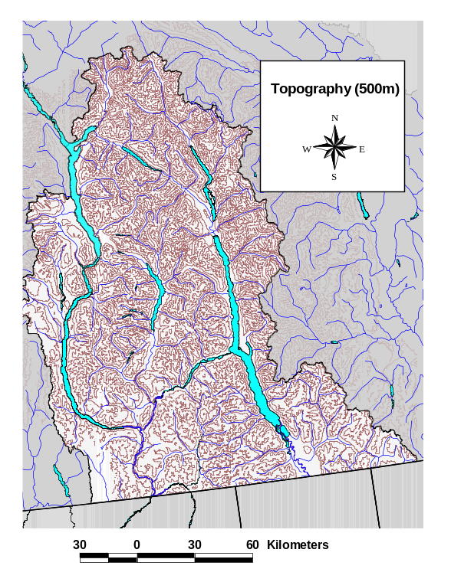
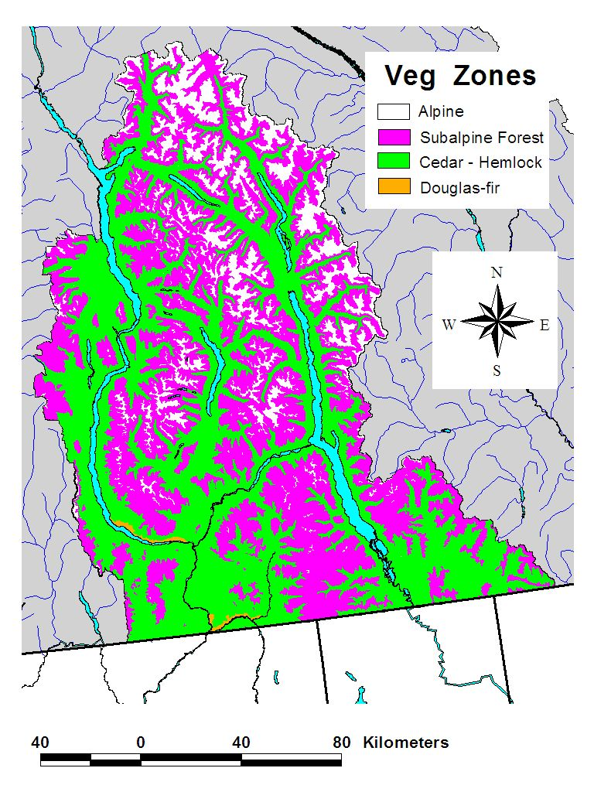
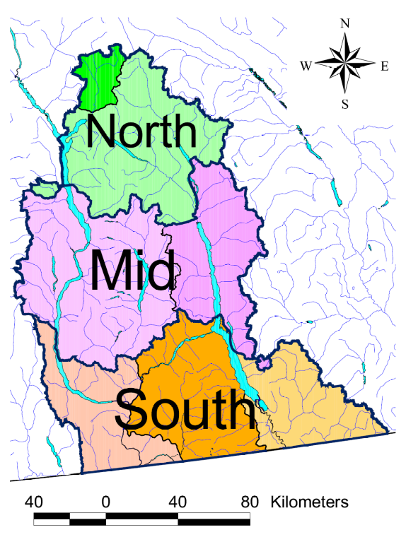
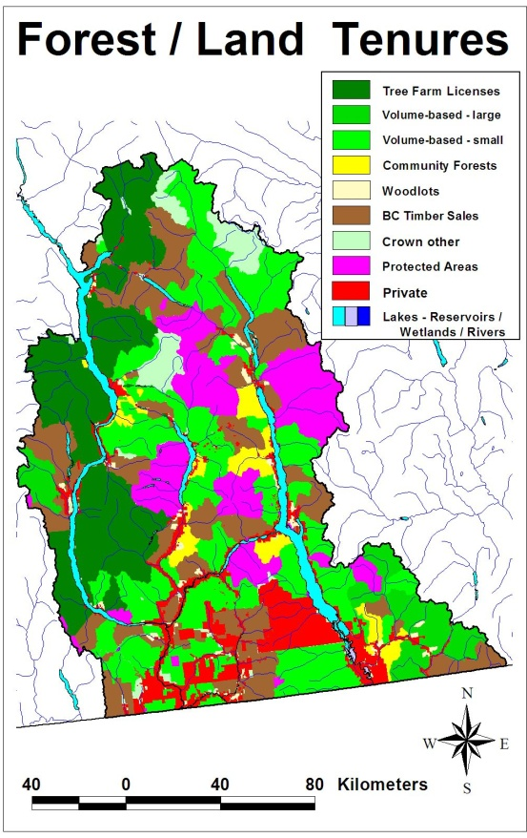

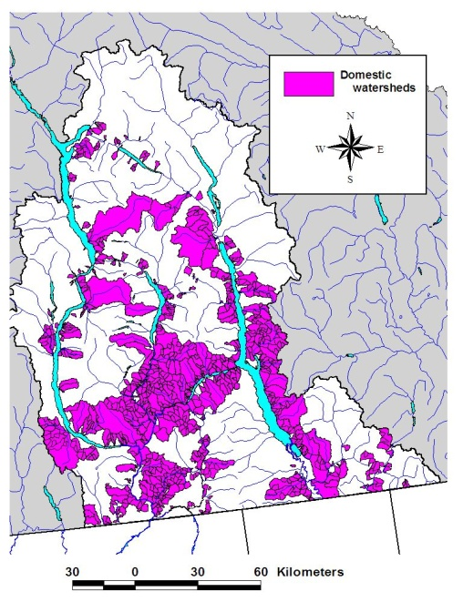
Study Area Characteristics
Social
Systems
Ecological
Systems

Slide 9
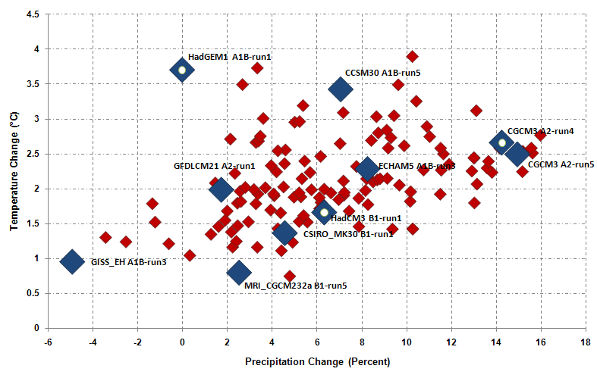
GCM / Scenario Combinations
2050s Mean Projections for British Columbia
Annual Temperature and Precipitation
Very Hot/ Dry
MIROC32hires A1B-run1
Hot/ Wet
Warm/ Moist
Blue diamonds recommended scenarios
Green/ Purple - scenarios investigated for the West Kootenays
Adapted from:
Murdock and Spittlehouse 2010

Slide 10
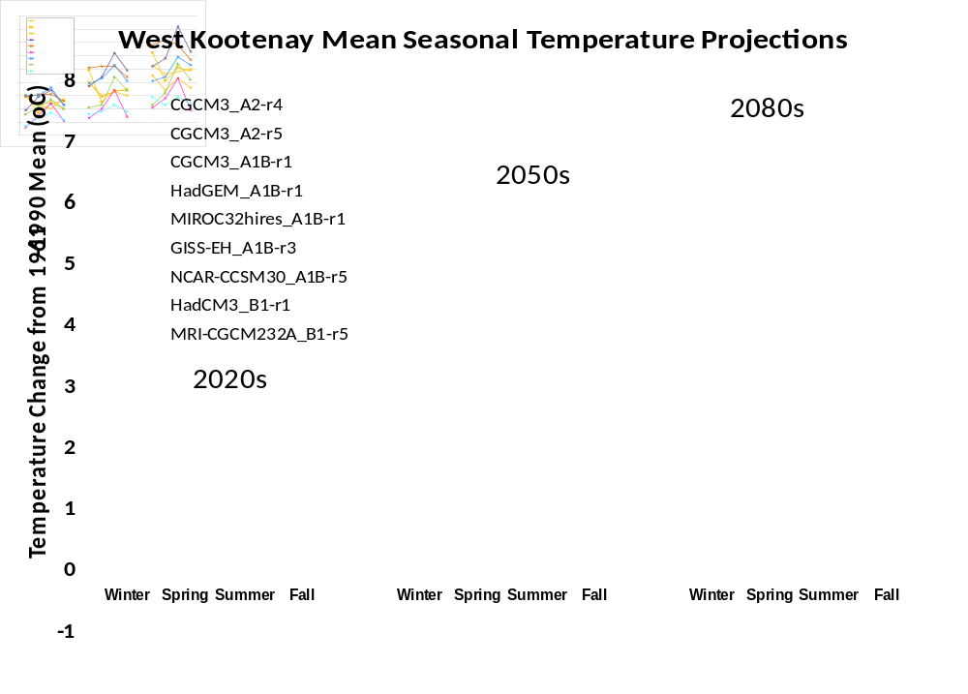
Data from: PCIC Regional Analysis Tool

Slide 11
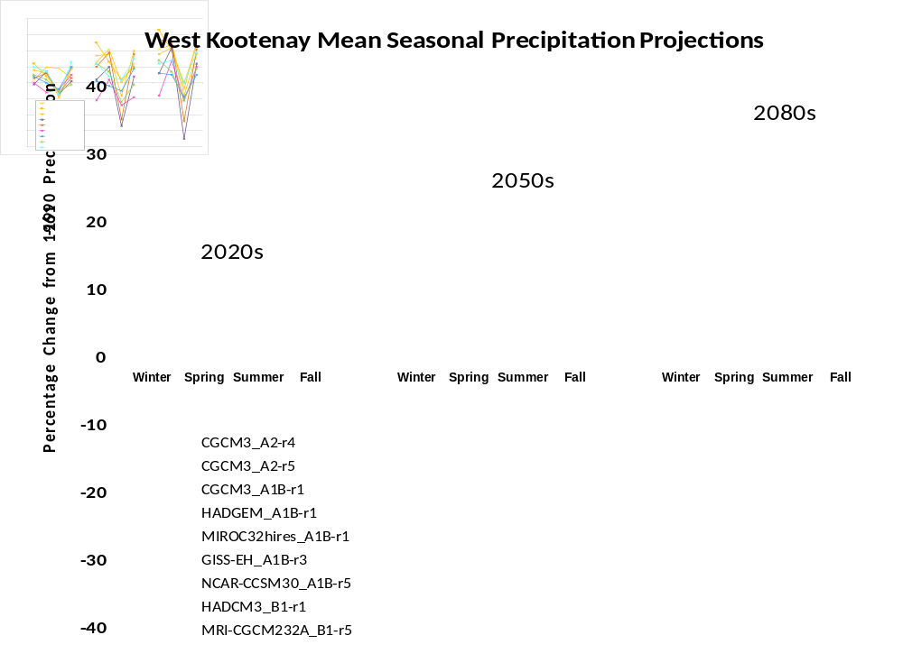
Data from: PCIC Regional Analysis Tool

Slide 12
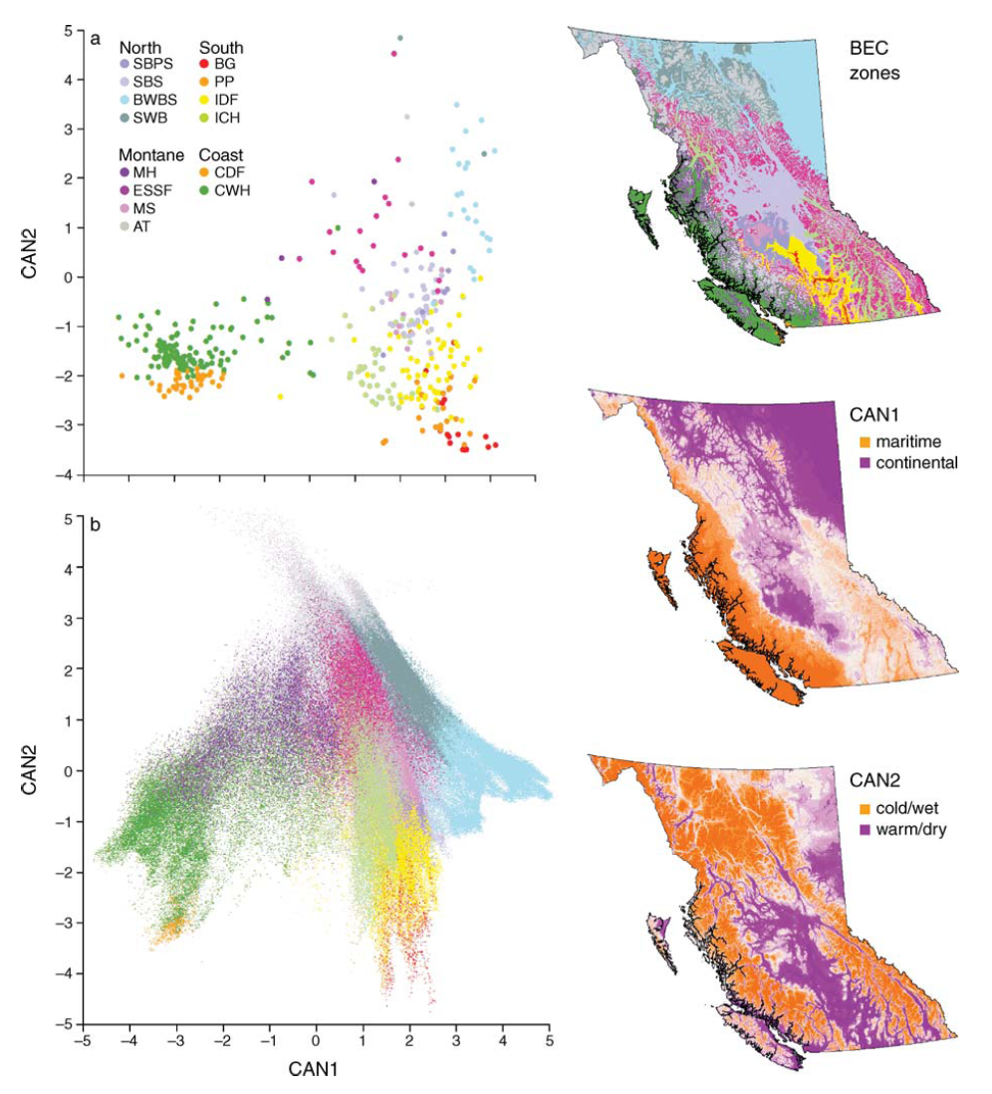
Ecosystem Units in Multivariate
Climate Space – “Bioclimate Envelopes”
Cold / wet
Biogeoclimatic
Zones
Weather Stations
Maritime
Continental
-5 -4 -3 -2 -1 0 1 2 3 4 5
Warm / dry
From:
Hamann and Wang 2006
Notes:
FIG. 1. Canonical discriminant analysis of weather station data (top) and PRISM data (bottom) for Biogeoclimatic Ecological
Classification (BEC) zones. Positive scores in CAN1 indicate continental conditions; negative scores indicate maritime conditions.
Positive scores in CAN2 indicate cold/wet climate; negative scores indicate warm/dry climate. For complete names of BEC zones,
refer to Fig. 2.

Slide 13

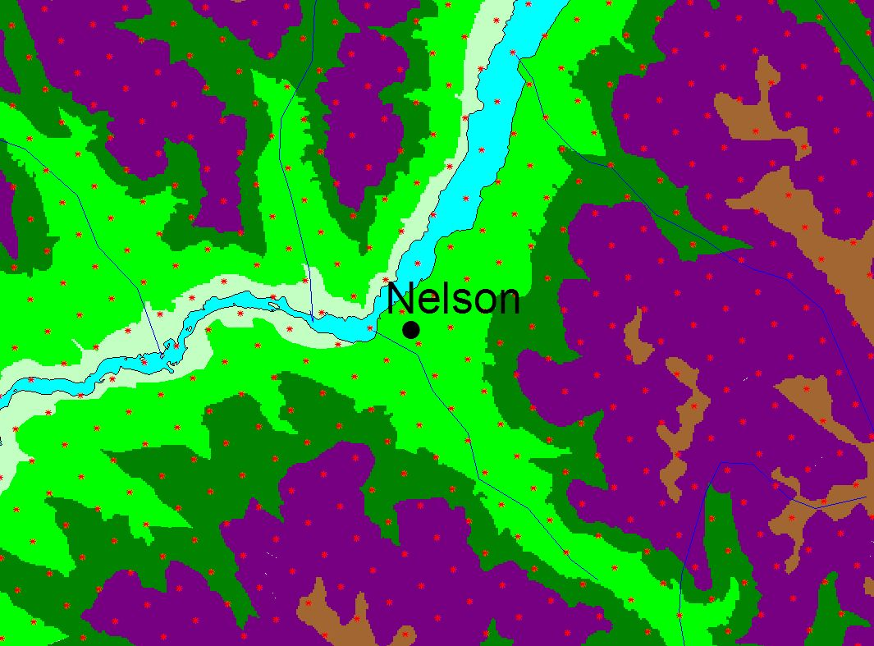
Ecosystem Units in Multivariate Climate Space
Prism Data (ClimateWNA)
Biogeoclimatic
Zones
(climate station data
interpolated to a 1 km grid)
Cold / wet
x
o
Maritime
Continental
X
o
?
Warm / dry
Non-analogue or Novel bioclimate envelopes
Adapted from:
Hamann and Wang 2006
Notes:
Prism Data – Climate Western North America – 1km grid – classified according to BEC units – this has also been extended to all of W North America
An over-simplified explanation ….. each grid point is reassigned new climate data based on global climate change projections
Then the model searches all the ecosystem climates in W NA for one that fits the new climate for each point – this is done for each fo the time periods and each model/scenario combination – then assigns that new ecosystem climate envelope to that point
Hamann and students have taken

Slide 14
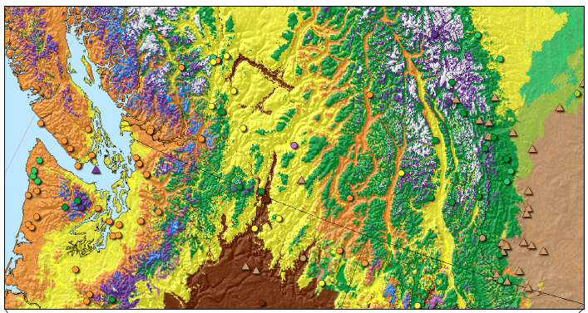
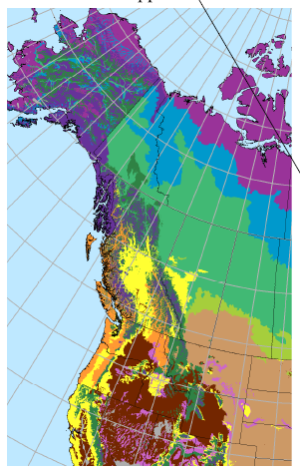
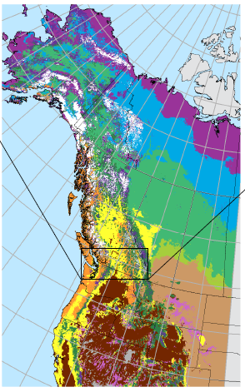
Projected Climate Envelope Shifts
Western North America (not limited to BC)
1 km grid
770 ecosystem units
BC – BEC subzone variants
Alberta – Seed zones
USA (48) – Level 4 Ecoregions
Alaska – Ecosystems of Alaska
Canada Other – National
Ecological Framework
University of Alberta
David Roberts/ Andreas Hamann
From:
Roberts and Hamann 2011

Slide 15
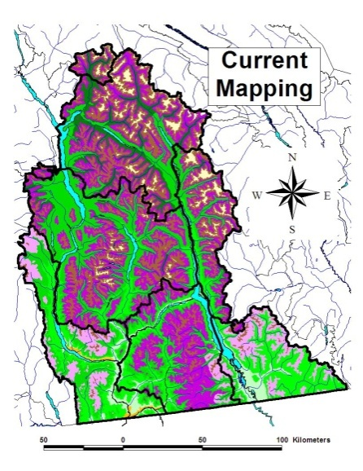
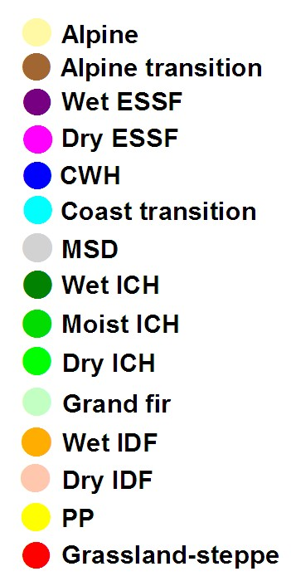
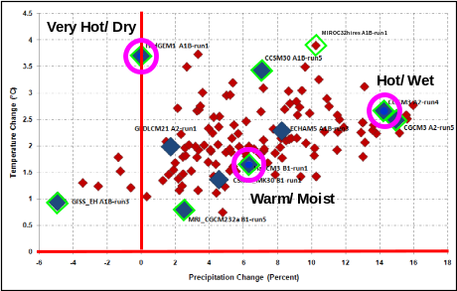
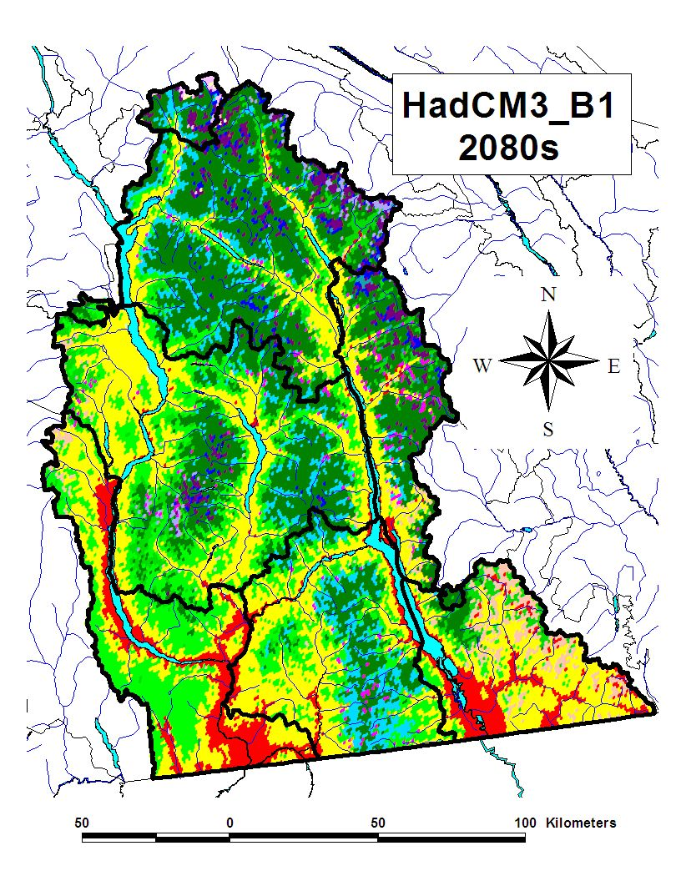
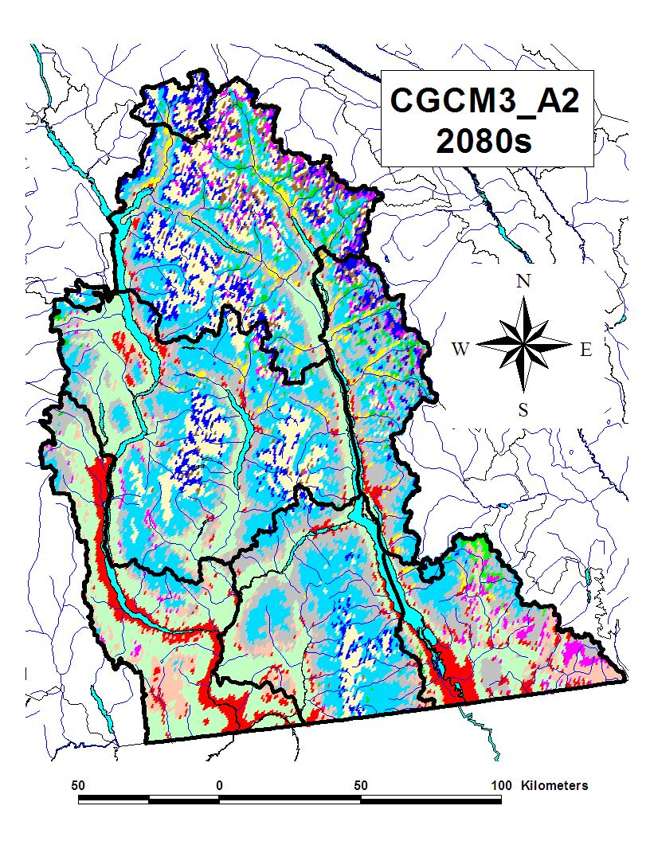
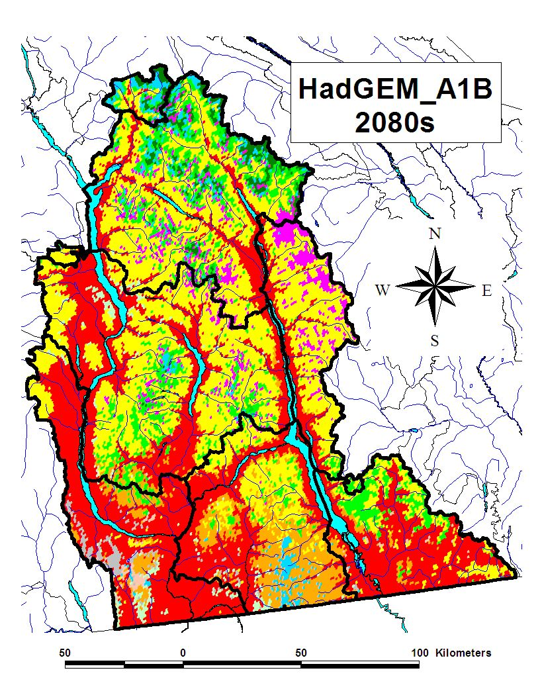
A Range of Projected
Bioclimate Envelopes
Alpine
Alpine parkland
Wet subalpine forest
Dry subalpine forest
Coastal hemlock
Transitional coast/ interior hemlock
Montane/sub-boreal spruce forest
Wet interior cedar/ hemlock
Moist interior cedar/ hemlock
Dry interior cedar hemlock
Grand fir/ Douglas-fir
Wet Douglas-fir
Dry Douglas-fir
Ponderosa pine savanah
Grassland/ steppe
Warm/ Moist
Hot/ Wet
Very Hot/ Dry
Original data from: Roberts and Hamann, U of A

Slide 16
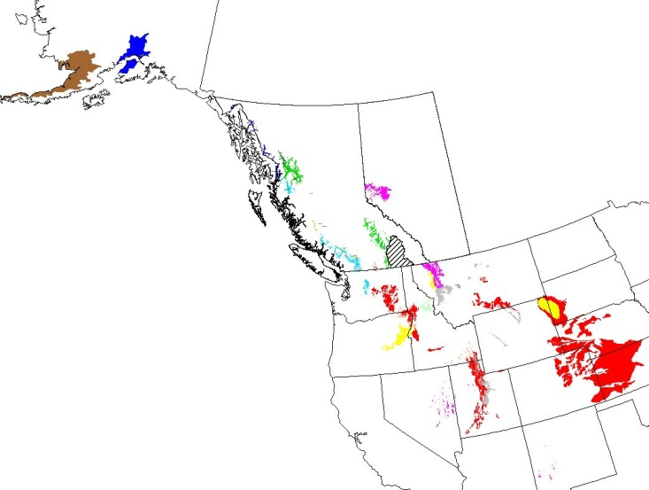
Bioclimate Envelopes and Ecosystems
Current locations of bioclimates
projected for the 2080’s in the
study area (>50 km²⁾
West Kootenays
Alpine
Alpine parkland
Wet subalpine forest
Dry subalpine forest
Coastal hemlock
Transitional coast/ interior hemlock
Montane/sub-boreal spruce forest
Wet interior cedar/ hemlock
Moist interior cedar/ hemlock
Dry interior cedar hemlock
Grand fir/ Douglas-fir
Wet Douglas-fir
Dry Douglas-fir
Ponderosa pine savanah
Grassland/ steppe
Original data from: Roberts and Hamann, U of A
Notes:
Contrary to initial expectations – the future climate space for the west kootenays is currently found in a very wide span in western NA – from the black hills of Dakota, to Alaska.

Slide 17
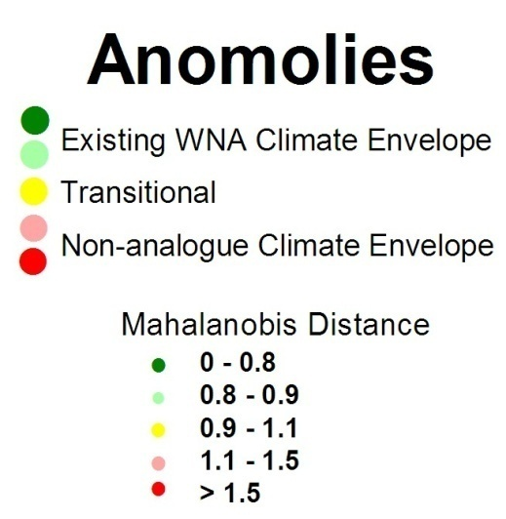
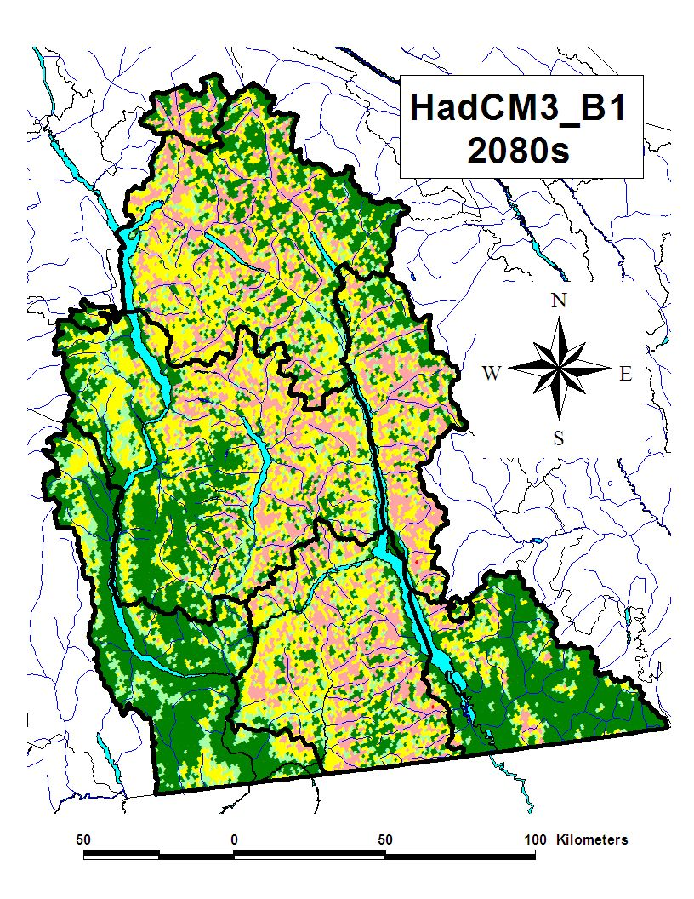
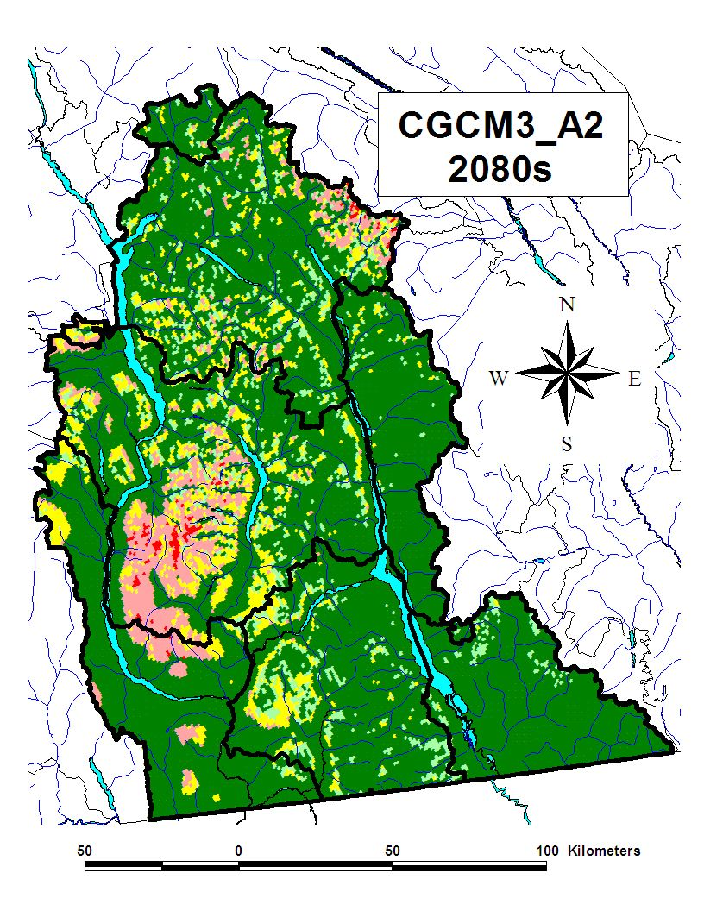
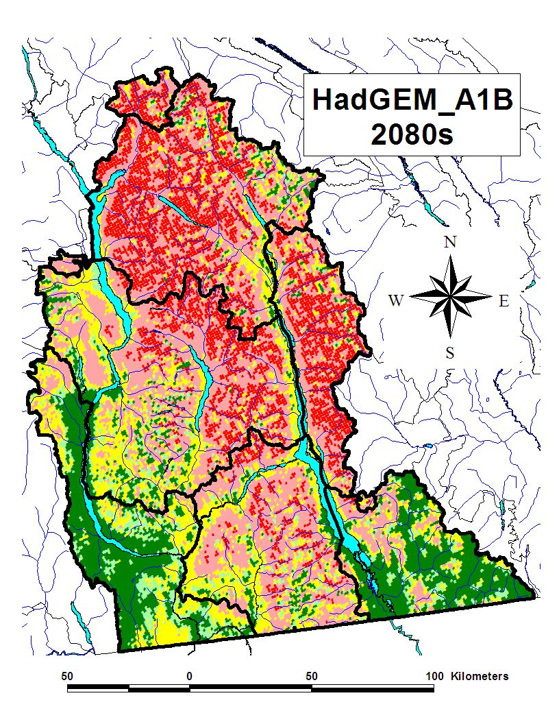
Potential for
Non-Analogue or Novel Bioclimate Envelopes
Legend
Warm/ Moist
Hot/ Wet
Very Hot/ Dry

Slide 18
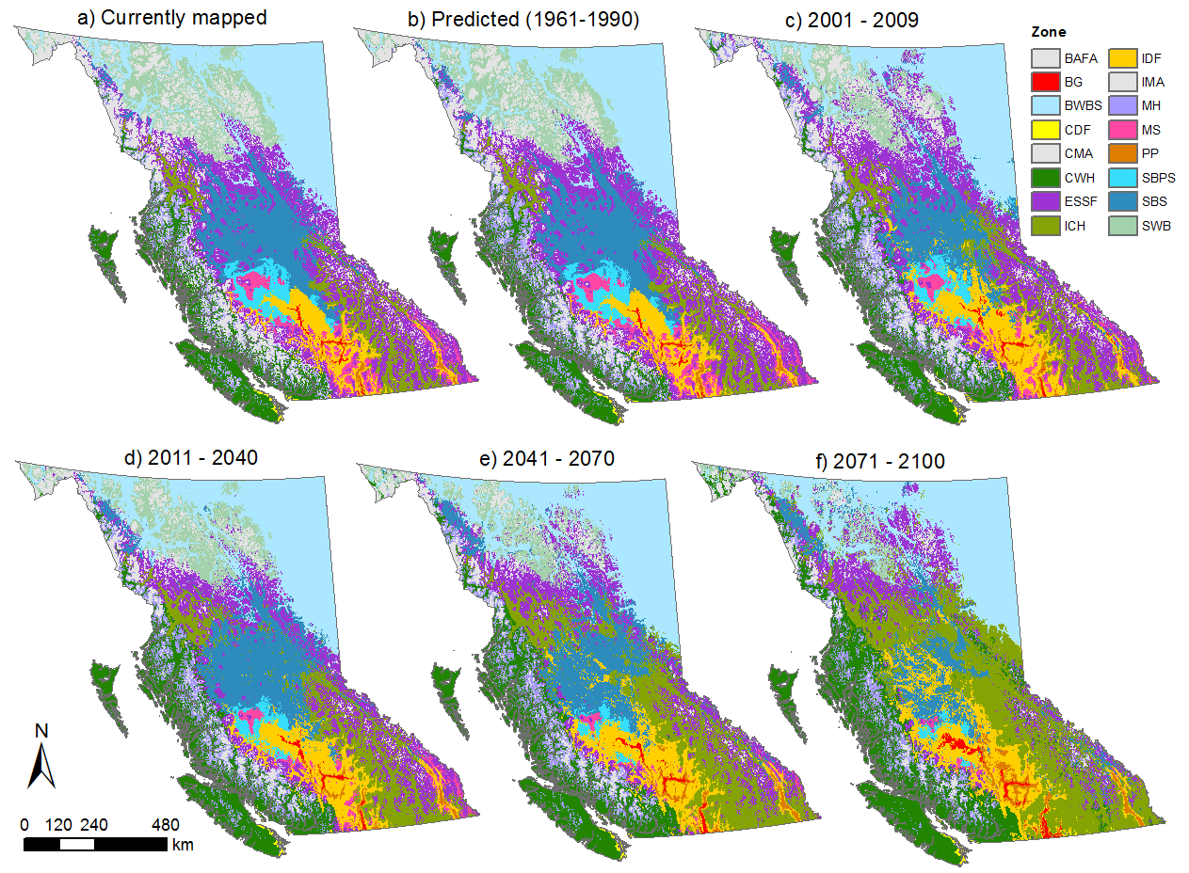
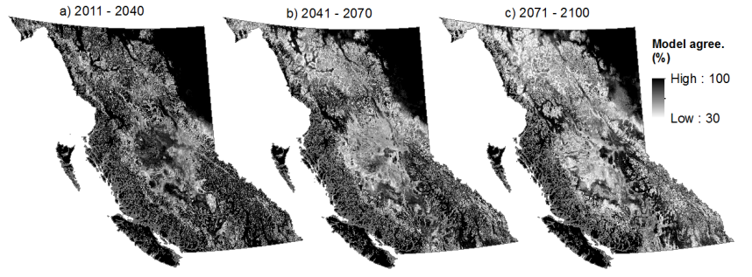
An Ensemble Projection of Bioclimate Envelopes
From: Wang et al. 2012

Slide 19
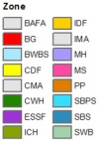
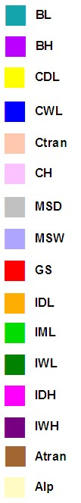
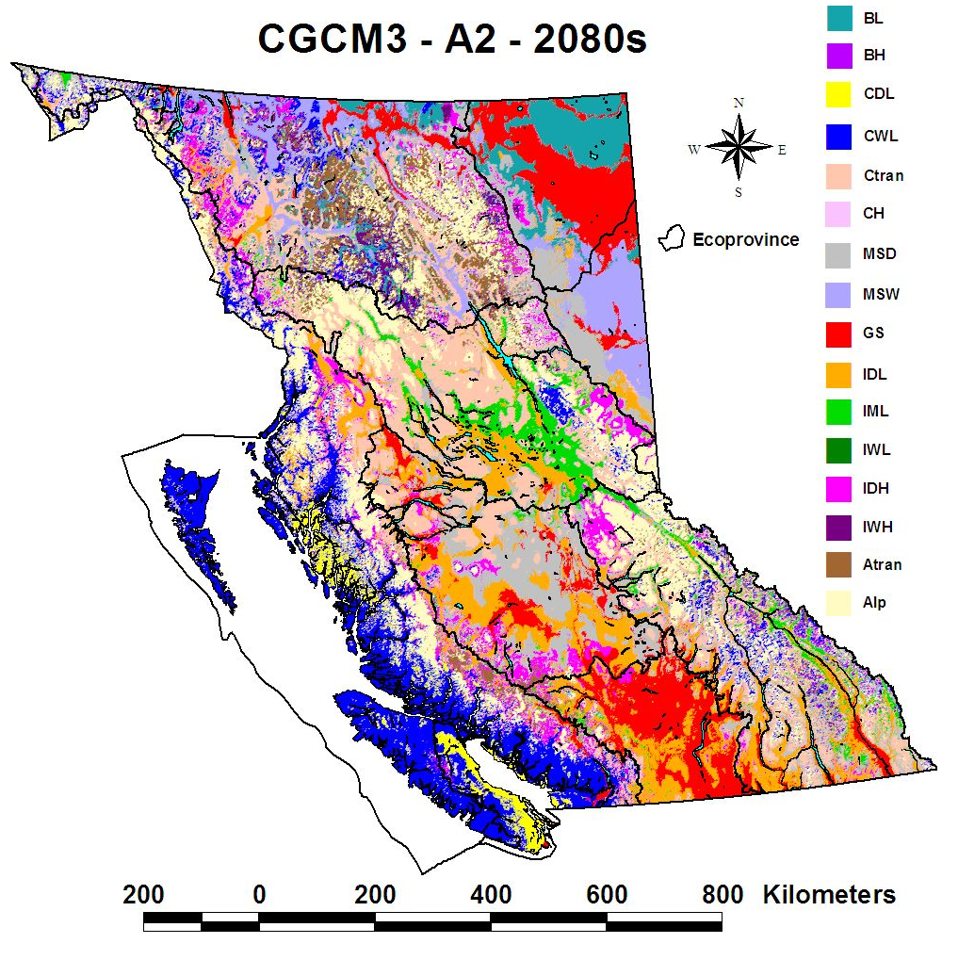
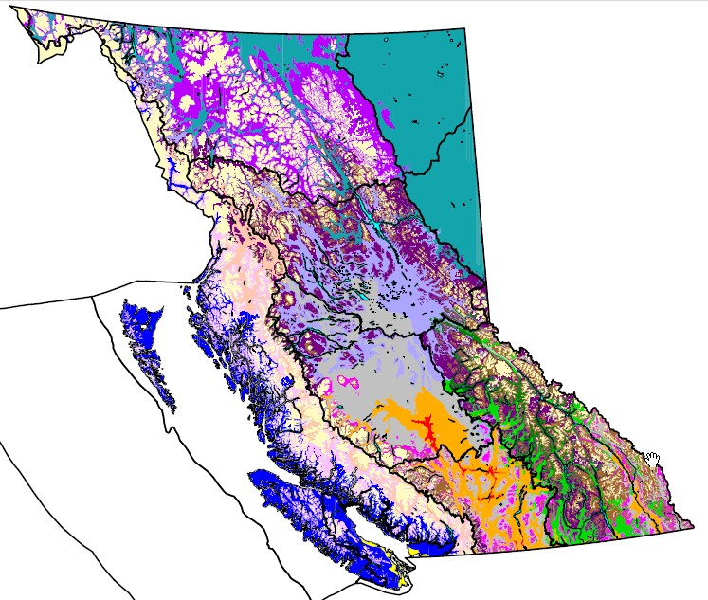
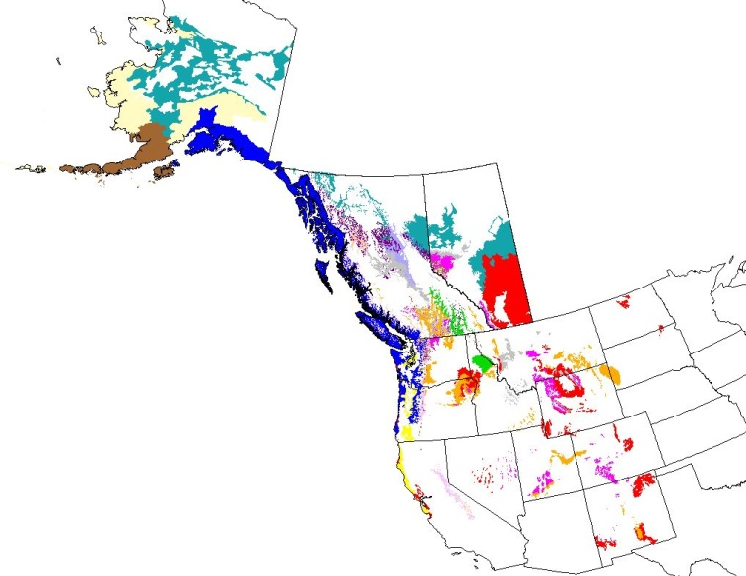
Bioclimate Envelope Projections
MIROC32hires A1B-run1
Hot/ Wet
Current
BEC
Mapping
From: Wang et al. 2012
Original data from: Roberts and Hamann, U of A

Slide 20
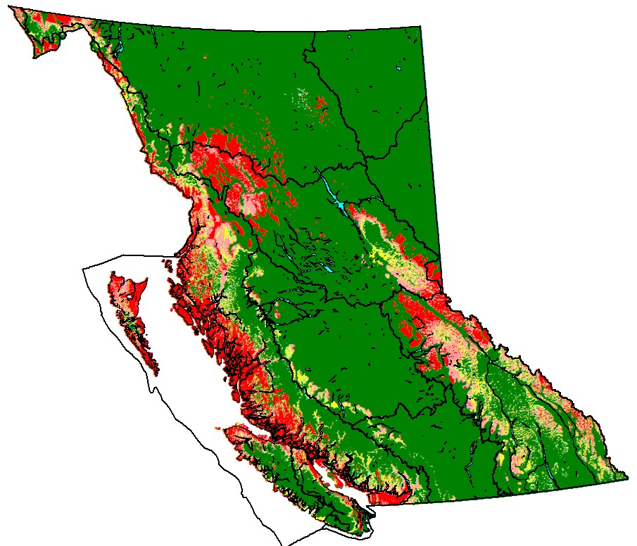
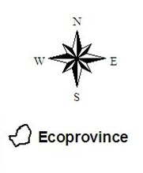
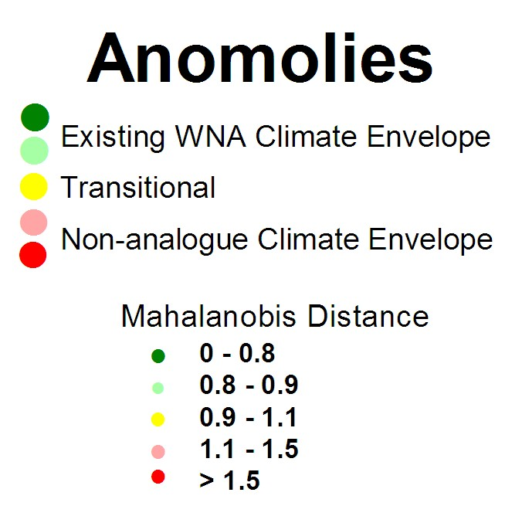
Novel or Non-analogue
Bioclimate Envelopes
CGCM3-A2 2080s
Legend
Original data from:
Roberts and Hamann, U of A

Slide 21
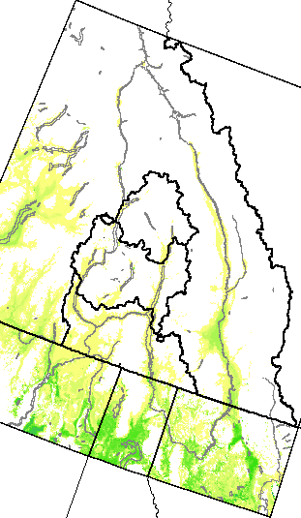
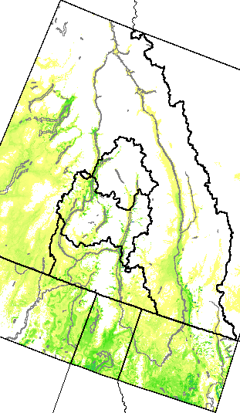
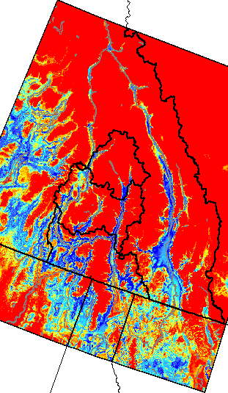


Habitat projections for Ponderosa Pine
Current
2020s
From:
Laura Gray 2010

Slide 22
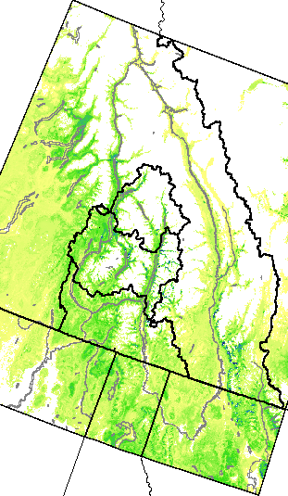
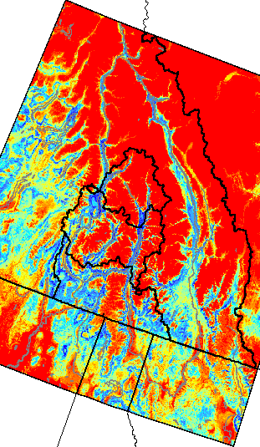
Habitat projections for Ponderosa Pine
Current
2050s
From:
Laura Gray 2010

Slide 23
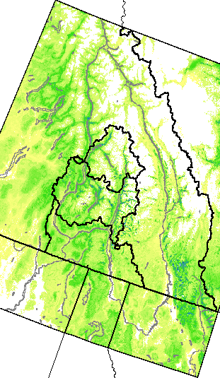
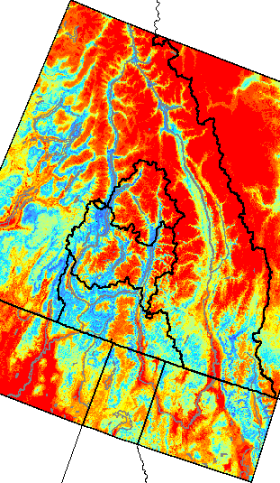
Habitat projections for Ponderosa Pine
Current
2080s
From:
Laura Gray 2010

Slide 24





West Kootenay
Fire History
North
Annual
Area Burned
South
Touchstones Archives, Nelson

Slide 25




Multiple Regression Analysis
South (r²=0.60)
Kutetl 2003
Sitkum
2007
Jordan 2007

Slide 26














Insects/ Pathogens /Decline Syndromes
Tree decline – drought/ loss of resistance
Bark Beetles
  Mountain pine beetle, spruce bark beetle, Ips beetles, Douglas-fir beetle …..
Defoliators, blights, pathogens
  Spruce budworm, dothistroma, larch needle cast, root disease
Complex Interactions
  Birch die-back, yellow cedar, 5-needle pines
From: Raffa et al. 2008
(A) Regions
(B) Elevation
(C) Stem diameter
(D) Genus
(E) Fire return interval

Slide 27





Climatic Extremes – One Example
Precipitation 2012 Johnson’s Landing
Impacts
4 people killed
4 houses destroyed
6 properties damaged/
loss of access
Community water
system destroyed
Main road destroyed
Damage to utilities
Ongoing future risks
TMTV
Increased Soil Moisture
Decreased Soil Strength
Landslide

Slide 28
Vulnerabilities
  Changing disturbance regimes (e.g. lack of appropriate seed sources after disturbance)
  Potential for climate change to amplify cumulative impacts of past development
  Complexity of impacts due to cross-scale
  interactions and inter-species relationships
  (competition, predator/prey, host/pest,
  interdependence)
From: www.resalliance.org
Notes:
Green Sky

Slide 29
Local adaptation options
  Suite of generally applicable recommendations:
    Silvicultural systems
    Stand level management/ biodiversity
    Regeneration strategies
  Started to develop subregion specific recommendations
    Requires significant focus of time / effort to continue
    Vulnerability assessment provides part of the base information
    need to incorporate risks / values assessment
Notes:
Green Sky

Slide 30

Barriers
  Uncertainty and insufficient knowledge regarding responses
  Limited research and monitoring capacity
  Lack of champion – this is nobody’s job ….
  Perceived / real legislative barriers
  Lack of climate-relevant land use plans and TSR
  Risks of doing nothing appear smaller than risks of adapting
  Lack of public interest and political will
  Psychological Dragons ……
Notes:
Green Sky

Slide 31
Opportunities
  Adaptive management and increasing resilience
  Reductions in GHG emissions and impacts
  Increasing integrated nature of resource management
  Develop leadership …….
    What are the alternatives if there is no leadership ?
Notes:
Green Sky

Slide 32

www.kootenayresilience.org
Thank You
“We have options, but the past is not one of them”
Sauchyn and Kulshreshtha 2008, p.295
“Times have changed – no longer is our goal sustainable development …. our goal must now be sustainable survival”
Blackstock 2008, p.15

