Slide 1
Communicating Science Into an Integrated Community Sustainability Plan
Tracy Summerville,
Political Science
&
Keith Egger,
Ecosystem Science and Management
The University of Northern British Columbia

Slide 2
The Context: Understanding the changing political culture
Democratization of processes and information
Absence of scientific literacy
Decline of trust and the rise of cynicism

Slide 3
Democratization of planning processes and information
Three phases of public perception of science
  post World War II era of science euphoria
  1960s awareness of the value of scientifically-based policy choices
  post-Vietnam decline of trust in public institutions
Miller, Jon. D. and Rafael Pardo. (2000) “Civic Scientific Literacy and Attitude to science and Technology: A Comparative Analysis of the European Union, The United States, Japan and Canada. In Meinolf Dierkes and Claudia Von Grote eds. Between Understanding and Trust: The Public, Science and Technology. Taylor and Francis e-library 2005

Slide 4
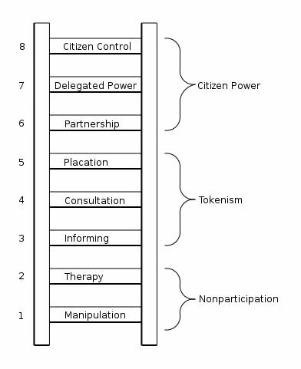
Democratization of processes and information
redrawn from Arnstein, SR. 1969. A Ladder of Citizen Participation. JAIP 35 (4): 216-224.
http://peoriachronicle.com/2006/11/15/arnsteins-ladder/

Slide 5
Critique of Arnstein
primarily concerned with power
creates a new hierarchy
“citizens” implies broad-based public inclusion
implies accountability and capacity to make complex decisions
implies inherent distrust of power elite
assumes all knowledge is equally valid
Tritter, Jonathan Quetzal and Alison McCallum. (2006). “The snakes and ladders of user involvement: Moving beyond Arnstein.” Health Policy Vol. 76: 156-168.

Slide 6
Absence of scientific literacy
general lack of literacy
lack of knowledge of simple scientific facts
misunderstanding of the scientific method
lack of understanding of the difference between science and research

Slide 7
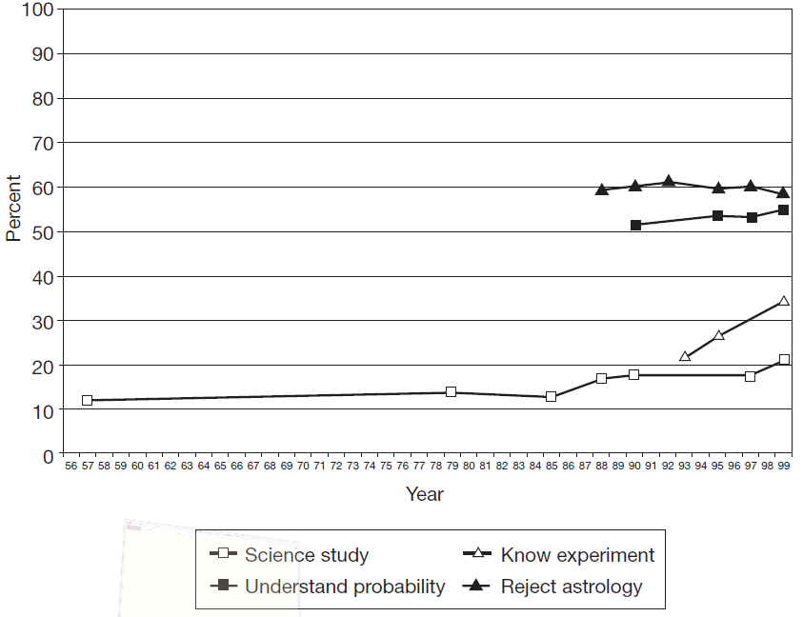
Miller JD. 2004. Public understanding of, and attitudes toward, scientific research: what we know and what we need to know. Public Understand. Sci. 13: 273-294.

Slide 8
Doctor “tells a couple that their genetic makeup means that they’ve got a one-in-four chance of having a child with an inherited illness.”
1. If they have only three children, none will have the illness.
2. If their first child has the illness, the next three will not.
3. Each of the couple’s children has the same risk of suffering from the illness.
4. If their first three children are healthy, the fourth will have the illness.

Slide 9
Miller JD. 2004. Public understanding of, and attitudes toward, scientific research: what we know and what we need to know. Public Understand. Sci. 13: 273-294.

Slide 10

Decline of trust and rise of cynicism
“This mindless tolerance, which places observable scientific facts, subject to proof, on the same level as unprovable supernatural fantasy, has played a major role in the resurgence of both anti-intellectualism and anti-rationalism.”

Slide 11
Decline of trust and rise of cynicism
“In a healthy democracy, every citizen has learned to exercise his or her own judgement. Clearly the right route for democracy is neither complacency or cynicism – it is sound critical judgement”
Stephan Dion. 1993-94 Winter. Rising cynicism: Who is to blame? Canadian Parliamentary Rev. pp. 33-35.

Slide 12
The Context: Individual decision-making
Increase in scientific literacy isn’t necessarily the solution
Individual ideology strongly influences decisions

Slide 13
Increase in scientific literacy isn’t necessarily the answer
“The idea seems intuitive: If people just had a better grasp of science, they would agree that climate change poses a serious risk to society. But that assumption doesn’t hold up, researchers have reported in Nature Climate Change. Instead of making people more concerned about the issue, scientific literacy makes them more polarized”
http://www.conservationmagazine.org/2012/05/flawed-logic/

Slide 14
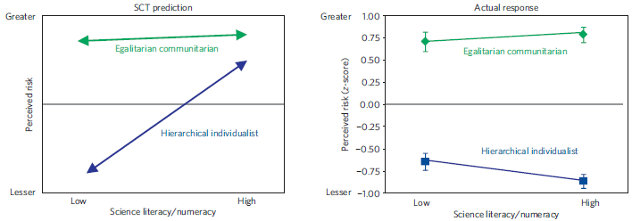
Individual ideology strongly influences decisions
Kahan et al. 2012. The polarizing impact of science literacy and numeracy on perceived climate change risks. Nature Climate Change doi: 10. 1038/nclimate 1547

Slide 15
Solutions for communicating science?
“… Effective strategies include use of culturally diverse communicators, whose affinity with different communities enhances their credibility, and information-framing techniques that invest policy solutions with resonances congenial to diverse groups”
Kahan et al. 2012. The polarizing impact of science literacy and numeracy on perceived climate change risks. Nature Climate Change doi: 10. 1038/nclimate 1547. p 3.

Slide 16

The Prince George Integrated Community Sustainability Plan

Slide 17
Solutions for communicating science?
Community of Practice
Visualizations

Slide 18
Community of Practice
Group of individuals interested in investigating a particular topic
  assumes democratic equality
  not necessarily decision-making
E.g. Citizen’s Assembly for a new voting system in BC
  public is less content with “elite” decision making
  lack of transmission of trust to the larger public

Slide 19
How best to communicate science into the PG ICSP
Three parts:
  Analysis of the best approach
  Visualizations
  Survey
Other project members: Loraine Lavallee, Scott Green, Ken Wilkening, Alvaro Palazuelos, Daniel Iwama

Slide 20
Visualizations
“Offering clear explanations of scientific data isn’t enough... Communicators also need to present information and policy options in a way that doesn’t clash with their listeners’ values” (http://www.conservationmagazine.org/2012/05/flawed-logic/)
Visualizations can present information in a neutral context that can be understood by non-scientists

Slide 21
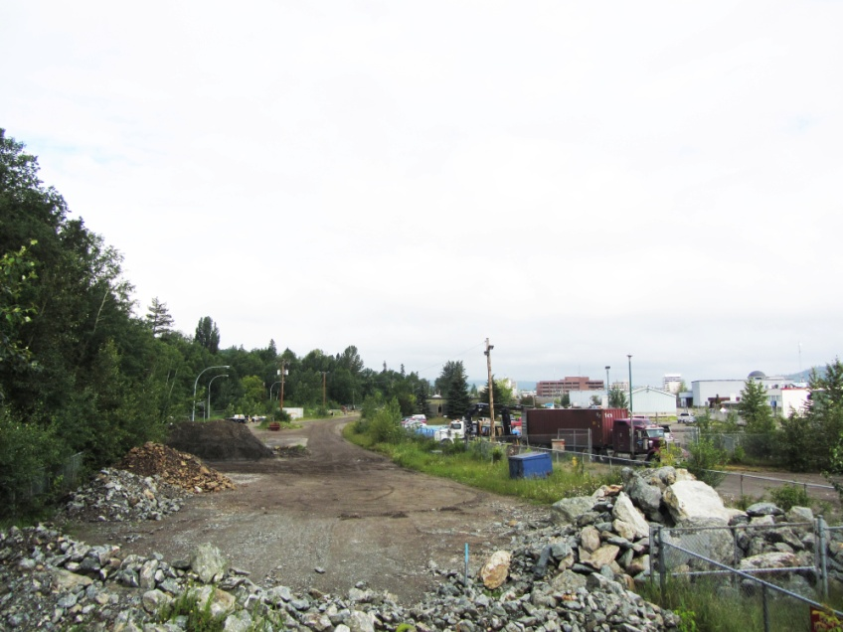

Slide 22
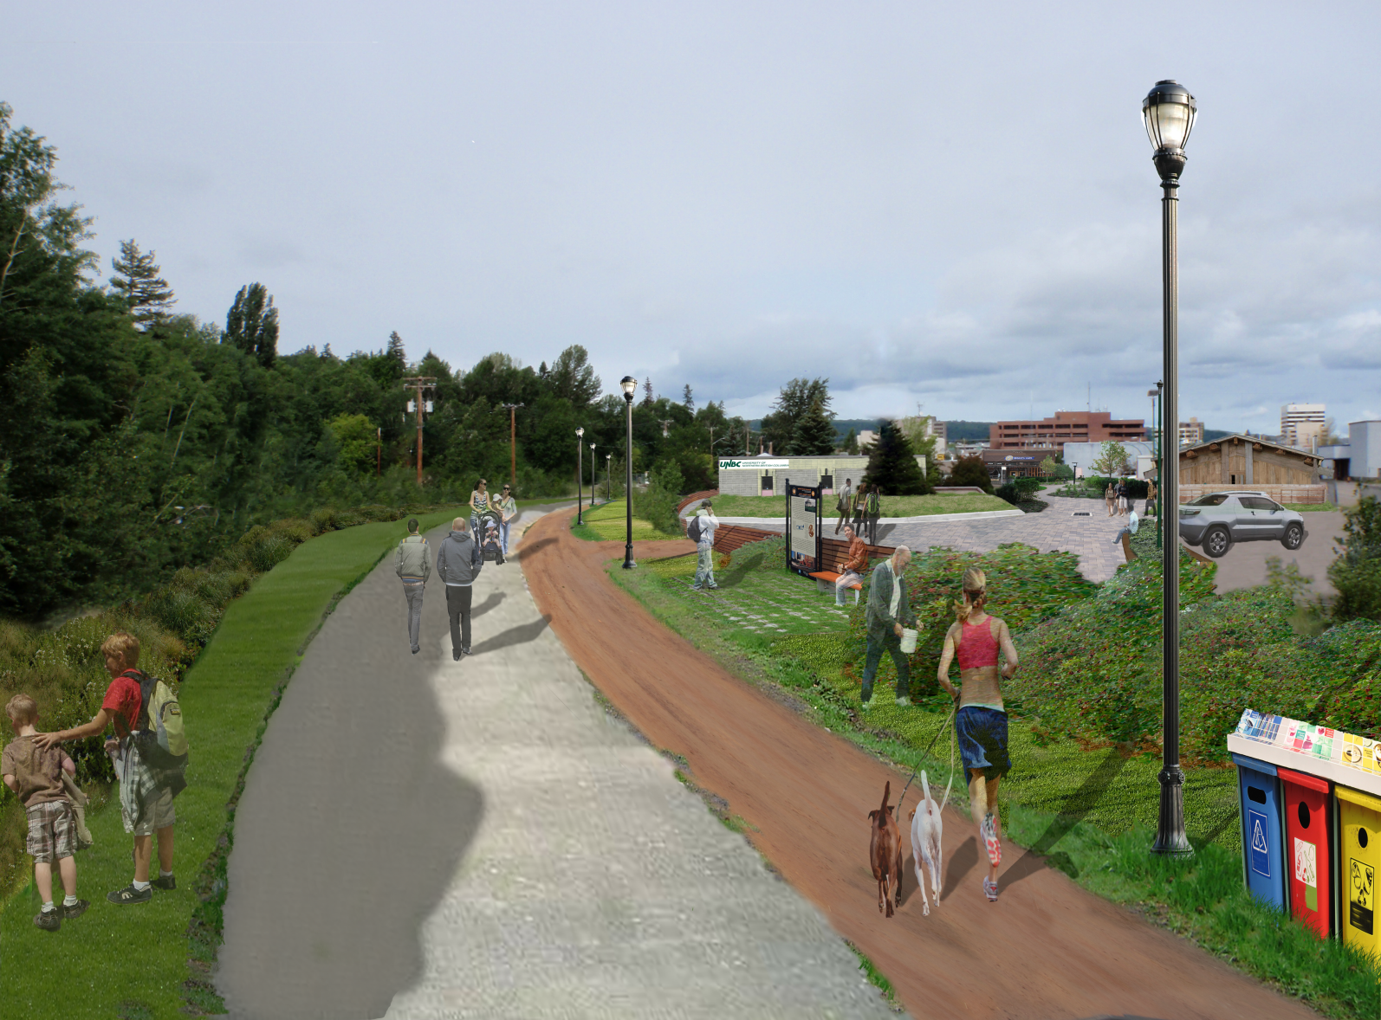

Slide 23
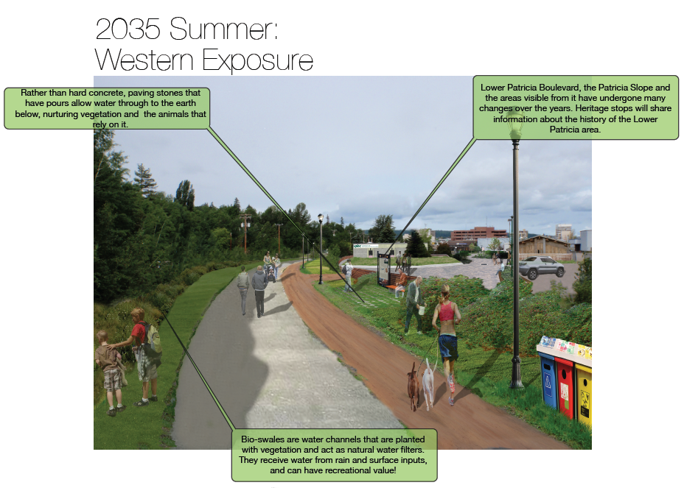
Historical Memory

Slide 24
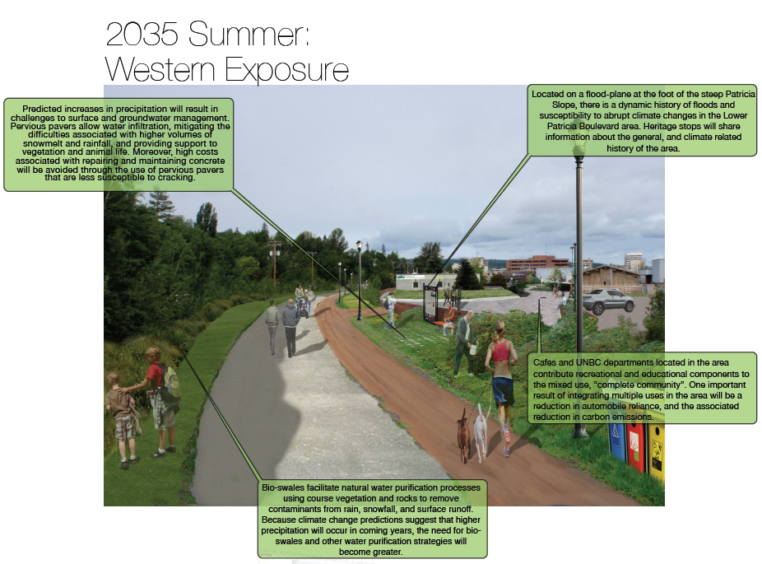
Science-based

Slide 25
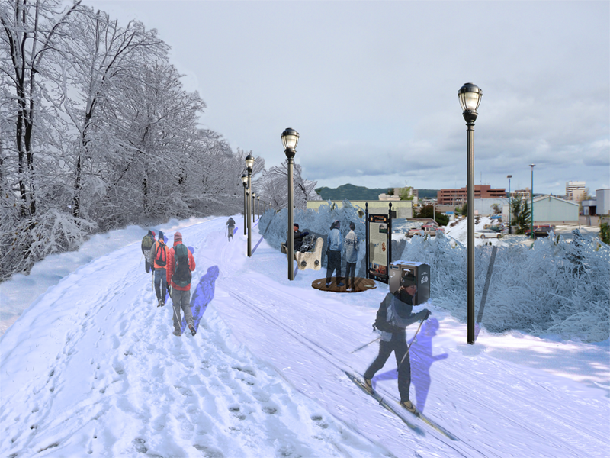

Slide 26
Visualizations to communicate science into the PG ISP
To briefly summarize the survey:
  There were significant differences in perception of the project between groups viewing visualizations and those who did not
  Both historical memory and science-based explanations were effective
  But the test group that viewed the science-based visualizations remembered more of the rationale for the landscape design features

Slide 27

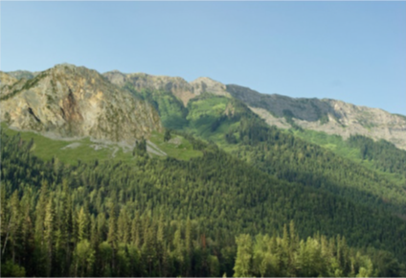
Examples

Slide 28
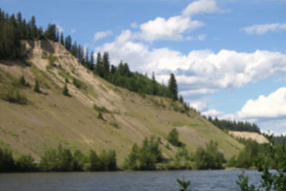
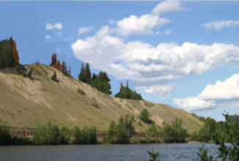
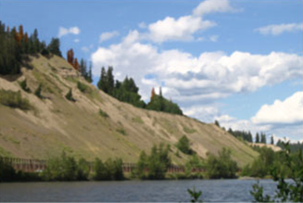
Examples

Slide 29
Communicating science
The solution is not to simply increase scientific literacy
The Pandora’s box of public participation has been opened so the public will expect to be consulted
The science must be presented in a meaningful yet neutral way that does not clash with individual values
We conclude that visualizations can satisfy these constraints

