Slide 1
Creating Growth & Yield Model Inputs Using Silviculture Information
FAIB Process Overview
Forest Analysis and Inventory Branch
Sept 23, 2020
Notes:
Collaborative effort between FAIB and RPB

Slide 2
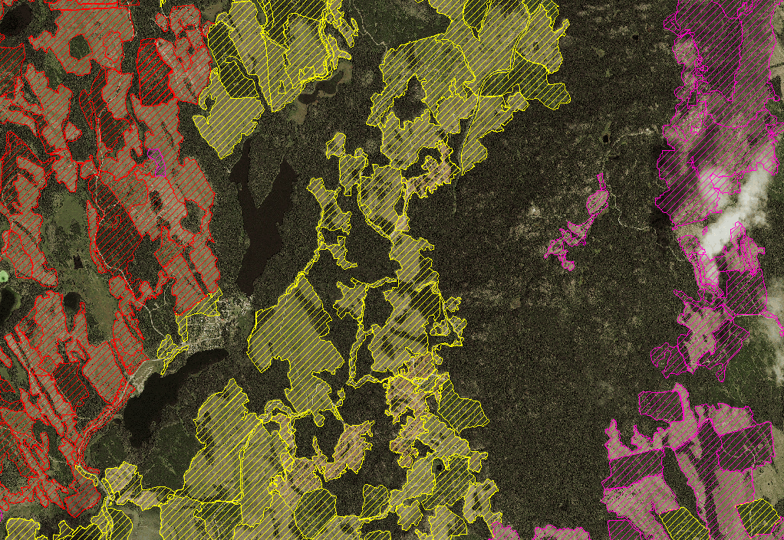
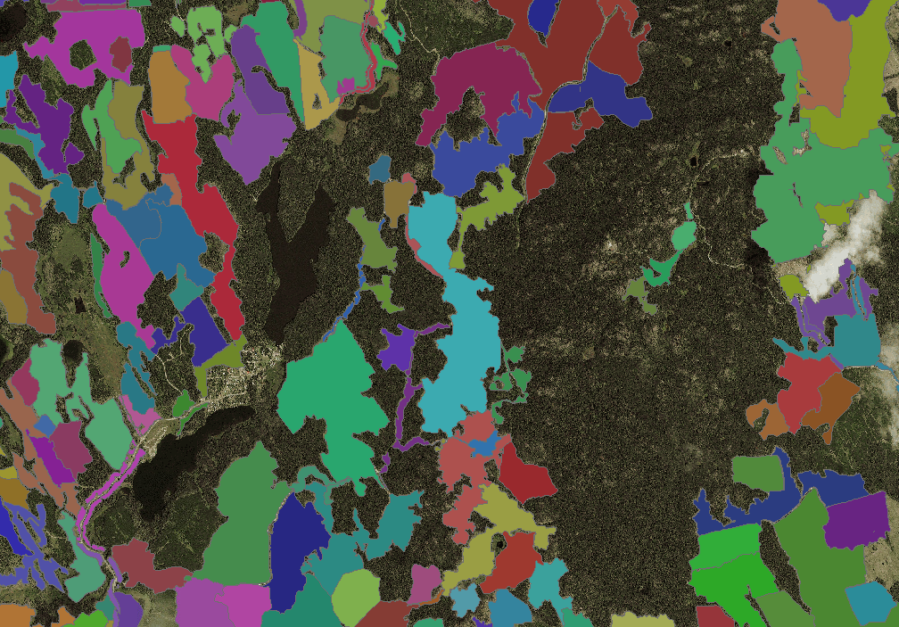
  Past Approaches:
analysis unit based: species/site index grouping
aggregate values extracted from various sources
  Planted density
  Planted species
BEC summarized
  Analysis Unit Based
  RESULTS Opening Based
Notes:
Past approaches tended to be generalized
Silviculture information came from Region / District staff input or
was derived in some aggregate manner from RESULTS
Site index tended to come from the Site Productivity Tile
Analyst’s choice / Highly aggregated / Unit specific

Slide 3
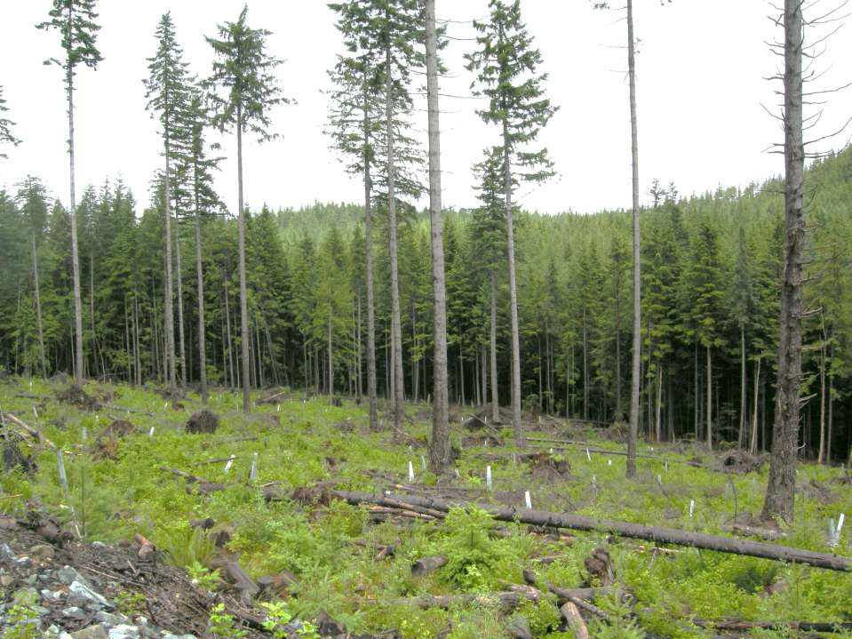
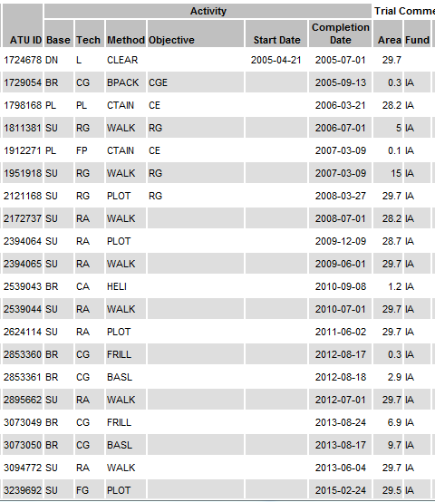
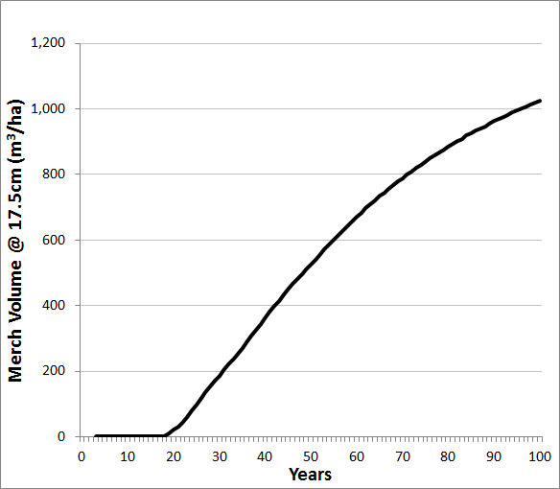
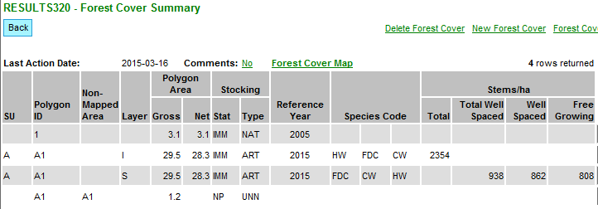
Present Approach
Other Information
Sources
Silviculture Survey
(field data)
Silviculture Reporting
(RESULTS)
GY Model Inputs
Yield Curve
Notes:
Data mining from Results
Results was intended to track obligation.
Not intended to feed information into GY models.

Slide 4
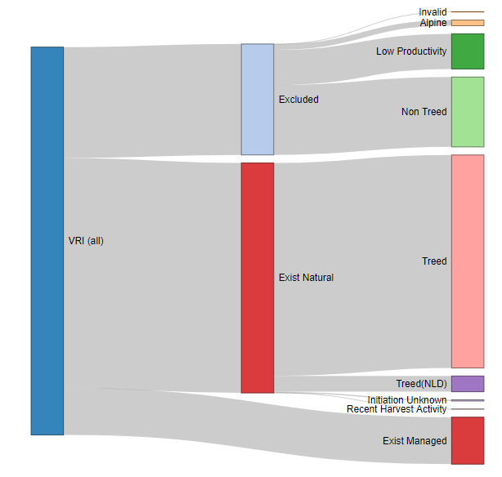
Notes:
Distinguish Exist natural vs Exist managed
Exist managed includes both planted and naturally managed stands.
Distinguished by where we can link via an opening to RESULTS data.
This shows the proportion of stands that have been classed as managed.

Slide 5
Forest Health
Damage agent prevalence
DSC, DSG
Planting Information
Opening
Planted Species Composition
- Planted Density (initial)
- Planted Genetic Worth
- Planting delay
Survey Information
Opening
Survey Species Composition
Survey Density
ADJUSTED FOR
- Planted Species Composition
- Planted Density (adjusted)
GY Model Inputs
- Tipsy
SPAR
- Genetic Worth
Site Productivity Layer
-Site Index by species
Yield Tables
RESULTS Planting
- Opening based
- Number Planted (Species)
- Area Planted (Species)
RESULTS Forest Cover INV (Survey)
- Opening based
- Natural Species Composition
- Density (at survey, total sph)
TSR
Notes:
Process view of Results data extraction
For stands with link to RESULTS
Note DOES not use Silv layer, well spaced or free growing stems.
Uses inventory total stems. (Required by GY models)
Note that forest health is used at a later stage of the process.
SPAR: Seed Planning and Registry Application

Slide 6
GY Model Inputs: Planted Stands
 | Attribute Name | Description
VRI Link | Opening | Links the RESULTS Opening to the VRI
Planted Component | Species | Planted Species (up to 5)
 | Density | Planted Density for each Species (Stems/ha)
 | Genetic Worth | Genetic Worth Rating for each Species
 | Planting Delay | Planting Delay (years)
 | Planting Percent | Proportion of the Stand Planted (%)
Natural Component
Other | Stand Age | Stand Age (Years)
 | BEC Zone | Biogeoclimatic Zone
 | BEC Subzone | Biogeoclimatic Subzone
 | SI | Site Index (m) by Species
 | OAFs | Adjustment Factors
Notes:
Basic information required to generate a yield table:
Planted component
Species composition
Planted Density
Genetic worth
Planting Delay
Site index
Density is based on the total number of planted stems

Slide 7
GY Model Inputs: Natural Component
 | Attribute Name | Description
VRI Link | Opening | Links the RESULTS Opening to the VRI
Planted Component
Natural Component | Species | Natural Species (up to 5)
 | Density | Total Density for each Species (Stems/ha)
Other | Stand Age | Stand Age (Years)
 | BEC Zone | Biogeoclimatic Zone
 | BEC Subzone | Biogeoclimatic Subzone
 | SI | Site Index (m) by Species
 | OAFs | Adjustment Factors
Notes:
Natural component
Surveyed Species composition
Total Density
Site Index

Slide 8
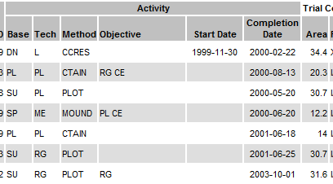
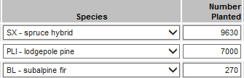

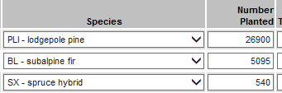

  Planted Inputs: Planting Species, Density and Genetic Worth
    Where more than 1 planting treatment is recorded, weighted totals are used.
SPAR
GW
3
0
0
7
0
12
Opening_ID | Species |  |  | Density |  |  | Genetic Worth
 | 1 | 2 | 3 | 1 | 2 | 3 | 1 | 2 | 3
122345 | PLI | SW | BL | 988 | 297 | 156 | 5.6 | 3.5 | 0.0
Notes:
Opening can have 1 or more activities related to planting
Need to derive a weighted species composition, a weighted density by species and weighted GW by species.
Attributes are weighted based on their contribution.
One of the basic assumptions is that activities are independent.
In this case, 20.3 ha was planted, then 14 ha was planted = 34.3 total

Slide 9
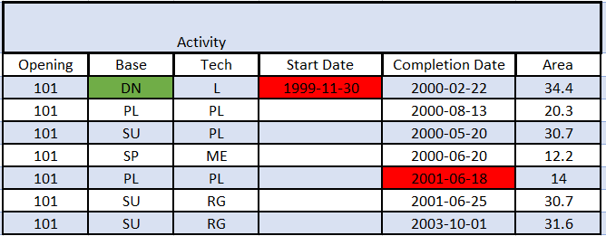
  Planted Inputs: Planting Delay
Opening_ID | Species |  |  | Density |  |  | Genetic Worth |  |  | Planting Delay
 | 1 | 2 | 3 | 1 | 2 | 3 | 1 | 2 | 3
122345 | PLI | SW | BL | 988 | 297 | 156 | 5.6 | 3.5 | 0.0 | 2
Notes:
Planting Delay is calculated: start date compared to planting completion date
Where more than one activity:
Start date: use largest area
Planted Date: latest treatment
Test for reasonable

Slide 10
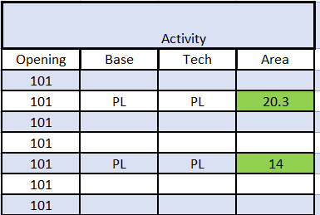
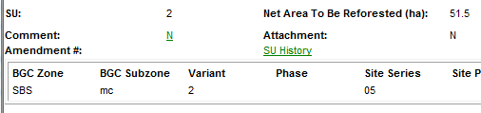
  Planted Inputs: Planting Percent
Opening_ID | Species |  |  | Density |  |  | Genetic Worth |  |  | Planting Delay | Planting Percent
 | 1 | 2 | 3 | 1 | 2 | 3 | 1 | 2 | 3
122345 | PLI | SW | BL | 988 | 297 | 156 | 5.6 | 3.5 | 0.0 | 2 | 68%
Planted Area = 34.3ha
NAR = 51.5ha
Notes:
-area planted divided by the sum of the net area to be reforested (NAR).
-capped at 100%.
-If planted 90-100% of the NAR area, the opening is assumed to be 100% planted.
-If planted is <10% of the NAR area, the opening is assumed to be 0% planted. (natural)
mixed plant/natural are directly modelled in Tipsy.
Otherwise, an opening is either a planted OR a natural stand.

Slide 11
  Planted Inputs: Validation
    The following rules are in place to flag invalid records:
    The density planted needs to be > 500 stems/ha and < 3,000 stems/ha
    Check for missing values
    Fill plants and replants are not included
    To be classed as managed planted, the disturbance start date of the largest treatment unit must be after April 1, 1987
Notes:
Validation checks that each opening has the required information to generate a yield table.
Where information is missing (or extreme) the problem is flagged for review.
If density is outside parameters, gets sent to RPB for checking
Fill plants and replants are not included
Pre 1987 are treated as a managed natural using Tipsy.
These stands had no reforestation obligation.
Previous TSRs used VDYP for these stands.
Managed Natural in Tipsy basically revises the spacing from even to random.
It is still a managed stand.
Planting Validation:
treatment area missing
missing NAR
missing number planted
planting not linked to ATU
planted species NULL
density < 500 or density > 3000

Slide 12
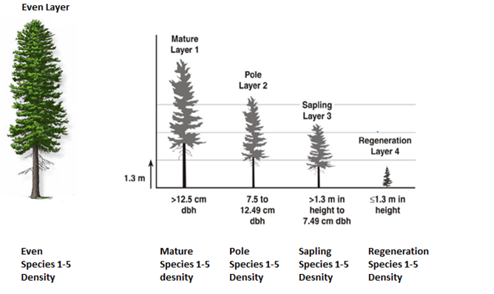
Natural Inputs: Natural Species and Density
Layered Data
Notes:
In addition to looking at planted information, also look at inventory survey information.
What has changed since planting.
Assess all layers and all forest cover polygons.
Remove those components that don’t contribute.
Derive a weighted stand description for yield purposes.
Residuals (retained overstory) are ignored. Age > 50 , sph < 300
SILV layers are ignored
Assess layers to looking for uneven aged stands

Slide 13
Natural Inputs: Retention
Retention:
Grouped Retention is identified by opening without harvest date in initial VRI assessment
Retention of this type will be assigned a VDYP yield curve
Dispersed retention:
  Residual (single layer)
  Multi-layer
Notes:
If part of the opening is a reserve, then that part gets assigned a VDYP curve.
Rest uses a MSYT.

Slide 14
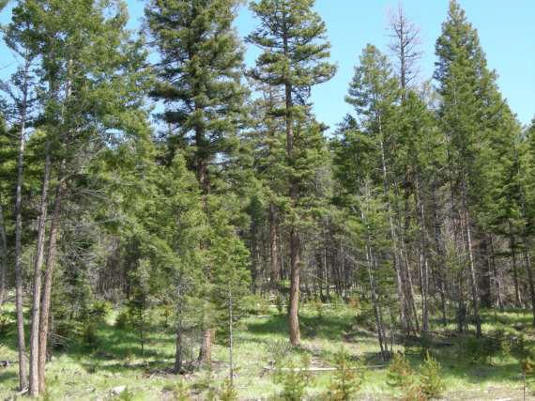
  Multi Layered Stands:
    Multi-layered stands are a challenge because stands with a well stocked understory and a minimal overstory should be modeled as even-aged while complex multi-layered stands should be modeled differently. The challenge is finding a set of rules to split stands into the 2 populations.
even-aged
complex
Notes:
While we are assessing FC layers, also try to identify uneven aged stands
Multi layered, multi cohort, complex
Mix of ages and heights that are not similar.
in the future, TASS will be used to model all “layers”
Today we simply tag for the analyst.

Slide 15
  Adjusting Species Composition.
  Use forest cover survey data to update planted species composition.
  Account for planted species mortality.
  When planted numbers too low, can revert to natural
  Ingress
  Keep track of ingress by species
  Identify scale of concern: Aspen in Pine stands
Notes:
In the perfect world we would model plant and natural together in one model. TASS
However, We can come up with an adjusted composition by looking at the plant and natural components.
Partial planted species mortality
Complete planted species mortality
If density drops too low, can revert to managed natural
Coast: 400, Interior: 600
Can’t model ingress in Tipsy, but can see where it is of significance.
Need TASS3 for this.
This are will be under study by the GY section.

Slide 16
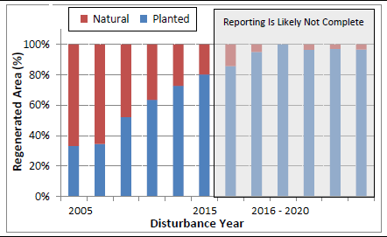
  Future Managed Stands
    Aggregate species composition:
      Based on “current performance”
      10 year average
Using 2020 as the analysis date
Notes:
Existing natural stands don’t have RESULTS data.
Need to build a representative curve for these stands once they are harvested.
Use current performance that defines average future management conditions.
Aggregate species composition based on existing management information.
Use 10 year average.
Ignore the latest 5 years as reporting to RESULTS is not likely completed.
Look at the inputs for planted stands between 2005 – 2015
Extract this data from the tabulated data for planting and natural

Slide 17
  Future Managed Stands
    Stand aggregate represents current practice for each BEC Zone and Subzone :
      Planted Species comp, planting density, GW, planting delay
      Natural Species composition
      Weighted by planting history for the unit
    Aggregate species composition assigned to each stand
    Stand specific Site index comes from the provincial site productivity layer.
Notes:
Using bec zone/subzone for high level grouping
Weighted Planted species and weighted natural species
Derive the current planting practice percent based on TSA.
Aggregate species composition combined with stand specific site index.
Unit (TSA) specific plant natural combination.

Slide 18
RESULTS data driven approach (provincial)
Consistency
Transparency
reflecting what is seen in the field
relying on RESULTS data
More robust validation process
Specific/Unique Yield curve input for each stand in the THLB
Notes:
2017 moved away from analyst’s choice
Results
Assuming that reporting is correct but validating as well
Monitoring is key
KEY Point: What is in results is what will be used to derive a yield curve
dawson, okanagan (previous)
macKenzie, kootenay lk, nass, north island and kispiox (current)
Quesnel, 100 Mile, Lillooet, Soo, Sunshine Coast, Revelstoke (this year)
Checking each unit as we go.

Slide 19
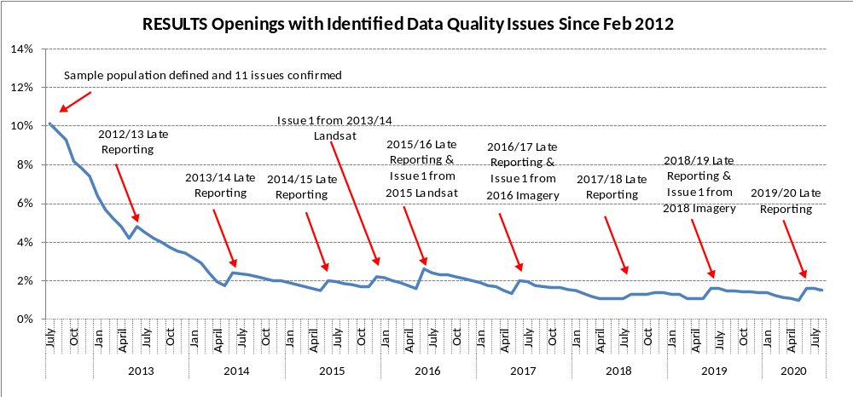
  RESULTS Monitoring and QA:
    Focused on the elements used in the growth & yield input development.
    Continued support is critical.
Notes:
the number of high priority RESULTS data quality issues was reduced from 19,553 (11.3%) to 3,464 (1.5%)

