Slide 1

Survey and Update of Backlog/NSR
in the
Mackenzie & Dawson Creek TSA’s
Anna Monetta, RPF
Silviculture Specialist - Omineca Region
Ministry of Forests Lands and Natural Resource Operations
March 8, 2012

Slide 2
Objective:
  To review backlog NSR areas created prior to October 1, 1987, and either
    Reclassify polygons as SR that meet specific conditions, or
    Plan reforestation treatments to be completed prior to January 2015.

Slide 3
Work Process
Planning
    Identify Project Openings
    File Review
    Flight Planning
    2. Aerial Survey
    Confirm and/or update stratification
    Update labels
    Opening/strata photographs
          3. Reporting
                Summarize data
                Update RESULTS

Slide 4
Work Standards:
    NSR Review Procedures, June 24, 2010
    FFT Stocking Standards Policy, August 15, 2007
    RESULTS Information Submission Specifications
    District or Regional guidance
        Local conditions
        Forest management objectives and considerations
        Treatment feasibility

Slide 5
Step 1. Planning
  Identify project opening population
    Obtain the latest spreadsheet for NSR on http://forestsfortomorrow.com/fft/node/628
    Filter openings in Microsoft Excel applicable to project or management unit
    Using GIS conduct a coarse filter netdown removing openings wholly within Parks, Private Land, area based tenures etc.
    Create list of project openings.

Slide 6
Step 1. Continued
  Conduct Office File review
    Obtain hard copy Opening Files.
    Locate opening in MapView.
    Review potential conflicts (landuse, tenure, other resources etc.) .
    Record geographic centre point of opening for flight plan.
    Make a Sketch Map on Ortho photo of the opening with stratum lines and stratum inventory and silviculture labels.
    Schedule opening for aerial survey.

Slide 7
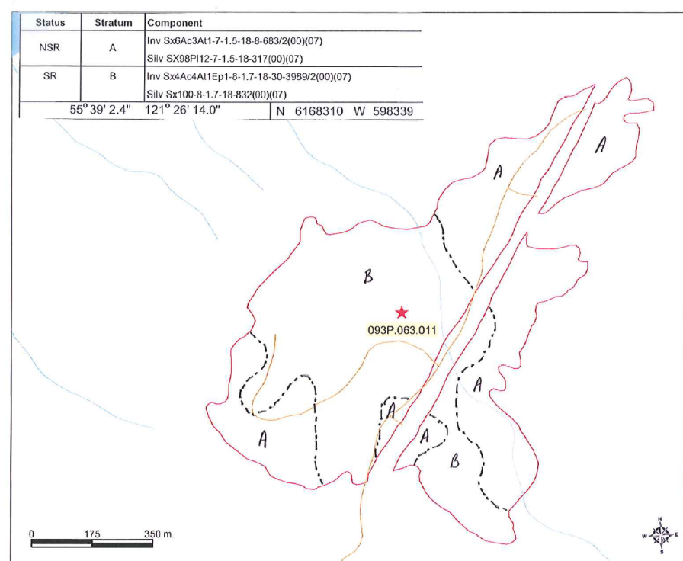
Step 1. Continued
  (5) Make a Sketch Map with stratum lines and stratum inventory and silviculture labels.

Slide 8
Step 2. Aerial Survey
Conduct aerial survey
  Create flight plan using opening coordinate centre points
  Conduct aerial survey using GPS control for navigation
  Use the Sketch Map to guide update of polygon shapes and labels; specifically:
    species composition,
    species %,
    heights, and
    crown closure.
  Photograph each stratum
  If opening cannot be adequately assessed or their current status cannot be easily determined from air, go to step 5.

Slide 9
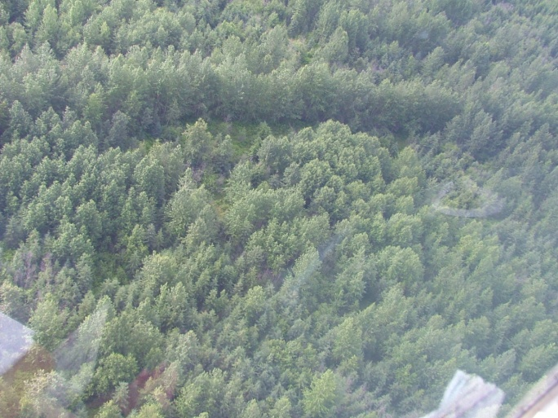

Step 2. Aerial Survey continued

Slide 10
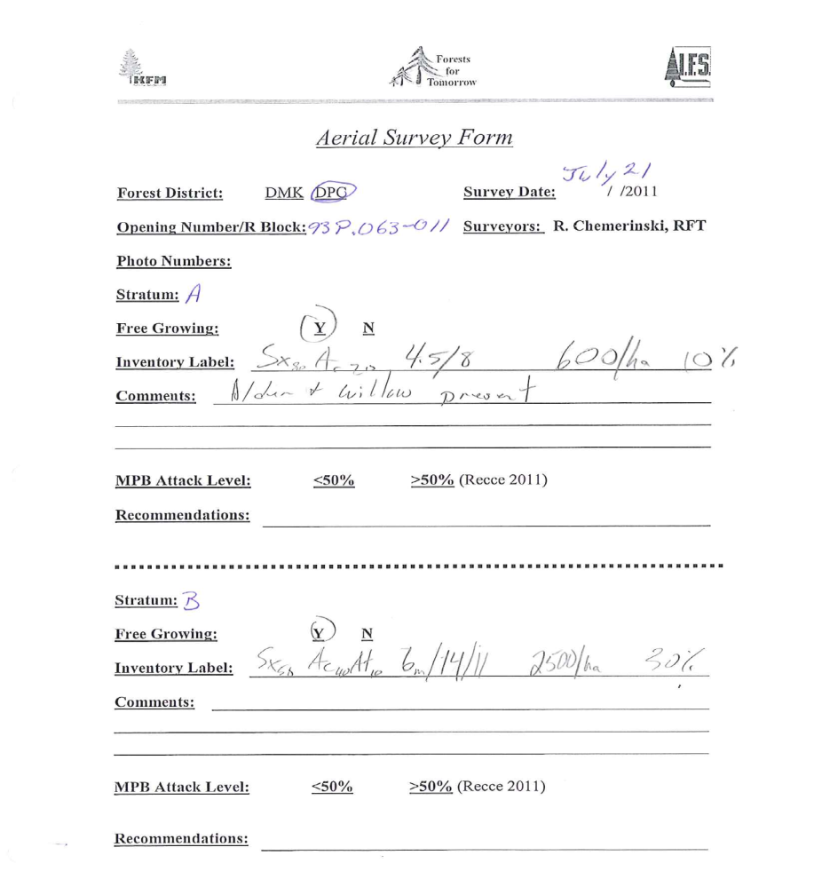
Step 2. Aerial Survey continued
Aerial Survey Form
Strata A and B

Slide 11
Step 3. Reporting
Update Spatial Data
  Using project Ortho in MapView digitize new spatial for
    Opening boundary if existing spatial information is inaccurate.
    Forest cover strata including road NP and natural NP (wetlands etc).

Slide 12
Step 3. Reporting Continued
Summarize tabular data
  Create summary spreadsheet containing
    opening
    standards units
    forest cover labels records from aerial survey
        update ages based on previous survey
        update site index based on SIBEC (2011)

Slide 13
Step 3. Reporting Continued
Update RESULTS
  Update RESULTS standards unit ID’s for each opening to ensure a 1-to-1 match between the SU’s and forest cover updates.
  Link tabular forest cover data and spatial polygons and create XML files.
  Upload XML files through ESF.
  Attach .pdf reports (survey summary or free growing milestone declaration report with color photographs (photos are optional but recommended) of each opening standards unit / stratum.
  Enter milestone declaration if applicable
  Enter completed survey activity into RESULTS
  RESULTS quality assurance

Slide 14
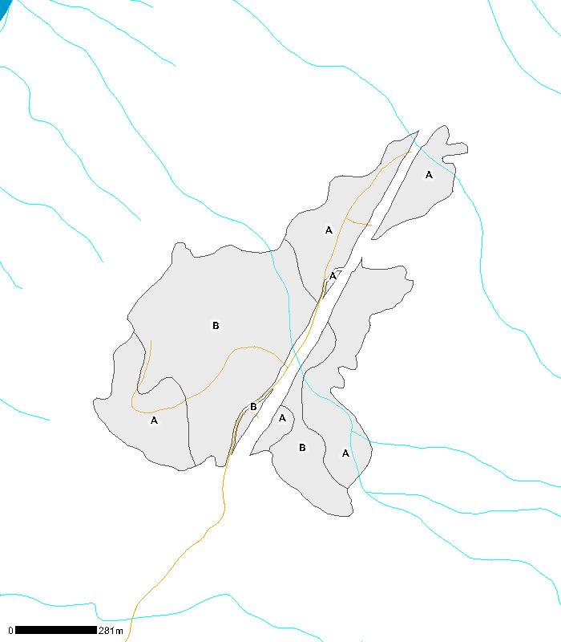
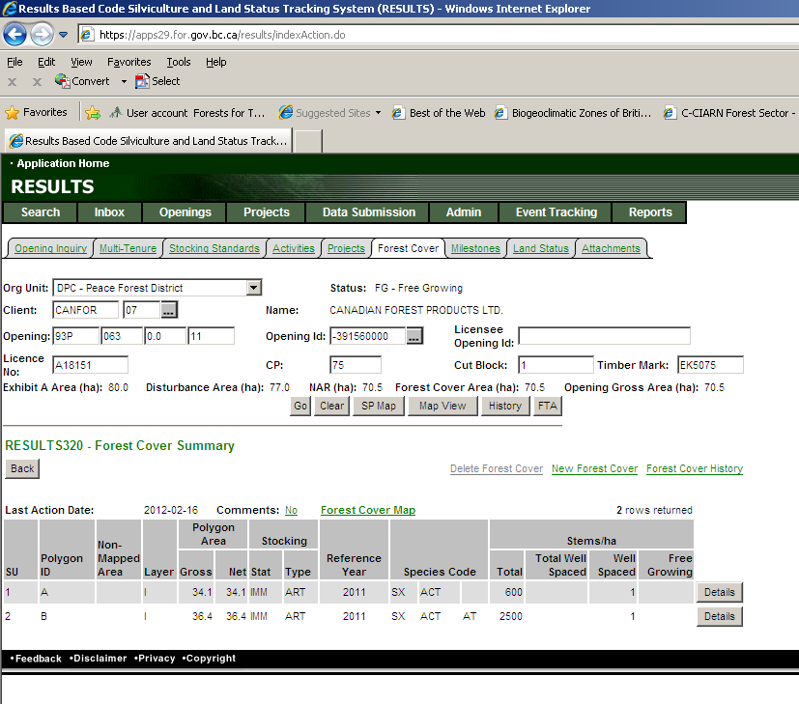
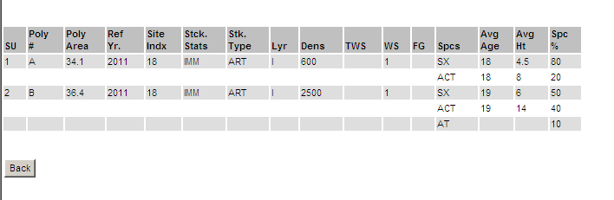

Slide 15
Step 5. Ground Surveys
For openings that cannot be adequately assessed from air schedule and/or ground survey:
  Normally < 10% of total project area.
  Conduct ground survey and RESULTS updates as per normal FFT procedures.

Slide 16
Project Costs
  File Review ≈ $1.30 / ha
  Aerial Survey ≈ $3.40 / ha
  Reporting and Results ≈ $3.40 / ha
  ≈ $6.80 / ha
  Ground Survey ≈ $25 - 50 / ha depending on economy of scale and access.

Slide 17
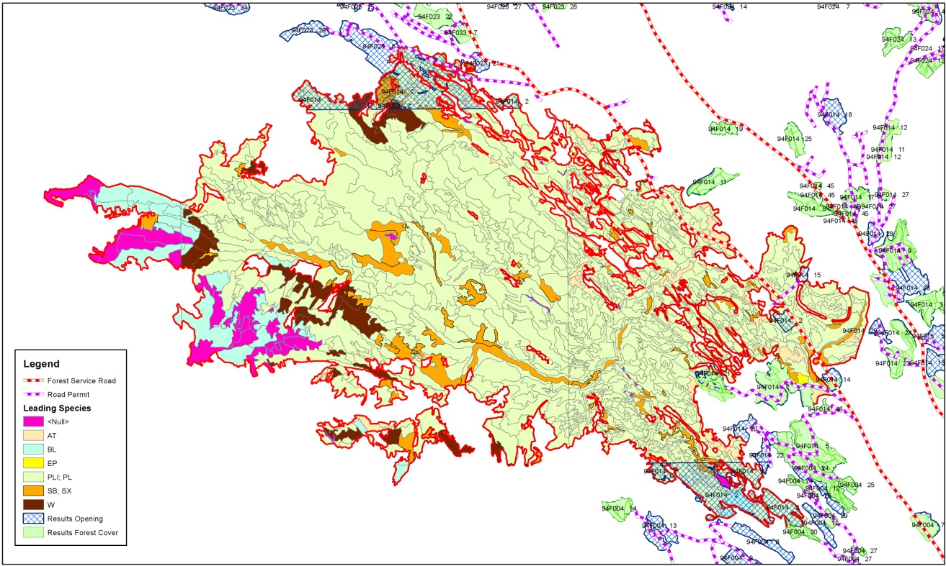
Older backlog openings resulting from wildfire disturbance.
  Accept VRI data and update RESULTS forest cover.

Slide 18
Feedback and Comments from District Staff
Feedback and Comments from District Staff
Feedback and Comments from District Staff
Acknowledgements
FFT Recipients
  Industrial Forestry Service Ltd.
  Kim Forest Management Ltd.
  Erafor Forestry Ltd.

