Slide 1

Wildfire Management and FFT Opportunities for Collaboration
Kelly Osbourne
Fire Management Planning Forester / Officer
Wildfire Management Branch
Victoria BC

Slide 2

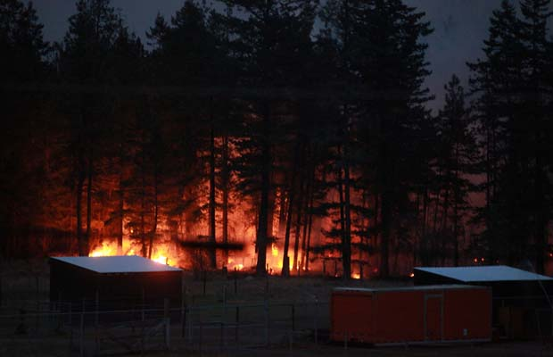
Presentation
Strategic Direction
Wildfire Trends
Landscape Fire Management Planning
Collaboration Opportunities

Slide 3
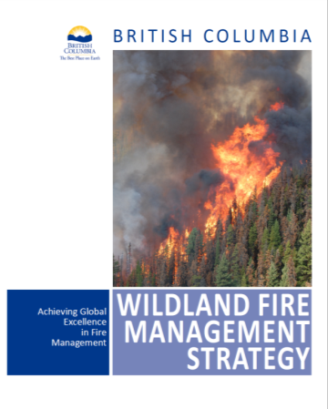
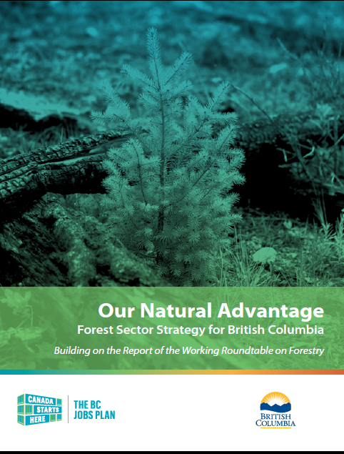
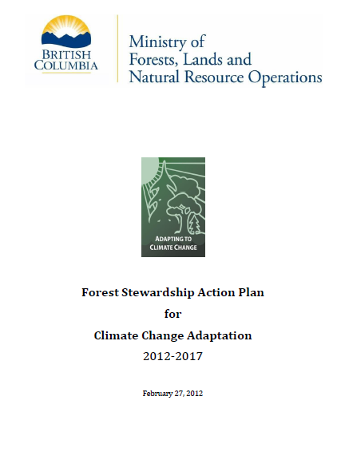
Strategic Direction
The BC Wildland Fire Management Strategy
Forest Sector Strategy for BC 2012
The BC Forest Stewardship Action Plan for Climate Change
Notes:
The BC Wildland Fire Management Strategy
Framework for achieving fire resilient landscapes, fire adapted communities, landscape-level wildfire planning and focussed interagency coordination
Forest Sector Strategy for BC 2012
Strengthen management of wildfire community interface - the Province will implement landscape fire management planning which identifies landscape level wildfire threats and sets objectives to mitigate them.
The BC Forest Stewardship Action Plan for Climate Change
Objective 2.2 Manage risks and capture opportunities - Build fire-resilient landscapes: conduct landscape wildfire risk assessments, and implement treatments on priority areas.

Slide 4
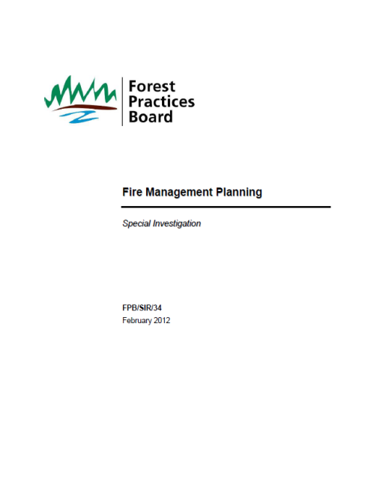
Strategic Direction
Forest Practices Board Report – February 2012
Make fire management planning a high priority and quickly move to prioritizing values and defining where fire is wanted or unwanted
Strengthen collaboration between WMB, land management staff and others, such as FN
Implement digital delivery of information for fire management planning
Notes:
Made three recommendations with regard to fire management planning:
Government make fire management planning a high priority by ensuring current plans are up-to-date . This should include prioritizing values and defines where fire is wanted or unwanted, and under what circumstances.
WMB and land management staff collaborate to refine the current Fire Management Plan model to focus on information important to fire managers while remaining simple and easy to access.
WMB implement the digital delivery of geographic and land management information for fire management planning.

Slide 5
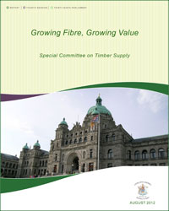
Strategic Direction
The Committee recommends to the Legislative Assembly that the Ministry:
Continue to fund strategies and activities for the reduction of fuel in the wildland-urban interface.
Ensure that tenure holders help to manage fuels across the broader forest landscape in addition to the urban interface.
Work closely with tenure holders by linking its fuel management programs to type 4 silvicultural strategies.

Slide 6
Wildfire Trends in British Columbia
BC Wildfire Management New Reality
Notes:
As we move forward, the impacts of extreme wildfire events and associated losses of communities, critical infrastructure and natural resource values are predicted to continue.
Although 2011 and maybe 2012, have had less fire impact, the graph paints the picture of a greater frequency of large impact fire years.
Steadily Increasing Suppression Costs
Hotter, drier summers and longer fire seasons (climate change)
$400M in 2009 and $200M in 2010
Steadily Increasing Complexity on Landscape
MPB generated fuel types - repeated evidence in BC of crown fires in red/grey fuel types (2010)
Expanded interface on the landscape
Widespread threat taxes capacity - 2003 BC 22 communities, 2011 AB 23 communities
More critical infrastructure on the landscape (IPP’s, O&G)
Impacts increasing
Slave Lake estimated 2nd biggest insurance payout in Canadian History
Air quality, public safety, evacuations
Loss of economic revenues, infrastructure
Impacts to watersheds and other natural resources
Loss of timber supply and silviculture investments

Slide 7
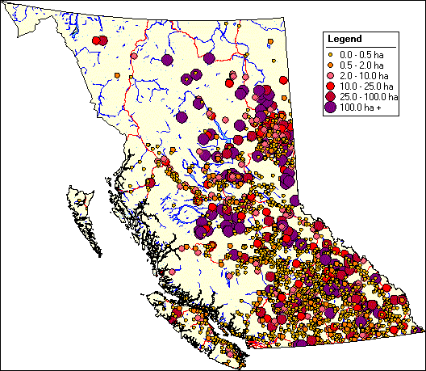
Map showing location and magnitude of wildfires in BC, 2006².

Slide 8
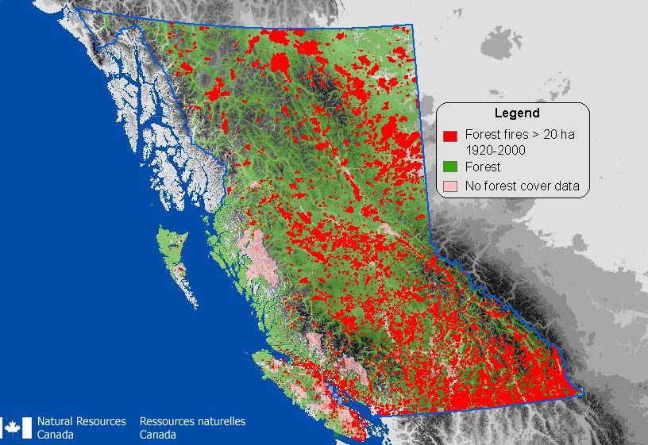
Spatial distribution of British Columbia fires >20 ha from 1920 to 2000.
Notes:
Nearly the entire vegetation landscape of British Columbia is shaped by wildfire.
The wildfire regime of a place is determined by the frequency, intensity, extent, and seasonality of wildfire, and especially the variability in those components.
First, the specific fire history of an individual site influences the species that are able to persist at that site, the availability of light and nutrients, the quality of the substrate, and the distance to propagules.
Second, variability in the fire regime across the landscape gives rise to environmental heterogeneity across the landscape.
For example, frequent low-severity fire favours the establishment of species like ponderosa pine (Pinus ponderosa), that have fire-resistant bark. Infrequent stand-replacing fire favours species that are shade intolerant, such as Douglas-fir (Pseudotsuga menziesii) (in coastal BC) or lodgepole pine (Pinus contorta) (in the interior).

Slide 9
Wildfire Trends in British Columbia – “Fire will play a role on the landscape managed or otherwise”
Steadily Increasing Suppression Costs
  Hotter, drier summers and longer fire seasons (climate change)
  $400M in 2009 and $200M in 2010
Steadily Increasing Complexity on Landscape
  MPB generated fuel types - repeated evidence in BC of crown fires in red/grey fuel types (2010)
  Expanded interface on the landscape
  Widespread threat taxes capacity - 2003 BC 22 communities, 2011 AB 23 communities
  More critical infrastructure on the landscape (IPP’s, O&G)
Impacts increasing
  Slave Lake estimated 2nd biggest insurance payout in Canadian History
  Air quality, public safety, evacuations
  Loss of economic revenues, infrastructure
  Impacts to watersheds and other natural resources
  Loss of timber supply and silviculture investments
Notes:
Fire seasons now regularly taxing resources
In 2009 over 2,500 national & international staff to supplement our resources
Options to expand response resources are limited
Internal expansion and focus growing local resources
Expensive
May not be effective in extreme fire situations
10 yr avg. $65M to >$200M
213 WUI fires in 2009, >300,000 ha burned in 2010

Slide 10
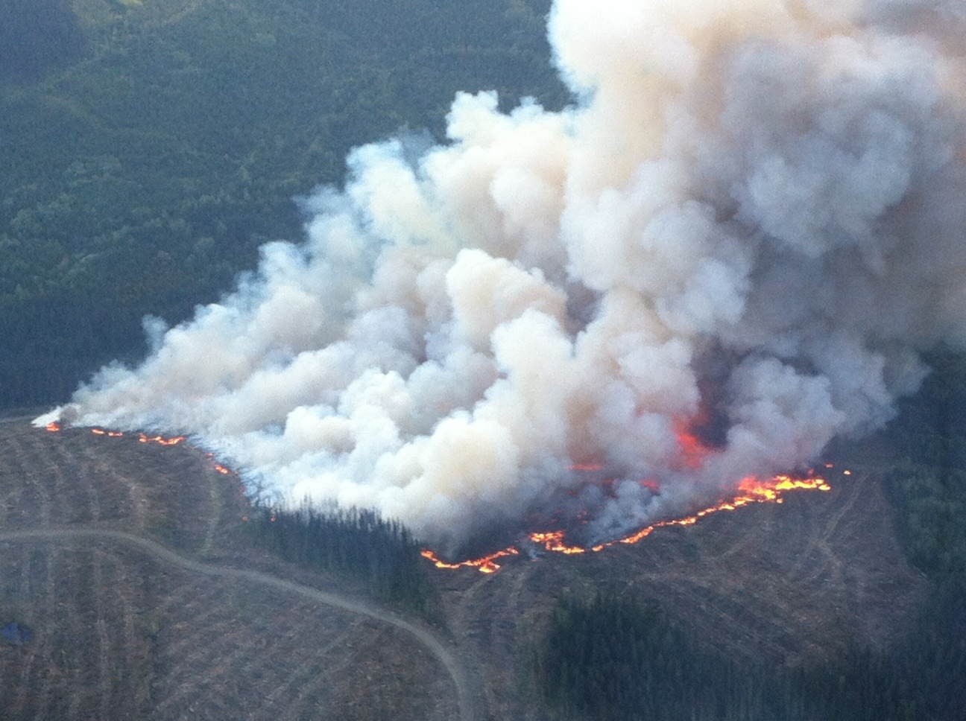
Landscape Fire Management Planning
Why? - To create a more fire resilient landscape to mitigate fire impacts on priority values in an era of increasing fire hazards and risks.
Notes:
2012 Fire in cut to length slash – with surrounding damp timber.
Requires a provincial level commitment within the Natural Resources Sector to create a framework that can then be implemented by the Land Manager at the District level.
Landscape fire planning and management benefits include,
Less severe impacts to Communities, public and private infrastructure during fire season
Reduced risk of high severity fires and subsequent damage to community watersheds and water sources
Reduced risk to ranching grasslands, and associated infrastructure
Increased security of timber. fiber, reduced risk to investments

Slide 11
Landscape Fire Management Planning what does it do?
Identify strategic zones where high hazard (high fire potential and consequence) areas can be mitigated through priority fuel modification or fire mitigation treatments.
Identify larger areas on the land base where prescribed fire and modified response will play a role in restoring fire dependent ecosystems and creating natural fire breaks over the long term

Slide 12
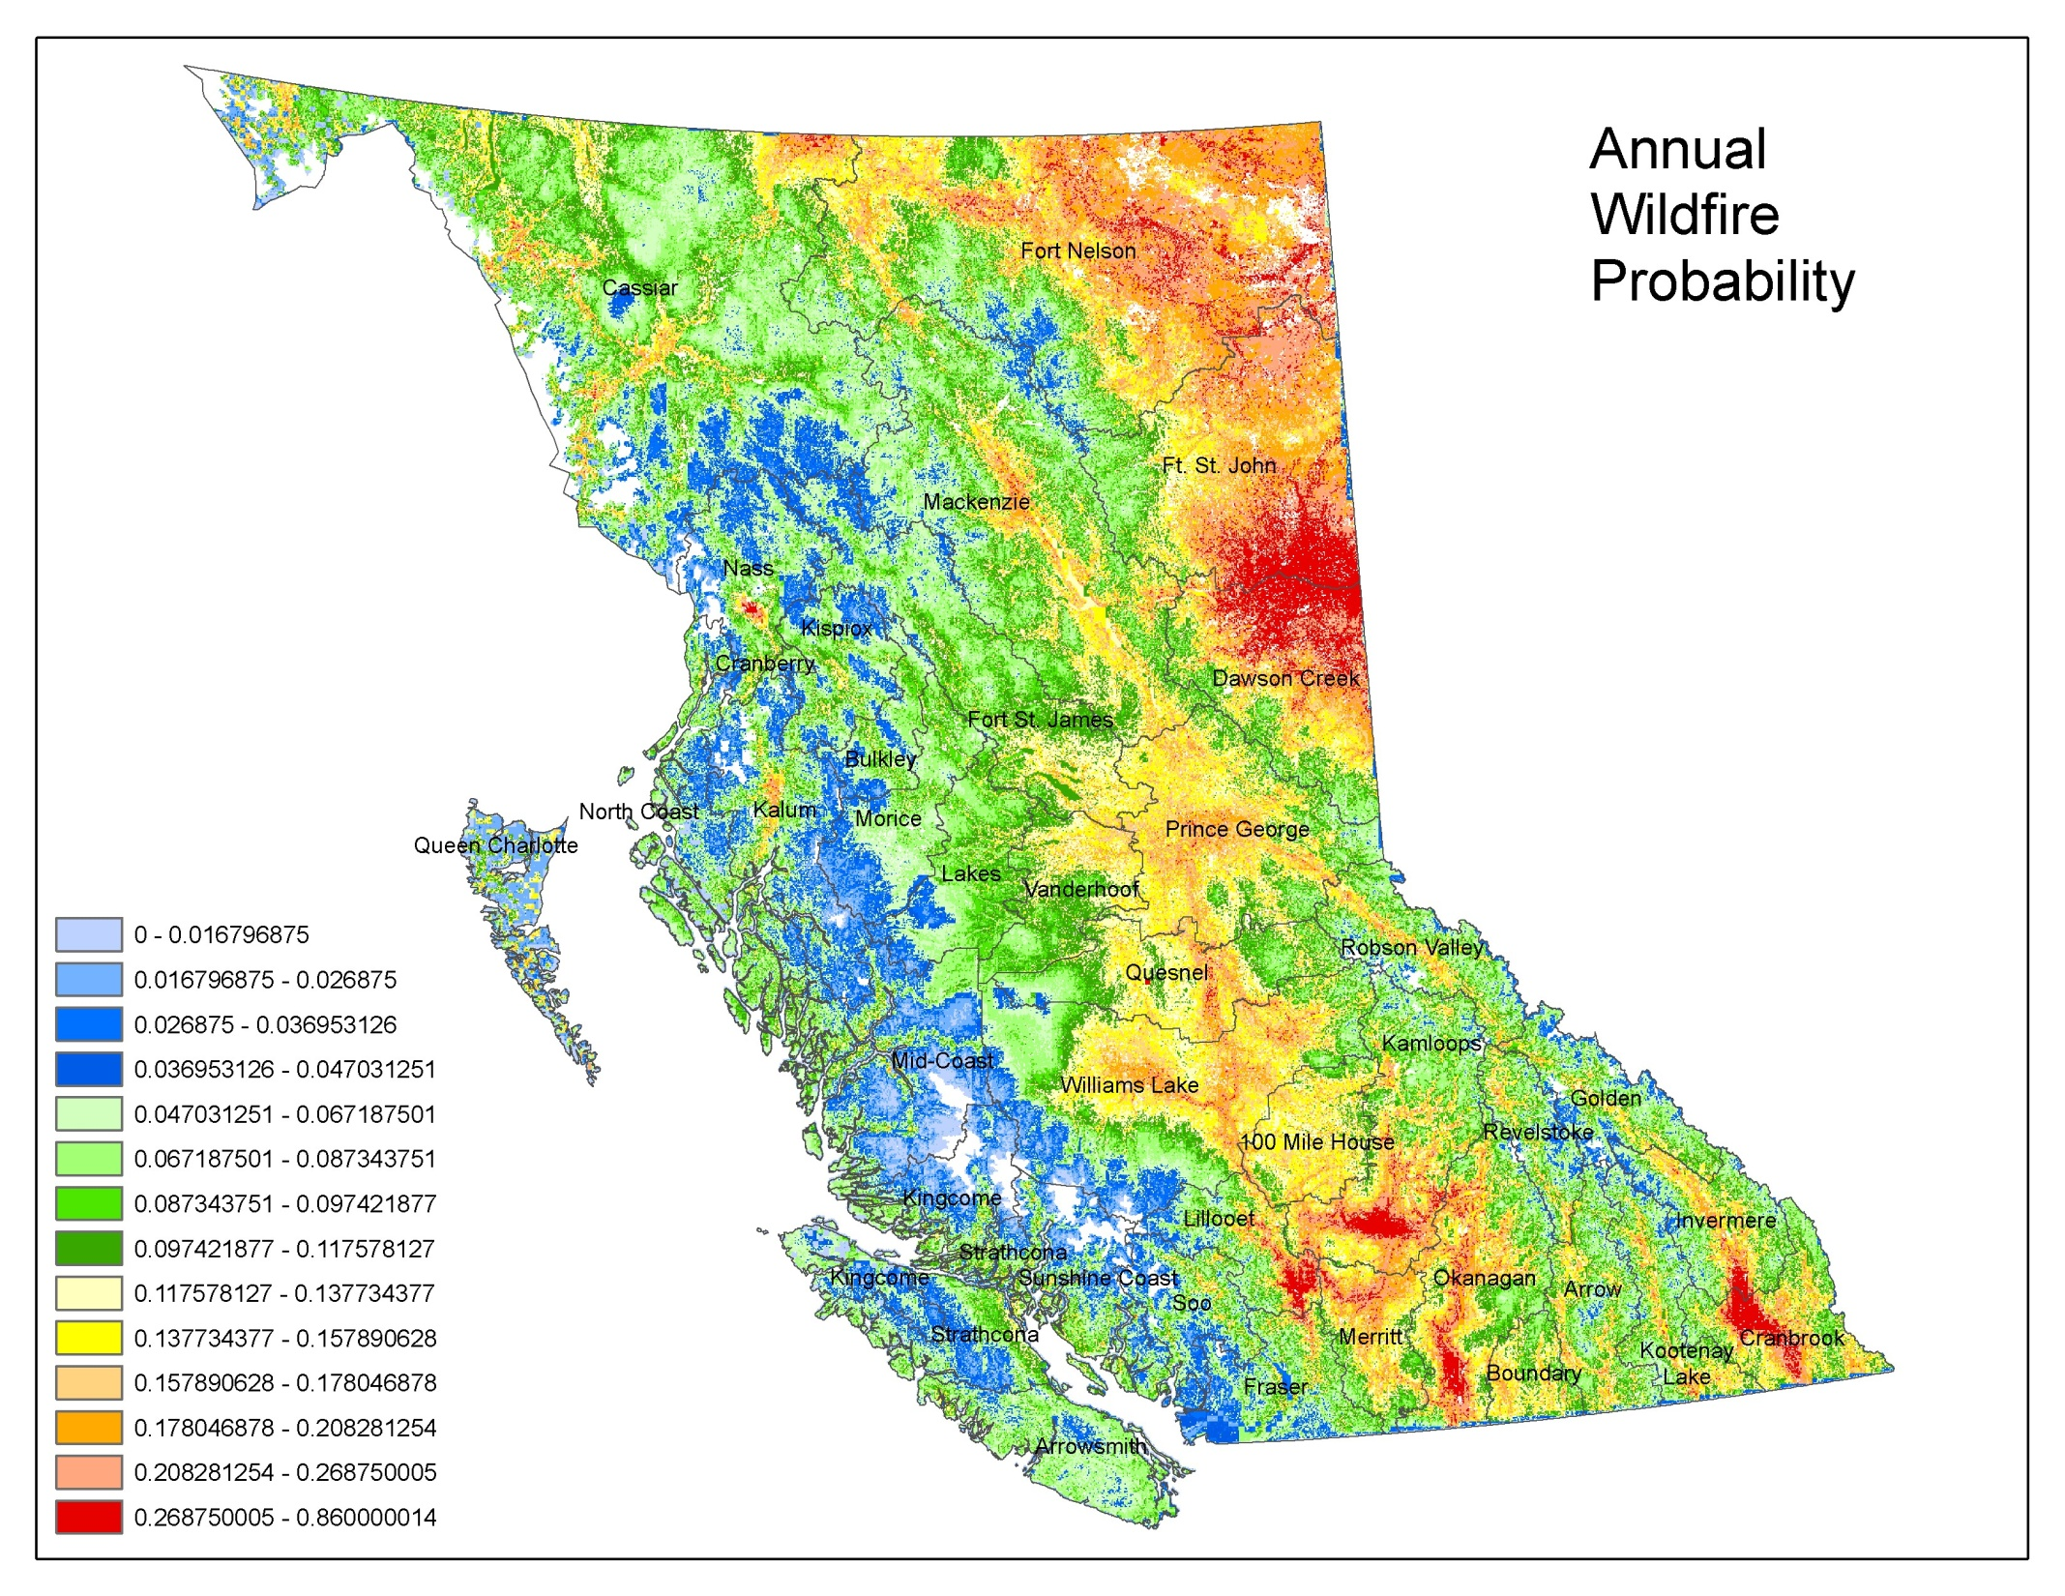
Notes:
Burn areas by TSA from 1960-2002.
The areas were determined by intersecting a digital layer of perimeters of fires > 20 ha with TSA boundaries. Fires of this size account for most of the area burned.

Slide 13
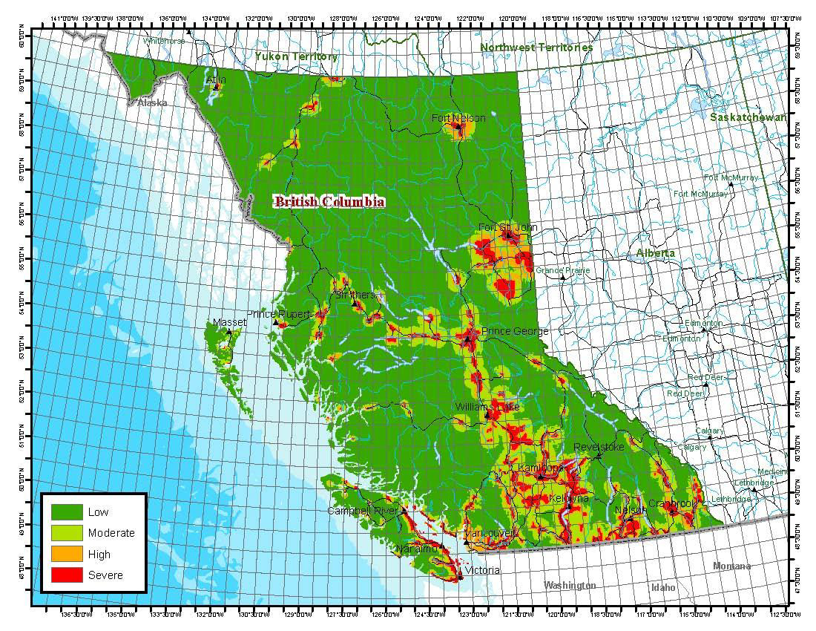
Fuel Hazard Abatement Map 2012
This map shows the fire risk in relation to distance to interface values.

Slide 14
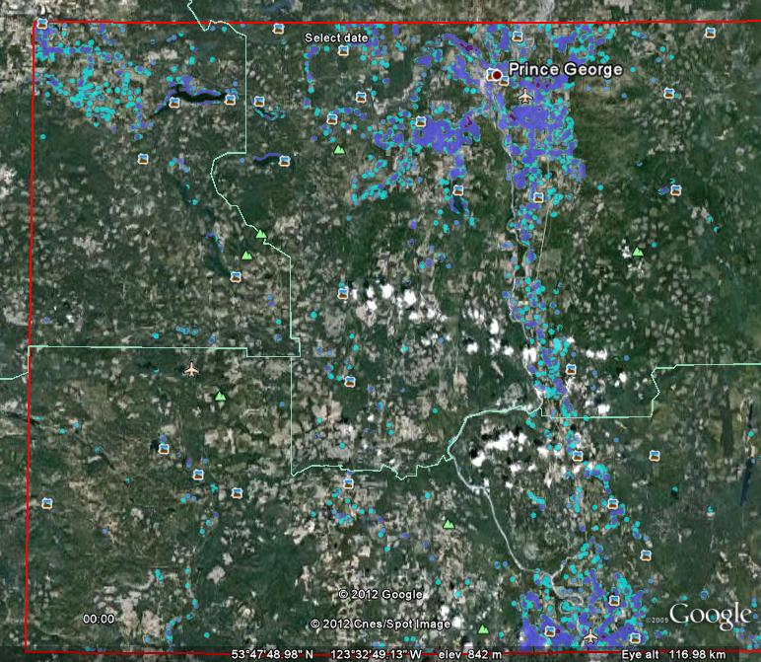

Slide 15
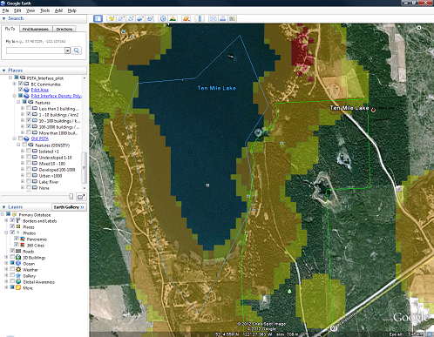
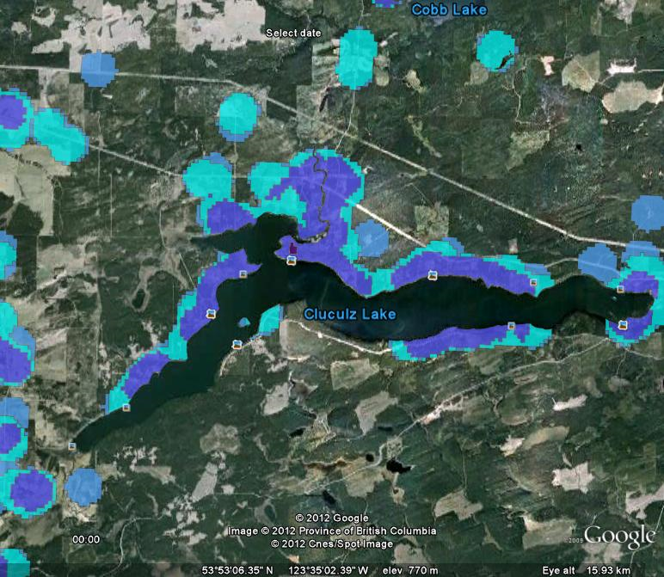
Strategic Wildfire Prevention
Initiative

Slide 16
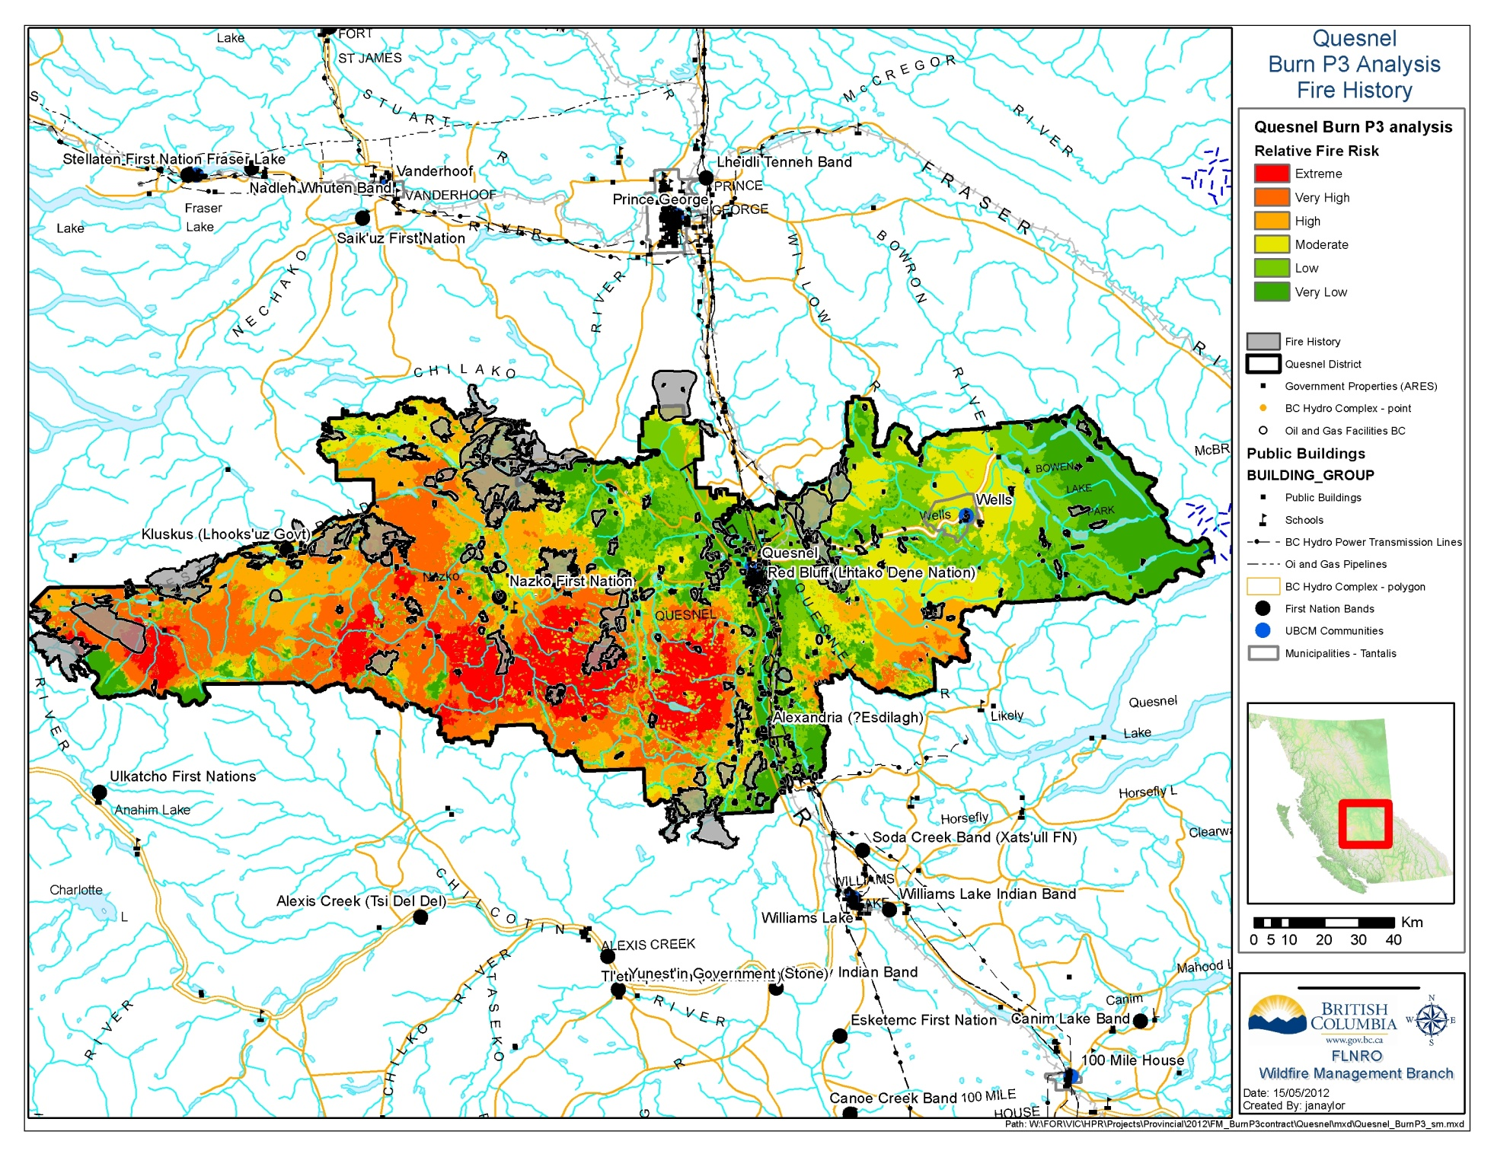
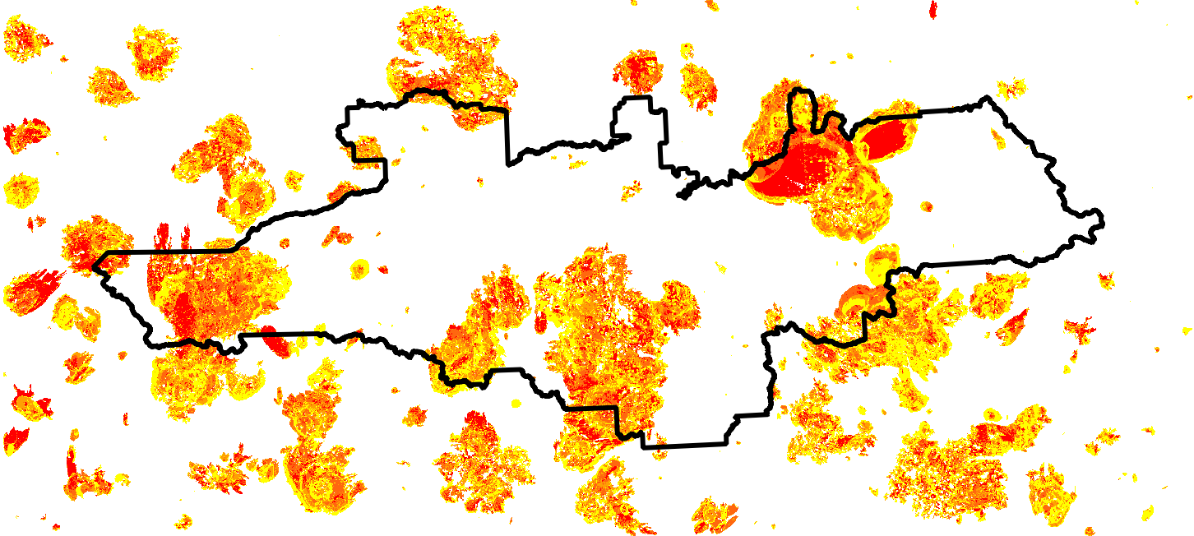
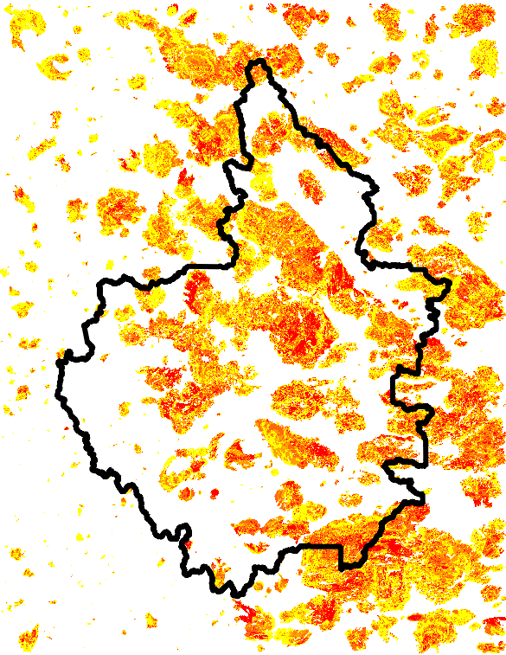
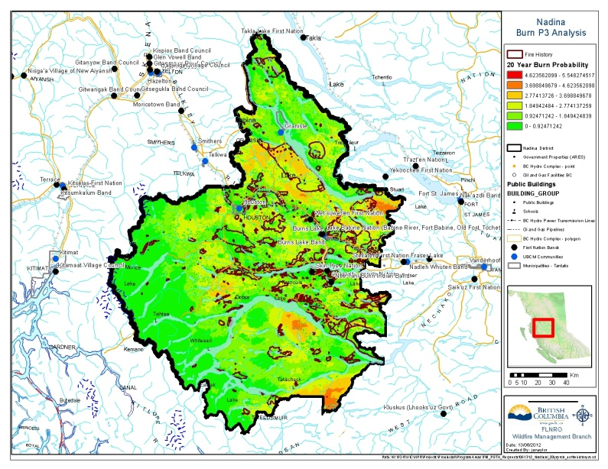
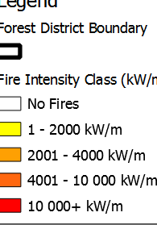
MU Planning
Mean Fire Intensity (Kw/m)
Burn P3 Fire Hazard Modelling 20 year probability
Notes:
Phase One – Assessment of the wildfire hazard, and risk to values on the landscape (TSA/District)
Wildfire hazard modelling to be completed for all of BC at the District / Timber Supply level
Collection and identification of values at risk and relative initial ranking using suppression priorities (RSWAP)
Determine the level of risk and threat to values
Determine fire management objectives for the landscape unit (e.g. reduce risk from extreme (rank 5, 6) and to moderate (rank 3,4 ) or less

Slide 17
Local Level - A Three Phase Approach
Phase Two – District and WMB led collaborative planning
Significant consultation with communities, First Nations, and stakeholders will be required to aid in applying a relative ranking to the values at risk and prioritizing mitigation options.

Slide 18
Local Value Identification
Priority Theme 1 HUMAN LIFE AND SAFETY
WUI – (1) SWTA Urban / Interface
Evacuation, Emergency protection of occupied interface areas, evacuation travel corridors, and other occupied sites
Priority Theme 2 PROPERTY and Critical Infrastructure
Infrastructure or assets important to public health and safety
  airports / power plants / communications
  drinking water sanitation systems
Isolated / Dispersed residences and associated infrastructure
Other infrastructure
  IPPs / Commercial Properties and Infrastructure
  High Value recreation infrastructure assets
  High Value Range Infrastructure

Slide 19
Local Value Identification
Priority Theme 3 HIGH ENVIRONMENTAL and Cultural VALUES
Community Watersheds
Cultural Values / TUA
GAR and SAR Group 1 (high priority and vulnerable to fire impacts)
Priority Theme 4 RESOURCE VALUES
Timber
  High Value Timber Areas
  Active or Planned Harvesting Areas
  Silviculture Investment Areas
  Timber Harvesting Land Base (Locally Defined Operability)
GAR and SAR Group 2 (low / mod priority and or fire resilient)
Parks, Protected Areas, non THLB
  Fire Adapted ecosystems, species, habitat
  Fire Susceptible ecosystems, species, habitat

Slide 20
Local Level - A Three Phase Approach
Phase Three – Operations
Determination of management actions and coordination of resources for fire management treatment activities at the District/TSA level

Slide 21
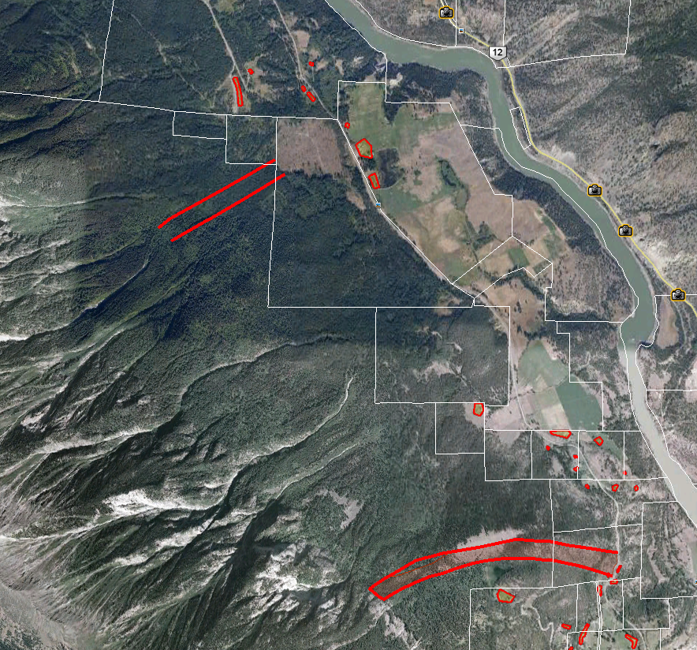
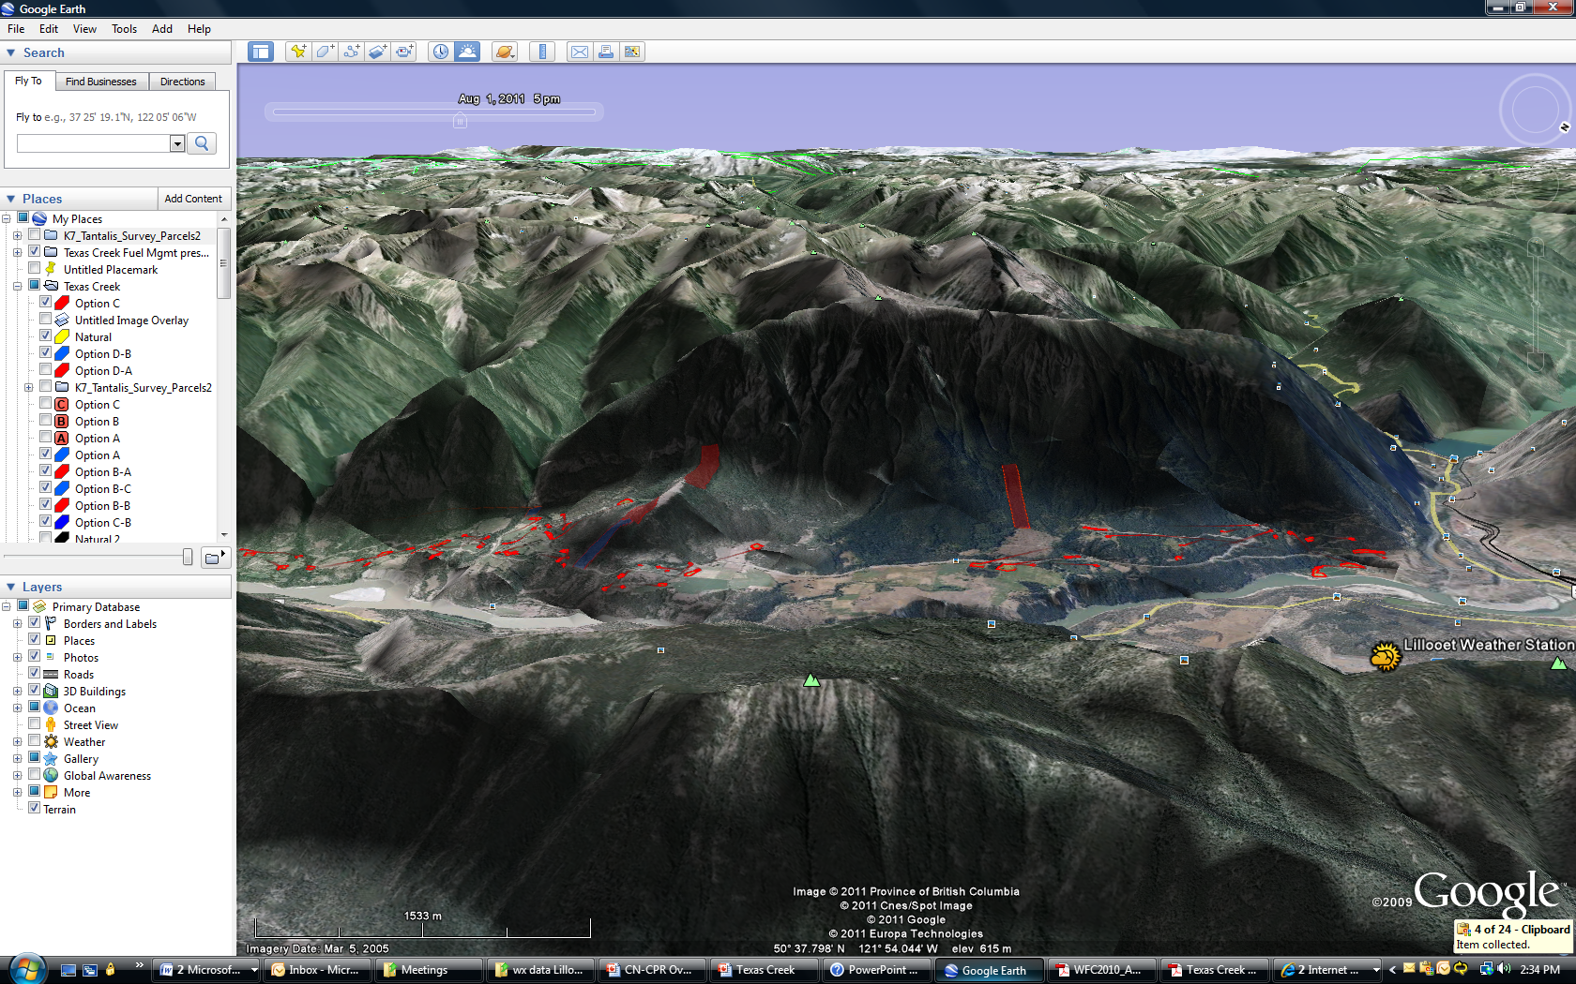
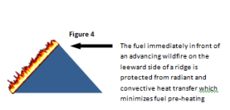
Landscape Fuel Management
Determine best strategic placement in combination with Interface and beyond
Licensees or district to implement, increased opportunities to partner with BCTS/FFT/ER to remove/modify fuel on crown land close to isolated values and to create larger fuel breaks
Notes:
Landscape fire management planning and subsequent implementation extends fire management initiatives from the area of municipal lands adjacent to communities, to provincial forests to further mitigate impacts to communities, critical infrastructure and natural resource values.

Slide 22
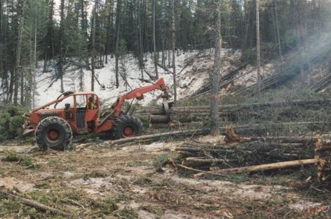
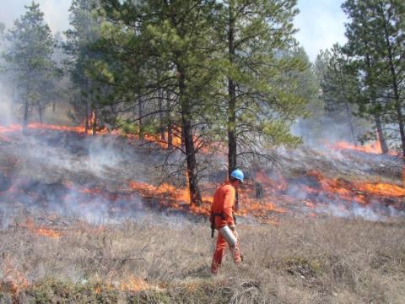
Coordination of Landscape Management Resources and Activities
  Fuel treatments for protection of Community and Infrastructure values
  Landscape wildfire risk mitigation activities for priority resource values
  Targeted Harvesting /biofuels /spacing projects etc
  Alternative silviculture regimes to protect values
  ER Projects and Prescribed Burns for fuel reduction, forest health
  Habitat Burns for habitat management, fuel reduction
  Line corridor , shaded and large scale fuel breaks

Slide 23
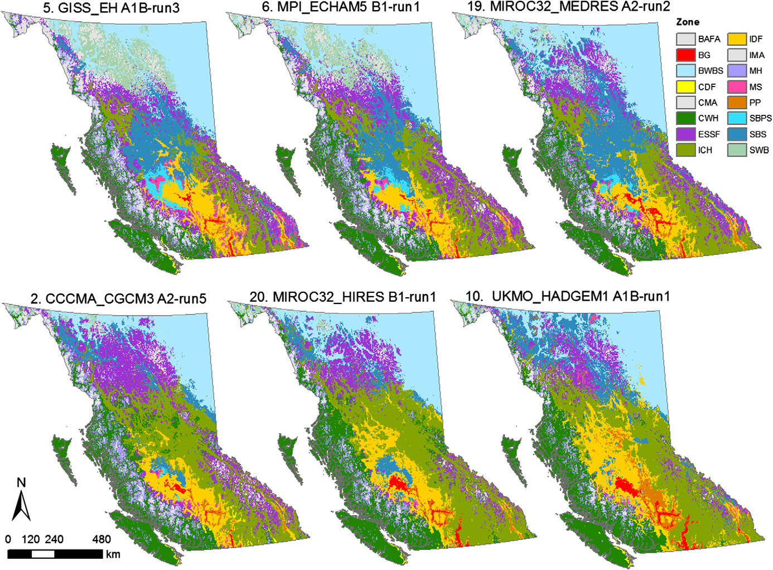
Projected distributions of climate envelopes of BC ecosystems for a CC scenario of average magnitude
T. Wang et al. / Forest Ecology and Management 279 (2012) 128–140
Notes:
In BC our fire regimes are driven by BEC or vice versa as the BEC zones shift in response to changing climatic factors so does wildfire activity. We need to be thinking about the future risks of wildfire as we plan to treat these ecosystems through reforestation and spacing etc.
The MPB and subsequent wildfire activity is seen by some as the ecosystems response to fire suppression and the shifting on marginal forested ecosystem back to their longer term pattern of open forest. OUR decisions on whether to reforest some of these impacted sites need to be taking these patterns into consideration.
AT a minimum leaving for natural regeneration may be a more strategic decision for current and forecasted “marginal” sites.

Slide 24
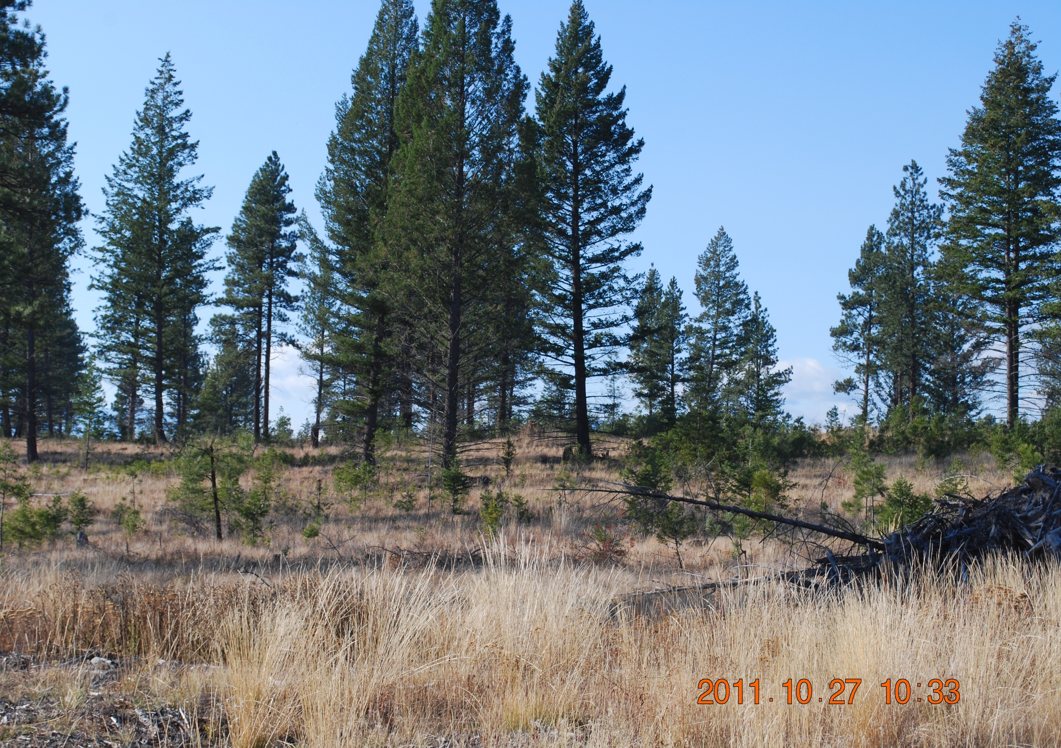
Landscape Fire Management – East Kootenies/Okanagan/Cariboo

Slide 25
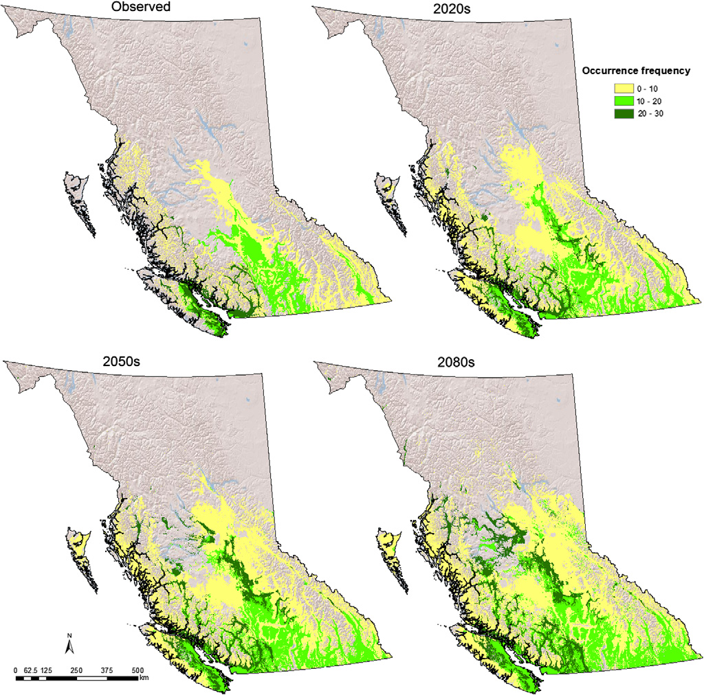
Random Forest Model projections of the Geographic distribution of Fdi
T. Wang et al. / Forest Ecology and Management 279 (2012) 128–140

Slide 26
Collaboration Opportunities
FFT Reforestation, and spacing/thinning investments in areas of mutual benefits that result in a reduced wildfire risk to communities.
Ensuring that fertilizer and reforestation projects are located in areas of reduced fire risk and strategically aligned in larger, more cohesive units that can be easily identified by WMB as a priority value for suppression.
FFT reforestation and spacing projects in areas that can buffer both High Value Mid Term TS and silviculture investment areas to reduce the potential of crown fires and allow for more effective suppression techniques.
Supporting better integration of Ecosystem Restoration, FFT and Fuel Management program planning that ensures the right treatments are occurring in the right stands, and incorporate the historical and future patterns of open forest and grassland ecosystem expansion in the interior of BC.

Slide 27
Collaboration Opportunities
Management unit timber objectives, silviculture regimes, and standards include a wildfire component that allows for modified harvesting or promotes the use of alternative species in areas of high or very high forecasted wildfire probability.
FRPA s.108 determinations around granting funding or relief of obligation could be linked to the patterns described above, and potentially licensee behavior related to slash management.
Building linkages between fire and forest management at the District stewardship level and have staff recognize that fire is part of the ecological process and a major driver on the landscape that must be accounted for up front in the planning process or risk destructive outcome.

Slide 28
Discussion

