Slide 1
Climate Change and Species selection
2013-2014 Forests For Tomorrow Business Meeting
Kevin Astridge RPF
Resource Practice Branch

Slide 2
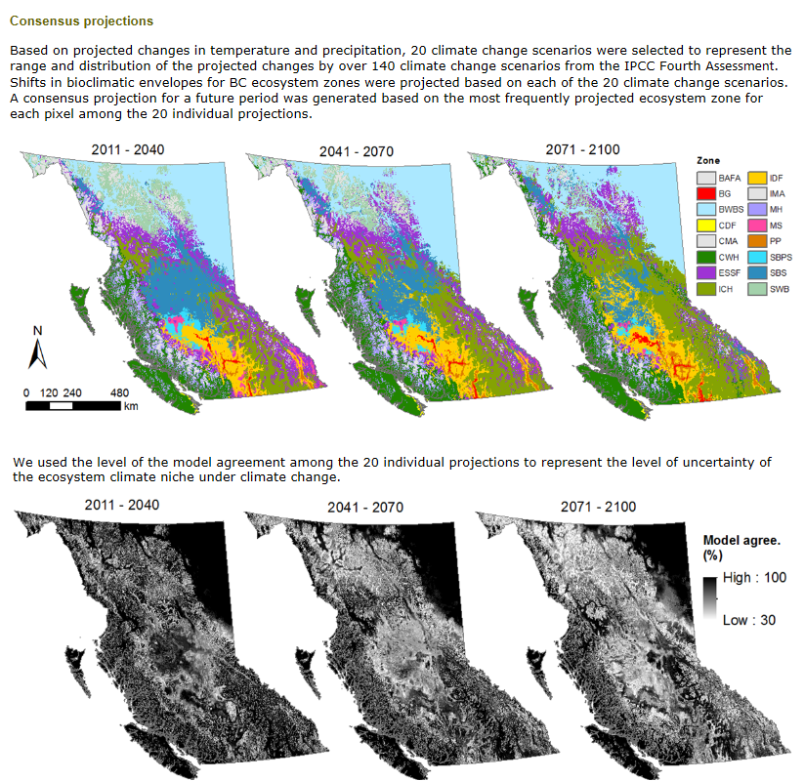
Consensus Projections – Wang et al
Notes:
2050 with the less moderate Hadley model and a pessimistic A1 greenhouse gas emission scenario.
You should note the differences here in the 3 scenarios – in the main valleys – the expansion of the very hot/dry IDF and/or Bunchgrass climates, while the IDFmw climates move upland into the ICH. Also note the retreat of the ESSF climates. Where they are found in this pessimistic Hadley scenario at 2050 is mostly where we only have rock, ice or alpine communities today.

Slide 3
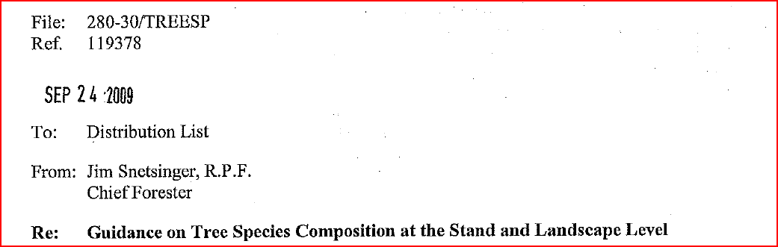
Chief Forester Guidance
A diversity of well adapted, healthy, resilient, stands across the landscape
Tree species diversity at multiple scales
No single “right” answer
Use the best science available

Slide 4
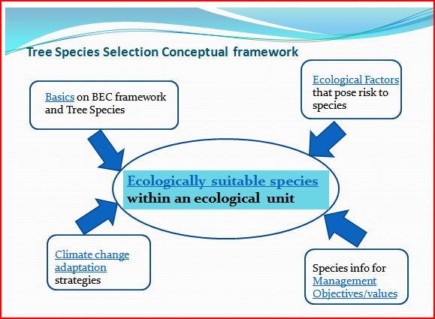
Tree Species Selection tool
Notes:
The goal of the Tree Species Selection Tool (TSST) is to provide practitioners with the best available information for informing tree species selection decision-making at the stand- and landscape-level in the context of a changing climate. The TSST core element are the landscape-level species descriptions and ecologically suitable species that are characteristic of each BEC subzone/variant and its site series; with the other elements providing information to support the evaluation of risk and strategies in managing for those species

Slide 5
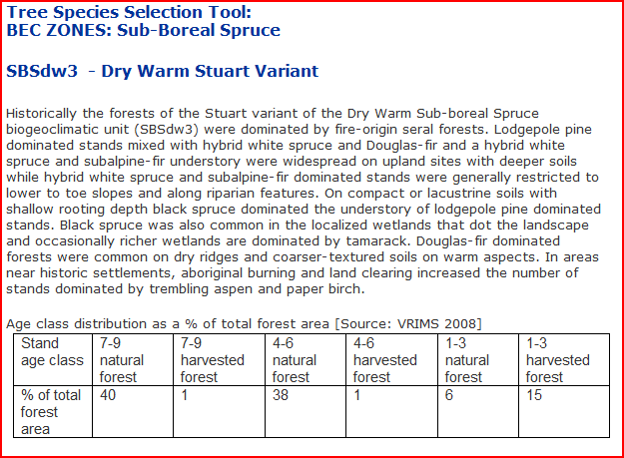
Tree Species Selection Tool

Slide 6
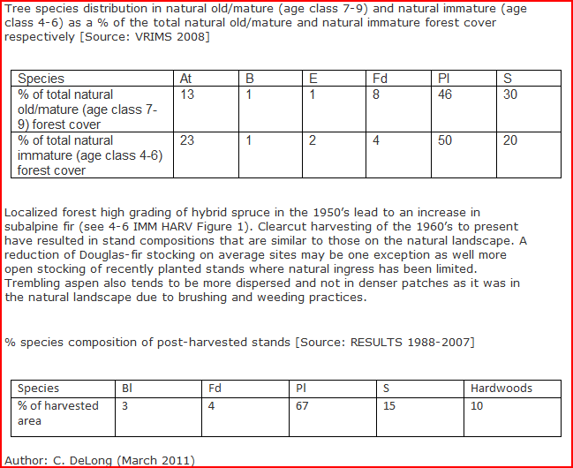
Tree Species Selection Tool

Slide 7
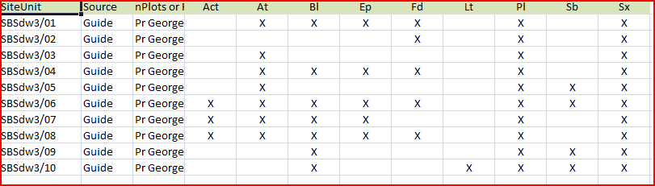
Tree Species Selection Tool
Updated ecologically suitable species lists for Northern Interior and Cariboo
Comparison of P/S/T from reference guide with BEC plot database
Provide the widest selection of species

Slide 8
Species Diversity
“Where feasible establish mixed species plantations”
“If exotics are chosen for reforestation, they should be established in mixes with native species”
“Maximizing diversity on every site may result in stands that are difficult to manage”
“The determination of an appropriate species mix, however, will be unique to each site and should include consideration, at the landscape level, of what percentage of cutblocks should have a species mix, and the species distribution within each cutblock”
“Reasons for promoting a species mix include.....improving stand resilience to damaging agents......enhancing biodiversity”
“The choice between establishing a single species or a mixture depends on......species compatibility”
READ THE ESTABLISHMENT TO FREE GROWING GUIDEBOOK (not just the tables in the reference guide)

Slide 9
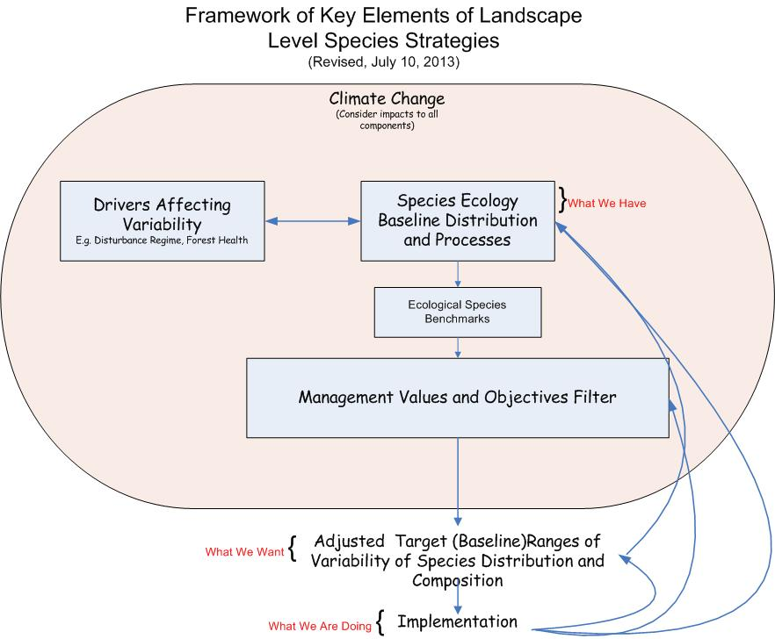
Landscape Level Species Strategies
Technical Report 67 - A Landscape-level Species Strategy for Forest Management in British Columbia Exploration of Development and Implementation Issues (Mah et al. 2012)

Slide 10
Ecological Benchmarks
Ecological benchmarks species targets or ranges
  biological baselines without management objectives
  guiding principle of building resilient stands through species diversity
Developed for Bulkley, Nadina, Vanderhoof, Prince George, Ft. St. James, Quesnel, and portion of Williams Lake Districts
Regional Specialists and Researchers, District Staff
Synthesis of existing species information at a landscape scale
  Landscape-level tree species composition
  Age-class distribution in the natural and harvested stands
  Reforestation trends for the BEC subzone/variants in the TSA
  Climate envelope projections
  Any other available information on potential risk to tree species establishment

Slide 11
Landscape Level Species Strategies
Ecological Benchmarks input into Type IV process
Development of specific targets for tree species composition and density variability at the landscape level for a management unit

Slide 12
Consensus Projections – Wang et al
Notes:
2050 with the less moderate Hadley model and a pessimistic A1 greenhouse gas emission scenario.
You should note the differences here in the 3 scenarios – in the main valleys – the expansion of the very hot/dry IDF and/or Bunchgrass climates, while the IDFmw climates move upland into the ICH. Also note the retreat of the ESSF climates. Where they are found in this pessimistic Hadley scenario at 2050 is mostly where we only have rock, ice or alpine communities today.

Slide 13
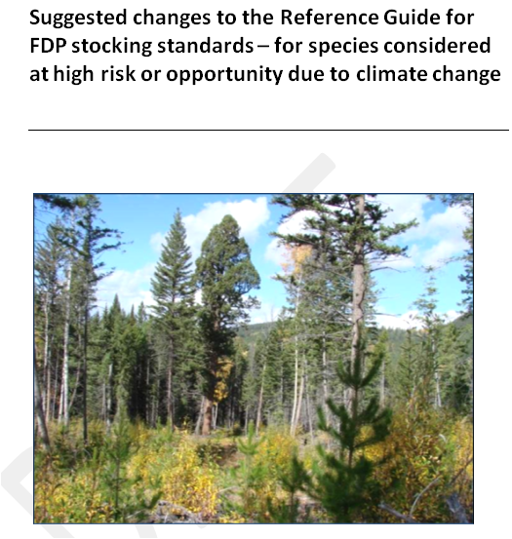
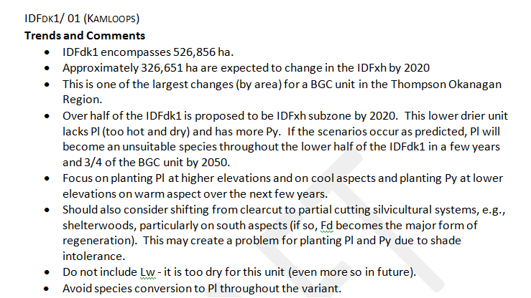
Adding the Climate Change Lens
DRAFT Ecologist input

Slide 14
Example
IDFdk – with a lens of climate change
Species | Present Category | Suggested Category | Preferred/ Acceptable | Promotion or Demotion | Rationale/Footnotes
Fd | 1 Fd (³²) | 1 Fd (³²) | Preferred | No change | Retain – dominant species in all IDF units. Avoid use in depressions and frost-prone sites.
Pl | 1 Pl | 2 Pl (¹³) | Preferred/ Acceptable | Demotion | Increased risk – shift planting to upper elevations. Over half of the IDFdk1 is proposed to be IDFxh subzone by 2020. This lower drier unit lacks Pl (too hot and dry) and has more Py. If the scenario occurs, Pl will become an unsuitable species throughout the lower half of the IDFdk1 in a few years and 3/4 of the BGC unit by 2050. Consider only using Pl as a preferred species on sites unsuitable for other species (cold air drainages and frost pockets) and where the previous stand was dominated by Pl.
Py | 2 Py (^{9, 14}) | 2 Py (^{9, 14}) | Preferred | Promotion | Shift to preferred. Opportunity for greater use at low elevations on warm aspects
Sx | 3 Sx (^{10, 13}) | 0 | Not suitable | Demotion | Increased risk due to drought - should avoid planting on zonal sites
Lw | 3 Lw (^{9,14, 23, 32}) | 0 | Not suitable | Demotion | Increased risk due to drought - should avoid planting on zonal sites. Appears to be error in footnotes – Lw should not be planted on warm aspects at low elevations in the IDFdk1
Consider only using Pl as a preferred species on sites unsuitable for other species (cold air drainages and frost pockets) and where the previous stand was dominated by Pl.
Make changes to trends or targets on previous slide

Slide 15
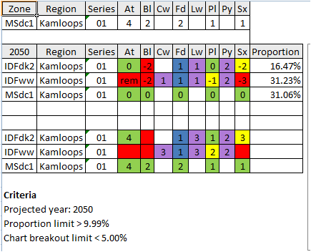
EXAMPLE
MSdc – with a lens of Climate Change
Consensus output for 2050 shown (Wang 2013)

Slide 16
Climate Change Updates to Reference Guide
Incorporate into reference guide as an additional line
Should be used in conjunction the background information/rationale from ecologists

Slide 17
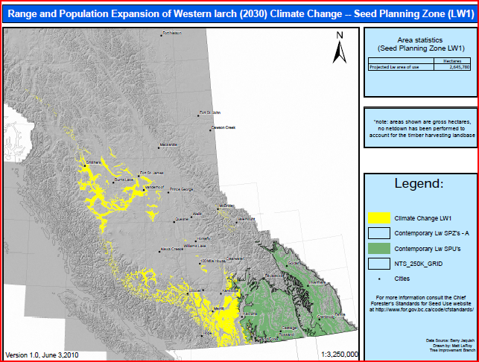
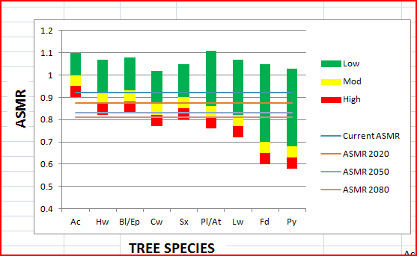
Other Tools

Slide 18
Summary
Tree Species Diversity at multiple scales
Tools available to aid in understanding diversity of natural forests and managed stands
Landscape level and stand level guidance is available/in development
Information will be in a permanent state of flux as climate change science and models change over time (Flying BEC version 3?)
“In the interim I expect that we will utilize the diversity of desirable tree species that are currently recognized as ecologically suitable” (Chief Forester 2009)

