Slide 1
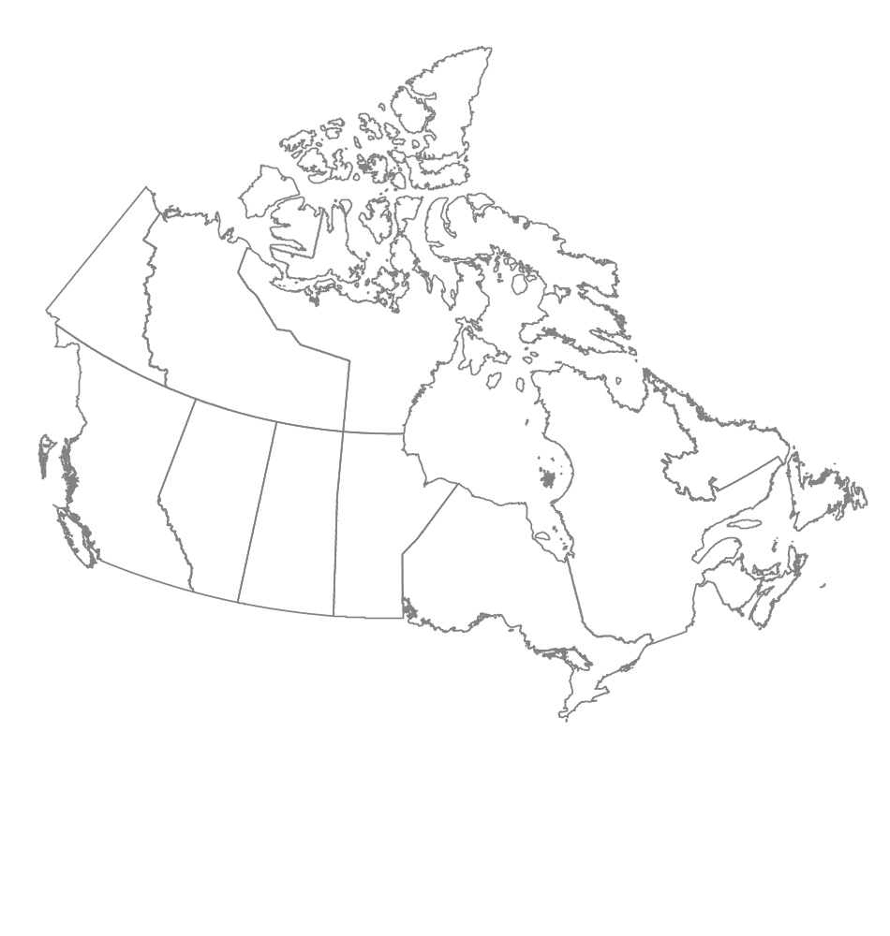




National Forest Pest Strategy
National Surveillance and Monitoring Standards
Janice Hodge
JCH Forest Pest Management
Coldstream, British Columbia
Tim Ebata
Ministry of Forests and Range
Victoria, British Columbia
Joan Westfall
Entopath Management
Kamloops, British Columbia

Slide 2
Objectives
Identify compatibilities and define methods for data standardization.
Recommend a forest health monitoring regime to address monitoring gaps.
Identify data format requirements for inclusion into the National Forest Pest Information System.

Slide 3
Data standardizaton:
Previous Conclusions
Developing national ground plot standards for collecting and reporting data are not appropriate due to differences in pest behavior, host types, etc.
Outstanding Tasks
Develop algorithms to convert ground plot data into a common reporting format in collaboration with IIM
Update monitoring matrix with new information (ex. lure formulation) and update compatibilities.

Slide 4
Data Standardization
Standardization of aerial survey categories ?
 | BC | YT | AB | SK | MB | ON | QB |  | NB | NS | NL
 |  |  |  |  |  |  | Hardwood | Conifer
Lightª | 1-30 | <25 | <35 | - | <35 | <50 | 1-25 | 1-34 | 1-30 | 10-29 | -
Mod | 30-50 | 26-65 | 36-70 | 30-69 | 35-70 | 51-75 | 26-60 | 35-69 | 31-70 | 30-69 | 31-70
Sev | >50 | >65 | >70 | >70 | >70 | >75 | >60 | >70 | >70 | >70 | >70
ª Defoliation severities based on average defoliation characteristics at a polygon level ^{b} BC categories for L and M do not include % but the authors consider these to be as noted.

Slide 5
Data Standardization
Standardization of pest codes and host species codes ?
Only a few provinces have pest codes (BC 3 letter codes)
ex. IDW = Insect, Defoliator, Western spruce budworm
  could be expanded to 4 letters to accommodate hardwoods
  IDCW = Insect, Defoliator, Conifer, Western spruce budworm
  IDHF = Insect, Defoliator, Hardwood, Forest tent caterpillar
Host species coding
  Presently no consistency between provinces
    2001 CANFI numeric coding ?
    2006 NFI coding – genus + species ?

Slide 6
Forest Health Monitoring regime
Collected data required to identify monitoring gaps:
  Information on location of monitoring plots, type of plots (PSS or PSP), MFD sampled, and monitoring frequency.
  Information on spatial extent of aerial surveys.
Participation by all Provinces and the Yukon
Data in shapefiles, Access or Excel
Cross-referenced with monitoring matrix
Imported into ArcMap and geodatabase

Slide 7
Ground Monitoring Summary
Some P/T’s submitted data spanning a number of years

Slide 8
Ground Monitoring Summary

Slide 9
Ground Monitoring Summary
 | # of sites | % sampled annually | % with multiple pest sampling | % with same pest sampled (life stages)
BC | 2547 | 28 | 7 | 2
AB | 1493 | 0¹ | 2 | 4
SK | 953 | 14
MB | 1014 | 21 | 2
ON | 253 | 86 | 86
QB | 2510 | 0¹
NB | 675 | 92 | 50 | 22
NS | 856 | 100 | 35 | 16
PE | 14 | 0¹
NL | 1817 | 0¹
¹ Some may be assessed annually but are not considered annual plots.
* Yukon did not report any monitoring sites

Slide 10
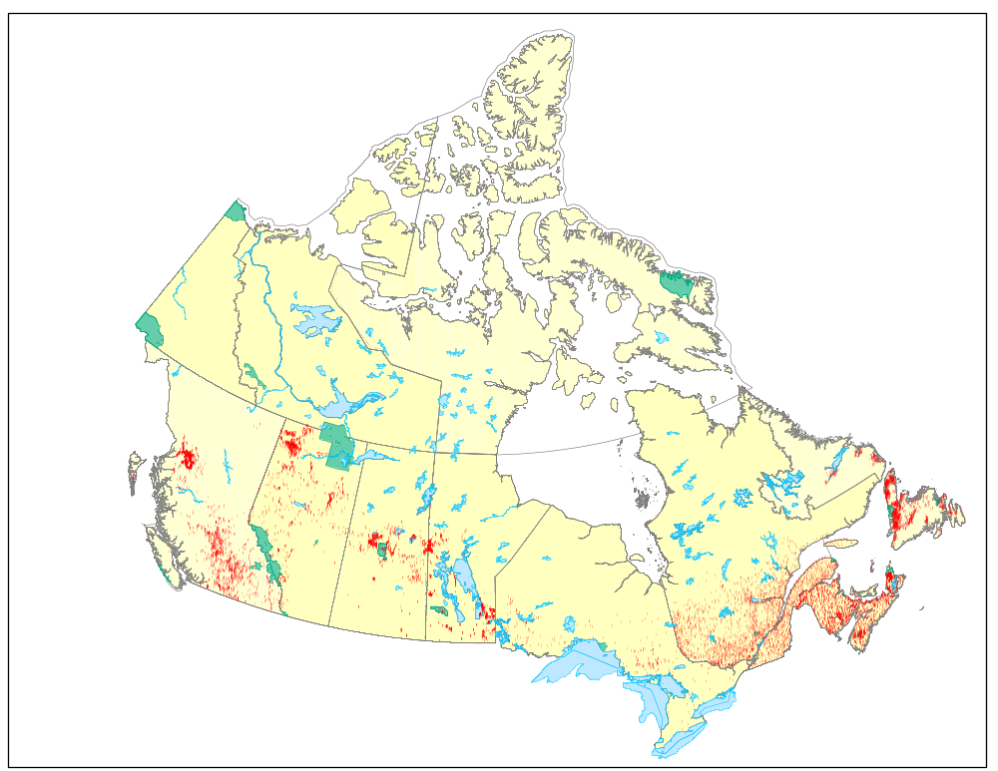
Ground Monitoring Sites
Spatial Distribution

Slide 11
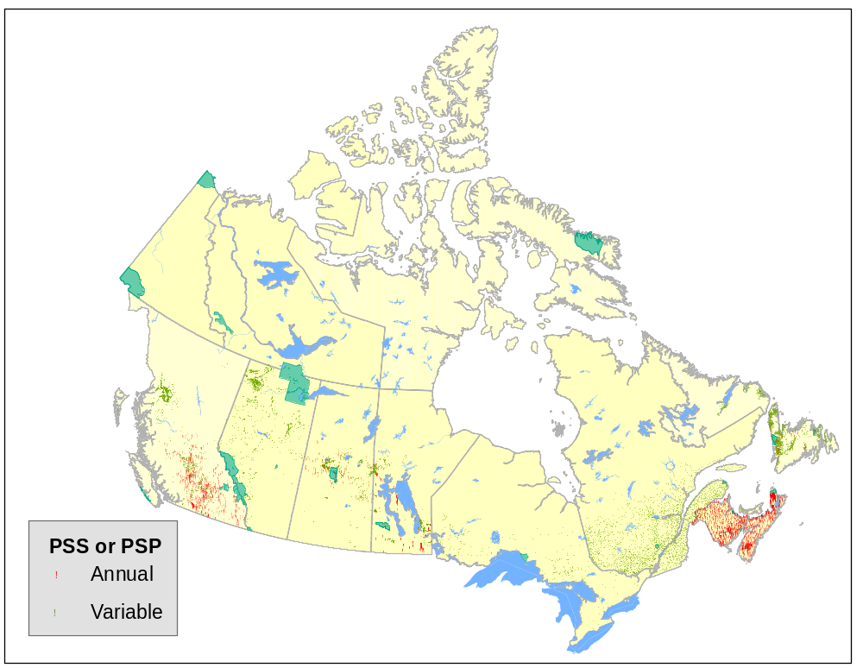
Ground Monitoring Sites
Monitoring Frequency

Slide 12
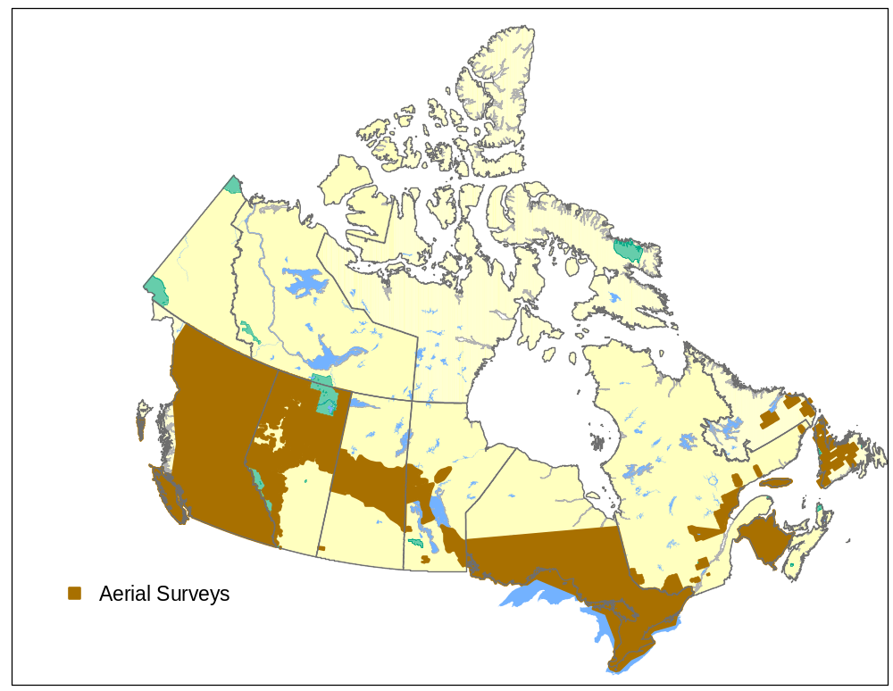
Aerial Monitoring

Slide 13
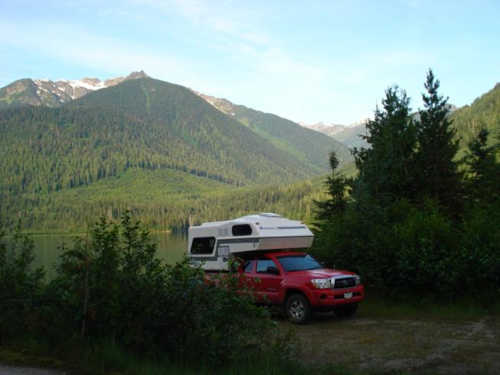
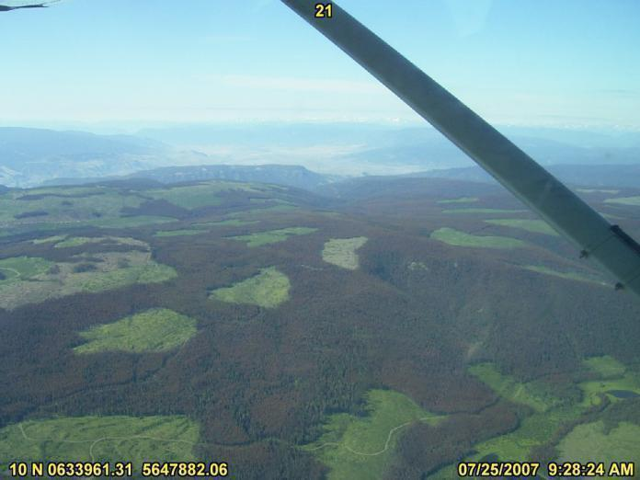
How well are we monitoring our 'forests'?
Forest as defined by Canadian National Forest Inventory 2001 is a CANFI cell where forested land is the dominant feature.

Slide 14
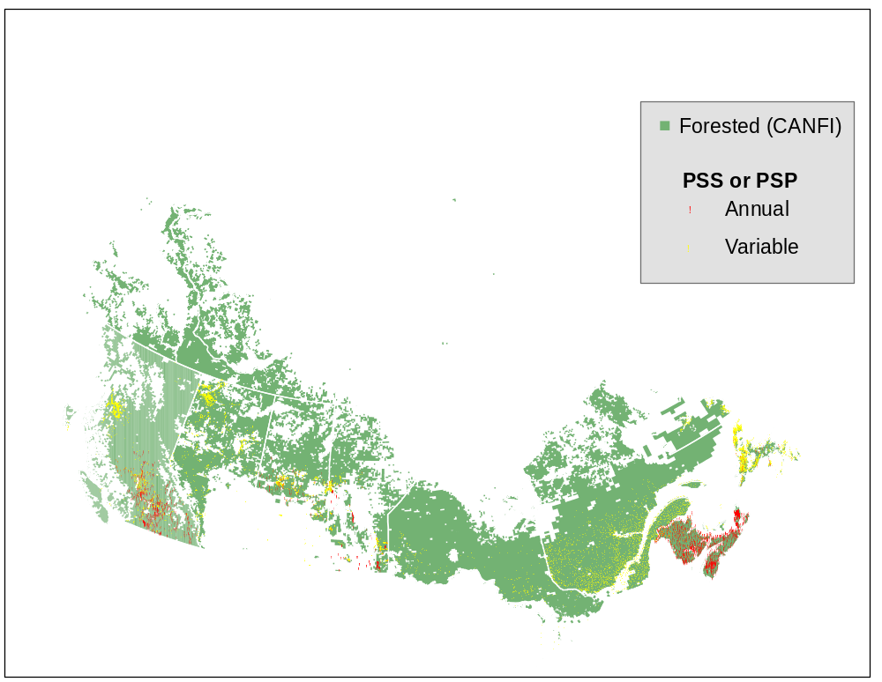
Ground
Monitoring

Slide 15
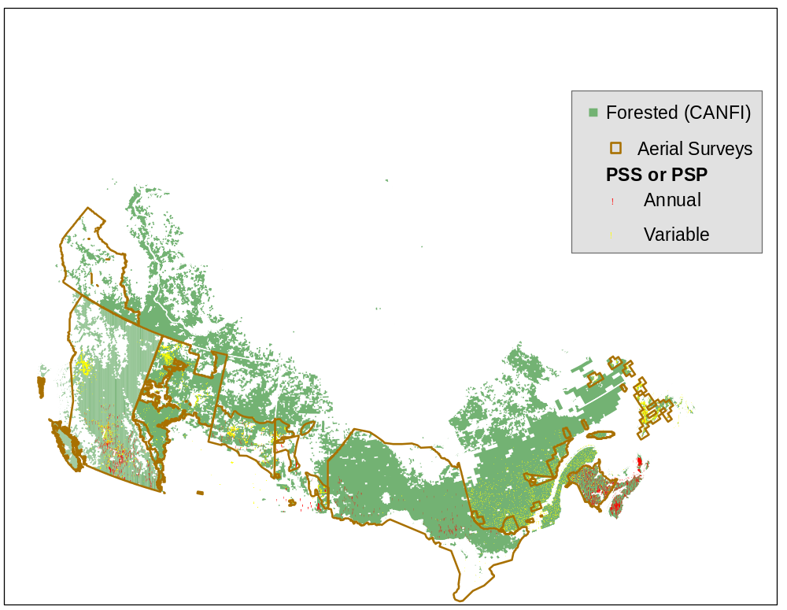
Ground and Aerial Monitoring

Slide 16
How well are we monitoring at an ecosystem-level?
NFPS - ecosystem-based reporting
Ecozones somewhat similar to Forest Regions of Canada
Ecozones as defined by the National Ecological Framework for Canada are:
  “ an area of the earth’s surface representative of large and very generalized ecological units characterized by interactive and adjusting abiotic and biotic factors.”
Ecozones used in NFI stratification

Slide 17
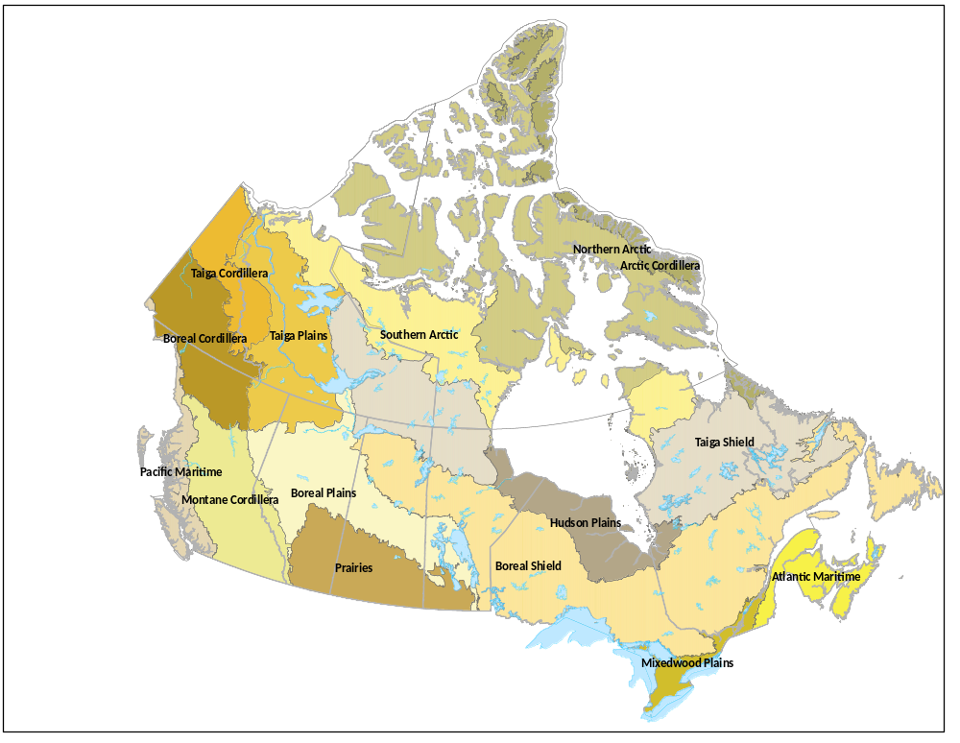
Ecozones

Slide 18
Ground monitoring (annual and variable) summary by Forested portions of Ecozones
 | BC |  | AB |  | SK |  | MB |  | ON |  | QB |  | NB |  | NS |  | NL |  | PE
 | % of plots | % Ecozone | % of plots | % Ecozone | % of plots | % Ecozone | % of plots | % Ecozone | % of plots | % Ecozone | % of plots | % Ecozone | % of plots | % Ecozone | % of plots | % Ecozone | % of plots | % Ecozone | % of plots | % Ecozone
Atlantic Maritime |  |  |  |  |  |  |  |  |  |  | 24 | 7 | 100 | 100 | 100 | 100 |  |  | 100 | 100
Boreal Cordillera | 0 | 12
Boreal Plains | 0 | 5 | 54 | 76 | 85 | 38 | 38 | 17
Boreal Shield |  |  | 0 | 1 | 9 | 50 | 50 | 55 | 93 | 92 | 66 | 66 |  |  |  |  | 99 | 54
Hudson Plains |  |  |  |  |  |  |  |  | 0 | 6 | 0 | 1
Mixedwood Plains |  |  |  |  |  |  |  |  | 7 | 3 | 11 | 1
Montane Cordillera | 67 | 56 | 6 | 8
Pacific Maritime | 32 | 18
Prairies |  |  | 1 | 0 | 6 | 1 | 7 | 0
Taiga Plains | 0 | 9 | 40 | 11
Taiga Shield |  |  | 0 | 3 | 0 | 12 | 0 | 12 |  |  | 0 | 24 |  |  |  |  | 1 | 46

Slide 19
Monitoring Summary
Gaps in Northern Canada and urban areas
Low percentage of plots monitored annually
Majority of ground monitoring plots are pest specific; very few at an ecosystem or forest type level ex. CIPHA.
Although some ecozones appear adequately monitored (proportional representation) the spatial distribution may not be adequate.

Slide 20
Approach to Monitoring Scheme
 | Good | Better | Best
Establish fixed radius plots @ established PS*’s and collect additional FH and climate change data | No | Yes | No (covered by ecosystem-based PSPs)
Ecosystem based reporting | Retrospective | Retrospective | Yes
Establish and monitor ecosystem-based PSP’s (using existing or historical FIDS where appropriate) | No | No | Yes
Remote sensing of northern Canada | No | Yes? | Yes
Improved communication ex. meetings, NFIS | Yes | Yes | Yes

Slide 21
Moving Forward
What attributes should be collected in the better and best scenario ground plots?
Fixed radius plots? No tagging.
Is remote sensing a feasible and reliable option for remote areas?
  northern Canada predicted to have greatest warming due to climate change
For the best scenario how do we stratify the landbase? Ex. proportional by ? (forest type, ecozone, host species)

Slide 22
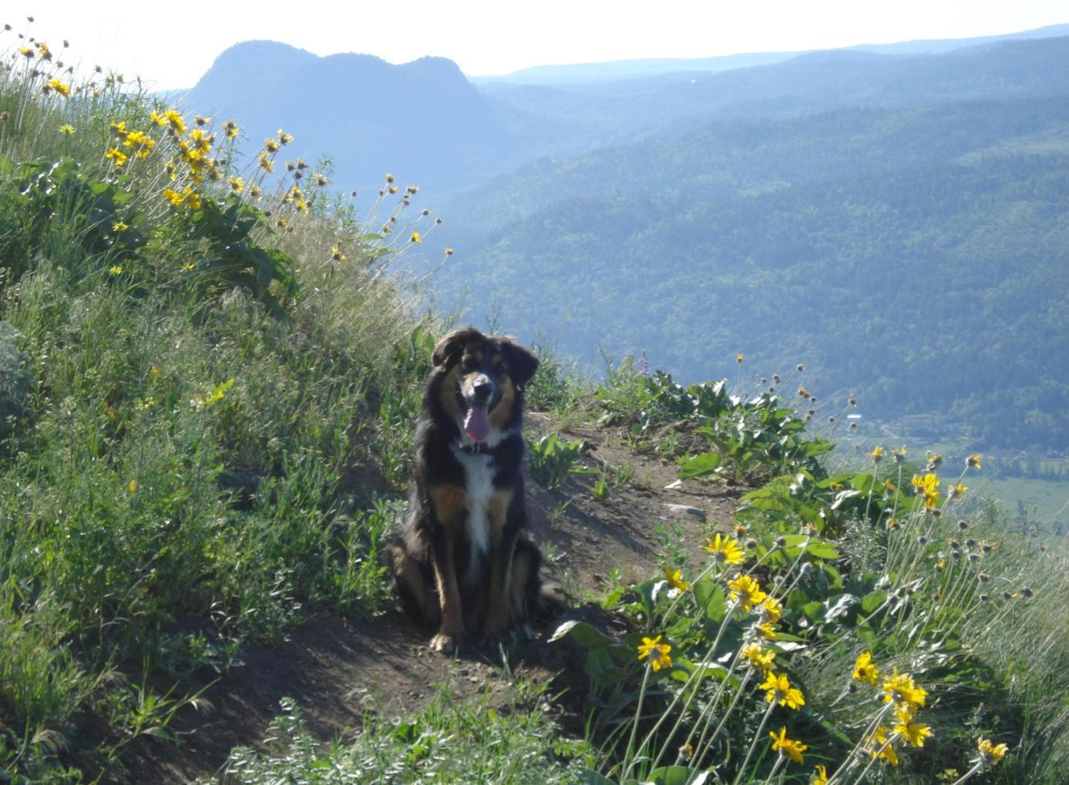
Acknowledgements
Many thanks to all participants whom contributed to this process.

