Slide 1
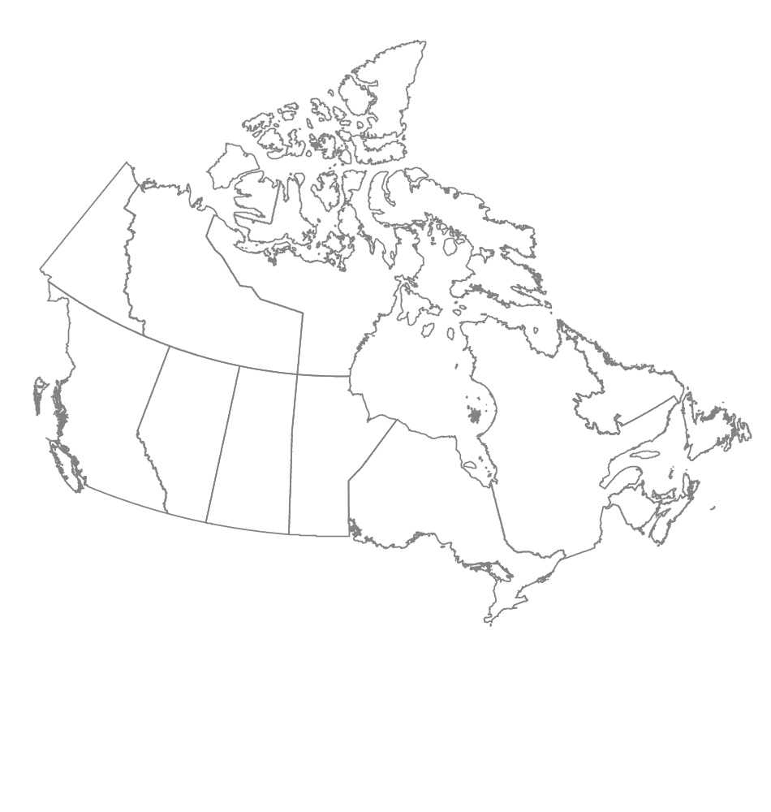




National Forest Pest Strategy
Monitoring and Diagnostics Update
Janice Hodge
JCH Forest Pest Management
Coldstream, British Columbia
Tim Ebata
Ministry of Forests and Range
Victoria, British Columbia
Joan Westfall
Entopath Management
Kamloops, British Columbia

Slide 2
Objectives
Identify current monitoring activities and gaps and develop a range of monitoring regimes (including approximate costs) required to fulfill NFPS objectives.
Identify compatibilities and opportunities for standardization of methodologies, thresholds, etc.
Capture and store existing and historical data.
Identify current diagnostic capacity.

Slide 3
Achievements to Date
Summarized nationwide monitoring activities
  Pest, frequency, methodology, thresholds, lure formulations, data format and availability
  Spatial data for permanent sample sites and aerial surveys
Identified compatibilities and opportunities for standardization
New Brunswick monitoring data submitted to IIM, BC in progress
Identified M and D objectives and developed a list of National major forest pests
Developed 3 Monitoring Scenarios
Completed diagnostic capacity survey

Slide 4
Current Monitoring Surveys
74 Major Forest Disturbances

Slide 5
Ground Monitoring Summary

Slide 6
Compatibility Example – Egg stage
Common Name | BC | YT | AB | SK | MB | ON | QB | NB | NS | NL | PEI
Balsam fir sawfly
Douglas-fir tussock moth | N/A
Eastern blackheaded budworm
Eastern hemlock looper
Eastern spruce budworm
Forest tent caterpillar
Jack pine budworm
Pale winged grey |  |  |  |  |  |  |  |  | N/A
Spruce bud moth |  |  |  |  |  |  |  |  |  | N/A
Two-year-cycle spruce budworm | N/A
Western hemlock looper | N/A
Western spruce budworm
Whitemarked tussock moth |  |  |  |  |  |  |  |  | N/A
 | Compatible: Conversion possible as reporting variable (ex. predicted defoliation) or unit being reported on (ex. avg # of eggs/10m2) the same but thresholds different.
 | Similar; threshold numbers the same or vary slightly.
 | Not the same thresholds and/or reporting parameter and/or reporting unit.
N/A | Only P/T conducting this survey

Slide 7
Data Standardization
Need to review pest methodologies and thresholds (origin, rationale, etc) where they are not compatible.
  Meeting used to be held in conjunction with the National Forest Pest Forum to discuss best practices and opportunities for standardization. This is the “Forest Pest Technology” meeting that is held on the Monday of Forum week.
Aerial survey categories
 | BC | YT | AB | SK | MB | ON | QB |  | NB | NS | NL
 |  |  |  |  |  |  | Hardwood | Conifer
Lightª | 1-30 | <25 | <35 | - | <35 | <50 | 1-25 | 1-34 | 1-30 | 10-29 | -
Mod | 30-50 | 26-65 | 36-70 | 30-69 | 35-70 | 51-75 | 26-60 | 35-69 | 31-70 | 30-69 | 31-70
Sev | >50 | >65 | >70 | >70 | >70 | >75 | >60 | >70 | >70 | >70 | >70
ª Defoliation severities based on average defoliation characteristics at a polygon level ^{b} BC categories for L and M do not include % but the authors consider these to be as noted.

Slide 8
Diagnostic capacity survey
Who provides free services?
 | Pathology |  | Entomology
 | Taxonomy | Diagnostics | Taxonomy | Diagnostics
Federal | 4 | 2 | 6 | 7
Provincial | 0 | 2 | 0 | 1
Academia | 0 | 0 | 0 | 0
Private/Ind | 0 | 1 | 0 | 1
89 respondents (61 Federal, 21 Provincial, 4 Academia, 3 Industry/Private) – over 600 surveys sent out. However, question was never asked if they would or could handle “buckets of bugs” from a trapping program.

Slide 9
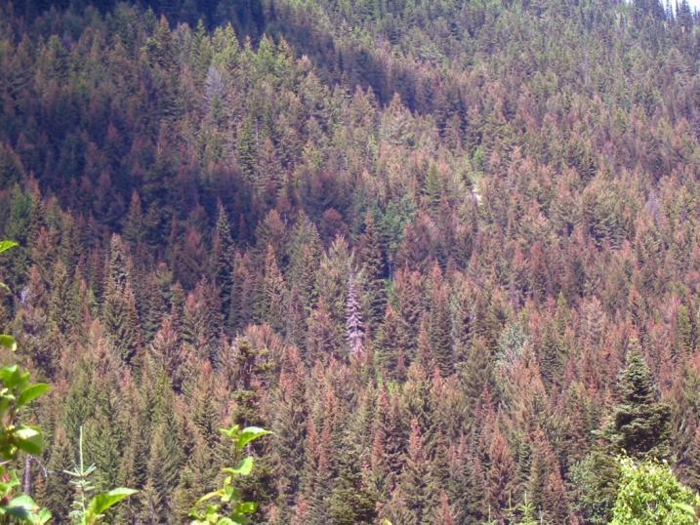
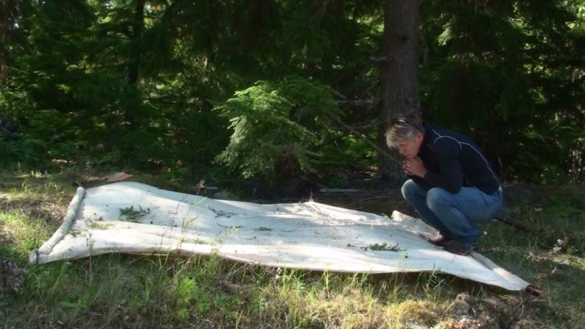
How well are we currently monitoring our 'forests'?
Forest as defined by Canadian National Forest Inventory 2001 is a CANFI cell where forested land is the dominant feature.

Slide 10
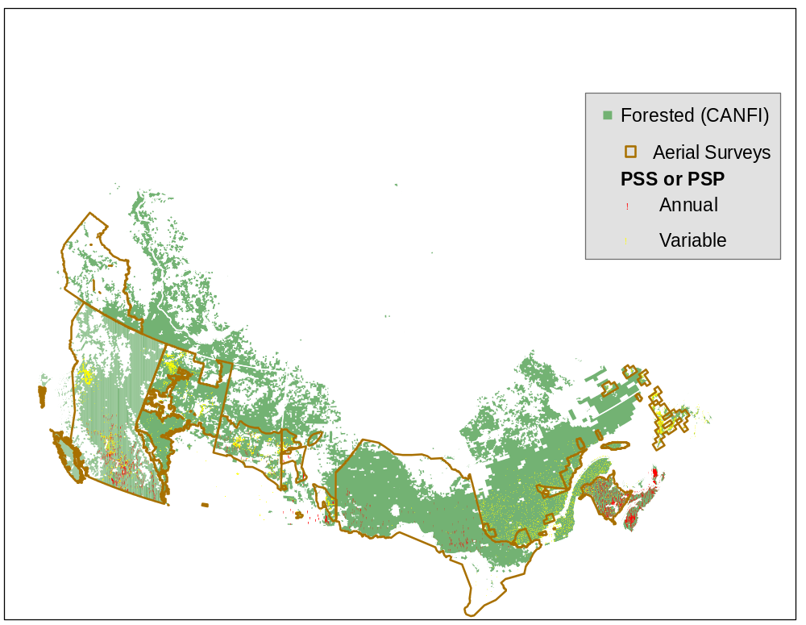
Ground and Aerial Monitoring

Slide 11
Ground Monitoring Summary
 | # of sites | % sampled annually | % with multiple pest sampling | % with same pest sampled (life stages)
BC | 2547 | 28 | 7 | 2
AB | 1493 | 0¹ | 2 | 4
SK | 953 | 14
MB | 1014 | 21 | 2
ON | 253 | 86 | 86
QB | 2510 | 0¹
NB | 675 | 92 | 50 | 22
NS | 856 | 100 | 35 | 16
PE | 14 | 0¹
NL | 1817 | 0¹
¹ Some may be assessed annually but are not considered annual plots.
*Some P/T already employing enhanced surveillance

Slide 12
Outcome of Victoria meeting
Defined Monitoring and Diagnostic objectives
Developed 3 Monitoring Scenarios
Identified the need to develop a National list of major forest pests
Discussed the need to review pest methodologies and thresholds (origin, rationale, etc).
  Recommend reviving the opportunity to have this discussion of best practices and opportunities for standardization during the week of the National Forest Pest Forum (FPT Meeting?)

Slide 13
Monitoring and Diagnostics Objectives
To collect, record and maintain historical and current pest (native and invasive) data and associated methodologies/standards) to facilitate:
  spatial and temporal ecosystem-based reporting of pest status (abundance, severity, trends, damage),
  informing short and long-term risk responses,
  forest depletion estimates,
  quantification of impacts on trade and carbon accounting, and,
  identification of climate-related changes caused by pest behaviour and/or impact.
To build upon national monitoring capacity and improve on diagnostic capacity.
Cont’d

Slide 14
Monitoring and Diagnostics Objectives
To identify/develop national best practices thru improved communication, evaluation of management decisions and harmonization / improvement of forest pest methodologies, i.e. adaptive management.
Incorporation of monitoring results into the other technical advisory group activities including information for risk analysis and the national database, and identification of national research needs.

Slide 15
Monitoring Scenarios
Good, Better, Best
  Where surveys are being conducted (land status)
  What is being surveyed (major, minor, all) and how
  Frequency of surveys
  Sampling distribution
  Harmonized best practices
  Ability to inform Risk Analysis
  Costs for each scenario – in progress

Slide 16
 | Good | Better | Best
Overview surveys (aerial or remote sensing) | Partial forest (accessible ground checks) | All managed forests including parks, DND, IR (aerial and/or ground checks) | All forested (aerial and/or ground checks)
Ground survey | Respond to P/T high priority major pests and general surveillance | Annual/periodic monitoring points with quantitative estimates of all major and potential pests in all managed forests, including parks, DND, and IR | Annual monitoring points with quantitative estimates of all pest conditions in all forest (enhanced FIDS)
Sampling design | Historical distribution of major pests | 50 sample points/leading tree species for managed forests including parks, DND, and IR | 50 + sample points/leading tree species on all forested lands and enhanced surveillance.
Ecosystem based reporting | Retrospective | Retrospective | Retrospective
Improved communication e.g. meetings, NFIS | Yes | Yes | Yes
Harmonized best practices to meet NFPS objectives | No | Yes | Yes
Ability to inform Risk Analysis | Increases with monitoring effort

Slide 17

Major Forest Pests
Pest | Number of P/T
Eastern spruce budworm | 10
Forest tent caterpillar | 10
White pine (spruce) weevil | 9
Large aspen tortrix | 7
Armillaria root disease | 6
Jack pine budworm | 6
Spruce beetle | 6
Mountain pine beetle | 5
Balsam woolly adelgid, pine shoot beetle, Warren’ root collar weevil, western gall rust, white pine blister rust | 4

Slide 18
Outstanding Tasks
MONITORING
Prepare final report which will include:
  approximate budgets for each monitoring scenario;
  comparison of current spatial distribution of PSS’s with leading species distribution and identification of gaps;
  update monitoring matrix and corresponding compatibility tables i.e. lure formulations; and
  summarize compatibilities or incompatibilities of major forest pests methodologies and/or thresholds.
Assist with developing algorithms to convert ground plot data into a common reporting format in collaboration with IIM.
Complete BC pest monitoring database and deliver to IIM.
cont’d

Slide 19
Outstanding Tasks
DIAGNOSTICS
Compile a database which identifies facilities which:
  Provide a free service,
  Provide a diagnostic and/or taxonomic service;
  Have Pathology and/or Entomology expertise; and
  Will provide natural history and management information.

Slide 20
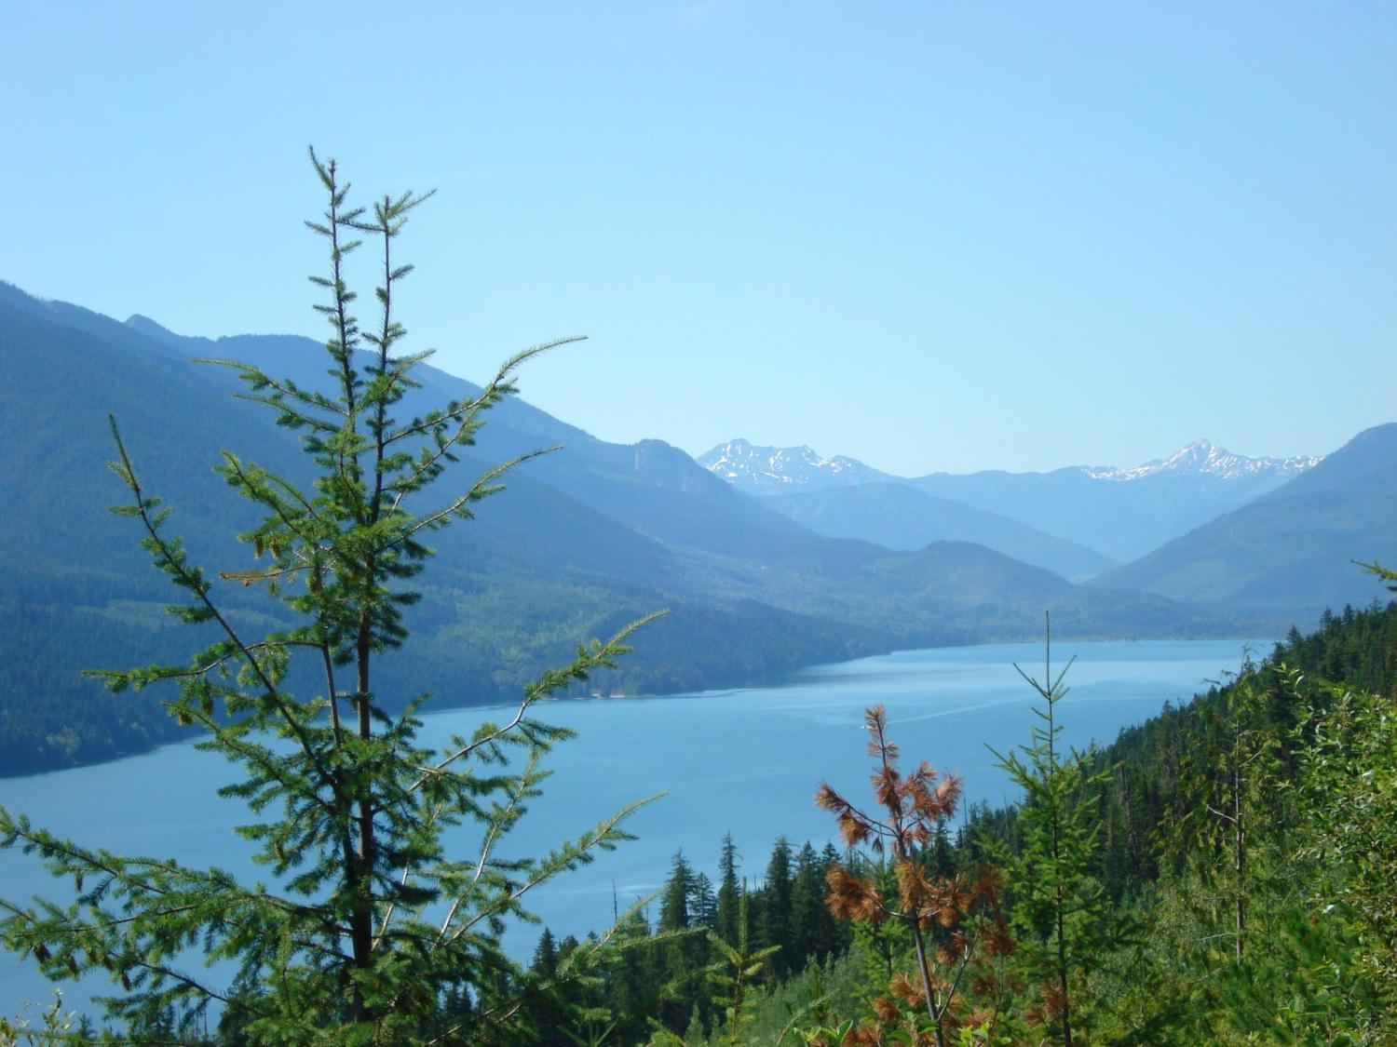
Acknowledgements
Many thanks to all participants whom contributed to this process.

