Slide 1
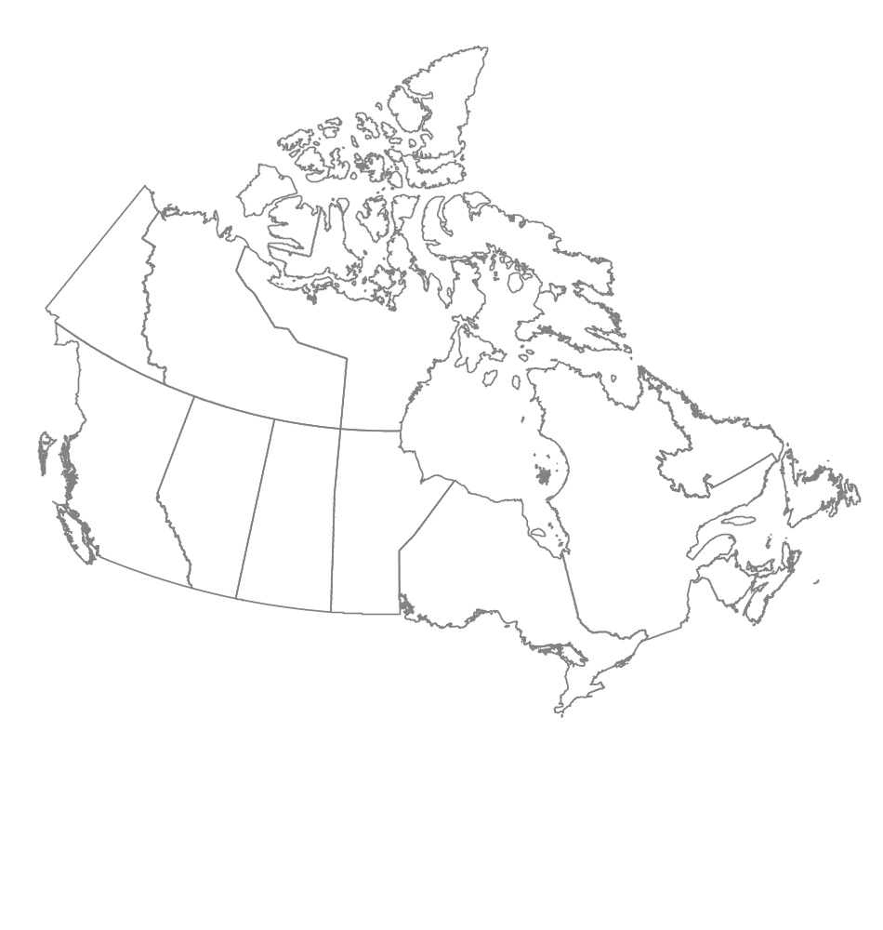




National Forest Pest Strategy
Monitoring and Diagnostics Workshop
Janice Hodge
JCH Forest Pest Management
Coldstream, British Columbia
Tim Ebata
Ministry of Forests and Range
Victoria, British Columbia
Joan Westfall
Entopath Management
Kamloops, British Columbia

Slide 2
Progress to Date
Year 1 – 2008/09
  Collated P/T monitoring information and produced year-end report.
Year 2 – 2009/10
  Collected additional monitoring information;
  Updated monitoring database;
  Created spatial database of ‘permanent sample plots’ and aerial survey coverages;
  Requested all high priority monitoring data from British Columbia forest health specialists and began developing a geodatabase for BC; and
  Developed a draft monitoring scheme (good, better, best).

Slide 3

2009/2010 Deliverables
Summary of National Monitoring Capacity (revised)
Current National Monitoring database
Proposed National Monitoring Scheme/Plan

Slide 4
“ A key initial decision in designing a monitoring program is balancing the need to monitor for current management issues against the need to detect future, perhaps unforeseen threats to (park) ecosystems. A monitoring program that only focuses on well-known threat/ response relationships will not provide the long-term information and understanding necessary to address unanticipated, high-priority issues that will arise in the future.”
Excerpt from “Northeast Temperate Network Vital Sings Monitoring Plan”,
National Park Service, Technical Report NPS/NER/NRTR –206/059

Slide 5
Monitoring Summary - Recap
Gaps in Northern Canada and urban areas
Low percentage of plots monitored annually
Majority of ground monitoring plots are pest specific; very few at an ecosystem or forest type level ex. CIPHA.
Although some ecozones appear adequately monitored (proportional representation) the spatial distribution may not be adequate.

Slide 6
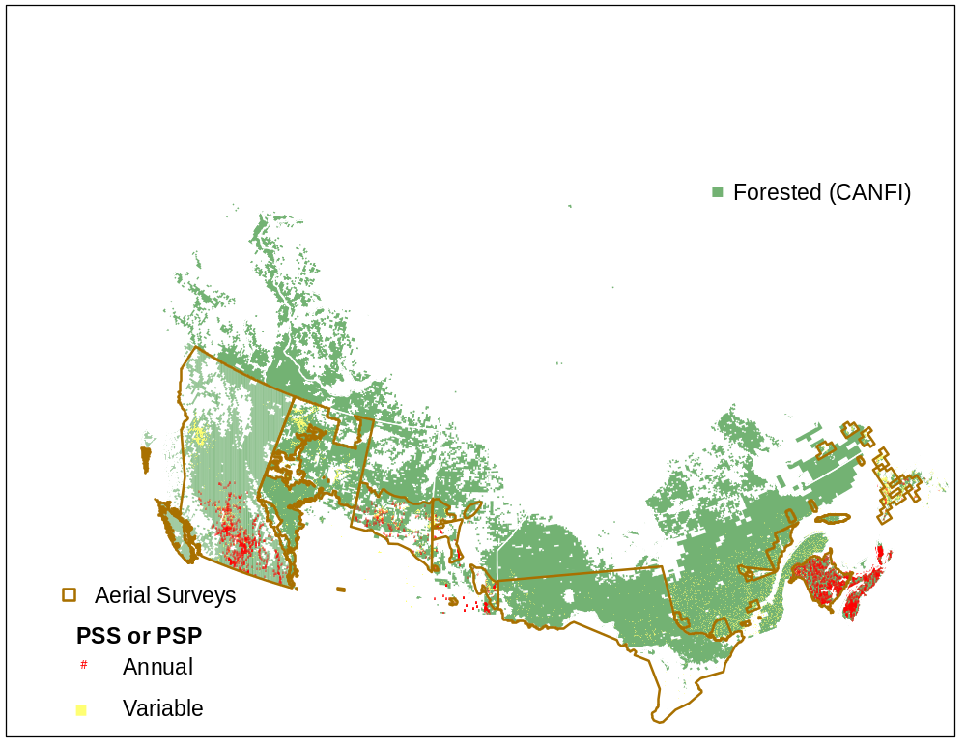
Ground and Aerial Monitoring

Slide 7
Ground monitoring (annual and variable) summary by Forested portions of Ecozones
 | BC |  | AB |  | SK |  | MB |  | ON |  | QB |  | NB |  | NS |  | NL |  | PE
 | % of plots | % Ecozone | % of plots | % Ecozone | % of plots | % Ecozone | % of plots | % Ecozone | % of plots | % Ecozone | % of plots | % Ecozone | % of plots | % Ecozone | % of plots | % Ecozone | % of plots | % Ecozone | % of plots | % Ecozone
Atlantic Maritime |  |  |  |  |  |  |  |  |  |  | 24 | 7 | 100 | 100 | 100 | 100 |  |  | 100 | 100
Boreal Cordillera | 0 | 12
Boreal Plains | 0 | 5 | 54 | 76 | 85 | 38 | 38 | 17
Boreal Shield |  |  | 0 | 1 | 9 | 50 | 50 | 55 | 93 | 92 | 66 | 66 |  |  |  |  | 99 | 54
Hudson Plains |  |  |  |  |  |  |  |  | 0 | 6 | 0 | 1
Mixedwood Plains |  |  |  |  |  |  |  |  | 7 | 3 | 11 | 1
Montane Cordillera | 67 | 56 | 6 | 8
Pacific Maritime | 32 | 18
Prairies |  |  | 1 | 0 | 6 | 1 | 7 | 0
Taiga Plains | 0 | 9 | 40 | 11
Taiga Shield |  |  | 0 | 3 | 0 | 12 | 0 | 12 |  |  | 0 | 24 |  |  |  |  | 1 | 46

Slide 8
Approach to Monitoring Scheme
 | Good | Better | Best
Establish fixed radius plots @ established PS*’s and collect additional FH and climate change data | No | Yes | No (covered)
Ecosystem based reporting | Retrospective | Retrospective | Yes
Establish and monitor ecosystem-based PSP’s (using existing or historical FIDS where appropriate) | No | No | Yes
Remote sensing of northern Canada | No | Yes? | Yes
Improved communication ex. meetings, NFIS | Yes | Yes | Yes

Slide 9
M and D TAG principles | Good | Better | Best
Build on current info and existing capacities
Include native and invasive
Cover public and forested lands
Fulfill provincial , national and international reporting
Info sufficient quality and resolution to be used for risk assessment
Include insects, diseases and major abiotic
Detection and evaluation
Accessible to all participants

Slide 10
Standardization of aerial survey categories ?
 | BC | YT | AB | SK | MB | ON | QB |  | NB | NS | NL
 |  |  |  |  |  |  | Hardwood | Conifer
Lightª | 1-30 | <25 | <35 | - | <35 | <50 | 1-25 | 1-34 | 1-30 | 10-29 | -
Mod | 30-50 | 26-65 | 36-70 | 30-69 | 35-70 | 51-75 | 26-60 | 35-69 | 31-70 | 30-69 | 31-70
Sev | >50 | >65 | >70 | >>70 | >70 | >75 | >60 | >70 | >70 | >70 | >70
Other | mort |  |  |  |  |  |  |  |  |  | >70 with mort
ª Defoliation severities based on average defoliation characteristics at a polygon level ^{b} BC categories for L and M do not include % but the authors consider these to be as noted.

Slide 11
Standardization of pest codes and host species codes
BC pest codes 3 letter codes could be expanded to include all MFD’s
  IDW = Insect, Defoliator, Western spruce budworm
  could be expanded to 4 letters to accommodate hardwoods
  IDCW = Insect, Defoliator, Conifer, Western spruce budworm
  IDHF = Insect, Defoliator, Hardwood, Forest tent caterpillar
Host species coding
  Presently no consistency between provinces
    2001 CANFI numeric coding ?
    2006 NFI coding – genus + species ?

Slide 12
Workshop Wish List
What are our objectives? What are we trying to measure? What question are we trying to answer (a la Taylor Scarr!)?
Ecosystem or pest-based?
Commercial forest or all forest? Or vary by monitoring scenario?
Is there a need for methodology/threshold standardization or are algorithms adequate? Host and pest coding standards?
Identify linkage with risk analysis.
What attributes should be collected in the better and best scenario ground plots? What type of plot (ex. fixed radius)?
Is remote sensing a feasible and reliable option for remote areas?
For plot placement how do we stratify the landbase? Ex. proportional representation by ? Is statistical validity required?

Slide 13
Ownership class of forest and other wooded land, CANFI 2001.

Slide 14
Forest and other wooded land by land status, CANFI 2001.

