Slide 1
Notes:
Shore-Safranyik hazard rating above 33 points, based on BC inventory data, 2013

Slide 2
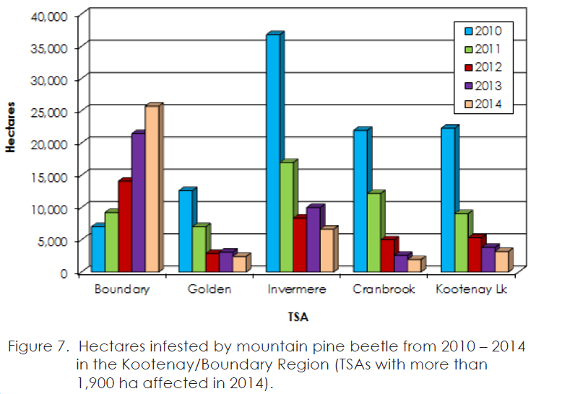

Slide 3
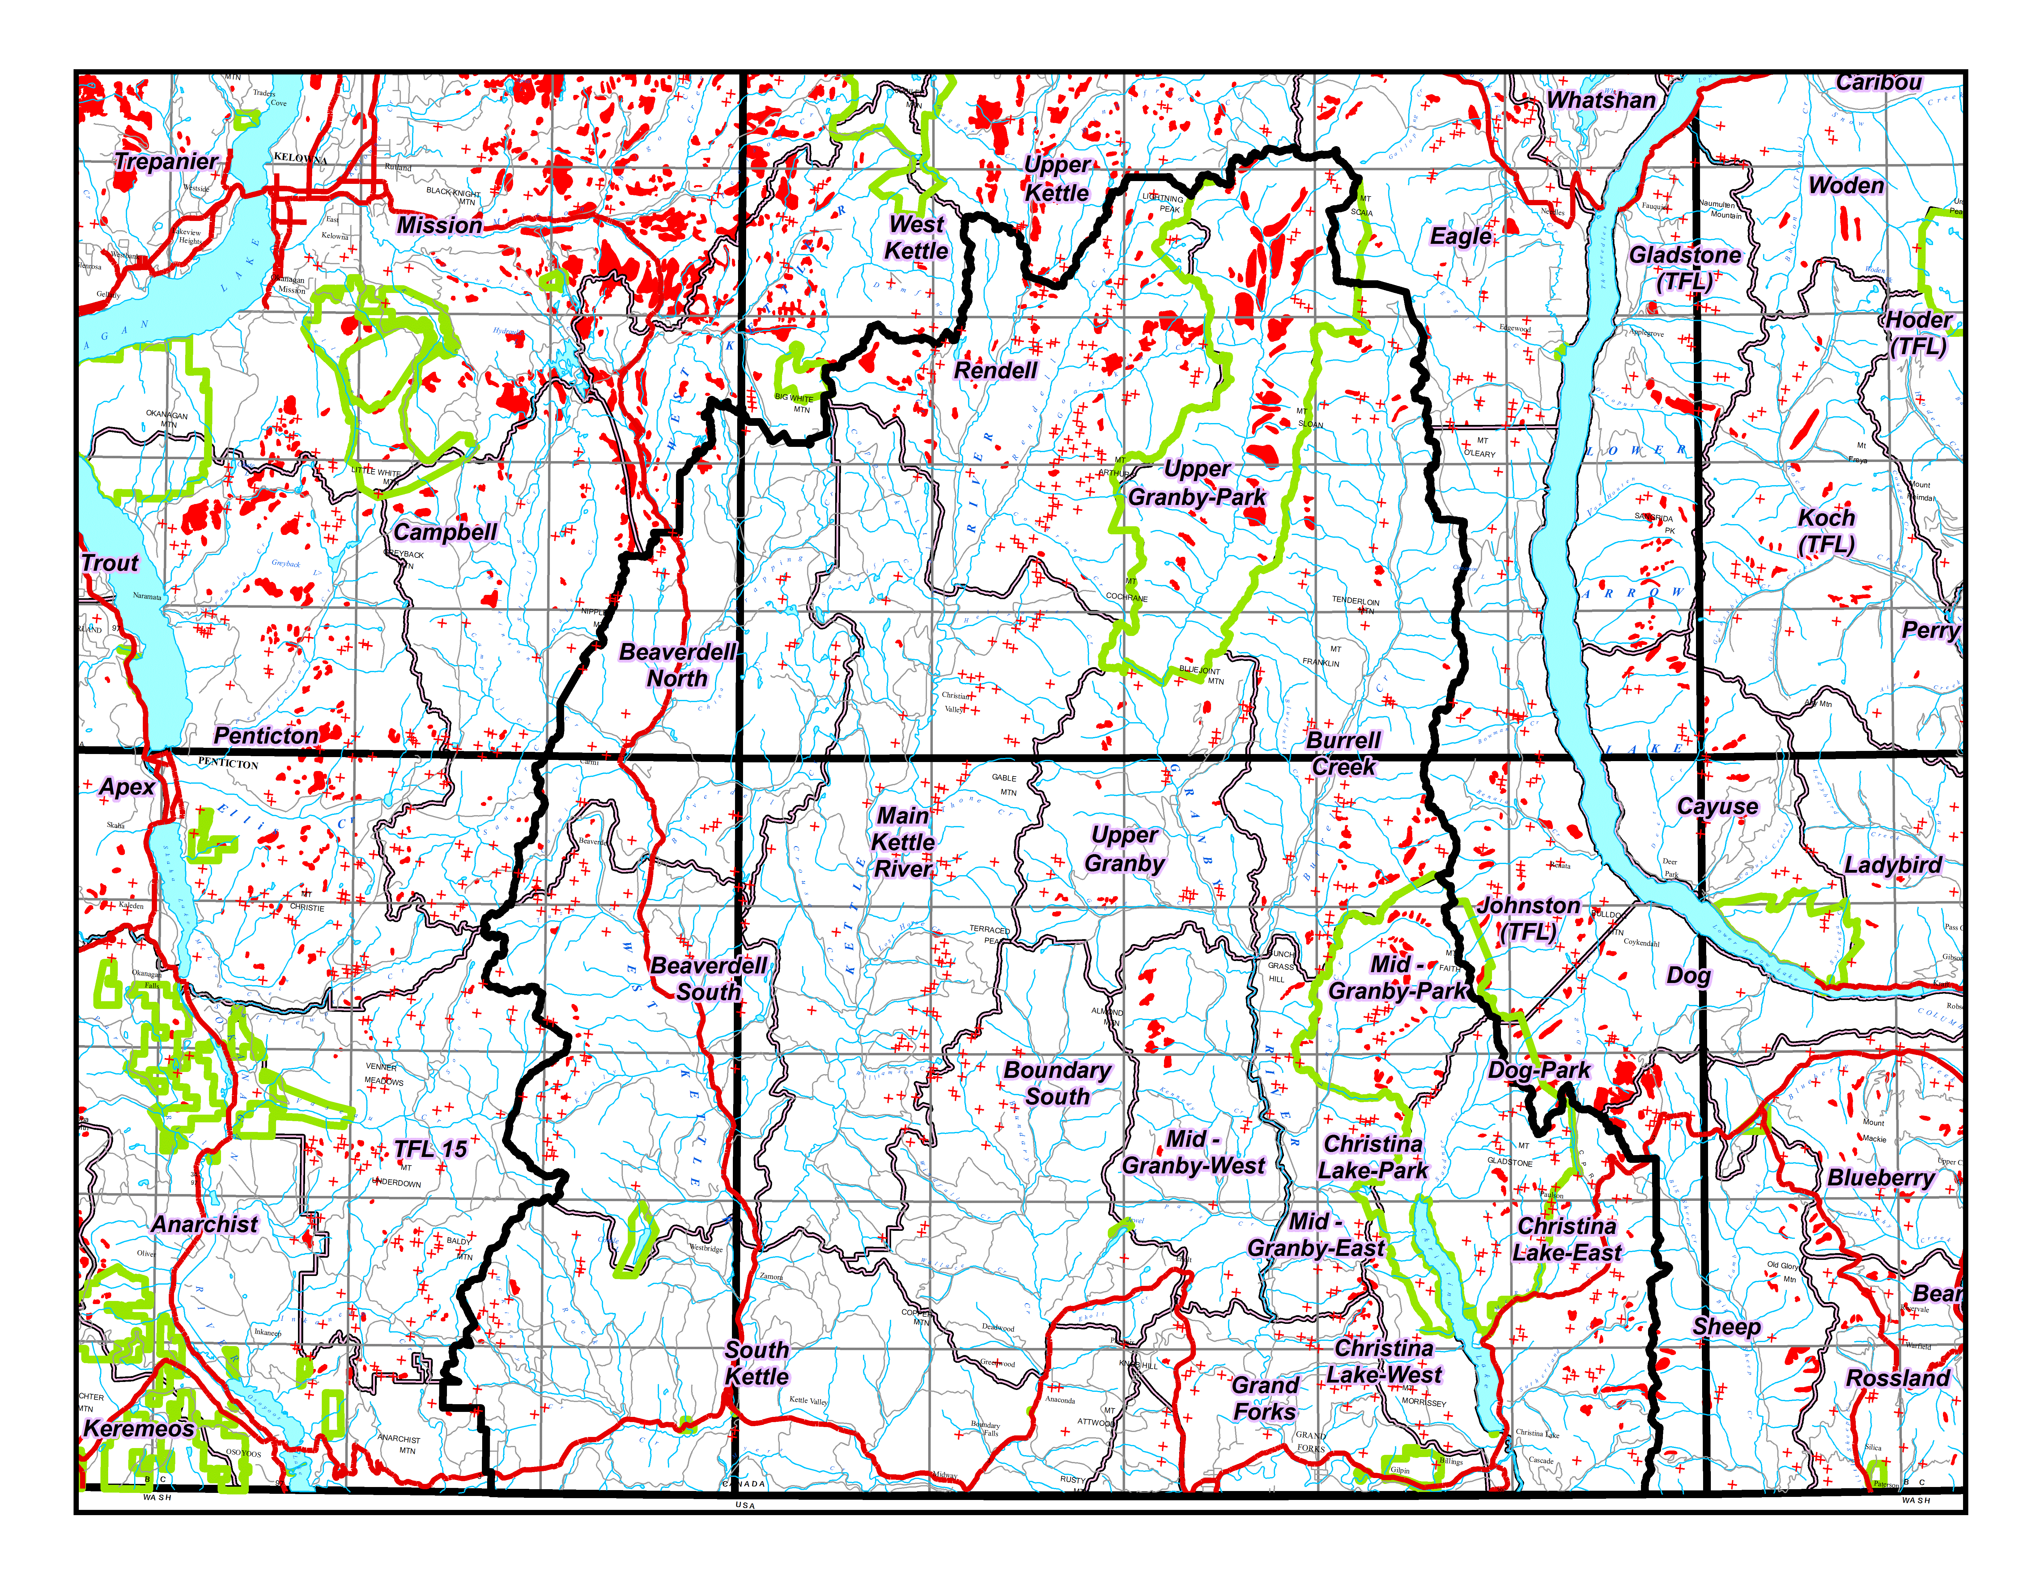
2010
Notes:
Boundary 2010

Slide 4
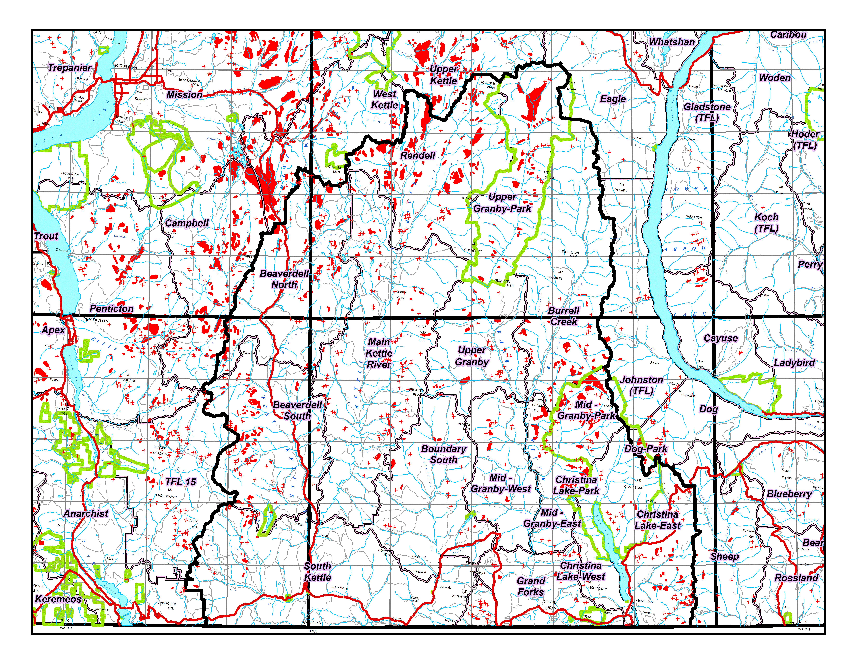
2012
Notes:
Boundary 2012

Slide 5
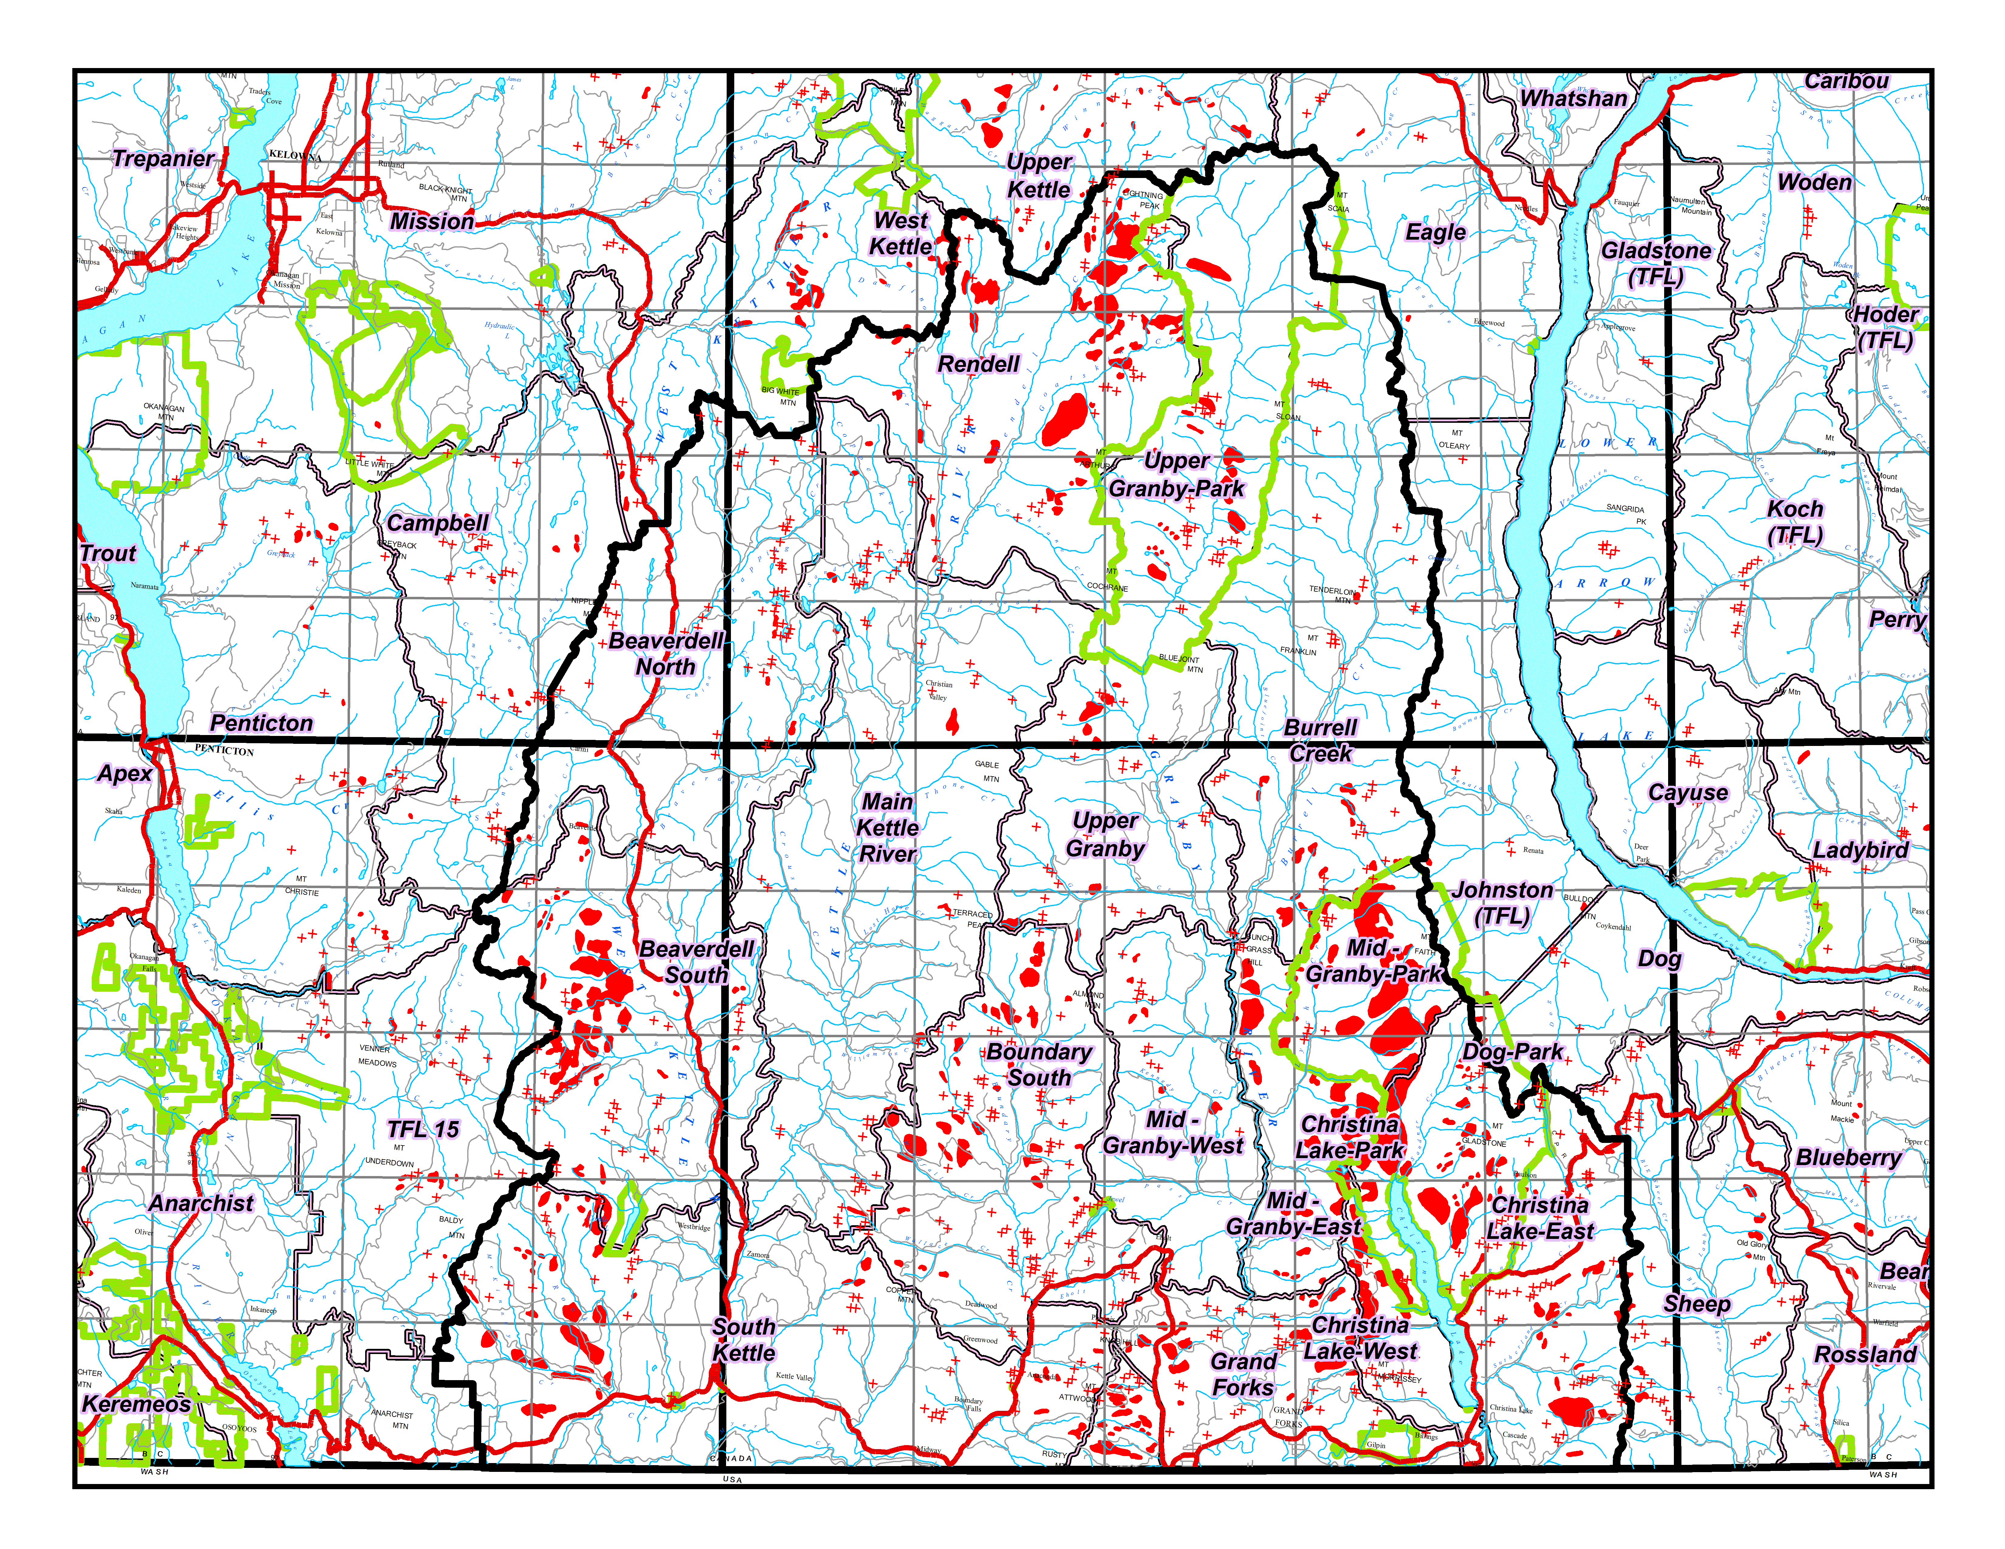
2014
Notes:
Boundary 2014

