Slide 1
Land Based Investment Strategy: Forest For Tomorrow
5 Year Silviculture Plan Development Process
Presented by
Kevin Telfer R.P.Bio., R.P.F.
Stewardship Forester
Coast Region
Notes:
I am a Biologist from the Ecosystem Section asked to help out with development of 5 year LBIS plan

Slide 2
Land Based Investment Strategy: Forest For Tomorrow
( A Biologist lost in the woods...)
5 Year Silviculture Plan Development Process
Presented by
Kevin Telfer R.P.Bio., R.P.F.
Stewardship Forester
Coast Region

Slide 3
Mission:
Familiarize District Staff & licensees with LBIS
Obtain detailed input about investment opportunities/priorities
Draft a defendable 5 year FFT plan
(oh, and could you do a little talk in Richmond???)

Slide 4
Tasks:
Familiarize myself with LBIS
Get a list of district contacts
Schedule a brief PowerPoint presentation at the district Forest Management Leadership Team meetings
Canvas Licensees for information
Compile a plan that optimises FFT investment
Notes:
Local input (licensees, districts staff, stakeholders) into the development of the 5 silviculture plan is encouraged. This local input will be balanced with provincial and regional needs.
It is hoped that local resource needs will assist in the development of Regional and provincial goals, objectives and priorities.

Slide 5
PowerPoint for FMLT’s :
Outline LBIS Goals
Stress Activities consistent with Silvicultural investment criteria
Describe District role
Provide planning resources and timeline
...and canvas interest to join a committee?
Notes:
Local input (licensees, districts staff, stakeholders) into the development of the 5 silviculture plan is encouraged. This local input will be balanced with provincial and regional needs.
It is hoped that local resource needs will assist in the development of Regional and provincial goals, objectives and priorities.

Slide 6
Presentations in:
Port McNeill
Campbell River
Port Alberni
Chilliwack
Powel River
Notes:
Local input (licensees, districts staff, stakeholders) into the development of the 5 silviculture plan is encouraged. This local input will be balanced with provincial and regional needs.
It is hoped that local resource needs will assist in the development of Regional and provincial goals, objectives and priorities.

Slide 7
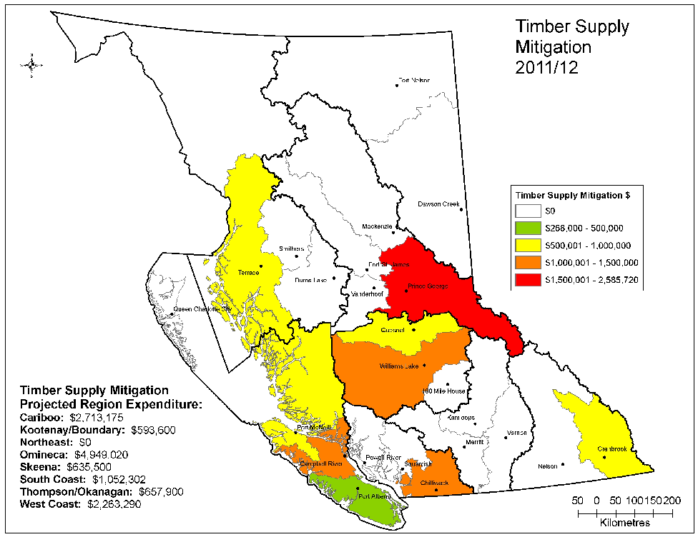
Timber supply mitigation:
Enhanced stock
Spacing
Fertilization
Pruning
Notes:
Timber supply mitigation is especially focused on those management units where there is a documented and projected mid term timber supply fall down (20-30 years out), and best Return on Investment (ROI)

Slide 8
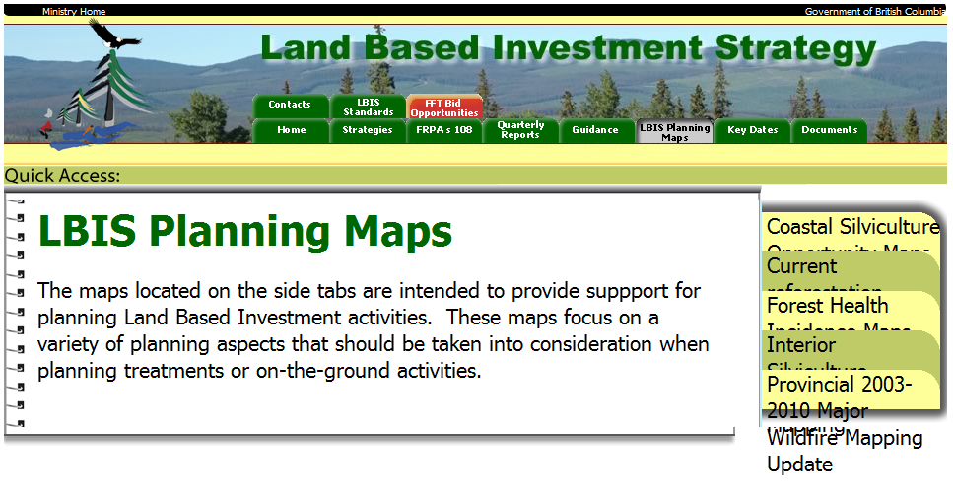
Information sources to guide plan development:
TSR Analysis Reports
Silviculture Opportunity maps
Wildfire mapping
Forest Health mapping
RESULTS reporting of planned activities
http://lbis.forestpracticesbranch.com/LBIS/node/180

Slide 9
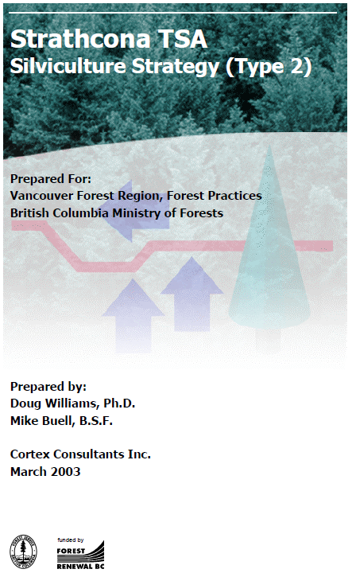
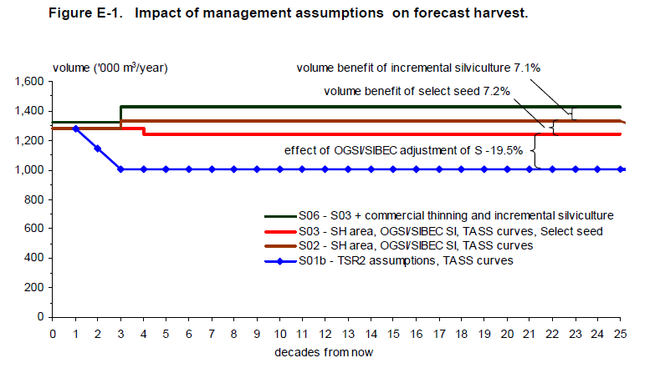
Incremental Silviculture offsets TSR impacts
http://www.for.gov.bc.ca/ftp/hfp/external/!publish/fft_standards_on_cms_web/SilvicultureStrategyDocuments/Strathcona_TSA_37/Strathcona%20Type%202%20Final%2019Mar03.pdf
Silviculture Strategy

Slide 10
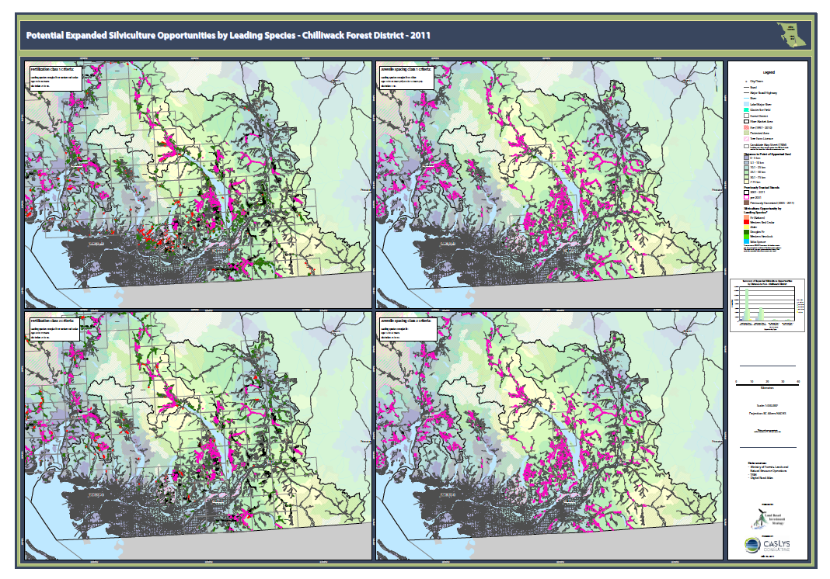
Silviculture Opportunity Mapping
http://www.for.gov.bc.ca/ftp/hfp/external/!publish/LBIS_web/LBIS_Fibre_Basket_Mapping/coast/Exp_Silv_Opp_Chilliwack_Poster_byLeading_Species_2011_42x60in.pdf
Notes:
Silviculture Opportunity Mapping generated from RESULTS reporting

Slide 11
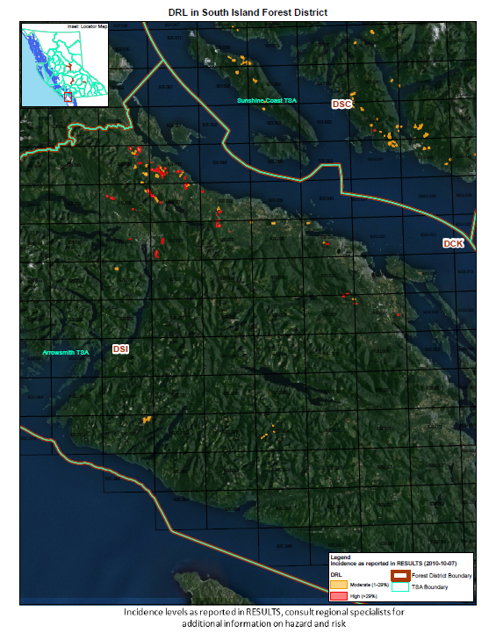
LBIS Planning maps
Forest Health Issues: a potential investment opportunity to off-set losses due to pest and disease
Forest Health Mapping
Notes:
LBIS Planning Maps show incidence of forest health factors that could be opportunities for investment

Slide 12
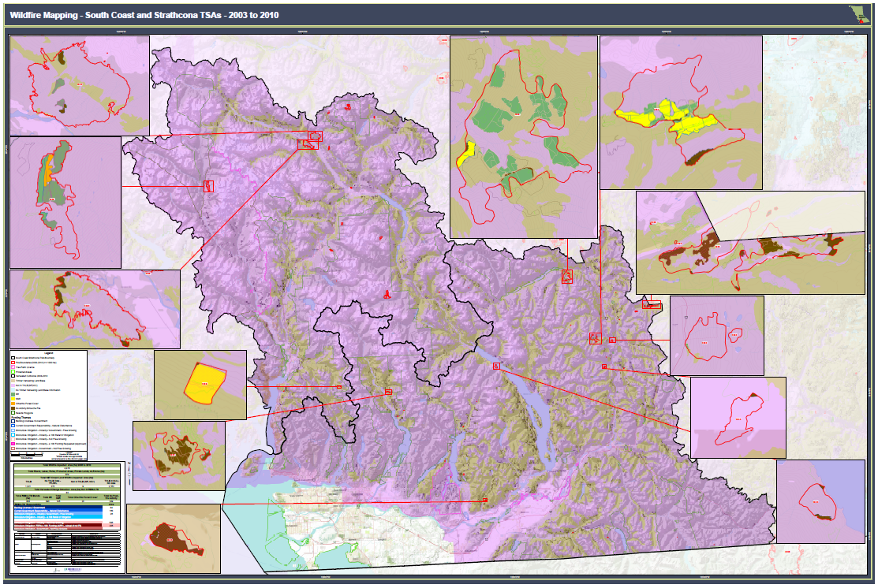
South Coast and Strathcona TSAs Fire mapping
Notes:
LBIS Fire mapping is another Resource for silviculture opportunities. The wildfire mapping shows the location of all wildfires between 2003 and 2010.

Slide 13
Other information gathering:
Meet with licensees directly to discuss their needs
Telephone interviews
Provide an excel spreadsheet to standardize responses

Slide 14
Land Based Investment Strategy Licensee Planning Input
Tenure________ Mgt Unit/TSA_______ Forest District__________
Planning Year | Activity type | Ha. to treat | Treatment Rational (Timber Supply constraint, forest health, fire, etc...)
1 |  |  | _______________________________________
2 |  |  | _______________________________________
3 |  |  | _______________________________________
4 |  |  | _______________________________________
5 |  |  | _______________________________________
Notes:
Helpful if Tree Farm Licence has supply blocks that straddle districts

Slide 15
Outcome of Information gathering:

Slide 16
Many respondents wanted to conduct unsupported activities such as:
  Fertilizing Coastal Western Hemlock
  Barge based fertilization in the North Gulf Islands and mainland coast
  Hand apply fertilizer for “job creation”
  Spacing to create habitat for Northern Goshawk to offset Wildlife Habitat Area impacts....
Notes:
Ask a silly question....

Slide 17
Results:
5 year LBIS Plan became very much a “top-down” process, with activities driven more by the investment criteria, than licensee aspirations
Many licensees discouraged by the “process”
Notes:
Meanwhile at the Coastal Silviculture meeting in June, great this will be a big help...

Slide 18
Coastal Silviculture Committee summer workshop in Mission BC:
Incremental Silviculture: Miracle or Myth?
Notes:
Uh oh....

Slide 19
Myth?
Notes:
Some very strong opinions one way or the other on incremental silviculture

Slide 20
Dichotomous key to Silviculturalists
Silvo-Pessimists
Silvo-Optimists

Slide 21
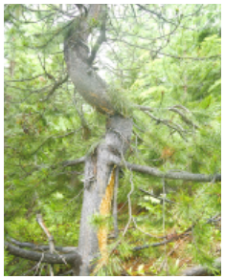
Silvo-Pessimist
Spacing leads to:
Decreased future volumes
Poor stem form
Decreased stand values
Weakening of moral values
Decline of western civilization
Phote: Suzanne Simard
Notes:
Decreased volumes due to fewer stems and baiting harvest into spaced stands near to town, made worse by inability to “lock up” stands until investment return is realized. TSR impacts as we are not harvesting “oldest stands first”

Slide 22
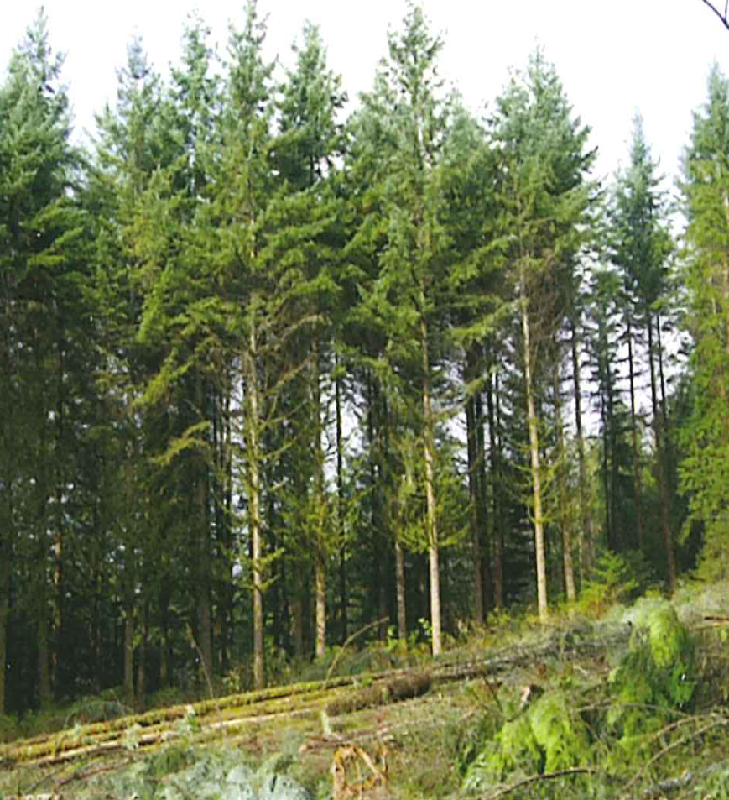
Silvo-Optimist
Spacing leads to:
Earlier harvests
Increased piece size
More clear wood (especially with pruning $$)
Product diversity
An abundance of half full glasses

Slide 23
So what’s a biologist to do?

Slide 24
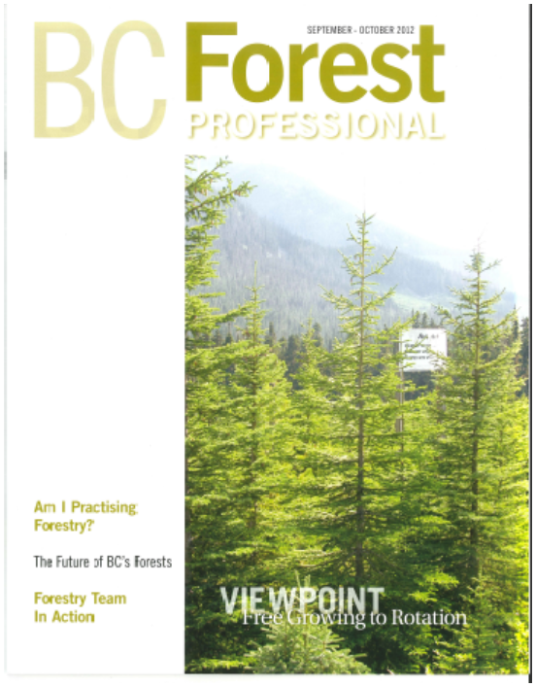
Publish an article in the BC Forest Professional??
(page 17)

Slide 25
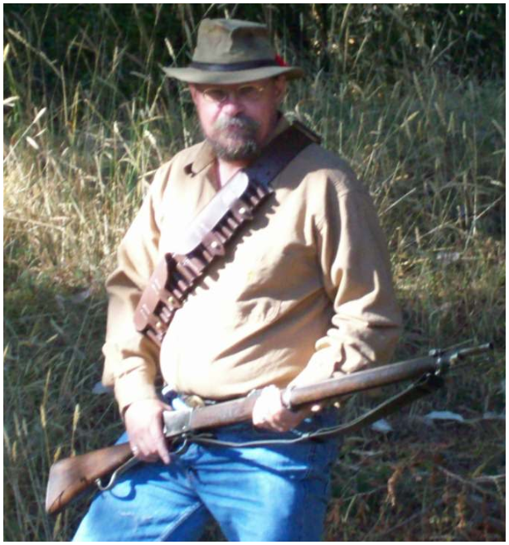
Become a wandering recluse?
$ Wanted $

Slide 26
D
Draft a compromise Plan?

Slide 27
D
Compromise Plan:
Current reforestation (fires)
Lots of fertilization
Some Red alder spacing
Some spacing & pruning if supported by TSR, licensees, District staff, Branch, budgets, & etc...
Rationale Document
Assumptions
Priorities in order of which activities to drop
Opportunities should investment criteria change

Slide 28
D
Compromise Plan: Similar budget as 2012-13
Current reforestation (150 ha.)
Lots of aerial fertilization (8,500 ha.)
Removal of Vexar tubing from defunct licensees in DHG
Some Red alder spacing (~100 ha./year)
Spacing (280 ha.) Chilliwack (Fd) & Haida Gwai (Ss) with PITA surveys
Pruning (100 ha. 2015) high SI stands, budget permitting
Some hand fertilization (~80 ha) where feasible
Consider barge based fertilization in future years
Notes:
Spacing of Red alder is important for managing density dependent stem form and branching

Slide 29

Thank you

Slide 30
Questions?

