Slide 1
Ammonia volatilization from urea
David E. Kissel
University of Georgia

Slide 2
Overview
Evolution of Urea consumption
Definitions
Urea Dissolution and Diffusion
Urea Hydrolysis
Ammonia Volatilization
Research Results
Summary

Slide 3
USA Evolution of N Fertilizers Consumption
Urea
21%
Ammonium nitrate
1973 / 74
Nitrogen solutions
2004 / 05
Anhydrous ammonia
Total compound N
0
1
2
3
4
5
Millions of tonnes
www.fertilizer.org
Notes:
No abreviar

Slide 4
Overview
Evolution of Urea consumption
Definitions
Urea Dissolution and Diffusion
Urea Hydrolysis
Ammonia Volatilization
Research Results
Summary

Slide 5
Definitions
Dissolution: urea absorbs water and converts from solid to liquid
Hydrolysis: urea converts to ammonium (NH₄⁺)
Diffusion: movement due to motion of molecules
  Urea has no charge, diffuses easily
  NH₄⁺ has charge, diffuses slowly

Slide 6
Overview
Evolution of Urea consumption
Definitions
Urea Dissolution and Diffusion
Urea Hydrolysis
Ammonia Volatilization
Research Results
Summary

Slide 7
Urea Dissolution
Urea has to be dissolved before it can be hydrolyzed

Slide 8
Urea Dissolution
Urea has to be dissolved before it can be hydrolyzed
Urea can absorb water from the atmosphere and from the soil/crop residue

Slide 9
Urea Dissolution
Urea has to be dissolved before it can be hydrolyzed
Urea can absorb water from the atmosphere and from the soil/crop residue
Absorption of water from the atmosphere depends on relative humidity (RH)

Slide 10
Urea Dissolution
Urea has to be dissolved before it can be hydrolyzed
Urea can absorb water from the atmosphere and from the soil/crop residue
Absorption of water from the atmosphere depends on relative humidity (RH)
Critical relative humidity (CRH) is the RH at which urea dissolves

Slide 11
Effect of Temperature on CRH and Water Solubility of Urea

Slide 12
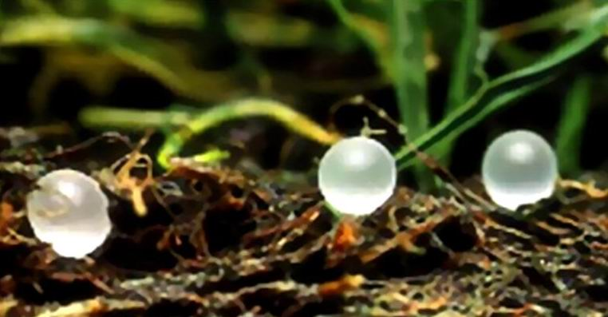
Urea dissolution
and diffusion
RH > CRH (80%)
www.agrium.com
Crop residue
Urea
Urea
Urea
Urea
Urea
Urea
Dry Soil

Slide 13
Urea dissolution
and diffusion
www.agrium.com
Crop residue
Urea
Urea
Urea
Urea
Urea
Urea
1/2 inch
Urea
Urea
Urea
Wet Soil

Slide 14
Crop residue
Urea
Urea
Urea
Urea
Urea
Urea
Urea
Urea
Urea
2 inches

Slide 15
Urea Diffusion into Soil
Urea
Urea
Urea
Urea
Urea
Urea
Diffusion
Depth
Urea
Urea
Urea
Determined by soil moisture

Slide 16
Urea Diffusion into Soil (after 10 days)

Slide 17
Overview
Evolution of Urea consumption
Definitions
Urea Dissolution and Diffusion
Urea Hydrolysis
Ammonia Volatilization
Research Results
Summary

Slide 18
Urea Hydrolysis
Urea
+
2
H⁺
2
NH₄⁺
Urease enzyme
Urease is derived from crop residues
and soil microorganisms

Slide 19
Urease inhibitor
Crop residue
Urea
Urea
Urea
Urea
Urea
Urea
Urea
Urea
Urea

Slide 20
Overview
Evolution of Urea consumption
Definitions
Urea Dissolution and Diffusion
Urea Hydrolysis
Ammonia Volatilization
Research Results
Summary

Slide 21
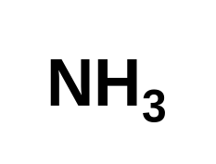
NH₃ Volatilization Process
Atmosphere
Hydrolysis
Urea
+ H⁺
NH₄⁺
Soil air
Soil solution
_{(gas)}
NH₄⁺
Clay
NH₄⁺
NH₄⁺
+
H⁺
_{(aq)}
_{(aq)}
OM
Equilibrium
NH₄⁺

Slide 22
Effect of soil pH on NH₃ as % of Total N

Slide 23
NH₃ Volatilization Process
Atmosphere
Hydrolysis
Urea
+ H⁺
NH₄⁺
Soil air
Soil solution
_{(gas)}
NH₄⁺
Clay
NH₄⁺
NH₄⁺
+
H⁺
_{(aq)}
_{(aq)}
OM
Equilibrium
NH₄⁺

Slide 24
Increase in soil pH
depends on soil H⁺
buffering capacity
Higher clay and OM
contents lead to higher
soil H⁺ buffering
capacity

Slide 25
Atmosphere
Urea hydrolyzes on the soil surface
Urea
Urea
Urea
Urea
NH₄⁺
NH₄⁺
NH₄⁺
NH₄⁺
NH₄⁺
NH₄⁺
NH₄⁺
NH₄⁺
NH₄⁺
NH₄⁺
NH₄⁺
H⁺
H⁺
½ inch
H⁺
H⁺
H⁺
H⁺
H⁺
H⁺
CEC
pH
6
7
8
9

Slide 26
Urea hydrolyzes below the soil surface
Urea
Urea
Urea
Urea
Urea
Urea
Urea
Urea
NH₄⁺
NH₄⁺
NH₄⁺
NH₄⁺
NH₄⁺
NH₄⁺
NH₄⁺
NH₄⁺
NH₄⁺
NH₄⁺
NH₄⁺
NH₄⁺
NH₄⁺
2 inches
NH₄⁺
H⁺
H⁺
H⁺
H⁺
H⁺
H⁺
H⁺
H⁺
CEC
pH
6
7

Slide 27
Effect of Temperature on NH₃ Volatilization
Temperature
Soil
½ inch
Urea
NH₄⁺
+
H⁺

Slide 28
Effect of Temperature on Urea Hydrolysis

Slide 29
Effect of Temperature on NH₃ Volatilization
Temperature
Soil
½ inch
Urea
NH₄⁺
+
H⁺

Slide 30
Effect of Temperature on % of NH₃
pH = 8.5

Slide 31
Effect of Temperature on NH₃ Volatilization
Temperature
Soil
½ inch
Urea
NH₄⁺
+
H⁺

Slide 32
Effect of Temperature on Conversion of
Aqueous NH₃ to Gaseous NH₃

Slide 33
Effect of Temperature on NH₃ Volatilization
Temperature
Soil
½ inch
Urea
NH₄⁺
+
H⁺

Slide 34
Effect of Wind Speed on NH₃ Volatilization
Atmosphere
Wind speed
Soil
½ inch
Urea
NH₄⁺
+
H⁺

Slide 35
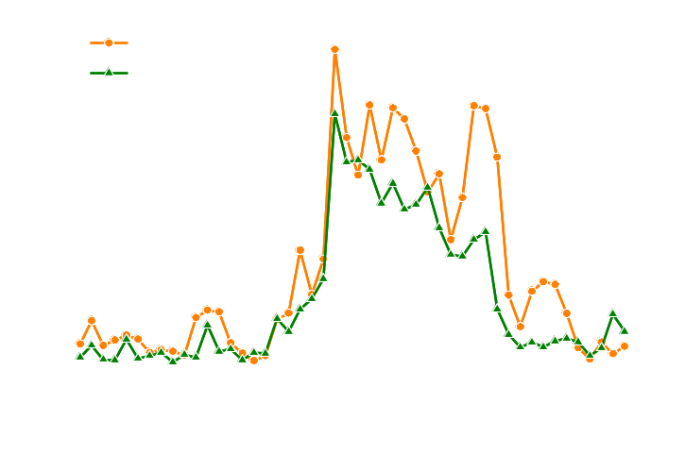
Replication I
20
UAN
UREA
Nitamin
15
10
51mm
5
0
Replication II
20
UAN
UREA
Nitamin
15
Ammonia Loss (% of Applied N)
10
51mm
5
0
Replication III
20
UAN
UREA
Nitamin
15
10
51mm
5
0
0
20
40
60
80
100
120
Days After Application

Slide 36
Optimum Conditions for Volatilization
Small diffusion depth into soil
RH > CRH
High temperature
High wind speed
Low pH buffering capacity

Slide 37
Overview
Evolution of Urea consumption
Definitions
Urea Dissolution and Diffusion
Urea Hydrolysis
Ammonia Volatilization
Research Results
Summary

Slide 38
Urea Applied to Pasture - Fall 2004
50
Nitamin®
UAN
40
Urea
Temp = 47ºF
30
NH₃ loss (% of applied N)
20
10
50
Rainfall
Soil water content
0.4
40
0.3
30
Soil water content (g g⁻¹)
Rainfall (mm)
20
0.2
10
0.1
0
20
40
60
80
100
120
Days after application

Slide 39
Urea Applied to Pasture – Spring 2005
50
Nitamin®
UAN
40
Urea
Temp = 63ºF
30
NH₃ loss (% of applied N)
20
10
Rainfall
50
Soil water content
0.4
40
0.3
30
Soil water content (g g⁻¹)
Rainfall (mm)
20
0.2
10
0.1
0
20
40
60
Days after application

Slide 40
Atmosphere
Urea
Urea
Urea
Urea
Urea
NH₄⁺
NH₄⁺
Urea
NH₄⁺
Clay
NH₄⁺
+
H⁺
OM
(aq)
_{(aq)}
Equilibrium

Slide 41
Urea Applied to Pasture - Fall 2005
Nitamin®
50
UAN
Urea
40
Temp = 62ºF
30
NH₃ loss (% of applied N)
20
10
Rainfall
50
Soil water content
0.4
40
0.3
30
Soil water content (g g⁻¹)
Rainfall (mm)
20
0.2
10
0.1
0
20
40
60
Days after application

Slide 42
Time of RH above CRH in the first 30 d
25
20
15
Time of RH > CRH (h)
10
5
0
0
5
10
15
20
25
30
Days after application
Total: RH > CRH =
63 %
19 days

Slide 43
Atmosphere
RH > CRH (80%)
Fescue thatch
Urea
NH₄⁺
Urea
Urea
Urea
Urea
Urea
NH₄⁺
NH₄⁺
NH₄⁺
NH₄⁺
NH₄⁺
NH₄⁺
Soil water content (0.07 g g⁻¹)
Permanent wilting point (0.04 g g⁻¹)

Slide 44
Urea Applied to Pasture – Spring 2006
Nitamin®
50
UAN
Urea
40
Temp = 69ºF
30
NH₃ loss (% of applied N)
20
10
Rainfall
50
Soil water content
0.4
40
0.3
30
Soil water content (g g⁻¹)
Rainfall (mm)
20
0.2
10
0.1
0
20
40
60
80
Days after application

Slide 45
Atmosphere
Urea
Urea
Urea
NH₄⁺
NH₄⁺
Urea
Urea
Urea
NH₄⁺
NH₄⁺
+
H⁺
Soil water content (0.15 g g⁻¹)
Field capacity (0.18 g g⁻¹)
_{(aq)}
(aq)
Equilibrium
CEC

Slide 46
Summary of Pasture Results
Ammonia volatilization losses under field conditions
Fertilizer
Fall 2004
Spring 2005
Fall 2005
Spring 2006
--------------- Ammonia loss (% of applied N) -----------------
Urea
19 a*
12 a
46 a
24 a
UAN
6 b
13 a
33 b
18 a
Nitamin®
6 b
14 a
34 b
18 a
Within a column, values followed by the same letter are not significantly different according to
Fisher’s LSD at p=0.05

Slide 47
Summary for Pastures/No-Till
Dry Soil, Dry Residue, RH < CRH: OK
Dry Soil, Dry Residue, RH > CRH: not OK
Wet Soil, Wet Residue: not OK
Apply on dry soil, dry residue, expected low RH, and
hope for 1 inch of rain whenever it rains.
Apply on wet soil if 1 inch rain/irrigation is expected.

Slide 48
Summary for Clean-Till Crops
Dry Soil: OK
Wet Soil: not OK
Apply on dry soil and hope for 1 inch of rain whenever
it rains.
Apply on wet soil if 1 inch of rain/irrigation is expected.

Slide 49
Summary for Pastures/Crops
Knifed or disked in
Dribbled
Broadcast
Knifed of disked in better than Dribbled
Dribbled better than Broadcast

Slide 50
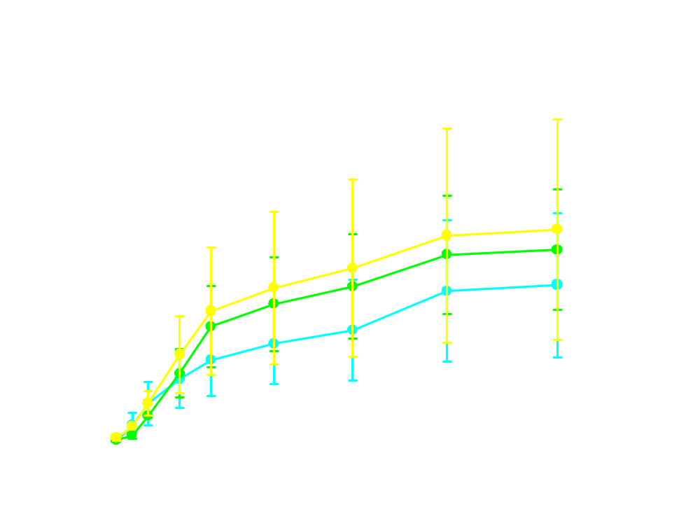
Urea Applied to Pine Plantations
March 14 – April 12 (59ºF)
Rain

Slide 51
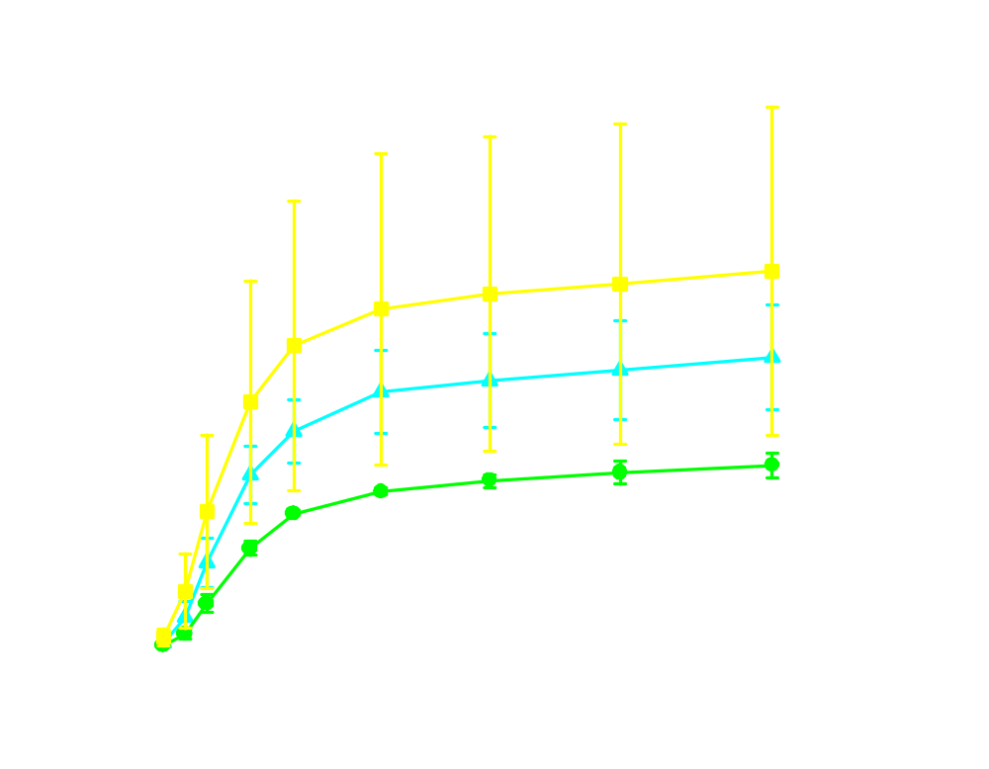
Urea Applied to Pine Plantations
Rain
66ºF

Slide 52
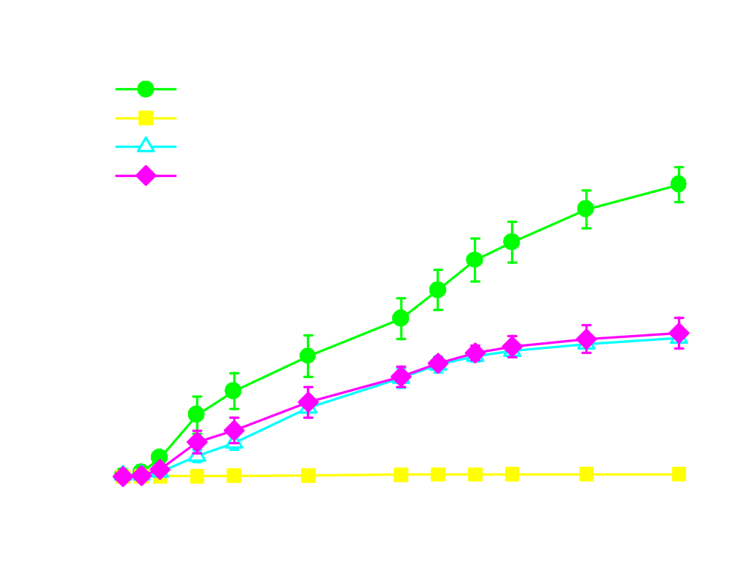
Laboratory Results (77ºF, 90% RH)

Slide 53
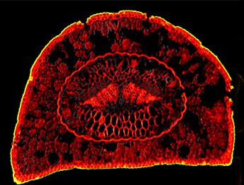
Pine needle photo
Urea
Urea
www.microscopyu.com
NH₄⁺
NH₄⁺
Organic Layer
CEC
CEC

Slide 54
Pine needle photo
Urea
Urea
NH₄⁺
NH₄⁺
www.microscopyu.com
NH₄⁺
NH₄⁺
NH₄⁺
Organic Layer
CEC
CEC

Slide 55
Summary for Pine Plantations
Dry Forest Floor, RH < CRH: OK
Dry Forest Floor, RH > CRH: not OK
Wet Forest Floor: not OK
Apply on dry forest floor, with expected low RH,
and hope for 1 inch of rain whenever it rains.
Apply on wet forest floor if 1 inch rain is expected.

Slide 56
Questions?

