Slide 1
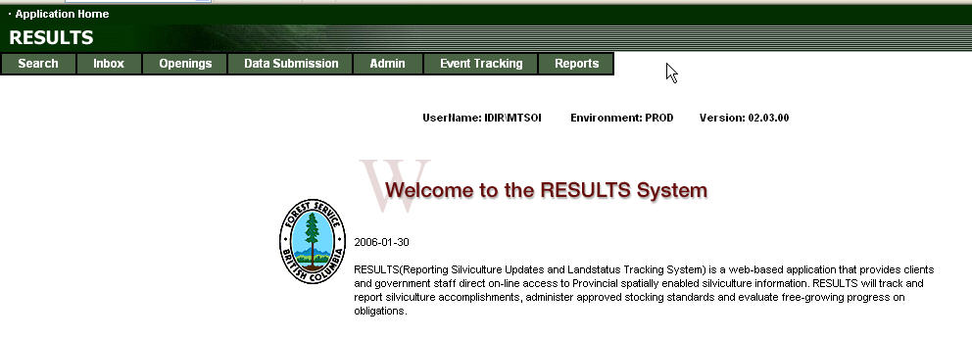
RESULTS
Amendments and Updates
Presented by Mei-Ching Tsoi
mtsoi@shaw.ca
March 2012

Slide 2
RESULTS – Agenda
Process
Critical Resources
5 Steps to complete amendment in RESULTS
Demonstration
  Corrections
  Minor Amendment
  Major Amendments
  Approved Variation
  Site Plan Amendment
          Learning Objectives
          Understand the type of changes that can be made based on whether there is a site plan or a silviculture prescription in place
          Understand on how to complete corrections, approved variations and amendments (online and ESF set up)

Slide 3


RESULTS – Process
SU Modification – two methods
Online Application (attribute only¹)
Silviculture Prescription
Site Plan
ESF (attribute and spatial)
Type | Code | Action
Silv Prescription
Correction | U | COR
Minor | M | MIN
S197 | M² | S197
Major Amendment | A | AMD
Site Plan
Approved Variation | V | VAR
Site Plan Amendment | A | SPA
¹ Online no spatial changes allowed
²197 subject to pre-condition in FSPTS use of SS ID associated with FSP with 197 Election Box Checked.

Slide 4
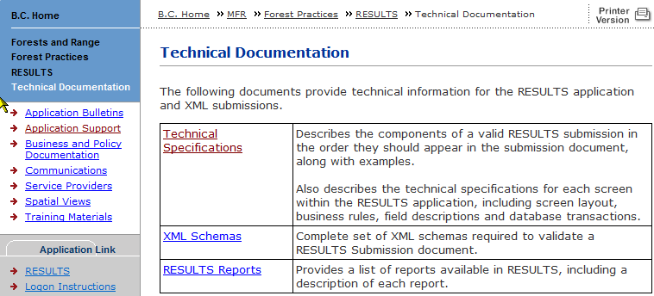
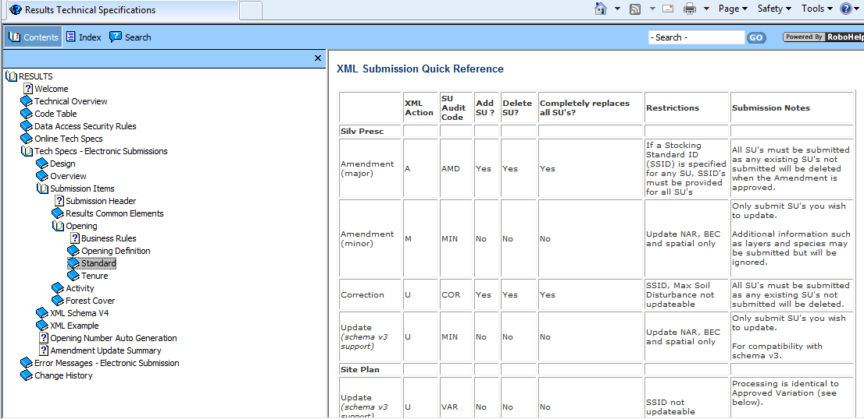
RESULTS – Rules/Technical Documentation – Online & ESF
http://www.for.gov.bc.ca/his/results/techDocs.htm

Slide 5
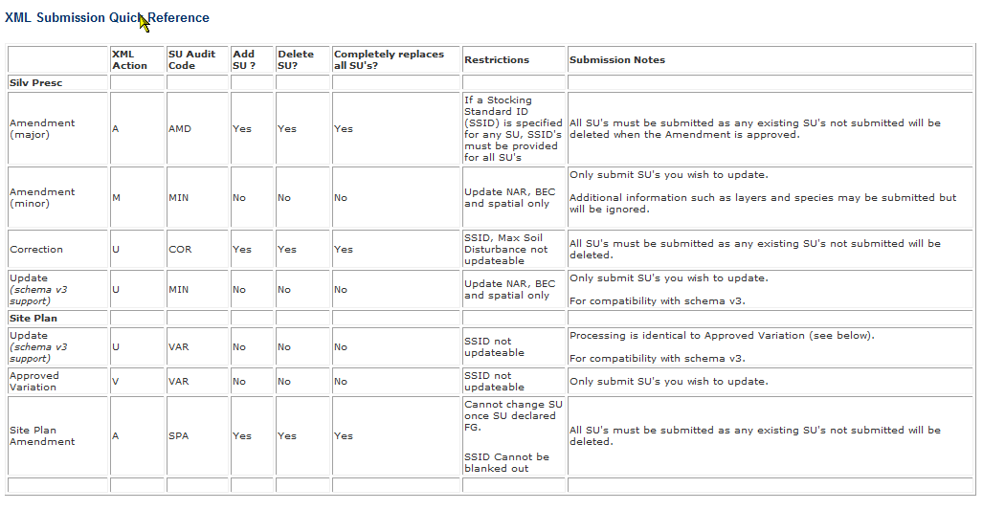
RESULTS –ESF Submission
(must adhere to rules)

Slide 6
RESULTS –ESF Submission
(must adhere to rules)
Rules are based on when the record was created
Did it have existing spatial (after RESULTS Opening Spatial Conversion creation date 2005-04-01)
For desired Action, must ensure that rules are followed.
Examples:
Correction, Major Amendments, Site Plan Amendment – all SUs must be submitted with the required intended corrections/amendment, any existing SUs not submitted will be deleted.
Minor & Approved Variation – can only submit the SU you intend to update
See technical documentation amendment matrix for Amendment Update Summary

Slide 7
RESULTS –Spatial Rules
Spatial Rules
Not required if Opening Approved (Creation date) is before 2003-12-01 RESULT Production release date
Not required if Spatial information exist and was prior to 2005-04-01 (RESULTS Opening Spatial Conversion)
Not Required for Minor Amendment when only BEC and NAR is updated.
Not required if not specified in Opening Spatial Requirement
Current requirements for spatial is in Opening Spatial Requirement: FTML, FTLEVY, FTFSM, FTSBF, FFTFLTC, FFTITSL, FTMSL.
Where amendments impact location/shape of SU boundaries, document must be provided with spatial data

Slide 8
RESULTS – General Process
Who | Process
Submitter | What type of Plan?
 | What type of Change?
 | Make Changes & provide any supplemental information
 | Submit / Save Changes
MOFR Approver | Review to Approve or Not Approve

Slide 9
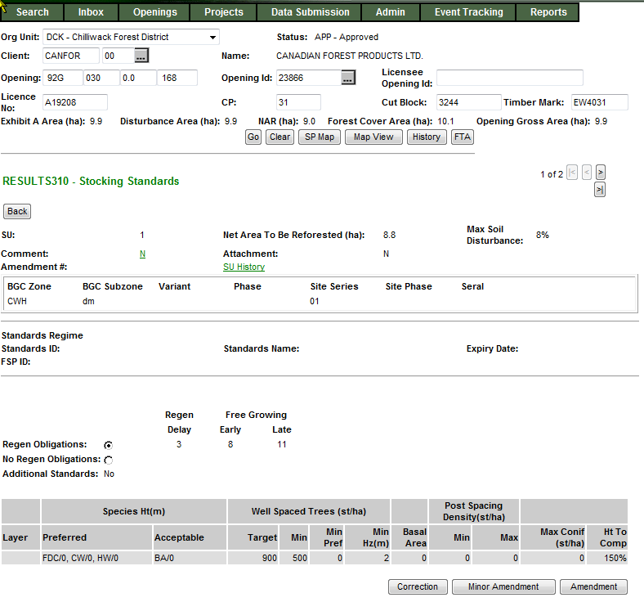
RESULTS – 1) What type of Plan?
Silviculture Prescription
S310 Stocking Standards
No Standards ID
Applies to ML Silviculture Prescription or WL Site Plan

Slide 10
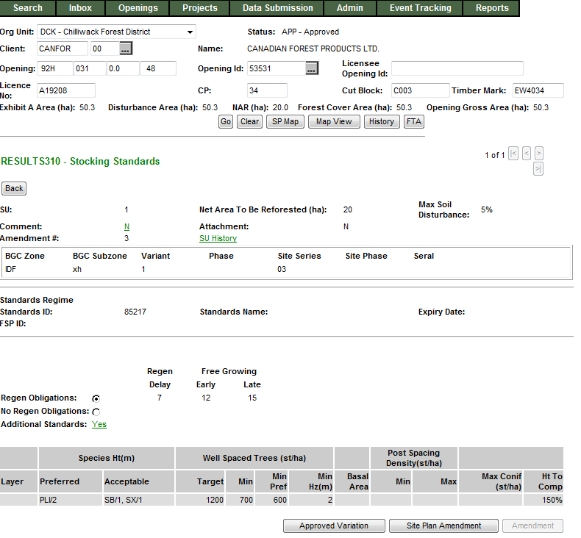
RESULTS – 1) What type of Plan?
Site Plan
S310 Stocking Standards
Standards ID exists
Applies to ML Site Plan or Woodlot Pre-Harvest Maps, and FFT Treatment Prescriptions

Slide 11
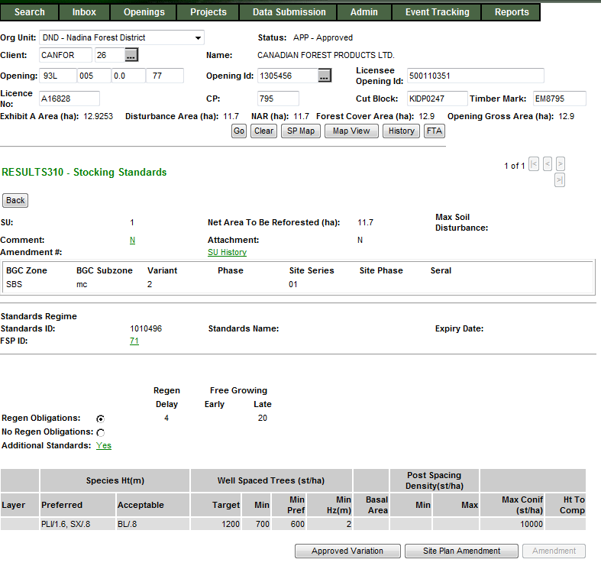
RESULTS – 1) What type of Plan?
FSP Site Plan
S310 Stocking Standards
Standards ID exists
Applies to ML Site Plan where the Standards ID is associated with FSP
Link exist to view details about FSPTS if have authorization

Slide 12

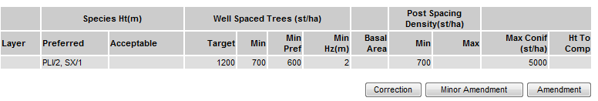
RESULTS – 2) What type of change?
Silviculture Prescription
  Corrections (for correcting paper-based pre-ESF records)
  Minor Amendments (No Approval Required)
  S197 (No Approval Required)
  Major Amendments (Approval Required)

Slide 13
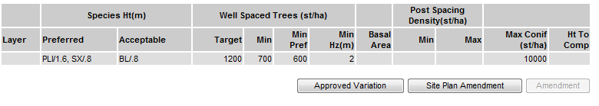
RESULTS – 2) What type of change?
Site Plan
Approved Variations (No Approval Required)
  S197 (No Approval Required)
Amendments (No Approval Required)

Slide 14

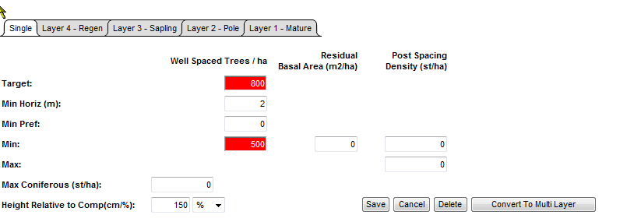
RESULTS – 3) Make Changes (online)
Silviculture Prescription Amendment Highlights changes
Silviculture Prescription – Corrections, Minor Amendment, s197
Site Plan – Approved Variation, s197 and Site Plan
Will not highlight changes – Accepted upon Save/Submission.

Slide 15
RESULTS – 4) Submit and Save
Silviculture Prescription Amendment - Submit for Approval
Silviculture Prescription – Corrections, Minor Amendment, s197
Site Plan – Approved Variation, s197 and Site Plan
Will not highlight changes – Accepted upon Save/Submission.

Slide 16
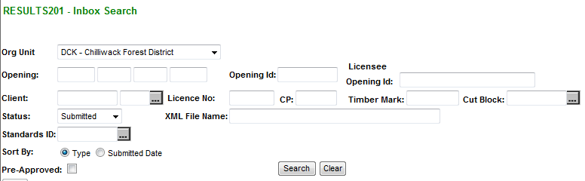

RESULTS – 5) Major Amendment Processing
Ministry approver to check RESULTS Inbox for proposed amendments
- Review proposed amendment
- Approved or Not Approve the proposal in the Inbox.

Slide 17
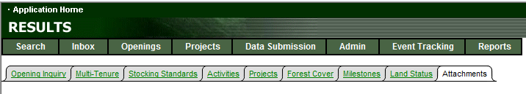
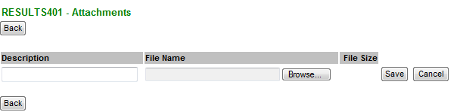
RESULTS – Attachment
Attachments can be used to provide supporting documentation.
Can only supply online – no ESF Attachment capability.
Limit size of 1 Meg per file
Provide meaningful file name and description to enable easy cross-reference.
Make reference in rationale if attachment is used for SU modification support so that Approver are aware of supplemental information.

Slide 18
RESULTS – SU Modifications
Walkthrough Individual
SU Modification Actions

Slide 19
RESULTS – Corrections
Business
  Intended to correct opening SUs entered during paper-based data entry (records pre-mandatory ESF prior to June 1, 2005)
  Corrections are to reflect legal approved documents that exists.
  Older records do not have online SP Maps (unless converted through RESULTS Opening Spatial Conversion process) and therefore making changes not require spatial; but you can always include (but then must be via ESF)

Slide 20
RESULTS – Corrections
Online function
Save as you go – SU is separated into sections:
  SU identification with BEC & Offsets
  Density information
  Preferred species & Ht
  Acceptable species & Ht
  Rationale
  Any changes to any of these section must be saved.
  Saving is accepting the data as entered.
SS ID is not updatable
Toggle to any of the SU for changes as required.
System does not highlight changed items– upon Save, data will be modified. “Back” out of the S311. Repeat steps for other SUs, if required.
All changes are audited via SU History and History

Slide 21
RESULTS – Corrections
ESF function
Action Code “U” - Update
  Must include all SUs even for those SU with no change
  Missed SU is assumed as deleted SU
  SS ID is not updatable
  Provide rationale
Spatial may be updated to provide missing spatial (pre-2005 records).
All changes are audited via SU History and History

Slide 22
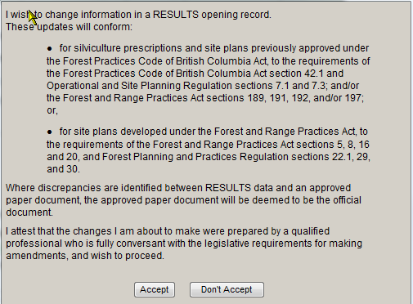
RESULTS – Corrections
Cannot proceed with Correction unless “Accept”

Slide 23
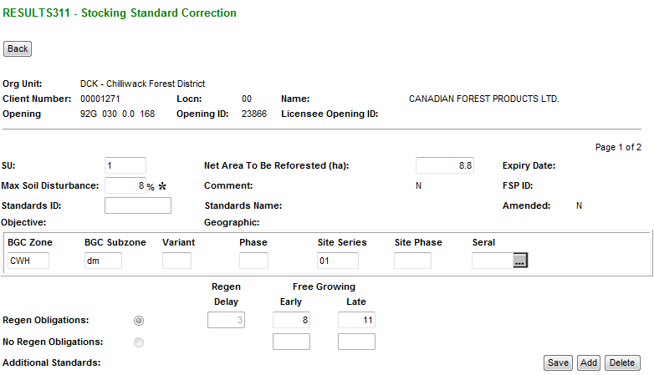
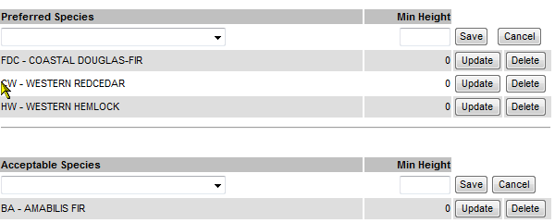
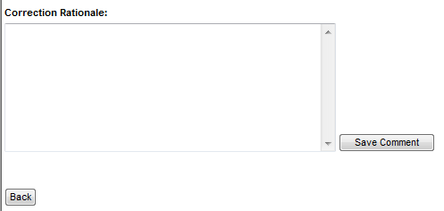
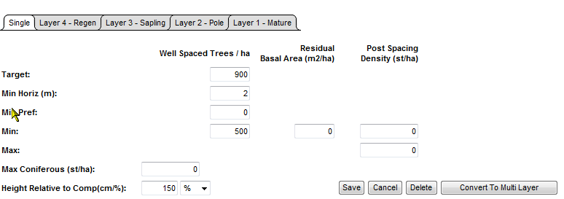
RESULTS – Corrections
Make changes to each of the required sections and Save as you Go.
Standards ID is not updatable.
If regeneration declared, regeneration offset is not updatable
Select “Back” to finish Correction for the SU.
Repeat steps for Corrections other SU for the same opening

Slide 24
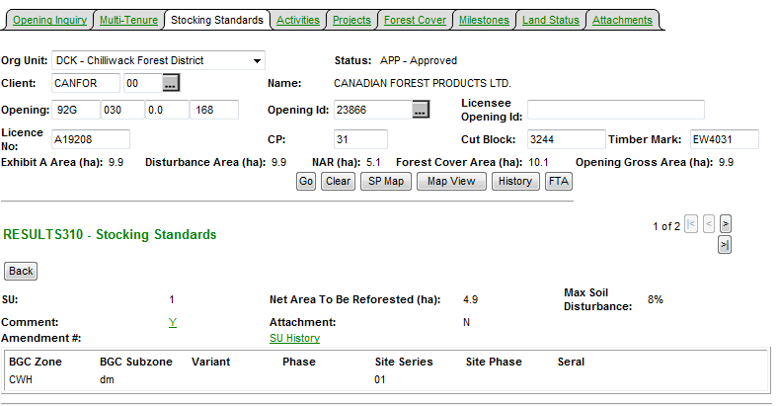
RESULTS – SU History
SU History provides details of all SU modifications.
This function only existed as of March 11, 2008
Therefore any modifications prior to this date is not reflected.
Entire Opening’s SUs are
Copied with tracking of changed items.

Slide 25
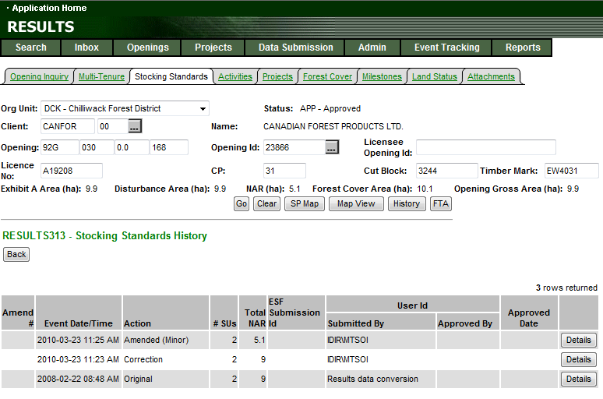
RESULTS – SU History
All records will have either “O” original or “ES”
As the baseline condition
to use as basis for comparison

Slide 26
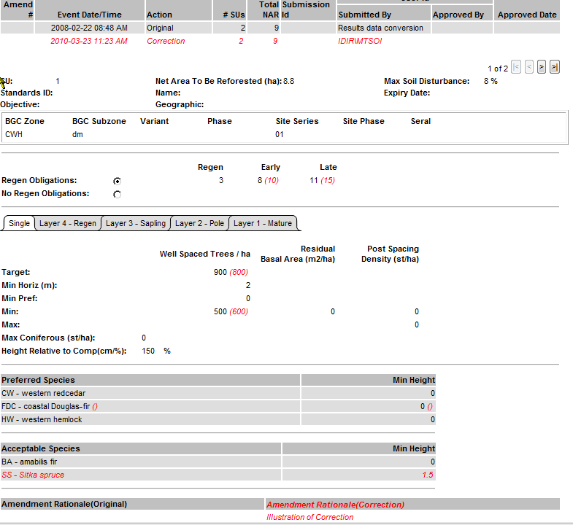
RESULTS – SU History Detail
Changes associated with SU Modification Action
is in (red).
Can review all SUs associated with the Event.

Slide 27
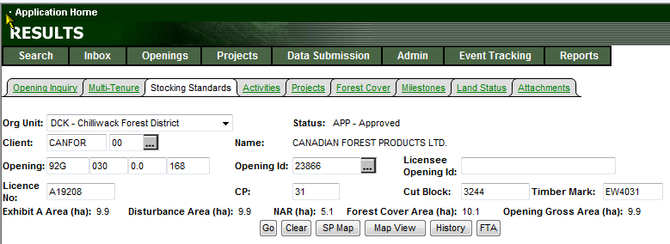
RESULTS – Tombstone History
Tombstone “History” also tracks all changes and events on the opening.

Slide 28
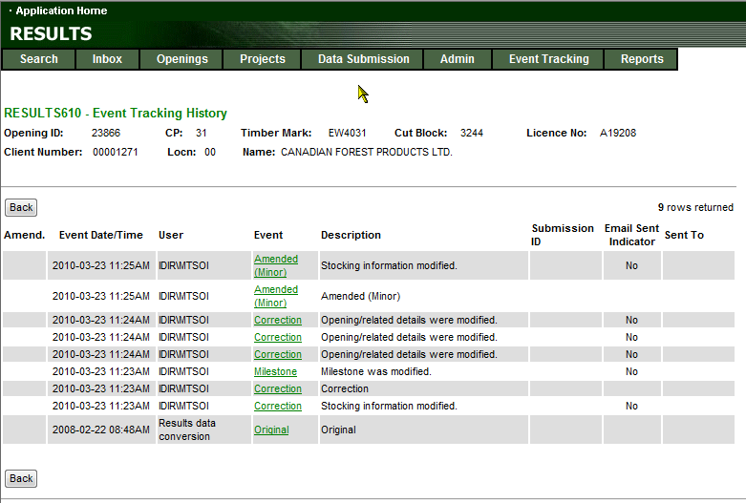
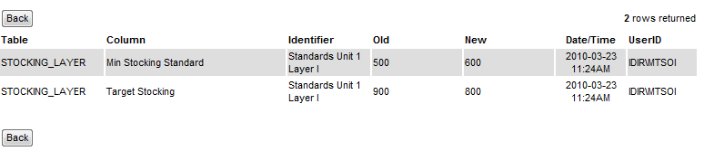
RESULTS – Tombstone History
Contains all events and
Detailed screen provides
Information of data changed via “Old” and “New” columns

Slide 29
RESULTS – Correction
Demo

Slide 30
RESULTS – Minor Amendment
Business
  Intended for making area adjustments based on better information from field surveys.
Online function
Save as you go – SU is separated into separate sections:
  Only Net Area to be Reforested and BEC information maybe changed
  SS ID can be changed BUT tied to s197 rollover
  Rationale
  Any changes to any of these section must be saved for each section.
  Saving is accepting the data as entered.
Toggle to any of the SU for changes as required.
System does not highlight changed items– upon Save, data will be modified. “Back” out of the S311. Repeat steps for other SUs, if required.
All changes are audited via SU History and History

Slide 31
RESULTS – Minor Amendment
ESF function
Action Code “M” - Minor
  Only submit SU you wish to update
  Any additional information submitted such as layers and species maybe submitted but ignored with exception of SS ID – but depending on usage tied to s197 rollover
  Only BEC and NAR updateable when associated with Minor amendment
  Provide Rationale
All changes are audited via SU History and History

Slide 32
RESULTS – Minor Amendment
Cannot proceed with Minor Amendment unless “Accept”

Slide 33
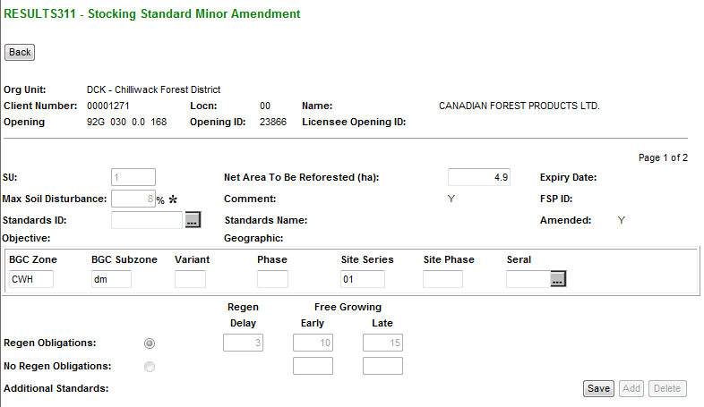
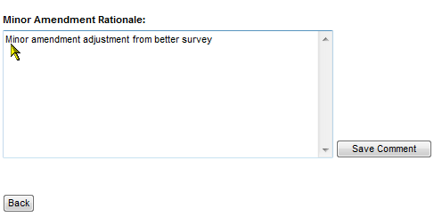
RESULTS – Minor Amendment
Make changes to each of the required sections and Save as you Go.
Net Area to be Reforested updatable
SS ID updateable but associated with s197 rollover
BGC information updatable
Select “Back” to finish Minor for the SU.
Repeat steps for Corrections other SU for the same opening

Slide 34
RESULTS – Minor Amendment
Demo

Slide 35
RESULTS – FRPA s197
S197 rollover requires no approval required as it has been already approved under FSP.
Online function
  Silviculture Prescription – “Minor”
  Site Plan (not FRPA) – “Site Plan Amendment”
ESF function
  Action Code “M” – s197 (interpreted as 197 under specific conditions)
  Provide SS ID associated with FSP with 197 Election Selected
  Provide rationale

Slide 36
RESULTS – FRPA s197
Standards Regime ID (SS ID) updatable and recognize as s197 rollover only if all of the following conditions are met:
  Allowed for Silviculture Prescription or Site Plan not in FSP
  Standards ID being applied is associated with a FSP that has s197 Election Checked (“Y”)
  Standards ID belongs to the client and org unit for the silviculture prescription site plan

Slide 37
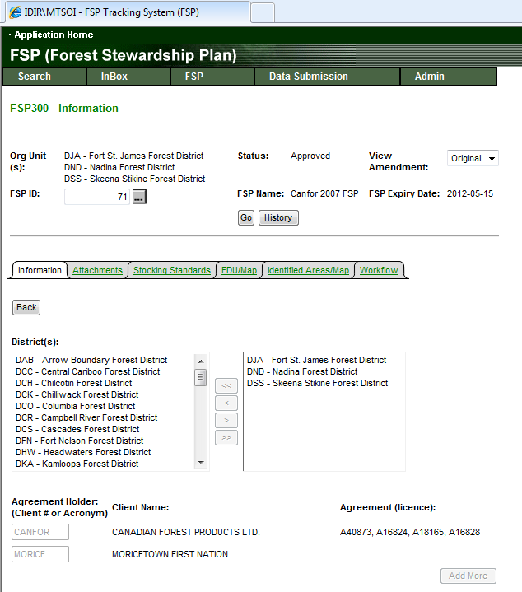
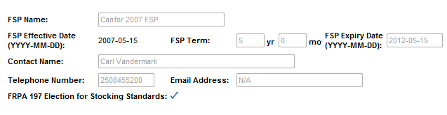
RESULTS – FRPA s197
FRPA s197 Election must be made using FSPTS in order for s197 rollover to work in RESULTS

Slide 38
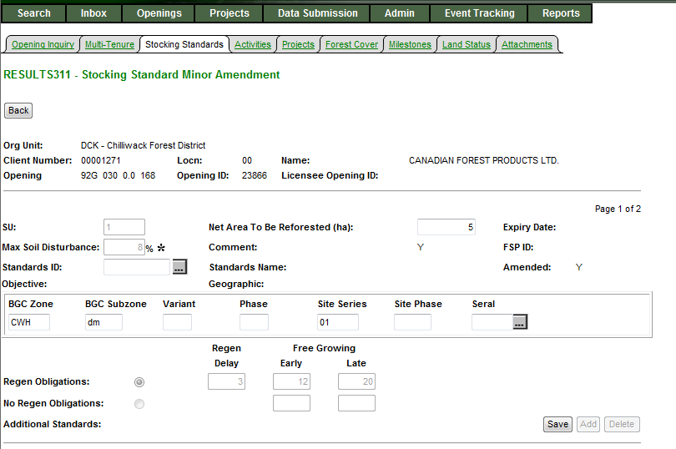
RESULTS – Rollover approved under FRPA s197
Silviculture rollovers will use
Minor Amendment
Enter Standards ID
To recognize as rollover, Standards ID must:
  Belong be associated with FSP with FRPA s197 Election checked
  Standards ID must be approved
  Standards ID must belong to be authorized for use for district & client.
Successful accepted rollover with be tracked as 197 Action Code.

Slide 39
RESULTS – FRPA s197
Demo

Slide 40
RESULTS – Approved Variation
Business
  Intended for changes to stocking standards based on approved variations as per Forest Stewardship Plan.

Slide 41
RESULTS – Approved Variation
Online function
Save as you go – SU is separated into sections:
  SU identification with BEC & Offsets (Standard ID not available to change)
  Density information
  Preferred species & Ht
  Acceptable species & Ht
  Rationale
  Any changes to any of these section must be saved for each section.
  Saving is accepting the data as entered.
Toggle to any of the SU for changes as required.
System does not highlight changed items– upon Save, data will be modified. “Back” out of the S311. Repeat steps for other SUs, if required.
All changes are audited via SU History and History

Slide 42
RESULTS – Approved Variation
ESF function
Action Code “V” – Approved Variation
  Only submit SU you wish to update
  SS ID is not updatable
  Provide rationale
All changes are audited via SU History and History

Slide 43
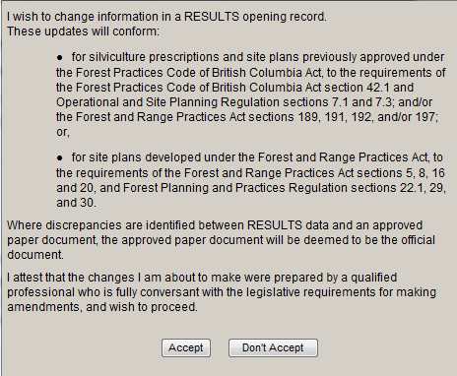
RESULTS – Approved Variation
Cannot proceed with Approved Variation unless “Accept”

Slide 44
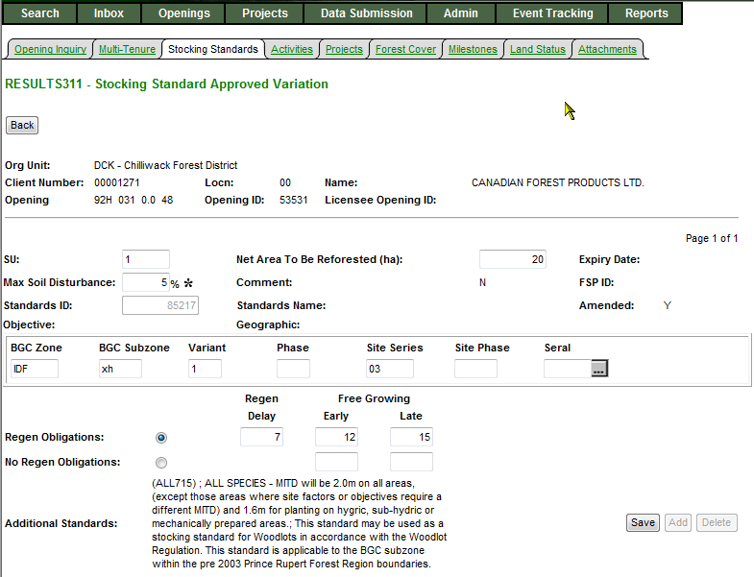
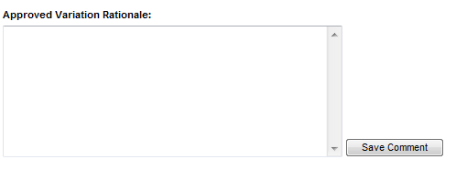
RESULTS – Approved Variation
Make changes to each of the required sections and Save as you Go.
Standards ID is not updatable.
Modify any portion of stocking standard as required to meet the required condition for the approved variation.
Select “Back” to finish Approved Variation for the SU.
Repeat steps for Approved Variation to other SU for the same opening
More sections exist but not included

Slide 45
RESULTS – Approved Variation
Demo

Slide 46
RESULTS – Site Plan Amendment
Business
  Amendment to site plans – can add, delete or modify Standard Unit information and SS ID.

Slide 47
RESULTS – Site Plan Amendment
Online function
Save as you go – SU is separated into sections:
  SU identification with BEC
  SS ID updatable
  Rationale
  Any changes to any of these section must be saved for each section.
  Saving is accepting the data as entered.
Toggle to any of the SU for changes as required.
System does not highlight changed items– upon Save, data will be modified. “Back” out of the S311. Repeat steps for other SUs, if required.
All changes are audited via SU History and History

Slide 48
RESULTS – Site Plan Amendment
ESF function
Action Code “A” – Amendment
  Submit all SUs you wish to amend
  Missing SU assumed deletion
  Changed SU identifier assumed new add SU
  SS ID must exist for each SU
  Provide rationale
All changes are audited via SU History and History

Slide 49
RESULTS – Site Plan Amendment
Cannot proceed with Site Plan Amendment unless “Accept”

Slide 50
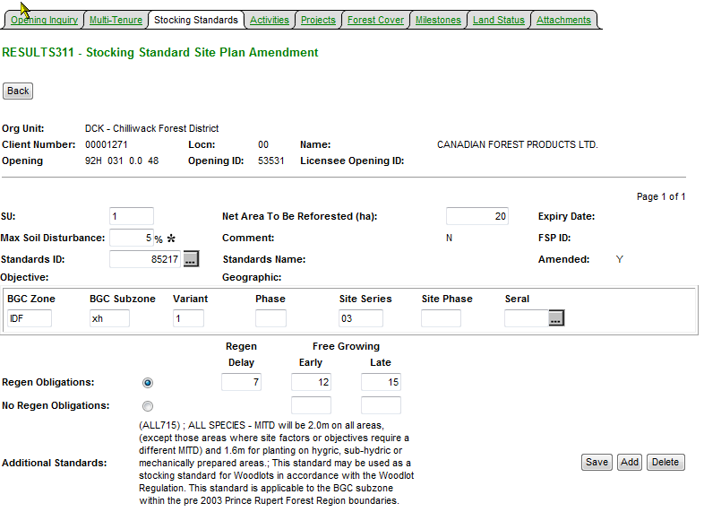
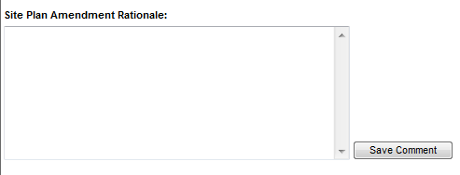
RESULTS – Site Plan Amendment
Make changes to each of the required sections and Save as you Go.
Standards ID is updatable.
Select “Back” to finish Site Plan Amendment for the SU.
Repeat steps for Site Plan Amendment to other SU for the same opening
More sections exist but not included

Slide 51
RESULTS – Site Plan Amendment
Demo

Slide 52
RESULTS – Silviculture Prescription Amendment (Requiring Approval)
Business
  Requiring changes to silviculture prescription.
Online function
  Save as you go – SU is separated into sections:
    SU identification with BEC & Offsets
    Density information
    Preferred species & Ht
    Acceptable species & Ht
    Rationale
    Any changes to any of these section must be saved for each section.
    Saving is accepting the data as entered.
  Toggle to any of the SU for changes as required.
  System highlights changed items in red in S312 screen.
  Opening Status is changed from “APP” to “AMD” – AMD is still draft amendment
  S310 shows Amendment Proposed.
  Must be Submitted to enable Inbox Processing.

Slide 53
RESULTS – Silviculture Prescription Amendment (Requiring Approval)
ESF function
Action Code “A” – Amendment
  All Standard Units (SU) must be submitted with same identifiers.
  If omit SU, assumed deletion. If change SU Identifier assume as new SU.
  Any elements that differ for a given SU is assumed proposed amendment for approval.
  ESF Submission of Silviculture Prescription Amendments automatically becomes an Opening in “SUB” – Submitted Status awaiting for Inbox Processing.
  Unable to recall amendment after submission. If there is a requirement to change, must make request to District contact to Not Approve amendment in order to resubmit.
All changes are audited via SU History and History

Slide 54
RESULTS – Major Amendment - Initiate
Cannot proceed with Amendment unless “Accept”

Slide 55
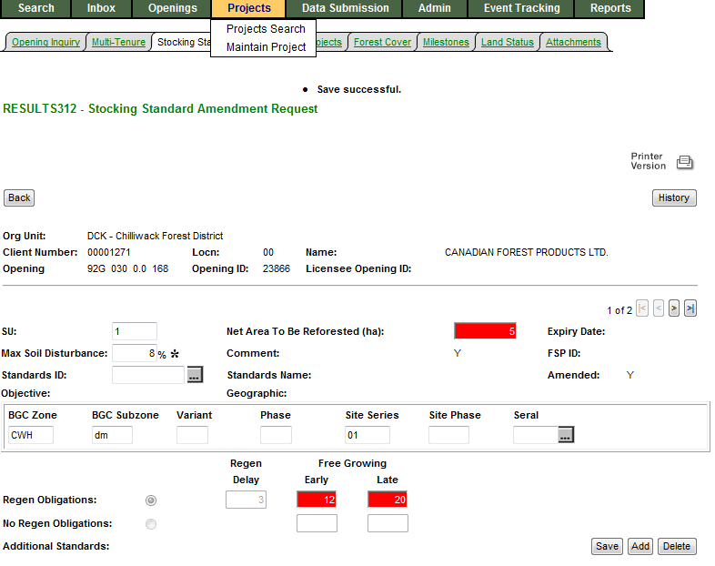
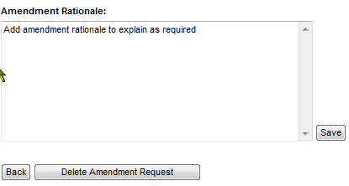
RESULTS – Major Amendment –
Proposed Amendment
S312 – Any changes are made are highlighted in red.
S312 – has Delete to remove “Proposed Amendment”
More sections not shown but exists – need to save each section if there is requirement to make changes.
Can add or delete SU’s as needed.
Once complete Select – “Back” button
This is a proposed amendment - in “AMD” status – no action unless Submitted.
Can only Delete proposed amendment amendment via S312.

Slide 56
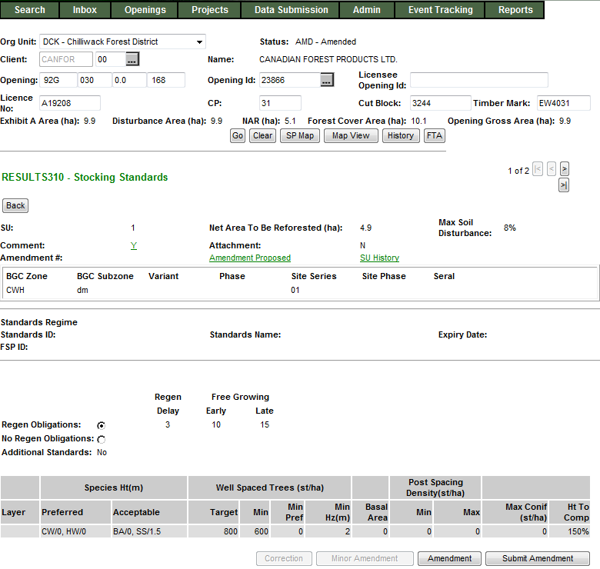
RESULTS – Major Amendment – Submit Amendment
Status is in “AMD” status.
Can view or modify Amendment using Amendment Proposed
Once Proposed Amendment is ready, need to “Submit Amendment”.

Slide 57
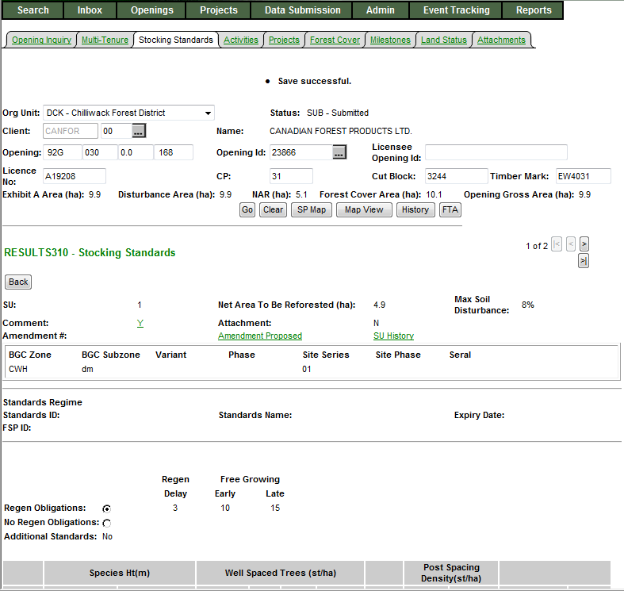
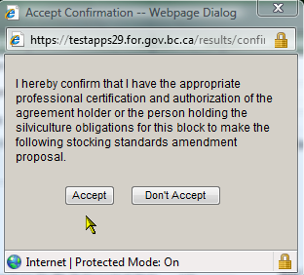
RESULTS – Major Amendment – Submit Amendment
Must “Accept” confirmation to proceed with submitting Amendment for Approval.
If “Don’t Accept”, opening stays in “AMD”-Amended Status.
Once “Accept”, the opening changes to “SUB”-Submitted Status.
Note that the data in S310 is the same as the Proposed Amendment is submitted but not yet approved.,

Slide 58
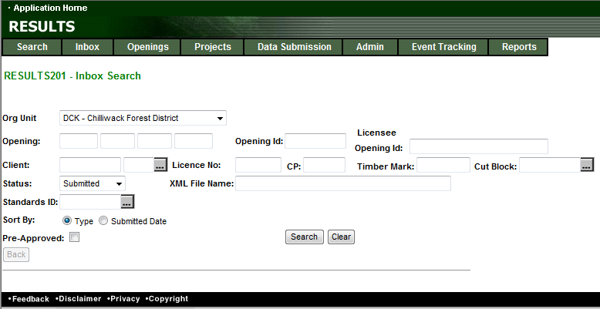
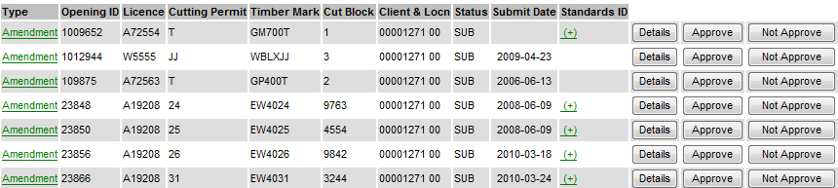
RESULTS – Major Amendment –
Inbox - MOF Approver role
S201 – Inbox Search
MOF personnel must have “Approver” role to action.
Set Status to “SUB” & Search
“SUB” status will not allow declaration and any attempt for any other SU modifications due to pending review.

Slide 59
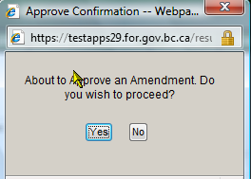
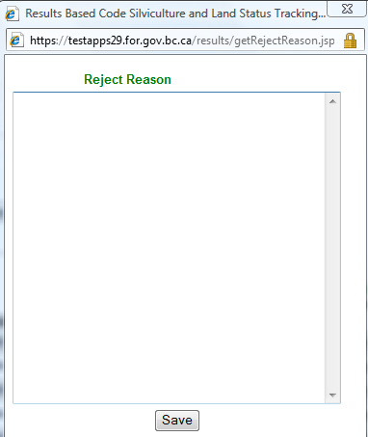
RESULTS – Major Amendment –
Inbox - MOF Approver role
S201 – Inbox Search
MOF personnel must have “Approver” role to action.
Details Take to S310 – to enable review of Submitted Proposal.
Approve Will approve Submitted Amendment –
Opening will change from “SUB” to “APP” status
-----------------------------------------------------------------------------------------------------------------
Not Approver: Requires mandatory reason to explain reason for not approval.
Approve Opening change from “SUB” to “AMD”
Submitter: Make decision for next step:
Delete Amendment – change from “AMD” status to “APP” to start over
Modify existing Proposed Amendment to resubmit – change from “AMD” to “SUB”

Slide 60
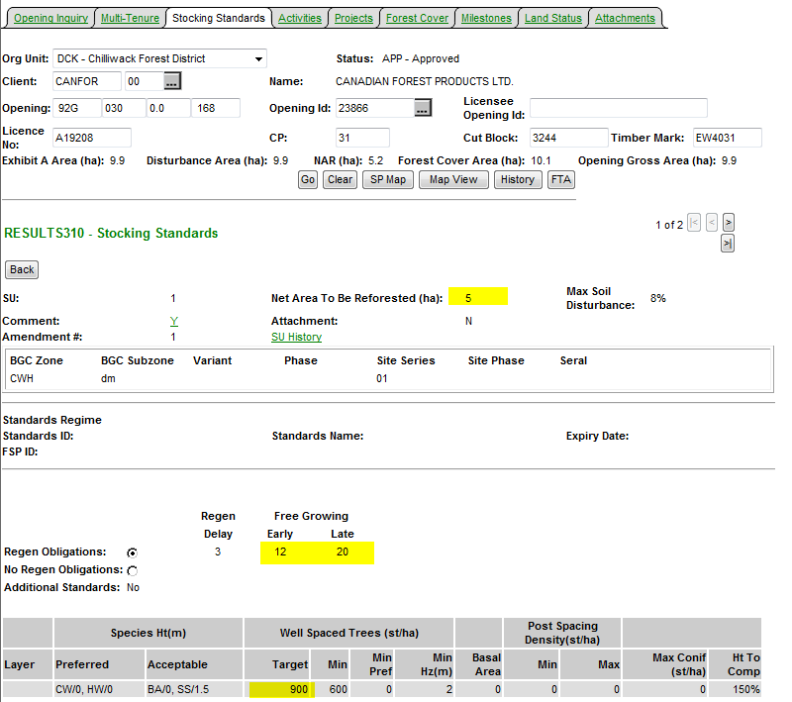
RESULTS – Major Amendment –
Inbox – Approved Opening
Upon Approval – Status changed to “APP”
All changes from the Amendment is now reflected current S310-Stocking Standards.
SU History & History contains Audited changes.

Slide 61
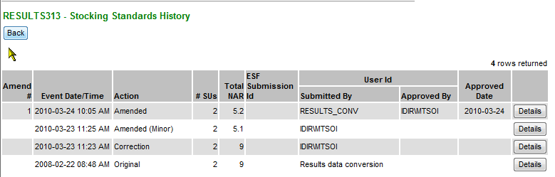
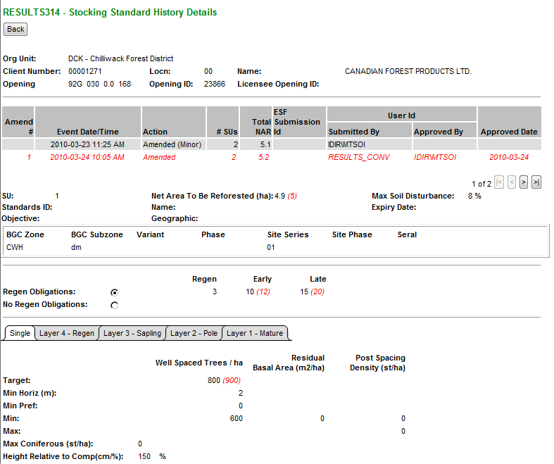
RESULTS – Major Amendment –
Auditing – SU History
Upon Approval – Status changed to “APP”
All changes from the Amendment is now reflected.
SU History & History contains Audited changes.
Changes items from the Action is in (red).
Only has changes effective March 11, 2008 (date which this infrastructure was created)

Slide 62
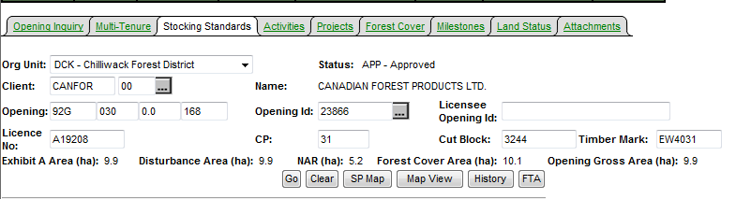
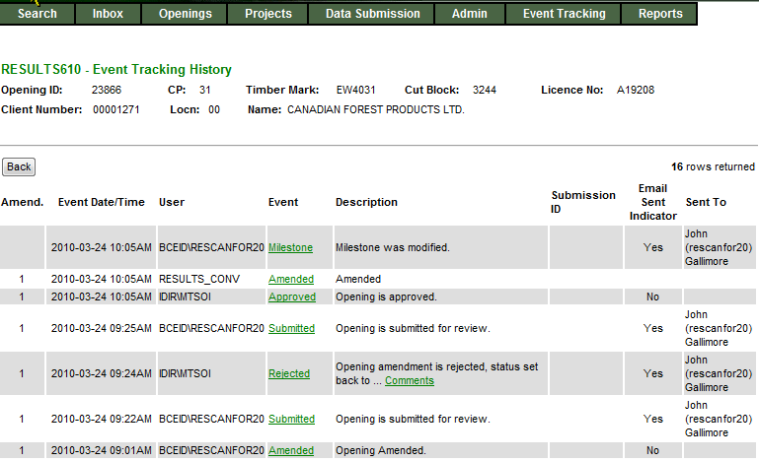
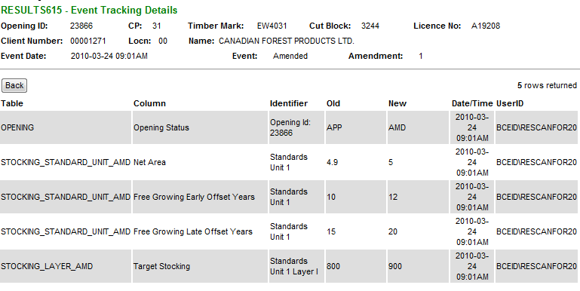
RESULTS – Major Amendment –
Auditing – History
S610 History provides each of event.
SU History data can also be accessed from S610.
History provides tracking of individual element changed

Slide 63
RESULTS – Silviculture Prescription Amendment
Demo

Slide 64
RESULTS – Major Amendment – Flow
Online
Approve
APP
AMD
SUB
APP
Changes reflected and audited
Not Approve
Submit
AMD
SUB
Delete
APP
ESF
Approve
APP
SUB
APP
Changes reflected and audited
Not Approve
AMD
No changes reflected
Submitter to respond
As required on their respective forest management system

Slide 65
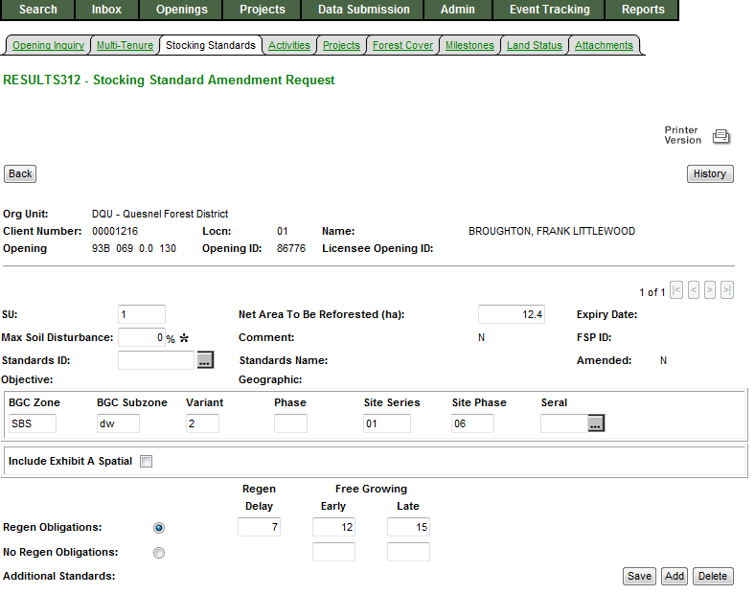
RESULTS – Woodlots
Woodlots are able to apply spatial via use of “Include Exhibit A Spatial” if spatial is available.
Limited to One SU for using “Exhibit A” capability.

Slide 66


RESULTS – CRS Reports SU History
Stocking Standard Modification Detail and Summary Reports are effective March 11, 2008 based on SU History function in RESULTS.
Any SU Modifications prior to this date is not reported via SU History function but information is available via Event History.

Slide 67

RESULTS – SU Modification Summary
Format CSV or PDF

Slide 68

RESULTS – SU Modification Summary

Slide 69

RESULTS – SU Modification Detail
Format CSV - but only View Online
PDF – View Online or Email

Slide 70

RESULTS – SU Modification Detail
Changes based on action will be in (brackets and italized)

Slide 71

RESULTS – Questions?
http://www.for.gov.bc.ca/his/results/support.htm

Slide 72
RESULTS – Amendment and Updates
Thank You!

