Slide 1
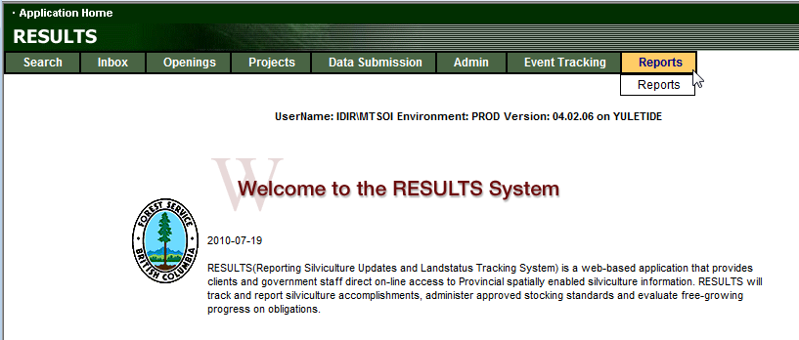
RESULTS
Corporate Reporting System
Presented by Mei-Ching Tsoi
mtsoi@shaw.ca
March 2012

Slide 2
RESULTS – Agenda
Process
Overview of running a CRS Report
Overview of types of CRS Reports
Review of resources available

Slide 3
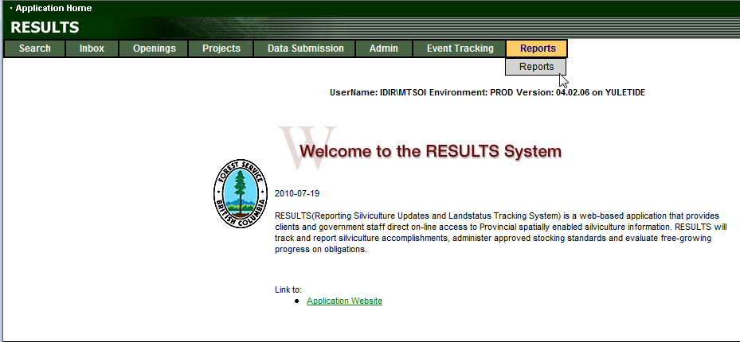
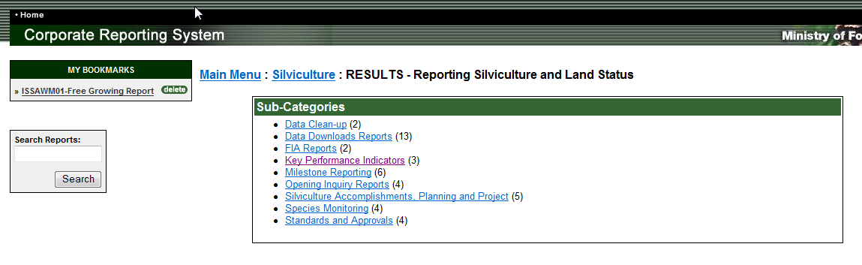
RESULTS – Reports in CRS
RESULTS
Corporate Reporting System (CRS)

Slide 4
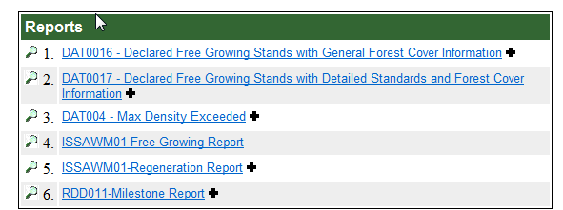
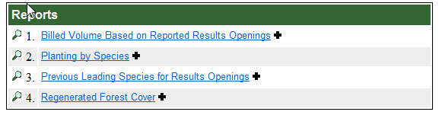
RESULTS – CRS
Sub-Categories indicates how many reports
Each category has number of reports

Slide 5
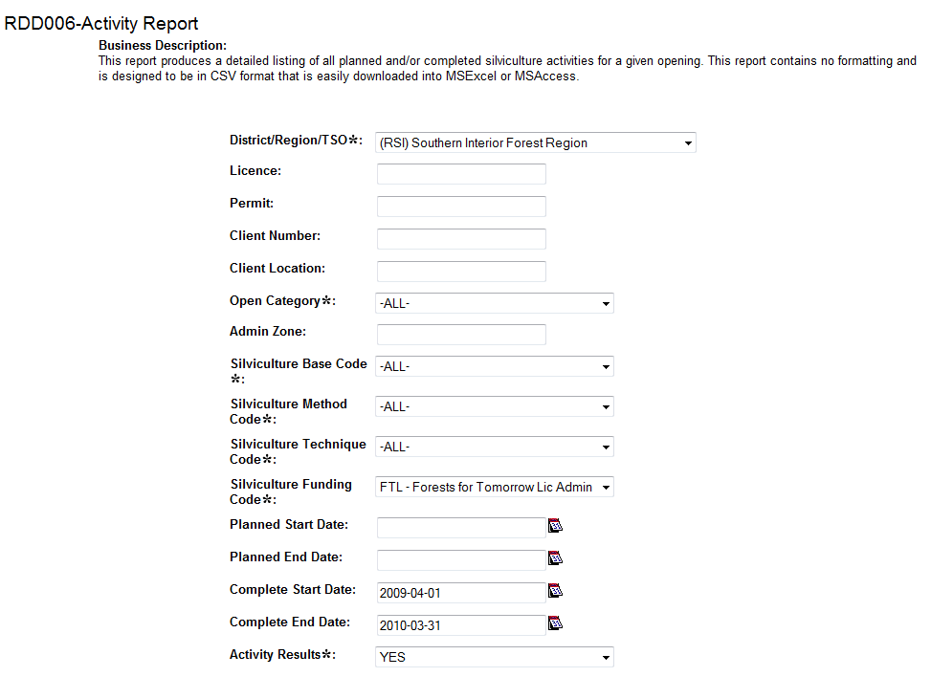
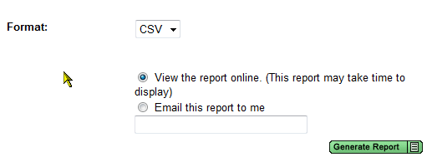
1. Specify Parameters as needed
Use of parameter will vary depending on report theme.
2. Format
PDF format – view online or send to email.
Most RDD are CSV only –
CSV do not run via email
Must set to View report online.
Runs Immediately (email this report does not work for CSV report)
3. Generate Report

Slide 6
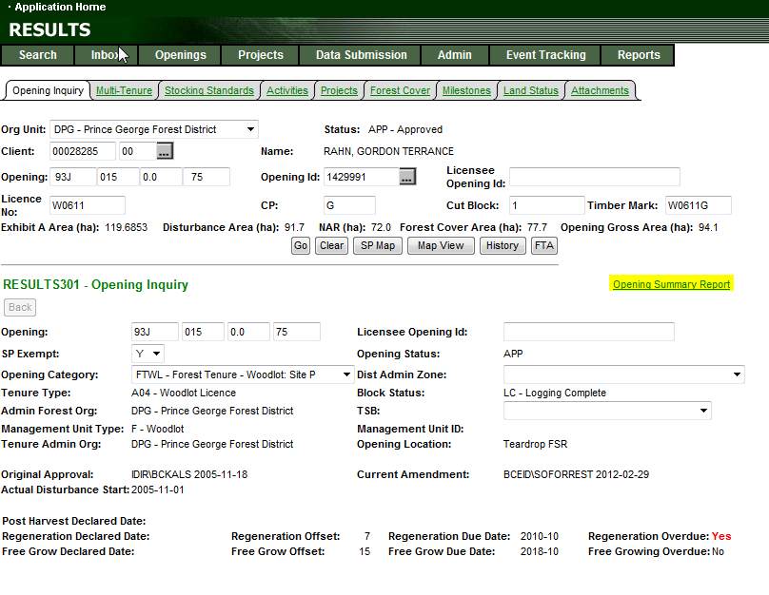
RESULTS – Opening Summary Report
Opening Inquiry has hyperlink to take to Opening Summary Report – ties directly to CRS

Slide 7
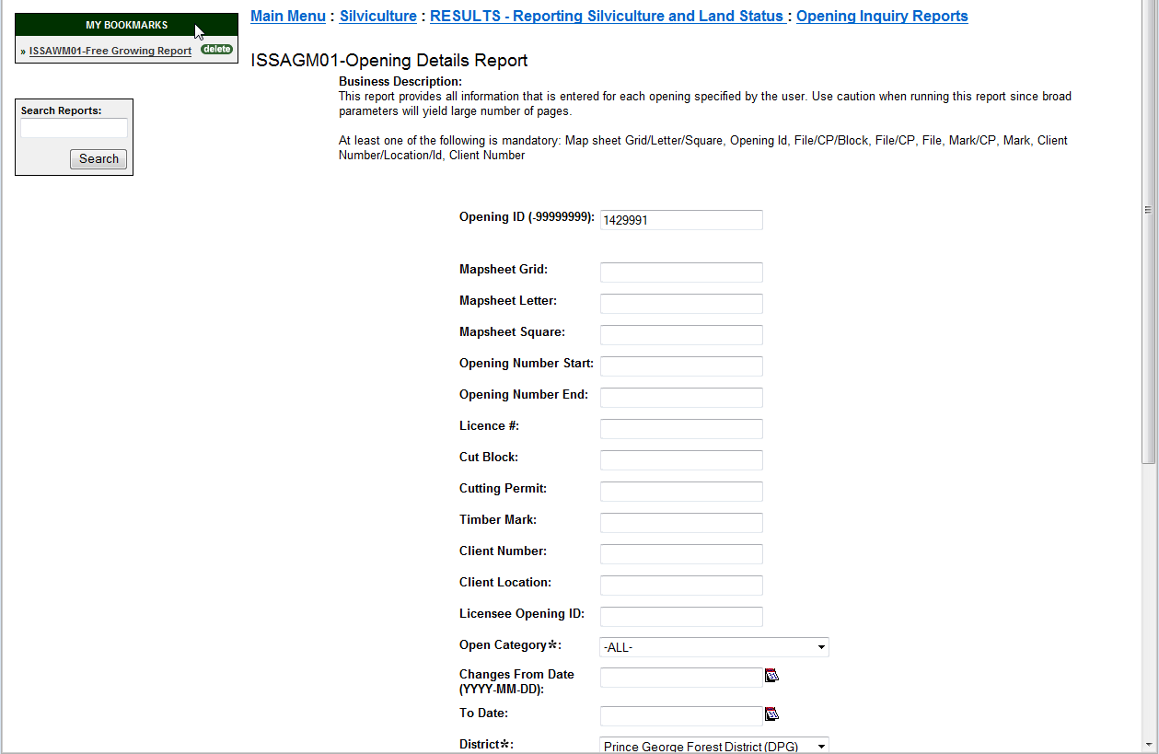
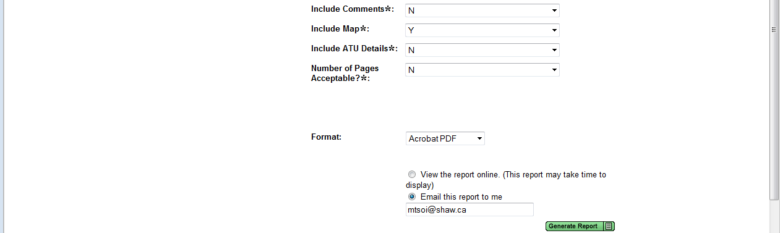
RESULTS – Opening Summary Report
Opening Inquiry has hyperlink to take to Opening Summary Report – ties directly to CRS
Auto-fills for Opening ID and Org Unit if used hyperlink
May specify include Map and/or comments
Large report – 1 opening = up to 10pgs
Careful if using broad parameters
Send via email

Slide 8
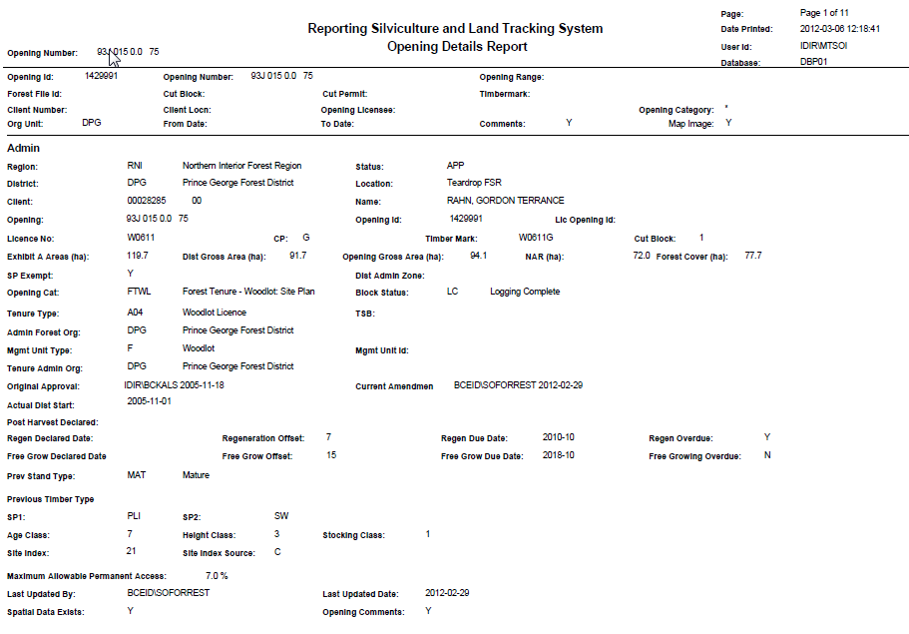
RESULTS – Opening Summary Report
Contains all information in RESULTS all key components:
Opening Def
SU & Stocking Standards
SP Map
Denudation
Silv Activity
Current Forest Cover
FC Map
Land Status
Milestones
Any Comments

Slide 9
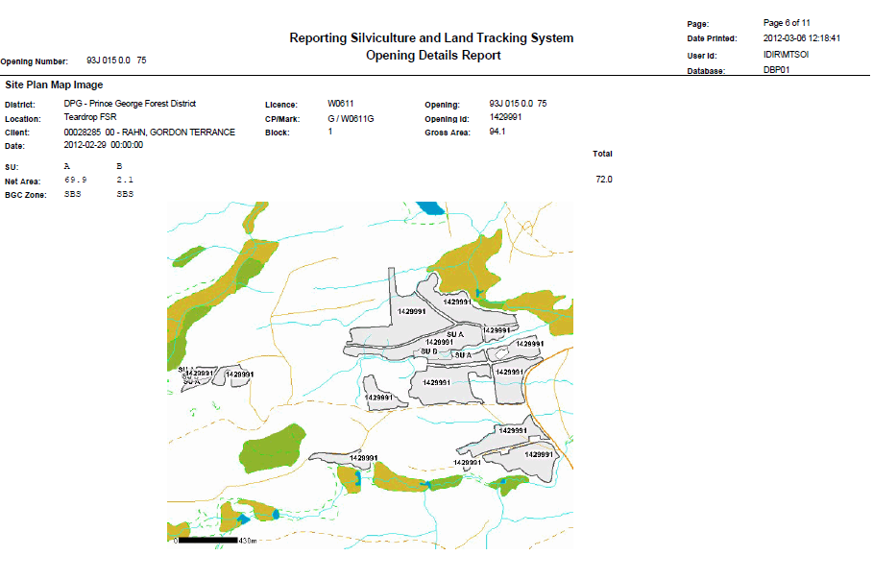
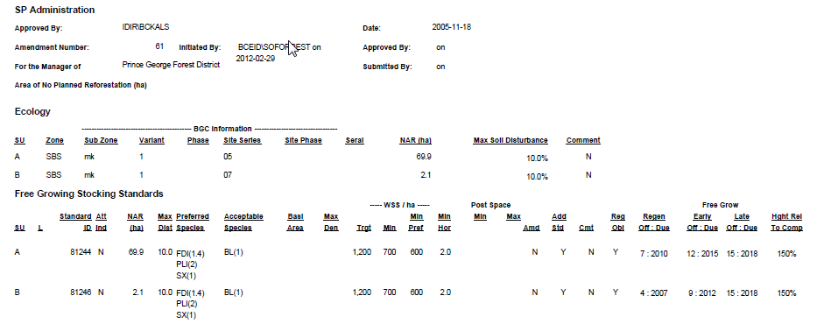
RESULTS – Opening Summary Report

Slide 10
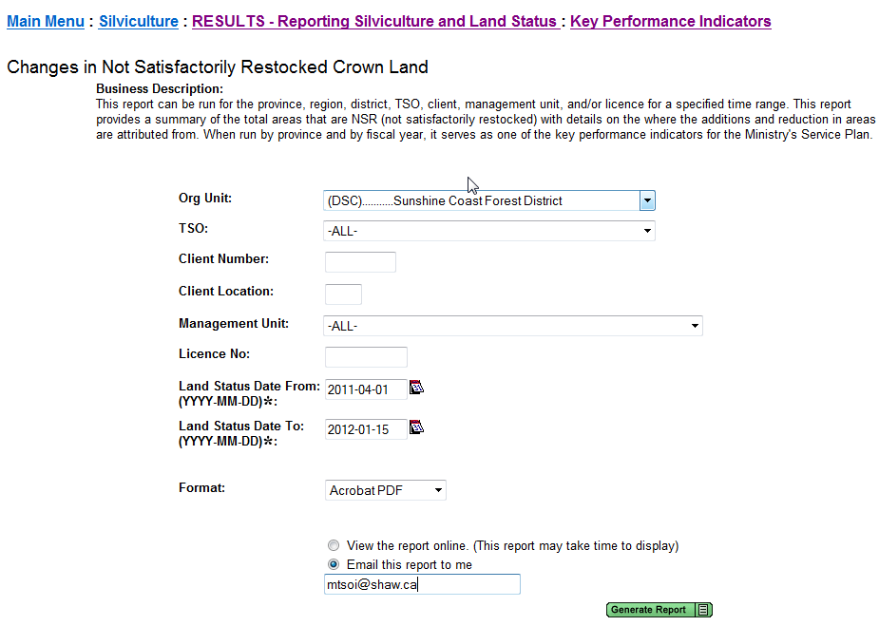
RESULTS – NSR

Slide 11
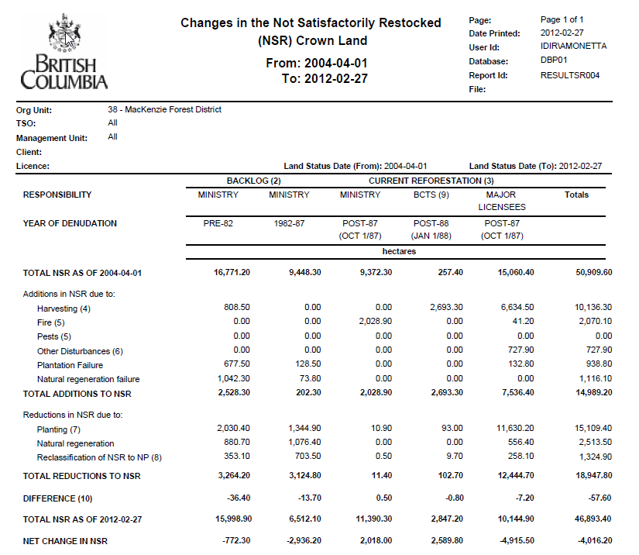

Slide 12
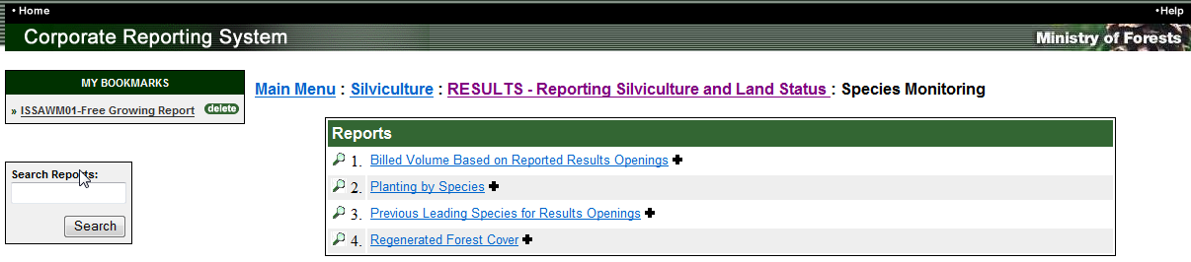
RESULTS – Species Monitoring
      Available in PDF or CSV
Added fields available not shown in .pdf – BEC Zone/subzone exist in CSV version
Shows broad trends, species shift major trends
Species generalized – but uses consistent colors for visual comparison
Tenured openings only
Billed volume starts from 1995 to current year
Prev, Planted, Regen from 1988 to current year
May run for most recent information
New Forest Cover Inventory exist in Oracle (Feb 2012) but no CRS report available yet – only two years available 2008 and 2011
Documentation to explain background, assumptions and generalization located at: http://www.for.gov.bc.ca/ftp/his/external/!publish/onlineclassroom/results/Generating_Reports_Basic/RESULTS_Species_Monitoring_Report_Feb2009_v2.pdf

Slide 13
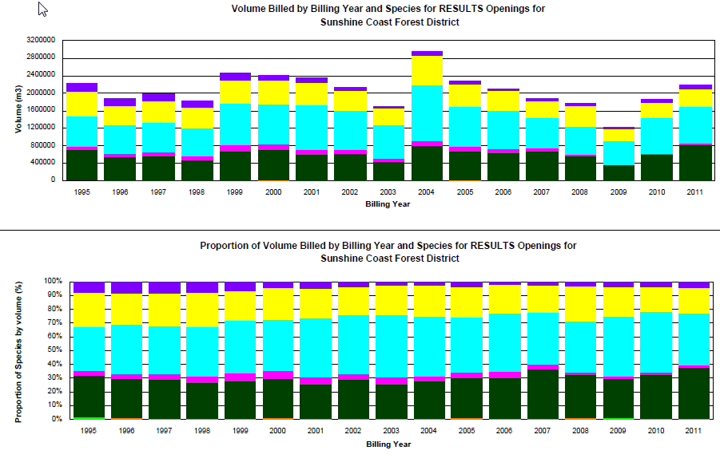
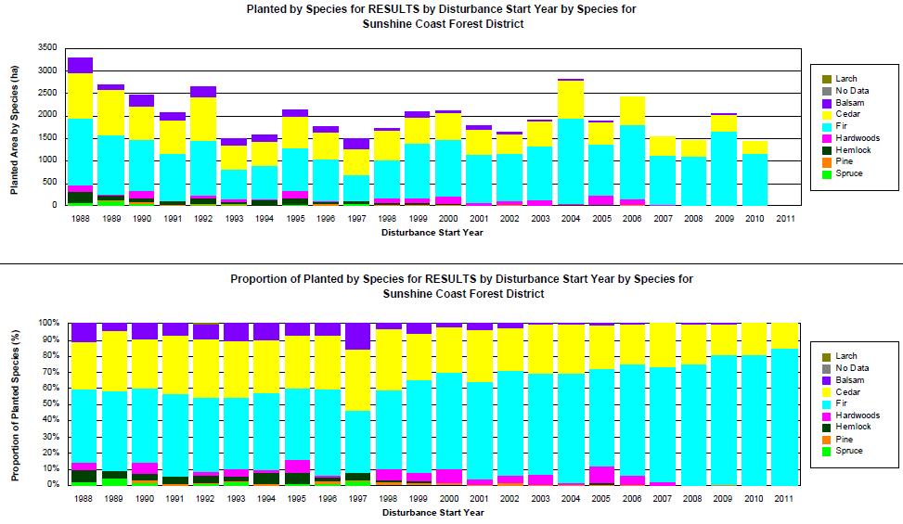
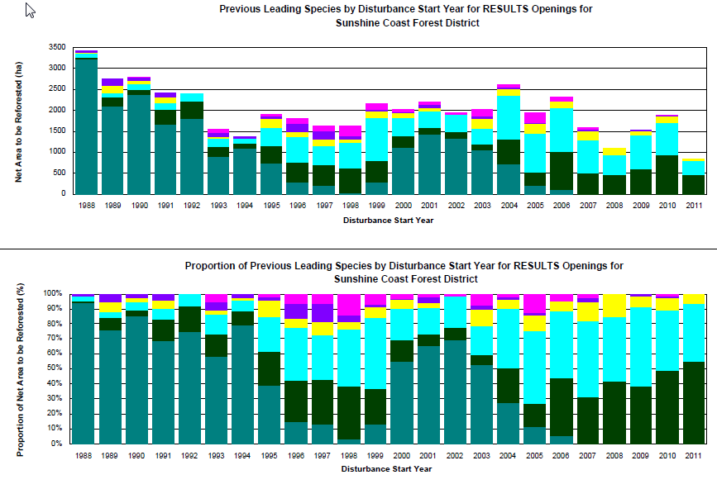
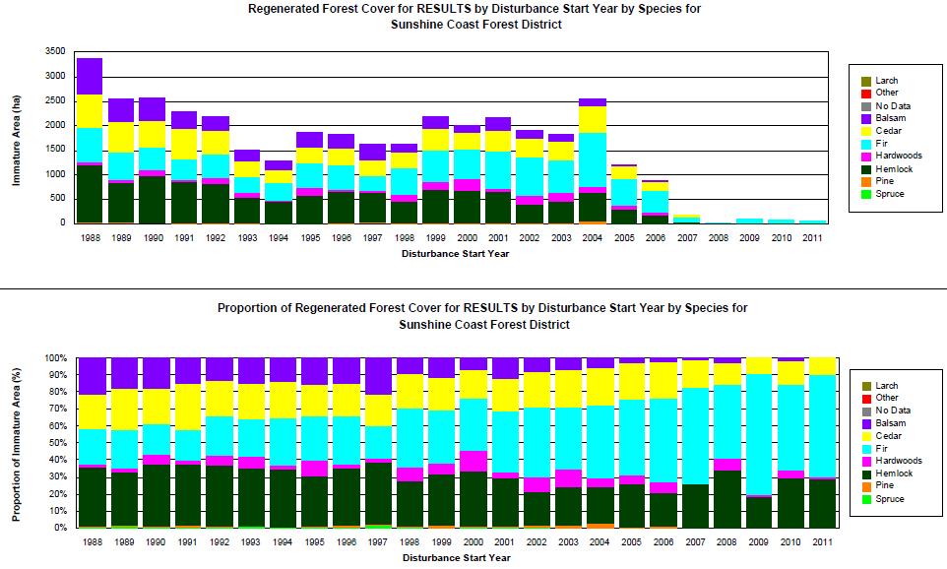
RESULTS – Species Monitoring

Slide 14
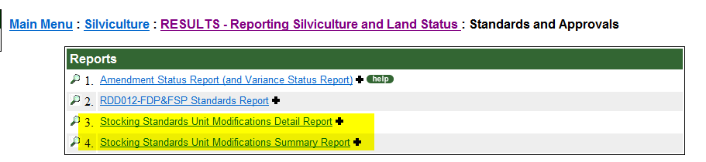
RESULTS – Standards and Approvals
Stocking Standard Modification Detail and Summary Reports are effective March 11, 2008 based on SU History function in RESULTS. Any SU Modifications prior to this date is not reported via SU History function but information is available via Event History.

Slide 15
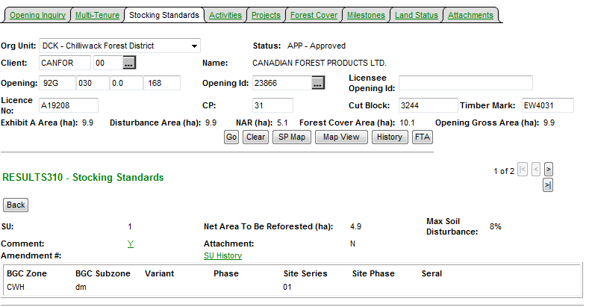
RESULTS – SU History
SU History provides details of all SU modifications.
This function only existed as of March 11, 2008
Therefore any modifications prior to this date is not reflected.
Entire Opening’s SUs are
Copied with tracking of changed items.

Slide 16
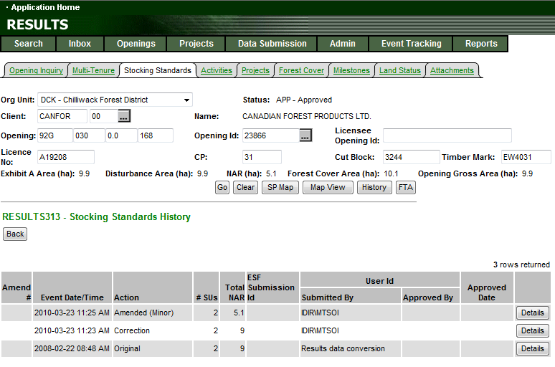
RESULTS – SU History
All records will have either “O” original or “ES”
As the baseline condition
to use as basis for comparison

Slide 17
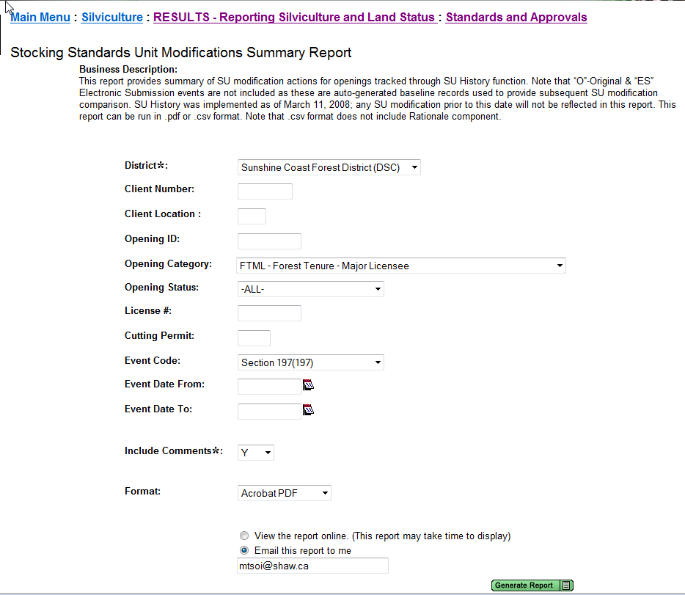
RESULTS – SU Modifications Summary
Format CSV or PDF

Slide 18
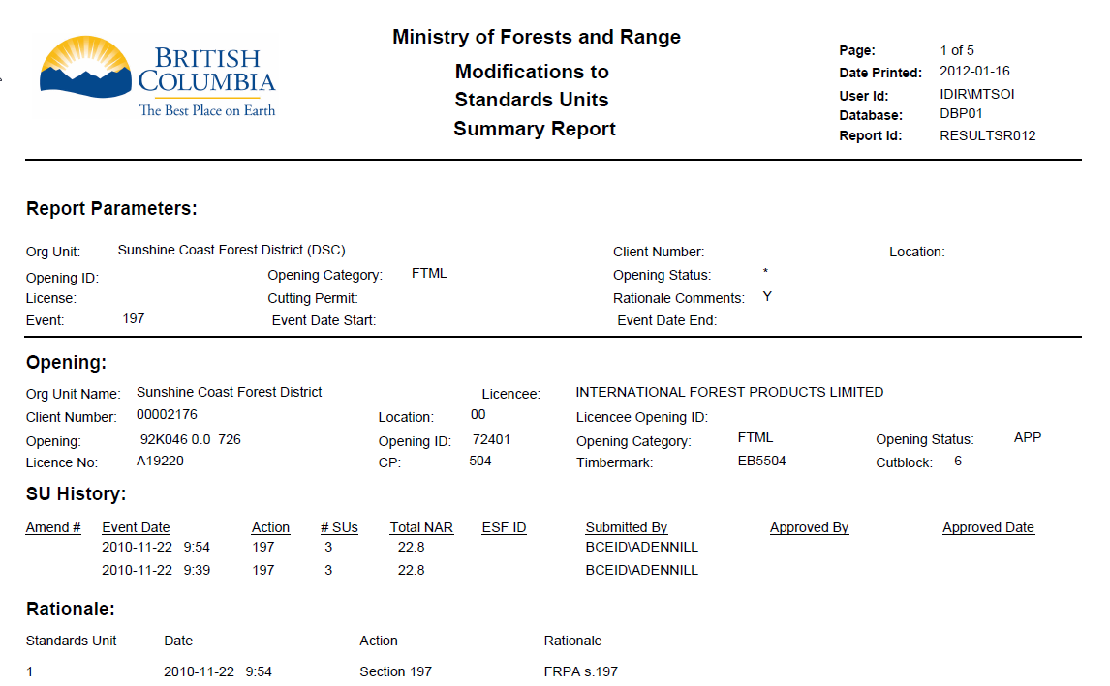
RESULTS – SU Modifications Summary

Slide 19
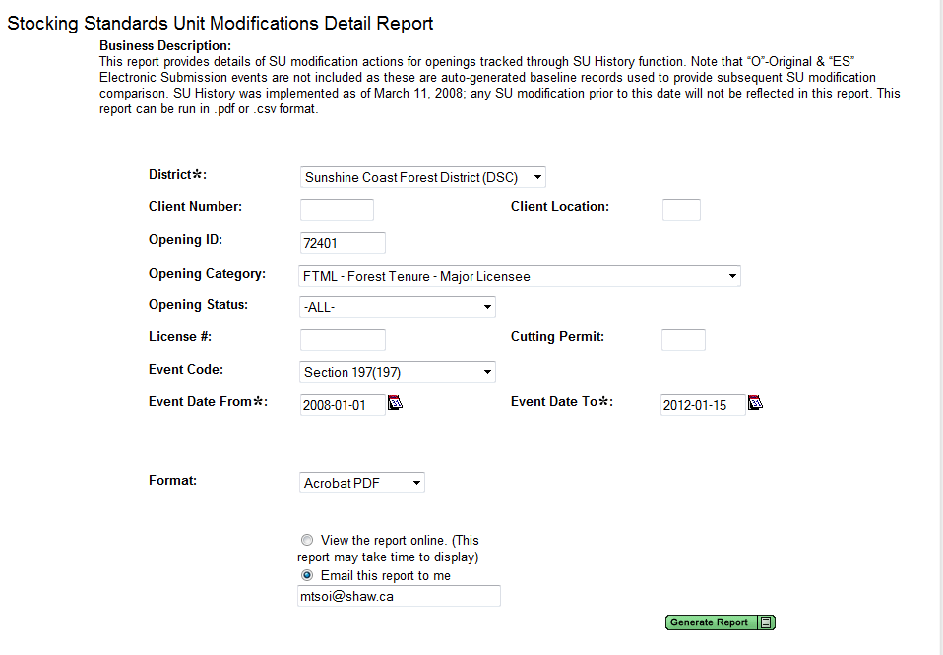
RESULTS – SU Modifications Detail
Format CSV - but only View Online
PDF – View Online or Email

Slide 20
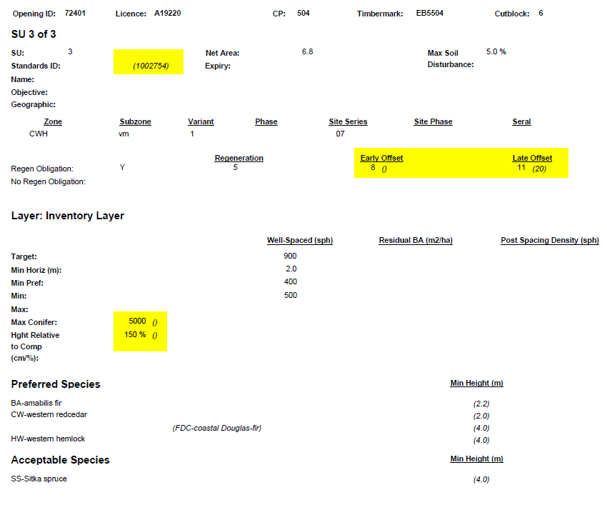
RESULTS – SU Modifications Detail
Changes based on action will be in (brackets and italized)

Slide 21
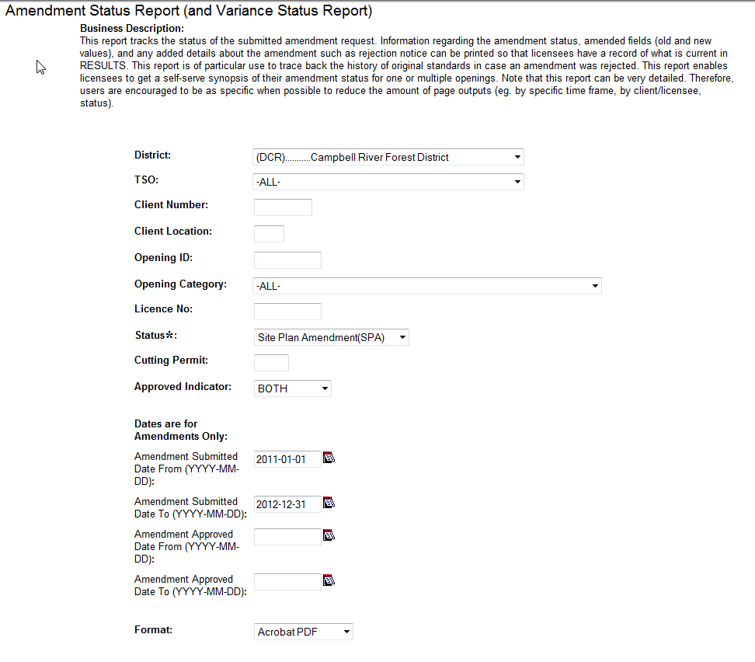
RESULTS – Amendment Status Report (and Variance Status Report)
Report format is available in .pdf or csv
Provides summary of SU Modification Events based on Event History that indicates data element changes Old and New Data

Slide 22
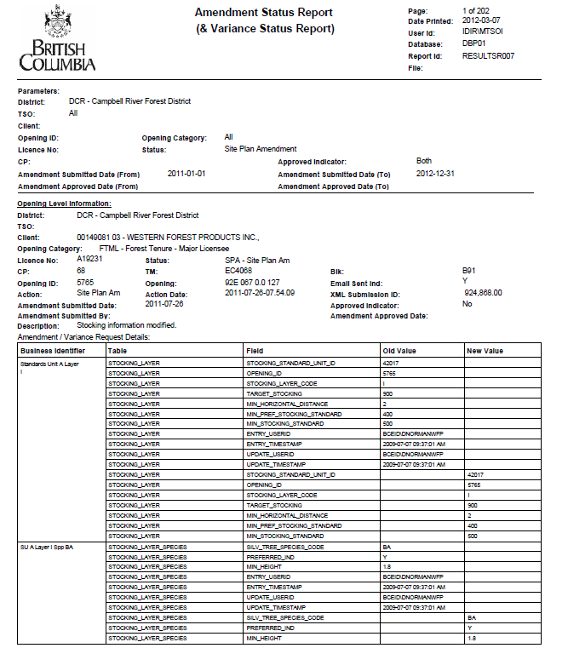
RESULTS – Amendment Status Report (and Variance Status Report

Slide 23
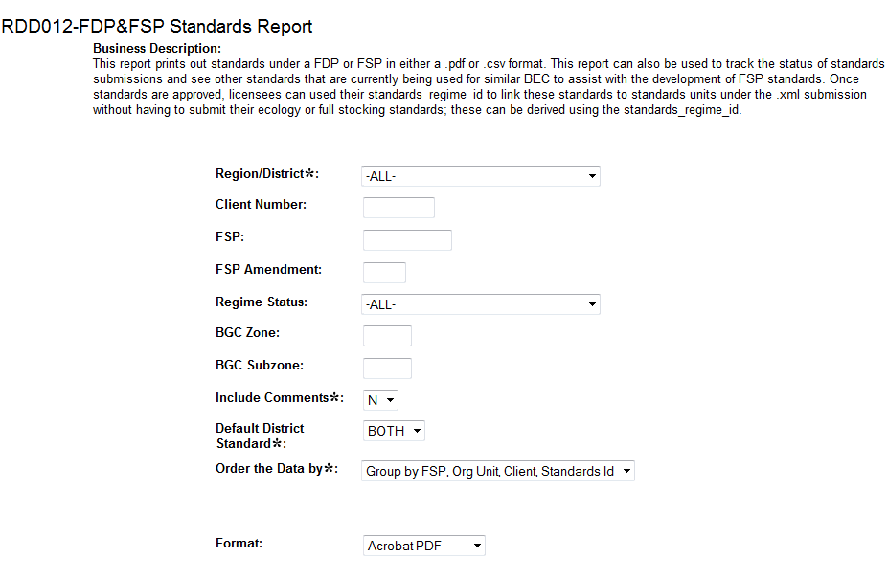
RESULTS – FDP and FSP Standards
Report may be useful for FSP Stocking Standards review and extensions

Slide 24
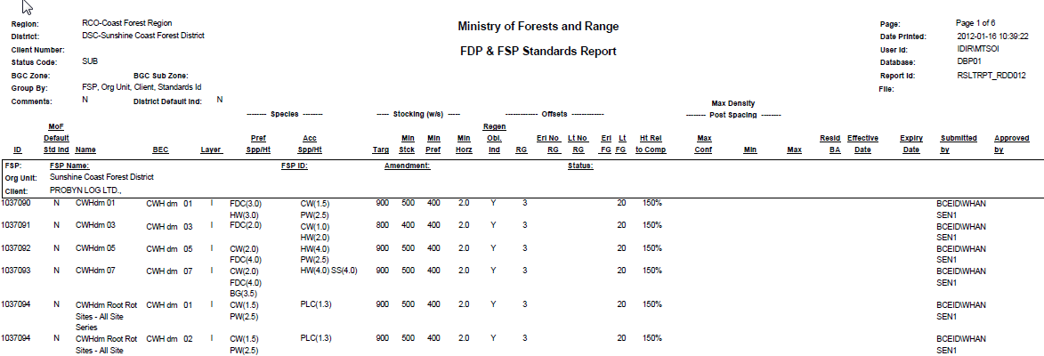
RESULTS – FDP and FSP Standards

Slide 25
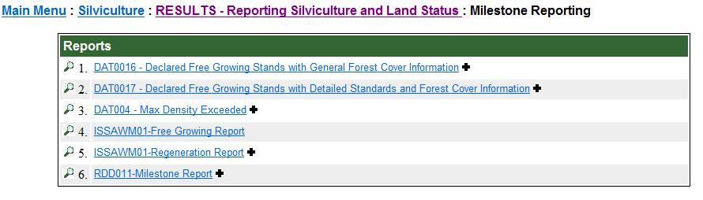
RESULTS – Milestone
      Available in PDF or CSV
ISSAWM01-Regeneration and ISSAWM01-Free Growing Report .pdf format has hyperlinks to Mapview for SUs with Opening Spatial
Most reports are flexible address many questions: due, overdue, when milestone reported

Slide 26
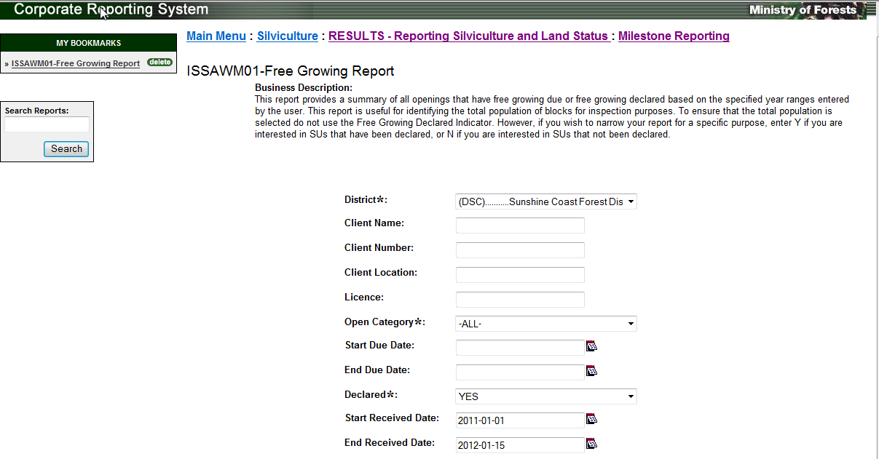
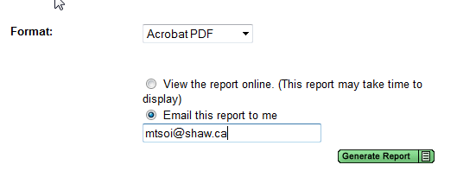
RESULTS – Free Growing Report
ISSAWM01 Regeneration and
Free Growing Reports
supports .pdf and .csv formats.
Powerful report
Due, Overdue, Declared or Not Declared
Not tied to FC
Links to Mapview – if OP spatial exist – hyperlink does not tie to FC spatial – but FC spatial will exist as this is a mandatory rule for all FT*

Slide 27
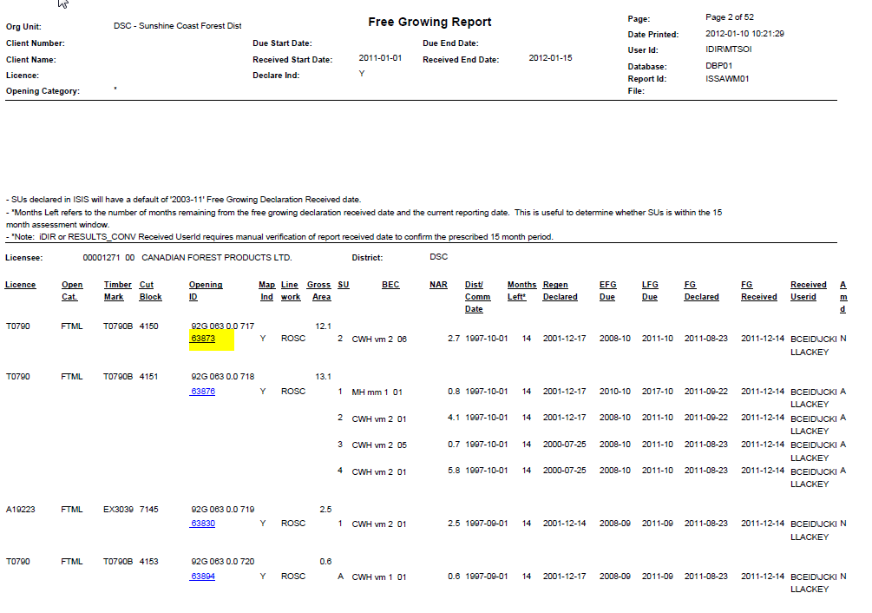
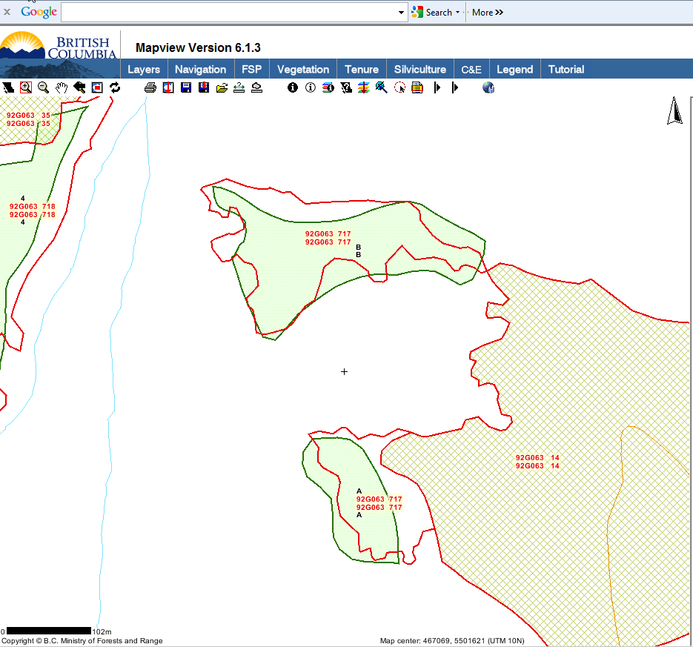
Embedded links to Mapview – if Opening Spatial exists Note that FC must be submitted for FG Declaration – so any recent declarations would have FC Spatial viewable in Mapview

Slide 28
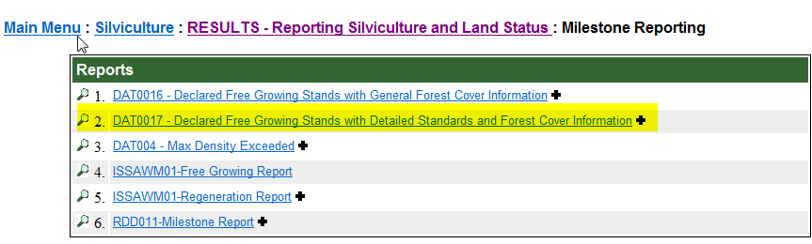
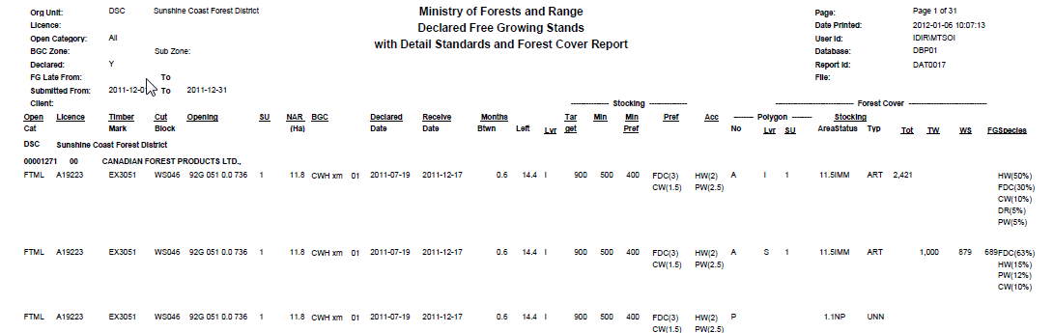
RESULTS – Declared FG with Detailed Standards and FC Info

Slide 29
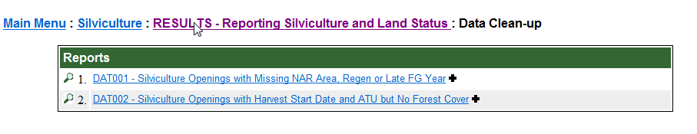
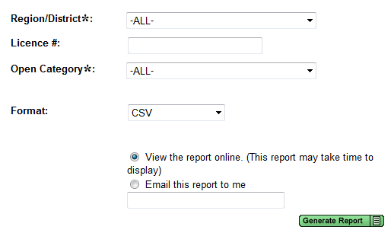
RESULTS – Data Clean up
      Available in PDF or CSV
Simple to run
Review record’s core data that is required to enable milestone reporting or confirmation of forest cover submitted

Slide 30
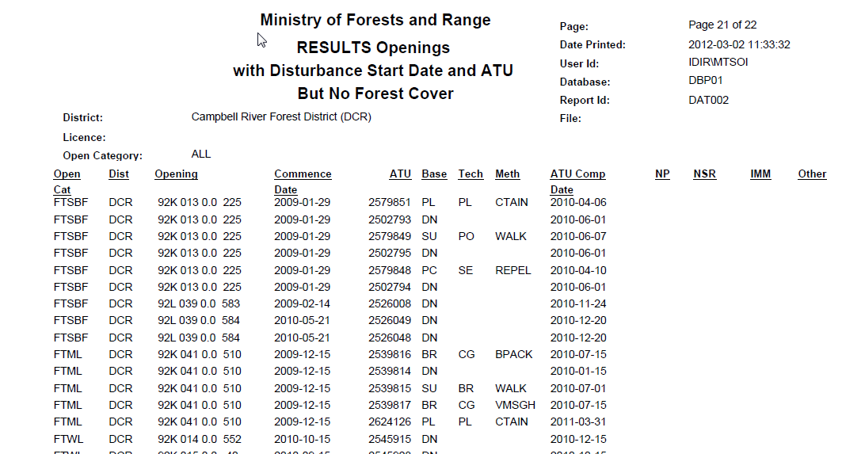
RESULTS – Data Clean up

Slide 31
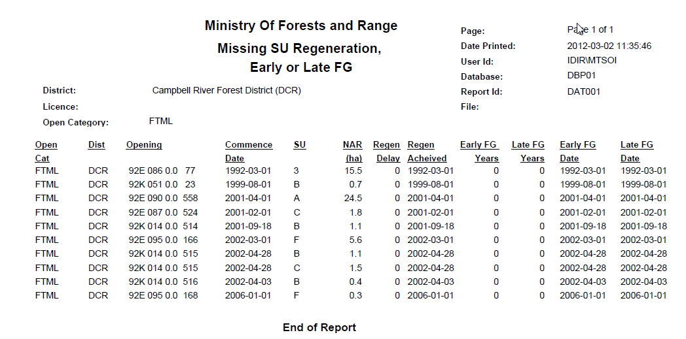
RESULTS – Data Clean up

Slide 32
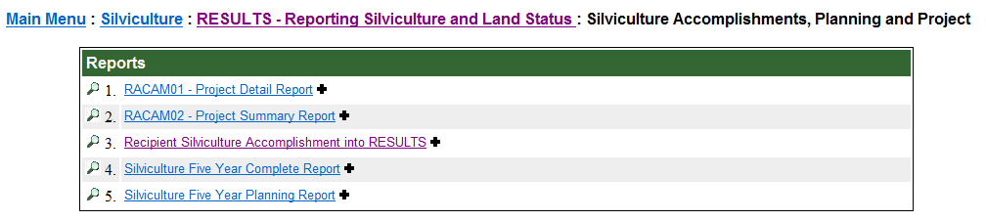
RESULTS – Silv Planning & Accomplishments
      Reports to support with program-specific reporting and planning requirements
      RACAM01 is based on the Project Tab within RESULTS

Slide 33
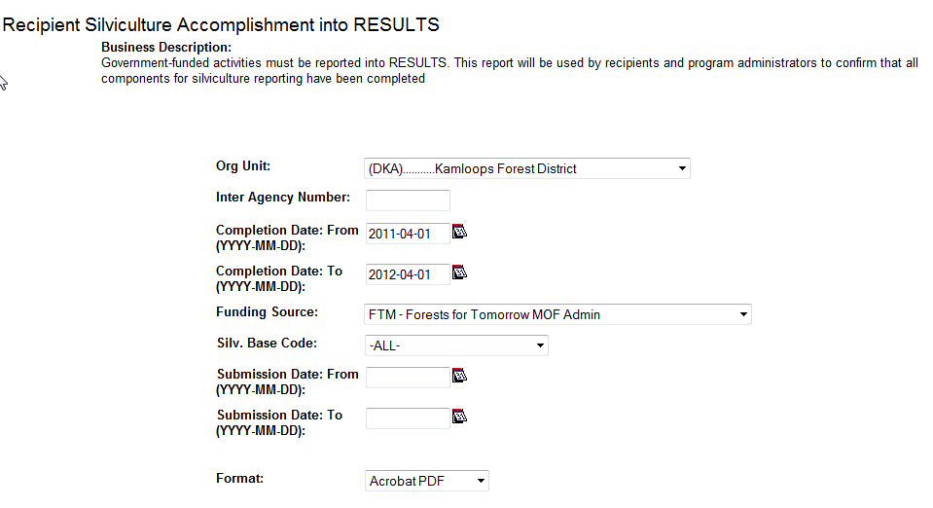
RESULTS – Recipient Silv Accomplishment

Slide 34
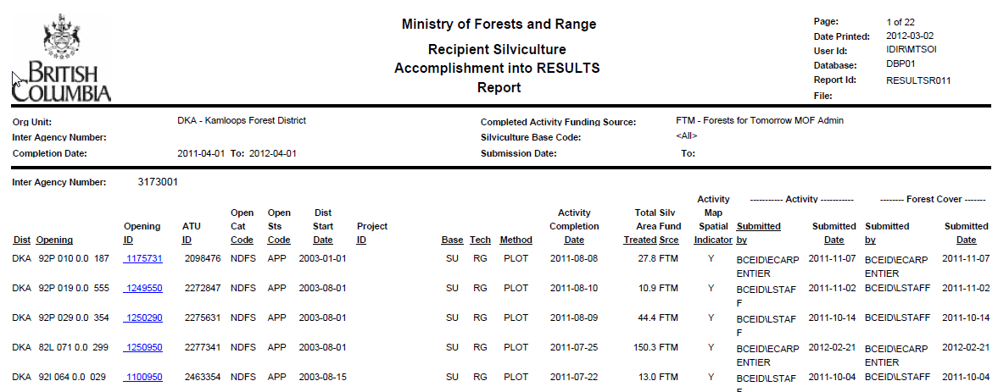
RESULTS – Recipient Silv Accomplishment

Slide 35
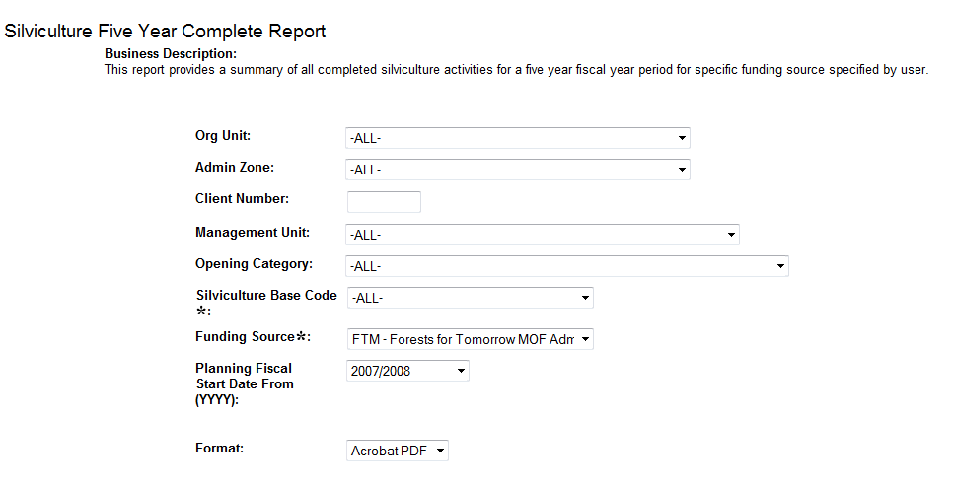
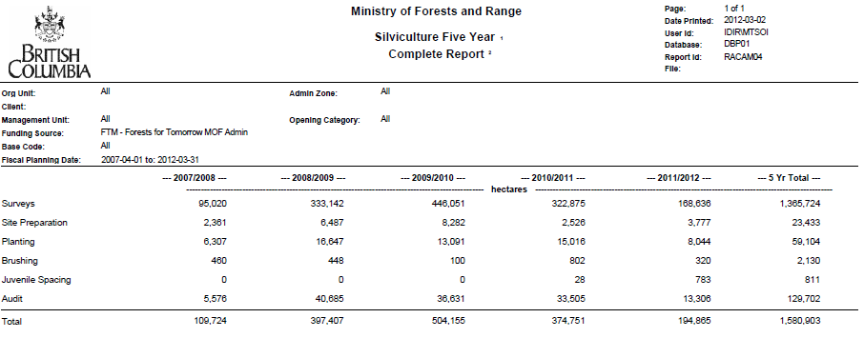
RESULTS – 5 Yr Completion Report
      Useful to run to check how much reporting has been completed

Slide 36
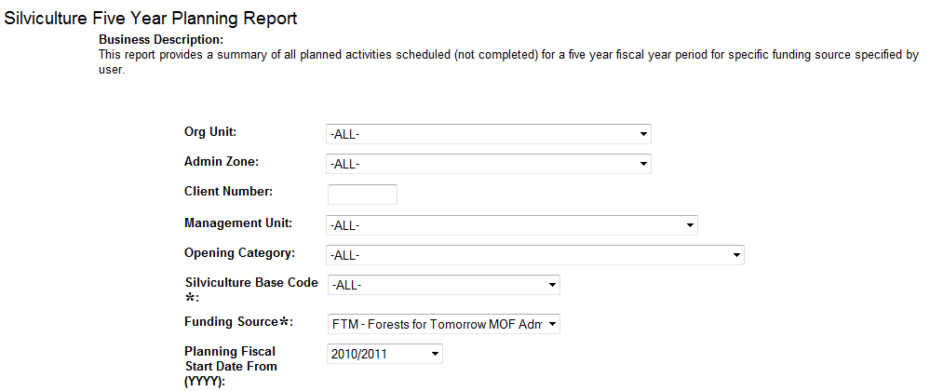
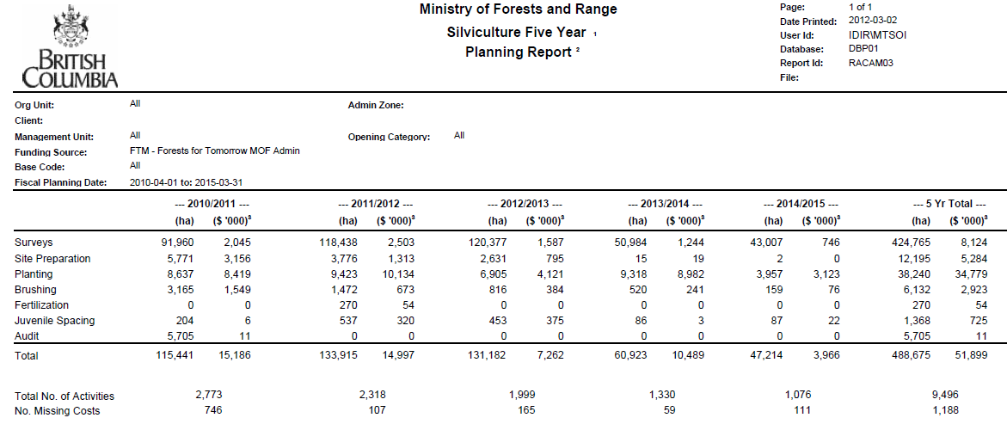
RESULTS – 5 Yr Planning Report
      Useful to check adequate forward activities has been scheduled

Slide 37
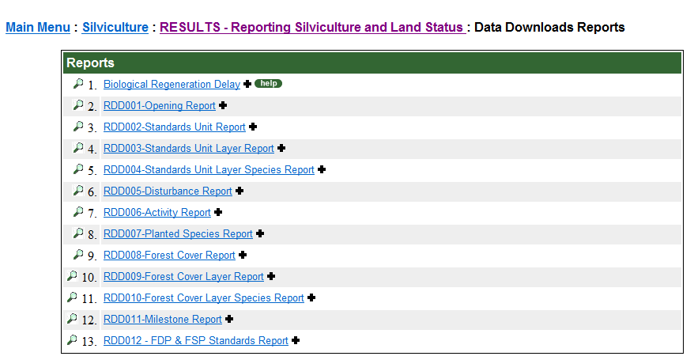

RESULTS – Data Downloads
All RDD-reports are designed for CSV only
Must run View Report Online Option only
RDD0012-has .pdf format

Slide 38

RESULTS – Data Downloads
Lots of data is provided. Delete unnecessary columns, sort, filter, summarize as needed

Slide 39
RESULTS – Data Downloads
DEMO Using RDD006 CSV –
Activity Report

Slide 40


FTA – TB04 – Cut Block Opening Report
(for FTA authorized users)
Helps identify gaps in reporting
Missing opening reporting
Opening reported but missing SUs (NAR= 0.0); and/or
Opening reported but missing forest cover (FC Area = 0.0)

Slide 41




Slide 42



Slide 43

FTA – TB04 – Cut Block Opening Report
(for FTA authorized users)
If blank – missing harvest start and end date – missed disturbance start date?
If missing harvest completion date – status not set to LC (unless manually set in FTA)
If NAR = 0, Missing RESULTS (No Site Plan
If FC Area = 0, Missing RESULTS Forest Cover
If blank – no opening reported
Missed reporting in RESULTS?

Slide 44

RESULTS – Training Recordings & documentation http://www.for.gov.bc.ca/his/results/training/index.htm

Slide 45

RESULTS – Training Recordings & documentation http://www.for.gov.bc.ca/his/results/training/index.htm

Slide 46


RESULTS – CRS Report Listing & Formats
Document provides description of RESULTS CRS reports and report format and content
http://www.for.gov.bc.ca/ftp/his/external/!publish/onlineclassroom/results/Generating_Reports/RESULTS-CRS-Report-Listing-2010-03-29.pdf

Slide 47

RESULTS – Questions?
http://www.for.gov.bc.ca/his/results/support.htm

Slide 48
RESULTS – Questions?
Thank You!

