Slide 1
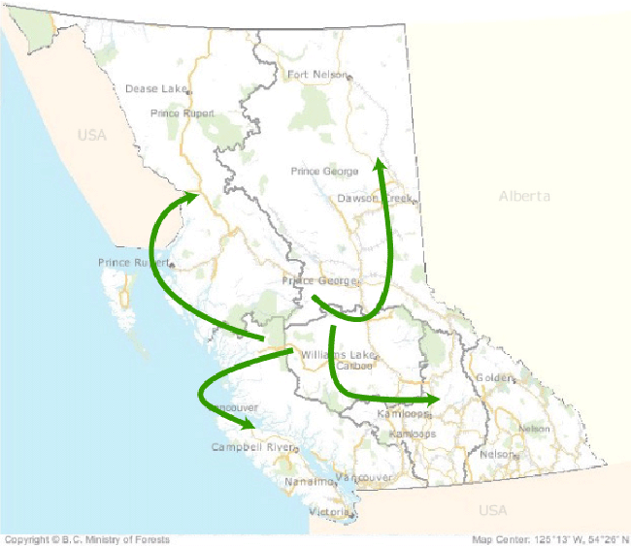

Obligation Reporting (Submissions)
MFR Information Management Branch March 2009
Module 2 – RESULTS Obligation Reporting (Submissions)

Slide 2
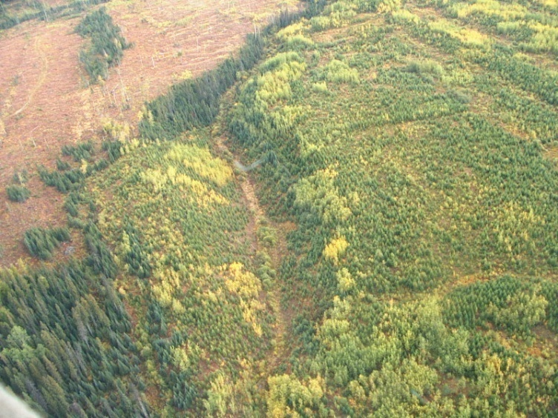
Agenda
Policy
Submission Components
Submitting Documents
Support
Learning Objectives
  Understand what to report, when to report
  Understand what a submission to RESULTS is
  (in general terms)
Notes:
Policy
Legislation/Regulation
XML/GML
Types and timing of Submissions
Submission Components
Opening Key
Opening Definition
Disturbance
Silviculture Activity
Forest Cover
Milestone
Submitting documents
Support

Slide 3
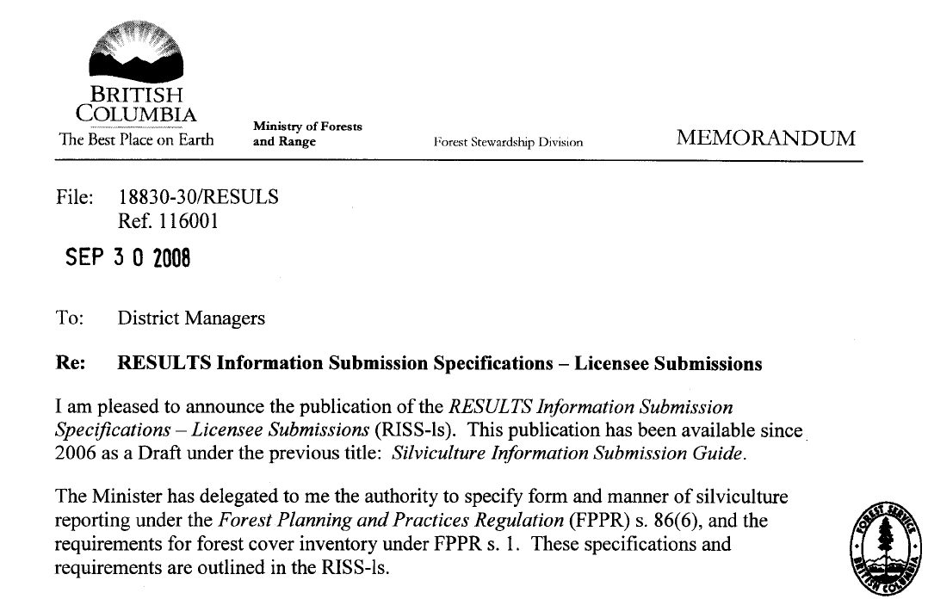
Form and Manner for Reporting
Form and Manner for Reporting Specified by Chief Forester
http://www.for.gov.bc.ca/his/results/RISS-ls_CFmemo.pdf
Notes:
Old Forms are cumbersome, labour intensive, and have room for human error.
Under ESF, essentially the same information is submitted, it is just submitted using the XML/GML technology instead of the old forms. If information was required on the old forms, it is still required under ESF.
Currently, the sources for submission content are the Silviculture Information Submission Guide and the RESULTS Tech Specs.

Slide 4
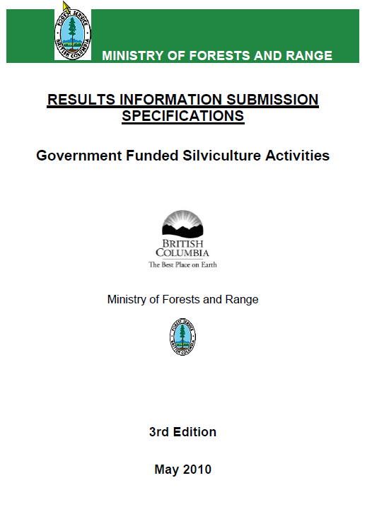

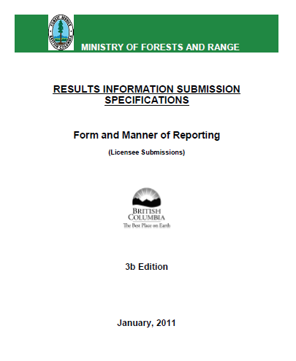
Business Documentation
http://www.for.gov.bc.ca/his/results/business.htm
Notes:
Old Forms are cumbersome, labour intensive, and have room for human error.
Under ESF, essentially the same information is submitted, it is just submitted using the XML/GML technology instead of the old forms. If information was required on the old forms, it is still required under ESF.
Currently, the sources for submission content are the Silviculture Information Submission Guide and the RESULTS Tech Specs.

Slide 5

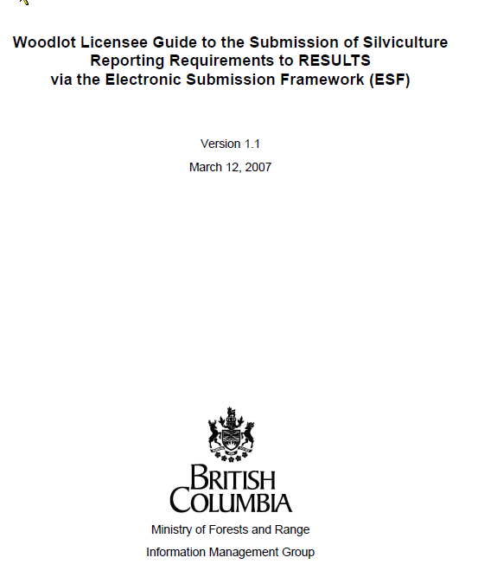
Business Documentation
Notes:
Old Forms are cumbersome, labour intensive, and have room for human error.
Under ESF, essentially the same information is submitted, it is just submitted using the XML/GML technology instead of the old forms. If information was required on the old forms, it is still required under ESF.
Currently, the sources for submission content are the Silviculture Information Submission Guide and the RESULTS Tech Specs.

Slide 6
Key Dates & Submission Method
January
February
March
April
May
FIA/FFT
Deadline
WL
Deadline
ML
Deadline
Submission Method
ESF (Electronic Submission Framework)
Online into RESULTS directly
Method depends on requirements established by RISS:
        obligation type,
        Reporting components
        age of opening and/or
        program-specific requirements.
Notes:
New ESF submissions replace forms.
The reporting deadline is Before June 1 for the previous reporting year (April 1 to Mar 31).
Milestone declarations are optional (under FRPA Sec 107).

Slide 7
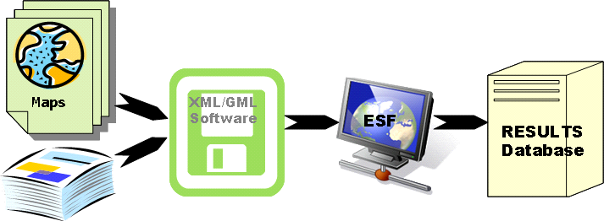
Options for ESF
Licensees can
  Submit data themselves
    Forest Management System (eg. Genus, Phoenix^{Pro}, TheForestManager)
    Form software (e.g. eziLink, FME), or
  Use a Service Provider who will submit on their behalf
http://www.for.gov.bc.ca/his/esf/
Notes:
Service providers: Forsite, JS Thrower & Associates, Chartwell Consultants Ltd., Integrated ProAction Corp, TM Pearson & Co.)
ForestManager is produced by Inform. It is essentially a database for forest management information.
Genus: originated by Canfor, used by many organizations. It is essentially a database for forest management info
Phoenix Pro: Produced by DR Systems. It is essentially a database for forest management info.
All of those systems have add-on modules that enable them to create XML documents.
Mention FME (generic data transformation tool), and eziLink (the only e-submission specific tool - this is the tool that MoFR purchased to generate its submission documents)

Slide 8
ESF vs. Online
ESF | RESULTS Screens
Opening Definition (Site Plan Information) | Opening Inquiry (S301) Multi-Tenure (S305) Stocking Standards (S310)*
Disturbance | Activity (S315) Disturbance Results (S316)
Silviculture Activity | Activity (S315) Maintain Activity (316)
Forest Cover Component* Must be submitted by ESF | Forest Cover Summary (S320) Forest Cover Detail (S321)
Milestone Component | Milestone (S325)
* Any spatial requirements must be submitted by ESF
Notes:
The reporting deadline is Before June 1 for the previous reporting year (April 1 to Mar 31).
Milestone declarations are optional (under FRPA Sec 107).

Slide 9

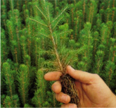

Policy
Harvest | Planting | Regen Surveys | Various Activities: BR, JS | FG Survey
Year 0 thru 20
Opening Definition Disturbance Forest Cover | Silv Activity | Silv Activity Forest Cover Milestone | Silv Activity | Silv Activity Forest Cover Milestone
Notes:
Opening Lifecycle from time of harvest through to achieving Free Growing Status (upper half of screen), and the expected cycle of submission types and timing (lower half).
Harvest – for areas harvested during the reporting year, must define the opening in RESULTS, report disturbance and update FC.
Planting and other Silv activities – must report any silviculture treatment reported during the reporting year
Surveys – surveys are not treatments therefore no requirement to report although it is recommended; however, must report forest cover updates at milestones. Milestone declarations are optional.

Slide 10
Policy
Submission type and electronic submission mechanisms
Submission Type | Via ESF | Direct data entry in RESULTS
Opening Definition submission | X | X**
Disturbance submission | X | X*
Silviculture Activity submission | X | X
Forest Cover submission | X | X**
Milestone submission | X | X*
*These submissions can be done in RESULTS but must be supported with a Forest Cover submission
**Theses submission can be done in RESULTS if it is for a Woodlot Opening and the Opening/SU/FC boundaries are the same as the Exhibit A boundaries

Slide 11
Policy
Silviculture Obligation Reporting requirements are outlined by:
Major Licensees and BCTS
RESULTS Information Submission Specifications for Licensee Funded Activities (RISS-ls)
Woodlots
Woodlot Licensee Guide to the Submission of Silviculture Reporting Requirements to RESULTS via ESF
FIA/FFT projects
RESULTS Information Submission Specifications for Government Funded Activities (RISS-gf)
      www.for.gov.bc.ca/his/results/business.htm

Slide 12
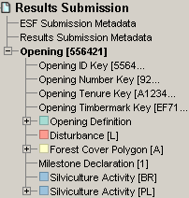
Policy
Submissions to RESULTS via ESF must conform to strict structure, formatting and content guidelines
  These are defined by the schema and associated business rules
  Conceptualized view of a submission components
MetaData
Opening Key
Opening Items
Notes:
Structure and formatting of submission documents governed by a Schema.
Submission documents must conform to schema or they will be rejected
Submission data must meet business rules or submission will be rejected.
Submission document can be broken into three main pieces: Metadata, Opening Key, and Opening Items.
A single submission document can contain multiple openings (identified by the opening key) and each opening can contain multiple Opening items. The opening items define the submission type (e.g. opening definition, disturbance, etc.).

Slide 13
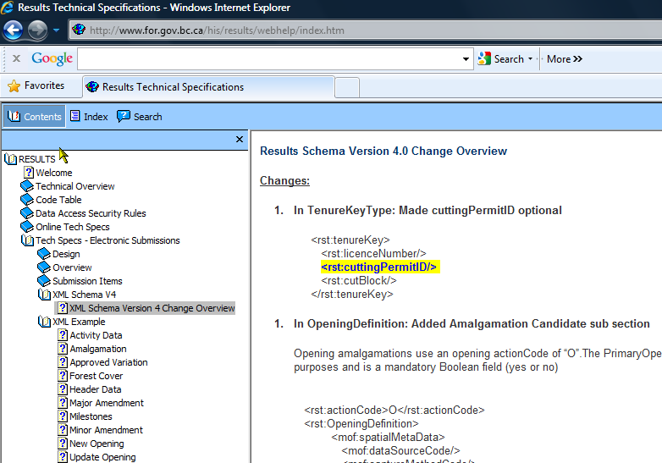
Submission
Schema is published on RESULTS Technical website.
http://www.for.gov.bc.ca/his/results/webhelp/index.htm
Notes:
Structure and formatting of submission documents governed by a Schema.
Submission documents must conform to schema or they will be rejected
Submission data must meet business rules or submission will be rejected.
Submission document can be broken into three main pieces: Metadata, Opening Key, and Opening Items.
A single submission document can contain multiple openings (identified by the opening key) and each opening can contain multiple Opening items. The opening items define the submission type (e.g. opening definition, disturbance, etc.).

Slide 14

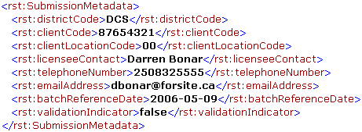
Submission Components
ESF Submission Metadata
  Identifies the submitter
RESULTS Submission Metadata
  Identifies the Licensee
  Indicates Validate or not
Note this info is automatically provided via BCeID for online entries
Notes:
ESF Submission metadata – put contact info for whoever is responsible for getting the submission through ESF into RESULTS.
RESULTS Submission metadata – put in contact info for who is responsible for the data contained in the submission.
Validate Indicator can be used to test the submission against ESF schema requirements.

Slide 15
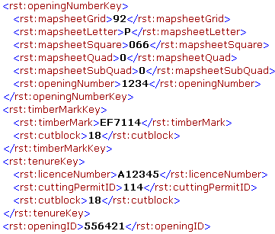
Submission Components
Opening Key
  Identifies the opening to which the submission belongs
  Can be any of
    Opening Number
    TimberMark/Blk*
    Licence/CP/Blk*
    Opening ID
*These keys link to FTA and bring tenure data forward to RESULTS. Must use either of these for first submission.
Notes:
In tenured situations the Opening Key links RESULTS to FTA.
Either of the Licence/CP/CB, or the Timbermark/CB must be used when an opening is first defined in RESULTS. After the initial opening definition has been created in RESULTS any of the 4 ways can be used.
When the opening is first submitted to RESULTS (i.e. opening definition submission), the opening key is critical for creating the relationship between what was tenured (i.e. the cutblock), and the opening that is being managed.

Slide 16
Submission Components
Opening Definition
  Used to:
    Create new openings
    Update existing openings
    Propose amendments to existing openings
    Propose cutblocks to amalgamate into a single opening
  Identifies:
    Site Plan information including
      Previous stand information
      Standard regime (standard id)
      Governing tenure
      Spatial location opening/SUs
  Key Links:
    FTA for Tenure Data
    LRDW for Spatial data
Notes:
In tenured situations the tenure data populates RESULTS from FTA, RESULTS will pass the Opening number to FTA
Any spatial data contained in the submission will be replicated in the LRDW which can then be viewed via MapView

Slide 17
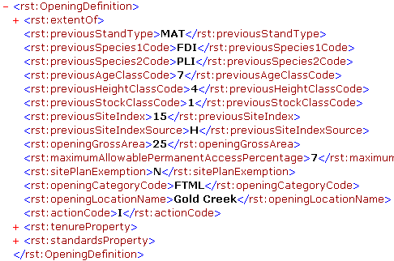
Submission Components
Opening Definition – 3 components
  Opening data
  Tenure data
  SU data
Action Codes
  I – Insert
  U – Update
  A – Amendments
  M – Minor Amendments
  V – Approved Variations
  O – Opening Amalgamation
Notes:
Note any ‘extentOf’ field represents a place holder for spatial data.
In this case that indicates that spatial data for the opening boundary may be submitted as part of an opening definition submission (optional – because it can be derived from forest cover later on.
The Action Defines what the intent of the submission is
I – for insert new information
U – for updating or correcting information already in the system
A – for site plan amendments and proposing Amendments to Silv prescriptions that need to go to MoFR for Review
M – for minor (area and BEC) amendments to Silv Pres
V – for applying approved variations to Site Plans
O – for proposing opening amalgamations to MoFR

Slide 18
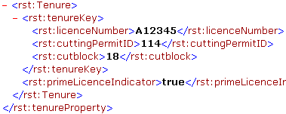
Submission Components
Opening Definition – 3 components
  Opening data
  Tenure data
  SU data
RESULTS allow multi-cutblock openings.
Prime Licence Indicator is set to true if only one cutblock is assigned to one opening.
If there is a requirement to have more than one cutblock associated with an opening, one must be true, all other cutblocks must be False (non-prime).
Notes:
In most cases there will be one tenure per opening, but there are many business cases for which multiple tenures will govern one opening. For instance an Opening may be made up of a portion of TFL tenure, and a portion of FL tenure; similarly a portion may be a TFL; while another portion maybe timber license; similarly one opening may be made up of a tenured cutblock and a series of salvage cutblocks.
In all cases one tenure must be identified as the prime licence. All other tenures will be considered secondary.

Slide 19
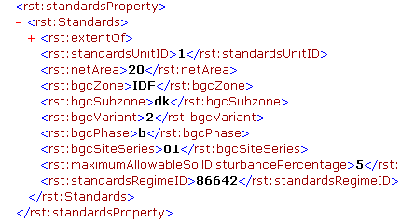
Submission Components
Opening Definition – 3 components
  Opening data
  Tenure data
  SU data
*Spatial data for Standard Units is required
Notes:
An opening may contain multiple SUs
SU spatial data is required (in the extentOf place holder)

Slide 20
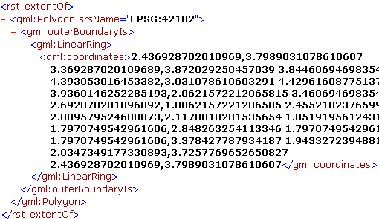
Submission Components
Opening Definition – 3 components
  Opening data
  Tenure data
  SU data
    Spatial Data
*Spatial data for Standard Units is required

Slide 21
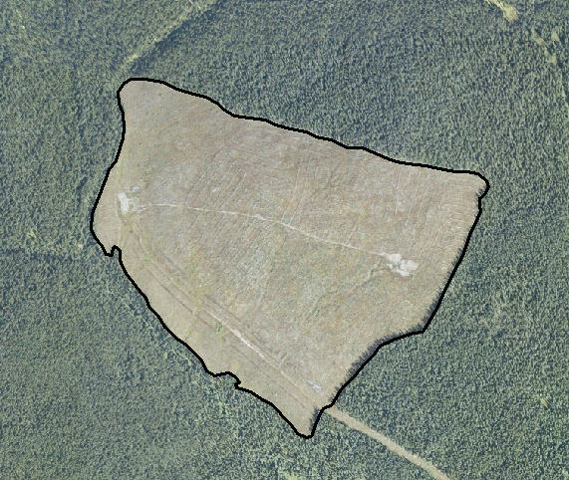
Submission Components
Opening Boundary
SU Boundary
Notes:
Required spatial information – may be different than FTA submission. But this opening is the planned/actual harvest area – depends on timing of submission, may be pre or post harvest. Simple opening definitions for Clearcut and partial cut
Opening boundary = SU boundary in each case. Required information found in the Mapping standards, Vivid guide and Industry Guide (as well as old FS 708 guide).
Simple opening boundary equals the SU boundaries.

Slide 22
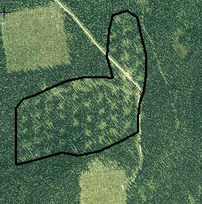
Submission Components
Opening Boundary
SU Boundary
Example spatial information for an Opening Definition
Notes:
Required spatial information – may be different than FTA submission. But this opening is the planned/actual harvest area – depends on timing of submission, may be pre or post harvest. Simple opening definitions for Clearcut and partial cut
Opening boundary = SU boundary in each case. Required information found in the Mapping standards, Vivid guide and Industry Guide (as well as old FS 708 guide).
Simple opening boundary equals the SU boundaries.

Slide 23
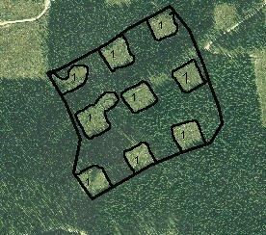
Submission Components
Opening Boundary
SU Boundary
Example spatial information for an Opening Definition
Notes:
Opening boundary is different than the SU boundary e.g., group selection – slightly more complex.
opening definitions for Patch cut
Opening boundary = Entire outside boundary
SU boundary = dark line around each patch identified as 1
One SU but two separate forest cover polygons. The unharvested does not have to be identified as an SU.

Slide 24

Submission Components
Disturbance Submission
  Used to:
    Create new Disturbances
    Update existing Disturbances
  Identifies:
    Disturbance type
    Silviculture System
    Harvest Start and Complete Dates
    Area disturbed
    Spatial Location*
  Key Links
    FTA for Harvest Area, Dates, and cutblock status
*Spatial data for disturbance reporting is optional

Slide 25
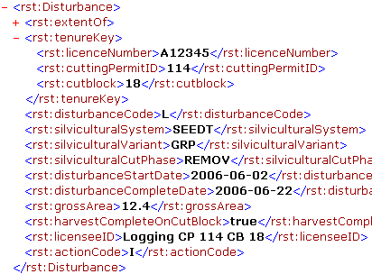
Submission Components
Disturbance
Multiple Disturbance Submissions per opening are required where there is more than one tenure governing an opening, and/or there are different silviculture systems within the same opening
Notes:
Disturbances must be submitted by tenure – therefore if more than one tenure, there must be more than one disturbance report. Click on the disturbance and it will pick the form, you will need to do it for each disturbance.
Not all attribute data is required. It can be optional (ie licensee ID, or conditional (ie required under certain conditions – silviculture variant is required under some silviculture systems, but not others so it is conditional)
Spatial data for SUs is madatory

Slide 26

Submission Components
Gross area-NPNAT-MATNAT=Disturbance Area
Roads are typically included in the disturbance area
Notes:
Example of Disturbance spatial
Only the harvested patches are included in the disturbance area

Slide 27
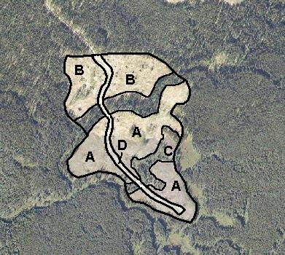
Submission Components
Gross area-NPNAT-MATNAT=Disturbance Area
Roads are typically included in the disturbance area
Notes:
Example of Disturbance Spatial.
NAR + Rds (NP NAT) = area disturbed
WTPs are not disturbed, so not included in disturbance area.

Slide 28


Submission Components
Silviculture Activity Submission
  Used to:
    Create new Activities
    Update existing Activities
  Identifies:
    Silviculture Treatments
    Area treated
    Spatial Location*
  Key Links
    LRDW
    SPAR (seedlot check)
*Spatial data for silviculture activities is optional with the exception related aerial fertilization activities (see RISS-gf).
Notes:
Formerly part of FS708 Form B
Silv Treatments include: Planting, Brushing, Spacing, Site Preparation, Fertilization, Pruning
Silv surveys are not considered treatments, therefore you are not required to report them (although they are happily accepted by MoFR). They are a recommended submission especially when in support of a forest cover updates and milestone submissions.
Under FRPA Licensees may submit some treatments as annual roll-ups by license. But can be done by block (which is the way most major licensees are setup to submit).
Spatial data is always optional for silviculture activities

Slide 29
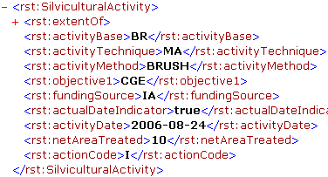
Submission Components
Silviculture Activities
  Site prep
  Planting
  Brushing
  Juvenile spacing
  Fertilization
  Pruning
Notes:
Base/Tech/Method/Obj codes can be found in the RESULTS Tech Specs or in the RESULTS application
Funding Project ID designed for FIA/FFT funded activities, but may be used by licensees
Activity Cost – to be used for FRPA 108 applications, NRFLs, FFT, FIA, but may be used by licensees
Actual Date Indicator – used to identify completed (ie True) or planned (ie false) activities

Slide 30
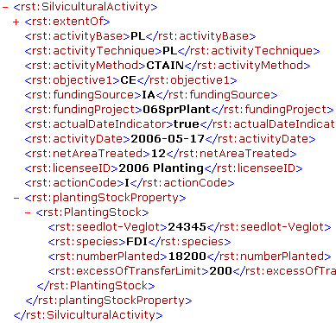
Submission Components
Silviculture Activity
Seedlot is validated against SPAR
Notes:
Planting activities require additional information specific to the planting stock used.
Seedlot must be 5 digits and match up with SPAR. Business rule that goes to SPAR to check that a valid seedlot is being used. Submission should be rejected if RESULTS submission seedlot does not match a seedlot in SPAR.
Excess of Transfer limit – number of trees outside of the Chief Foresters standards for seed use

Slide 31
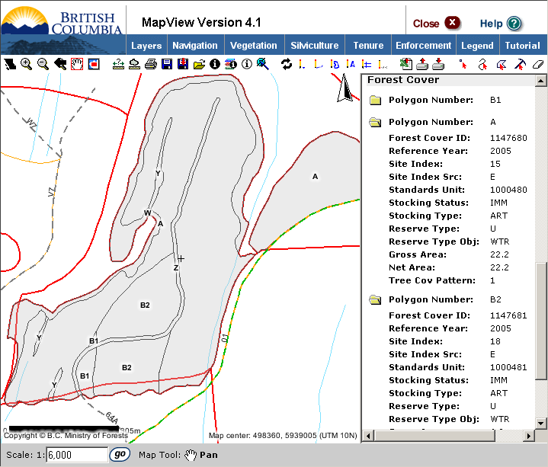
Submission Components
Forest Cover Submission
  Used to:
    Create new Forest Cover
    Replace existing Forest Cover
  Identifies:
    Polygons/strata
    Inventory/silviculture data
    Forest health
    Spatial Location
  Key Links
    Forest Inventory (VRIMS)
    LRDW (Mapview)
Notes:
Replace Forest Cover: FC submissions are delete and replace. There is no updating of FC data via ESF.
Key Links
All forest cover information will be used to update the Forest Vegetation inventory which will be used in timber supply and AAC calculations
All spatial data is stored in LRDW and available for viewing in mapview

Slide 32
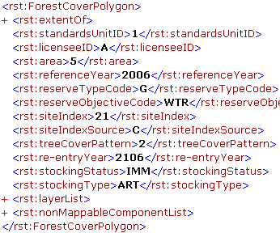
Submission Components
Forest Cover – 3 main components
  Polygon Data*
  Layer Data
    Tree Species
    Damage Agent
  NonMappable Component
*Spatial data for forest cover polygons is required
Notes:
Licensee ID: - forest cover polygon name (ie 1,2,3, or A, B, C, or X, Y, Z or whatever the licensee wants to call it)
Reference Year: - this is the year the this information was collected
Re-entry Year: - is the projected year that the next stand will be harvested
Reserve Objective and Type: - must be filled in if this forest cover polygon is a reserve
Tree Cover Pattern: - for reserves
Site Index and Source: - important to include accurate, up to date site index as this is used in Timber supply calculations!
extentOf: For spatial data
All forest cover polygons must be associated with an SU (Standard Unit ID:) either spatially (ie there is FC spatial data and SU spatial data that can be overlaid), or by attributes (ie including which SU a given FC polygon falls under
Same information as was required by old Form C – If you submitted something on the old forms you will continue to submit that info via ESF

Slide 33
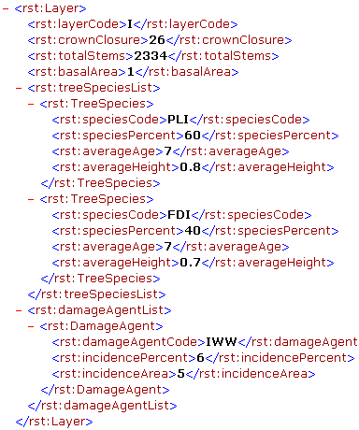
Submission Components
Forest Cover – 3 main components
  Polygon Data
  Layer Data
    Tree Species
    Damage Agent
  NonMappable Component
Notes:
Layer data for each layer required (e.g. I and S in even aged stand, 1,1S, 2, 2S, 3, 3S, 4, 4S in uneven aged stand)
Example Inventory Label.
Need to include tree species. All information in the tree species box is required for a single species. Note there is no limit to the number of tree species you submit, but if you submit more than one species the age and height are only required for the dominant species.
For Damage agent – There is no requirement to submit information on damaging agents. If you choose to submit information about a damage agent(s) fill in all fields.
Incidence Percent - The percent of host species within the forest cover polygon impacted by the damage agent with damage that exceeds the free growing criteria.

Slide 34
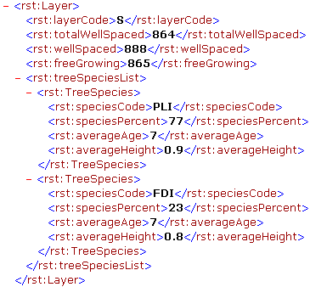
Submission Components
Forest Cover – 3 main components
  Polygon Data
  Layer Data
    Tree Species
    Damage Agent
  NonMappable Component
Notes:
Example Silv Layer
Total Stems needs to be blank for silv layer
Basal area is not applicable to layer 2,3,4 trees
Total well spaced – disregards m-value
Well spaced – with m-value
Same information as was required by old Form C – If you submitted something on the old forms you will continue to submit that info via ESF

Slide 35
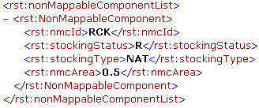
Submission Components
Forest Cover – 3 main components
  Polygon Data
  Layer Data
    Tree Species
    Damage Agent
  NonMappable Component
Notes:
NonMappable Component.
Designed to track small Non-forested/non-productive patches which are present in the stratum (maybe as single units, maybe as dispersed units). These patches are too small to invest in stratification/mapping, but there is a desire to recognize their existence.
Examples include swamps, rocky out crops, etc

Slide 36
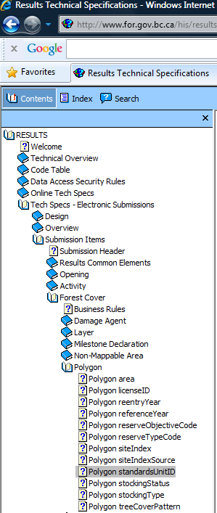
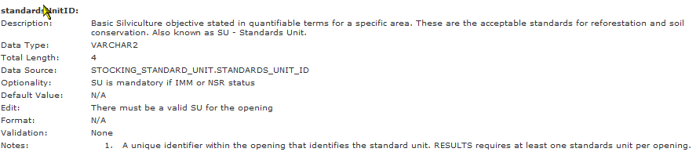
Submission Components
Forest Cover contains many validation rules to ensure data completeness where expected.
These rules are explained in the RISS-ls and also in the ESF technical specifications.
Notes:
NonMappable Component.
Designed to track small Non-forested/non-productive patches which are present in the stratum (maybe as single units, maybe as dispersed units). These patches are too small to invest in stratification/mapping, but there is a desire to recognize their existence.
Examples include swamps, rocky out crops, etc

Slide 37
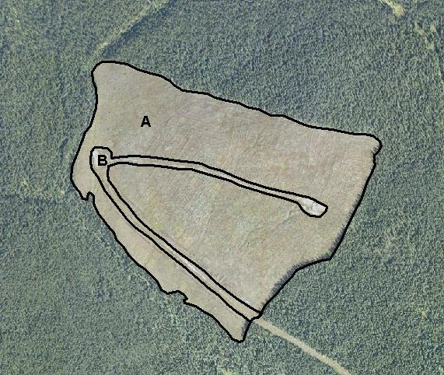
Submission Components
Polygon | Description | Standards Unit | Area (ha)
A | Clearcut | 1 | 55.0
B | NP UNN |  | 5.0
Polygon | Description | Standards Unit | Area (ha)
A | Cutover | 1 | 10.0
B | Mature |  | 35.0
C | NP UNN |  | 5.0
Notes:
Spatial information is required for forest cover polygon submissions
First picture: Two polygons (one for the productive forest area, and one for the Road) one SU – all polygons must be associated with an SU (either via attributes or spatially).
Second picture: Three polygons required: one for the patch cuts, one for the reserved areas, and one for the roads. All are associated with SU1

Slide 38
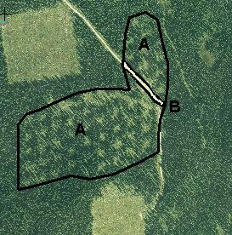
Submission Components
C
Polygon | Description | Standards Unit | Area (ha)
A | Clearcut | 1 | 30.0
B | Seedtree | 2 | 20.0
C | Reserves |  | 10.0
D | NP UNN |  | 3.0
Polygon | Description | Standards Unit | Area (ha)
A | Variable Retention | 1 | 20.0
B | NP UNN |  | 5.0
Notes:
Picture 4: two polygons required
Picture 5: two polygons required

Slide 39
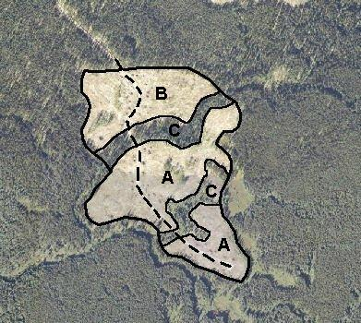
Submission Components
Polygon | NMC | Description | Standards Unit | Gross Area | NAR
A |  | Clearcut | 1 | 30.0 | 27.0
 | a | NP UNN |  | 2.8
 | b | NP NAT |  | 0.2
B |  | Seedtree | 2 | 20.0 | 19.0
 | c | NP UNN |  | 1.0
C |  | Reserve |  | 10.0 | 9.0
 | d | NP UNN |  | 1.0
Notes:
Picture 6: Three polygons are required in this case as the roads are not being mapped. One polygon for the clearcut area, one for the Seedtree area, one for the reserve area, and the roads are tracked as non-mappable areas of each forest cover polygon.

Slide 40
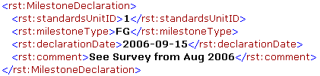
Submission Components
Milestone Submission
  Used to:
    Declare SUs have met a Milestone
  Identifies:
    Stratum
    Milestone type
    Date
  Key Links
    FTA (once all SUs are FG)
    LRDW (Mapview)
Milestone Submissions are optional under FRPA Section 107 (although highly recommended)
Milestone declarations must be supported by forest cover
Notes:
Formerly found on FS708 Form C
Post Harvest declarations is typically for intermediate cuts (e.g. commercial thinning) with no regeneration objectives
Declarations are always optional, but by declaring an obligation has been met effectively remove liability from licensee (subject to review by MoFR within 15 months review)
Declarations are made by SU
No spatial information is required (RESULTS already has the SU boundaries because they were submitted for the Opening definition)
Can submit a single SU at a time (i.e. don’t need to declare entire block at once)
Date should be before late free growing date, but could be after if official documentation on file with licensee is dated on or before late free growing date
Milestone Type: free growing, regen delay, post harvest.
Declarations are professional opinion, therefore require RPF to submit them. (non-RPF may submit, but there must be a signed and sealed declaration in licensee’s files to back that up – maybe included a scanned copy of this signed and sealed declaration as an attachment if declared in RESULTS application)
May added a comment (optional)

Slide 41
Policy
Notes:
Service providers: Forsite, JS Thrower & Associates, Chartwell Consultants Ltd., Integrated ProAction Corp, TM Pearson & Co.)
ForestManager is produced by Inform. It is essentially a database for forest management information.
Genus: originated by Canfor, used by many organizations. It is essentially a database for forest management info
Phoenix Pro: Produced by DR Systems. It is essentially a database for forest management info.
All of those systems have add-on modules that enable them to create XML documents.
Mention FME (generic data transformation tool), and eziLink (the only e-submission specific tool - this is the tool that MoFR purchased to generate its submission documents)

Slide 42
Accessing the ESF
Website (www.for.gov.bc.ca/his/esf)
via RESULTS Application – data submission tab
via ESF document creation software
Requires BCeID or IDIR and appropriate authorizations

Slide 43
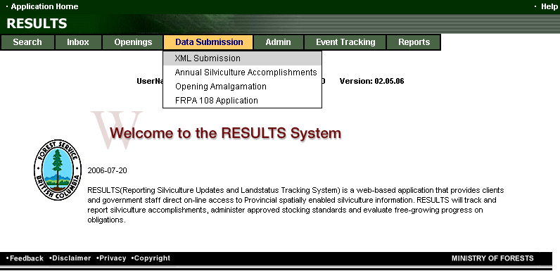
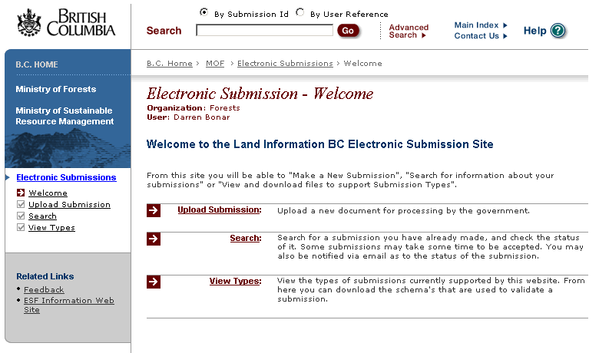
Submissions

Slide 44
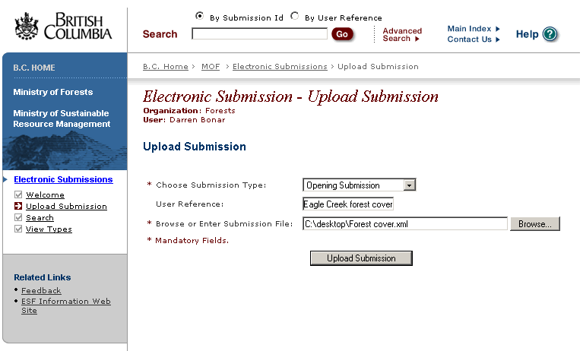
Submissions

Slide 45
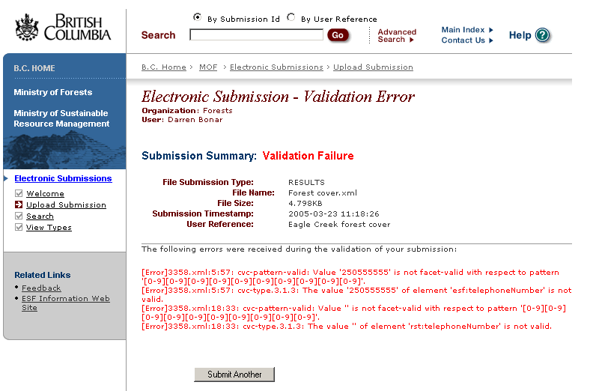
Submissions

Slide 46
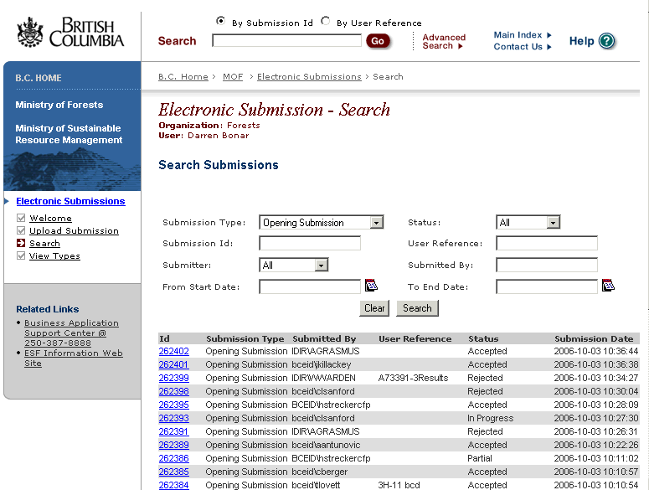
Submissions

Slide 47
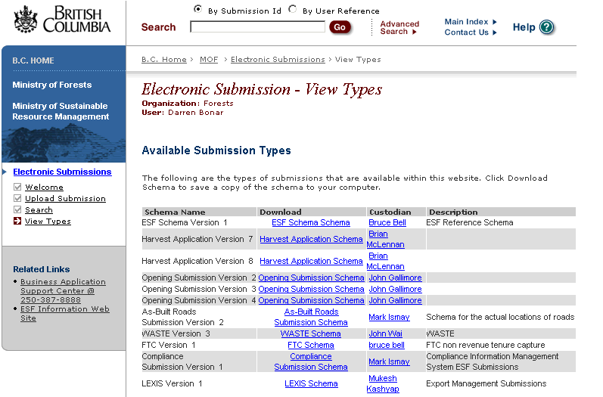
Submissions

Slide 48
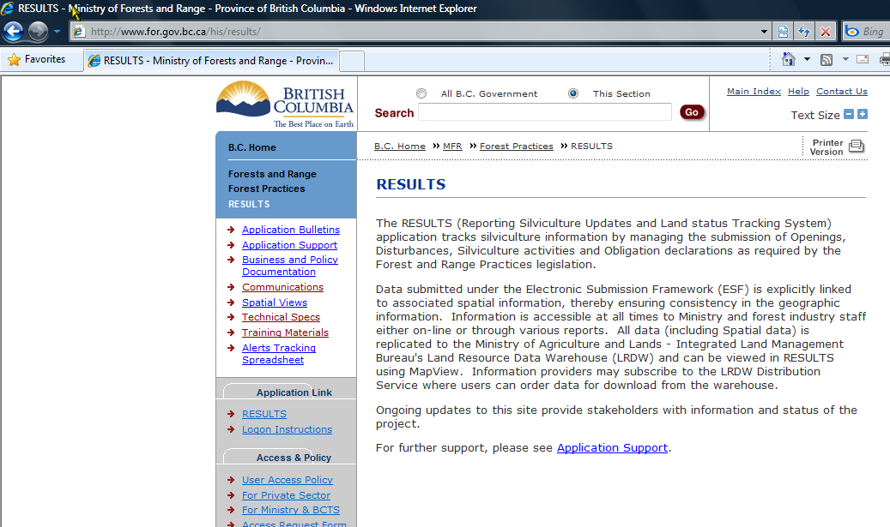
Support
http://www.for.gov.bc.ca/his/results/index.htm

Slide 49
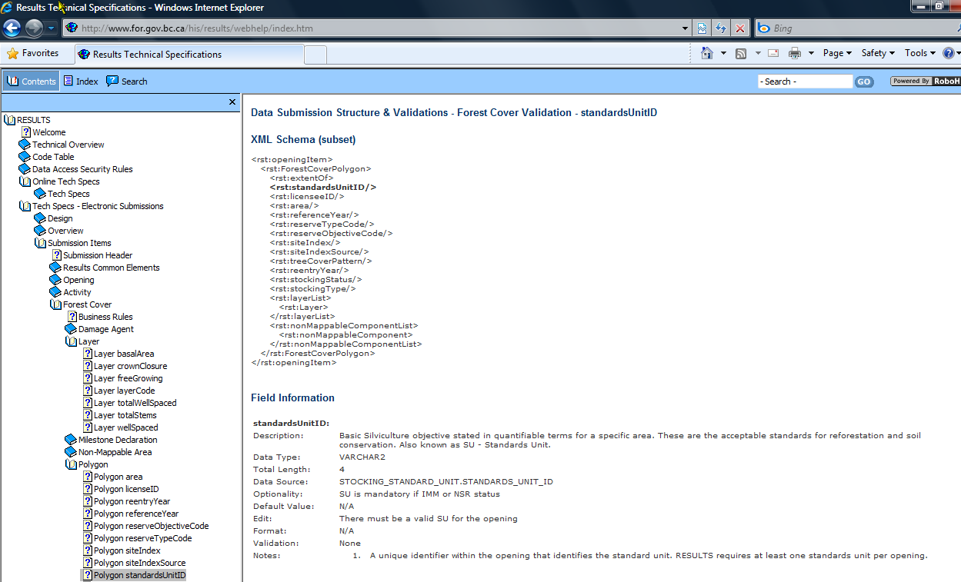
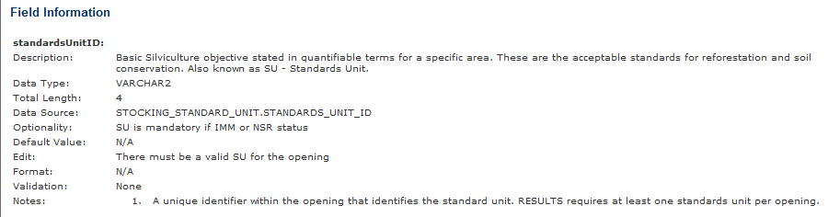
Technical Documentation
Description
Database Mapping (Oracle)
Optionality
Edit Rules
http://www.for.gov.bc.ca/his/results/webhelp/index.htm

Slide 50
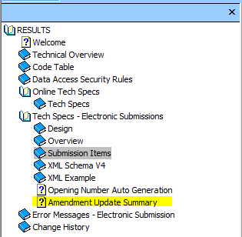
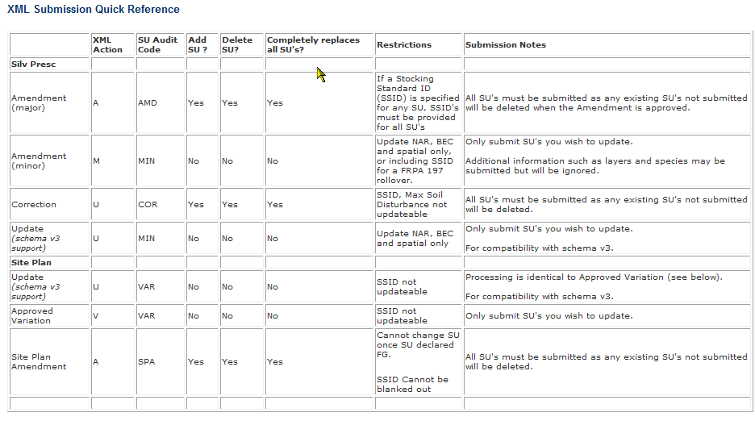
Technical Doc
Good source of Business Rules, Edit Checks, Codes, Schema format
http://www.for.gov.bc.ca/his/results/webhelp/index.htm

Slide 51
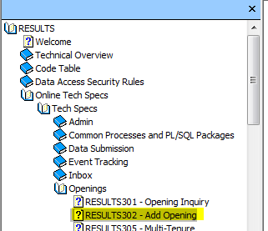
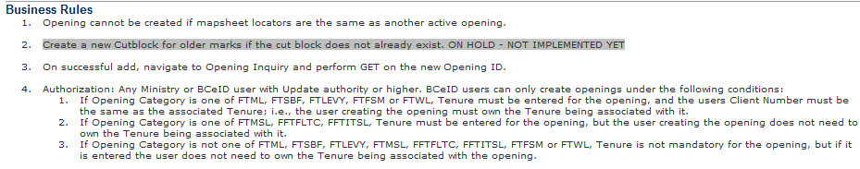
Technical Doc
Business Descriptions and Edit Checks are important to ensure core business rules are met.
Impossible to have all the permutations and nuances of business capture systematically.
Submitters must understand business and data requirements.
http://www.for.gov.bc.ca/his/results/webhelp/index.htm

Slide 52
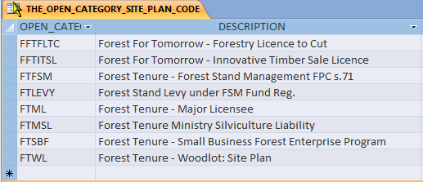
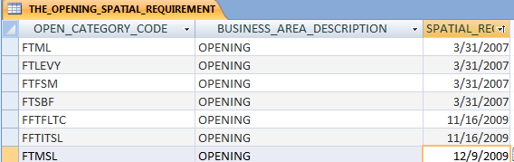
Rules
New Openings must follow rules based Opening Category Codes.
Must have:
Site Plan
Tenure required
Opening spatial
http://www.for.gov.bc.ca/his/results/webhelp/index.htm

Slide 53
Action Codes - Usage
Code | Action | Opening Definition | SU Modification | Disturb. | Silv | FC | Mile-stone
I | Insert | New | New SU with new opening def'n | Add | Add | Add | Add
U | Update | Modify Existing | Correction (Silv Presc only) | Modify Existing | Modify Existing | * | Modify Existing
M | Minor | n/a | Minor Amendment (Silv Presc only) | n/a | n/a | n/a | n/a
V | Variation | n/a | Approved Variation (Site Plan under FSP only) | n/a | n/a | n/a | n/a
A | Amendment | n/a | Silv Presc or Site Plan | n/a | n/a | n/a | n/a
Notes:
The reporting deadline is Before June 1 for the previous reporting year (April 1 to Mar 31).
Milestone declarations are optional (under FRPA Sec 107).

Slide 54
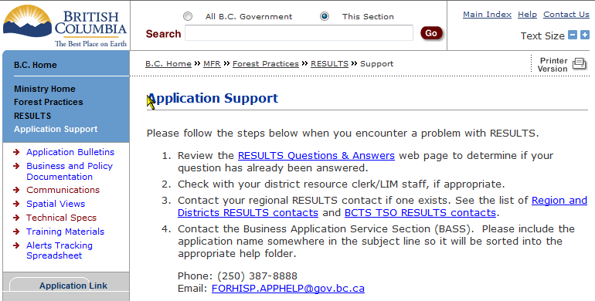
Support
http://www.for.gov.bc.ca/his/results/support.htm

