Slide 1

Wildfire Costing
(WFCST) for Recorders
A component of Wildfire One
Fire Season 2016
Notes:
Introduction to the call and people presenting; roll call

Slide 2
Why Wildfire One and WFCST?
Wildfire One
Replace BCWS systems
Enter one time, one source of information
Wildfire Costing system
One place for all direct fire cost estimates
  Ability to enter estimated costs where they are incurred
  Ability to advise Treasure Board of best estimates of spending on a daily basis through fire season, and for budget purposes in fall
  Ability to report on estimated costs in different ways
  Ability to compare estimates with CAS actuals
  No more manual roll-ups!
Notes:
Introduction to the system

Slide 3
Purpose of this training
Understand new terminology
Learn how to:
  Access the system
  Find online training
  Create and correct cost estimates
  Find existing cost estimates
  Run reports
Notes:
Please use Mute (*6) not hold during the call

Slide 4
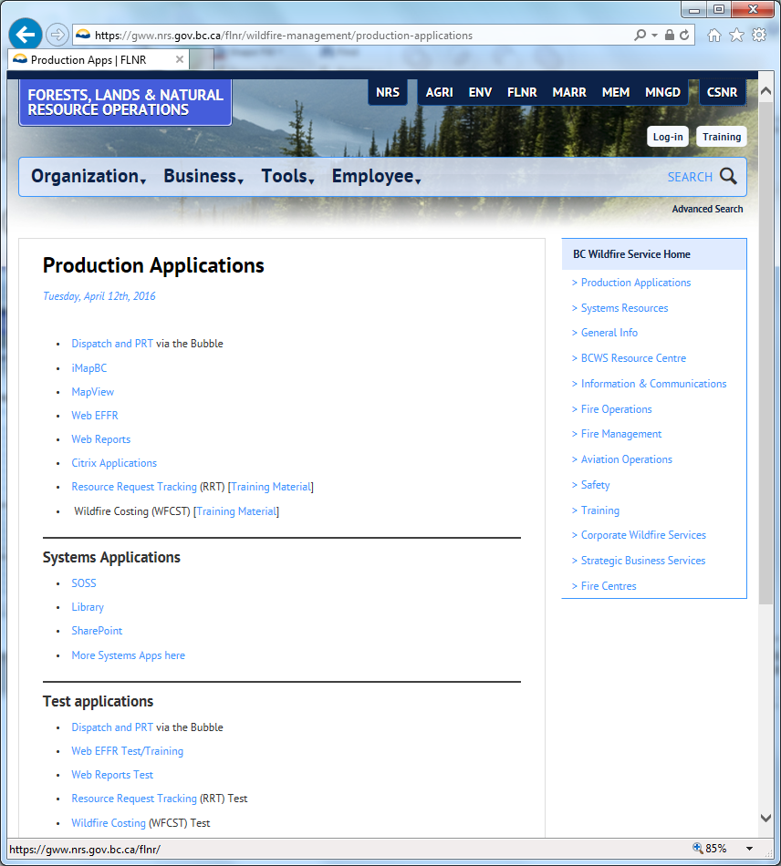

Getting started & training
https://gww.nrs.gov.bc.ca/flnr/wildfire-management/production-applications
WFCST
Training Material
WFCST Test
Notes:
Bring up the web page. Open Training page and walk through.
Introduce the videos that will be viewed in this training

Slide 5
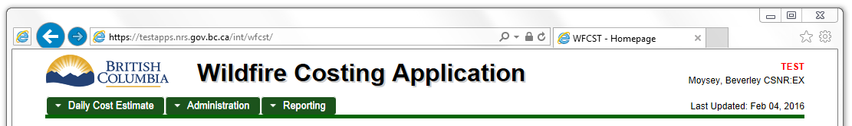
Which system are you using?
We have several WFCST systems running
  DLVR: Testing a new version of the system
  TEST: Training a new person to use the system
  PROD: Real cost estimates only
Notes:
Note that there are no links to Delivery – only the people who were involved in testing the system are in that environment. Normal users will be in only test or prod.
Templates that are Test won’t be the same as the ones in Prod.

Slide 6
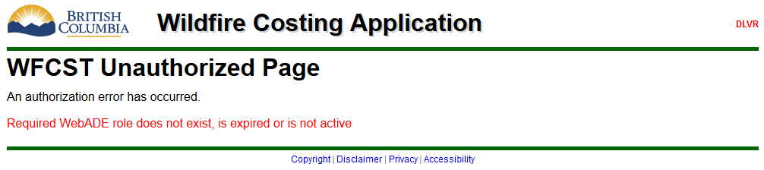
Accessing WFCST
To access WFCST (either TEST or PROD) you need to be added as a user.
If you do not have access you will see:
Notes:
How to request access to the system: Contact CWS staff and they will request that you are added.

Slide 7

User Permissions - Recorders
Most users will be Recorders
Enter new DECs (Daily Estimate of Costs)
Make corrections to existing DECs
Notes:
Finance Chiefs at the fireline
Role of the recorder at the field/ zone level
Responsibilities - enter costs to incident/project level. Enter corrections in the system when discovered. Notify RC Level if correction made.
Role of the recorder at the RC Level (FC, PWCC, RAP)
Responsibilities - enter costs to incident/project level. Enter corrections in the system when discovered. Notify RC Level if correction made. Make sure each section at RC level knows they are responsible to enter their own costs by section Eg Air, Info, Admin Training, etc
Role of the recorder at the HQ level
Responsibilities - enter costs to incident/project level. Enter corrections in the system when discovered. Enter salaries, standby, revenue recoveries and HQ RC Costs

Slide 8

User Permissions - Approvers
Typically Fire Centre Finance staff, or Zone staff (e.g. FPO)
Verify submitted DECs are correct
Confirm all expected DECs have been submitted
Enter adjustments
Notes:
Role of the approver at the zone level
There will not be a mandatory approver role at the zone level. When dealing with adjustments and corrections make sure to review comments of why this was done
Role of the approver at the RC Level
Responsibilities - mandatory review of all submitted cots from the field, zone and office level within the RC. Follow up with recorders if costs are missing or if they have questions on the costs that have been submitted. Data enter adjustments on behalf of zones and sections if an adjustment is required. Notify HQ if an adjustment is needed to be done and discuss adjustment with HQ prior to entry. Adjustment must be approved by HQ prior to being entered.
Role of the approver at the HQ Level
Responsibilities - Running daily reports for the roll up of provincial costs. Reviewing roll up reports. Follow up with the RC level if costs have not been reported. Follow up with the RC Level if they have questions on submitted costs. Approves adjustments being entered into system.

Slide 9

User Permissions - Administrators
Headquarters Finance staff
Enter default rates at start of year
Maintain list of project numbers, STOBs, etc.
Maintain DEC Templates
Notes:
Role of administrator(s)
Responsibilities - HQ level, ability to create and maintain templates and set rates within the program.

Slide 10
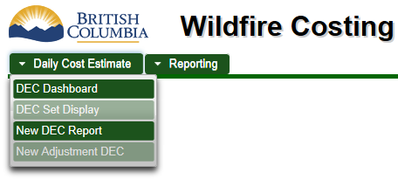
Menus & Permissions
Menus adjust based on your permissions; not all options are available to all users.

Slide 11
Creating a new DEC
Create a new Daily Estimate of Costs (DEC) and save it in Draft status
Search for the DEC on the dashboard
Finish filling it out and Submit it
Using the “Nothing to Report” field.
Notes:
In this section:
Play video “Starting a New DEC” [4:37]
Play video “Filling out a DEC” [3:19]
Play video “Finding a DEC using the Dashboard” [3:29]
Play video “Submitting a DEC” [2:22]
Play video “Using the Nothing to Report field” [2:02]

Slide 12

Starting a new DEC
How to get set up to record a new DEC, or Daily Estimate of Costs. You will do this any time you need to report estimated Direct Fire costs for a project or incident.
Play video
Notes:
Play video “Starting a New DEC” [4:37]
In this video for Wildfire Costing, I will show you how to get set up to record a new DEC, or Daily Estimate of Costs. You will do this any time you need to report estimated Direct Fire costs for a project or incident.
I am viewing a DEC that was created earlier. The screen has three sections. The first section of the screen is the DEC Summary, and it identifies the responsibility centre that is reporting the costs, which project or incident the costs are associated with, and for which day. This is also where you select which area of the organization you are submitting these costs to for review and approval, such as your fire centre. This area also provides additional details about this DEC, such as who created it and when, and what its current status is.
The second section of the screen is the Cost Expenditure List, where you will record your Direct Fire expenditures and provide comments for each line item.
The final section of the screen, at the very bottom, is the Comments and History Log, where you can add comments that aren’t specific to individual line items; as well as review any previous comments entered by users, or events automatically captured by the system, such as when the DEC was verified as correct. See the video “Using the Comments and History log” for more information.
To begin a new DEC, select the Daily Cost Estimate menu and click on New DEC Report. The Cost Estimate Date is for the day the costs were actually incurred. It defaults to yesterday if the current time is before 5 pm, or today if it is after 5 pm. I have previously set up defaults in my responsibility centre and reviewing org unit fields. See the video titled “Using defaults when recording a DEC” for more information. In the Cost Expenditure List section, the DEC Template drop down box is currently greyed-out because I have not yet filled out all of the required fields, indicated by the red asterisk.
I need to report costs for an incident that were incurred yesterday. [Hover over the date] It is currently the morning of the 7th, so the default date of yesterday, the 6th is correct. The defaults I set up previously [hover over RC and Rev Org Unit] are correct for this DEC so I won’t change them. I am recording costs for an Incident, not a Project so I will change that.
If I drop down the incident list without typing anything, I’ll get a random selection of incidents, and the one I want is unlikely to be on this list.
Instead, I will start typing in the incident number. [Type 005] When you have typed at least three characters, the system will give you a list of incidents that includes those characters somewhere in the incident number. It will only return a certain amount of rows, so keep typing more characters of the incident number if you don’t see the one you want. Note that there are fires in the list from previous years to allow for fires that span multiple fire seasons such as due to being spring fires or rehab fires, so be sure you select the one from the fire season you intend.
I’m going to type a fourth number in this box to further shorten the list, and then select the incident I’m looking for either using the keyboard or the mouse. [Type 3 so it is now 0053]
If I didn’t have a default org unit already saved, the system would now automatically set the reviewing org unit to the zone this fire belongs to, and the response centre to the fire centre for this fire. If that is not correct for the DEC you are recording, you can change it. For example, if you were at a fire in a different fire centre than the one you normally work in, and are charging the costs of equipment repair to the fire you would select your home response centre, but the reviewing org unit would be the zone the fire was in.
Now that I have filled out all of the required fields in the DEC Summary section with the red asterisks, I am now able to choose a DEC template; you can see the template box [hover over template box] is no longer greyed out.
Before you select a template, take a moment to verify the DEC Summary section correct, as it is a bit tricky to change it later if you’ve made a mistake. See the video “Fixing a mistake in the DEC Summary” for more information.
Templates are related to the selected reviewing org unit, as well as the cost estimate date, so depending on where you are sending your DEC for approval, you may have a different list of templates available to you. I will select the Incident template. [Click it] Now that I have selected a template, the date and reviewing org unit are greyed out and I can’t change them. I can still change the incident number and the response centre at this point. In the video “Submitting a DEC” you will see at what point these fields become greyed-out. I am now ready to record my daily estimate of costs. See the video “Filling out a DEC” to find out what to do next.

Slide 13

Of Note
Incident numbers include the fire season in which they began
  New fire season begins on April 1, so incidents that were discovered in March 2016 have a 2015 fire year
Old zones are used due to integration with legacy systems such as Fire Chart and Dispatch
  WFCST will be updated with the current zones after legacy systems are replaced and retired

Slide 14
Filling out a DEC
How to fill out a DEC and save it to continue working on later.
Play video
Notes:
Play video “Filling out a DEC” [3:19]
In this video for Wildfire Costing, I will show you how to fill out a DEC and save it to continue working on later. In the previous video, “Starting a new DEC” I filled out the DEC Summary information. I am now ready to record the costs for my fire. Notice that the ID and Status are both showing as “Unsaved” to remind me that I have not yet saved any of my work on this DEC.
I will scroll down to the Cost Expenditure List section to begin entering my costs. [Scroll down a couple of clicks so entire Ministry Staff section is showing.] Take a moment to be sure that you have selected the correct template. If I start to fill out my DEC [enter a 2 in the top line], and then realize I should have selected a different template [select 2015 FACE], I am given a warning that all of the data I have entered in the Cost Expenditure List section will be deleted and I’ll have to redo the Cost Expenditure List section. [Click OK on the error.] I was actually on the right template already, so I will go back to the correct one [Select Incident 2015, click ok], but the information I entered a moment ago is gone.
The layout of the Cost Expenditure List section is similar to the old Excel DEC template format that was used to record Incident costs prior to this system being created. As I hover over various parts of the screen, a window pops up to explain what that section is for. In most cases, such as the Number of Units box, the same information is presented regardless of which Units box I hover over. However, there are some special cases. If I hover over the STOB number, the description of that STOB is displayed. If I hover over the name of the line, detailed instructions are given to assist me in filling out the specific line I am looking at.
I have 2 Ministry staff incurring overtime at my fire, so I will put a 2 in the # of Units box. [Enter 2 in top line.] The Total Daily Cost for this line is automatically calculated and displayed. See the video “Types of DEC line items” for more information on the units, rate, and cost columns. I will enter a comment providing more detail about this line item. [Enter “Smith, Jones” in comments box.] The information that appeared when I hovered over the name of this line item may provide guidance on what sort of details to include in the comments box.
I don’t need to enter anything else in the Ministry Staff section, so if I wish, I can click on the header of this section to close it and display only a total for this section. [Close Ministry Staff section.] I don’t have any stat hires at my fire, so I will close that section as well. [Close Stat Hires section.]
Now I’m going to save my DEC. It is important to save regularly, because the application will eventually time out and you will lose your work. I will go to the very bottom of the page and click the Save button. [Press Ctrl+End, save.] After a moment, I am automatically scrolled back up to the top, and a success message is displayed. The ID field now shows this DEC’s unique number, and the Status field now says Draft. I can use that information later to find this DEC again if I was to close the system at this point. See the video “Finding a DEC using the dashboard” to learn more.
I could now continue working on this DEC, saving it regularly, until it is ready to be submitted. See the video “Submitting a DEC” to learn about finishing a DEC and sending it in for approval.

Slide 15
Of Note
Comments and History Log doesn’t appear until DEC is saved to database.
90-minute (or less) system timeout – save frequently!
DEC Statuses
  Unsaved – not in database yet, on screen only
  Draft – in database, but not finished
  Submitted – finished and ready for review
  Verified – reviewed by Approver
  Withdrawn – deleted
Notes:
Renee has comments at this point:
* Remember that the templates you’ll see in the videos aren’t real. For example, Ministry Staff incurring overtime is split into regular day versus day of rest.

Slide 16
Finding a DEC using the Dashboard
How to find a DEC using the dashboard.
Play video
Notes:
Play video “Finding a DEC using the Dashboard” [3:29]
In this video for Wildfire Costing, I will show you how to find a DEC using the dashboard. I can use any combination of fields to look for what I want to find right now, with the exception of the DEC Report ID which is a special case. If you fill out an ID number, all other fields are ignored.
When I first open the dashboard, it has a default in the Cost Estimate Date field only. It defaults to yesterday’s date if today is before 5 pm, or today if it is after 5 pm. Since I’m not only looking for DECs for yesterday, I will clear that default that by clicking into the field and clicking the small x button. [Do it.]
The DEC Dashboard can be thought of as a search screen. If I am a recorder, I might want to search for all DECs that I have previously started, but are still in Draft status. I am logged in as a recorder using the WMBTEST3 IDIR account, so I will search for all DECs created using that account. [Choose my ID from the list.] At this moment, I am only trying to find the one I created earlier today that is in Draft status, so to avoid having all of the DECs I ever created returned, I will just search for the ones with a status of Draft. [Select Draft.] I could also search for that DEC using the Cost Estimate Date, but by using the Status field, I’ll also quickly see if there are any other drafts in the system I may have forgotten to go back to. When I have selected all of the fields I am interested in, I will use the Update Dashboard button to search for everything that matches what I’ve selected. [Click it] All of the DECs that match all of the criteria I’ve selected are shown below.
Now that I’ve searched for something, I might want to search for something else. I can, of course, delete or change the values from each box that I’ve previously filled out, or I can quickly clear the entire screen using the Reset button.
If I was an approver, I might want to search for all DECs that have been submitted to my reviewing org unit and have not yet been reviewed and verified; they’re still in the Submitted status. I definitely don’t want to include the cost estimate date filter, because I want to see all of the DECs that are waiting for me to approve, regardless of what day the costs were incurred. I will set the Reviewing Org Unit to my fire centre [Select Prince George] and the status to Submitted.
I could click the Update Dashboard button to search for that now, but if this is a search I’m going to want to do all the time, I can save it. I will click the Save Filter button to save this search to the database, and search for it now. [Do it] I am automatically scrolled back to the top, and a success message is displayed along with a count of how many DECs were found. I can click on the Filter Information header to close up the section so I can see the results without scrolling down.
Now any time I want to look for DECs waiting for my action, I can click on Reload Filter to do this this same search again. I can only save one search Filter at a time, so if I save a new filter, the previous one is lost. It is not necessary to save a filter to perform a search; I can always just use the Update Dashboard button to do a one-time search or to refresh my screen to see if anything new has come in since I last searched.

Slide 17
Submitting a DEC
How to open a DEC started previously, and submit it for review and approval.
Play video
Notes:
Play video “Submitting a DEC” [2:22]
In this video for Wildfire Costing, I will show you how to open a DEC you started previously, and submit it for review and approval. In the video “Finding a DEC using the dashboard” I showed you how to save a filter. I have previously saved a filter that searches for all DECs I have created that are in Draft Status. I will reload my filter [Click Reload Filter] and hide the Filter Information section [click title bar], and here’s the DEC I am interested in. I will click on its ID number to open this DEC in a new tab.
As you can see, this DEC is still in Draft status. I need to add a stat hire that is on standby, so I will enter a 1 in the standby units field. [Do it] That’s all I needed to add, so I will click out of this field, and then use my page down button to get to the bottom of the page. [Use page down button]
Now I will click the Submit for Review button. A message is displayed confirming this is what I wish to do and reminding me that only corrections can be performed after a DEC is submitted. See the video “Making corrections to a DEC” for more information. I will click OK on this warning to confirm that I am ready to submit my DEC.
The system now checks for required fields. Comments aren’t required when the DEC is in Draft status, but they are required when you submit, so this message is telling me I’ve missed entering a comment on one or more items. I forgot to add a comment to my new Stat Hires line, so I will add a meaningful comment to provide more details for the person reviewing my DEC. [Add Brown to comments box]
I will try again to submit this DEC. I’ll click OK on the confirmation message, and I am automatically scrolled back up to the top. [Do it] This time I have filled out all of the required fields and passed the validation checks, so a success message is shown, and the status has been changed from Draft to Submitted.
I am now finished entering this very simple DEC and it is ready for an Approver to verify it. If, however, I realize I have made a mistake, I can still fix it. See the video “Fixing a mistake in the DEC Summary” to learn what to do if you’ve made a mistake in the top section, or the video “Making corrections to a DEC” if you’ve made a mistake or have missed recording something in the Cost Expenditure List section.

Slide 18
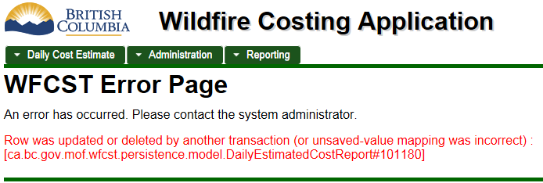
Of Note
Multiple people can work on the same DEC at different times. If two people try to edit the same DEC simultaneously, the second one will get an error when they save.

Slide 19
Using the Nothing to
Report field
You will use this field any time you have a day in which you did not incur any Direct Fire costs, but you still need to submit a DEC by the cut-off time.
Play video
Notes:
Play video “Using the Nothing to Report field” [2:02]
In this video for Wildfire Costing, I will show you how to use the Nothing to Report field. You will use this field any time you have a day in which you did not incur any Direct Fire costs, but you still need to submit a DEC by the cut-off time
I work in the Cariboo Fire Centre in the Logistics section, so I have previously set my defaults accordingly. See the video “Using defaults when recording a DEC” for more information.
I’m doing my DEC for yesterday, so this default date is correct. The template I use every day to report my direct fire costs is called “Office.” [Select it from the list.] I am going to review what is on the “Office” template. If you are very familiar with the template you don’t need to do this, but it doesn’t hurt to review it and make sure you haven’t missed something. I’ve reviewed the template and determined that we haven’t incurred any direct fire costs in my section for this date, so I will click the Nothing to Report box. I get a confirmation message reminding me that doing this will delete everything I have entered in the Cost Expenditure List section. That’s fine, because I haven’t entered anything, so I’ll click OK.
The Cost Expenditure List section disappears, and all I need to do now is submit this DEC for review. [Click Submit for Review] I’ll confirm that’s what I want to do. [Click OK.] Now that the DEC has been saved to the database, I get the Comments and History log section. I could now add a comment so the person who reviews and verifies my DECs knows why I’m reporting nothing for this day. See the video “Using the comments and history log” for more information.
If I later discovered that I did, in fact, need to report costs for this day, I would not be able to make a correction to this DEC as shown in the video “Making corrections to a DEC” because there is no Cost Expenditure List section to make corrections to. Instead, I would withdraw this DEC, as shown in the video “Withdrawing a DEC” and then submit a new one using the appropriate template.

Slide 20

Processes
Timelines for reporting costs
  What to do if you miss the daily deadline
  How long costs must be submitted for an incident
Resources that work multiple incidents in one day
  Report on incident where they spent the most time
When to use the Nothing to Report field.
  Primarily used at the office level
  Incidents will not typically need to submit a “nothing to report” DEC.
Costing to the project level
  Use of project codes versus incident numbers
Notes:
Renee to talk about processes related to standard DEC submissions.
Nothing has changed for timelines for reporting costs, it is still midnight for the previous 24 hours. Your RC may choose to change this depending on fire load.
For resources that work multiple fires in one day. You can only report for a resource once a day. Record cost and number of resources to the incident where they spent the most time, unless you know for sure a fire is a recovery.
Incidents might use “nothing to report” if there is a day they are rained out or cannot get to the fire, so that the RC isn’t waiting for those costs.

Slide 21

Questions?
Creating a new DEC
Create a new Daily Estimate of Costs (DEC) and save it in Draft status
Search for the DEC on the dashboard
Finish filling it out and Submit it
Using the “Nothing to Report” field.
Notes:
Any questions on this section?

Slide 22
Fixing mistakes
Make changes to a DEC that is in Draft Status
Fixing a mistake in the DEC Summary section
Make corrections to a DEC that has been Submitted or Verified
Adjustments
Withdrawing a DEC
Notes:
Play video “Fixing a mistake in the DEC Summary” [1:57]
Play video “Making corrections to a DEC” [3:43]
Play video “Withdrawing a DEC” [3:11]

Slide 23
Making changes to a DEC
If a DEC is still in Draft status (or Unsaved) you can make as many changes to it as needed; they are not considered “corrections” until the DEC has been Submitted.

Slide 24
Fixing a mistake in the DEC Summary
How to fix a mistake in the DEC Summary section.
Play video
Notes:
Play video “Fixing a mistake in the DEC Summary” [1:57]
In this video for Wildfire Costing, I will show you how to fix a mistake in the DEC Summary section.
The current status of the DEC affects which fields can be edited in the DEC Summary section.
I’ve just started working on this DEC so it is still in the Unsaved status. I have not yet selected a template, so I can edit all five of the fields in the DEC Summary section. If I select a template [do it], the Cost Estimate Date and Reviewing Org Unit fields become greyed out, and I can only edit the other three fields. In order to make these two fields be editable again, I will have to select the blank line in the Template box, and lose any work I may have done in the Cost Expenditure List section.
[Click into second tab] This DEC has been saved in Draft status. It behaves exactly the same way as the Unsaved DEC, so I can still edit the Responsibility Centre, Reported For, and Nothing to Report boxes.
[Click into third tab] This DEC has been Submitted. DECs that have been Verified will behave the same way. All five fields are greyed-out and I cannot change them. The DEC Template field is also greyed out, so I cannot even set it back to the blank line the way I could in the Unsaved or Draft DECs.
At this point, if I needed to make a change to one of these fields, an Approver could make a copy of the DEC. An Approver can change the Reviewing Org Unit or the Cost Estimate date field when creating the new copy. The new copy will then be in an Unsaved status, so the Responsibility Centre, Reported For, and Nothing to Report fields will be editable as long as that DEC is unsaved or is in Draft status. This original, incorrect DEC could then be withdrawn. See the video “Withdrawing a DEC” for more information.

Slide 25
Making corrections to a DEC
How to make corrections to a DEC when you know exactly where you’ve made a mistake.
Play video
Notes:
Play video “Making corrections to a DEC” [3:43]
In this video for Wildfire Costing, I will show you how to make corrections to DECs when you know exactly where you’ve made a mistake.
I have just realized we have missed reporting a First Aid contractor the past two days, so I need to update those DECs. I have set the Incident number, and the Cost Estimate Date to the first date the mistake was made. I’ll use the Update Dashboard button to search, then hide the Filter Information section, and now I can see the two DECs for this fire.
I’m logged in as Rebecca Recorder using the WMBTest3 IDIR account, and I submitted one of the DECs, but the other one was submitted by WMBTest2. This is the IDIR account for April Approver. You’ll see that I am able to make corrections to either DEC.
This DEC [point to the white one] has not yet been verified, it is still in the Submitted status. I’ll click on its ID [do it]. Notice that it opens in a new tab, so my dashboard is still open. I’ll add my missing contractor [Put 1 in First Aid Line, enter comment of “First Aid Inc”]. Now when I go to the bottom, I will see that since this has already been submitted, I only have a save button, the Submit For Review button is greyed out. I’ll click the save button [do it] and close this tab to return to the dashboard.
Tabs are independent so if I want to see the changes I just made, I can click Update Dashboard. The Updated Timestamp shows the current date and time.
This other DEC [point to the green one] has already been Verified. I’ll open it and add my missing contractor in again. [Put 1 in First Aid Line, enter comment of “First Aid Inc”]. When I save this one, I will get a warning to let me know that this is going to undo the Verified status, and set it back to Submitted. This is because it has previously been verified, and now it needs to be verified again because I’ve made this change. I’ll click OK on that and I see the status is now Submitted.
If I scroll down to where I made the change, I can see that the row is highlighted in yellow. It shows who made the change and when. If I go to the very bottom of the page to the comments and history log, I can see an Event that shows the same information, along with the new and original values. This is a bit cryptic, so it’s a good idea to add a comment as well to let the approver know why you’ve made this change to a DEC they’ve already verified. [Add comment “Added missing First Aid contractor.”] I’ll click the Add Comment button to save that Comment, and now I can close this tab; it’s not necessary to save again after only adding a comment. See the video “Using the comments and history log” for more information.
I’ll Update my dashboard again, and now I can see that both of these DECs were updated and are ready to be verified by an approver.
If I didn’t know exactly where my error was, but I knew that my estimates were significantly too high or too low in a particular area of the DEC when compared with actuals, I could contact an approver to have them perform an adjustment. Adjustments modify the total cost spent against a line item without knowing exactly where and when the estimates have gone off track, while corrections, as shown in this video, are used when you do know exactly what was reported incorrectly.

Slide 26
Adjustments
Only approvers can create adjustments
Similar to corrections, but done when source of error is not known
Typically done at the RC level, not zone
Adjustments will be very rare; corrections are preferred
Notes:
Speak to CWS staff prior to initiating an adjustment

Slide 27
Withdrawing a DEC
How to withdraw a DEC that has been created in error. This is essentially the same as deleting the DEC.
Play video
Notes:
Play video “Withdrawing a DEC” [3:11]
In this video for Wildfire Costing, I will show you how to withdraw a DEC that has been created in error. This is essentially the same as deleting the DEC, although a record of it remains in the database rather than disappearing entirely.
You might be tempted to withdraw a DEC if you realize that you’ve made an error in the DEC Summary section. This may not be necessary; see the video “Fixing a mistake in the DEC Summary section” for more information.
There are different reasons for withdrawing a DEC. One reason is if you submitted a DEC as shown in the video “Using the Nothing to Report field”, and then later found out you did, in fact, have something to report. In that case, you would withdraw the “Nothing to Report” DEC and submit a new one using the appropriate template.
Another reason is if two DECs are accidentally created with the same information in the DEC Summary section, for example the same day and incident. It may be valid to have multiple DECs with the same DEC Summary information, but if this is an accidental duplicate, you can withdraw one of the copies.
That’s what has happened in this case. Two different people accidentally both submitted costs for the same day for the same incident. I’ve set my dashboard to search for those DECs and you can see one was entered by Rebecca Recorder using the WMBTest3 account, and the other was entered by me, using my BMOYSEY account. The Total Cost of DECs field is showing a number twice as high as it should be. Rebecca and I have spoken and figured out what’s happened, and have decided that I’m going to withdraw mine.
First I’m going to copy the ID number of her DEC because I want to put that into a comment stating why I’m withdrawing mine. [Use right-click, copy method] Now, I’ll click on the ID number of my DEC to open it in a new tab [do it] and then use my Ctrl and End keys to go to the very bottom where the buttons are. I’ll click the Withdraw Report button and I’m given a chance to cancel out if that’s not what I meant to do. I really do want to withdraw this DEC, so I’ll write a comment. [Type “Duplicate of ”] and I’ll paste in ID number I copied. [use right-click, paste method] I’ll click on the “Withdraw DEC” button to complete the process.
I can now see in the Comments and History log that a comment has been added with the reason I typed, and an Event has been added with the fact that I have withdrawn this report.
If I use my Control and Home keys to go back up to the top, I can see that the status of this DEC is now “Withdrawn”. Once a DEC has been withdrawn, it is not possible to “unwithdrawn” it. However, if it was withdrawn in error, an Approver can make a copy of it into a new DEC.
Now, If I go back to my dashboard and click Update Dashboard to refresh it, I can see that my DEC is now shown in the grey colour, and has a status of Withdrawn. The cost of the withdrawn DEC is not included in the Total Cost of DECs field, and the information in this DEC will no longer show up in any reports.

Slide 28
Processes
Enter meaningful comments to assist approvers and others to understand why you’ve made a correction.
After making a significant correction, notify the RC (response centre) that you have done so.
Withdraw a DEC if:
  duplicate DECs were submitted for the same project/incident on the same day, or
  you need to replace a Nothing To Report DEC with one that uses a template.
Notes:
Renee has comments at this point:
“Significant” correction threshold will be defined by each RC.

Slide 29
Questions?
Fixing mistakes
Make changes to a DEC that is in Draft Status
Fixing a mistake in the DEC Summary section
Make corrections to a DEC that has been Submitted or Verified
Adjustments
Withdrawing a DEC
Notes:
Any questions on this section?

Slide 30
Beyond the basics
Using defaults
Types of DEC line items
Adding line items to a DEC
Notes:
Play video “Using defaults when recording a DEC” [2:50]
Play video “Types of DEC line items” [4:33]

Slide 31
Using defaults when recording a DEC
How to set your preferred defaults on the New DEC Report screen.
Speeds up the process of entering a DEC if you always report costs with the same information in the DEC Summary section.
Play video
Notes:
Play video “Using defaults when recording a DEC” [2:50]
In this video for Wildfire Costing, I will show you how to set your preferred defaults on the New DEC Report screen. This is not something you NEED to do, but it can speed up the process of entering a DEC if you always report costs with the same information in the DEC Summary section.
To begin, go to the New DEC Report screen. If you have not previously set any defaults, everything will be blank except for the date which has its own default of yesterday if it is currently before 5 pm, or today if it is after 5 pm. I currently don’t have any defaults for my Response Centre, Reported For, or Reviewing Org unit. I can set defaults for any combination of those three fields. In the Reported For field, you can choose to set your default to either Incident or Project, and then you can select a specific Incident or Project as well, if you like.
If I work in the South Island Zone, for example, and will always need to use the same reviewing org unit and Response Centre, I can set defaults on those fields and save them. I will set my reviewing org unit to South Island Zone, and my response centre to 71482 – Coastal. I have not set a default for the project or incident, because I report costs for several different projects and incidents, however I mostly report costs for Incidents so I will change that box to Incident. I will click on the Save Defaults button, and I get a success message. Now if I close this window, and then start another new DEC, those same values are automatically filled out. If I no longer want to have a default in a particular box, I can clear it out, for example by selecting the blank line at the top of the response centre box. [Select blank line] I can then save defaults again, and the next time I create a DEC, this field would no longer be filled out.
I can also temporarily override my defaults if I normally report costs for a particular project, or to a particular reviewing org unit, for example, but this time I need to do something different. In that case, I would just change the values on my screen, and I would NOT save those defaults. My original saved defaults would come back again the next time I started a new DEC.
Having saved defaults can make it very fast to report costs at an office, particularly if you have a day in which you have nothing to report. See the video “Using the Nothing to Report field” for more information.

Slide 32
Types of DEC line items
The different types of line items you might encounter when using the system.
Play video
Notes:
Be aware that the line items shown in this video are examples from the test system, and are likely different in the production environment.
Play video “Types of DEC line items” [4:33]
In this video for Wildfire Costing, I will show you the different types of line items you might encounter when using the system.
[open Equipment and Vehicles section.] All lines have a STOB and a name. I can hover over the STOB number to see its full name. If I hover over the name of the line item, I can see the instructions the administrator has provided to guide me in reporting costs against this line item. All lines items have a units field. In some cases, this units field may not actually make sense, so review the instructions displayed for the line item to determine whether you need to enter a value in this field or not. All line items also have a comments field, which is optional when you’re first entering a DEC and it is still in Draft status, but you must fill it out before you submit your DEC for review.
There are four different configurations of line items you might see on a DEC template. The simplest possibility is one like # of Vehicles on VRA. [2nd line down in Equip & Vehicles section] It has a units box, there is no standby units box, and there is a default rate already entered by the system administrator. All I need to do is enter the number of vehicles I have on VRA [type a 1 in the units box] and the Total Daily Cost is automatically calculated.
[Collapse Equipment and Vehicles Section, open Contract and Contract Personnel section.] The next possibility adds the Standby Units field. The standby rate is not displayed on the screen, but it is also set by the system administrator. The First Aid Services line is an example of this. [2nd line in Contracts section.] As before, I enter the total number of units, personnel in this case, that I have working in the units box. [Enter 3 in # units.] I enter the number of units I have on standby only in the standby units box. [Enter a 1 in # standby.] The Total Daily Cost is automatically calculated.
[Collapse Contract and Contract Personnel section; open Equipment and Vehicles section.] The third possibility is when a default rate has not been entered by the system administrator. The # standby units field may or may not be displayed. The Ministry Vehicles line is an example of this. [1st line in Equipment section.] There is now a box available in the Average Rate field, so I can enter the average rate per unit for this line item. The standby rate will automatically be set to half of the average rate. I’ll enter 100 in the Average Rate field [do it] and then a 1 in the standby units field [do it], and now the total daily cost for this item is calculated as $50.
[Collapse Equipment and Vehicles Section, open Contract and Contract Personnel section.] The fourth possibility occurs when a line item doesn’t use a rate field; it just has a Total Daily Cost. # standby units field may or may not be displayed. The OFC Structure Protection Agreement field is an example of this. Since rates are not used for this line, entering units or standby units does not cause an automatic calculation to be done. [Enter a 1 in the # units field] I must manually enter the total daily cost for this line item. [Enter 1234 in the Total Daily Cost box]
[Collapse Contract and Contract Personnel section; open Equipment and Vehicles section.] On top of these four different configurations, there are also Shadow Costs. Shadow Costs are used for calculating the total cost of an incident or project when the line item in question is also being costed at the fire centre or provincial level. For each Shadow Cost line, there will be a corresponding regular cost line on a template being used at a higher level. Shadow Costs can be configured in any of the four ways previously mentioned, but can be distinguished because of their darker grey background colour. The Ministry Vehicles line I filled out earlier is actually a shadow costs, as are all of these other lines. [Point to other dark grey ones] The administrator may choose to put the words “Shadowed Cost” into the name of the line to make it more obvious, as they have done here.
Shadow Costs are used in some of the reports. The Project or Incident Total Costs report [hover over the name] is a report for a specific project or incident, so it includes the shadow costs. In other reports such as the Total Costs Summary report, [hover over the name] the report provides a roll-up of several projects or incidents, so to avoid double-counting that line item, Shadow Costs are not included.

Slide 33
Of Note
In the video, Ministry Vehicles was an example; this line has a different configuration in the production system.
Shadow Costs
  Used for calculating the total cost of an incident or project when the line item is also being costed at the fire centre or provincial level.
  There will be a corresponding (regular) cost line on a template being used at a higher level.
Notes:
Renee has comments at this point:
The Daily Activity Cost Report (which replaces the FS60) has been set up both as a stand-alone template, and is also incorporated into the Incident template
This template is the only one where you are permitted to do bulk data entry. Use the comments field if you do so, e.g. Consumables – 14, comment = Apr 1 -14 for John Doe

Slide 34
Adding line items
Line items can be added to a DEC even if they’re not on the selected template
  Each template is for a specific service line, so it may not be valid to add the item you want to your current template
Notes:
Imagine this section has red flashing warning lights on it

Slide 35
Adding line items
How to add a new line item to a DEC that uses the same service line as the current template.
Play video
Notes:
In this video for Wildfire Costing, I will show you how to add a new line item to a DEC. You can do this any time you wish to report costs for an item that does not appear on the template you are using, but has already been set up by an administrator as a possible line item to report costs against.
I am doing a DEC for my office, so I will select the Office template. I normally would only need to report on the items shown in this template, but today an unusual situation has occurred, and I need to report on something that does not appear on this template. I could, of course, submit two DECs – one using this template, and a second one using another template that has the line item I want on it, or I can just add the extra line items to this DEC. This does not affect the template, it is just a modification to the specific DEC I am working on at the moment. If it made sense for this change to be made permanently to the template, an administrator could do so.
I need to report a cost for meals for people on per diems. This is not on the Office template, so I will go to the bottom of the Cost Expenditure List section to the “New DEC Item” section. I will start to type in the name of the line item I am looking for. As soon as I have typed at least 3 characters, I will get a list of everything that includes the characters I have typed. [Type “per”] I can continue typing to shorten the list further. [Type “ d”] Now I see the one I am looking for, under the Miscellaneous heading. I will click on in, and then press the “Add DEC Item” button. This new DEC line item is now available in the Miscellaneous section above, so I can enter my costs.
It is possible to enter a DEC item that already is present on the DEC you’re working on. I could add another copy of the same line I just added, or another copy of a line already on the template, such as Travel Expenses. This isn’t something that will make sense to do most of the time, but if there is a situation where it does make sense, the system will allow it. I might wish to do this, for example, for a line where I need to enter both units and an average rate because the administrator has not provided a default rate, and I have two units with very different rates. However, on lines where the administrator has provided a default rate, or where I am simply entering a total cost, then one copy of the line will usually suffice. See the video “Types of DEC line items” for more information.

Slide 36
Of Note
When adding line items to a DEC beyond what is on the template
  Use caution!
  Ensure your template has the correct Service Line for the new item
  Be careful of items with Shadow Costs
Notes:
The system doesn’t know which line items can be used with which service lines.
For example, aircraft costs use 42003 or 42004, but the Incident template uses 42000 so no aircraft costs can be added to this template
For shadow costs, there will be a regular and a shadow line item for the same thing; ensure you select the right one
Talk to CWS staff before you use this feature.

Slide 37
Processes
What to do if you don’t have internet access at your site
How to report costs for MZOCs
How to deal with Rehab costs
Notes:
Other processes that don’t fit anywhere else.
What to do if you don’t have internet access at your site.
Use Excel/paper form, record when back at the office. Or, RC may ask to have them called in; be sure to mark on form that it has already been entered so it doesn’t get entered again.
How to report costs for MZOCs
No changes to basic process. RC may have instructions on particular MZOCs.
Report to MZOC project number unless costs can be attributed to incident with a Fire Analysis Plan
How to deal with Rehab Costs
* Be sure you are choosing the correct fire year

Slide 38
Questions?
Beyond the basics
Using defaults
Types of DEC line items
Adding line items to a DEC
Notes:
Any questions on this section?

Slide 39
Reports
No shadow cost entries
  Total Costs Summary Report
  Costs To Date By Fire Centre
  Weekly Fire Situation Report
Shadow cost entries included
  Project/Incident Cost Summary
  Man Hours vs Time Loss
Notes:
You may not have access to all 5 reports.

Slide 40
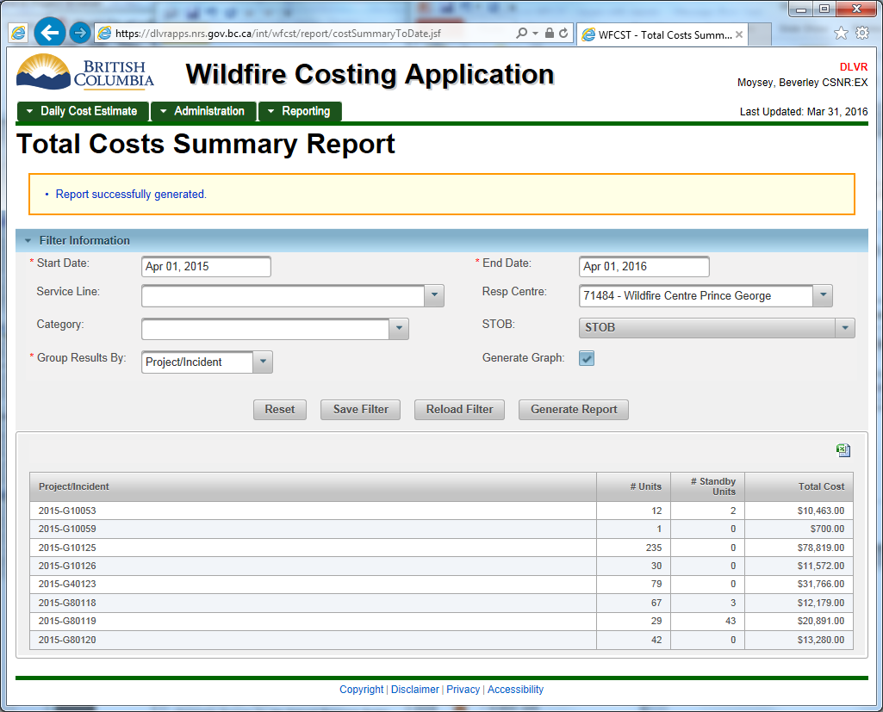
Total Costs Summary Report
Notes:
Does NOT include Shadow Costs
Start and End dates default to the current fiscal
Can choose to filter by service line, responsibility centre, category (single), or STOB (multi).
Must choose how to group the results
Can save Filter if you always run this report in the same way.
Click on a line to see the specific transactions (DEC entries) that created it.

Slide 41
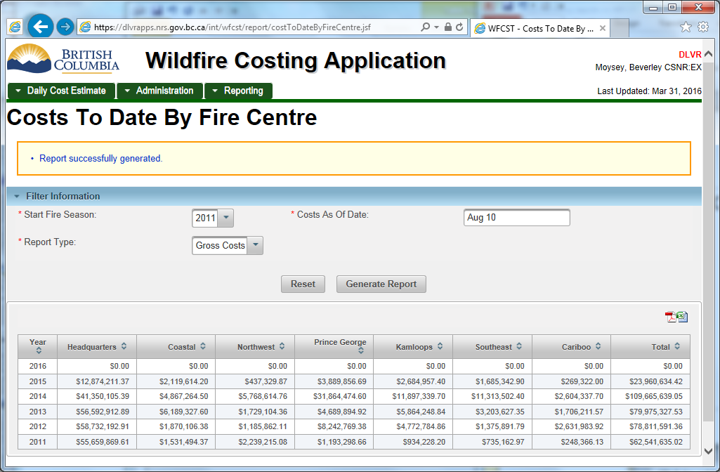
Costs To Date By Fire Centre
Notes:
Does NOT include Shadow Costs
Gives the Gross Costs, Net Costs, or Recoveries for each fire centre, starting in the selected year and going up to the “As of date” in each year.
Can be sorted on screen.
Can be exported to PDF or Excel (but does not keep screen sort order)
Replaces report by same name in Web Reports

Slide 42
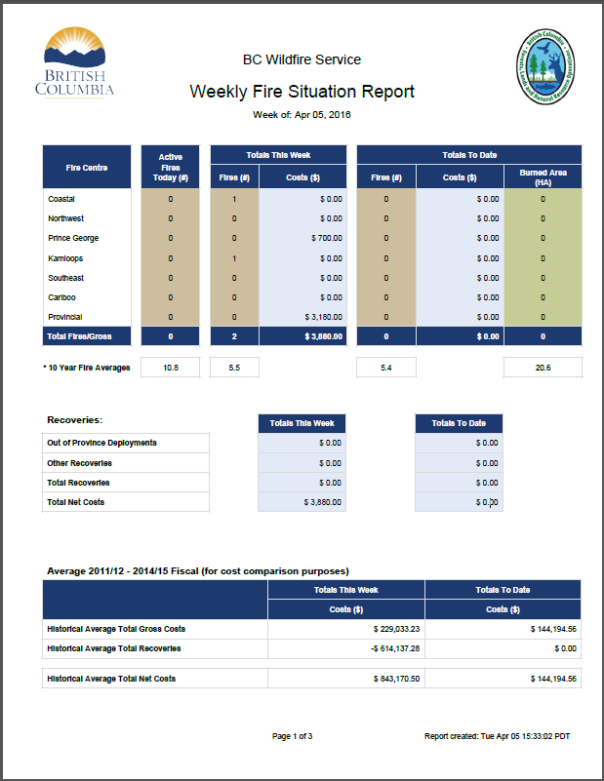
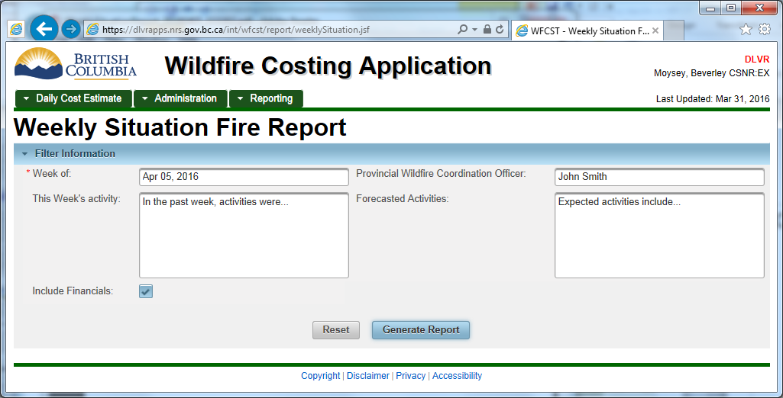
Weekly Fire Situation Report
Notes:
Does NOT include Shadow Costs
Can only be generated into PDF format (no on-screen or Excel formats)
Replaces report by same name in Web Reports
Primarily used by Information Officers

Slide 43
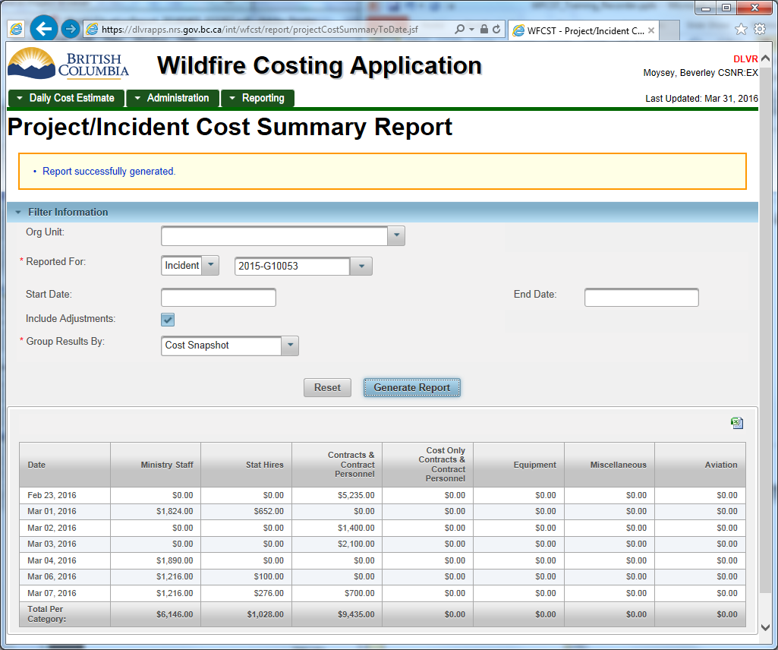
Project/Incident Cost Summary
Notes:
Includes Shadow Costs
Can use the Org Unit box to shorten the list of Incidents available – also DOES affect results.

Slide 44
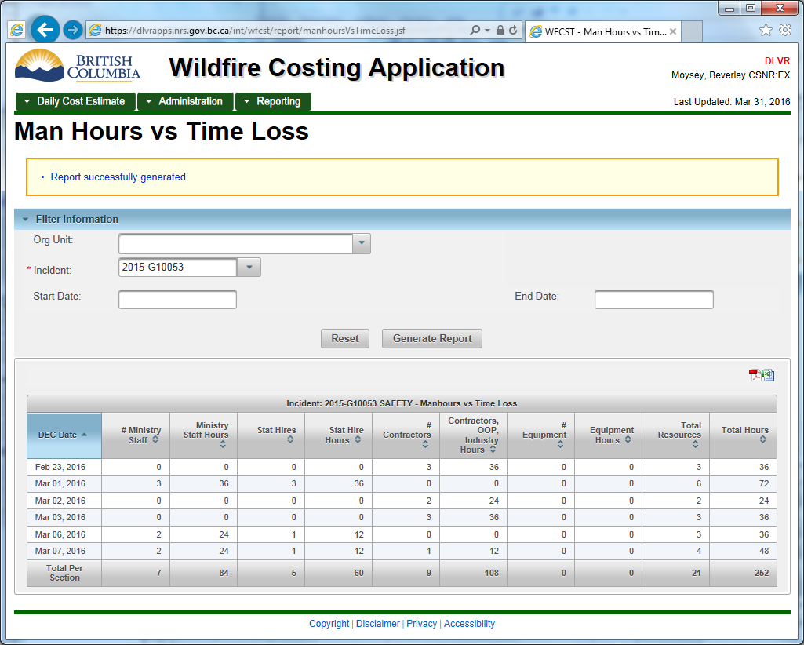
Man Hours vs. Time Loss
Notes:
Includes Shadow Costs
Report is incident-specific – must select one incident. Can’t be run for a project.
Can use the Org Unit box to shorten the list of Incidents available – doesn’t affect results.
Can choose to reduce the results to a specific time frame.
Shows the number of units (people) in specific categories.
Hours are estimated based on standard 12 hour days.
Can be sorted on screen.
Can be exported to PDF or Excel (but does not keep screen sort order)
Replaces report by same name previously found in FACE Excel file
Primarily used by Safety Officers

Slide 45
Questions?
Reports
No shadow cost entries
  Total Costs Summary Report
  Costs To Date By Fire Centre
  Weekly Fire Situation Report
Shadow cost entries included
  Project/Incident Cost Summary
  Man Hours vs Time Loss
Notes:
Any questions on this section?

Slide 46
Using Templates
Incident DEC
Daily Activity Cost Report
Aviation costs
  Air Tankers
  Rotary Wing
Depot costs
Notes:
Templates are being developed for specific needs.
You may need to fill out two different templates if you report costs for two different service lines.
Green Book has help specific to Incident template and Daily Activity Costs.

Slide 47
Questions?
Send list of attendees to Glenna Tomlins
Or: http://tinyurl.com/WF1Train
Please send any feedback on this training session to CBSWildfireApps@gov.bc.ca
or fill out anonymous survey at
http://tinyurl.com/WF1TrainFeedback
Notes:
Any other questions?

