Slide 1

Resource Request Tracking
(RRT)
The first component of Wildfire One
June 2015

Slide 2
Purpose of this training
Learn how to:
Access the system
Find online training
Create a Resource Request
Find a Resource Request
Respond to a Resource Request
Receive a resource
Notes:
Please use Mute (*6) not Hold during the call

Slide 3
Why Wildfire One and RRT?
Wildfire One
Replace WMB systems
Enter one time, one source of information
Resource Request Tracking system
One place for all Requests
  No more lost Requests!
  No more spreadsheets or local copies of Requests!
  No more calls to find your Request!

Slide 4
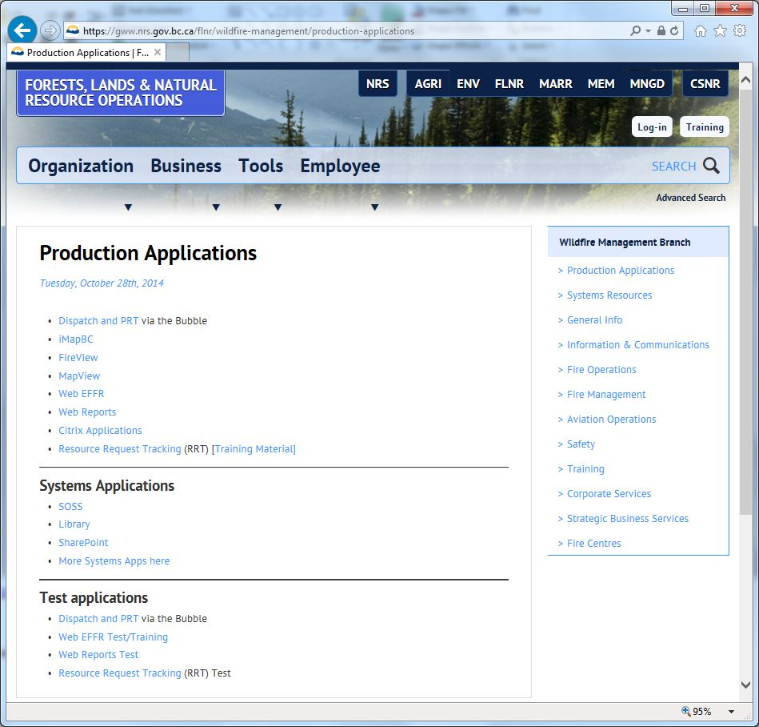
Demo – Getting started & Training
https://gww.nrs.gov.bc.ca/flnr/wildfire-management/production-applications
RRT
Training Material
RRT Test
Notes:
Show Training page
Introduce the videos
Walk through Quick Reference Sheet
Support contacts

Slide 5
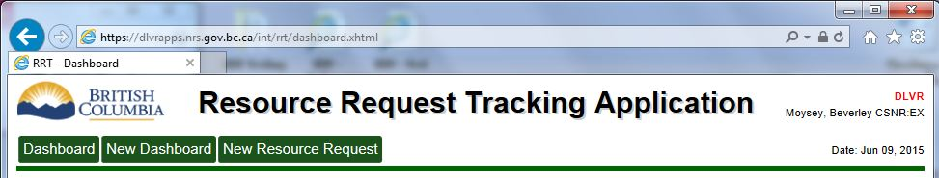
Which RRT are you using?
We have several RRT systems running
  DLVR: Testing a new version of the system
  TEST: Training a new person to use the system
  PROD: Real resource requests only
Notes:
Note that there are no links to Delivery – only the people who were involved in testing the system are in that environment. Normal users will be in only test or prod.

Slide 6
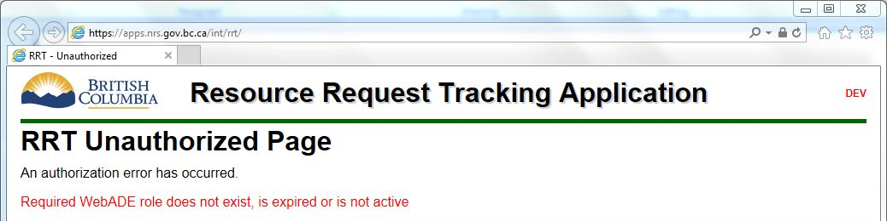
Accessing RRT
To access RRT (either TEST or PROD) you need to be added as a user.
If you do not have access you will see:

Slide 7
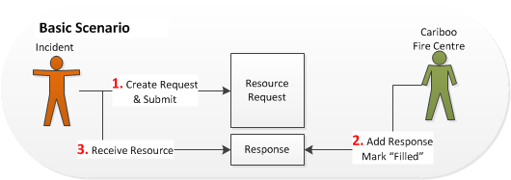
A Basic Scenario

Slide 8
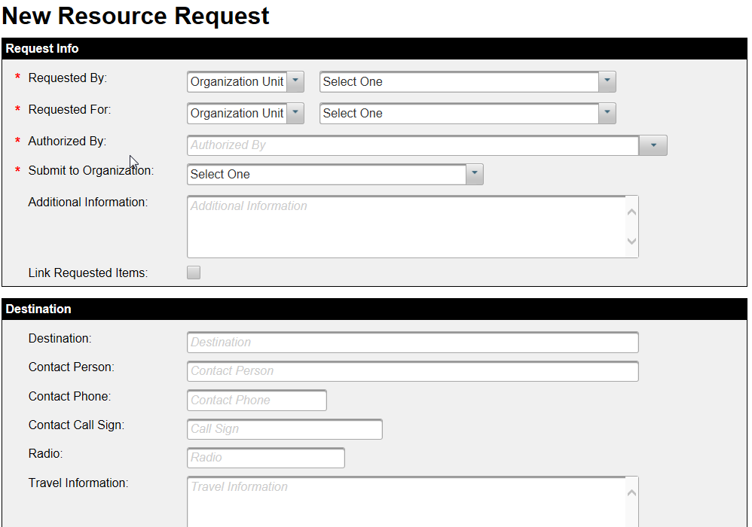
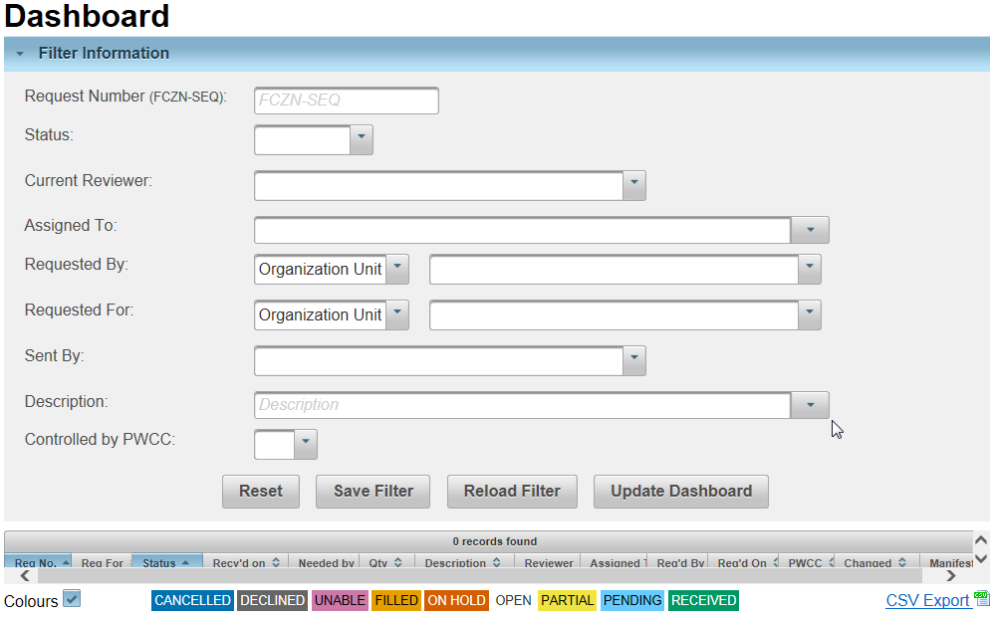
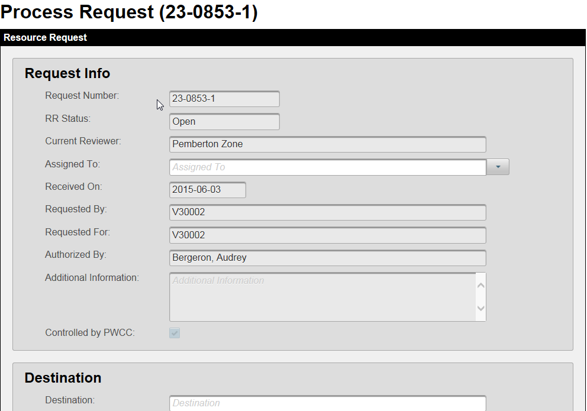
The 3 screens in RRT

Slide 9
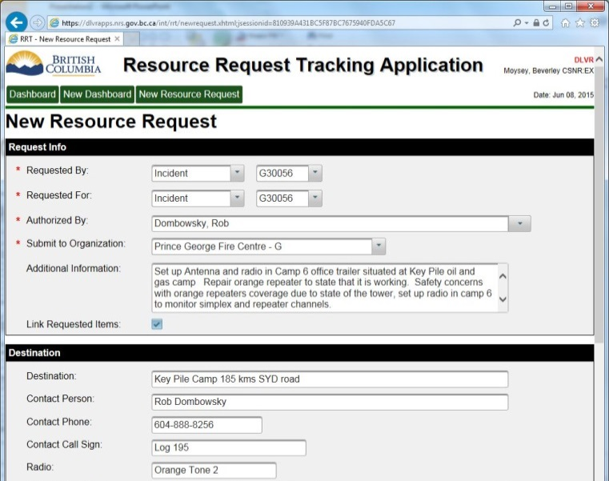
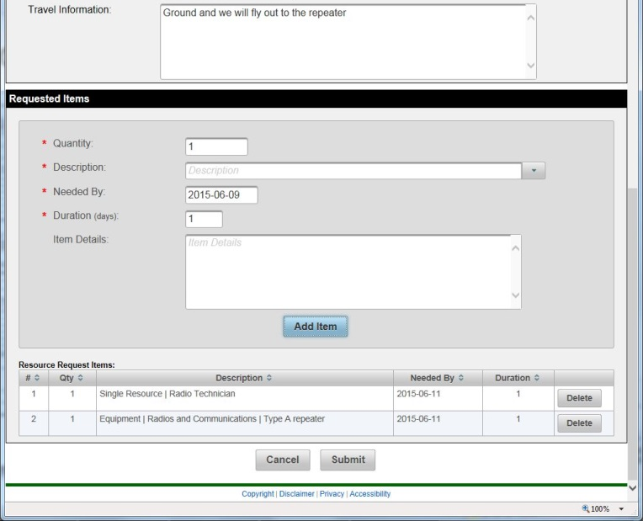

Demo - New Resource Request
Notes:
** Walk through “Demo 1” script **
Create a new resource request for three items (not linked) by and for a fire. Submit to a zone.
* PWCC decision to only do Quantity of one for each request, and do two identical lines for 1 each of something, plus a third line for something else.
* Fires show up within 5 minutes of being created in Fire Chart.
* Only system users show up in the Authorized By box
Create a new resource request for two linked items. Create it by the zone on behalf of the same fire. Submit to fire centre.

Slide 10
New Resource Request
Click on “New Resource Request” button
Form is based upon the old paper/PDF forms so should be mostly familiar, with some nuances
  Requested By and Requested For can be the same organization, or different
“Authorized By” is who has signed the RR.
  List contains all users of the system.
Use “Link Requested Items” if it makes sense to acquire all items being requested, or none.
  e.g. Radio Technician + Radio Repeater

Slide 11
New Resource Request (con’t)
Destination fields can be filled out at time of creation, or later if not known yet.
System allows for multiple of same item to be requested using Quantity field; PWCC has requested that people only order 1 item per line. (Can enter multiple lines for same item type.)
RR lines are treated as separate requests throughout the system upon creation.

Slide 12
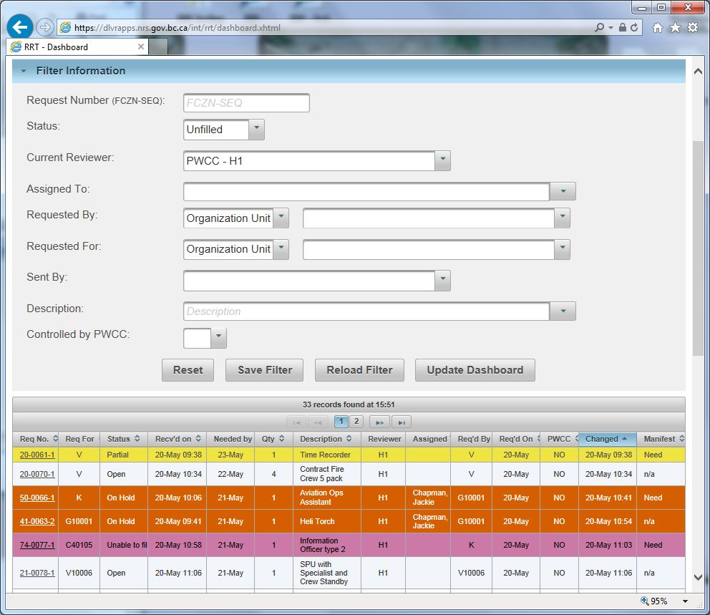
Demo – Using the Dashboard
Special “Unfilled” status
Multiple pages
Ctrl + Click to sort multiple
Notes:
** Walk through “Demo 2” and “Demo 7” scripts **
Find the two resource requests created in previous demo.
* Filter by “Requested For” and “Requested By” and search for the fire used in previous demo
* Filter by “Current Reviewer” and look for the RRs at the Zone and Fire Centre used in previous demo
The “Unfilled” status is a roll-up of multiple status codes including Open, Pending, Unable To Fill, and others.
The results may be displayed over several pages. Click on column headers to sort. (Click again to sort the opposite way.) Hold the Ctrl key and click on multiple columns if desired.

Slide 13
Dashboard
Set filters to display only those RRs you are interested in
  Incoming requests: Current Reviewer
  Outgoing requests: Requested By or Requested For
  Requests that were passed along: Sent By
  Special status of “Unfilled”
Save filter if desired, or simply “Update Dashboard” to see results without saving
You may collapse the filter section by clicking on its header after you’ve set it.
Dashboard automatically refreshes every 5 minutes

Slide 14
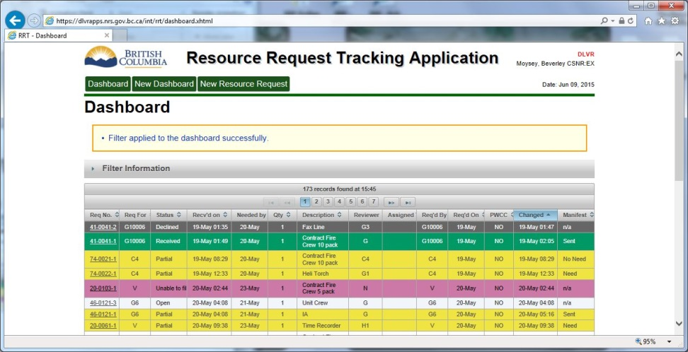
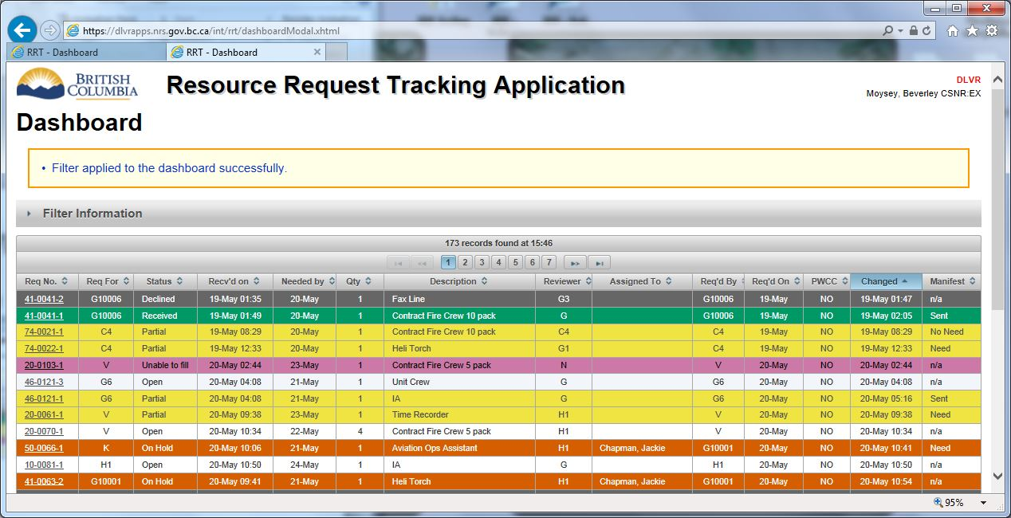
Two ways to display the Dashboard
Notes:
“Dashboard” is fixed width and has navigation buttons to get to the other parts of the application. This screen is launched when first accessing the application.
“New Dashboard” is 100% width and does not have menus.
You can open multiple copies of either. Function is identical between the two windows.

Slide 15
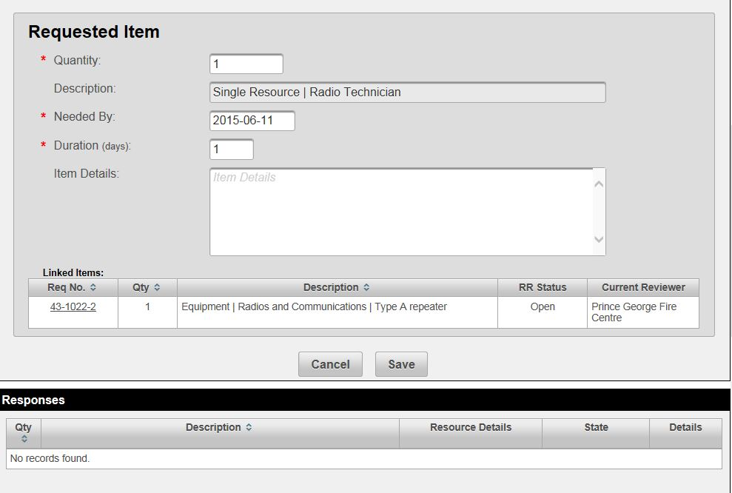
Demo – Review the RRs just created and assign to a person
Note linked items
Notes:
* Open the RRs just created
* Demonstrate how linked items are displayed
* Assign one of the RRs to someone to process – save – note that the status is now Pending

Slide 16
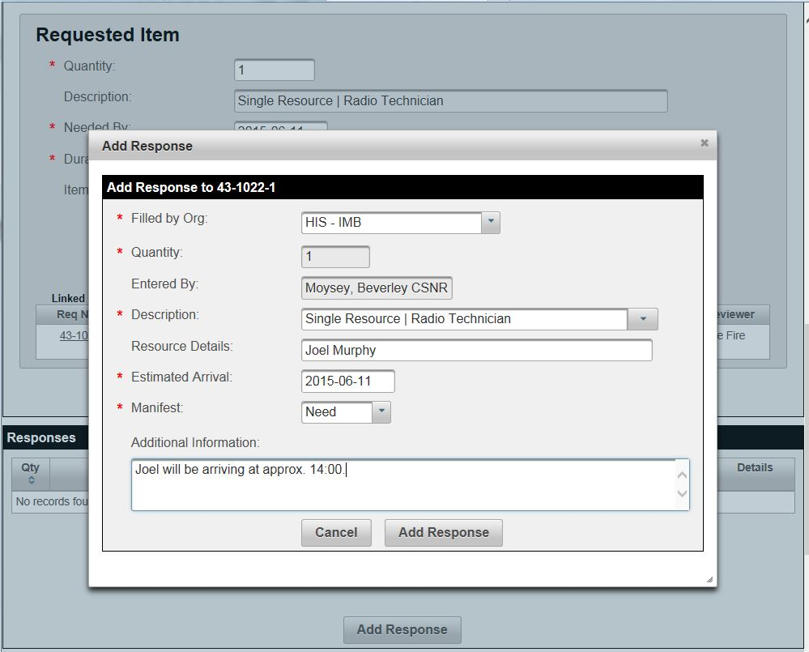
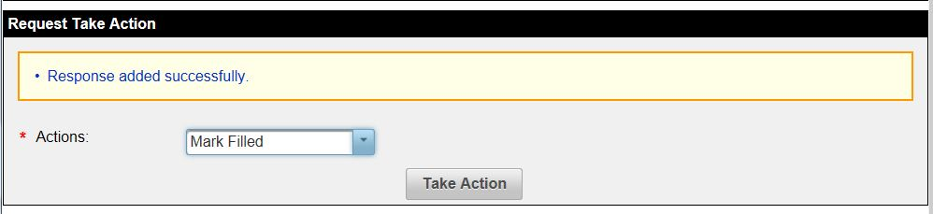
Demo – Adding a response and marking the request as filled
Notes:
** Walkthrough “Demo 3” script (also covers “Demo 4” script) **
* Assign a person to the RR
* Add the response – save – note that status is now Partial and show dashboard
* Mark the request as filled – note that the status is now Filled and show dashboard

Slide 17
Responding to a Resource Request
Click on the RR number on the Dashboard to open the Process Request screen
Optionally, claim the RR by entering your name in the “Assigned To” box and clicking Save. This sets the RR to “Pending” state.
When ready to process the RR, add a Response.
If request is now fully filled, select the action “Mark Filled” and click “Take Action” button. Otherwise it will be in a “Partial” status.

Slide 18
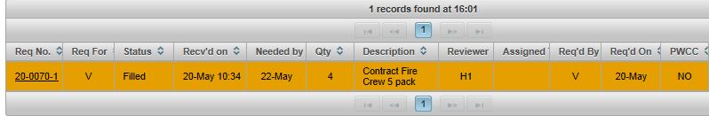
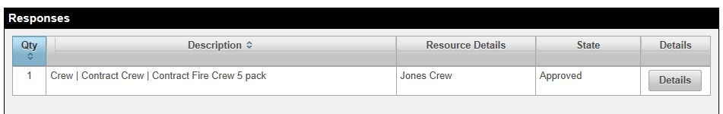
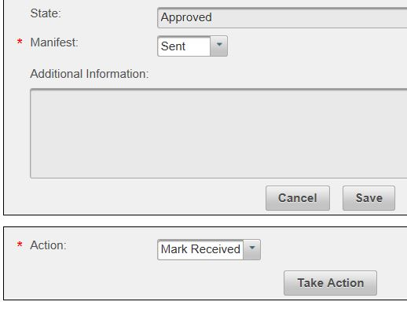
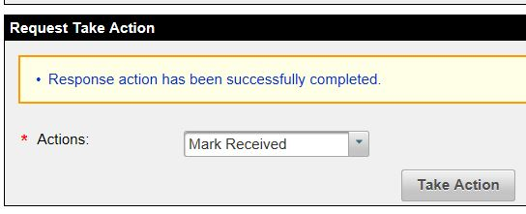
Receiving a Resource
When the requesting organization physically receives the resource, they mark the response as received in the system, along with the request as a whole if appropriate.
Notes:
** Walk through “Demo 5” script **
This is a new step for WMB, similar to signing for a parcel. Sometimes filled <> arrived if a higher priority request diverted your item.
Must receive both the response and the request as a whole (e.g. request for 1 unit crew is filled by two 10-packs)

Slide 19
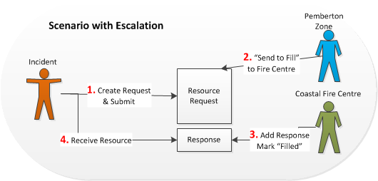
Escalating a Request

Slide 20
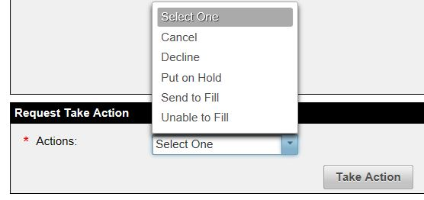
Demo - Not able to fill a request
If you are unable to fill a request, use the “Unable to fill” action only if you are the end of the line (i.e. PWCC) but still hope to fill it
  Re-open the request if you later start working on it again, or Decline it if it will not be filled.
Otherwise, escalate it to the next level of the organization (e.g. your fire centre, or PWCC) using the “Send to fill” action.
Notes:
“Send To Fill” can be used to escalate whether the request came up to you from below (e.g. a fire sent it to you at the zone) or down from above (e.g. your fire centre sent it to you at the zone). If you cannot fill it, send it back up to your fire centre using the same Send To Fill action.
** Walk through “Demo 6” script **
Send a RR to PWCC to fill
Decline a RR
Put an RR on hold and then re-open
Cancel a RR
If a request has been “Put on Hold” it has an additional “Re-Open” action that returns it to the Open status.

Slide 21
Questions?

