Slide 1
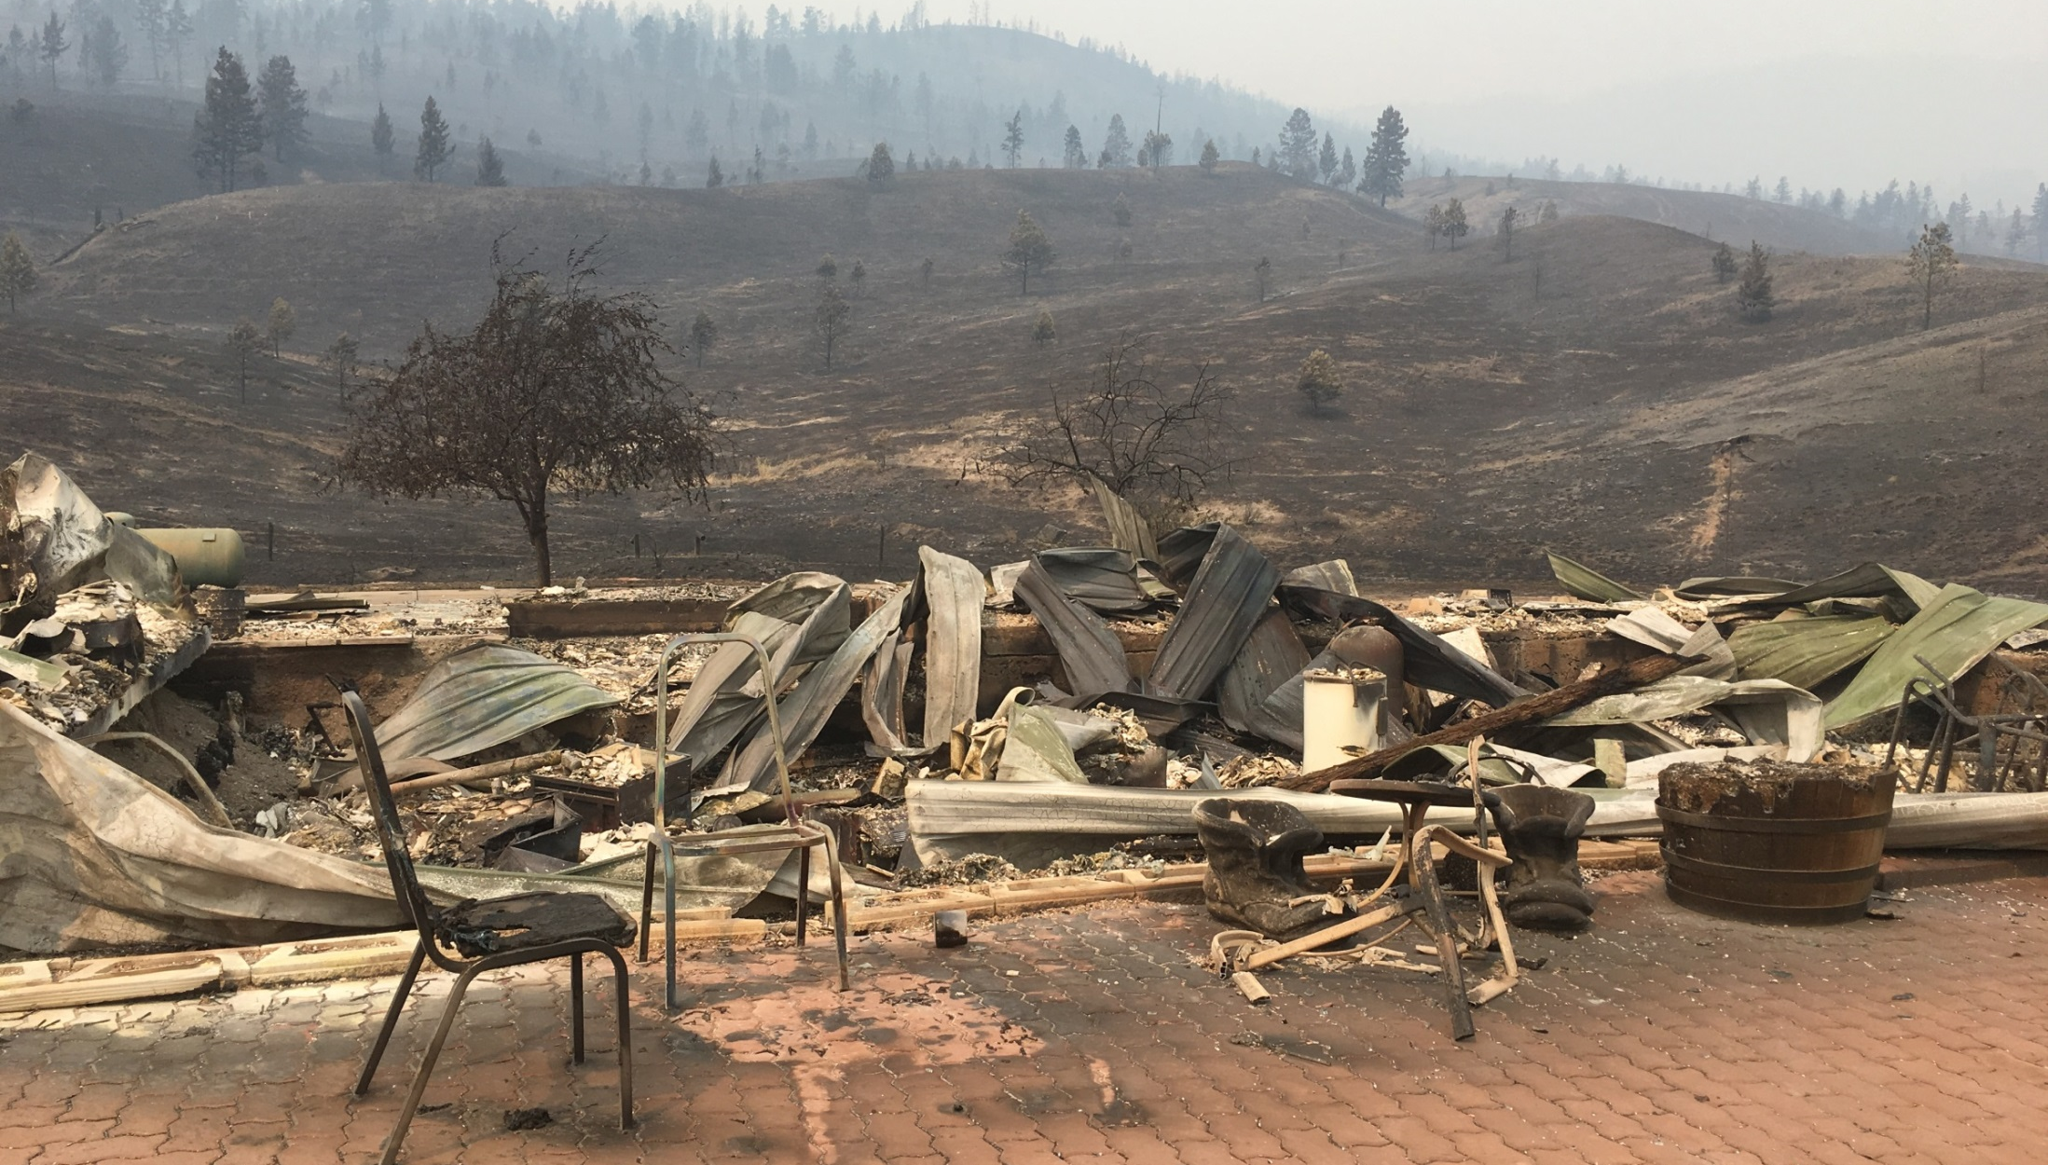
FireSmart 2018
Notes:
NOTE for presenter: Please do not change the key messaging in this presentation.
If there is a prevention topic that you would like added to this presentation please contact BCWS.PreventionComms@gov.bc.ca.
Feedback is always welcome!

Slide 2
OVERVIEW
Review of the 2017 wildfire season
Seasonal outlook for 2018
Wildfires in B.C.
Role of FireSmart
A Case for FireSmart
FireSmart resources
Contact information

Slide 3
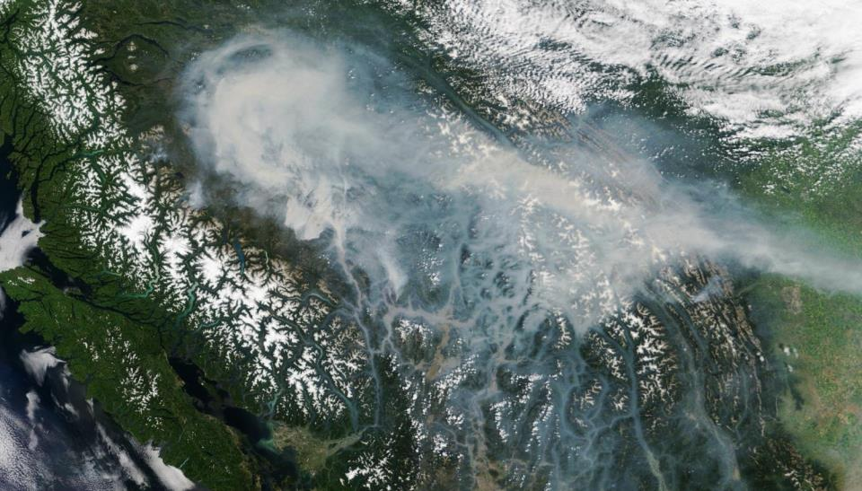
1. Review of the 2017 Wildfire Season
Notes:
In 2018 about 1.2 milllion hectares of the province was burned during what the BC Wildfire Service has called an ‘unprecedented’ season that cost $568 million and displaced roughly 65,000 people.

Slide 4
JULY 6-8: THE TURNING POINT
Over 220 fires ignited between July 6 and July 8.
July 7
July 8
Notes:
In 2017 there were 1352 fires in the Province. 781 fires were lightning-caused while 571 were human-caused fires.

Slide 5
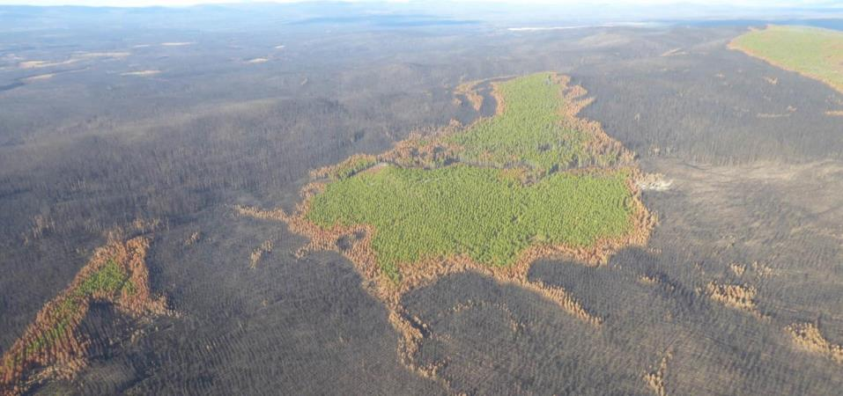
HECTARES BURNED
1,200,000 hectares
of land were burned by the 1,347 wildfires in 2017

Slide 6
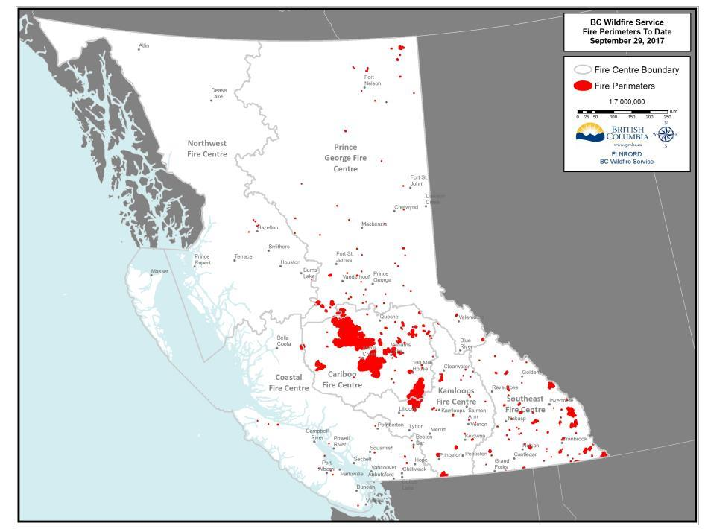
Notes:
At peak capacity, BCWS was utilizing:
•4,700+ personnel total
•1,200+ out-of-province personnel
•2,000+ contract personnel
•236 aircraft
•300+ personnel from the Canadian Armed Forced
Out-of-province personnel came from every province and territory in BC (except Nunavut), as well as from the following countries:
•Mexico
•Australia
•New Zealand

Slide 7
HECTARES BURNED
Historical records (1912-2017): number of hectares burned
Notes:
BC Wildfire Service recognizes the challenges that will hamper their ability to respond effectively to escalating wildfire situations in the future:
Continued population expansion into remote areas;
Expanded industrial activity;
Climate change causing increased temperatures and a higher incidence of drought-like conditions; and
Forest stand conditions have shifted as well as areas of high fuel load due to past suppression efforts

Slide 8
LARGEST WILDFIRES ON RECORD
No. | Year | Name of fire | Size (hectares) | Cause
1 | 2017 | Plateau Fire | 521,012 | Lightning
2 | 1958 | Kechika River | 285,935 | Human
3 | 2017 | Hanceville/Riske Creek | 239,298 | Lightning
4 | 2017 | Elephant Hill | 191,865 | Human
5 | 1982 | Egnell Lake/Liard River | 182,725 | Lightning
6 | 2014 | Chelaslie | 133,100 | Lightning
7 | 1948 | Beatton River (East of Pink Mtn.) | 132,261 | Human
8 | 1971 | Teeter Creek/Liard River | 110,334 | Lightning
9 | 1950 | Gundy - Townsend Creek/Cameron River | 99,767 | Human
10 | 1950 | Chinchaga Fire - Blueberry and Beatton River | 76,923 | Human
Notes:
In 2017 there were 1352 fires in the Province. 781 fires were lightning-caused and 571 were human-caused fires.
While we can do nothing about the weather, we can mitigate the hazard through Prevention programs such as FireSmart.
People who live in areas adjacent to forested lands represent serious problems for fire risk management.
First, fire ignition sources, generated by the presence of people, increase the probability of wildfires starting near urban structures; and second, populated wildlands are areas where fires can have disastrous social and economic consequences altering people’s homes, livelihoods, safety, even recreational space. And when a community is impacted it can take decades to recover.

Slide 9
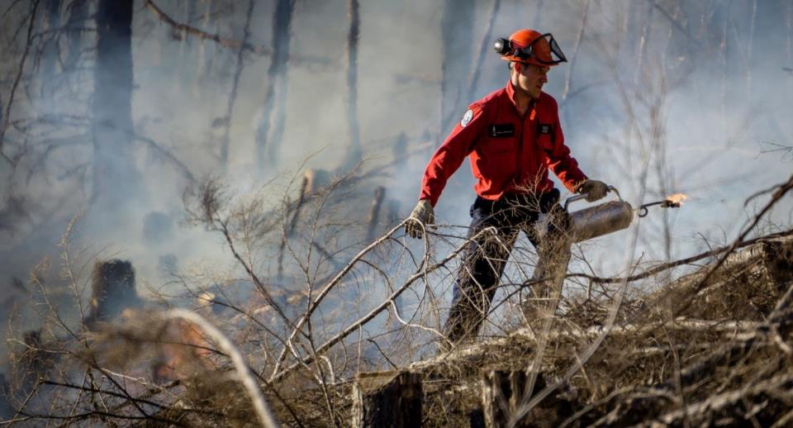
FIRE SUPPRESSION COSTS
Total cost of $568,000,000
for wildfire suppression to date in 2017-18

Slide 10
FIRE SUPPRESSION COSTS
Historical records (1991–2017): season costs
Notes:
Increasing fuel loads have made today’s wildland fires harder to control, expensive to suppress, and a threat to the lives of firefighters and the public. That is why prevention is so important.

Slide 11
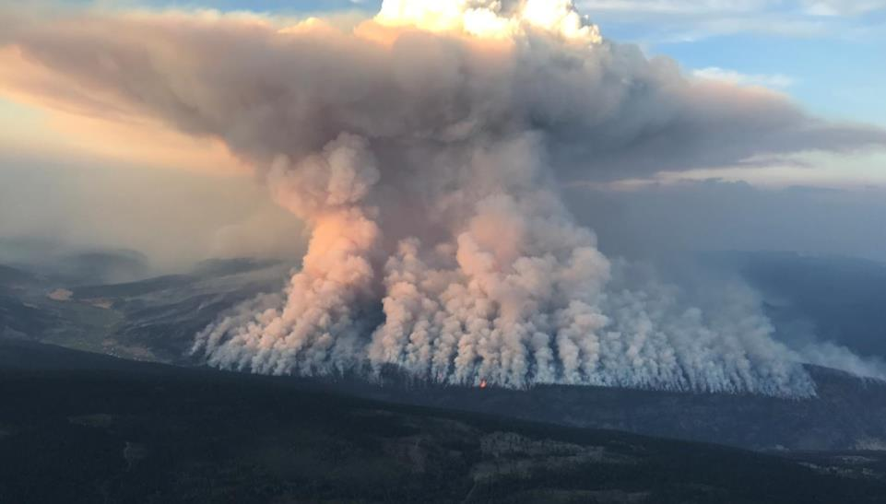
2. Seasonal Outlook for 2018

Slide 12
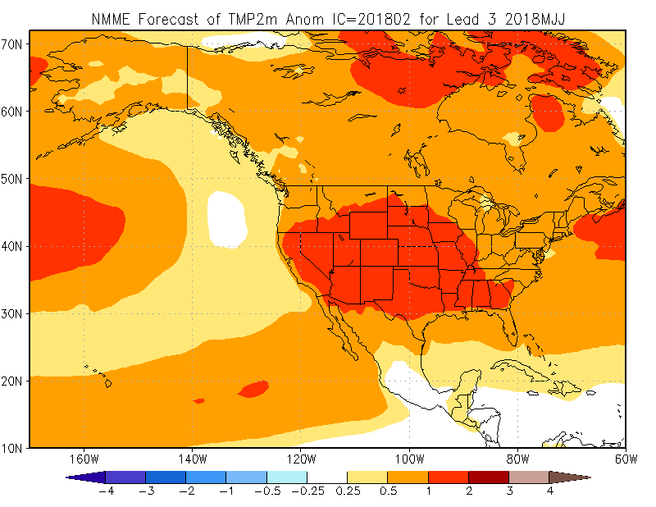
Spring temperature forecast
Notes:
The latest guidance from BCWS weather techs and Environment Canada favours warmer than average temperatures this spring.
A relative ‘cool’ region offshore could mean an upper low/trough may remain the dominant feature off the west coast of North America.
This is a possible sign that Pacific storms will be able to continue to bring spring rains to BC and 2018 may not be as busy as 2017 as a result. (If this model showed warmer temperatures offshore we’d be talking about a blocking ridge and the potential for a dry spring)

Slide 13
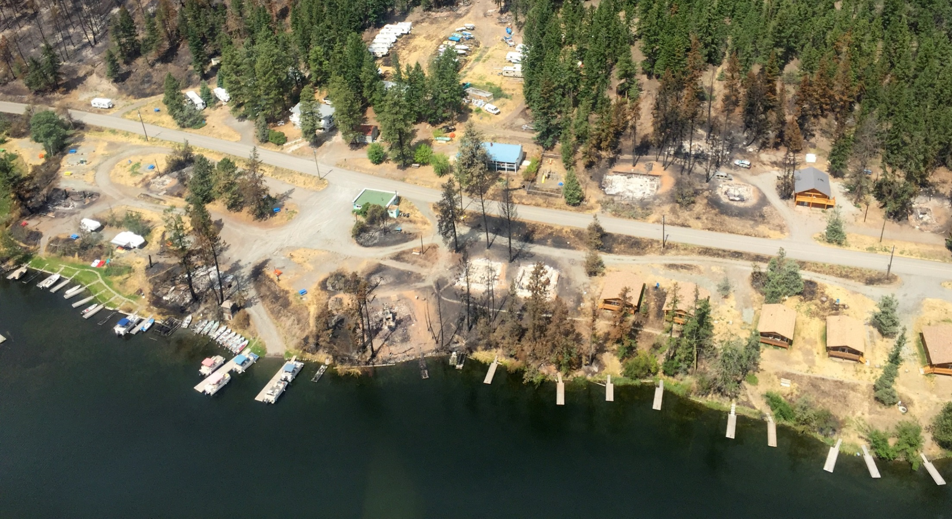
3. WILDFIRES IN B.C.
B.C. is experiencing a serious and sustained increase in extreme wildfire behaviour in the
Wildland Urban Interface (WUI).

Slide 14
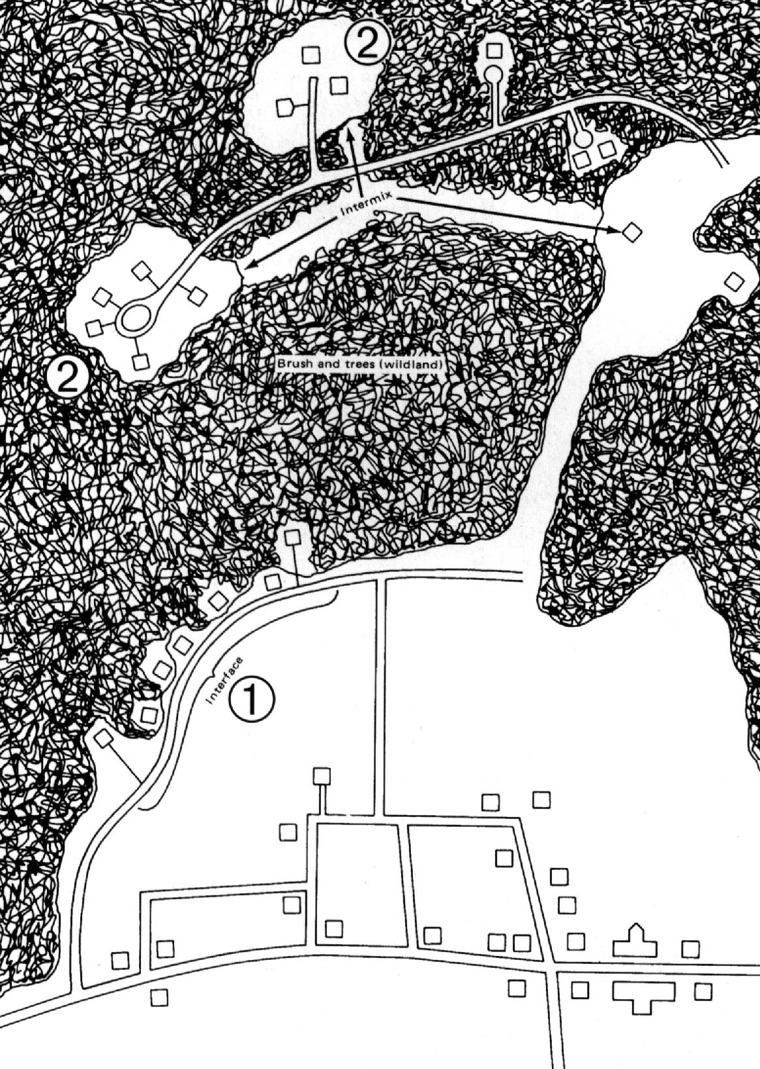
WILDLAND URBAN INTERFACE
What is the WUI?
WUI refers to the “wildland urban interface”.
It is the zone of transition between wildland forest and human development.
The lands and communities next to and surrounded by wildlands are at risk of wildfires.
Wildland Urban Interface

Slide 15
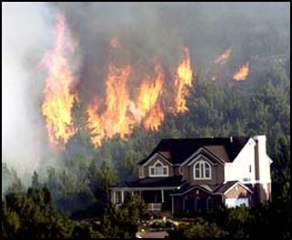
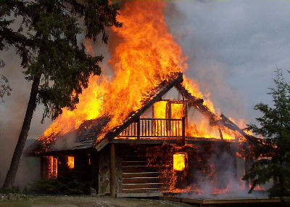
WHAT IS A WILDLAND URBAN INTERFACE FIRE?
Where the fuel being consumed by a wildfire…
…changes from wildland fuel to urban fuel …
Structural ignition occurs when wildfire embers or flames kindle vulnerable parts of a structure.
Notes:
SO, WHAT is a Wildland Urban Interface (WUI) fire?
A WUI fire is where the fuel being consumed by a wildfire changes from wildland to urban fuel.
It does not matter to a fire, it’s all fuel! But it does matter to us!
WUI fire occurs when wildland fire embers or flames contact the ignitable parts of a structure.
Note that the trees surrounding this home are not burning, but the home is. How could that be – in the midst of an intense forest fire?

Slide 16

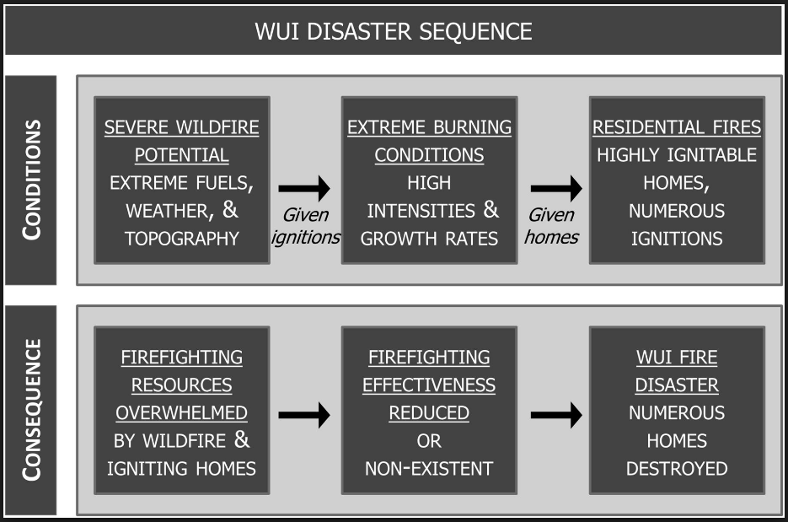
WUI DISASTER SEQUENCE
Notes:
This is the WUI disaster sequence. The pattern of how wildfires turn into urban disasters is well known and documented. This diagram shows how a catastrophic wildfire disaster occurs in which numerous homes are lost.
In order to break the cycle and prevent future disasters we need to address the point where the wildfire event makes the transition from forest fuel to structural fuels in the WUI, that is by preventing the ignition of homes, and this is where FireSmart comes into play.
“ If a home does not ignite, it cannot burn… if homes don’t burn, then there is no disaster” – Jack Cohen

Slide 17

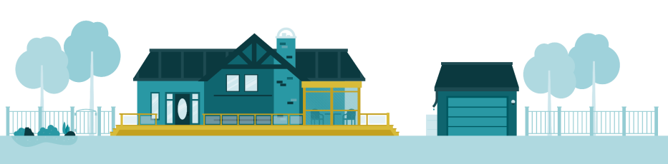
4. THE ROLE OF FIRESMART
Notes:
FireSmart is a brand owned by FireSmart Canada that includes a comprehensive set of tools and guidance on how to undertake and implement community based wildfire prevention and mitigation initiatives.
FireSmart is based on the premise of shared responsibility and promoting integration and collaboration on wildfire prevention and mitigation. It is founded on seven disciplines that are under the responsibility or mandate of different organizations and/or levels of government.
Leadership and cooperation between the responsible agencies is necessary to fully realize the benefits of implementing FireSmart principles.

Slide 18
FIRESMART
FireSmart is about living with and
managing for wildfire on our landscapes
FireSmart is the Canadian standard recognized by all provinces and territories.
It’s based on National Fire Protection Association (NFPA) standards and has evolved over 40 years.
It’s backed by a vast amount of field, laboratory and modelling research.
FireSmart guidelines have proven their legitimacy as measures of hazard.
FireSmart methods have been demonstrated time and time again to reduce the risk of losses, under even the most extreme fire conditions.
Notes:
The science behind the FireSmart principles is indisputable.

Slide 19
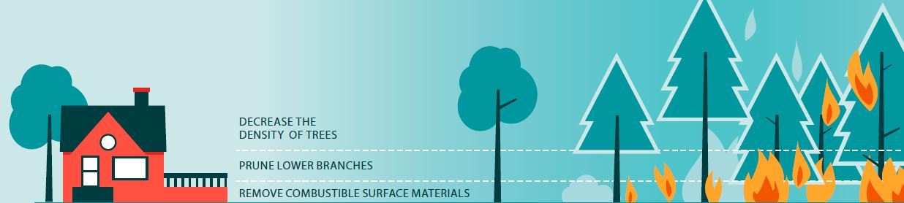
SEVEN FIRESMART DISCIPLINES
1) Education
2) Emergency planning
3) Interagency co-operation
4) Cross-training
5) Fuels management
6) Legislation & planning
7) Development
considerations
Notes:
FireSmart utilizes seven disciplines. In order to ensure that communities are as prepared as possible for the eventuality of wildfire, they need to consider each of the seven disciplines.
The definition of the FireSmart disciplines are:
Education: Raising awareness of wildfire risks while teaching about prevention and mitigation.
2) Emergency Planning: Participating and encouraging emergency planning by combining local knowledge with expertise in wildfire management.
3) Interagency Cooperation: Promoting collaboration between government departments and the different levels of government to better support wildfire preparedness, prevention, response, and recovery.
4) Cross training: Participating and promoting cross-training opportunities that support the delivery of the FireSmart program. For example, training with fire departments to improve fighting fires in the Wildland Urban Interface.
5) Fuels Management: Managing fuels on the landscape through effective treatments using the best available science.
6) Legislation and planning: Development of policy and legislation related to: forestry management practices; integrated land use planning; compliance and enforcement programs; and legal orders.
7) Development considerations: Using best available science and technology to promote effective local government and land use planning that supports community wildfire resiliency and infrastructure survivability.

Slide 20
B.C. FIRESMART COMMITTEE
A B.C. FireSmart Committee was created in the spring of 2017 to guide the use and priorities of FireSmart in BC. It consists of members from:
BC Wildfire Service (BCWS)
Office of the Fire Commissioner (OFC)
Union of B.C. Municipalities (UBCM)
B.C. Fire Chiefs Association (FCABC)
Emergency Management BC (EMBC)
Forest Enhancement Society of B.C. (FESBC)
First Nations Emergency Services Society (FNESS)
Notes:
The delivery of a successful and effective FireSmart program in BC was previously hindered by a lack of stable funding and resourcing, inconsistent application of FireSmart principles and disciplines, and no overarching authority to ensure consistent participation.
To help overcome these challenges and ensure greater direction and integration of the seven FireSmart disciplines* across the province, a new BC FireSmart Committee (BCFSC) was established in May 2017.

Slide 21
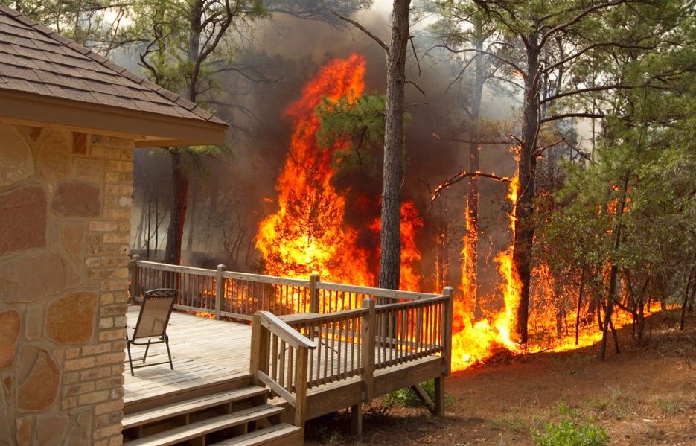
FIRESMART
Why should I care?
During the fire season, British Columbians may be evacuated from their communities and homes may be destroyed.
Living in a forested area means that you and your community eventually will have to contend with the threat of a wildfire.
Your best protection is PREVENTION
and your tool is the
FireSmart program.

Slide 22
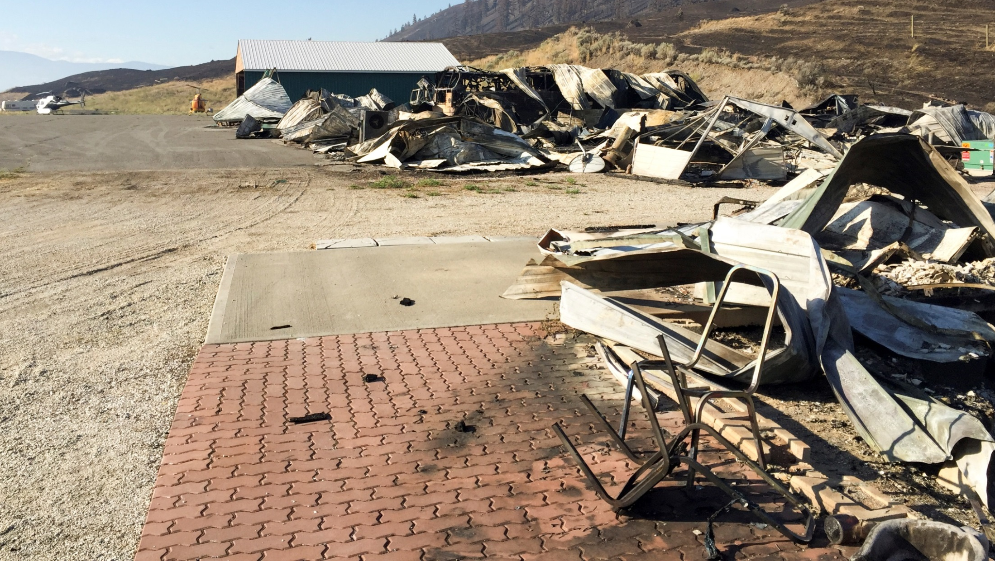
WILDFIRE PREVENTION
Wildfire prevention begins BEFORE
the fire occurs and in our own backyards.
FireSmart is a shared responsibility.
Notes:
Wildfire is a threat to our community and its neighbourhoods.
This threat cannot be solved by firefighters or more equipment.
Solving the problem depends on what happens BEFORE the fire occurs and in our own BACKYARDS.

Slide 23
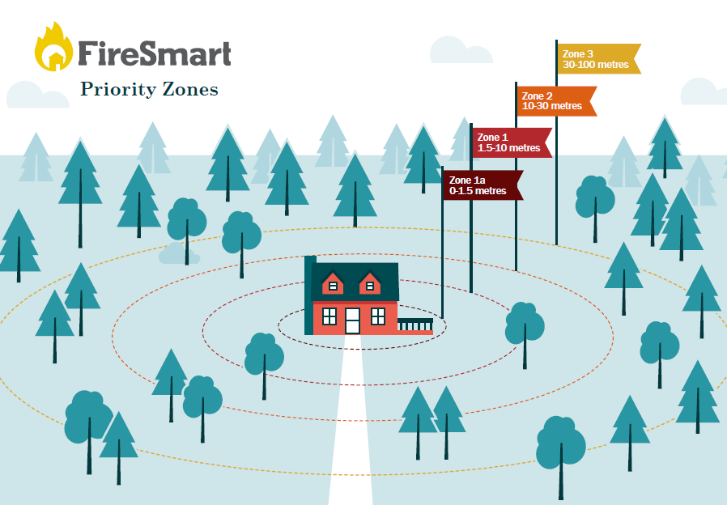
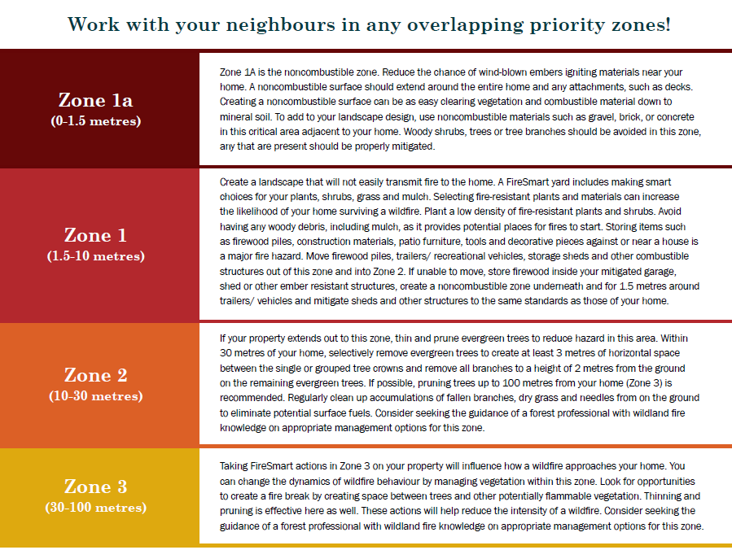
HOME IGNITION ZONES
Notes:
The main focus to reduce WUI wildfire disasters is within the home ignition zone, which is the home plus three priority zones spanning outwards from the structure, as shown in this image.
The goal is to protect homes from:
Convective heat or direct flame
Radiant heat from the flame front or from other homes
Embers
NOTE for presenter: If time this video demonstrates ember risk very well: https://www.youtube.com/watch?v=_Vh4cQdH26g

Slide 24
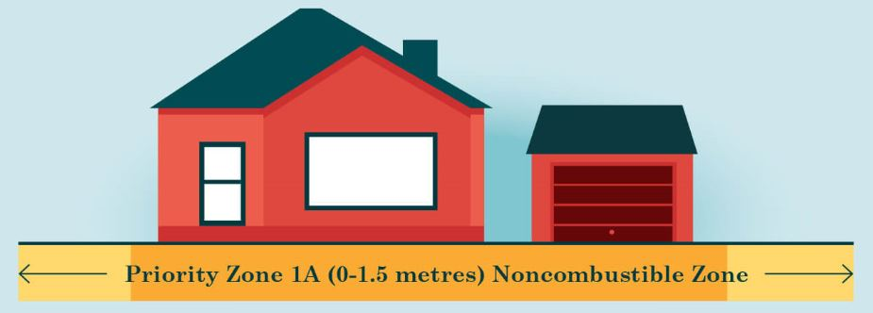
ZONE 1A
The most critical zone (0 to 1.5 metres from the home)
Remove combustible material right down to the mineral soil
Use non-flammable materials such as gravel, brick or concrete in this critical area adjacent to your home
Avoid having woody shrubs, trees or tree branches in this zone

Slide 25
ZONE 1A
CHARACTERISTICS OF FIRE RESISTANT PLANTS
Moist, supple leaves
Accumulates minimal dead
vegetation
Water-like sap with little odour
Low amount of sap or resin material
CHARACTERISTICS OF HIGHLY FLAMMABLE PLANTS
Leaves or needles are aromatic
Accumulates fine, dry, dead material
Contain resin or oils
Loose papery or flaky bark
Examples of plants to AVOID planting: Cedar, Juniper, Pine,
tall grass and Spruce.

Slide 26
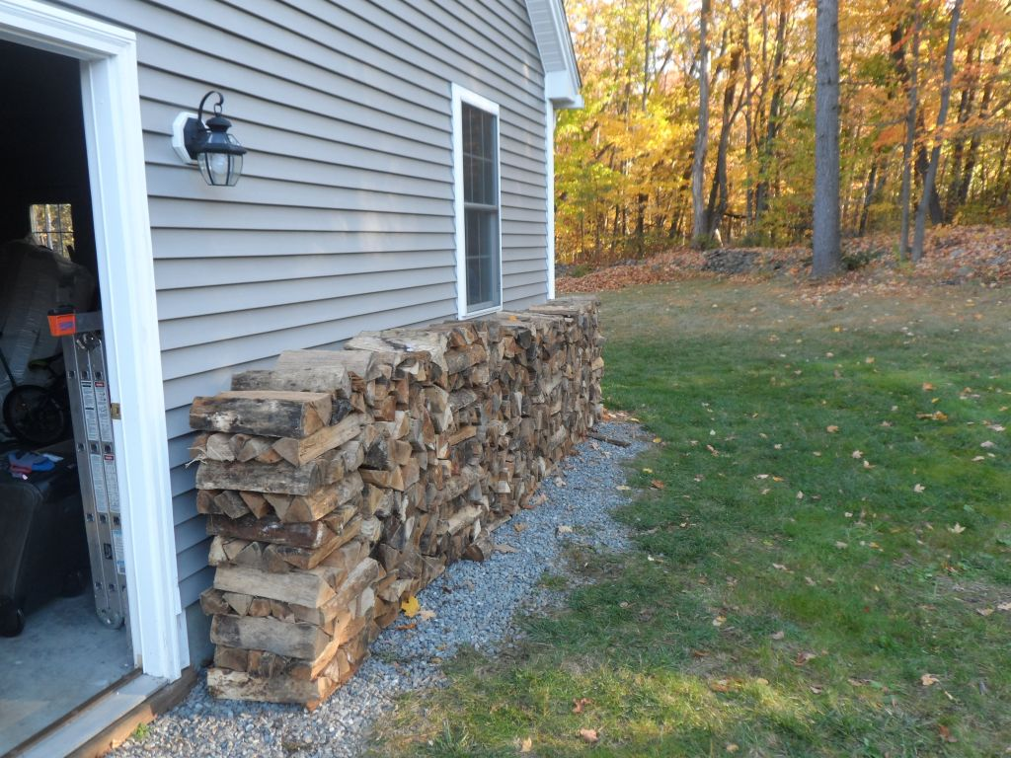
ZONE 1
1.5 to 10 metres from the home
Create a FireSmart yard so that fire will not easily transmit to your home.
Plant low-density, fire-resistant plants and shrubs.
Avoid planting coniferous trees (cones and needles) in this zone, since they are highly flammable.
Keep lawns mowed.
Move firewood piles, construction materials, storage sheds and other combustible structures out of this zone and into Zone 2.
Notes:
Avoid planting coniferous trees (cones and needles) as they are highly flammable and should not be within 10 metres of your home.
Trees to plant are deciduous (leafy) trees are resistant to wildfire and include:
• poplar
• birch
• aspen
• cottonwood
• maple
• alder
• ash
• cherry

Slide 27
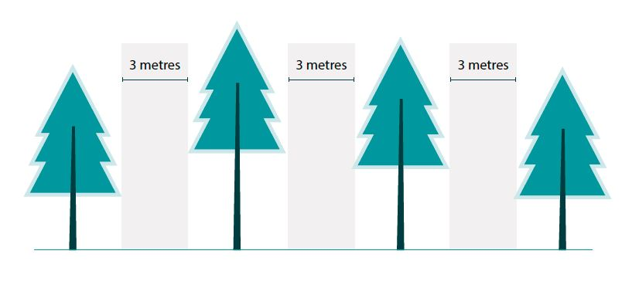
ZONE 2
10 to 30 m from home
Prune and trim evergreen trees to create at least 3 metres of horizontal space between the single or grouped tree crowns
On remaining evergreen trees, remove all branches to a height of 2 metres above the ground
Regularly clean up fallen branches, dry grasses and needles from the ground to eliminate the potential surface fuels
Notes:
Avoid planting coniferous trees (cones and needles) as they are highly flammable and should not be within 10 metres of your home.
Trees to plant are deciduous (leafy) trees are resistant to wildfire and include:
• poplar
• birch
• aspen
• cottonwood
• maple
• alder
• ash
• cherry

Slide 28
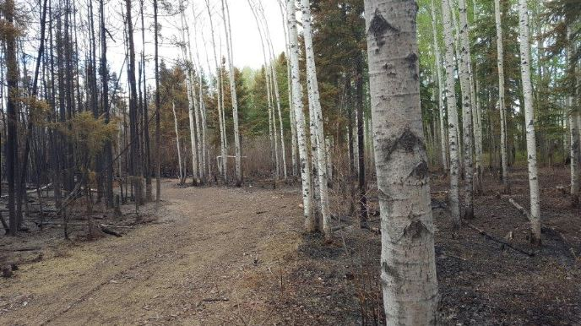
ZONE 3
30 to 100 m from home
Create an environment that will not support high intensity crown fires
Focus on fuel reduction and conversion (rather than removal) is the main priority in this zone
Look for opportunities to create a fire break by creating space between trees and other flammable vegetation
Notes:
Avoid planting coniferous trees (cones and needles) as they are highly flammable and should not be within 10 metres of your home.
Trees to plant are deciduous (leafy) trees are resistant to wildfire and include:
• poplar
• birch
• aspen
• cottonwood
• maple
• alder
• ash
• cherry

Slide 29
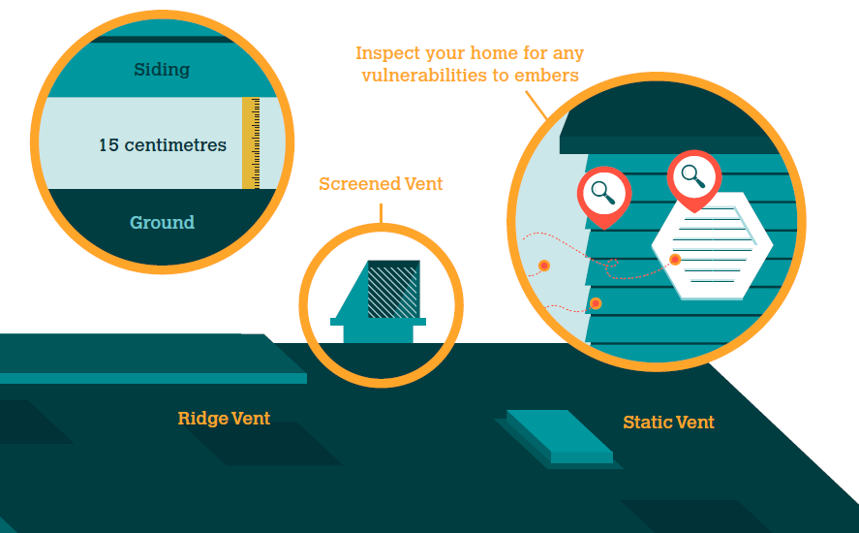
HOME BUILDING CONSIDERATIONS
Always ensure roofs and gutters are clear of combustible material, vents and eaves are screened in or enclosed ,and siding is free of gaps where embers could accumulate.
Notes:
Unscreened vents can allow heat and embers to enter a building and ignite.
With inadequate ground-to-siding clearance, accumulated embers can ignite combustible siding directly. 15 centimetres of ground-to-siding non-combustible clearance is recommended.
Install non-combustible material for all vents. Should be 3 millimetre screening or ASTM (American rating system) fire rated vents. Metal products are recommended for vents and vent flashing.

Slide 30
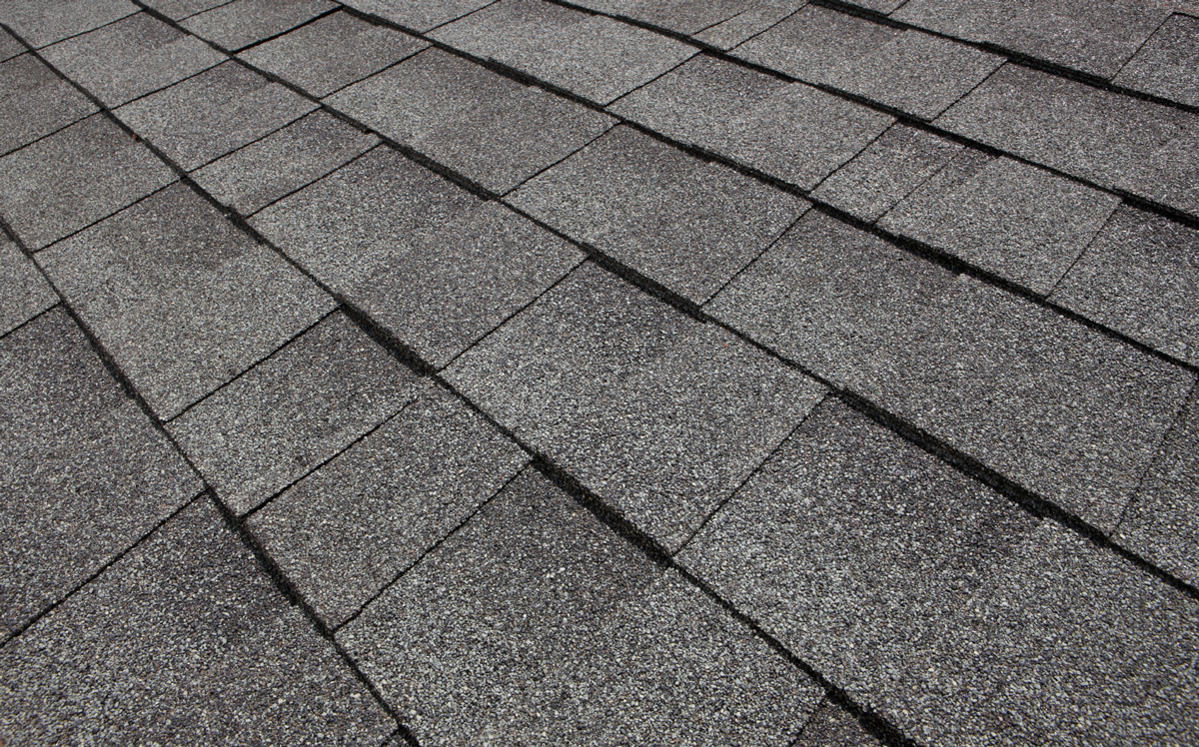
RECOMMENDED HOME ROOFING MATERIALS
Roofing material tested for flammability is assigned a classification:
CLASS A – high resistance to fire
CLASS B – moderate resistance to fire
CLASS C – low resistance to fire
The roof is the most VULNERABLE component of your home. Sparks and burning embers from a wildfire can travel long distances and quickly ignite flammable roofing material.
.
Notes:
The fire rating of roof covering relies on the entire roof assembly (sheeting, drip edges and end caps) to offer the rated protection.
Class A fire-rated roof assembly offers the best protection. Examples of Class A roofing material include clay tile, concrete tile,
metal and asphalt shingles.
Class C roofing has the lowest resistance to fire. Untreated wood shakes are a Class C because they create a dangerous combination of combustible material and crevices for embers or sparks to enter.
Roof features such as skylights and solar panels, could be an entry or accumulation point for wind-blown embers. Keep these features clear of combustible debris and properly maintained.

Slide 31
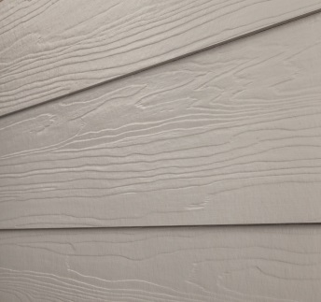

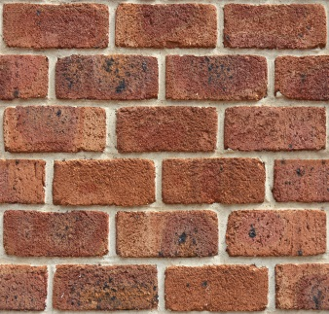
RECOMMENDED HOME SIDING MATERIALS
Fibre cement siding
Aside from the roof, the structural component most vulnerable to wildfire is siding material.
Vinyl siding can melt when exposed to high temperatures , allowing fire to reach the interior of the building.
Fibre cement board panels, stucco, brick and poured concrete offer superior fire resistance.
Stucco siding
Brick siding
Notes:
Siding is vulnerable when it ignites and when flames or embers get into the cavity behind the siding. With inadequate ground-to-siding clearance, accumulated embers can ignite combustible siding directly. 15 centimetres of ground-to-siding non-combustible clearance is recommended.
Examine your siding for locations where embers could accumulate or lodge. Maintaining and removing combustible debris (such as lumber, stored vehicles, branches, grass and leaves) and firewood near the exterior walls will reduce a building’s vulnerability to ignition during a wildfire.

Slide 32
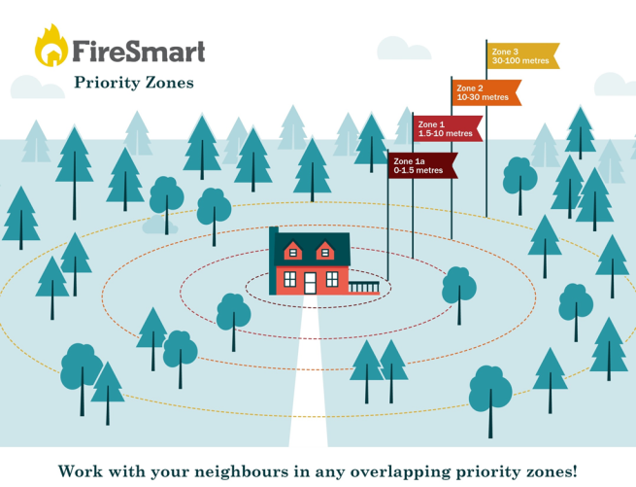
FIRESMART PRIORITY ZONES
Wildfire structure survival statistics
4% survival: flammable roof, no treatment and no defensive action
20% survival: flammable roof
70% survival: non-flammable roof
90% survival: < 10 metres (Zone 1) or more of vegetation is treated
Notes:
4% survival in homes with flammable roof, no treatment and no defensive action
20% survival of homes with flammable roof
70% survival of homes with non-flammable roof
90% survival if 10 metres (Zone 1) or more of vegetation is treated

Slide 33
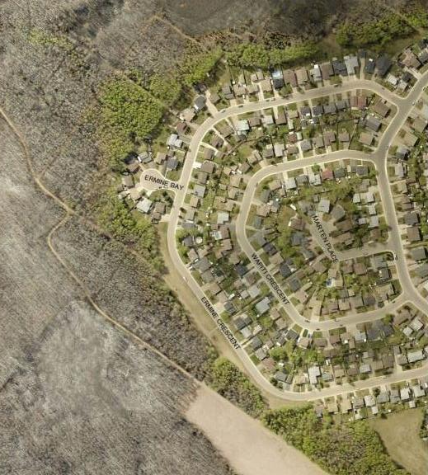
5. THE CASE FOR FIRESMART
The findings from the Horse River wildfire (Fort McMurray) in 2016 suggest that the use of FireSmart principles was one of the main reasons why some houses survived.
*Photo credit: Regional Municipality of Wood Buffalo
Notes:
An investigative study prepared by Alan Westhaver for the Institute for Catastrophic Loss Reduction found homes in Fort McMurray that were rated "low" to "moderate“ hazard using FireSmart criteria survived much more frequently than homes that had higher hazard ratings.
Some of the other early results and conclusions presented in this interim report include:
• On average, surviving homes in urban and country residential areas rated with ‘Low’ to ‘Moderate’ hazard using FireSmart® criteria, whereas homes destroyed rated ‘High’ to ‘Extreme’ hazard.
• In 89% of the side-by-side comparisons conducted (where one home survived and the other did not), the surviving home rated with substantially lower risk.
• 100% of homes/home groups that survived extreme exposure without igniting rated ‘Low’ hazard.
• 81% of all assessed homes that survived had a FireSmart rating of ‘Low’ – ‘Moderate’ whereas 56% of homes that were destroyed had a FireSmart rating of ‘High’ to ‘Extreme’.
• All of the isolated homes that survived amidst heavily damaged urban neighbourhoods rated with ‘Low’ hazard when vegetation further than 30m from the home was discounted.
• All of the isolated homes that ignited amidst otherwise undamaged neighbourhoods were either rated with ‘Extreme’ hazard, or had critical weaknesses making them immediately vulnerable.
From these, and other interim results, some clear patterns and conclusions are already emerging:
• In all neighbourhoods studied, homes whose owners had adopted FireSmart guidelines survived much more frequently than homes where they had not, despite the extraordinarily harsh conditions.
• Recommended FireSmart guidelines work. They are effective in reducing the probability of home ignition and wildfire losses. Home survival does not appear to be random or a matter of luck.
• Home survival depends on conditions in the home ignition zone, for which owners are responsible.
• While low total hazard rating is important, a single critical weakness can lead to home loss.
It was also concluded that this fire fits a pattern widely recognized as the ‘wildland/urban interface disaster sequence.’ That sequence can be broken, and catastrophic home losses can be prevented; however this depends on widespread adoption of risk mitigations within the home ignition zone. Therefore, it is speculated that if homeowners became more aware of how homes ignite and better understood how and why simple FireSmart measures work, they may be better motivated to correct weaknesses in wildfire defences.

Slide 34
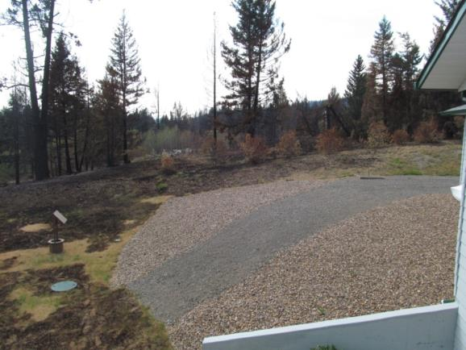
CARIBOO FIRESMART EXAMPLE
Located in the 150 Mile House area
The owner built the home with the intention of applying FireSmart principles.
The home next door
was a log structure
with overhanging
trees and was surrounded by
long grass. It did not
survive the fire.
Gravel, cement and mowed grass 10 metres from house.

Slide 35
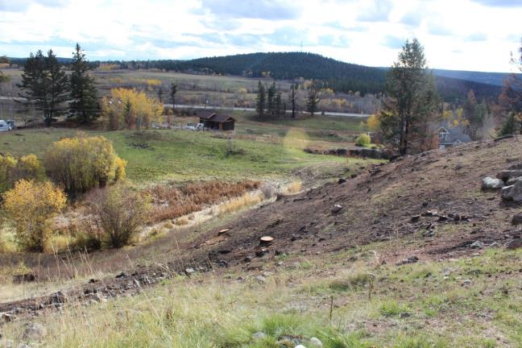
CARIBOO FIRESMART EXAMPLE
Trees were spaced at least 3 metres apart in Priority Zone 2
(10-30 metres away from the house).
The homeowner burned long, dead grass in the spring and fall (when possible) to reduce fire hazards.

Slide 36
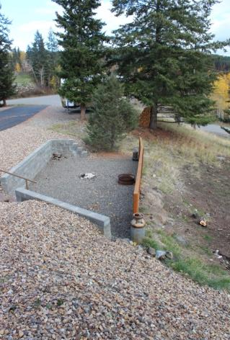
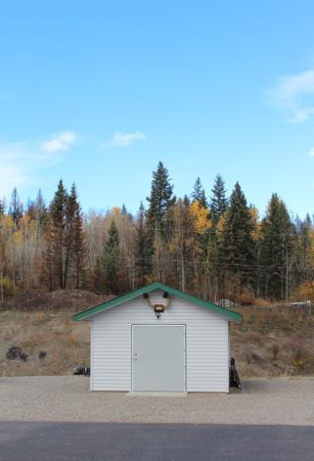
CARIBOO FIRESMART EXAMPLE
The woodpile was placed well away from the home.
The outbuilding was located well away from the home.

Slide 37
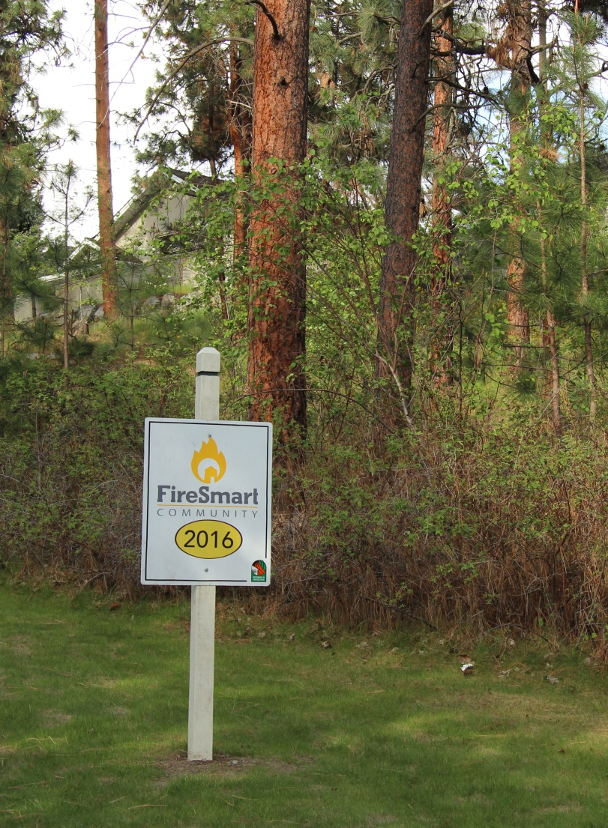
BECOME A RECOGNIZED
FIRESMART COMMUNITY
Neighbourhoods, subdivisions and small towns can earn FireSmart recognition status by creating dedicated local FireSmart Boards and by implementing FireSmart principles tailored to specific community needs.
Working with your neighbours can increase your neighbourhood’s resiliency to wildfires.
More information:
www.firesmartcanada.ca

Slide 38
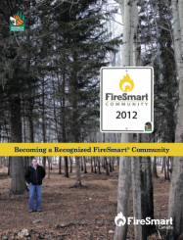
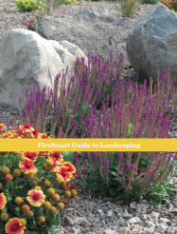
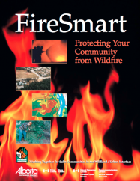
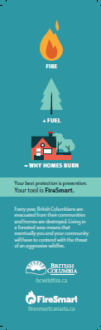
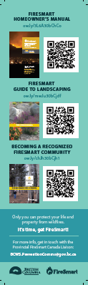
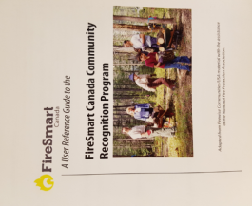
6. FIRESMART RESOURCES
FireSmart Becoming a Recognized FireSmart Community
FireSmart Canada Community Recognition
FireSmart Guide to Landscaping
FireSmart Protecting your Community from Wildfire
Bookmark with QR Coding to Link you to FireSmart Manuals
Available from FireSmart Canada
Also may be acquired from the BC Wildfire Service, subject to availability.

Slide 39
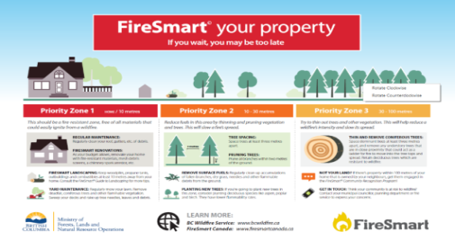
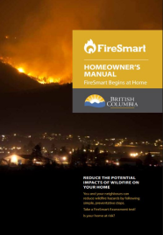

FIRESMART RESOURCES
FireSmart Homeowner’s Manual
Presentation material
FireSmart Poster
Available from BC Wildfire Service
Contact your local Wildfire Prevention Officer or
Communications and Engagement Specialist.
BCWS.PreventionComms@gov.bc.ca

Slide 40

Questions?

