Slide 1
TASS III:
The Next Generation…
of a Growth & Yield Model
for Complex Stands
TASS Trek - we’re going where few have gone before….
Jim Goudie, Research Leader
Stand Development Modelling Group
Research and Knowledge Management Branch

Slide 2
The star ship TASS crew
  Ken Mitchell (scientist emeritus, Captain Kirk)
  Jim Goudie (SDMG research leader, Captain Picard )
  Catherine Bealle Statland (complex stand development, Counselor Deanna Troi )
  Mario Di Lucca (G&Y applications specialist, Lt. Commander Data)
  Roberta Parish (Quantitative population biology, Dr. Beverly Crusher)
  Ken Polsson (programmer/analyst, Geordi La Forge)
  Shelley Grout (software application specialist – TIPSY, Lt. Tasha Yar, security)
  George Harper (hardwoods) (Q)
  Ian Cameron (Azura Formetrics; biometrics/modelling, Commander Riker)
  Stephen Stearns-Smith (SSS and Assoc.;extension specialist Worf)

Slide 3
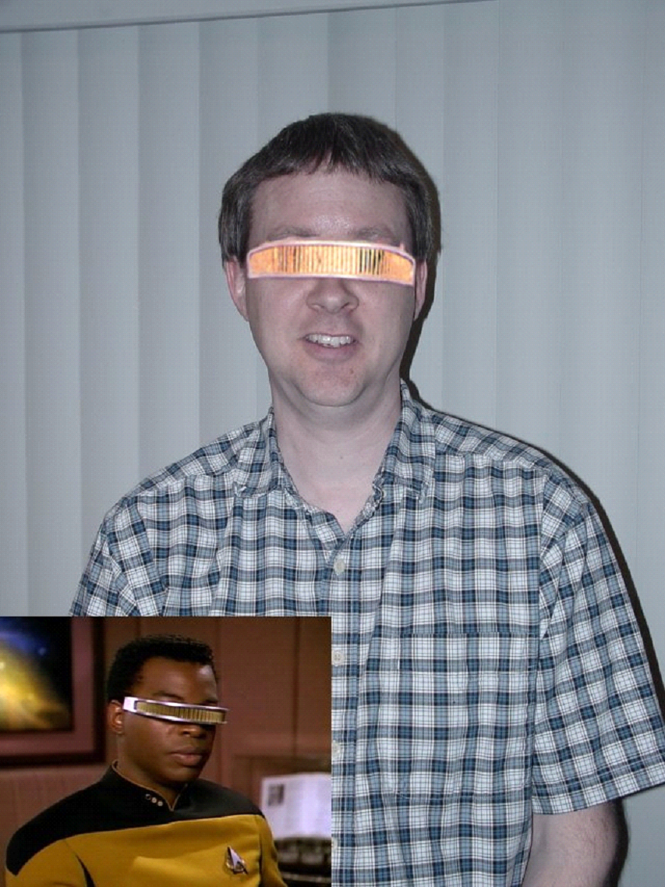
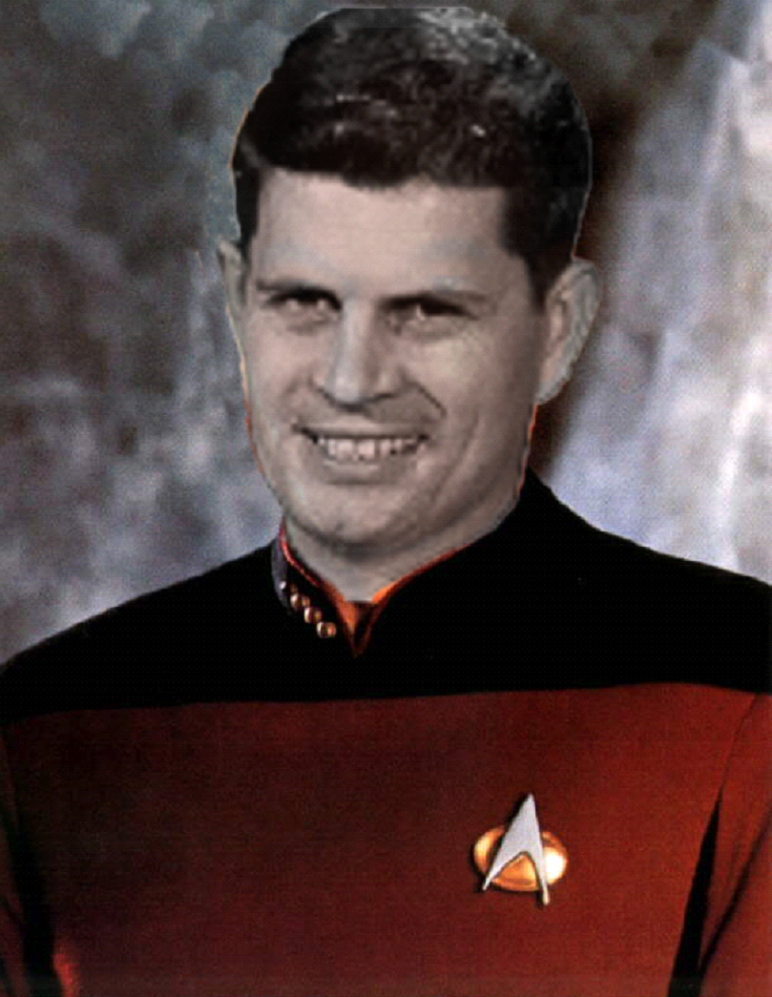
Ken “Geordi La Forge” Polsson
Ken “Captain Kirk” Mitchell
Circa 1975

Slide 4
Outline
About TASS
TASS I – II – III history
TASS III modifications
  tRAYci light model
  Crown profiles
  Crown competition
  Mortality
TASS Graphical User Interface
PLOTSY

Slide 5
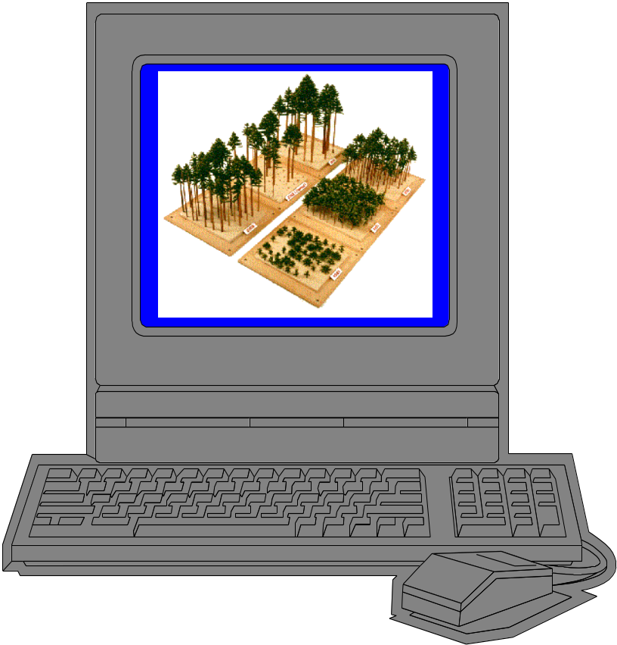
TASS – Tree And Stand Simulator
40+ years and still exploring space
(because it is spatial)
TASS and TIPSY provides managed stand yield tables for use in:
Timber Supply Review (AACs)
Silvicultural prescriptions and strategies
Predictions of non-timber forest values

Slide 6
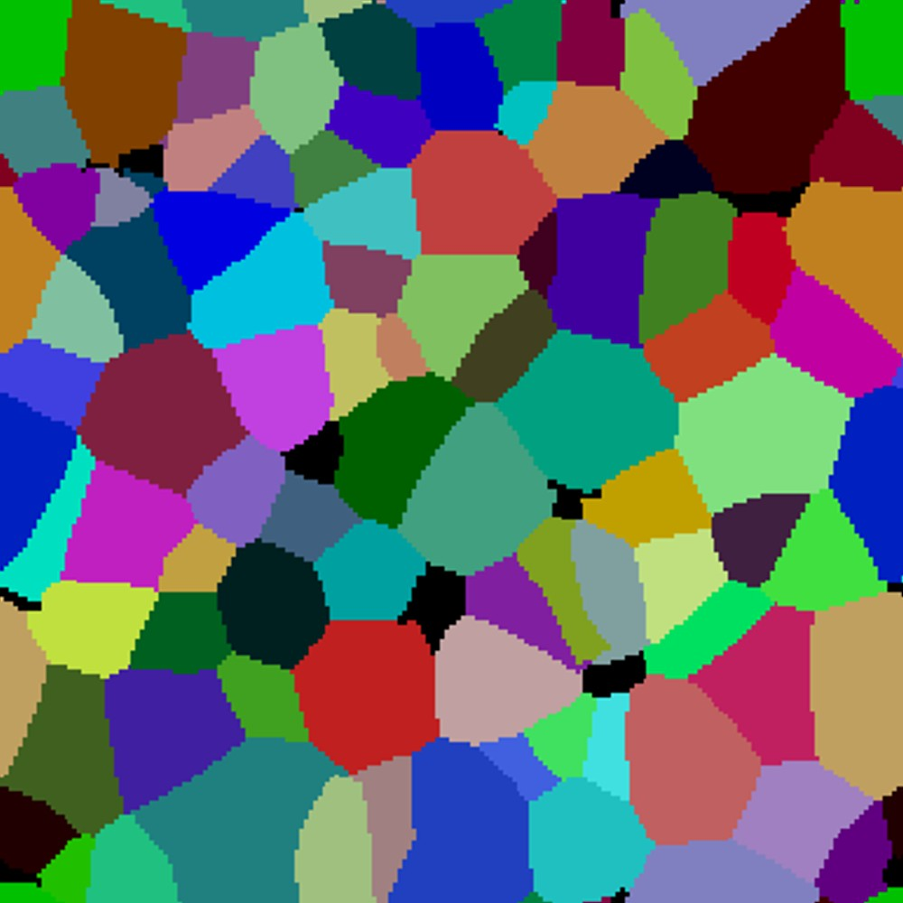
TASS I:
1963-1968
Dr. Ken Mitchell,
UBC grad and Yale PhD (1968)
(Yale Bulletin No. 75)
Two-dimensional crown modelling

Slide 7
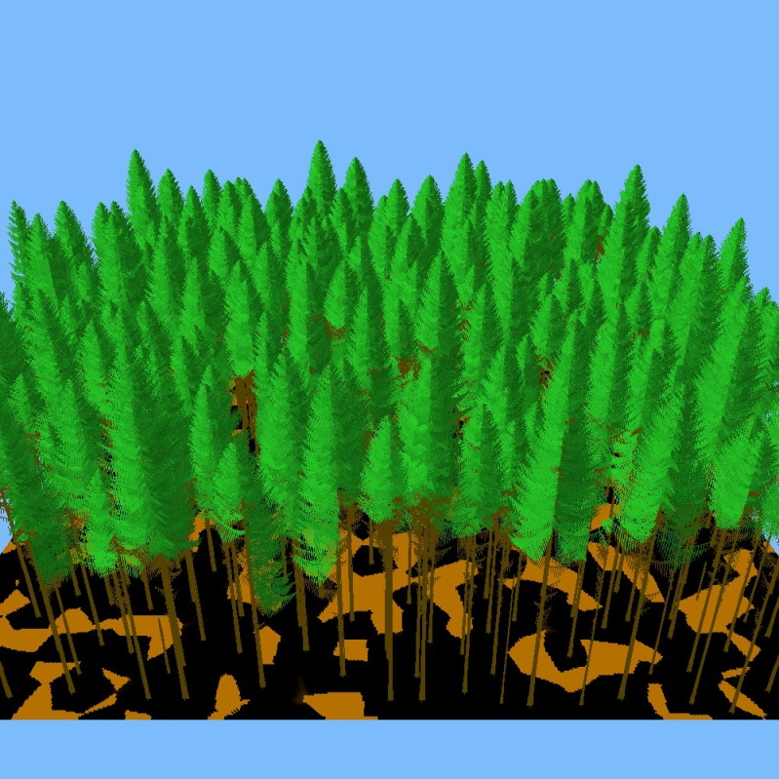
TASS II:
1968 – present
1975 For. Sci. Monograph 17
Three-dimensional crown modelling

Slide 8
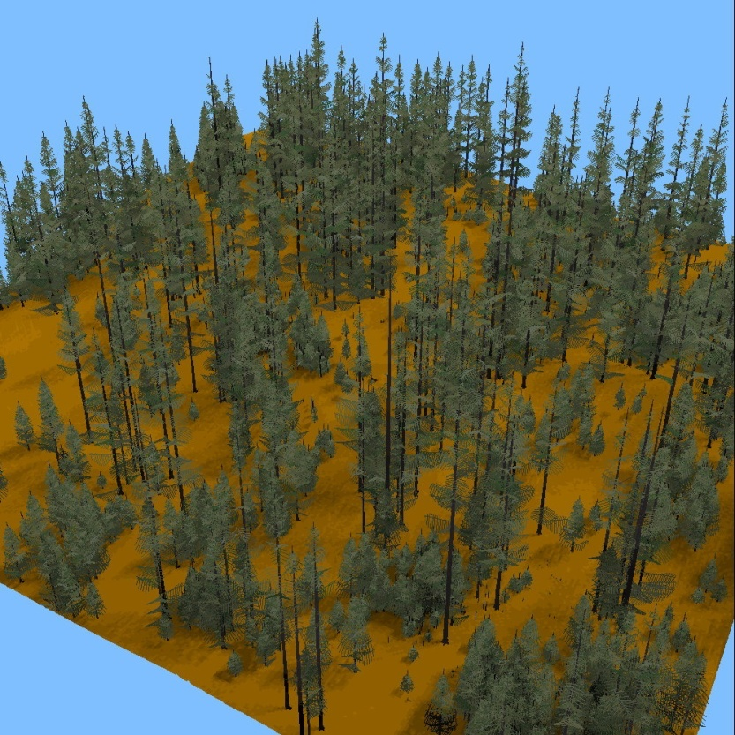
TASS III
1996 – present
Three-dimensional crown modelling and light model (tRAYci)

Slide 9
TASS II Key Components
Height Growth = f(potential, light)
Crown morphology (branch extension)
Competition
Mortality
Ring characteristics
  size, juvenile-mature wood, relative density, strength, cell characteristics

Slide 10
Height Growth
Top height (m)
60
1.0
50
Site trees
40
Average tree
0.8
Low vigor trees
~0.6
30
20
10
0
0
20
40
60
80
100
120
140
160
Total age (years)
Notes:
Site index curves currently define the potential height growth of dominant trees. Each tree is assigned a proportion of height growth with mean of about 0.8 and range between ~0.6 to 1.1.
Trees under severe competition do not achieve their potential

Slide 11
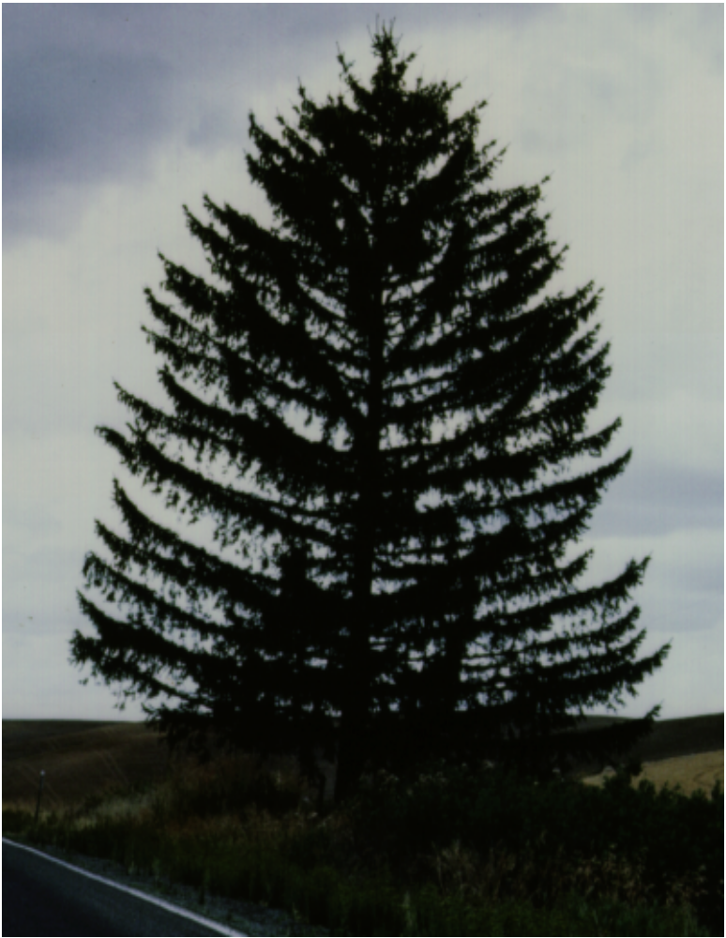
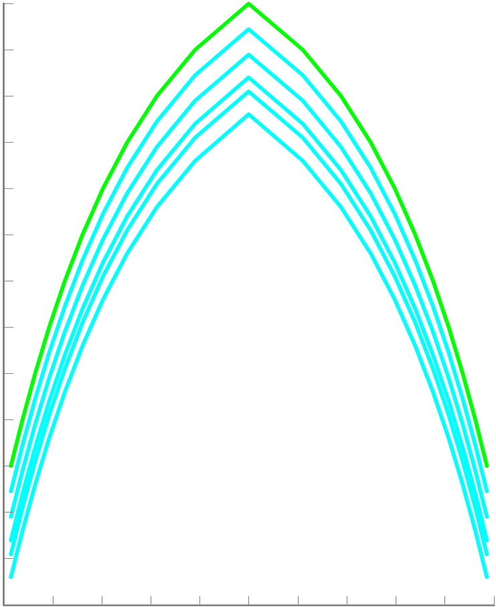
Crown Growth

Slide 12
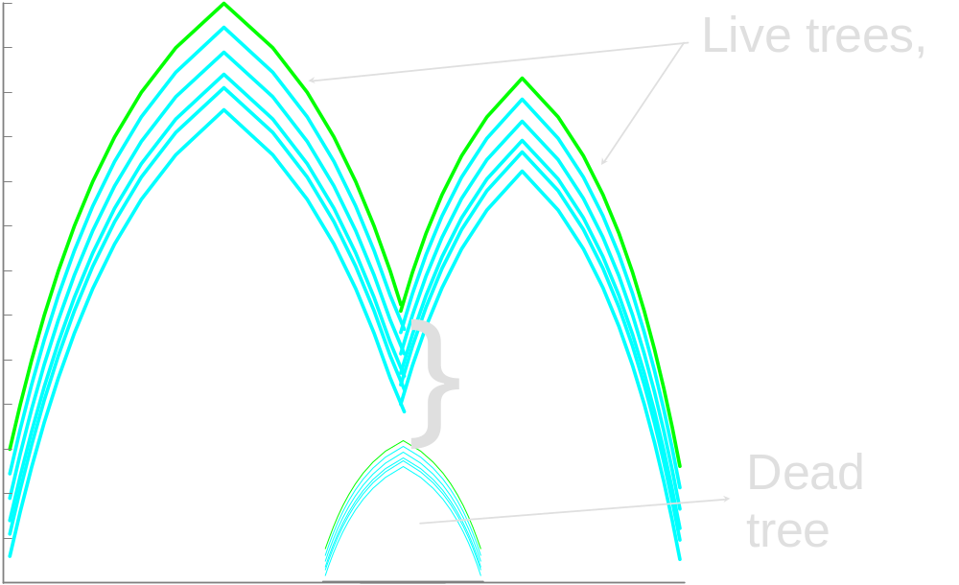
Competition - Mortality

Slide 13
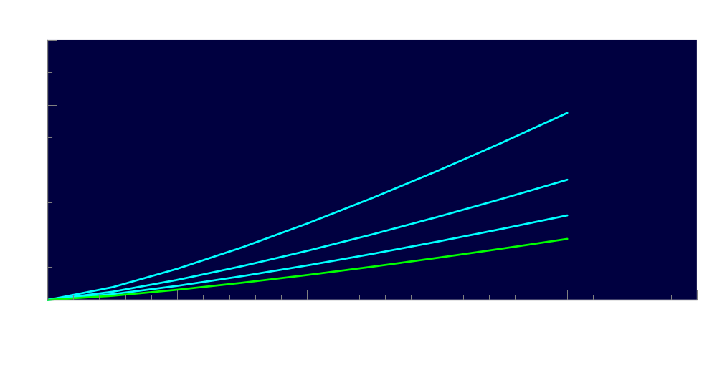
Bole Increment
Suppressed
Open grown
Notes:
The size of a particular crown (FV) determines in large part how much bole increment is added. Depending on species, this relationship differs with social status (vigor). The amount of juvenile, mature and clear wood is maintained for each tree.

Slide 14
Outline
About TASS
TASS I – II – III history
TASS III modifications
  tRAYci light model
  Crown profiles
  Crown competition
  Mortality
TASS Graphical User Interface
PLOTSY

Slide 15
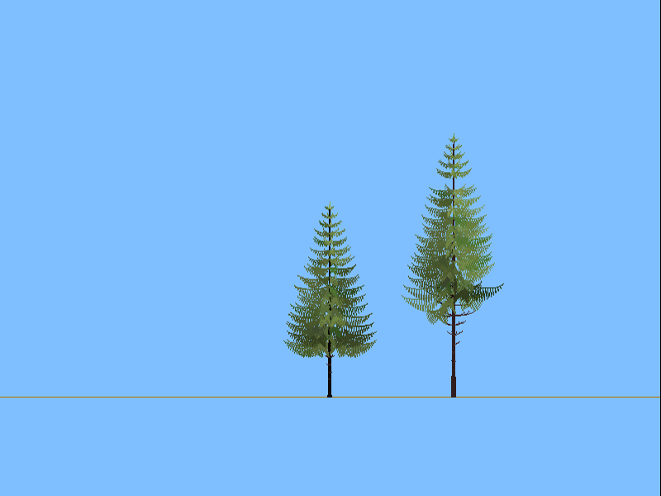
tRAYci light model
(Brunner, 1998)
North South

Slide 16
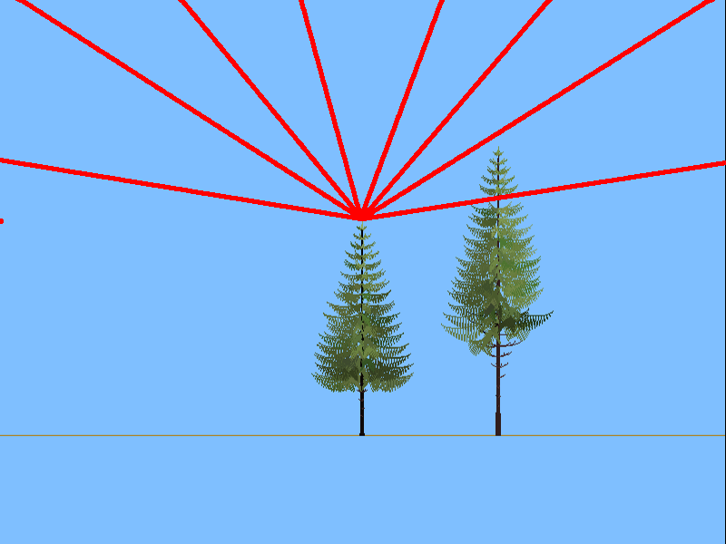
tRAYci light model
(Brunner, 1998)
Beam me up,
Scottie
Intersection
Max 32,400 beams (1º)
We typically use 48
(15º zenith, 45º azimuth)
North South

Slide 17
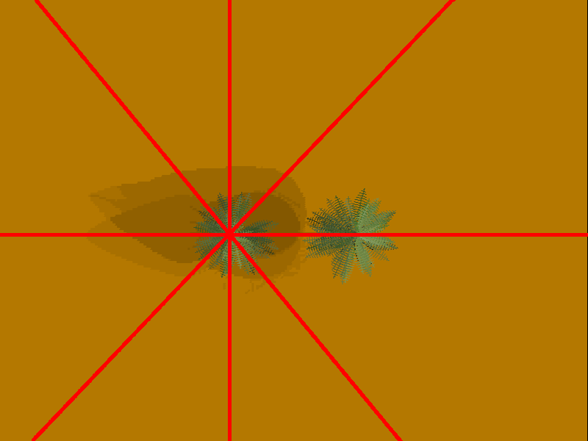
tRAYci light model
(Brunner, 1998)
North South

Slide 18
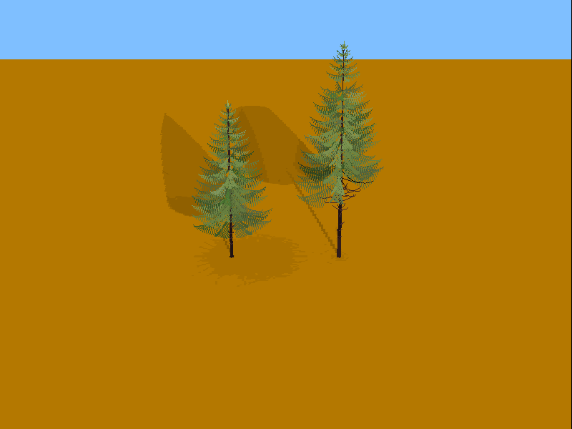
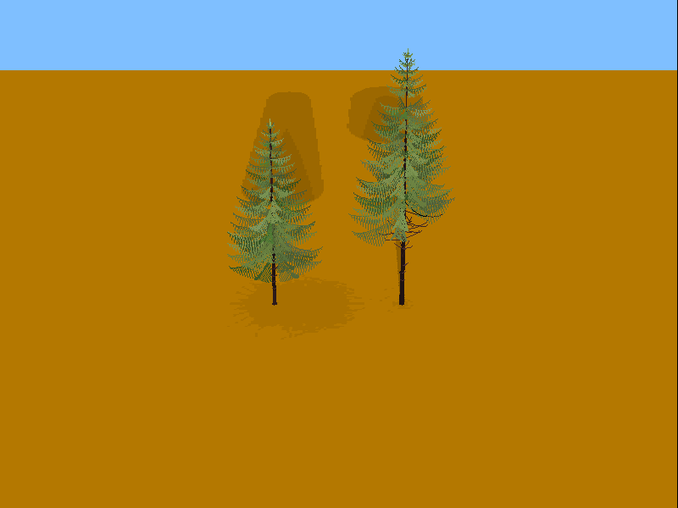
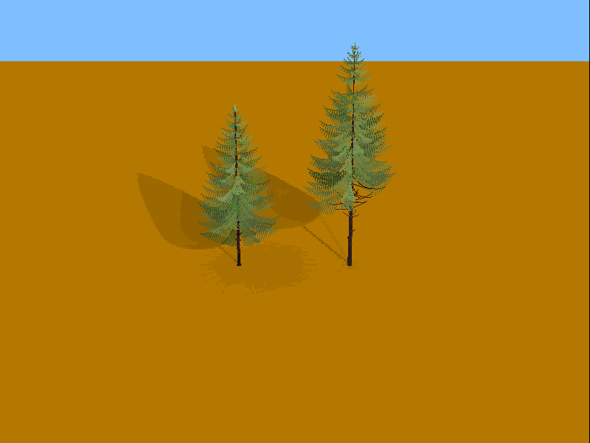
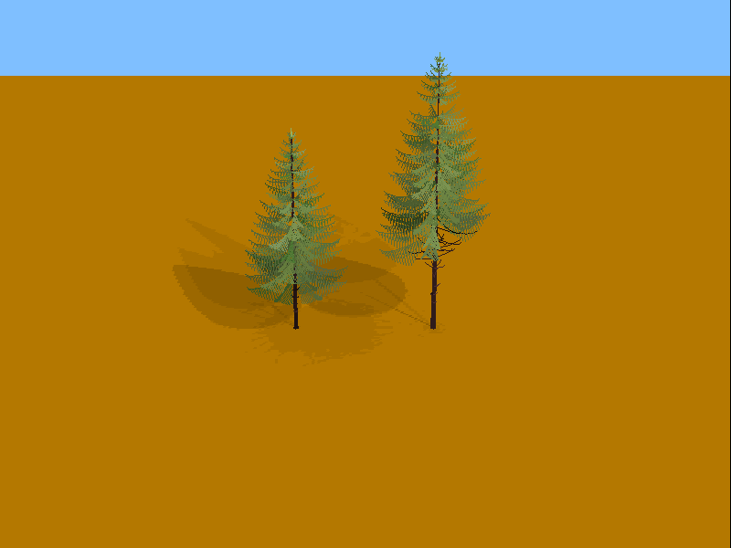
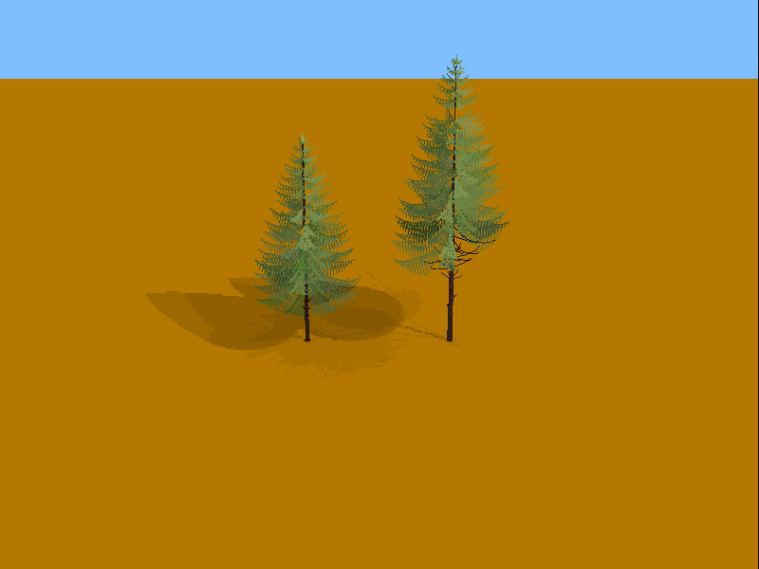
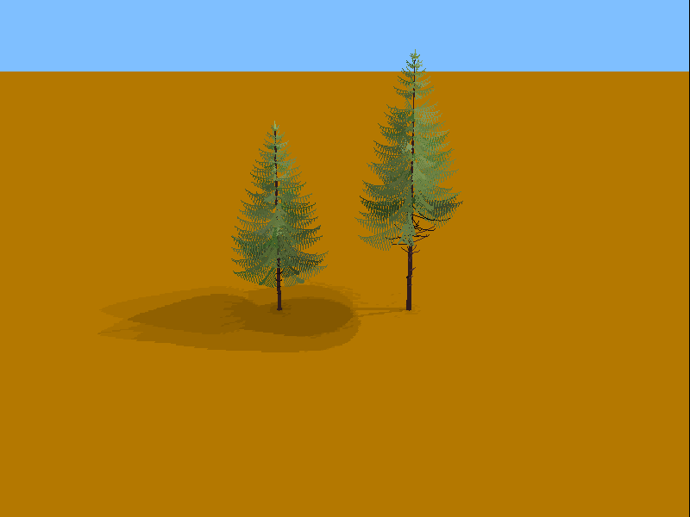
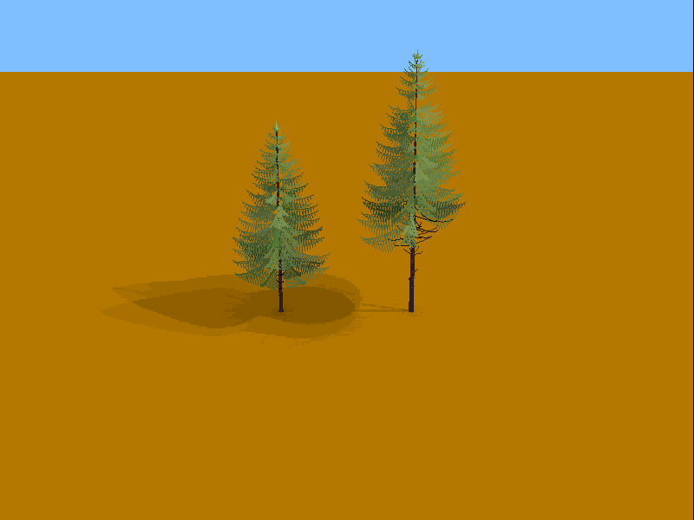
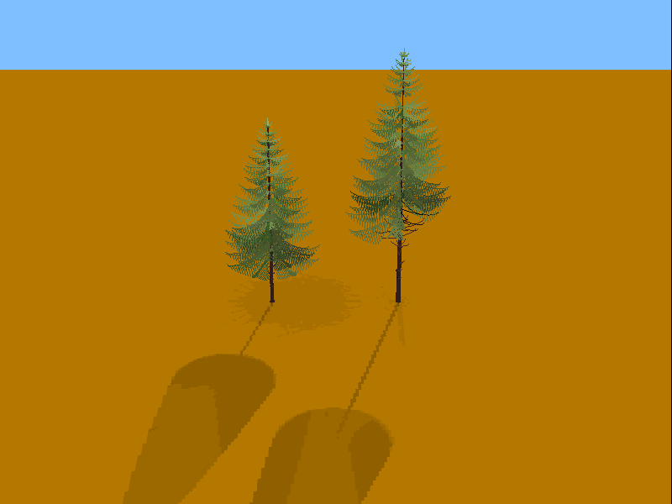
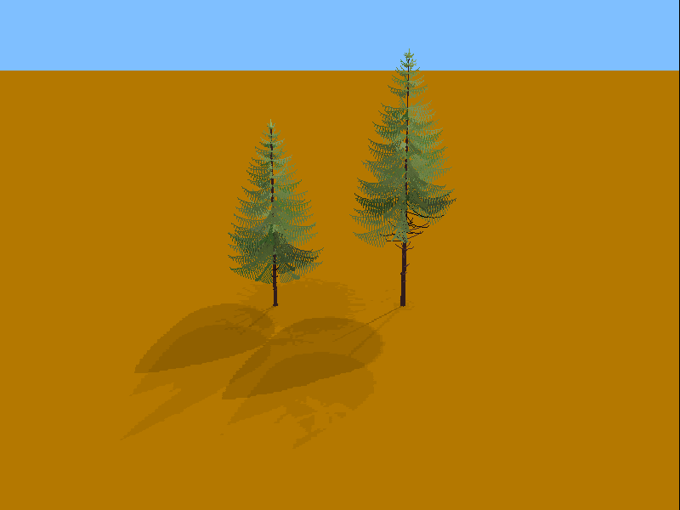
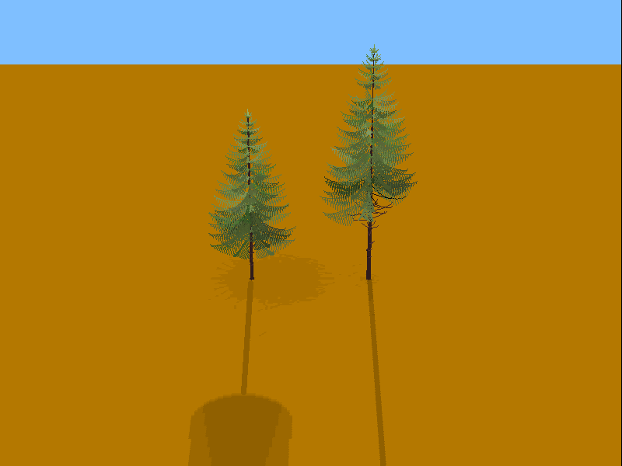
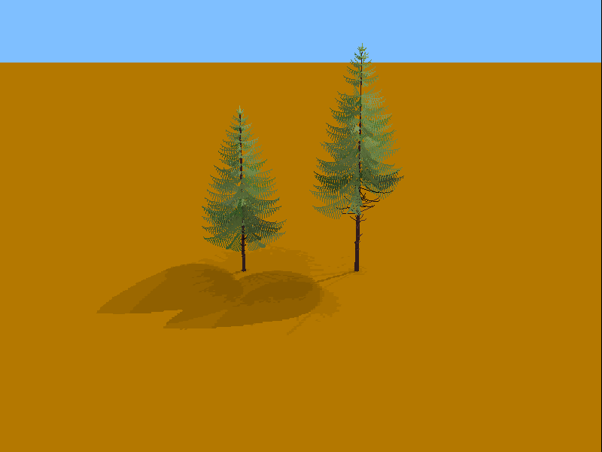
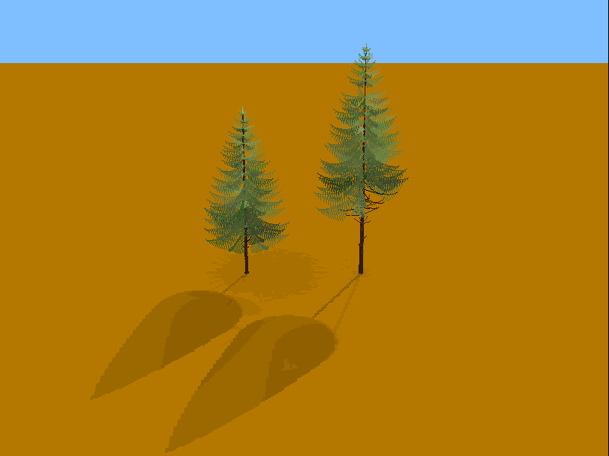
tRAYci light model
(Brunner, 1998)
April 7, 2010: 5:00pm
April 7, 2010: 4:00pm
April 7, 2010: 3:00pm
April 7, 2010: 6:00pm
April 7, 2010: 7:00am
April 7, 2010: 8:00am
April 7, 2010: 9:00am
April 7, 2010: 10:00am
April 7, 2010: 11:00am
April 7, 2010: 12:00am
April 7, 2010: 1:00pm
April 7, 2010: 2:00pm
North South
Latitude 50º N

Slide 19
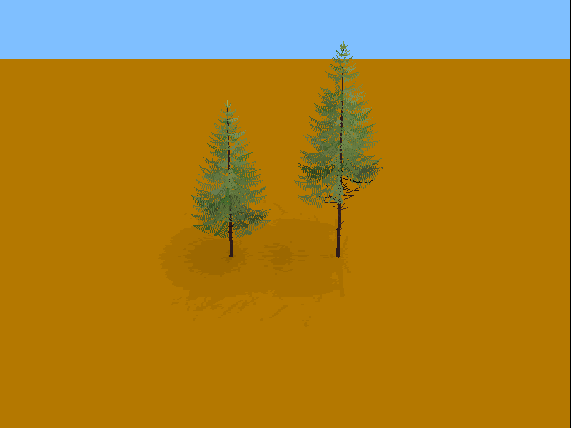
tRAYci light model
(Brunner, 1998)
2010
North South
Latitude 50º N

Slide 20
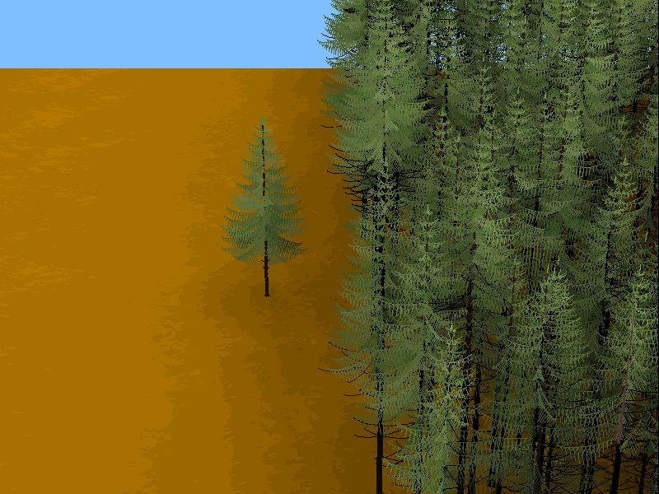
tRAYci light model
(Brunner, 1998)
PACL=0.86
PACL=0.42
North South
Latitude 50º N

Slide 21
Relative height growth
P_{m}

Slide 22
Outline
About TASS
TASS I – II – III history
TASS III modifications
  tRAYci light model
  Crown profiles
  Crown competition
  Mortality
TASS Graphical User Interface
PLOTSY

Slide 23
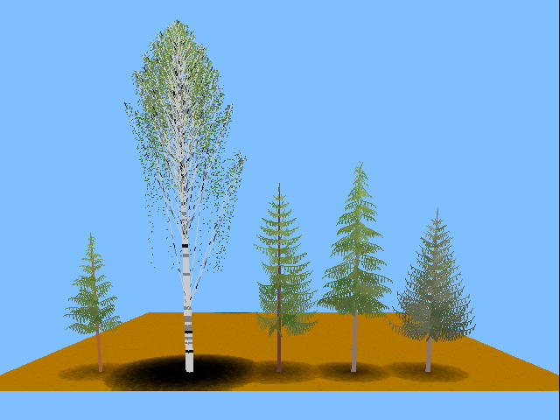
Crown Profiles
Red alder
Western
Hemlock
Douglas-fir
Sitka
spruce
western
redcedar
Crown area
Coastal species

Slide 24
TASS II:
L_{H}
B_{H}
L_{L}
B_{V}
B_{C}
B_{L}
branch
tree bole

Slide 25
TASS III:
L_{H}
Four major changes:
  Used all data (600+ trees)
  Mixed effects model.
  Predict horizontal extension rather than B_{L}
  Solved b₂ to minimize the difference between measured and predicted crown area
B_{H}
L_{L}
B_{V}
B_{C}
B_{L}
branch
tree bole

Slide 26
Crown profile samples
Species | No. trees | No Branches
 |  | Radius | Total
Hwc | 154 | 1619 | 8307
Fdc | 150 | 1302 | 3751
Ba | 63 | 510 | 1121
Ss | 96 | 504 | 2006
Si | 60 | 863 | 2763
Pl | 115 | 1106 | 1761
Total: | 638 | 5904 | 19709

Slide 27
Hwc – TASS II
Pl – TASS II

Slide 28
Hwc – TASS II
Hwc – TASS III
Pl – TASS II
Pl – TASS III

Slide 29
Outline
About TASS
TASS I – II – III history
TASS III modifications
  tRAYci light model
  Crown profiles
  Crown competition
  Mortality
TASS Graphical User Interface
PLOTSY

Slide 30
Crown - columns of growing space
TASS II
TASS III
Allows only one live canopy
layer per grid column – Overtopped canopy layers die
Supports multiple live canopy
layers per grid column - Light governs understory growth and mortality

Slide 31
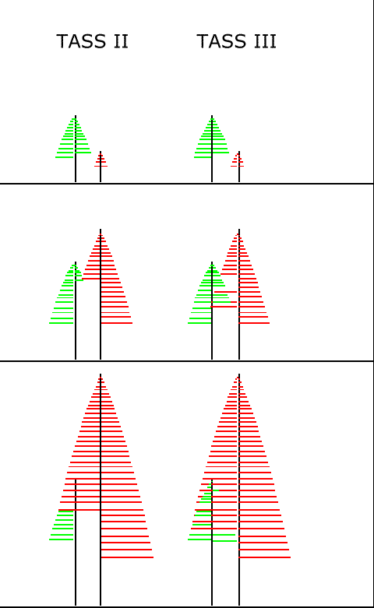
Crown - Competition
Age 30
Age 50
Age 80

Slide 32
Outline
About TASS
TASS I – II – III history
TASS III modifications
  tRAYci light model
  Crown profiles
  Crown competition
  Mortality (our nemesis, the Borg)
TASS Graphical User Interface
PLOTSY

Slide 33
Mortality steps
Collected all stem-mapped PSPs
Input tree list and x-y coordinates into TASS
Estimated the PACL of each tree at each measurement
Used this derived PACL and other variables to predict the probability of death (or survival).
Tried several approaches but now,

Slide 34
Classification And Regression Trees (CART)
Classification for categorical variables (i.e. live or dead) or Regression for continuous variables
Random forests is the most well known software
While similar in concept to principle components analysis (which creates linear combinations of variables), this routine is non-paramentric (no assumptions necessary about the underlying distribution) and uses if-then-else logic.
Results are fairly straightforward to interpret, however, the algorithms are very complex
Need to decide:
  The criteria for predictive accuracy
  When to stop splitting
  What is the "right-sized" tree (i.e., over fitting can be a problem)

Slide 35
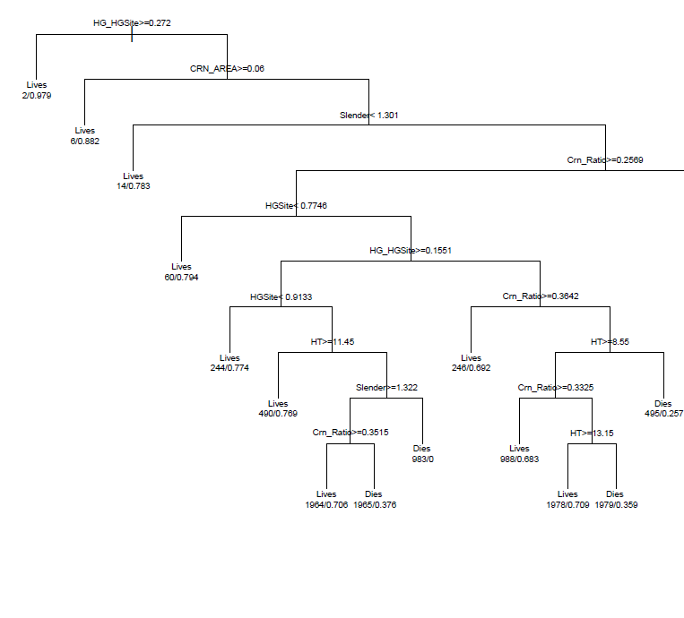
Classification And Regression Trees (CART)
Leaf Label is node number and probability of survival
Lives/Dies label is simply based on probability of survival:
e.g., at node 2
< =0.979 → Lives
< 0.070 → Dies
Individuals will live or die based on probabilities and random draws, not the Lives/Dies label.
Moving through the Tree
- If the test statement is True, go left

Slide 36
Simple Tree
HG_HGSite >= 0.65
1
2
CrnRatio < 0.15
PACL >= 0.25
3
4
5
6
7
P(s) = 0.225
P(s) = 0.985
P(s) = 0.835
P(s) = 0.10
We have coded in the CART mortality algorithm for testing purposes. When satisfied that it is working “correctly” (i.e., passes test of reasonableness), then we use the information (e.g., variables, interactions) to conduct logistic regression.....

Slide 37
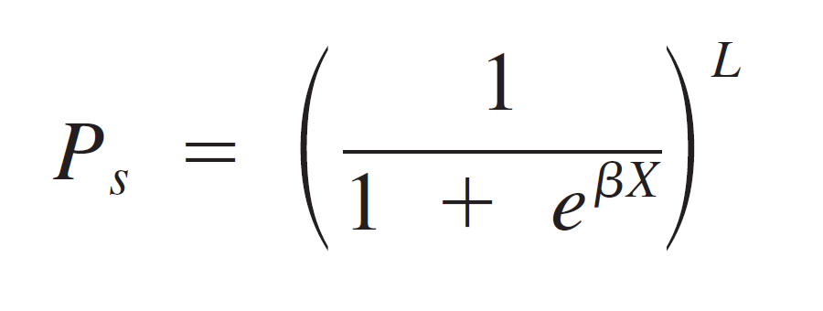
Logistic Regression
- generic tool for fitting a dichotomous dependent variable (e.g. Live-Dead) to categorical and continuous independent variables .
βX = b₀ + b₁C₁ + b₂C₂ … + b_{n}C_{n}+ b₁₂C₁C₂ + … + b_{nm}C_{n}C_{m}
with individual covariates (C_{i}) and possible interaction terms that are selected in part from the CART results.

Slide 38
Outline
About TASS
TASS I – II – III history
TASS III modifications
  tRAYci light model
  Crown profiles
  Crown competition
  Mortality
TASS Graphical User Interface (the holodeck)
PLOTSY

Slide 39
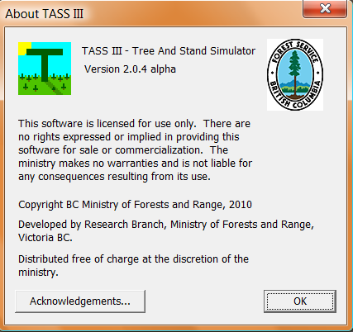
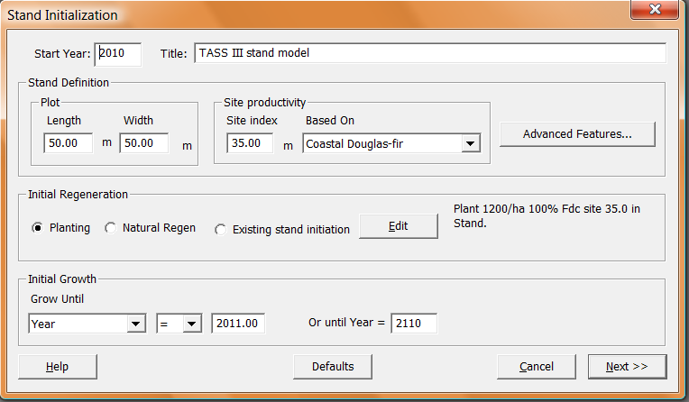
TASS Graphical User Interface
(the holodeck)

Slide 40
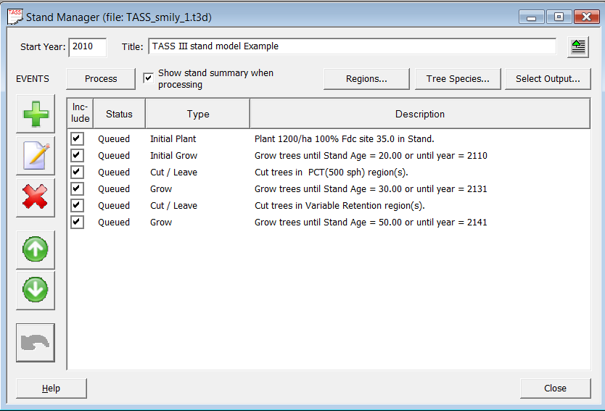

Slide 41
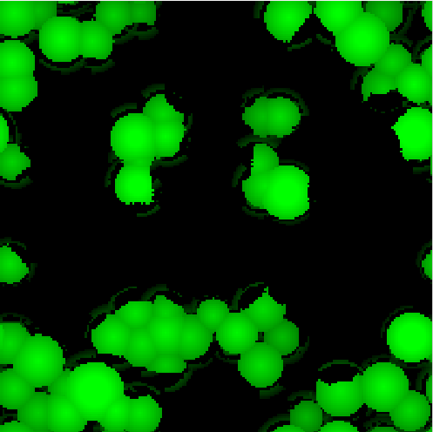
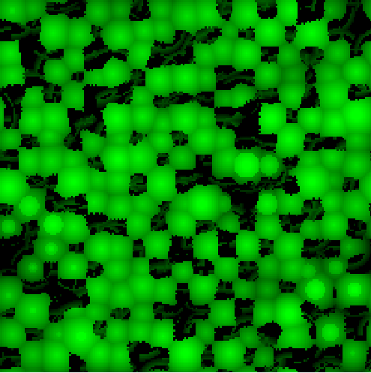
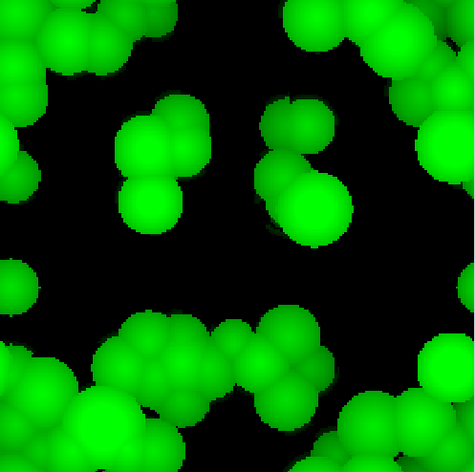

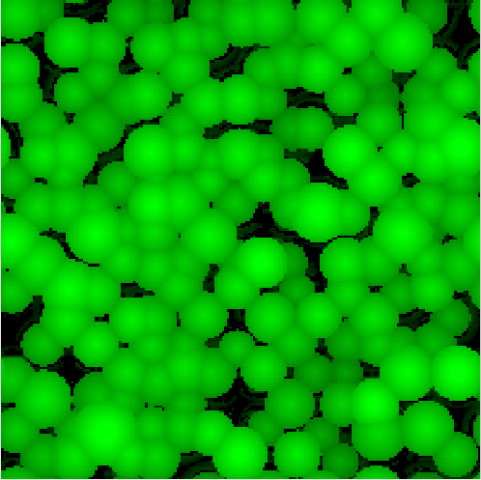
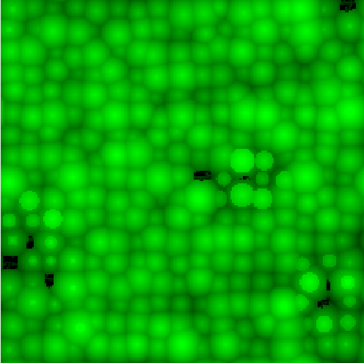
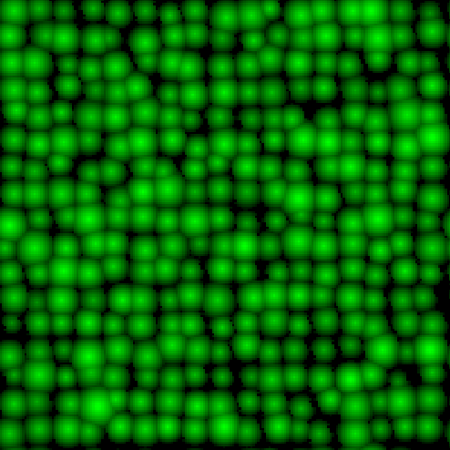
Age 30 VR 400 sph
Age 50
Age 20 PCT 500 sph
Age 5
Age 30
Age 20
Age 10

Slide 42
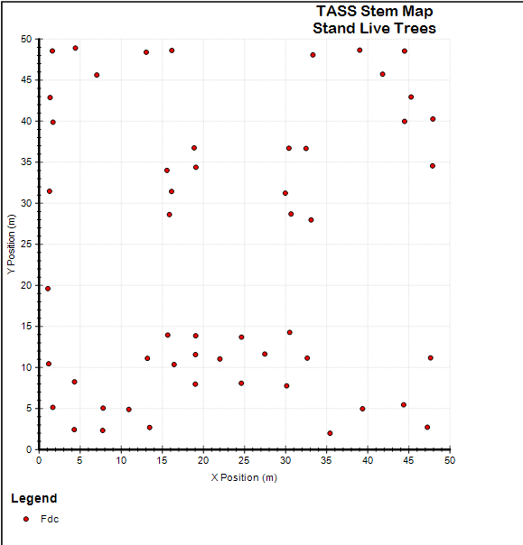

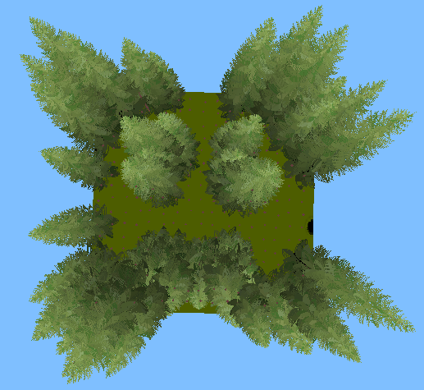


Slide 43
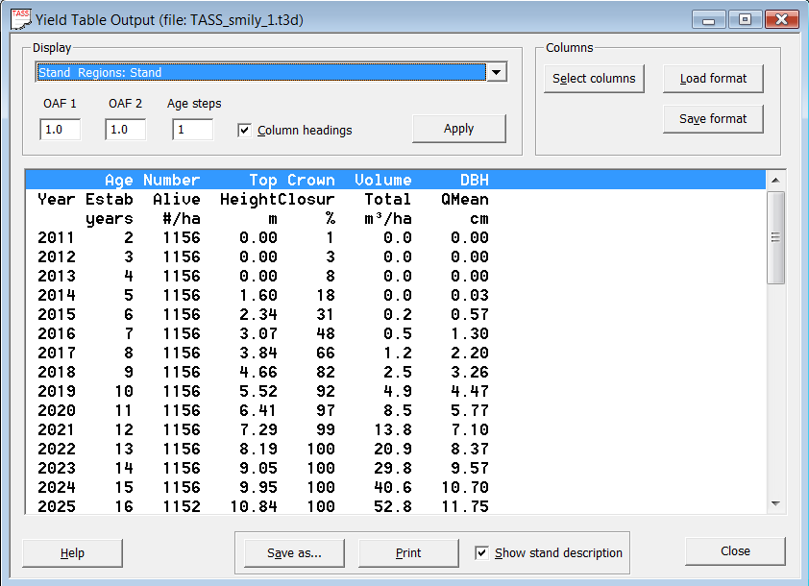
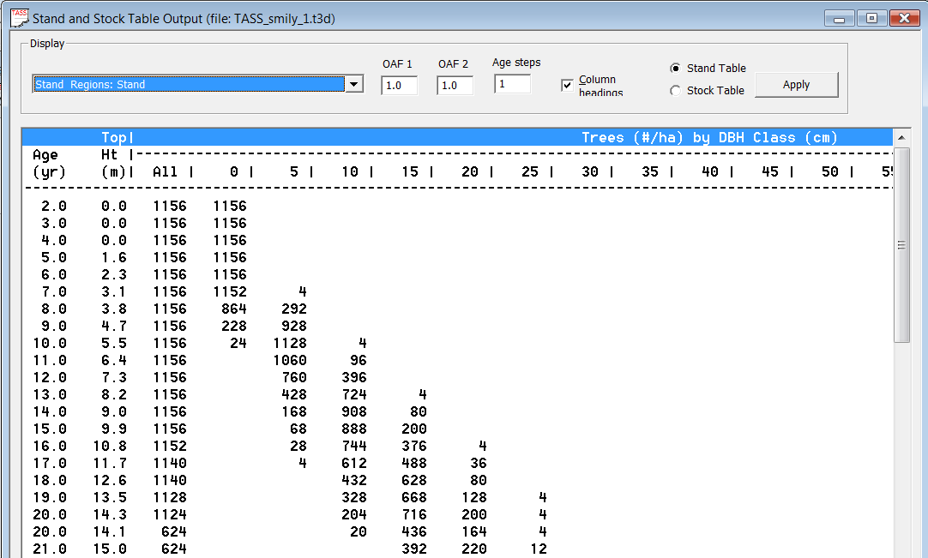
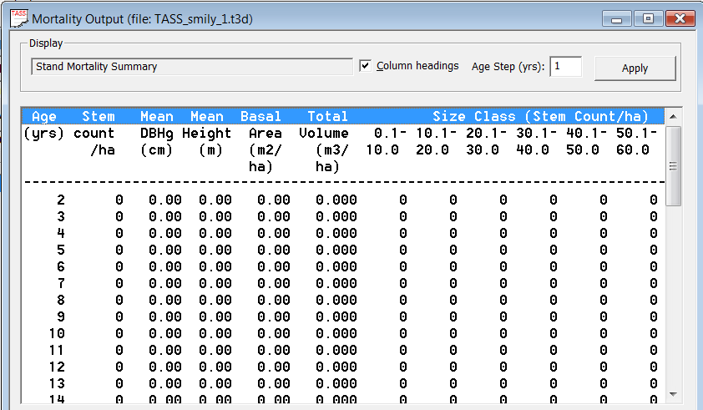
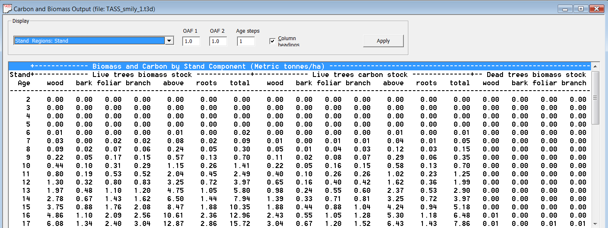
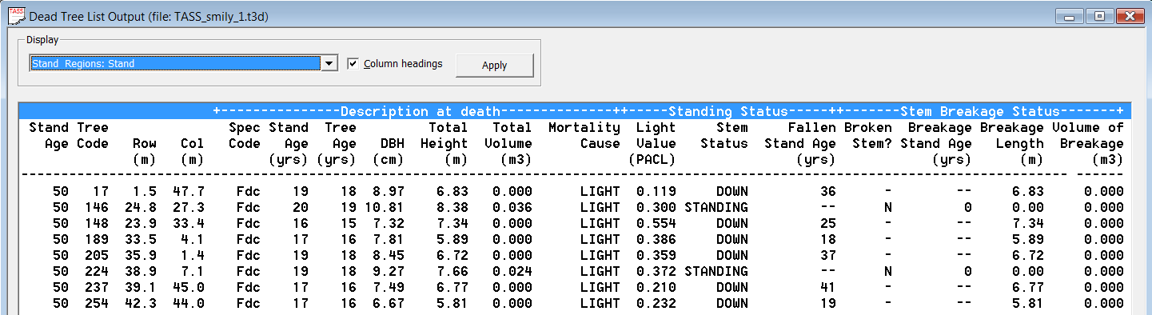
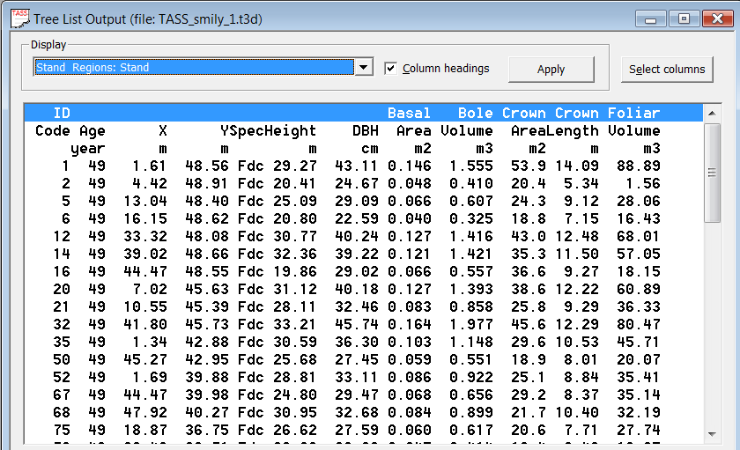

Slide 44
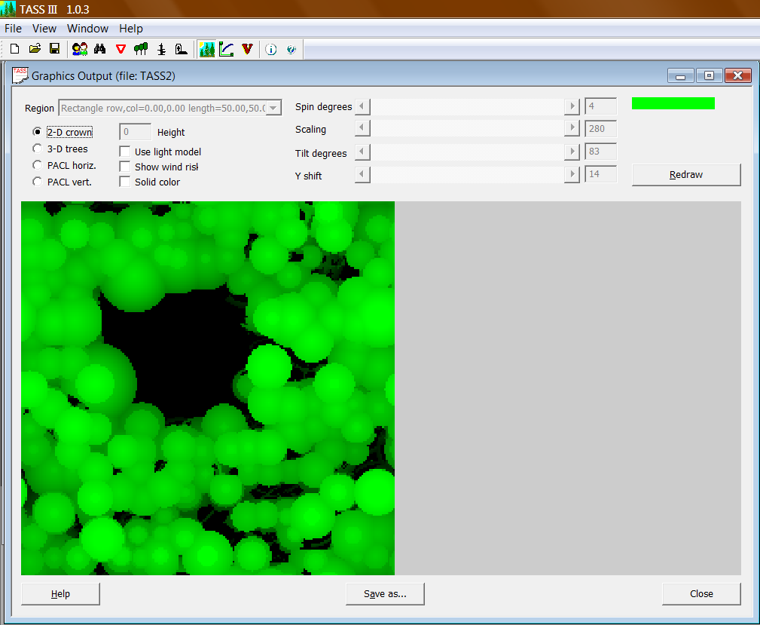
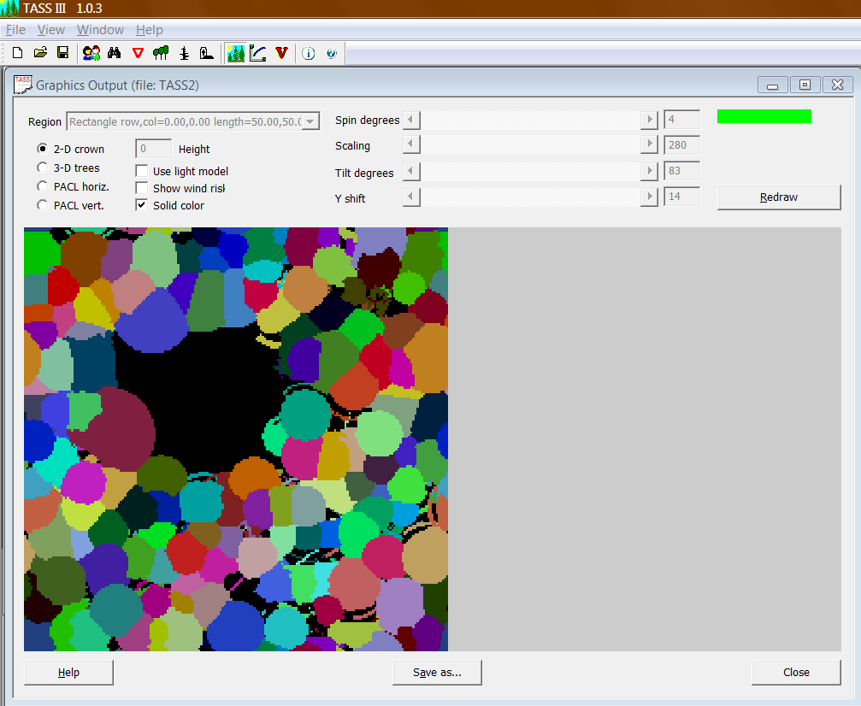

Slide 45



Slide 46



Slide 47
Outline
About TASS
TASS I – II – III history
TASS III modifications
  tRAYci light model
  Crown profiles
  Crown competition
  Mortality
TASS Graphical User Interface
PLOTSY

Slide 48


Slide 49


Slide 50

Merch Volume & Juvenile Wood Volume
Merch Volume
PCT
Control
+23 m³/ha
JW Volume
PCT
+27 m³/ha
Control

Slide 51
TASS III
Underlying philosophy unchanged:
Advancing the prediction of stand growth and yield by focusing on the spatial dynamics of individual tree crowns, the biological engine of tree growth.
TASS is a framework for synthesis of world-wide research on tree growth and stand development, with a focus on treatment response.

Slide 52

Thank you for your attention

