Slide 1
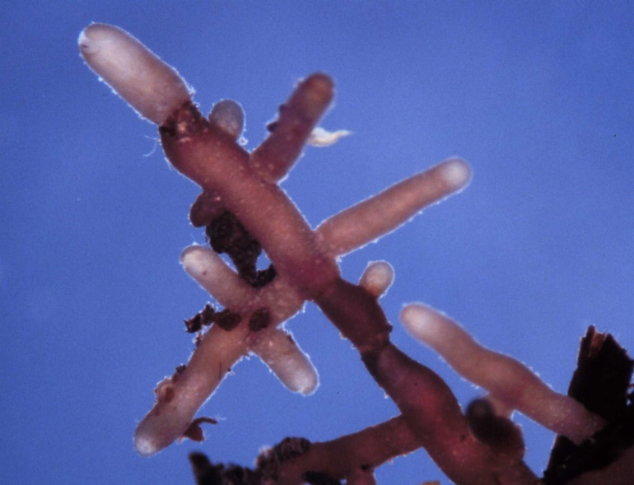
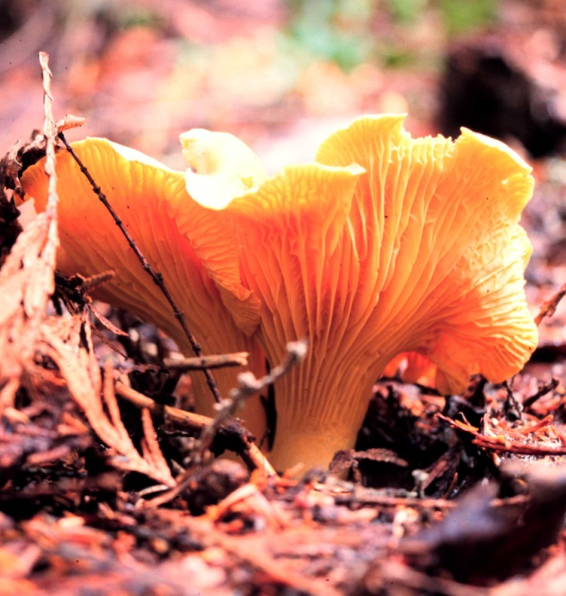
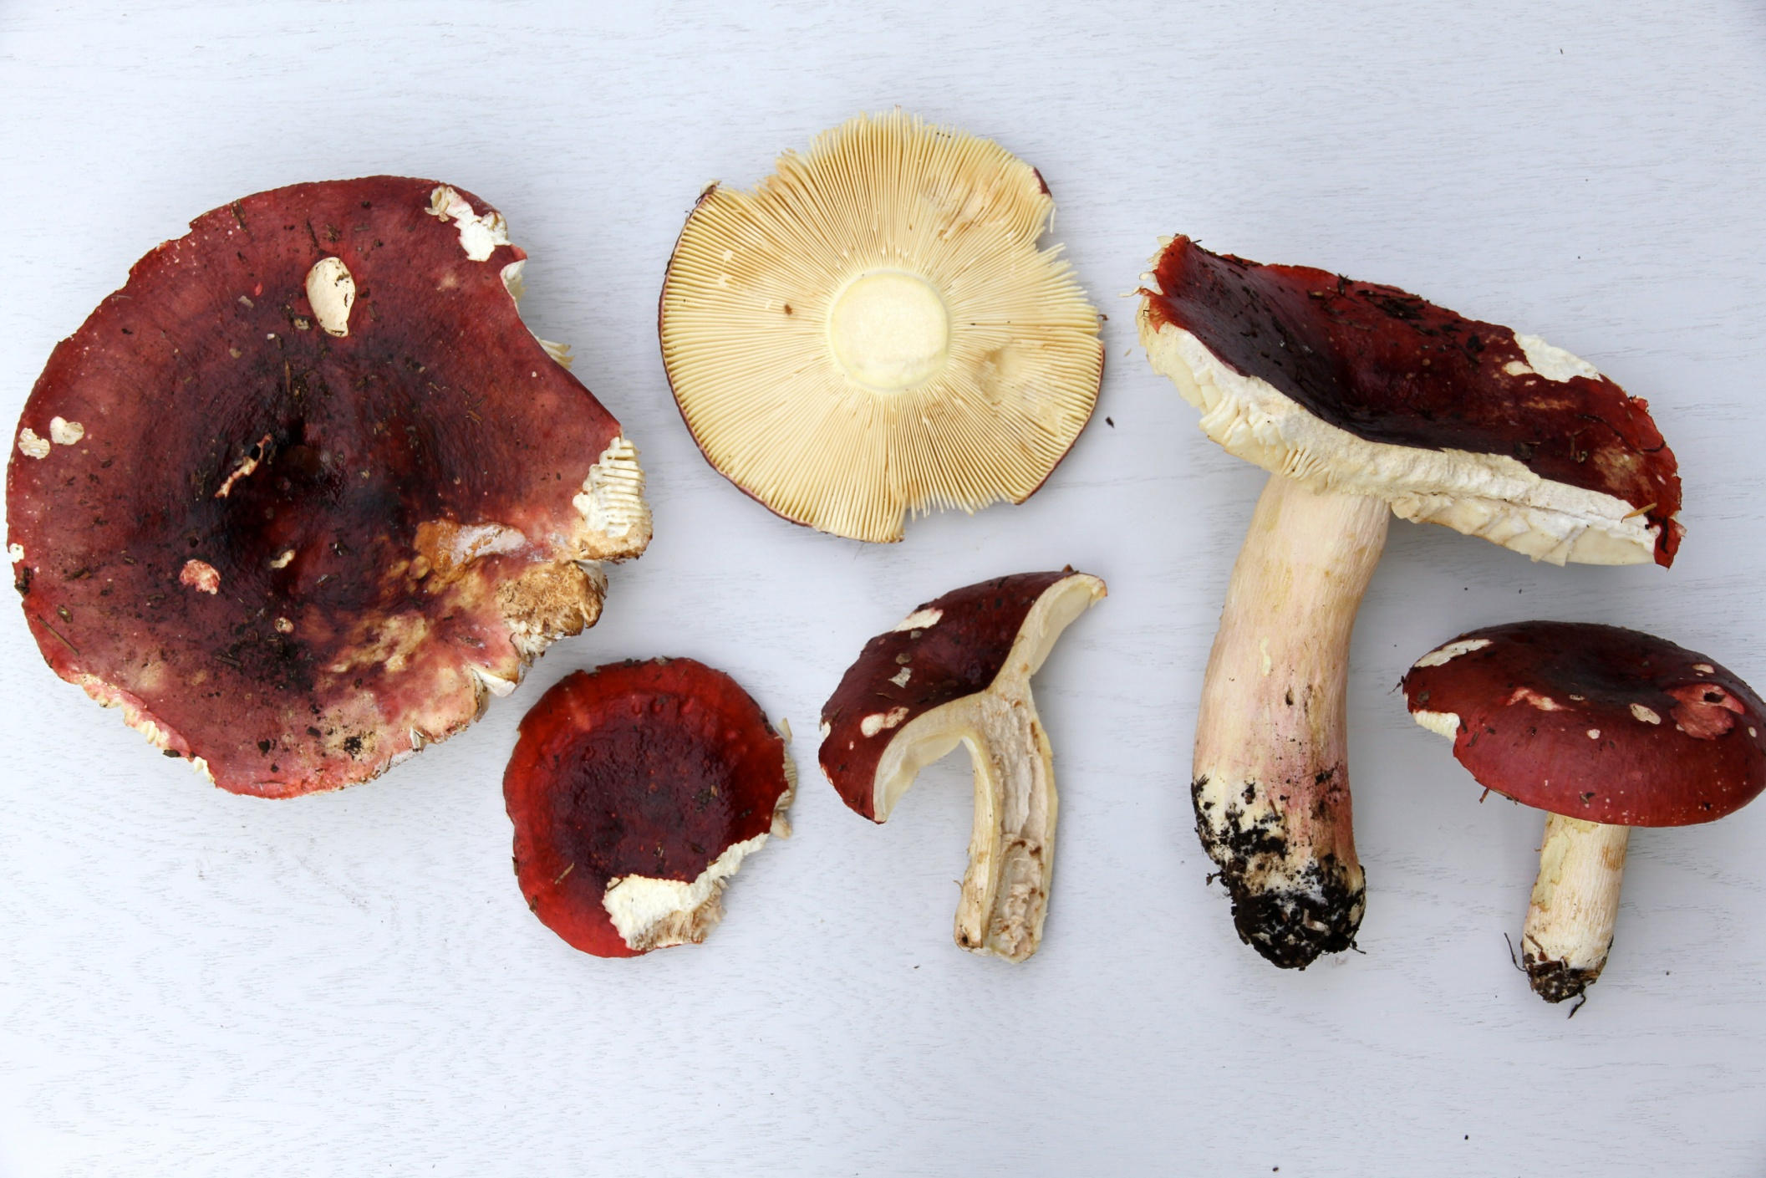
Coevolution of ectomycorrhizal fungal communities with local populations of Douglas-fir and implications for assisted migration
JM Kranabetter
Coast Region

Slide 2
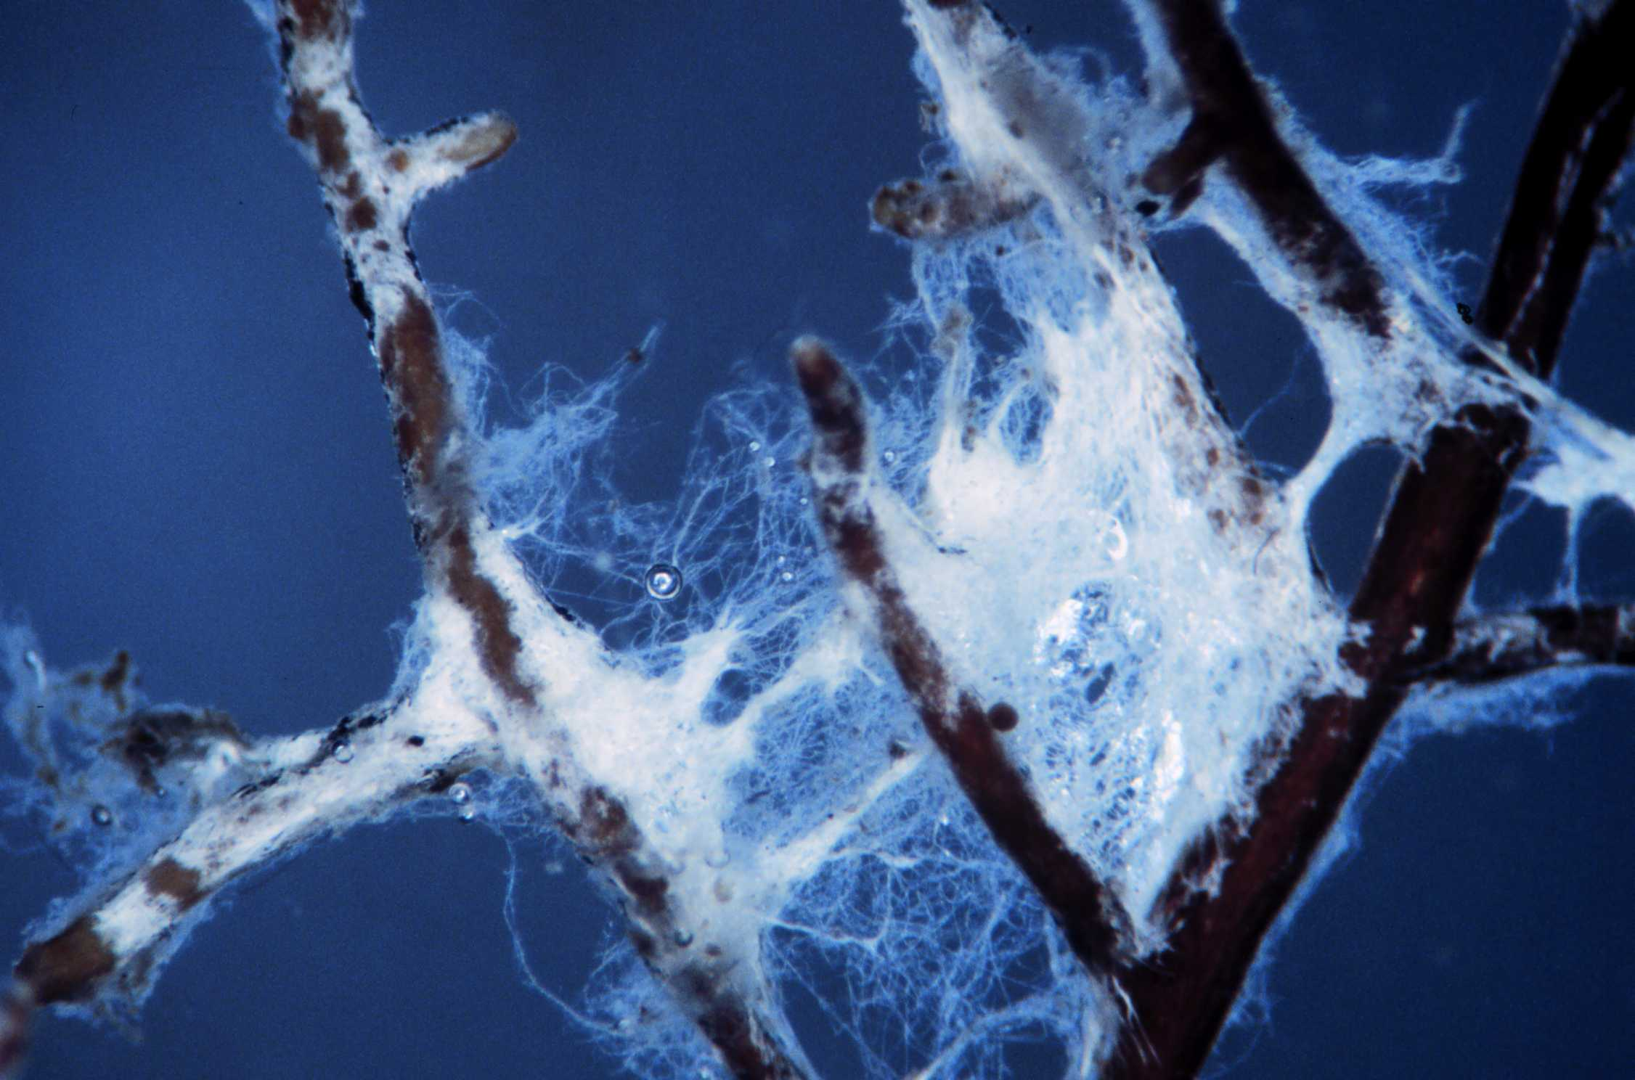
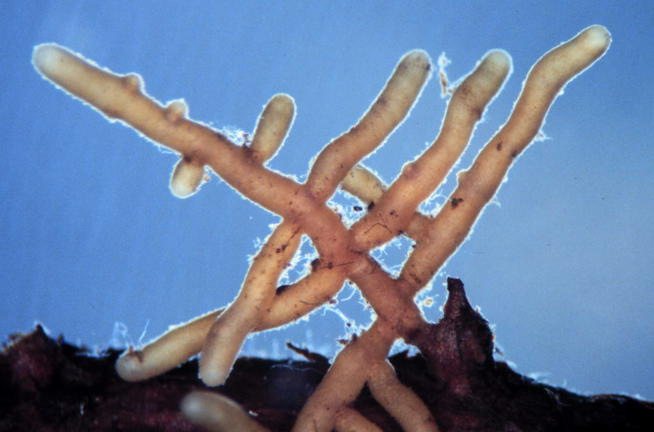
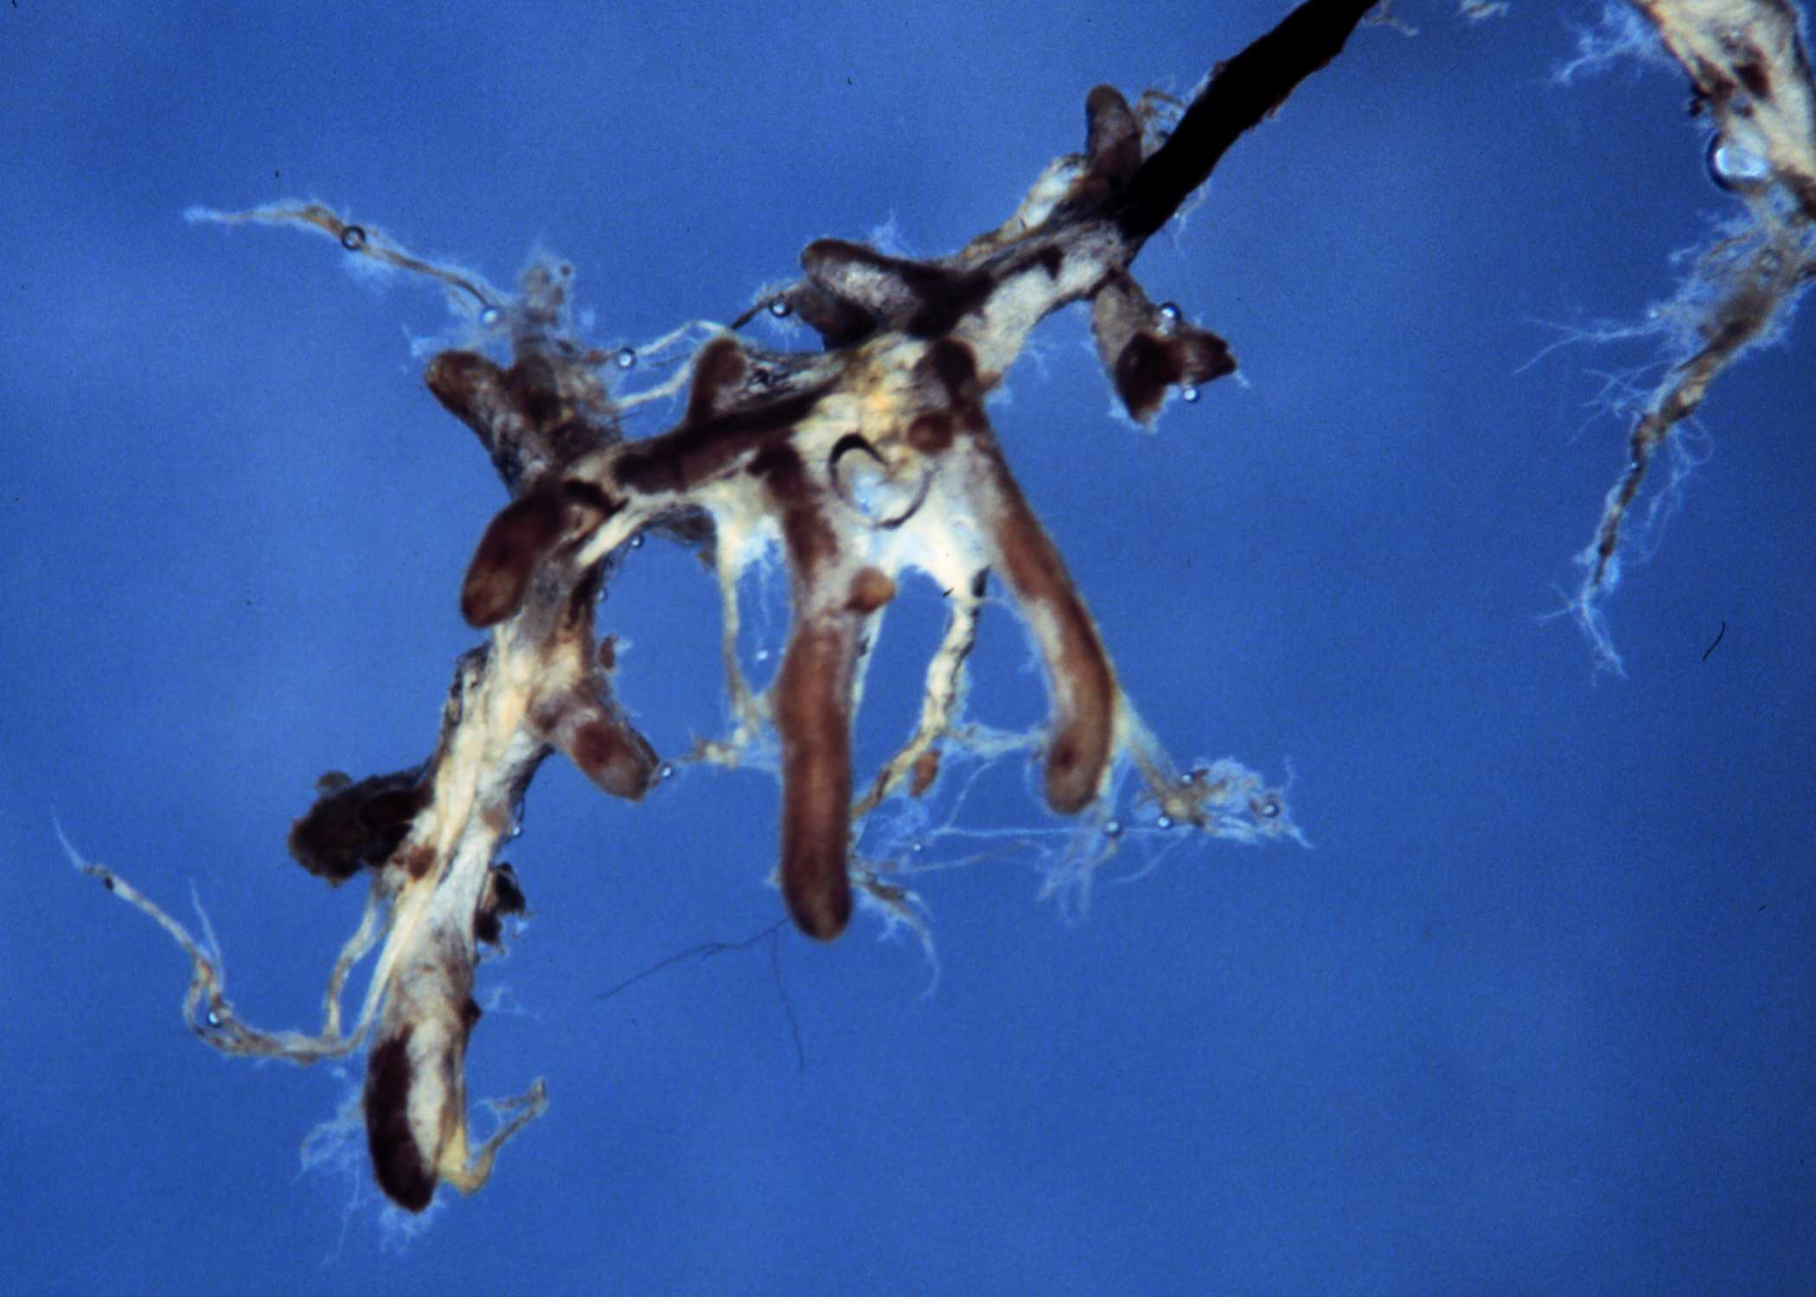
1. How important is community genetics in regards to
ectomycorrhizal fungi and the assisted migration of
trees?
2. Is it possible to have a maladapted ectomycorrhizal
fungal community?

Slide 3
~25 species of EMF fungi on a single mature tree (?), completely regulating soil-root interface
Not just an individual tree, but a symbiotic species collective

Slide 4
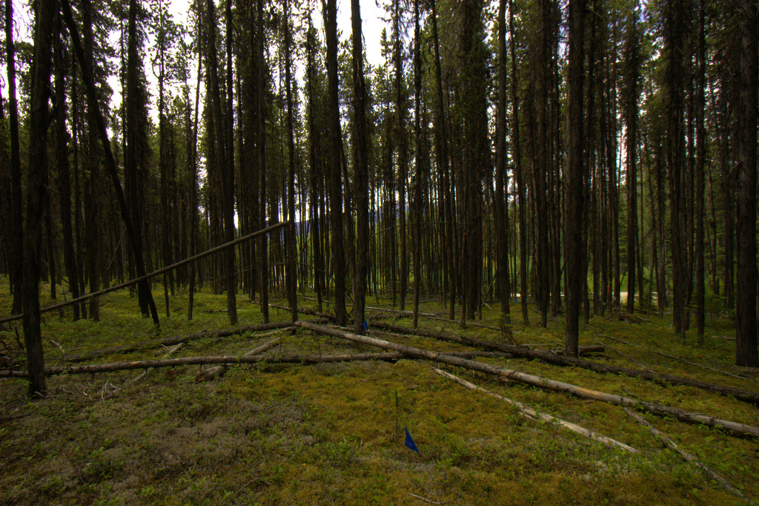
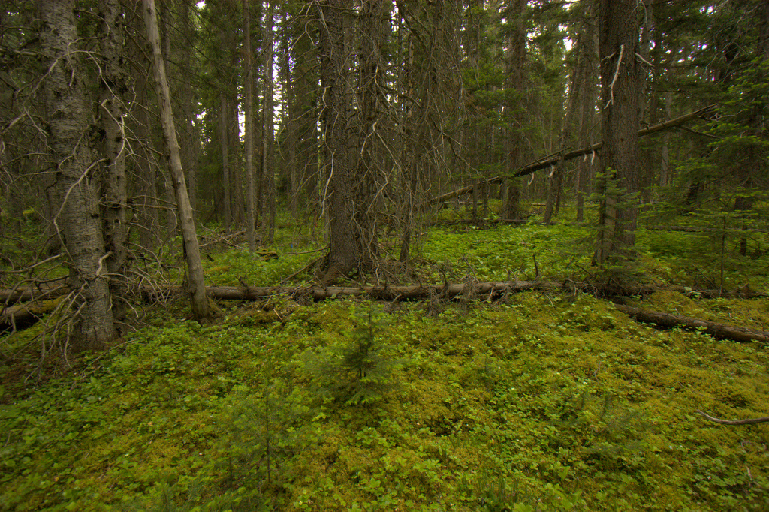
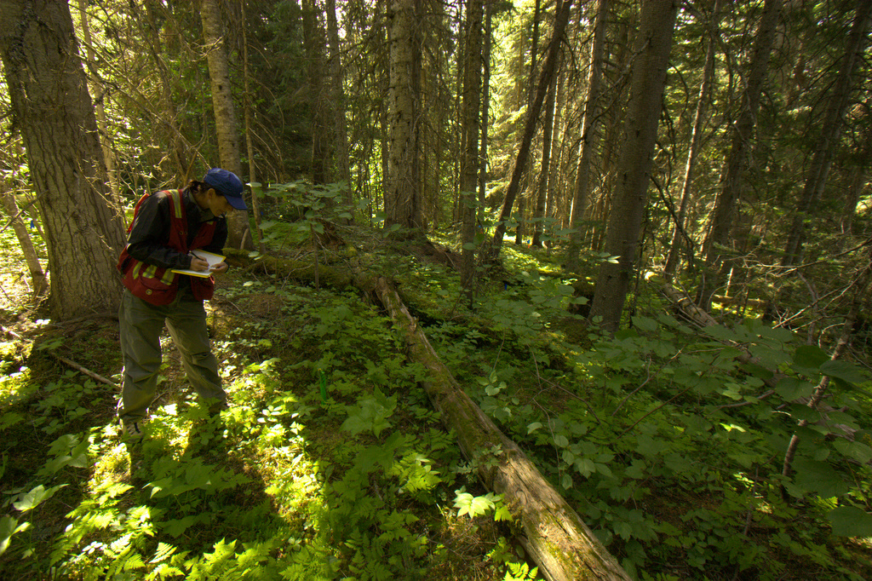
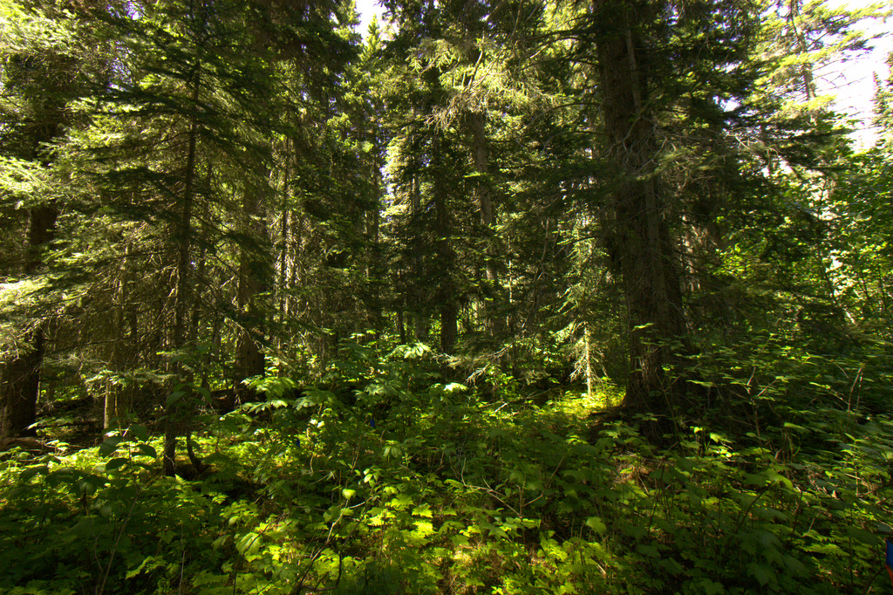
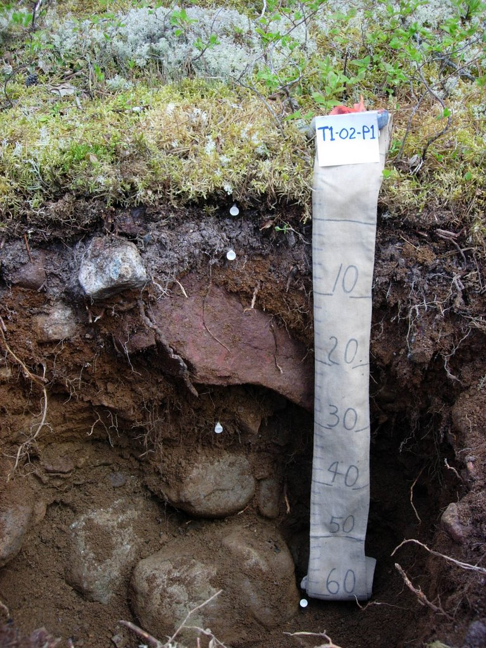
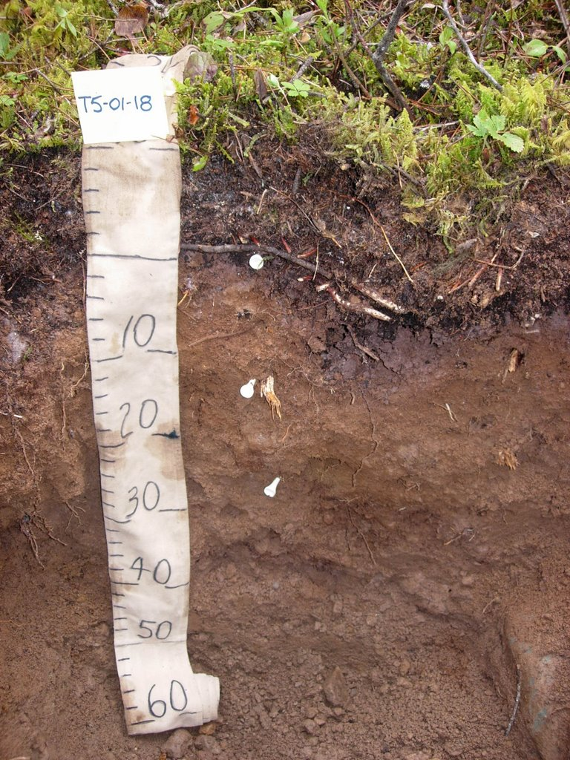
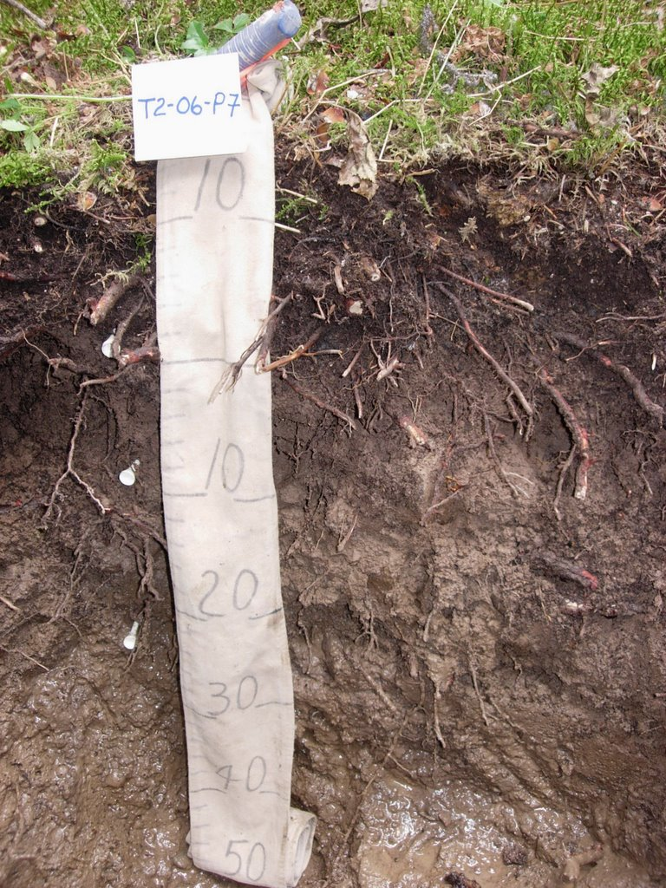
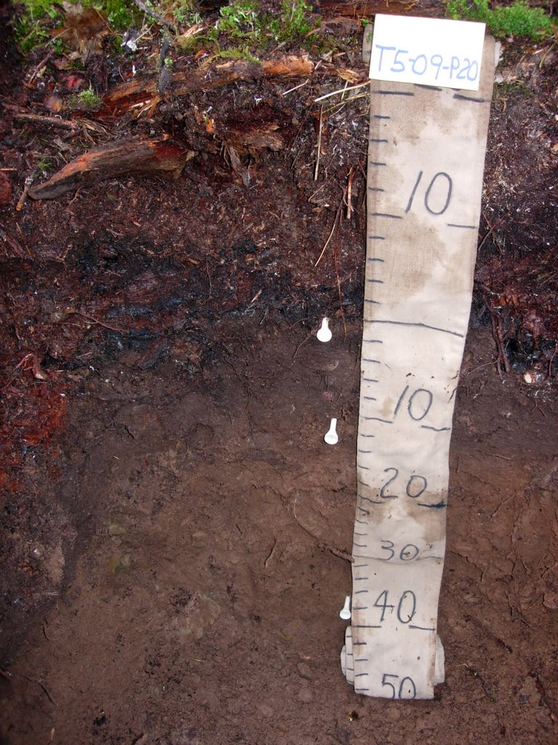
Soil fertility

Slide 5
Functional differences in type of nitrogen, as well as available moisture, pH, exch cations etc.

Slide 6
Ordination of EMF communities across site fertility gradients
Poor - Cladonia
Medium - Huckleberry
Rich - Oakfern
Very rich – Devil’s club
Rank
Well defined, site-adapted fungal communities, responding to resource availability and stress tolerance
Axis 1
Composed of generalist, tolerant, specialist and rare EMF species
Approx. 100 spp. per plot, ~ 15, 25, 25, 35 respectively in this SBS landscape
Mycorrhiza 19: 99-111 and Mycorrhiza 19: 535-548

Slide 7
3 tree species, 200+ fungal species;
‘Soil is the poor man’s rainforest’
Soil fertility
Notes:
a quarter square kilometer (62 acres) of Ecuadorian rainforest supports more than 1,100 tree species

Slide 8
How would a maladapted EMF community affect forest fitness?
Soil fertility

Slide 9
Genetic
(vertical)
selection
Environmental (horizontal) selection
Tree populations coevolve with EMF fungal populations; these relationships are inherited to some degree and are defined by localized selection pressures across geographic locations

Slide 10
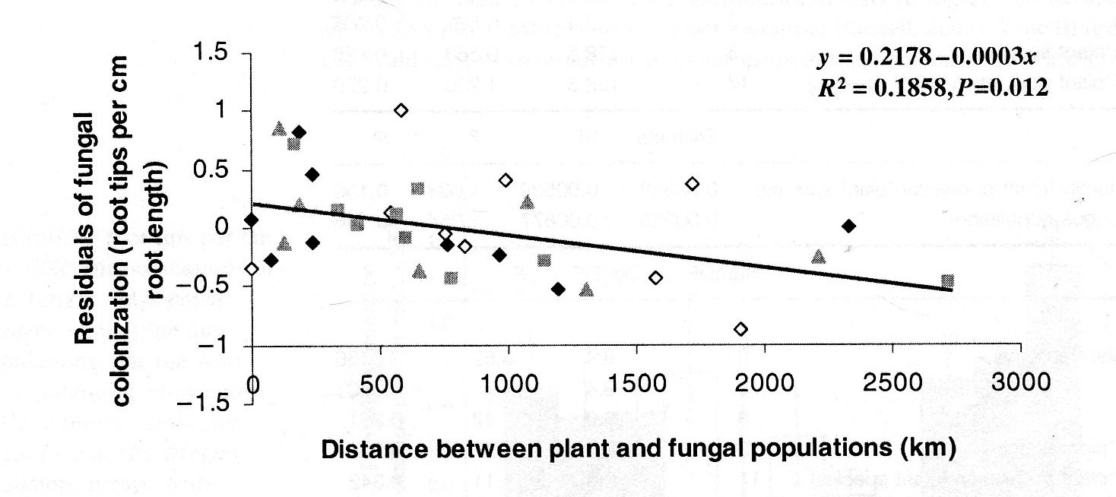
Hoeksema and Thompson 2007. Fungi have clinal pattern of local adaptation to their host plants across the geographic range.

Slide 11
Assisted migration would match appropriate populations of trees to anticipated future climates.
Introduced host populations may not be as genetically compatible with local EMF fungi
- biodiversity concerns
- forest fitness concerns

Slide 12
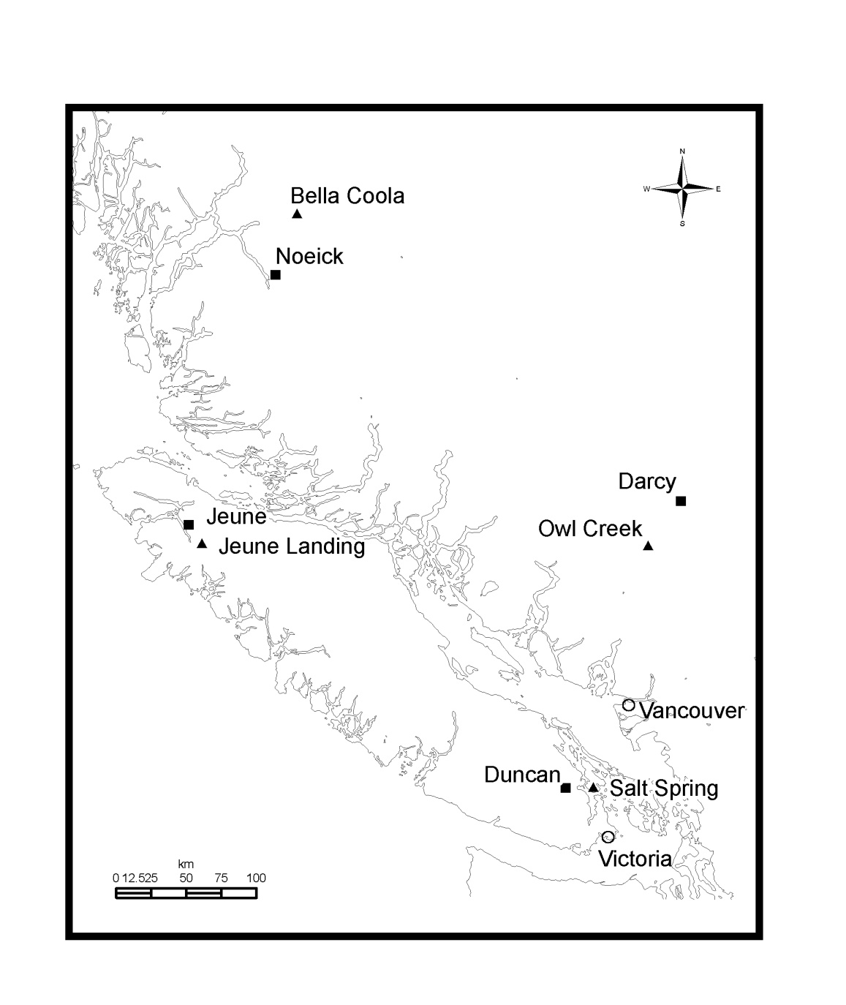
‘Common garden’ or reciprocal transplant design
Provenance:
Noeick – north coastal
Darcy – coast-interior transition
Jeune Landing – wet midcoastal
Duncan – dry south coastal
Transfer up to 450 km, 3° MAT, 4600 MAP
Sampled 8 trees per provenance over 2 seasons at each site; 128 trees in total, 25600 root tips
EP 599.03 Coastal Douglas-fir provenance trial

Slide 13
No effect of transfer distance on species richness, slight decline in diversity index

Slide 14
Jeune*
Noeick
Duncan
Darcy
Bray-Curtis
0.65
Axis 2
0.55
Salt Spring
Jeune Landing
Bella Coola
Noeick
0.38
Duncan
Jeune
Jeune
Noeick*
Darcy
Darcy
Duncan*
0.44
Owl Creek
Darcy*
Noeick
Jeune
Duncan
Axis 1

Slide 15
Host genetics exert more influence on EMF species’ colonization success where soil resources are plentiful – not strictly related to transfer distance

Slide 16
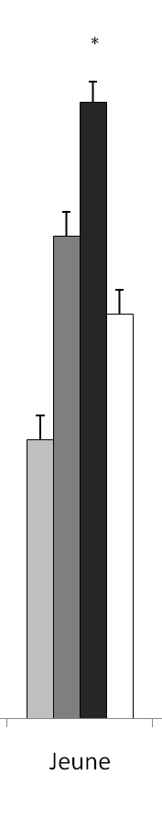
Maladapted ectomycorrhizal communities?
EMF species | Jeune L. % root colonization
 | Darcy | Duncan | Jeune | Noeick
Amphinema byssoides | 8.1 | 27.0 | 1.8 | 10.8
Cenococcum geophilum | 20.4 | 11.5 | 6.6 | 0.9
Piloderma olivaceum | 11.1 | 4.0 | 1.4 | 0.2
Tomentella stuposa | 5.2 | 10.7 | 18.6 | 9.1
Tylospora asterophora | 12.5 | 4.5 | 17.2 | 0
Clavulina cristata | 12.0 | 9.9 | 0 | 3.8
Generalists
Specialists
Cheater?
Successful colonization of these nitrophilic fungi is dependent on the genetically-based ability of the host to support high rates of N uptake (?)

Slide 17
Jeune*
50% of roots occupied by 6 generalist species
Noeick
Duncan
Darcy
Drying
Salt Spring
Jeune Landing
Warming
Bella Coola
Noeick
Axis 2 - AH:M
Duncan
Jeune
Jeune
Noeick*
Darcy
Darcy
Duncan*
Owl Creek
Darcy*
Noeick
Jeune
Duncan
Axis 1 - MAP

Slide 18
Coastal Douglas-fir extends from northern California to B.C. midcoast,
1500 km, ~500 fungal species?
Precipitation, Temperature

Slide 19
Does host population source matter to ectomycorrhizal fungi?
Absolutely
- direct abiotic selection on tree and fungal traits
Does the host genetic relationship with ectomycorrhizal communities affect growth?
Almost certainly sometimes
- inconsequential to profound
Is it possible to define the site context of this relationship and match introduced host populations with local EMF fungi?
Maybe
- requires more resources than we have

Slide 20
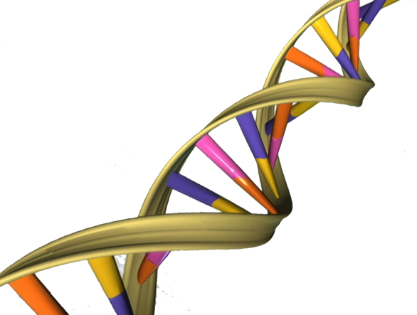
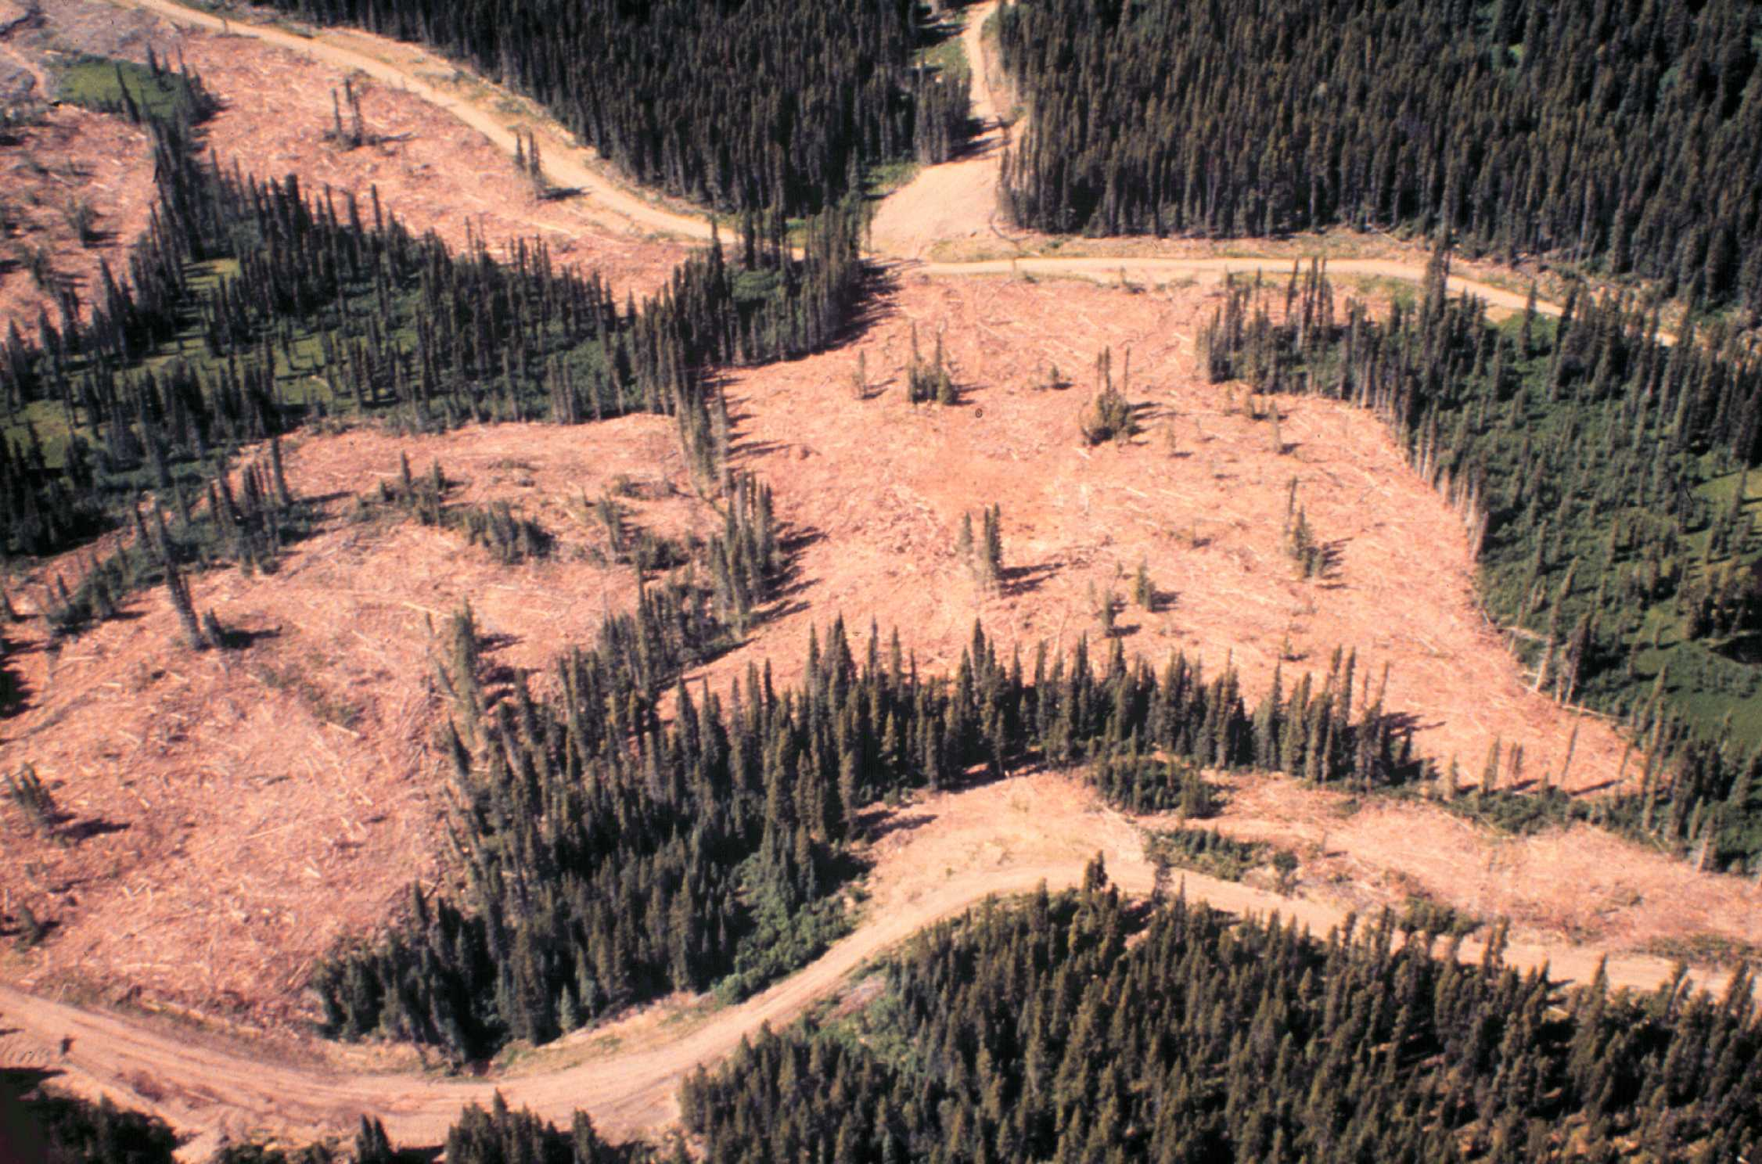
Ecosystem memory – what has worked well in the past will
probably work well in the future (Resilience Alliance)
Be conservative in seed transfer, always keep some local genetic diversity, and maintain refugia and green tree retention for EMF

Slide 21
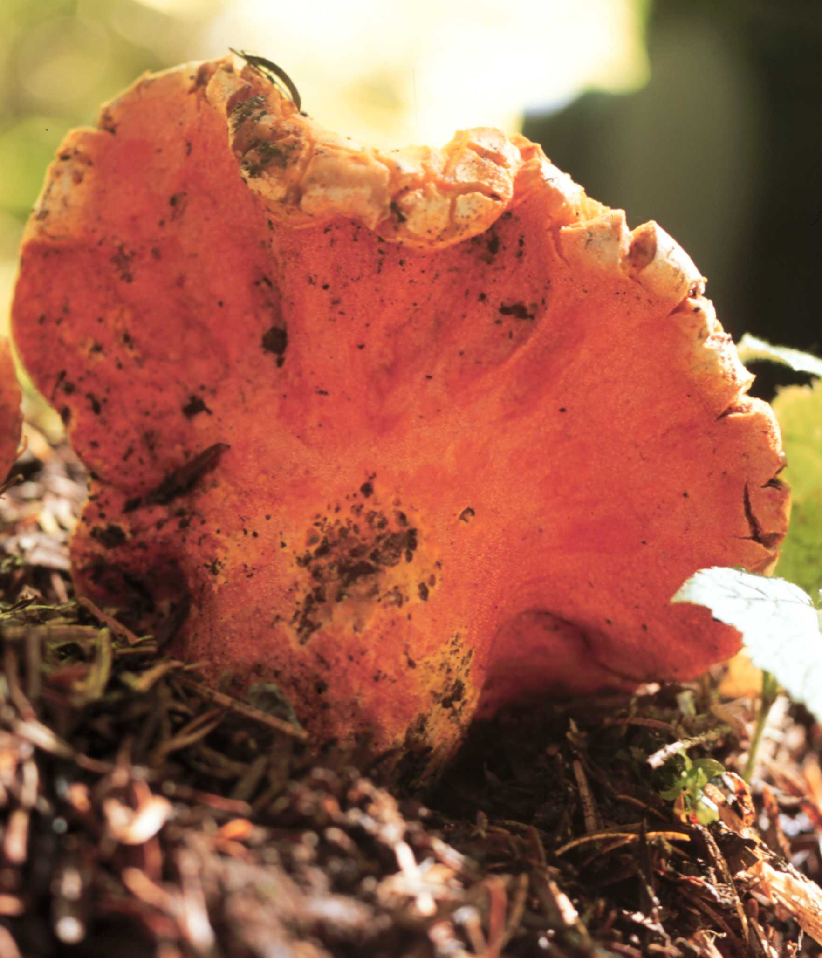
Acknowledgements
Michael Stoehr and Greg O’Neill for ideas and feedback;
Doug Ashbee and Jodi Krakowski for
plot maintenance, maps and tree data;
Funding provided by the
Forest Genetics Council of BC

