Slide 1
Looking ahead:
Will Free-growing stands produce the volumes we expect?
Wendy Bergerud
Research Branch
Ministry of Forests and Range
December, 2009

Slide 2
Planning for the future
What do we want our forests to look like?
After harvesting a stand or group of stands, we usually reforest them so that we can get . . . ??
What is our target/goal?
We must make decisions now hoping that they will have the right long-term effect.

Slide 3
From here to there?
How do we assess how recently reforested areas are doing? Whether we are likely to get the desired volume from that stand(s)?
This means that we want a way to measure how a stand is doing NOW in order to predict whether we are likely to get the desired outcome at rotation.
I am going to talk about which measure of density sampled NOW will do the trick.
This is more of a “methods” talk.

Slide 4
Key Messages
TASS and TIPSY now have well-spaced density, free-growing density, and mean stocked quadrants as output variables.
  Can use to project volume at rotation
  Modeling young stands still hampered by lack of information on:
    Ingress
    Forest Health
    Vegetation Competition
    Mixed species and uneven aged stands

Slide 5
Key Messages
Spatial distribution is very important when projecting volumes at rotation for current densities.
So is Site Index.
Under optimum conditions, well-spaced density
10 to 20 years after FG declaration should be about the same. The free-growing density might actually increase.
Modeling stand dynamics with TASS and TIPSY require a good understanding of the assumptions that must be made.

Slide 6
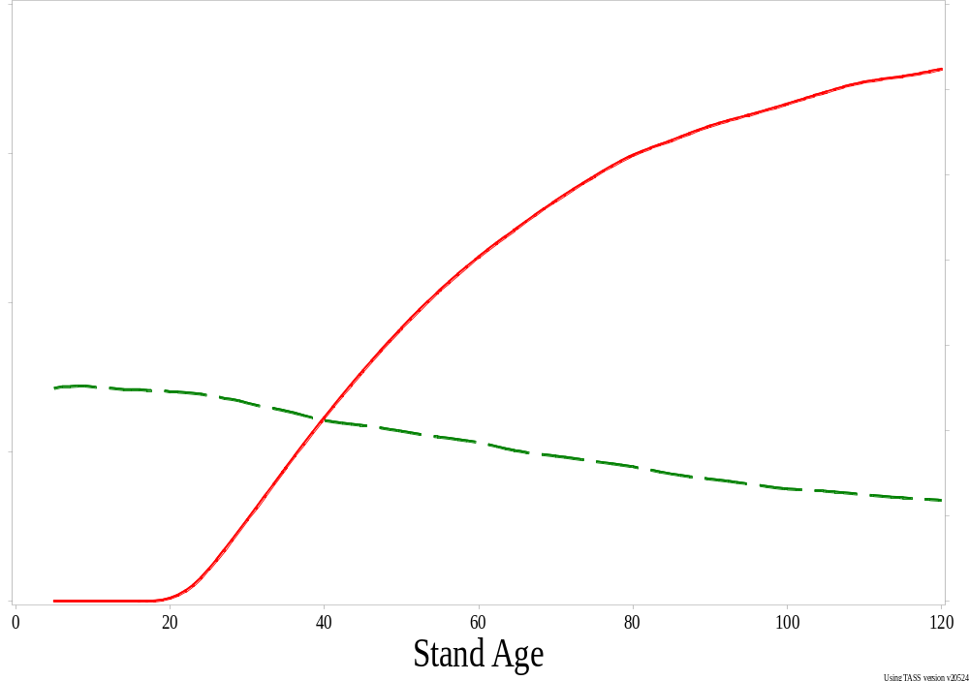
Density & Volume with Stand Age
Projected Volume
Density
Notes:
This talk is all about how to do this connection of density now to projected volume later.

Slide 7
Factors affecting the prediction of projected merchantable volume as a function of density include:
Species
Site Index
Spatial Distribution
Growth Model used
Other factors?
Health Effects
Competition
Unexpected events
(e.g. MPB)

Slide 8
Discussion Assumptions
Spatially homogeneous, even-aged stands.
No brush or competition issues
No forest health issues or unexpected events
No OAFs
Minimum inter-tree distance (MITD) is 2.0 m
Minimum height to be free-growing is 2.0 m
Well-spaced and free-growing density are all “uncapped” estimates.
Notes:
Capped values (M-value) are used for the determination of free-growing status in our standard survey.

Slide 9
Discussion Assumptions
Preliminary results
– I reserve the right to correct, if necessary
Look at the TRENDS, not the specific numbers
The TRENDS are more likely to remain the same under a different set of assumptions than would the specific numbers presented.

Slide 10
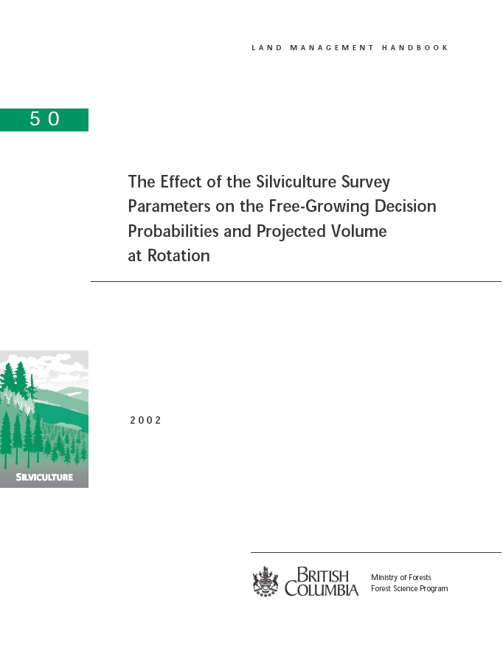

Slide 11
Different Types of Density
Nominal - TASS input (often called Initial density)
Total - All trees (regardless of spacing)
Well-spaced - depends on choice of MITD
FG - Well-spaced with height restriction
MSQ – Mean stocked quadrant
(All count only acceptable trees)

Slide 12
Total Density
All trees or all healthy trees
Total:
19 trees
3800 sph
50 m² plot 2 m

Slide 13
Well-spaced Density
All trees a Minimum Inter-tree Distance (MITD) apart
WSP:
9 trees
1800 wsph
50 m² plot 2 m
Notes:
9 well-spaced trees or 1800 wsph. Only 6 counted for making a decision about whether the stand is free-growing.

Slide 14
Free-growing Density
Well-spaced trees taller than a minimum height
Remove Short Trees First
50 m² plot 2 m

Slide 15
Free-growing Density
Well-spaced trees taller than a minimum height
Now look at the well-spaced trees remaining
FG:
6 trees
1200 fgsph
50 m² plot 2 m

Slide 16
Mean Stocked Quadrant (MSQ)
Count of acceptable tree in each quadrant
?
MSQ:
3 filled quadrants or, is it 4?
50 m² plot 2 m

Slide 17
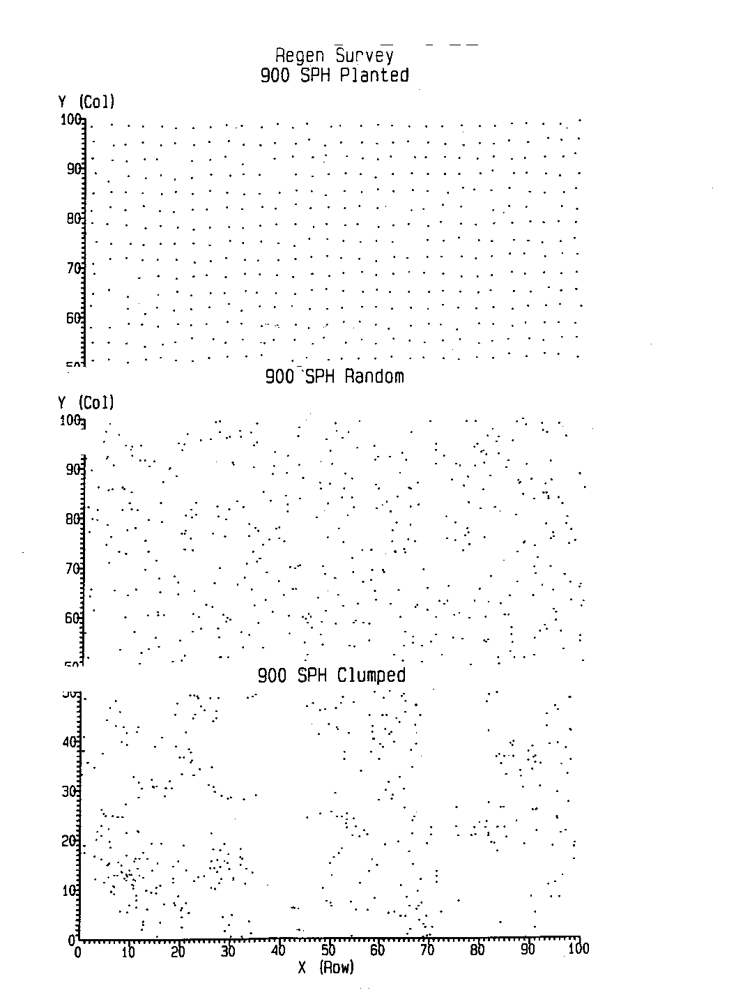
Example Density Map showing spatial distributions
900 sph (nominal density)

Slide 18
Which type of Density to use?
(assuming even-aged stands)
Total - All trees (regardless of spacing)
  Easy to measure
  Projected Merchantable Volume (PMV) is sensitive to site index misspecification
  PMV very sensitive to spatial distribution misspecification

Slide 19
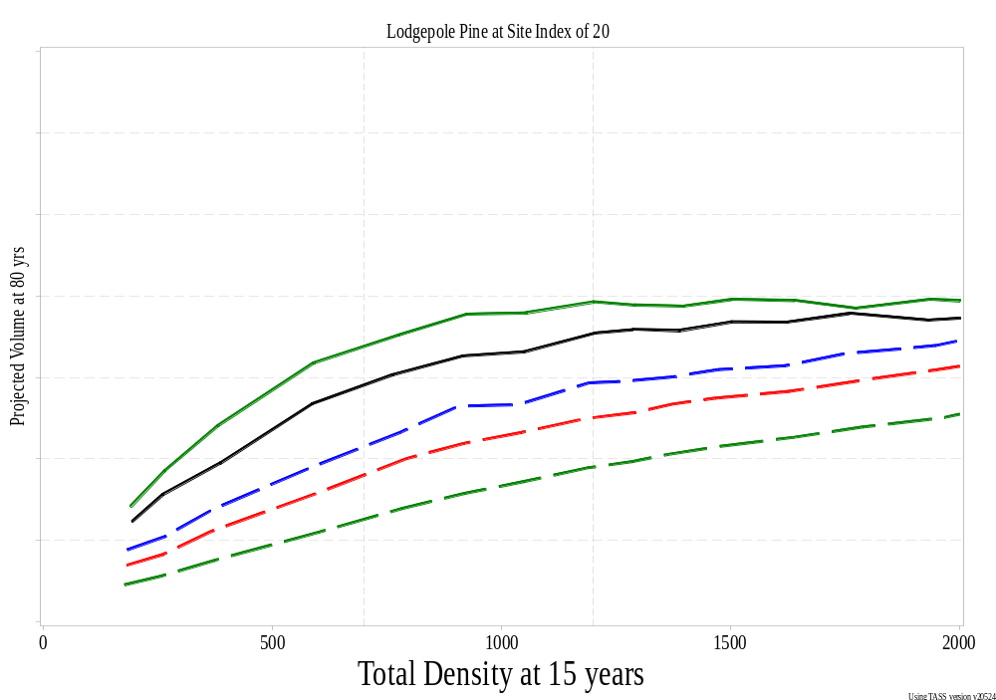
PMV (80 yrs) vs Total at 15 years (SI = 20)
Notes:
Top line: regular, then random then 3 different clumpy distributions

Slide 20
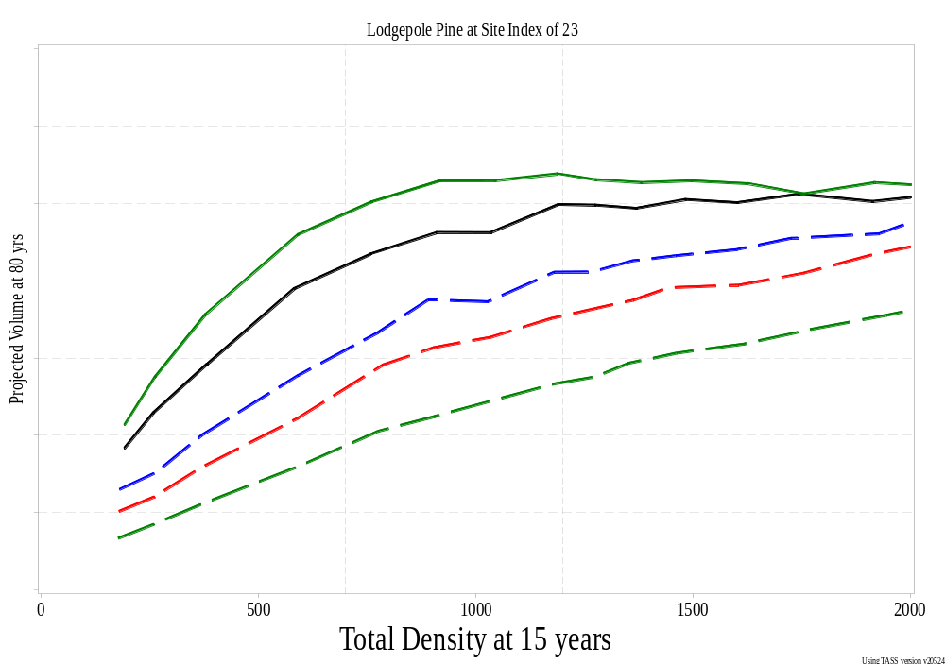
PMV (80 yrs) vs Total at 15 years (SI = 23)
Notes:
Top line: regular, then random then 3 different clumpy distributions

Slide 21
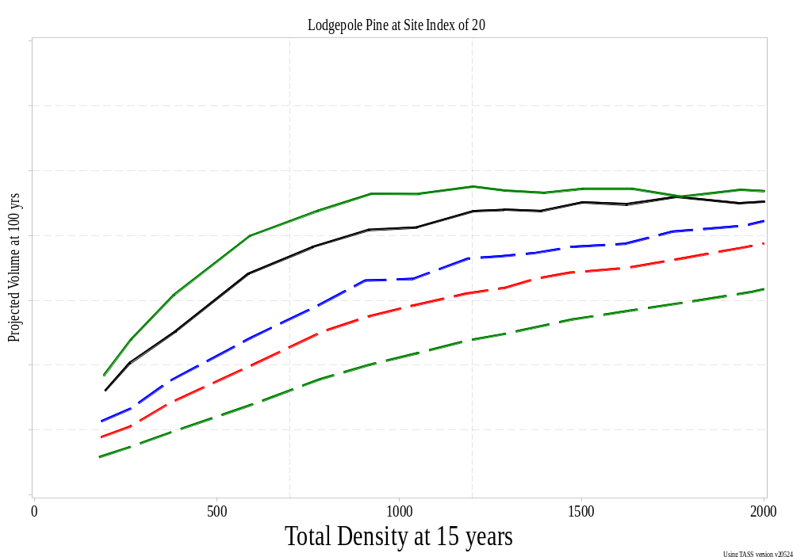
PMV vs Total: Bigger SI > Waiting 20 yrs
Notes:
Even waiting 20 more years isn’t as good as increasing the site index by 3 meters!

Slide 22
Which type of Density to use?
(assuming even-aged stands)
Well-spaced - depends on choice of MITD.
  Not so easy to measure but
  PMV less sensitive to spatial distribution misspecification
FG - Well-spaced with height restriction
  More sensitive to site index and to
  Stand age for ages less than 30 years or so
  (and in the field, more sensitive to brush and competition)

Slide 23
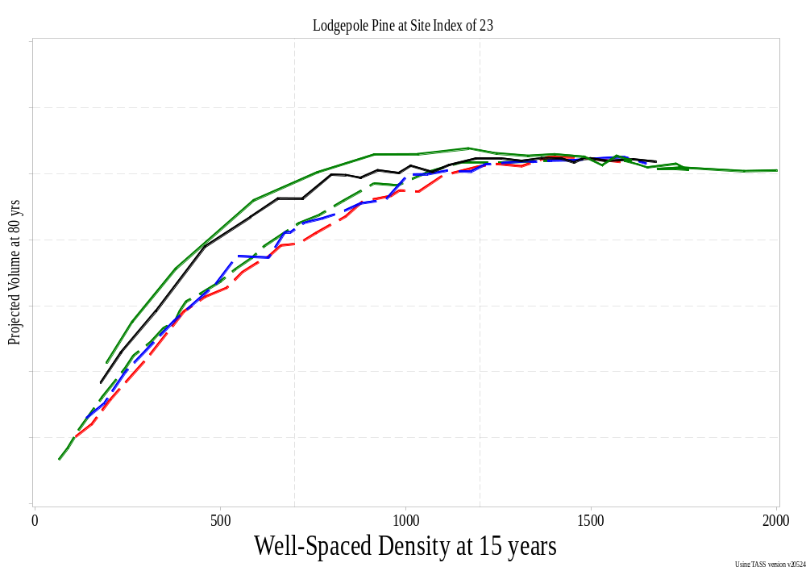
PMV vs WS at 15 years
Notes:
Top line: regular, then random then 3 different clumpy distributions (blue, red, green)

Slide 24
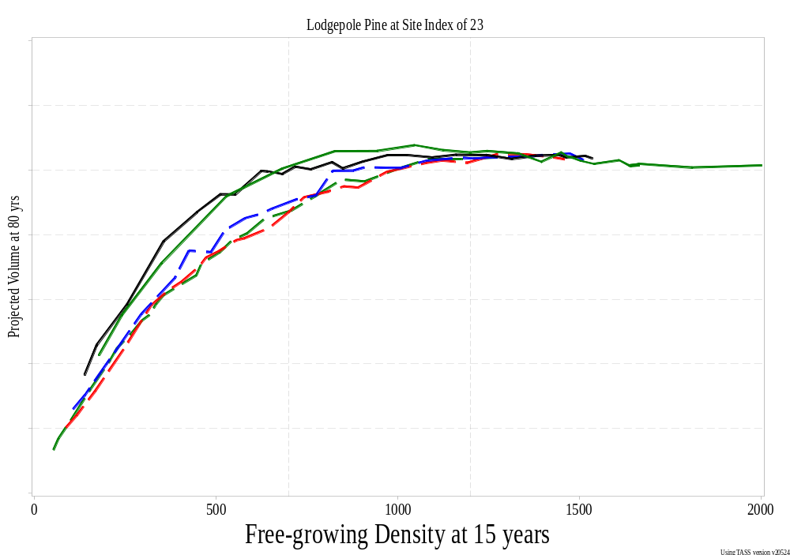
PMV vs FG at 15 years
Notes:
Top line: regular, then random then 3 different clumpy distributions (blue, red, green)

Slide 25
Which type of Density to use?
(assuming even-aged stands)
MSQ – Mean stocked quadrant
  Easier to measure
  PMV less sensitive to spatial distribution misspecification
  Not as familiar to foresters
  Capped at 4 which occurs at all higher densities even extremely high densities

Slide 26
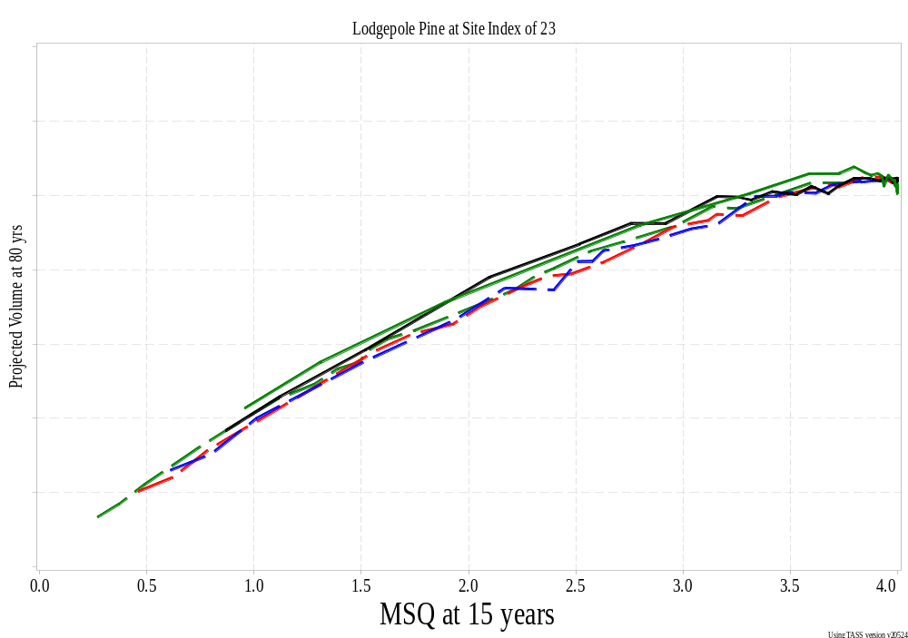
PMV vs MSQ at 15 years
Notes:
Top line: regular, then random then 3 different clumpy distributions (blue, red, green)

Slide 27
Relationships between Density Measures

Slide 28
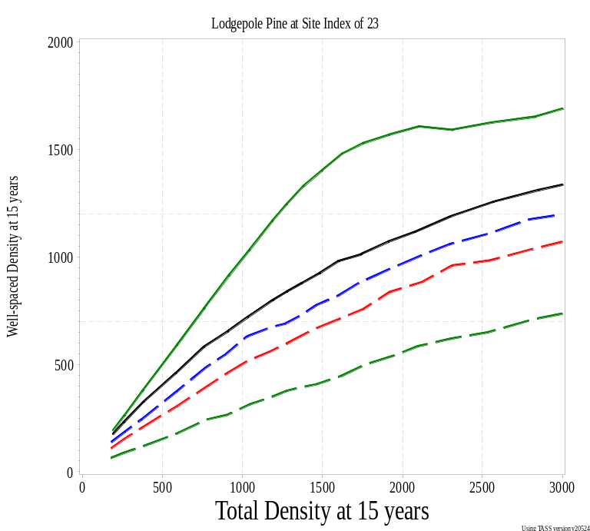
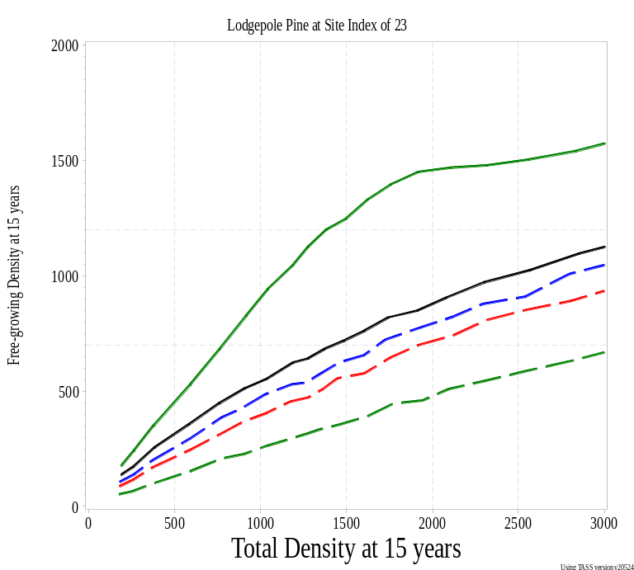
WS and FG vs Total Density at 15 years

Slide 29
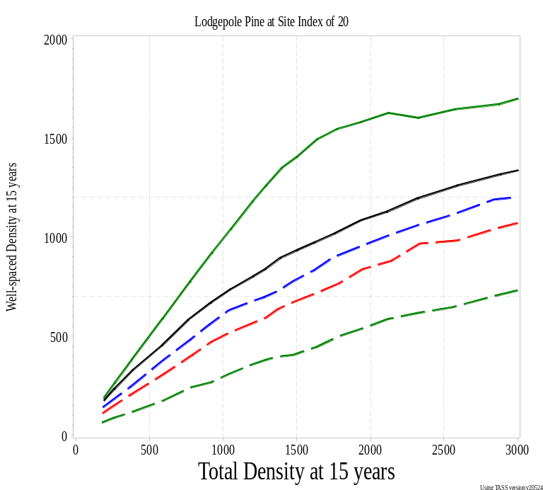
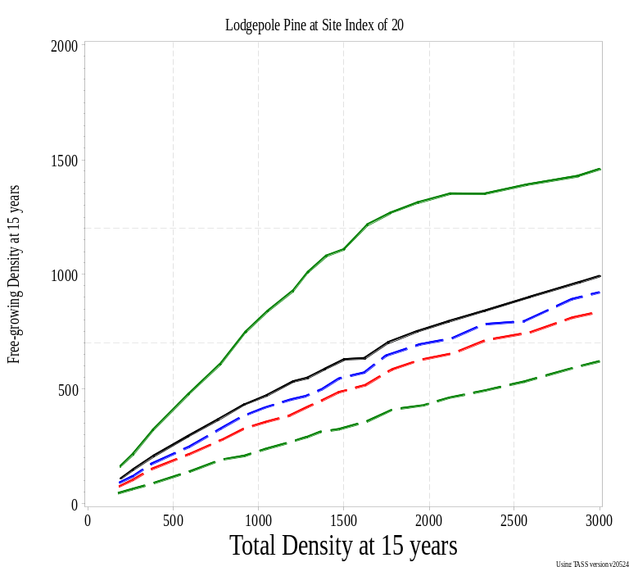
WS and FG vs Total Density effect of Site Index

Slide 30
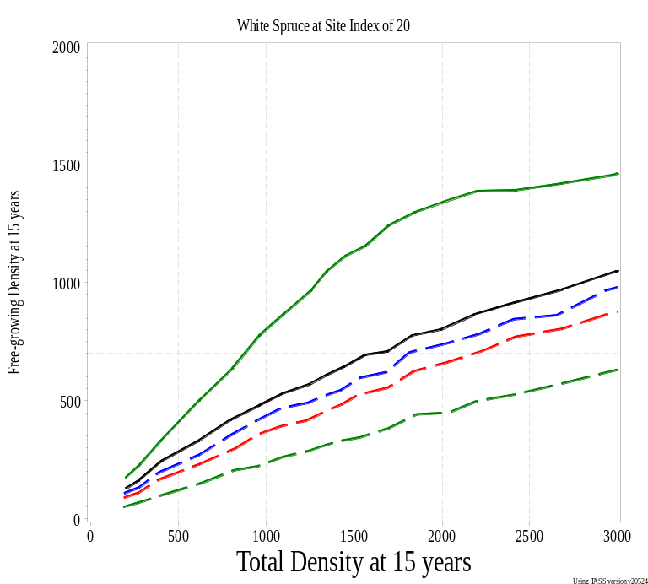

WS and FG vs Total Density effect of Species (SI = 20)

Slide 31
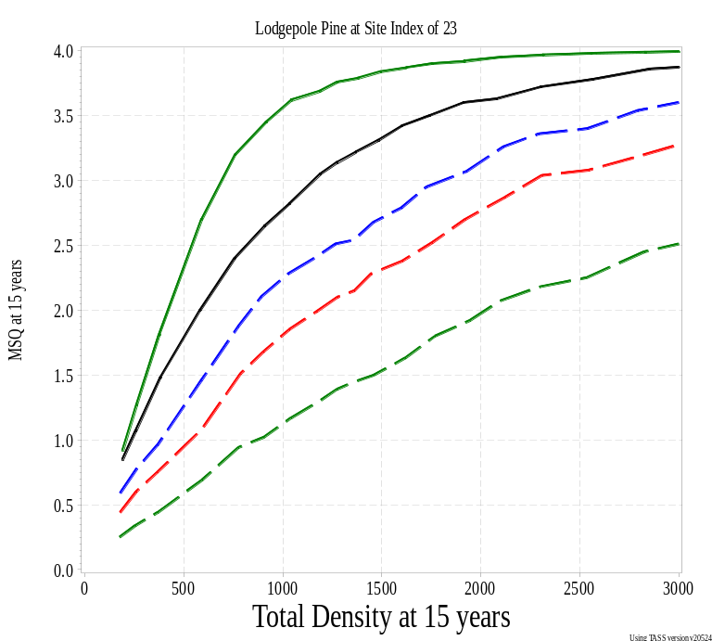
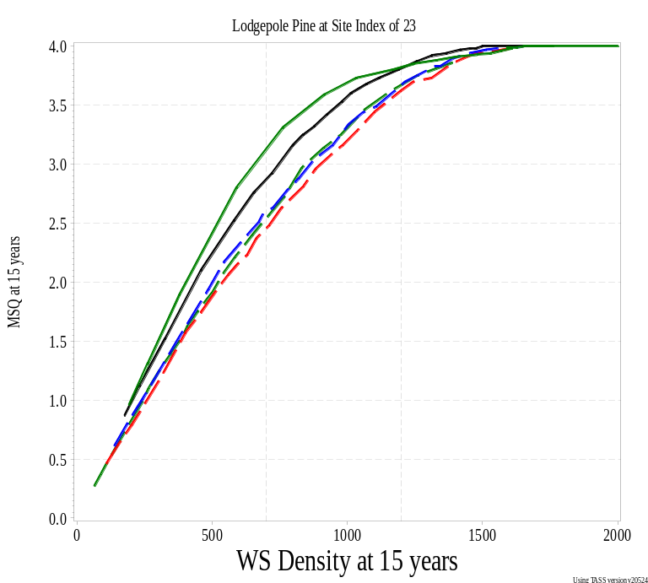
MSQ vs Total and WS Density at 15 years

Slide 32
But, what about all those trees?

Slide 33
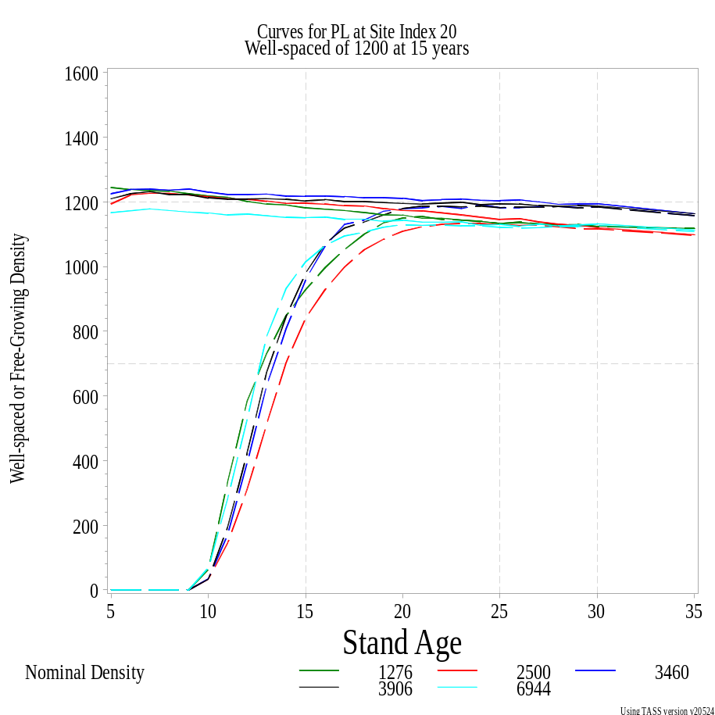
Stands with the same WS density produce about the same Volume
Spatial Distribution | Total Trees at 15 years | Volume at 80 yrs
Regular | 1202 | 393
Natural | 2336 | 385
Clump (3) | 3199 | 378
Clump (2) | 3669 | 378
Clump (1) | 6224 | 380

Slide 34
Density values at 15 years
(about 1200 wsph)
Spatial Distribution | Nominal | Total | Well-spaced | Free-growing | Total at 80 yrs | Volume at 80 yrs
Regular | 1276 | 1202 | 1181 | 928 | 1087 | 393
Natural | 2500 | 2336 | 1196 | 840 | 1114 | 385
Clump (3) | 3460 | 3199 | 1217 | 958 | 1123 | 378
Clump (2) | 3906 | 3669 | 1203 | 978 | 1092 | 378
Clump (1) | 6944 | 6224 | 1151 | 1014 | 1070 | 380

Slide 35
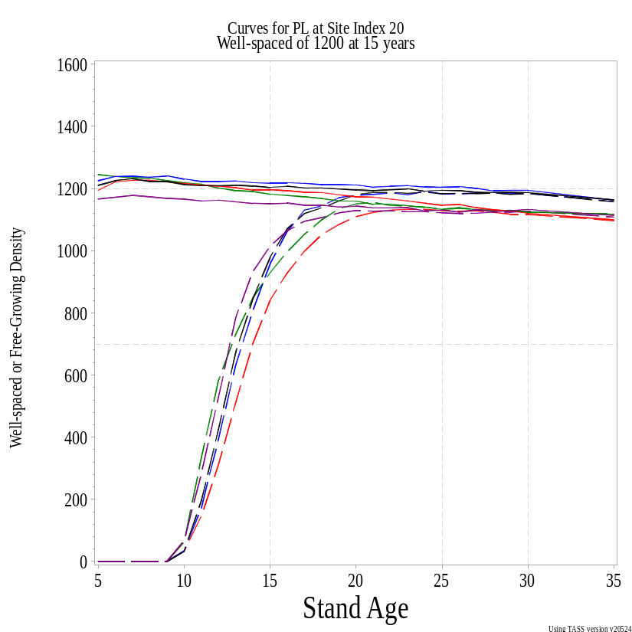
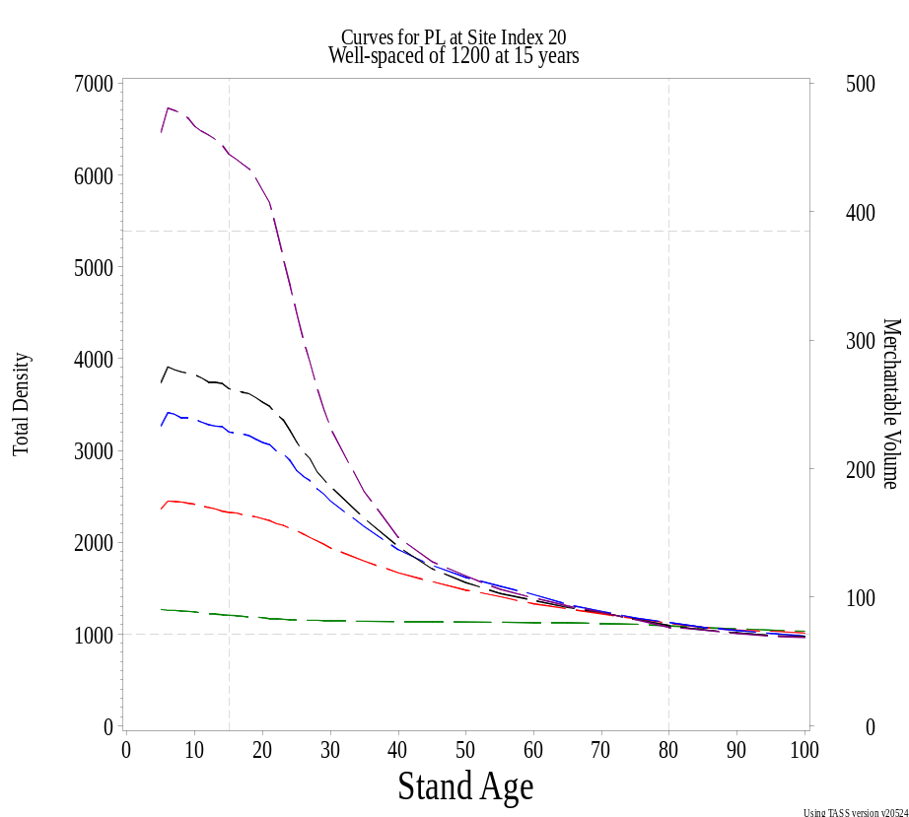
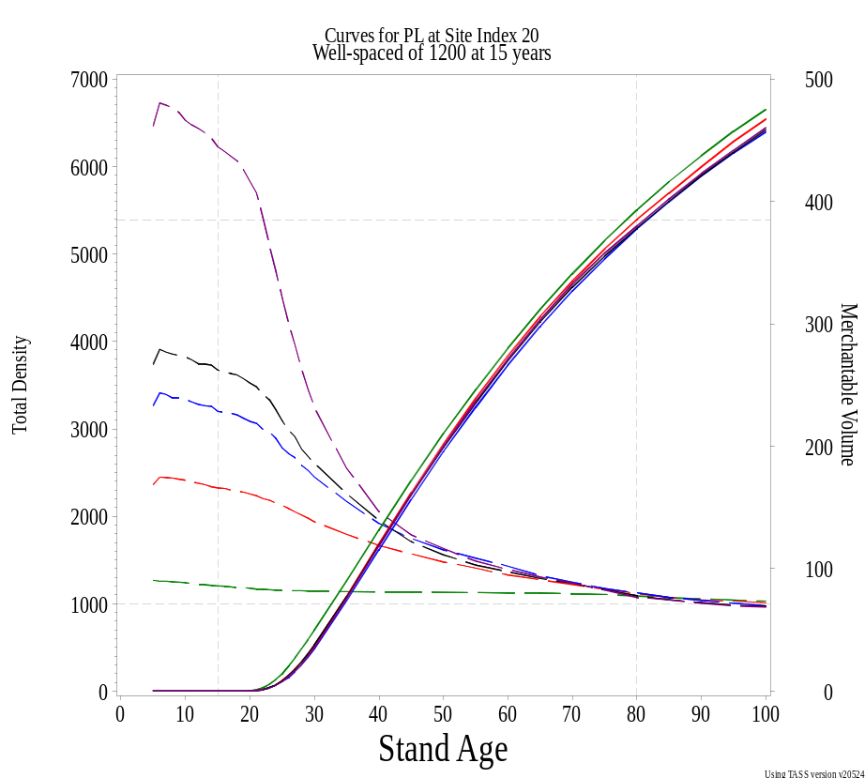
But, what about all those trees?
Green: Regular at 1276 Red: Natural at 2500
Blue: Clumpy(3) at 3460 Black: Clumpy(2) at 3906 Purple: Clumpy(1) at 6944
Notes:
All those trees at declaration don’t matter if they aren’t well-spaced.

Slide 36
Density values at 15 years
(about 700 wsph)
Spatial Distribution | Nominal | Total | Well-spaced | Free-growing | Total at 80 yrs | Volume at 80 yrs
Regular | 816 | 775 | 775 | 608 | 733 | 352
Natural | 1111 | 1049 | 736 | 473 | 786 | 332
Clump (3) | 1372 | 1276 | 696 | 469 | 695 | 295
Clump (2) | 1736 | 1627 | 715 | 517 | 702 | 283
Clump (1) | 3086 | 2860 | 706 | 595 | 757 | 305
Projected volumes not as close for lower well-spaced densities

Slide 37
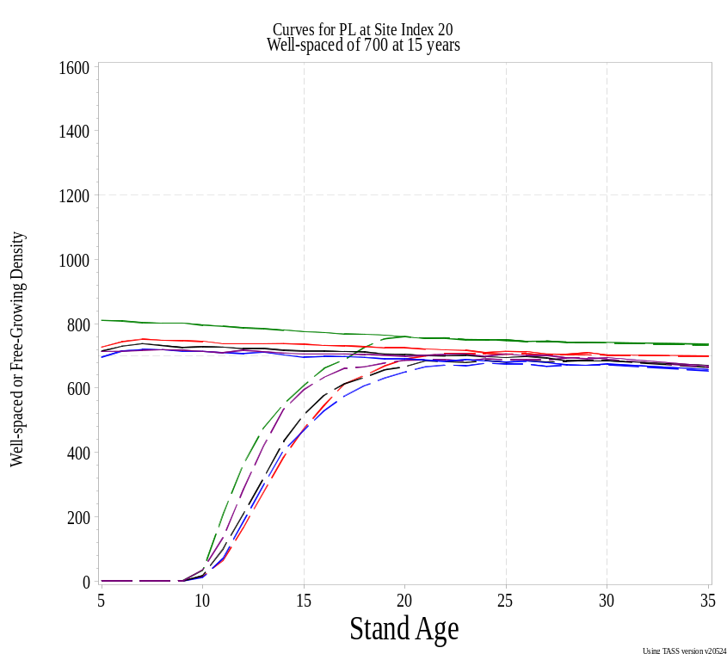
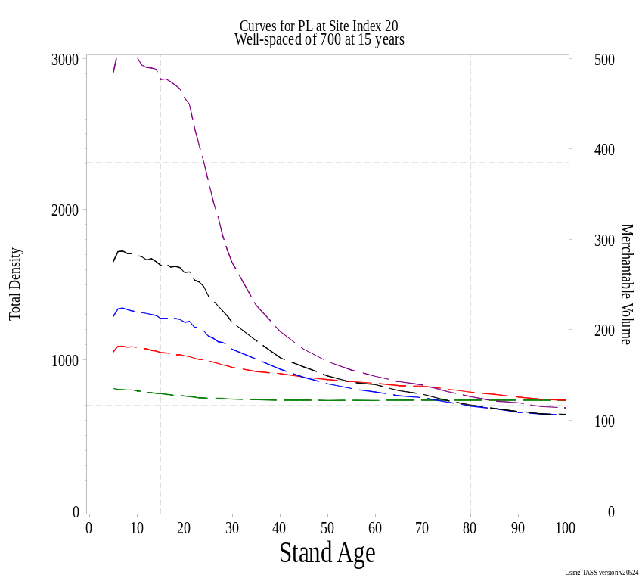
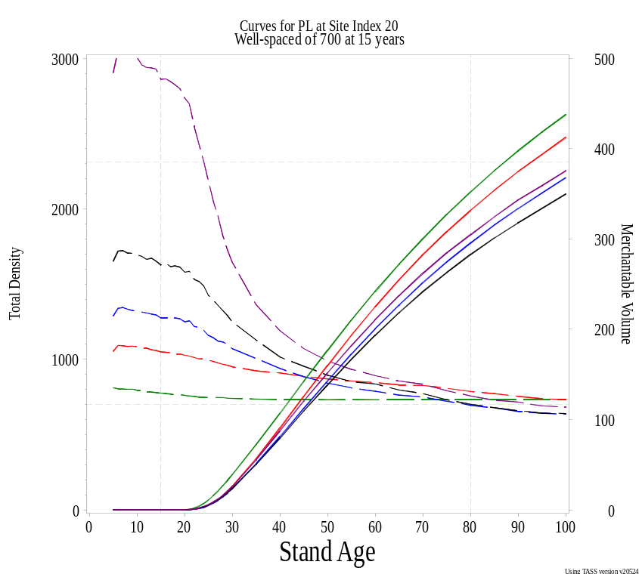
But, what about all those trees?
Green: Regular at 816 Red: Natural at 1111
Blue: Clumpy(3) at 1372 Black: Clumpy(2) at 1736 Purple: Clumpy(1) at 3086

Slide 38
What spatial distribution to use?
How can we tell from field data which spatial distribution best matches the stand?
There are several indices in the literature, e.g. Pielou’s index of dispersion or Morisita’s index.
We could also consider the ratio of the total trees to the well-spaced trees, both readily available from survey data. Preliminary work shows that this ratio is a simple function of the total trees.
  I’ve been thinking about this for years, but haven’t been able to pull anything together yet.

Slide 39
Fort St John District Data
District collected 895 standard silviculture survey plots in many but not all of the Multi-block strata of the Fort St John Pilot Project (15 year old cutblocks)
Also collected MSQ data – plots divided into quadrants and presence of an acceptable tree determined for each quadrant – values 0 to 4.
Plots placed into 18 strata, regardless of cutblocks
Three species groups: Pl, Pl/Sx, Sx
Wide range of site index observed
Notes:
Species group cut-offs were 80%

Slide 40
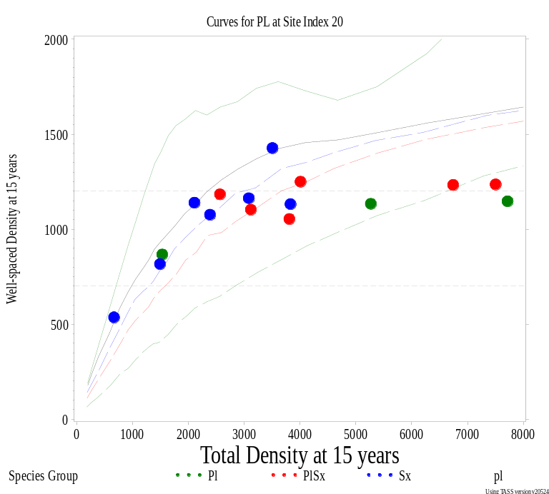
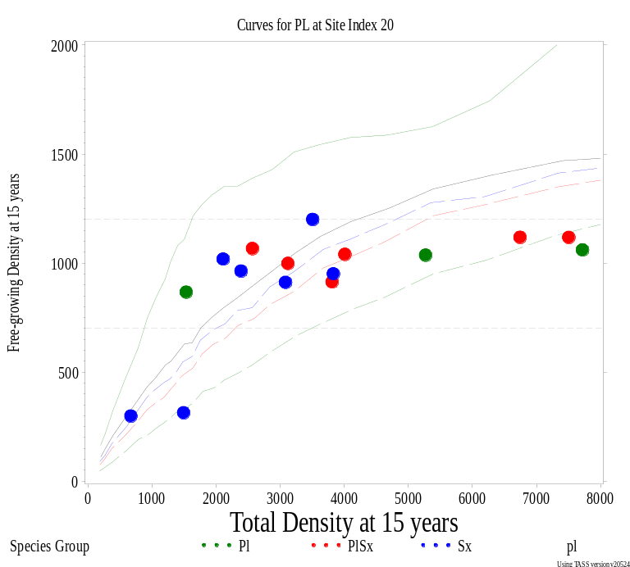
WS and FG vs Total Density
Fort St John District Data
Data plotted without regard to estimated site index of the data
Notes:
Two strata are way over to the right with densities of 29,000 and 32,000 and MSQ of 3.8 and 3.6 and WSP of 1292 and 1280.

Slide 41
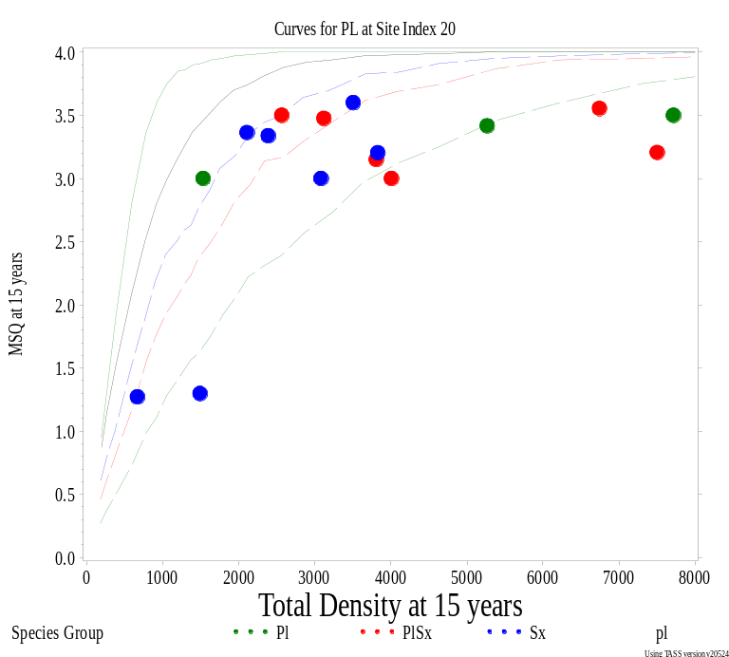
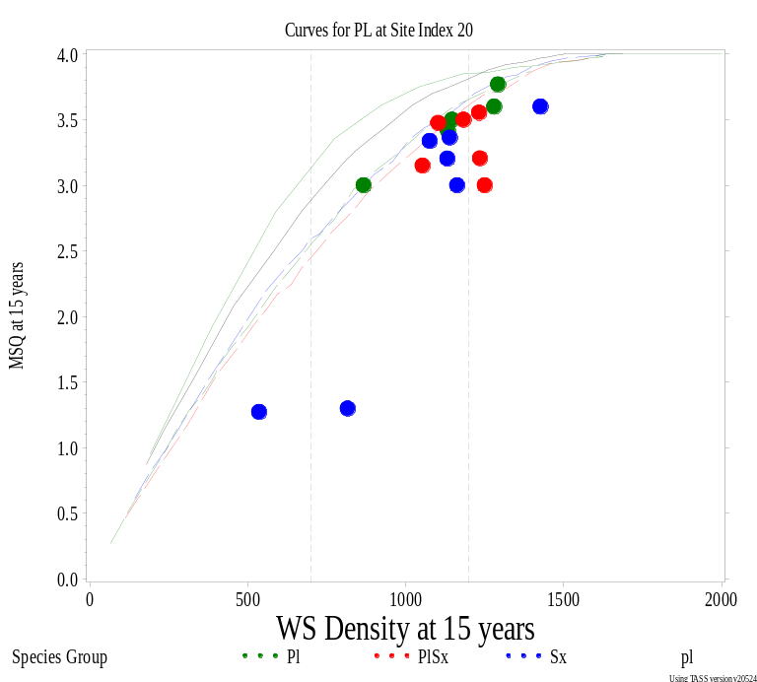
MSQ vs Total & WS Density
Fort St John District Data
Data plotted without regard to estimated site index of the data
Notes:
Two strata are way over to the right with densities of 29,000 and 32,000 and MSQ of 3.8 and 3.6 and WSP of 1292 and 1280.

Slide 42
Post-free growing Survey Study
FREP project with Alex Woods in Smithers
Sixty stands in two areas declared free-growing between 1987 and 2001 were randomly selected using RESULTS
Stands re-surveyed in 2005 (Lakes) and 2006 (Okanagan) using standard silviculture survey methodology and current forest health standards.
FREP is now piloting a Stand Development Monitoring (SDM) program based on this work.

Slide 43
Purpose of Free-Growing Policy:
“free-growing requirements ensure that reforested stands remain successfully reforested.” Forest Practices Board Special Report No. 16 (2003),
The licensee obligation to create free-growing stands is one of the few measurable results under the Forest and Range Practices Act.

Slide 44
Features of the Silviculture Survey
  Uses 50 m² plots (3.99 m radius -- 1/200th ha)
  Usually 1 plot per hectare placed in survey area
  Count number of acceptable, well-spaced trees
  Trees must be a minimum tree height to be counted in Free-growing surveys
  Well-spaced is defined by the Minimum Inter-tree Distance (MITD)
  Count is capped by the M-value (this is the equivalent plot count for the Target Stocking Standard, TSS, i.e.,
  M = TSS/200)

Slide 45
Post-FG Surveys – Stand Ages
 | Declaration |  | Post Free-Growing
Age Range | Lakes | Okanagan | Lakes | Okanagan
< 12 years | 19 | 13 | -- | --
12 - 18 years | 35 | 26 | 9 | 8
19 - 21 years | 4 | 11 | 9 | 2
22 - 28 years | 2 | 10 | 34 | 23
29 - 33 years | -- | -- | 6 | 22
> 33 years | -- | -- | 2 | 5
Average Age: | 14 yrs | 16 yrs | 24 yrs | 27 yrs

Slide 46
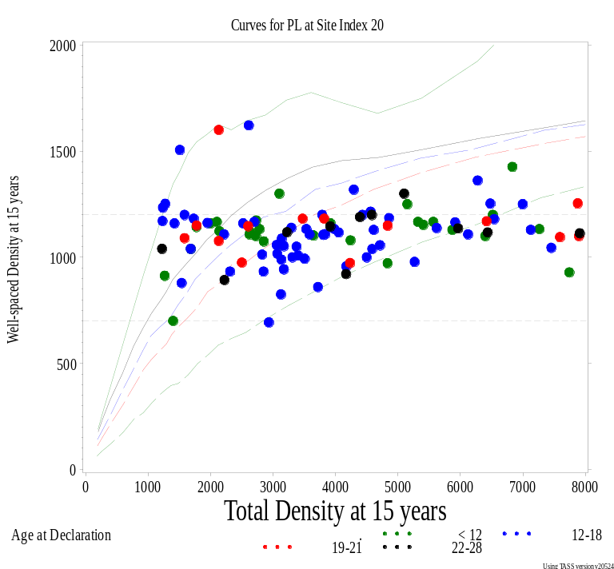
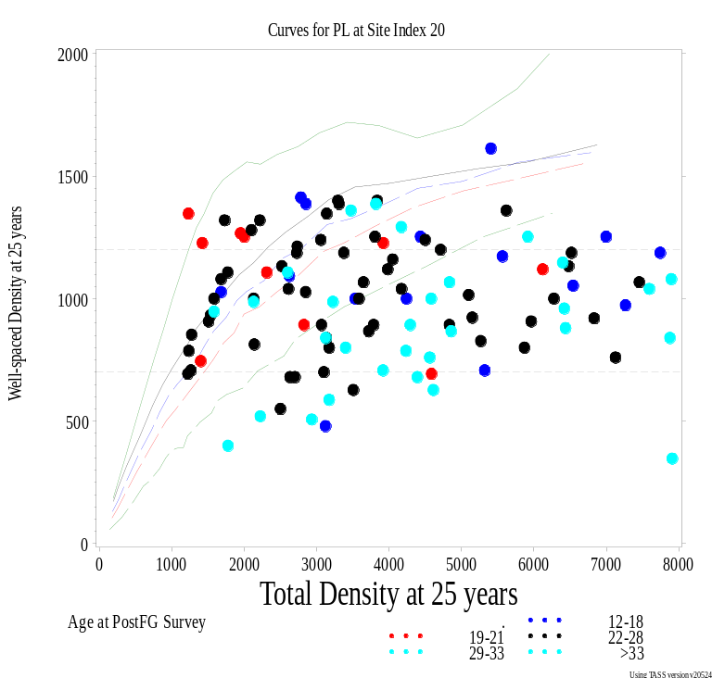
WS Density vs Total Density
Lakes & Okanagan Data
At Declaration
At Post FG Survey
Dot colours show different age range of the cutblocks
Curves use stand age of 15 or 25 years
Notes:
This tells us that stands tend to get more clumpy with time, even more clumpy than we’d expect based on TASS runs

Slide 47
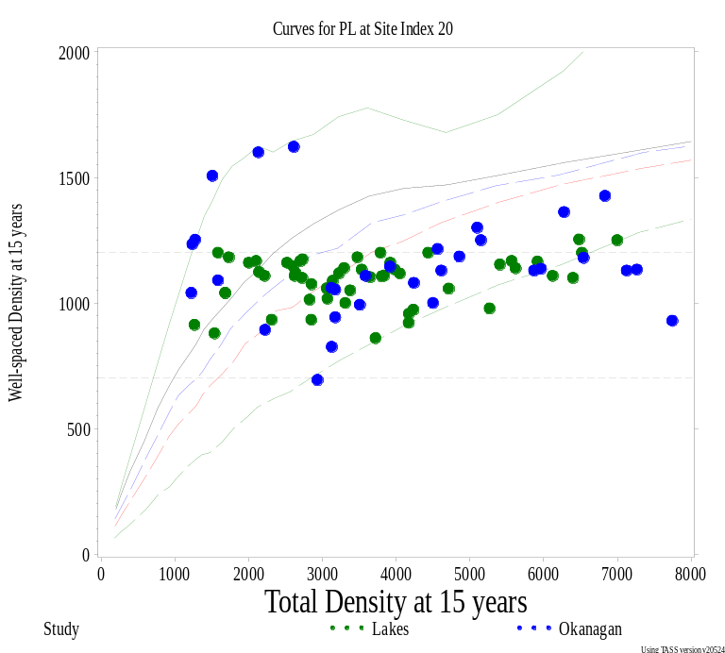
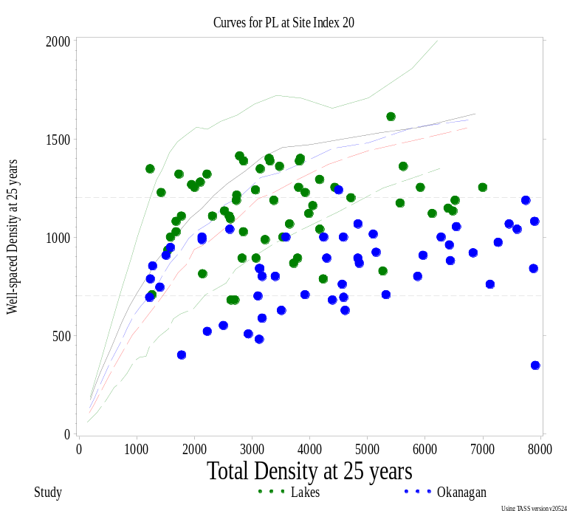
WS Density vs Total Density
Lakes & Okanagan Data
At Declaration
At Post FG Survey
Dot colours show cutblocks from different areas
Curves use stand age of 15 or 25 years
Notes:
This tells us that stands tend to get more clumpy with time, even more clumpy than we’d expect based on TASS runs
Stands at Declaration may or may not have used the M-value – this isn’t clear from the records.

Slide 48
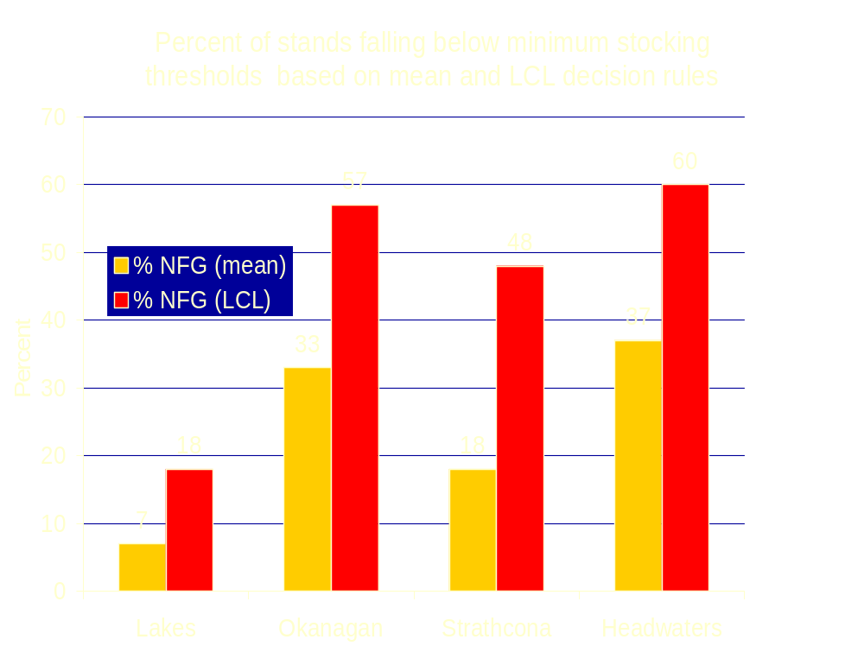
Notes:
Fort St John District Data Strata: 2/18 failed with mean: 11% and 3/18 failed with LCL: 17% This is at 15 years and at FG declaration

Slide 49
Post FG Question:
Should stands at 25 years of age (or older) have about the same well-spaced and free-growing densities as at declaration?
Or should these values have decreased, and if so, by how much?
Used TASS and TIPSY with the new output density variables to assess this.

Slide 50
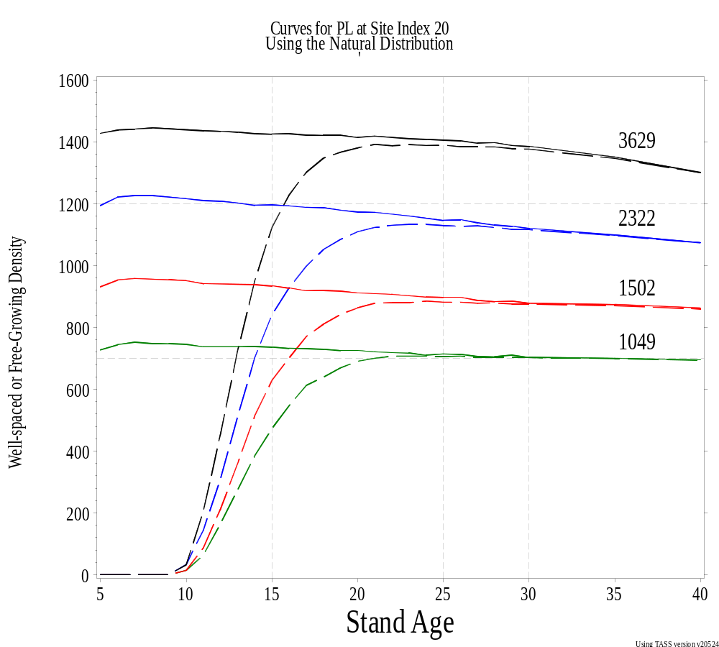
Post FG Question:
Total density at age 15 are shown above each curve
Nominal Densities were 3906, 2500, 1600, and 1111
Solid lines show Well-spaced Densities
Dashed lines are Free-growing Densities

Slide 51
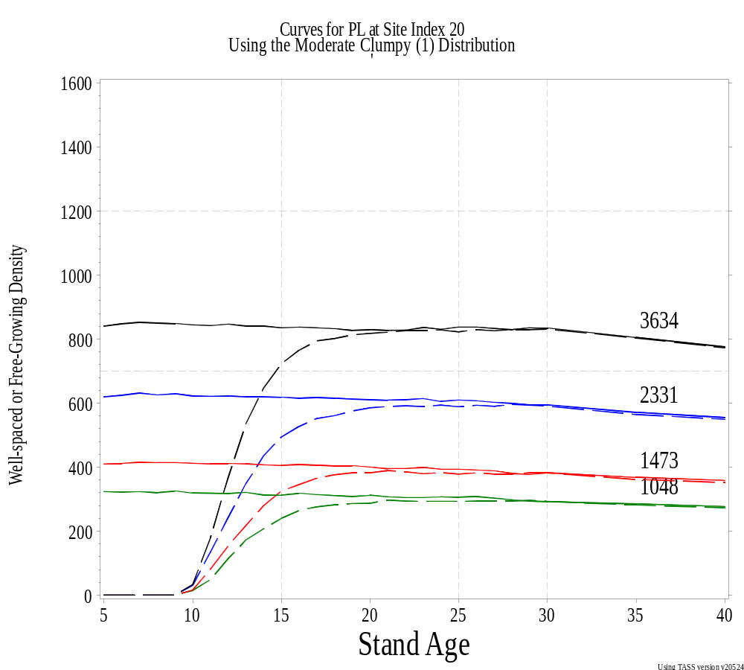
Post FG Question:
Total density at age 15 are shown above each curve
Nominal Densities were 3906, 2500, 1600, and 1111
Solid lines show Well-spaced Densities
Dashed lines are Free-growing Densities

Slide 52
Answer to Post FG Question:
Well-spaced Densities should decline a “little” from declaration to 25 or 30 years
Free-growing Densities should either increase or hardly change depending upon the site index and tree age at declaration.
That is, the MSS at 25 or 30 years should probably not be different from that at declaration.
Under optimum conditions, stands at 25 or 30 years should still pass the same numerical FG tests as at declaration.

Slide 53
Notes:
Why the change in outcome? Largely forest health?

Slide 54
Conclusions
Spatial distribution and site index have a significant impact on PMV – it is important to have good estimates for effective modeling.
Well-spaced density minimizes these impacts, especially near target densities.
Under optimum conditions, stands passing the FG tests at declaration should still pass them 10 to 20 years later.

Slide 55
This is the end

Slide 56
The MITD reduces the effect of gaps in the spatial distribution
It defines WS and FG density
AND it helps maintain the
Ministry’s risk at a reasonable level

Slide 57
MITD and Projected Volume Losses
Remember that there are many assumptions in all of the graphs in this presentation.
Remember to look more at the TRENDS or patterns than the specific values – these are more likely to remain the same under a different set of assumptions than would the specific values presented.

Slide 58
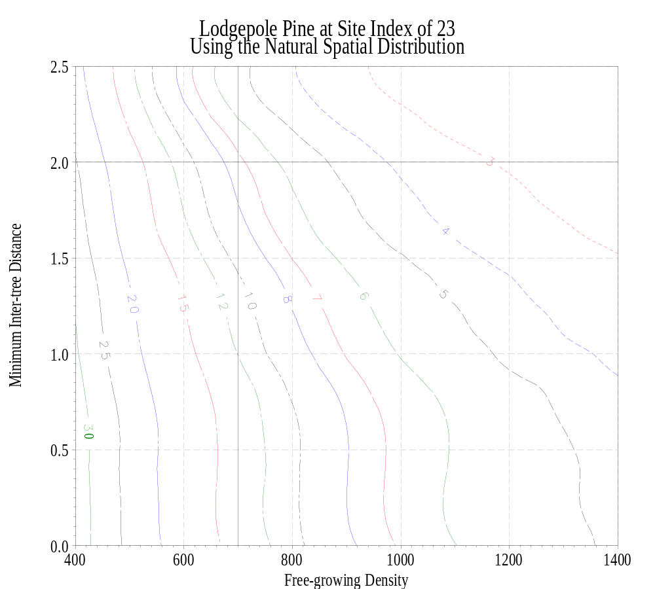
MITD and Projected Volume Losses
At MITD of 2 .0 m we see ~ 3% volume loss at 1200 fpgh
But at 700 we have >7% volume loss

Slide 59
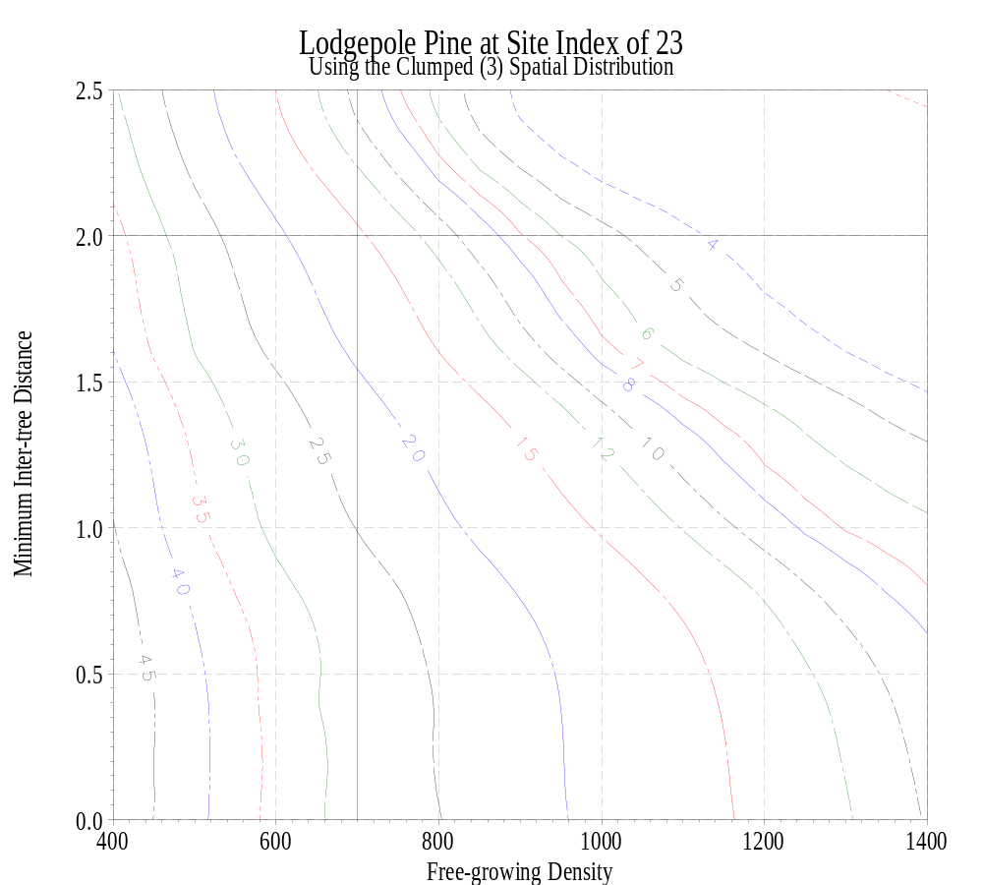
MITD and Projected Volume Losses
At MITD of
2 .0 m we see
3 - 4% volume loss at 1200 fpgh
But at 700 we have 15-16 % volume loss

Slide 60
At TSS and MITD = 2 m, volume losses similar regardless of spatial distribution

Slide 61
MITD and Projected Volume Losses
At the target stocking of 1200 fgph with an MITD of 2.0 m, we see a similar volume loss regardless of spatial distribution.
BUT at the minimum stocking of 700 fgph, the volume loss increases from ~7% for the “natural” distribution to ~15% for the standard clumped distribution in TIPSY.
For the more clumpy distributions, the volume loss at 1200 remains about the same, but at the minimum the losses rise to about 20%.

Slide 62
What if we reduce the MITD?
Reducing the MITD increases the volume loss.
Increasing the MSS from
700 to 800 compensates for this.

Slide 63
What if we reduce the MITD?
Reducing the MITD increases the volume loss.
Increasing the MSS
from
700 to 830 compensates for this.

Slide 64
At TSS and MITD = 1.5 m, volume losses differ more wrt spatial distribution

Slide 65
Changing the MITD
Changing the MITD from 2.0 m to 1.5 m without any other compensating changes can substantially increase the projected volume losses and the Ministry’s risk.
Projected volume losses at the TSS of 1200 fgsph are less sensitive to spatial distribution misspecification than at the MSS of 700 fgsph when an MITD of 2.0 m is used.

Slide 66
The M-value keeps poor stratification and/or heterogeneous strata from increasing the
Ministry’s risk too greatly

Slide 67
What if we don’t stratify?
(And average density is at MSS=700)
200 fgph
2000 fgph
What proportion of area can be understocked?
Notes:
72%

Slide 68
What if we don’t stratify?
(And average density is at MSS=700)
200 fgph
2000 fgph
The proportion of area that can be understocked ➔ 72% !!

Slide 69
What if we use the M-value?
(And average density is at MSS=700)
200 fgph
2000 fgph
The proportion of area that can be understocked ➔ only 50%

Slide 70
What if we don’t use the M-value?
(And average density is at MSS=700)
200 fgph
2000 fgph
The proportion of area that can be understocked ➔ 72% !!

Slide 71
Percent Understocked Area
(with an overall average of 700 fpgh)
Understocked Density (fgph) | Density (fgph) in Stocked Areas
 | 800 | 1000 | 1200 | 1600 | 2000
0 | 12.5% | 30 % | 42 % | 56 % | 65 %
200 | 17 % | 38 % | 50 % | 64 % | 72 %
400 | 25 % | 50 % | 62 % | 75 % | 81 %
600 | 50 % | 75 % | 83 % | 90 % | 93 %
650 | 67 % | 86 % | 91 % | 95 % | 96 %

Slide 72
How does this effect the
Projected Volumes?
All the points on the following graphs represent cutblocks with an average density at the MSS value of 700 fgph.
The projected volume loss increases the greater the disparity between the understocked and stocked densities.
The M-value limits the possible extreme projected volume loss.

Slide 73
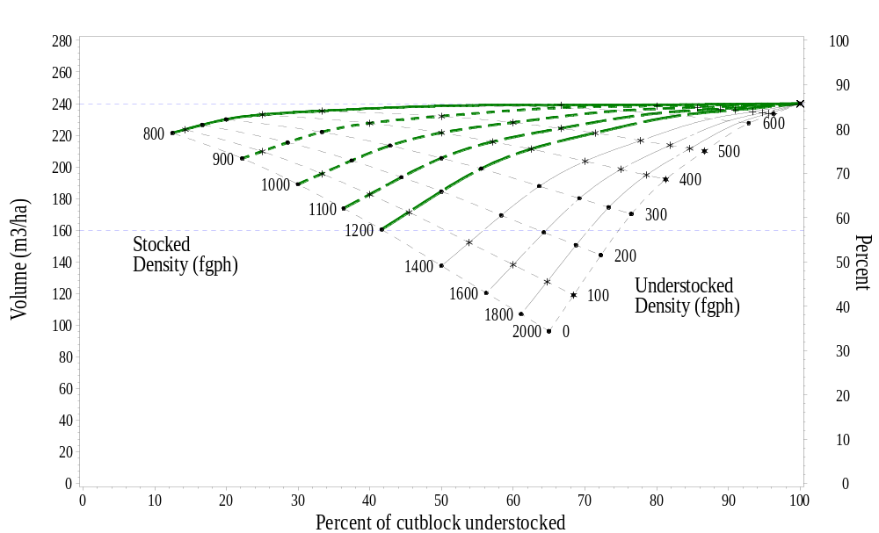
Average density of 700 fgph
Natural Distribution

Slide 74
Average density of 700 fgph
(Stocked density of 800 fgph)
Natural Distribution

Slide 75
Average density of 700 fgph
(Stocked density of 2000 fgph)
Natural Distribution

Slide 76
Average density of 700 fgph
(Stocked density of 1200 fgph)
Natural Distribution

Slide 77
Decision Rules

Slide 78
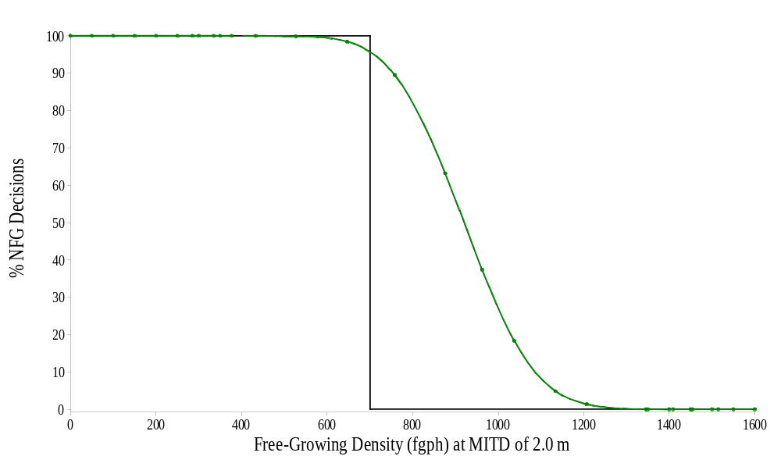
LCL Decision Rule - NFG decisions
(Ministry’s risk)
MSS
Incorrect NFG decisions occur here.
Ideal Decision Curve
LCL Decision Rule
NFG is correct decision in this area.
Clumped distribution

Slide 79
LCL Decision Rule - NFG decisions
(Ministry’s risk)
MSS
95 %
Ministry’s risk
LCL Decision Rule
Clumped distribution

Slide 80
LCL Decision Rule - NFG decisions
(Ministry’s risk)
This decision rule sets 5% as the maximum risk for accepting as stocked an understocked stand.
That is, no more than 5 out of 100 truly understocked stands would be accepted as free-growing.
Or, we would correctly identify at least 95 out of 100 understocked stands as not free-growing.

Slide 81
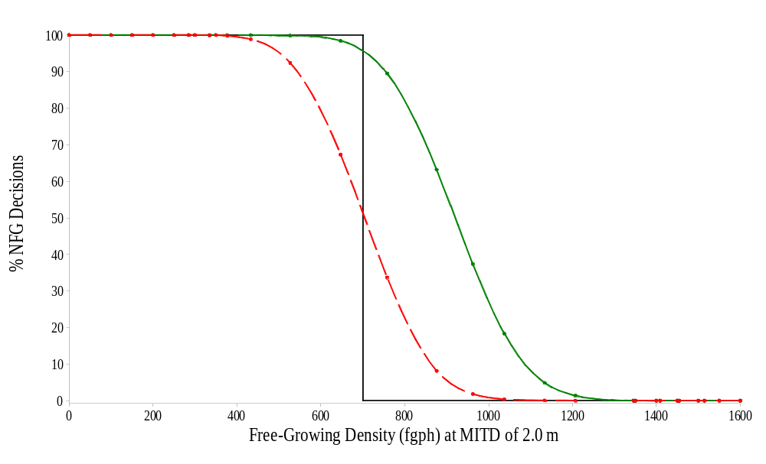
LCL Decision Rule - NFG decisions
(Ministry’s risk)
MSS
Incorrect NFG decisions occur here.
Mean Decision Rule
LCL Decision Rule
NFG is correct decision in this area.
Clumped distribution

Slide 82
Mean Decision Rule - NFG decisions
(Ministry’s risk)
MSS
Ministry’s risk
with LGL rule
95 %
Mean Decision Rule
LCL Decision Rule
Ministry’s risk
with Mean rule
50 %
Clumped distribution

Slide 83
Mean Decision Rule - NFG decisions
(Ministry’s risk)
This decision rule sets 50% as the maximum risk for accepting as stocked an understocked stand.
That is, no more than 50 out of 100 truly understocked stands would be accepted as free-growing.
Or, we would correctly identify at least 50 out of 100 understocked stands as not free-growing.

Slide 84
Comparing Decision Rules
(Ministry’s risk)
Which is better:
LCL: At least 95 out of 100 understocked stands correctly identified as such, or
Mean: At least 50 out of 100 understocked stands correctly identified as such?

Slide 85
Mean & LCL Decision Rules
MSS
Mean Decision Rule
LCL Decision Rule
NFG is correct decision in this area.
Clumped distribution

Slide 86
Decision Rules – Effect of Variability
(Ministry’s risk)
LCL: Ministry’s risk of 5% is always at the MSS.
Mean: Ministry’s risk of 5% changes depending upon variability but is always at a true free-growing density less than the MSS.

Slide 87
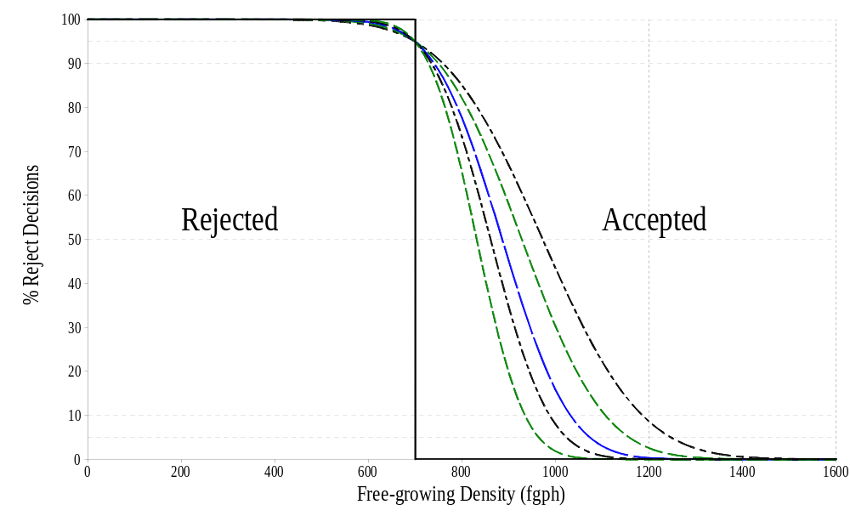
LCL Decision Rule – Variability
(Ministry’s risk – at the MSS)
700

Slide 88
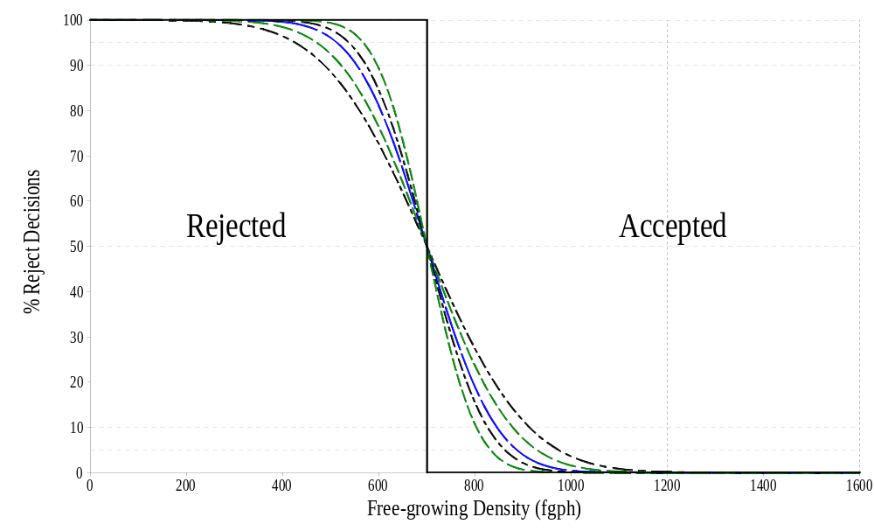
Mean Decision Rule – Variability
(Ministry’s risk – at some density < MSS)
700

Slide 89
Decision Rules – Effect of Variability
(Ministry’s risk)
LCL: Ministry’s risk of 5% is
always at the MSS = 700 fgph.
Mean: Ministry’s risk of 5% in graph ranges from 420 to 570
-- > but is always less than 700 fgph.
This is an example only and other ranges are possible.

Slide 90
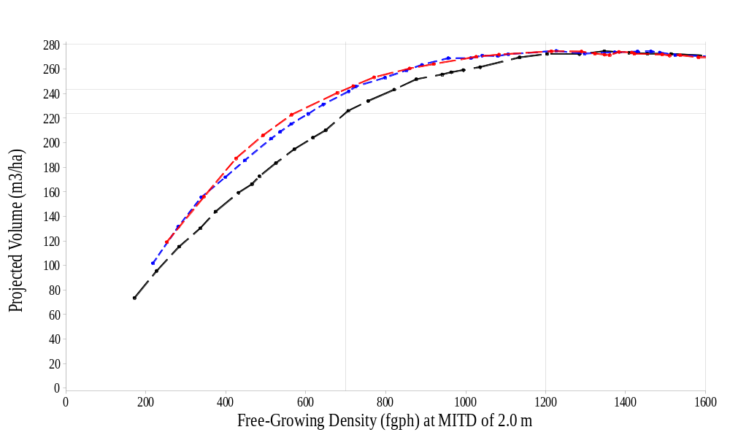
Projected Volume: FG Density
(MITD = 2.0 m)
LCL
Decision Rule
Regular
Mean
Decision Rule
Natural
Clumped
700

Slide 91
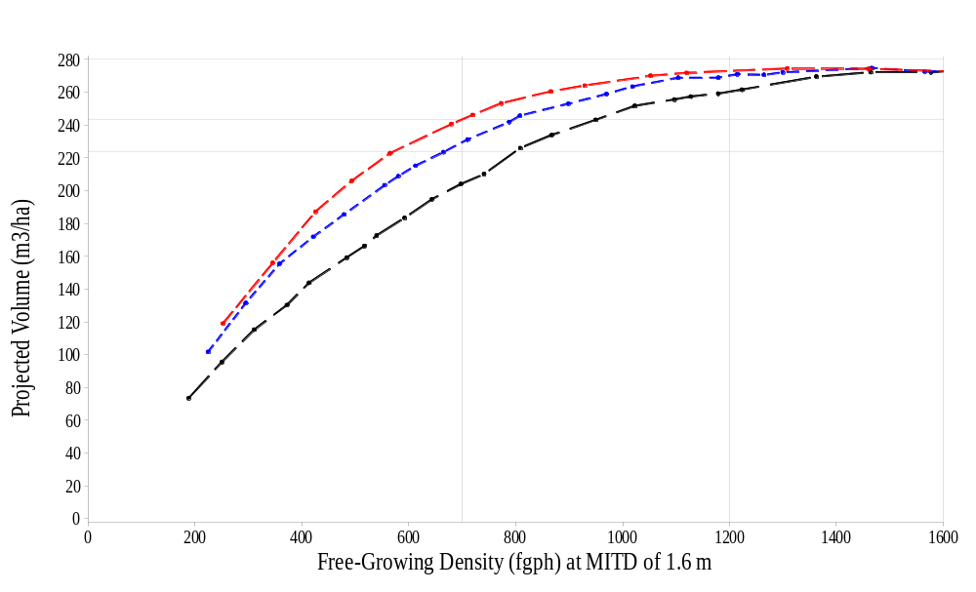
Projected Volume
(MITD = 1.6 m)
LCL
Decision Rule
Regular
Natural
Mean
Decision Rule
Clumped
700

Slide 92
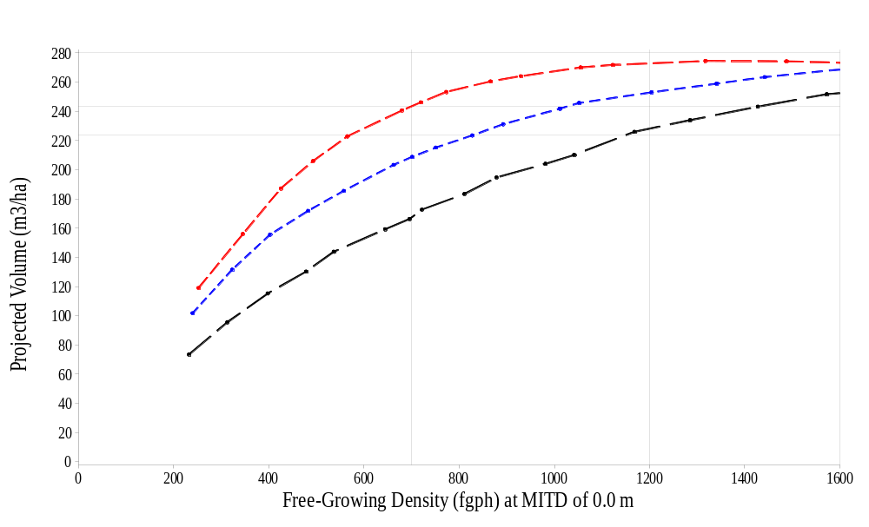
Projected Volume: Total Density
(MITD = 0.0 m)
Regular
LCL
Decision Rule
Natural
Mean
Decision Rule
Clumped
700

Slide 93
Mean Decision Rule
(Ministry’s risk is high and unknown)
Can easily lose a lot of projected volume if used carelessly.
Could still control risk if require variability (measured by SE, LCL or CV) to be within a narrow limit.
  This might require larger sample sizes.
Easier to simply use LCL rule at a lower MSS.

Slide 94
Licensees’ Risk

Slide 95
LCL Decision Rule - FG decisions
(Licensees’ risk)
MSS
Ideal Decision Curve
LCL Decision Rule
FG is correct decision in this area.
Incorrect FG decisions occur here.
But where do we measure the risk?
Clumped distribution

Slide 96
LCL Decision Rule - FG decisions
(Licensees’ risk)
MSS
Ideal Decision Curve
LCL Decision Rule
At TSS?
Clumped distribution

Slide 97
LCL Decision Rule - FG decisions
(Licensees’ risk)
MSS
Ideal Decision Curve
LCL Decision Rule
At fixed error rate?
5%
Clumped distribution

Slide 98
LCL & Mean Decision Rules
MSS
Ideal Decision Curve
Mean Decision Rule
LCL Decision Rule
NFG is correct decision in this area.
FG is correct decision in this area.
Clumped distribution

Slide 99
Conclusions
Stocking standards are currently measured in free-growing density NOT total density.
The purpose of the Silviculture Survey is to make a decision.
The LCL decision rule controls the Ministry’s risk of incorrectly accepting understocked strata.

Slide 100
Conclusions
The MITD is an essential part of the definition of free-growing.
The M-value is important for heterogeneous or clumpy areas, BUT
Stratification can do a better job of ensuring that understocked areas are properly identified.

Slide 101
Conclusions
Considerable preparation work is required to demonstrate that we will get the same results as before if:
  We change the method of determining if free-growing has been achieved.
  We change current standards from density measures to projected volume measures.

