Slide 1
Ecology and Earth Sciences Section
An overview of recent accomplishments
Evelyn Hamilton, MSc, RPBio
Manager, Ecology and Earth Science Section, Research Branch
BC Ministry of Forests and Range

Slide 2
Outline
Overview of Research Branch
Ecology and Earth Sciences Section
EES Program Highlights
  Ecology
  Watershed Science
  Soils
  Climatology and Carbon
  Range Ecology
  Landscape Ecology
  Wildlife Habitat
Summary

Slide 3
Overview of Research Branch
Research Branch
A/Director
Winn Hays-Byl
Ecology and Earth Sciences Section
Manager
Evelyn Hamilton
Forest Genetics
Section
Manager
Barrie Phillips
Forest Productivity and Decision Support Section
A/Manager TBA

Slide 4
Ecology and Earth Science Section
Organization chart
Main activities
Key drivers
Key clients and collaborators

Slide 5
Description of EES Section
Organization chart
Locations – Victoria, Smithers, Kamloops
Allocation of effort
Strengths
Notes:
The Section is divided into 7 programs – Ecology (BEC and forest ecology), Soils, Climatology and Carbon, Watershed, Landscape ecology, Wildlife habitat, Range ecology (See Table 1) . Staff are located in Victoria, Kamloops, Smithers and Vernon.

Slide 6
EVELYN HAMILTON
Manager
(2086) ML6
WATERSHED
ECOLOGY &
RESEARCH
BIOGEOCLIMATIC
LANDSCAPE
RANGE
CLIMATOLOGY
SOILS
WILDLIFE
ECOSYSTEM
ECOLOGY
ECOLOGY
HABITAT
CLASSIFICATION
Tschaplinski, P.
MacKenzie, W.
Walton, A.
Newman, R.
Spittlehouse, D.
Berch, S.
Morgan, Don
Research Scientist
A. Research
Research Landscape
Range Ecologist
Senior Research
Forest Soils
Team Leader,
Fish Habitat Biology
Ecologist
Ecologist
(3677) LSO3
Climatologist
Ecologist
Wildlife Habitat
(3804) LSO4
(3665) BIO R27
(3183) BIO N27
(3664) LSO4
(3836) LSO4
(2095) BIO R30
Hogan, D.
Mah, S.
Chen, H.
Wallace, B.
Dymond, C.
Bulmer, C.
Hovey, F.
Research Scientist
Interpretation
Landscape
Range Ecologist
Carbon Modeller
Soil Restoration
Wildlife Habitat
Geomorphology
Ecologist
Modelling Biologist
(96225) LSO2
(93243) LSO3
Ecologist
Analyst
(4611) LSO4
(3792) LSO3
(4784) BIO N24
(5080) LSO3
(5078) BIO N24
Pike, R.
Parminter, J.
McLellan, B.
Watershed
Research Ecologist
Senior Wildlife Habitat
Ecosystem Specialist
Forest Dynamics
Ecologist
(91608) LSO3
(3675) LSO3
(3672) LSO5
Campbell, E.
Research Ecologist
(87299) BIO N27
Vacant/MacKenzie, W.
Research Ecologist
Wetland & Riparian
Specialist
(5063) BIO N24
Heemskerk, B.
Assistant
Research Ecologist
(97198) BIO R21

Slide 7
Main activities
Provincial research program coordination.
Research on long and short term projects
Providing expert advice to decision makers
Developing assessment procedures
Analysis of implications of management actions
Using existing info to address new issues (e.g., implications of climate change)
Extension and consulting
Approx. 40% of time spent on research
Approx. 60% of time supporting clients through consulting and other activities
Notes:
Responsibilities include:
provincial program coordination.
research = the network of long term research installations and data we have collected that we now use to address new issues – such as predicting the implications of climate change on ecosystem function.
extension etc
Most staff spend about 40% of their time on research and 30% supporting FSDMT clients through consulting and other activities and 30% of their time supporting other clients including Ops. Div., Resource Tenure and Revenue Division and BCTS as well as other agencies. The EES Team Leaders are responsible for provincial program coordination. A strength of the EES section is the high level of expertise in a broad range of disciplines and the network of long term research installations and data we have collected that we now use to address new issues – such as predicting the implications of climate change on ecosystem function.

Slide 8
Key drivers
MFR Act (S. 4) - Manage, protect, conserve and plan the use of forest and range resources, encourage maximum productivity and competitive forest and range industries
Economics/industry competitiveness – green energy; carbon economy; supporting communities
Balancing competition for forest resources
Climate change and carbon economy
First Nations partners in the new economy
Maintaining public trust in resource management
Notes:
Key Drivers
Key drivers for the program include:
MFR Act (S. 4) - Forest/range resources – manage, protect, conserve and plan the use of; encourage maximum productivity; encourage vigorous, efficient and competitive industry
Economics/Industry – reduced funding; BC forest economy; green energy; carbon economy; communities
Competition for forest resources – overlapping interests; cumulative effects
Climate change and carbon economy
First Nations – New Relationship; partners in the new economy
Maintaining public trust in resource management
Internal drivers - demographics, integrated business, efficiencies through technology

Slide 9
Key clients and collaborators
Key clients
Forest Stewardship Division
Operations Division
Tenure and Revenue Division
BCTS
Other agencies – MOE, MEMFR, DFO
Key collaborators
Regional MFR scientists, UBC, UNBC, SFU, TRU, CFS, FP Innovations, BVC, FORREX
Notes:
Staff supporting FSDMT clients through consulting and other activities and other clients including Ops. Div., Resource Tenure and Revenue Division and BCTS as well as other agencies.
Main clients of EES
The main clients are the
Chief Forester,
FPB (e.g. supporting FREP, FRPA regulations, policy and guidances),
FAIB (e.g. TSR, MPB projections & inventory) and
TIB (e.g. BEC for seed transfer zones) in Forest Stewardship Division.
In Operations Division we support the
Regions and Districts (e.g. leadership of provincial research, advice to planners and field staff),
Compliance and Enforcement (e.g. impacts of MPB salvage on soils),
Wildfire Management Branch (e.g. fire disturbance regimes) and Range Branch (e.g. management prescriptions).
Other clients include
Economics and Trade (e.g. mt. caribou TSA risk and NTFP policy),
Revenue (e.g. $0.25 stumpage appraisal),
Resource Tenures and Engineering (e.g. bioenergy)
Aboriginal Affairs Branches (e.g. First Nations knowledge systems and NTFPs).
We also support BCTS (e.g. silviculture interpretations), ILMB (e.g. advice to LRMPs), other agencies - (e.g. advice to DFO, MOE, MEMP) and industry (e.g. riparian management guidance).
Research Collaborators
We collaborate with universities (e.g. FFESC projects) industry, other Branches (e.g. CC&FC adaptation policy assessment), other sections (e.g. seed transfer rules), industry (e.g. Canfor) and ENGOS (e.g. NCC and BV Center).

Slide 10
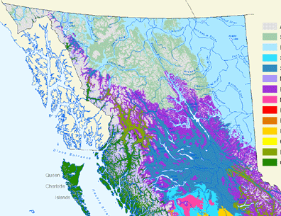
Ecology Program
Staff and locations
Accomplishments
What’s new
Future directions
Notes:
Staff and locations = Shirley, Will, Eliz, Ben and John (emeritus)
Accomplishments –
Developing Ecosystem Classification system (BEC) zone maps, PEM/TEM maps & field guides.
Decision support tools (e.g. SIBEC site specific tree species yield projections.
Resource management recommendations (e.g. stocking standards).
Landscape disturbance regimes (e.g. NDTs)
What’s New
EC - Conducting research and develop operational indicators of ecological resilience for temperate and boreal ecosystem
Developing management framework (i.e. BEC system) to deal with climate change (CC)
Multi scale (local, regional, provincial) assessments of forest vulnerability in the face of CC.
Future directions
Tree species selection decision support tool
Landscape species strategies
Fire history synthesis
Work to be done by March 31 2010. - from SM
EC - Two extension notes on climate change and ecological resilience that transfer scientific knowledge to operation managers/clients
WM - Draft climate change-related journal paper with Dan McKenney, title?
SM – SIBEC 2010 Approximation site index estimates reports published to SIBEC website
SM – FFEI Tree species selection project – key information for tree species selection decision-making posted to Tree species selection project website

Slide 11
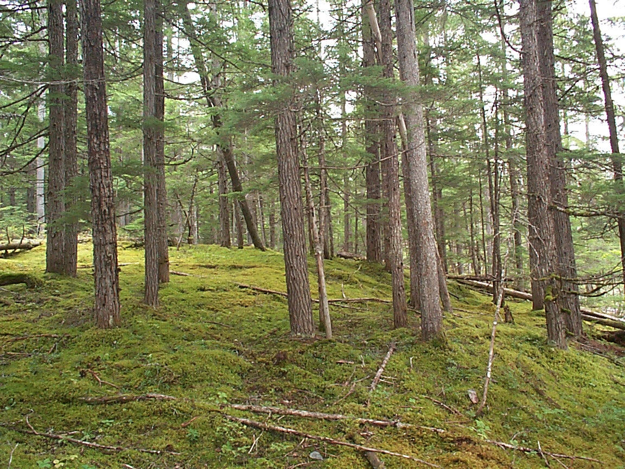


Shirley Mah
A/ Team Leader, Ecology Program and Interpretations Ecologist
Victoria
Notes:
About the Program
About Shirley
Shirley's areas of responsibility include research in the development of ecologically-based management interpretations that include the long-term SIBEC project, and implementing their use at operational and strategic levels of forest management.
Her current interests are ecosystem-site productivity relationships, tree species selection, landscape level strategies , relationship of ecosystems to people and management, and non-timber forest products.

Slide 12

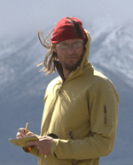
Biogeoclimatic
Ecosystem
Classification
Climate Change
&
Will Mackenzie
Research Ecologist- BEC system
Smithers
Notes:
Will has 15 years experience as an ecologist in BC and the northern territories. Initially hired by the Research Branch in 1995 to create a province-wide classification of wetland and riparian ecosystems. Will has moved on to constructing a provincial alpine classification, and a seral classification of the SBS. Will manages the provincial ecological dataset and is actively building software tools for collection of field data and management and maintainance the provincial classification . His main interests are in botany, plant and wildlife ecology, and informatics.
New BEC brochure
International Boreal Classification working group

Slide 13
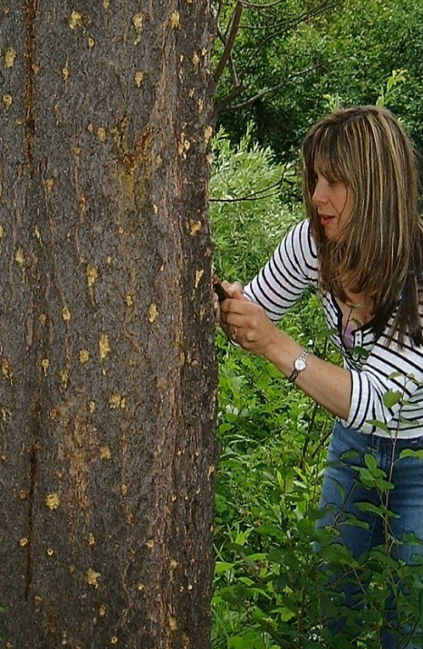
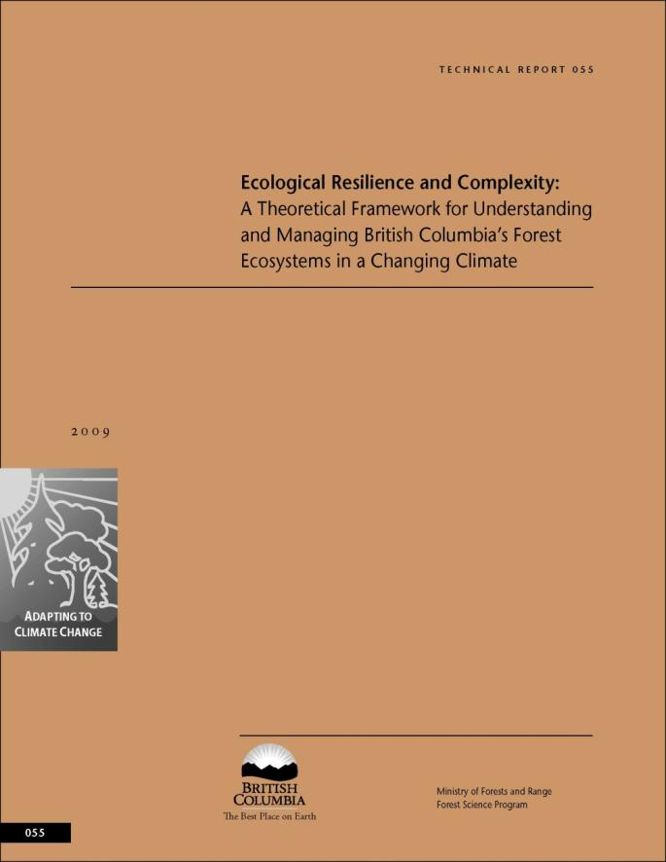
Elizabeth Campbell
Research Ecologist – Ecosystem Processes
Victoria
Notes:
Lead FFEI Tech team work on framework document.
Ecosystem process research, landscape level disturbances, resiliency projects – operational indicators of resilience
Resiliency and tree regeneration projections under CC (TACA model). With UBC
Coast region – landscape level pilot project with Sari and A Fall – large scale disturbances
Modelling changes to tree species regeneration niches
Recently invited to PCIS workshop on resiliency research strategy development
White bark pine studies
Manuscript submitted: Projected shifts in ecological zones and selected tree species: implications for management
b. Draft manuscript: Projected changes in tree (seedling) regeneration niches in three regions of British Columbia
c. Published: USDA For. Serv. Technical Report: Range-wide conservation strategy for whitebark pine
d. Resilience extension note
e. SELES proof of concept construct: landscape model of climate change impacts/ecological resilience in RMFD, & framework developed for coastal implementation of SELES
f. RF projections of range shifts for some tree species
g. Projections of historical, current and future impacts of MPB outbreaks on high-elevation pine forests (climate change analysis, mulitiple scenarios)
h. MoFR tehnical report: high resolution projections of BEC zone shifts for PR, RMFD, Coast, Kamloops, Nadina (summer)
i. Publication of Ecoscience manuscript on: boreal landscape composition and defoliator outbreak severity.
h. Manuscript: growth patterns of high elevation trees.
To year end
1.BEC and climate change (UBC sessional lecture)
2.Climate change and MPB in high-elevation pine forests of BC (High –five pine conference: I am on the organizing committee, sessional organizer, and speaker) (june, Montana: will likely get someone to pay for this)
3. A resilience presentation for MoFR (probably June,

Slide 14
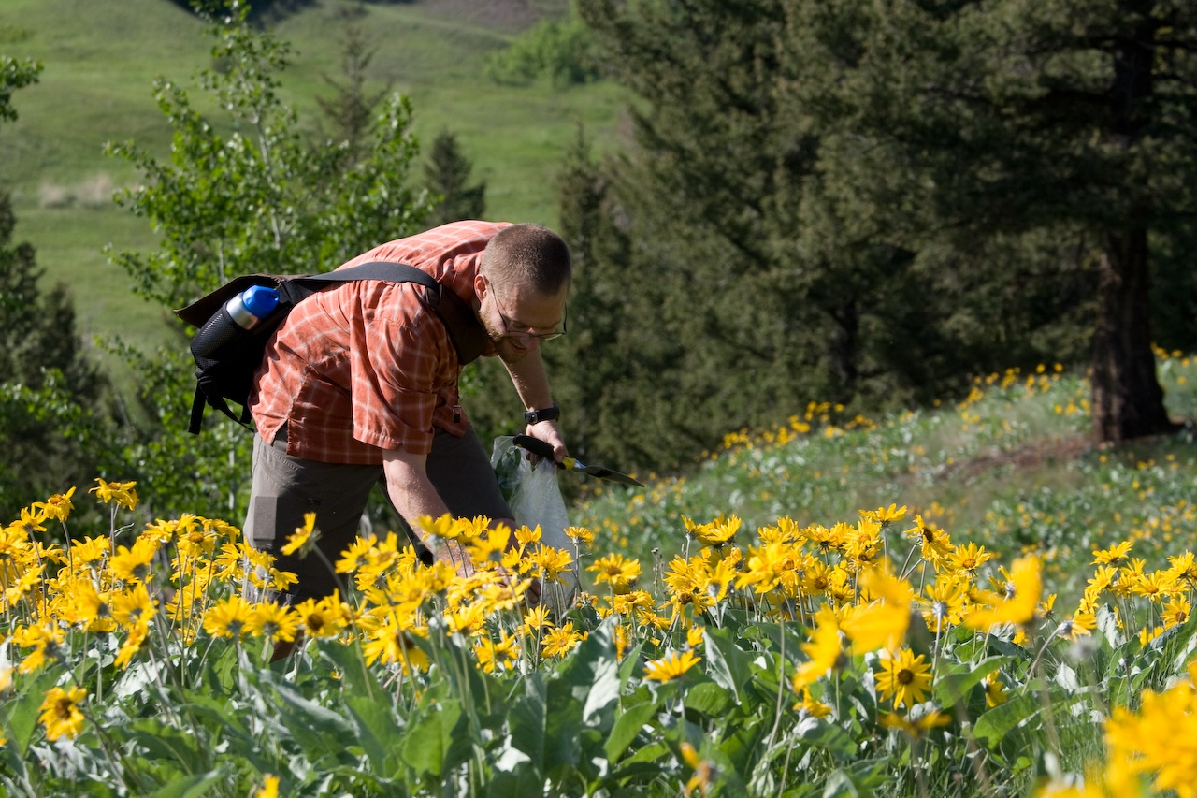
Ben Heemskerk
Assistant Ecologist
Smithers
Notes:
Ben Heemskerk – the assistant ecologist in the Ecology program who works out of Smithers - doing vegetation plot sampling and plant identification with Will Mackenzie in the southern interior last summer. Seral sampling
Also helped on many other projects and pubs

Slide 15
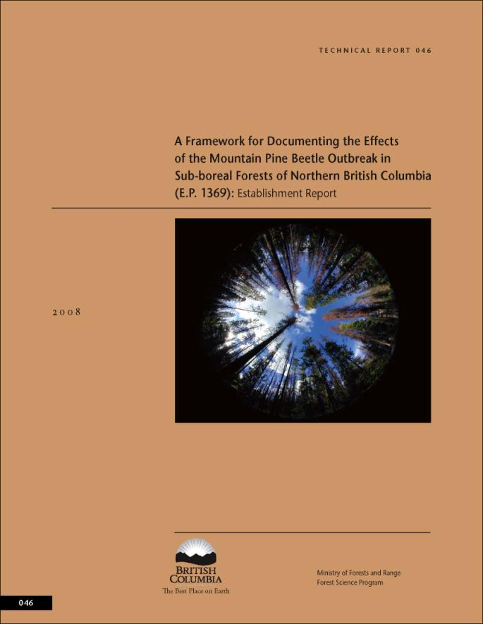
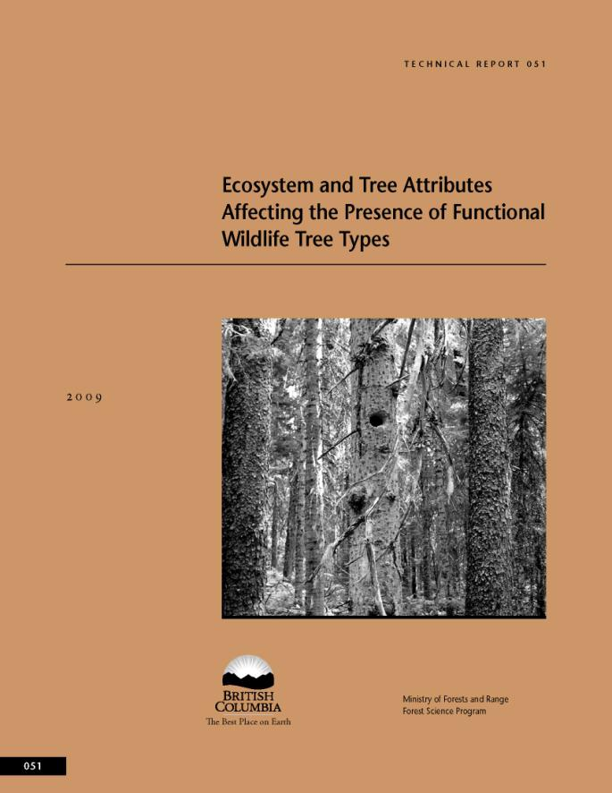
Notes:
Some publications Ben has been involved with producing

Slide 16
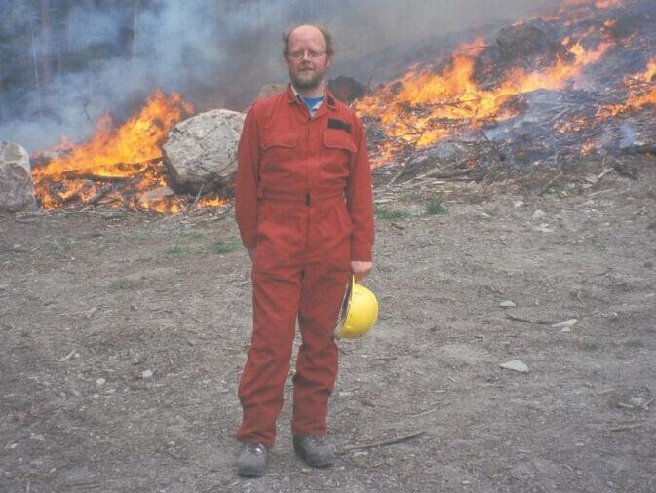
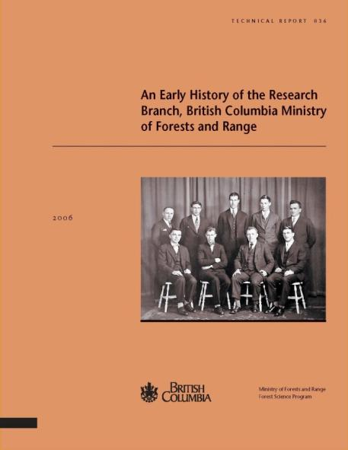
John Parminter
Fire Ecologist
(Emeritus scientist )
North Road Lab
Notes:
John has been involved with the FPC Biodiversity Guidebook, procedures for monitoring range and wildlife habitat management activities, the Vegetation Resources Inventory, coarse woody debris dynamics, natural disturbance ecology and ecosystem restoration.
He has a long standing interest in forest history – including that of the Branch
These are my main projects -
To finalize and co-publish a report with the Canadian Forest Service summarizing the known wildfire history of B.C. from social, historical and scientific perspectives. The purpose of this report is to provide an overview of the role of fire in B.C.’s forests based on field research, databases, oral and written histories and analyses of digitized map records of wildfire locations, dates and causes. Such information is useful for landscape level planning, resource management, modelling of fuel and vegetation dynamics, wildland fire threat analyses and ecosystem restoration activities.
To provide content on natural disturbance ecology for the Research Branch website in the form of an annotated bibliography.
For a) I am contributing the first 7 sections of the report. Five are done, 6th is nearly complete, 7th is in outline form only. I expect Steve Taylor will contribute to that section as well. Probably need two months to finish my contributions.
Project b) will be addressed when a) is done. I have gathered many references and will produce an annotated bibliography for BECWeb. Should be more straightforward than a).

Slide 17
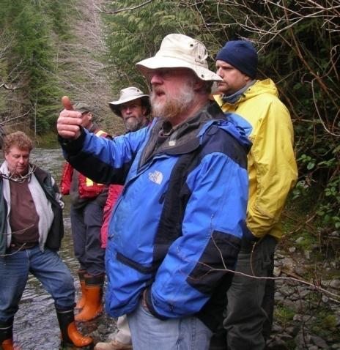
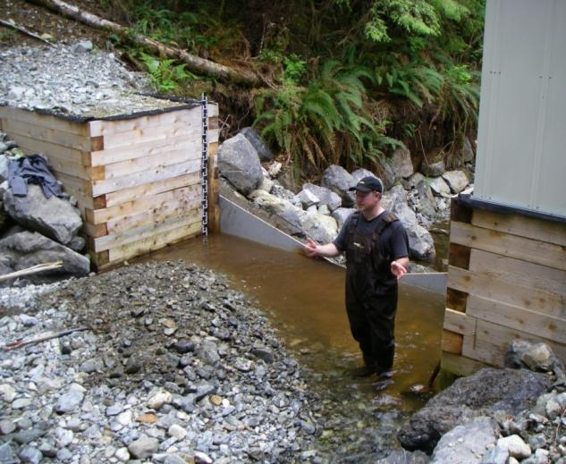
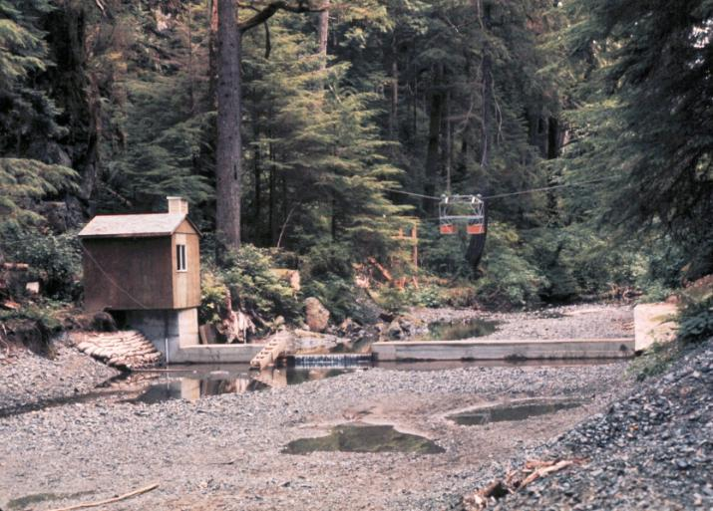
Watershed Program
Staff and locations
Accomplishments
What’s new
Future directions
Notes:
Staff and locations – Peter, Robin and Dan
Accomplishments
Watershed assessment procedures
FRPA riparian management policy & regulations and effectiveness
FREP riparian assessment procedures
Stream crossing & fish passage assessment protocols and guidance
Impact of harvesting on water & fish
Effects of MPB and salvage harvesting on watersheds
Effects of forest fertilization on water quality
Consulting to MFR regions, districts MOE, FSW, TSS, Living Water Smart, State of BC’s Water, Wetland Stewardship Partnership and MPB-hydrologic monitoring initiatives, DFO, and industry
What’s New
Compendium chapter on Effects of CC on watershed hydrology (e.g. Water
Future Directions /Underway
Hydrology Compendium publishing
FREP reports

Slide 18
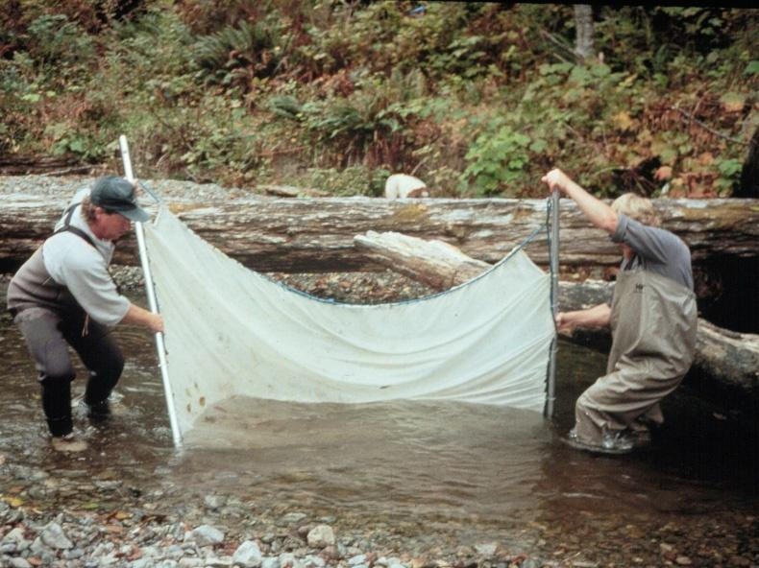
Peter Tschaplinski
Manager Watershed Research Program, Victoria office
Dan Hogan
Research Scientist ,Geomorphology , UBC office
Notes:
About Peter
Here Peter T is seining juvenile coho salmon, steelhead, and rainbow trout at Carnation Creek to determine summertime population abundance after logging. This is one part of a larger study looking at the long-term effects of forest harvesting on watershed physical processes, aquatic habitats and fish. 39 yrs – longest salmon study in world.
Peter has been working on completing a 5 Yr FREP riparian assessment report, revising the Water Act and defining “material adverse effects” .
Participates on Rip Reg WK Gr, Fish Passage Tech working Group producing guidebook for stream crossings (applied for TB fund to do needed work), Fish sens wateshed WG, T sens watershed WG
Dan Hogan is looking at physical channel changes at Carnation Creek and elsewhere
Dan Hogan Research Scientist – Geomorphology
Leads provincial geomorphology program research projects.
Consulting to MFR regions, districts, MOE, DFO & industry.
Hydrology Compendium chapters
“Protocol for Evaluating the Condition of Streams and Riparian Management Areas”
“Sediment storage and transport in coarse bed streams”
“A landscape level assessment of post-beetle change in stream riparian function”
“Stream channel morphology and large woody debris dynamics in both harvested and unharvested drainages in various biogeoclimatic zones in British Columbia”

Slide 19
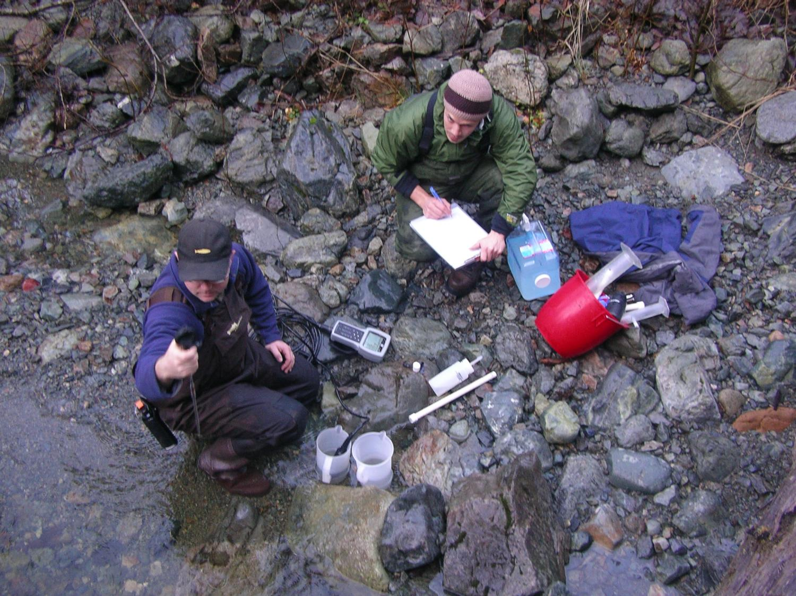
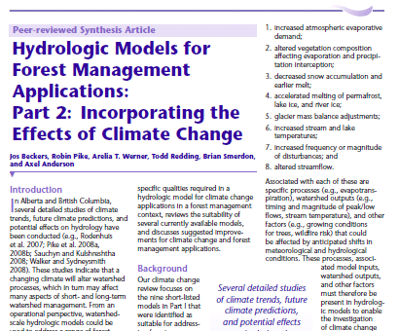
Robin Pike
Watershed Ecosystem Specialist
Victoria office
Notes:
Robin Pike Victoria. Watershed Research Hydrologist
Leads Carnation Creek hydrology research and CC and watershed processes projects.
FFEI Tech Team member.
Watershed extension and consulting.
Robin Pike‘s has lead a number of extension products . Some of his field work has consisted of using salt as a tracer to gauge streamflow at Carnation Creek. To calculate discharge in our creeks
Hydrologic Models for Forest Management Applications: Incorporating the Effects of Climate Change/ Summary of climate change effects on watershed hydrology
Robin is working on Hydrology and Geomorphology Compendium chapters: a comprehesive synthesis of watershed science and hydrology research
Watershed Measurement Methods and Data Limitations/ Detecting and predicting changes in watersheds/ Water Quality and Forest Management/ Stream, Riparian, and Watershed Restoration/ Riparian Management and Effects on Function/ Climate change and watershed processes

Slide 20
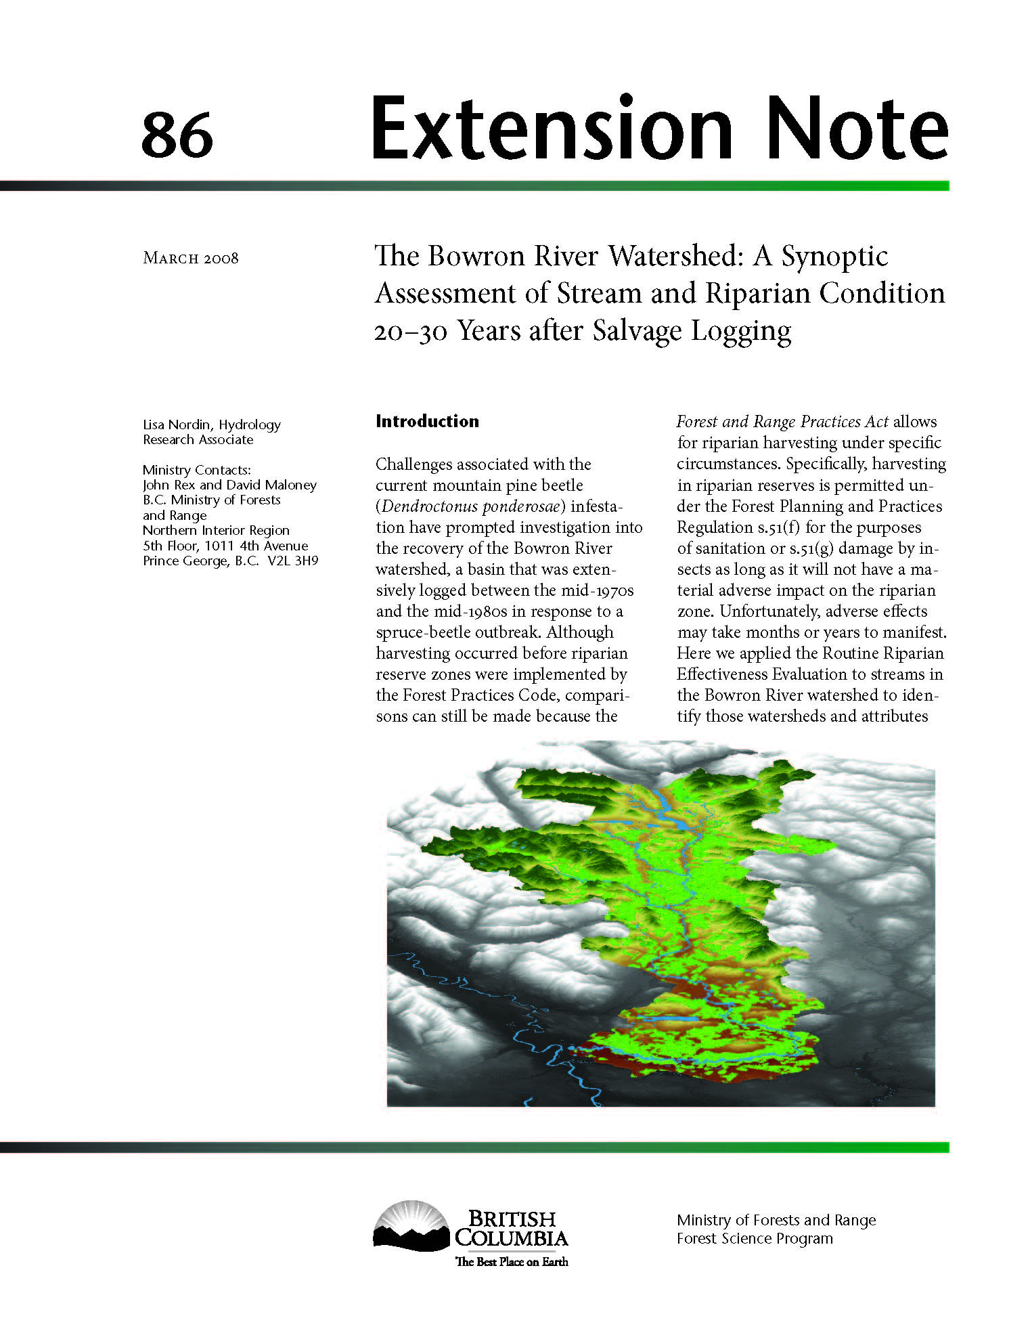
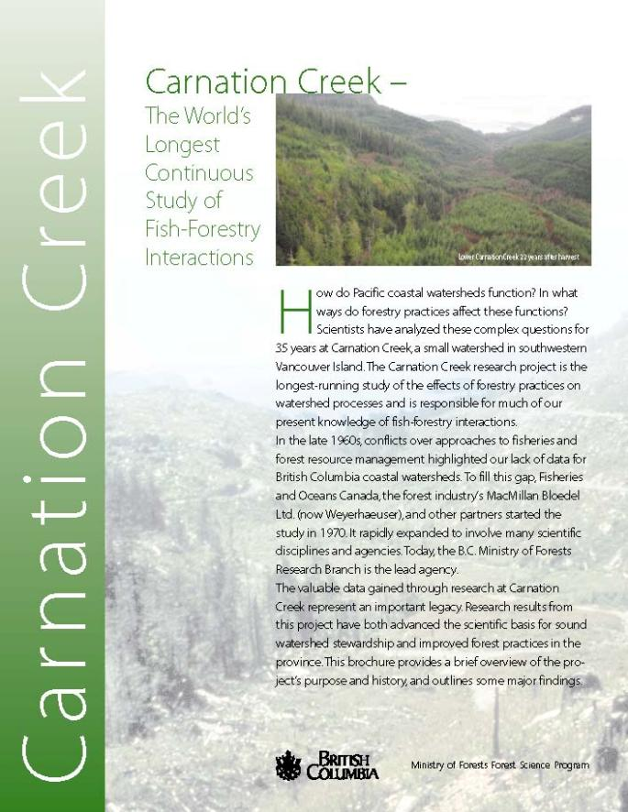
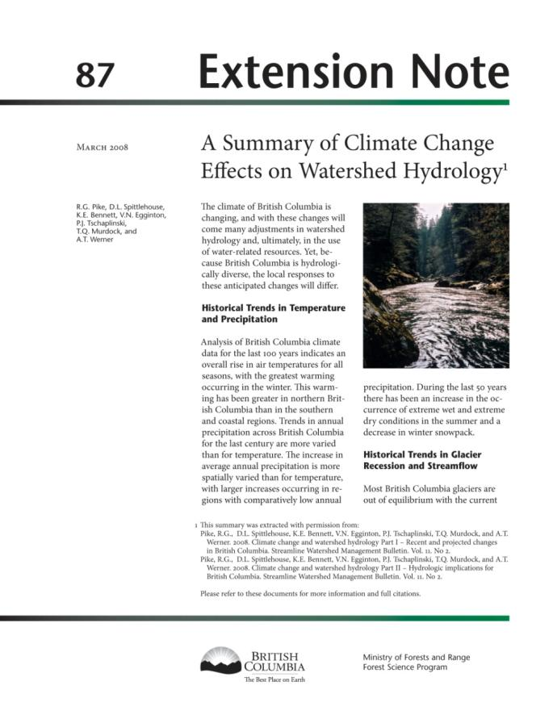
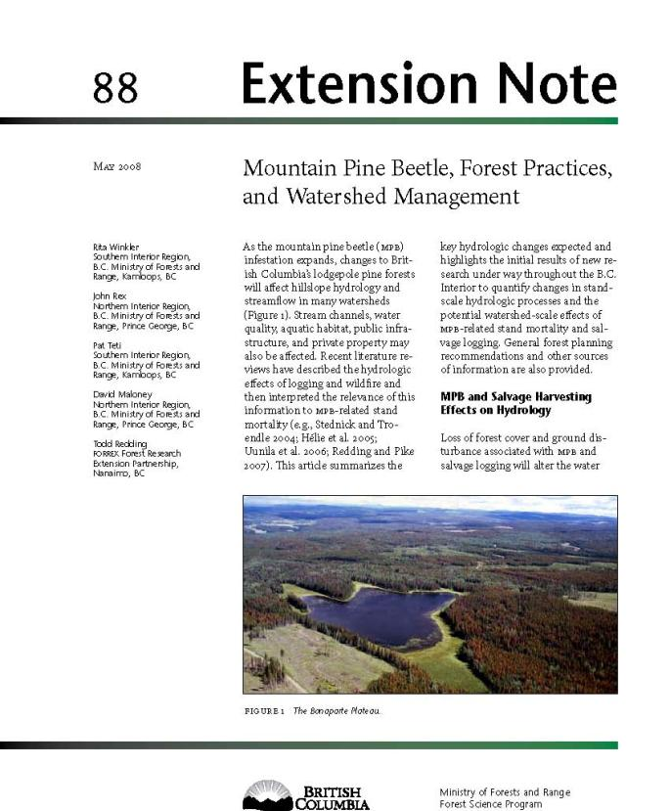
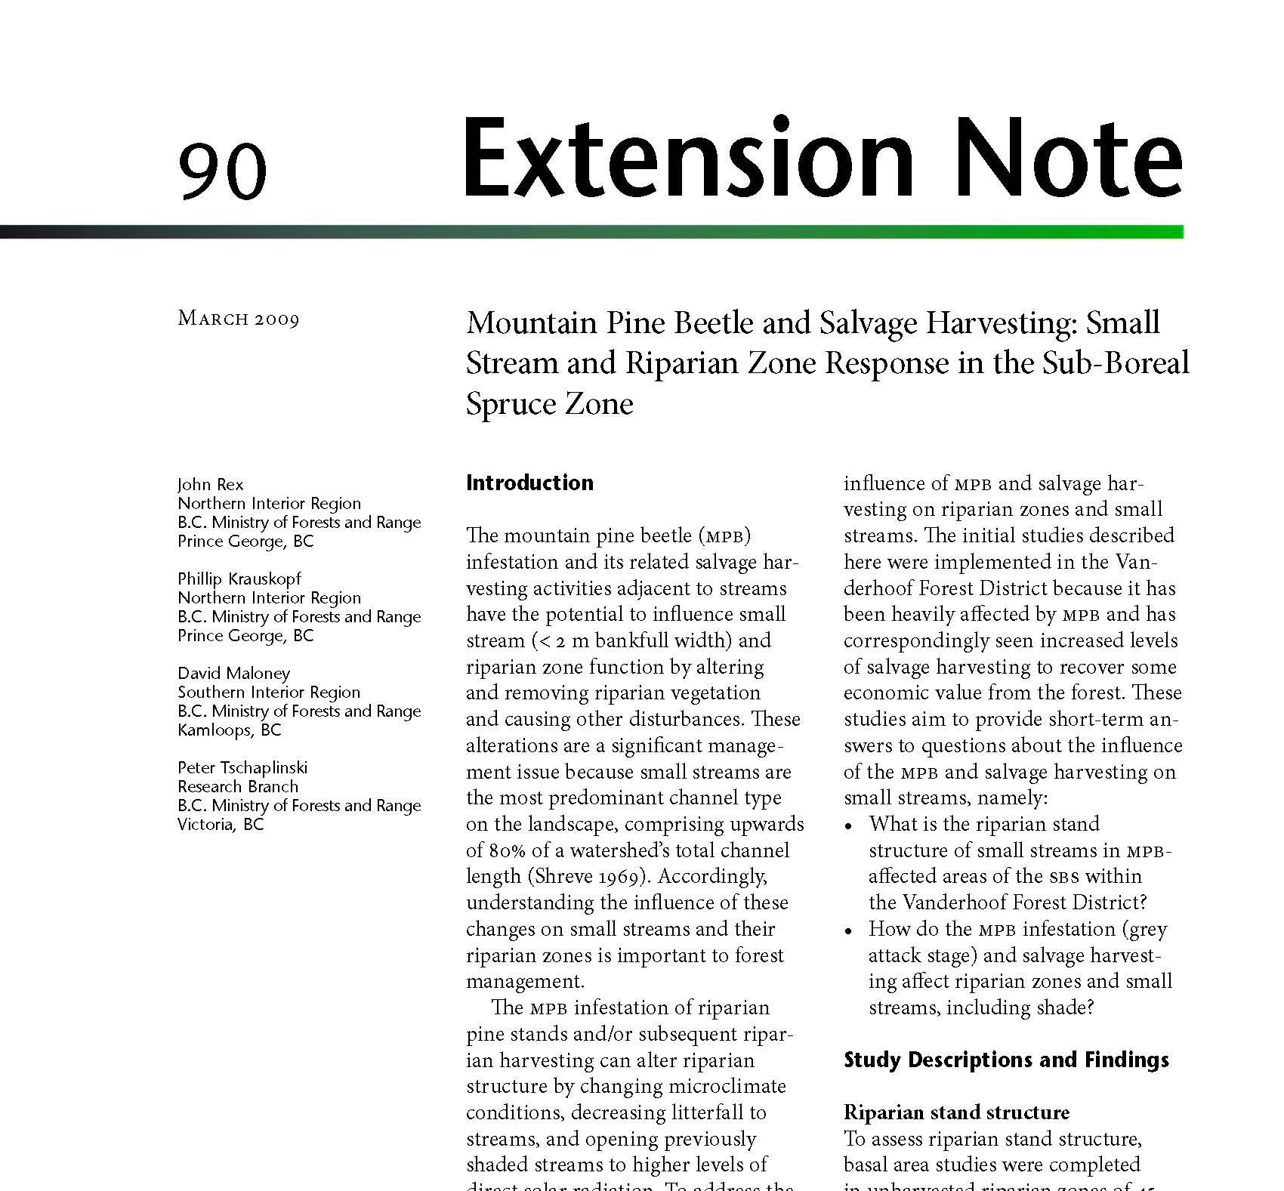
Notes:
Some of the extension products produced recently

Slide 21
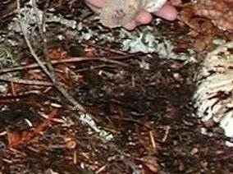
Soils Program
Staff and locations
Accomplishments
What’s new
Future directions
Notes:
Staff and locations Shannon – N Road Lab chuck – Kal
Accomplishment
Leads provincial soils, LTSP, biomass/ bioenergy, and NTFP research programs
Implications of biomass harvesting on ecosystem sustainability
FREP soil disturbance evaluation procedures
Soil conservation guidance
Leads provincial research on effects forestry on soil productivity
Leads soil restoration research program
Improving techniques for evaluating soil compaction
Improving access to soil information
What’s New
Vulnerability of soils to climate change
Contribution of soil C to C cycle
Effects of CC on soil productivity
Future directions
Digital provincial soils map
Bio-energy harvesting guidance

Slide 22
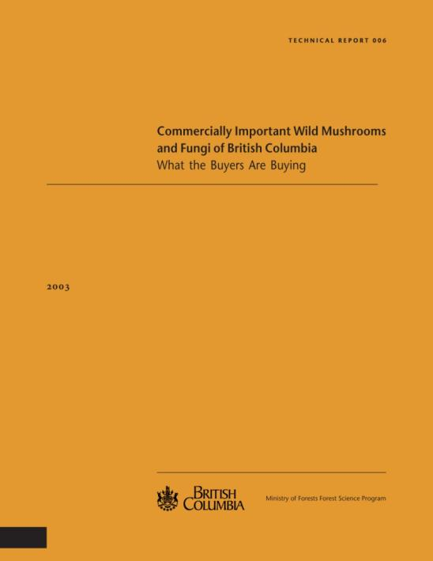
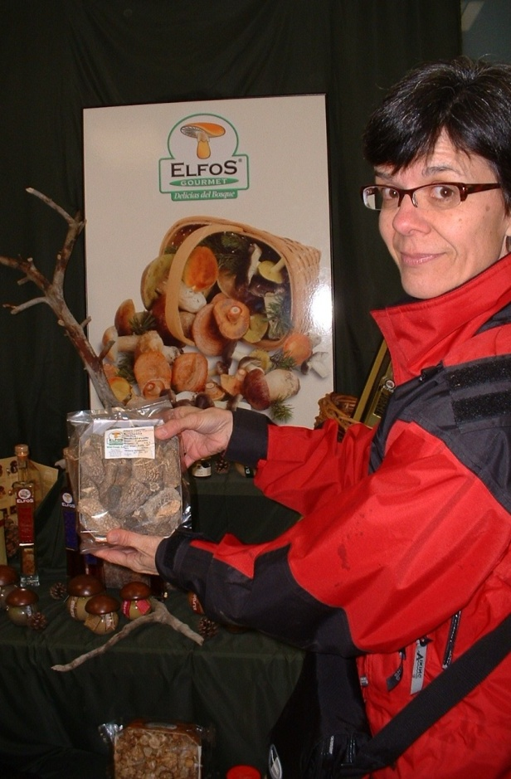
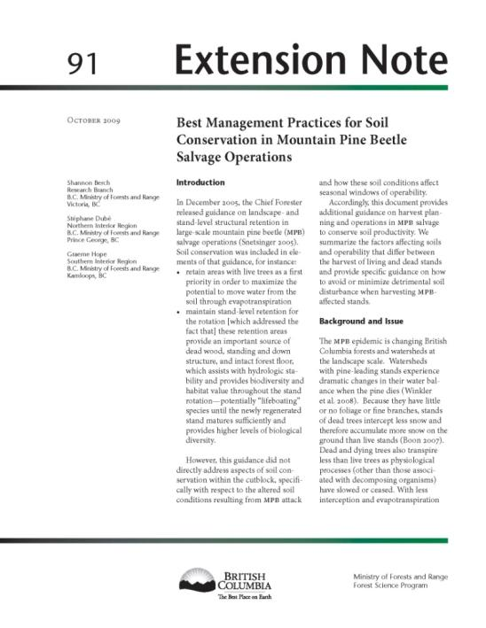
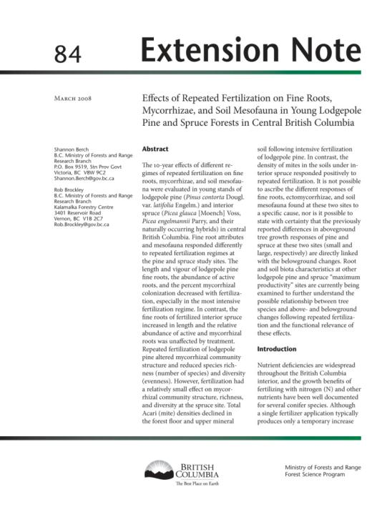
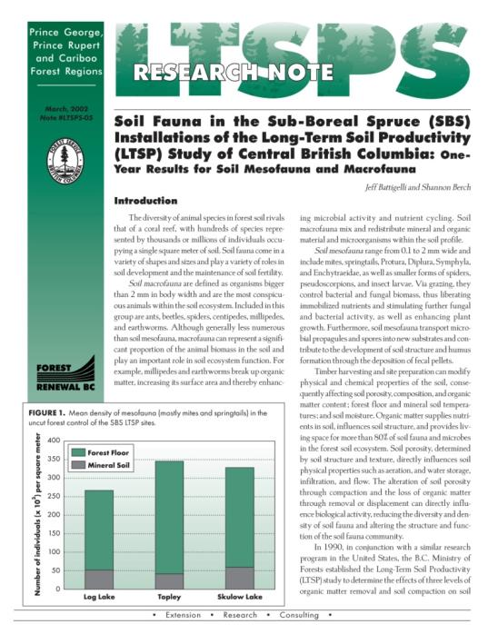
Shannon Berch
Team Leader, Soils and
Research Scientist
North Road Lab, Victoria
Notes:
Shannon in Europe at mushroom conference, recently invited to talk about biomass harvesting in Germany International Energy Agency Commission.
Helping TRU organize bioenergy and biomass workship for June
Recenlty invited to Quebec Ctiy to talk on BC policies and practices wrt NTFPS

Slide 23
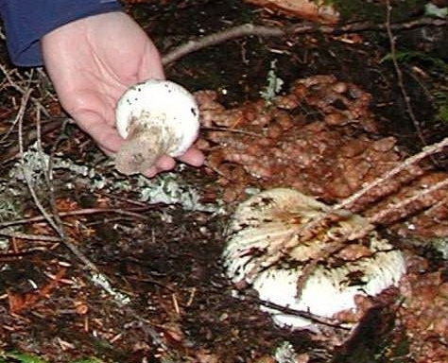
Compatible Management of Timber and Pine Mushrooms
Ministry of Forests and Range, Research Branch
The Centre for Non-Timber Resources
Royal Roads University
March 2009
Photo credit: Shannon Berch
Shannon M. Berch and J. Marty Kranabetter
BC Ministry of Forests and Range
Research Branch, Victoria
Notes:
One of Shannon’ recent publications – coming out in MFR series

Slide 24
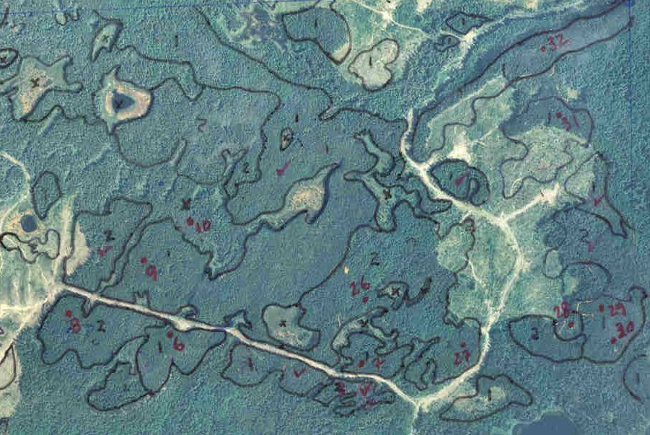
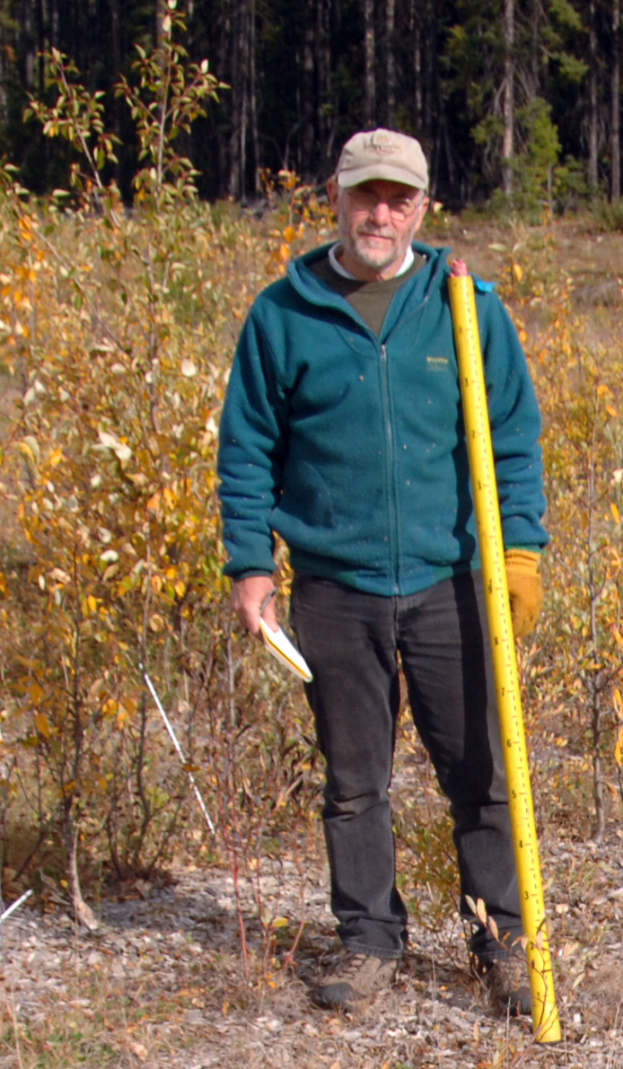
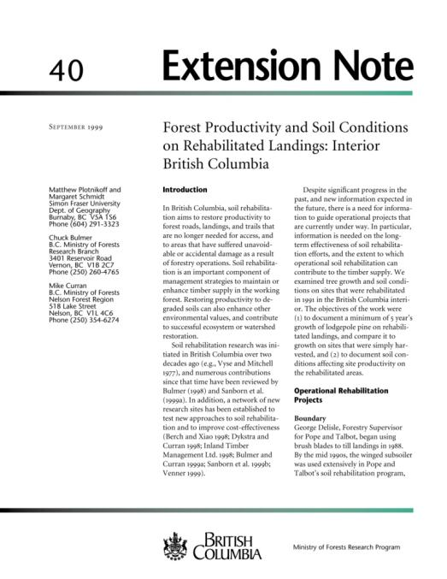
Chuck Bulmer
Research Soil Scientist
Kalamalka Lab
Vernon
Notes:
Chuck Bulmer Soil scientist
Leads provincial research on effects of harvesting & fertilization on soil productivity
Leads soil restoration research program
Chuck measuring trees near Dawson Creek.
Working on improving techniques for evaluating soil compaction / rehab effects on productivity through field studies and lab testing of soil properties.. and
(b) Predictive soils map - working with a large group of people to improve the availability and quality of existing soil survey information to address old and new challenges like hazard assessment, biomass harvesting effects, climate change, carbon accounting.
Part (b) involves getting existing information into a format more suitable for computer modeling over large areas as well as exploring and evaluating predictive techniques to estimate soil conditions in those parts of the province that do not have existing soil surveys
Post wildfire effects on watersheds – risk of flooding and mass wasting

Slide 25

Climatology and Carbon Program
Staff and locations
Accomplishments
What’s new
Future directions
Notes:
Staff and location – Dave and Caren
Accomplishments
Leadership of provincial climatology and carbon research program and FFEI Tech. Team climate modelling work
Liaison with PCIC and PICS
ClimateBC database (now Climate Western North America climate database)
Improved access to high resolution spatial CC data.
Climate change and BEC zone shift scenarios
Research and consultation in support of carbon
What’s New
Carbon man EN
Future Directions/Ongoing by year end
Establishing CC and Carbon research group
Modelling framework for climate change impacts.
Provincial greenhouse gas inventories – to be published
More offset protocols, ZND, SOF published

Slide 26
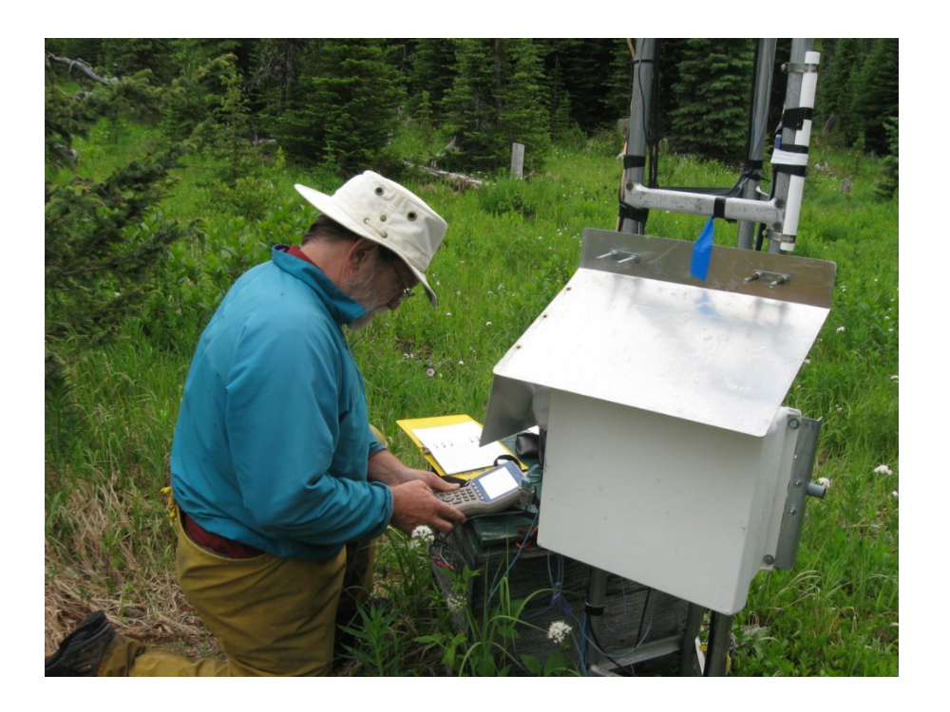
Dave Spittlehouse
Team Leader, Forest Climatology and Carbon Research
Victoria office
Notes:
Dave – climate data collection Pent Crek Car crk
Carbon and water flux measurements of forest stands
Hydrologic impacts of forest management
Organizing committtee for PCIS Carbon workshop in June

Slide 27
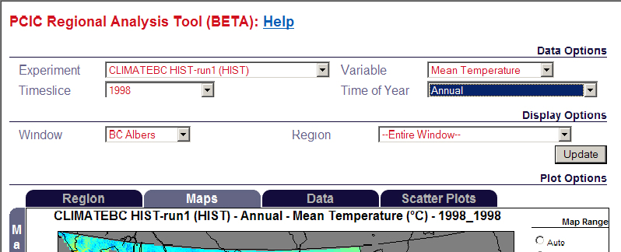
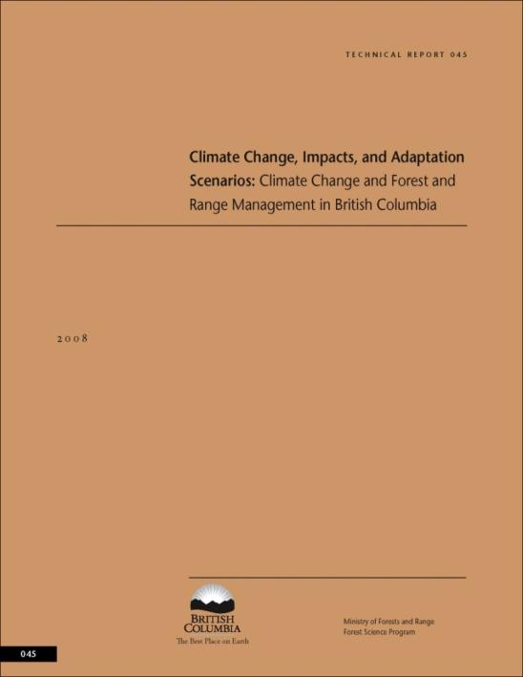
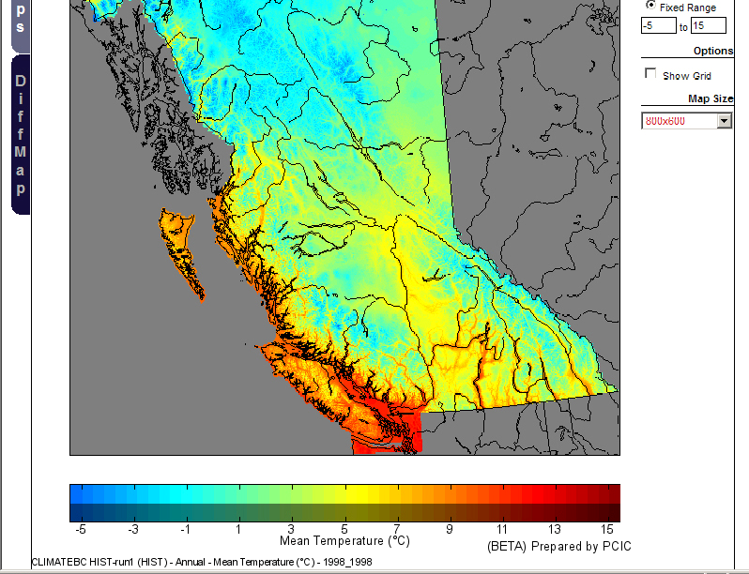
Notes:
Dave’s recent Tech Report on scenarios
PCIC regional analysis tool

Slide 28
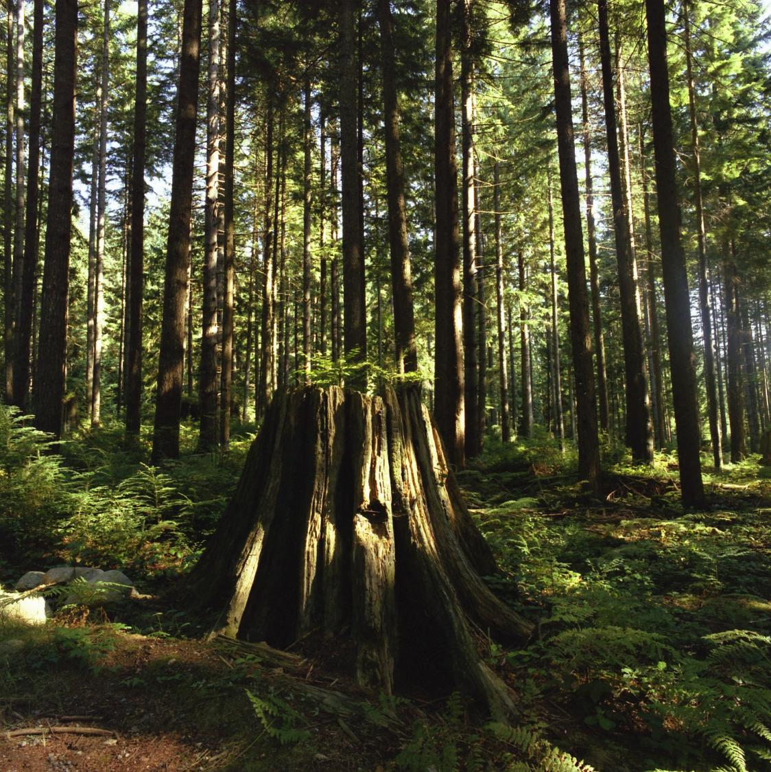
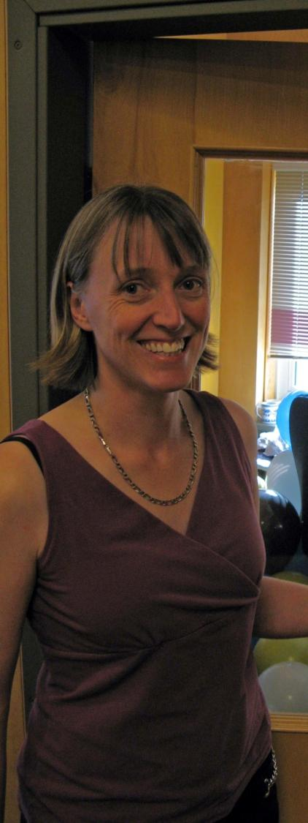
Caren Dymond
Forest carbon and
climate change researcher
Victoria office and PFC
Notes:
Carbon Modeller
Leads MFR provincial carbon research program
Cross ministry technical support on certification, reporting, policy and regulation development.
Modelling effects of alternative management practices CC and pests on carbon balance
Wood products life cycle assessment of determine offsets and GHG emissions
Technical support to policy and regulation development by MoFR, MoE, MAL, ILMB, and certification bodies.
Carbon offset protocols
Contributions to development of zero net deforestation policy
Future
1. Completion of a modelling framework for climate change impacts on forest carbon.
2. Preliminary estimates of climate change impacts on forest carbon emissions and sinks for BC.
3. Publication of an Extension Note on carbon consequences of fire management activities in fire-prone ecosystems (co-author with Wildfire Protection Branch).
4. Publication of Canada's GHG Inventory report (led by Environment Canada).
State of the Forest Report.

Slide 29

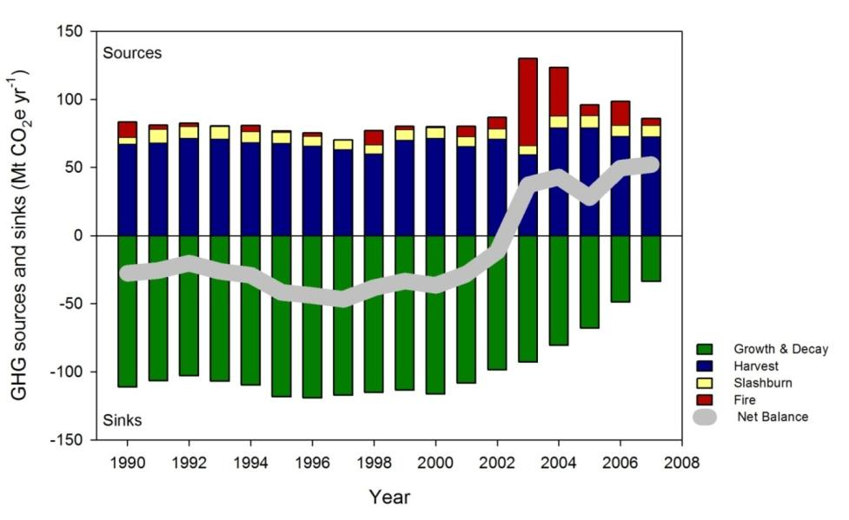

Slide 30
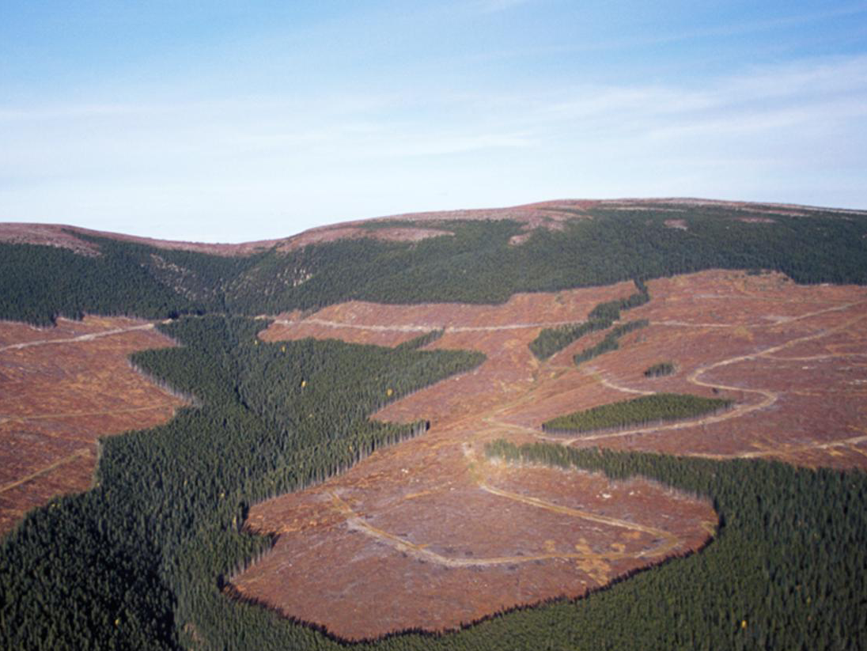
Landscape Ecology Program
Staff and locations
Accomplishments
What’s new
Future directions
Notes:
Staff and location – Adrian Huapeng Victoria
Accomplishments
MPB projections – susceptibilities and impacts
BEC zone and subzone maps
BEC climate data summaries
25 cent stumpage project with Econ & Trade Branch
Landscape models (e.g. SELES, LANDIS)
What’s New
Carbon modelling
Future directions
MPB needs –for Melanie - cumulative effects at a landscape level of MPB salvage and implications for biodivesity
Working with Coast Region on BEC projections with climate change

Slide 31
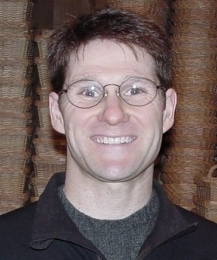
Adrian Walton
Team Leader,
Landscape Ecology
Victoria office
Notes:
Adrian Walton
Victoria
Team Leader, Landscape Ecology
Leads Landscape Ecology program

Slide 32
Distance to Mills
Mill
Notes:
Distance to mill – for 25 cent stumpage project
Looking at ways to more efficiently assess the value of low value wood –without having to do one the ground cruising

Slide 33
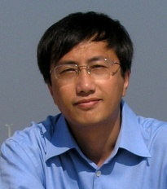
Huapeng Chen
Landscape Modelling Biologist
Victoria office
Notes:
Huapeng Chen
Victoria
Landscape Modelling Biologist
Leads landscape ecology projects including MPB forecasting
MPB modelling work – projections of spread
Updating BEC maps
Landscape models (SELES, LANDIS)

Slide 34
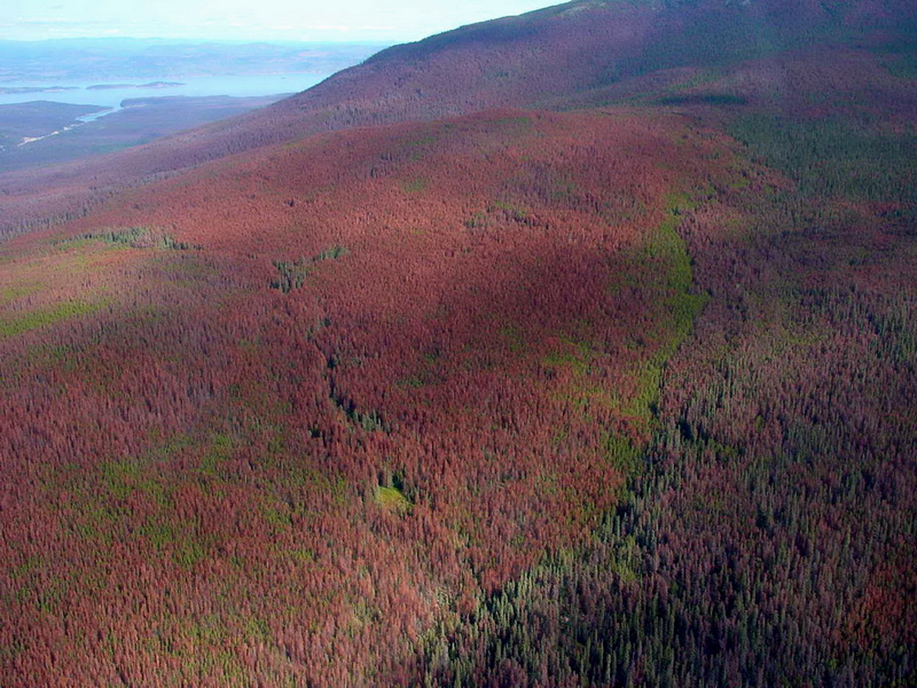
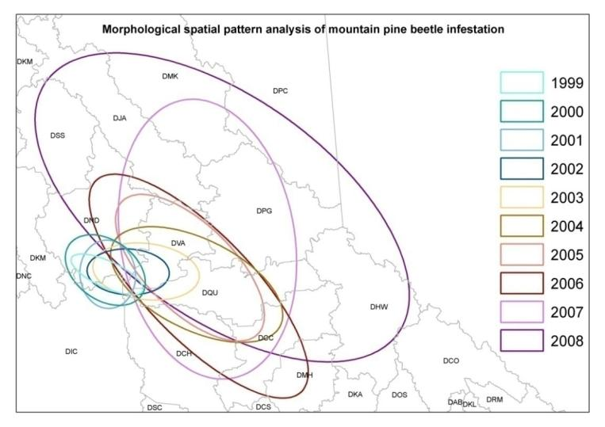
Notes:
MPB spread projections

Slide 35
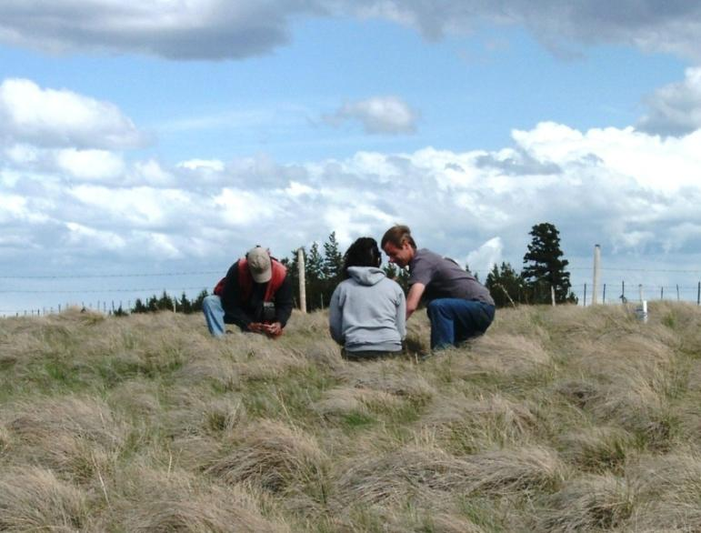
Range Ecology Program
Staff and locations
Accomplishments
What’s new
Future directions
Notes:
Staff and location – Reg and Brian Kamloops
Accomplishments
Leads range research program.
Range management recommendations
Effects of grazing & forest ingress on forage values
Guidance to restoration program
Effects of range use on water quality
What’s New
Leading interdisciplinary FFESC project on impacts of climate change on range values.
Effects of climate change on range values and adaptation strategies
Agroforestry policy
Future Directions
CC and carbon

Slide 36
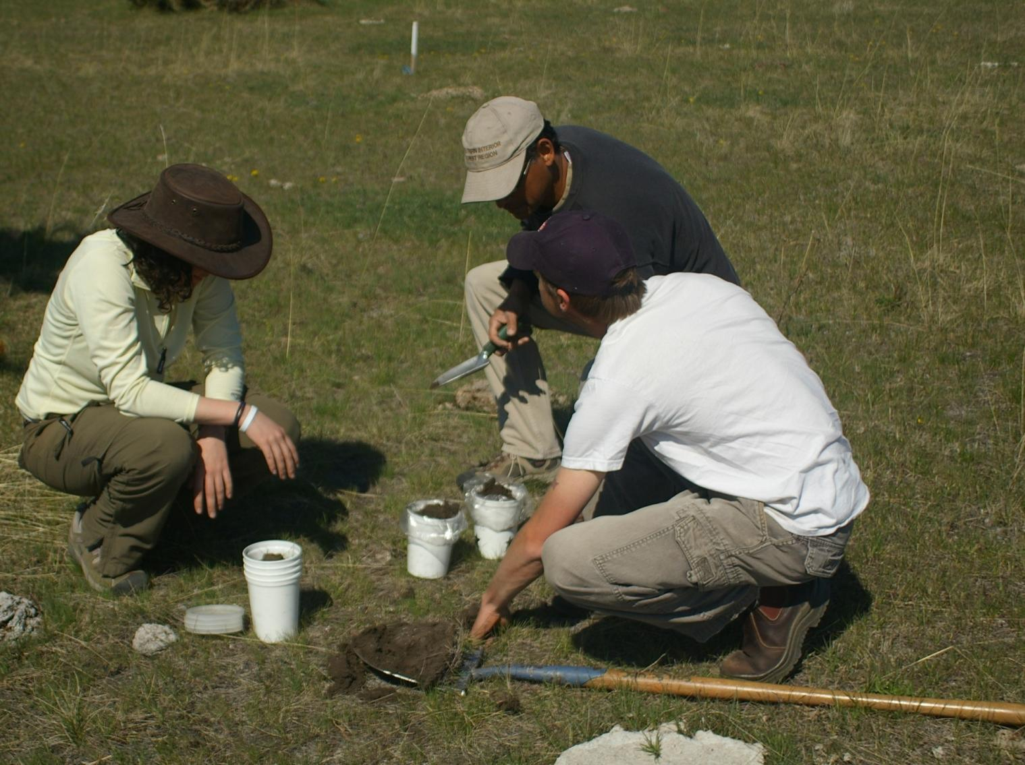
Reg Newman, Team Leader, Range Ecology Research
Brian Wallace, Range Ecologist - Soils
Kamloops office
Notes:
Reg and Brian doing soil sampling – looking at soil carbon. Reg is helping lead the development of a comprehensive provincial range ecology project looking at impacts of climate change (FFESC funded) with about 30 other scientists from various universities . Reg is drafting an EN on biocontrol of knapweed
Range management recommendations (e.g. effects of grazing & forest ingress on forage & water quality).
doing grassland sampling
Brian Wallace Kamloops
Range ecologist – Soils
Leads range soils research and soil carbon studies
Effects of grazing on range values
Contribution of soil carbon to carbon cycle
Effects of CC on rangeland soils and productivity
Modelling carbon sequestration in grasslands
Brian was recently invited to attend a conference in US for young soil scientists where he gave a talk on his soil C work.
He is working with the Grassland Conservation Council to define goods and services grasslands can provice

Slide 37
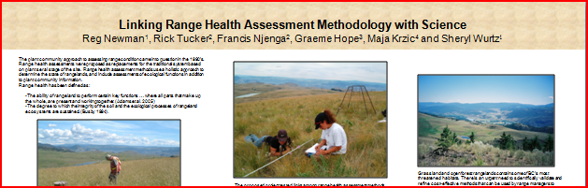
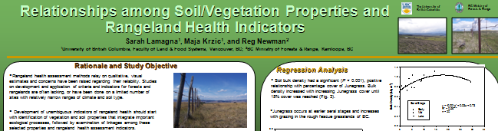
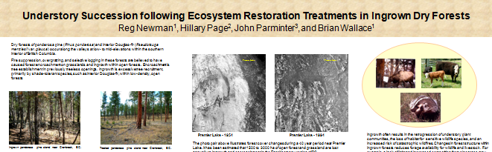

Slide 38
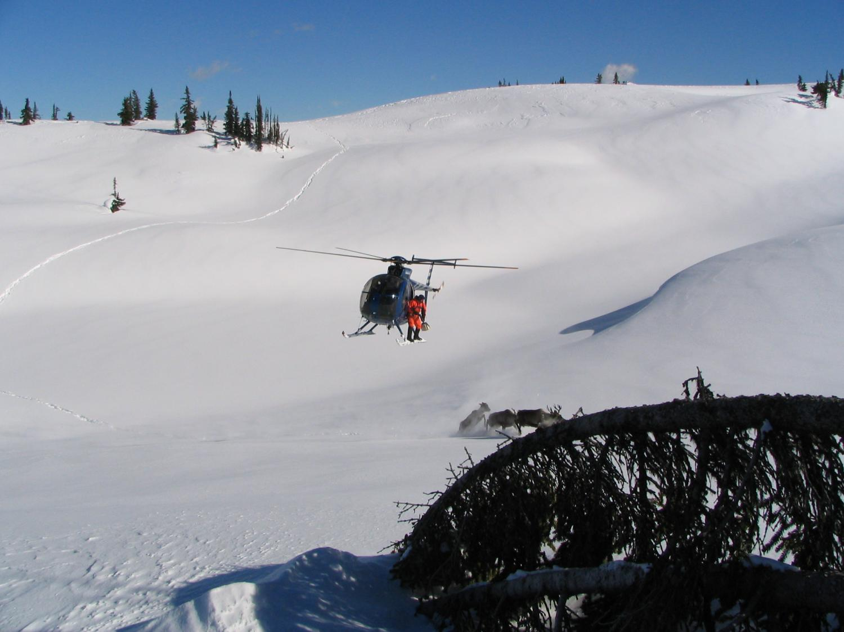
Wildlife Habitat Program
Staff and locations
Accomplishments
What’s new
Future directions
Notes:
Staff and location – Don Bruce and Fred
Accomplishments
Climate change vulnerability assessments - application of scenarios
Guidance to maintain habitat (e.g. caribou, moose, grouse, deer, wolverine, lynx habitat in MPB areas).
Disturbance modeling to evaluate habitat and timber supply model interactions
Developing habitat supply models for caribou and grizzly bears
What’s New
FFESC project – provincial VA

Slide 39
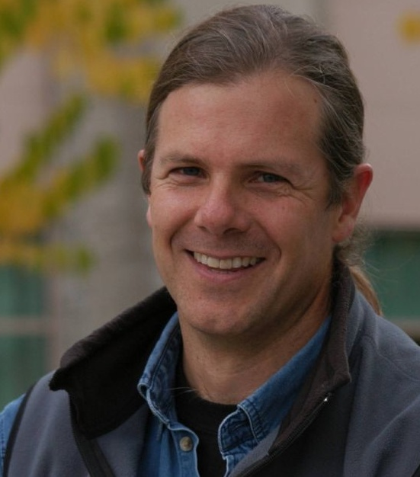
Don Morgan
Team Leader,
Wildlife Habitat
Smithers office
Notes:
Don Morgan, Team Leader for Wildlife Habitat . Don works out of Smithers .
Leading FFEI Tech Team work on climate change vulnerability assessments.
Guidance to maintain habitat (caribou, moose, grouse, deer, wolverine, lynx in MPB areas).
Disturbance modeling to evaluate habitat and timber supply model interactions
Resource management approach comparison using meta-models (e.g. National University of Quebec/Labrador project).
Developing habitat supply models for caribou in MPB affected areas with Bruce and Fred.
By year end
Grizzly Bear Security Area Analysis under a range of scenarios, including climate change
Resilience Management – thesis chapter Collaboration on Resilience Research with Ecology group – Elizabeth Campbell – end of fiscal project reports on Cranbrook.
FFEI Climate change adaptation and forest and range policy – various reports – resilience and forest management, characteristics of resilience and forest policy
FFEI provincial VA project initiation – no deliverables planned for end of fiscal besides updated work plan, working group coordination, and try to move the CC and wildlife extension note along.
FFESC research project – 2 workshops and summaries related to project, draft Nadina CC impact
Review of MoE’s “Climate Change Adaptation Options and Best Practices for Biodiversity”
Co-organizing, moderating/facilitation of complexity workshop in Smithers with the BVCentre
Skeena watershed project – cross government and organization Skeena research and monitoring project – participant workshop, summary and project work plan

Slide 40

Notes:
Fred Hovey Kamloops Wildlife Habitat Analyst
Leads wildlife habitat supply model development work.
Developed Habitat supply web page with information on habitat requirements of SAR and projects habitat supply - will allow users to access information on species and their habitat requirements and projected supply.
Wildlife data base management
By year end
Habitat Supply Web Site – updates, cataloguing of provincial habitat supply projects.
Oil and Gas Commission proposal – cumulative effects in the Flathead
Re-organization of Research Branch wildlife data into standardized format

Slide 41

Notes:
Don has helped develop climate change scenarios – following an approach developed by Peter Duinker. This was presented at a workshop for decision makers last year. Helps us think about alternative futures.
Application of scenarios to incorporate uncertainty into decision making (e.g. Climate Change adaptation policy development

Slide 42

Bruce McLellan
Wildlife Habitat Biologist
Kamloops
Fred Hovey
Wildlife Habitat Modeller
Kamloops
Notes:
Bruce McLellan – wildlife program biologist doing grizzly bear work in Flathead – attaching a sat. radio collar to a bear and taking measurements on the bear. Looking a cumulative effects of forestry, coal bed methane highways and people on bears in Flathead. Also working on bears in Lillooet area and Alberta.

Slide 43
Summary
Ecology, Watershed, Soils, Climate, Carbon, Landscape, Range and Wildlife Habitat
Support clients across MFR and other agencies thru research, assessments and expert advice to develop policy and practices
Climate change and carbon, resiliency, vulnerability assessments, bioenergy, provincial soils map, HSMs, watershed science synthesis, TSSDST, MPB, ClimateWNA, GHC, offset protocols and scenarios
Notes:
EES section includes ...
Focus is to ...
Key topics include. ...

Slide 44
Contact information
Evelyn Hamilton
Manager, Ecology and Earth Science Section
Ministry of Forests and Range, Research Branch,
4th floor, 727 Fisgard Street, Victoria, V8W 9C1
Phone (o) 250 387-3650 (c) 250 213 2808
email Evelyn.Hamilton@gov.bc.ca
website www.for.gov.bc.ca/hre

