Slide 1
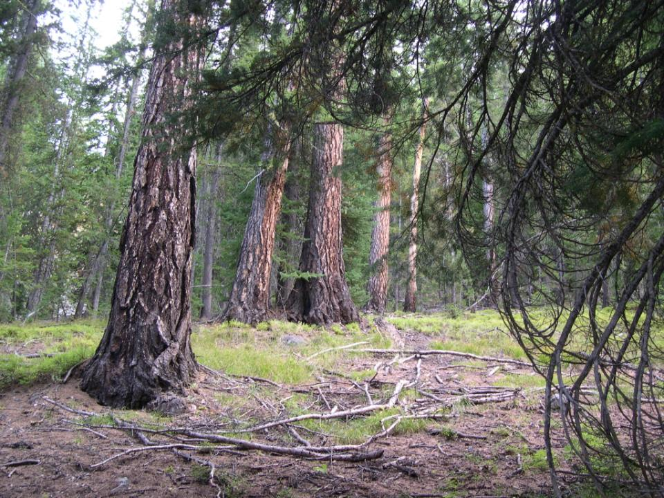
Ecological impacts and associated management strategies for western larch in the face of climate change
Barry Jaquish
Kalamalka Forestry Centre
Vernon, B.C.
Research Branch

Slide 2
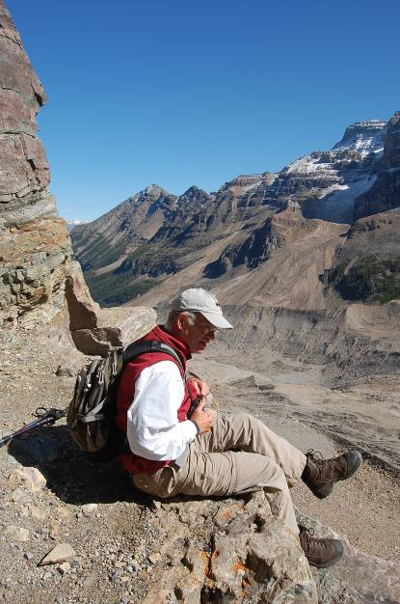
Dr. G. Rehfeldt
U.S. Forest Service, retired
Moscow, Idaho

Slide 3
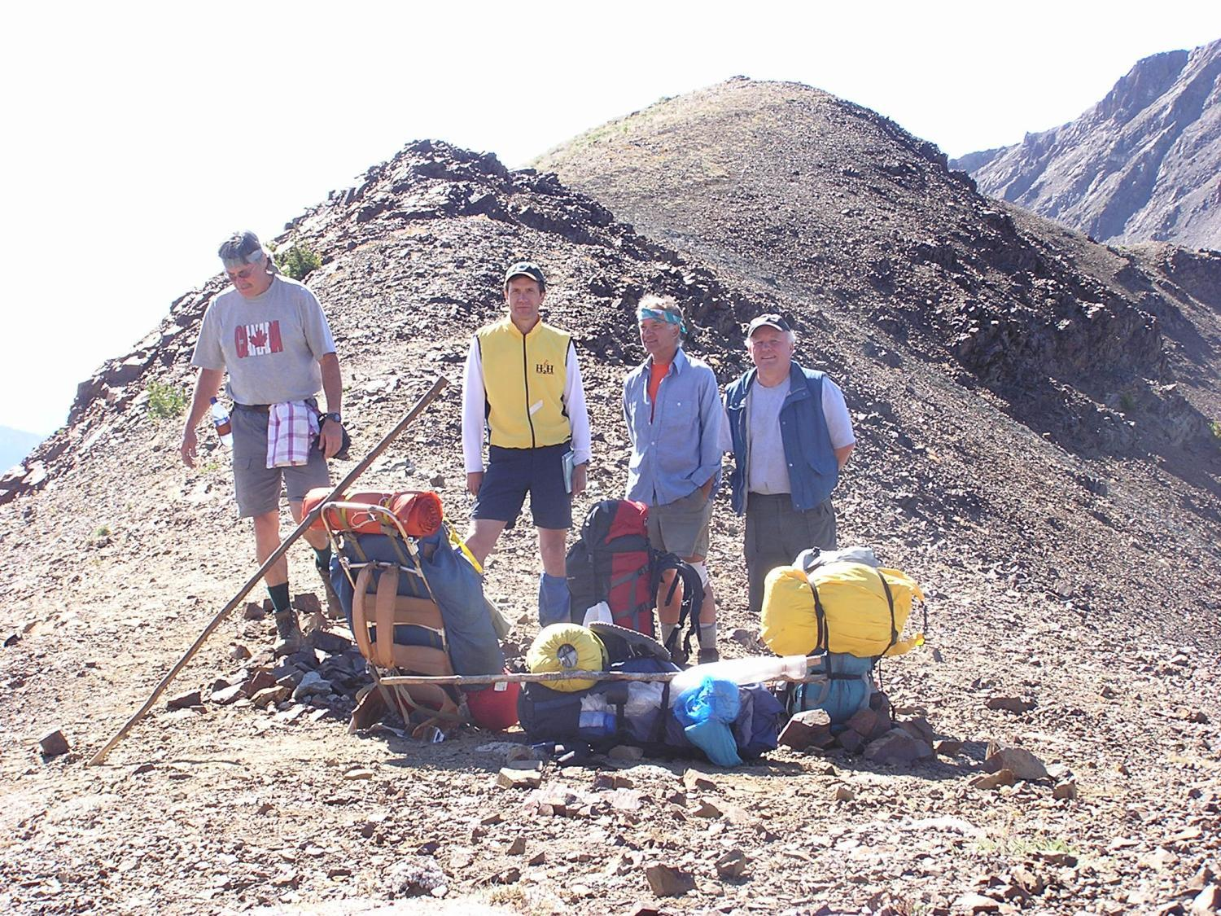

Slide 4
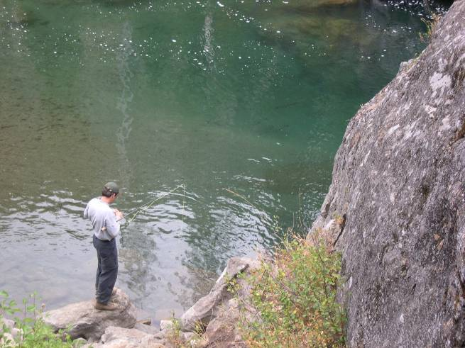

Slide 5
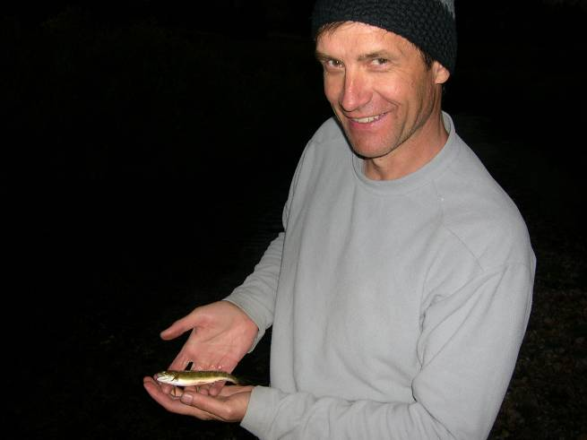

Slide 6
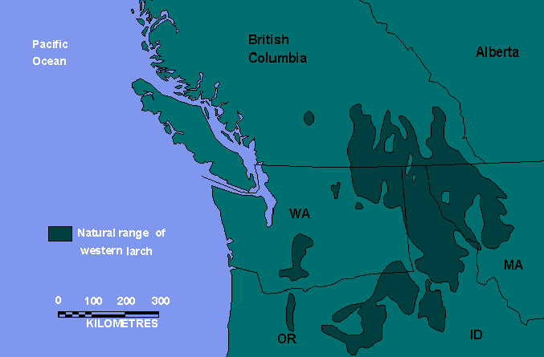
Natural distribution of western larch (Larix occidentalis)

Slide 7
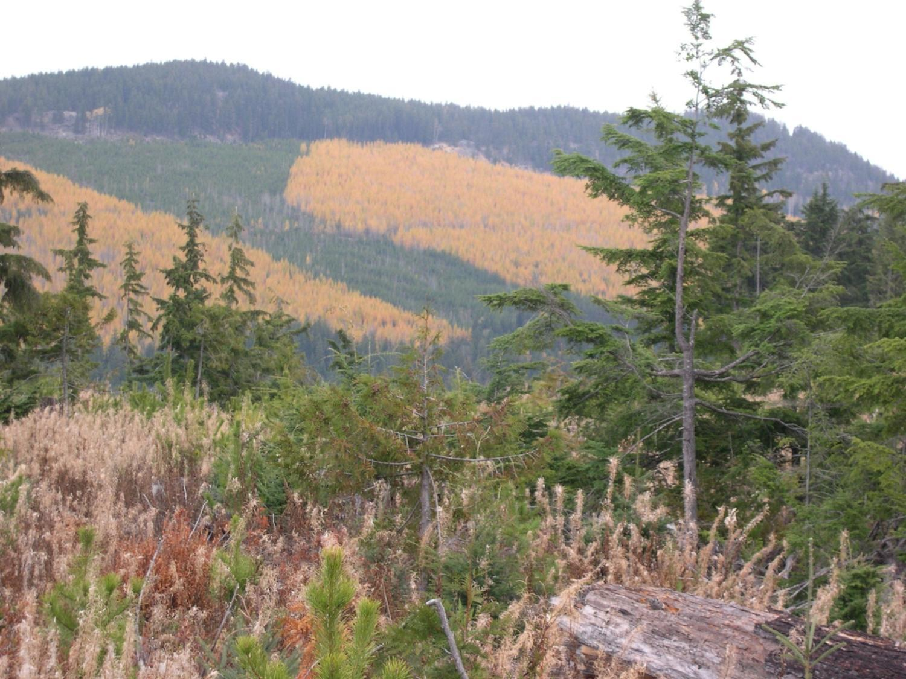
North-west of Golden, near Rogers Pass

Slide 8
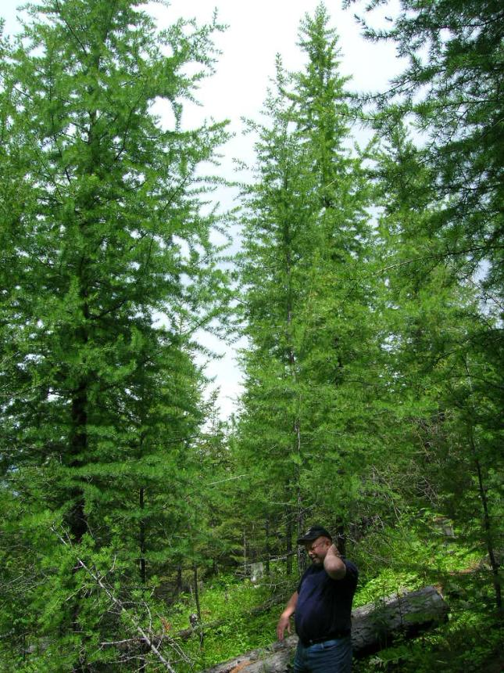
Prairie Ck, south-east
of Horsefly

Slide 9
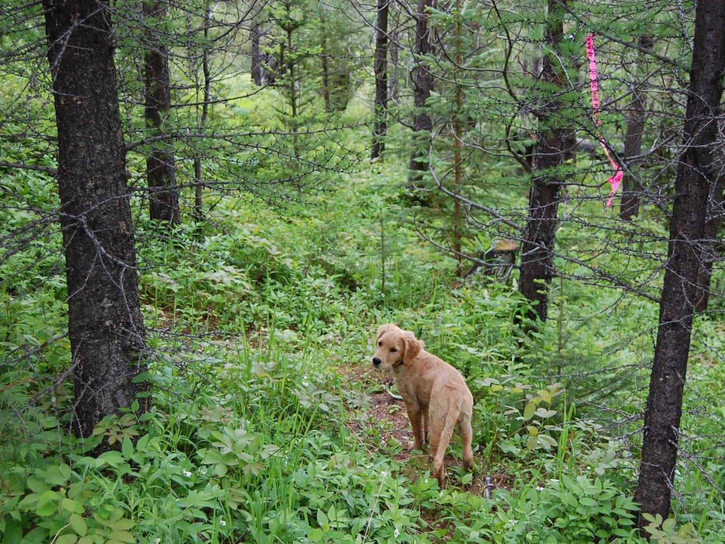
Prairie Ck, south-east of Horsefly

Slide 10
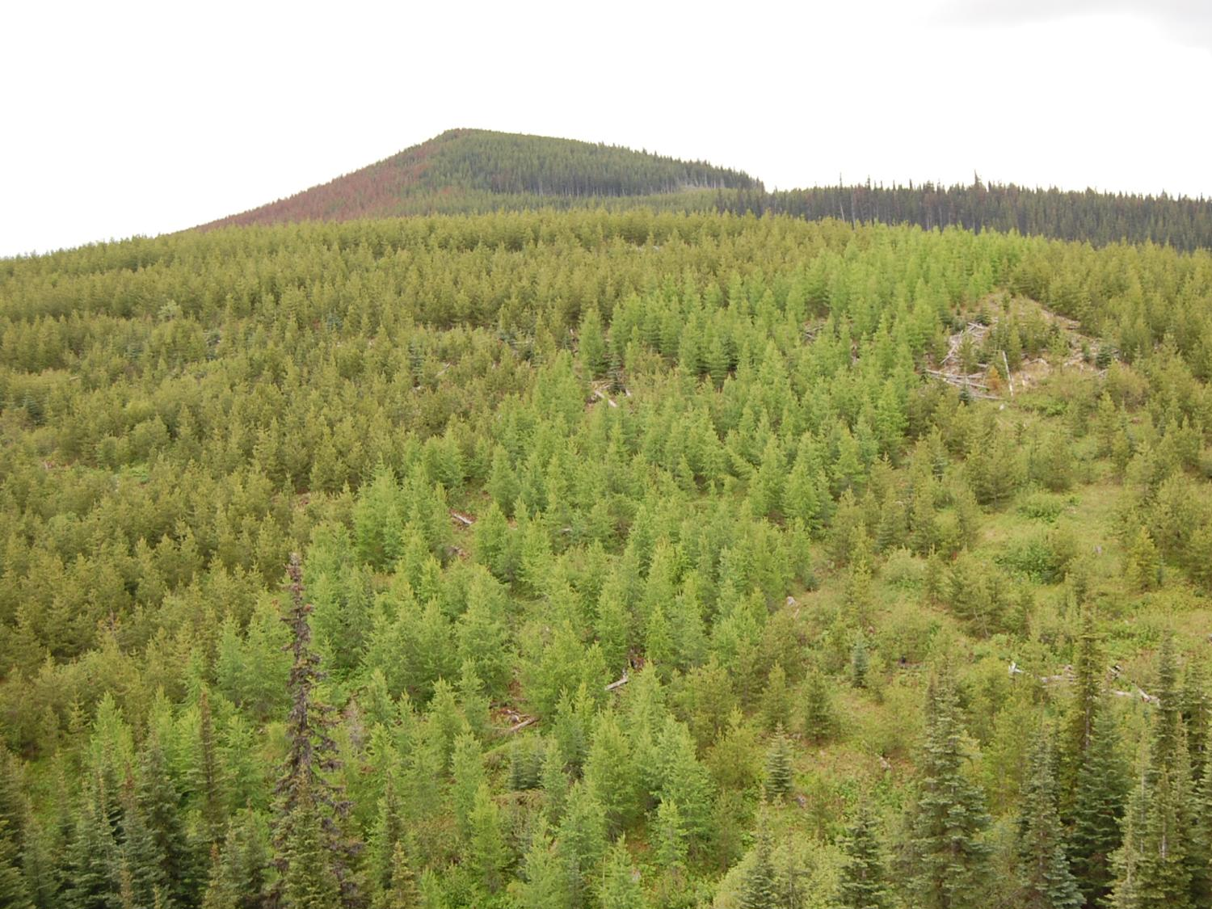
South-west Burns Lake: SBS mc, 1020 m, blk E100

Slide 11
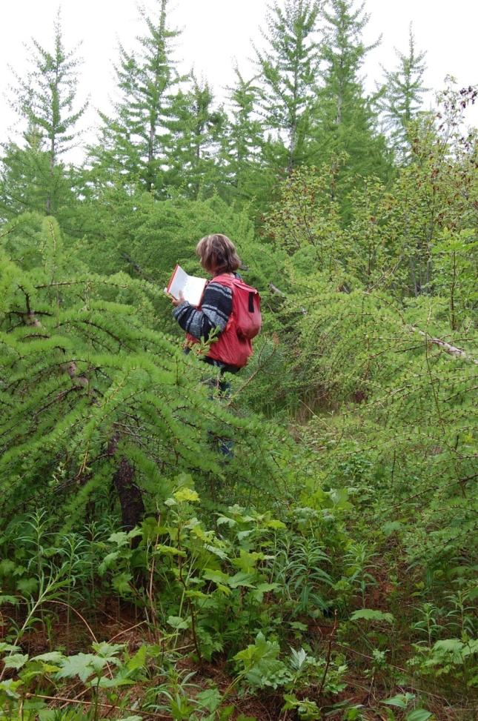
South-west Burns Lake,
SBS mc, 1020 m, blk E100
snow press

Slide 12
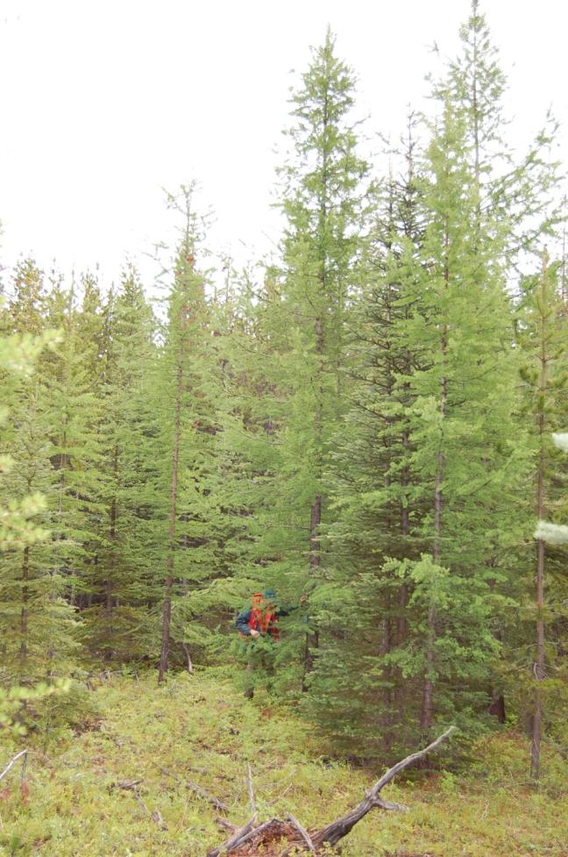
South-west of Burns Lake
SBS mc, 840 m, blk E098

Slide 13
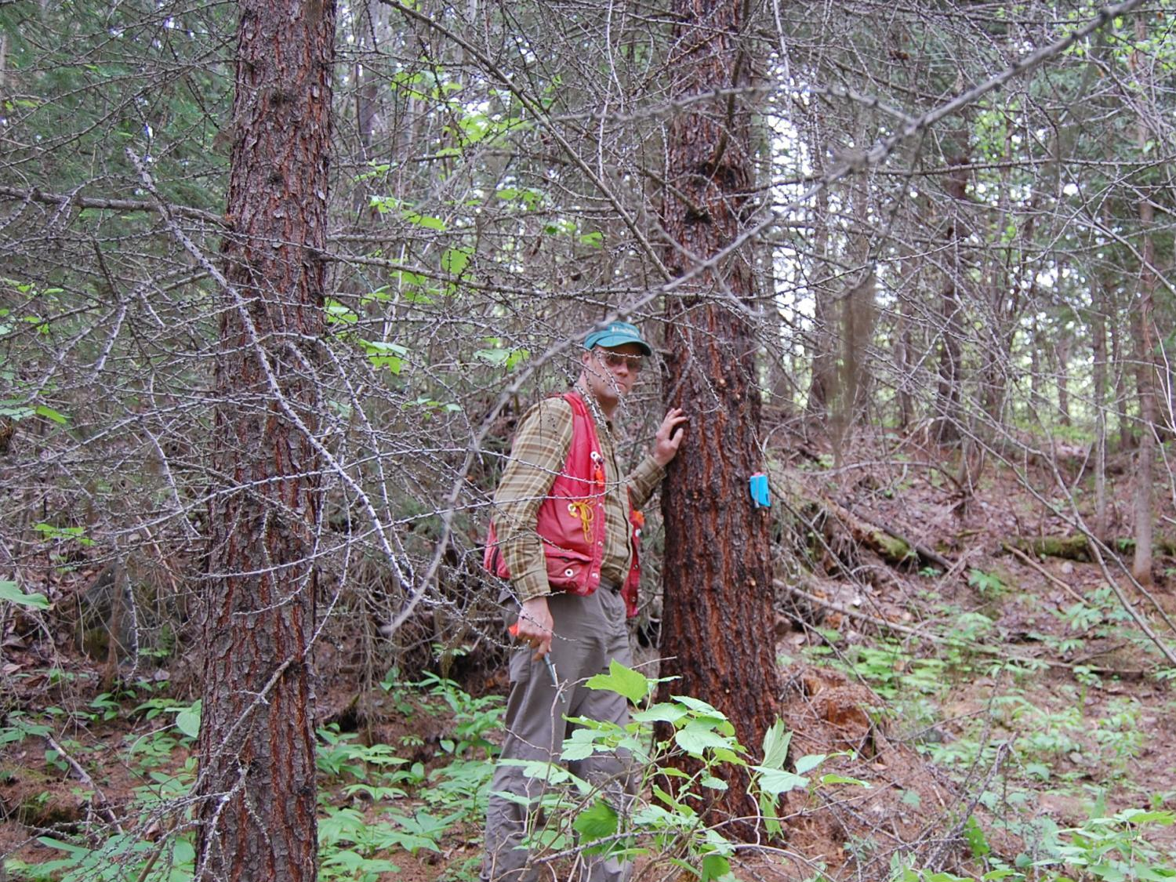
West of Burns Lake
SBS dk 01, 640m, blk L046

Slide 14
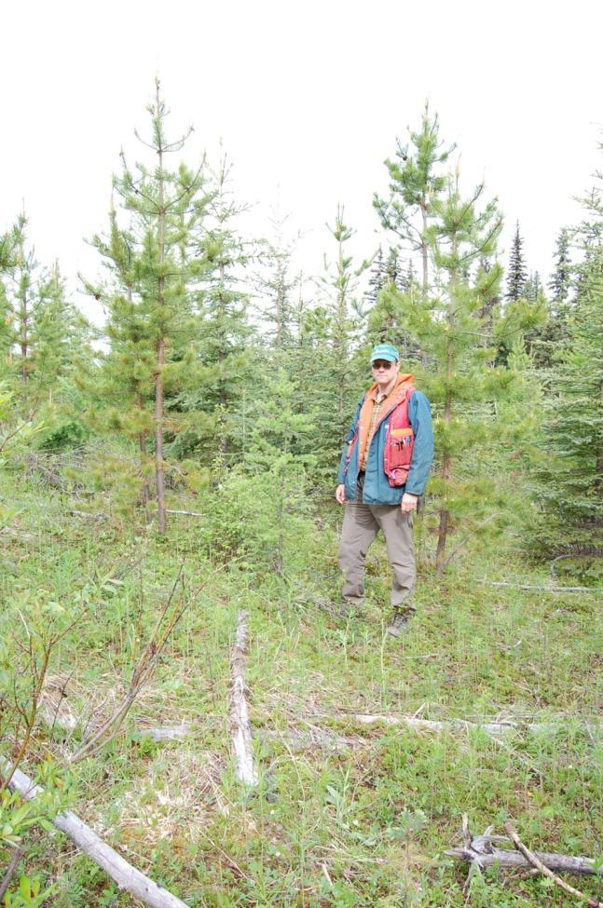
South-east of Burns Lake
SBS dk 07, 740m, blk K003

Slide 15
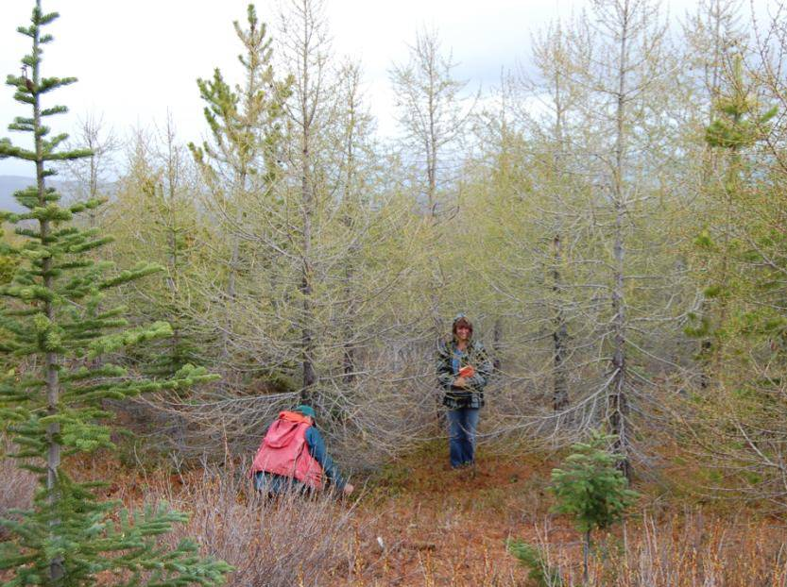
West of Burns Lake: ESSF k 04, 1320 m, blk L029

Slide 16
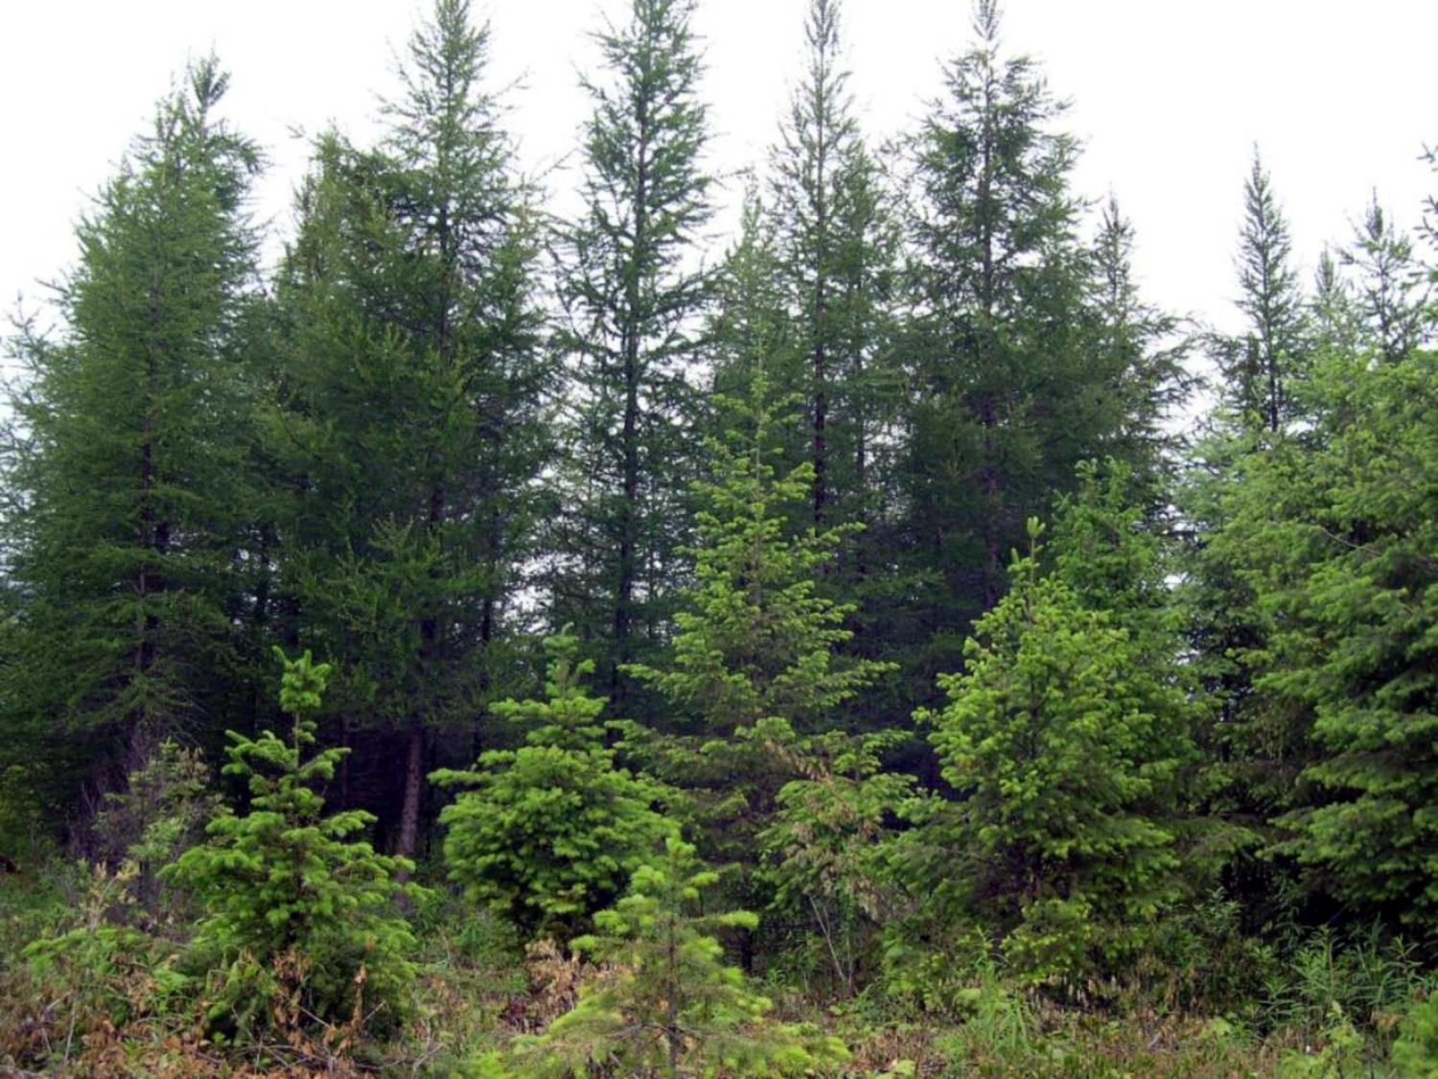
Date Ck Demonstration Forest (north of Kispiox) - 20-years

Slide 17
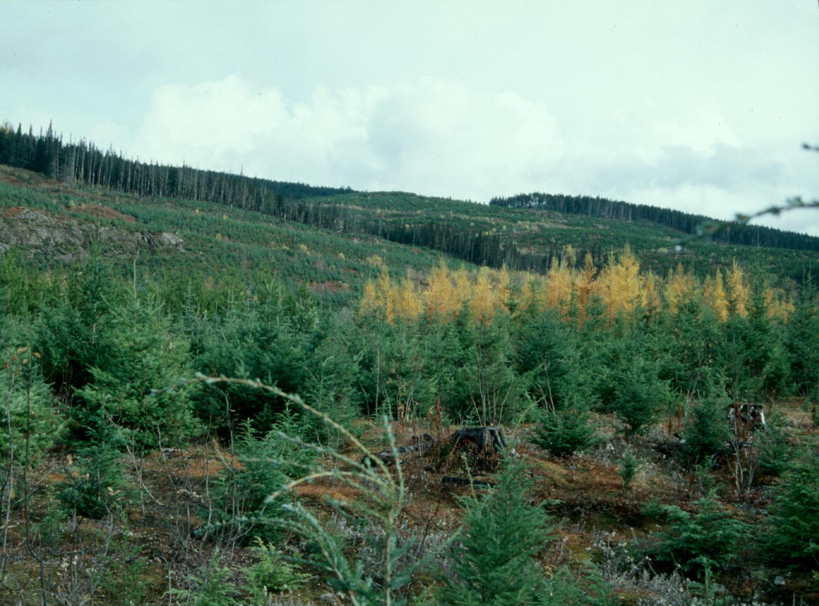
Bell-Irving, north of Meziadin Junction – 12-years

Slide 18
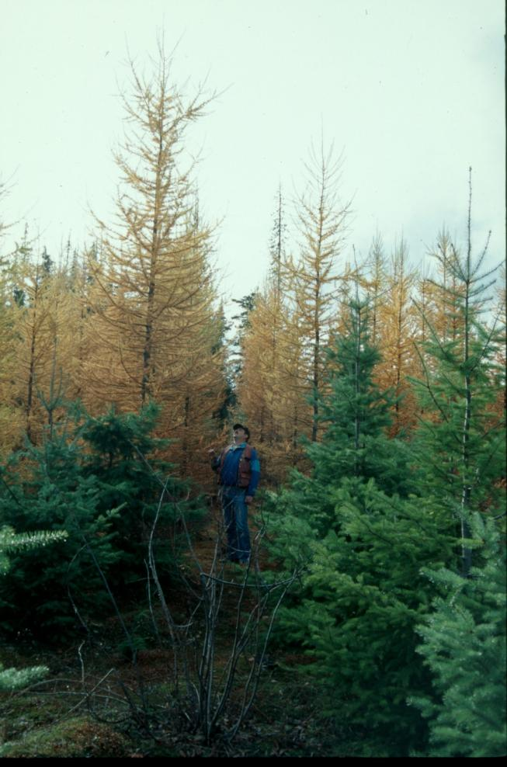
Bell-Irving, north of
Meziadin Junction
12 - years

Slide 19
Background
Mountain pine beetle infestation, climate change and assisted migration, and a desire increase ecosystem complexity to increase resilience prompted Chief Forester to request the establishment of seed transfer rules for planting western larch outside its natural distribution.
Jaquish and Rehfeldt - range-wide study based on climate variables; biological and ecological considerations only

Slide 20
Introduction
Over the last decade - dramatic increase in research focused on documenting and describing biotic responses to a rapidly warming climate ;
Statistical and mechanistic models to describe bioclimatic relationships and model responses to climate change in: biomes and ecosystems, species, and populations;
Results suggest a wholesale geographic redistribution of vegetation will be required to re-establish a semblance of equilibrium between climate and vegetation by the end of the century.

Slide 21
Introduction
Unfortunately, one of the weaknesses of much of this work centres on their inability to account effectively for species’ intrinsic abilities to respond to climate change
- life history characteristics, adaptive strategies, population genetic structure, and patterns of
genetic variation are commonly ignored

Slide 22
Introduction
Climate is the primary factor controlling plant distributions, largely through edaphoclimatic interactions that function as selection agents to mould systems of genetic variation;
Responses to selection determine adaptive strategies, genetic architecture, dispersal and establishment rates that interact to control adaptation to changing climate.

Slide 23
Introduction
Therefore, without basic genetic knowledge managers lack information fundamental necessary to making informed decisions
e.g. conservation, seed transfer & zones
General objective: to assess the potential impacts
of changing climate on western larch taking into consideration ecologic and genetic responses

Slide 24
Objectives
Define climate profile with a bioclimate model that predicts presence or absence from climate variables;
Develop models of genetic variation;
Develop and map seed zones within predicted distributions for present and future climates;
Identify threatened populations and develop conservation strategies; and,
Develop strategies for transfer of seed sources to future locations of their optimal climate considering: future distributions, adaptation of populations, and variability of GCM models

Slide 25
Methods
185,000 observations from 4 data sources,
4,548 contained western larch;
Climate surfaces of Rehfeldt 2006 (Hutchinson’s anuspline)
using 34 climate variables, 18 derived from monthly climate
estimates ;
Random Forest classification tree used to predict presence/absence of western larch from climate variables;
Genetic variation assessed from two experiments:
15-year-old range-wide provenance test at Lamb Ck, south of Cranbrook (128 populations), and,
re-analysis of 4-year data from farm-field tests in north Idaho (143 populations);

Slide 26
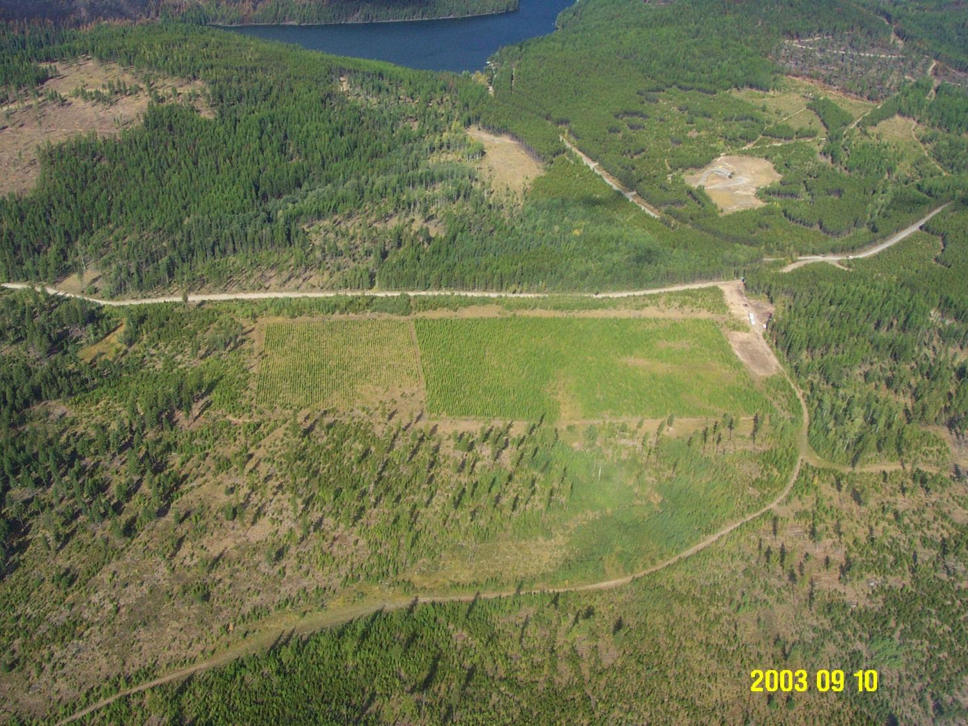
Lw range-wide provenance test
Lamb Creek western larch research installation,
South-east of Cranbrook, B.C.

Slide 27
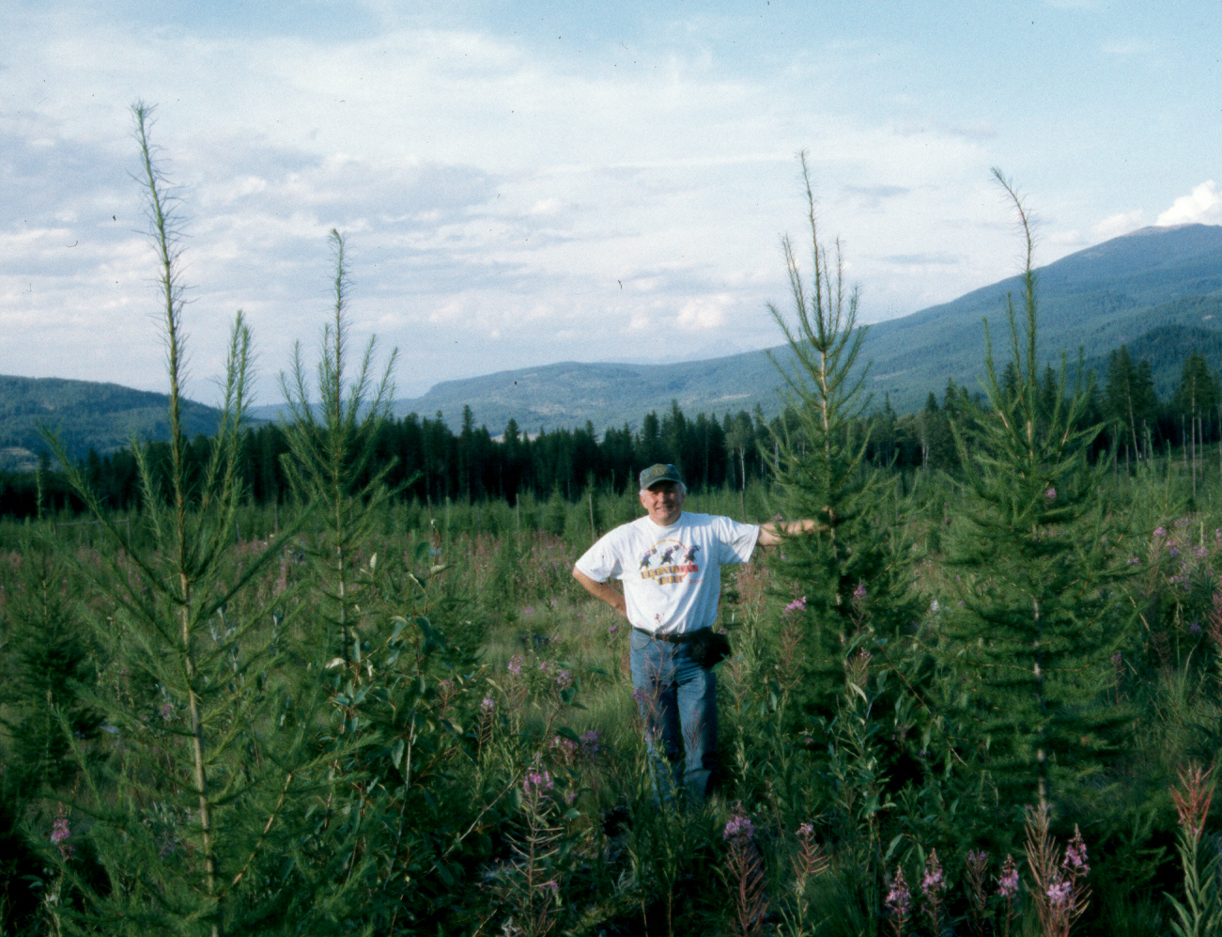
Lamb Creek western larch research installation,
South-east of Cranbrook, B.C.

Slide 28
Methods
Multiple regression used to relate genetic variation to climate of the seed source;
Climate grids ( 1 km²) for geographic area run through bioclimate and genetic models to construct maps;
Three GCMs and two scenarios used to project climate profile and genetic attributes into future climate space:
CCCNA, UKMO and GFDL.

Slide 29
Results
8-variable model used to describe climate profile
(error of prediction = 2.9%);
Most important climate variables for western larch occurrence:
- summer dryness x winter temperatures (cool winters, cold temperatures weighted by summer precipitation);
- ratio summer to total precipitation (moisture stresses generally minimized); and,
- DD>5 x MTCM (winter and summer temperature not extreme).

Slide 30
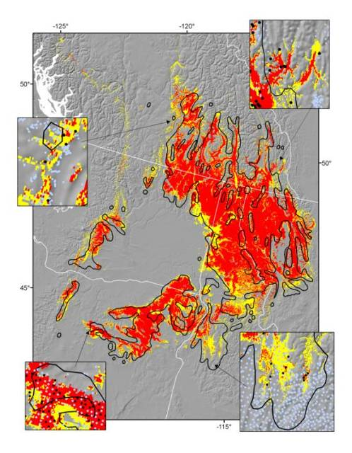
Mapped western
larch climate
profile
Yellow = 50 – 75% votes
Red = 75 – 100% votes
Insets present
location of data points
black = Lw
light = no Lw
Black line = Little’s range
map

Slide 31
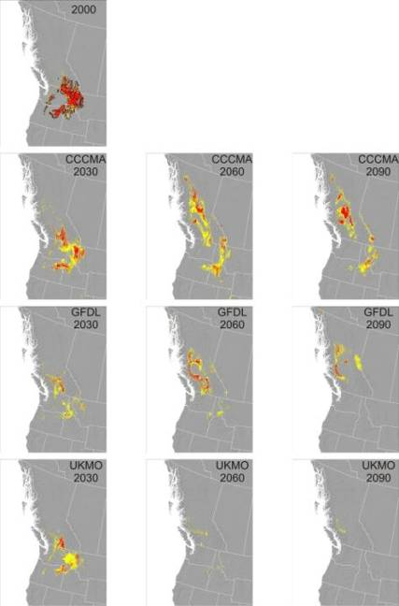
        Contemporary profile
Mapped climate profile for
contemporary and future
climates for three GCMs and
scenario A2 (unrestrained
carbon emissions)

Slide 32
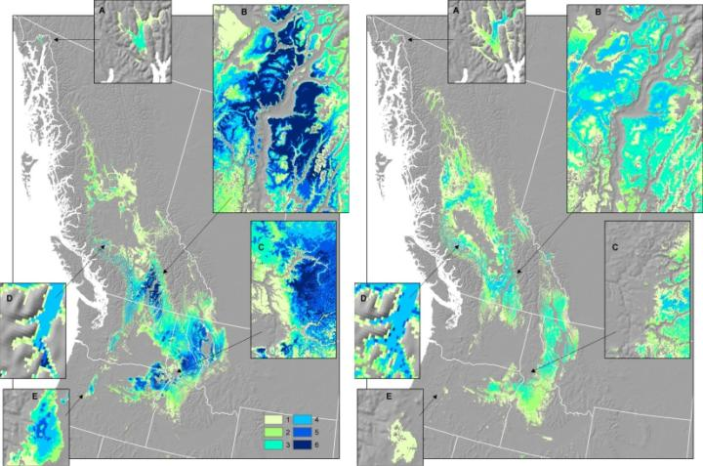
Mapped climate profiles of western larch for decade 2030
and 2060 superimposed for three GCMs and two scenarios
(degree of concurrence coded to key in bottom right corner of 2030 figure)
2030
2060

Slide 33
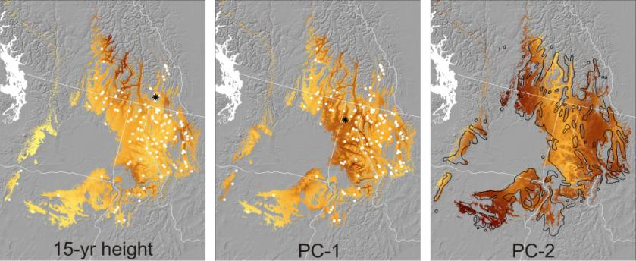
Mapped genetic variation in three characters
predicted from regression models.
Dark and light shading indicates high and low values, respectively.
White and black dots indicate populations sampled and test locations.
4-yr ht and Meria resistance
mortality

Slide 34
Results
Seed transfer and seed zones
Seed transfer (climate based)
Location specific seed transfer guidelines can be constructed by searching for all pixels with predicted values for our three genetic attributes (Ht15, PC-1 and PC2)

Slide 35
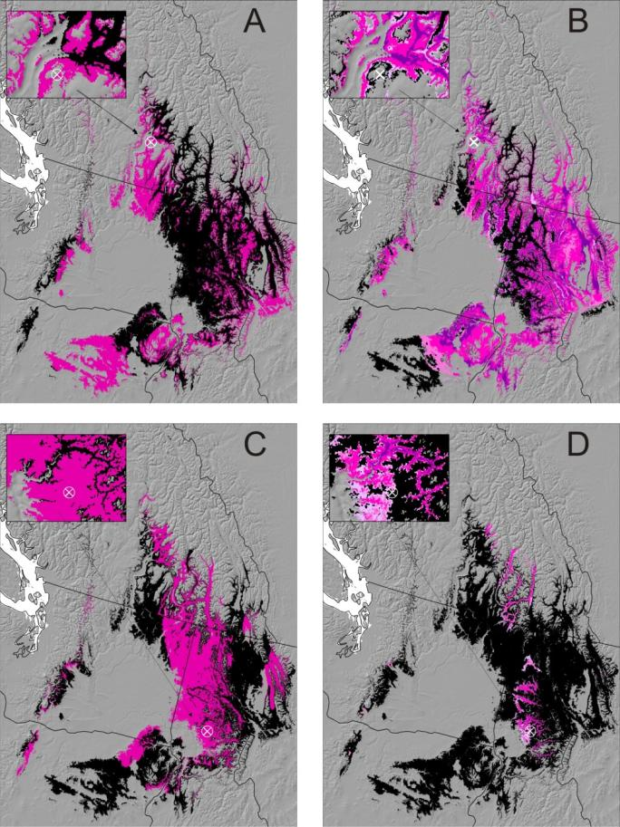
Current climate
2030
Western larch seed
source procurement
within current range
for current and 2030
climate
Vernon
= planting site
Black shading = climate profile
Pink shading = locations to procure seeds genetically compatible with test site
North
Idaho

Slide 36
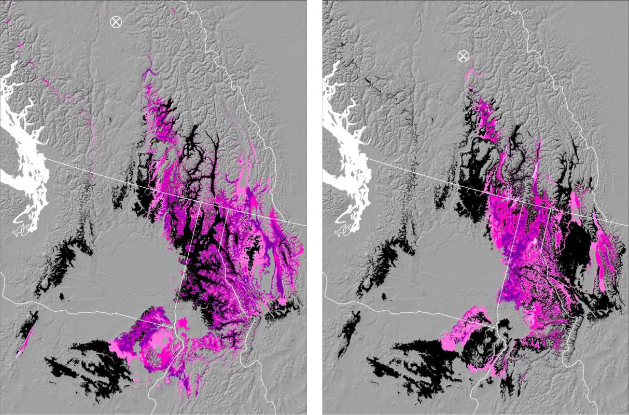
Western larch seed procurement for
sites outside current range for 2030 climate
Gavin Lake
Mahood Lake

Slide 37
Results
Seed transfer and seed zones
Seed zones
Climate ecotypes (seed zones) can be delineated by the qualitative subdivision of the continuous genetic variation

Slide 38
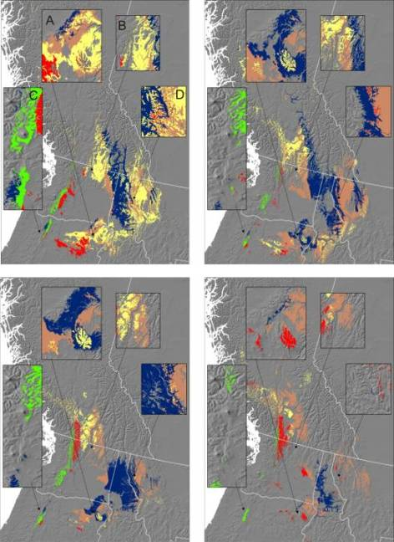
Map of five western larch
seed zones (upper left)
and their 2030 projections
to A2 scenarios of three
GCMs
CCCMA
Four insets are repeated
in all four panels
GFDL
UKMO

Slide 39
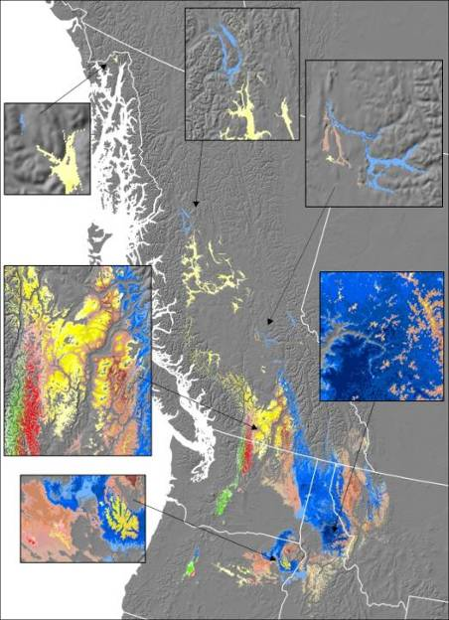
Range-wide concurrence
among three GCM and
two scenarios for the 2030
location of the five seed zones
lightest = agreement among 3
darkest = agreement among 6

Slide 40
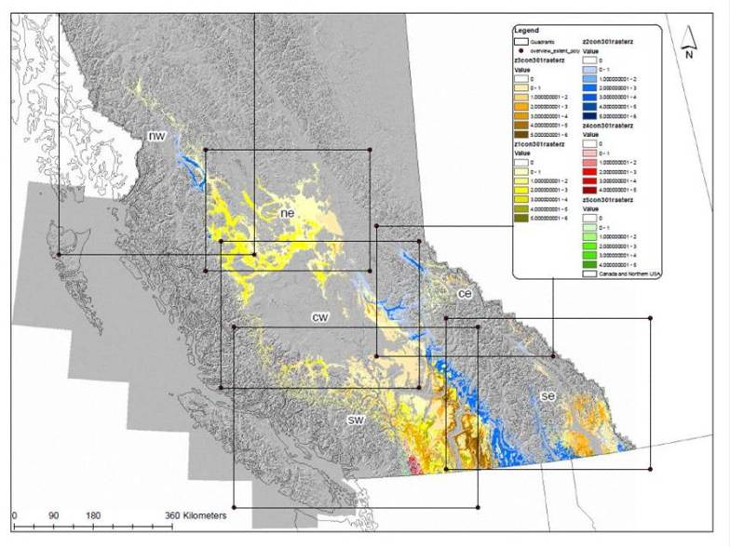
2030 location of the five western larch seed zones
lightest=1 scenario; darkest=6 scenarios

Slide 41
Elevation bands (m) for western larch seed sources for six B.C. quadrants
Geographic region | Seed Zone (zone colour in maps)
 | EK high (yellow) | NE low (blue) | EK low ª (brown) | SSM high ª (red) | SSM low ª (green)
North-west | 600 - 1000 | 200 - 600 | - | - | -
North-east | 600 - 1000 | - | 600 - 800 | - | -
Central-west Interior | 700 - 1100 | 700 - 1100 | 700 - 900 | - | -
Central-west coast | 700 - 1500 | - | - | - | -
Central-east | 900 - 1500 | 600 - 1100 | 900 - 1300 | - | -
South-west | 900 - 1600 | 600 - 1200 | 900 - 1300 | 1100 - 1600 | 700 – 1300
South-east | 1000 - 1700 | 600 - 1400 | 1000 - 1400 | - | -
ª no seed orchard presently in place

Slide 42
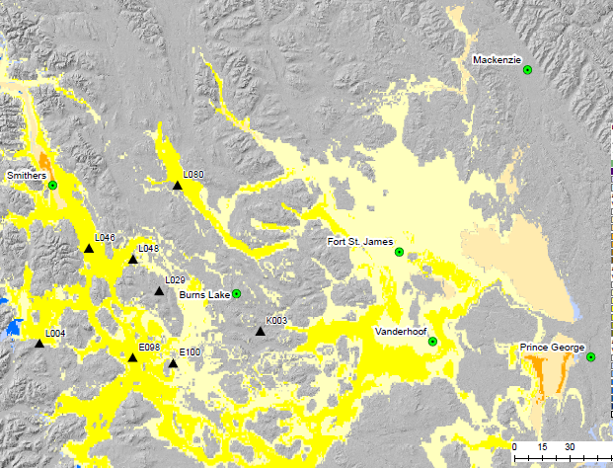
Predicted seed source validation: Sites within black
circles are keyed to block numbers on slides 10 – 15

Slide 43
Conclusions
Predicted climate profile closely related to present distribution of western larch;
Considerable variation in GCM predictions of future climate space; however, agreement of northwest migration far outside its contemporary range;
Contemporary climate space can be subdivided into five ecotypes (seed zones) largely differentiated by region and elevation; close agreement with current B.C. western larch class A seed zones;

Slide 44
Conclusions
Maps of climate model concurrence for seed zones provide land managers with basic information for making informed decisions;
presently in B.C. 3 western larch seed orchards
NE low = blue EK & NE high=yellow
consider establishing EK low (brown);
Cascade populations (including Tyner Lake) merit conservation effort; and,
New zones fail to align consistently with contemporary BEC zones or variants.

Slide 45
Options for western larch climate based seed transfer
Systems based seed transfer
Seed zone maps
- determine if planting site is within the projected climate space;
- identity appropriate seed source for the site and note the level of risk from the respective colour shade; and,
- confirm elevation suitability from table.
Ecotype (seed zone) polygons suitable for GIS mapping and analyses

