Slide 1

The Carnation Creek
Fish-Forestry Interaction Project
by
Peter J. Tschaplinski
Research & Knowledge Management Branch
BC Ministry of Forests and Range

Slide 2
Carnation Creek Background
Basin-scale case study of the effects of forestry practices on watershed processes and fish populations
Now in its 40th Year
Has generated the longest-term continuous datasets on fish-forestry interactions
Initiated in mid 1970 by Fisheries and Oceans Canada & key industry and government partners
Initiated because of lack of local BC information on the effects of harvesting on fish populations
2

Slide 3
Research & Monitoring Objectives
What is the cumulative effect of watershed-scale harvesting beyond specific levels (e.g., 65% harvest)?
What is the effect on channel morphology and aquatic (e.g., salmon) habitats in both larger streams and their smaller tributaries when the riparian vegetation is removed or modified?
What biological changes result from these altered stream habitats?
How long do these physical and biological changes persist?
What has been the contribution of climate variability to observed physical and biological changes?
What are the implications of climate change for watershed processes and Pacific salmon?
3

Slide 4
Presentation Objectives
Illustrate changes in salmon populations in Carnation Creek over 5 Pre-Logging, 6 During-Logging, and
28 Post-Logging Years (1970 − 2009)
Demonstrate that the effects of forest harvesting are complex
  vary by species (coho, chum, trout)
  vary by life stage (eggs, fry, smolts, adults)
4

Slide 5
Presentation Objectives (cont’d)
Illustrate that salmon production from coastal streams depends on
  Watershed processes and land-use management
  Marine processes including fishing & predation
  Interactions between freshwater and marine processes
  Climate variability
Point to the value of long-term, multi-disciplinary studies for clarifying complex interactions among land-use practices, climate variations, watershed processes, and salmon populations
5

Slide 6
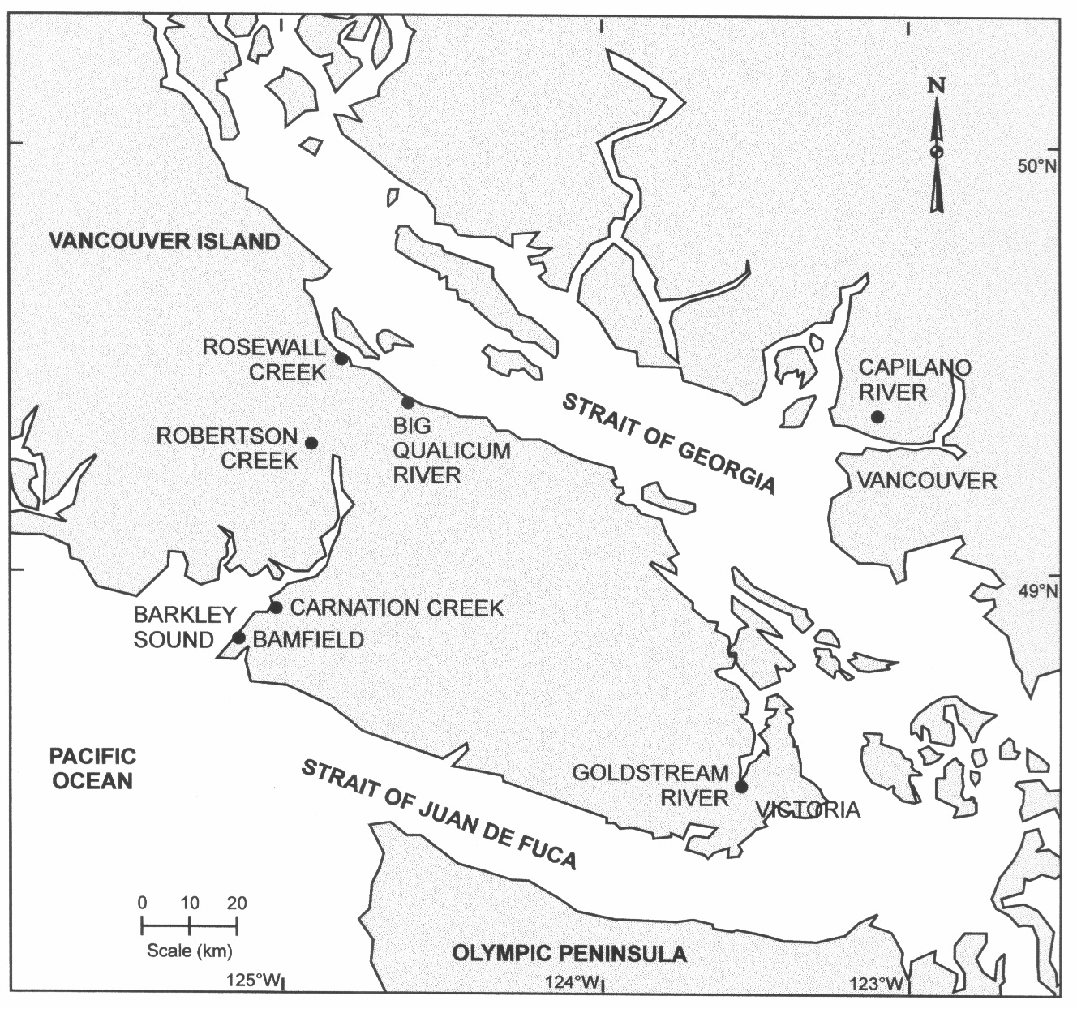
6

Slide 7
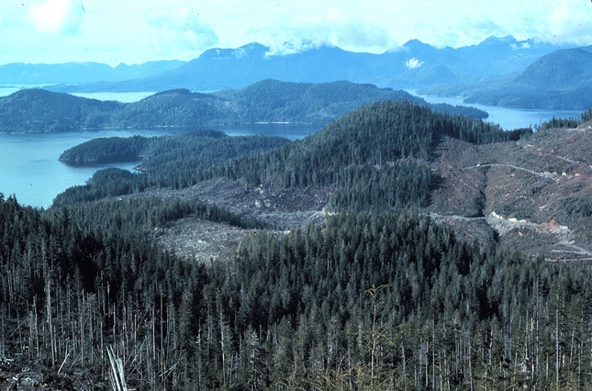
Barkley Sound
Carnation Creek ca. 1977
Watershed area: 11 km²
Elevation: Sea level to 800 m
Hillslopes: 40 – 80% gradients
Creek length: 7.8 km
Anadromous salmon habitat: 3.1 km
Annual precipitation (rain-dominated): 2,900 mm at low elevation, up to 4,800 mm at high elevation
7

Slide 8
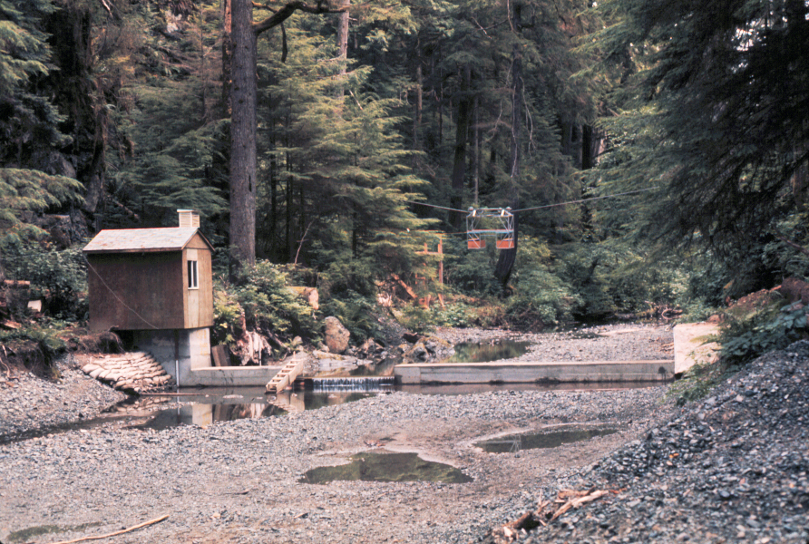
Summer low flow – 0.02 m³/s
Station B streamflow weir
8

Slide 9
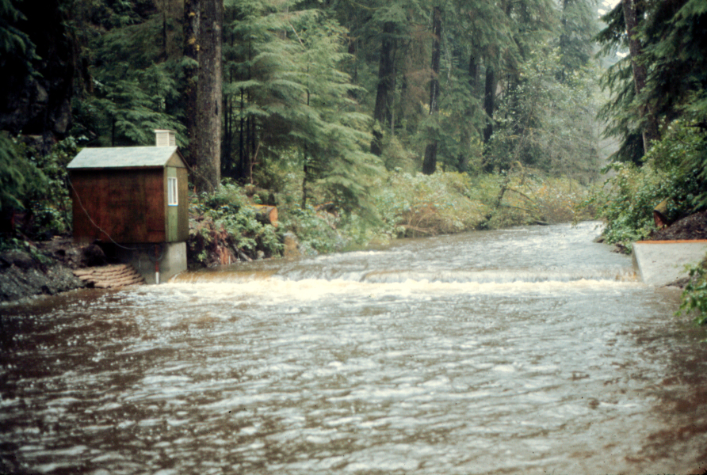
Autumn freshet at Station B streamflow weir
Storm discharges up to 65 m³/s
9

Slide 10
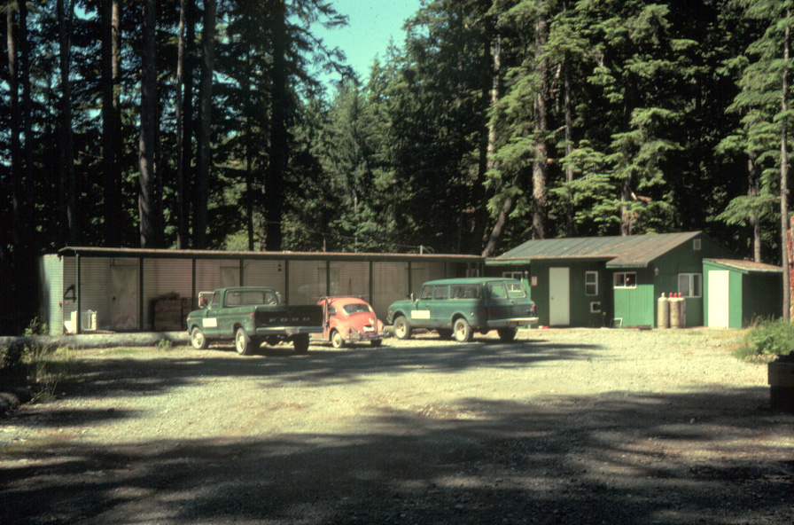
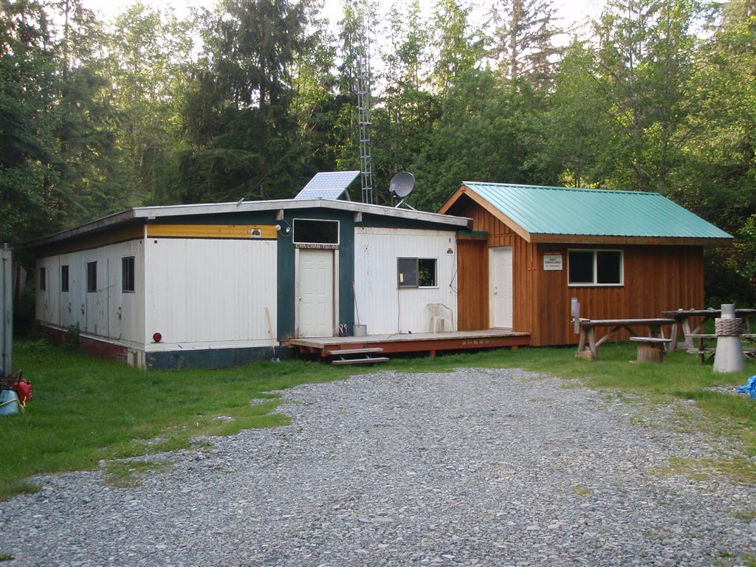
Carnation Creek Camp,
late 1970s
Carnation Creek Camp, June 2010
Steve Voller photo
10

Slide 11
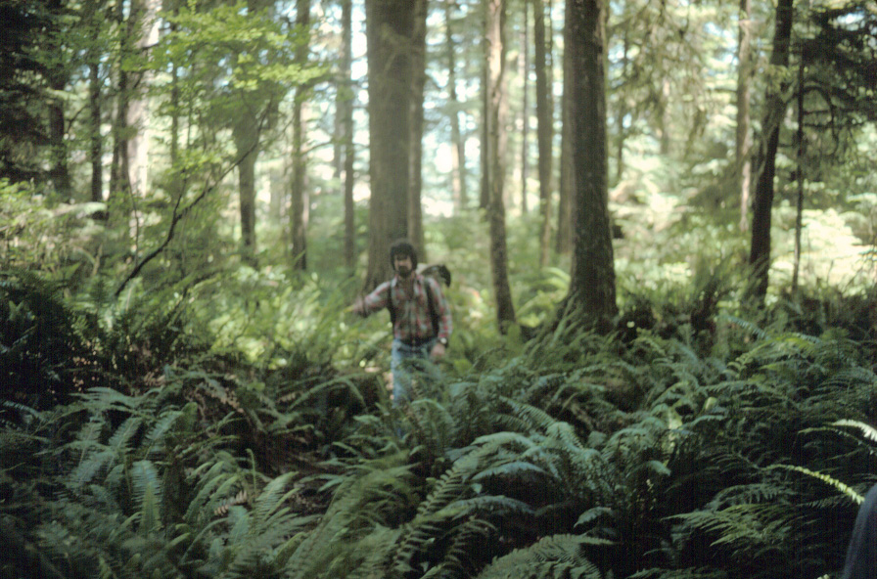
Carnation Creek mature forest and ground cover near new harvest opening
11

Slide 12
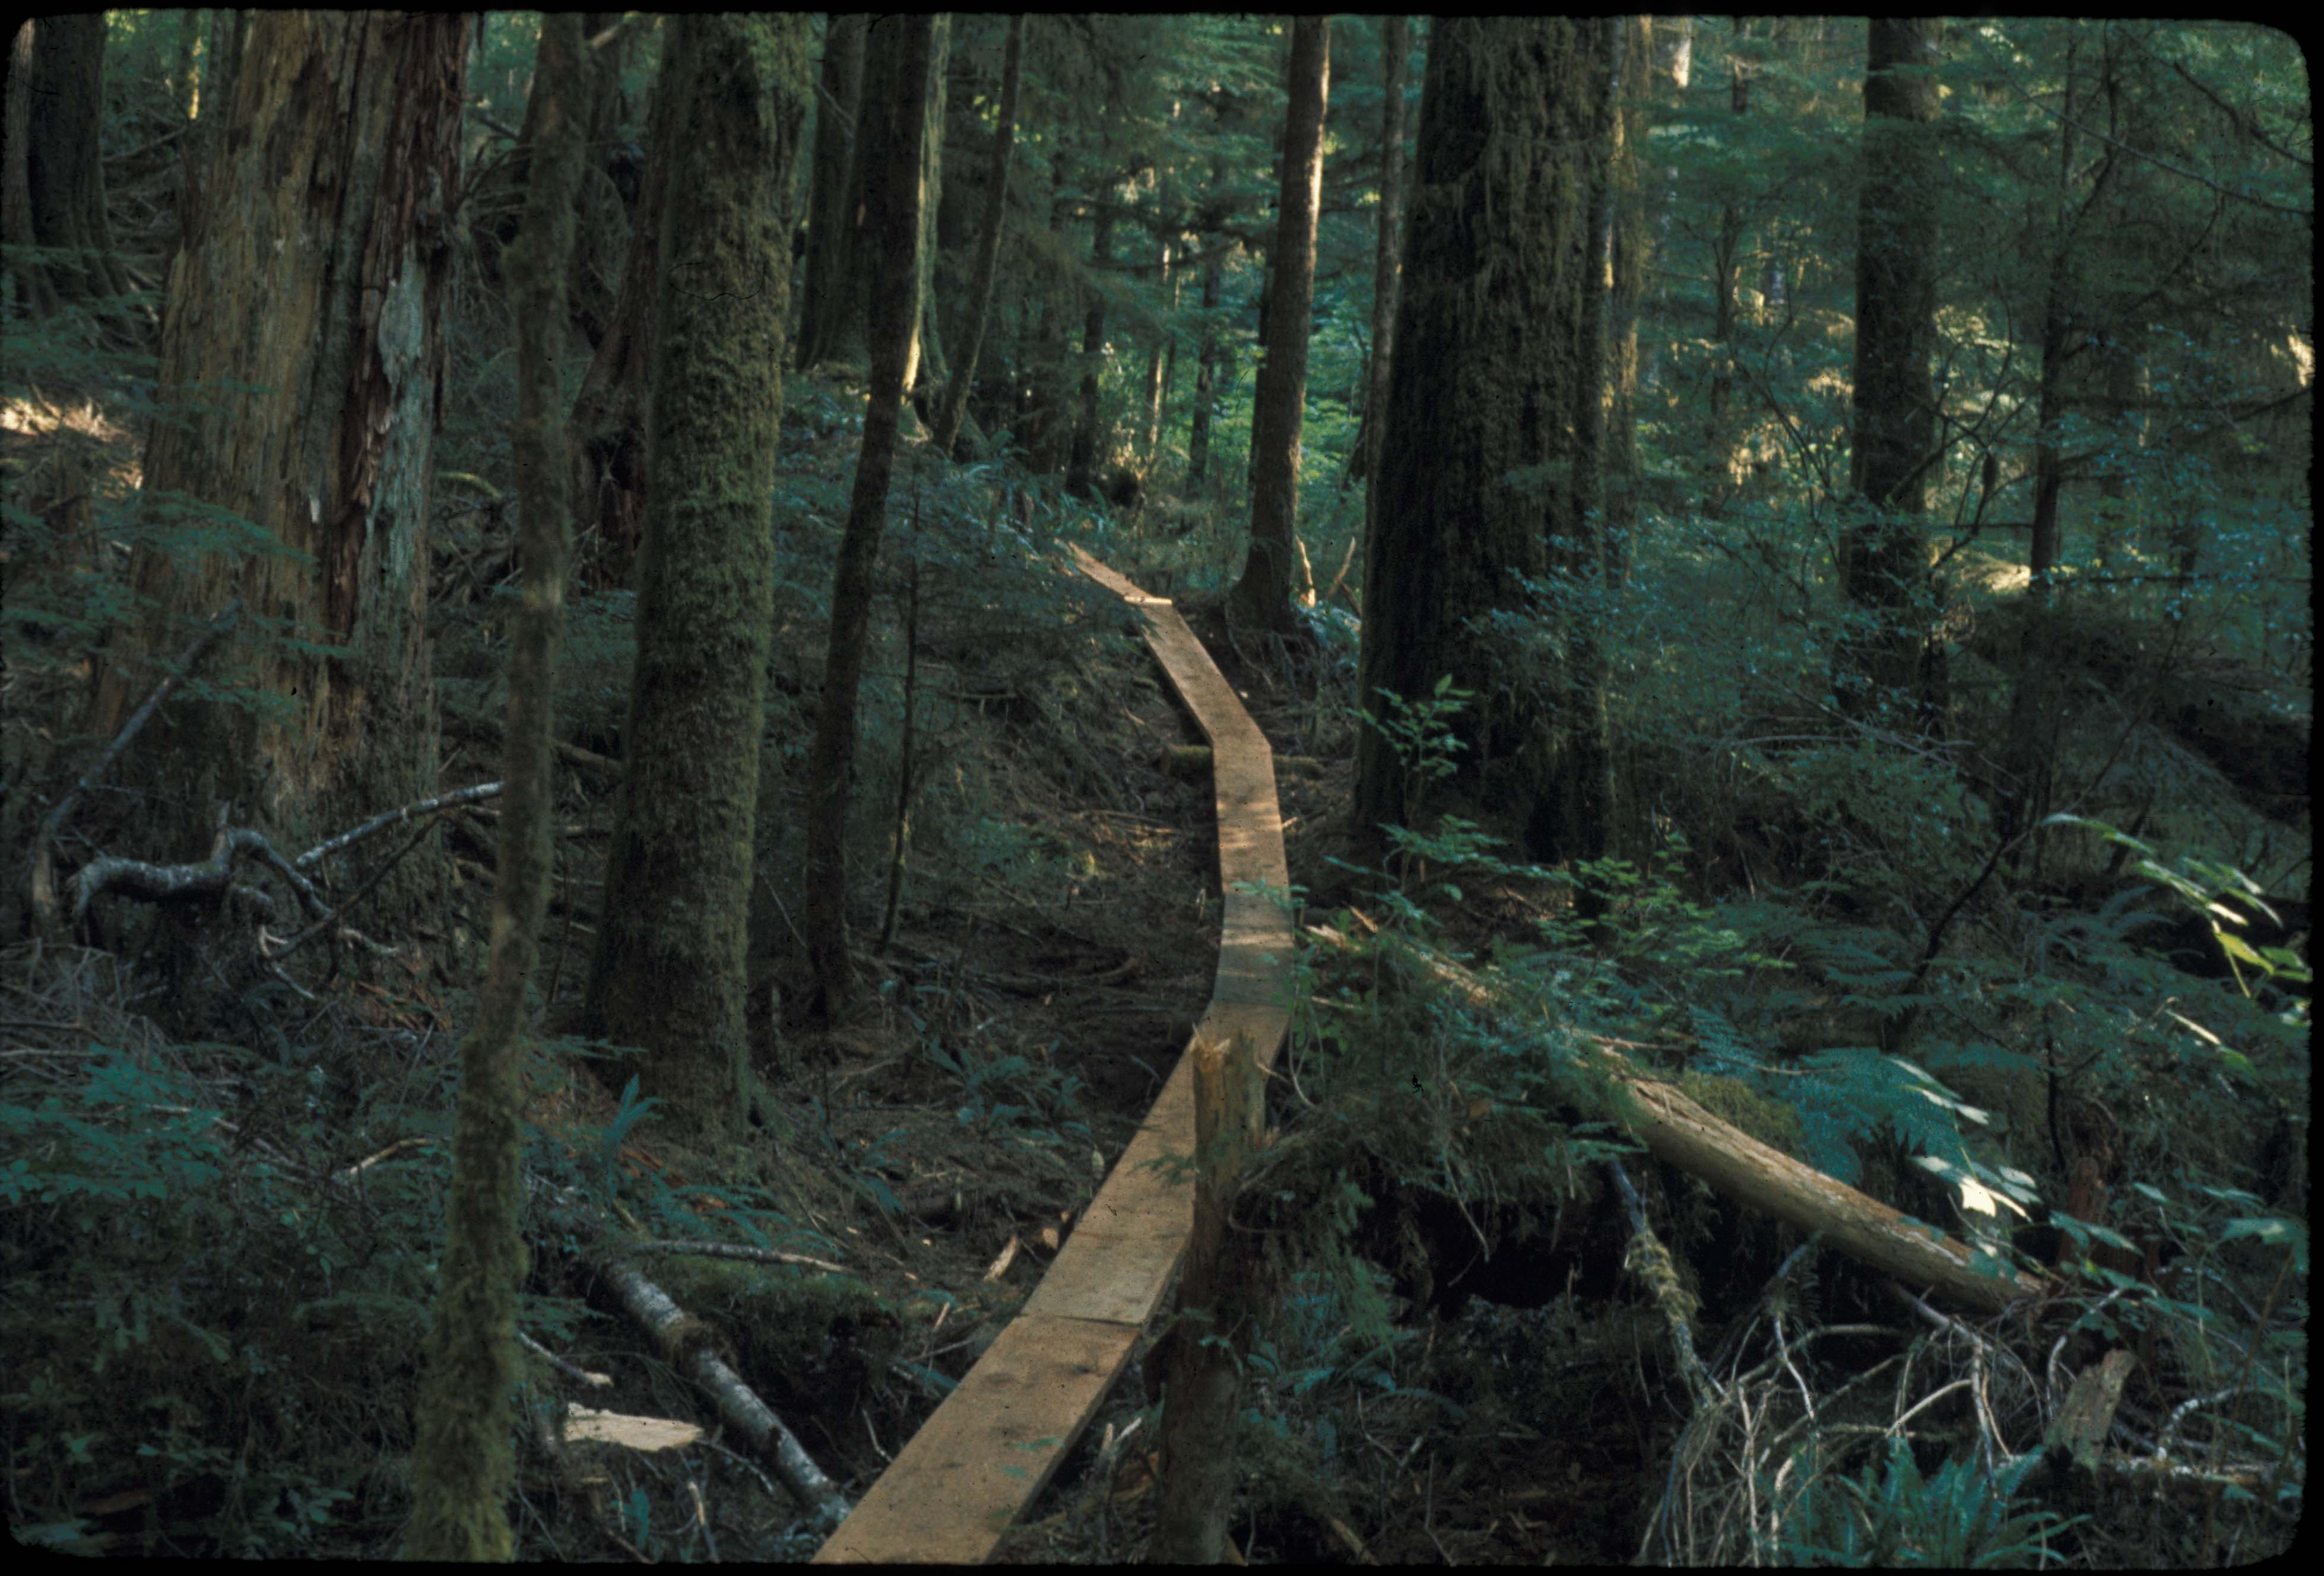
Research site access by valley-bottom boardwalk
12

Slide 13
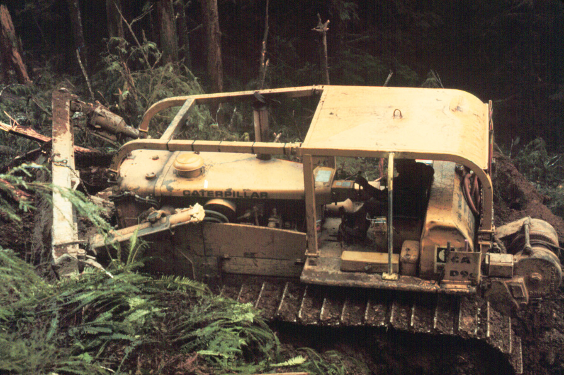
Road building, 1975
13

Slide 14
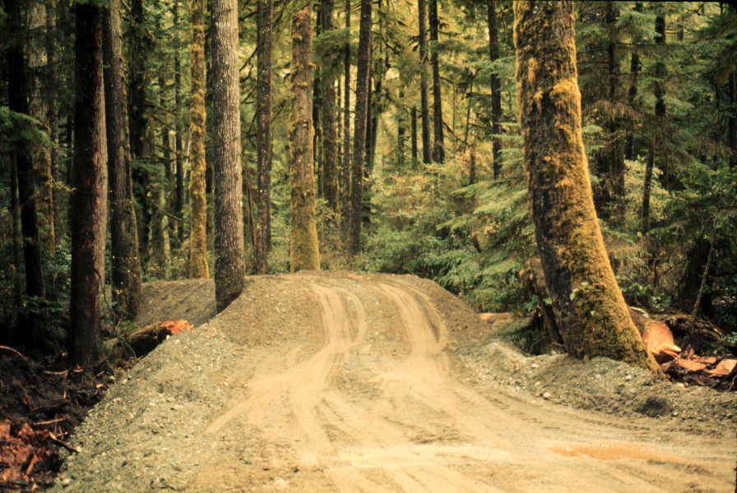
Road to camp
14

Slide 15
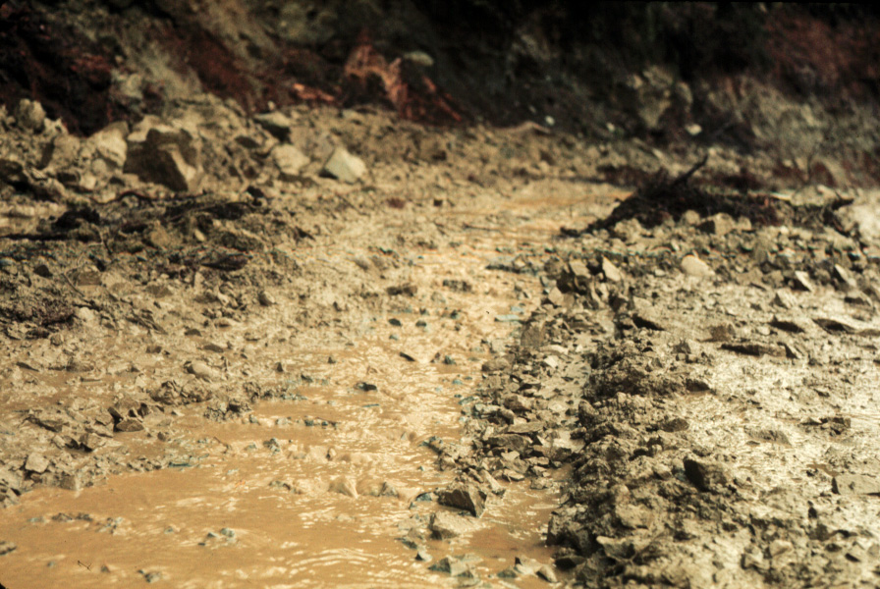
Fine sediment mobilization from road surface
15

Slide 16
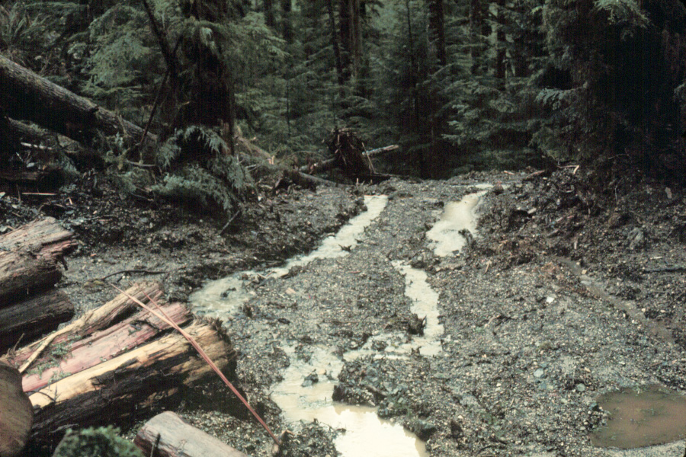
Fine sediment runoff downslope from stream crossing
16

Slide 17
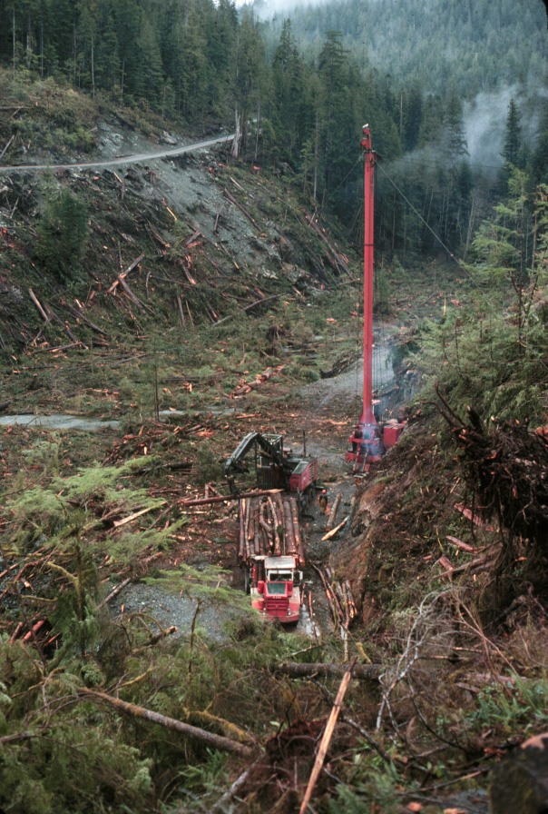
Harvesting initiated in winter 1975-76
progressive clearcuts
3 riparian management treatments
main harvest phase complete by 1981
  41% of watershed area harvested
  Additional 25 % later under CFFG
  (Coastal Fishery Forestry Guidelines)
17

Slide 18
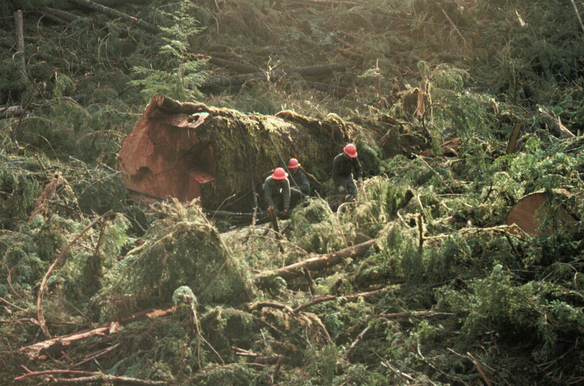
Tree felling on valley bottom
18

Slide 19
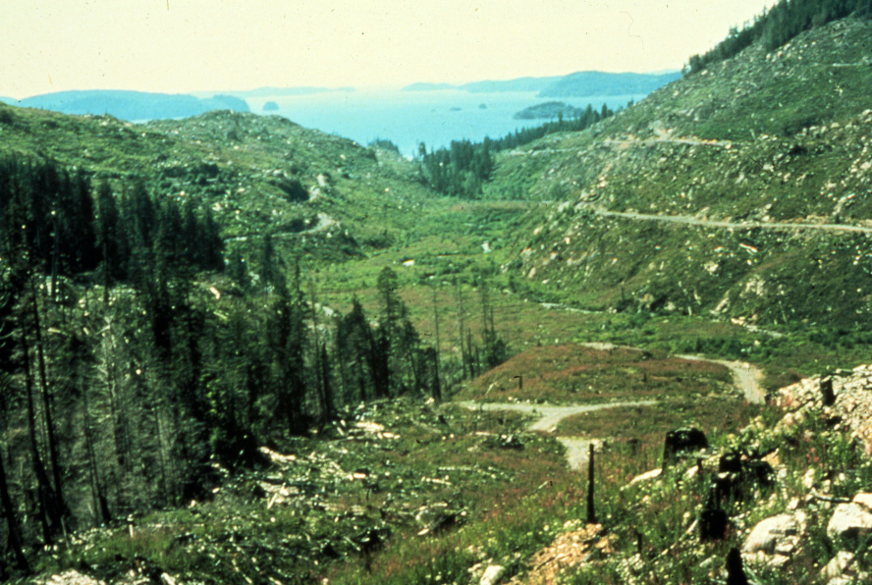
Carnation Creek 1981
Main harvest phase complete
19

Slide 20
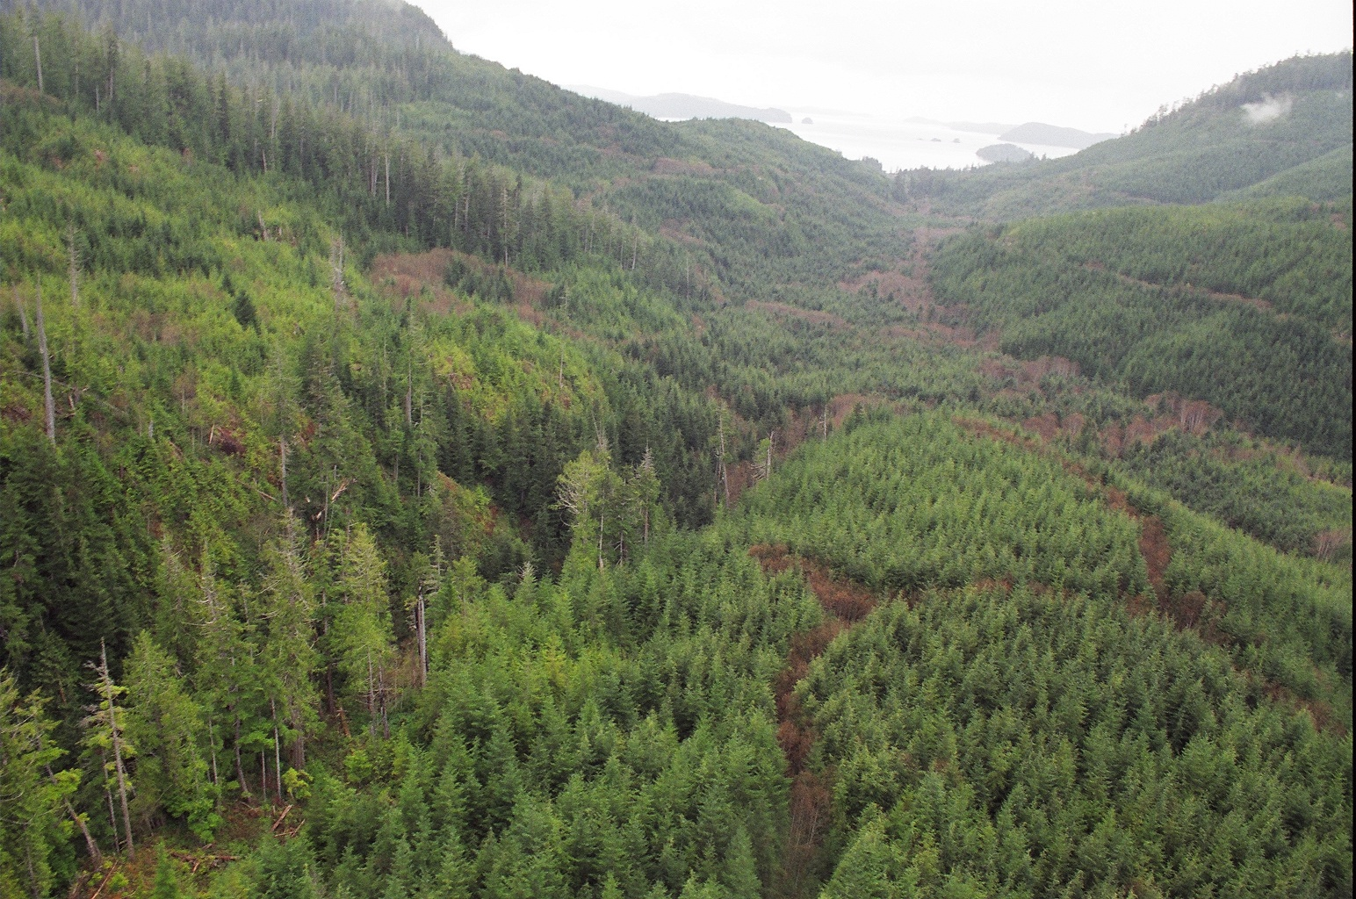
Carnation Creek 2004
20

Slide 21
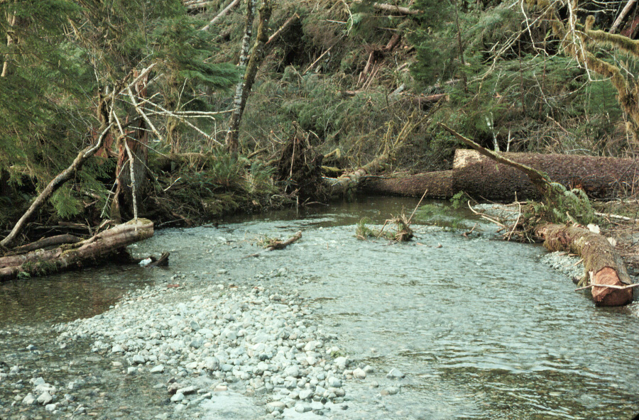
Intensive riparian harvest treatment
21

Slide 22
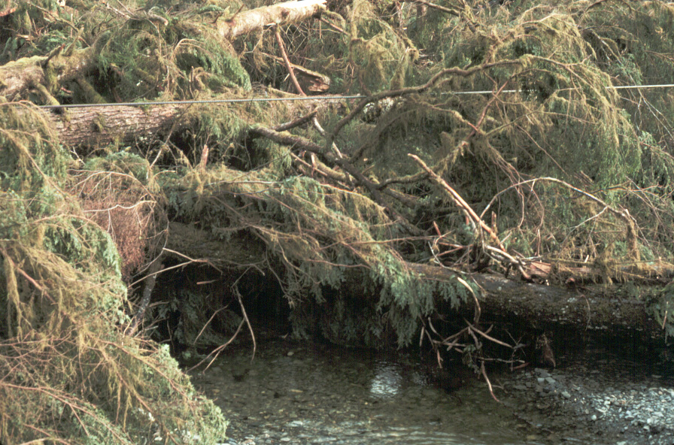
Cross-stream cable yarding
22

Slide 23
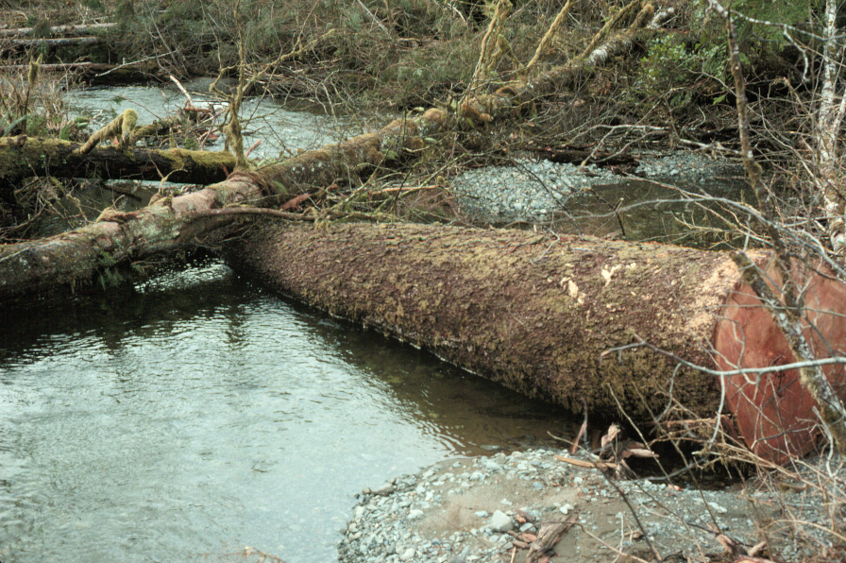
In-stream wood salvage
23

Slide 24
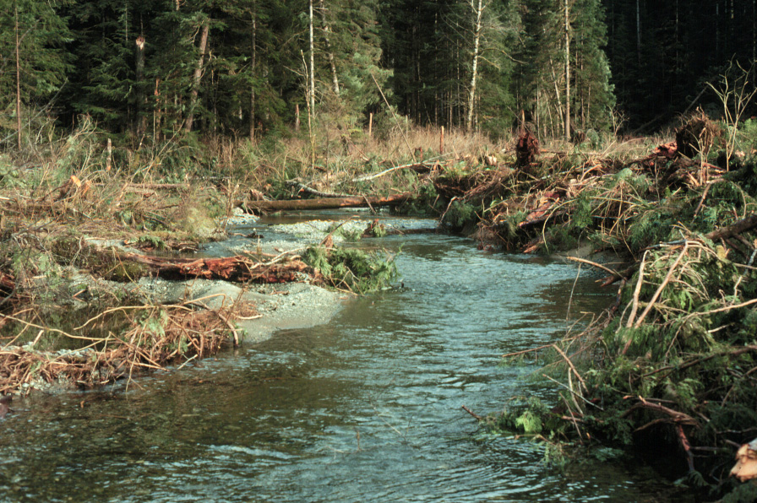
Riparian clearcut harvesting
Two treatments: intensive (with in-stream activity), 900 m long
careful (no in-stream activity), 900 m long
24

Slide 25
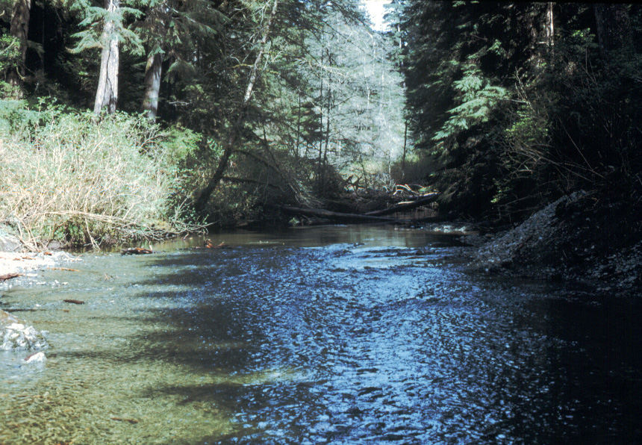
Variable-width riparian buffer, < 5 – 70 m wide, 1.3 km long
25

Slide 26
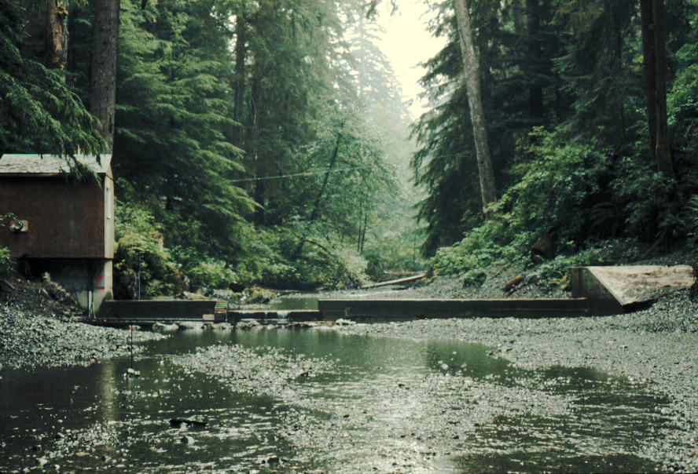
Station B Main Streamflow Weir
26

Slide 27
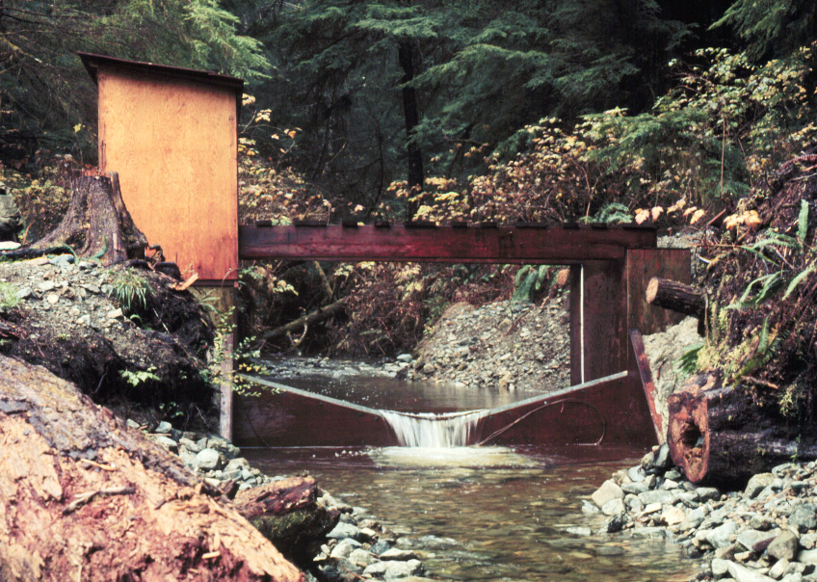
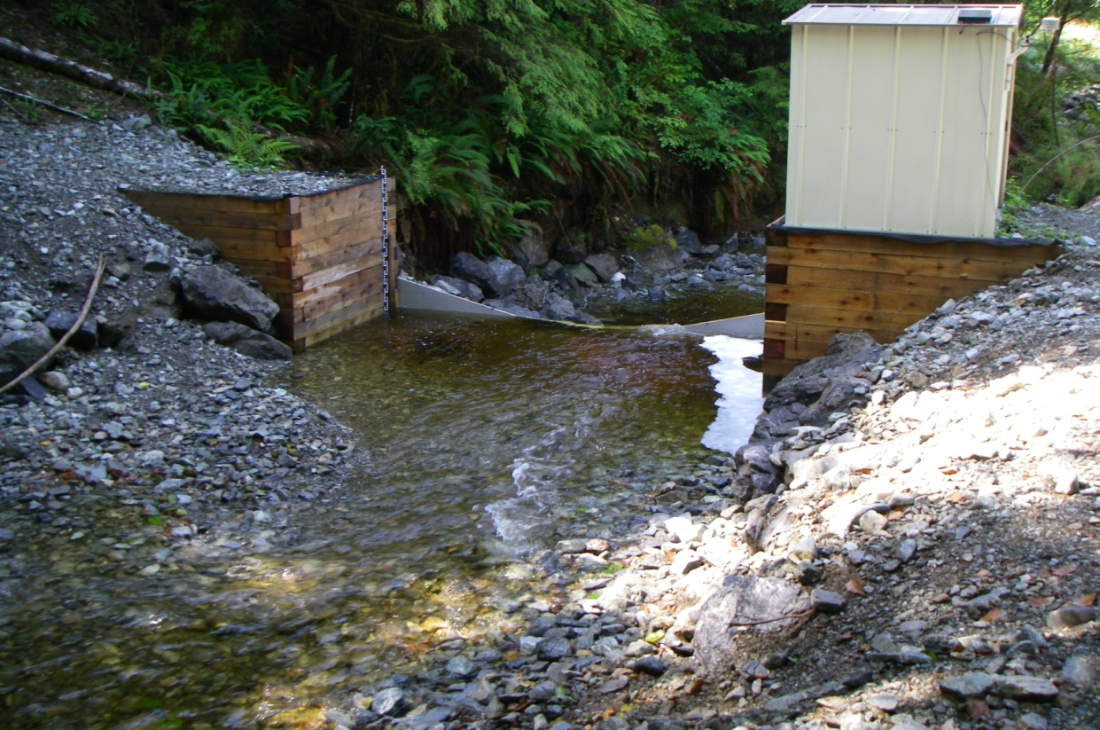
1973
Tributary C (control sub-basin) Weir
Robin Pike photo
2008
27

Slide 28
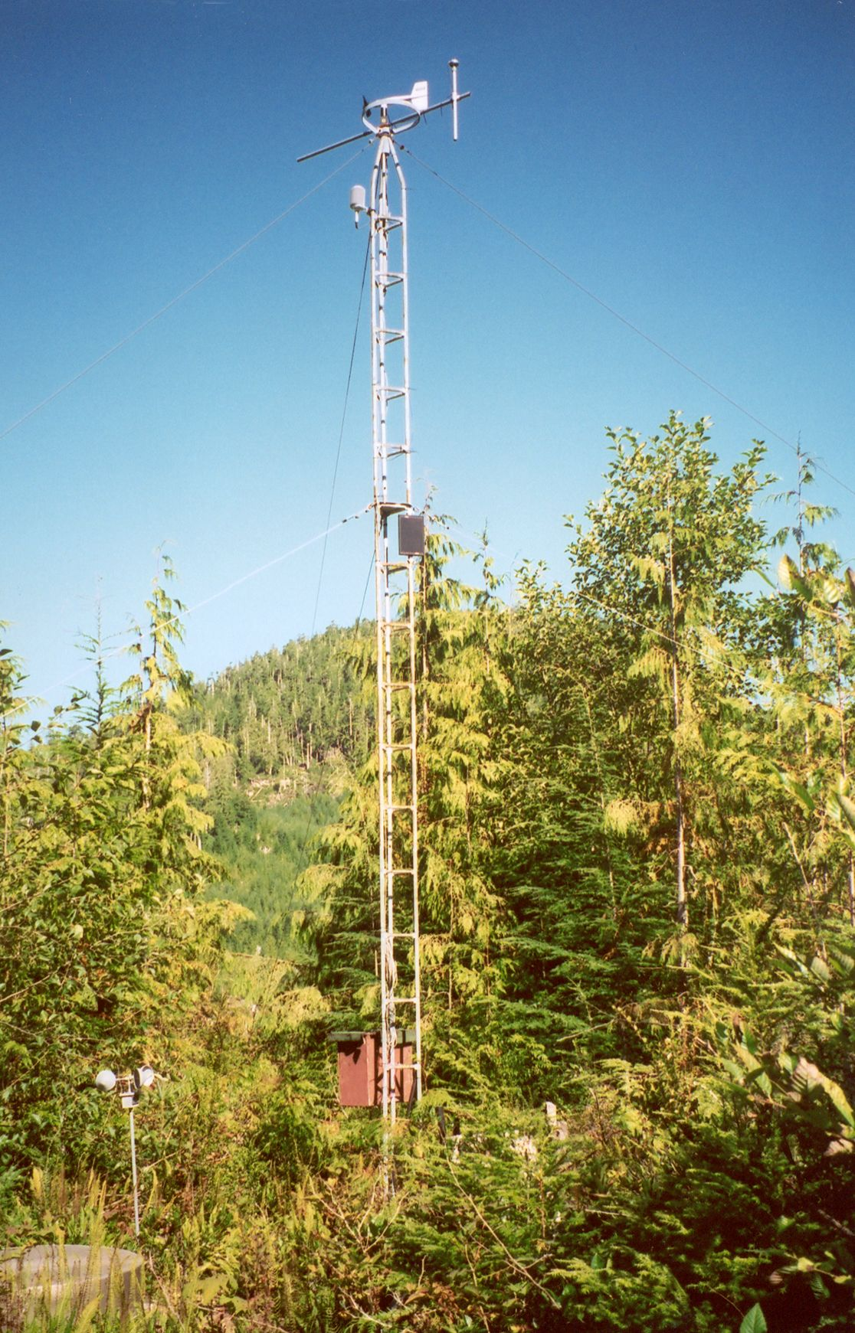
Low elevation Climate Station A
near Camp
28

Slide 29
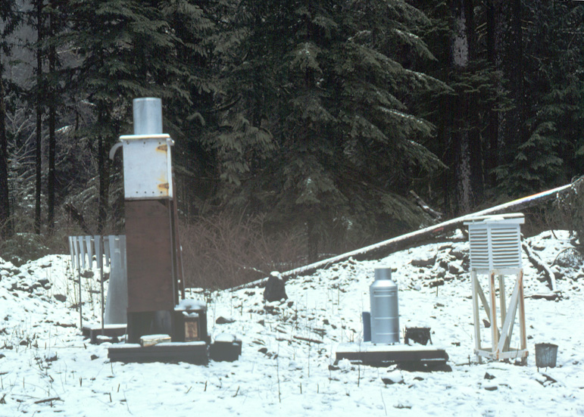
Mt. Blenheim, high-elevation Climate Station D
29

Slide 30
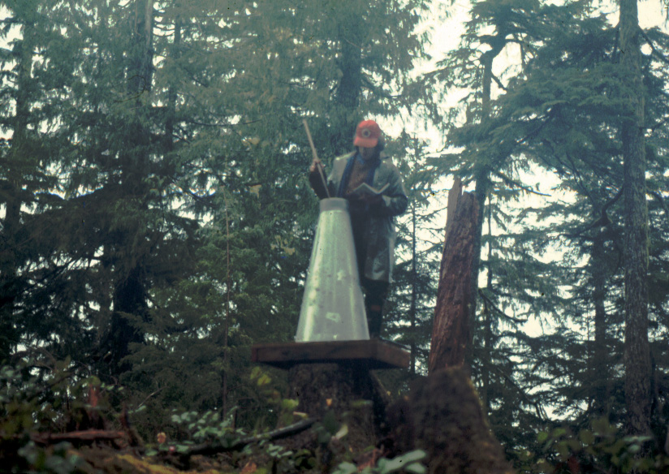
Cumulative precipitation measurements the old-fashioned way, 1970s
30

Slide 31
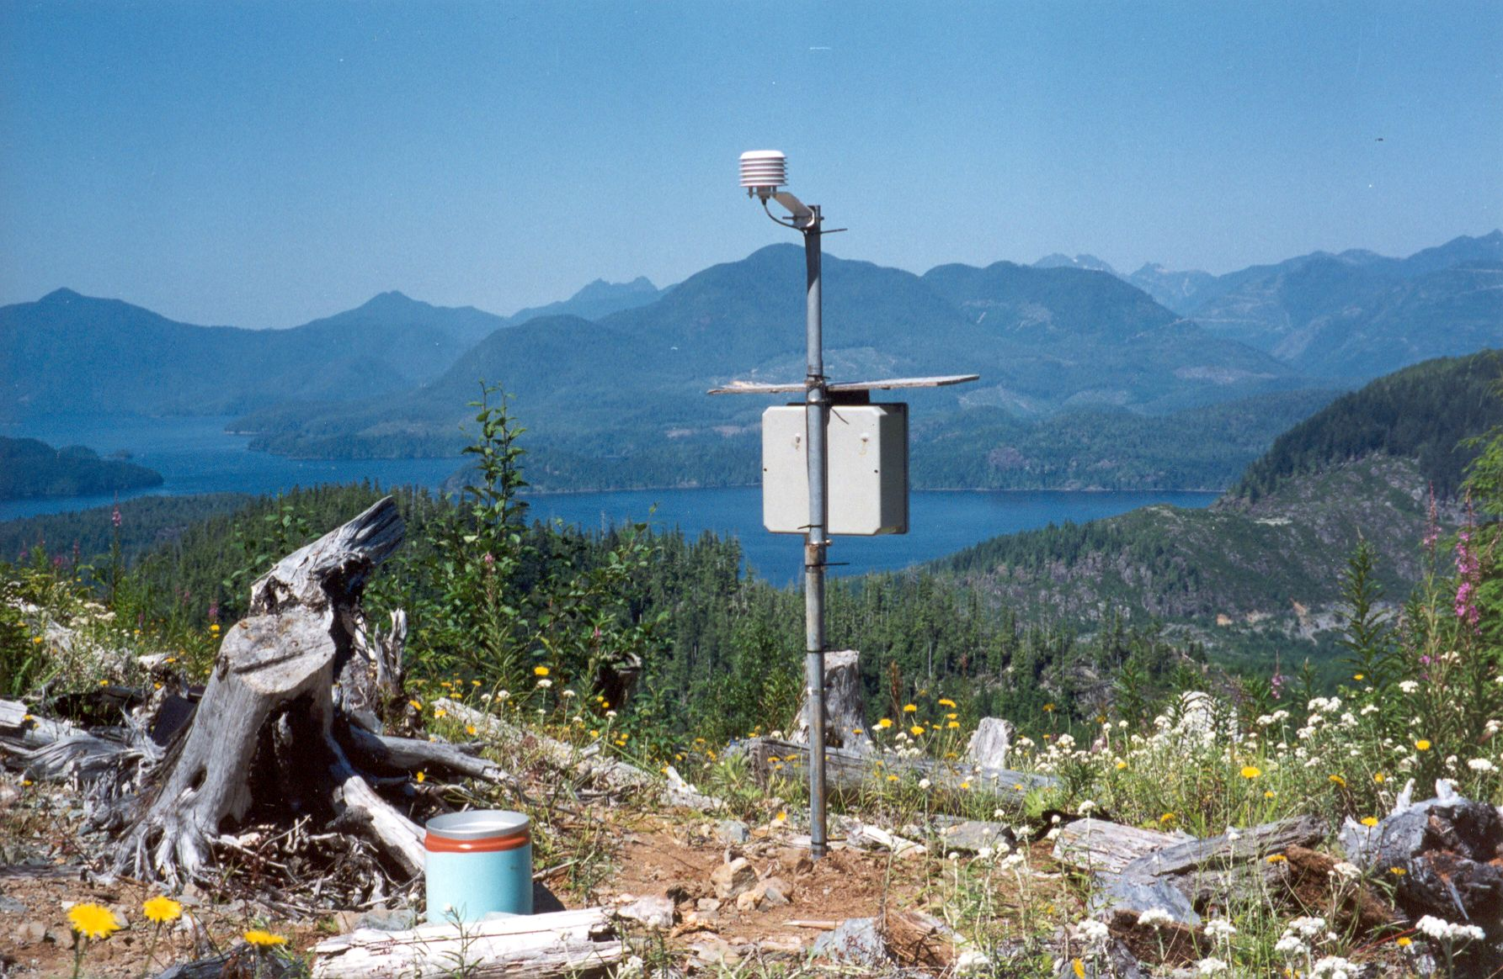
Climate station N
David Spittlehouse photo
31

Slide 32
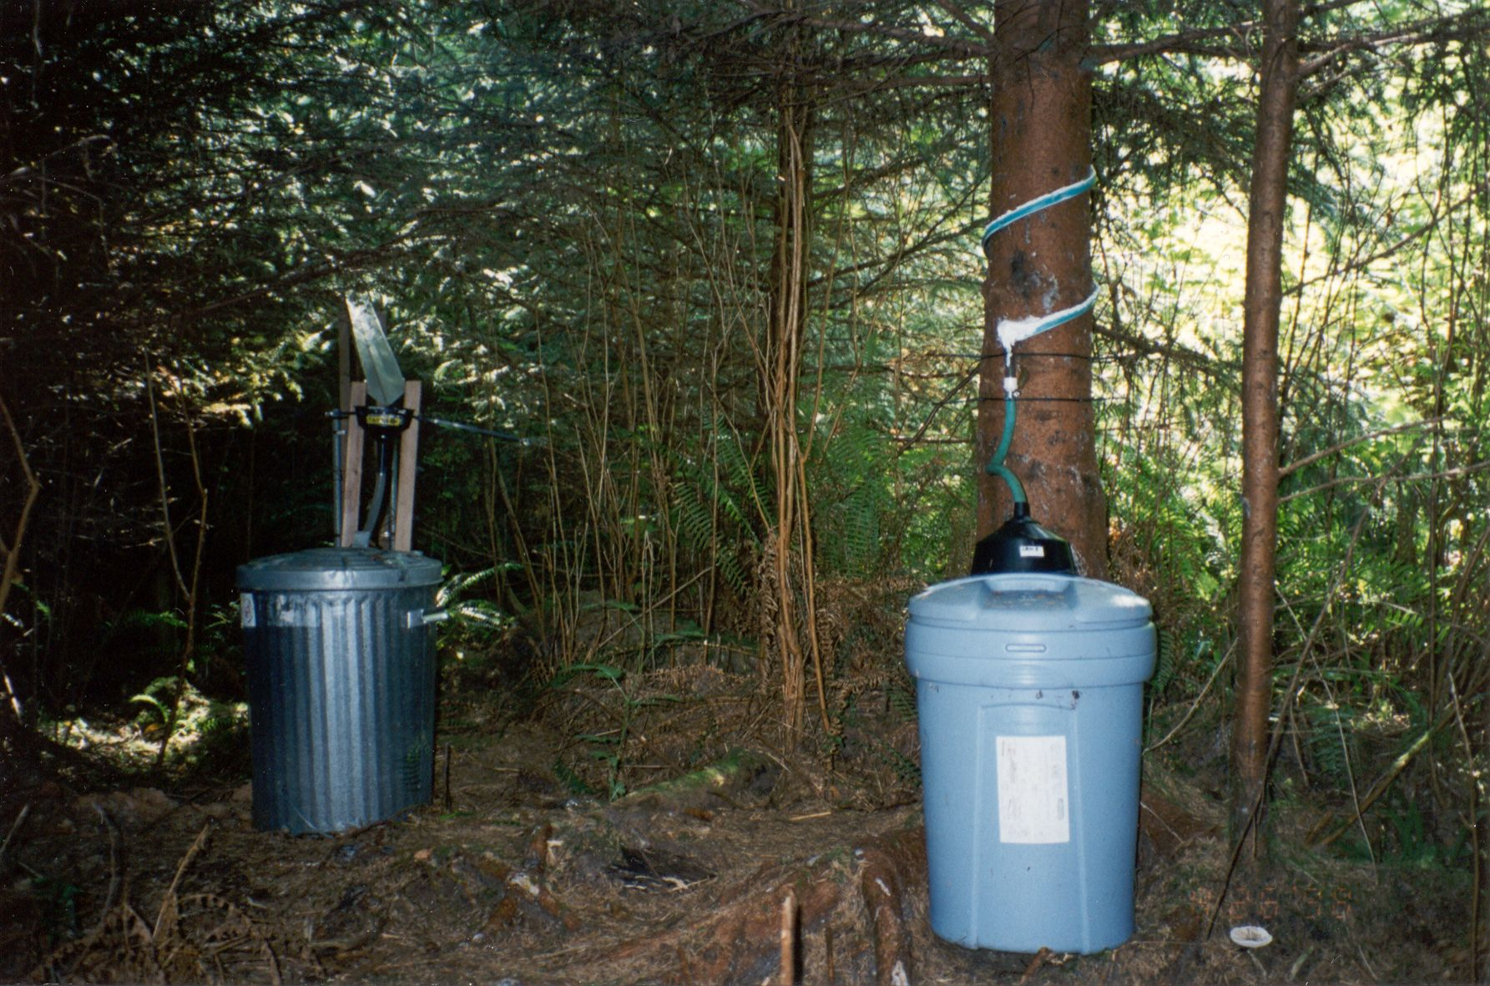
Canopy rainfall interception, runoff, & stemflow – young forest stands
David Spittlehouse photo
32

Slide 33
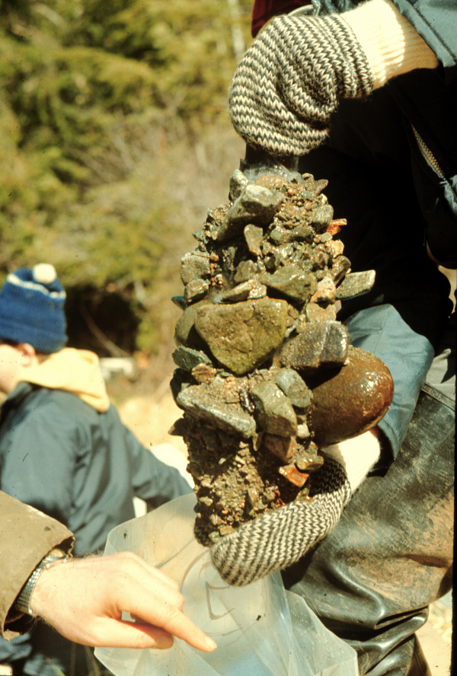
Streambed sediment samples
frozen-core techniques
track changes in amount &
distribution of fine particles
(e.g., sand)
33

Slide 34
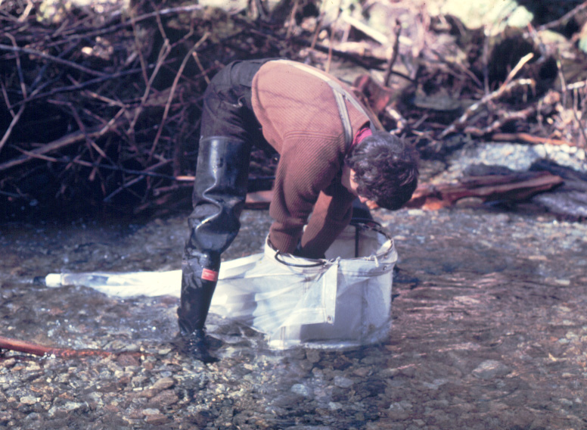
Benthic invertebrate sampling
streambed insects and other species
important food source
for juvenile salmon
34

Slide 35
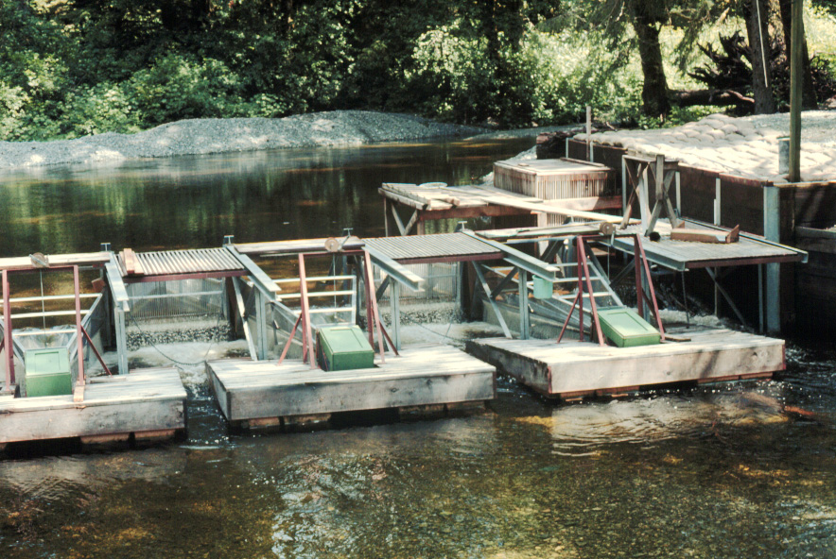
Fish fence at head of tidal influence
configured for monitoring seaward migrations
(juvenile salmon in spring & early summer)
35

Slide 36
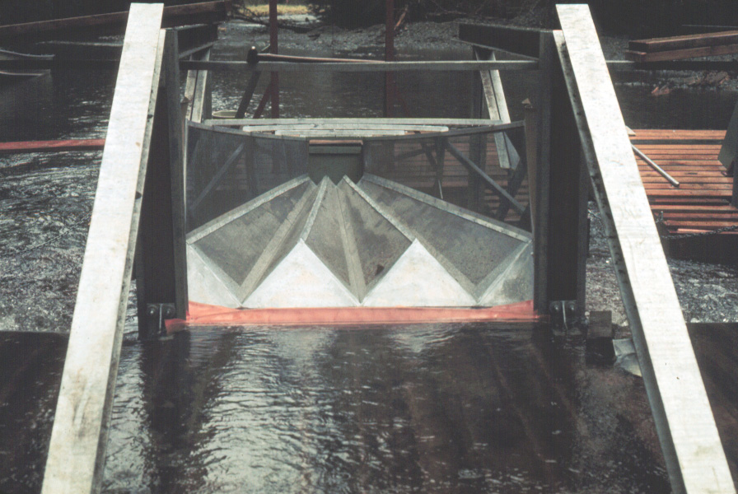
Fan traps
36

Slide 37
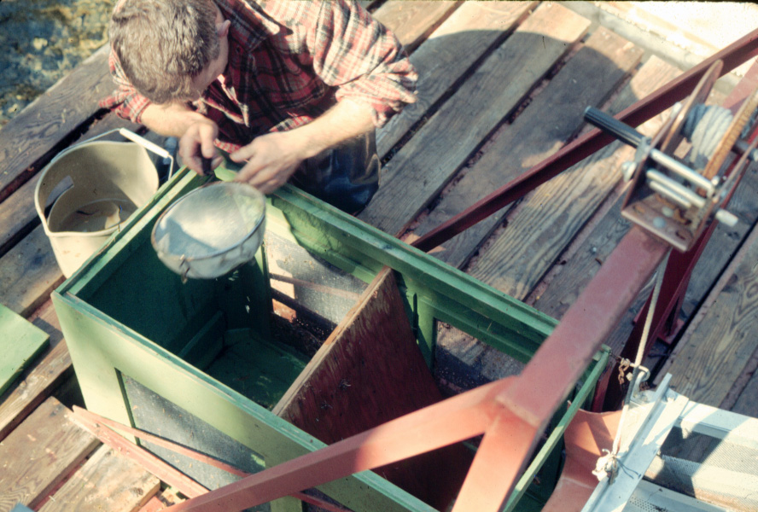
Sampling juvenile salmon
37

Slide 38
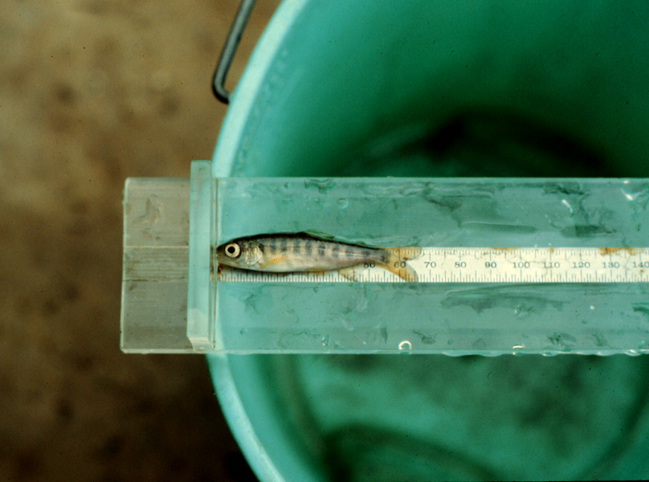
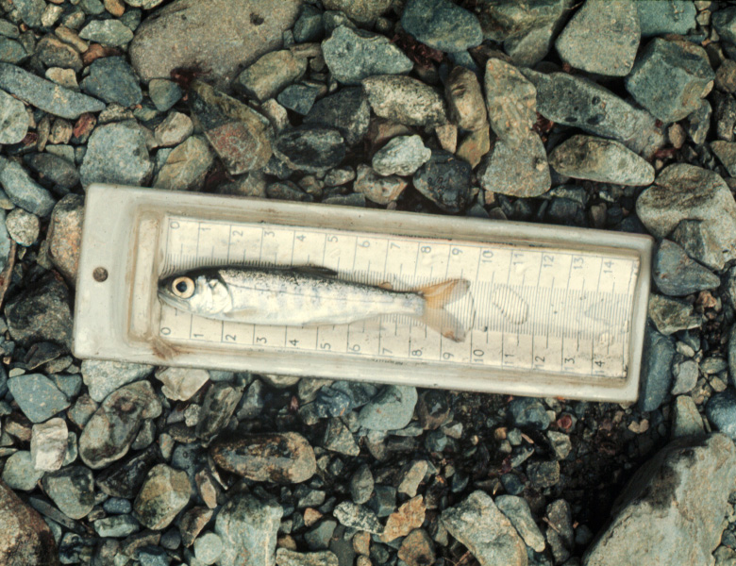
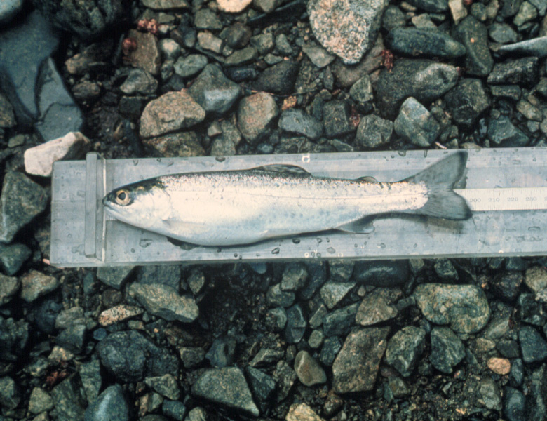
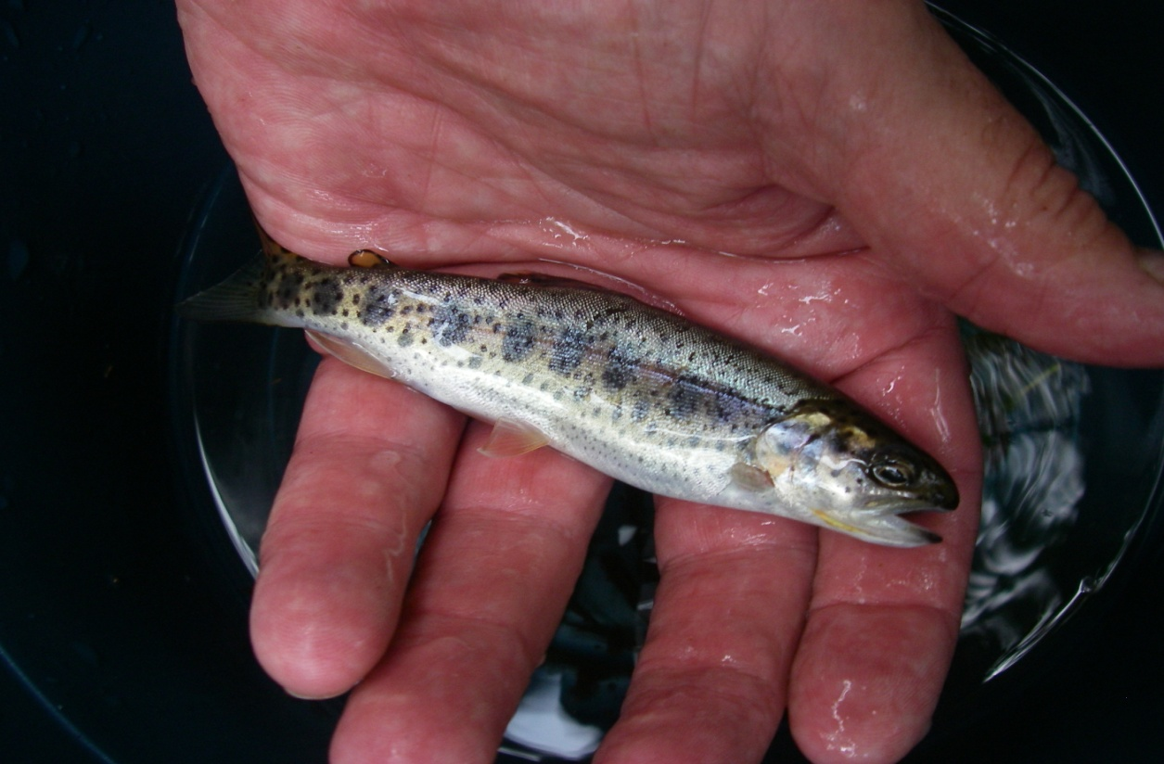
Coho salmon fry (young of the year + Age 0); 60 mm long
Late summer
Coho salmon smolt – Age 1;
90 mm long
Steelhead (sea-going rainbow) trout smolt – Age 3; 190 mm long
Sea-going (anadromous) Cutthroat trout – Age 2
38

Slide 39
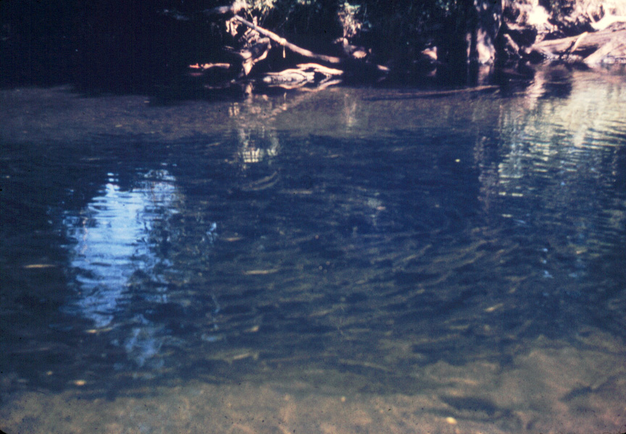
Chum salmon spawners – Estuary pool
39

Slide 40
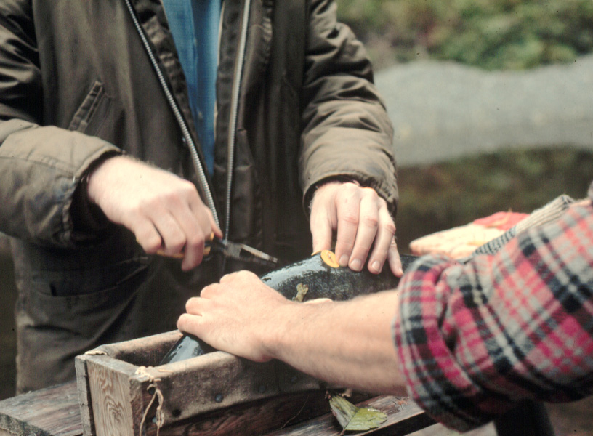
Marking adult salmon with disc tags
40

Slide 41
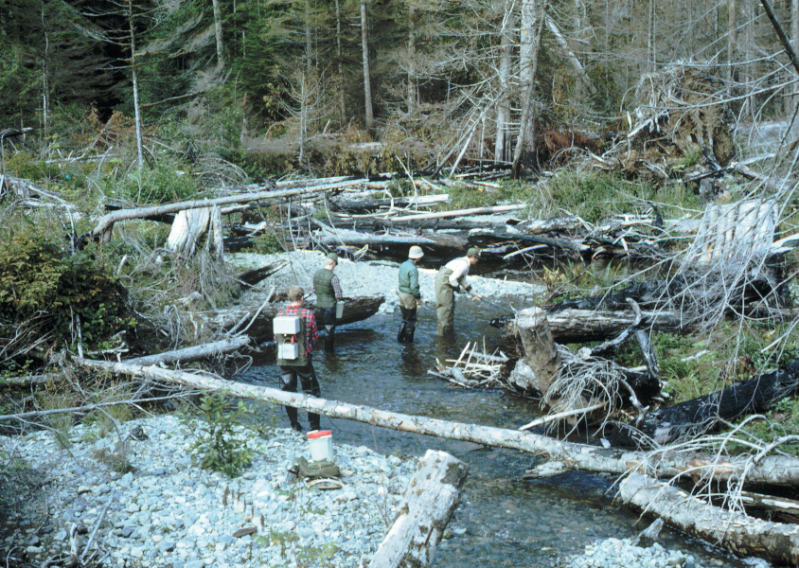
Summer assessments – resident fish population
Multi-pass electro-fishing
41

Slide 42
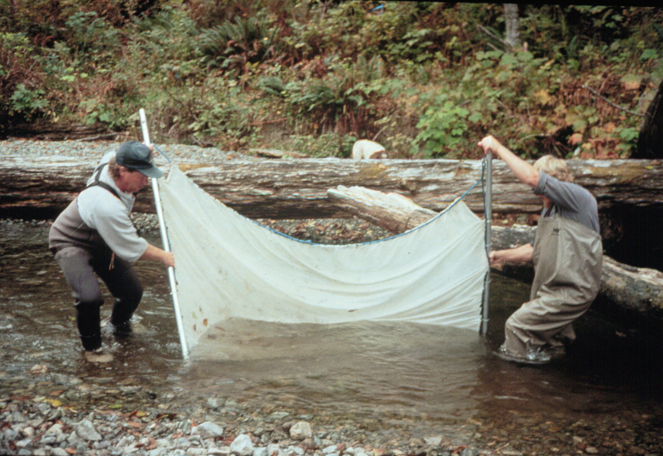
Summer assessments – resident fish populations
Multi-pass seining
42

Slide 43
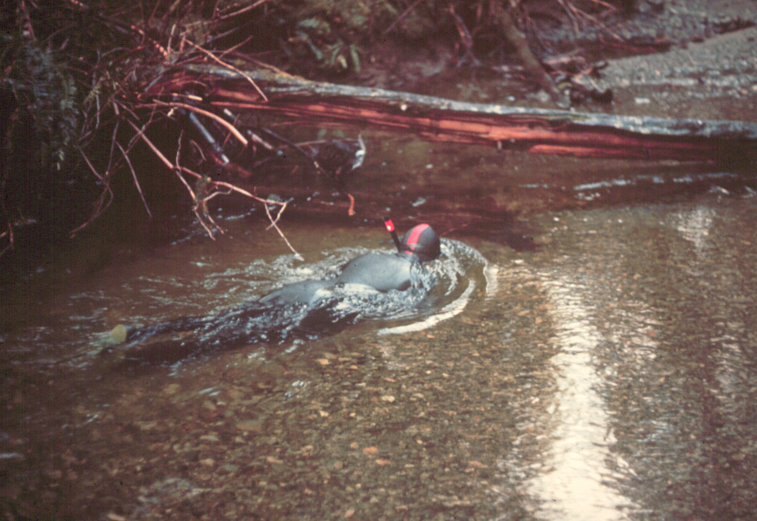
Overwinter fish population surveys
Snorkel counts
43

Slide 44
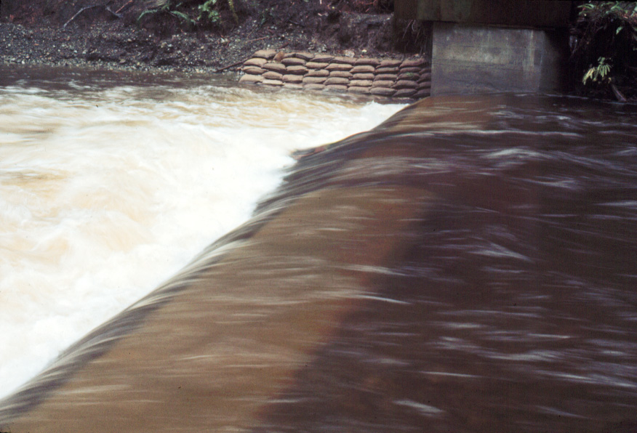
Winter storm flows – Carnation Creek main channel
Survival impacts for overwintering fish
Many coho salmon and cutthroat trout leave the
main channel in autumn
Steelhead (rainbow) remain
44

Slide 45
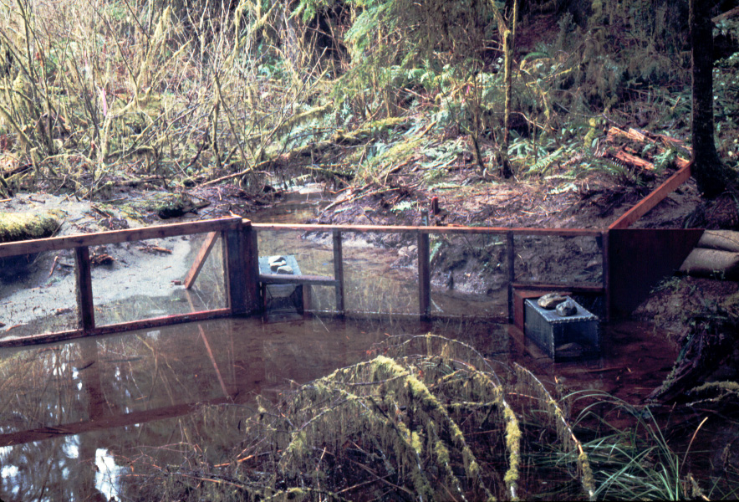
Valley-bottom overwinter habitat
for coho salmon & cutthroat trout
45

Slide 46
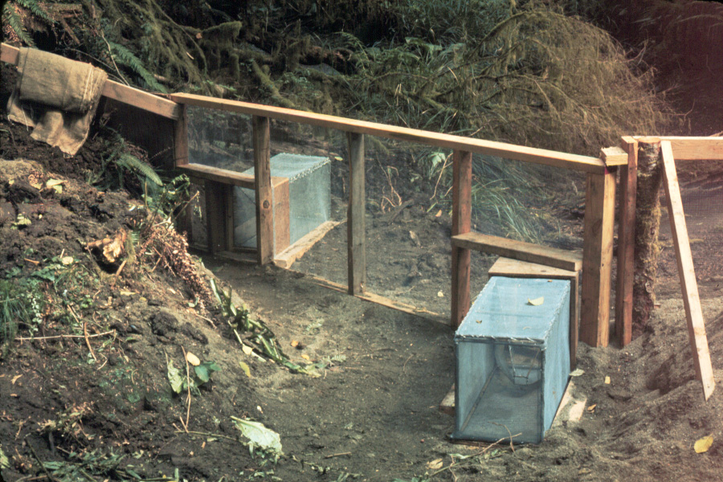
This is fish habitat?
Winter habitat can look like this in summer
46

Slide 47
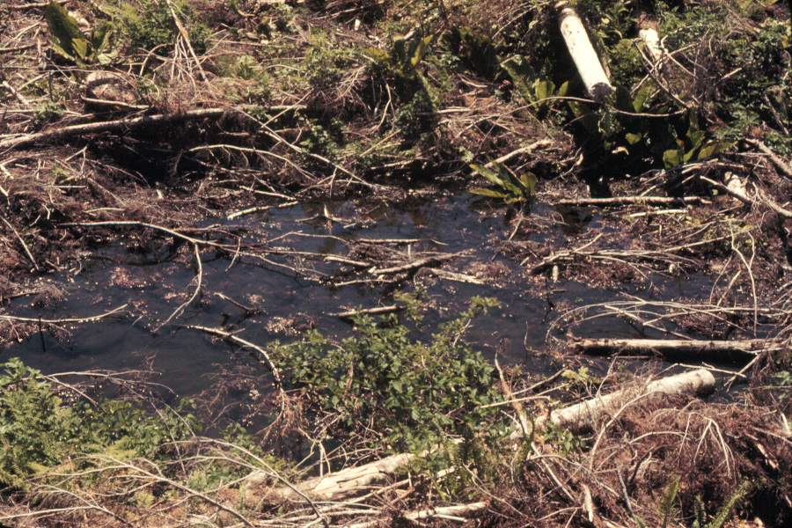
Valley-bottom ponds and puddles – this too is
important winter habitat – Fisheries Sensitive
Zones (FSZs) or “Features” under FRPA
47

Slide 48
48

Slide 49
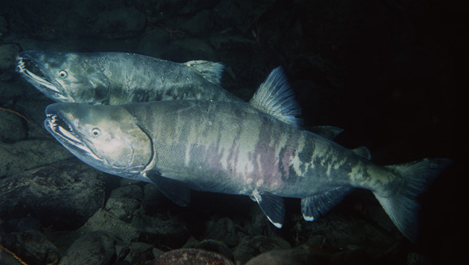
Chum salmon
Forestry-related effects:
45% decline in egg survival (20% to 11%)
Post-harvest fine sediment accumulation in spawning & egg incubation areas of
streambed
Thermal effects in stream affected marine survival: earlier egg hatch, fry emergence,
seaward migration
Account for 25% of interannual variability in chum spawner returns
Dominant effects: Climate-related (~equal fresh water vs. ocean)
freshwater: increased water temperatures
ocean: lowered salinities, increased water temperatures, increased predation
49

Slide 50
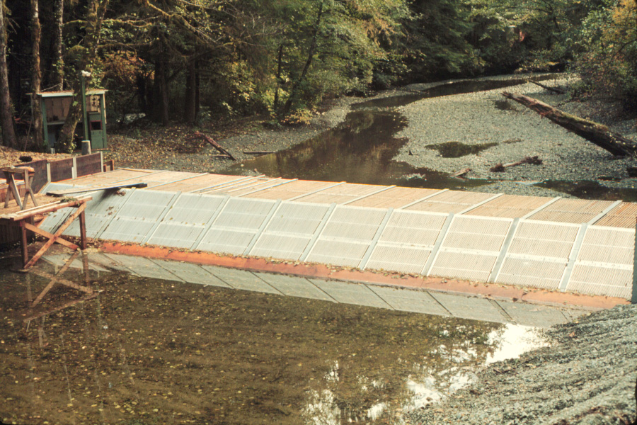
Chum salmon spawning area – lower Carnation Creek & estuary
Fish fence configured for adult salmon
migration monitoring
50

Slide 51
Fishery Restricted/Closed
El Niño
El Niño
El Niño
El Niño
El Niño
El Niño
51

Slide 52
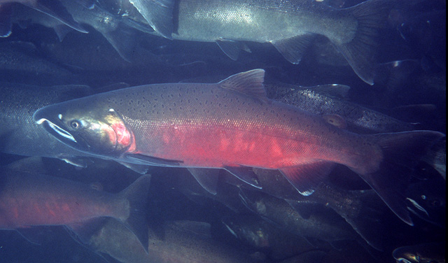
Coho salmon
Forestry-related effects mixed:
Habitat alterations have reduced stream rearing capacity and juvenile population
abundance
Thermal effects have increased growth, overwinter survival, and smolt production
< 10% of interannual variability in coho spawner returns attributable to forestry
Pre-dominant effects: Climate-related with ocean changes outweighing freshwater changes
Ocean effects: (1) Long-term temperature increases associated with global warming
(2) Periodic cycles of lowered salinities, increased water temperatures, lowered
productivity, increased predation
52

Slide 53

Diverse salmon rearing and spawning habitats:
pools, shallow riffles, & stable in-stream wood
53

Slide 54

Prime pool habitat
stable undercut banks
overhanging vegetation
provides shade, cover &
terrestrial invertebrate food
source
54

Slide 55

Post-harvest habitat changes
loss of structural diversity & in-stream functional
wood
accelerated bedload movements
channel 2-3 X wider
unstable, mid-channel bars and sediment wedges
changes persist today
55

Slide 56

Landslides, logjams, &
long-term channel changes
Channel instability; lateral erosion; bedload
& woody debris movements
Coho salmon egg survival reduced by nearly
½ from 29% to 16%
56

Slide 57
57

Slide 58

Thermal Effects on Coho Salmon
forestry and climate components
riparian harvesting increased mean water
temperatures in all seasons:
  0.7°C in winter
  3.2°C in summer
Outcomes of Winter Thermal Changes:
- Accelerated egg development
Earlier fry emergence in spring
(up to 6 weeks)
Longer period of summer growth
Larger size by autumn (11 mm longer)
Better overwinter survival
1.6X increase in post-logging smolt numbers
Coho salmon fry populations reduced by nearly ½ in post-logging period producing 1.6 X more smolts.
58

Slide 59
Thermal Effects
Start of
riparian
harvest
59

Slide 60
Thermal Effects of Riparian Harvesting
60

Slide 61

Ocean Survival Declines
More smolts going seaward do not mean
more adult spawners returning
Decade-scale ocean survival reductions
appear widespread & regional
Freshwater-marine linkages:
shifts warmer stream temperatures mean shifts
in smolt migration timing – up to 1 month
earlier in spring
survival-related implications
migrations occurring during period of low
marine productivity
61

Slide 62

Freshwater-Marine Linkages
Consequences for early migrations linked
to forestry and climate
Winter marine conditions
northwest-flowing currents
warm, low salinity, low productivity
poor conditions for smolt survival
long-term climate warming to emphasize these
patterns?
El Niño prolongs patterns into summer
  moves zone of upwelling away from coast and
  to the north
More coho smolts entering the ocean in conditions
unfavourable for survival
Summer marine conditions
counter-current coastal flow generates upwelling
Cold, nutrient-rich water
high biological productivity (e.g., zooplankton)
excellent conditions for smolt survival
62

Slide 63
Future Implications for Watershed Conditions
Second-growth forest management will predominate
Conditions at Carnation Creek will be common in many watersheds harvested decades ago
Streams will have residual forestry-related alterations from 1st harvest
  Low abundance of functional in-stream wood (LWD)
  Low levels of LWD input for several decades
  Channel habitat quality alterations: wider, shallower, more bedload
  Reduced capacity to support juvenile salmon
Climate-linked shifts progressing with implications for water temperatures and salmon thermal preferences and tolerances
Implications for riparian and watershed management for professionals in a result-based FRPA
63

Slide 64
Future Implications for Research & Monitoring
Future Thermal Regimes and Effects on Salmon
Thermal regimes in Carnation Creek main channel have not recovered to pre-harvest levels 29-34 years after riparian harvesting
Residual forestry effects: channel remains 2-3X wider – affecting shade available from 2nd growth riparian canopy
Long-term climatic warming – differential effects on main channel and tributaries
Can monitor changes in Carnation Creek with changes in unharvested, control Tributary C
Monitor consequences for salmon population parameters, habitat use
Distinguish climate-related & forest management effects
64

Slide 65
Future Implications for Research & Monitoring
Climate-related Disturbance Shifts in Rain-dominated Coastal BC Watersheds
Increased frequency and magnitude of winter storms, peak flows, and related disturbances
  Landslide frequency, channel disturbances, aquatic habitats
  Impacts on fish egg survival, juvenile overwinter survival
Drier summers & more low-flow days
Egg mortality for spring spawners (trout); habitat reduction for juveniles and
resident adults for all species; thermal stress; thermal optima reached
Impacts to small-stream communities: benthic invertebrate production & implications for fish food resources
65

Slide 66
Carnation Creek Research Team & Project Partners
BC Ministry of Forests and Range
BC Ministry of Environment
Environment Canada – Water Survey of Canada
Fisheries and Oceans Canada
FORREX
Huu Ay Aht First Nation
University of British Columbia
University of Texas, San Antonio
Western Forest Products Ltd.
66

