Slide 1
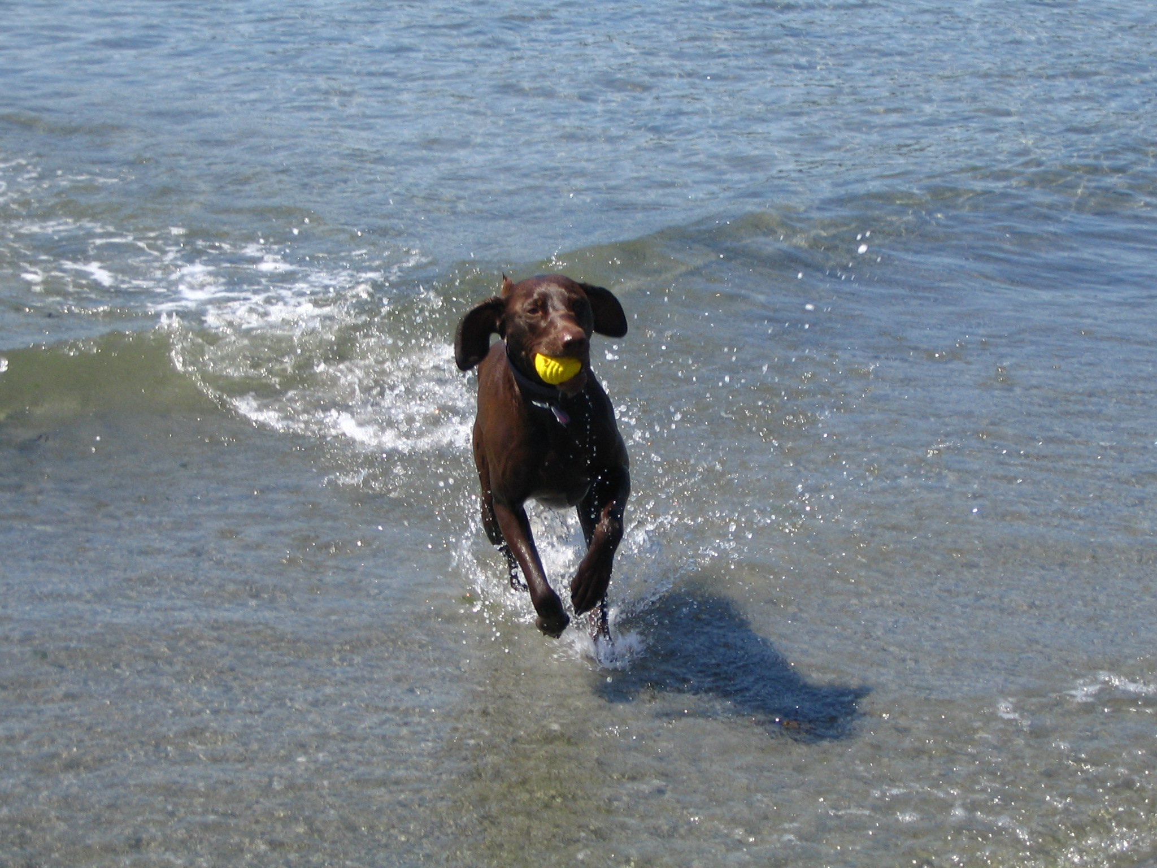
How we could be spending Friday afternoon...

Slide 2
Nonparametric Regression Methods
an overview of modelling with kernels, loess and splines

Slide 3
Nonparametric Regression Methods
This presentation deals with the situation where there is one dependent (response) variable and at least one independent (predictor) variable
Approaches i’ll cover
Splines (90%)
Loess (5%)
Kernel Regression (5%)
Notes:
Motivation & inspiration
Richness of splines
Note that dimension (d) is defined with respect to predictors (i.e. domain). Most examples here will be 1-D.

Slide 4
Nonparametric Regression Methods
Why do we need nonparametric regression?
Relationship is nonlinear
Parametric form of relationship is not always intuitively obvious or required
Higher order polynomials (order ≥ 4) suffer Runge’s phenomenon – undesired oscillation of interpolated fit between data points

Slide 5
Runge Phenomenon

Slide 6
“The dataset”

Slide 7
Splines
Splines – piecewise polynomials
Want to represent nonlinear f (or at least something very close to it) as a linear combination of basis functions:
Seen them before with multiple regression – the polynomial basis:
Notes:
Original term refers to drafting tool used to draw curves (e.g. strip of metal or wood)
Rather than get into mathematical explanation of bf (see Chapter 3 of Simon Wood’s GAM book), use above equation to define them...

Slide 8
Polynomial basis

Slide 9
Splines
Spline consists of sections of a polynomial joined together at pre-specified knots
Value of y is usually equal at knot so curve is continuous, and first and second derivatives (WRT x) may also be equal
Notes:
Usually cubic

Slide 10
TPF basis example #1: Linear Spline Basis
Say we set-up 3 knots... and then
where
Notes:
Truncated Power Function (TPF) Spline Bases are easy to construct

Slide 11
TPF basis example #1: Linear Spline Basis
Notes:
Note that only values of are equal at knots

Slide 12
TPF basis example #1: Linear Spline Basis
proc transreg data=whatever;
model identity(y)=pspline(x / degree=1 knots=-0.66667, 0, 0.66667);
output out=pred predicted coefficients;
title ‘Linear tpf spline with 3 knots';
run;
Notes:
Note the poor knot placement
Describe basis functions

Slide 13
TPF basis example #2: Cubic Spline Basis
In general, the truncated power function (TPF) spline basis functions of degree p are:
Notes:
Note that values and first and second derivatives are equal at knots

Slide 14
TPF basis example #2: Cubic Spline Basis
proc transreg data=whatever;
model identity(y)=pspline(x / degree=3 knots=-0.66667, 0, 0.66667);
output out=pred predicted coefficients;
title 'Cubic tpf spline with 3 knots';
run;
Notes:
Better but knots are still poorly

Slide 15
TPF basis example #2: Cubic Spline Basis
proc transreg data=whatever;
model identity(y)=pspline(x / degree=3 knots= -0.75, -0.5, -0.25, 0, 0.25, 0.5, 0.75);
output out=pred predicted coefficients;
title 'Cubic tpf spline with 7 knots';
run;
Notes:
More knots here – model fits better

Slide 16
General TPF basis
Can make these by hand or use proc transreg or the effect statement in SAS 9.2:
proc transreg data=whatever design;
model pspline(x / degree=3 knots= -0.75, -0.5, -0.25, 0, 0.25, 0.5, 0.75);
id y;
output out=tpfsplineout;
title 'getting cubic TPF basis functions';
run;
data tpfsplineout;
set whatever;
array b{7} b1-b7;
b[1]=x-(-0.75); b[2]=x-(-0.50); b[3]=x-(-0.25);
b[4]=x-0; b[5]=x-0.25; b[6]=x-0.50; b[7]=x-0.75;
do i=1 to 7;
if b[i]<0 then b[i]=0;
else b[i]=b[i]**3;
end;
title 'getting cubic TPF basis functions';
run;
effect spl_x=spline(x / knots= -0.75, -0.5, -0.25, 0, 0.25, 0.5, 0.75);
Notes:
Effect statement available in many model procedures, inlcuding new(ish) proc glmselect

Slide 17
General TPF basis
At this point, two things should be obvious:
Could fit these in any software that fits linear models (e.g. proc glm, proc reg, proc quantreg, proc glmselect, lm (R), etc)
A predictive equation is available

Slide 18
Natural (restricted) cubic spline basis
Improved behaviour before the first knot and after the last knot (derivative of polynomial must be zero at endpoints)
4 less parameters to estimate
Notes:
Show demo?
Natural cubic splines are the ‘smoothest’ interpolators
i.e. of all functions that interpolate data and have continuous first derivatives, these will lead to the smallest penalty term over the range of the data.

Slide 19
Basis example #3: B-Spline Basis (the cadillac)
Numerically more stable than TPF basis, although this should not be an issue in most cases
Start with interior knots:
where are defined recursively with:
and
Notes:
Show Excel demo
Basis works for any degree but generally p ≤ 3

Slide 20
B-Spline Basis
Notice there are K-p+1 basis functions, and each is ‘local’ in the sense that it is non-zero over the intervals between p+1 adjacent knots
Some exterior knots added by SAS
proc transreg data=whatever design;
model bspline(x / degree=3 knots= -0.75, -0.5, -0.25, 0, 0.25, 0.5, 0.75);
output out=bsplineout;
title 'getting cubic b-spline basis functions';
run;
Notes:
Originally made-up the basis functions for P-splines, which will touch on later...

Slide 21
Cubic B-Spline Basis
proc transreg data=whatever;
model identity(y)=bspline(x / degree=3 knots= -0.75, -0.5, -0.25, 0, 0.25, 0.5, 0.75) / details;
output out=pred predicted coefficients;
title 'Cubic B-spline basis regression spline with 7 knots';
run;
Notes:
Looks same as cubic TPF model but basis functions are quite different

Slide 22
Knot number and placement
Placement where there is data, evenly spaced along x, or along quantiles of x
Number and placement of knots may have dramatic effect on fit and smoothness. Lots of work in this area and it’s hard to know the optimum number.
In general, the placement is not as critical to model fit as the number of knots
Splines we have looked at so far are called regression splines or interpolating splines. We will now discuss penalized splines or smoothing splines – which involve a penalty for wiggliness.
Notes:
Mention problem of unknown knot location is related...
Software can often choose knots for you based on accepted approaches
Backward selection idea (?): a model with K-1 evenly spaced knots is not always nested within a model with K knots. Could also drop knots one at time but uneven spacing could lead to problems too. Better is to keep the number of knots and basis functions fixed, possibly even higher than necessary, and control smoothness by adding a penalty...

Slide 23
Smoothing Splines
Instead of estimating parameters by minimizing the sum of squares, add a penalty for wiggliness:
where is an unknown parameter that controls the wiggliness or roughness
results in an unpenalized regression spline
results in a straight-line estimate of f(x)
How to choose ? Want smoothing spline to capture signal but not the noise.
Notes:
More generally, the order of derivative in the penalty term (m) can differ from 2 (e.g proc glimmix or proc tpspline) – but good idea to leave it alone unless you have good reason...
Replace SSE with log-likelihood and you have penalized likelihood (GAMs).

Slide 24
Ordinary Cross validation (OCV)
Remove data point then estimate model using all data except
Determine OCV score with:
Choose that yields the lowest OCV score

Slide 25
Generalized Cross Validation (GCV)
too computationally expensive to remove points one-at-a-time so rely on ‘influence’ or hat matrix:
where and is a matrix describing the relationship between the coefficients of the basis functions in the penalty term (i.e. ).
Choose that yields the lowest GCV score
Notes:
See § 3.2.2. of Wood 2006. Because f is linear in parameters, penalty term can be written as a quadratic form.
Others (Mallow’s CP, AIC, etc)

Slide 26
Generalized Cross Validation (GCV)
proc gam data=whatever;
model y=spline(x) / method=gcv;
output out=pred_gam predicted;
title 'Penalized cubic spline';
run;

Slide 27
Mixed model formulation
Smoothing splines can be cast as mixed models, where the basis functions that do not depend on the knots are the fixed effects, and the ones that are functions of the knots are the random effects
The resulting variance component associated with the ‘knot effects’ is equal to (recall that p is the degree of the basis), so we can estimate the ’s and simultaneously
Can add other effects, error structures, any other embellishments do-able with mixed models
A p-spline is a penalized/smoothing spline using b-spline basis functions.
Notes:
Note that the BLUPS are the coefficients associated with the basis functions involving knots.
Extend to d>1 with tensor (i.e. Kronecker) product spline
New idea (early 1990’s)

Slide 28
Mixed model formulation
proc transreg data=whatever design;
model pspline(x / degree=3 nknots=15); *lots of knots;
id y;
output out=tpfsplineout;
title 'getting cubic TPF basis functions';
run;
proc mixed data=tpfsplineout;
model y=x_1 x_2 x_3 / s outp=predicted;
random x_4-x_18 / type=toep(1) s;
title 'Penalized cubic spline';
run;
Notes:
Not really fair to stick with only 7 knots and include wiggliness penalty
Could also use:
data tpfsplineout2; set whatever; array b{7} b1-b7; b[1]=x-(-0.75); b[2]=x-(-0.50); b[3]=x-(-0.25); b[4]=x-0; b[5]=x-0.25; b[6]=x-0.50; b[7]=x-0.75; do i=1 to 7; if b[i]<0 then b[i]=0; end; title 'getting cubic TPF basis functions'; run;
proc mixed data=tpfsplineout2; model y=x x*x x*x*x / s outp=predicted; random b1-b7 / type=toep(1) s; title 'Penalized cubic spline'; run;

Slide 29
Mixed model formulation
Eduardo’s research – remove ‘unit structure’ from model and let spatial coordinates explain variation.
Relies on tensor-product spline
Notes:
B-spline basis is more efficient beyond 1-D because many cross-products disappear
Smoothing does not have to be isotropic

Slide 30
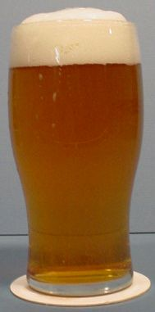
Soon....

Slide 31
Thinplate splines
Forget about knots and basis functions for a second...
Say we just wanted a function to minimize:
or
Solution to this problem is a function that relies on radial basis functions and function passes through data without knots.
d=1 (with m=2):
d=2 (with m=2):
where
Notes:
Where m is the order of the derivative to use in the penalty term
J is the penalty term (for d=2 and m=2), J = int{ (d2f/dx[1]^2)^2 + 2(d2f/(dx[1]dx[2])) + (d2f/d2x[2]^2)^2, dx[1]dx[2] }

Slide 32
Thinplate splines
Still need to estimate , usually via GCV
Original derivation was for
Works great but computational cost is high, especially with more than one predictor. Number of free parameters is equal to the number of unique predictor combinations.
For this reason often see knot-based approximation, which looks very similar to smoothing spline with radius basis functions
Only one smoothing penalty ( ), so wiggliness must be isotropic, and scale of predictors must be chosen carefully
Notes:
More general radial basis function for any d or m can be found in most texts, internet, etc..
Related to kriging
Coeff (Coefficients) option in output statement of proc tpspline gives estimates for alpha[0], alpha[1], ... , alpha[d], beta[1], beta[2], ... and the betas are listed as if the data was sorted by x1, x2, etc.

Slide 33
Thinplate splines
proc tpspline data=whatever;
model y = (x);
output out=pred1 pred std coef;
title 'Thin plate spline';
run;
proc glimmix data=whatever;
model y = x / s dist=normal link=identity;
random x / type=rsmooth;
output out=pred_smooth pred=predicted;
title ‘Approx thin plate spline';
run;
Notes:
Score statment not used here...

Slide 34
Thinplate splines
proc tpspline data=whatever2;
model y = (x1 x2);
output out=pred1 pred std coef;
score data=inputters out=pred2;
title 'Thin plate spline';
run;
proc glimmix data=whatever2;
model y = x1 x2 / s dist=normal link=identity;
random x1 x2 / type=rsmooth;
output out=pred_smooth pred=predicted;
title ‘Approx thin plate spline';
run;
Notes:
Added another predictor variable x2 to dataset.
Glimmix does not have score statement so append input dataset with observations with desired covariates but missing y
R package RGL

Slide 35
Generalized additive models (GAMs)
A GAM is a generalized linear model (e.g. logistic regression, etc) with a linear predictor involving a sum of smooth functions as covariates (e.g. penalized spline or loess):
Some of the predictors can be ‘old school’ predictors, and some smoothers (leading to semiparametric models).
Notes:
Simplest case is testing nonlinearity of model
Wiggliness makes-up effective DF.
Splines and Loess rely on distribution of y for inference (e.g. the residual error is normal)

Slide 36
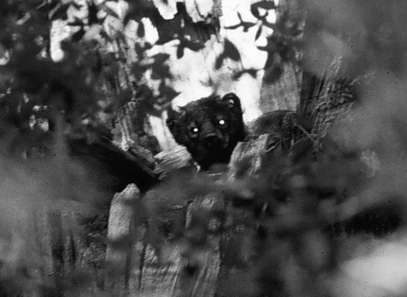
Generalized additive models (GAMs)
Example –Zielinski et.al. 2006. Using Forest Inventory Data to Assess Fisher Resting Habitat Suitability in California. Ecological Applications: Vol. 16, No. 3, pp. 1010-1025.

Slide 37
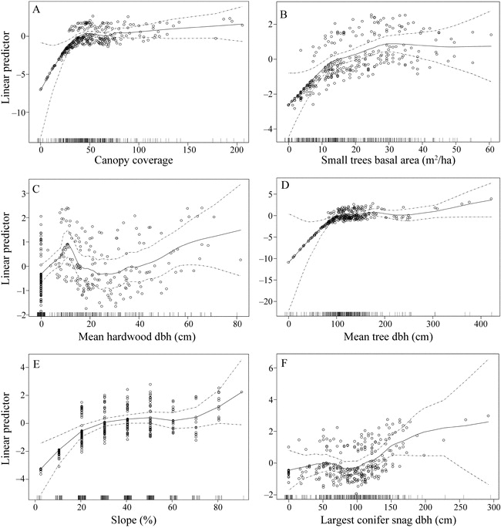
Generalized additive models (GAMs)

Slide 38
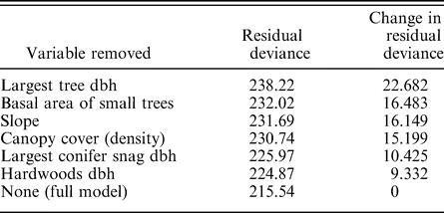
Generalized additive models (GAMs)

Slide 39
Locally weighted Scatterplot Smoothing (Loess & Lowess)
Loess is newer (p=1 or 2) and lowess is older (p=1). When p=0, you have a type of moving average
Fit local polynomial (p=0, 1, or 2) to sequential ‘windows’ or subsets of the data. Predicted value is the fitted value from the local regression.
Span of window (or neighbourhood) is defined by smoothing parameter q, the proportion of data used for each fit. A rule of thumb for q is somewhere between 0.10 and 0.50 – but can use an ‘automatic’ method such as GCV to choose
The subset of data used in each weighted least squares fit is comprised of the n×q (rounded to the next largest integer) points whose explanatory variables values are closest to the point at which the response is being estimated
Notes:
Not the sediment deposit or soil!
This p is a different from the earlier p

Slide 40
Loess
Regression is based on weighted least-squares - points further from the reference observation (within the window) are down-weighted using (usually this) function:
where d(x) is the distance along the abscissa from x to the most distant predictor value within the neighborhood
Span is of constant size (even near the edge) but distribution of weights within the span may not be symmetric
Interpolation can be achieved by determining the closest point to the ‘new’ x, and then applying the appropriate the regression equation (associated with the closest point) to extract a fitted value. Or, use k-d trees and blending (see http://www.netlib.org/a/cloess.pdf or SAS loess help for details).
Notes:
w(x) is the tri-cube weight function.
Further extension is to use robust estimation, which re-iteratively down-weights outliers or points having large residuals.
2-d too, but scale of variables is important since window is based on nearest neighbours

Slide 41
Loess
proc loess data=whatever;
model y=x / degree=2 all details smooth=0.75; *select=gcv;
score data=new;
ods output scoreresults=scorepred;
title ‘Loess with p=2 and span=0.75';
run;
> fit.loess <- loess(y ~ x, span=0.8, control=loess.control(surface="direct"))
> predict(fit.loess, data.frame(x=seq(-1, 1, 0.1)), se=FALSE)
Notes:
2-d too, but scale of variables is important since window is based on nearest neighbours

Slide 42
Kernel Regression
weighted moving average, requires predefined bandwidth h, which affects smoothness
Kernel is just a weight function, used in a variety of smoothing applications (e.g. pdf estimation, home range delineation, filtering, etc.)
No procedure in SAS for it, although do-able in SAS IML/Studio (formerly SAS/Insight) , and kernels used for density estimation in proc univariate
R functions ksmooth (base package), npreg (NP package), many others
Examples:
  np.fit <- ksmooth(x, y, kernel="normal", bandwidth=0.541, n.points=40)
  np.fit <- npreg(y ~ x, bws=0.2)
Notes:
Show kernel demo

Slide 43
Kernel Regression
Nadaraya (1964) and Watson (1964) estimator:
Where for example,
Kernel regression can also yield error bounds can be placed on the relationship between y and x, R², etc.
Extensions to handle nuisance terms, random effects, autocorrelation, etc. are one-offs...
Starts to become ugly beyond two predictor variables
‘Error’ distribution is nonparametric too, so entire analysis has no distributional assumptions
Notes:
Differs from regression splines or GAMs, where you still require parametric distribution for inference

Slide 44
Kernel Regression
Notes:
Using NP package in R, function npregbw (via least squares cross-validation) estimates ‘best’ bandwidth h as 0.028.

Slide 45
Conclusion
Splines, loess and kernel regression are great tools for interpolation and curve fitting when no parametric form is needed
Splines can also be used for predictive modelling, and smoothing splines fit nicely within the mixed model framework
Smoothing splines and loess can constitute the functions inside of GAMs
TPF and radial basis functions are simple enough that getting derivatives is straightforward, something not easily do-able with loess or some kernels
Notes:
Interpolation in Loess is strangely complicated

Slide 46
References
Cappa, E.P. and Cantet R.J.C. 2006. Bayesian estimation of a surface to account for spatial trend using penalized splines in an individual-tree mixed model. Can. J. For. Res. 37: 2677-2688. http://article.pubs.nrc-cnrc.gc.ca/RPAS/rpv?hm=HInit&journal=cjfr&volume=37&calyLang=eng&afpf=x07-116.pdf
Cohen, R. A. 1999. An introduction to PROC LOESS for local regression. Pages 273–281 in Proceedings of the Twenty-fourth SAS Users Group International Conference (M. Lajiness, Ed.). SAS Institute, Cary, North Carolina. http://support.sas.com/rnd/app/papers/loesssugi.pdf
Harrell, Frank E. Jr. 2001. Regression Modeling Strategies with Applications to Linear Models, Logistic Regression and Survival Analysis, Springer, New York. 568 pp.
Ngo, L and M.P. Wand. 2004. Smoothing with mixed model software . Journal of Statistical Software, 9 (1). http://www.stat.ucl.ac.be/ISpersonnel/lambert/NgoWand2004JrStatSoft.pdf
Wand, M.P. 2002. Smoothing and mixed models. http://www.stat.ucl.ac.be/ISpersonnel/lambert/STAT3221/Wand2002.pdf
Wood, Simon N. 2006. Generalized Additive Models. An introduction with R. Chapman & Hall/CRC, New York. 392 pp.
Simon Wood’s webpage: http://www.maths.bath.ac.uk/~sw283/
Wikipedia!

