Slide 1
Ecological sustainability of forest biomass harvesting
Shannon M Berch
Research and Knowledge Management Branch
BC Ministry of Forests and Range

Slide 2
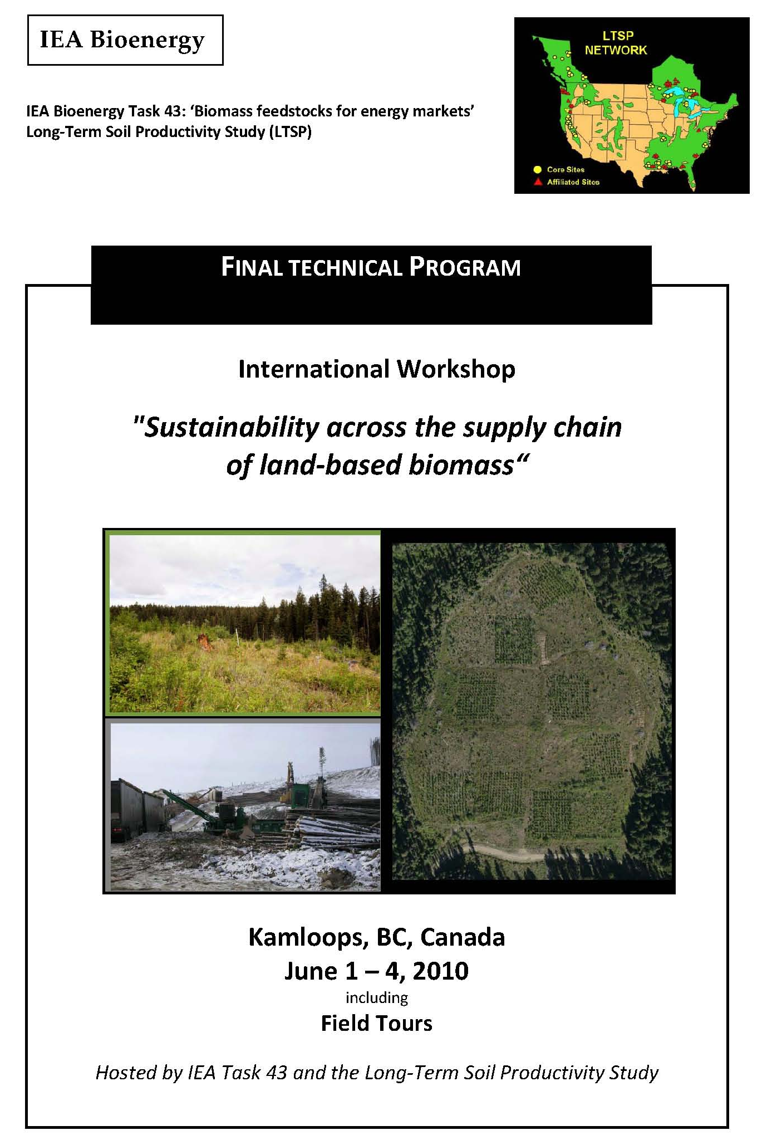
Objectives:
Overview of issues
Examples from BC and from recent international workshop
Gleanings
73 registrants
From: Australia, Brazil, Canada, Denmark, Finland, Germany, Ireland, Netherlands, New Zealand, Norway, Sweden, United Kingdom, USA
Follow-up:
Proceedings to be published in new on-line journal Forest Energy (journal sponsored by European Cooperation in Science and Techology) http://journal.forestenergy.org/index.php/JFE

Slide 3
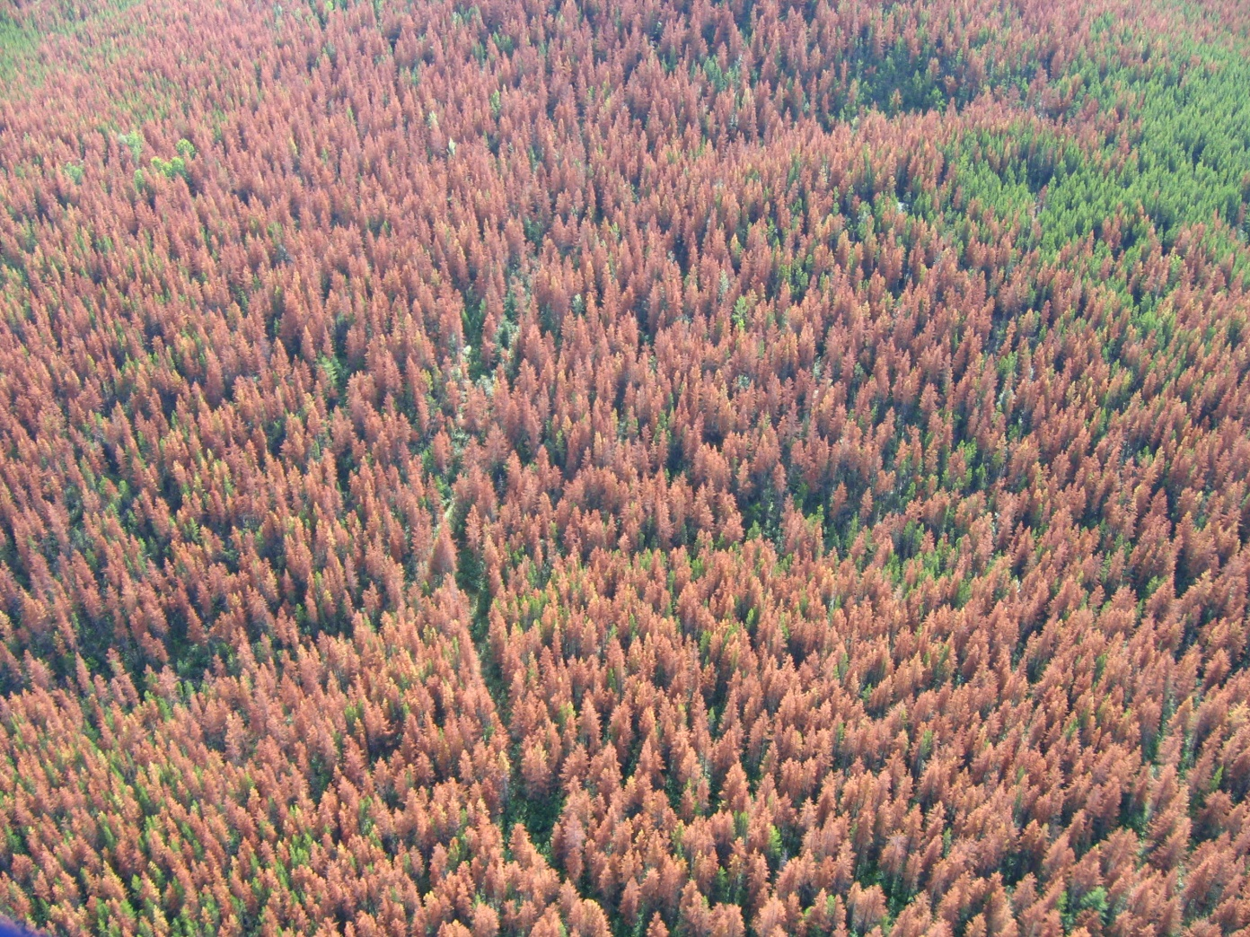
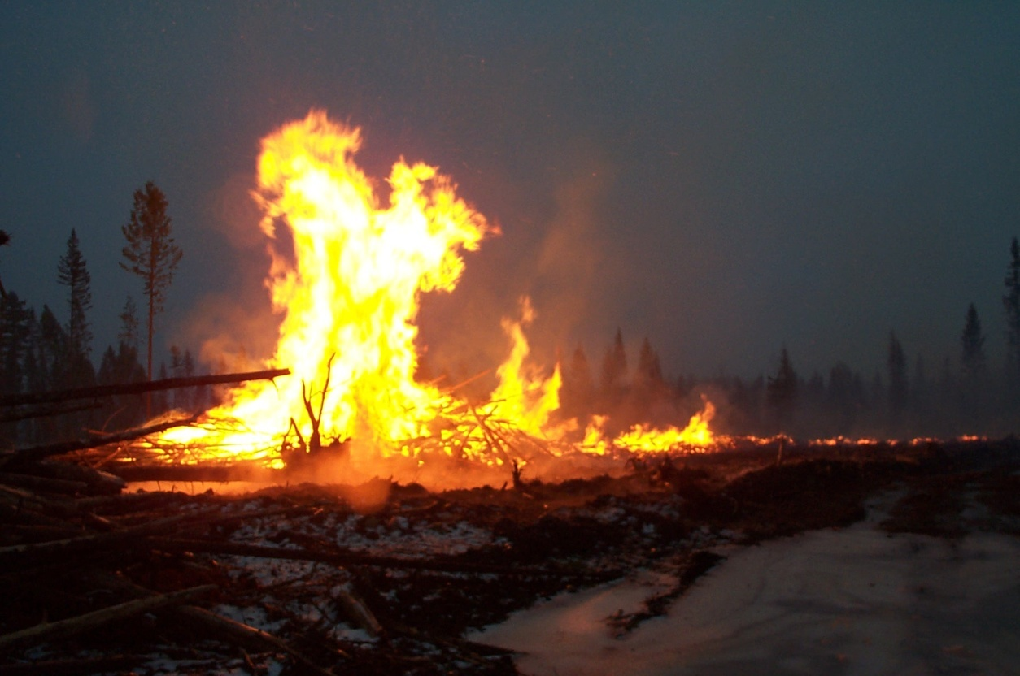
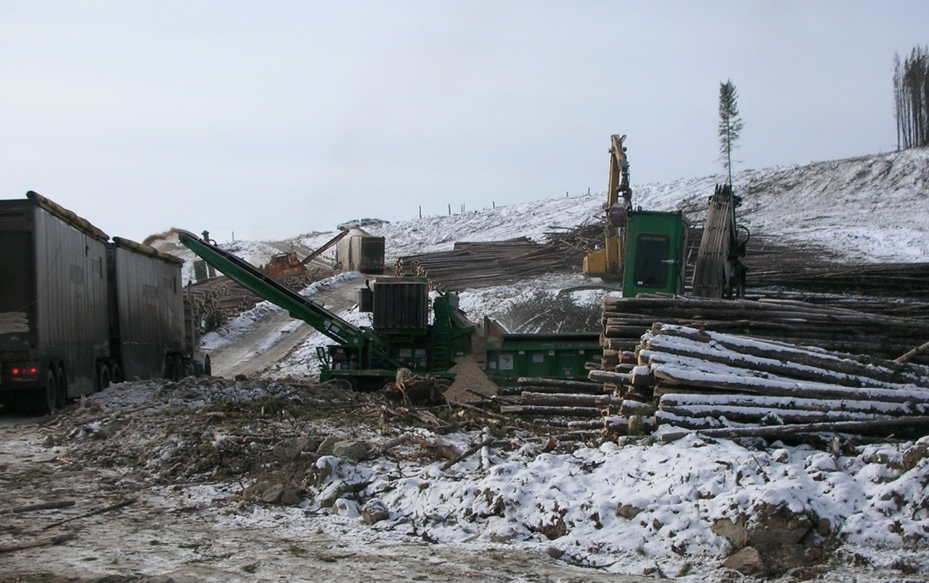
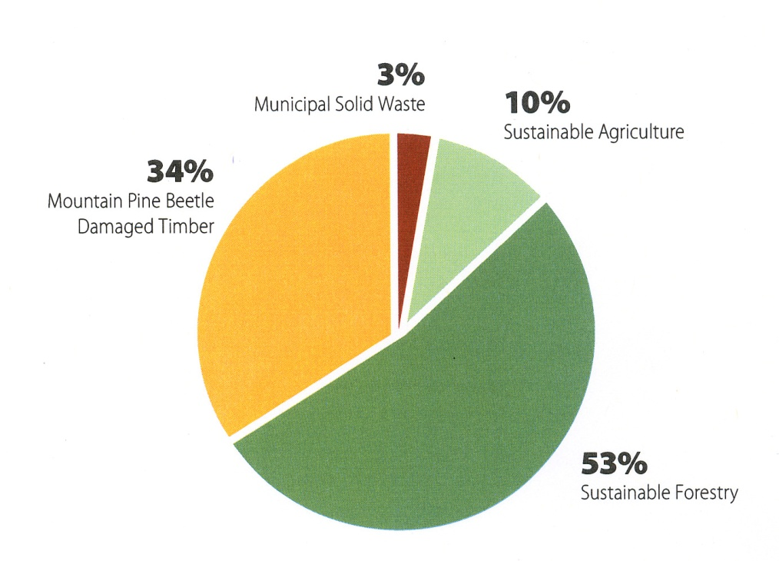
Context
Bill Chapman photo
Lorraine Maclauchlan photo
Walt Klenner photo

Slide 4
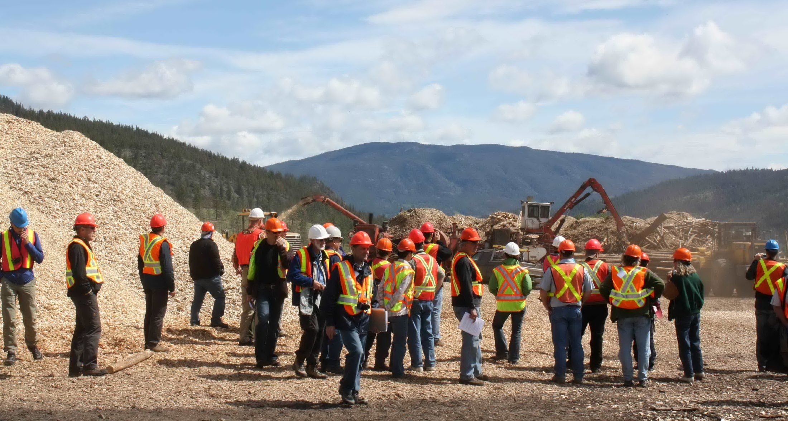
Forest biomass utilization field trips organized by Graeme Hope
e.g. Trace Resources, Merrit
innovative timber sale licences (BC Timber Sales)
forestry licences to cut
pulp-log supply agreements with Harmac in Nanaimo and Celgar in Castlegar
contracts with Domtar in Kamloops and Windset Farms in Delta to supply hog fuel
Tim Philpott photo

Slide 5
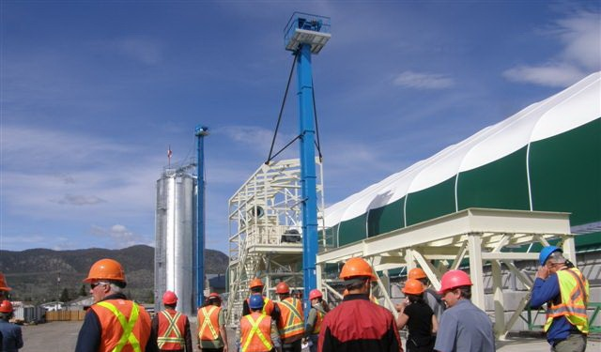
Forest biomass utilization
e.g. Highland Pellet, Merritt
initial capacity 32,000 short tons of pellets per shift
36 workers on site and 12 in the bush
Sue Grayston photo

Slide 6
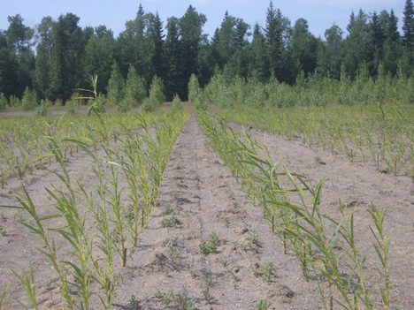
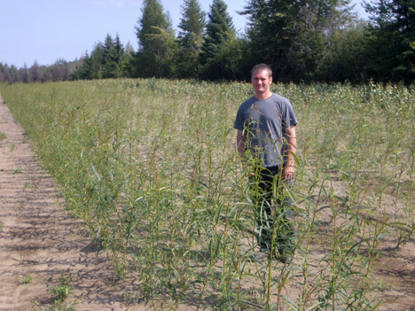
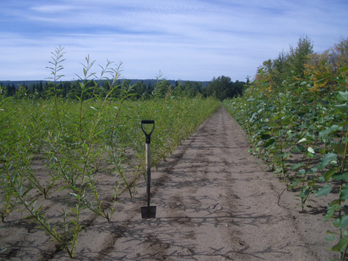
Short rotation crops
e.g. PRT Red Rock bioenergy project
30 ha (75 acre) willow and poplar plantation
biomass for a bioenergy heating system
~1 ha (over 2 acres) of forest-seedling greenhouses
9,000 gigajoules of natural gas energy per year
displacing about 500 tonnes of CO₂ emissions
reduced heating costs for the long run
Productivity of Willow Clones Across an Environmental Gradient in Saskatchewan
K.C.J. Van Rees¹, B.Y. Amichev¹, R.D. Hangs¹ and T.A. Volk²
1. Dept. of Soil Science, University of Saskatchewan SK Canada, 2. ²College of Environmental Science and Forestry, State University of New York, NY USA
ken.vanrees@usask.ca
8 weeks
12 weeks
15 weeks
Bioenera, PRT Energy Crop Solutions, Prince George, BC, http://bionera.com/index.html
Double A Willow, Fredonia, NY, http://www.doubleawillow.com/projects-prt.php

Slide 7
Environmental factors in biomass harvesting
(Lattimore et al. 2009. Biomass and Bioenergy 33: 1321-1342.)
Soil Physical, chemical, biological properties
Exposure of mineral soil, e.g. stump removal
Hydrology and water quality
Flux; physical, chemical, biological properties
Site productivity
Regeneration, soil quality
Biodiversity
Landscape, ecosystem, habitat, species, genetic
Greenhouse gas balance
Net carbon sequestration, non-carbon GHG, substitution
Global and supply chain impacts of bioenergy
Environmental sustainability of the supply chain, global environmental health

Slide 8
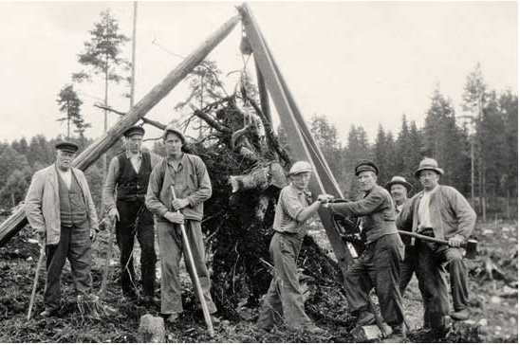
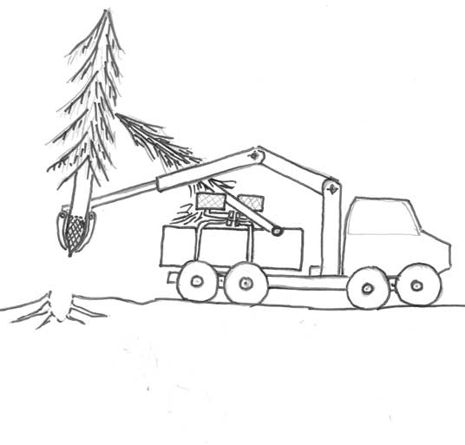
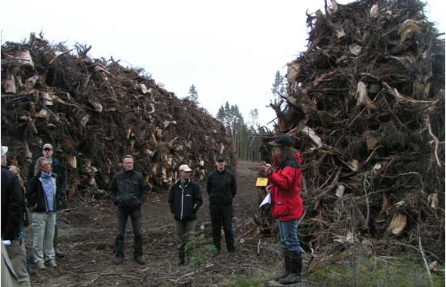
Environmental factors in biomass harvesting
(Lattimore et al. 2009. Biomass and Bioenergy 33: 1321-1342.)
Soil Physical, chemical, biological properties
Exposure of mineral soil, e.g. stump removal
Stump-harvest in Sweden – From an Environmental Impact Assessment Study to Recommendations and an Adaptive Forest Management approach from the Swedish Forest Agency
Gustaf Egnell
Swedish University of Agricultural Sciences, Faculty of Forestry, Department of Forest Ecology and Management, SE-901 83 Umeå, Sweden
Gustaf.Egnell@seksko.slu.se
Illustration: Tomas Nordfjell
SFA EIA carried out
New guidelines from Swedish Forest Agency
Revisit after 2013

Slide 9
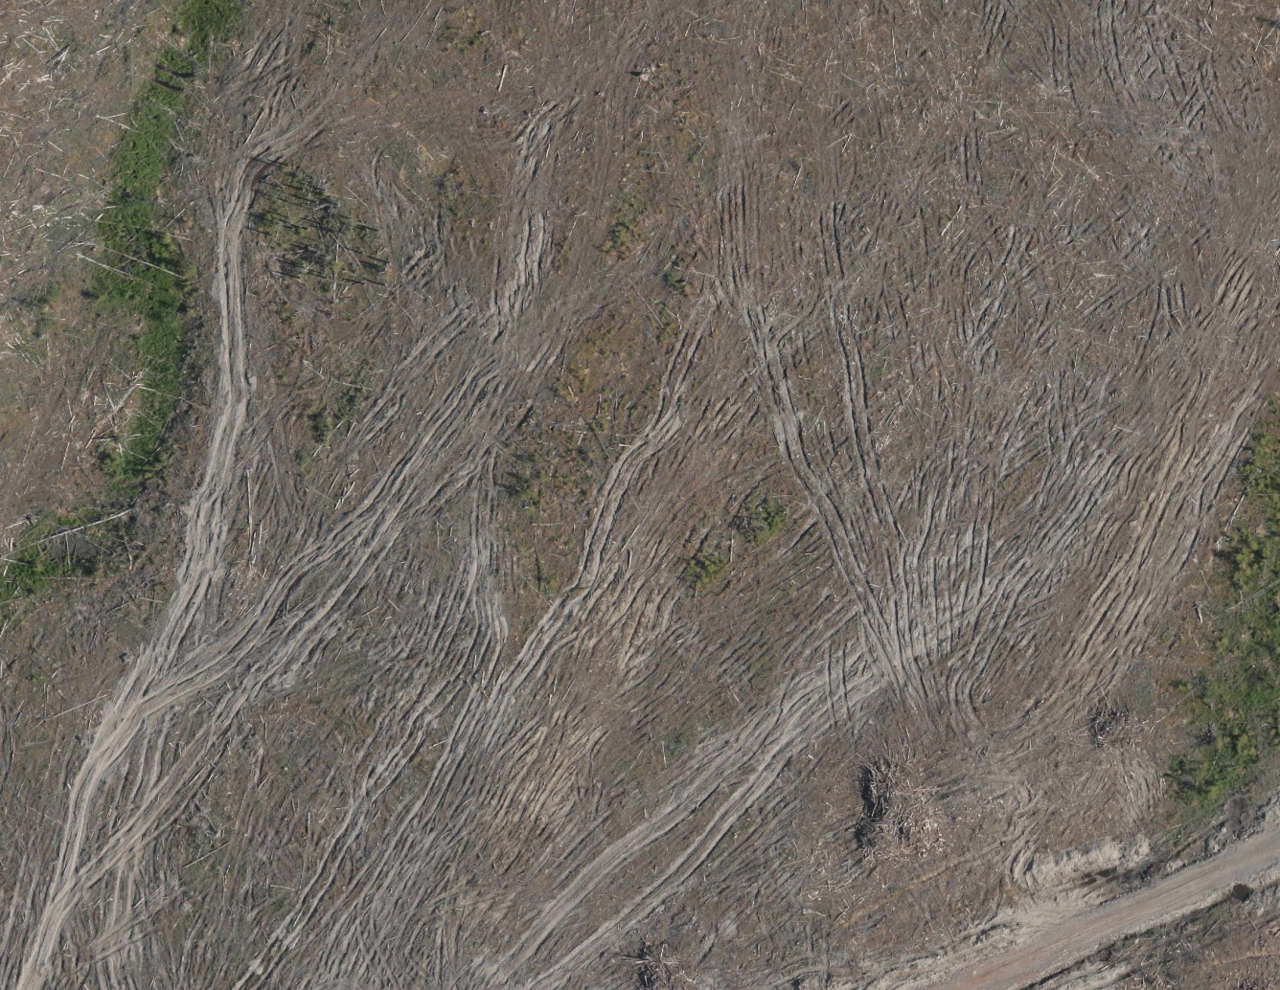
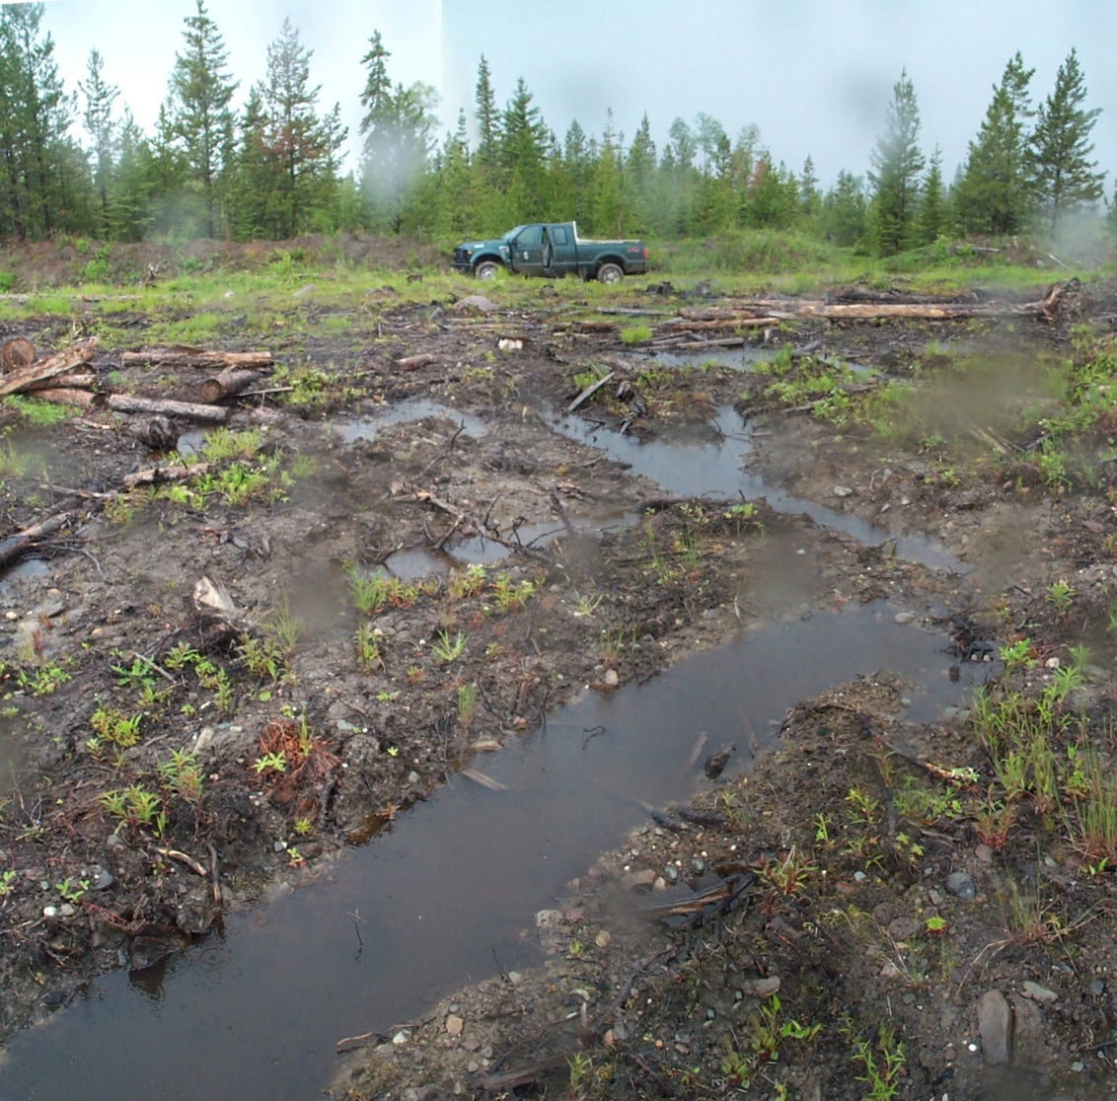
Mountain pine beetle salvage
Bill Chapman, photos
Best management practices for soil conservation in mountain pine beetle salvage operations. S.M. Berch, S. Dube, and G.D. Hope. 2009. MFR Forest Science Program Extension Note 51. http://www.for.gov.bc.ca/hfd/pubs/Docs/En/En91.htm

Slide 10
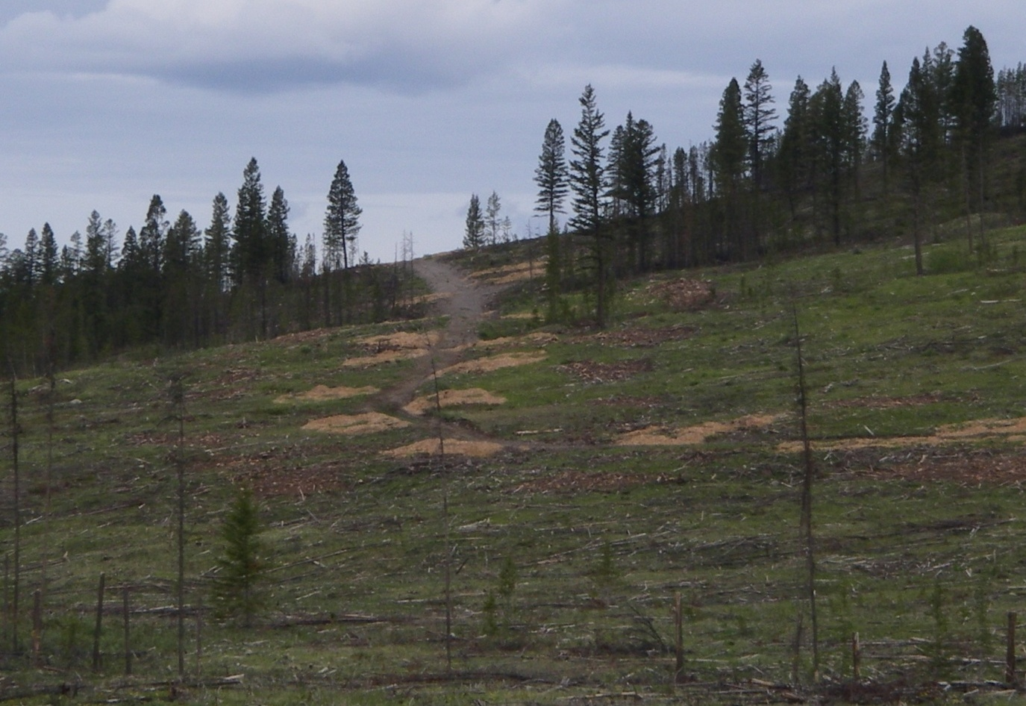
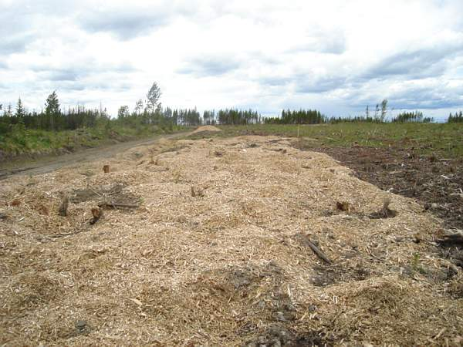
In-block chipping
Maintaining Soil Productivity and Hydrologic Function in Forest Biomass Chipping Operations: Best Management Practices for Soil Conservation
R. Kabzems, S. Dube, M. Curran, B. Chapman, S. Berch, G. Hope, M. Kranabetter and C. Bulmer
British Columbia Ministry of Forests and Range
Richard.Kabzems@gov.bc.ca
Mike Carlson photo
BMP document in prep.
Chip deposit < 8 cm
Bill Chapman photo

Slide 11
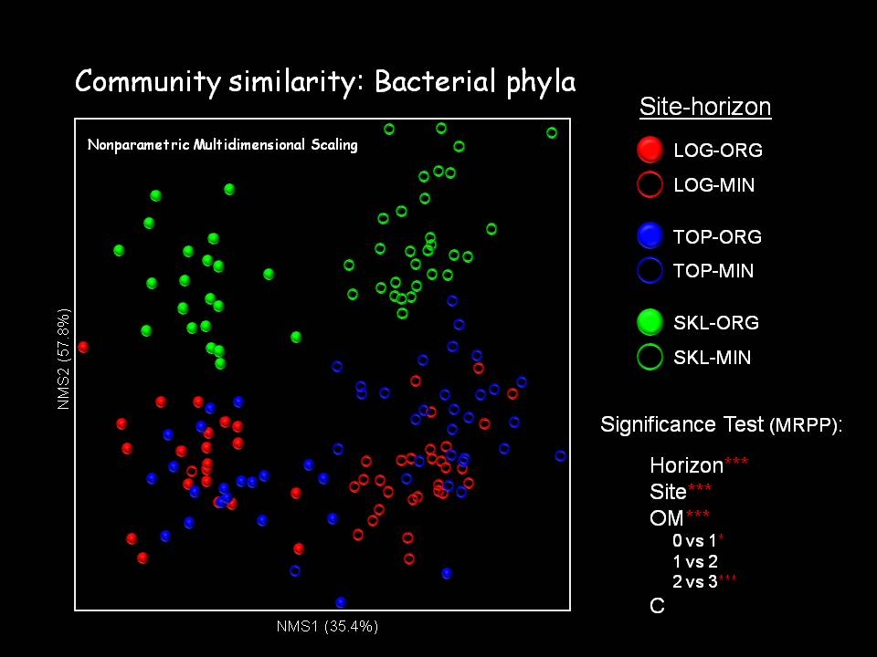
Environmental factors in biomass harvesting
(Lattimore et al. 2009. Biomass and Bioenergy 33: 1321-1342.)
Soil Physical, chemical, biological properties
Exposure of mineral soil, e.g. stump removal
Genomic investigation of forest soil microbial communities in the Long-Term Soil Productivity Study in British Columbia
William W. Mohn, Department of Microbiology & Immunology, Life Sciences Institute, University of BC
wmohn@interchange.ubc.ca
LTSP treatments:
Organic matter
Bole only
Whole tree
Whole tree plus forest floor
Compaction
None
Moderate
Heavy

Slide 12
Environmental factors in biomass harvesting
(Lattimore et al. 2009. Biomass and Bioenergy 33: 1321-1342.)
Hydrology and water quality
Flux; physical, chemical, biological properties
Long Term Effects of Stump Harvest on Total and Methyl Mercury in Discharging Groundwater
Tord Magnusson
Department of Forest Ecology and Management, Swedish University of Agricultural Sciences, SE-90183 Umea, Sweden
Tord.Magnusson@sek.slu.se
importance of riparian buffer zones

Slide 13
Environmental factors in biomass harvesting
(Lattimore et al. 2009. Biomass and Bioenergy 33: 1321-1342.)
Site productivity
Regeneration, soil quality
Productivity Response to Varying Levels of Organic Matter Removal Along Broad Soil Fertility and Climatic Gradients: A North American-wide LTSP Synthesis
Dave Morris¹, Rob Fleming², Andy Scott³, Jianwei Zhang⁴, Brian Palik⁵,
and contributing Principle Investigators from the LTSP Technical Steering Committee
250
OM0
OM1
OM2
Bole only
Whole tree
Whole tree plus forest floor
200
)
150
avg
100
RGR - Biomass (% of OM0
50
0
-50
LA
Loblolly
MS
Loblolly
Ont
Pj
BC
Lodgepole
Ont
Sb
(sand)
Ont
Sb
(loam)
BC
Spruce
CAL
Mixed
Conifer
Lake States
Aspen
(sand)
Lake States
Aspen
(loam)
Lake States
Aspen
(clay)
-100

Slide 14
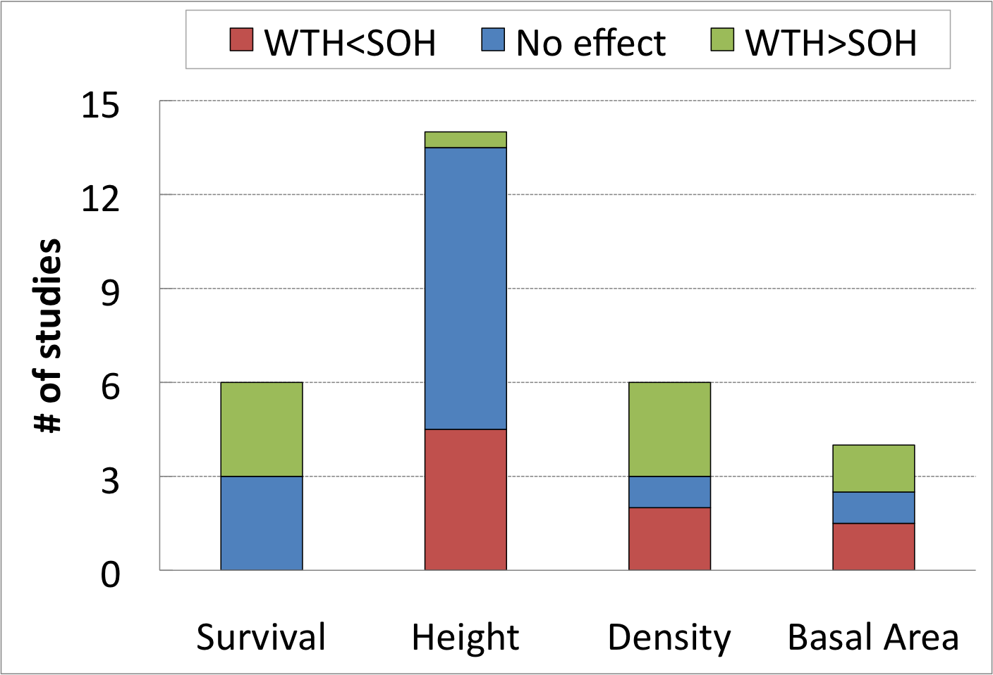
The implications of biomass harvesting for soil productivity in boreal and temperate forests
Evelyne Thiffault¹, Kirsten Hannam², David Paré¹, Brian Titus², Paul Hazlett³, Rob Fleming³, and Doug Maynard²
kirsten.hannam@gmail.com
 | Spp. | Foliar N, P… | Height | Basal Area | Needle Mass
Central BC¹ | Sx | ✓ | ✓
 | Pl | • | •
Sweden² | Sn |  | ✓ | ✓
 | Ps |  | • | •
Quebec³ | Sb | • | • |  | •
 | Pj | ✓ | ✓ |  | ✓
¹Kranabetter et al. ‘06; ²Egnell & Leijon ‘99; ³Thiffault et al. ’06; Paré unpub’d

Slide 15
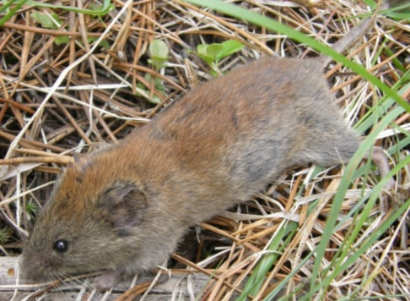
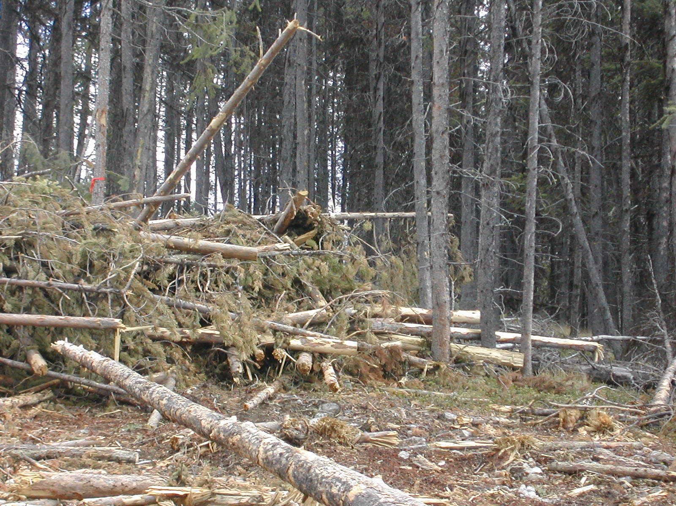
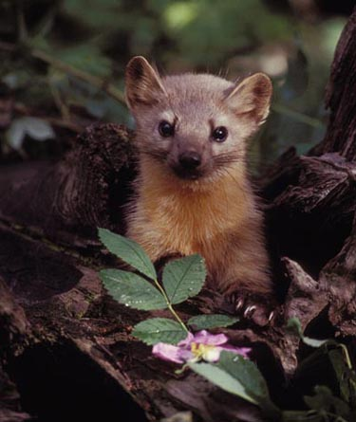
Environmental factors in biomass harvesting
(Lattimore et al. 2009. Biomass and Bioenergy 33: 1321-1342.)
Biodiversity
Landscape, ecosystem, habitat, species, genetic
Bioenergy or Biodiversity: Whither the Future for Woody Debris and Wildlife Habitat?
Tom Sullivan, Agroecology Program - Faculty of Land and Food Systems, Dept of Forest Sciences - Faculty of Forestry, University of British Columbia
tomsu@interchange.ubc.ca

Slide 16
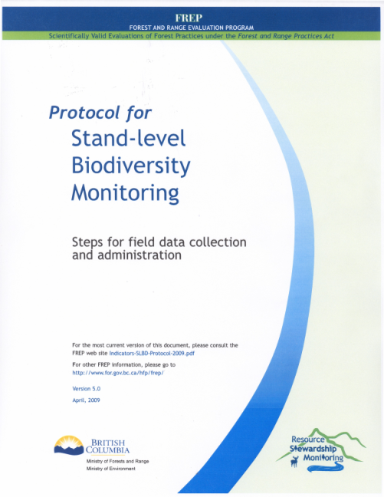
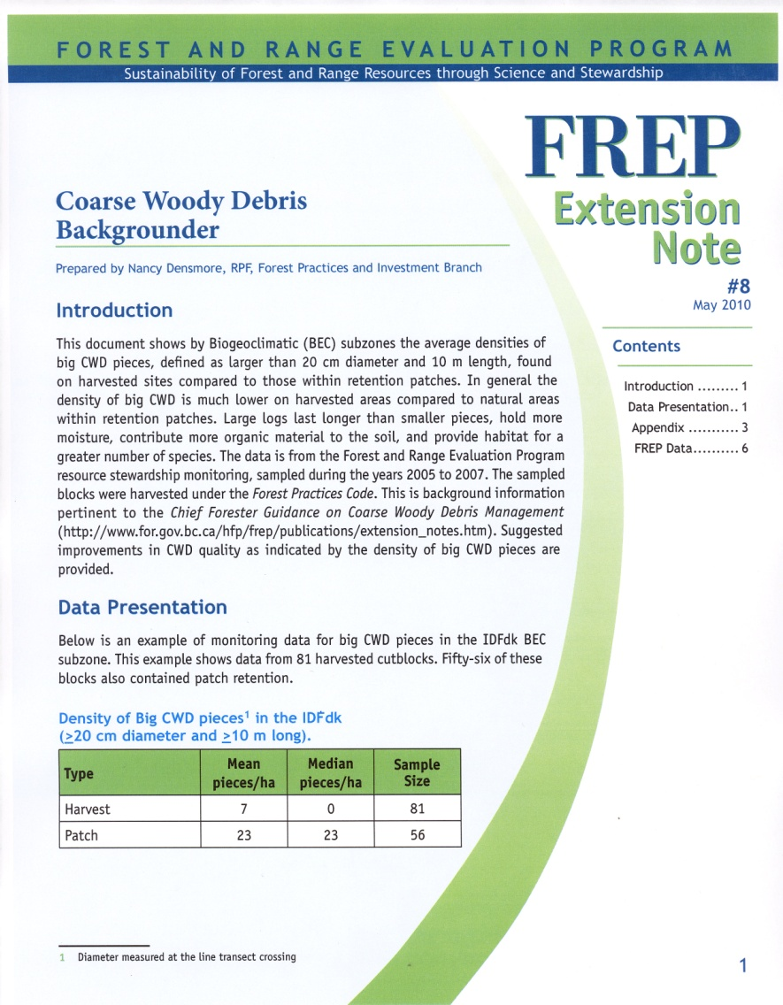
Chief Forester’s Guidance on Coarse Woody Debris Management
May 2010
http://www.for.gov.bc.ca/ftp/HFP/external/!publish/FREP/extension/Chief%20Forester%20short%20CWD.pdf
flora and fauna dependent on dead wood are at risk when CWD levels fall below 30% of what occurs in the natural forest
when harvesting B.C.’s forests for saw logs, pulp, bioenergy or any other resource, it is necessary to plan for a long-term supply of CWD
have a large diversity among cutblocks of CWD volume and density of large pieces
20% improvement in median density of large pieces (FREP)

Slide 17
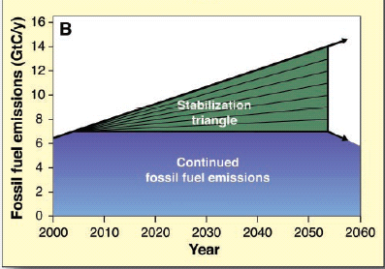
Environmental factors in biomass harvesting
(Lattimore et al. 2009. Biomass and Bioenergy 33: 1321-1342.)
Greenhouse gas balance
Net carbon sequestration, non-carbon GHG, substitution
Can bioenergy derived from forests contribute to climate change mitigation?
Werner A. Kurz
Natural Resources Canada, Canadian Forest Service, Victoria BC, V8Z 1M5,
wkurz@nrcan.gc.ca
Pacala and Socolow. 2004. Science 305: 968 – 972.

Slide 18
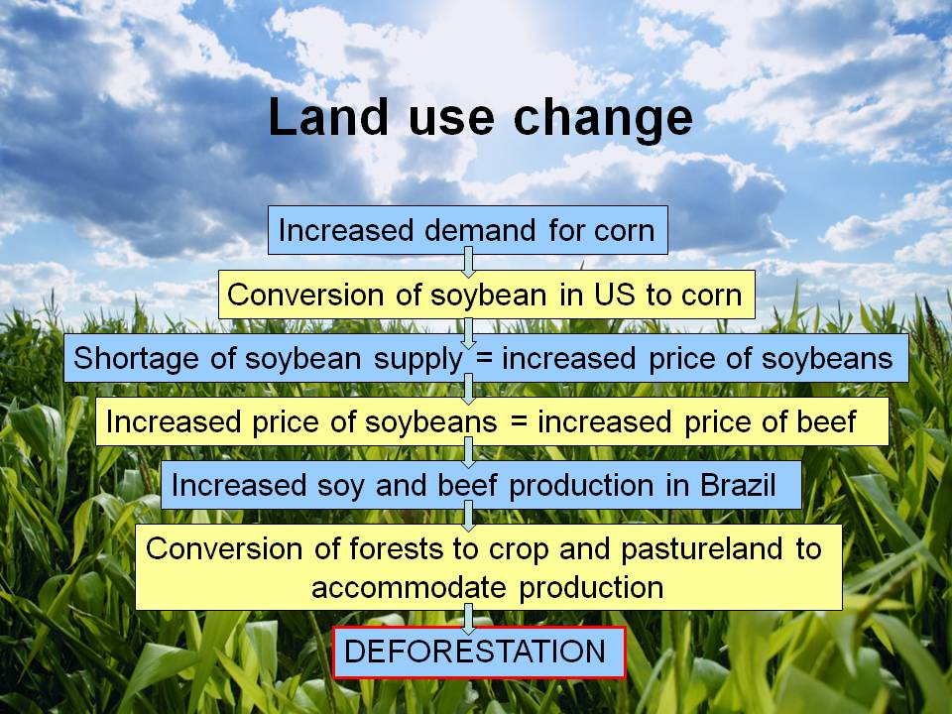
Environmental factors in biomass harvesting
(Lattimore et al. 2009. Biomass and Bioenergy 33: 1321-1342.)
Global and supply chain impacts of bioenergy
Environmental sustainability of the supply chain, global environmental health
Biofuel feedstocks from agricultural resources: environmental risks and criteria and indicators for sustainable practices
Brenna Lattimore
University of Toronto, Faculty of Forestry, 33 Willcocks Street, Toronto, Ontario, M5S 3B3
brenna.lattimore@utoronto.ca

Slide 19
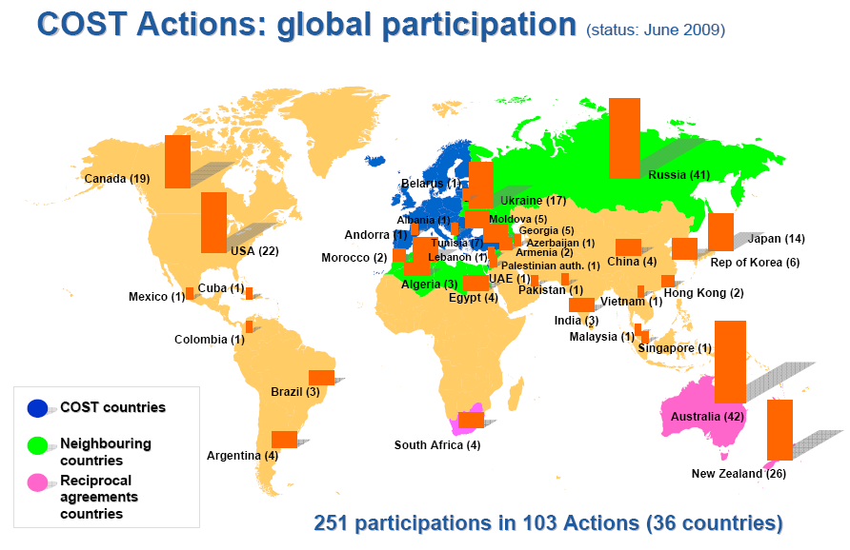
COST (European Cooperation in Science and Technology)
FPS Action FP0902
http://www.cost.esf.org/domains_actions/fps/Actions/
Modernization of forest biomass operations research – powered by the EU
Dominik Röser, Finnish Forest Research Institute, P.O.Box 68, FIN-80101 Joensuu
dominik.roser@metla.fi

Slide 20
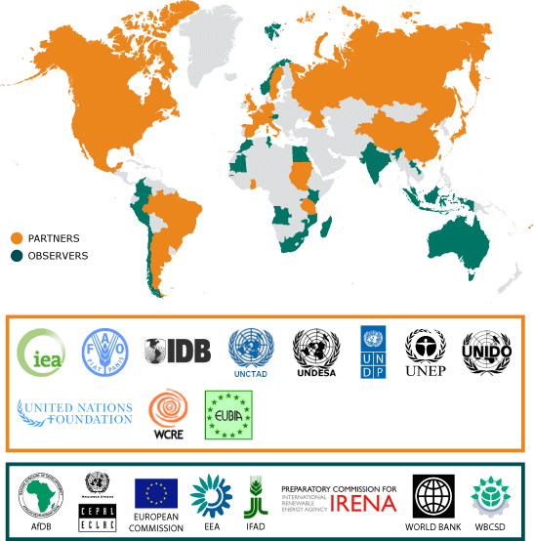
GBEP (Global Bioenergy Partnership)
http://www.globalbioenergy.org/
GBEP (Global Bioenergy Partnership) and the development of measures for representing bio energy sustainability
Sven-Olov Ericson
Deputy Director
Swedish Ministry of Enterprise, Energy, and Communications
+46 8 405 24 02
sven-olov.ericson@enterprise.ministry.se
Sustainability considerations:
truly multidimensional
manageable number
inform decision-making
facilitate sustainable development
not limit trade inconsistently with multilateral trade obligations

Slide 21
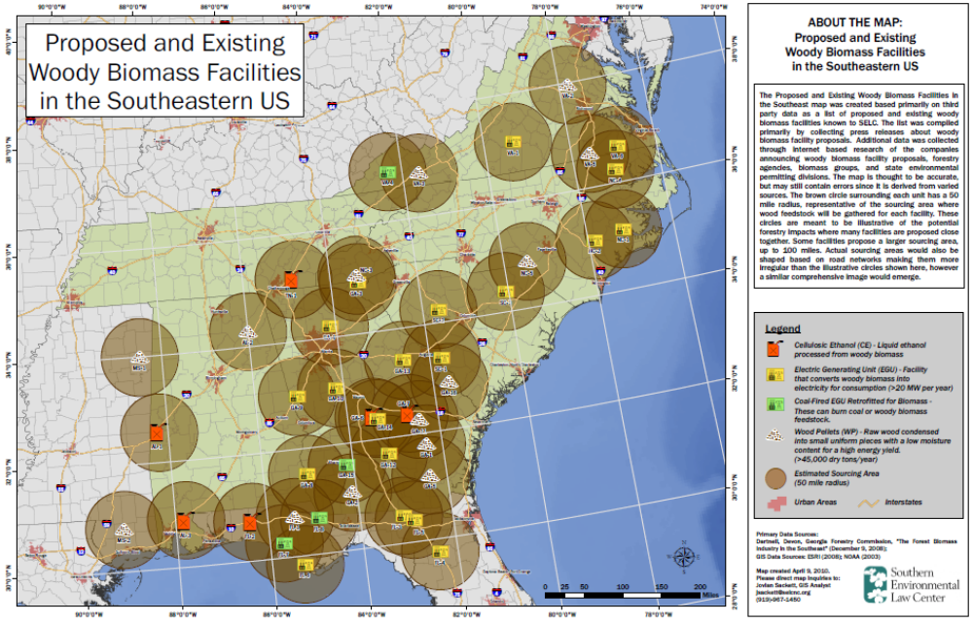
Biomass supply estimates
Ensuring Forest Sustainability in the Development of Wood Bioenergy:
Current Technology and Policy in the US
V. Alaric Sample
President, Pinchot Institute, 1616 P Street NW, Washington, DC 20036, USA
alsample@pinchot.org

Slide 22
Brian Titus and Evelyne Thiffault, Natural Resources Canada:
Findings from Nordic countries on intensive forest harvesting:
Base cation depletion can occur
Site productivity (ht, ba) can decline in Norway spruce stands but less so in Scots pine
Early annual growth reduction (7 – 8 years) no longer apparent after 15 years
Strategies for overcoming growth loss: fertilizer, ashing, immediate reforestation
Growth reduction can occur with whole-tree thinning (NB NS vs SP)
Not strong evidence that growth loss is related to site quality
Swedish and Finnish guidelines:
Retention of 20% of harvesting residues in Sweden, 30% in Finland, spread evenly
Whole-tree thinning of pine and hardwoods on better sites in Finland but not spruce
No whole-tree thinning where previously harvest residue was removed
Fertilization and ashing on some sites
Considerations:
High N saturation in Nordic countries
Centuries of intensive forest management
Some trials included extreme, non-operational residue removal

Slide 23
Gleanings
Base management decisions on sound science (i.e. species and sites differ); monitor; adapt
Participate in national and international programs, activities, projects
Plan land use (relative to facilities, ecological attributes, intensity of use)
Vary residue retention across the landscape (don’t do the same thing everywhere)
Vary residue retention through time (don’t do same thing on same block in next rotation)
Adhere to existing SFM legislation & regulations (detrimental soil disturbance, biodiversity) or develop specific biomass harvesting guidance
50% residue retention (Titus et al. 2009. Science (Letters) 324: 1389-1390)
Retain CWD using existing guidelines (CF: aim for improvement in large CWD)
Minimize additional soil disturbance from biomass harvest (e.g. single pass)
Put chipped material directly into containers
Surface mulch < 8 cm

Slide 24
Forest Biomass guidelines – Canada
New Brunswick Crown Land, Forest Biomass Harvesting Policy, Department of Natural Resources. Effective date October 22, 2008. To Be Reviewed: October 22, 2012
Site suitability based on Forest Biomass Decision Support System (FBDSS from Dr. Paul Arp, UNB)
Nova Scotia, Forest Panel of Expertise, Nova Scotia Natural Resources Strategy 2010
Restoring the health of Nova Scotia’s forests:
recommendations: 1) ban whole-tree harvesting, 2) limit forest biomass harvesting for electricity to small amounts already committed for current facilities.
The roots of sustainable prosperity in Nova Scotia:
recommendations: 1) complete biomass guidelines (FWD and CWD retention), 2) incorporate FBDSS.
Ontario, Forest Biofibre - Allocation and Use (Forest Management Directive FOR 03 02 01)
Allocation, management, sustainable use - established legislation & existing policy
Sorry, this content is no longer available on our website. You are getting this error message because we have intentionally removed this content from our website.
Prince Edward Island
Biomass heat on Prince Edward Island: A pathway forward.
Recommendation: 3 pilot projects (forestry, agriculture, building waste)

Slide 25
PDF of workshop program with abstracts and contact information for authors is available from me:
Shannon Berch
Shannon.berch@gov.bc.ca

