Slide 1
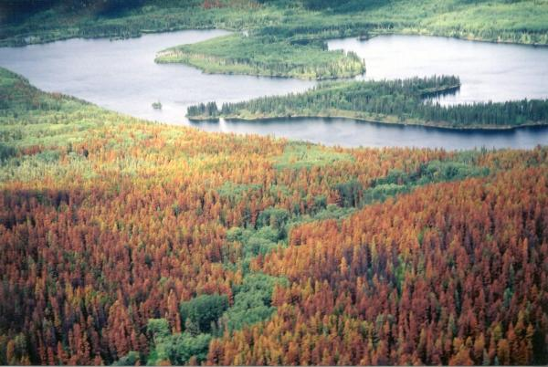
Mapping of mountain pine beetle red-attack forest damage: discrepancies by data sources at the forest stand scale
Huapeng Chen and Adrian Walton

Slide 2
Outline
Background
Introduction
Objectives
Study area
Data and method
Results
Discussion
Conclusions

Slide 3
Background
A part of the research project “Integration of the satellite Year of Death (YOD)mapping data into the provincial BCMPB model”

Slide 4
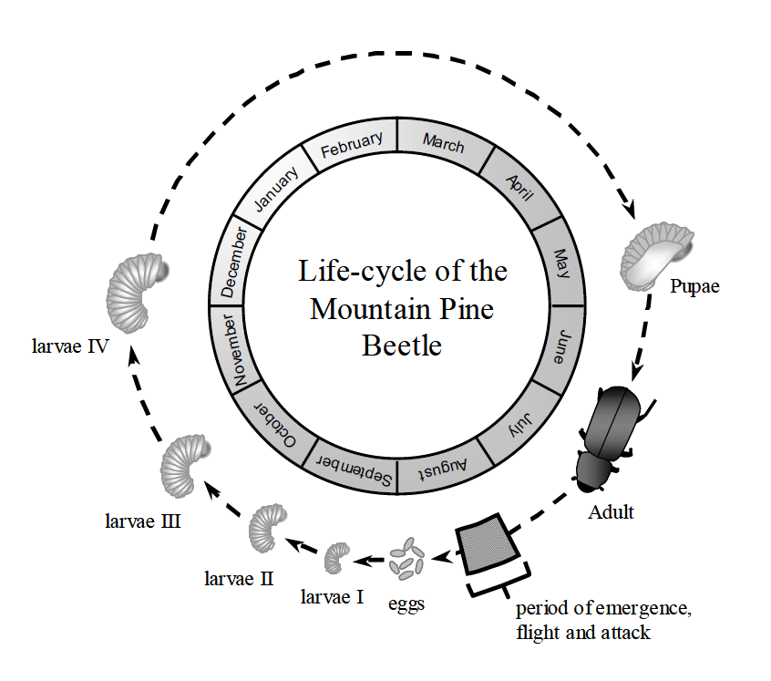
Introduction
Life cycle of MPB
Notes:
Typically, MPB completes a single generation each year.
In mid to late summer, adult beetles emerge, start to fly, search, and attack the host trees.

Slide 5
Introduction
Attack stages based on signs and symptoms
  Green-attack
    Green and greenish yellow needles
    between the attack and June following the attack
  Red-attack
    Orange and red needles
    July and August following the attack
  Gray-attack
    Lost of needles
    About 3 years following the attack
Notes:
After the host trees are attacked and dead, they usually experience three stages over time: green attack, red attack, and gray attack.

Slide 6
Introduction
In BC, at provincial level, available data to map MPB red-attack damage
  Aerial overview survey data
  Satellite Year of Death data
  Orthophoto interpretation data
Notes:
To map MPB infestation, it is easiest to map red attack damage.

Slide 7
Introduction
Aerial overview (sketch mapping) survey data
  Spatial extent (coverage): province
  Temporal scale: 1914 up to present
  Spatial scale: 1: 100, 000 to 1: 250, 000
  Severity estimation: yes, based on a representative polygon drawn on a topographic map

Slide 8
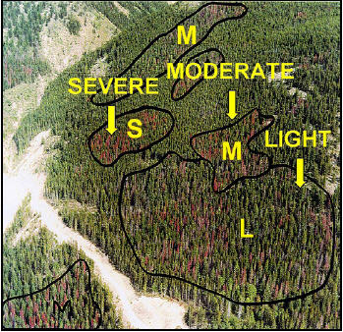
Introduction
Aerial overview survey data
Severity classes
T (Trace, < 1%)
L (Light, 1 – 10%)
M (Moderate, 11 – 30%)
S (Severe, 31 – 50%)
V (Very severe, 51 – 100%)
Notes:
This slide shows how to capture red attack damage in the aerial overview survey data
Basically, an observer on a fixed wing airplane looks over the ground, draws a polygon delineating the infested areas on a topographic map, and assigns a defined severity code to each drawn polygon.
Five severity classes were defined in the aerial overview survey data:
T (Trace, < 1%)
L (Light, 1 – 10%)
M (Moderate, 11 – 30%)
S (Severe, 31 – 50%)
V (Very severe, 51 – 100%)

Slide 9
Introduction
Satellite Year of Death data
  Spatial extent (coverage): province
  Temporal scale: 1999 to 2007
  Spatial resolution: 30 metre
  Severity estimation: No
  Possible year that red-attack occurred for each pixel

Slide 10
Introduction
Vegetation reflectance
Notes:
X-axis is wavelength and y-axis is reflectance. Vertical bars are Landsat spectral bands 1 to 6.
This slide shows a foundation to detect red attack using Landsat satellite imagery data
It is easy to see how differently healthy and stressed vegetations respond to the light in different bands
And because of this difference, it possible to differentiate stressed vegetation from healthy vegetation, that is, possible to detect red attack trees (stressed vegetation)

Slide 11
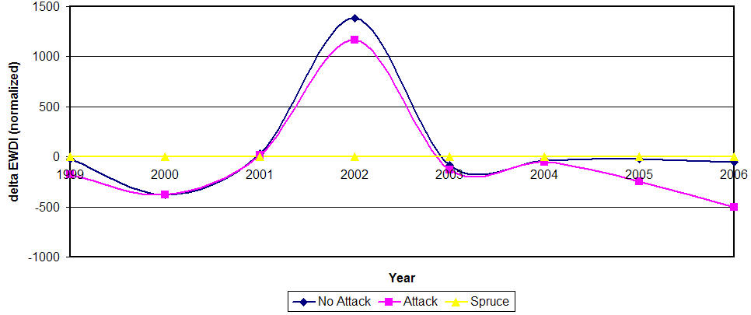
Introduction
Enhanced Wetness Difference Index
Larger than threshold mark as year of death
Notes:
This slide shows technical approach, commonly called “change detection”, to detect red attack in the YOD data
Basically, it looks at the profile of EWDI at each pixel through a series satellite images from 1999 to 2006, the earliest year that the EWDI is larger than the defined threshold is the year when red attacks possibly occur

Slide 12
Introduction
Orthophoto interpretation data
  Spatial extent (coverage): parts of province
  Temporal scale: 2005
  Spatial scale: 1 : 20, 000
  Severity estimation: yes, based on a VRI polygon

Slide 13
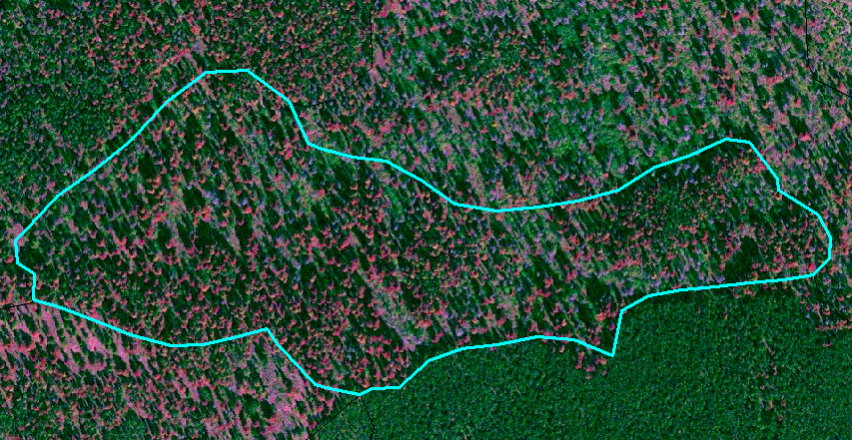
Introduction
Orthophoto visual interpretation
Severity classes:
  Trace (T, < 11%)
  Moderate (M, 11 – 30%)
  Severe (S, 31 – 50%)
  Very severe (V, > 50%)
Notes:
This slide shows how to capture red attack in orthophoto interpretation data
VRI polygons are overlaid with ortho-rectified and enhanced airphoto
An interpreter looks at the computer screen and estimates how much percentage of an assessed VRI polygon are red attacked trees crown
Four severity classed are defined:
Trace (T, < 11%)
Moderate (M, 11 – 30%)
Severe (S, 31 – 50%)
Very severe (V, > 50%)

Slide 14
Introduction
Quick review of red-attack mapping data
 | Scale | Time | Extent
Overview | Coarse | 1914 up to now | Province
YOD | Medium | 1999 to 2007 | Province
Orthophoto | Fine | 2005 | Part of province
 | Pros | Cons
Overview | Cost effective | Large position and omission errors
YOD | Cost effective, precise | Data gaps and time constraint
Orthophoto | Fine scale, more accurate | Higher cost and limited coverage

Slide 15
Introduction
Information on severity of red-attack infestation at stand level is crucial to:
  Stand susceptibility assessment
  Timber supply analysis
  Sanitation harvesting planning
  Forest modeling

Slide 16
Objectives
Is the YOD data a good alternate to the Overview survey data to estimate red-attack severity at the stand level??
  The accuracy assessment of the YOD - How good is the YOD data?
  With the orthophoto interpretation data as a reference (basis line), does the YOD data match the orthophoto interpretation data better than the overview survey data, in term of the severity estimates?
  Is the match or agreement either between the YOD or the overview data and the orthophoto interpretation data affected by stand structure characteristics? and how??

Slide 17
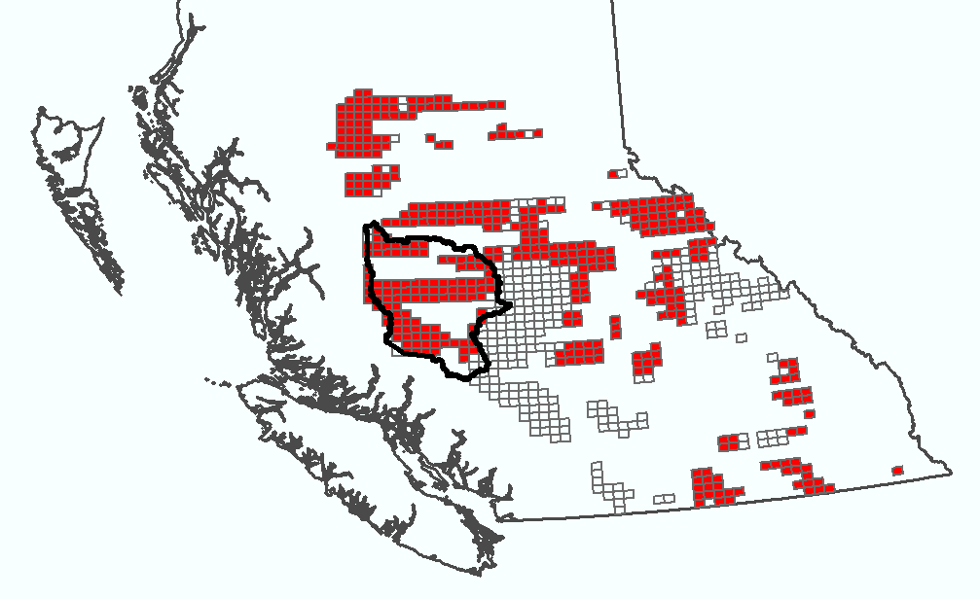
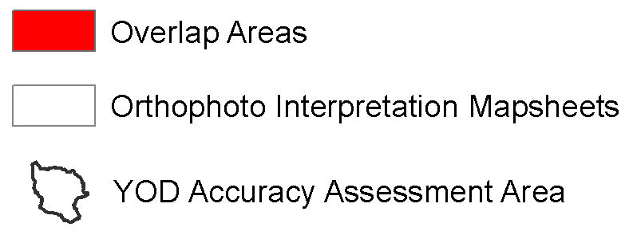
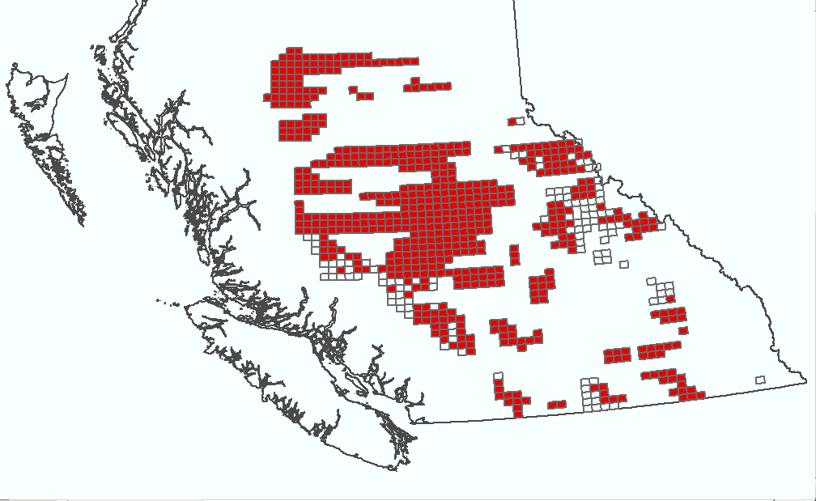
Study area
A: area of overlap
between YOD and Orthophoto
A
B
B: area of overlap
between Overview and Orthophoto

Slide 18
Data and methods
Data
  Aerial overview survey data 2005 (MFR, Forest Practice Branch)
  Satellite Year of Death data 2005 (Version one, MFR, Forest Analysis and Inventory Branch)
  Orthophoto interpretation data 2005 (MFR, Forest Analysis and Inventory Branch)

Slide 19
Methods
How good is the YOD data??
Accuracy assessment of the YOD data
  Assessment area: west Williams Lake TSA
  Assessment year: 2005
  Validation sample points (359)
    From orthophotos
Combined severity classes | Pure pine (age over 60 yrs, leading lodgepole composition > 99%) | Pine leading (age over 60 yrs, leading lodgepole composition >=50% and <=99%)
Severe and very severe (SV) | 129 | 107
Trace and moderate (TM) | 62 | 61
Notes:
SV: combined severity code, S: severe, V: very severe
TM: combined severity code, T: trace, M: moderate
Purepine: forest stands, which age are over 60 yrs and leading lodgepole pine composition > 99%
Pineleading: forest stands, which age are over 60 yrs and leading lodgepole pine composition >= 50 % and <= 99%

Slide 20
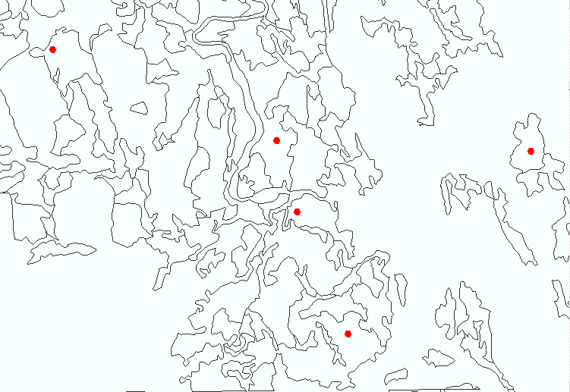
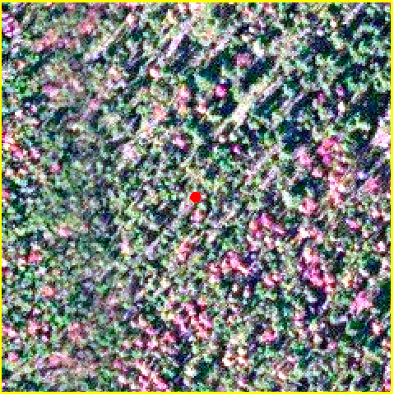
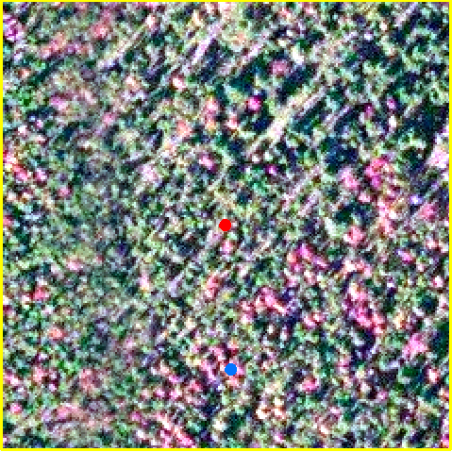
How to create validation points?
For both purepine and pineleading stands:
SV: 200 points
TM: 300 points
Validation point
Notes:
For both pure pine and pine leading stands, create 200 random points for SV polygons and 300 points for TM polygons
With each random point as a center, a image chip of 120x120meter (4x4 pixels) was clipped from a orthophoto
Create a validation point from a hot spot clearly identified on the image chip

Slide 21
Methods
How to measure accuracy of YOD?
Proportion of validation samples correctly identified by the YOD mapping data
Accuracy assessment of the YOD
  Accuracy measurements
    Error matrix – Producer’s accuracy
Just a example here!
 |  | YOD data
 | Classes | No Attack | Red Attack | sum | Producer’s accuracy | Omission error
Validation data | No Attack | 140 | 10 | 150 | 93% | 7%
 | Red Attack | 60 | 90 | 150 | 60% | 40%
 | Sum | 200 | 100 | 300
 | User’s accuracy | 70% | 90%
 |  |  |  | Overall accuracy: 77%
 | Commission error | 30% | 10%
 |  | YOD data
 | Classes | No Attack | Red Attack | sum | Producer’s accuracy | Omission error
Validation data | No Attack | 140 | 10 | 150 | 93% | 7%
 | Red Attack | 60 | 90 | 150 | 60% | 40%
 | Sum | 200 | 100 | 300
 | User’s accuracy | 70% | 90%
 |  |  |  | Overall accuracy: 77%
 | Commission error | 30% | 10%
Notes:
How to count validation samples “correctly”, which are identified by the YOD?

Slide 22
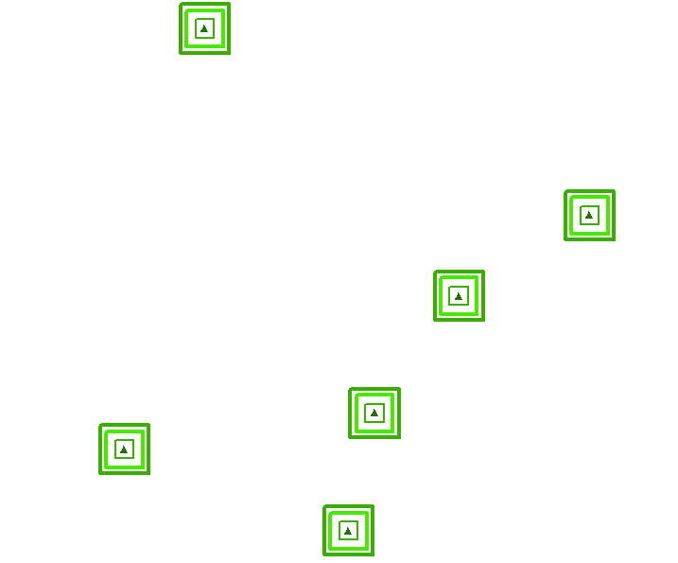
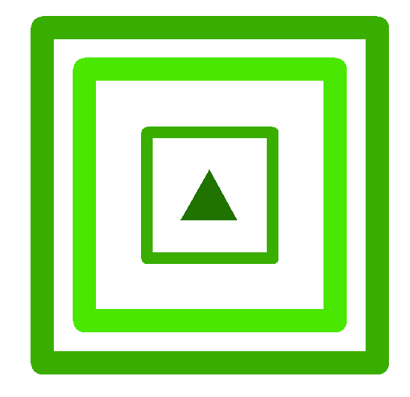
Validation sample layer
How is a validation sample CORRECTLY identified by the YOD?
Two buffer sizes:
15 metres
25 metres
C D
Notes:
Use a validation box of one pixel in size instead of a point because satellite resolution is 30 meter
Because there is a shift between satellite imagery data and orthophoto data, apply different buffer, 15 and 25 meter

Slide 23
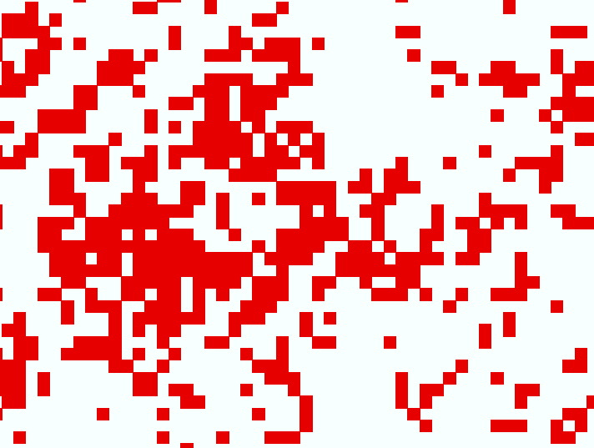
YOD data layer

Slide 24
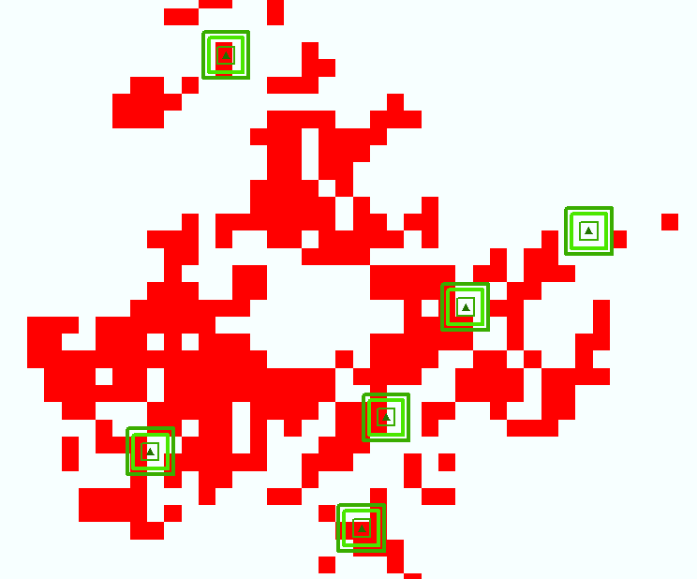
Validation sample layer overlaying with YOD data layer

Slide 25
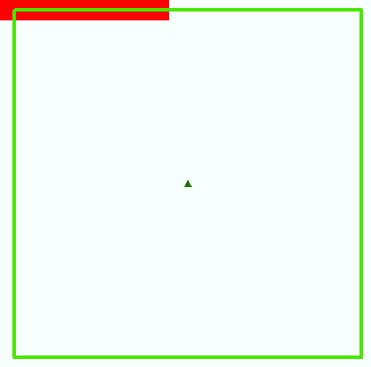
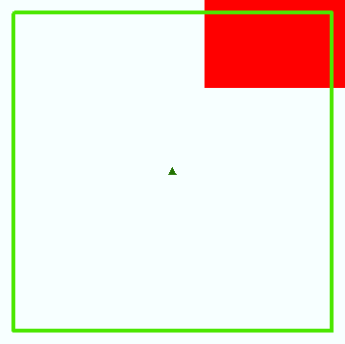
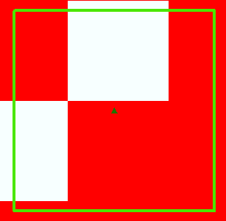
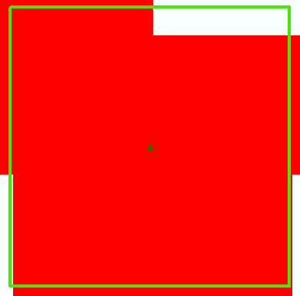
Intersection types:
Type I: any buffered validation box overlapping or touching the YOD red-attack pixels (A, B, C, and D)
Type II: any buffered validation box which cumulative overlapping areas are equal or greater than
one Landsat satellite image pixel size, 900 square metres
A
B
C
D
Notes:
Intersection type:
Type I: Any validation box overlapping or touching the YOD pixel is counted
Type II: Only validation box with a cumulative overlap area equal or greater than on Landsate pixel is counted

Slide 26
Methods
Does the YOD data match the orthophoto interpretation data better than the overview survey data, in term of the severity estimates?
Data comparison
  Area: area of overlap
  Year of red-attack data: 2005
  Reference data: orthophoto interpretation data
  Method integrating the YOD and overview survey data into forest stands (VRI polygons): polygon decomposition approach
  User’s accuracy to measure the agreement in a red-attack severity class between two datasets

Slide 27
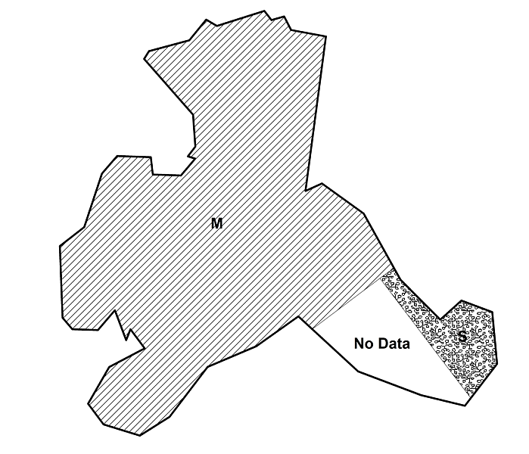
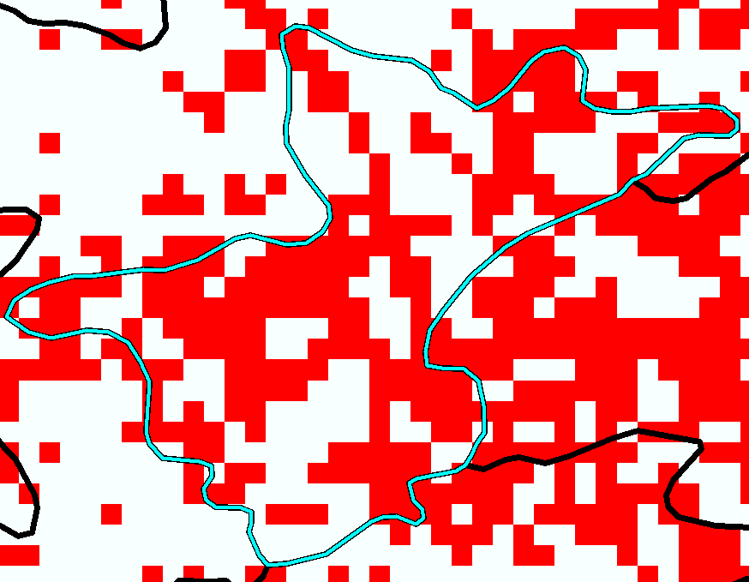
Methods – data comparison
M:75ha, S:10ha, NoData:15ha
Middle value for M, S, and NoData: 20%, 40%, and 0%
New severity estimate: 19% (75*20%+10*40%+15*0)
New severity class, M, will be assigned to the VRI polygon
  Polygon decomposition approach
Assigned severity code: M
Assigned severity code: V
Aerial overview survey data
The YOD data
Notes:
Use average area weighted severity class in the integration of the aerial overview data into the VRI polygons
One VRI polygon has three parts from aerial overview survey polygons, M, S, No Data
Supposed that the areas for M, S, and No Data are 75, 10, and 15 in ha and the middle values for these severity classes are 20%, 40%, and 0. Thus, percentage of infested area in this VRI polygon will be 19% (75 * 20% + 10*40% + 15*0) so a new severity class, M, will be assigned to this VRI polygon based on aerial overview survey data.

Slide 28
Methods – data comparison
Proportion of the VRI polygons labelled as one severity class by the aerial overview or YOD data, are actually that severity class as determined by the orthophoto data
  User’s accuracy
Just a example here!
 |  | YOD data
 | Severity Classes | T | M | S | V | sum | Producer’s accuracy | Omission error
Orthophoto interpretation data | T | 140 | 30 | 70 | 10 | 250 | 56% | 44%
 | M | 30 | 200 | 5 | 10 | 245 | 81.6% | 18.4%
 | S | 50 | 30 | 100 | 10 | 190 | 52.6% | 47.4%
 | V | 60 | 20 | 90 | 120 | 290 | 41.4% | 58.6%
 | Sum | 280 | 280 | 265 | 150 | 975
 | User’s accuracy | 50% | 71.4% | 37.7% | 80%
 |  |  |  |  |  | Overall accuracy: 57.4%
 | Commission error | 50% | 28.6% | 62.3% | 20%
Notes:
Basically user’s accuracy was used as an index to measure agreement between two datasets in term of severity

Slide 29
Methods
Impacts of stand structure characteristics on the agreement in a severity class
  Simple correspondence analysis
    Is the agreement in a severity class significantly related to a particular stand structure variable class??
  Stand structure characteristics: stand size, leading lodgepole pine composition, crown closure, and age
  Severity classes: T, M, S, V, TM, and SV
Notes:
The agreement in one severity class between two datasets varies with stand structure
Basically, correspondence analysis provides a tool to analyze the association between rows and columns in a contingency table
In this case, stand structure variables were as columns and severity classes as rows, user’s accuracy was used as an agreement index

Slide 30
Results
Accuracy assessment of the YOD data
Notes:
Lines represents the intersection type I while boxes represent the intersection type II
Orange color lines and boxes represent a buffer size of 15 metres while blue color lines and boxes represent a buffer size of 25 metres

Slide 31
Results – accuracy assessment of YOD
Accuracy assessment of the YOD data
  Producer’s accuracy: 48.2±5.2% to 73.9±4.6%
  Red attacks were more accurately detected by the YOD data in pure pine stands than in pine leading stands
  Red attacks were more accurately detected by the YOD data in severely infested stands than in lightly infested stands

Slide 32
Results – Data comparison
The aerial overview survey data match the orthophoto interpretation much better than the YOD data, for both individual and combined severity classes
Data comparison
TM
T
T
SV
M
SV
S
YOD Overview

Slide 33
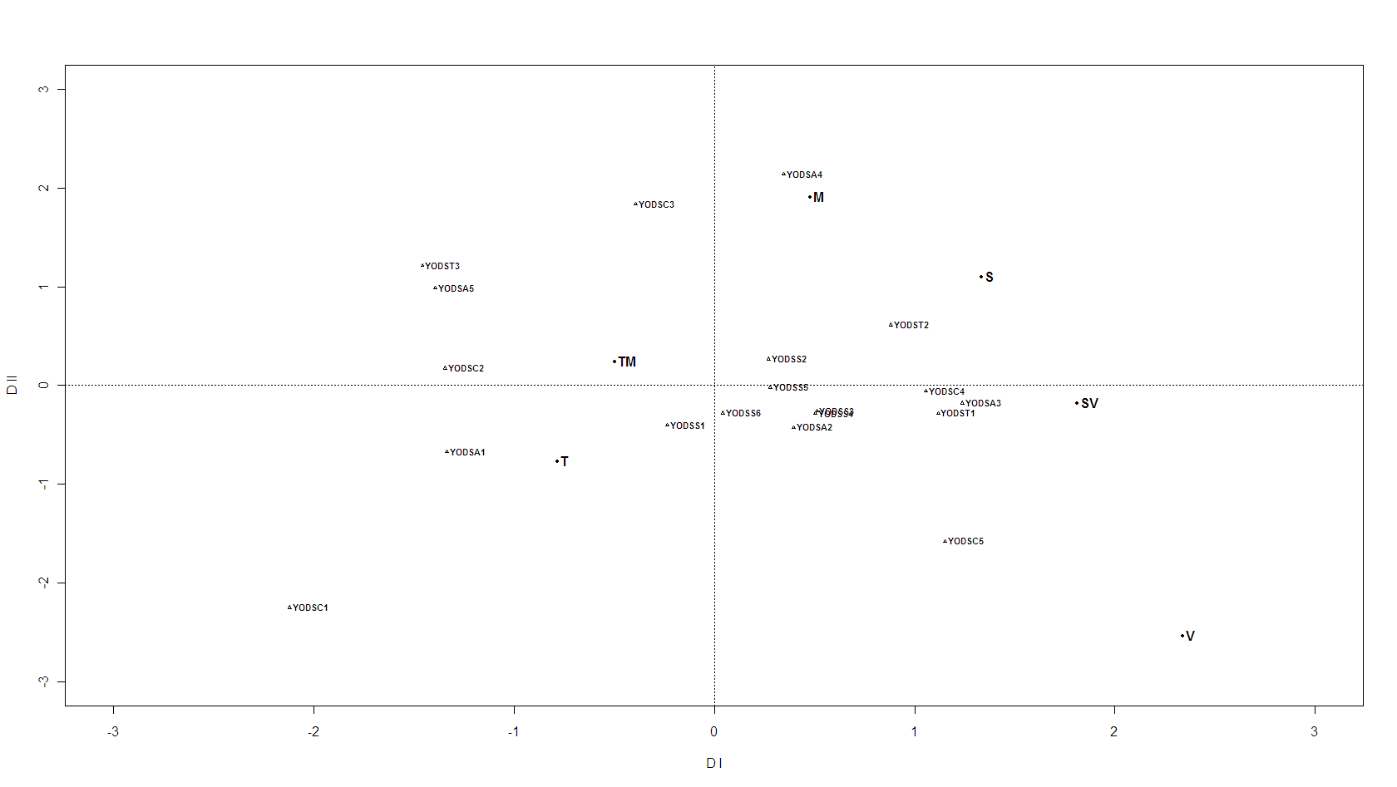
Results
Impacts of stand structure characteristics
  Y the agreement in a severity class
YOD and orthophoto interpretation data
Total variance for the first two dimensions: 96.3% and 89.7% from the first dimension
Higher agreement in S or SV more likely occurs in middle age class (124-171 yrs) pure pine stands with higher crown closure (>65%)
YODST1: pure pine
YODSA3: age 124-171 yrs
YODSC4: crown closure 50-66%
YODSC5: crown closure > 66%
Notes:
The cumulated variance was largely and sufficiently explained by the first two dimensions, particularly first dimension.
The closeness of rows or columns in the diagram basically indicates a close association, which means either a particular row or column has important role or weight in this column or in this row

Slide 34
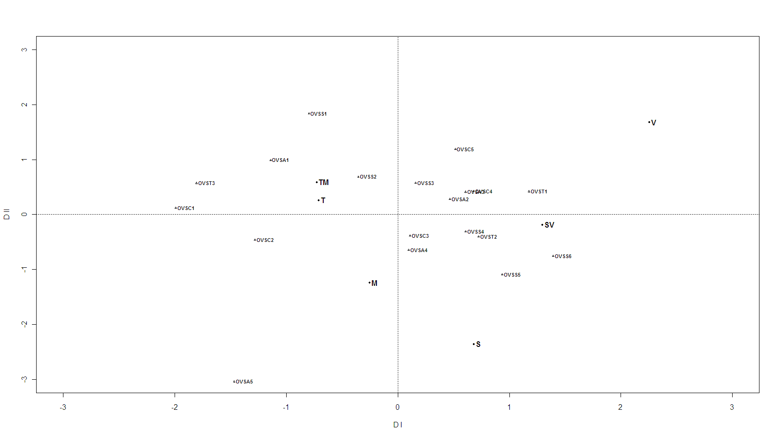
Results
Impacts of stand structure characteristics on
Total variance for the first two dimensions: 97.5% and 91.4% from the first dimension
Higher agreement in S or SV more likely occurs in pure pine stands with a larger size (> 54 ha)
Aerial overview survey and orthophoto interpretation data
OVST1: pure pine
OVSS6: stand size >90 ha
OVSS5: stand size 55-99 ha

Slide 35
Discussion
Why does the aerial overview survey data match the orthophoto interpretation data much better than the YOD data?
  Similarity in technical approaches used by the aerial overview survey and orthophoto interpretation data
Notes:
The first and third factors are easy to understand and pretty straight forward
Only difference is that a observer on board look at ground for overview data while a interpreter looks at the computer screen
Some masks used in the YOD data: cloud mask, pine mask, fire mask,

Slide 36
Discussion
Why does the aerial overview survey data match the orthophoto interpretation data much better than the YOD data?
  Similarity in technical approaches used by the aerial overview survey and orthophoto interpretation data
  Higher misclassification in lightly infested forest stands for the YOD data
    Increased spectral confusion
      Condition of forest stands
Notes:
The first and third factors are easy to understand and pretty straight forward
Only difference is that a observer on board look at ground for overview data while a interpreter looks at the computer screen
Some masks used in the YOD data: cloud mask, pine mask, fire mask,

Slide 37
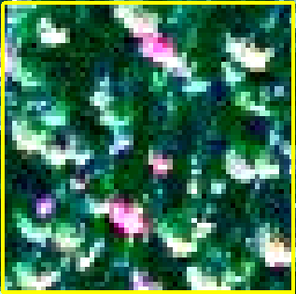
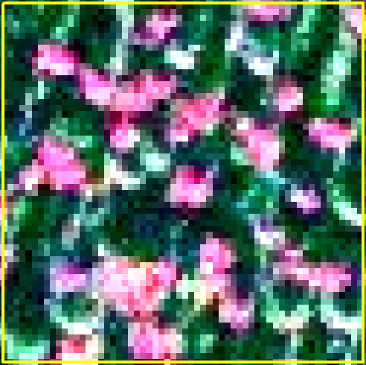
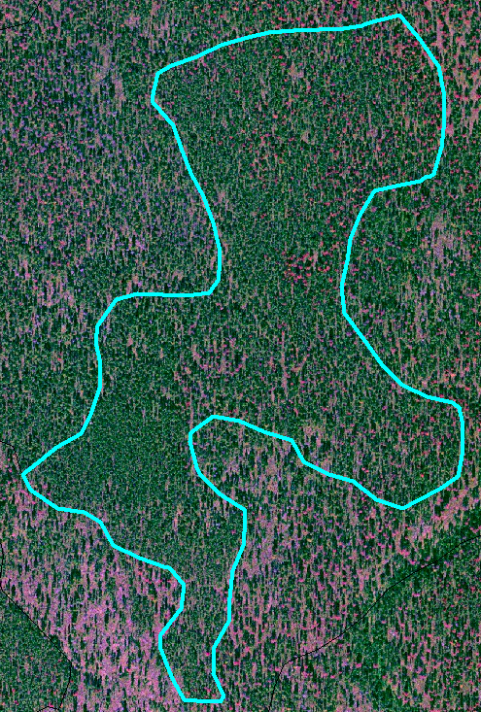
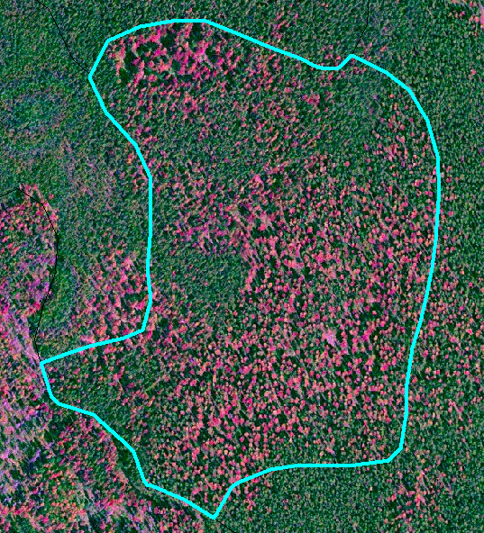
Weaker spectral signature
Stronger spectral signature
Lightly infested stand
Severely infested stand
Notes:
In lightly infested stands, more satellite pixels like the image on the left, weak spectral signature
In severely infested stands, more satellite pixels like the image on the right, strong spectral signature
Lightly infested stands have much lower crown closure than severely infested stands
Fewer lightly infested stands are pure pine stands compared to severely infested stands

Slide 38
More background noise
SV stand
TM stand

Slide 39
Discussion
Why does the aerial overview survey data match the orthophoto interpretation data much better than the YOD data?
  Similarity in technical approaches used by the aerial overview survey and orthophoto interpretation data
  Higher misclassification in lightly infested forest stands for the YOD data
    Increased spectral confusion
      Condition of forest stands
  Data gaps with the YOD data
Notes:
Some masks used in the YOD data: cloud mask, pine mask, and fire mask

Slide 40
Conclusions
Discrepancies in the red-attack severities estimated from different data sources are significant, particularly for the severe infestation classes, S and V
It may be inappropriate to assign a subjective severity code to a VRI polygon based on the percentage of the YOD pixel coverage in a VRI polygon

Slide 41

Question??

