Slide 1
Rhizina root disease
Throughout B.C. especially on burned areas of the ICH and CWH biogeoclimatic zones
Disease occurrence is slight where sites receive a light burn, such as an early spring burn, or a severe burn where all litter and humus is removed
Risk usually only lasts ~ 2 years following fire
Notes:
If the fire is too hot (severe burns that totally removes the duff) then Rhizina is also destroyed. If the fire is light (the duff remains intact) – the other fungi will remain active so Rhizina cannot compete. Fires that are considered moderate (burn at an intensity that duff temperatures reach a range from 34-37^{O}C) are the best environments for this fungus to grow.

Slide 2
Incidence of Rhizina root disease, Nelson Forest Region, 1988.
Location | No. cutblocks | % seedlings infected | % cutblock area | Tree spp.
Chatter Cr. | 2 | 4 | 100 | pine
Bush R. | 1 | 44 | 60 | spruce
Beaverfoot R. | 2 | 14 | 80 | spruce/pine
Redding Cr. | 2 | 33 | 25 | spruce
Downie Cr. | 1 | 15 | 100 | spruce
Cariboo Cr. | 1 | 6 | 100 | Douglas-fir
S. Fosthall Cr. | 1 | 2 | 100 | larch/pine
Upper Koch Cr. | 1 | 2 | 100 | Douglas-fir
Redrock Harbour | 1 | 0 |  | spruce
Mica Dam | 1 | 0 |  | spruce

Slide 3
Symptoms & Signs
Seedlings appear stressed – chlorotic needles
Seedlings appear girdled at/below the soil line – can appear similar to beetle galleries
Fruiting structures are very distinct, up to 6 cm in diameter, and grow within 50 cm of infected seedlings
They are chestnut to dark brown with many brain-like lobes and fissures
Most common in late summer and fall in wet years
Lack of Fireweed may be a good indicator of the presence of Rhizina – since fireweed tends to get stunted and won’t flower if growing close to a Rhizina inoculum source.

Slide 4
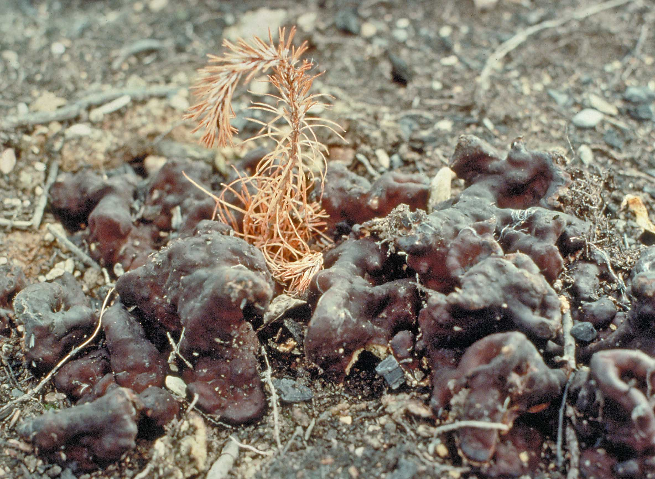
Symptoms & Signs

Slide 5
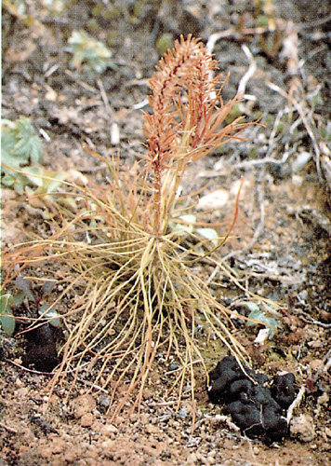
Symptoms & Signs

Slide 6
Rhizina Management Options
Occurrence and impact is “immediate”.
If fire was 10 to 16 months earlier – conduct survey for fruiting bodies, look around stumps, large woody debris
Delay planting 1.5 – 2 years post fire
Avoiding planting sites immediately adjacent to food bases such as stumps and large pieces wood may decrease the spread of the fungus
Notes:
Suggestions for action:
Hazard rate for risk your burn sites by the presence of hemlock and by the intensity of the burns you experienced.
Monitor/assess fireweed growth on your sites – plant in areas where fireweed is doing well (may require some brush control) and avoid areas where fireweed is stunted and not flowering (this will usually occur around dead stumps).
Wait at least two years before planting – rhizina looses it ability to kill seedlings over time (at the very least wait one year – plant in areas where fireweed is doing well - since rhizina’s impact is immediate and perhaps fill plant later in those areas where fireweed was impacted).

Slide 7
Rhizina Management Options
Under most situations seedling mortality is confined to one year following the burn but it can persist at a reduced level into the second year.
As a precaution, fill planting of openings created by seedling mortality should be delayed for 2 years.

Slide 8
