Slide 1

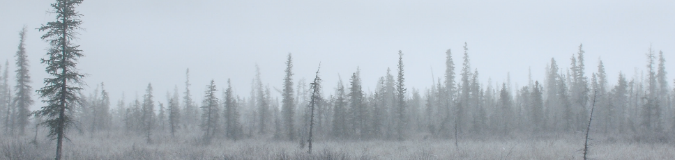



SARA and SMC
Help!
Presentation to: Revelstoke Complex and Central Selkirks Caribou TWG
Robin Steenweg
Canadian Wildlife Service – Pacific Region
Environment and Climate Change Canada
May 30, 2022

Slide 2

Fed / prov Decision Making For CARIBOU
Federal (SARA) | Provincial (multiple pieces of legislation)
Listing of species on SARA Schedule 1 (discretionary) | Listing of species as endangered/threatened/vulnerable under Wildlife Act (discretionary)
Publish recovery strategy, action plans | Hunting / management of caribou, other ungulates, predators
Orders to protect species or critical habitat (discretionary) | Virtually all land use planning and decisions
Enter into conservation agreements (discretionary) | Herd planning (discretionary)
Not specific to caribou, but may impact them: major projects climate change mitigation / adaptation
Notes:
(on non-federal lands)

Slide 3
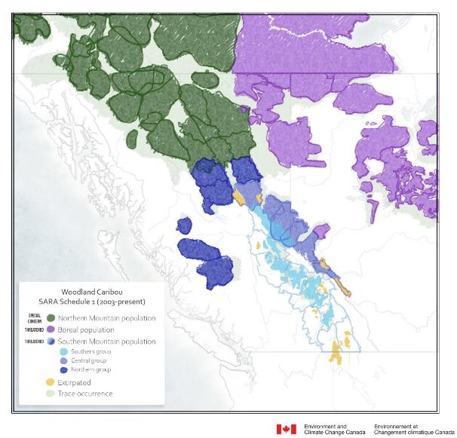
Schedule 1 of SARA
Woodland Caribou (Northern Mountain population) – Special Concern (listed in 2005)
Caribou (Boreal population) – Threatened (listed in 2003; confirmed in 2014)
Woodland Caribou (Southern Mountain population) – Threatened (listed in 2003)
  Southern group
  Central group
  Northern group

Slide 4
SMC protection under sara
Destruction of critical habitat on non-federal land is prohibited
  ONLY if a s.61 Order is made
    Minister must recommend an order if of the opinion that no federal provisions or measures (including any section 11 agreements) protect the critical habitat AND the laws of the province do not effectively protect the critical habitat
    Decision to make the order is at Cabinet’s discretion
    No s.61 orders have been made to date, for any species
    Since June 2019, ECCC has been reporting on steps taken for the protection of critical habitat for all listed species.
The federal government has a number of discretionary options to protect species at risk and their habitat on non-federal lands.
Risk of that discretion being exercised is lower if constructive measures are being taken to move toward habitat protection.
Risk of discretion being exercised is higher if critical habitat is actively being destroyed.
Notes:
https://species-registry.canada.ca/index-en.html#/consultations/1423

Slide 5
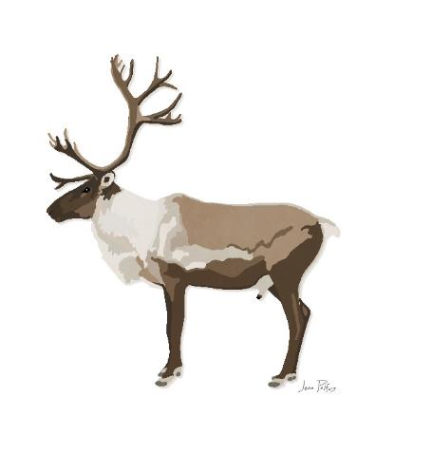
SMC protection under sara
Emergency Orders (s80): provide for the protection of a species that is determined to be facing imminent threats to its survival or recovery.
  On May 4, 2018, the Minister of ECC publicly disclosed her opinion that SMC is facing imminent threats to its recovery.
  Recommendation was based on the Imminent Threat Assessment (ITA) that was conducted.
  Minister recommended an emergency order to provide for the protection of the species; Government of Canada decided not to make the order, after considering many factors including the negotiation of conservation agreements for SMC under Section 11 of SARA.
Notes:
SARA does allow the Federal government to issue orders for protection on provincial land where the provinces have failed to protect but this is an uncommon intrusion into what is usually provincial jurisdiction. Emergency orders have been issued only twice, protecting the western chorus frog and the greater sage-grouse in other parts of the country.

Slide 6
SMC – current s.11 agreements
Canada-BC Conservation Agreement for Southern Mountain Caribou in BC
  Framework agreement for cooperation; identifies high level conservation and recovery measures.
  Includes Revelstoke complex & South Selkirks
Agreement for the Conservation and Recovery of Caribou in Alberta (Canada, AB)
Partnership Agreement for the Conservation of the Central Group of SMC (Canada, BC, Saulteau First Nations, West Moberly First Nations)
Notes:
https://species-registry.canada.ca/index-en.html#/consultations/3202 (Feb 2020)
https://open.alberta.ca/publications/agreement-for-the-conservation-and-recovery-of-the-woodland-caribou-in-alberta (Oct 2020)

Slide 7
SMC – Herd Planning
Included in bilateral Canada-BC s.11 agreement
Led by Province, with Federal support – collaborative with Indigenous communities
Process has evolved. Whether “herd plans” or land use plans, expectation is that caribou recovery will be supported through:
  Reduction in disturbance in medium-long term (restoration, habitat protection, planning, over 10-20+ years)
  Active management where necessary in short-medium (predator control, maternity pens, etc, over ~5-10 years)
Recovery potential for Revelstoke surrounding LPUs, despite complexities

Slide 8
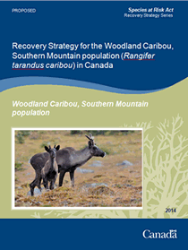
SMC – Recovery Strategy
2014 Release
Upcoming Amendment:
  Critical Habitat update
  Inclusion of Indigenous knowledge and perspectives
  Starting with Indigenous language

Slide 9
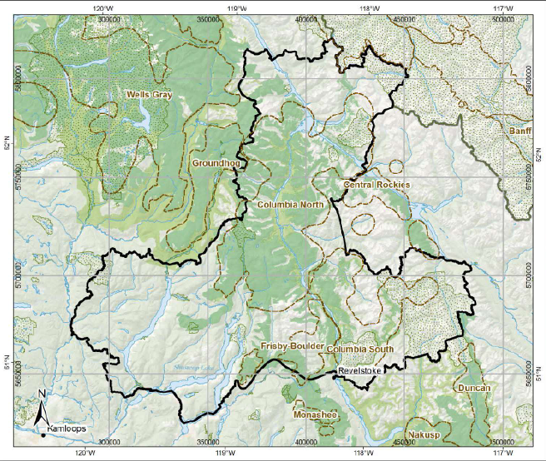
critical habitat
Definition in SARA:
“the habitat that is necessary for the survival or recovery of a listed wildlife species and that is identified … in the recovery strategy or in an action plan for the species”
In 2014, critical habitat was partially identified for all LPUs.
Not all identified CH was mapped.
3 components:
Location: Map of boundaries
Type: biophysical attributes
Amount: best available info
Notes:
Biophysical attributes = “those habitat characteristics required by SMC to carry out life processes.” in Appendix C.
Amount of CH includes currently undisturbed, as well as disturbed habitat that needs to be restored.

Slide 10
Population & distribution objectives
To the extent possible:
stop decline in both size and distribution of all Local Population Units (LPUs)
maintain the current distribution within each LPU
increase the size of all LPUs to self-sustaining levels and, where appropriate and attainable, to levels which can sustain a harvest with dedicated or priority access to Indigenous peoples
Notes:
LPUs are considered to be “self-sustaining” when:
the LPU on average demonstrates stable or positive population growth over the short term (≤20 years)
is large enough to withstand random events and persist over the long term (≥50 years), without the need for ongoing active management intervention
there is an increase to at least 100 caribou within LPUs that currently consist of fewer than 100 caribou, and there is no reduction in the number of caribou within LPUs that currently consist of over 100 caribou

Slide 11
Federal support for recovery implementation
Funding to BC Caribou Recovery Program (via s.11 Bilateral Agreement)
population trend monitoring habitat monitoring planning for habitat protection habitat restoration maternal penning, supplemental feeding, predator management health studies engagement (e.g. herd planning) communications compliance and enforcement
Notes:
(on non-federal lands)

Slide 12
Federal support for recovery implementation
Funding to BC Caribou Recovery Program (via s.11 Bilateral Agreement) | Funding to First Nations (via Contribution Agreements)
population trend monitoring habitat monitoring planning for habitat protection habitat restoration maternal penning, supplemental feeding, predator management health studies engagement (e.g. herd planning) communications compliance and enforcement | gathering & weaving of IK caribou habitat use monitoring planning for habitat restoration habitat restoration predator management (traditional methods) participation in herd planning other research to address knowledge gaps health studies community outreach and education
Notes:
(on non-federal lands)

Slide 13
Habitat Restoration
Canada’s Strengthened Climate Plan:
a Healthy Environment and a Healthy Economy
Carbon sequestration
Provide co-benefits (e.g. SAR)
Natural Climate Solutions Fund:
Two Billion Trees
(Growing Canada’s Forests)
NRCAN
$3.2 Billion
Nature Smart Climate Solutions Fund
ECCC
$631 Million
Agricultural Climate Solutions
AAFC
$185 Million

Slide 14

Thank you!

Slide 15
Additional slides just in case

Slide 16
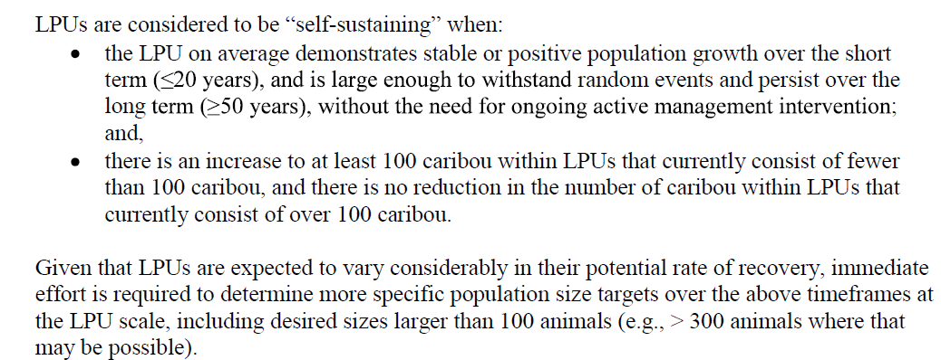
Population & distribution objectives
Self sustaining:

