Slide 1
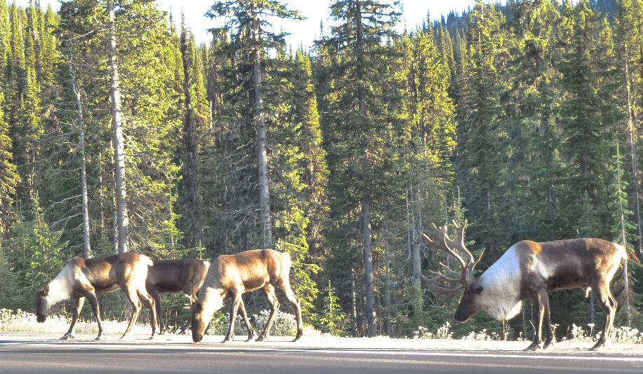
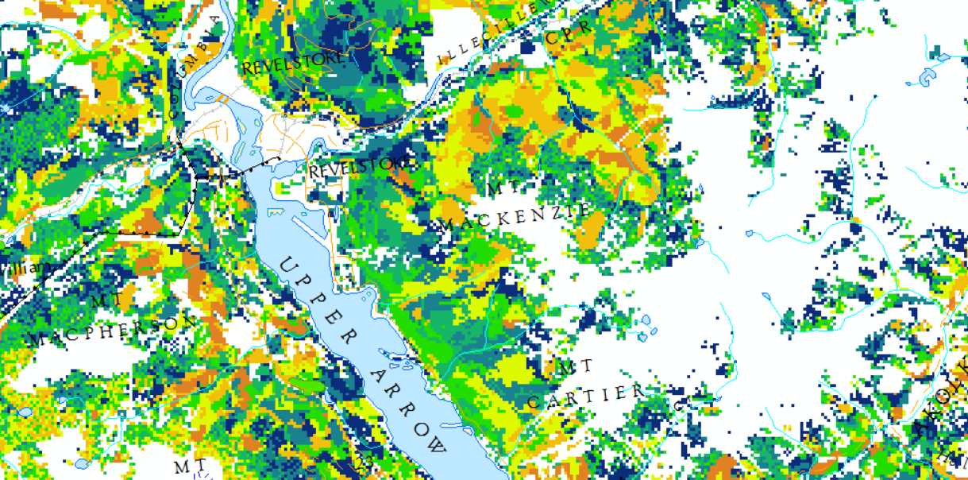
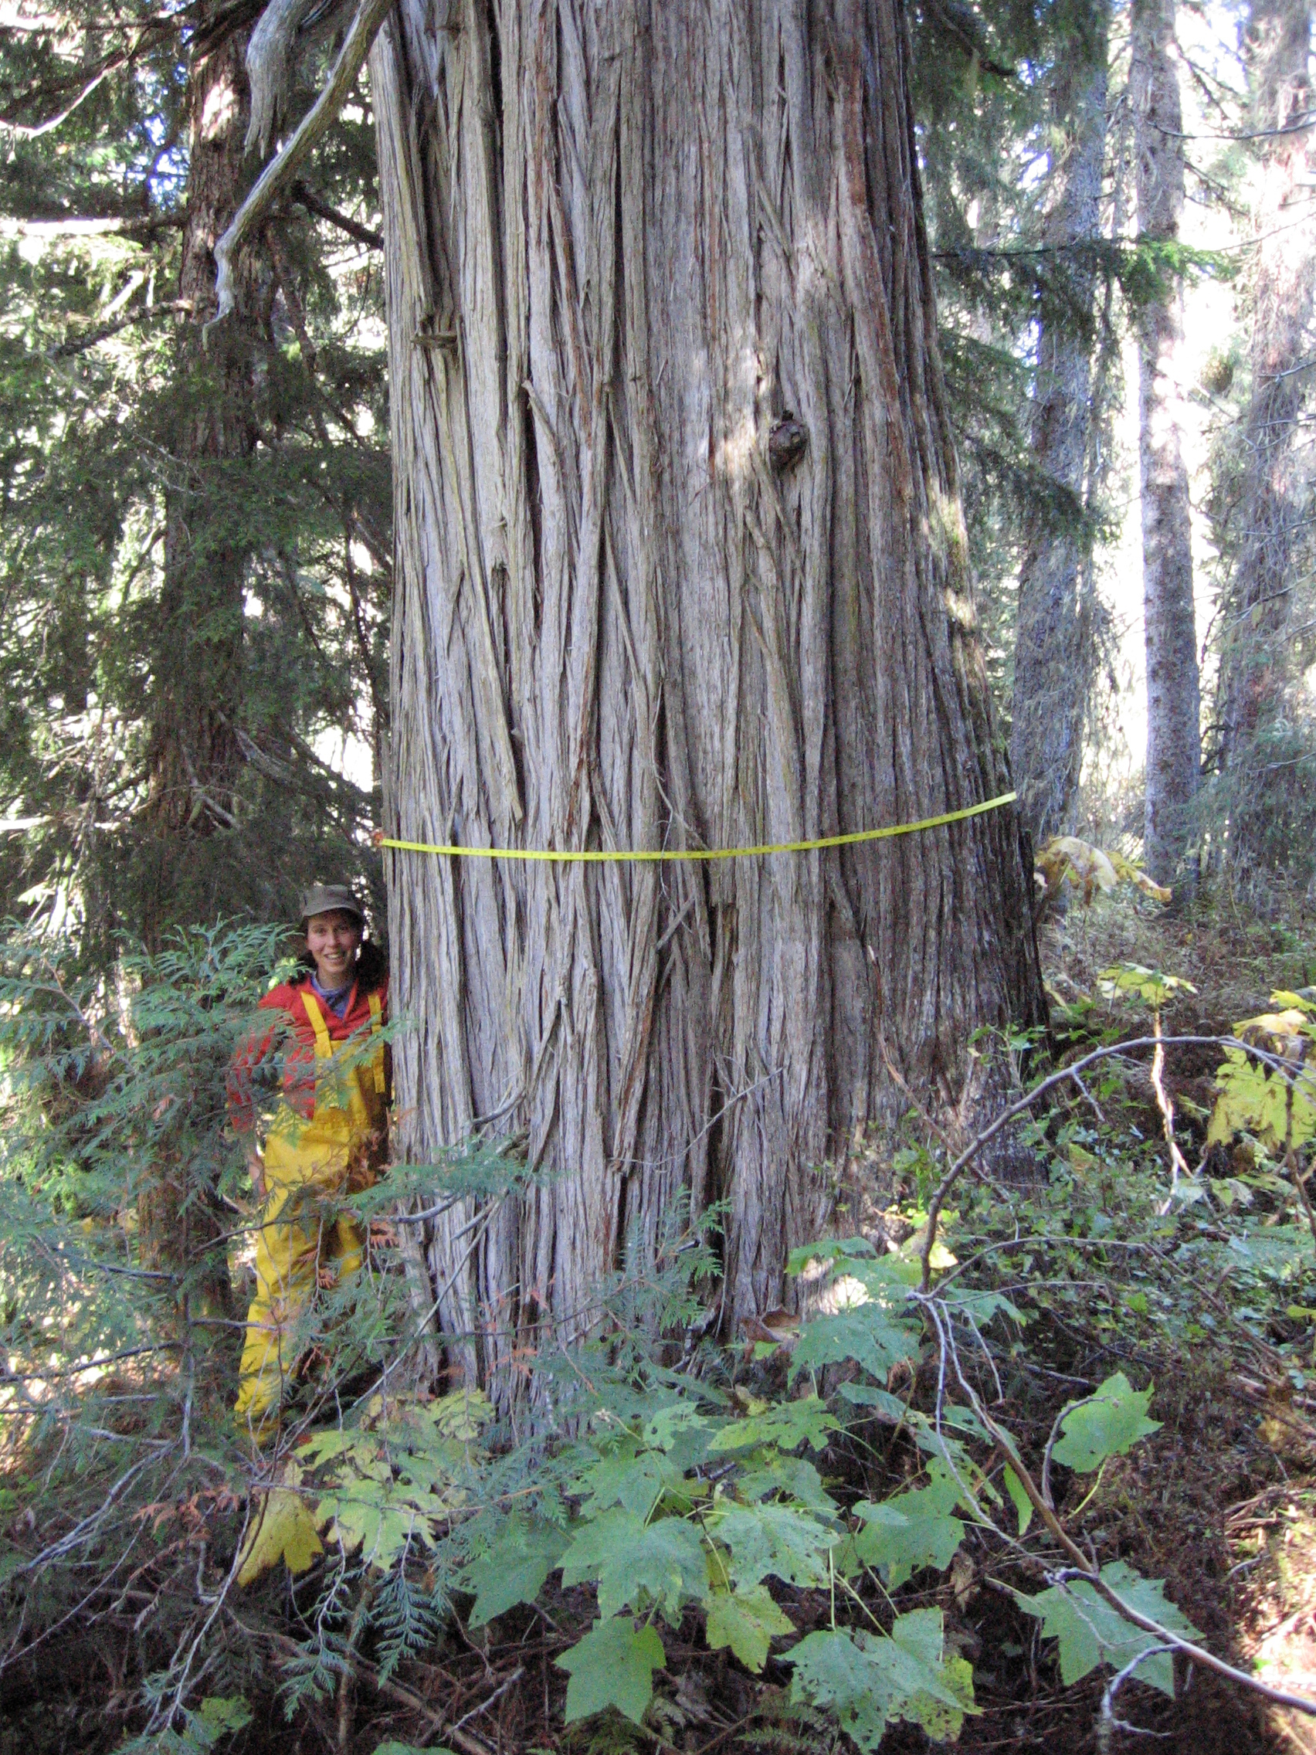
Carbon in Caribou Habitat
Revy Complex
Deb MacKillop
Research Ecologist, FOR
October 24, 2022

Slide 2
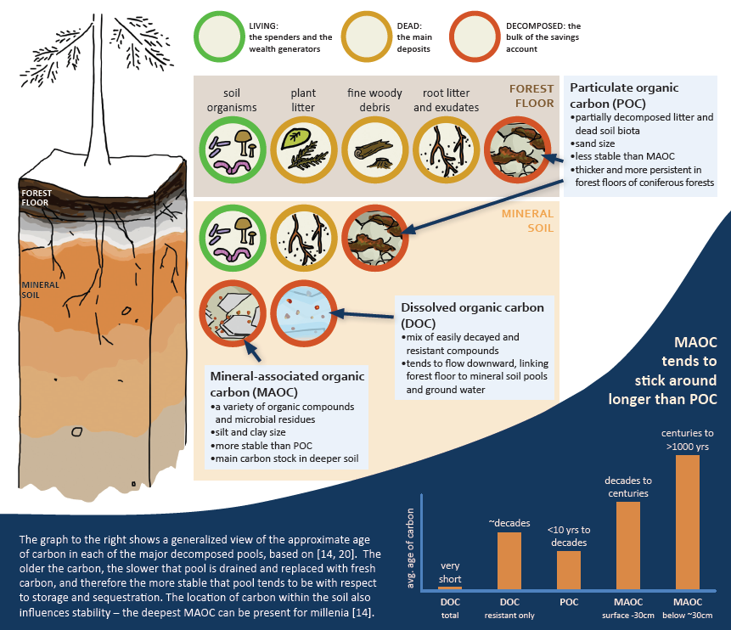
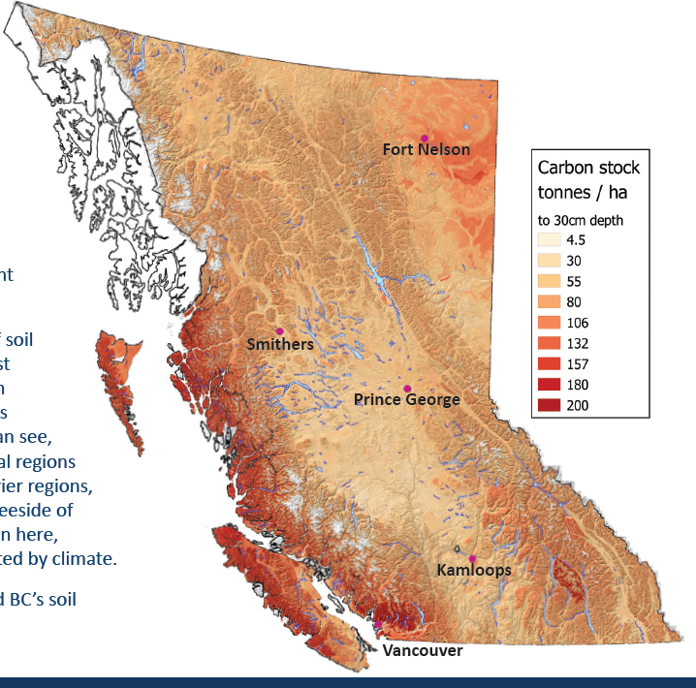
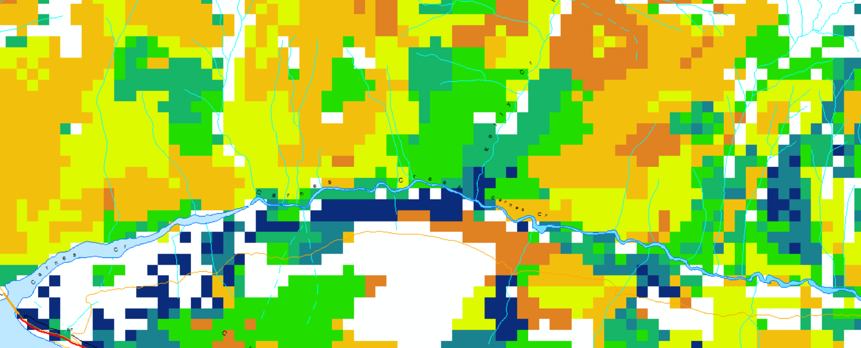
Preliminary Carbon Model Outputs
Model results from Robbie Hember, Forest Carbon Modeller, Office of the Chief Forester
Carbon in four pools:
      Live biomass
      Dead wood
      Litter
      Soil
Total Carbon (Mg/ha = Tonnes/ha)
Soil carbon images from Bulmer et al. 2021

Slide 3
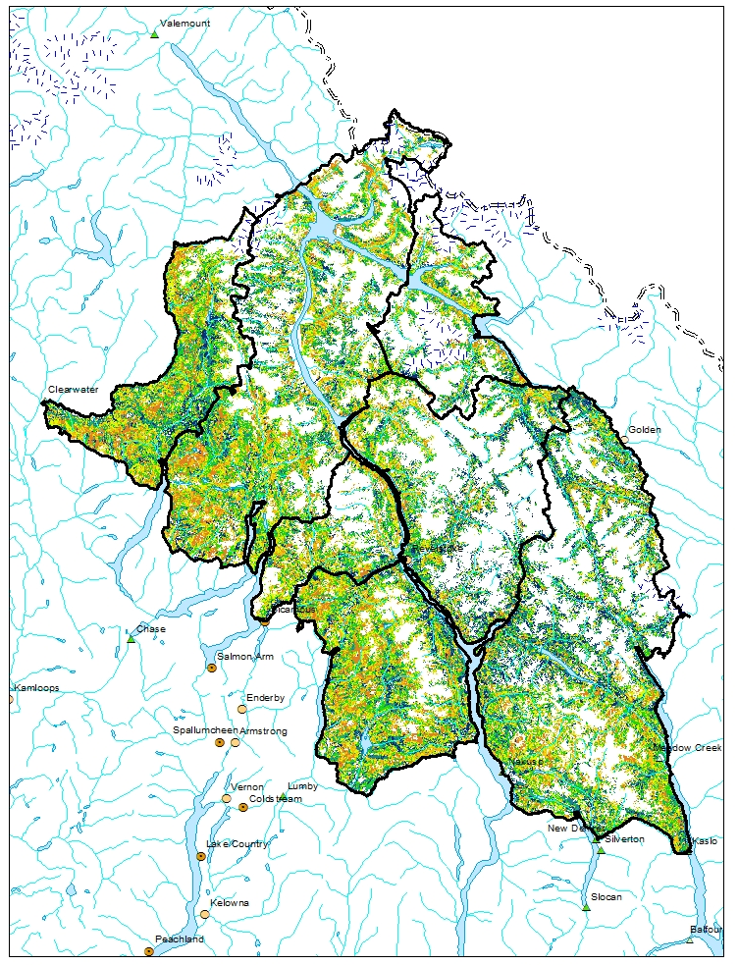
Carbon and Caribou
Total Carbon in Revy Complex Area
  462,277,680 Tonnes
  Includes total vegetated area, not just caribou protection areas
  According to the internet, this is equivalent to:
    Burning 200 million L of gas in your car
    Annual emissions of ~ 29 mil people
Notes:
BC forests have 6-7 billion tonnes of aboveground biomass carbon, for approximately 12 billion tonnes of total carbon (all pools). Revy complex is about 5% of that.

Slide 4
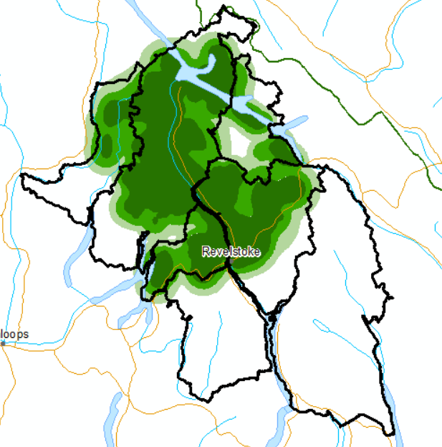
Carbon and Caribou – Considering Scenarios
What are the carbon stocks in caribou habitat?
Carbon in Columbia North
  Kernel95 = 102 mil tonnes Carbon
  Kernel75 = 92 mil tonnes Carbon
  Kernel50 = 70 mil tonnes Carbon
Full kernel area; additional habitat not separated out

Slide 5
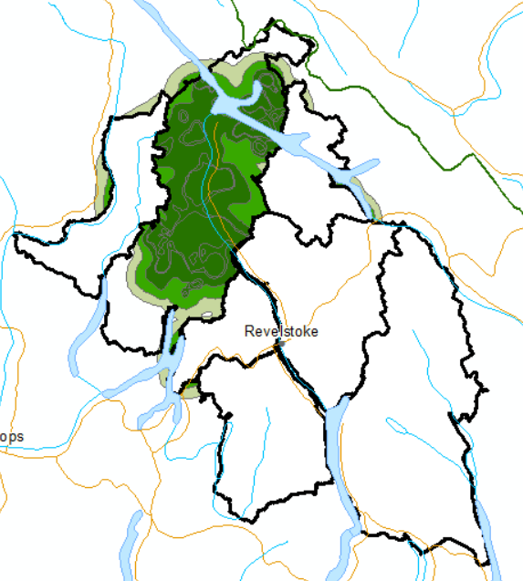
Carbon and Caribou – Considering Scenarios
What are the carbon stocks in caribou habitat?
Carbon in Columbia North
  Kernel95 = 102 mil tonnes Carbon
  Kernel75 = 92 mil tonnes Carbon
  Kernel50 = 70 mil tonnes Carbon
Full kernel area; additional habitat not separated out

Slide 6
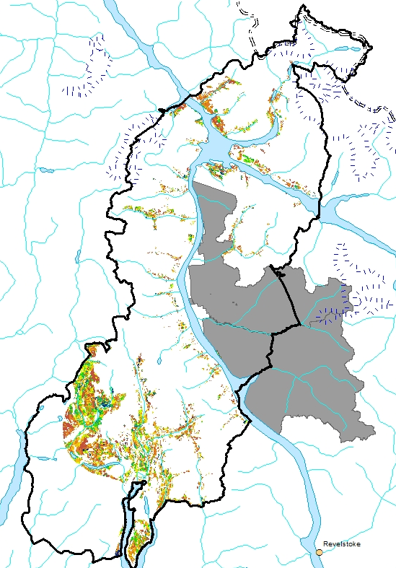
Carbon and Caribou – Columbia North THLB
THLB is a small proportion of total area
Total Carbon in proposed caribou habitat protection areas in THLB is much less than total carbon
  Want to show amount of carbon in incremental protection in each Kernel scenario…
Missing a step to show incremental habitat protection areas in scenarios…

Slide 7
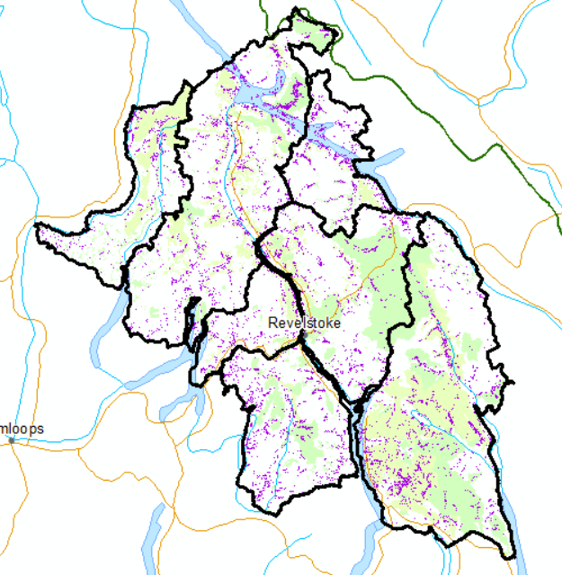
Carbon in Old Growth Deferral Areas
Total Area = 183,745 ha
Total Carbon = 58,251,201 Tonnes
Need to calculate overlap between OG TAP deferrals, unprotected areas, incremental caribou protection scenarios, and THLB
Notes:
Should have overlap between unprotected OG and Proposed new Caribou. 317 T carbon/ha (avg Robbie said was 325 T…)

Slide 8
Can we help to address the climate and biodiversity crises through caribou recovery and old growth conservation?
Canada has international commitments to carbon management
Canada Nature Agreement
  25 by 25; 30 by 30
Federal Caribou Recovery Expectations
Carbon offset sales

Slide 9
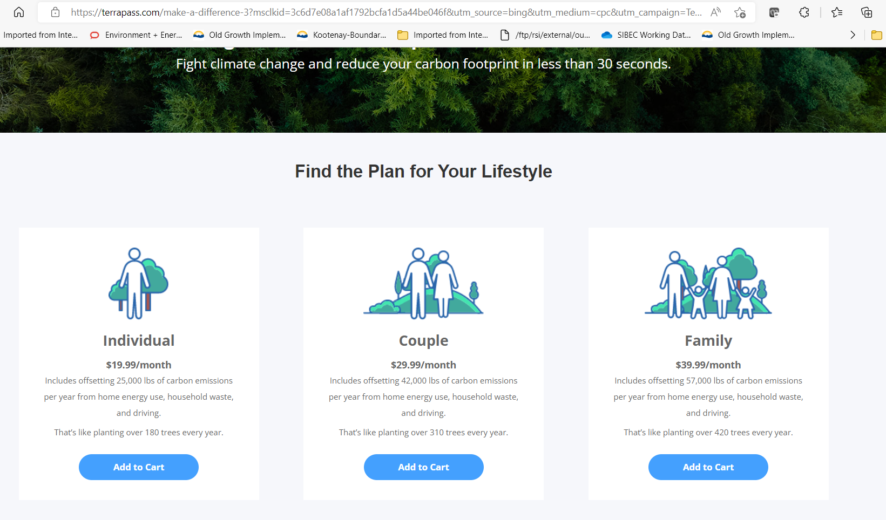
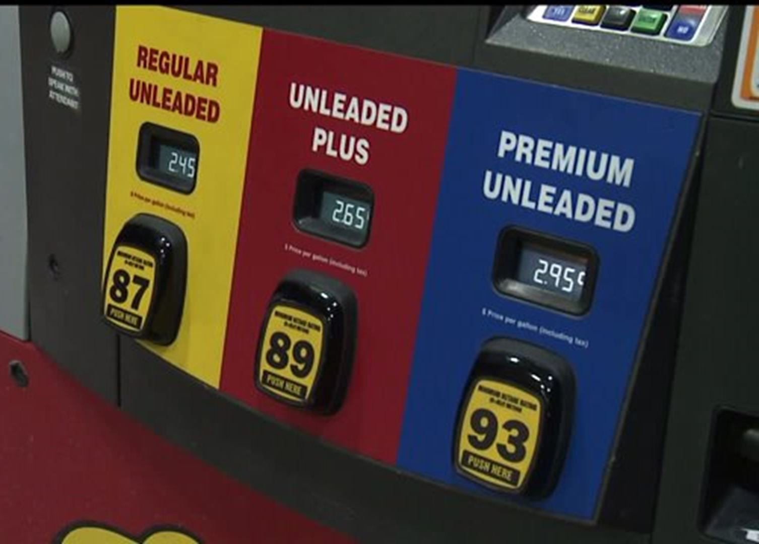
Carbon and Caribou – Economic Potential?
How much $ value is there in carbon stored in caribou habitat?
In 2020, carbon pricing generated $53bn in revenue and $3.4bn in Canada (source: Wikipedia)
In 2015, the BC government purchased 499,537 tonnes of carbon offset for a price of $5,826,480 ($11.66/tonne)
Leakage: assume that only 50% of carbon stock is available for monetization
Carbon Gas Tax “pollution price”
  $50/tonne
  increased from $20/tonne in April 2022
  will increase by $15/year starting in 2023 up t $170/tonne in 2030
“Social cost” of carbon
  Ranges from ~$65/tonne¹ to $185/tonne²
  monetary damage caused by a tonne of CO₂ from landslides, fires, and social impacts of climate change
Carbon offset market
  Up to $16.50/tonne
¹ average; ² Rennert et al. 2022 Nature

Slide 10
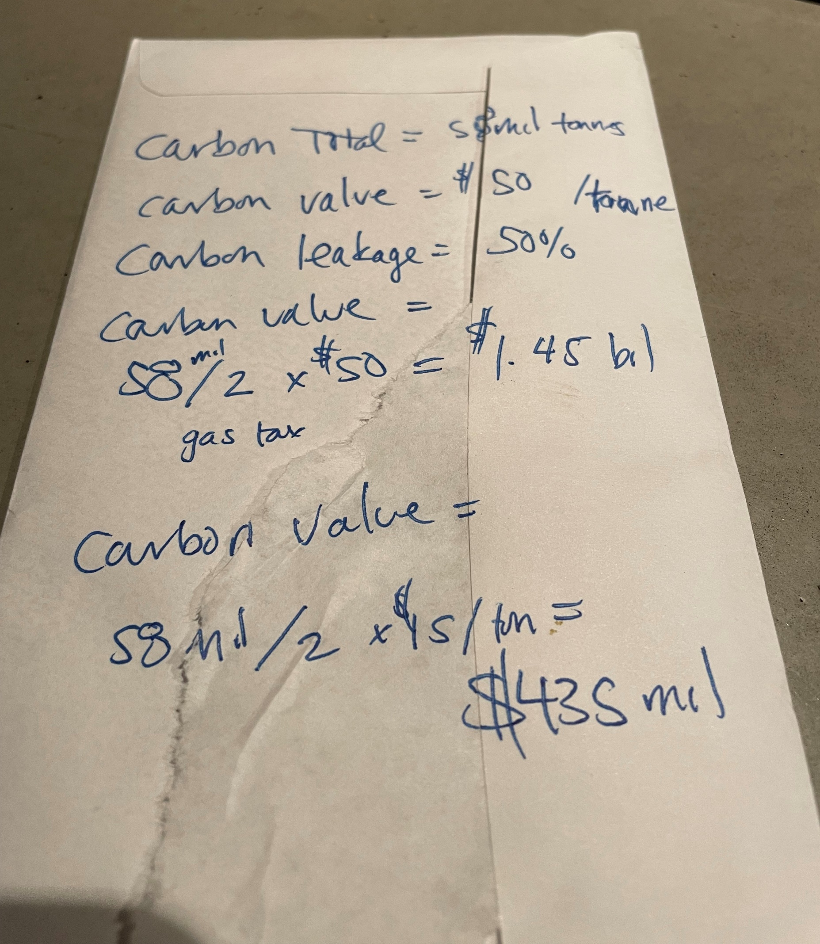
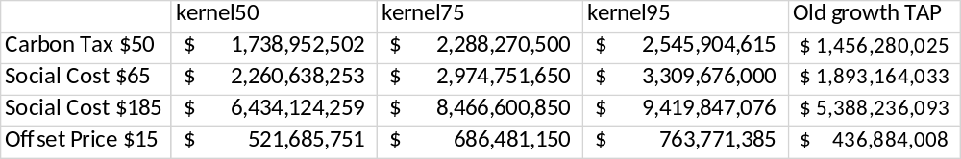
Carbon Value $$$
Old Growth Deferrals
THLB ~ 7% of Area
$ 53 mil @ $15/ha
(kernel95)
THLB ~ 7% of Area
$ 30 mil @ $15/ha
(kernel95)
$ 101 mil @ $50/ha
Assumes leakage of ½ the total carbon present in each scenario with the other ½ available for sale/credit
Calculations are “back-of-the-envelope” rough… intended to provide the range of what could be possible
Caribou economic values may be too high because they include all area within the kernel area – logged, protected, proposed

Slide 11
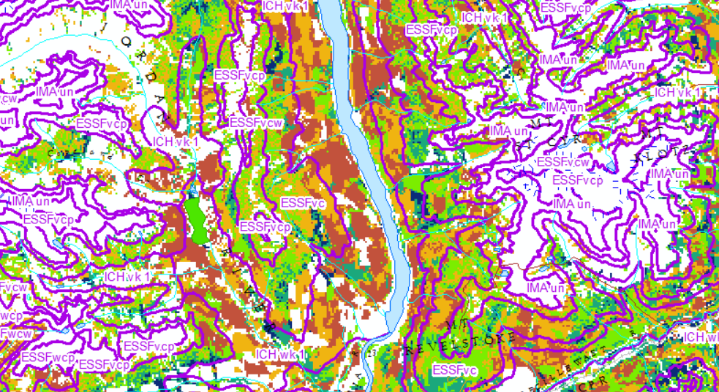
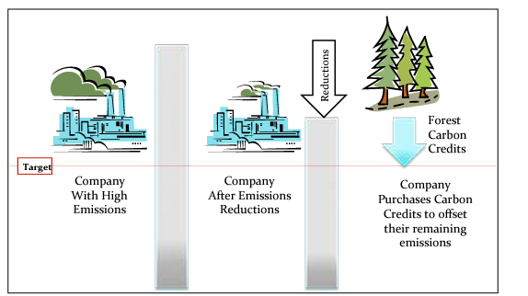
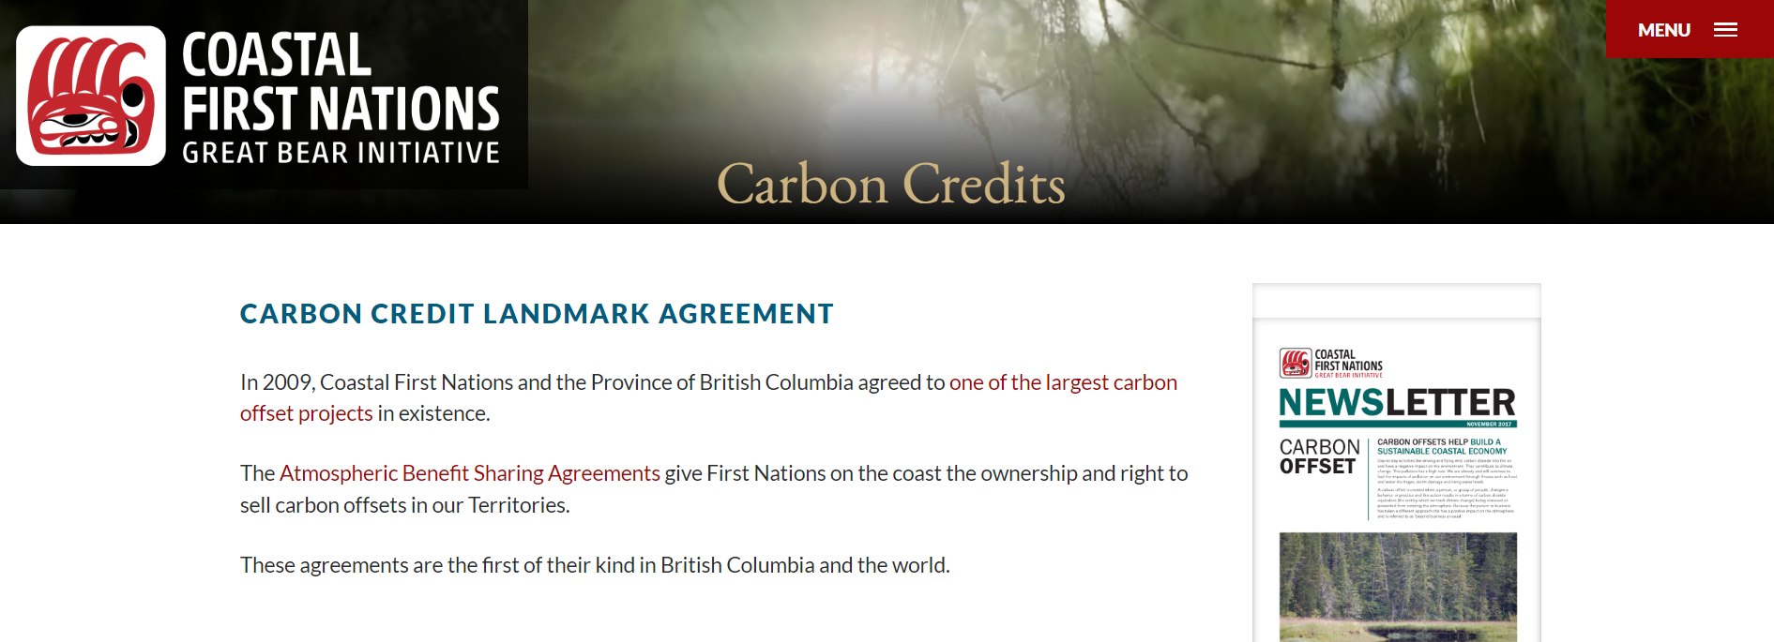
Uncertainty
Quick calculation with the Carbon model
  Local model calibration needed
  Inconsistencies between carbon values in ICH and ESSF, and older and younger forests
Rough GIS calculations
Economic value of carbon
  Does not take complexities into account
    Carbon in stored wood products
    Disturbance scenarios
    THLB and “additionality”
  Pricing is uncertain
  Analysis does not single out new caribou protection areas within broader analyses

Slide 12
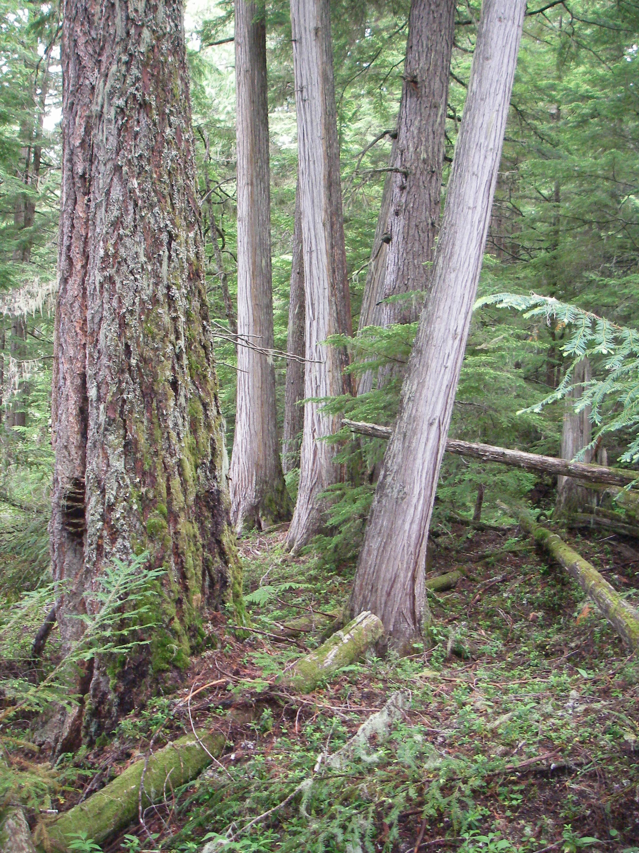
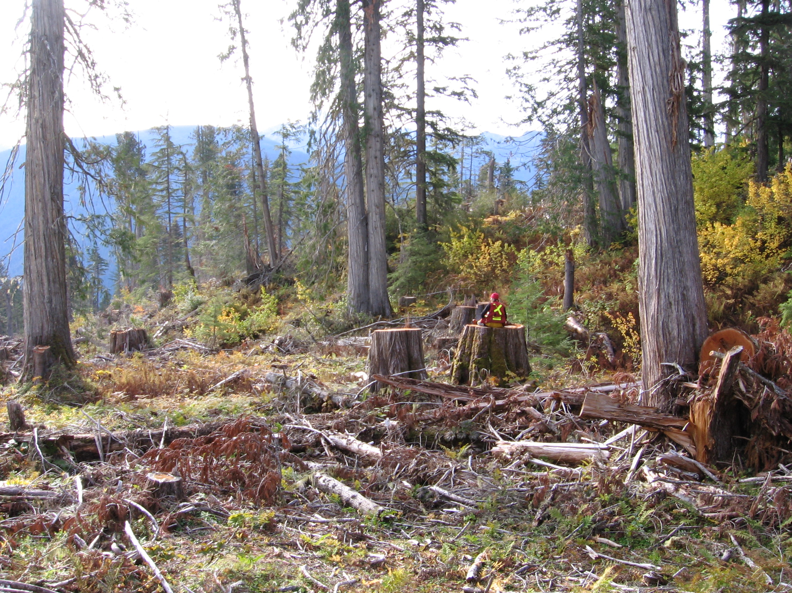
Research:
Carbon Dynamics in Old Growth
Research Proposal to Min Forests
  Extend work from Coastal BC to ICH
Field data collection in
  Ancient forests (>400 yrs)
  Old forests (>250 yrs)
  Mature forests (>100 yrs)
Model calibration
Looking for partners
  Help guide research questions
  Field data collection
  Field data QA

Slide 13
Methods
Carbon was summed across 4 pools: live biomass, dead wood, litter, soil
Raster data were converted to vector, resulting in per hectare values for carbon
Carbon data were unioned with kernel scenarios, herd boundaries, THLB
Area of each unioned cell was calculated, and carbon was calculated by multiplying the area by the carbon/ha
Carbon economic opportunities were measured by multiplying carbon, for each scenario, by value of carbon per tonne in different markets

Slide 14
Carbon and Caribou – Considering Scenarios
What are the carbon stocks in caribou habitat?
Carbon in Columbia North
  Kernel95 = 102 mil tonnes Carbon
  Kernel75 = 92 mil tonnes Carbon
  Kernel50 = 70 mil tonnes Carbon
Full kernel area; additional habitat not separated out

