Slide 1
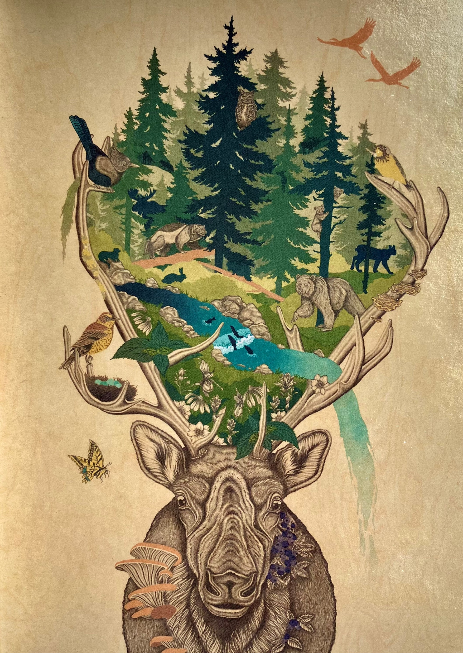
Ecosystem Health
Co-benefits to retaining and restoring caribou habitat
Presentation to the RCCSCTWG
Revelstoke, October 23, 2022
By Kathi Zimmerman
Artwork by Caitlin Bodewitz

Slide 2
Integrating values
Economic – timber volume impacts have been analyzed; non-forestry tenures include recreation, sand & gravel quaries, wind
Cultural – Indigenous knowledge, reconciliation and co-governance – DRIPA, UNDRIP, Wildlife Act.
Social – jobs, recreation opportunities, hunting, conservation
Environmental – … next slide
>
>
>
Environ-mental
>
Economic
>
>
>
>
RECONCILIATION &
CO-GOVERNANCE

Slide 3
Caribou are an umbrella species for a multitude of values
When we protect or manage caribou to allow for their recovery, we can:
Provide Habitat Protection for caribou as well as habitat for all species that live within herd ranges, including other Species at Risk.
Contribute towards the Nature Agreement (30% protection by 2030) by adding protected and conserved areas in BC.
Protect Old-Growth Forests, as well as mature forests.
Provide Watershed Security – reduce risk and frequency of flood and drought.
Provide Carbon Offsets by preventing deforestation that releases carbon and conducting reforestation.

