Slide 1
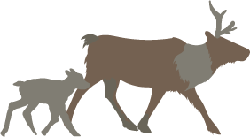
Revelstoke Complex and Central Selkirks Caribou Range Planning Options
September 26th, 2022

Slide 2
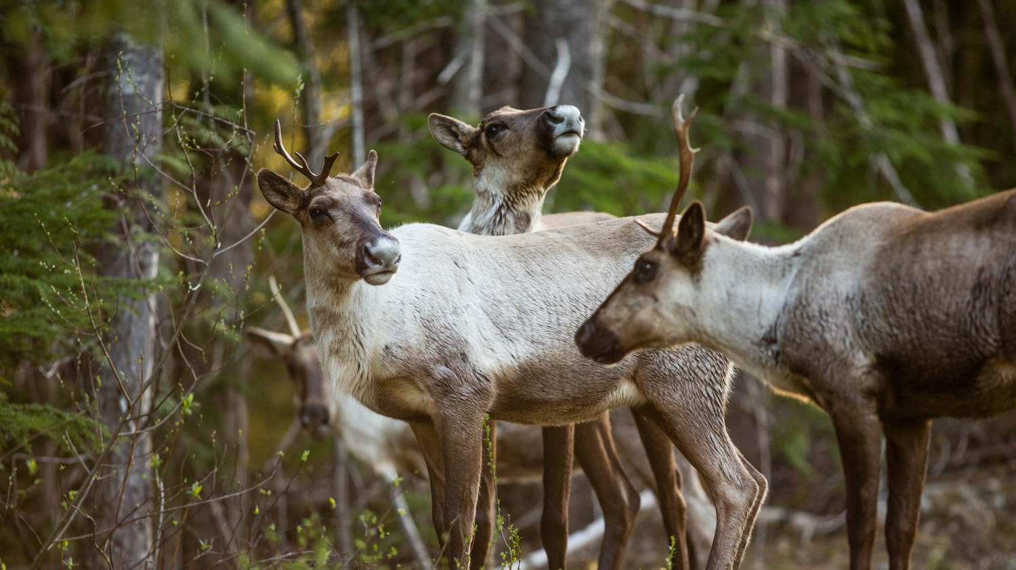
The Ultimate Goal
To produce a unified, evidence-based, and “caribou-first” range planning statement. To be sent to the province and forestry tenure holders as soon as possible.

Slide 3
Goal of this PowerPoint
1. Present evidence-based options to establish habitat protection for caribou recovery in the Revelstoke and Selkirk complex areas
2. Define important terminology and maps
3. To be shared
4. Discuss and provide input

Slide 4
Definitions
Old/Mature Forest: > 100 years old
Recruitment Forest: >80 years old
THLB: Timber Harvesting Land Base
Core caribou habitat: Used directly by caribou – necessary habitat for survival
Matrix caribou habitat: not directly used by caribou, but still very important
Kernel Density: heat map of animals
Buffer: added area or distance from point (e.g., 500m)
GAR: Government Action Regulation – also known as “Ungulate Winter Range” protections
Notes:
ALL GARs are not Ungulate Winter Range – wildlife habitat areas under the GAR – research areas under the GAR – legistlation piece that allows Gov to exclude range or forestry from specific areas.

Slide 5
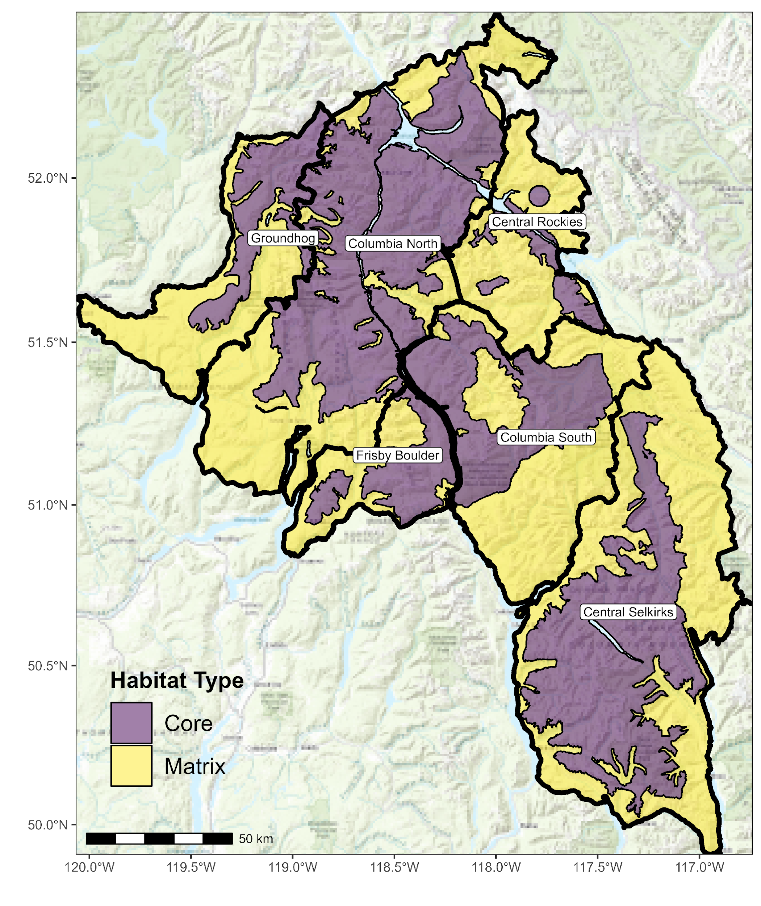
Core vs. Matrix
Core: Used directly by caribou – necessary habitat for survival
Matrix: not directly used by caribou, but still very important. The concern is disturbing matrix habitat will produce more
moose and wolves. Thus, Matrix habitat is still very important to recovering caribou.

Slide 6
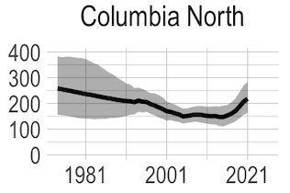
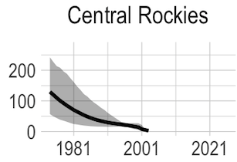
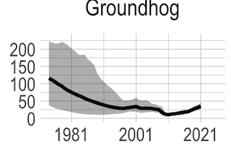
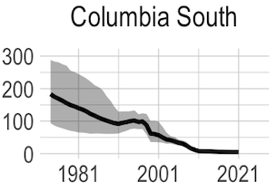
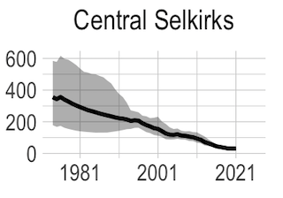
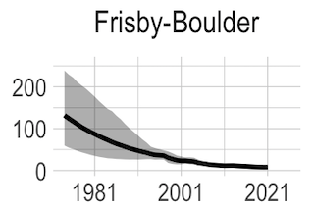
Caribou Population

Slide 7
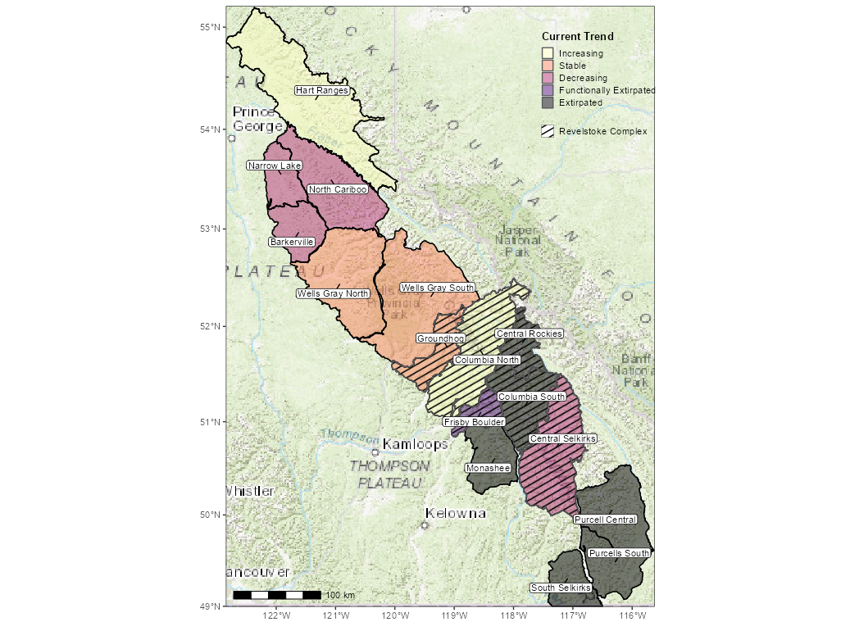
Current Caribou Populations Trends

Slide 8
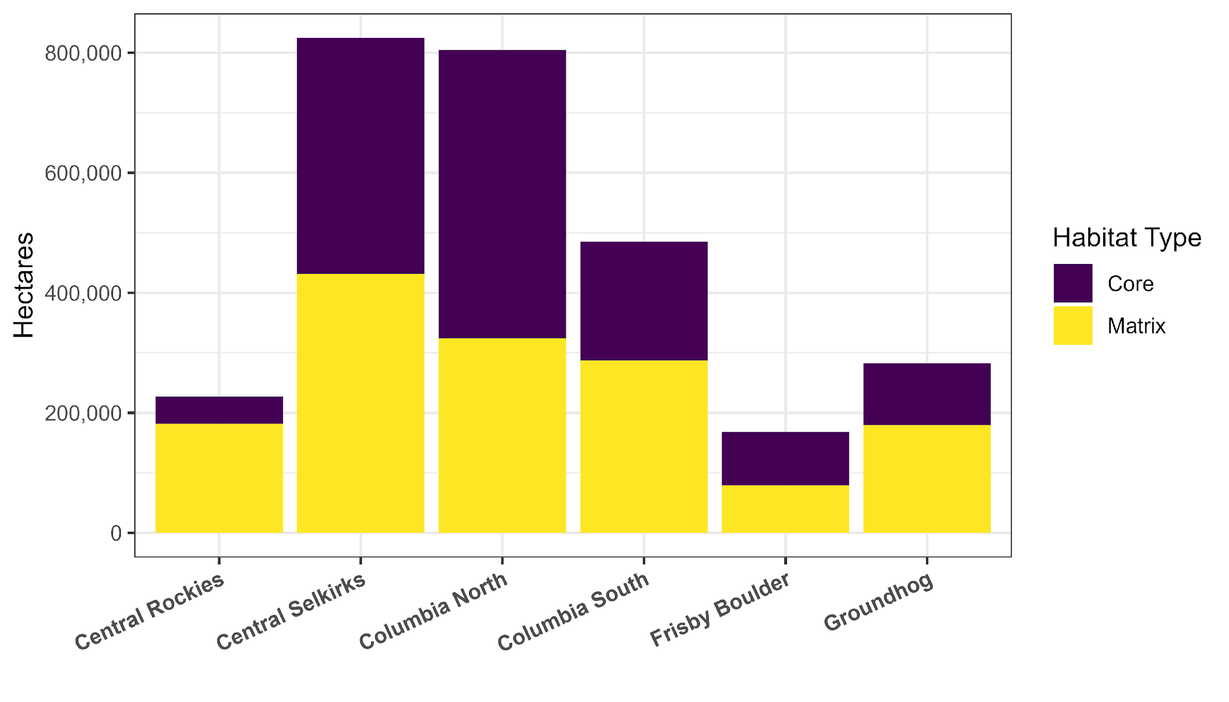
Breakdown of Core vs. Matrix

Slide 9
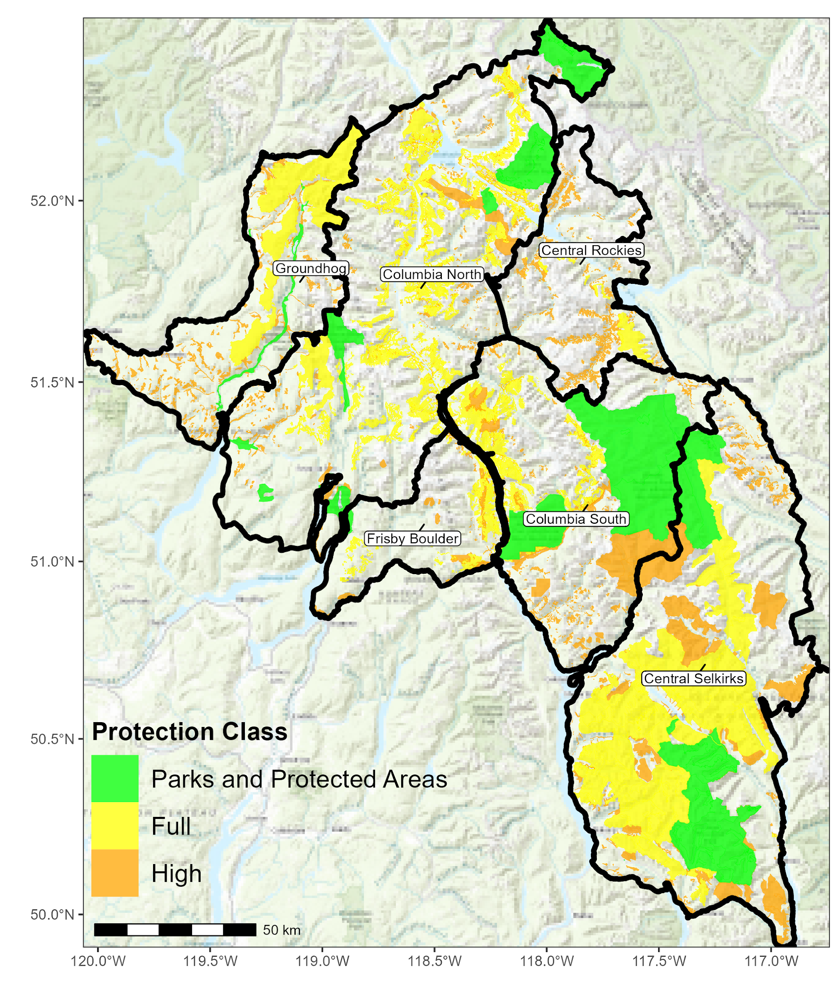
Existing Habitat Protections
Parks and Protected Areas: National Park, Provincial Park, highest level of protection
Full: No forestry permitted, for example Ungulate Winter Range (GAR)
High: 98% protection, tiny bit of harvest may bleed into these areas but only 2% incursion. Example: Old Growth Management Areas
Notes:
Full = eg., ungulate winter range – no forestry permitted. Not all GARS are included. ALL yellow is no harvest.
High = as an example Old Growth Management Areas. National wildlife areas. Tiny bit of harvest in High – good example is in OGMA’s. Allowed a 2% incursion – under strict designations.

Slide 10
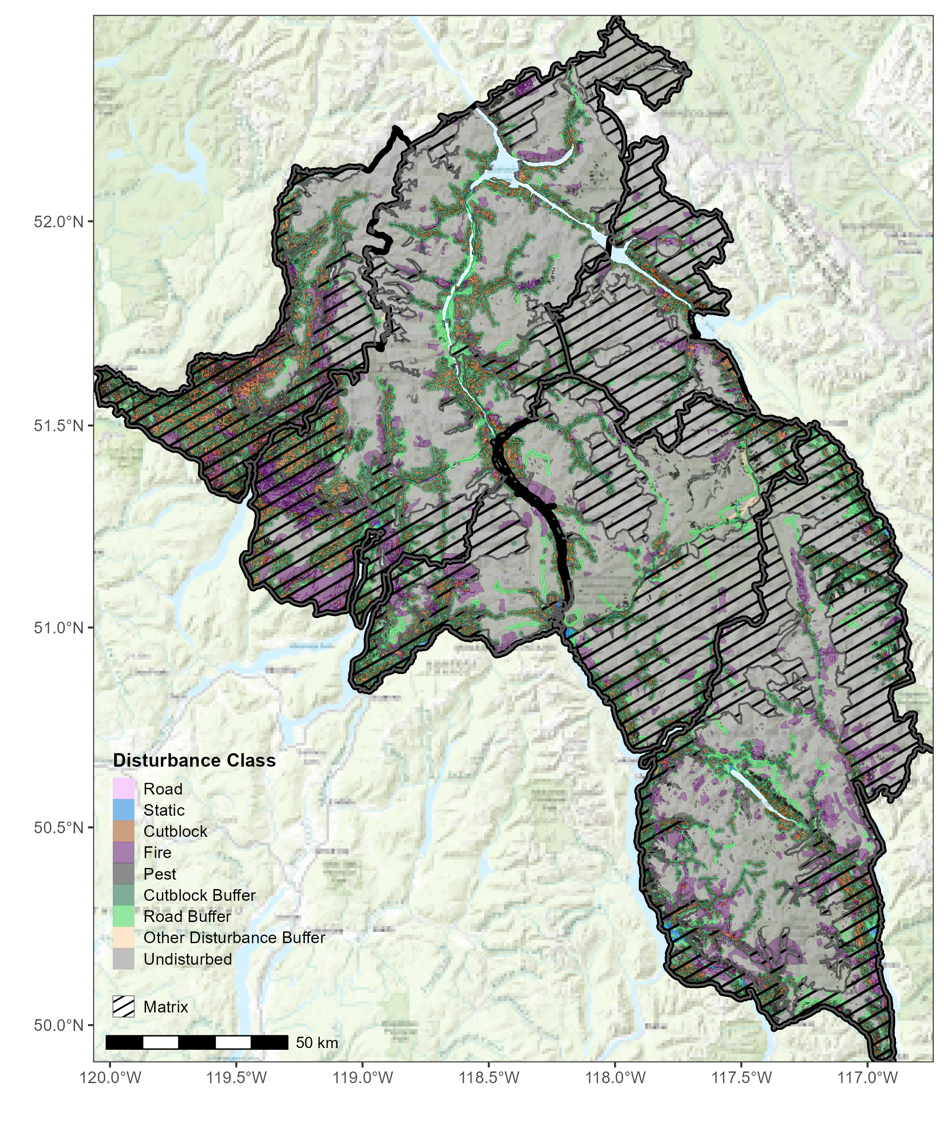
Current Disturbances
Road: All roads
Static: Permanent disturbance
Cutblock: logged area
Fire: burned area
Pest: e.g., pine beetle
Cutblock Buffer: 500m
Road Buffer: 25 meters
Other Disturbance Buffer: 500 meters
Undisturbed: not affected by any of the above disturbances

Slide 11
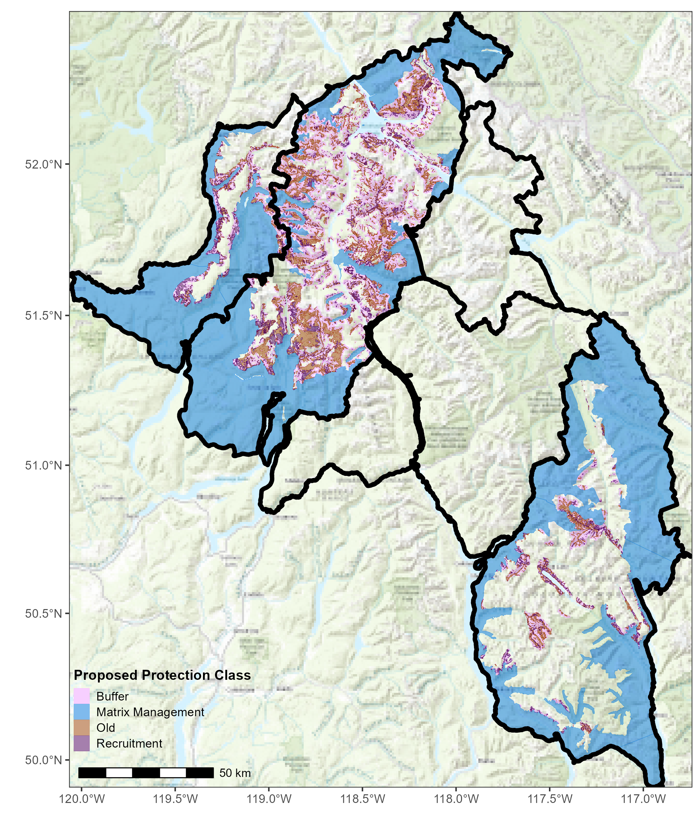
Proposed Protection Class
Buffer: 500 meters from old and recruitment forest stands
Matrix Management: 17% cap (of early seral)
Older Forest: Old growth forest, greater than 100 years old
Recruitment: A forest 80 years old or greater

Slide 12
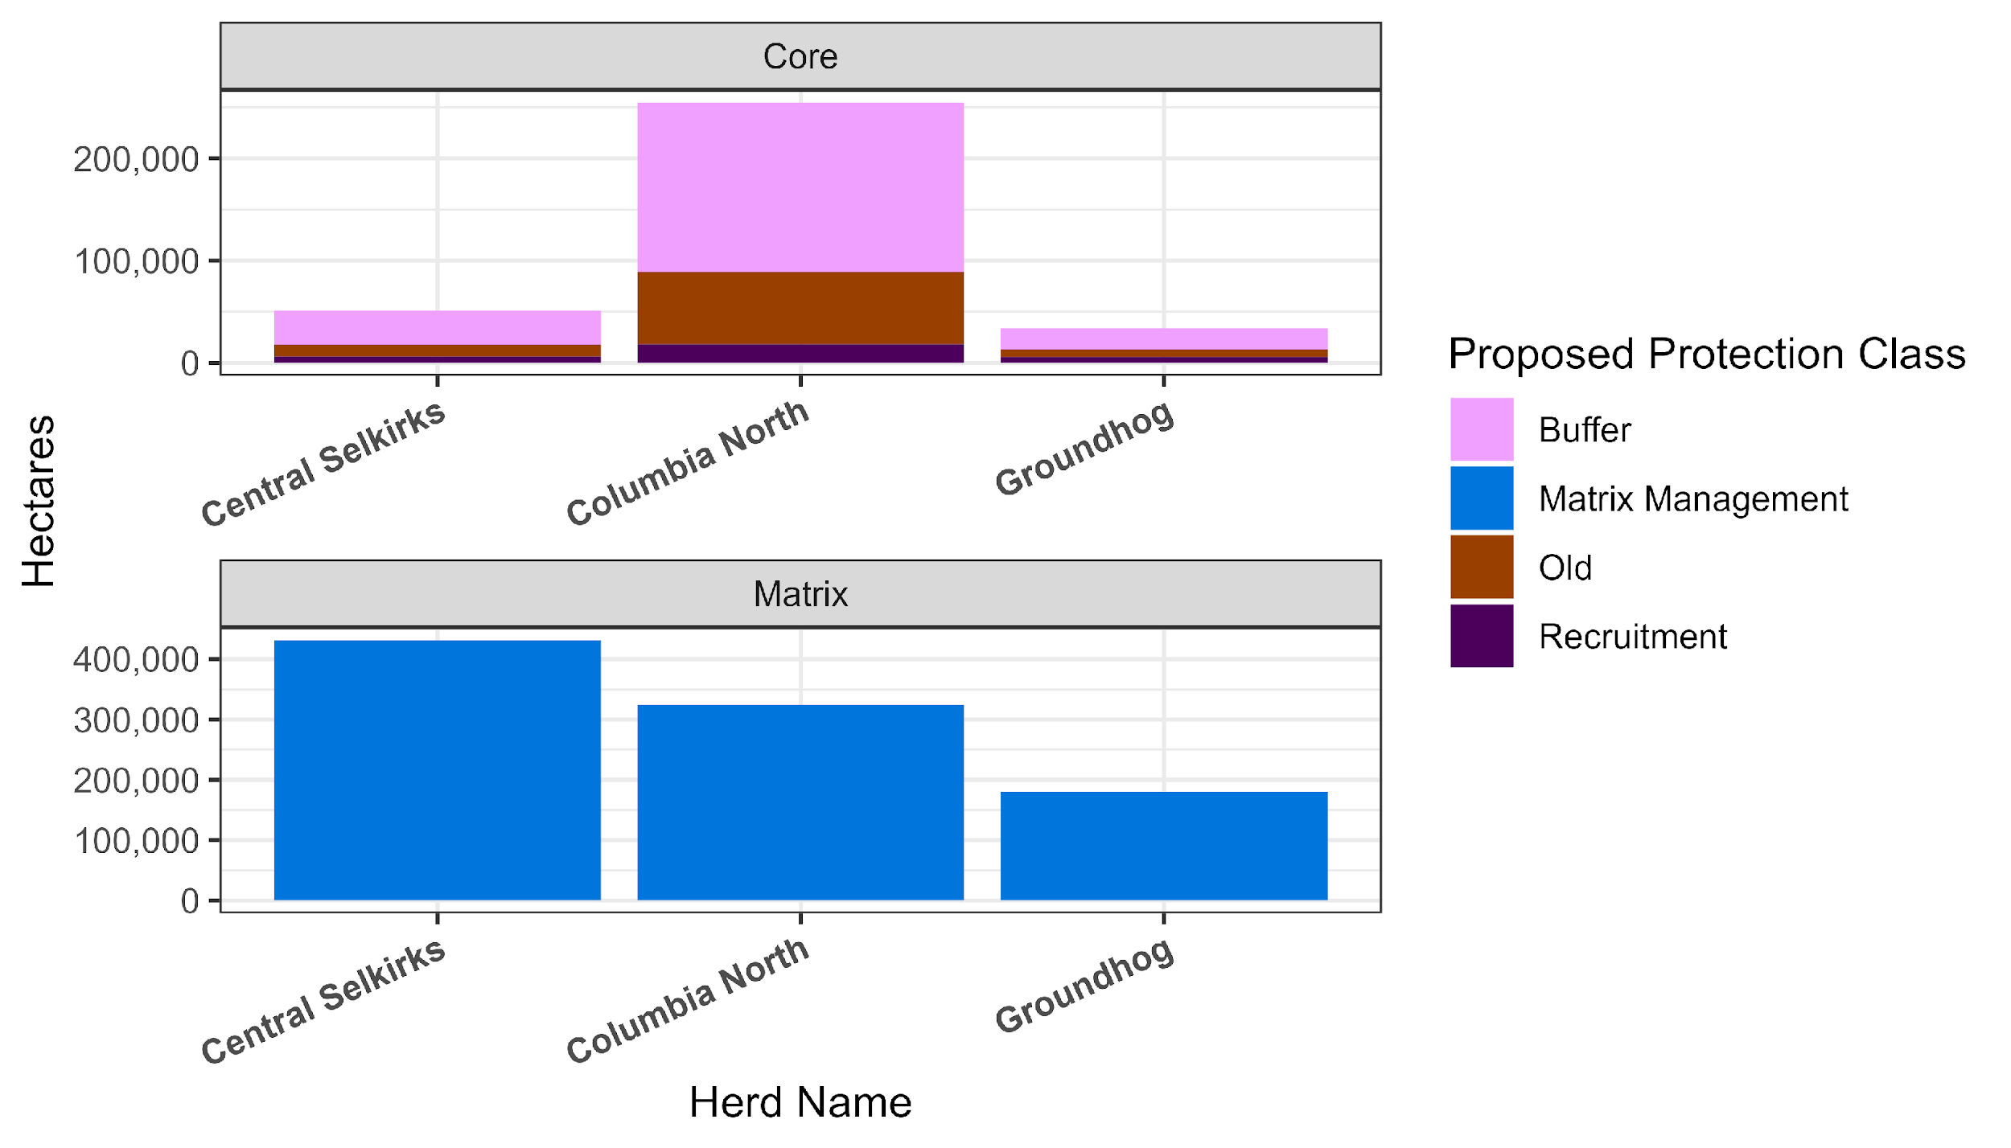
Proposed Protection Class – Core vs. Matrix
Notes:
Buffer bigger in CN because there is more habitat to bump into. If a buffer extends into a full habitat protection – it is not included.

Slide 13
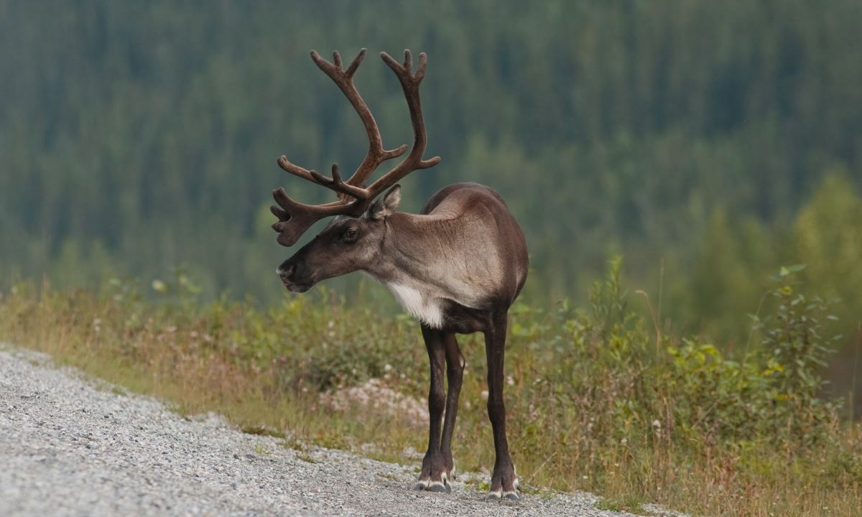
Options

Slide 14
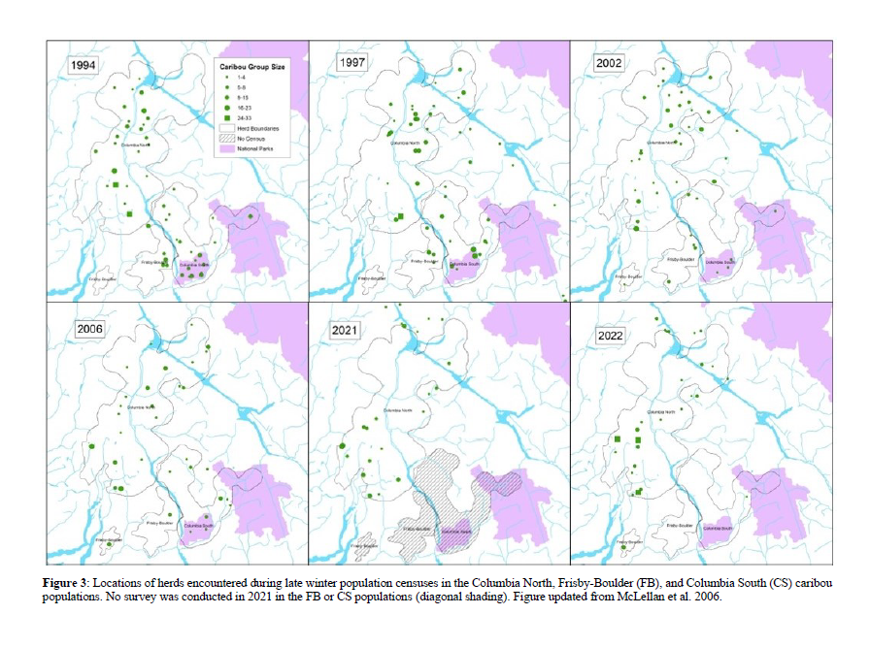
Caribou Locations (Columbia North, Columbia South, Firsby Boulder Queest)

Slide 15
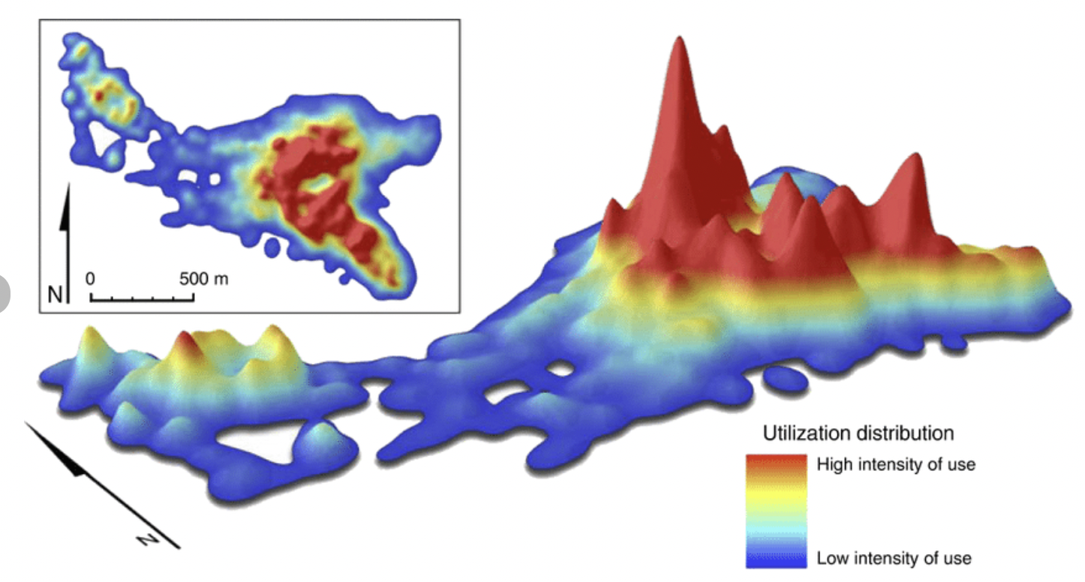
Kernel Density
Kernel Density: a tool used to define what areas animals spend the most amount of time in
Willems and Hill 2009

Slide 16
How options are defined
*Options are IN ADDITION to existing protections
Exclude disturbed habitat (<80 years old)
Include older forest (>100 years) & recruitment forest (>80-100 years old)
Exclude steep slopes (>70%)
Buffer 500 meters from what the old & recruitment
Assign priority classes (3 options) – either Kernel density or subject matter experts
  50, 75, 90 (high, medium, low)
Notes:
“undisturbed habitat” does not have anything listed as a disturbance – refer to Table 2.
70% - maximum slope for attainable THLB.
First four steps are the structure condition of the habitat
Steps 1-5 are just caribou habitat values
(6) Points – Nations can chime in on how these options are defined - partners may want to include different criteria at different steps — can add to it. *Intended to be a process.
old + recruitment forest stand with slopes greater than 70% were excluded as priority areas due to these areas being steeper than current operational feasibility for forestry
*flow chart or visual (entire habitat already protected, throw out protected, throw out what is already disturbed, throw out anything >70% — grab the old stuff of what is left – buffer out – separated by A, B, C — functionally grab 80 years and older (that is our starting point), not on super steep slopes.
Throwing out disturbed – we don’t want to waste protection capital on already disturbed landscapes – that 20 yo cutblock – we know that is a barrier we will run into.
500m buffer will include cutblocks + pests + if there is buffer inbetween them – still of value. We want to protect those inbetween areas. ”Armour Up.” Value of habitat patches diminishes if they are isolated – science based, include citation.

Slide 17
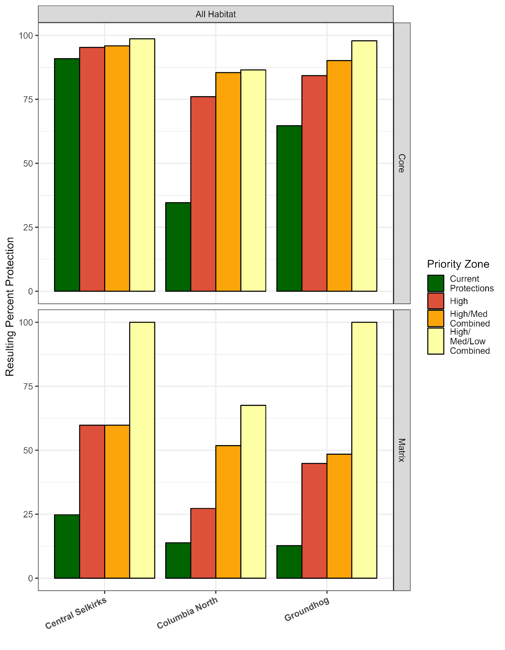
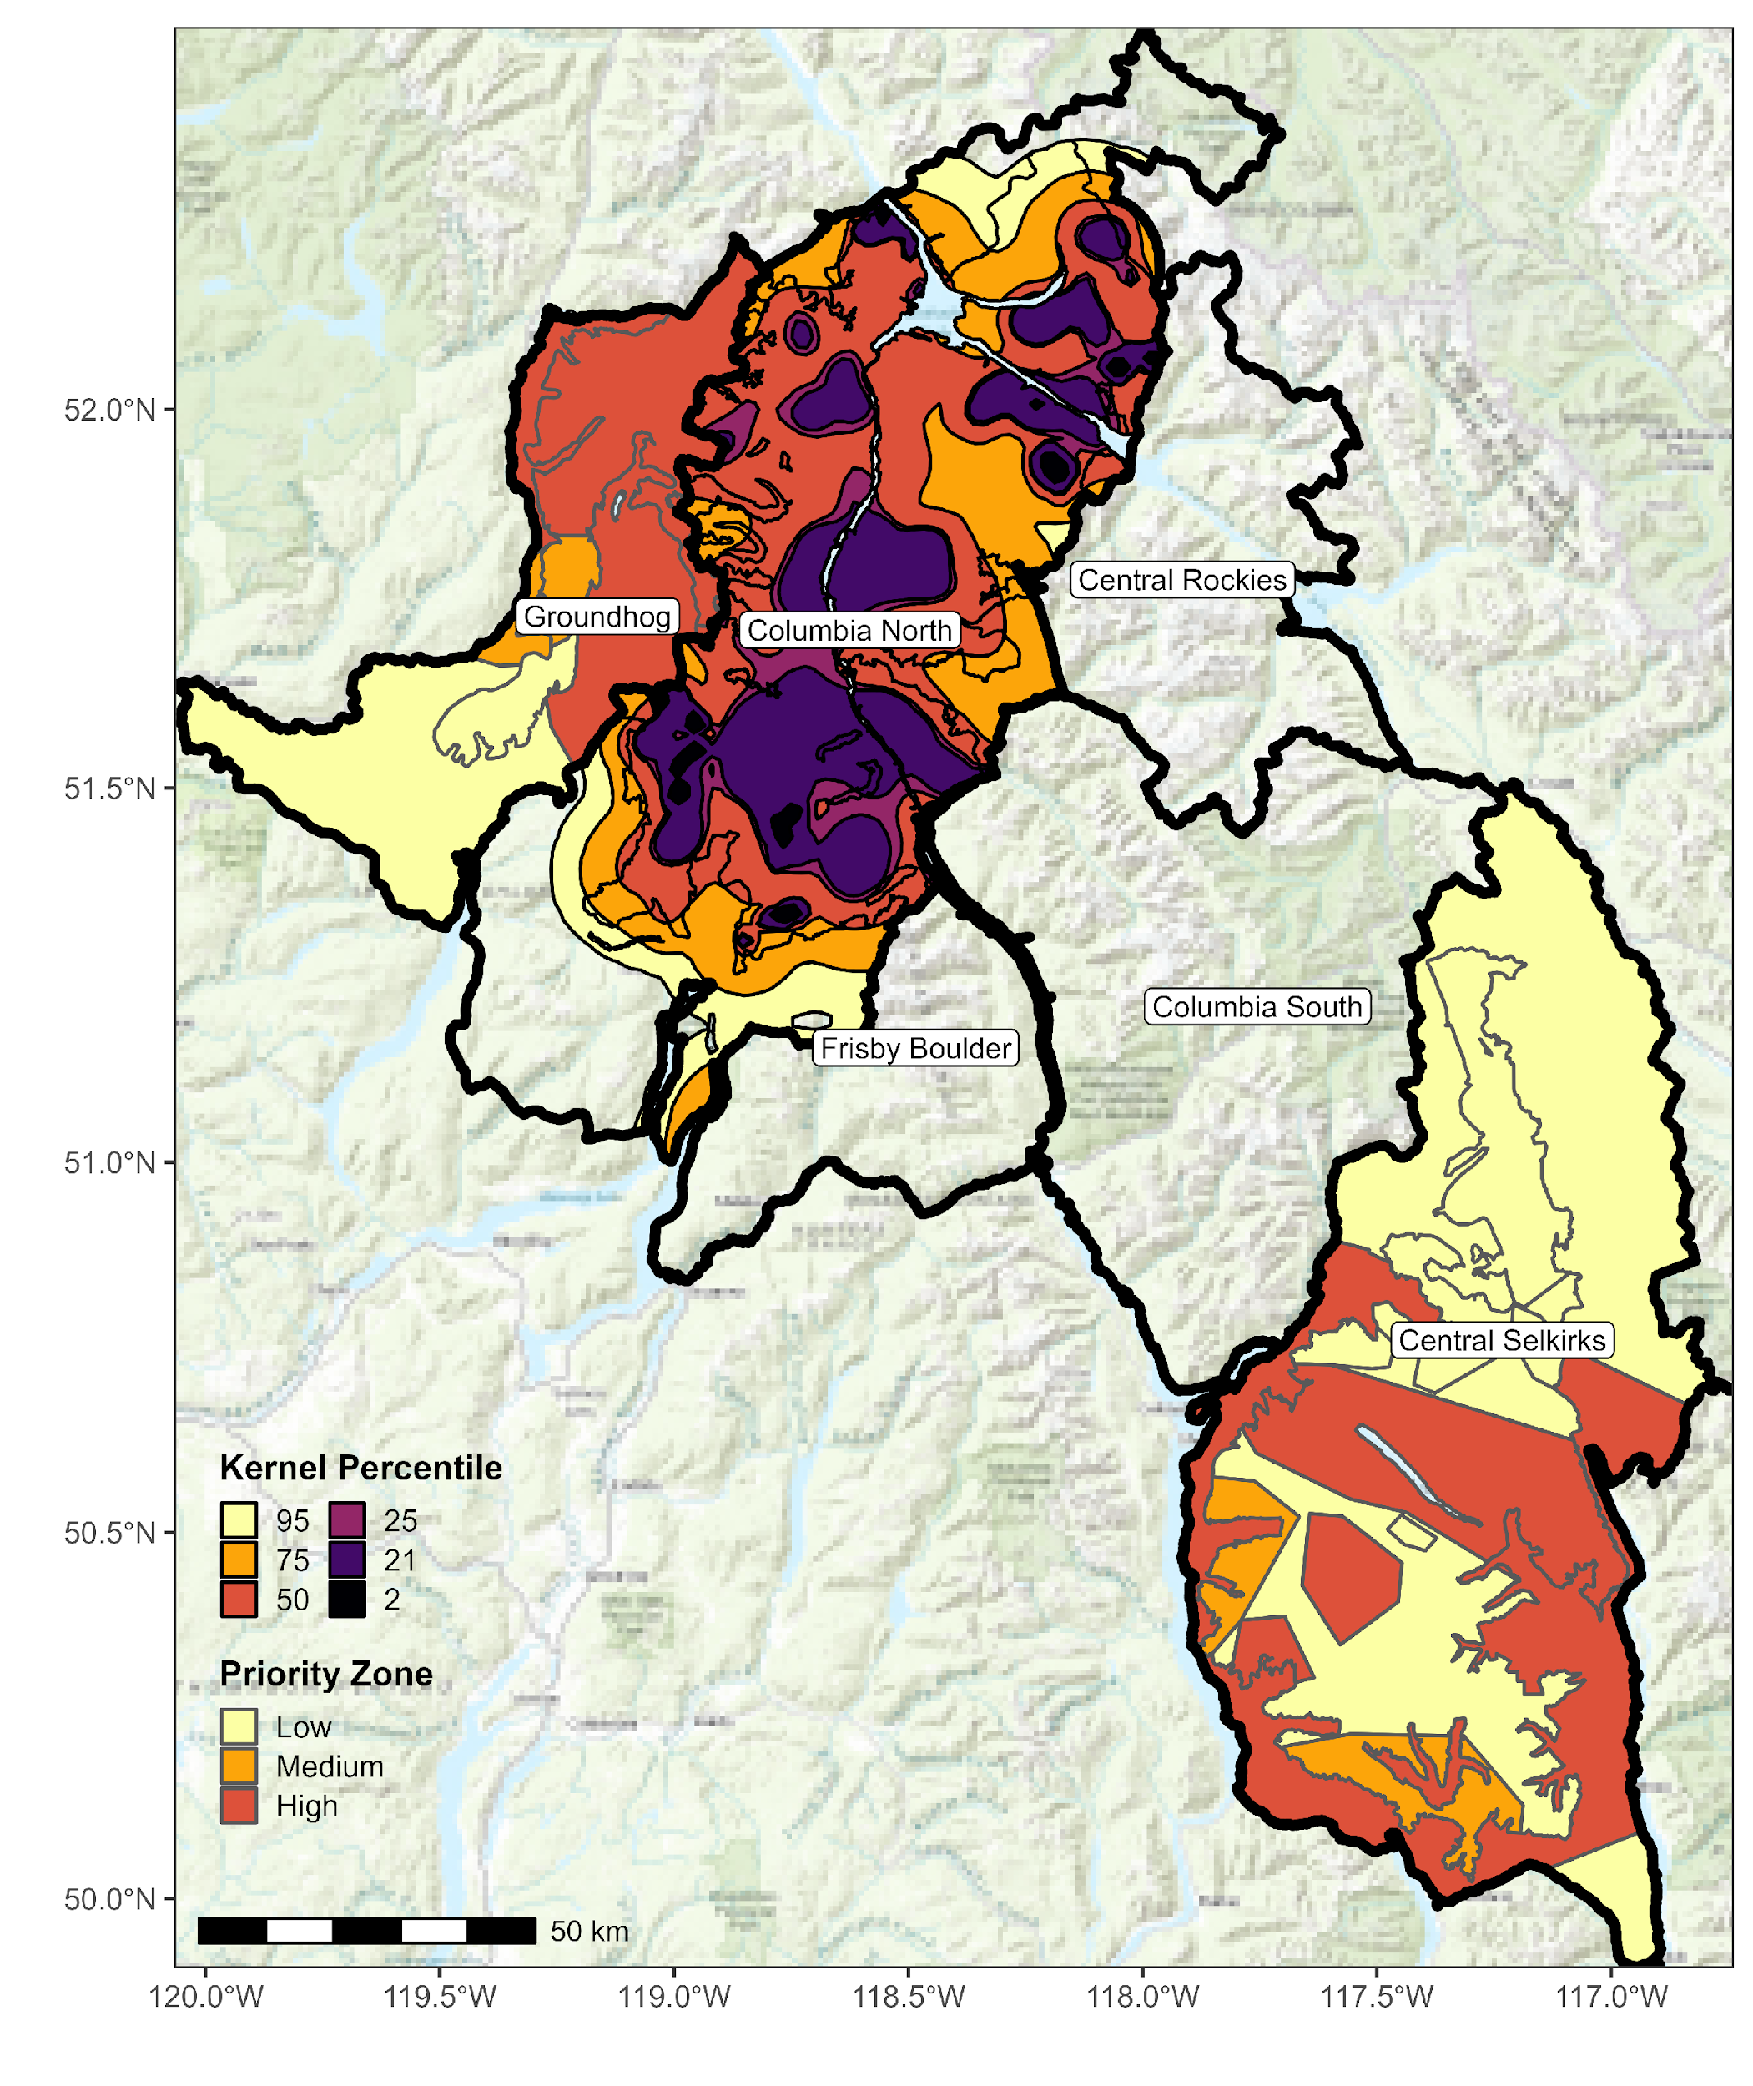
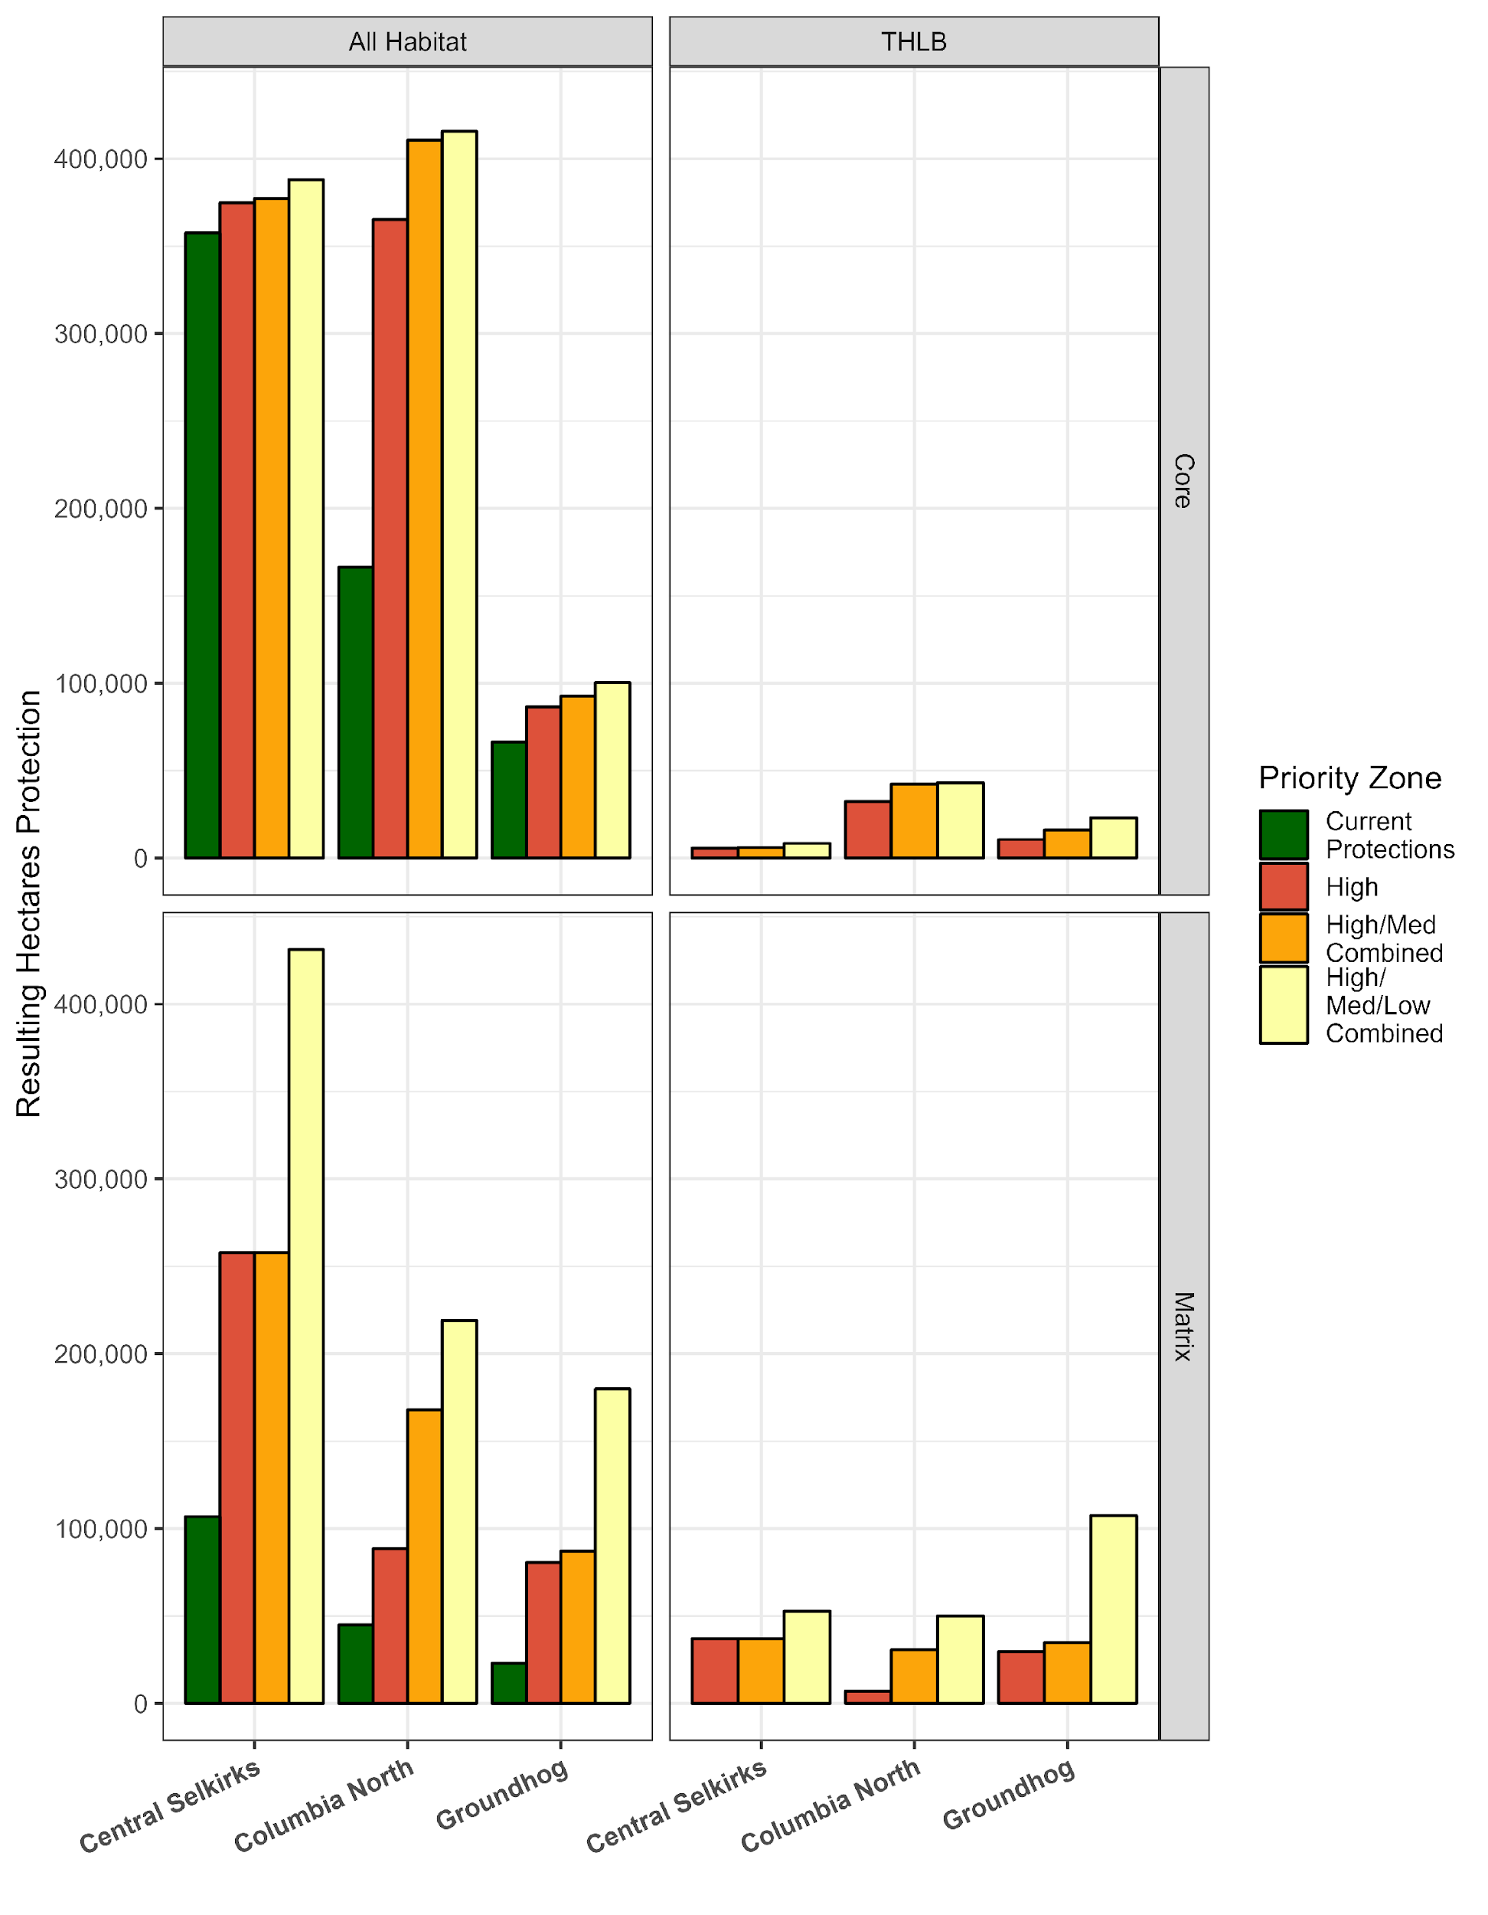
How options are defined – flow chart
Options are IN ADDITION to existing protections
Identify Core and Matrix Habitat
Exclude Existing Disturbances
Include Areas with Stand Age > 80 years
Exclude Areas > 70% slope
Assign Priority (SME or Kernel)
Calculate Resulting Protection and THLB Impact

Slide 18
Options Summary
Kernel Percentiles
Tier 1: *Best for caribou – 95%
Tier 2: 75%
Tier 3: 50%
Priority Zone
Tier 1: *Best for caribou – low, medium, and high
Tier 2: medium and high
Tier 3: high

Slide 19
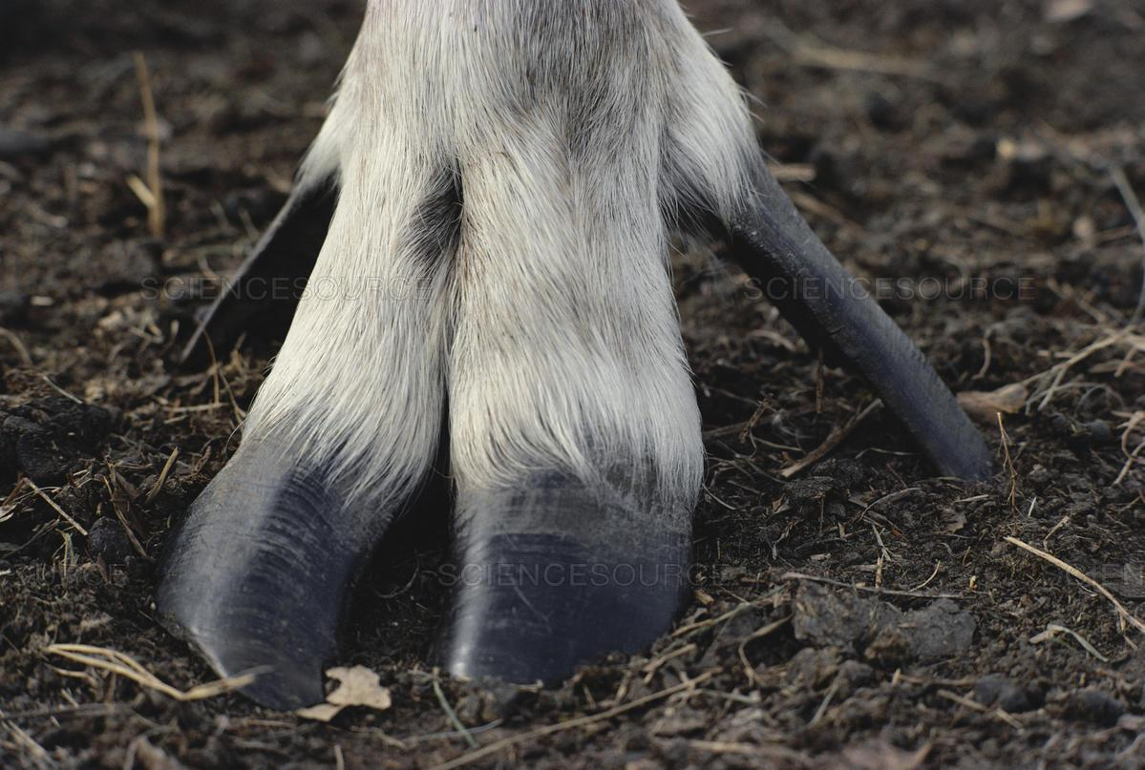
Why not Columbia South, Frisby Boulder, Central Rockies?
Prioritize habitat protection in areas where caribou currently are
Maximize conservation capital

Slide 20

How can these options be improved?

Slide 21

Questions/Discussion

Slide 22
References
BC Forest Analysis and Inventory Branch. 2021. “VRI - 2021 - Forest Vegetation Composite Polygons - Datasets - Data Catalogue.” https://catalogue.data.gov.bc.ca/dataset/vri-2021-forest-vegetation-composite-polygons.
Bergerud, A. T., and J. P. Elliott. 1998. “Wolf Predation in a Multiple-Ungulate System in Northern British Columbia.” Canadian Journal of Zoology 76 (8): 15511569.
Dickie, Melanie, Robert Serrouya, R. Scott McNay, and Stan Boutin. 2017. “Faster and Farther: Wolf Movement on Linear Features and Implications for Hunting Behaviour.” Journal of Applied Ecology 54 (1): 253–63. https://doi.org/10.1111/1365-2664.12732.
Dyer, S. J., J. P. O’Neill, S. M. Wasel, and S. Boutin. 2002. “Quantifying Barrier Effects of Roads and Seismic Lines on Movements of Female Woodland Caribou in Northeastern Alberta.” Canadian Journal of Zoology-Revue Canadienne De Zoologie 80 (May): 839–45. https://doi.org/10.1139/z02-060.
Dyer, Simon J., Jack P. O’Neill, Shawn M. Wasel, and Stan Boutin. 2001. “Avoidance of Industrial Development by Woodland Caribou.” The Journal of Wildlife Management, 531542.
Environment Canada. 2014. “Species at Risk Public Registry - Recovery Strategy for the Woodland Caribou, Southern Mountain population (Rangifer tarandus caribou) in Canada - 2014.” https://www.sararegistry.gc.ca/default.asp?lang=En&n=26702D59-1.
Johnson, Chris J, Katherine L Parker, Douglas C Heard, and Michael P Gillingham. 2002. “A Multiscale Behavioral Approach to Understanding the Movements of Woodland Caribou.” Gillingham Source: Ecological Applications Ecological Applications 12 (126): 18401860. http://www.jstor.org/stable/3099941 http://www.jstor.org/stable/3099941?seq=1&cid=pdf-reference#references_tab_contents http://about.jstor.org/terms.
Seip, Dale R. 1991. “Predation and Caribou Populations.” Rangifer, October, 46–52. https://doi.org/10.7557/2.11.4.993.
Teucher, Andy. 2018. “Land Designations That Contribute to Conservation in BC - Spatial Data - Spatial Data (Geopackage): Land Designations That Contribute to Conservation - Data Catalogue.” https://catalogue.data.gov.bc.ca/dataset/land-designations-that-contribute-to-conservation-in-bc-spatial-data/resource/5f2382cc-58c5-4063-84cd-a5938ca28def.
Weckworth, Byron V., Mark Hebblewhite, Stefano Mariani, and Marco Musiani. 2018. “Lines on a Map: Conservation Units, Meta-Population Dynamics, and Recovery of Woodland Caribou in Canada.” Ecosphere 9 (7): e02323.
Willems EP, Hill RA. Predator‐specific landscapes of fear and resource distribution: effects on spatial range use. Ecology. 2009 Feb;90(2):546-55.

Slide 23
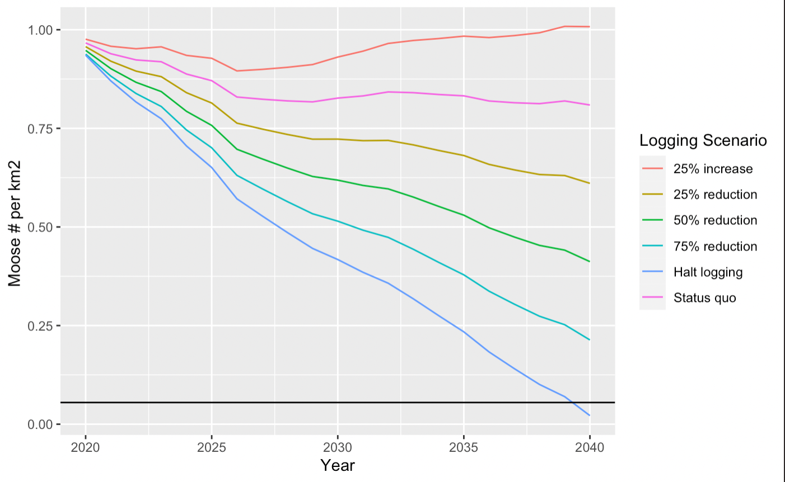

Appendix: Future scenarios of moose density (Columbia North herd boundary)
# of moose per km2
Threshold of moose density adequate for caribou recovery
610 hectares logged per year
Notes:
Explain things on the graph
LEGEND
Make Bigger
# of Moose per squm
Projected Moose carrying capacity (measured as # of moose per km2). Scenario 1: 0 hectares cut annually. Scenario 2: average forest harvesting, defined as the mean annual area cut between 2010-2019 (631 hectares annually). Scenario 3: 25% reduction of average forest harvesting. Scenario 4: 50% reduction of average forest harvesting. Scenario 5: 75% reduction of average forest harvesting. Scenario 6: 25% increase of average forest harvesting. This is for the Columbia North caribou population, in the Revelstoke Valley (Management Units 438,439)
Black line is the threshold of moose density (and therefore wolves) where caribou growth has been observed across multiple systems.

Slide 24
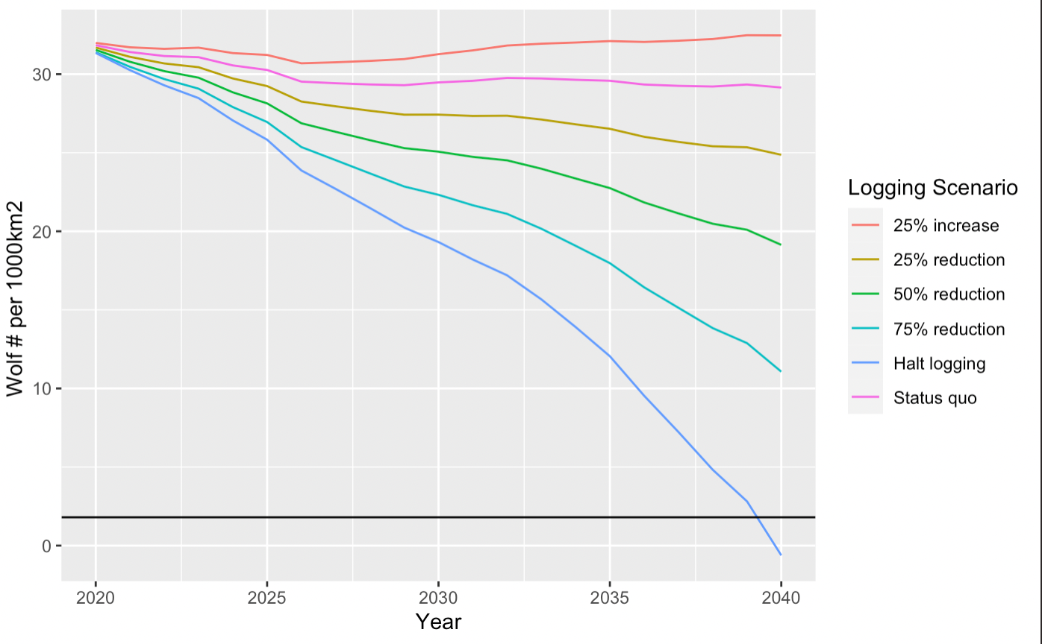
Future scenarios of wolf density (Columbia North herd boundary)
610 hectares logged per year
Threshold of wolf density adequate for caribou recovery
Predicted year (2038) where wolf removals will no longer be needed due to an aging forest (and a “halt logging” scenario)
Notes:
Wolf population following the Messier wolf-moose conversion equation projected from 2020-2040 based on habitat based (K=carrying capacity) moose population simulation where no moose reduction or stabilization harvest regime was enacted.

