Slide 1
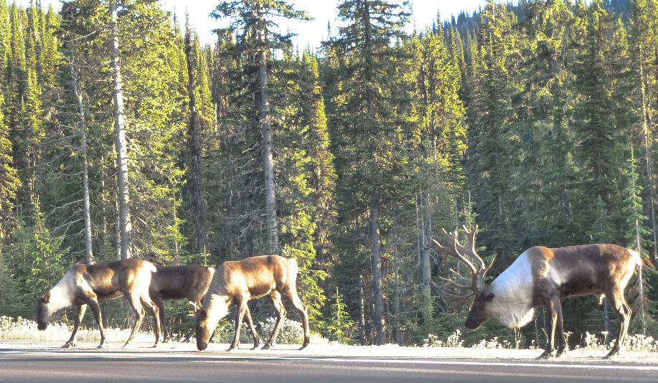
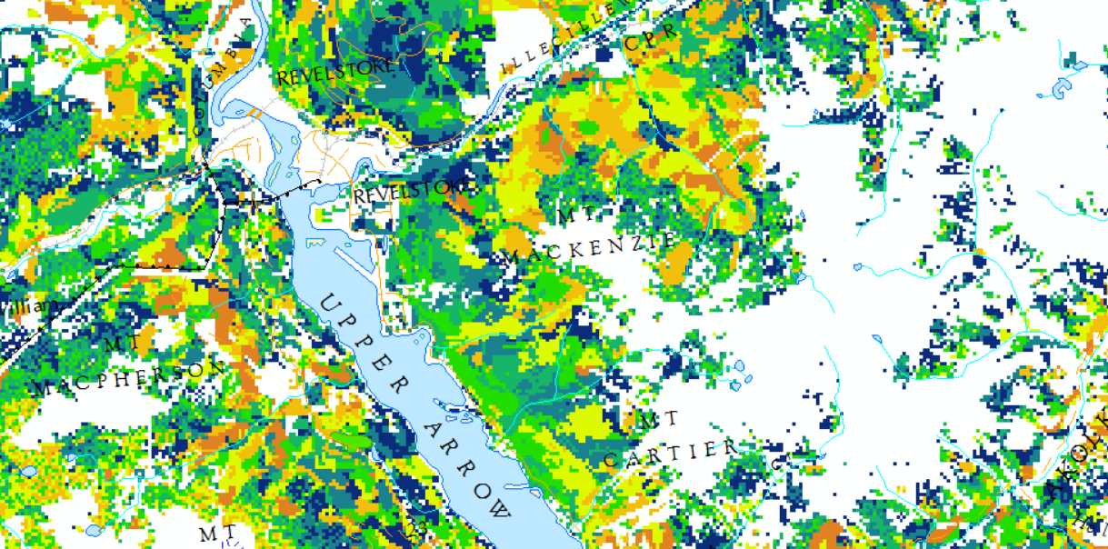
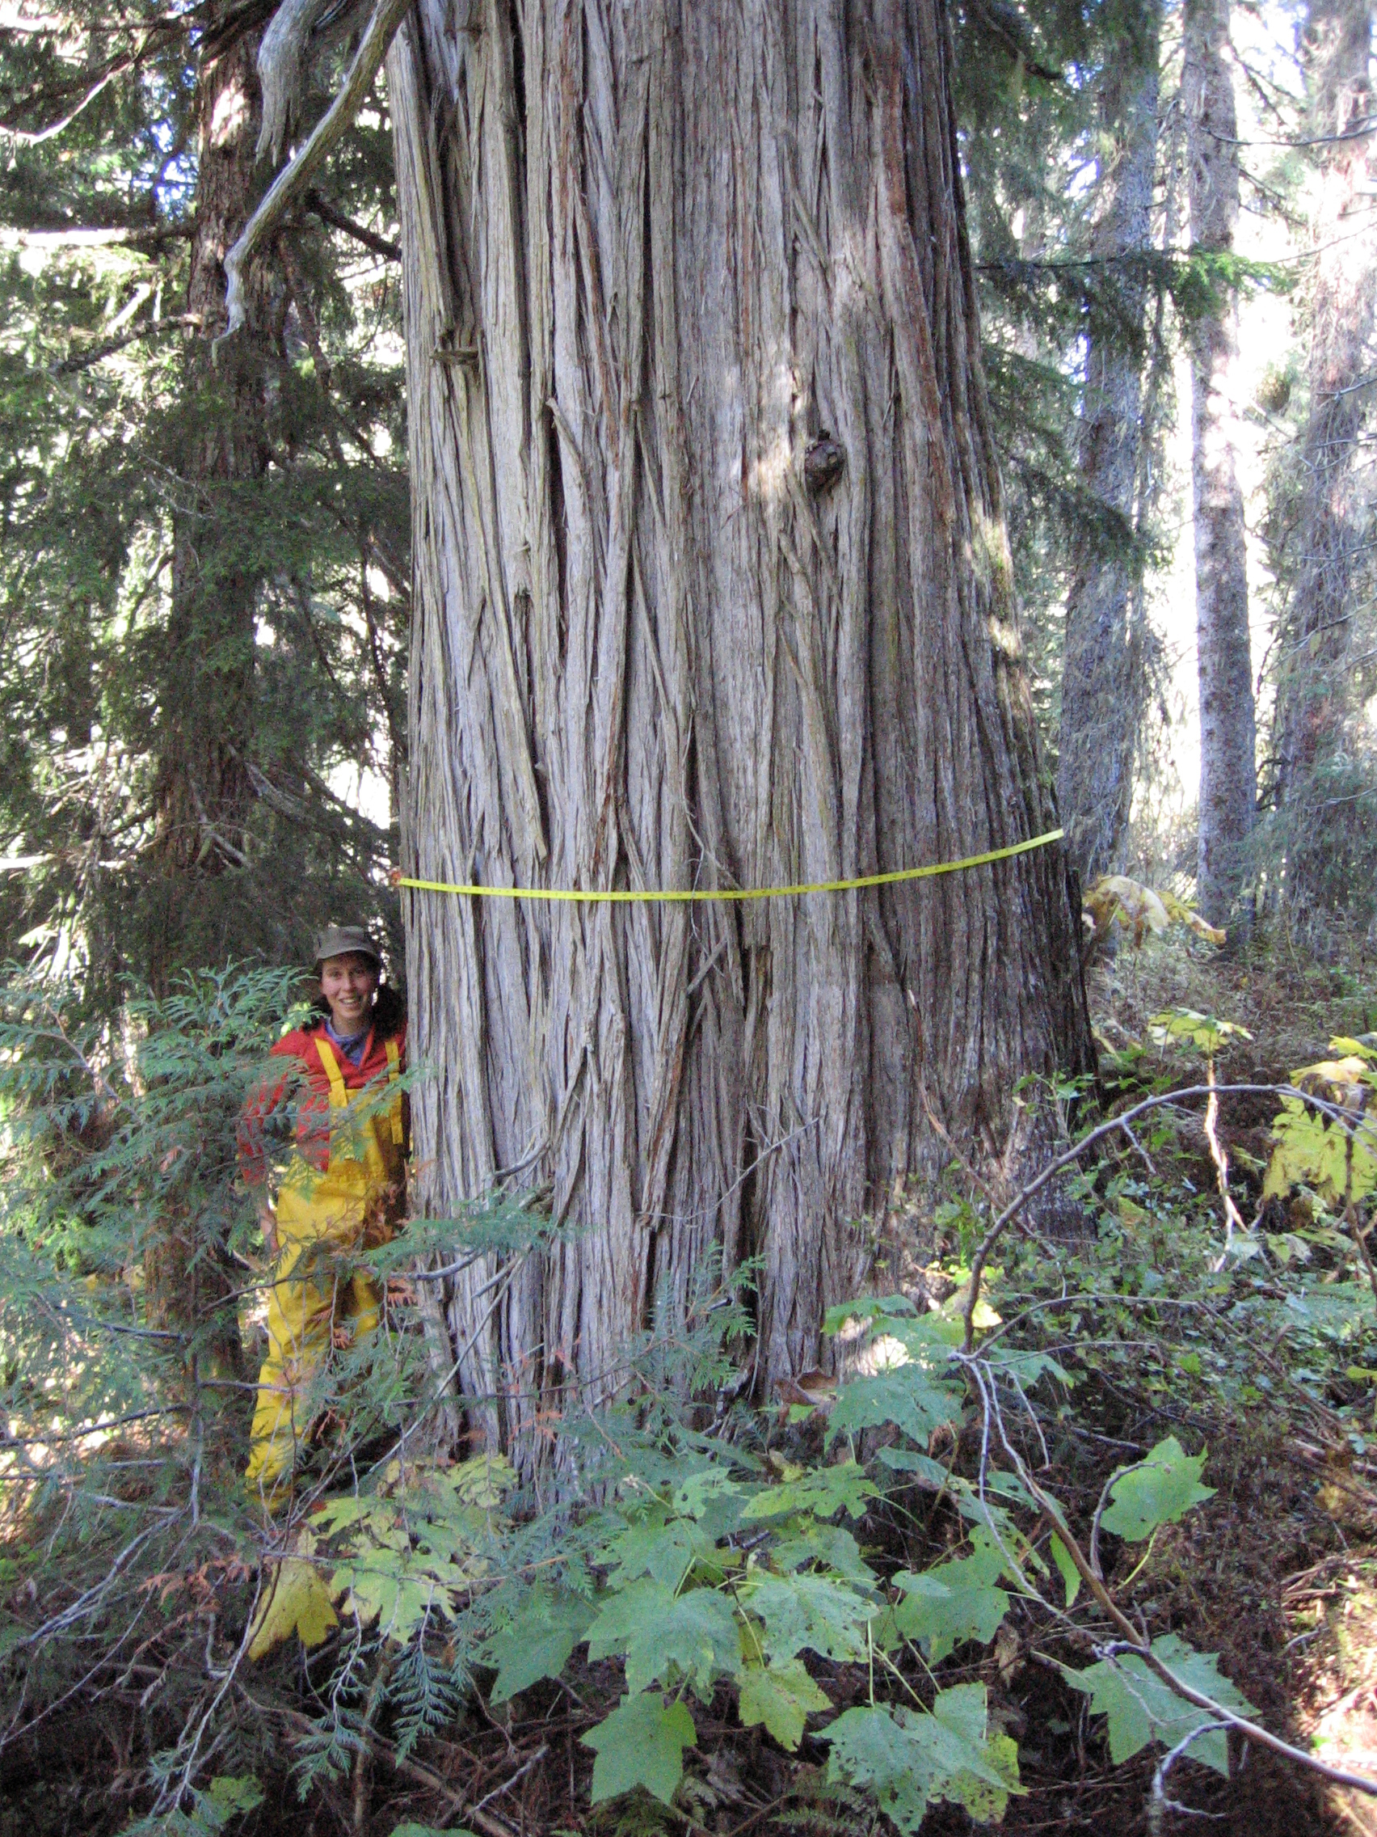
Carbon in Caribou Habitat and Old Growth
Revy Complex and Central Selkirk Herds: an assessment of offset potential
Deb MacKillop
Research Ecologist, FOR
April 3, 2023

Slide 2
Can we help to address the climate and biodiversity crises through caribou recovery and old growth conservation?
Ongoing:
Canada has international commitments to carbon management
Federal Caribou Recovery Expectations (Section 80)
November 2022:
COP 15 Biodiversity Convention (2022)
  Canada Nature Agreement
    25% by 2025; 30% by 2030
  WLRS Mandate Letter
February 2023:
Carbon offset sales
  BC announced development of mechanisms for Nations, Community Forests, and Woodlots to sell carbon
Philanthropic conservation funding
  BC is developing new mechanisms
  Rich people/foundations
April 2022
$131mil provincial forestry revenue sharing
How do conservation options compare to timber impacts?
What is the feasibility for carbon offsets to provide economic benefit?
  Establishing “additionality” in decision making
Notes:
There are a number of recent initiatives announced by government that could support different approaches to addressing climate change and biodiversity conservation.

Slide 3
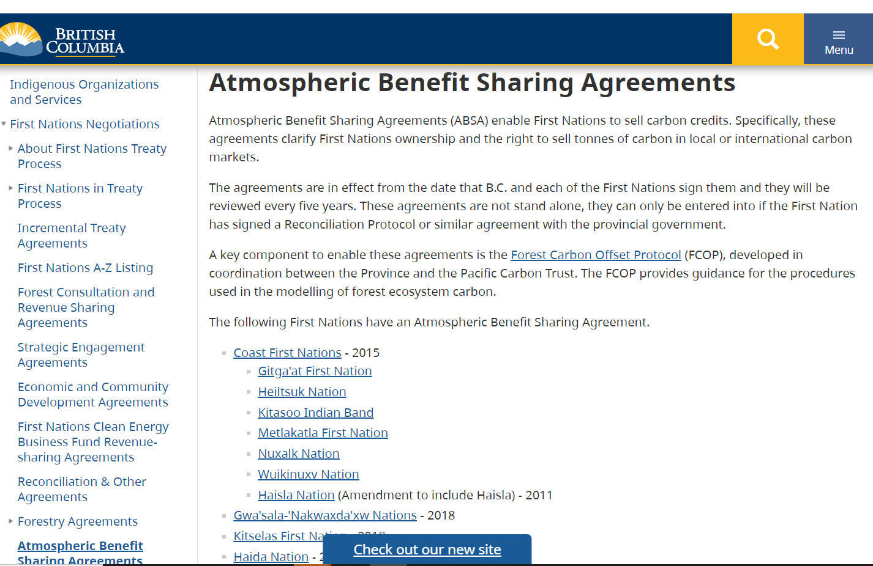
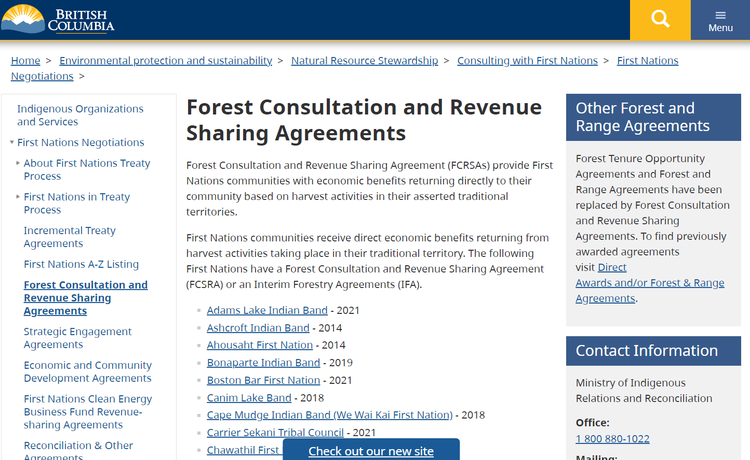
Resource Benefit Sharing Agreements
Atmospheric Benefit Sharing
  Cash for Carbon
    80% of the annually calculated atmospheric benefits produced in the previous calendar year goes to Indigenous Nations
https://www2.gov.bc.ca/gov/content/environment/natural-resource-stewardship/consulting-with-first-nations/first-nations-negotiations/atmospheric-benefit-sharing-agreements
Forestry Revenue Sharing
  Cash for Logging
    8% - 10% of stumpage revenue goes to Indigenous Nations
      This value was doubled in April 2022
https://www2.gov.bc.ca/gov/content/environment/natural-resource-stewardship/consulting-with-first-nations/first-nations-negotiations/forest-consultation-and-revenue-sharing-agreements
Notes:
The BC government currently has two types of resource benefit sharing agreements for Indigenous Nations. Forestry Revenue Sharing agreements have been signed by many Nations in BC and provide funds for each cubic metre (m3) of wood harvested within a Nation’s area. The percentage of stumpage revenue shared with Indigenous Nations increased last year (doubled) to between 8-10%. Atmospheric Benefit Sharing Agreements are less common and have mostly been signed by coastal Nations within the Great Bear Rainforest. In these agreements, Indigenous Nations are able to sell 80% of the carbon that is conserved (either through avoided harvest or increased sequestration) each year. These are similar in nature, although with Atmospheric Benefit Sharing, Indigenous Nations are responsible for marketing and sales of carbon while Forestry Revenue Sharing is a more passive income.
In general, total income could be similar across both resource benefit sharing approaches: there is less total dollar value for carbon than stumpage, but a much higher proportion of carbon $ goes to Indigenous Nations, so total dollar value to Nations could be similar.

Slide 4
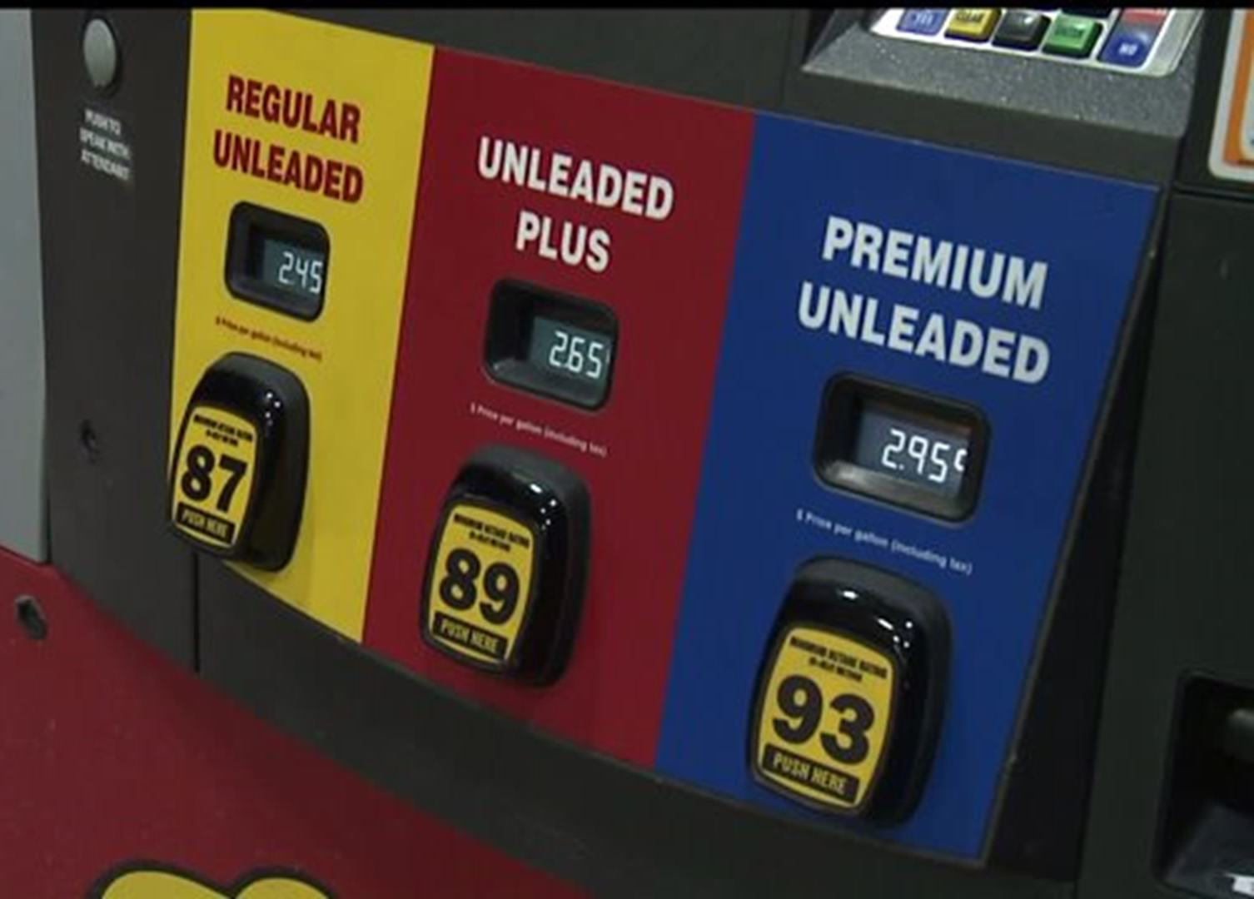
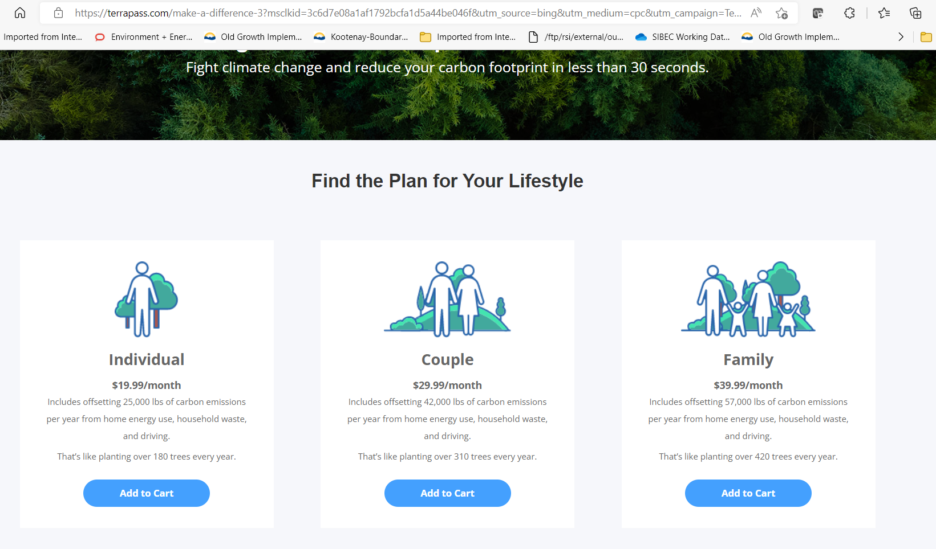
How Carbon Offset Credits Work
Carbon offset credits are a way to balance carbon emissions with carbon storage/sequestration during the transition to a low-carbon economy
When an activity has a positive effect on reducing carbon dioxide emissions that is in addition to regulated requirements, it can be a carbon credit
Carbon emitters can purchase credits to offset, or balance, their own carbon emissions (net-zero or net-positive)
Carbon trading is considered an interim/transitional approach to reduce carbon emissions. As the cost of emitting carbon (e.g., carbon tax) rises, carbon emissions are expected to drop.
In the interim, while governments, companies, and individuals are transitioning to activities with lower carbon emissions, offsets can balance ongoing carbon emissions.
There are two broad types of carbon markets.
Compliance markets: are regulated by regional, national or international regimes of emission reductions.
  greenhouse gas emitters are required by government regulations to reduce their emissions; carbon credits can offset any carbon emissions in excess of the allowable threshold.
  Compliance markets lead to emission reductions by gradually reducing the available emission allowances over time.
Voluntary markets: exist outside of government-mandated compliance programs.
  businesses, governments and nongovernmental organizations to voluntarily purchase carbon credits.
  Pricing has traditionally been lower in voluntary markets than compliance markets
In 2020, carbon pricing generated $53bn in revenue and $3.4bn in Canada (source: Wikipedia)
In 2015, the BC government purchased 499,537 tonnes of carbon offset for a price of $5,826,480 ($11.66/tonne)

Slide 5
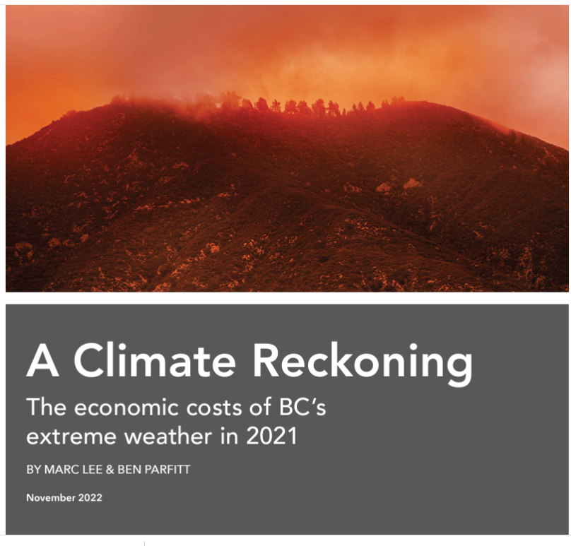
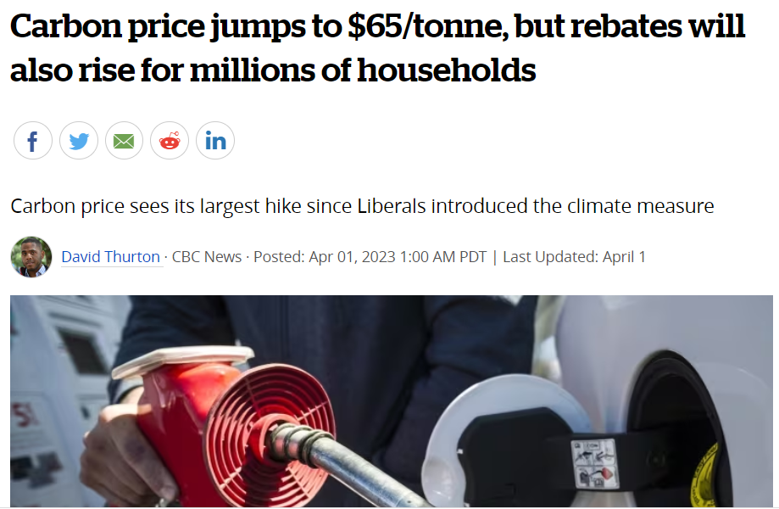
The value and cost of Carbon in a Changing Climate
Two different ways to value Carbon
Carbon Gas Tax “pollution price”
  Social cost of carbon: cost of monetary damage caused by a tonne of CO₂ from landslides, fires, and social impacts of climate change
  $65/tonne as of April 2023
  will increase by $15/year up to $170/tonne in 2030
Carbon offset voluntary market
  Price buyers are willing to pay
  Average $15/tonne
    Ranges from $12-$16.50/t
    BC government average is $12-13/t

Slide 6
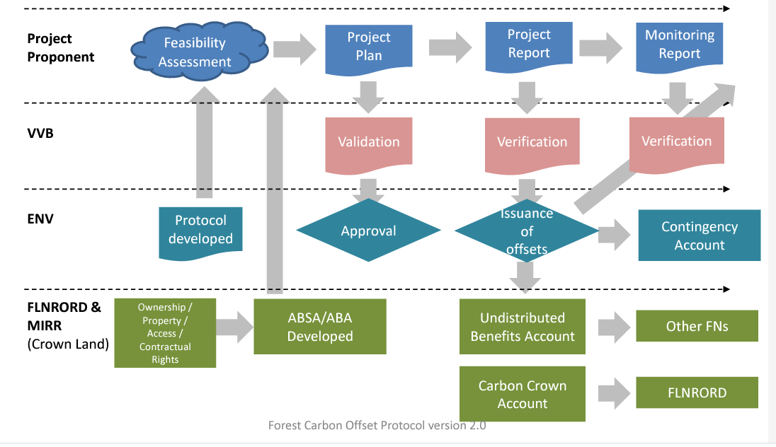
BC’s Forest Carbon Offset Protocol 2.0
3 types of projects
  Afforestation/Reforestation
    Planting trees
  Avoided harvest and Improved Forest Management
    Conservation
    Longer rotation ages
    Faster carbon sequestration
    Partial cutting?
  Avoidance of Conversion
    Urbanization or industrial development
Outdated process flowchart for a Carbon Offset Project (circa 2021)
Establish carbon offsets as an element of land use decisions to show “additionality”.
Business as Usual is the continuation of current assumptions in Timber Supply Review.
Decision to increase conservation could be in part based on opportunities to fund transition using carbon offset credit sales
Notes:
Focus of this analysis is Avoided Harvest; other improved forest management offset projects are not considered at this time.

Slide 7
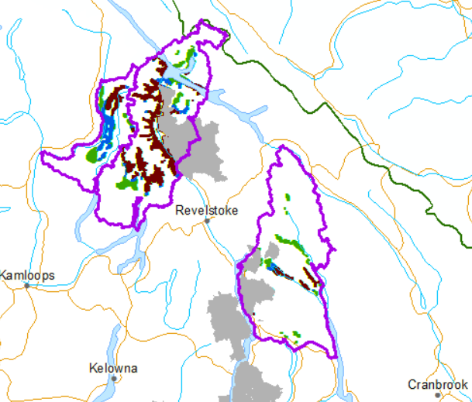
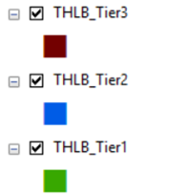
THLB within Caribou Protection Scenarios
THLB all ages
Avoided harvest = Areas that would otherwise get logged
  Based on the next ~ 25 years
  Use Timber Supply Review assumptions
    THLB area and AAC projections
  Calculate harvestable THLB for each Tier/Scenario
    Exclude existing cutblocks
    Harvestable > 60 years old
Tree Farm License areas are shown in grey
Notes:
Process for identifying “avoided harvest”. This is difficult to do in a Timber Supply Model because the caribou herd boundaries cross so many TSAs. However, based on existing timber supply review documents and assumptions, it is clear that most of the remaining old and mature forest (e.g., caribou habitat) in THLB is planned for harvest over the next 20-30 years. Thus, remaining forest > 60 years old (min harvestable age in TSRs) is considered the harvestable THLB and is the area where harvest would be avoided (and carbon sold).

Slide 8
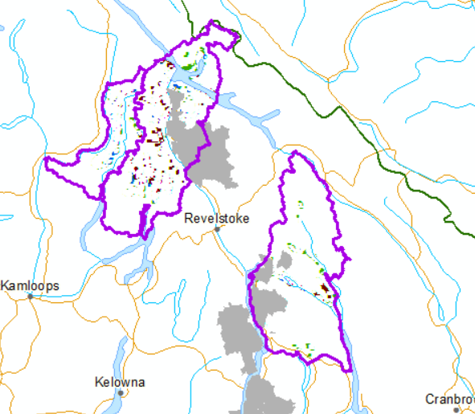
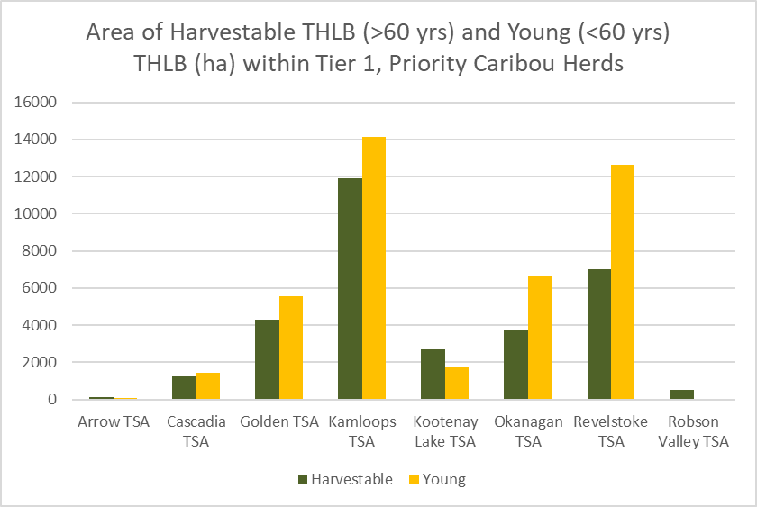
Harvestable THLB within Caribou Protection Scenarios
Avoided harvest = Areas that would otherwise get logged in the next ~ 25 years
    Harvestable (> 60 yrs old) THLB is 43% of total THLB (Tier 1)
      Drops to 38% in Tier 3
    In Revelstoke, 35% of the THLB in Tier 1 is of harvestable age
Harvestable THLB > 60 years old
Notes:
Revy: Harvestable THLB is 35% of tier 2 and 32% of tier 3.
In Columbia North 60% of the THLB in Tier 1 protection scenario is < 60 yrs old (harvested) (65% in Tier 3)
These numbers suggest that dropping from Tier 1 to Tier 3 not only reduces total area, total THLB, but also protects a higher proportion of young forest.

Slide 9
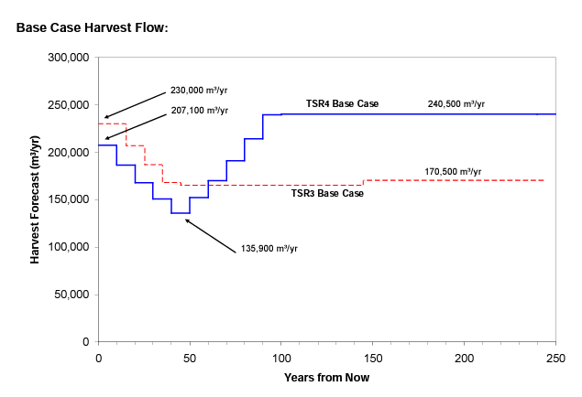
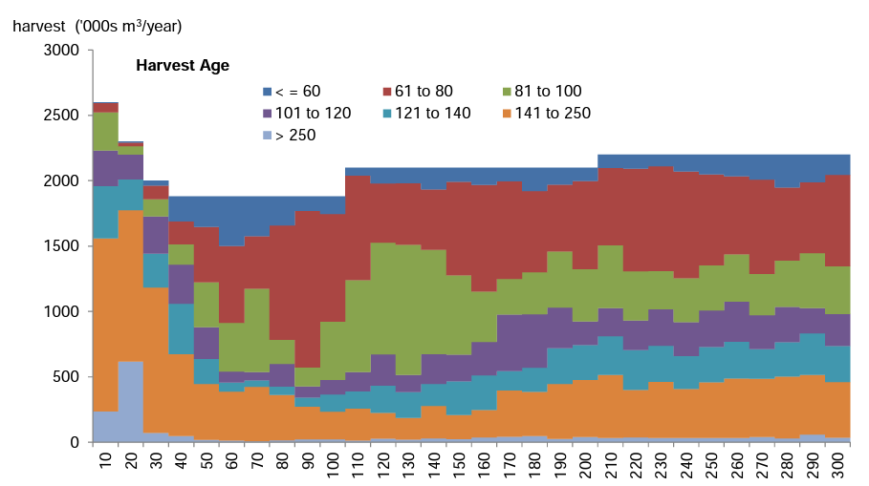
Declining Timber Supply and the “Falldown”:
The basis for identifying “harvestable THLB”
Revelstoke TSA:
Average age of harvested forests is ~110 years old
  Minimum harvestable THLB is > 60 years old
“In the first 3 decades, the harvest of timber is almost exclusively from existing natural stands. In the 5th decade, existing managed stands begin to contribute to the harvest forecast as they become available for harvest.” (TSR 4, 2011 – see figure)
TSR 5 (in progress) Data Package indicates a min 12% reduction in THLB, mostly from removal of non-merchantable timber profiles
  Hemlock (Hw and Hm) and subalpine fir (Bl) forests
  Low volume stands (< 273 m3/ha on gentle slopes (<30%) and < 341 m3/ha on steeper slopes (> 30%)
Kamloops TSA (2015 Discussion paper):
Most old forests (>250) in the THLB will be harvested in the next 20 years and most stands > 140 in the next 30 years (see figure).
Okanagan TSA (2017 data package):
Concentrated harvest in the north of the TSA will be investigated to address a concern about greater harvest in the north of the TSA as identified during discussion with First Nations.
Revelstoke TSR
In 2011, timber supply was anticipated / planned to decline by ~ 40% by 2050. Source: Revelstoke TSR Discussion Paper 2011
Kamloops TSR From the 2015 discussion paper, basecase scenario:
Forests > 250 = light purple/grey
Forests > 140 = orange
Notes:
We will get to the lowered AAC, either through the planned stepdown from TSR or through caribou protection. The difficult dilemmas are around when and by prioritizing/maintaining which values? Timber (as per timber supply graphs) or habitat conservation (with carbon offset opportunities)?

Slide 10
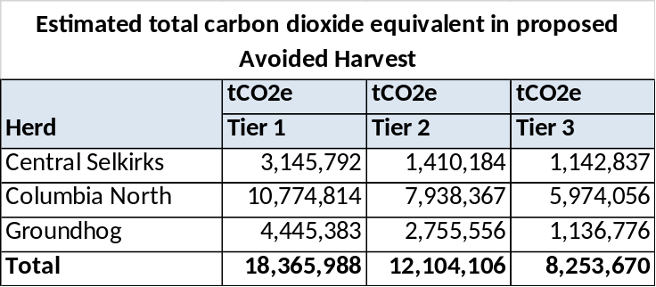
Carbon Calculations
For Harvestable THLB Area in each Scenario:
Aboveground Biomass (VRI) * 0.5 = Carbon
  Did not use other carbon pools
    Dead wood, soil, litter, belowground biomass
Carbon * 44/12 = tCO2e
Reductions for FCOP 2:
Harvested Wood Products (6%)
Market Leakage (58% - average of coastal and interior default values)
Contingency (27% - average of coastal and interior default values)
  Insurance fund
Result is ~ 29% of the tCO2e could be available for sale
Annual Carbon Offset Value is based on 25 years of carbon available for sale
Notes:
Used VRI Biomass and BC’s draft FCOP 2 process. Made assumptions to approximate netdowns for this feasibility level assessment. Of the total carbon dioxide equivalent (tCO2e) in the forest, 29% could be available for sale. The remainder is not either because it is not an avoidance (Harvested wood product storage = 6%) or Market leakage = other forest will be harvested instead in other areas = 58%) or because some is needed as an insurance policy against fire.

Slide 11
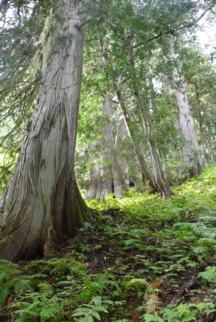
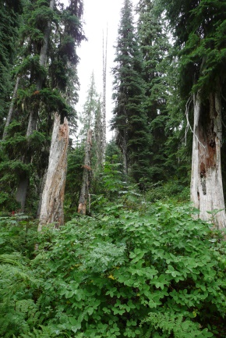
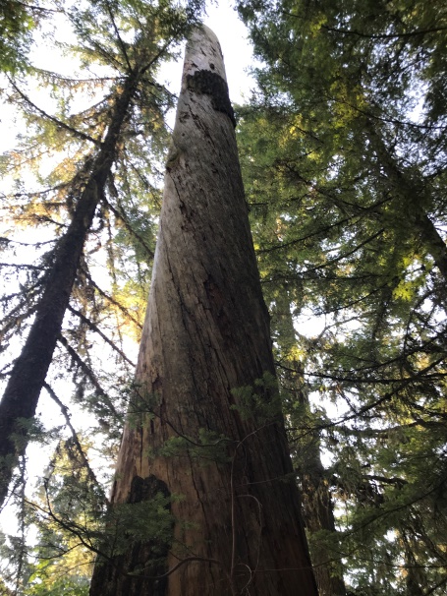
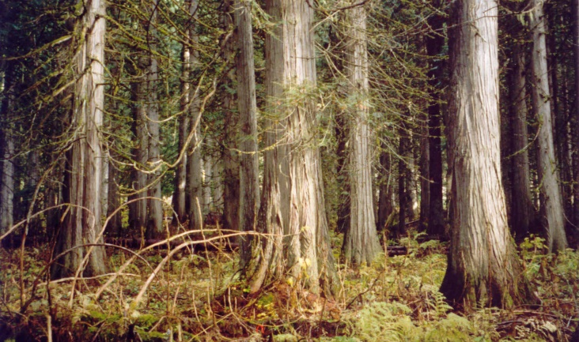
Not included in the analysis…
Additional carbon pools → could provide more carbon offset value
  Dead wood
  Belowground biomass
  Soils
Matrix management
  Short term harvest avoidance
  Improved forest management opportunities (FCOP2)
    E.g., partial cutting
Carbon offset potential for restoration projects
  Degraded lands, ecosystem restoration
New Revelstoke VRI data
  Biomass is from new VRI; age and volume are from previous VRI
Notes:
This is a feasibility assessment, not a final answer. A more robust approach would include other carbon pools, and it could include other restoration opportunities like longer rotations, partial cutting, etc. Excluding these other values ensures that the estimates provided here are on the low side and are not overly optimistic.

Slide 12
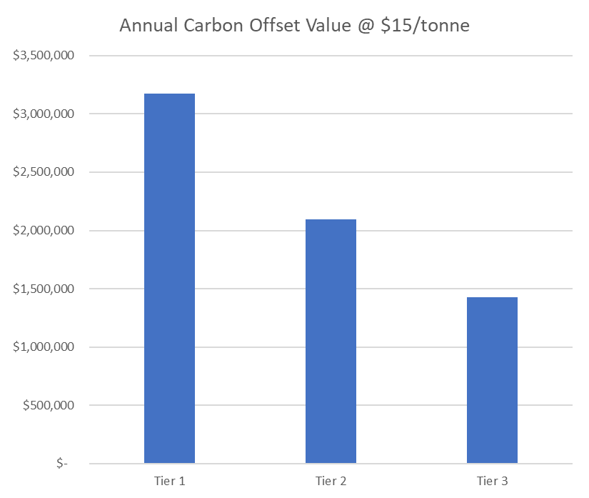
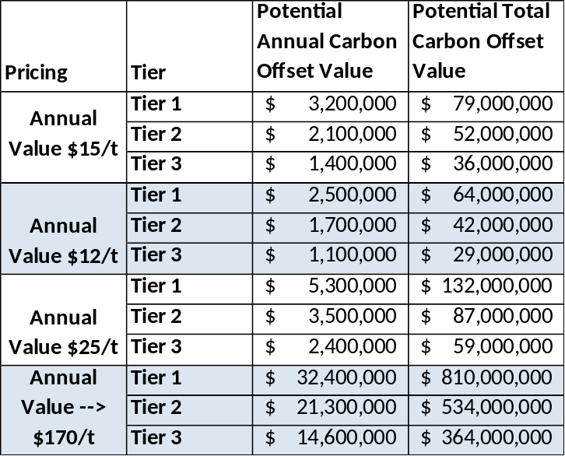
$$ Carbon Offset Potential $$
Based on harvestable THLB Area (> 60 yrs old) in each Scenario
Carbon Offset Value: annually for 25 years
  No inflation; no discount rate
  Assume equal harvest each year
Tier 1 has > 2x as much carbon value as Tier 3
  $1.4mil/yr (Tier 3) to $3.2mil/yr (Tier 1)
    ($15/tCO2e)
Range in total potential carbon offset value over 25 yrs:
  Tier 3 from:
    $29mil ($12/tCO2e) to
    $364mil (increase in price to $170/tCO2e by 2030, then steady)
  Tier 1 from
    $64mil ($12/tCO2e) to
    $810mil (increase in price to $170/tCO2e by 2030, then steady)
CAUTION: These are estimates of the carbon potentially available for sale. Actual revenue depends on finding a buyer and selling offset credits.
Value for → $170/t is based on the average value starting at $65mil/yr, increasing by $15/yr up to $170/t in 2030, then remaining static
Notes:
This shows how much money could be made from carbon offset sales, with different prices for carbon ranging from $12/t (BC price paid in last decade) to $15/t (average value on the voluntary market) to $25/t (anticipated increase in carbon value on the voluntary market), to the “social cost”, which is planned to increase from $65/t in 2023 to $170/t in 2030. The annual value is the average value over 25 years, assuming pricing starts at $65/t and stays steady at $170/t after 2030. Note that at this time, the social cost reflects the value of avoided harvest carbon storage, but it is not anticipated that buyers will pay that price.

Slide 13
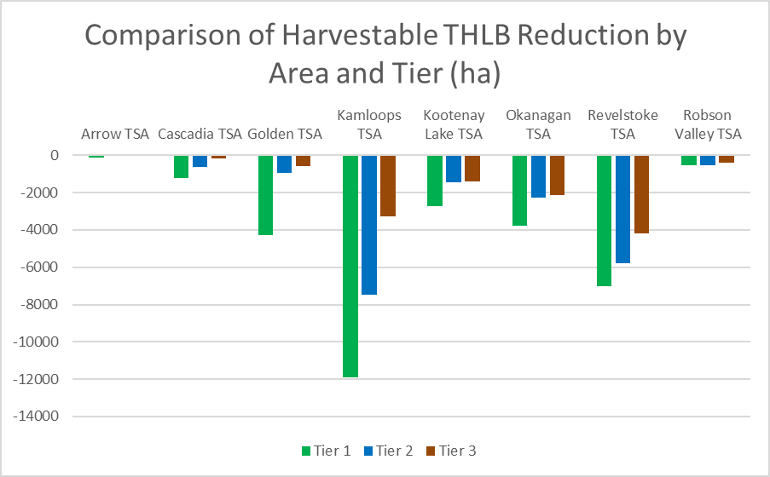
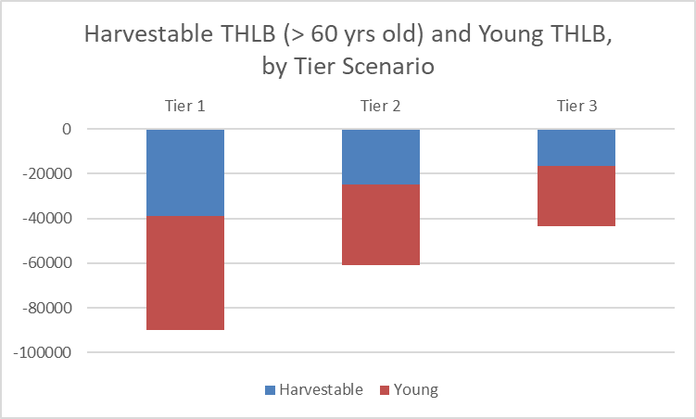
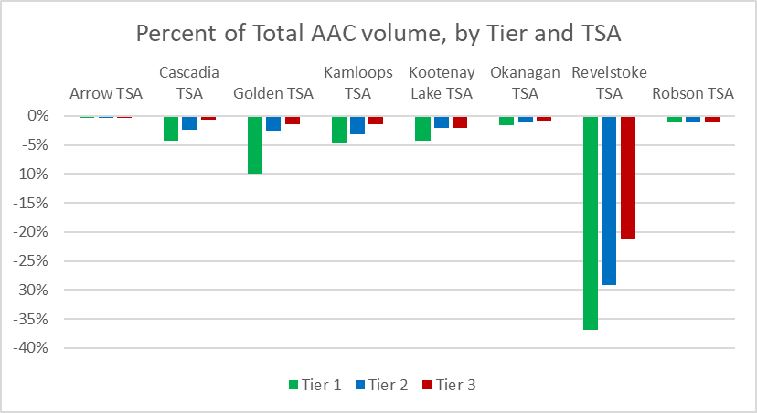
Harvestable THLB within Caribou Protection Scenarios
Using current Allowable Annual Cut (from TSR decisions) and harvestable THLB (GIS data):
  Tier 3 includes 43% as much harvestable THLB as Tier 1
  The largest affected area in Tier 1 and 2 is the Kamloops TSA; in Tier 3, Revelstoke TSA has highest affected area
  Revelstoke has the highest % of current AAC affected in all Scenarios
Based on the volume of the harvestable THLB (> 60 yrs old)
Notes:
While there could be millions of dollars worth of offsets from carbon storage, conservation would have a substantial impact on timber availability. Most of the THLB area, across all three caribou scenarios, is young (e.g., harvested). These cutblocks (and some burns) are not available for harvest or carbon offset over the next 25 years. Only the older stands are. The figures on the right show that the largest area of THLB loss is in the Kamloops TSA, followed by the Revelstoke TSA (although Tier 3 has highest area in Revelstoke). However, when the volume in the caribou protection scenarios is compared to the total AAC for each TSA (based on the most current AAC level), the impact in Kamloops is small (< 5%). The impact in Revelstoke is large, ranging from low 20% to > 35% of the total AAC for the TSA. This suggests that TSA level impacts are not reflective of local impacts (e.g., licensee chart areas) except in Revelstoke where the impact is large by area and by proportion of total AAC affected.

Slide 14
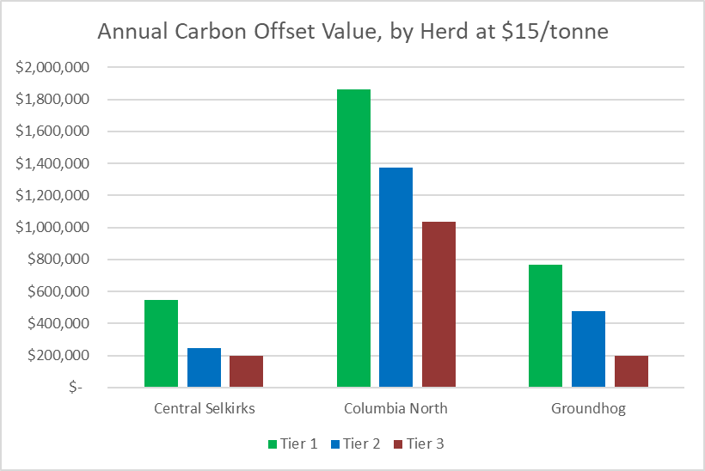
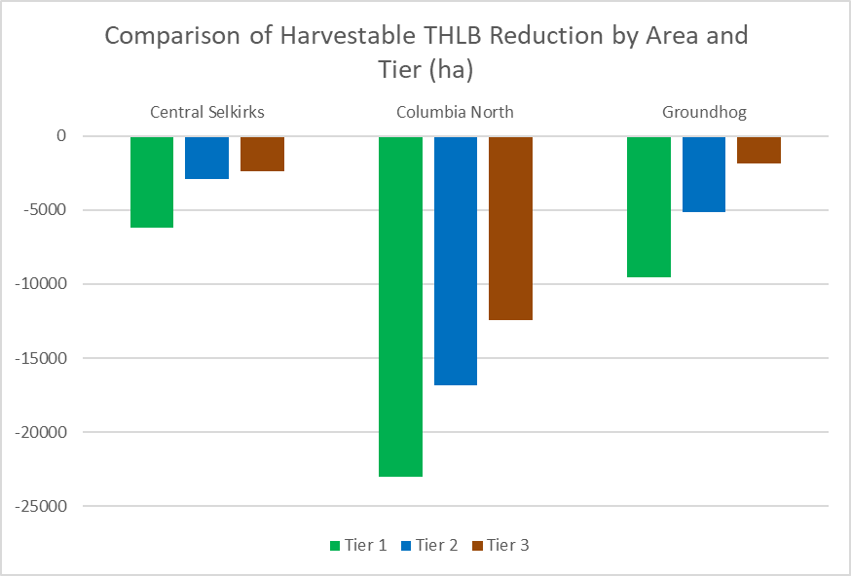
Carbon Offset Potential is the Inverse of Harvestable THLB Impact
Notes:
Carbon opportunity is the mirror image of harvest impacts: the more carbon that is stored and available for sale, the greater the reduction in timber supply.

Slide 15
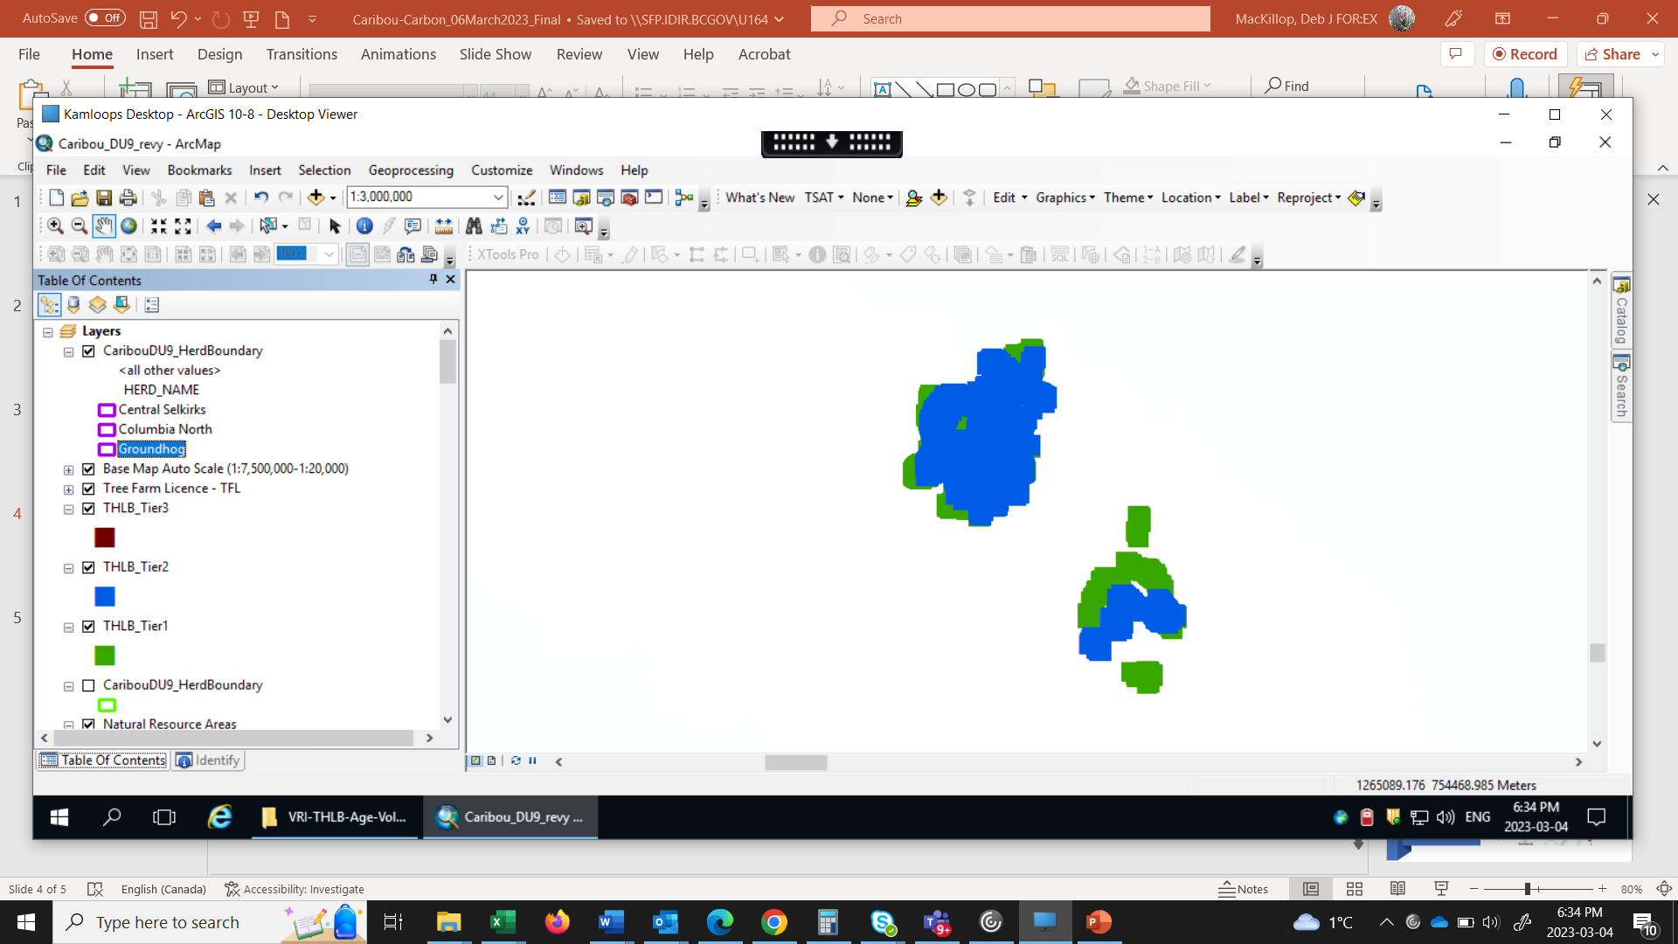
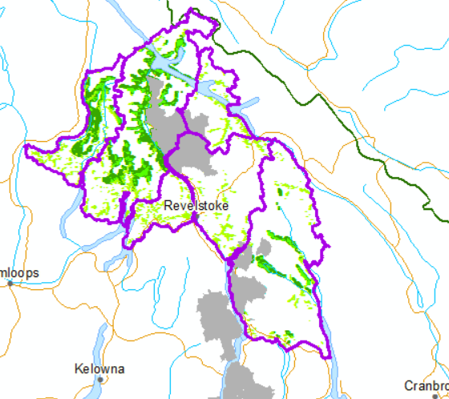
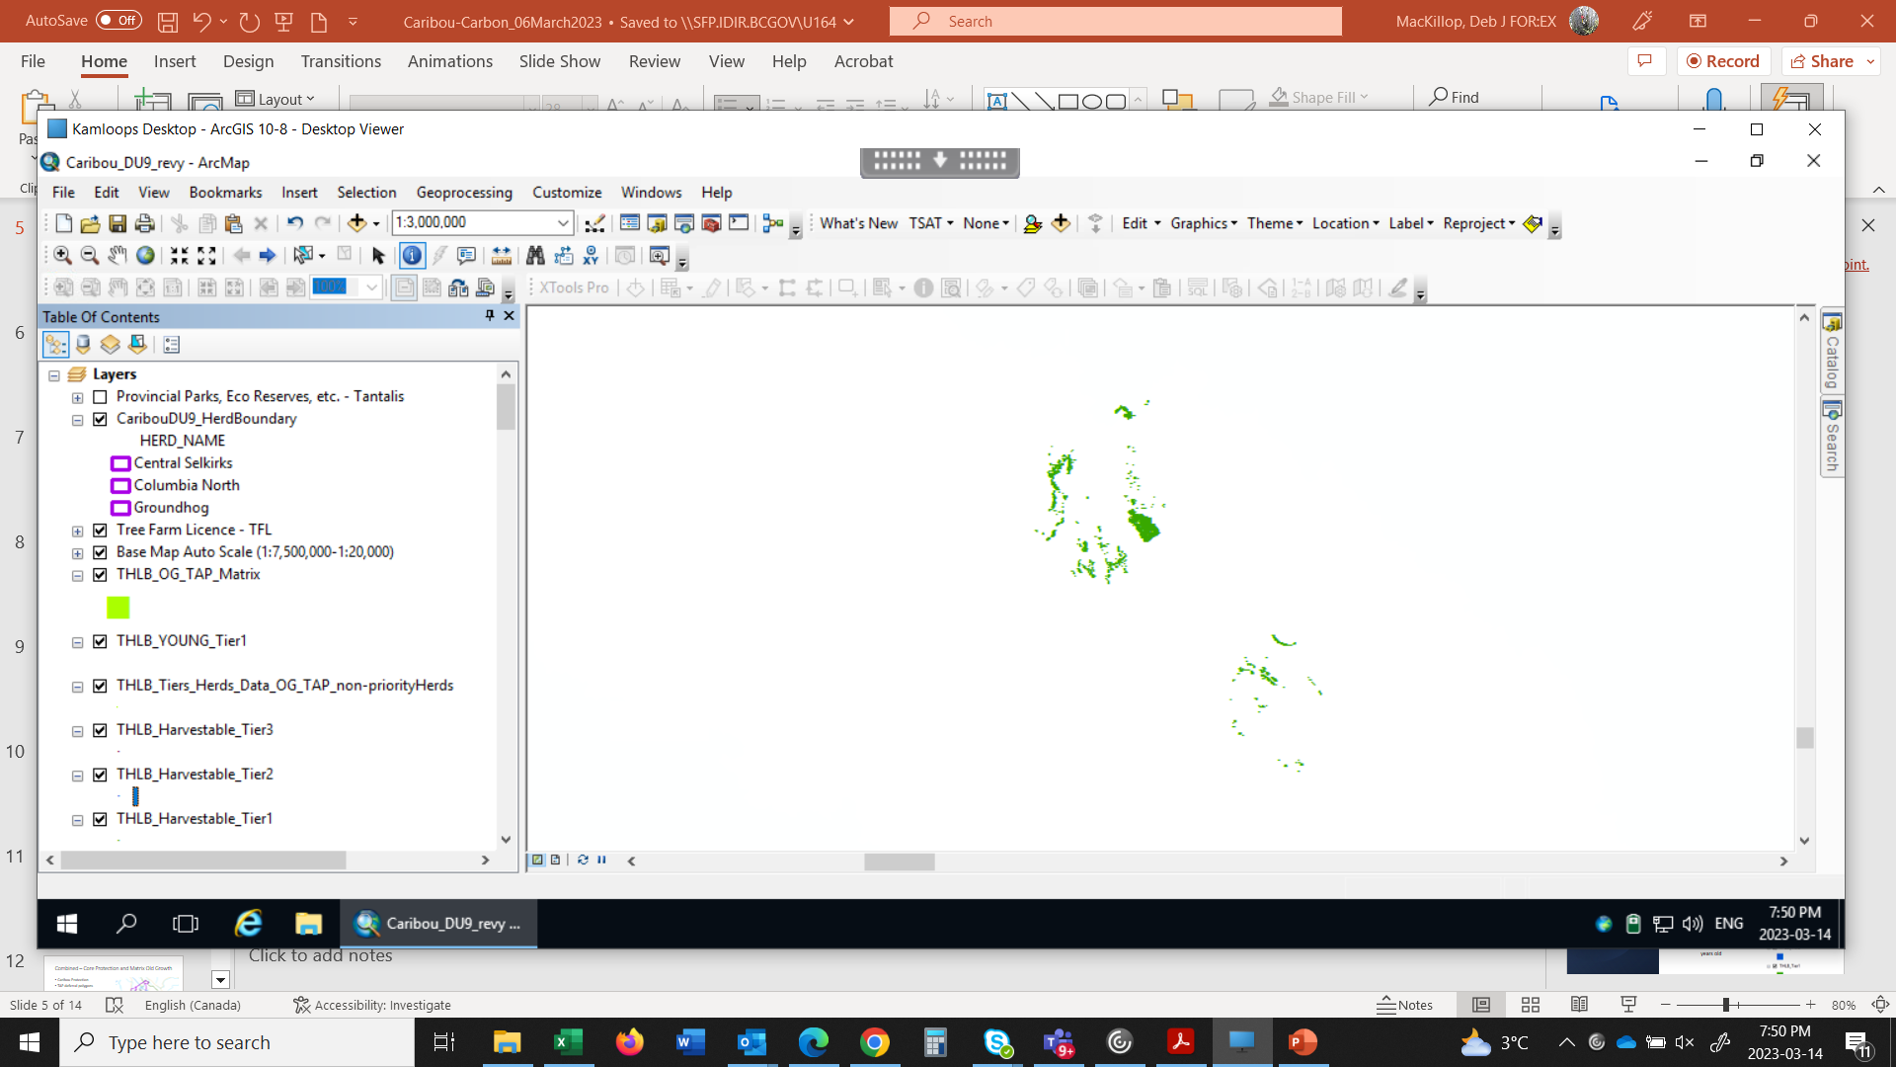
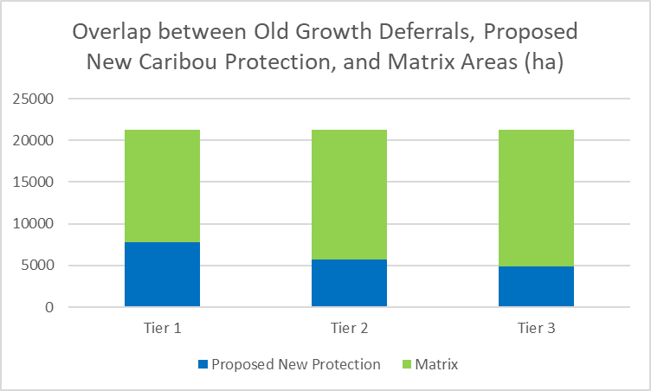
A more full picture: Caribou Protection and Matrix Old Growth
Caribou Protection Scenarios (as above)
TAP deferral polygons as one scenario for old forests
  Matrix in priority herds
  Non-priority herds
    Frisby-Boulder, Central Rockies, Columbia South
~ 45% of the TAP polygons within the priority herd areas are in currently protected areas
  The remainder (55%) are NOT in existing Parks, Caribou No-harvest, OGMA, etc
Most of the OG Deferral areas are outside of the core caribou protection scenarios
  This analysis looks only at those in matrix areas (e.g., herd boundaries
63%
73%
77%
Notes:
The province is currently engaged in several land use discussions. Caribou recovery and old growth conservation have considerable overlap and have both been expressed as priorities for provincial, federal, and indigenous governments. This figure shows the overlap between old growth deferrals (e.g., Technical Advisory Panel priority old growth) and caribou protection scenarios. It includes matrix areas in the priority herds (Groundhog, Columbia North, Central Selkirk) as well as all old growth deferral areas within non-priority herd boundaries (Frisby-Boulder, Central Rockies, Columbia South). Old growth deferrals in non-priority herds are included to reflect the expressed desire (by all governments) to eventually recover caribou in these areas. Maintaining old forests will be key to meeting that objective. Adding old growth deferrals from the matrix to the carbon offsets / protections substantially increases the conservation area, above core caribou habitat. Old growth deferrals are just one possible scenario for long term old forest protection. Other scenarios could be explored.
45% of the identified deferral polygons are within areas that currently have protection (OGMAs, parks, caribou no-harvest, etc). Of the remainder, most of the old growth within herd boundaries is in the matrix, not in proposed caribou core habitat areas. As shown above, 63% of the old growth deferral areas are in the matrix for Tier 1. Because areas that are proposed for protection in Tier 1, but not Tier 2 or Tier 3 were added into the matrix, the proportion of deferrals in matrix increases as caribou protection tiers decrease. Caribou biologists say that protecting the matrix is critical for caribou survival, but matrix protection requirements from the federal government are temporary. Identifying old growth deferrals in the matrix as long term protection and carbon offsets is one way to manage the matrix.

Slide 16
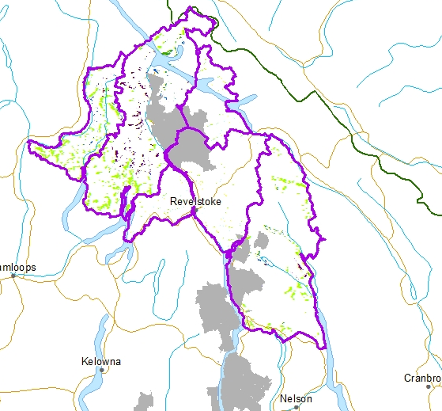
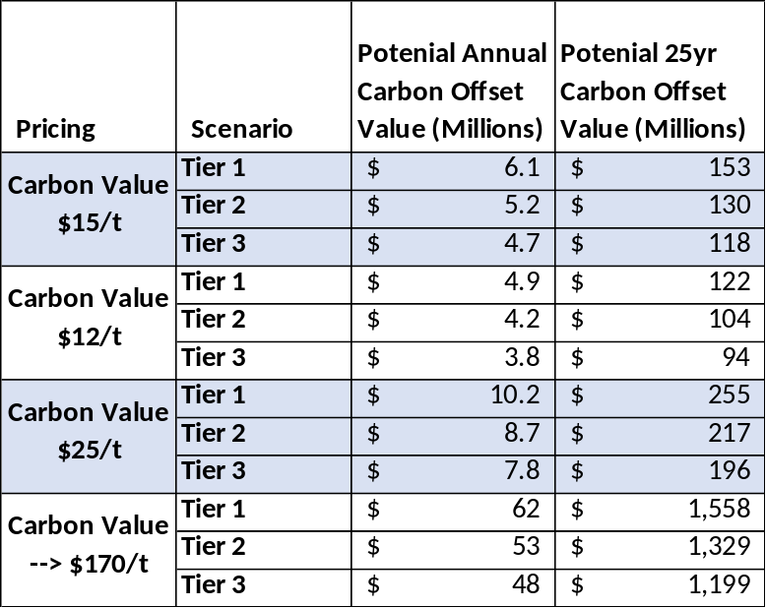
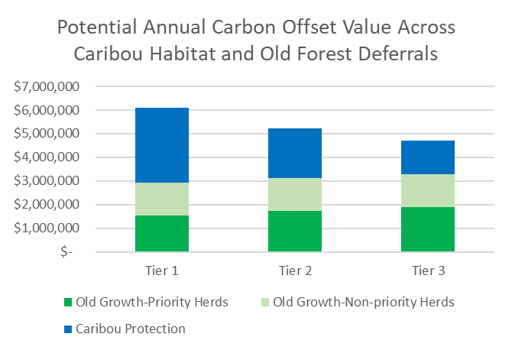
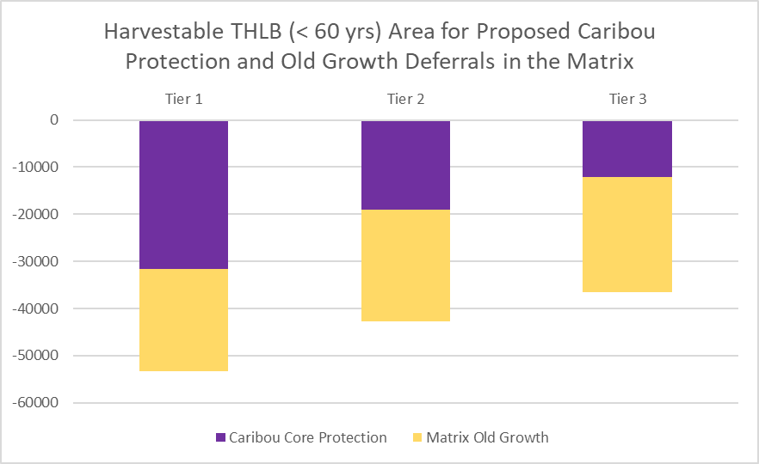
Combined – Carbon Potential across Caribou Protection and Matrix Old Growth
Harvestable THLB (>60 yrs)
Caribou Protection Scenarios
Old Growth deferral polygons as one scenario
  OG in Matrix areas and non-priority herds is ~ $3mil/yr
Combined Caribou + OG
  ~ $4.7mil/yr (Tier 3) to $6.1mil/yr (Tier 1)
    @ $15/tCO2e
    More carbon offset potential in OG than in Tier 2 or Tier 3 protection areas
Total value, over 25 years, using the social cost of carbon could range from:
  $1.2 billion (Tier 3) to $1.6 billion (Tier 1)
CAUTION: These are estimates of the carbon that is potentially available for sale. Actual revenue depends on finding a buyer and selling offset credits.
Value for → $170/t is based on the average value starting at $65mil/yr, increasing by $15/yr up to $170/t in 2030, then remaining static
Notes:
There is a lot of potential revenue from carbon for caribou and old growth. Based on the average carbon offset value of $15/t, combined caribou and old growth protection could generate between $4.7 million (in Tier 3) and $6.7 million (in Tier 1) annually. At the “social cost of carbon”, where pricing increases from $65/t to $170/t, over 25 years, this value could be between $1.2 billion (in Tier 3) and $1.6 billion (in Tier 1). This would coincide with substantial decreases in timber supply. As before, carbon offset opportunity is the inverse (mirror image) of timber impacts; as area for carbon offset increases (and more carbon is stored through harvest avoidance) less area is available for harvest. As per the last slide, this analysis includes old growth deferrals within non-priority herds.

Slide 17
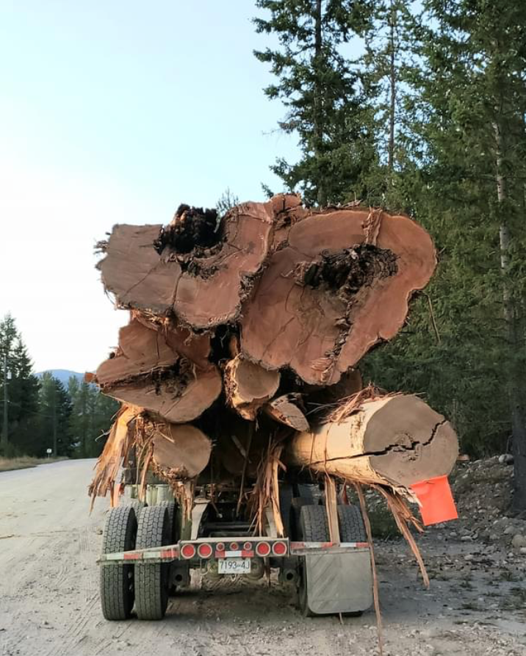
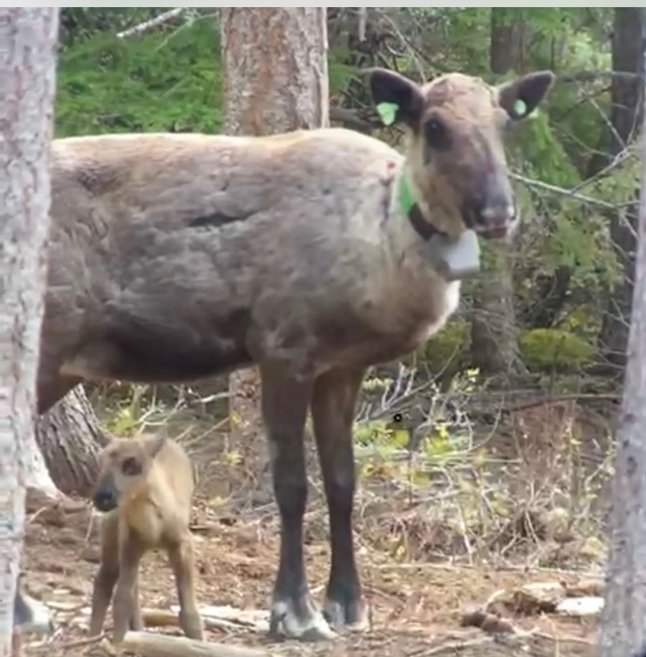
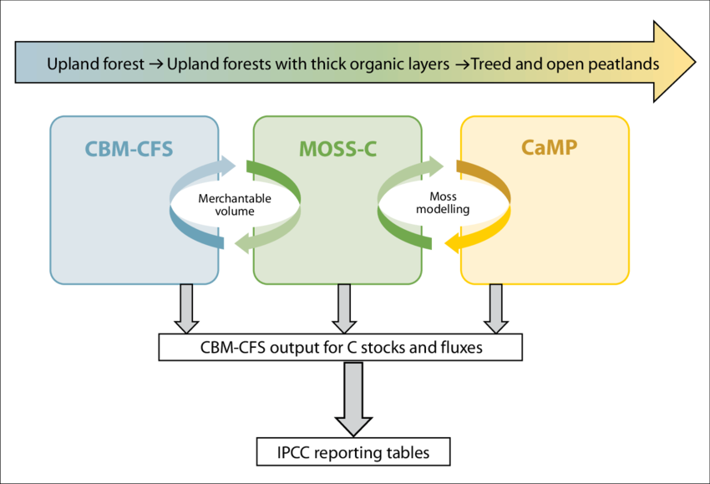
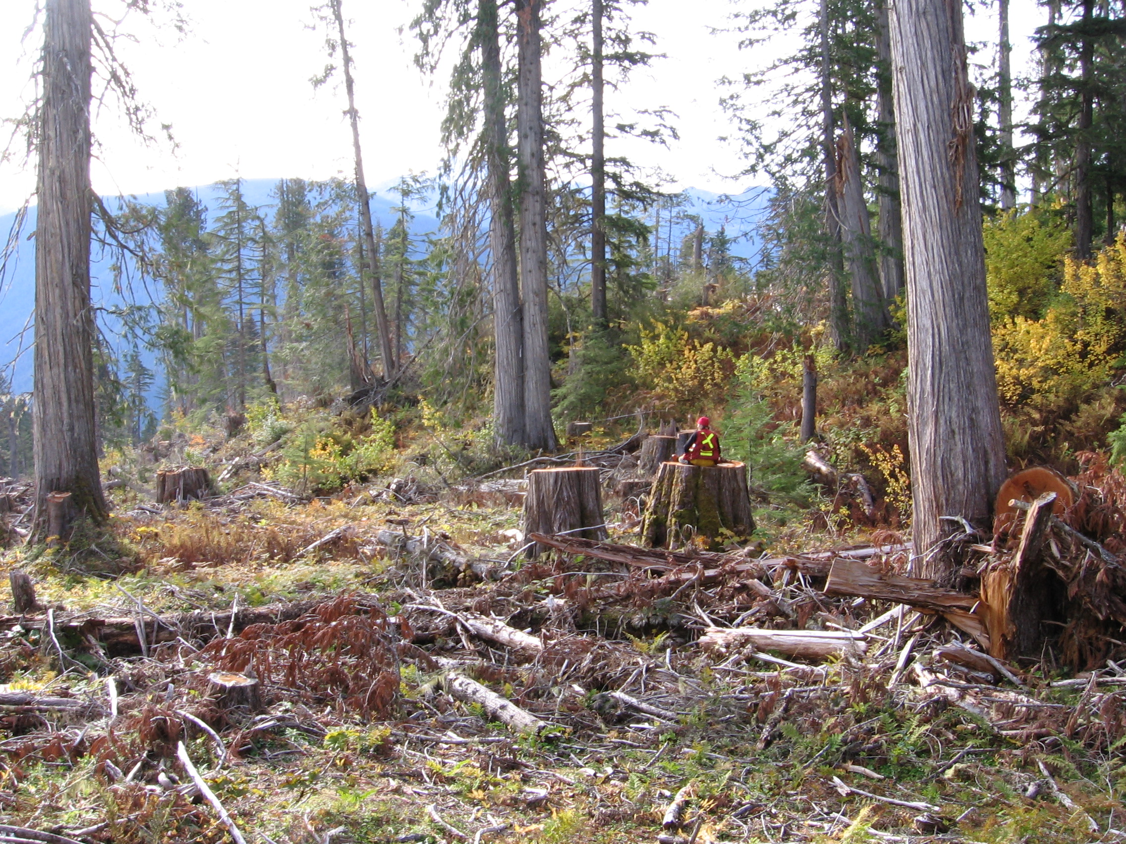

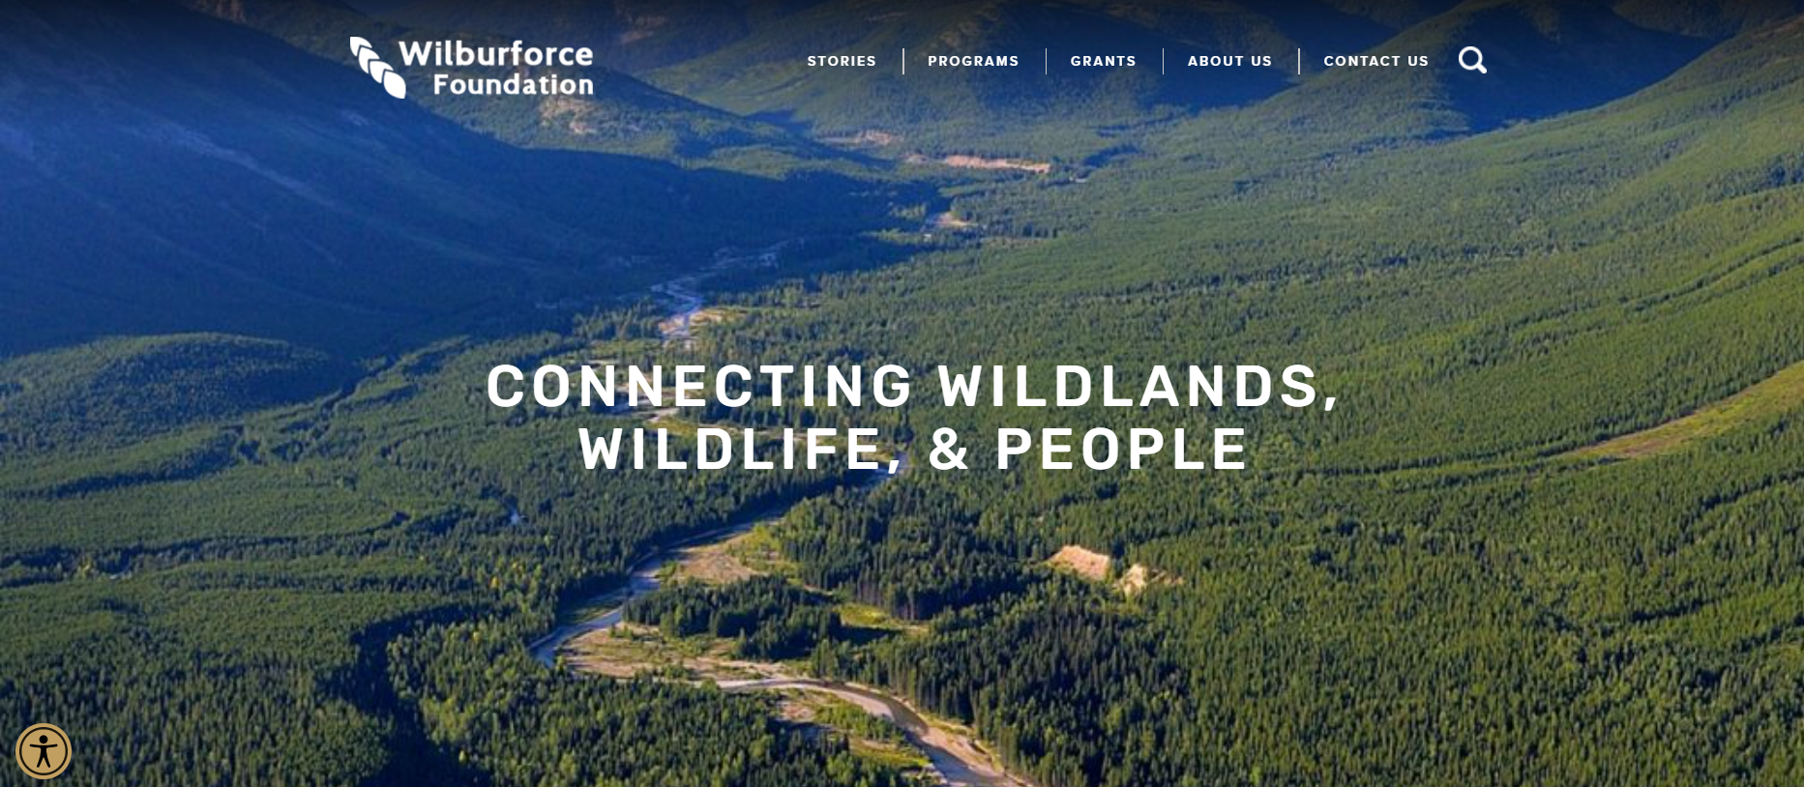
Potential Next Steps and Additional Information
Socio-economic and environmental cost-benefit analysis
  Cost of infringement vs reconciliation
  Full economic sector assessment
    Carbon, timber, recreation, tech, service/tourism, etc
Detailed carbon analysis
  Work so far is at the feasibility analysis level
  Moving forward with a carbon program would require considerable work, both in terms of specific carbon quantification and market/sales development
Philanthropic conservation funding
  Explore BC government mechanisms
  Consider Indigenous Nations’ interest
  Determine leadership/approach
Notes:
This has been a course scale analysis focused on understanding the feasibility of carbon offsets for caribou habitat and old forest conservation. Potential next steps include a full socio-economic and environmental cost-benefit analysis that includes carbon, timber, and other economic sectors, including recreation (with it’s positive and negative impacts on caribou), and other industries.
If a decision to proceed with carbon offsets is made, detailed modelling and assessments will be required to more accurately quantify available carbon. This would likely include assessments of other carbon pools, such as soil carbon and carbon in deadwood (especially large snags and logs).
Carbon funding could provide substantial revenue, but pursuing a transition to a conservation and restoration economy is likely to be more successful if additional conservation mechanisms are explored. This could include provincial and federal government funding as well as the potential for conservation donations.

Slide 18
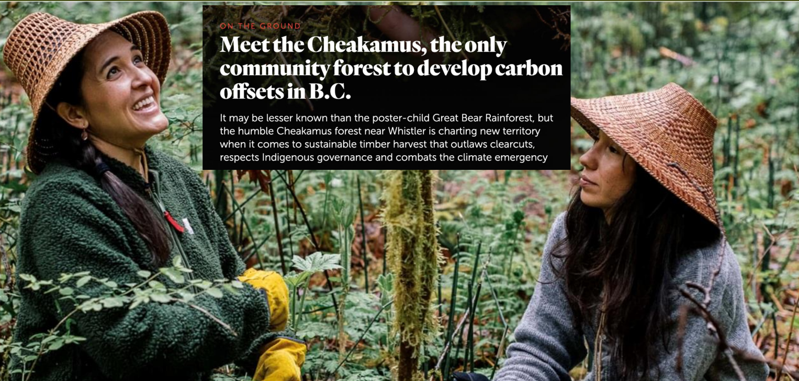
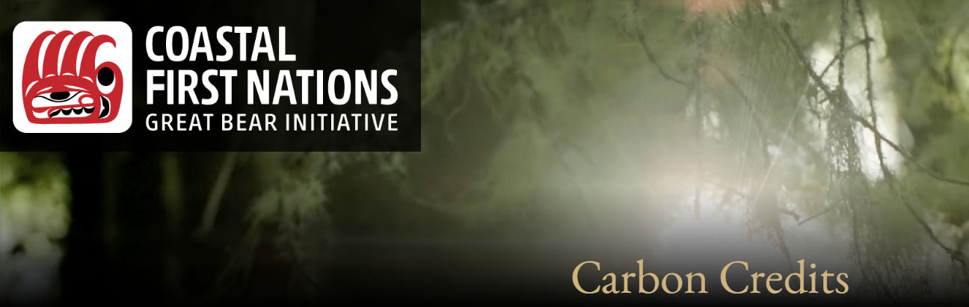
Examples of Indigenous led Carbon Offsets in BC https://www.bcafn.ca/priority-areas/environment/climate-emergency/first-nations-carbon-offsets
Great Bear Rainforest
Initiated through federal and provincial funds, matched by Conservation Funding
Carbon is one component
  Funds stewardship, monitoring, permitting
    E.g., 1/3 of Nuxalk Guardian Program (2020)
    Serves as match funding for other grants
BC Government is the primary purchaser
  GBR has more carbon than BC gov needs to meet carbon-neutral goals
  Sales have not lived up to expectations
https://greatbearcorp.ca/great-bear-carbon-credit-corporation/
https://www2.gov.bc.ca/assets/gov/environment/natural-resource-stewardship/consulting-with-first-nations/agreements/2016_05_02_nanwakolas_absa_signed.pdf
Cheakamus Community Forest
Partnership between:
  Sḵwx̱wú7mesh Úxwumixw (Squamish Nation)
  Lil̓wat7úl (Líl̓wat Nation)
  Municipality of Whistler
Offset credits sold to:
  Municipality of Whistler
  VanCity, Tinhorn Creek, Sharp Six Consulting, Ecotrust Canada, Brinkman Climate, Eclipse Awards, Local Practice Architecture, MET Fine Printers
Offsets based on “reduced harvest volumes, extended harvest rotations, expanded reserves, and protection of old growth forests and other important wildlife habitat.”
https://www.cheakamuscommunityforest.com/carbon-project/
Notes:
Carbon has been an important part of other indigenous conservation and management approaches. The links provided here give more information on the Great Bear Rainforest, which was initiated in 2008 with funding from the provincial and federal governments ($30mil each) and philanthropic conservation donations ($60 mil). It is an important source of funds for Nations with Atmospheric Benefit Agreements. However, the BC government is the primary purchaser of carbon and there is still more carbon available than being purchased.
At a smaller scale, the Cheakamus Community Forest is a partnership between Squamish Nation, Lilwat Nation and Whistler. Whistler is the primary purchaser of carbon offsets, but private companies have also purchased offsets. There are links to both projects here.

Slide 19
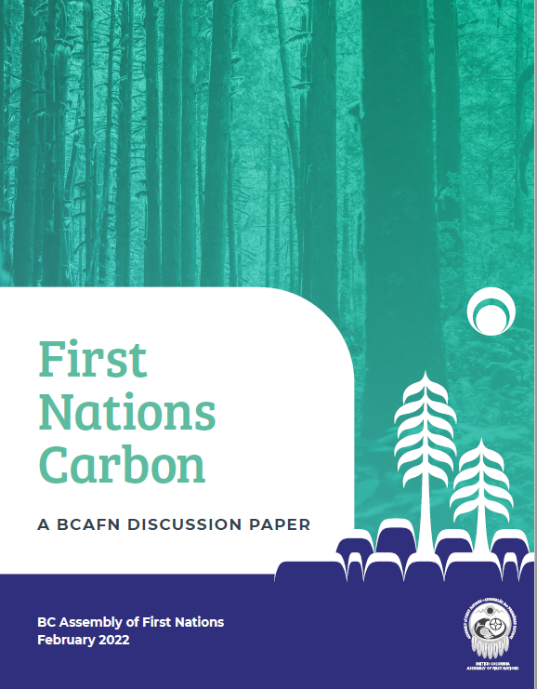
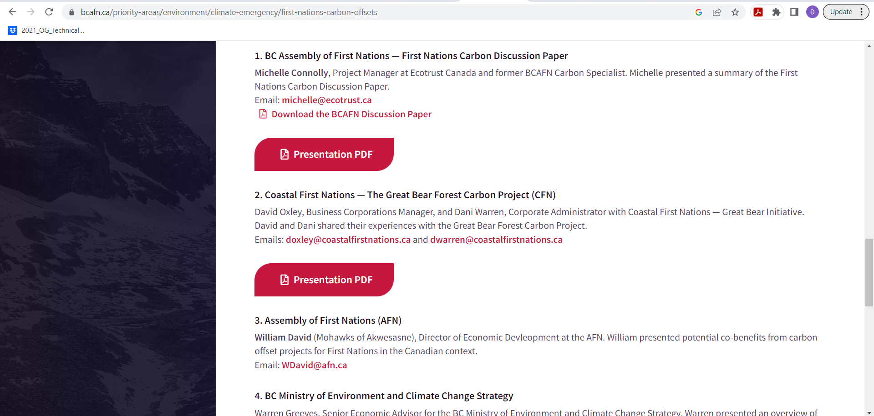
Other Resources
BC Assembly of First Nations
  https://www.bcafn.ca/priority-areas/environment/climate-emergency/first-nations-carbon-offsets
Notes:
In 2022, the Assembly of First Nations produced a Discussion Paper on carbon. There are also some interesting presentations on the website.

Slide 20
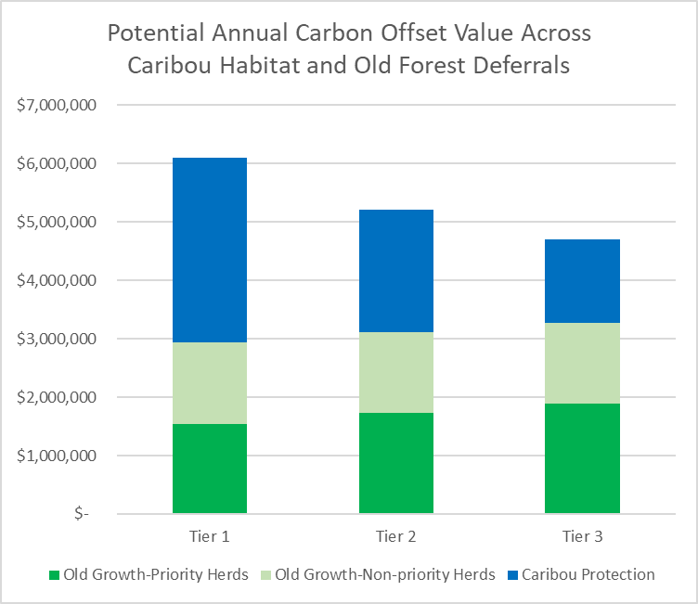
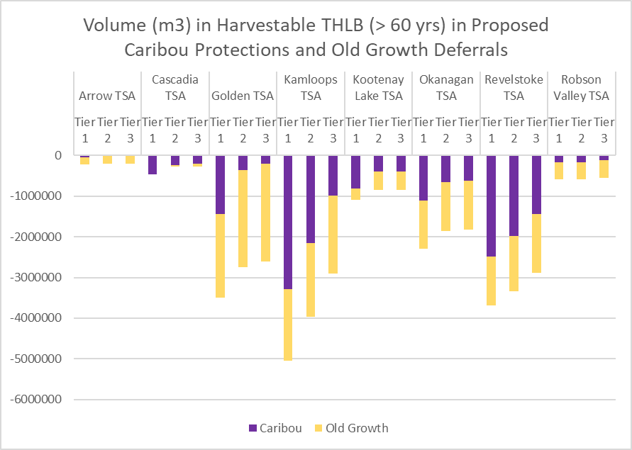
Take home messages #1
Tier 1 has the best chance for self-sufficient caribou populations
  Highest area for protection
  Most restrictive matrix management
highest impact on timber
  Close to double the area impacted compared to Tier 3
most potential for carbon and conservation funding
Tier 3 has opposite pros/cons
Lowest protection for caribou
Highest risk to caribou
Lowest, but still substantial, impacts on available timber for harvest
Lowest carbon offset sales potential
Including old forest protection within the matrix with caribou core habitat protection adds considerable carbon and caribou conservation value
  Old growth deferral areas could contribute significantly to carbon offset potential
    They have more carbon offset potential value than protection scenarios in Tier 2 and Tier 3
  Could also consider other values like watersheds, salmon streams, or other species of concern for carbon offsetting (not included here)
Carbon $
Volume in Harvestable THLB
Notes:
So.. Some take home messages and conclusions. More protection leads to less risk for caribou, more old growth, more carbon offset potential, and greater timber supply impacts. However, much of the proposed conservation area would be harvested over the next 25 years, resulting in loss of most of the remaining caribou habitat and a substantial (planned) decline in timber within 20 to 30 years (as described above using timber supply graphs).

Slide 21
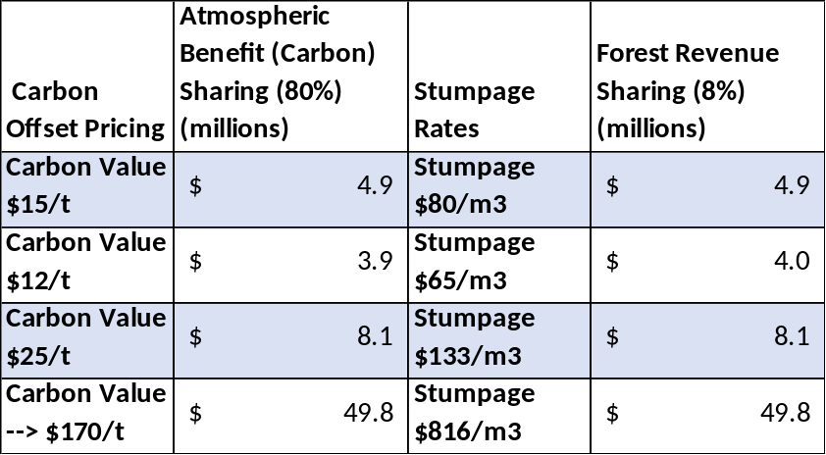
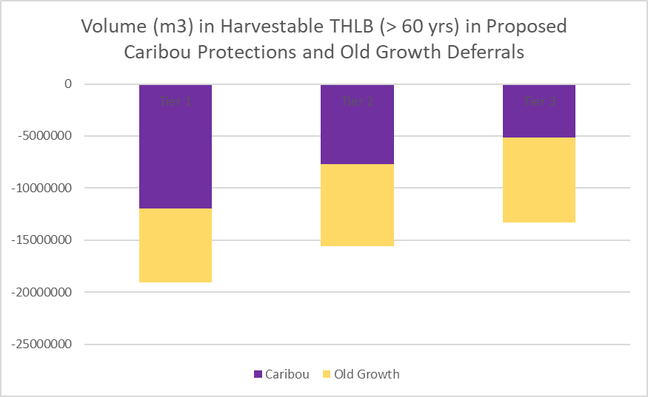
Take home messages #2
Comparing Annual Atmospheric Benefit and Forestry Revenue Sharing across Price Gradients
The Conservation Economy has substantial impacts on timber supply.
  Based on Timber Supply Analysis assumptions, the majority of remaining old and mature forest within the THLB in caribou herd boundaries is planned for harvest within the next 20-30 years.
Carbon has potential to provide considerable revenue, but pricing is uncertain
  Future cost of carbon is unknown
  At low pricing, the opportunity looks to be between a minimum of:
    ~ $4.7 mil/yr (Tier 3 + OG) to $6.1 mil/yr (Tier 1 +OG)
  At Carbon Tax pricing (social cost of carbon), value increases from
    Between $1 billion and $1.5 billion over 25 years
      (increasing value from $65 → $170/t from now to 2030)
  Assuming there is a market for this much carbon
Forestry Revenue Sharing is variable
  Depends on fluctuating stumpage rates and harvest levels
  Results in losses to caribou habitat and old forests
Atmospheric (carbon) benefit sharing and Forestry revenue sharing could provide similar economic value to Indigenous Nations
  80% of carbon value can be sold by Indigenous Nations
  8-10% of stumpage value is shared with Indigenous Nations
Full economic cost/benefit has not been done
Stumpage rates are the average stumpage value that results in similar revenue sharing as could be obtained from carbon offset sales at set pricing.
Values ($) are based on carbon (tCO2e) and volume (m3) for caribou (Tier 1) and old growth deferrals, combined, with 80% attributed to Indigenous Nations.
Carbon $
Volume in Harvestable THLB
Notes:
Both carbon offset revenue and Forestry Revenue Sharing have uncertainties around pricing. Forestry revenue sharing fluctuates with stumpage rates and annual harvest levels, which vary widely. The figure above shows a comparison of the stumpage pricing required to match carbon pricing. Because Indigenous Nations can sell 80% of the carbon offset potential, revenue could be similar to current forest revenue sharing because, although total stumpage value is much higher, Indigenous Nations receive a much lower proportion of revenue: 8-10% of the stumpage revenue harvested from within their area. The figure shows that stumpage rates of $80/m3 are equivalent (to a Nation’s revenue) to selling carbon from the same area at $15/tonne. To achieve the “social cost of carbon”, stumpage would have to rise to $816/m3. Forestry revenue sharing varies from 8-10% of stumpage. The table here uses 8%, based on review of some agreements within the study area, and changing revenue sharing proportion (e.g., increasing to 10%) has a substantial impact on total revenue to Indigenous Nations (not shown here.
These values suggest that carbon could provide similar income to forestry revenue sharing, depending on fluctuations in stumpage rates and volume harvested. When stumpage is high and the full AAC is harvested, Nations may make more funds from forestry revenue sharing. However, when stumpage drops or less AAC is harvested, atmospheric (carbon) benefit sharing could out-pace revenue from harvesting. And, after 25 years, funding from atmospheric (carbon) benefit sharing will result in habitat protection for caribou and old forests that would otherwise be lost under a forestry revenue sharing approach.

Slide 22
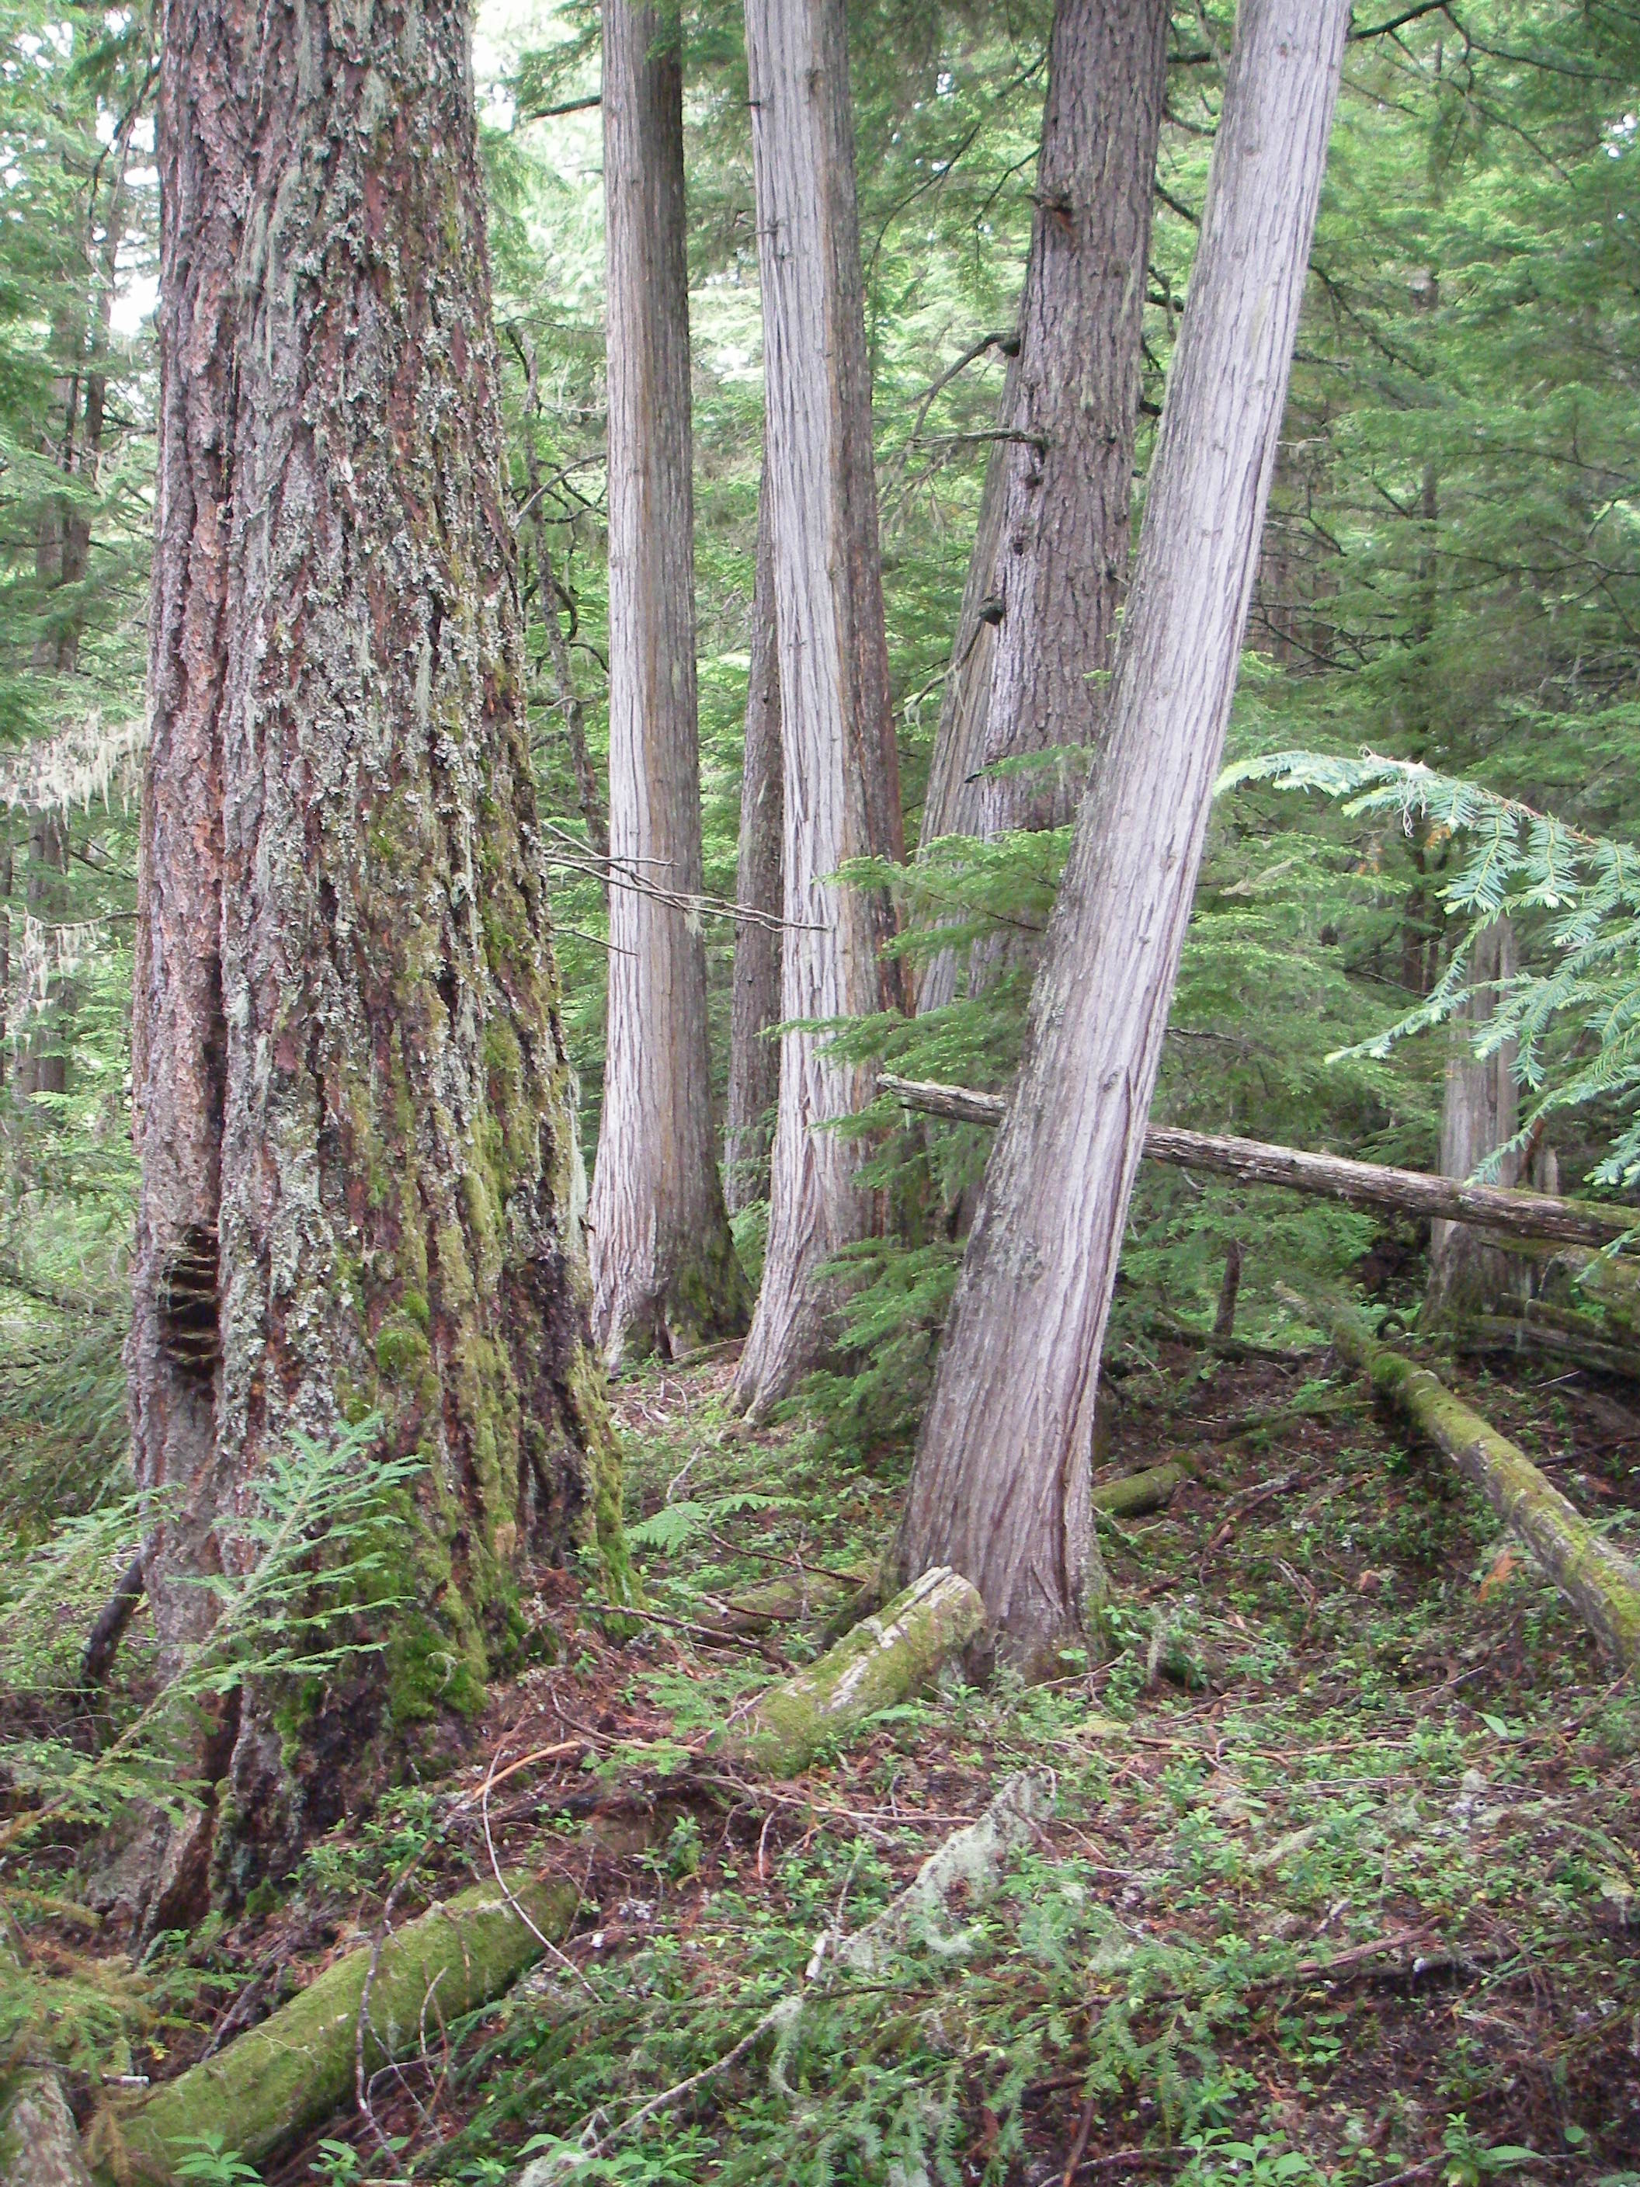
Research:
Carbon Dynamics in Old Growth
Research Proposal to Min Forests
  Extend work from Coastal BC to ICH
  $100,000 contract for data collection to UBC
Field data collection in
  Ancient forests (>400 yrs)
  Old forests (>250 yrs)
  Mature forests (>100 yrs)
  Potentially harvested stands (<40 yrs)
Model calibration and decision support tool
Opportunities for partners
  Help guide research questions
  Field data collection
  Field data QA
  Field work opportunities
FNFC Scholarship with research
Notes:
Deb MacKillop and Caren Dymond from the FOR Research Program have initiated a project with funding from FOR to study carbon dynamics in old growth forests in the wet ICH (ICHvk1 and ICHwk1). Funds were allocated to UBC to measure carbon across ancient, old, mature, and potentially in harvested stands to improve model calibration and develop decision support tools for understanding trade-offs. Many of the Indigenous Nations within the TWG have indicated an interest in this work. Once job descriptions are developed by UBC, information will be shared to see if there are any people interested in working on this project. Deb will also continue to provide updates and seek feedback on this project from the TWG. This information will help to improve estimates of carbon in old forests to better reflect climate change mitigation and offset opportunities. Please contact deb.mackillop@gov.bc.ca for more information or to provide input. Thanks!

