Slide 1
Revelstoke Complex
Caribou Habitat Management
Draft
Long-term Timber Supply Impact Estimates
March 6, 2023
Forest Analysis and Inventory Branch

Slide 2
Purpose
Broadly:
Assess the implications of additional caribou habitat management actions on long-term fibre flow
Focus here: Timber Supply
Some key features:
  Long-term: 200 years
  Large area: No operating areas or plans; the model can harvest anywhere in a harvest unit at any time subject to various constraints
  ‘Greedy’: All available timber (in the timber harvest land base) will likely get harvested at some point

Slide 3
Purpose
Important:
Timber supply analysis is one analysis to consider economic impacts, not the only answer
    Should be blended with additional information, expertise, interpretation, etc.
Strategic Model – how much timber could be harvested in the long-term given ideal conditions and what we know about the forest now?

Slide 4
Timber Supply Analysis
Assumptions:
Current forest inventory, growth and yield and timber harvest land base
No natural disturbances
Simple harvest rules
  Harvest target
  Harvest priority clustered to ‘disturbed’ areas (i.e., near existing roads and cutblocks)
    But also tested a scenario with ‘oldest first’; more consistent with timber supply reviews
  Minimum volume (150 m³/ha – probably too low for some parts of the region)

Slide 5
Timber Supply: Scenario Analysis
Objectives: Compare proposed caribou habitat management scenarios against a baseline = “Business-as-Usual” (BAU):
By timber supply area (TSA) or tree farm license (TFL)
  8 TSA’s and 4 TFL’s
BAU = max. even-flow, non-declining harvest
Existing legal objectives / ‘constraints’ are included in all scenarios
  GARs, BEO’s, watershed protections, parks
Clustering harvest -> priority closest to disturbance (existing cutblocks and roads)
Note: Any limitations, problems with the model are built into all scenarios (i.e., they are equally biased)
Timber Supply Units:
Arrow
Cascadia-Okanagan
Golden
Kamloops
Kootenay Lake
Okanagan
Revelstoke
Robson Valley
TFL14
TFL23
TFL55
TFL56

Slide 6
Timber Supply Analysis
Four Caribou Habitat Management Scenario “Tiers”:
In All Tiers:
  “core” habitat = protected
  “matrix” habitat = early seral ‘constraint’
    maximum 12% < 40 year old forest
  Columbia North, Central Selkirks, Groundhog, Wells Gray South
Amount of area protected varies between Tiers
  Highest (Tier 1) to Lowest (Tier 4)
Estimated the percent change in timber supply from BAU
  Average over 200 years

Slide 7
Area of Interest
Area of interest = ~10,250,000 ha
  For context:
    BC = ~95 M ha
    BC forested area = ~57 M ha
~2,700,000 ha of area is timber harvest land base (thlb)
“Protection” scenario areas (approximate)
  Tier 1 = 1,500,000 ha; 525,000 ha thlb
  Tier 2 = 1,250,000 ha; 450,000 ha thlb
  Tier 3 = 900,000 ha; 325,000 ha thlb

Slide 8
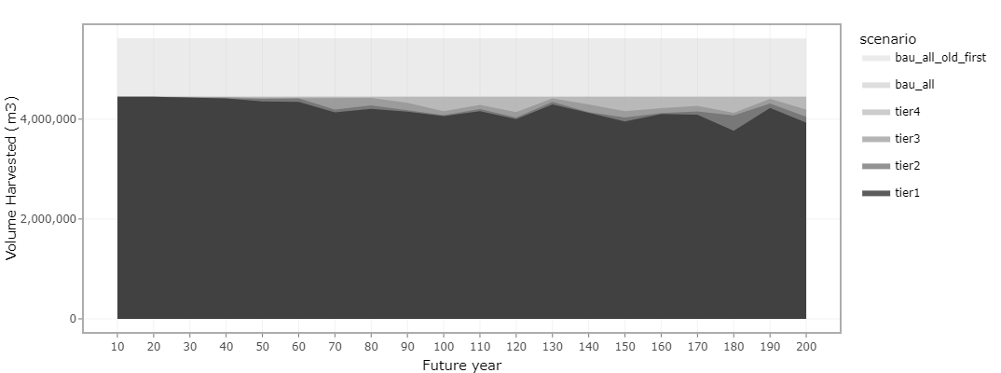
Draft Results
5.62 M m³
4.45 M m³

Slide 9
Draft Results – Closest to Disturbance
Scenario | Average Annual Volume (m³) Harvested | Percent of Business-as-Usual
BAU (closest to disturbance) | 4,450,000 | 100
Tier 1 | 4,180,000 | 94
Tier 2 | 4,240,000 | 95
Tier 3 | 4,320,000 | 97

Slide 10
Draft Results – Oldest First
Scenario | Average Annual Volume (m³) Harvested | Percent of Business-as-Usual
BAU (oldest) | 5,620,000 | 100
Tier 1 | 4,180,000 | 74
Tier 2 | 4,240,000 | 75
Tier 3 | 4,320,000 | 77

Slide 11
Draft Results – Closest to Disturbance
 |  | Percent of BAU
Timber Supply Unit | BAU volume (m³) | Tier 1 | Tier 2 | Tier 3
Arrow | 310,000 | 100 | 100 | 100
Cascadia (TKO) | 72,500 | 97 | 100 | 100
Golden | 400,000 | 98 | 100 | 100
Kamloops | 1,100,000 | 85 | 87 | 92
Kootenay Lake | 450,000 | 100 | 100 | 100
Okanagan | 1,100,000 | 98 | 100 | 100
Revelstoke | 150,000 | 81 | 89 | 95
Robson Valley | 235,000 | 96 | 95 | 100
TFL 14 | 115,000 | 100 | 100 | 100
TFL 23 | 435,000 | 99 | 100 | 100
TFL 55 | 50,000 | 44 | 44 | 56
TFL 56 | 32,500 | 83 | 83 | 86
Total | 4,450,000 | 94 | 95 | 97

Slide 12
Draft Results – Oldest First
 |  | Percent of BAU
Timber Supply Unit | BAU volume (m³) Oldest First | Tier 1 | Tier 2 | Tier 3
Arrow | 400,000 | 78 | 78 | 78
Cascadia (TKO) | 90,000 | 78 | 81 | 81
Golden | 500,000 | 79 | 80 | 80
Kamloops | 1,400,000 | 67 | 68 | 72
Kootenay Lake | 575,000 | 78 | 78 | 78
Okanagan | 1,400,000 | 77 | 78 | 79
Revelstoke | 210,000 | 58 | 63 | 68
Robson Valley | 300,000 | 75 | 75 | 78
TFL 14 | 145,000 | 79 | 79 | 79
TFL 23 | 500,000 | 86 | 87 | 87
TFL 55 | 60,000 | 36 | 37 | 47
TFL 56 | 40,000 | 68 | 68 | 70
Total | 5,620,000 | 78 | 78 | 78

Slide 13
Conclusions
Draft estimate of long-term, large-scale impacts to timber supply in the region
  Tier 1: 6% to 26%
  Tier 2: 5% to 25%
  Tier 3: 3% to 23%
Impacts vary within the region
  Kamloops, Revelstoke, TFL55 and TFL56 bear more of the percent impact

Slide 14
Conclusions
These are draft results
  Model is amenable to testing different assumptions, etc.
Not a comprehensive economic assessment
  Long-term timber supply perspective
    Supports a strategic decision
    Doesn't consider local, short-term economics
Simplification may be ‘optimistic’
  Other factors will impact total timber supply:
    natural disturbances, climate change, other constraints, local conditions….
  But all scenarios are equally optimistic

