Slide 1
BC Timber Sales Sustainable Forest Management Practices:
Mt. Elphinstone
BCIT
March 1, 2018

Slide 2
Outline:
Interface Areas: SFM
Interface Areas: BCTS’ Approach
Mt. Elphinstone
  Background
  Land Use Designations
  Community Engagement
  Management Approaches
  Roads

Slide 3
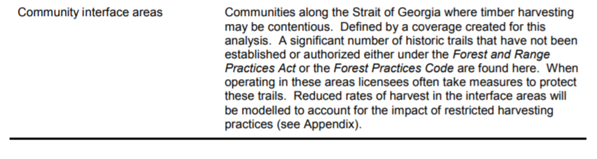

Interface Areas: SFM
Notes:
The last AAC determination for the Sunshine Coast Timber Supply Area (TSA) assumes a reduction in harvest levels in urban interface areas.
Unique challenges in urban interface areas include:
more recreational values;
community expectations;
some of the most threatened ecosystems and habitats in BC (urban development);
visual impacts;
drinking Water; and
risk of interface fires.

Slide 4
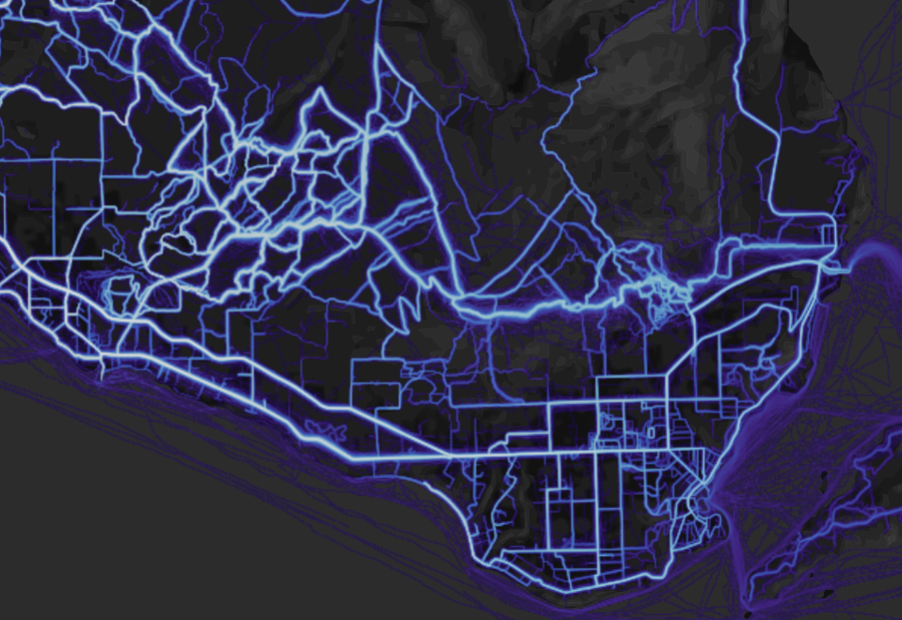
Interface Areas: BCTS’ Approach
Notes:
BCTS recognizes the importance of forests near local communities
Focus on open-dialog, transparency and relationship building – listening to concerns and adapting plans
Cutblocks are designed to be small with increased buffers for streams, trails and other identified values
Interface areas on the sunshine coast have some of the highest economic, environmental and recreational values – the more voices/perspectives the better the plan

Slide 5
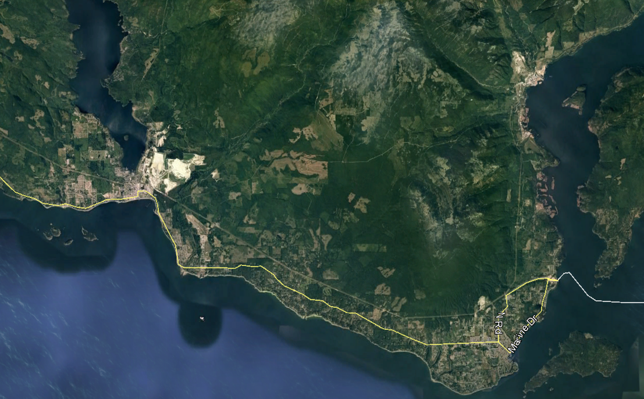
Mt Elphinstone: Background
Notes:
Urban interface areas where a reduction in timber harvest was accounted for in the Sunshine Coast TSA AAC determination did not include Mt. Elphinstone.
History of conflict 30+ years
In 2005, BCTS committed to a harvest rate of 27ha/yr
Half what the area can sustain under typical forestry practices
150 year rotation vs 75 year rotation
Lower Mainland Protected Areas Strategy
New parks identified in 1996
Consensus-based process: environmental groups, conservation groups, forest industry, tourism, labour, government, wildlife associations, etc.
Lower elevations contain some of the most valuable second growth timber in BC (productive growing sites)
The Mt Elphinstone Operating area has been in place since the inception of Small Business Enterprise Program in 1986 and subsequently continues with BCTS since 2003. Local residents have had concerns with logging from the beginning and numerous types of plans and alternative harvest methods have resulted. The research forest is one of these alternatives and Brian D’anjou will speak to you regarding that process tomorrow.
Growing older forests through the harvest reduction. Appeasing the public and FNs. Movement towards strengthening the social licence before social licence was a catch phrase.

Slide 6
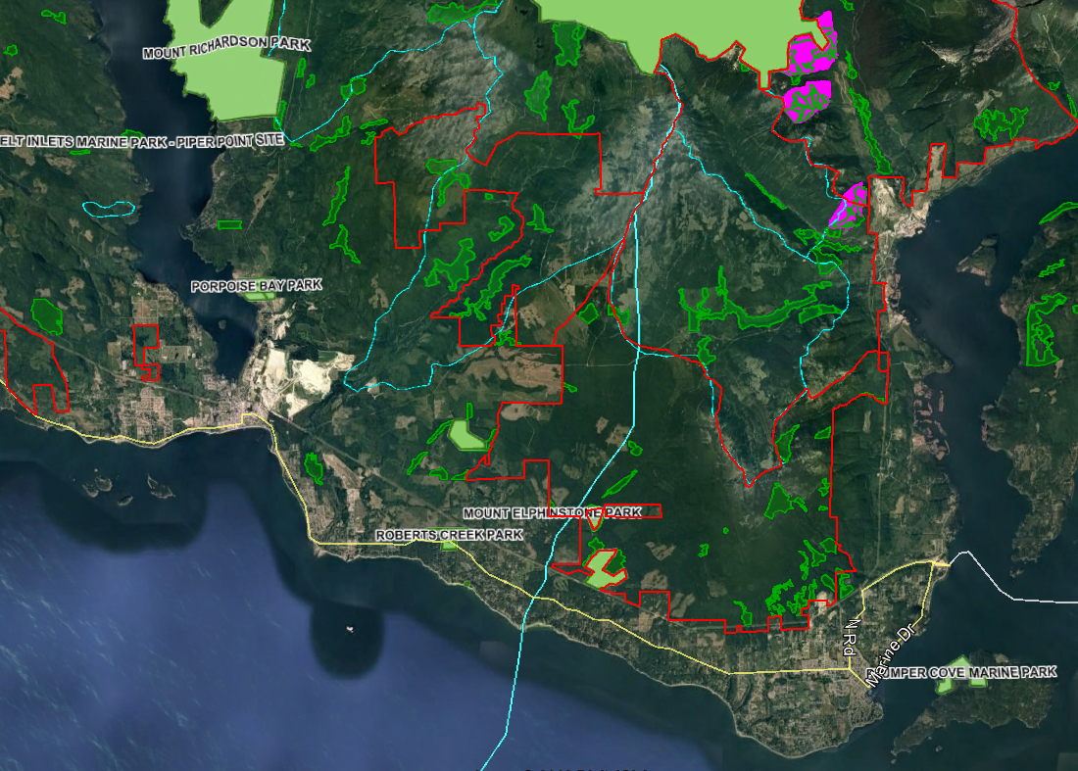
Mt Elphinstone: Land Designations
Notes:
Two landscape Units:
Chapman (22 000ha THLB)
Howe (25 000ha THLB)
BCTS Operating Area ~5100ha
shíshálh and Squamish Nation Territories
shíshálh has declared Mt. Elphinstone as a Conservation Area
10 watersheds ~7000ha (Non designated)
Provincial Parks ~9000ha
NGO lobbying for another 2100ha park
OGMAs ~6000ha
WHAs ~500ha
Woodlots and Community Forest ~200ha
BTCS and shishalh are currently working together: RA (overarching agreement – relationship principles and engagement framework), CMA (B2B – Bill 12 RVC), blocks form Mt Elphinstone will be used to fill part of the volume commitment.
Watersheds in the Mt Elphinstone area are not designated community watersheds but are treated with mitigation strategies for water quality and road construction
Tetrahedron Park (6000ha) has some of the oldest and undisturbed forests in Canada
Spipyus Park (3000ha) protects old-growth Fd and some of the oldest Cy, Hw, and Hm in the world.

Slide 7
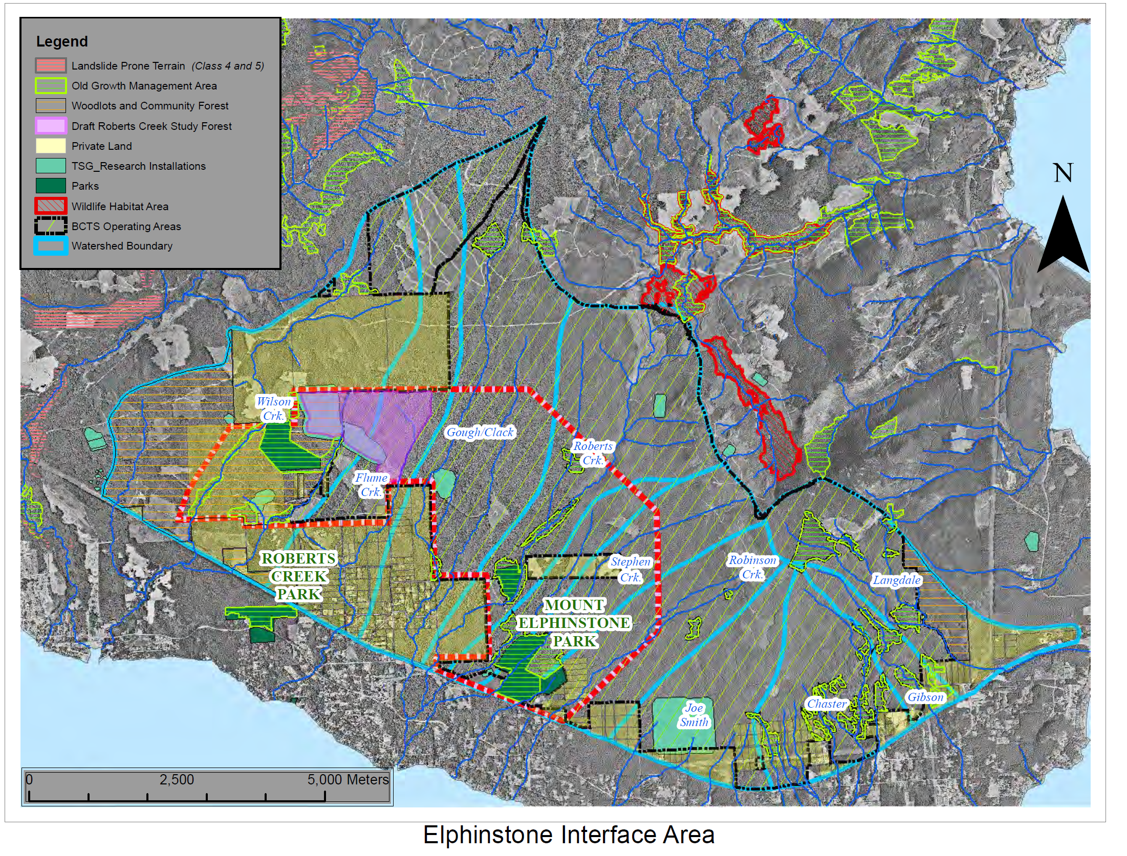
Notes:
Note LU break
Highlight BCTS OA
Highlight Values:
communities below
watershed overlaps
Provincial Parks and NGO expanded
OGMAs
WHAs
trails
Robert’s Creek Research Forest
20 years of forestry research that informs BCTS approach
Research topics included:
Alternative forestry method and cutblock designs
Water Quality/Quantity
Amphibians
Beetles
Soils
Fungi
Birds
Worker Safety
Economics since 2005:
$ 1.1 million in direct revenue per year
Volume is 309 553m³
Average area harvested 21.3ha/yr

Slide 8
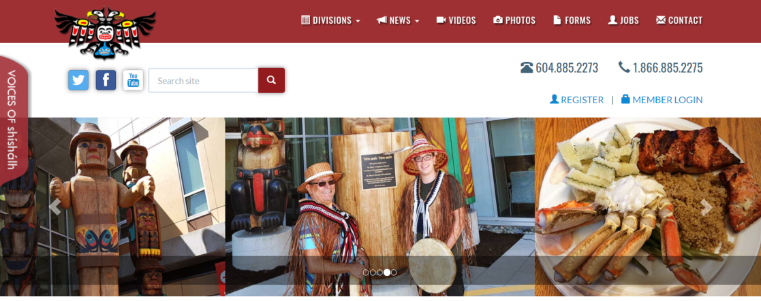
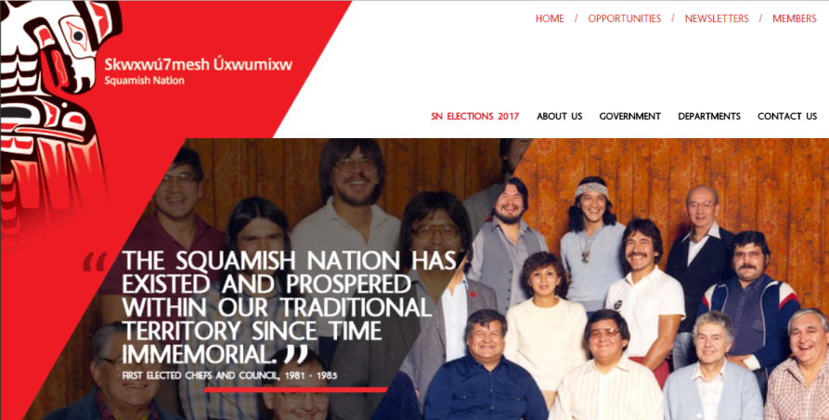
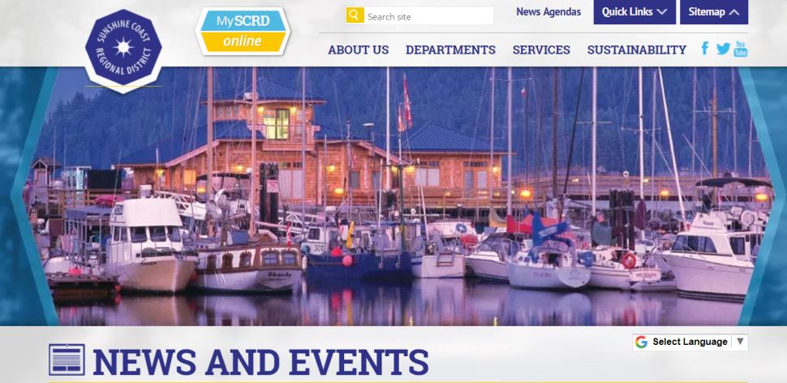
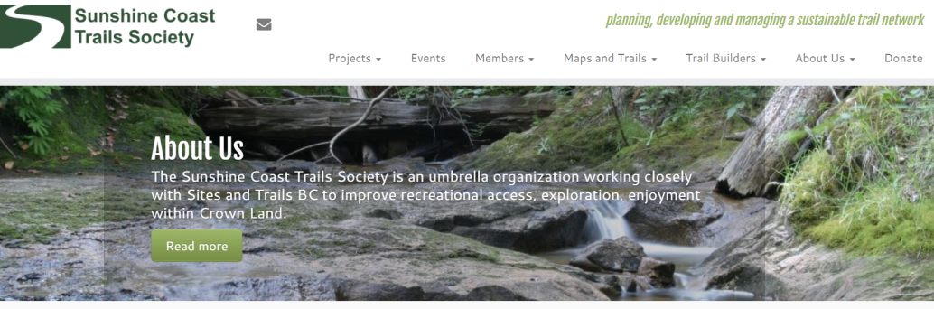
Mt. Elphinstone: Community Engagement
Notes:
Information sharing
5-year plans shared publically, many meetings held, feedback solicited from stakeholders
First Nations Consultation
5-year plans are shared
Agreements have to be followed:
Squamish Nation Forest Consultation and Revenue Sharing Agreement
shíshálh Shared Decision Making Agreement
BCTS-Sunshine Coast Trails Society MoU
communication with mountain bikers and others to protect priority trails and re-establish others
Funding provided for trail projects
BCTS and Sunshine Coast Regional District (SCRD) Communication Protocol
Signed in 2014
Commits to the Parties to ensuring open and honest communication as well as fostering a collaborative relationship
BCTS and SCRD are currently working on increased involvement with constituents
Summer bus tours
Information Kiosk
ELF
Non-profit BC based environmental group
Since 2010, ELF has steadily escalated their anti-logging tactics
Proficient at using local and social media
Small in number, but astute campaigners
Recent campaigns related to A87125 and Reed Road:
- Stop OG harvesting
- Harvesting blue/red listed plant communities
- Increase the size of Mt. Elphinstone Provincial Park
- Moratorium on logging in Mt. Elphinstone area – for LRUP’s
- Water quality and quantity

Slide 9
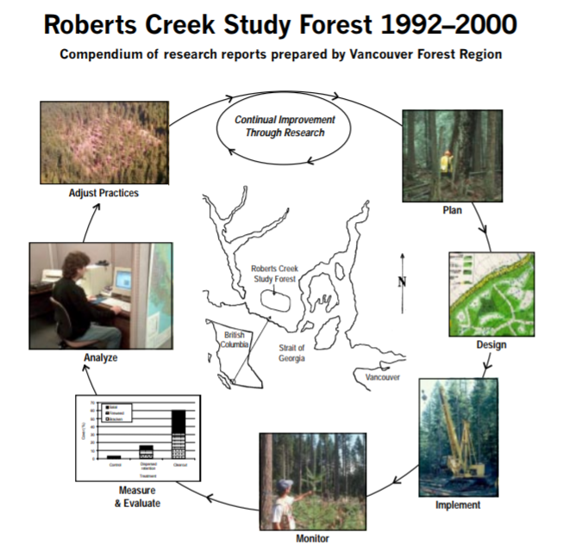
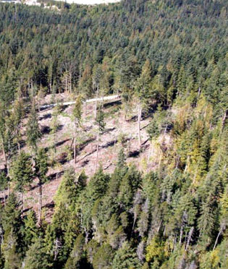
Mt Elphinstone: Management
Notes:
Research at Robert’s Creek indicates that small cutblocks regenerate with hemlock
BCTS approach is to create smaller openings while still maintaining Douglas fir and Cedar regeneration and leaving large veteran trees for biodiversity and visual purposes
Water quality research showed the importance of maintaining buffers on small creeks while properly managing windthrow
A wind throw study was completed for BCTS in the Mt Elphinstone area which resulted in smaller openings and fetch to be less than 7 tree lengths to reduce the prevailing South Eastern winds.

Slide 10
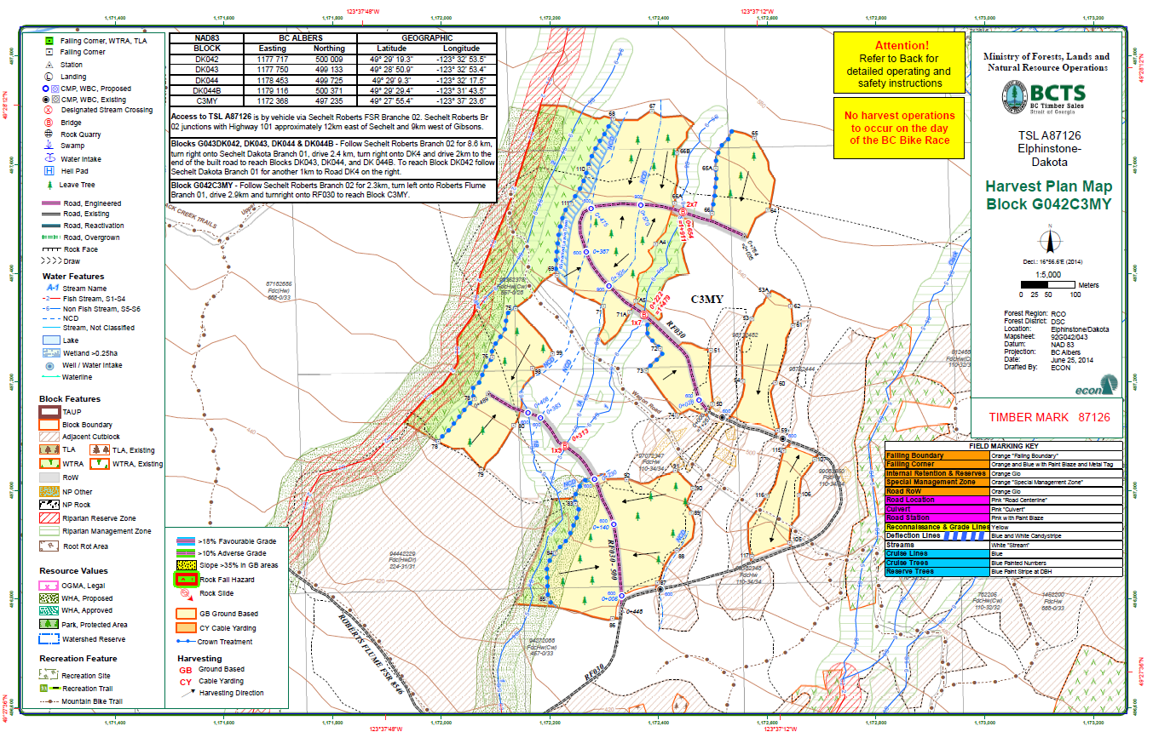
Mt Elphinstone: Management
Notes:
Retention is anchored on species and ecosystems at-risk
Blue-listed Rubus Nivalis snow bramble monitoring and protections
In-block veteran retention (BCTS Legacy Tree Policy)
Protection and monitoring of at-risk amphibians
Protection of drinking water:
Extensive buffers on creeks;
Reduced rainfall shutdown guidelines for equipment; and
Roads and cutblocks designed to mitigate sediment potential.

Slide 11
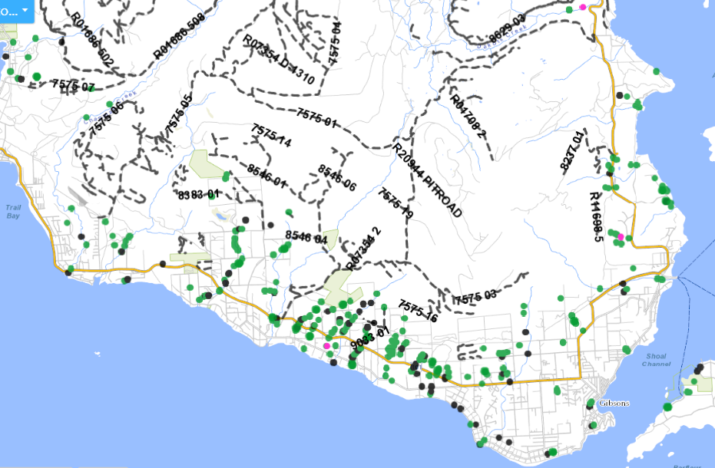
Mt. Elphinstone: Roads
Notes:
In the Sunshine coast Resource district there are approximately 340 km of road many of which are isolated (air or boat access only);
Aquifers and Points of diversions (POD) linked to communities below the operating area necessitate strategies for ensuring that water quality is protected
BC Timber Sales (BCTS) Manages two kinds of access roads to facilitate timber extraction and reforestation activities:
Forest Service Roads are built under contract and have contractual language and specifications that allow BCTS to build roads to a specified standard as per plans, profiles, cross sections and any prescribed material specifications;
Contracts ensure greater control and protection of things like hydrology, visuals, species at risk etc. when compared to roads built by TSL holders.
Maintained through BCTS contracts and also by BCTS Licensees while active hauling is taking place.
Deactivated by BCTS when no longer required or transferred to the Resource District when still needed for other users
RP roads are constructed by BCTS Licensees. These roads are generally non go ahead roads built solely for the harvesting and silviculture activities for a single Timber Sale.
Built by BCTS Licensee with potential to change road plans
Maintained by licensee and then deactivated by Licensee

Slide 12
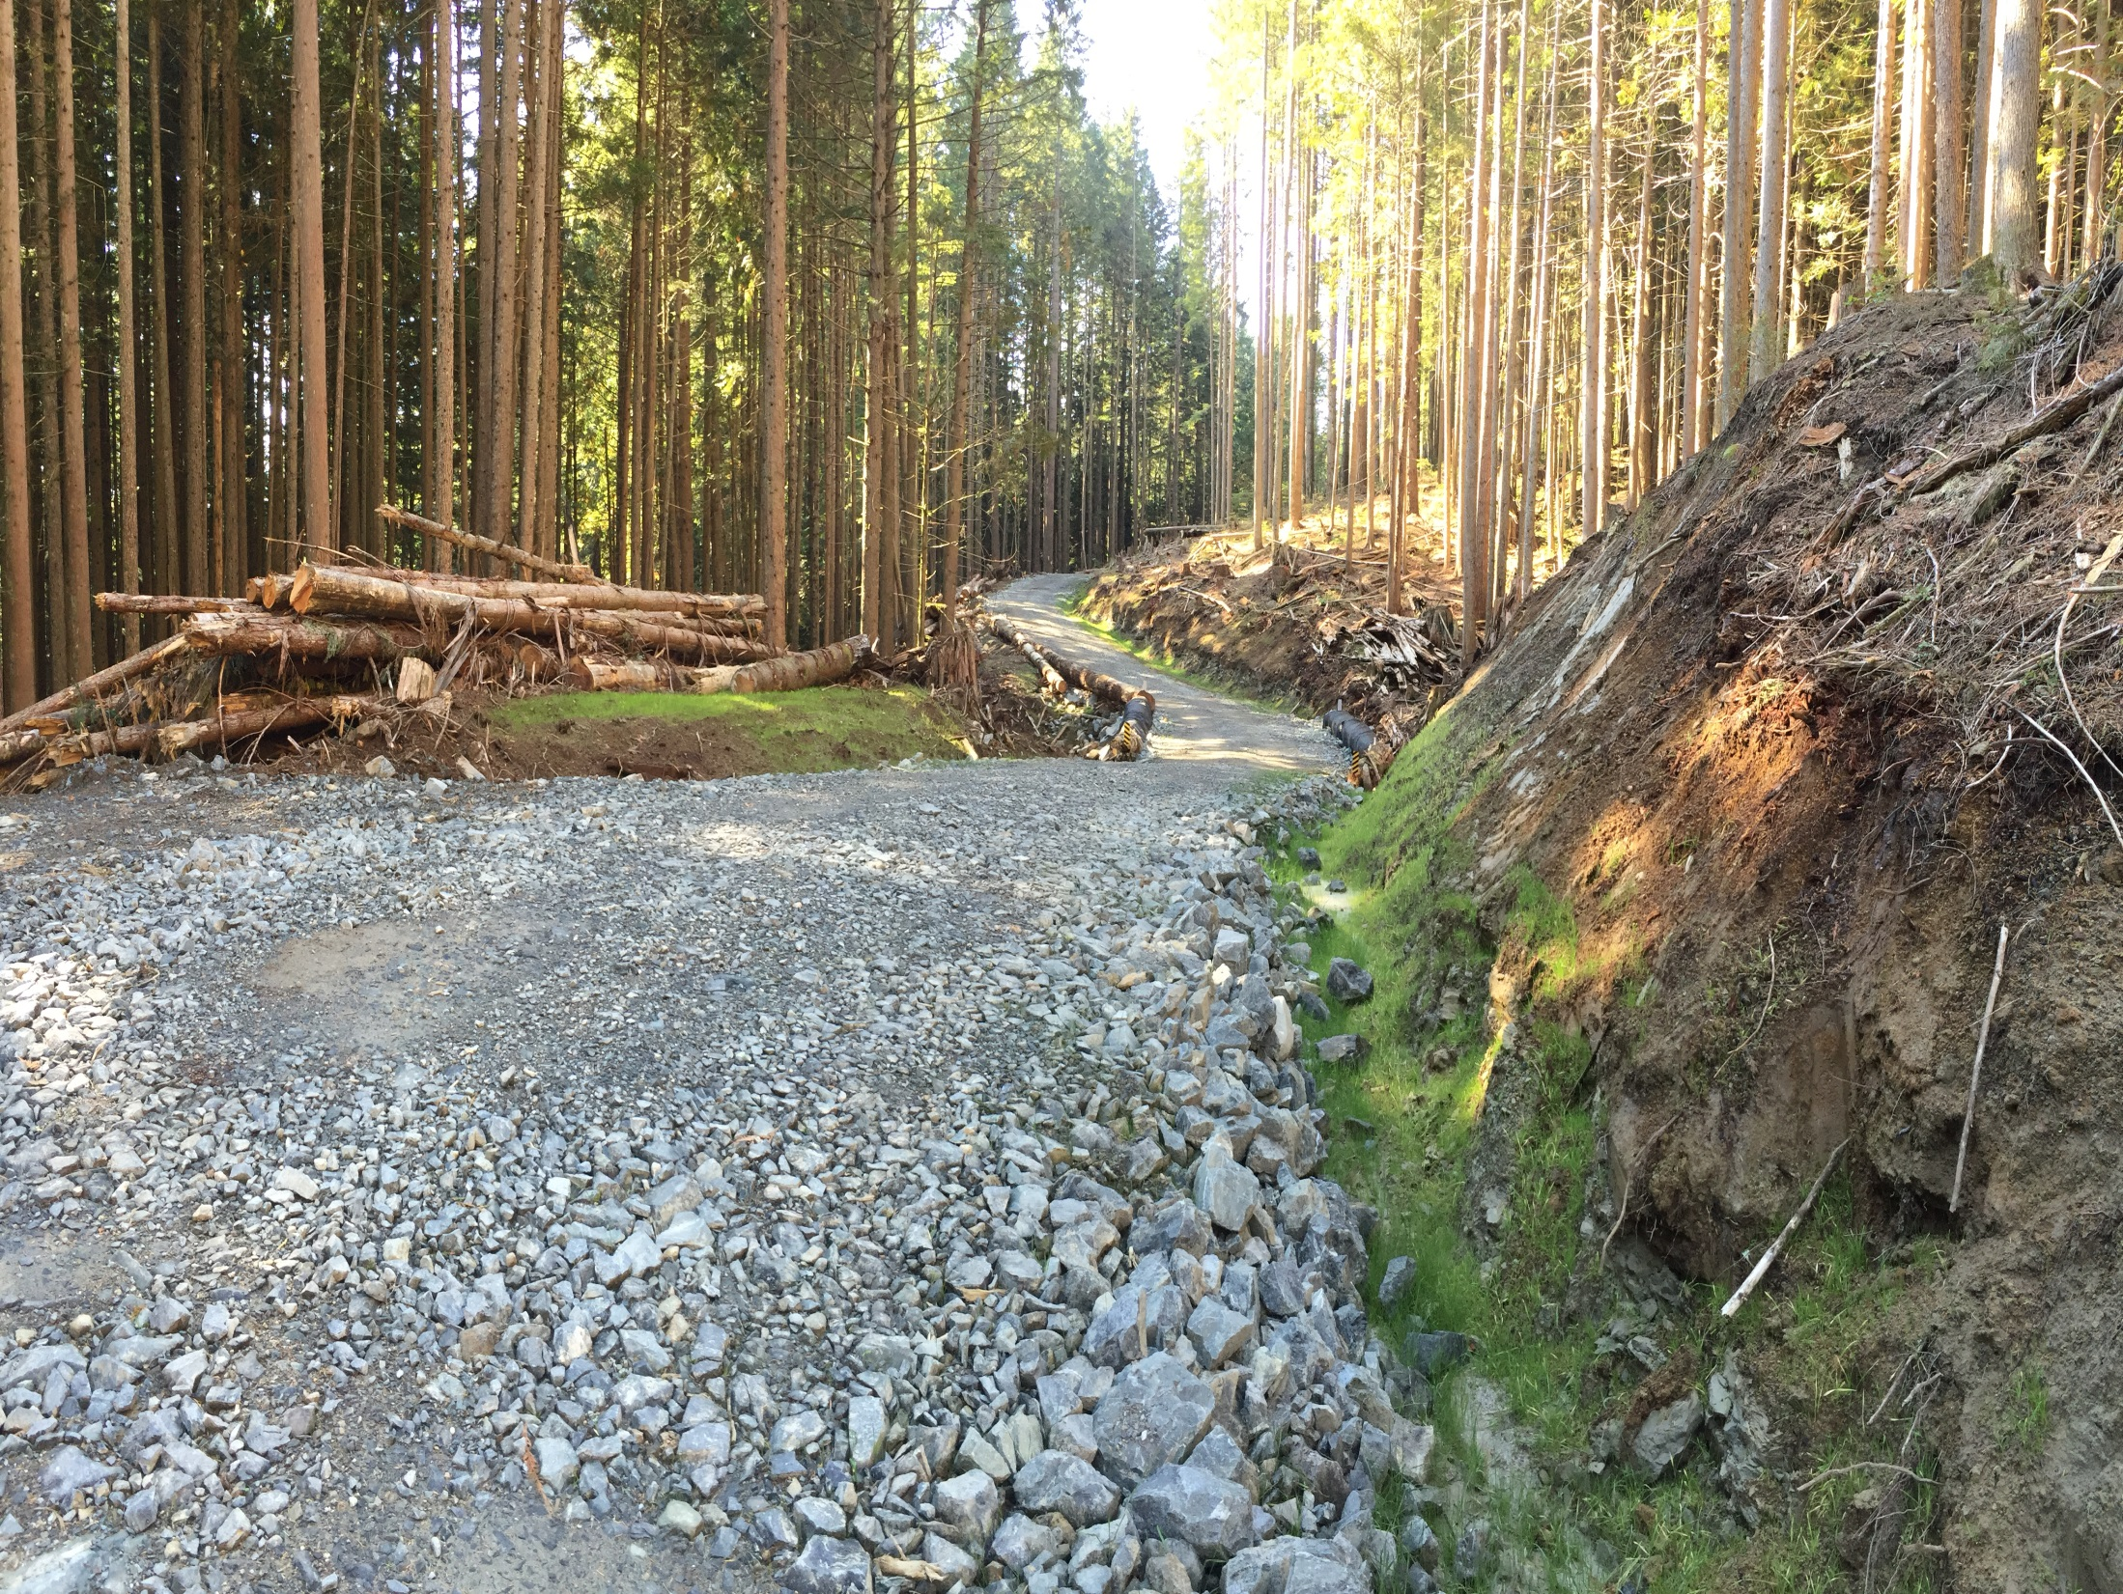
Notes:
Sediment Drainage management plans are produced to guide operators during the installation of drainage structure installation.
Drainage structure redundancy (ie culverts spaced so that if a culvert fails the next culvert will handle the increased flow.
Utilization of surfacing materials linked to reduced sediment such as shot rock and crushed well graded 3 inch minus aggregates.
Shot rock surfacing, grass seeding and undulating grade reducing movement of fines.
Grass seeding is also effective in mitigating invasive plant species.

Slide 13
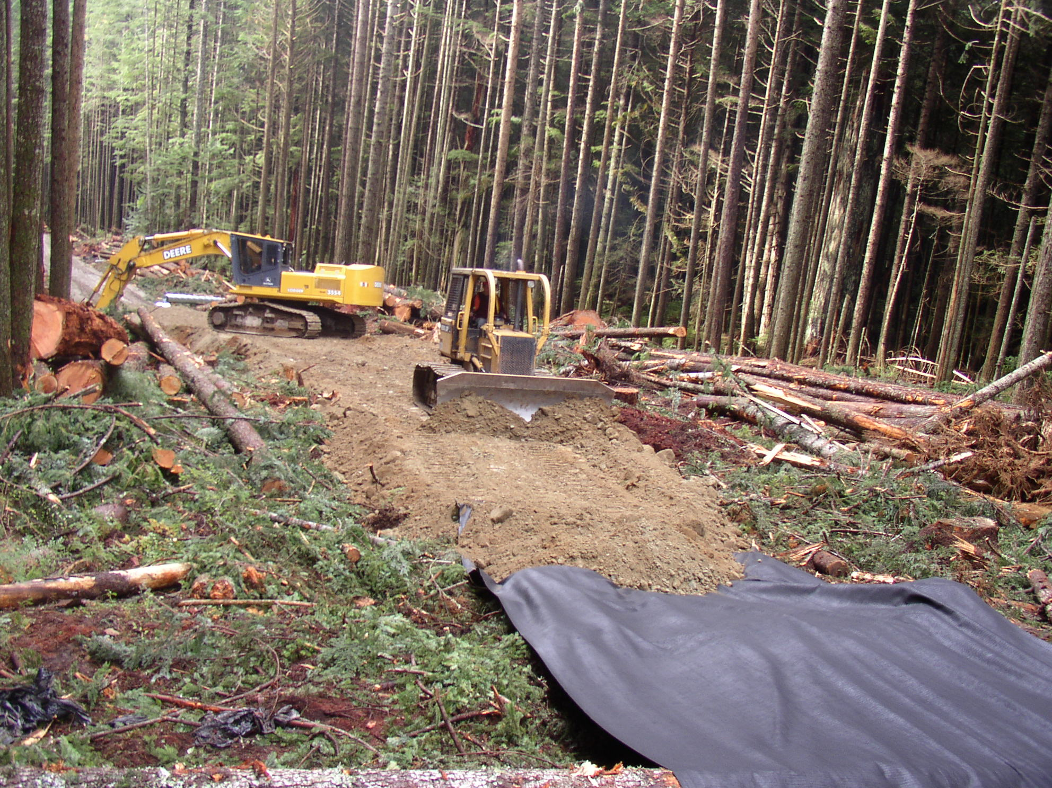
Notes:
Overland construction subgrade using geotextile over non grubbed forest floor. Material is from small pits along subgrade.
Road construction strategies include:
Where possible overlanding road construction techniques are used to minimize ground water interception (no cut banks);
drainage structure redundancy;
utilization of surfacing materials linked to reduced sedimentation;
geotextiles are used to separate fine textured subgrade materials from mixing with surfacing;
shot rock buttressing for high fine textured cut banks;
clear span structures on high value creeks; and
open bottom structures are used to ensure passage of tailed frogs in streams that have identified populations;

Slide 14
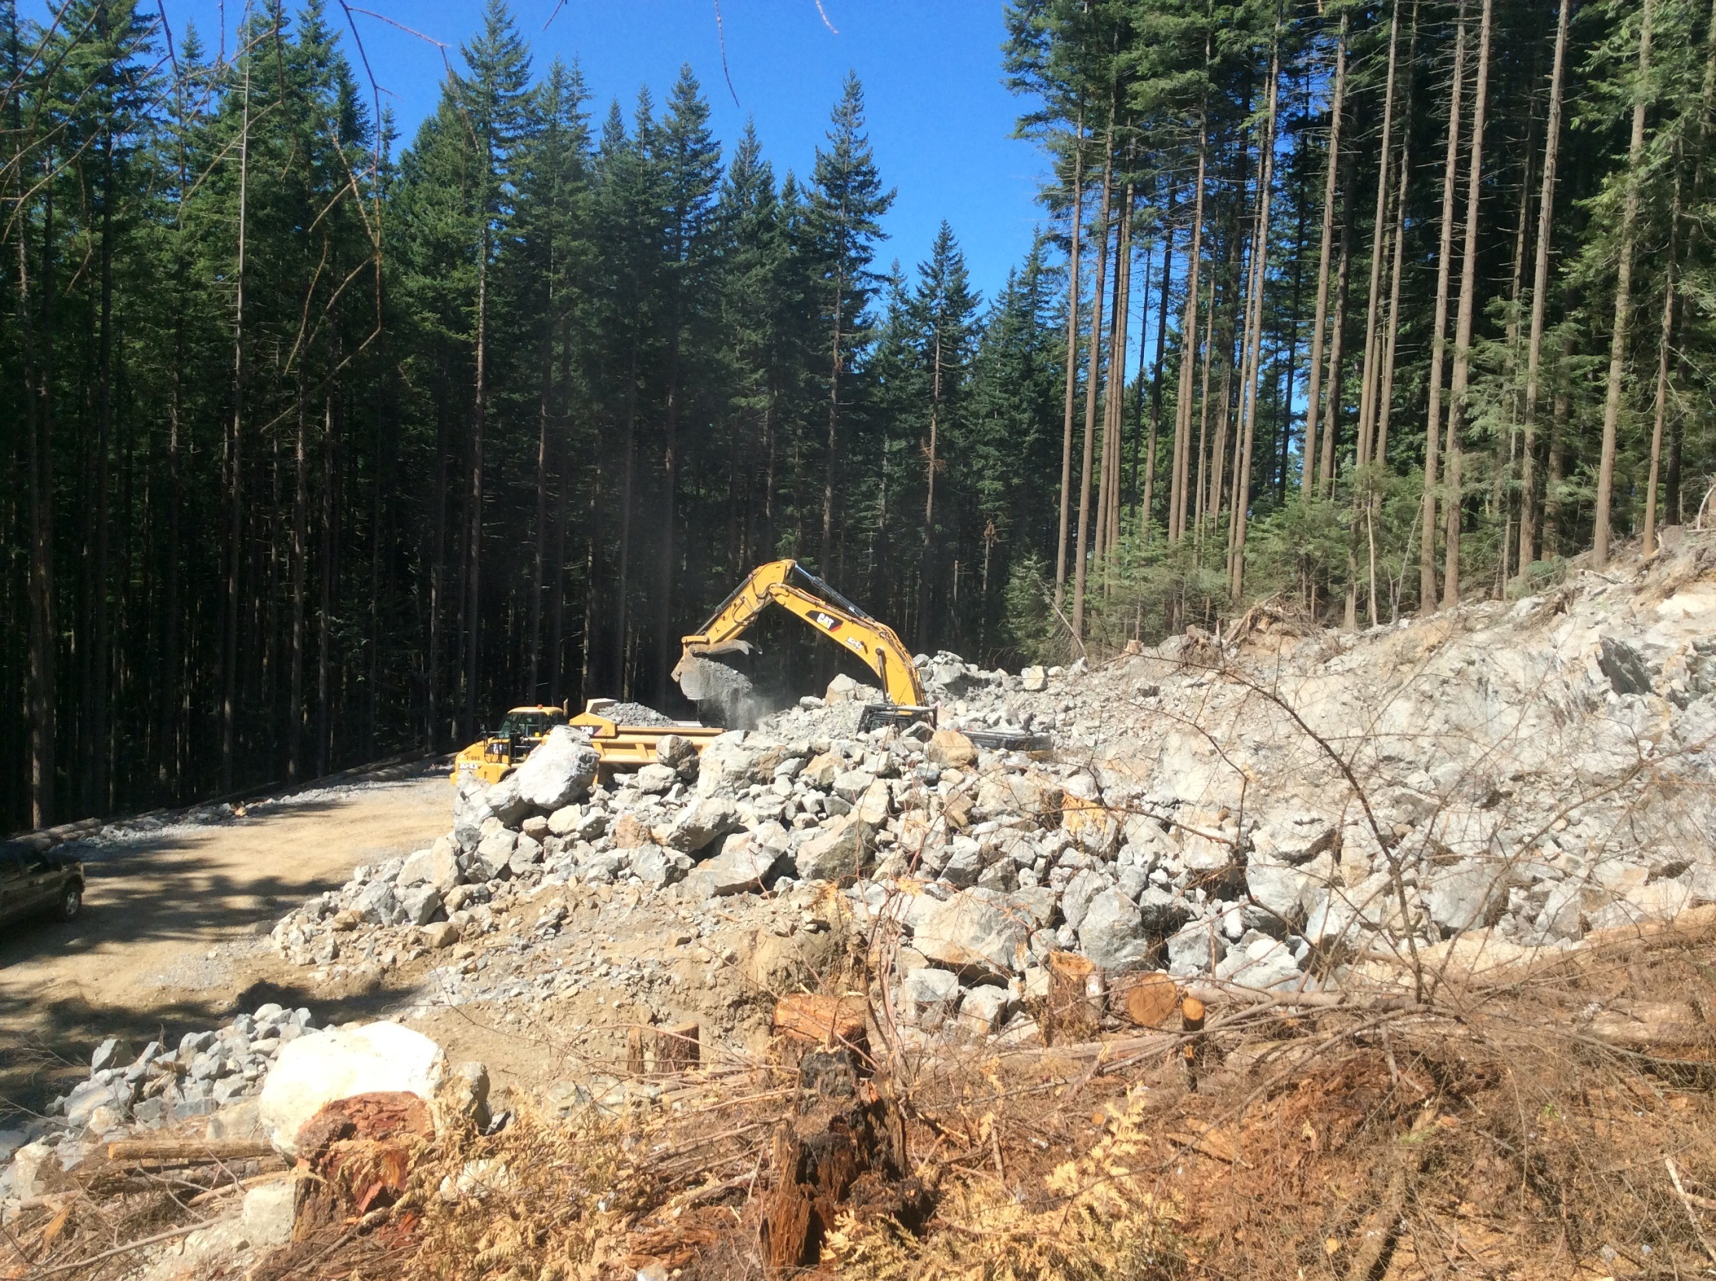
Notes:
Rock quarry for shot rock surfacing and rip rap armouring.
The typical geomorphology of the Elphinstone mid to lower slope consists of thin 1m layer of soil over an impermeable layer of consolidated glacial till. This results in overland flow in heavy rain or rain on snow events. Rock out crops are not common so when found are utilized for shot rock surfacing and rip rap

Slide 15
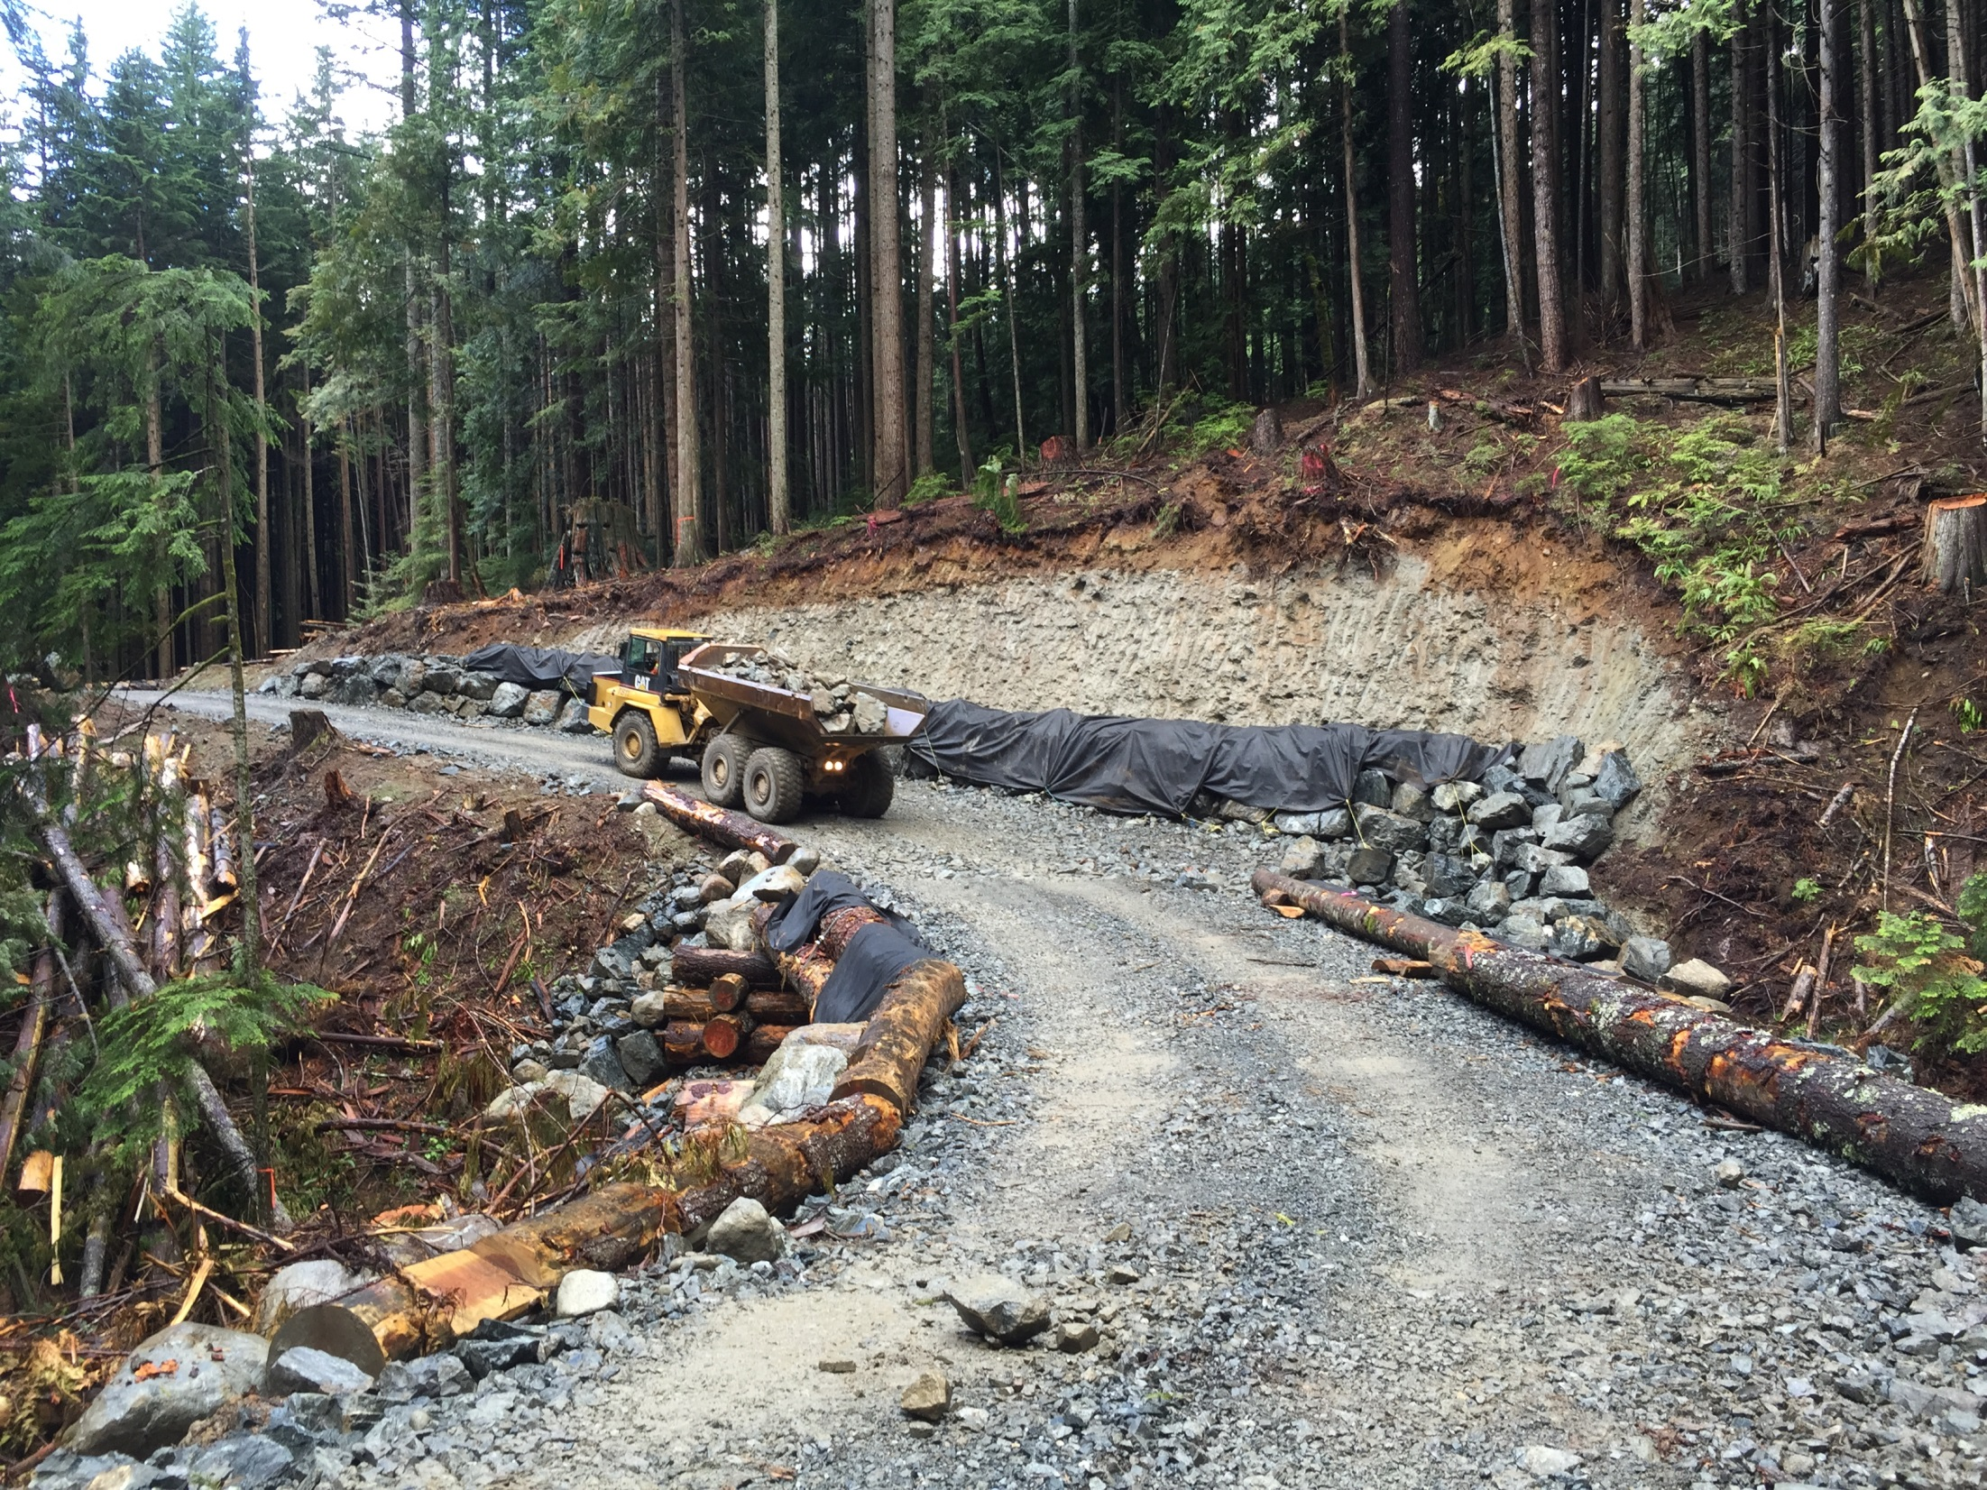
Notes:
Rock buttress wall to manage high, fine textured cut bank. Bridge installation with shot rock running surface. Healthy tailed frog population in pool above and below the bridge.

Slide 16

Questions?

