Slide 1
Ground Truthing of
Cariboo Consolidated Roads
May 16 & 18, 2023

Slide 2
Cariboo Consolidated
Roads Project Goal
Create a single, reliable, and up-to-date road dataset for the Cariboo Region that meets the business needs of Cariboo Region staff and supports collaborative decision making

Slide 3
Multi-Phased, Multi-Year Approach
COMPLETED (2019-2020)
Phase 1: Requirements gathering & prioritization
Phase 2: Data modelling & base road network creation; development of tools/apps to support phase 3 & 4
Phase 3: Ortho-verification of base road network (desktop exercise)
Phase 4: Ground truthing
Phase 5: Ongoing maintenance
COMPLETED
(2020-2023)
IN PROGRESS/ONGOING (2020 – 2024?)
STARTING NOW!

Slide 4
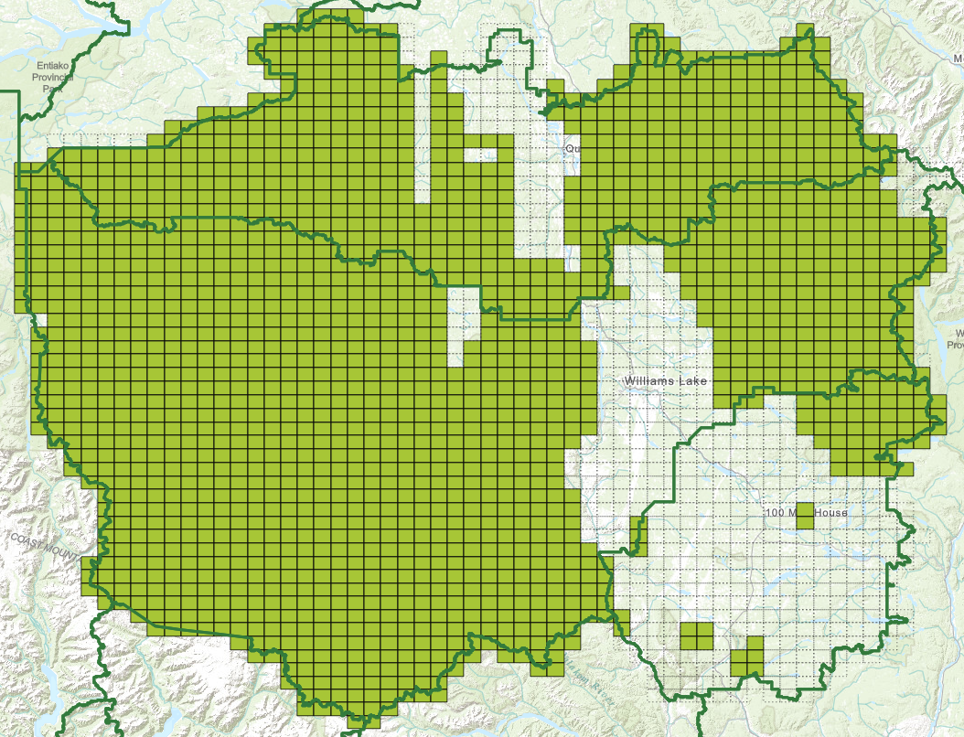
Desktop Exercise Progress* by the numbers
77% of Cariboo area completed (not roads)
29,328 km of roads added to dataset
27,150 km of roads identified as not existing
4,405 km roads flagged for ground truthing
*as of March 31, 2023

Slide 5
Ground Truthing Phase
Check Out Road Data
Collect Info in Field
GIS Verification
Field Updates Incorporated into Primary Road Dataset
Sync Collected Data Back
4,405km of road flagged for ground truthing – need your help
ArcGIS Field Maps-based app (iOS + Android) developed by WLRS GIS
App available to other Ministries/branches (i.e. BCWS), Guardians/other Indigenous NR workers, contractors – additional sessions coming in May

Slide 6
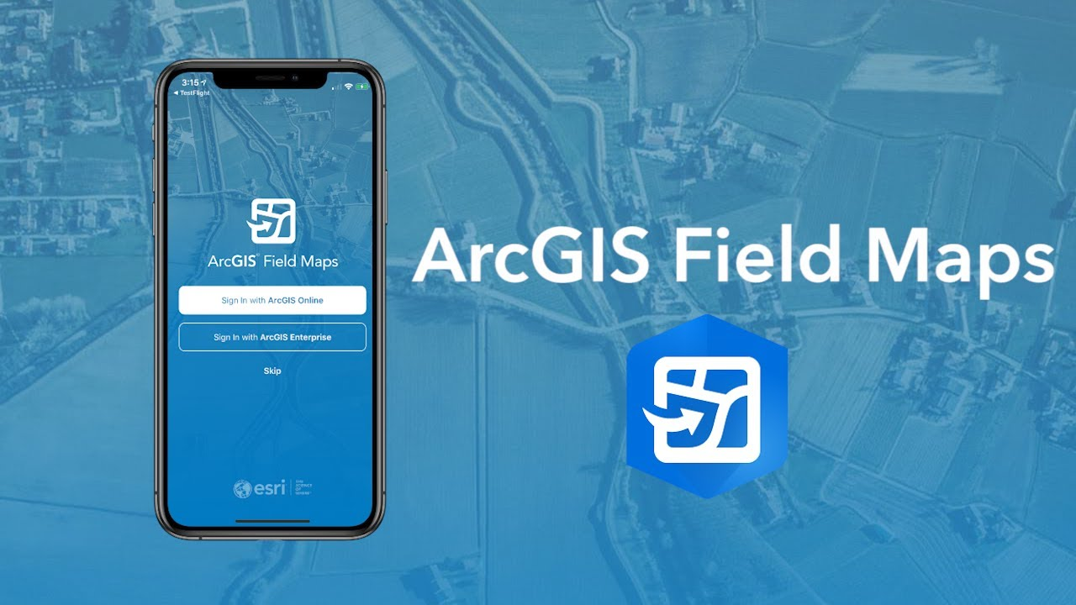
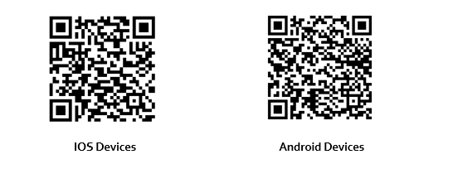
Field Maps the APP
Username: PX.FLNR.CAR.RDS
Password: CarRoads1

Slide 7
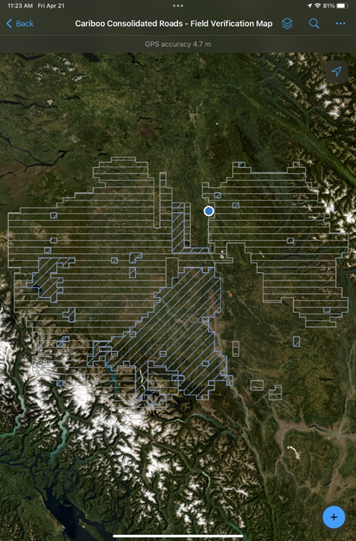
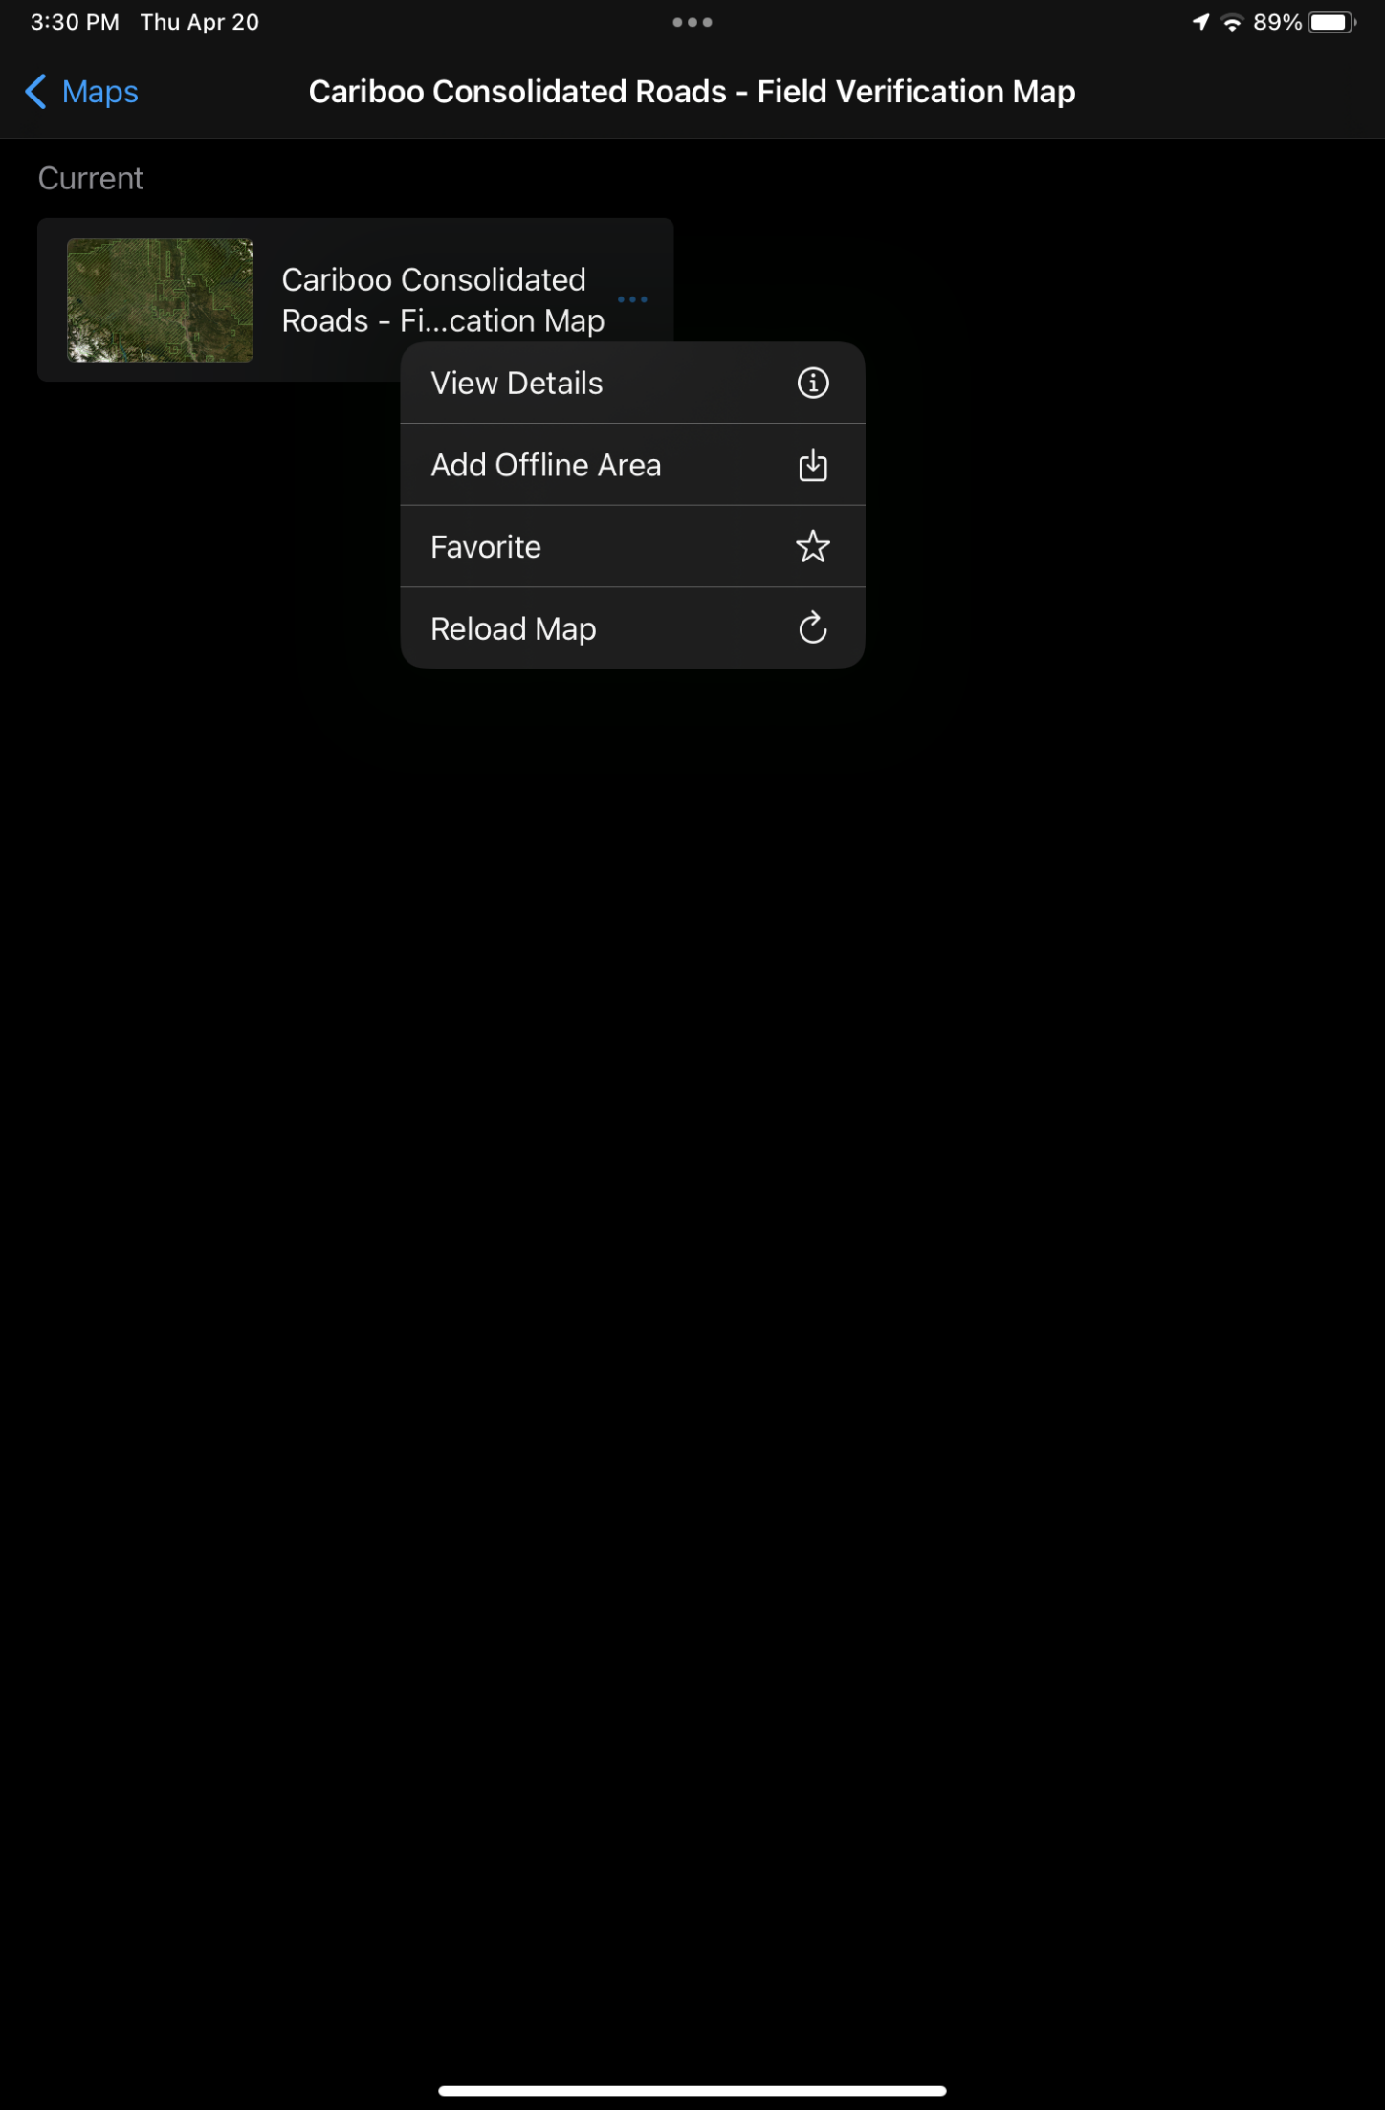
Getting to know the App
You are at the blue dot
Explore the options
  Maps (online & offline)
  Layers on and off
  Updating data
  Changing Imagery
  Using Markup

Slide 8
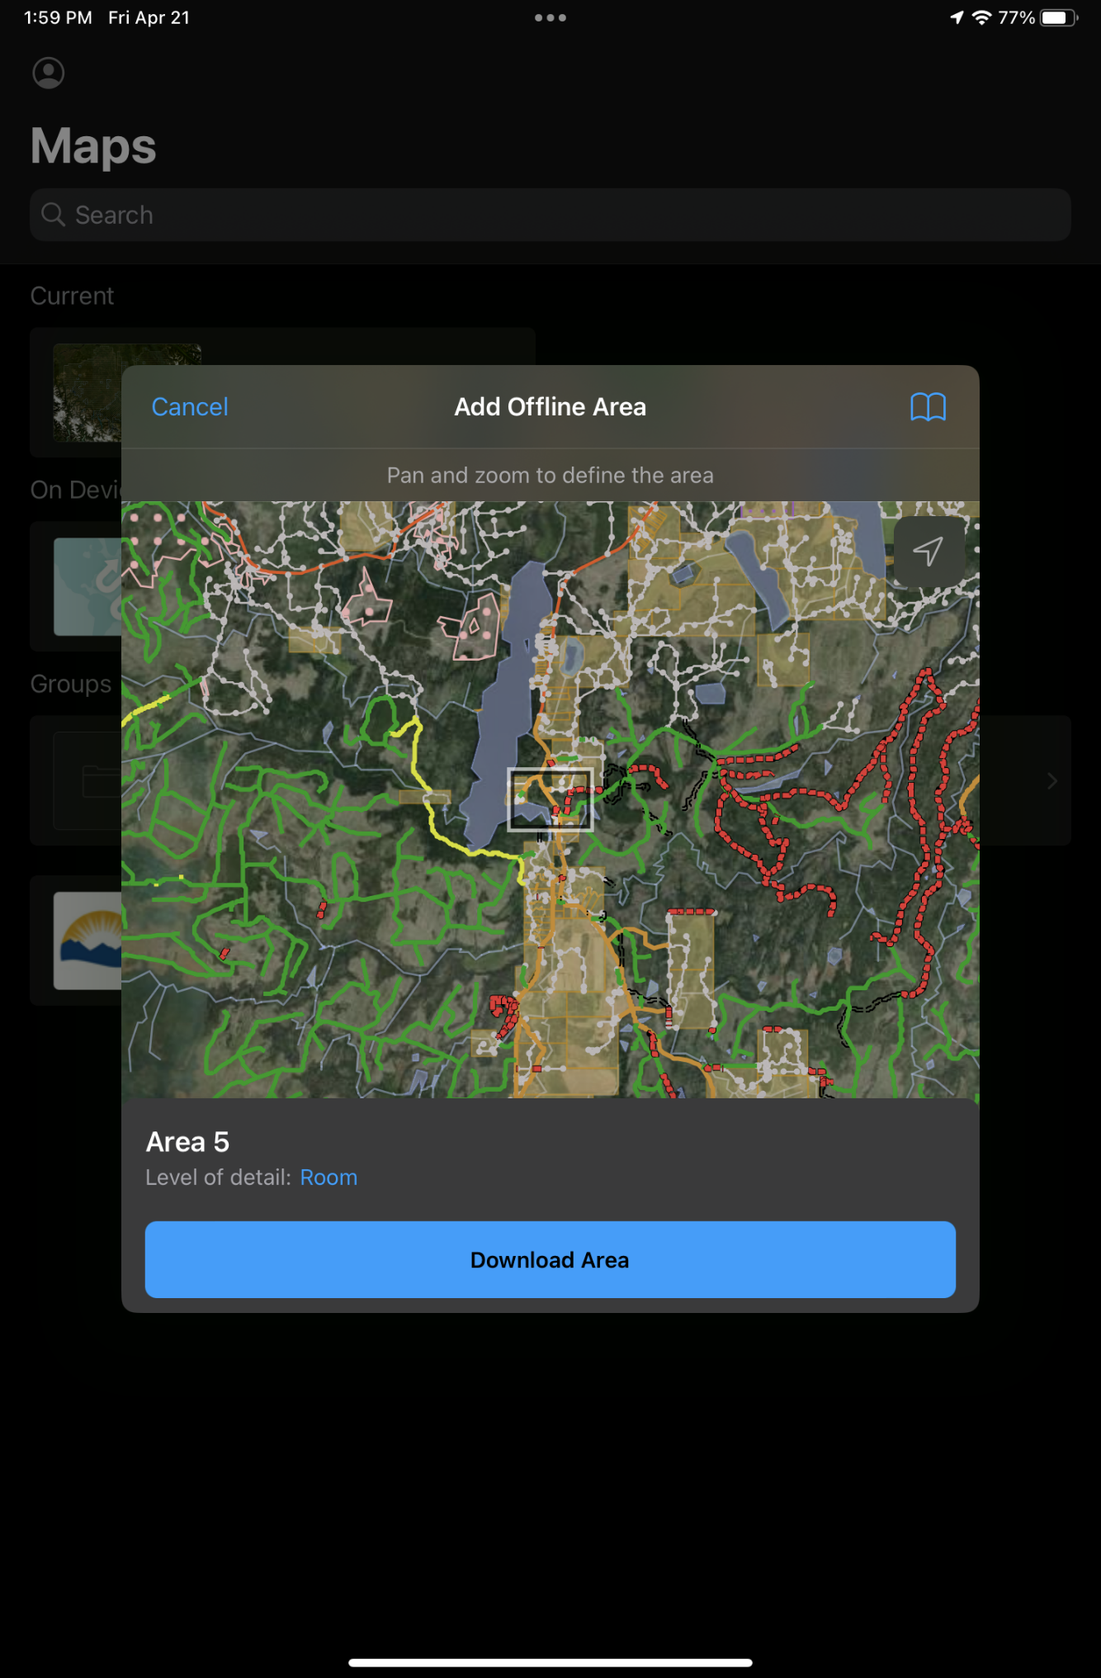
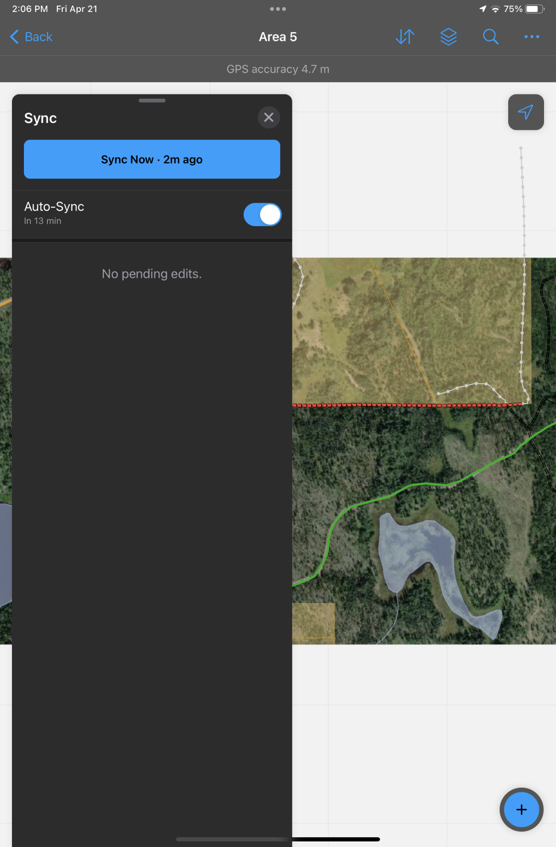
Offline Areas
& Sync
To capture data out of service, areas will need to be downloaded ahead of time
Be sure to check that items are syncing when back on a network!
  BCNGN preferred (BC Gov. staff only)

Slide 9
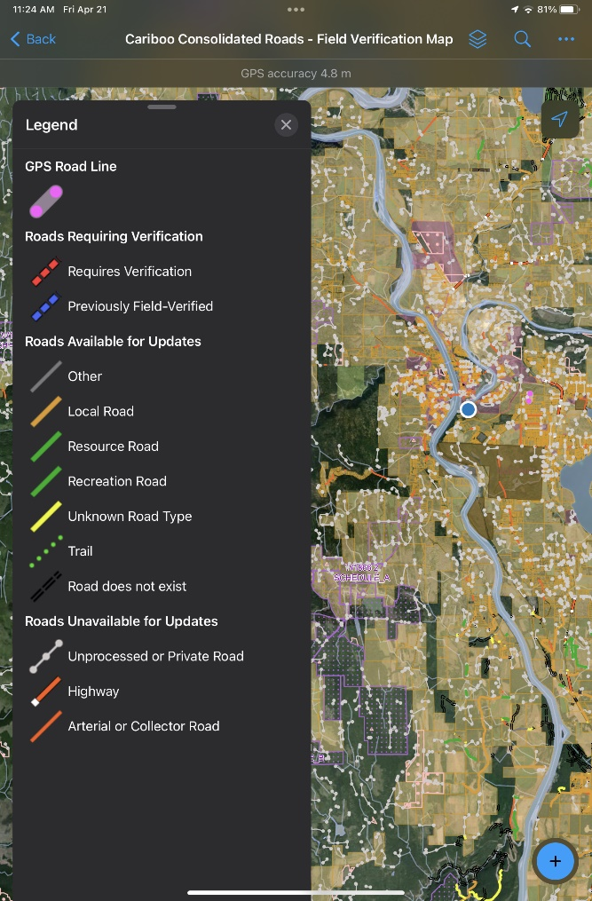
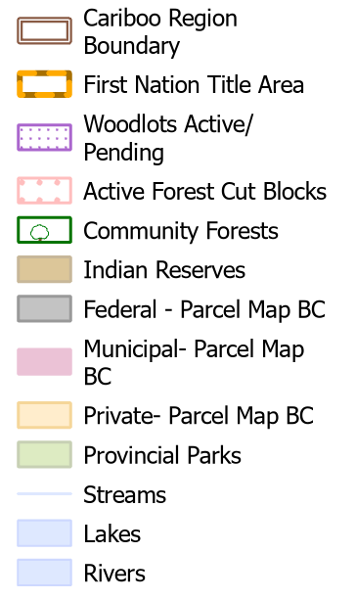

Updating Data
Check out the manual
Get ready for a live demo!

Slide 10
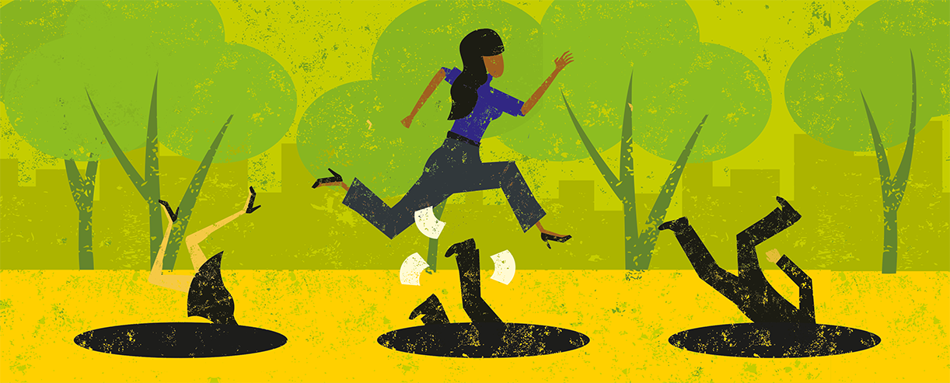
Avoiding Pitfalls
Sign-in to the app before going into the field and do not sign-out of Field Maps unless on WIFI
Sync when getting back from the field and ensure Auto-Sync is enabled
Avoid downloading offline areas in currently ‘Checked out’ locations (do not overlap red polygons)
Don’t forget to click ‘Stop Streaming’ after collecting a GPS line.
Delete offline areas when you have no intention of going back for verification, allowing other field crews to work in the area.
Be cognizant of the end-of month sync cycle to avoid the manual process of updating the data. Do not reuse offline areas after the month-end cycle.

Slide 11

Thanks for Helping gather data for the CCR!
Any questions please email the CaribooGeospatialServices@gov.bc.ca

